Slide 1
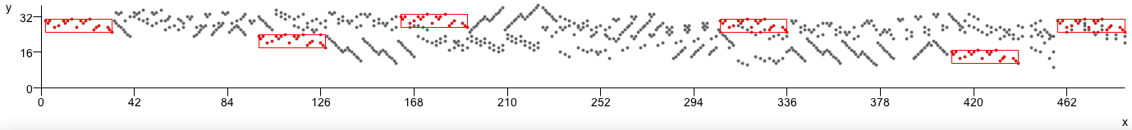

Analysis by Compression
Automatic Generation of Compact Geometric Encodings of Musical Objects
David Meredith
The Music Encoding Conference
Mainz, 22-24 May 2013

Slide 2
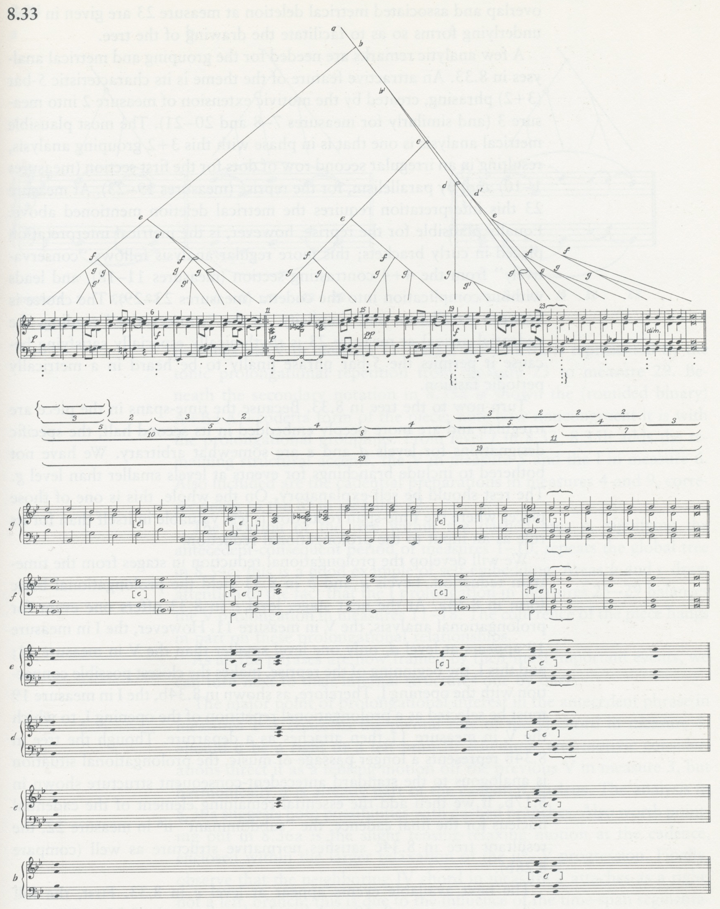
The goal of music analysis
The goal of music analysis is to find the best possible explanations for musical works
The “best possible” explanation for a musical work is one that allows you to
  remember it most easily
  identify errors most accurately
  predict best what will come next
The best possible explanation
  is as simple as possible
  accounts for as much detail as possible
Lerdahl and Jackendoff (1983, p.205)

Slide 3
A musical analysis as a program
A musical analysis can be represented (or encoded) as a computer program or algorithm
  The program must generate an in extenso representation of the music to be explained as its only output
The program is usually a compact or compressed encoding of its output
The program is a description of its output
If this description is short enough, it becomes an explanation of its output
Meredith (2012)
Notes:
Some notes
----- Meeting Notes (08/11/2012 15:10) -----
Some meeting notes

Slide 4
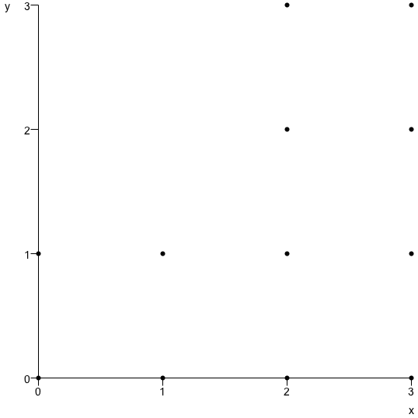
Program length as a measure of complexity
P(p(0,0),p(0,1),p(1,0),p(1,1),p(2,0),p(2,1),p(2,2),p(2,3),p(3,0),p(3,1),p(3,2),p(3,3))
T(P(p(0,0),p(0,1),p(1,0),p(1,1)),V(v(2,0),v(2,2)))
From Kolmogorov (1965) complexity theory:
  can use the length of a program to measure the complexity of its corresponding explanation
  The shorter the program, the simpler and better the explanation

Slide 5
Level of detail depends on representation
The level of detail on which the structure of the music is explained depends on the amount of detail represented in the output of the program (i.e., the compact encoding)
The output should be an in extenso description of the music
  e.g., MIDI, audio, MusicXML, MEI, chord sequence
Chord sequence
MIDI
Increasing detail
MusicXML/MEI
Audio

Slide 6
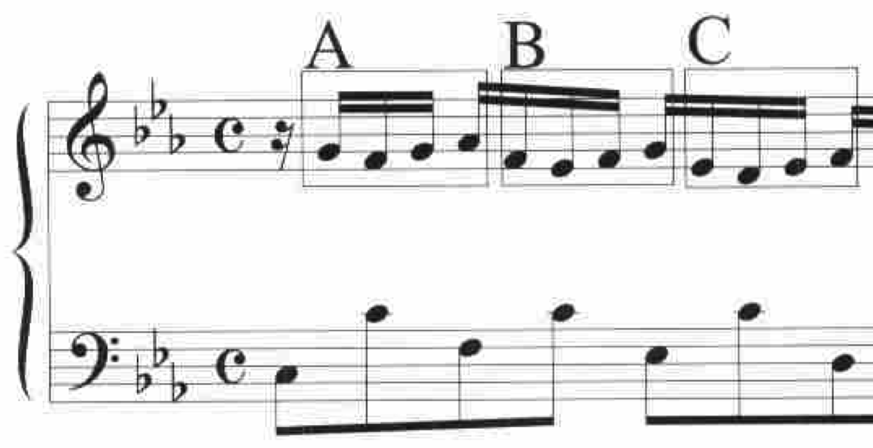
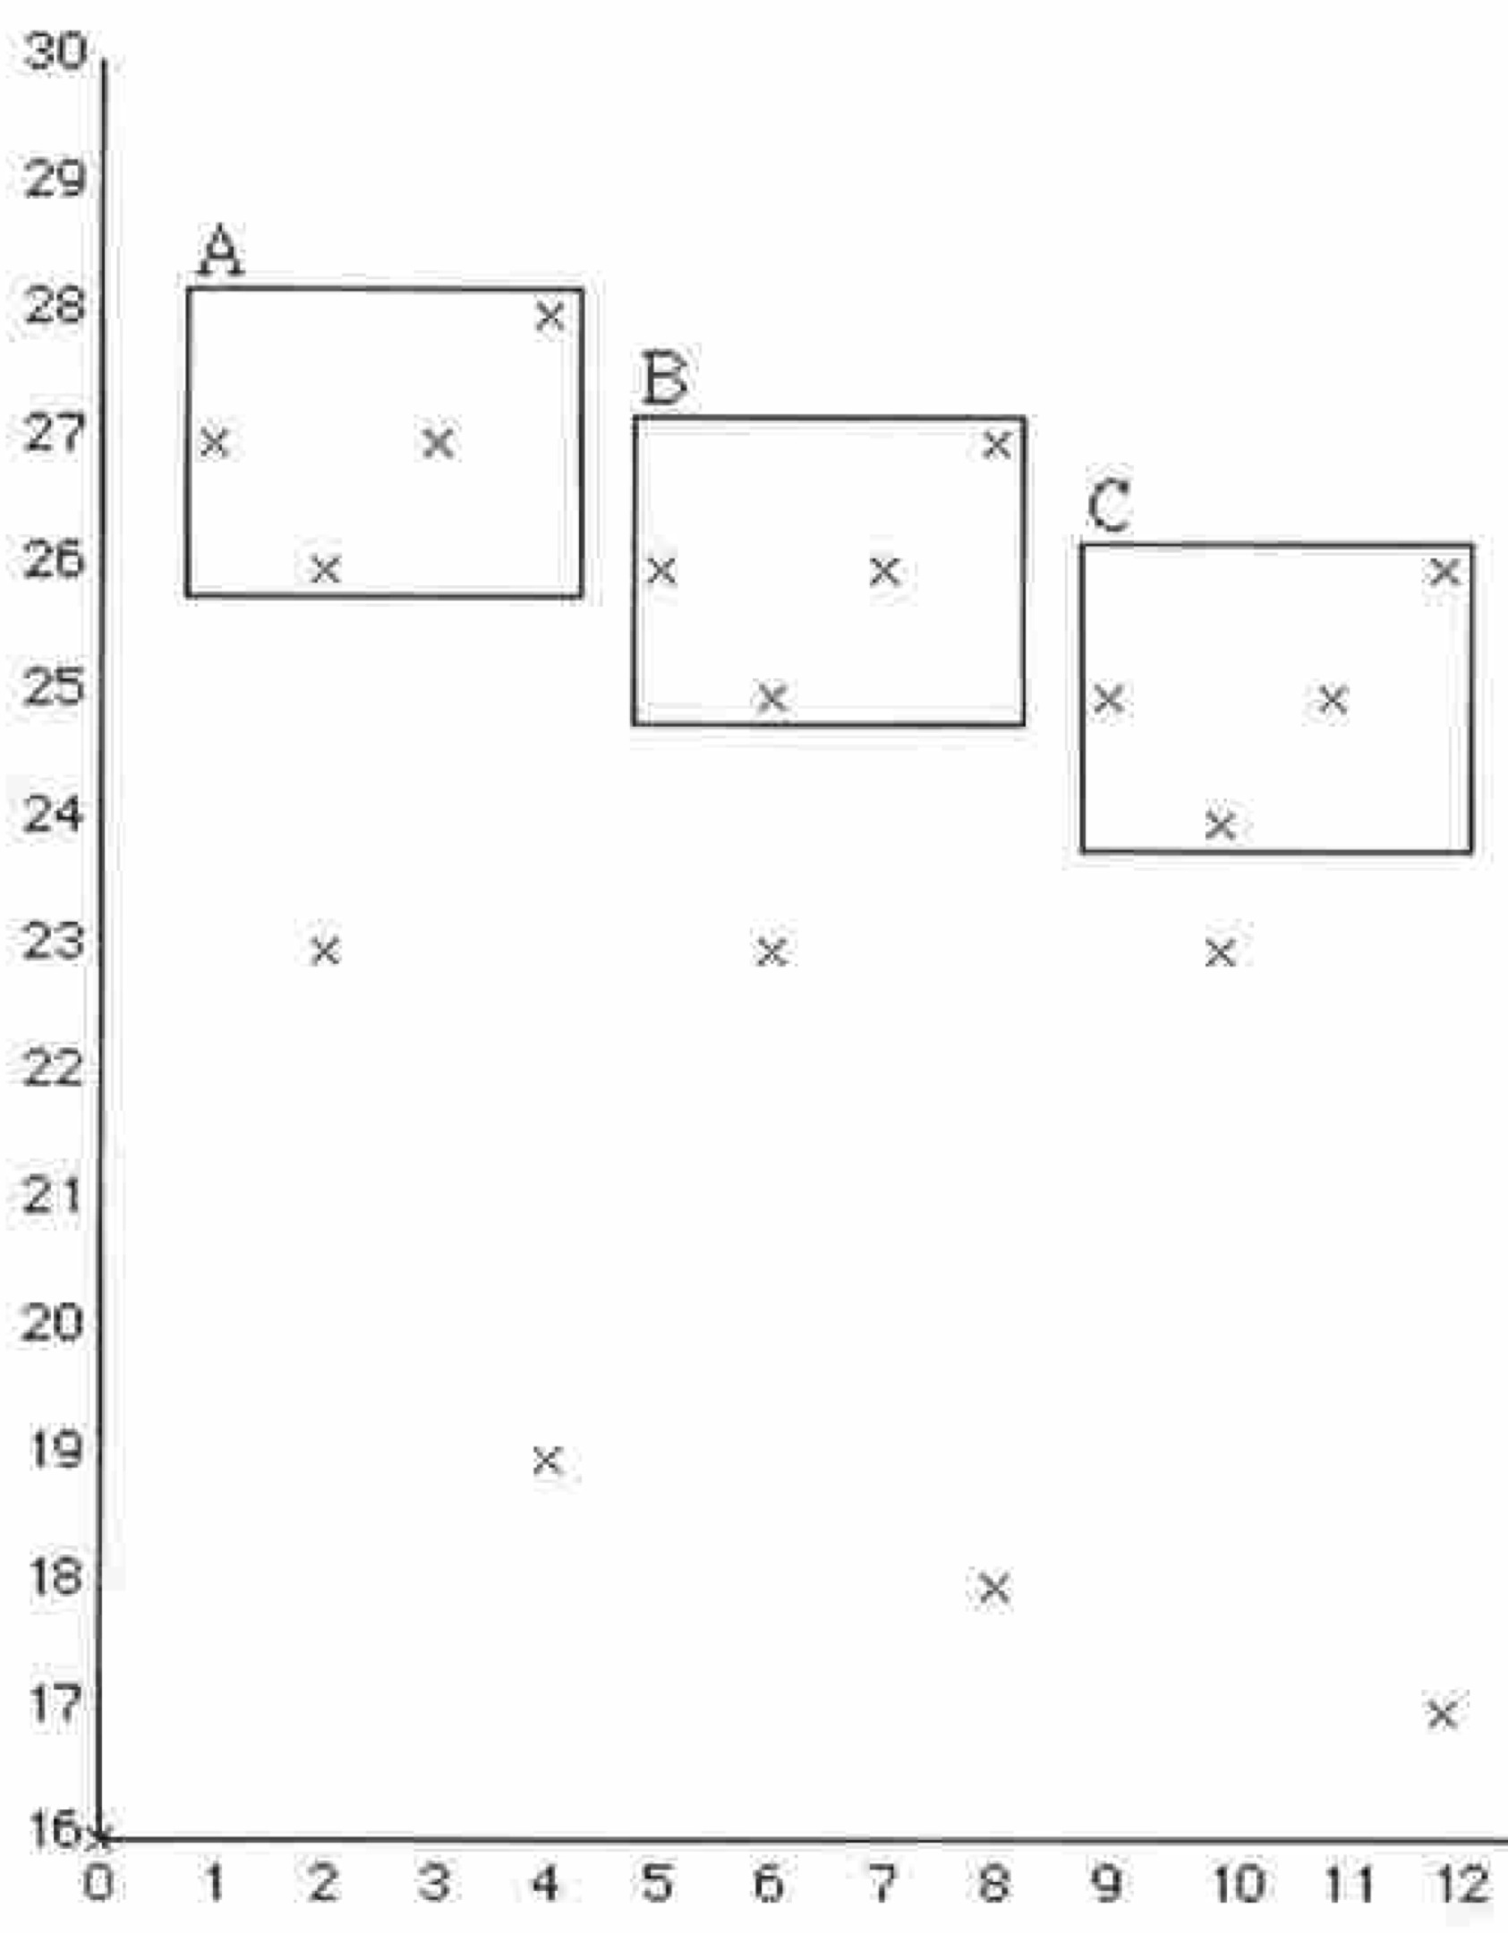
Music analysis aims to compress music
P(p(1,27),p(2,26),p(3,27),p(4,28),p(5,26),p(6,25),p(7,26),p(8,27),p(9,25),p(10,24),p(11,25),p(12,26))
T(P(p(1,27),p(2,26),p(3,27), p(4,28)),V(v(4,-1),v(8,-2)))
Since the best explanations are the shortest descriptions, the aim of music analysis is to compress music as much as possible
Meredith, Lemström and Wiggins (2002)

Slide 7
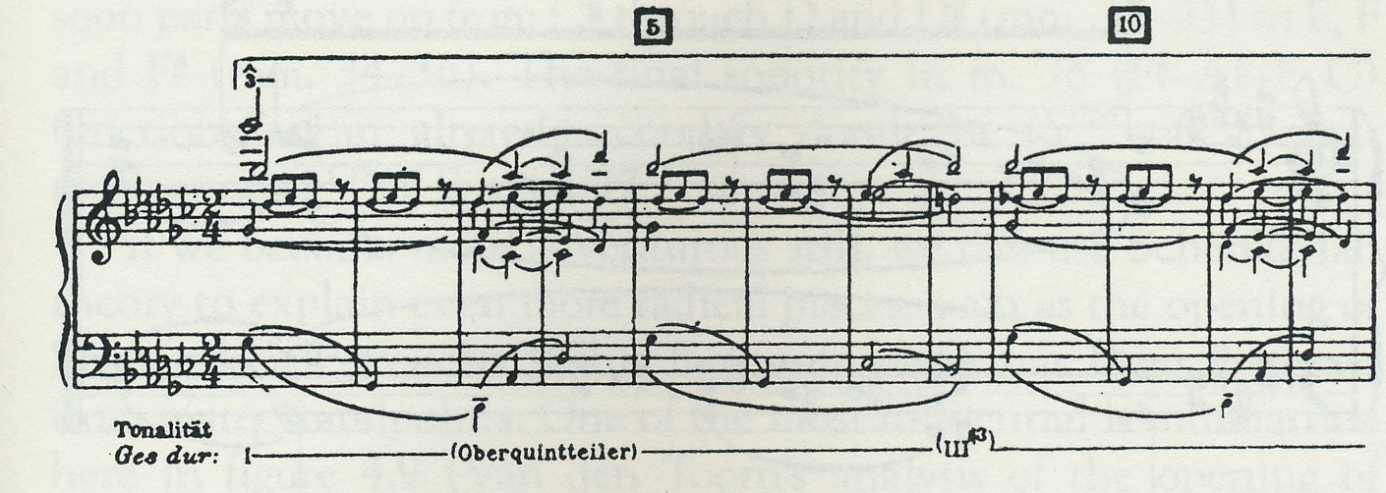
Perceptual organisations of surfaces
Analysis of Chopin Op.10, No.5
Schenker (1925, p.92)
Music analysis aims to find the most satisfying perceptual organisations that are consistent with a musical surface
  could be a score or a performance
Analysis of first bar of Chopin Op.10, No.5
Meredith (2012)

Slide 8
Likelihood vs. Simplicity
Chater (1996, p.571)
Theories of perceptual organisation mostly based on either
  Likelihood principle: Prefer the most probable interpretation (Helmholtz, 1910) (cf. Shannon)
  Simplicity principle: Prefer the simplest interpretation (Koffka, 1935) (cf. Kolmogorov)
In the psychological literature, Chater (1996) showed that the two principles are mathematically identical
  Equivalence known much earlier in information theory
Likelihood
Simplicity

Slide 9
Coding theories
Long tradition in Gestalt-influenced psychology of coding languages designed to represent the structures of patterns in particular domains
  preferred organisations have shortest encodings in the coding language
    i.e., the simplicity principle
Coding theories proposed for
  serial patterns (e.g., Simon 1972)
  visual patterns (e.g., Leeuwenberg 1971)
  musical patterns (e.g., Simon and Sumner 1968, Deutsch and Feroe 1981, Meredith 2012)
Simon (1972, p.373)
Leeuwenberg (1971, pp. 317-8)
Deutsch and Feroe (1981, p. 510)

Slide 10
Problems with coding theories
LISP:
(dotimes (j 10) (pprint j))
Chater (1996) identifies 2 problems with coding theories
  Each domain needs its own pattern language
  Length of an encoding depends on the design of the language
  Also depends on how you decide to measure “length”...
C:
#include <stdio.h>
main(){
char i;
for(i = 0; i < 10; i++)
printf("%d\n",i);
}
JAVA:
public class OneToTen {
public static void main(String[] args) {
for(int i = 0; i < 10; i++) System.out.println(i);
}
}

Slide 11
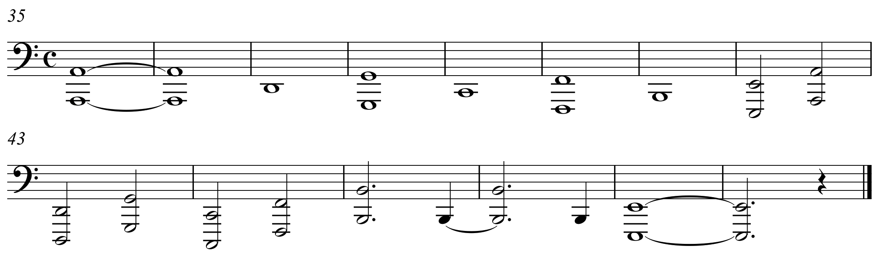

A simple pitch class analysis
Score represents bass part of bars 35 to 48 Chopin’s Étude in C major, Op.10, No.1
Pitch class structure can be represented by the sequence:
  9 2 7 0 5 11 4 9 2 7 0 5 11 4

Slide 12
In extenso encoding of the structure
9 2 7 0 5 11 4 9 2 7 0 5 11 4
Could understand pitch class sequence as 14 unrelated pitch classes
Writing out the sequence in extenso, as shown, represents this way of understanding the structure

Slide 13
A better, shorter interpretation
2(9 2 7 0 5 11 4)
Could understand sequence as two consecutive occurrences of the same 7-element sequence
Requires only 8 independent pieces of information to be remembered
Leads to shorter description
Intuitively a better interpretation or explanation of the sequence

Slide 14
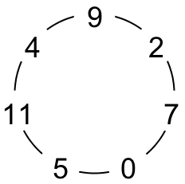
A better explanation?
Sequence can also be understood as two turns around the diatonic fourths cycle in C major
This recognizes structure within each of the two 7-element subsequences
Can be encoded with a single formula

Slide 15
A better explanation?
But this formula requires us to remember
  5 unrelated numbers
  5 unrelated operations
  2 boundary values of i
12 pieces of independent information
  cf. 8 items in 2(9 2 7 0 5 11 4)

Slide 16
A better explanation?
Advantage of using formula becomes apparent when encoding a longer sequence which is not an integer number of full turns around the C major circle of fourths
  e.g.,
    9 2 7 0 5 11 4 9 2 7 0 5 11 4 9 2 7 0 5 11 (20 items)
    p(i) = (((i+2) mod 7) * 5 + 11) mod 12, 0 ≤ i ≤ 19 (12 items)

Slide 17
A better explanation?
  Formula can also be parametrized and reused to describe any sequence of pitch classes formed by circulating around any diatonic fourths cycle
  It provides a highly compressed or compact representation of a very large class of structures that occur often in tonal music

Slide 18
Musical objects are interpreted in the context of larger containing objects
A musical object (phrase, section, movement, work, corpus, ...) is usually interpreted within the context of some larger object that contains it
  e.g., a work is often interpreted in the context of its composer’s other works, or other works in the same genre or form or other works for the same instrument(s)
M
I
T
W
S
P
C
F

Slide 19
Analysts look for short programs that compute collections of musical objects
The analyst tries to find the shortest program that computes a set of in extenso descriptions of
  the object to be explained (the explanandum)
  other objects, related to the explanandum, defining a context within which the explanandum is to be interpreted
P

Slide 20
Listener interprets new music in the context of previously heard music
When the (expert) listener interprets a new piece, the existing explanation (program), P, for all music previously heard is modified (as little as possible), to produce a new program, P', to account for the new music in addition
P
P'

Slide 21
Perceived structure represented by process by which object is generated
Perceived structure of new musical object represented by specific way in which P' computes that object
On this view, both music analysis and music perception are the compression of collections of musical objects
P
P'

Slide 22
Perception and analysis are non-optimal compression
Both analyst and (expert) listener aim to find shortest encodings
Neither analyst nor listener achieve this aim in general
Hampered by limitations of perceptual system
    e.g., require recognizable patterns to be fairly compact in pitch-time space (Collins et al., 2011)

Slide 23
Individual differences depend on order of presentation of context
Prefer to re-use previous encodings wherever possible
  “greedy algorithm”: means that way in which a new object is understood depends on the order of presentation of previous objects
Implies that each individual will have a different interpretation of the same musical object that depends, not only on what previous music has been heard, but also the order in which it was encountered

Slide 24
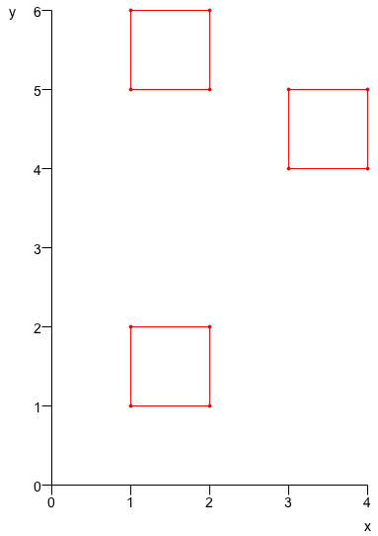
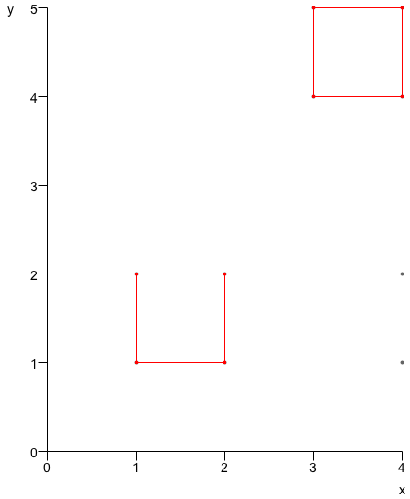
Simple example using SIATECLearn

Slide 25
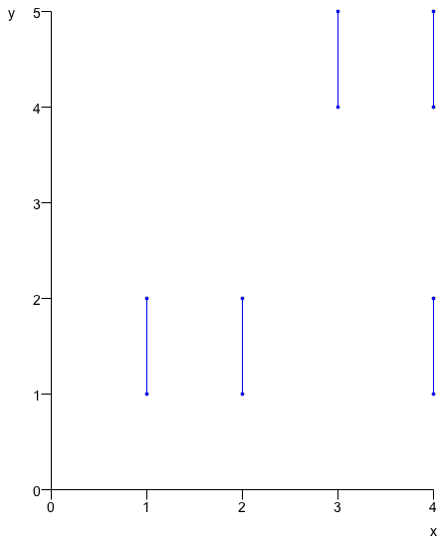
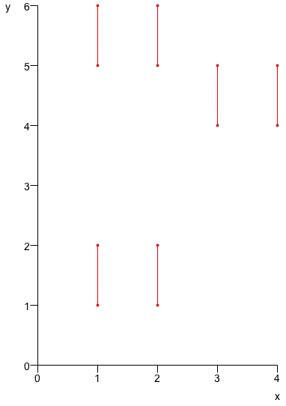
Simple example using SIATECLearn

Slide 26
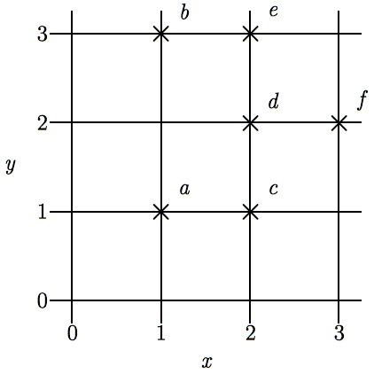
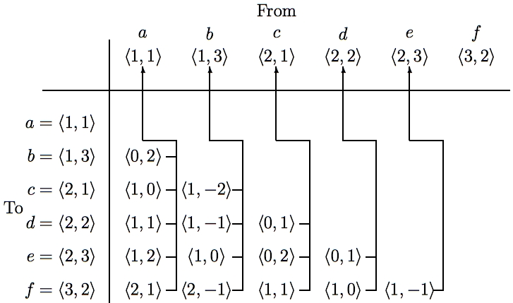
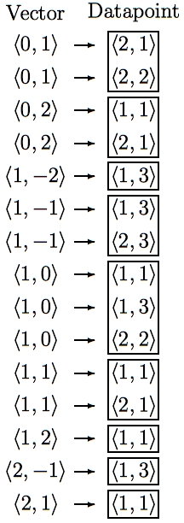
SIA - Discovering all maximal translatable patterns (MTPs)
Pattern is translatable by vector v in dataset if it can be translated by v to give another pattern in the dataset
MTP for a vector v contains all points mapped by v onto other points in the dataset
O(kn² log n) time, O(kn²) space
where k is no. of dimensions & n is no. of points
O(kn²) average time with hashing
Notes:
The first algorithm I’m going to describe is the SIA algorithm which takes as input a multidimensional point set and discovers, for every vector, the points in this point set that are mapped onto other points in the point set by that vector.
For convenience, I’ll call the complete set of points being analyzed the DATASET and any subset of the dataset a PATTERN.
I say that a pattern is TRANSLATABLE by a particular vector within a dataset if it can be translated by that vector to give another pattern in the dataset. For example, the pattern {a,d} here is translatable within this dataset by the vector <1,0>.
And the pattern that contains ALL the points that are mapped onto other points in the dataset by a particular vector is the MAXIMAL TRANSLATABLE PATTERN for that vector. So the maximal translatable pattern or MTP in this dataset for the vector <1,0> is the pattern {a,b,d} and the MTP for the vector <1,1> in this dataset is {a,c}.
So SIA discovers all the non-empty maximal translatable patterns in a dataset.
It does this by first sorting the points in the dataset into lexicographical order and then computing the vector from each point to every other point in the dataset that is lexicographically greater. These vectors are stored in a table like this one here which we call a VECTOR TABLE. And each vector is stored with a pointer that points back to the origin point for which it was computed, as indicated by these arrows here.
The vectors in this table are then sorted into lexicographical order to give a list like the one here on the right and the MTP for each vector can be found directly by reading off the points attached to the adjacent occurrences of that vector in this list.
The most expensive step is sorting the vectors which can be done in O(kn^2 log n) time. However, by storing the origin points in a hash table and hashing the vectors to get the slot indices, this time complexity can be reduced to O(kn^2).
And also, obviously, the space used is O(kn^2)

Slide 27
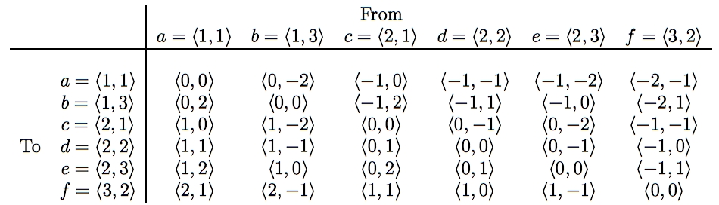
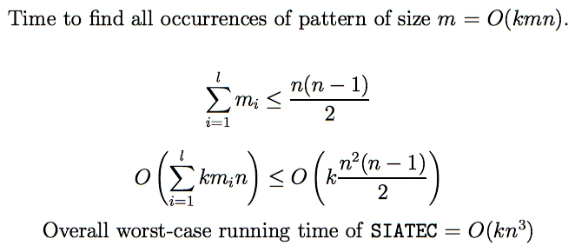
SIATEC - Discovering all occurrences of all MTPs (TECs)
Translational Equivalence Class (TEC) is set of all translationally invariant occurrences of a pattern
Notes:
SIA only finds one occurrence of each MTP and one vector by which that MTP is translatable within the dataset.
SIATEC, on the other hand, finds all the MTPs using a slightly modified version of SIA and then finds all the vectors by which each MTP is translatable within the dataset.
In other words, it finds all the non-empty MTPs and then all the patterns within the dataset that are translationally equivalent to each MTP.
In SIA, we only needed to compute the vector from each point to every lexicographically greater point because the MTP for a particular vector -v is the same as the pattern that you get by translating the MTP for v by v itself.
However, in this simple implementation of SIATEC, we can find all the occurrences more efficiently by computing all the interpoint vectors and storing them in a table like this one here.
If the points in the dataset are sorted into lexicographical order first, then the vectors in this table increase lexicographically as you descend a column and go from right to left along a row.
Each column contains all the vectors by which the point at the top of the column is translatable within the dataset.
Therefore the set of vectors by which a given pattern in the dataset is translatable is equal to the intersection of the columns headed by the points in that pattern. For example, the pattern {a,c} is translatable within this dataset by the intersection of the columns for which a and c are the origin points.
By exploiting the orderedness of this table, we can find all the occurrences of a k-dimensional pattern of size m in a dataset of size n in a worst case running time of O(kmn).
Now, all the MTPs in a dataset can be found by reading through the list of sorted vectors generated by SIA so we know that sum of the cardinalities of the MTPs is less than or equal to n(n-1)/2.
Therefore the worst case time complexity of this implementation of SIATEC is [as shown] which implies that it is O(kn^3).
And, obviously, it uses O(kn^2) space.

Slide 28
COSIATEC
COSIATEC(S)
while S is not empty
Find the best TEC, T, using SIATEC
Add T to the encoding, E
Remove the points covered by T from S
return the encoding E

Slide 29
Finding the best TEC
Run SIATEC to find the TECs
Add in the dual or conjugate TECs
Remove redundant translators
Sort TECs by quality
Return the best TEC

Slide 30
Comparing TECs
Given two TECs, the better one is
  the one with the higher compression ratio
  otherwise (i.e., they have the same compression ratio), the one which is more compact
  otherwise, the one that has the better coverage
  otherwise, the one that has the larger pattern
  otherwise, the one whose pattern has the shorter duration
  otherwise, the one with the smaller bounding box

Slide 31
Dual or conjugate TECs

Slide 32
Redundant translators
Square pattern starting on (0,0) can be translated by (1,0), (2,0), (2,1) and (2,2)
But only need two of these to cover whole dataset
So (1,0) and (2,1) can be removed from the set of translators to give a shorter encoding

Slide 33
Example COSIATEC encoding
(NLB015569_01, “Daar zou er een maagdje vroeg opstaan 2”, from the Nederlandse Liederen Bank, http://www.liederenbank.nl. Courtesy of Peter van Kranenburg.)

Slide 34
Example COSIATEC encoding
(NLB015569_01, “Daar zou er een maagdje vroeg opstaan 2”, from the Nederlandse Liederen Bank, http://www.liederenbank.nl. Courtesy of Peter van Kranenburg.)
Input:
T(P(p(0,27),p(40,26),p(80,27),p(120,28),p(240,28),p(300,28),p(360,28),p(480,31),p(520,30),p(560,31),p(600,26),p(719,25),p(839,24),p(960,31),p(1020,30),p(1080,29),p(1140,30),p(1200,31),p(1260,32),p(1320,32),p(1500,31),p(1560,30),p(1740,29),p(1800,28),p(1920,28),p(1960,29),p(2000,30),p(2040,31),p(2159,28),p(2219,30),p(2280,29),p(2400,31),p(2440,30),p(2480,31),p(2520,28),p(2639,27),p(2759,26),p(2939,28),p(3000,27),p(3120,26),p(3180,27),p(3240,28),p(3300,29),p(3360,31),p(3400,30),p(3440,31),p(3480,25),p(3719,24)),V(v(0,0)))
(48 points)
Encoding:
T(P(p(0,27),p(40,26),p(80,27)),V(v(480,4),v(2400,4),v(3360,4)))
T(P(p(1080,29),p(1140,30),p(1200,31),p(1260,32)),V(v(2040,-3)))
T(P(p(960,31),p(1020,30),p(1500,31)),V(v(540,0),v(780,-2)))
T(P(p(600,26),p(719,25),p(839,24)),V(v(1920,2)))
T(P(p(120,28),p(240,28),p(300,28),p(360,28),p(1320,32),p(1920,28),p(1960,29),p(2000,30),p(2159,28),p(2219,30),p(2939,28),p(3000,27),p(3480,25),p(3719,24)),V())
(34 points or vectors)
Compression ratio: 1.41

Slide 35
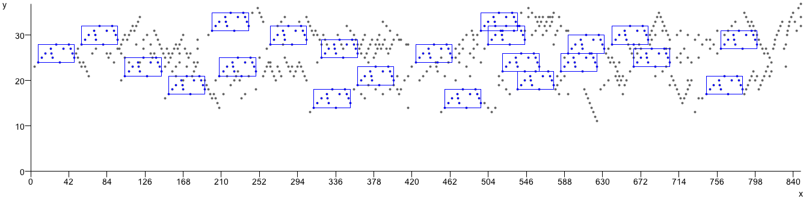
Running COSIATEC on the Fugues from Book 1 of J. S. Bach’s “The Well-Tempered Clavier”
Fugue in C major, BWV 846
  Input length: 729 points
  Encoding length: 247 points or vectors
  27 TECs used to account for piece
  21 notes (2.88%) not included in repeated patterns
  Compression ratio: 2.95

Slide 36
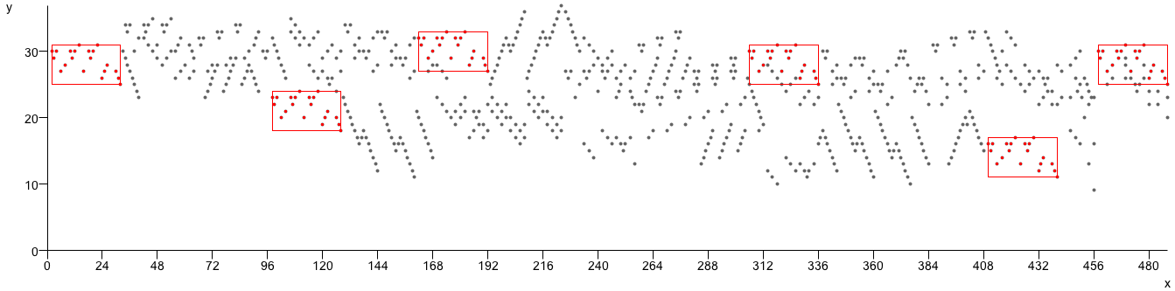
Running COSIATEC on the Fugues from Book 1 of J. S. Bach’s “Das Wohltemperirte Clavier”
Fugue in C minor, BWV 847
  Input length: 751 points (notes)
  Encoding length: 268 points or vectors
  26 TECs (patterns) used to account for piece
  20 notes (2.66%) not included in a repeated pattern
  Compression ratio: 2.80

Slide 37
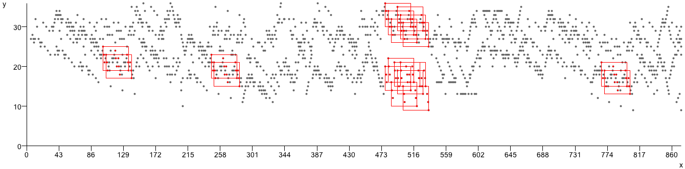
Running COSIATEC on the Fugues from Book 1 of J. S. Bach’s “Das Wohltemperirte Clavier”
Fugue in C# major, BWV 848
  Input length: 1408 points (notes)
  Encoding length: 520 points or vectors
  54 TECs (patterns) used to account for piece
  30 notes (2.13%) not included in a repeated pattern
  Compression ratio: 2.71

Slide 38
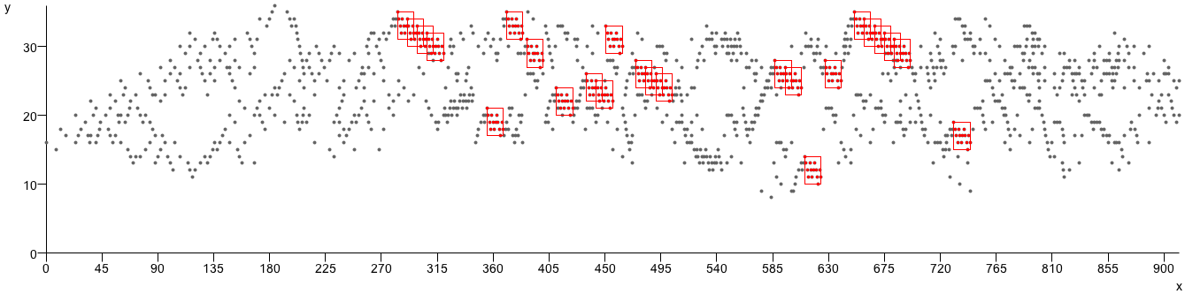
Running COSIATEC on the Fugues from Book 1 of J. S. Bach’s “Das Wohltemperirte Clavier”
Fugue in C# minor, BWV 849
  53 TECs used to account for piece
  Input length: 1311
  Encoding length: 492
  Compression ratio: 2.66
  29 notes (2.21%) not included in repeated patterns

Slide 39
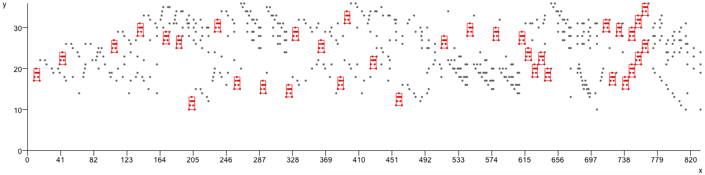
Running COSIATEC on the Fugues from Book 1 of J. S. Bach’s “Das Wohltemperirte Clavier”
Fugue in D major, BWV 850
  Input length: 772 points
  Encoding length: 266 points or vectors
  28 TECs used to account for the piece
  Compression ratio: 2.90
  26 notes (3.37%) not included in repeated patterns

Slide 40
References
Chater, N. (1996). Reconciling simplicity and likelihood principles in perceptual organization. Psychological Review, 103(3):566-581.
Deutsch, D. and Feroe, J. (1981). The internal representation of pitch sequences in tonal music. Psychological Review, 88(6):503-522.
Koffka, K. (1935). Principles of Gestalt Psychology. Harcourt Brace, New York.
Kolmogorov, A.N. (1965). Three approaches to the quantitative definition of information. Problems of Information Transmission, 1(1):1-7.
Leeuwenberg, E.L.J. (1971). A perceptual coding language for visual and auditory patterns. American Journal of Psychology, 84(3):307-349.
Lerdahl, F. and Jackendoff, R. (1983). A Generative Theory of Tonal Music. MIT Press, Cambridge, MA.
Meredith, D. (2012). A geometric language for representing structure in polyphonic music. Proceedings of the 13th International Society for Music Information Retrieval Conference, Porto, Portugal.
Meredith, D., Lemström, K. and Wiggins. G. A. (2002). Algorithms for discovering repeated patterns in multidimensional representations of polyphonic music. Journal of New Music Research, 31(4):321-345.
Schenker. H. (1925). Das Meisterwerk in der Musik (Vol. 1). Drei Masken Verlag, Munich.
Shannon, C.E. (1948). A mathematical theory of communication. The Bell System Technical Journal, 27(3):379-423.
Simon, H.A. (1972). Complexity and the representation of patterned sequences of symbols. Psychological Review, 79(5):369-382.
Simon, H.A. and Sumner, R.K. (1968). Pattern in music. In Kleinmuntz, B. (ed.), Formal Representation of Human Judgment. Wiley, New York.
von Helmholtz. H. L. F. (1910/1962). Treatise on Physiological Optics. Dover, New York.

