Slide 1
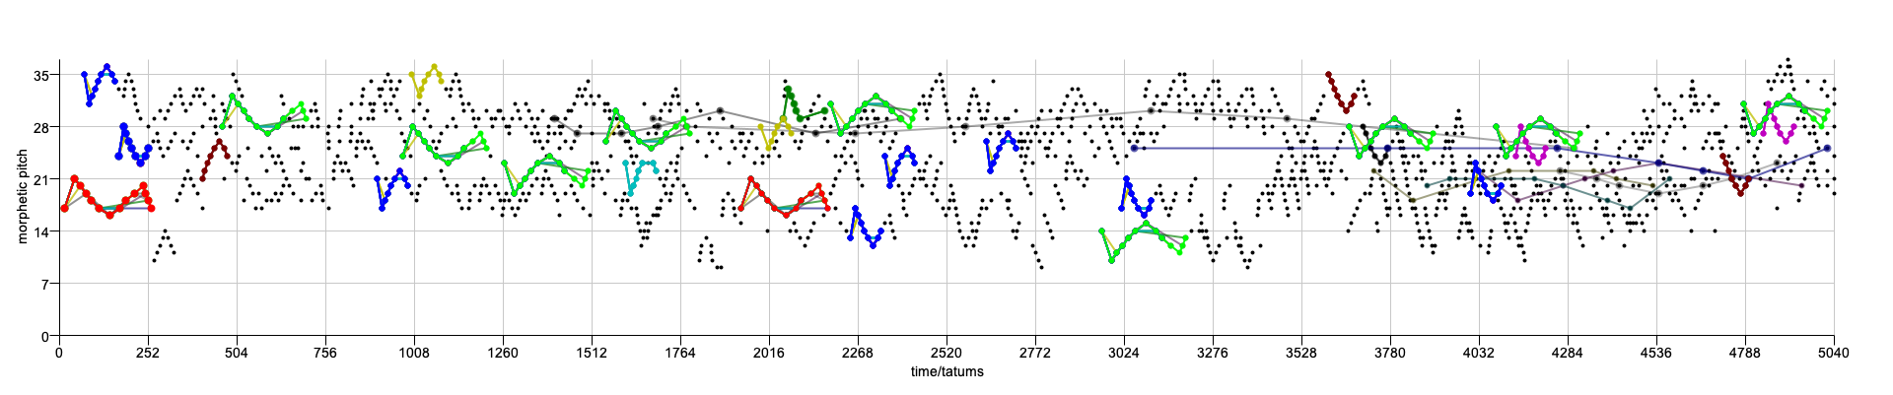
Understanding and Compressing Music with Maximal Transformable Patterns
David Meredith
dave@create.aau.dk
https://www.titanmusic.com
https://scholar.google.com/citations?user=bs-237cAAAAJ

Slide 2
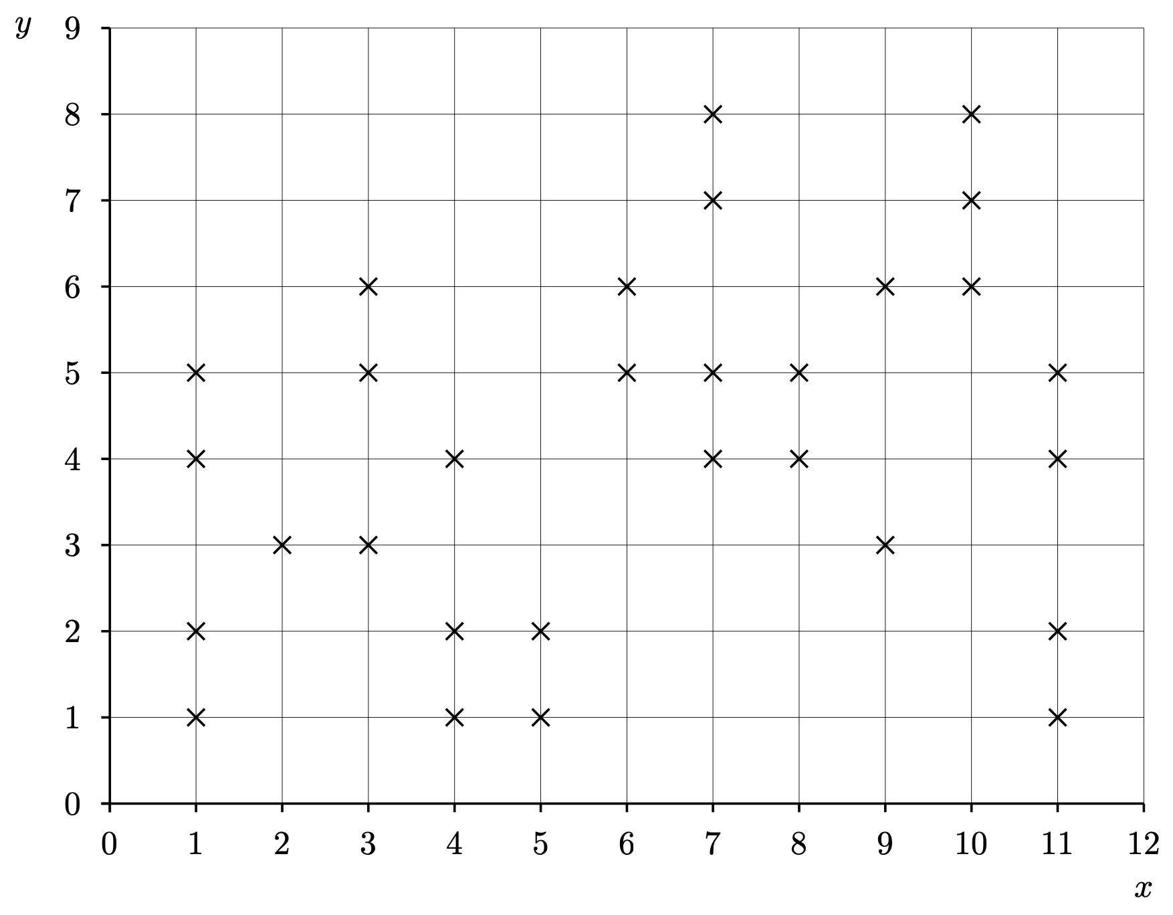
Understanding sets of observations
Suppose you have some set of observations that you want to understand, in the form of a set of points
  We call such a set a dataset
What we want is a hypothesis as to how the data came about - that is, a way of understanding the data
If we know something about the domain, then this can give us a clue as to what kinds of regularity to look for
But we want an approach that is as domain-general as possible
So what we want is an algorithm that generates the data and describes a possible process that could have given rise to the observed data

Slide 3
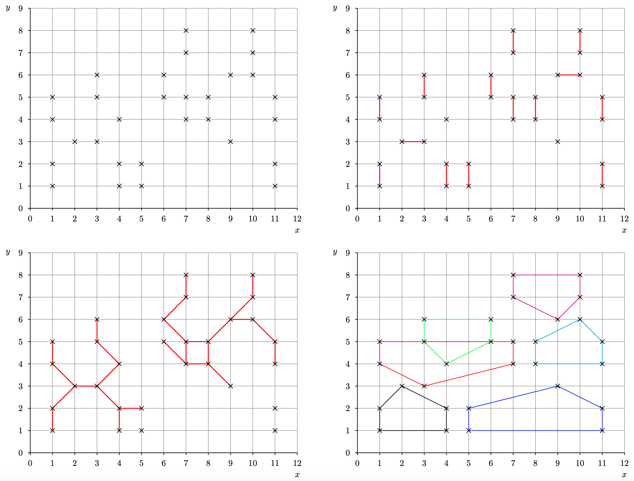
Understanding sets of observations as being constructed from transformed patterns
There are typically many different algorithms that output the dataset that we want to understand
But we expect only a small number of these to faithfully describe the actual process that gave rise to the dataset
We can use the parsimony principle to predict that the simpler algorithms that accurately generate the data are more likely to be correct descriptions of how the data arose
We believe that the simplest explanation that accurately accounts for the data is less likely to be an accurate description by chance than an equally accurate but more complex explanation

Slide 4
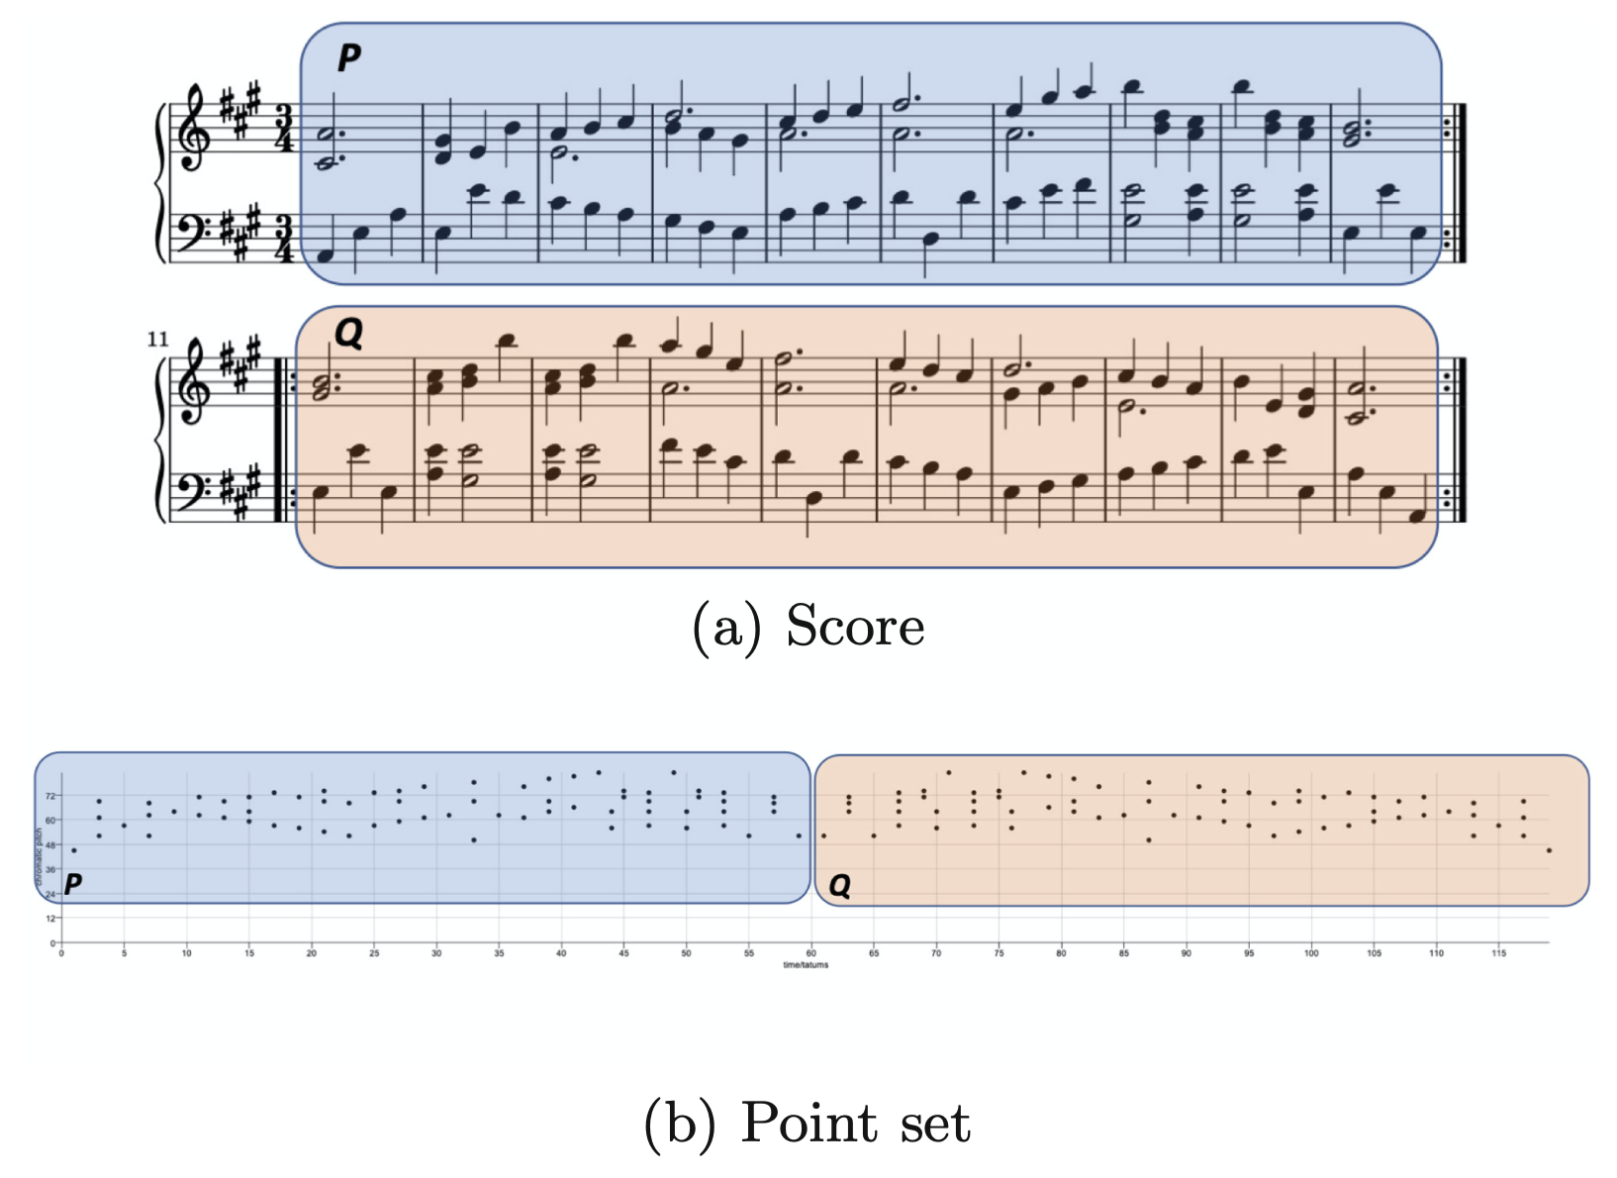
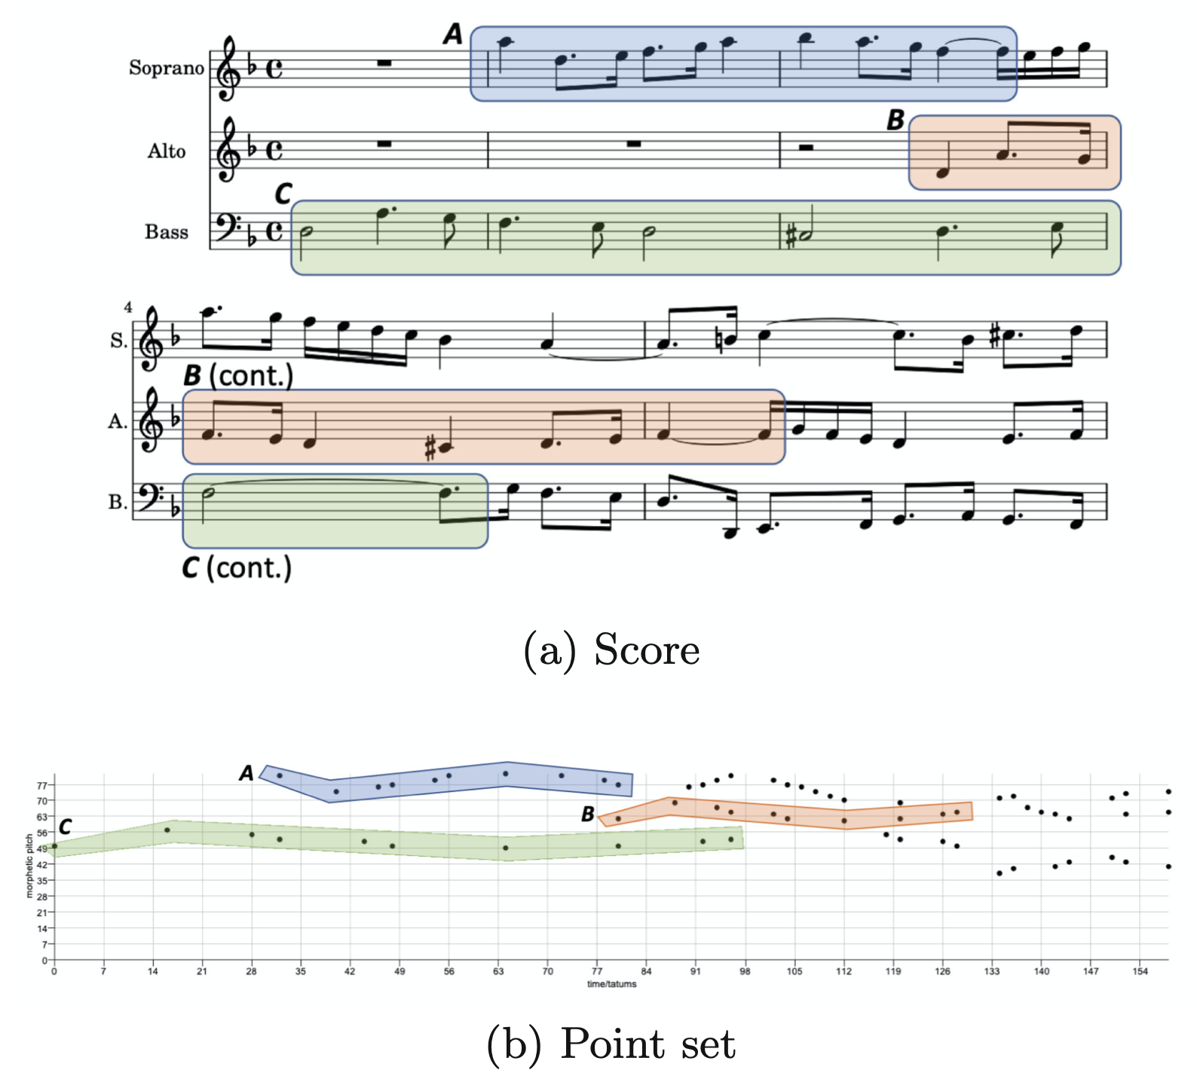
Geometric pattern transformations in music
Above: 2nd mvt from Haydn’s Sonata in A major, Hob.XVI:26, Op.13 No.6 (“Menuetto al Rovescio”). The second half of the piece, Q, is an exact retrograde of the first half.
On right: bars 1-5 of Contrapunctus VI from J. S. Bach’s Die Kunst der Fuge, BWV 1080. Pattern C is an inverted augmentation of pattern A and pattern B is an inversion of pattern A.

Slide 5
Maximal translatable patterns (MTPs)

Slide 6
Translational equivalence classes (TECs)
Translational equivalence class (TEC) of a pattern P is the set of all patterns in the dataset that are translationally equivalent to P
A TEC can be compactly expressed as a <pattern,vector set> pair
Covered set of a TEC is the set of points that are members of patterns in the TEC

Slide 7
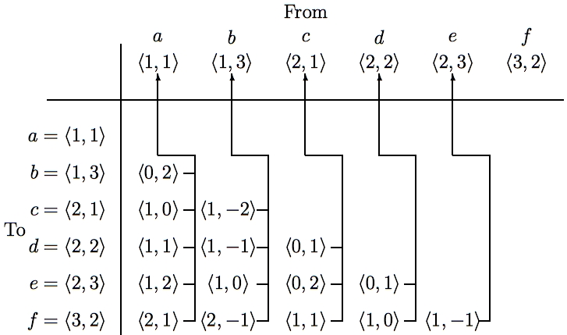
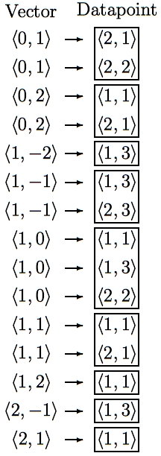
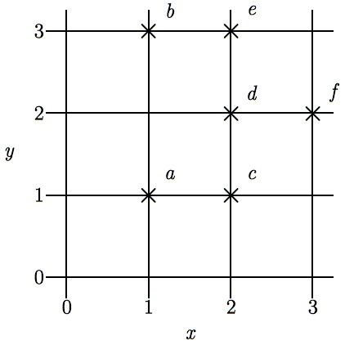
SIA
Discovering all maximal translatable patterns (MTPs)
Pattern is translatable by vector v in dataset if it can be translated by v to give another pattern in the dataset
MTP for a vector v contains all points mapped by v onto other points in the dataset
O(kn² log n) time, O(kn²) space
O(kn²) time if use direct address table to store vectors
Notes:
The first algorithm I’m going to describe is the SIA algorithm which takes as input a multidimensional point set and discovers, for every vector, the points in this point set that are mapped onto other points in the point set by that vector.
For convenience, I’ll call the complete set of points being analyzed the DATASET and any subset of the dataset a PATTERN.
I say that a pattern is TRANSLATABLE by a particular vector within a dataset if it can be translated by that vector to give another pattern in the dataset. For example, the pattern {a,d} here is translatable within this dataset by the vector <1,0>.
And the pattern that contains ALL the points that are mapped onto other points in the dataset by a particular vector is the MAXIMAL TRANSLATABLE PATTERN for that vector. So the maximal translatable pattern or MTP in this dataset for the vector <1,0> is the pattern {a,b,d} and the MTP for the vector <1,1> in this dataset is {a,c}.
So SIA discovers all the non-empty maximal translatable patterns in a dataset.
It does this by first sorting the points in the dataset into lexicographical order and then computing the vector from each point to every other point in the dataset that is lexicographically greater. These vectors are stored in a table like this one here which we call a VECTOR TABLE. And each vector is stored with a pointer that points back to the origin point for which it was computed, as indicated by these arrows here.
The vectors in this table are then sorted into lexicographical order to give a list like the one here on the right and the MTP for each vector can be found directly by reading off the points attached to the adjacent occurrences of that vector in this list.
The most expensive step is sorting the vectors which can be done in O(kn^2 log n) time. However, by storing the origin points in a hash table and hashing the vectors to get the slot indices, this time complexity can be reduced to O(kn^2).
And also, obviously, the space used is O(kn^2)

Slide 8
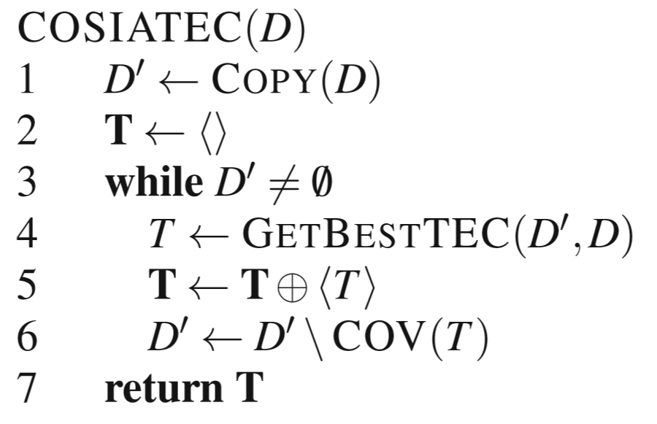
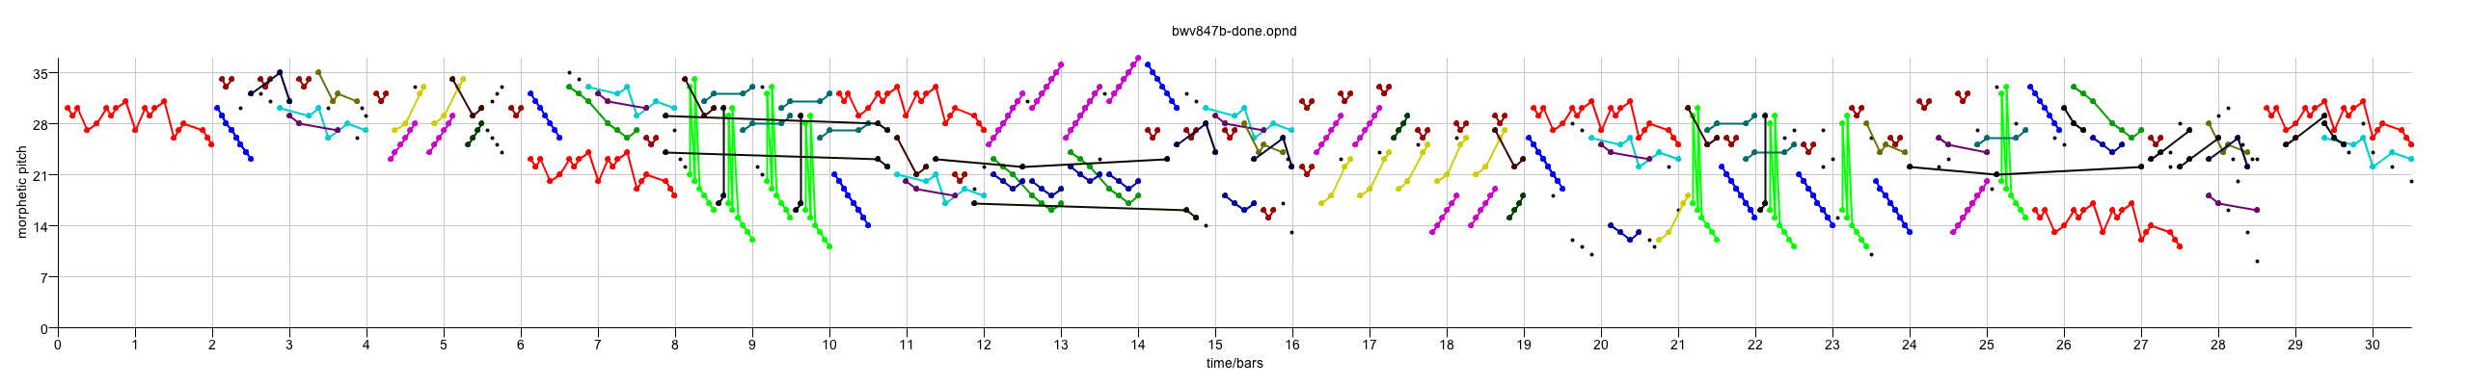
COSIATEC
Compression and covering with MTP TECs
Start
Dataset
SIATEC
Computes a set of TECs that collectively cover the input dataset
The dataset is exclusively and exhaustively partitioned into TEC covered sets
Typically gives better compression than the other strategies tried
GetBestTEC runs SIATEC and selects the best TEC using the heuristics
List of <Pattern, Translator_set> pairs
Add best TEC, <P,V> to encoding
Remove points covered by <P,V> from dataset
Is dataset empty?
No
Yes
Output encoding
Notes:
We can use SIATEC together with the heuristics I’ve just described to construct a simple compression algorithm which I call COSIATEC. COSIATEC works like this.
First we use SIATEC to generate a list of <Pattern, Translator_set> pairs in which each pattern is an MTP and each translator set contains all the non-zero vectors by which the pattern is translatable within the dataset. This generally gives a more efficient representation of the set of points covered by the occurrences of a pattern.
Then we can use the heuristics I’ve just described - compression ratio, coverage and compactness - to choose the “best” pattern P and this pattern is printed out together with its translator set.
Then all the points covered by P and its occurrences are removed from the dataset.
Then if the dataset is empty, we end; otherwise, we again run SIATEC on the remaining points in the dataset.
The result is a print out of the “best” pattern and its translators for each iteration of the cycle and this printout is usually a compressed representation of the input dataset.
Obviously, the degree of compression achieved depends on the amount of repetition in the dataset.

Slide 9
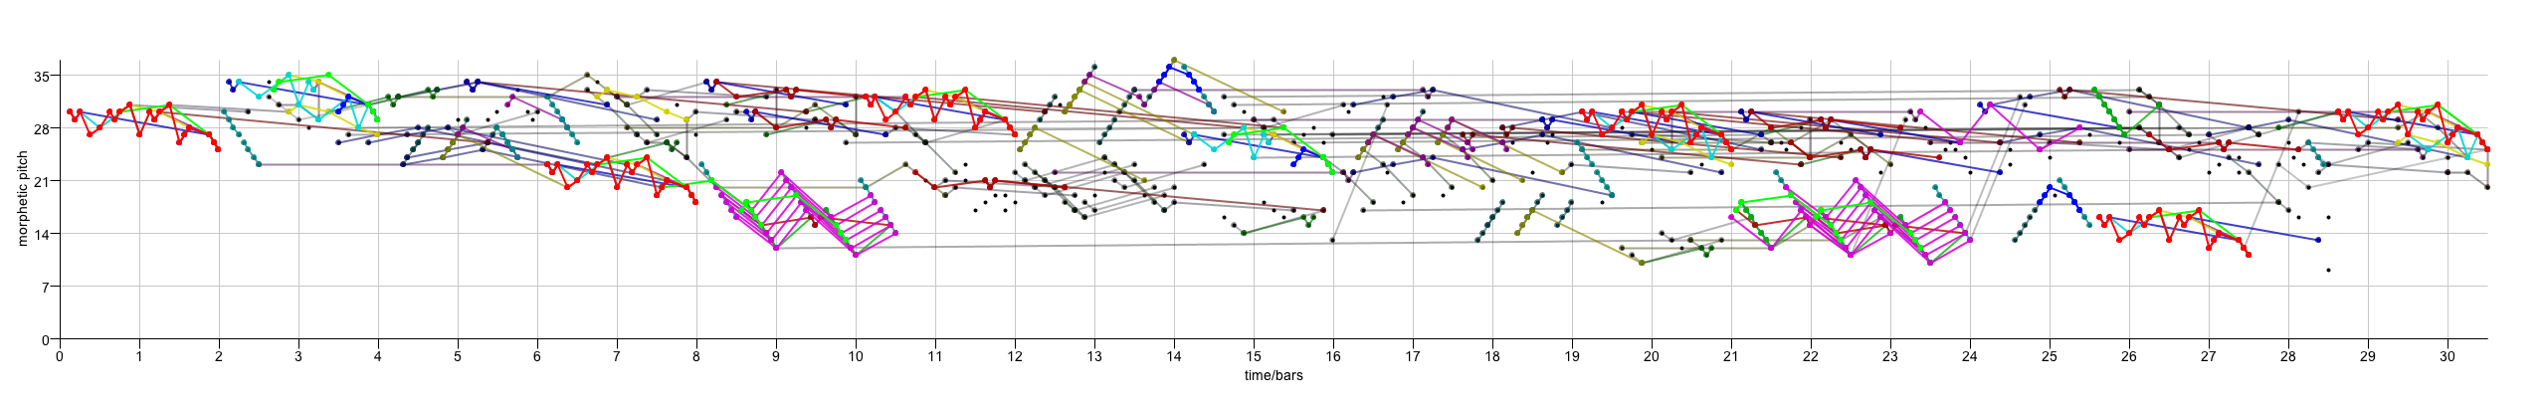
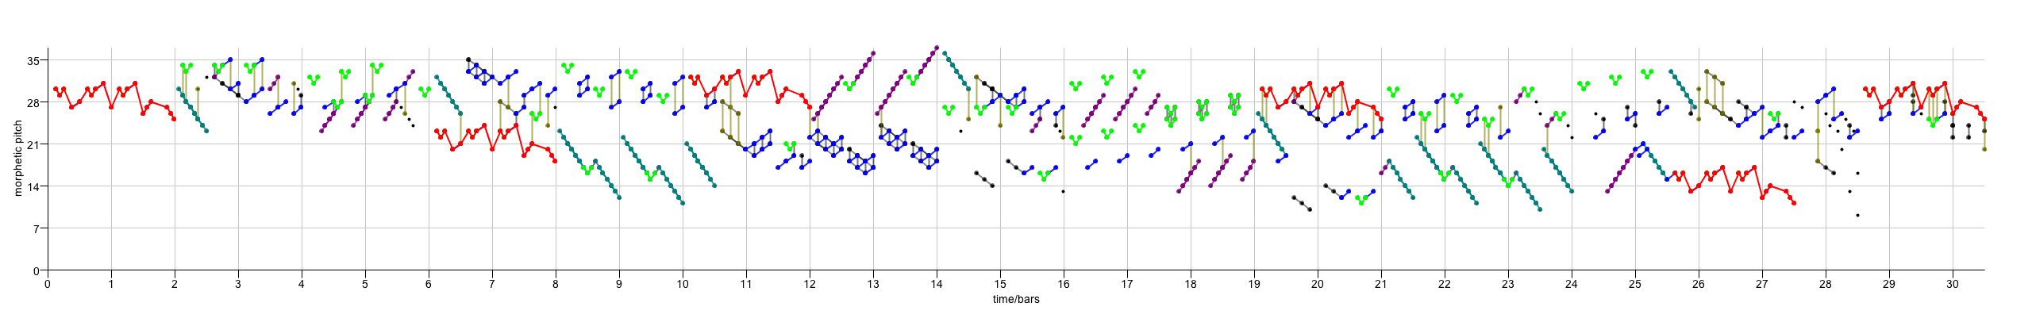
Compression-driven point-set pattern discovery in music
Principle of parsimony:
  Given two models that equally accurately describe the data, the simpler one is less likely to be an accurate description by chance
Have applied compression-based point-set cover algorithms to a number of different musicological tasks with some success
  classification of folk songs, simulation of human analyses, discovery of subjects and counter-subjects in fugues
Some evidence that better compression is correlated with better performance (Louboutin and Meredith, JNMR, 2016) and better simulation of cognition (Collins et al., Music Perception, 2011)
Motivated to develop techniques that give us better compression, in the hope that the more compressed encodings of musical objects will represent better ways of understanding them
One way of potentially getting better compression and better explanations is to discover occurrences that are transformed by a broader class of transformation than just translation
COSIATEC
SIATECCompress
Forth’s algorithm

Slide 10
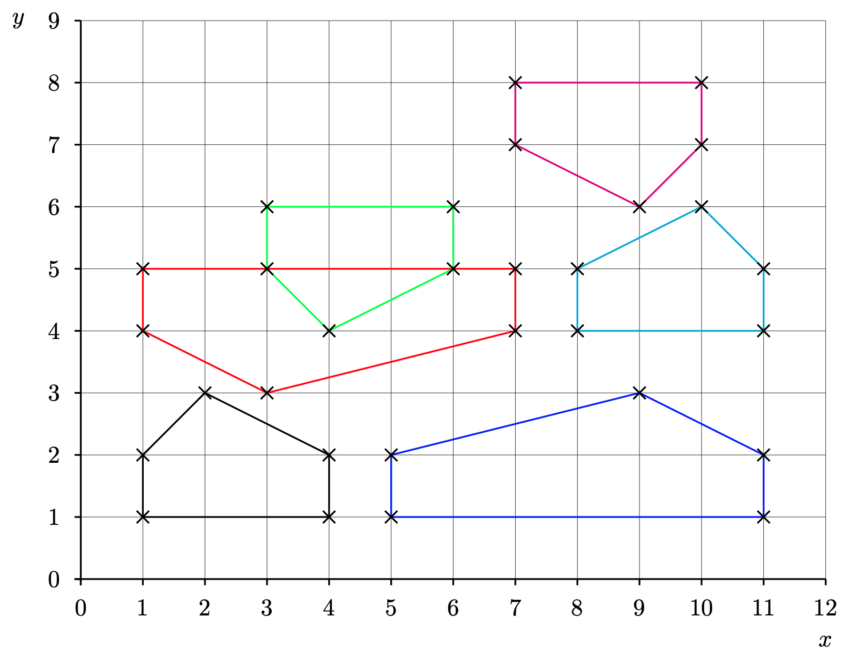
User-specified transformation classes
We introduce a framework that allows users to specify the class (or classes) of transformations that they are interested in
If the dataset is k-dimensional, then the transformation class must be a set of bijections over the universe of k-dimensional points
We present an algorithm that takes a dataset, D, and a transformation class, F, and discovers all occurrences of the maximal transformable patterns in D wrt F
It then computes a short cover of D that consists of a subset of these occurrence sets

Slide 11
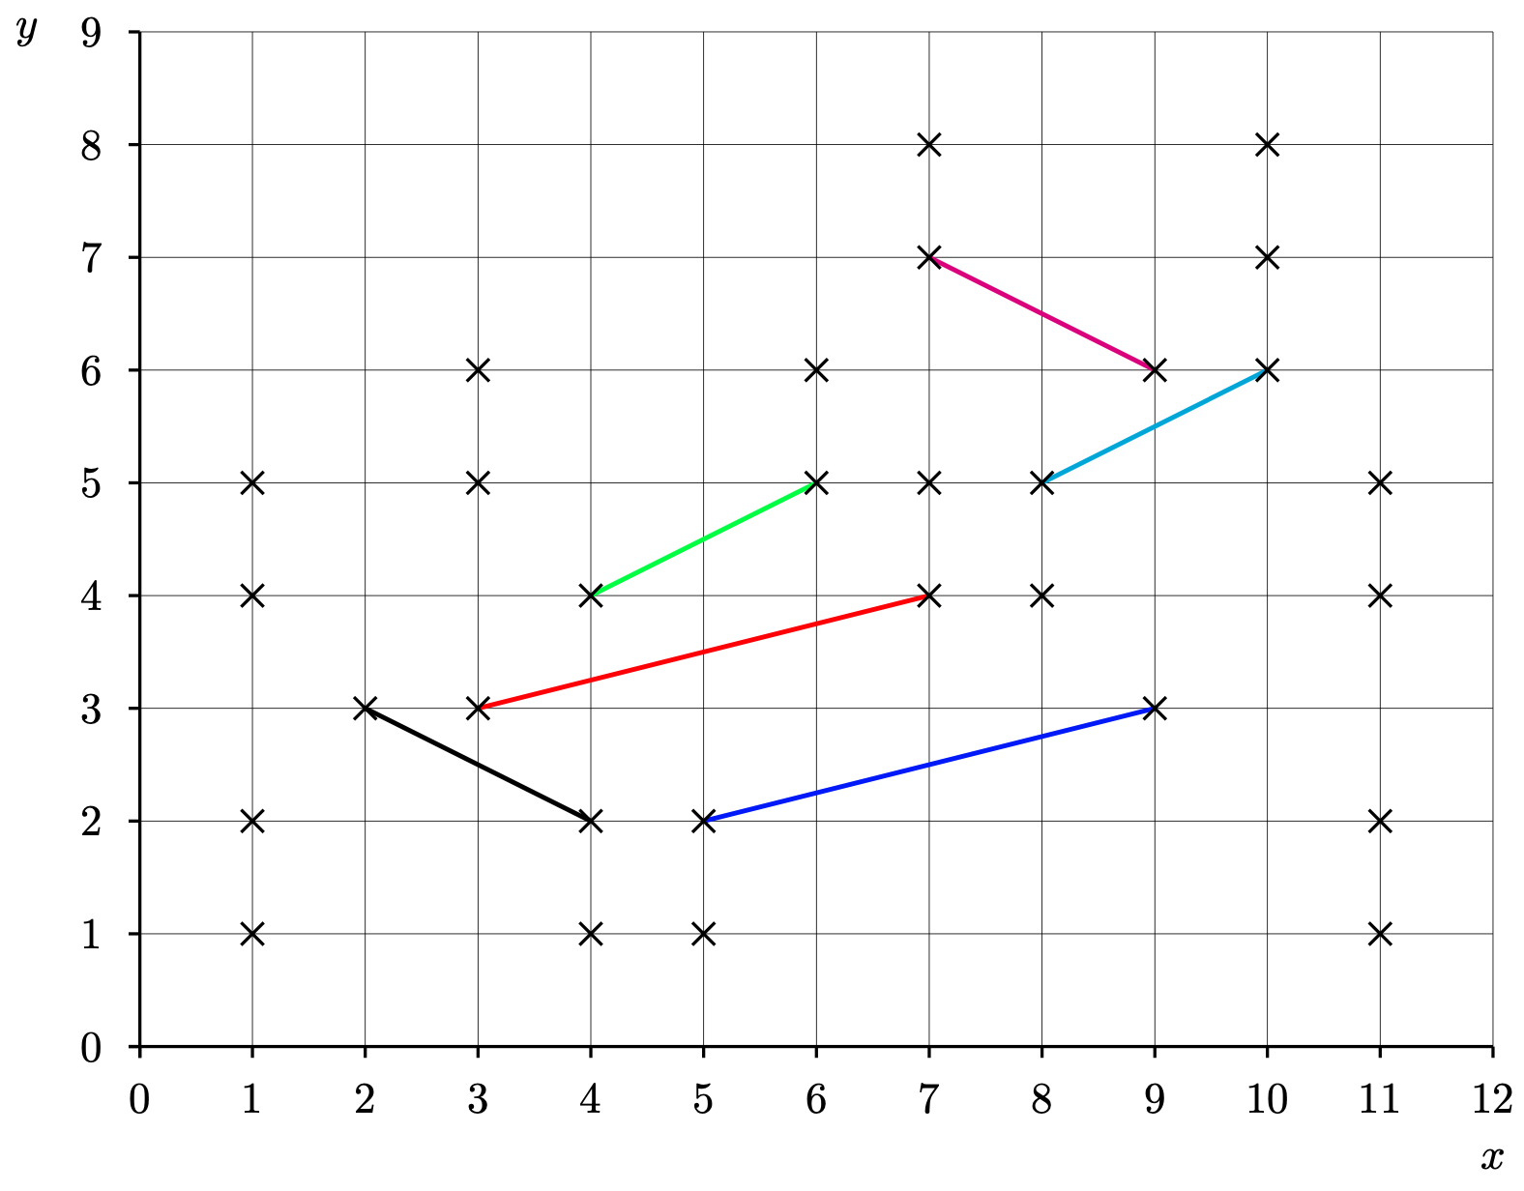
Example: F_{2STR}
F_{2STR} contains all transformations consisting of a scaling parallel to the the x-axis, followed by a translation and then optionally followed by a reflection in the x-axis
If our dataset is a pitch-vs-time representation of some music, then F_{2STR} contains the transformations corresponding to the traditional musical contrapuntal transformations of transposition, inversion, retrograde, diminution and augmentation
We can identify each transformation in F_{2STR} by a transformation parameter, (s,v,b), where
  s is the scale factor by which the x-coordinate is stretched
  v is the vector by which the point is translated
  b indicates whether or not the point is reflected in the x-axis
e.g., mapping black line to red line could be achieved using the following transformation parameters:
  (-2,(11,1),1)
  (2,(-1,-6),-1)

Slide 12
Discovering inter-basis transformations
If we take two ordered pairs of points in a point set, (p1,p2) and (p3,p4), then there are at most two distinct transformations in F_{2STR} that map (p1,p2) onto (p3,p4) and we can define a function that discovers these transformations given (p1,p2) and (p3,p4)
Compare this with the case of F_{2T ,} computed by SIA, which contains all 2-dimensional translations. In this case,
  each instance of a transformation in F_{2T} can be represented by a single 2-d vector
  given a pair of points, p1 and p2, there is a unique translation that maps p1 onto p2

Slide 13
Basis pairs
Suppose we have
  a dataset, D, and a transformation class, F
  two ordered sets of points in D, P and Q, each of size 𝛽, such that there is at least one transformation in F that maps the points in P onto corresponding points in Q
  Then, for F, we can choose a basis size, 𝛽, which is just large enough so that there is a manageably small maximum number of distinct transformations in F that map P onto Q
    so for F_{2STR}, 𝛽=2, whereas for F_{2T}, 𝛽=1
We call P and Q an image basis and object basis, respectively

Slide 14
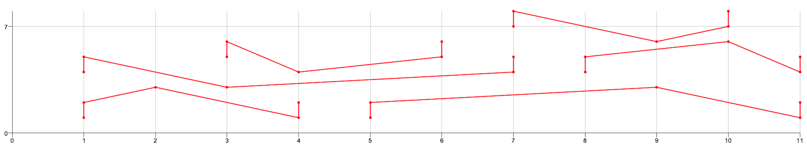
Maximal transformable patterns algorithm
We present an algorithm that computes the
(transformation,image basis) pairs for all basis pairs, then combines those pairs with the same transformation into maximal transformable patterns
We then find the set of occurrences of each maximal transformable pattern
We then attempt to select a subset of the occurrence sets that collectively cover the dataset as efficiently as possible
Above is the output of the algorithm for the running example (i.e., it correctly describes the method by which the dataset was constructed)

Slide 15
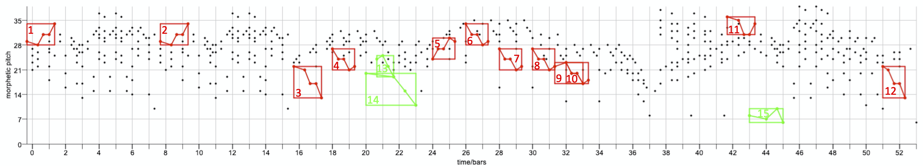
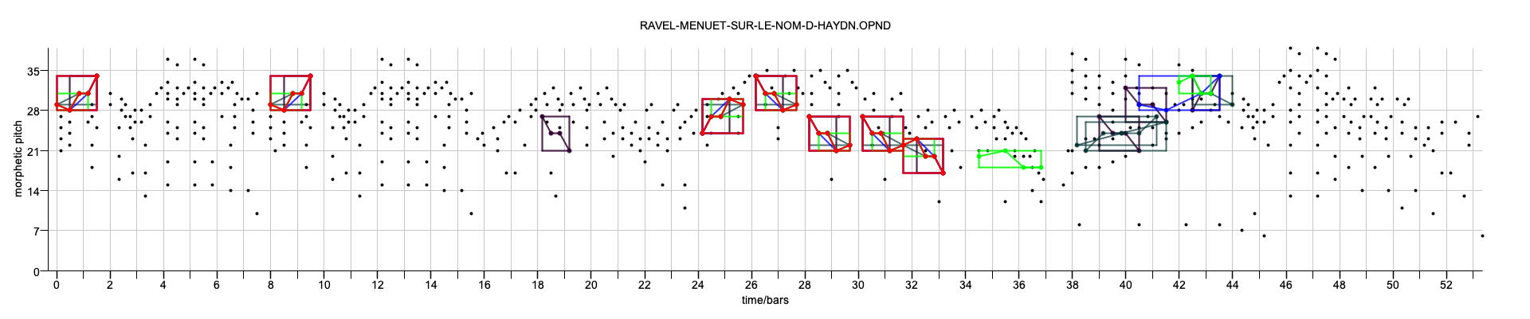
Ravel’s Menuet sur le nom d’Haydn
The example above shows a representation of the score of Ravel’s Menuet sur le nom d’Haydn, which contains 12 complete and 3 partial occurrences of the motif, B-A-D-D-G
The upper diagram shows the 15 examples, while the lower diagram shows the occurrences discovered by the algorithm (with some filters applied for maximum pattern size and minimum compactness)

Slide 16
Contrapunctus VI from Bach’s Die Kunst der Fuge
Bach’s Contrapunctus VI from Die Kunst der Fugue. Partial or complete matches with all 29 occurrences of the subject are found when the subject is given as a query

