Slide 1
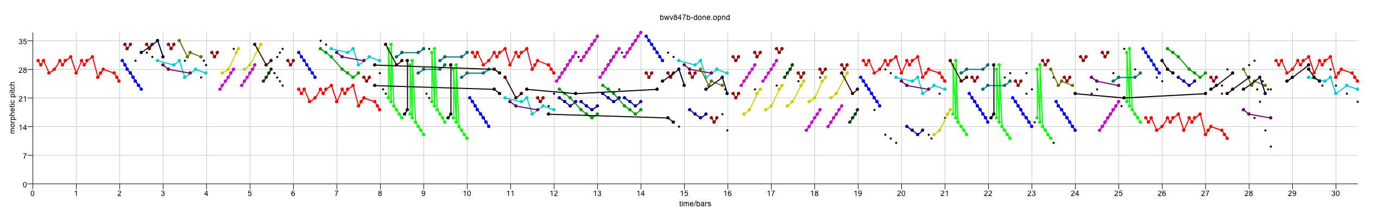

Geometric, Compression-based Pattern Discovery in Music
David Meredith

Slide 2
New Springer book on Computational Music Analysis
http://link.springer.com/book/10.1007/978-3-319-25931-4

Slide 3
Pattern discovery in Lrn2Cre8
We want to build systems that can learn to compose convincing novel music in recognizable styles
Such systems must learn in a bottom-up way from examples of pieces in a target style how pieces in that style are typically structured
  thematic and motivic structure
  metrical structure
  grouping structure and form
  harmonic and tonal structure
  rhythmic structure
  voice-leading structure and contrapuntal structure
  instrumentation
  production techniques
  ...

Slide 4
Pattern discovery in Lrn2Cre8
Focus here is on discovery of various classes of repeated pattern
  provides essential information for
    metrical structure
    grouping structure and form
    motivic/thematic structure
    voice-leading and contrapuntal structure
  can potentially be used to inform a system for automatic expressive performance

Slide 5
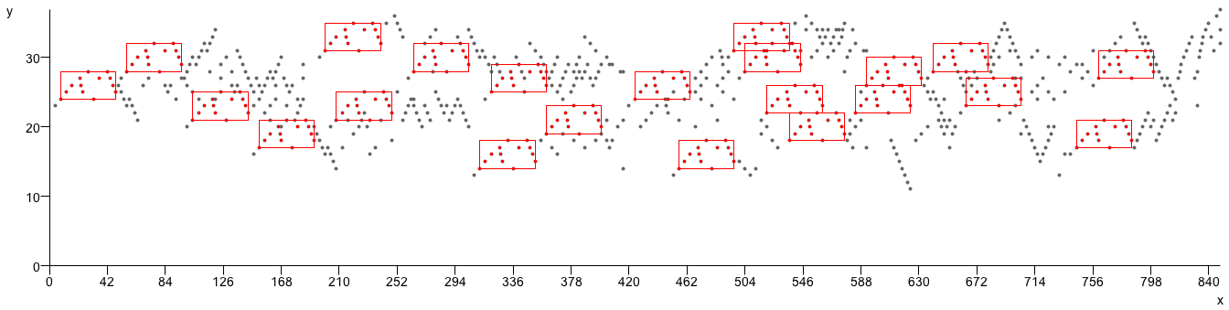

Repeated patterns in music
J.S. Bach, Fugue in C major, BWV 846
“the importance of parallelism [i.e., repetition] in musical structure cannot be overestimated. The more parallelism one can detect, the more internally coherent an analysis becomes, and the less independent information must be processed and retained in hearing or remembering a piece”
  Lerdahl and Jackendoff (1983, p.52)

Slide 6
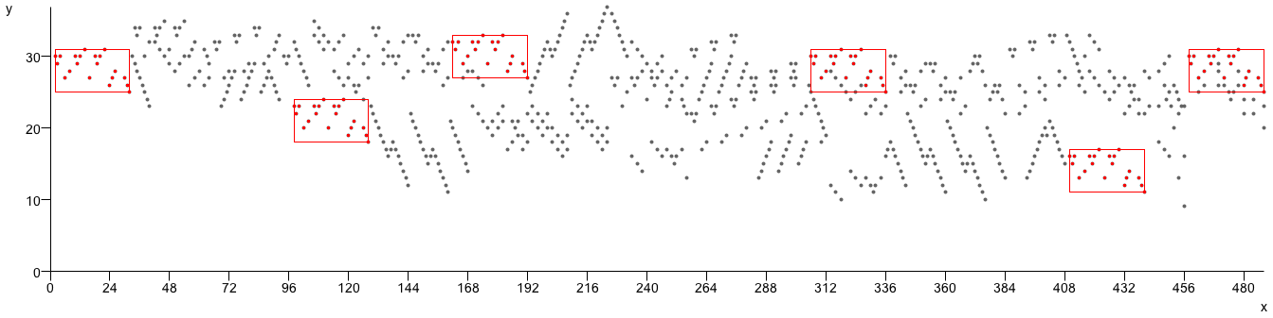
Repeated patterns in music
J.S. Bach, Fugue in C minor, BWV 847
repetition “is the basis of music as an art”
  Schenker (1954, p.5)
Notes:
Accepted among music analysts and music psychologists that identifying perceptually significant repetitions is an essential step in the process of achieving a rich understanding of a piece of music.

Slide 7
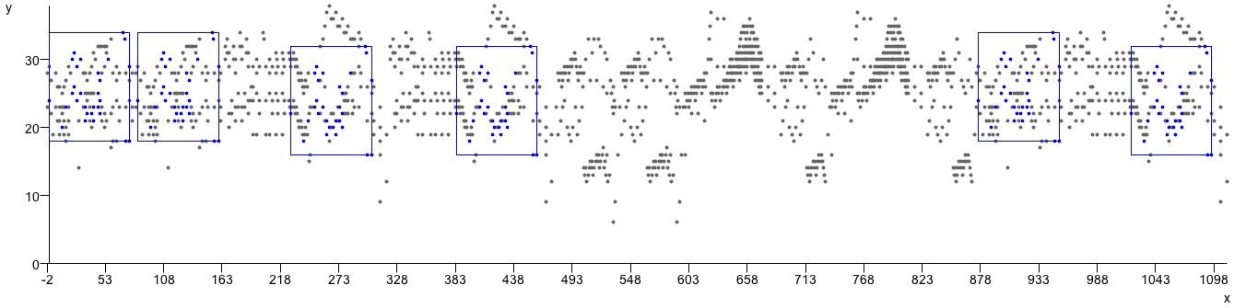
Repeated patterns in music
L. van Beethoven, Piano Sonata, Op.2, No.1, 3rd movement
“the central act” in all forms of music analysis is “the test for identity”
  Bent and Drabkin (1987, p.5)

Slide 8
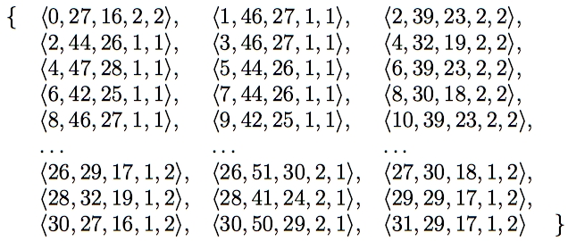
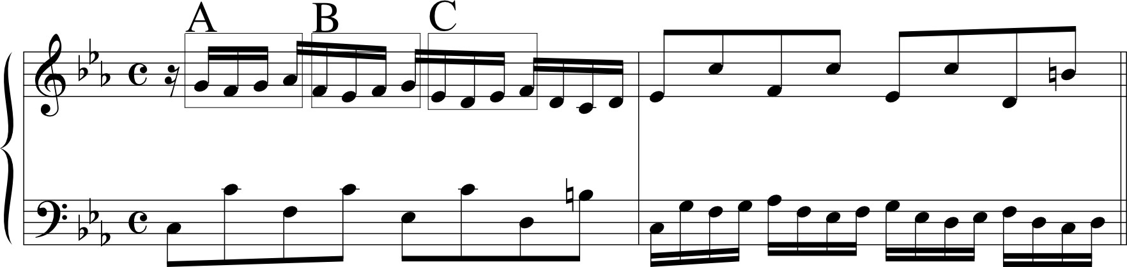

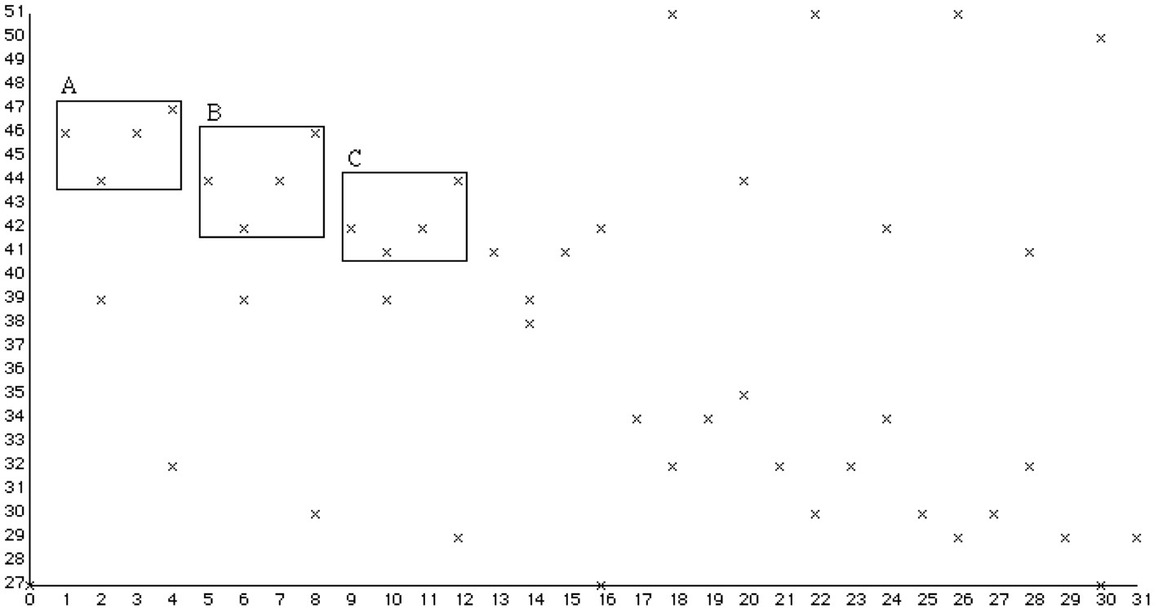
Using multidimensional point sets to represent music (1)
Notes:
I tried to avoid the problems I’ve just described by using multidimensional point sets instead of strings to represent the music and then developing algorithms to work on these point sets.
The algorithms developed work on point sets of any dimensionality.
There are many possible ways of representing a passage of music using a multidimensional point set but the way shown here has proved to be very useful.
Note that patterns A, B and C sound like versions of the same thing but have different representations in the chromatic-pitch-against time representation. Thus, to find these matches in this representation, you’d have to use an approximate matching algorithm.
However, the notation nicely represents the fact that these three patterns are heard as being versions of the same thing by representing each one as a falling step followed by two rising steps.
By using the diatonic pitch dimension and onset time, we can obtain such a representation.

Slide 9
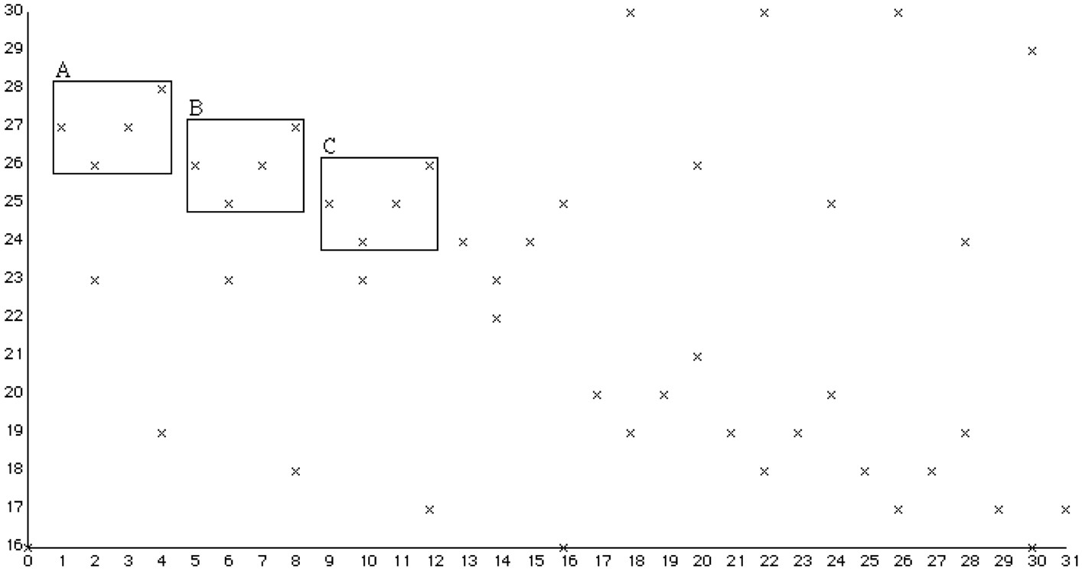
Using multidimensional point sets to represent music (2)
Notes:
However, when we’re trying to find interesting repeated patterns in tonal music, that is, music which has a key, it is often more fruitful to use a two dimensional projection which gives the diatonic pitch of the note and its onset time, as shown here.
Here, patterns A, B and C are exactly translationally equivalent and can thus be discovered using a fast exact matching algorithm.

Slide 10
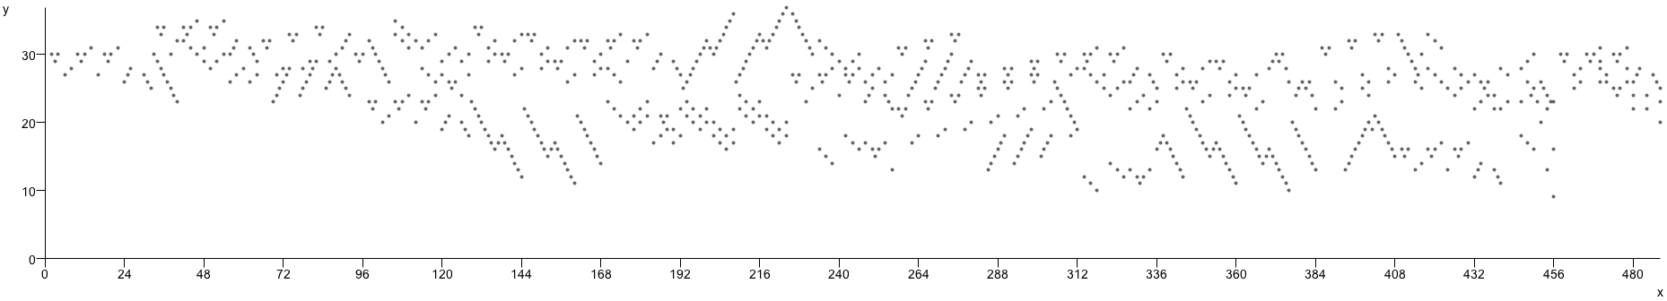
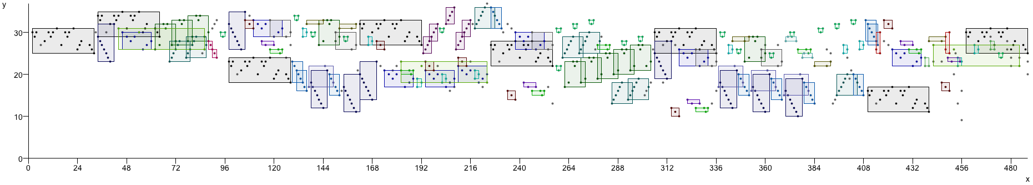
Motives, themes and translatable patterns in pitch-time space

Slide 11
Compression and explanation
Hypothesis: The shortest descriptions provide the best explanations
  Ockham’s razor, MDL, MML, Solomonoff’s theory of inductive inference
Suggests that knowledge can be extracted from data by finding short descriptions of it (i.e., by compressing it)
Identifying the maximal repeated patterns and their occurrences is an excellent strategy for compressing data

Slide 12
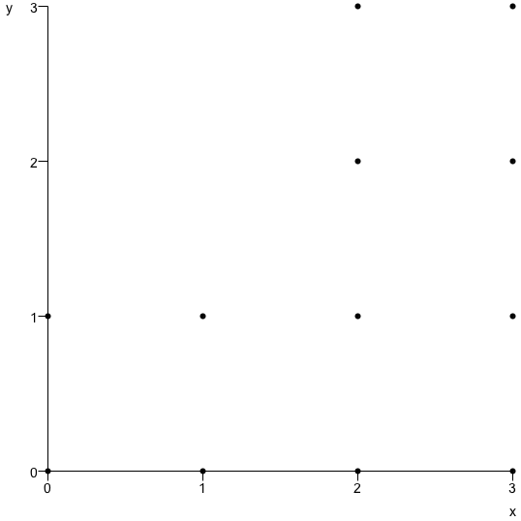
Encoding length as a measure of complexity
P(p(0,0),p(0,1),p(1,0),p(1,1),p(2,0),p(2,1),p(2,2),p(2,3),p(3,0),p(3,1),p(3,2),p(3,3))
T(P(p(0,0),p(0,1),p(1,0),p(1,1)),V(v(2,0),v(2,2)))
From Kolmogorov (1965) complexity theory:
  can use the length of an encoding to measure the complexity of its corresponding explanation
  The shorter the encoding (“program”), the simpler and better the explanation

Slide 13
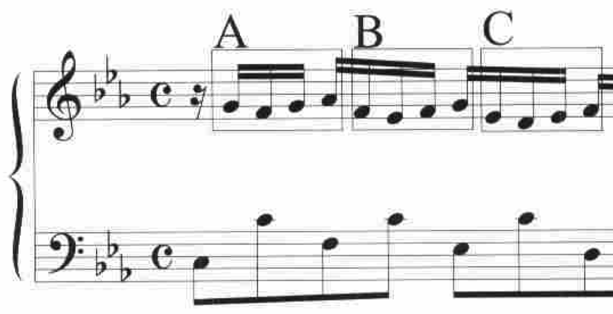
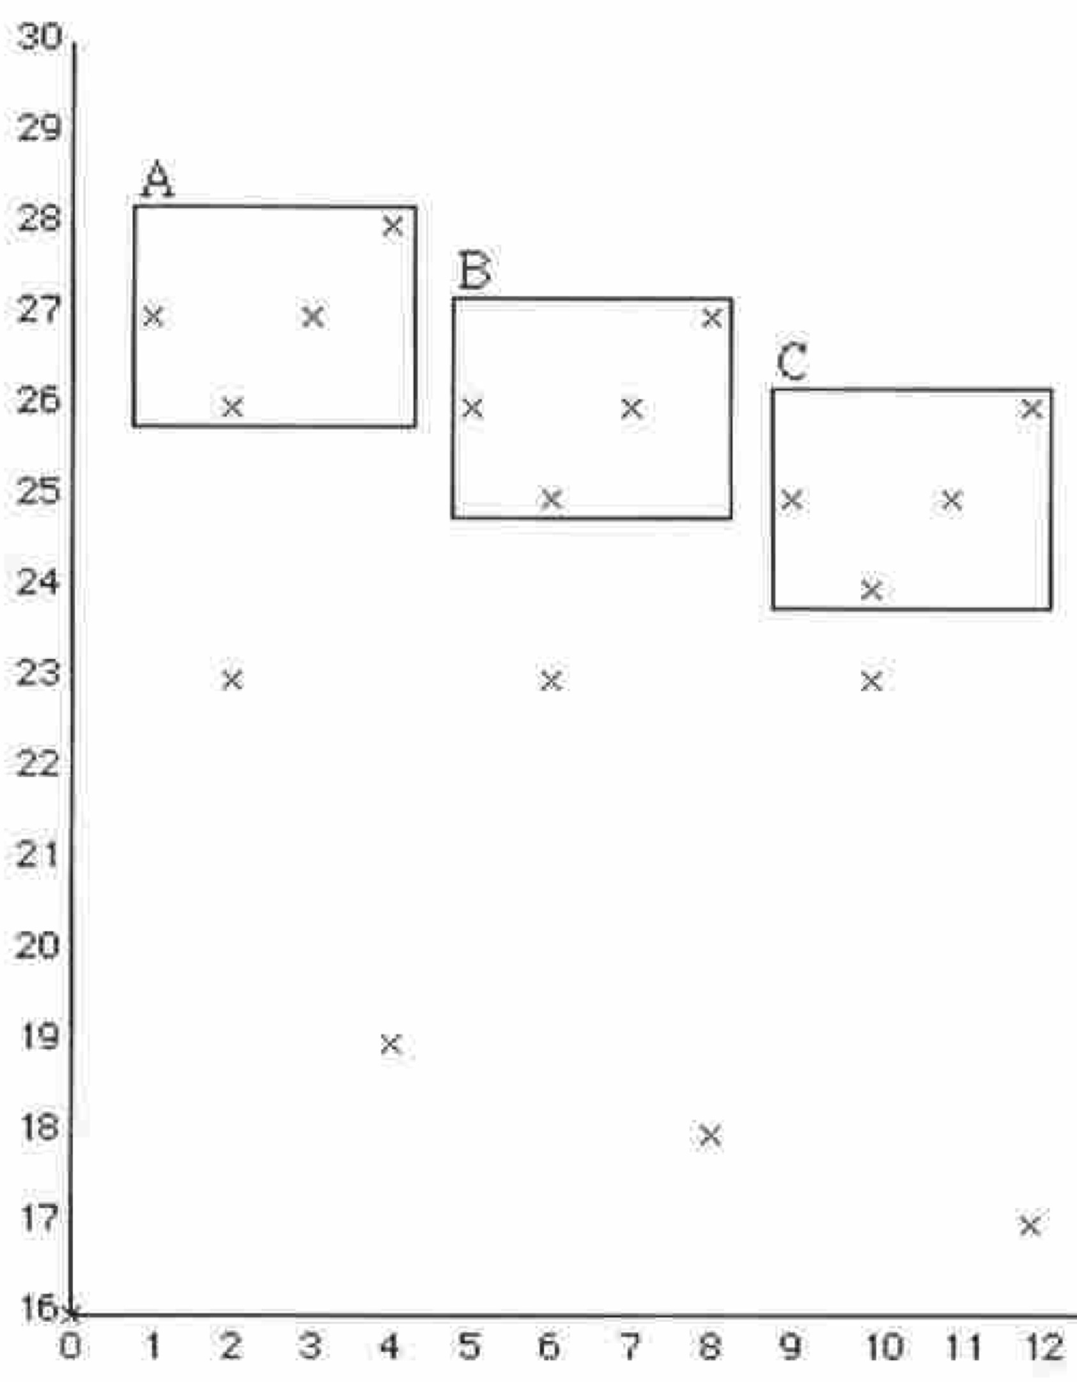
Music analysis aims to compress music
P(p(1,27),p(2,26),p(3,27),p(4,28),p(5,26),p(6,25),p(7,26),p(8,27),p(9,25),p(10,24),p(11,25),p(12,26))
T(P(p(1,27),p(2,26),p(3,27), p(4,28)),V(v(4,-1),v(8,-2)))
Since the best explanations are the shortest descriptions, the aim of music analysis is to compress music as much as possible
Meredith, Lemström and Wiggins (2002)

Slide 14
Music analysis and point-set compression
Meredith, D. (2015). Music analysis and point-set compression. Journal of New Music Research, 44(3):245-270.
  http://www.tandfonline.com/doi/abs/10.1080/09298215.2015.1045003
Meredith, D. (2016). Analysing music with point-set compression algorithms. In Meredith, D. (ed.) Computational Music Analysis, pages 335-366. Springer.
  http://link.springer.com/chapter/10.1007/978-3-319-25931-4_13

Slide 15
Maximal translatable patterns (MTPs)

Slide 16
Translational equivalence classes (TECs)

Slide 17
Compression with TECs

Slide 18
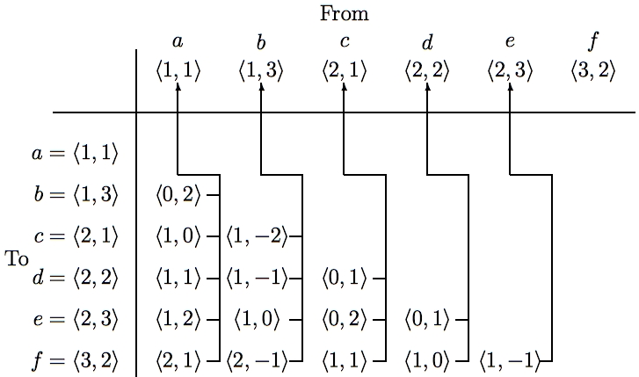
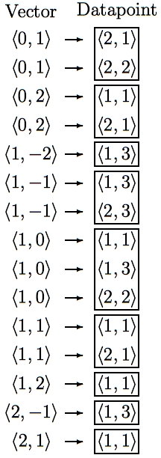
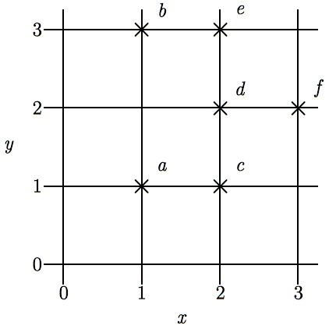
SIA - Discovering all maximal translatable patterns (MTPs)
Pattern is translatable by vector v in dataset if it can be translated by v to give another pattern in the dataset
MTP for a vector v contains all points mapped by v onto other points in the dataset
O(kn² log n) time, O(kn²) space
O(kn²) time if use direct address table to store vectors
Notes:
The first algorithm I’m going to describe is the SIA algorithm which takes as input a multidimensional point set and discovers, for every vector, the points in this point set that are mapped onto other points in the point set by that vector.
For convenience, I’ll call the complete set of points being analyzed the DATASET and any subset of the dataset a PATTERN.
I say that a pattern is TRANSLATABLE by a particular vector within a dataset if it can be translated by that vector to give another pattern in the dataset. For example, the pattern {a,d} here is translatable within this dataset by the vector <1,0>.
And the pattern that contains ALL the points that are mapped onto other points in the dataset by a particular vector is the MAXIMAL TRANSLATABLE PATTERN for that vector. So the maximal translatable pattern or MTP in this dataset for the vector <1,0> is the pattern {a,b,d} and the MTP for the vector <1,1> in this dataset is {a,c}.
So SIA discovers all the non-empty maximal translatable patterns in a dataset.
It does this by first sorting the points in the dataset into lexicographical order and then computing the vector from each point to every other point in the dataset that is lexicographically greater. These vectors are stored in a table like this one here which we call a VECTOR TABLE. And each vector is stored with a pointer that points back to the origin point for which it was computed, as indicated by these arrows here.
The vectors in this table are then sorted into lexicographical order to give a list like the one here on the right and the MTP for each vector can be found directly by reading off the points attached to the adjacent occurrences of that vector in this list.
The most expensive step is sorting the vectors which can be done in O(kn^2 log n) time. However, by storing the origin points in a hash table and hashing the vectors to get the slot indices, this time complexity can be reduced to O(kn^2).
And also, obviously, the space used is O(kn^2)

Slide 19
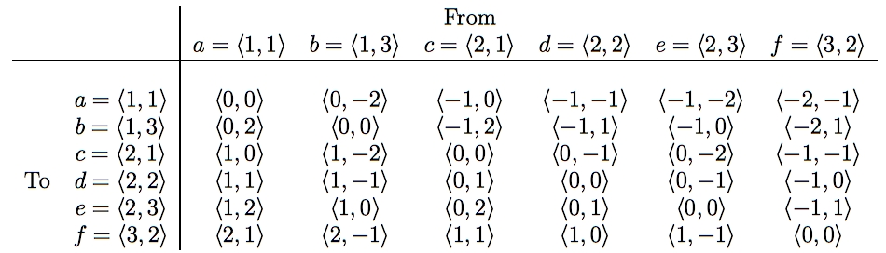
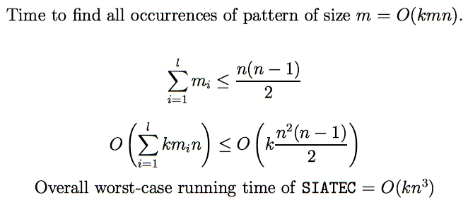
SIATEC - Discovering all occurrences of all MTPs
Translational Equivalence Class (TEC) is set of all translationally invariant occurrences of a pattern
Notes:
SIA only finds one occurrence of each MTP and one vector by which that MTP is translatable within the dataset.
SIATEC, on the other hand, finds all the MTPs using a slightly modified version of SIA and then finds all the vectors by which each MTP is translatable within the dataset.
In other words, it finds all the non-empty MTPs and then all the patterns within the dataset that are translationally equivalent to each MTP.
In SIA, we only needed to compute the vector from each point to every lexicographically greater point because the MTP for a particular vector -v is the same as the pattern that you get by translating the MTP for v by v itself.
However, in this simple implementation of SIATEC, we can find all the occurrences more efficiently by computing all the interpoint vectors and storing them in a table like this one here.
If the points in the dataset are sorted into lexicographical order first, then the vectors in this table increase lexicographically as you descend a column and go from right to left along a row.
Each column contains all the vectors by which the point at the top of the column is translatable within the dataset.
Therefore the set of vectors by which a given pattern in the dataset is translatable is equal to the intersection of the columns headed by the points in that pattern. For example, the pattern {a,c} is translatable within this dataset by the intersection of the columns for which a and c are the original points.
By exploiting the orderedness of this table, we can find all the occurrences of a k-dimensional pattern of size m in a dataset of size n in a worst case running time of O(kmn).
Now, all the MTPs in a dataset can be found by reading through the list of sorted vectors generated by SIA so we know that sum of the cardinalities of the MTPs is less than or equal to n(n-1)/2.
Therefore the worst case time complexity of this implementation of SIATEC is [as shown] which implies that it is O(kn^3).
And, obviously, it uses O(kn^2) space.

Slide 20
COSIATEC
Start
Dataset
SIATEC
List of <Pattern, Translator_set> pairs
Add best TEC, <P,V> to encoding
Remove points covered by <P,V> from dataset
Is dataset empty?
No
Yes
Output encoding
Notes:
We can use SIATEC together with the heuristics I’ve just described to construct a simple compression algorithm which I call COSIATEC. COSIATEC works like this.
First we use SIATEC to generate a list of <Pattern, Translator_set> pairs in which each pattern is an MTP and each translator set contains all the non-zero vectors by which the pattern is translatable within the dataset. This generally gives a more efficient representation of the set of points covered by the occurrences of a pattern.
Then we can use the heuristics I’ve just described - compression ratio, coverage and compactness - to choose the “best” pattern P and this pattern is printed out together with its translator set.
Then all the points covered by P and its occurrences are removed from the dataset.
Then if the dataset is empty, we end; otherwise, we again run SIATEC on the remaining points in the dataset.
The result is a print out of the “best” pattern and its translators for each iteration of the cycle and this printout is usually a compressed representation of the input dataset.
Obviously, the degree of compression achieved depends on the amount of repetition in the dataset.

Slide 21
SIATECCompress
Adds a TEC to encoding if its <P,Θ> representation is shorter than the set of new points covered

Slide 22
Forth’s algorithm
(Forth 2012, Forth and Wiggins 2009)

Slide 23
SIACT and SIAR
(Collins et al. 2010, Collins 2011)

Slide 24
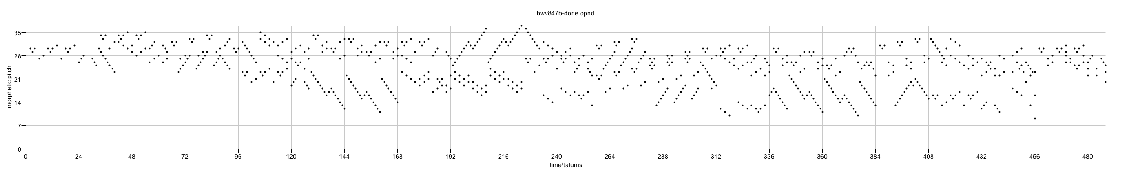
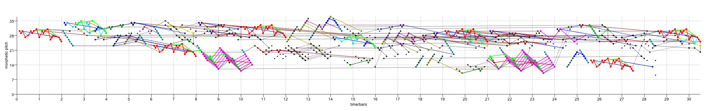
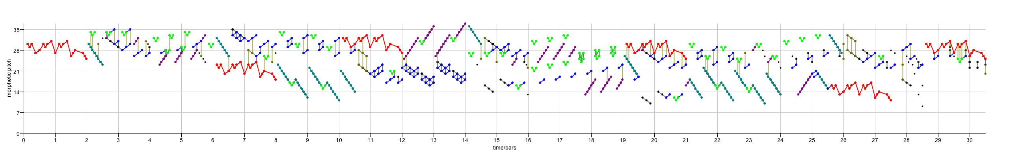
Music analysis and point-set compression
Input point set
J. S. Bach, Fugue in C minor, BWV 847
COSIATEC
SIATECCompress
Forth’s algorithm

Slide 25
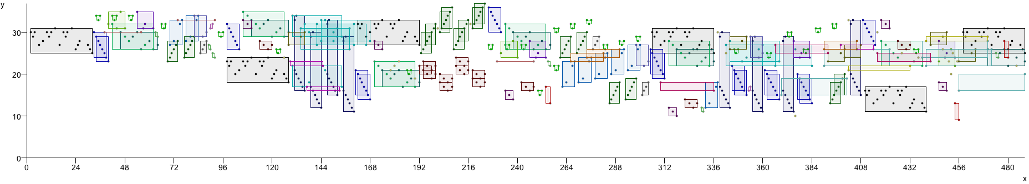
COSIATEC
J.S. Bach, Fugue in C minor, BWV 847
Number of TECs: 26
Encoding length: 268
Number of notes: 751
Encoding length without residual point set: 248
Number and proportion of residual points: 20, 2.66%
Compression ratio: 2.80
Compression ratio excluding residual point set: 2.95

Slide 26
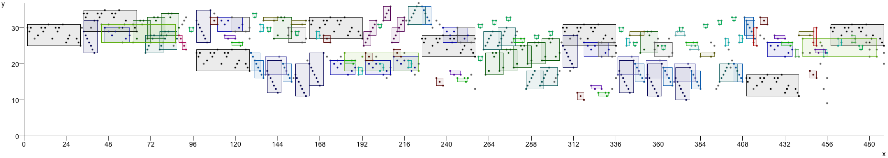
COSIACTTEC
J.S. Bach, Fugue in C minor, BWV 847
Number of TECs: 21
Encoding length: 277
Number of notes: 751
Encoding length without residual point set: 210
Number and proportion of residual points: 67, 8.92%
Compression ratio: 2.71
Compression ratio excluding residual point set: 3.26

Slide 27
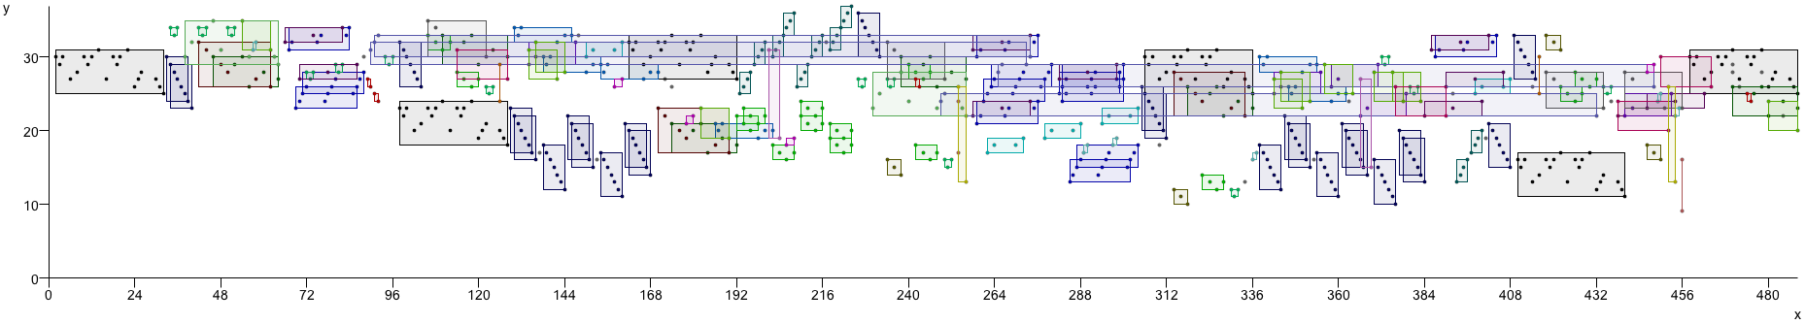
COSIARTEC
J.S. Bach, Fugue in C minor, BWV 847
Number of TECs: 26
Encoding length: 269
Number of notes: 751
Encoding length without residual point set: 248
Number and proportion of residual points: 21, 2.80%
Compression ratio: 2.79
Compression ratio excluding residual point set: 2.94

Slide 28
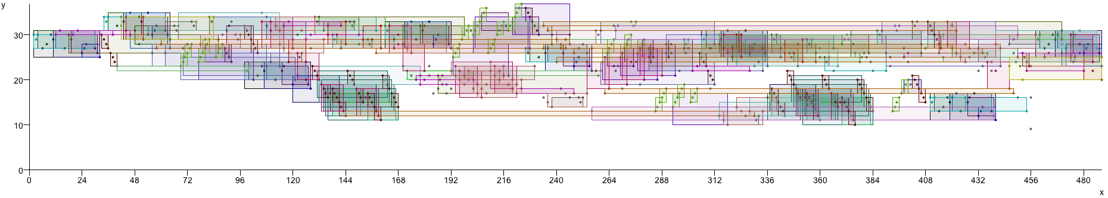
SIATECCompress
J.S. Bach, Fugue in C minor, BWV 847
Number of TECs: 26
Encoding length: 496
Number of notes: 751
Compression ratio: 1.51

Slide 29
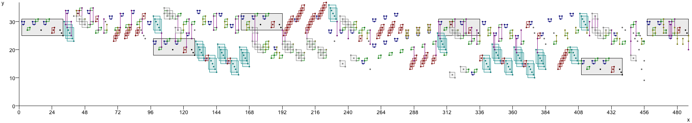
Forth’s algorithm
J.S. Bach, Fugue in C minor, BWV 847
Number of TECs: 8
Compression ratio: 1.4
Encoding length: 534
Number of points in dataset: 751
Total number of points covered: 725
Total proportion of points covered: 0.97

Slide 30
Using point-set compression algorithms for folk-song classification

Slide 31
Example COSIATEC encoding of NLB folk song
(NLB015569_01, “Daar zou er een maagdje vroeg opstaan 2”, from the Nederlandse Liederen Bank, http://www.liederenbank.nl. Courtesy of Peter van Kranenburg.)

Slide 32
MIREX 2013:
Discovery of repeated themes and sections
First MIREX competition on pattern discovery
  http://www.music-ir.org/mirex/wiki/2013:Discovery_of_Repeated_Themes_%26_Sections
JKU Pattern Development database
  https://dl.dropbox.com/u/11997856/JKU/JKUPDD-noAudio-Jul2013.zip
  Five pieces, each with a set of “ground-truth” patterns (occurrence sets)
    Patterns come from analyses by well-known analysts (e.g., Schoenberg, Bruhn)

Slide 33
Johannes Kepler University Patterns Development Database
(JKU-PDD)
Gibbons, “Silver Swan” (madrigal) (1612)
J. S. Bach, Fugue in A minor (BWV 889) from 2nd book of the WTC (1742)
Mozart, Piano Sonata in E flat major (K. 282), 2nd movement (1774)
Beethoven, Piano Sonata in F minor, Op.2, No.1 (1795)
Chopin, Mazurka in B flat minor, Op.24, No.4 (1836)

Slide 34
Results on MIREX 2013 test set
DM10 (SIATECCompressSegment) generally performed best overall
Full results available at
http://www.music-ir.org/mirex/wiki/2013:Discovery_of_Repeated_Themes_%26_Sections_Results

Slide 35
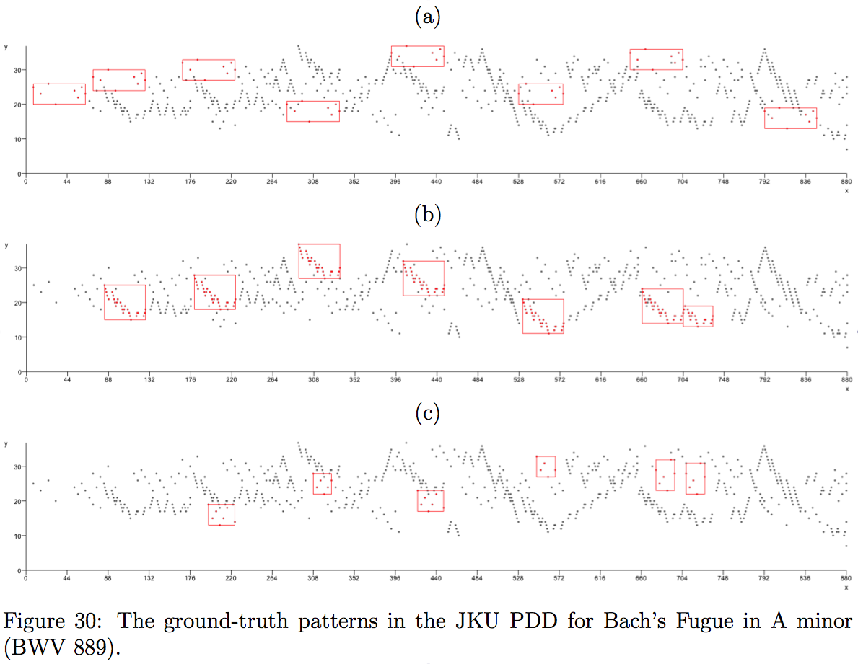

Slide 36
Raw, BB and Segment modes

Slide 37
Point-set compression algorithms on JKU-PDD

Slide 38
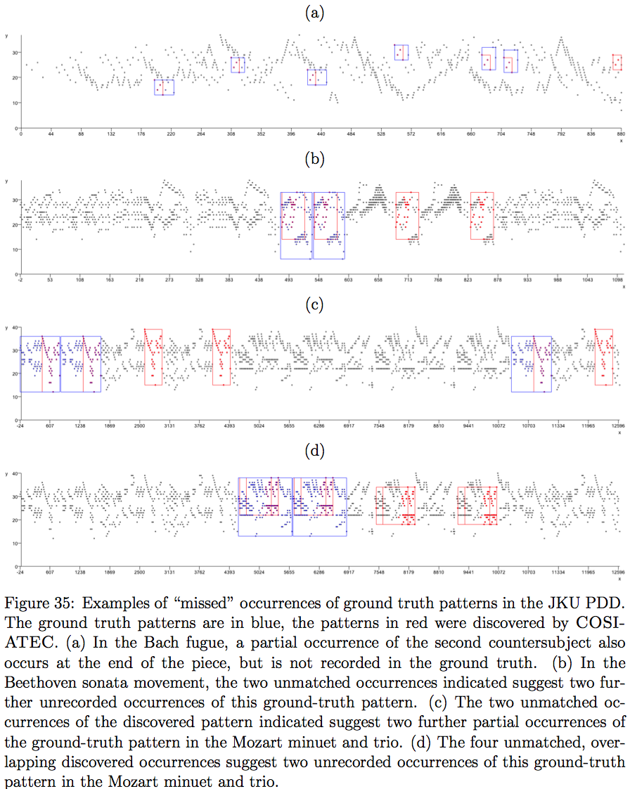

Slide 39


Some interesting non-ground-truth patterns discovered by COSIATEC

Slide 40
Some interesting non-ground-truth patterns discovered by COSIATEC

Slide 41
Discovering fugue subjects and counter subjects in WTC1

Slide 42
Maximal Transformable Patterns
Maximal translatable pattern is intersection of a dataset and the dataset translated by –v
  Can represent each occurrence by –v which is the parameter of the translation transformation for that particular pattern
Maximal transformable pattern for a specific transformation, T(τ,θ,D) is the intersection of the dataset D and the the dataset transformed by a transformation of type τ with parameters θ
Need to define some finite repertoire of transformations
For compression, we are most interested in transformations whose parameters are short (e.g., translation, affine transformations)
Maximal transformable patterns and symmetry

Slide 43
Using general-purpose compression algorithms for music analysis
Louboutin, C. and Meredith, D. (2016). Using general-purpose compression algorithms for music analysis. Journal of New Music Research, 45(1):1-16.

Slide 44
Results of point-set compression algorithms does not fully support parsimony principle – why?

Slide 45
Using general-purpose compression algorithms for music analysis
Compared LZ77, LZ78, Burrows-Wheeler and COSIATEC on classifying folk songs in the NLB
  k-nearest neighbour
  combined representations (ensemble) classification method
  novel similarity metric, corpus compression distance, based on NCD
Compared LZ77 and COSIATEC on discovery of fugue subject and countersubject entries in WTC1

Slide 46
Viewpoints

Slide 47
Single-viewpoint NLB classification

Slide 48
Combined viewpoints NLB classification
(Ensemble classifiers)
10’ is obtained by combining 8 of the 10 best compressed viewpoints, omitting (LZ77, int0 * ioi) and (COSIATEC,int)

Slide 49
Comparing LZ77 and COSIATEC on discovery of fugue subject and countersubject entries
Correlation between CF and TLF1: r= 0.86, N = 9, p = 0.003
(NB: SIATECCompressBB achieved TLF1 of 0.301)

Slide 50
Demo of OMNISIA

Slide 51
The “Kolmogorov-Shannon” Divide
Kolmogorov
assumes data is ordered
complexity
simplicity (Koffka)
top-down
(ideal) MDL principle
hierarchical structure
music analysis
composition
explanation
stories
algorithms
explicit learning
conscious
left brain
determinism
Lerdahl and Jackendoff
Browne and Butler
SIA
Shannon
assumes data is random
entropy
likelihood (Helmholtz)
bottom-up
Bayesianism
Markov models
music perception
listening
prediction
counting
probability
implicit learning
unconscious
right brain
indeterminism
Meyer, Huron
Krumhansl
IDyOM

Slide 52
Questions
Blending, metaphor and analogy as applied to creativity in music and the arts
Formal models and musical creativity: issues and applications
The role of constraints in the process of creativity
Connections between more abstract models and more practical methods

Slide 53
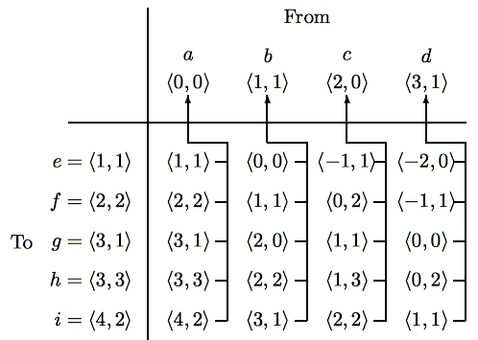
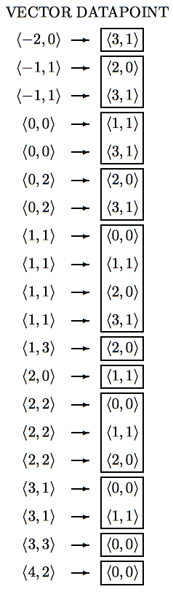
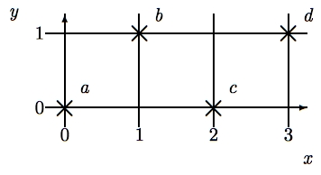
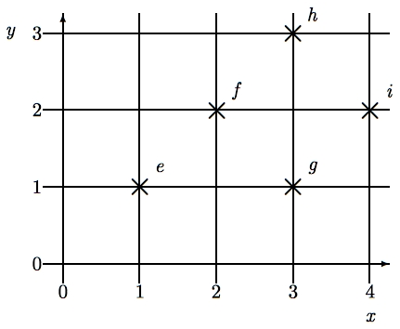
SIAM - Pattern matching using SIA (Finding maximal matches)
Query pattern
Dataset
O(knm log(nm)) time
O(knm) space
O(knm) average time with hashing
Notes:
SIA can easily be adapted for point set pattern matching, that is, for finding all the maximal matches under translation of a query point set of size m within some dataset of size n.
Let’s suppose we want to find, for each possible vector, the best match for this k-dimensional query pattern in this k-dimensional dataset.
We sort the points in the query pattern and the points in the dataset into lexicographical order and then compute the vector from each query pattern point to each dataset point and store the vectors in a vector table like this with a pointer from each vector back to its origin point.
Then we sort the vectors in this table to get a list like this.
The maximal match for a given vector is given by the points attached to the consecutive occurrences within this list of the vector.
This algorithm works in O(knm log(nm)) time and O(knm) space. But, again, by storing the origin points in a hash table and hashing the vectors to get the slot indices, the average time complexity can be reduced to O(knm).
Note that to do this in the completely naive way by trying all possible alignments between the query and the dataset and then seeing which query points match up for each alignment would take O(kn^2m^2) time.

Slide 54
Improving SIAM - Ukkonen, Lemström & Mäkinen (2003)
Use sweepline-like scanning of the dataset (Bentley and Ottmann, 1979)
Generalized to approximate matching of sets of horizontal line-segments
Improved running time to O(mn log m) (without hashing) and working space to O(m)

Slide 55
Improving SIAM - MSM
(Clifford et al., 2006)
Finding size of maximal match is 3SUM hard (i.e., O(n²) )
Reduce problem of multi-dimensional point-set matching to 1d binary wildcard matching
  Random projection to 1D
  Length reduction by universal hashing
  Binary wildcard matching using FFTs
  Find best match and check in O(m) time exactly how many points match at the location that can be inferred from this match
Reduces time complexity to O(n log n)

Slide 56
Evaluating MSM: Precision-Recall
Compared with OMRAS (Pickens et al., 2003)
Test set of 2338 documents, 480 used as queries
All score encodings in strict score time
Queries had notes deleted, transposed and inserted

Slide 57
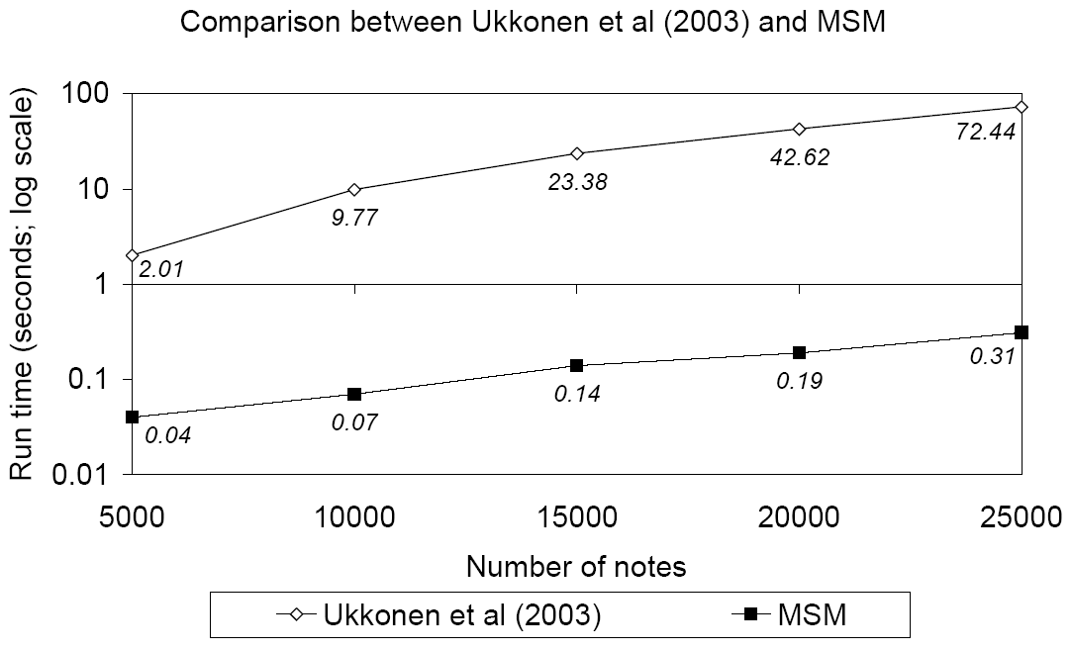
Evaluating MSM: Running time
Run on prefixes of various sizes of first movement of Beethoven’s 3rd Symphony
Each prefix matched against itself
Compared with largest common subset algorithm of Ukkonen, Lemström and Mäkinen (2003)
  MSM nearly 2 orders of magnitude faster (log scale)

Slide 58
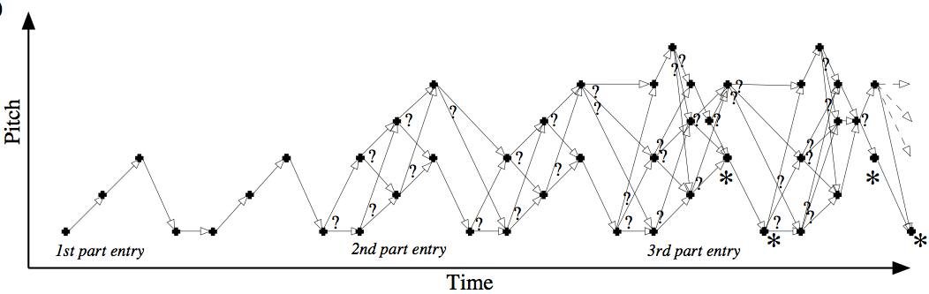
Problems with string-based approach - Polyphony
If searching polyphonic music and
  do not know voice to which each note belongs (e.g., MIDI format 0 file); or
  interested in patterns containing notes from 2 or more voices
then
  combinatorial explosion in number of possible string representations
  if don’t use all possible representations then may not find all interesting patterns

