Slide 1

Arrays
Art &Technology, 3rd Semester
Aalborg University
Programming
https://art.moodle.aau.dk/course/view.php?id=33
David Meredith
dave@create.aau.dk

Slide 2
Reading
Chapter 9 of Shiffman, Learning Processing

Slide 3
Overview
What is an array?
Declaring an array
Initialization
Array operations – using the ‘for’ loop
Arrays of objects

Slide 4
Making lots of similar objects
When we wanted two different cars, we wrote
  Car myRedCar = new Car(…);
  Car myBlueCar = new Car(…);
What if we want 1000 different cars?
  Car car1 = new Car(…);
  Car car2 = new Car(…);
  …
  Car car1000 = new Car();
  This is extremely tedious and error-prone

Slide 5
Arrays
0 1 2 3 4 5 6 7 8 9
Can use an array to store any number of objects of the same type, e.g.,
  100 Car objects
  10 Fish objects in an aquarium simulation
  52 Card objects in a Whist game
  22 Player objects in a football game
An array is a list of n boxes, all the same size, all designed to hold the same type or class of thing, numbered from 0 up to n – 1
  Counting from zero is actually quite useful – consider the % operator…

Slide 6
Declaring an array variable
In Processing, you have to declare a variable before you use it, e.g.,
  int x;
  float y;
  Car myCar;
You also have to declare an array before you use it
You declare an array by putting a pair of empty square brackets, [], immediately after the type of object that the array will hold, e.g.,
  int[] myArrayOfInts;
  float[] myArrayOfFloats;
This just declares the array, it does not construct it!

Slide 7
Constructing an array
Once an array has been declared, you can actually make it
When you make an array, you set its size and this stays fixed throughout the life of the array
Create (construct) an array as follows:
  int[] arrayOfInts = new int[10];
  (An array of 10 ints)
  float[] arrayOfFloats = new float[42];
  (An array of 42 floats)
  Car[] arrayOfCars = new Car[27];
  (An array of 27 Car objects)

Slide 8
Initializing an array
Having declared and constructed an array, now we want to store some objects in it
We can do this the hard way:
  int[] arrayOfInts = new int[3];
  arrayOfInts[0] = 10;
  arrayOfInts[1] = 9;
  arrayOfInts[2] = 8;
We refer to an element in an array using the format, arrayName[n], where
  arrayName is the name of the array variable
  n is the index of the element in the array that we want to access, modify or set

Slide 9
Initializing array values all at once
Set all the values all at once:
  int[] intArray = {10,9,8,7,6,5,4,3,2,1};
  float[] floatArray = {5.6, 3.141, 0.618, 2.3};
This method isn’t scalable – it isn’t practical for very large arrays as you still have to manually say what goes into each box

Slide 10
Initializing an array with a loop
The fastest way to initialize a very large array is to use a loop
  Condition is that we need to be able to calculate the value that goes into every box in the array
Create an array with 1000 random numbers between 0 and 1000 using a while loop:
  int i = 0;
  int[] array = new int[1000];
  while (i < 1000) {
  array[i] = random(0,1000);
  i++;
  }
Same thing with a for loop:
  int[] array = new int[1000];
  for(int i = 0; i < 1000; i++)
  array[i] = random(0,1000);

Slide 11
Finding the number of elements in an array: array.length
If we think we might want to change the size of an array in some later incarnation of the program, and we iterate through an array several times in a program, then it’s better not to “hard code” the size of the array at each point it is used
For example, if we hard code the array length,
  int[] array = new int[1000];
  for(int i = 0; i < 1000; i++)
  array[i] = random(0,1000);
  Then if we change the size to 2000, we have to change 1000 to 2000 in two different places
Instead, should simply find the length of the array:
  int[] array = new int[1000];
  for(int i = 0; i < array.length; i++)
  array[i] = random(0,1000);
  Now we only have to change the size in one place (where the array is constructed)

Slide 12
array.length
Note that array.length uses the “dot” syntax, where we give the name of a variable, then write a dot, then write either
  the name of the instance variable inside the object whose value we want or
  the method inside the object that we want to call
For example:
  myRedCar.display()
  array.length

Slide 13
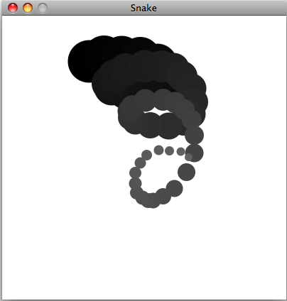
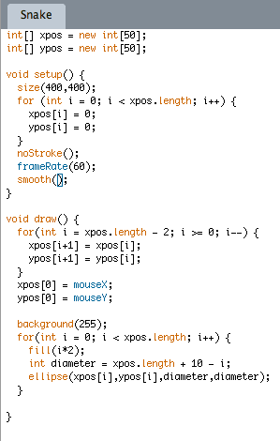
Using an array to store recent mouse positions

Slide 14
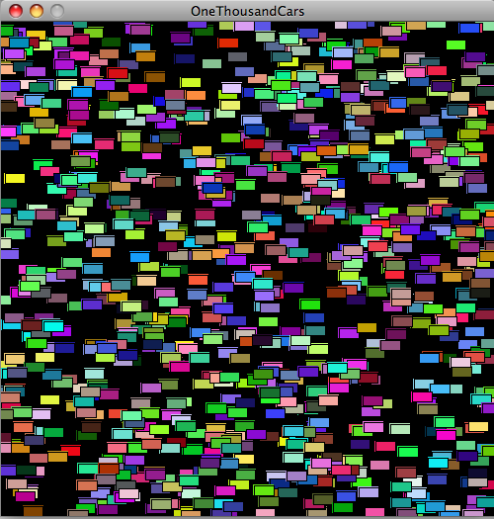
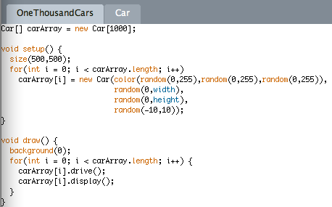
1000 cars!

Slide 15
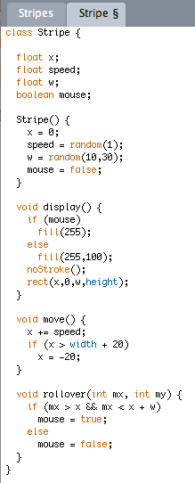
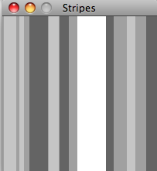
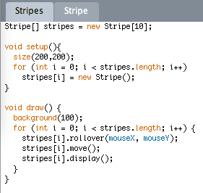
Interactive Stripes

Slide 16
Array functions
There exist a number of useful functions for manipulating arrays:
  shorten(), concat(), subset(), append(), splice(), expand(), sort(), reverse()
    Look up these functions in the reference!!!

