Slide 1
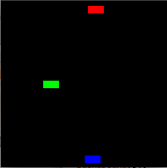
Objects
Art &Technology, 3rd Semester Aalborg University
Programming
https://art.moodle.aau.dk/course/view.php?id=33
David Meredith
dave@create.aau.dk

Slide 2
Reading
Chapter 8 of Shiffman, Learning Processing

Slide 3
Overview
Data and functionality together in one place
What is an object?
Writing your own classes
Creating your own objects
Processing tabs
Constructors with arguments

Slide 4
Object-oriented programming
An object is a thing that has certain attributes and can perform certain operations
The operations an object can perform are defined in its methods
A method is just a function, but inside an object
The attributes that an object has are defined by the values of its instance variables
Instance variables are just variables but inside an object
An object therefore contains data (instance variables) and functions (methods) inside it

Slide 5
Objects
In object-oriented programming (OOP) you use all the things we’ve learned already
variables, conditionals, loops, functions, etc.
But you repackage them so that all the data and functions that relate to a particular type of thing (object) are packaged together inside that thing

Slide 6
A simple human object
An object has attributes stored in its data
An object can do things, perform operations, defined by its methods (internal functions)
A simple human object could have:
Attributes (data, variables, properties):
weight, height, gender, swimming ability,…
Operations (functions, methods):
Sleep, eat, swim, wake up, drive a car, ride a bike,

Slide 7
Class
A class is a template (skabelon) for making any number of objects of a particular type
Like a cookie cutter can make as many cookies of the same shape as you want
A class defines the properties and functions that are common to all objects of a particular type

Slide 8
Non-OO pseudocode for a Car sketch
Data (global variables)
car colour
car x location
car y location
car x speed
Setup
Initialize car colour
Initialize location
Initialize speed
Draw
Fill background
Change car’s location
Display car
Global variables defined at top of sketch
Initialization done once in setup function
draw function executed on every frame to update the position of the car

Slide 9
OO pseudocode for Car sketch
Data (global variables)
Car
Setup
Create a Car object and set its attributes
Draw
Fill background
Instruct the Car object to move
Instruct the Car object to display itself
All global variables are gone
hidden inside the Car object
Car object created once in setup function
Car object can do stuff, like move itself and display itself
so we tell it to do this!

Slide 10
An OO sketch for a moving car
Car myCar;
void setup() {
myCar = new Car();
}
void draw() {
background(255);
myCar.move();
myCar.display();
}
Make a new Car object by calling the “new” operator
Store the new Car object in a Car type variable
Get the Car object to do stuff by calling it by its name (myCar), then typing a dot, then typing the name of the function (method) that you want it to perform
e.g., myCar.move() means “Oy, myCar, move!”

Slide 11
Writing the class (cookie cutter)
Name
class WhateverNameYouWant
Instance variables (Attributes, Data)
color c;
float xpos; …
Constructor
Must have same name as class, followed by arguments in parentheses
just like a function! (But without the return value)
Car() {
…
}
Methods (“functions”, operations)
void display() {
…
}
Class definition can appear anywhere outside of setup() and draw()

Slide 13
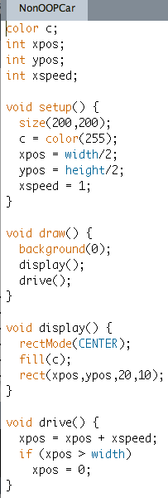
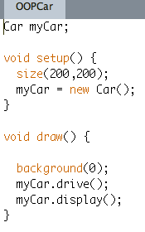
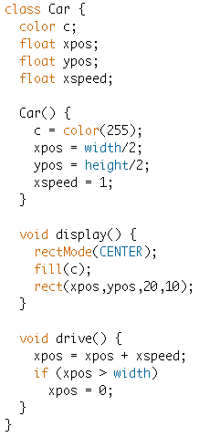
Calling methods defined on the class Car
Definition of the class Car

Slide 14
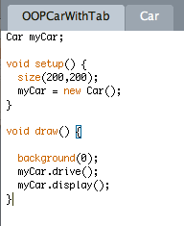
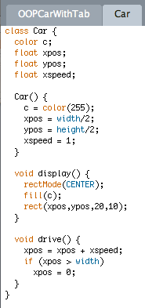
Putting a class in its own tab
Can put each class in its own tab
Give the tab the same name as the class
Creates a new pde file, e.g.,
Car.pde
OOPCarWithTab.pde

Slide 15
Making two (or more) different cars
What if we want to make two different cars in the same sketch, e.g.,
a red car, starting at the top left with a speed of 2
a blue car, starting at the bottom right with a speed of -3
Currently, cannot change values of attributes of Car
Should be able to construct a new car from scratch with these values
Means must be able to set the instance variables from the constructor
Means constructor must be able to take arguments
e.g.,
Car redCar = new Car(color(255,0,0), 0,0, 2);
Car blueCar = new Car(color(0,0,255), width,height, -3);

Slide 16
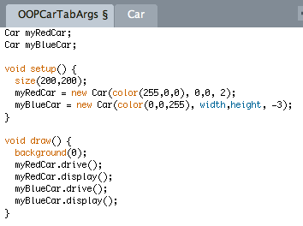
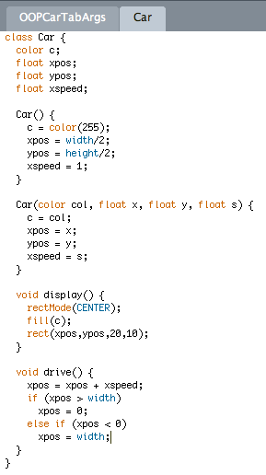
Constructors with arguments

