Slide 1
Functions
Art &Technology, 3rd Semester Aalborg University
Programming
https://art.moodle.aau.dk/course/view.php?id=33
David Meredith
dave@create.aau.dk

Slide 2
Reading
Chapter 7 of Shiffman, Learning Processing

Slide 3
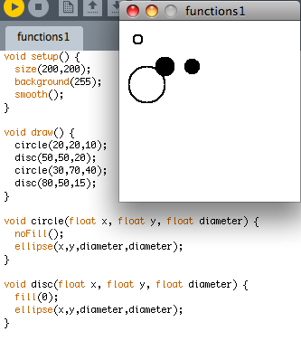
Functions
If you find yourself writing the same sequence of lines in various places in your program, then maybe those lines should be stuck together in a block called a function
In the sketch on the right, circle and disc are user-defined functions
Using functions increases modularity
a module is a logical structural unit of a program that is as independent as possible from the rest of the program
Using functions increases reusability
a function can be used many times in different situations to carry out a useful job without having to repeat all the code inside it every time you want the job done
Here, instead of having to define noFill and remember to use the diameter twice in ellipse, we simply call the circle function

Slide 4
Defining a function
ReturnType functionName(ArgType1 arg1, ArgType2 arg2) {
ReturnType r = something;
doSomethingWithR();
return r;
}
To define a function, you need to specify
the return type
the function name
the arguments of the function and their types
the body of the function which contains all the statements that have to be executed when the function is called
Standard, system-defined functions follow the same pattern
If a function returns anything other than void, then there must be a line in the function of the form return x; where the type of x is the same as that returned by the function

Slide 5
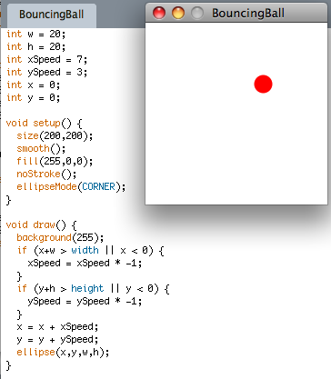
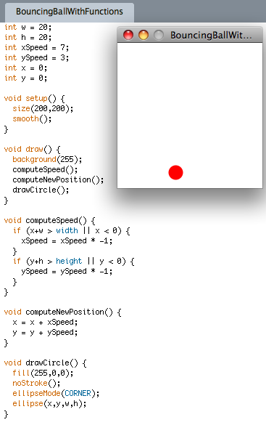
Bouncing Ball using functions

Slide 6
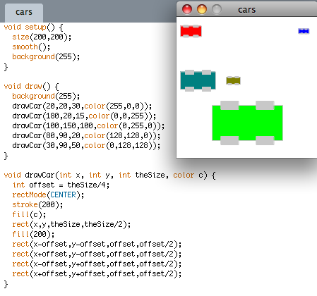
Functions with arguments

Slide 7
Things to remember about parameters
Pass the same number of parameters as defined in the function
Each parameter passed must be the same type as defined in the function
You can pass
a literal value to a function as a parameter
e.g., 20, 5, 4.3
an expression that evaluates to a value of the right type
e.g., 8+3, 4 * x/2, random(1,10), etc.
The arguments of a function act as local variables and are not accessible outside of the function

Slide 8
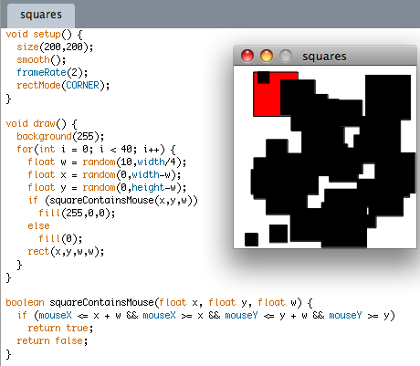
A function that returns a value
The function squareContainsMouse returns the boolean value true if a square contains the mouse and colours this square red. Otherwise, the function returns false and the square is coloured black. On every frame, 40 squares are drawn of random size in random positions.

