Slide 1
Loops
Art &Technology, 3rd Semester Aalborg University
Programming
https://art.moodle.aau.dk/course/view.php?id=33
David Meredith
dave@create.aau.dk

Slide 2
Reading
Chapter 6 of Shiffman, Learning Processing

Slide 3
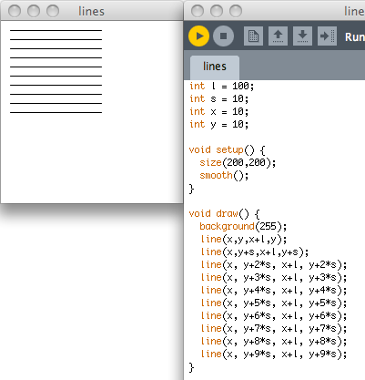
Doing a similar thing over and over again
What if we wanted to draw 100 lines?

Slide 4
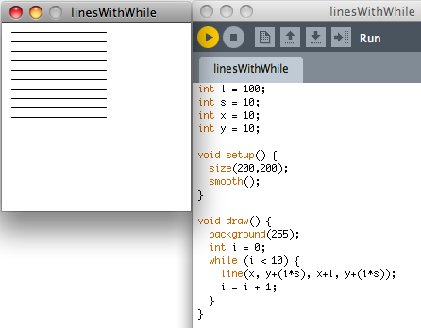
Using a while loop
while (condition) { doStuff(); doMoreStuff(); }

Slide 5
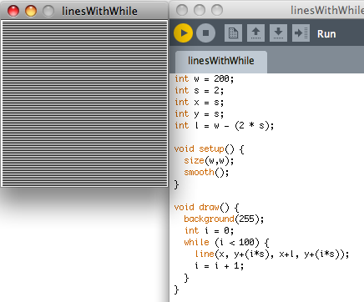
Drawing 100 lines

Slide 6
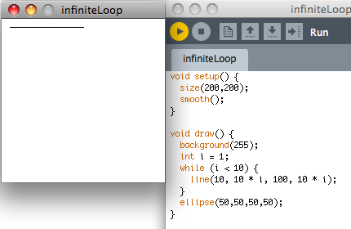
Avoid infinite loops
Variable i is never changed so remains 1
So never gets to equal 10
So line drawn repeatedly in the same place
And ellipse is never drawn

Slide 7
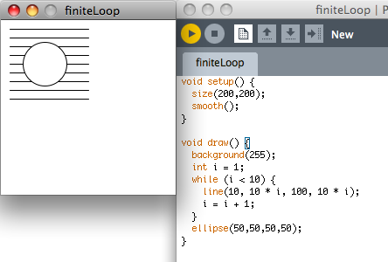
Avoiding infinite loops
Now i is incremented on each iteration of the while loop
So i eventually gets to 10, the condition becomes false and the loop terminates
Then the ellipse can be drawn

Slide 8
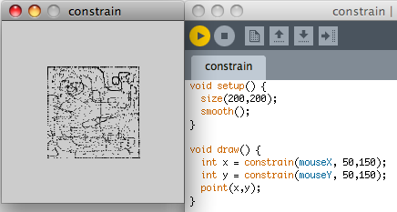
constrain(value, min, max)
The constrain(val, min, max) function returns a value that is preferably val, but
if val is greater than max, constrain returns max and
if val is less than min, constrain returns min

Slide 9
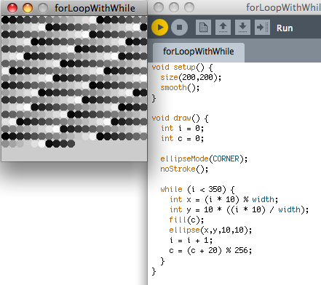
Using a while loop with several variables
The variable i is used to control the position of each circle and is incremented on each iteration of the while loop
The variable c is used to control the shade of the circle and this is increased by 20 on each iteration
When c gets to be greater than 255, its value starts “going round the clock” again
Remember that x % y gives the remainder after dividing x by y

Slide 10
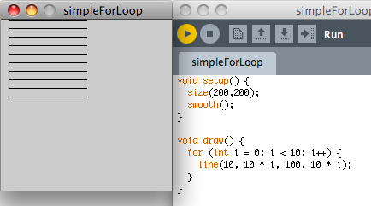
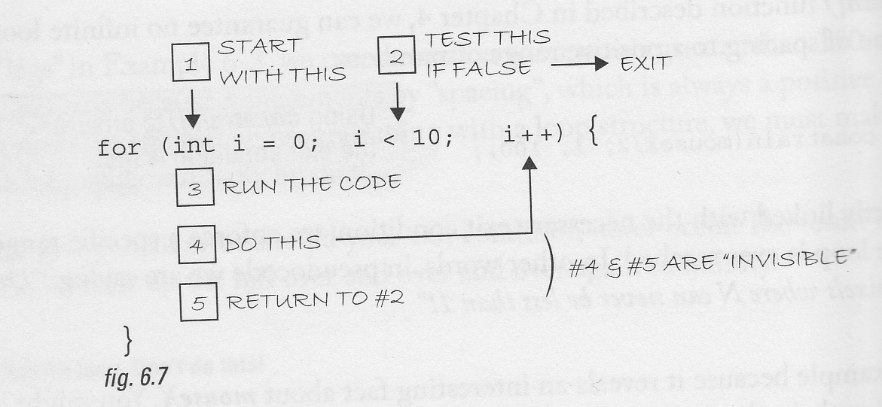
for loop
i++ means the same as i = i + 1
i-- means the same as i = i – 1
i += 3 means the same as i = i + 3
i -= 1 means the same as i = i – 1
i *= 2 means the same as i = i * 2
i /= 2 means the same as i = i / 2
and so on…

Slide 11
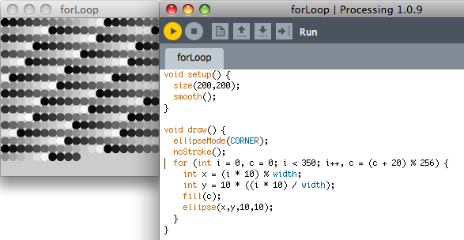
Using a for loop

Slide 12
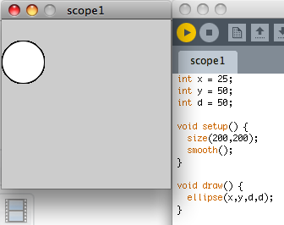
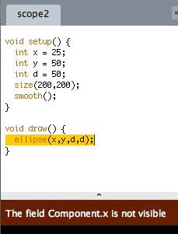
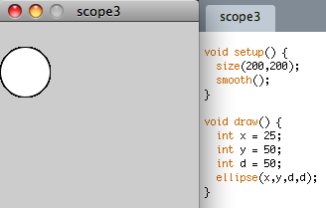
Scope

Slide 13
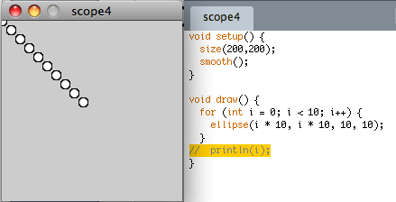
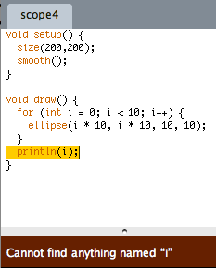
More on scope

Slide 14
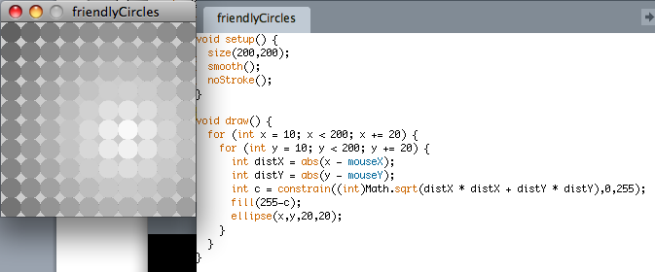
Loops within loops
Remember that draw() is executed once on every frame
Here, each time draw() executes, an array of discs is drawn using two nested for loops
The brightness of each disc increases the closer it is to the current mouse position, so the bright spot moves around with the mouse

