Slide 1
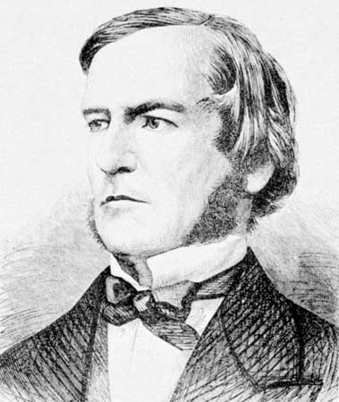
Conditionals
Art &Technology, 3rd Semester Aalborg University
Programming
https://art.moodle.aau.dk/course/view.php?id=33
David Meredith
dave@create.aau.dk

Slide 2
Overview
Boolean expressions
Conditional expressions: “if”, “else”, “else if”
Logical operators: “&&” and “||”
Multiple rollovers
Boolean variables
Bouncing ball

Slide 3
Boolean expressions
Expressions in normal language can be true, false, ambiguous or meaningless, e.g.
TRUE: “The picture shows George Boole (1815-1864), an English mathematician who invented formal logic”
FALSE: “The picture shows Mickey Mouse”
MEANINGLESS: “Flurby zilches blab wibberously”
AMBIGUOUS: “Slow children at play”

Slide 4
Boolean expressions
A boolean expression is one that has a truth value
This truth value can be either false or true
A boolean expression is usually a statement about the relationship between two numbers or variables that contain numbers, e.g.
12 > 10 (true)
5 <= 10 (true)
x < 5 (don’t know – depends on value of x)

Slide 5
Relational operators
In order to compare numbers in a boolean expression, we use the following operators
> greater than
< less than
>= greater than or equal to
<= less than or equal to
== equal to
NB:compare with ‘=‘ which means “becomes equal to”
!= not equal to

Slide 6
Examples of boolean expressions
Comparing numbers
5 < 5
false
5 <= 5
true
5 = 5
error – ‘=‘ is the assignment operator and means “becomes equal to”
5 == 5
true
Comparing variables – what are the values of b and c in the following?
int x = 5; int y = 7; boolean b = (x == y); boolean c = (x < y);
b is false, c is true

Slide 7
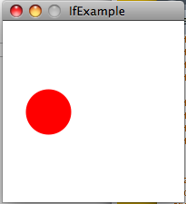
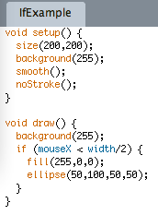
if
If expression has format: if (boolean expression) { doThis(); doThat(); }
doThis() and doThat() are only done if boolean expression is true

Slide 8
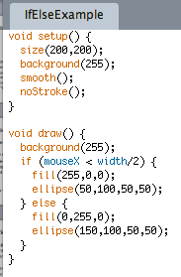
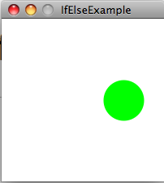
if-else
When does it draw a green circle?
Format of If-Else is:
if (bool exp) { doStuff1(); } else { doStuff2(); }
Does doStuff1() if bool exp is true, otherwise it does doStuff2()

Slide 9
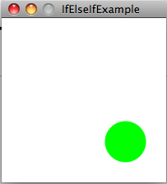
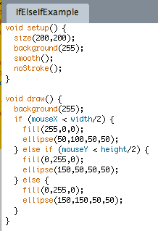
if-else if
if-else if statement has format:
if (condition1) { doStuff1(); } else if (condition2) { doStuff2(); } else if (condition3) { doStuff3(); }… } else { doStuffOtherwise(); }

Slide 10
Logical operators
We can deal with single boolean expressions: if (I have a fever) {take me to the doctor;}
But what about if (I have a fever OR I have a rash) { take me to the doctor; }
or if (I am stung by a bee AND I have an allergy) { take me to the doctor; }
or if (I am stung by a bee AND I am NOT breathing) { call an ambulance; }
For these, we need to be able to combine boolean expressions using the logical operators, “OR”, “AND” and “NOT”

Slide 11
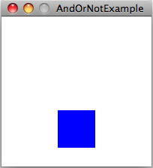
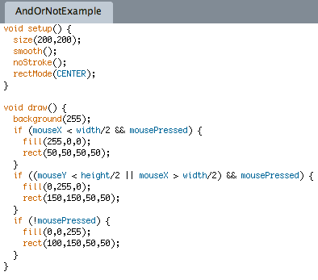
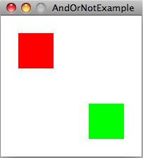
&&, || and !
In processing,
&& means logical AND
|| means logical OR
! means logical NOT

Slide 12
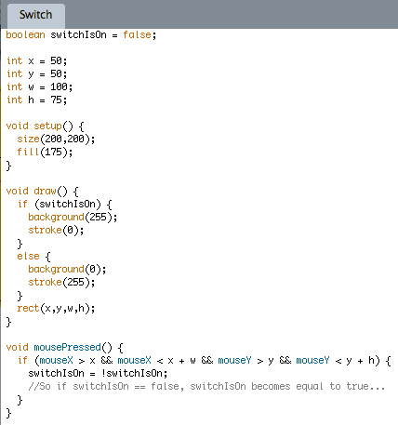
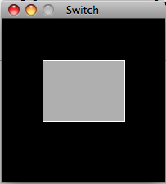
Boolean variables – programming a switch

Slide 13
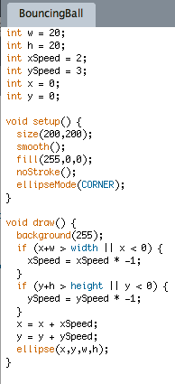
Bouncing ball
Speed has two components, x and y
The “speed” is actually how much you change the coordinate value between two consecutive frames
When the ball hits an edge, the speed is reversed by negating the xSpeed if it hits a vertical edge and negating the ySpeed if it hits a horizontal edge

