Slide 1
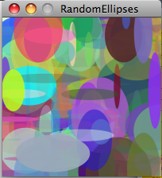
Variables
Art &Technology, 3rd Semester Aalborg University
Programming
https://art.moodle.aau.dk/course/view.php?id=33
David Meredith
dave@create.aau.dk

Slide 2
Reading
Chapter 4 of Shiffman, Learning Processing.

Slide 3
Overview
Variables
Types
Variable declaration and assignment
Incrementing variables
System variables
Generating random numbers
Type casting

Slide 4
Variables
x
y
z
int x = 3;
int y = 5;
int z = x + y;
x = 6;
z = x + y;
3
6
5
8
11
When a program runs on a computer, it processes information that is stored in its memory
Think of a computer’s memory as consisting of a huge array of boxes in which we can store information
We’re able to assign names to these boxes, so that if we want to get the information stored in a box, we just have to refer to the box by its name
A labelled memory “box” like this is called a variable, because the information in it (its value) can vary
We have to create (or declare) a variable before we use it by giving it a name and stating what type of data we can store in it (e.g., integers, decimal numbers, strings of characters, etc.)

Slide 5
Types
The type of a variable is the kind of data that it can hold, e.g.,
whole numbers (int, byte, short, long)
e.g., … -2, -1, 0, 1, 2, …
floating-point numbers (double, float)
e.g., 3.14159, -2.5, 0.4, 2.0, …
characters (char)
e.g., ‘a’, ‘b’, ‘c’, ‘*’, ‘€’, ‘2’, etc.
boolean (boolean)
e.g., true, false

Slide 6
Declaring type and initializing
When we create a variable, we must define what its name is and what its type is:
int x; //Declares a variable called x of type int
double d; //Declares a variable called d of type double
char letter; //Declares a variable called letter of type char
Can (and should) also initialize a variable when we create it, by storing some value in it
//Declare a variable called x of type int, initialized to 0
int x = 0;
//Declare a variable called d of type double, initialized to 0.0
double d = 0.0;
//Declare a variable called letter of type char, initialized
//to ‘a’
char letter = ‘a’;

Slide 7
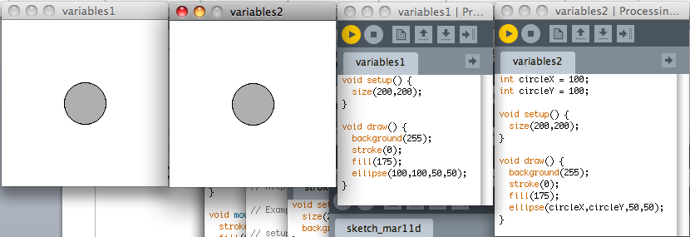
Using variables
If you want a variable to be available everywhere in the program, declare it before the definition of setup(), at the beginning of your file

Slide 8
Assigning a value to a variable: The ‘=‘ symbol
We assign a value to a variable by using the ‘=‘ operator, thus:
x = 5; // Sets the value of x to 5
x = 7; // Sets the value of x to 7
Remember that ‘=‘ means “becomes equal to” so
x = 5; means “x becomes equal to 5”
If we want to increase (increment) the value of a variable by 1, then we write:
x = x + 1; // “x becomes equal to x plus 1”

Slide 9
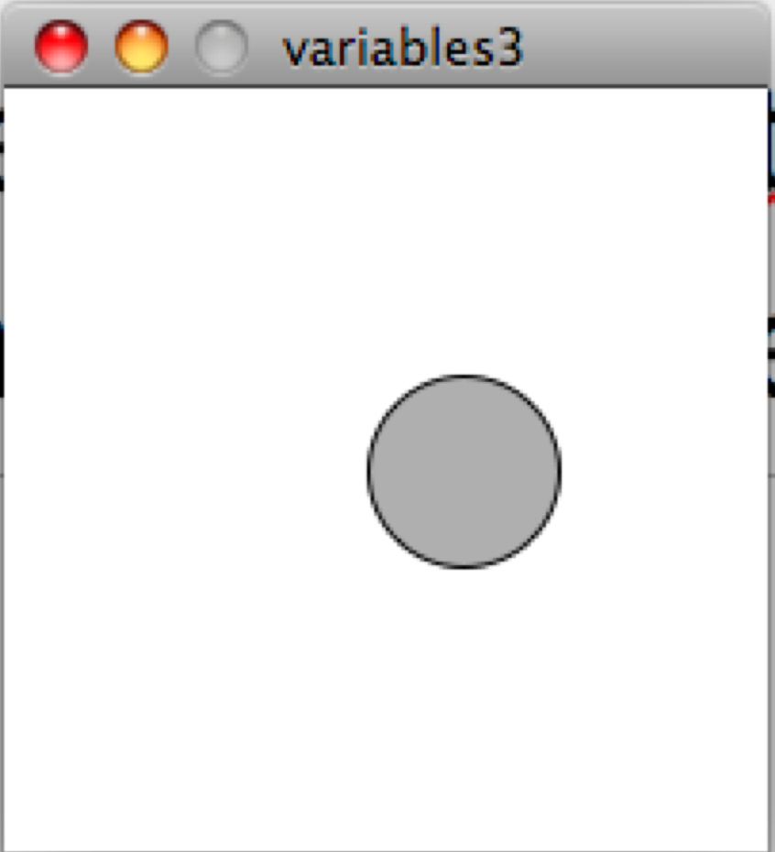
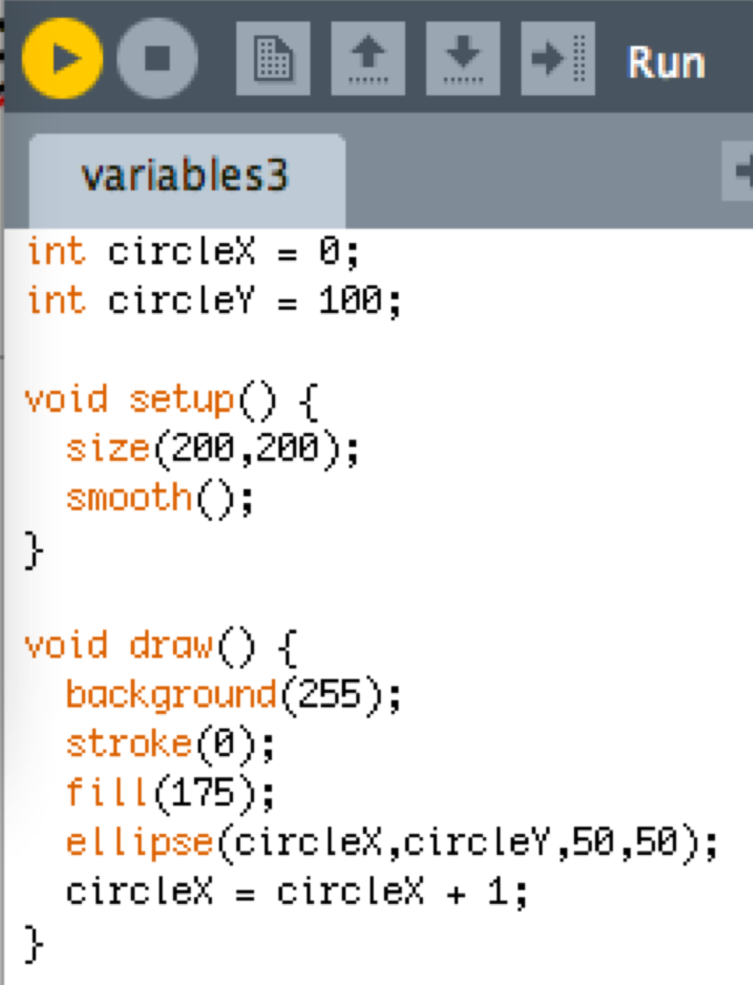
Incrementing a variable to animate an image
Initialize circleX to 0 so circle starts at left
draw() is executed on each frame
circleX is increased by 1 on each frame
So circle moves to the right

Slide 10
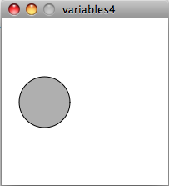
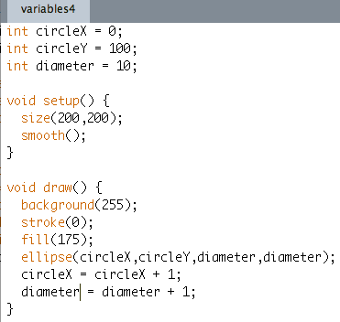
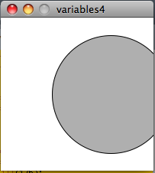
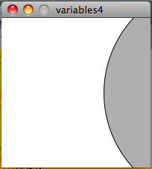
The circle moves and grows in size
diameter of circle stored in diameter variable
diameter increased by 1 on each frame

Slide 11
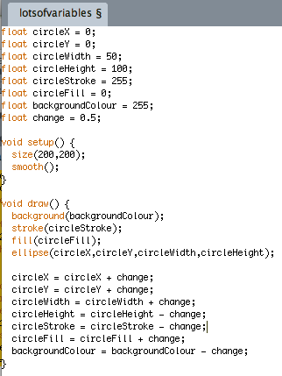
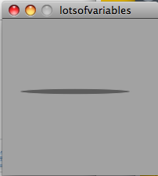
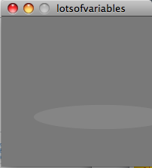
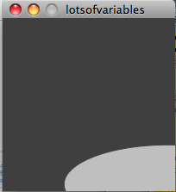
Lots of variables

Slide 12
System variables
width – the width of the sketch output window
height – the height of the sketch output window
frameCount – the number of frames processed by the sketch so far
frameRate – the number of frames per second
screen.width – the width of the screen
screen.height – the height of the screen
key – most recent key pressed
keyCode – a numeric code for the last key pressed
mousePressed – true if the mouse button is pressed, false otherwise
mouseX – current x-coordinate of mouse position
mouseY – current y-coordinate of mouse position
pmouseX – x-coordinate of previous mouse position
pmouseY – y-coordinate of previous mouse position
mouseButton – the mouse button that was last pressed (LEFT, RIGHT, CENTER)

Slide 13
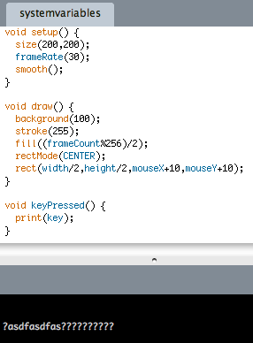
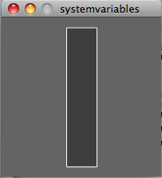
Using system variables

Slide 14
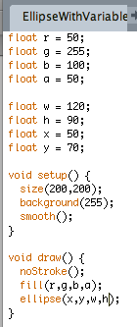
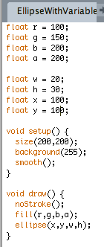
Drawing an ellipse with variables Which program produced which image?

Slide 15
random() – a function that returns a value
When you call the functions line(), ellipse() & rect(), you just get something printed to the output window
The function random() gives you a random number:
float w = random(1,100);
This line of code generates a random floating point number between 1 and 100 and stores this value in the float type variable called w
We can then do stuff like
rect(100,100,w,50);
This line of code draws a rectangle with the top left corner at (100,100), a width equal to the random number stored in w and a height equal to 50 pixels

Slide 16
random(low, high) and random(high)
random() returns a floating point value, so random() is defined somewhere as follows:
float random(float low, float high) {
…
}
You can also call random() with just one argument – it then returns a random floating point number between 0 and the number you give it as its argument:
float w = random(10);
This line of code generates a random floating point number between 0 and 10 and stores this value in the float type variable called w

Slide 17
Type casting
random() returns a float – but what if you really want an int?
int w = int(random(1,100));
generates a random float between 1 and 100, then converts this to an int and stores it in the int type variable, w

Slide 18
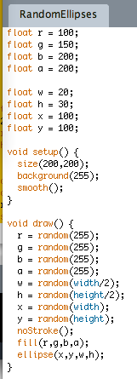
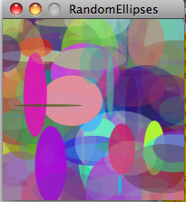
Random ellipses
Note use of system variables, width and height, to control position and size of ellipses

