Slide 1
Introduction to Processing
David Meredith Aalborg University Art &Technology, 3rd Semester Programming

Slide 2
Introduction
Course will teach you how to build interactive, image and sound systems using the Processing language (www.processing.org)
Recommended reading:
Shiffman, D. (2008). Learning Processing: A Beginner’s Guide to Programming Images, Animation, and Interaction. Morgan-Kaufmann. ISBN: 978-0-12-373602-4
Rease, C. and Fry, B. (2007). Processing: A Programming Handbook for Visual Designers and Artists. MIT Press. ISBN: 978-0-262-18262-1
Shiffman book has an accompanying website:
www.learningprocessing.com

Slide 3
Overview of this lecture
Pixels
Graph paper, simple shapes, grayscale, RGB, transparency
Processing
Installing Processing, menus, the Sketchbook, coding, errors, reference, Play button, writing and publishing a program
Interaction
setup() and draw(), mouse input
Based on Chapters 1 to 3 of Shiffman (2008)

Slide 4
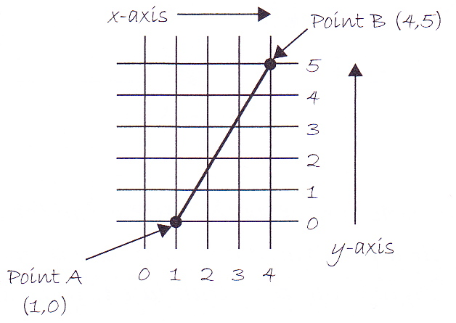
Graph paper
Can specify a straight line by giving its end points
On a normal cartesian, “xy” graph, x increases to the right and y increases upwards
The Processing instruction for drawing the line above is
line(1,0,4,5);
“line” is the command or function in Processing for drawing a line
To specify precisely which line to draw, we give the line function 4 arguments: the x and y co-ordinates of the two end points of the line

Slide 5
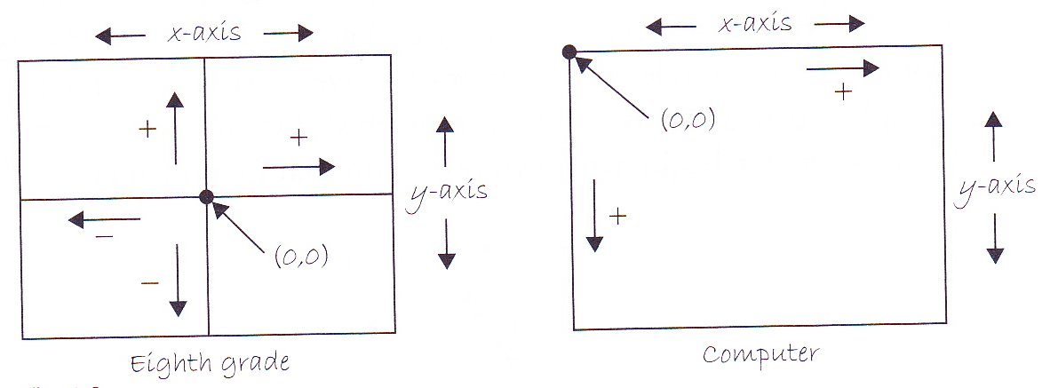
Pixels
The screen is divided up into tiny square areas called pixels (short for “picture cells”)
Each pixel has a single colour – you cannot draw different things on different parts of the same pixel
Each pixel has an x and y coordinate, but the origin is in the upper left corner of the screen (unlike a standard mathematical graph)
To draw something on the screen, we simply have to set the colours of some or all of the pixels on the screen

Slide 6
Simple shapes
Can build up complex graphics by combining primitive shapes: points, lines, rectangles and ellipses
We’ll learn how to draw these in Processing and exactly what information we need to provide about each type of shape

Slide 7
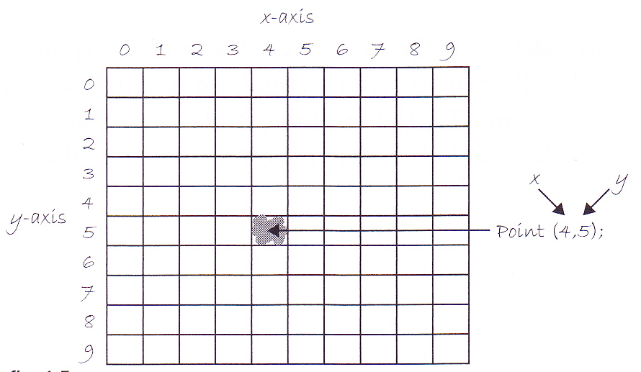
Point
For a point, we just provide the x and y co-ordinate of the pixel that has to be coloured:
point(4,5);

Slide 8
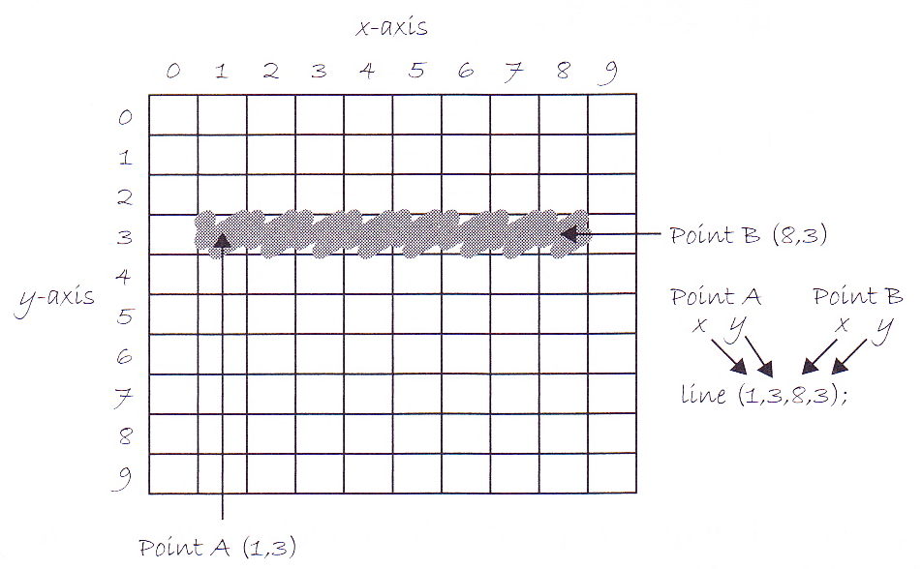
Line
Line requires two points to specify its position:
line(1,3,8,3);
line function colours endpoints and all points in between to form a straight line

Slide 9
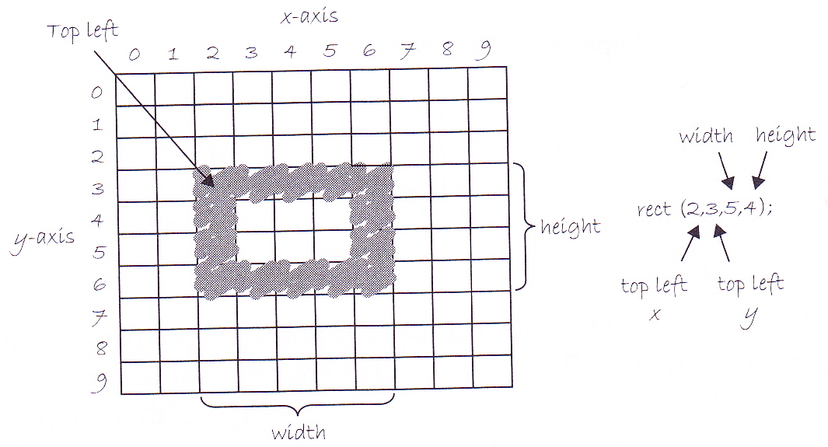
Rectangle
Specify a rectangle by giving the coordinates of the top left corner as well as width and height
rect(2,3,5,4);
Draws a border in the “stroke” colour (default black), and colours in the pixels inside this border using the “fill” colour (default is white)

Slide 10
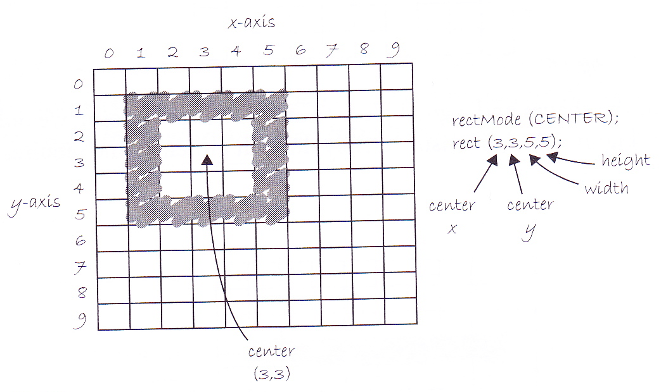
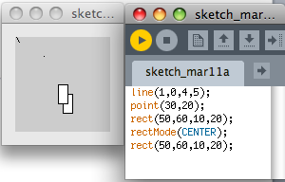
rectMode CENTER
Can also specify a rectangle by giving its centre coordinates along with width and height
But must precede rect function call with a rectMode function call that changes the rect drawing mode to CENTER (from the default which is CORNER)
rectMode(CENTER);
rect(3,3,5,5);

Slide 11
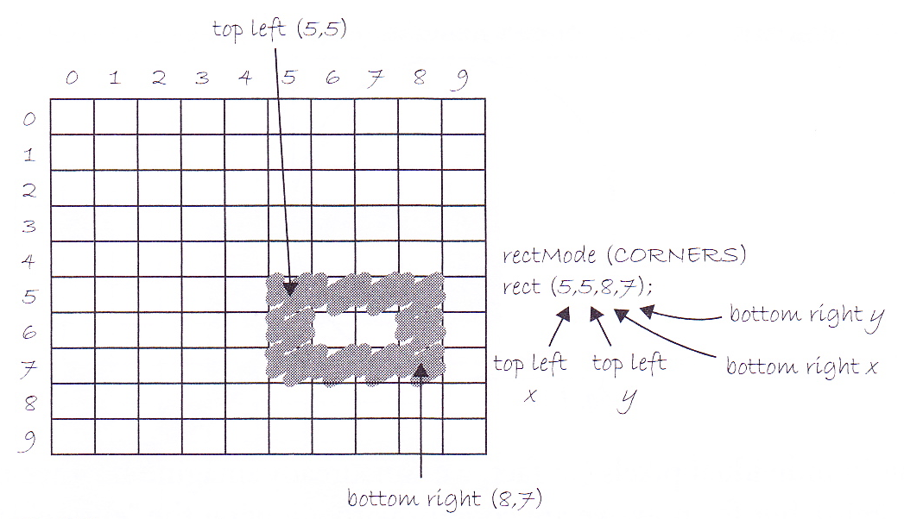
rectMode CORNERS
If change rectMode to CORNERS, then can specify a rectangle by giving its top left and bottom right corners:
rectMode(CORNERS);
rect(5,5,8,7);

Slide 12
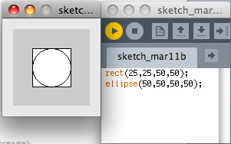
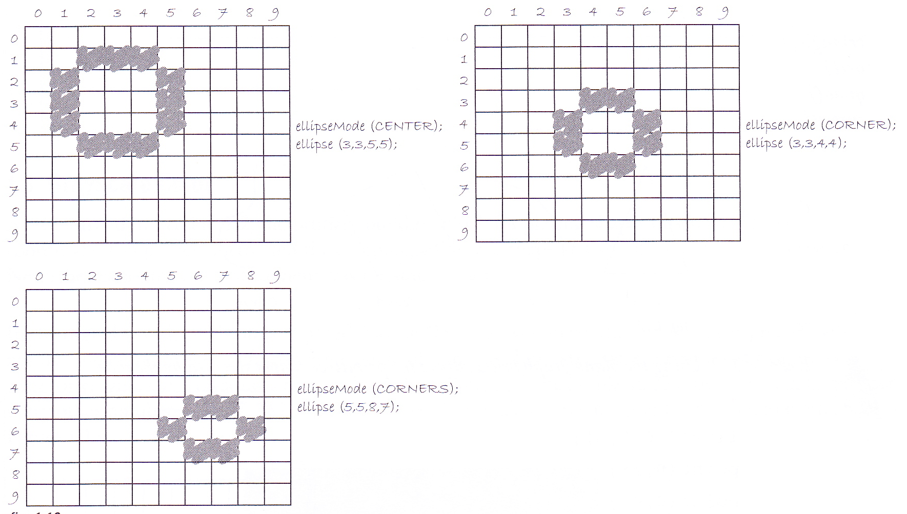
Ellipses
Ellipses drawn like rectangles using ellipseMode to determine meaning of arguments to ellipse function
Default ellipseMode is CENTER
Ellipse drawn in bounding box of rectangle defined by arguments

Slide 13
Greyscale
Can specify the shade of a pixel using greyscale in a black and white image
0 means black, 255 means white
256 different values since this is the number of different values that can be stored in a byte = 8 bits

Slide 14
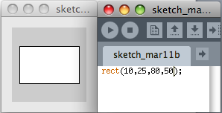
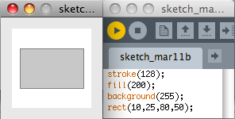
stroke(n), fill(n) & background(n)
stroke(n) sets the greyscale colour of the outline of a shape
default is n=0, black
fill(n) sets the greyscale colour of the colour inside the outline of a shape
default is n=255, white
background(n) sets the greyscale colour of the background
default is grey

Slide 15
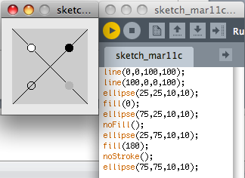
noStroke() and noFill()
noStroke() makes the outline invisible
noFill() makes the area inside the outline completely transparent

Slide 16
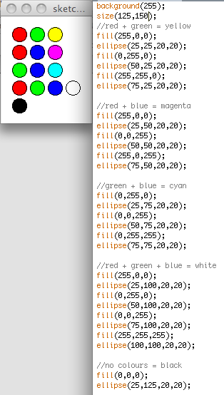
RGB colour
fill(r,g,b) defines fill colour using RGB code
each value of r, g and b must be between 0 and 255
red + green = yellow red + blue = magenta green + blue = cyan red + green + blue = white

Slide 17
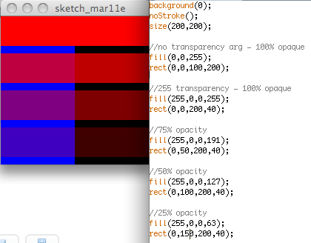
Colour transparency
Optional fourth argument to fill function that gives “alpha” – that is, degree of opacity
The alpha values for an image are called its “alpha channel”

Slide 18
Processing
Processing is free and open-source
“Open source” means you can download the source code if you want, customise it and find out how it works
Developed by Ben Fry and Casey Rease at MIT Media Lab
Built on Java
Means that you can extend it when you know enough Java
Interactive development environment which lets you see immediately the effects of changes in your code
For some examples of what you can do with Processing, see http://www.processing.org/exhibition/
Download and install from the www.processing.org site (Very simple!)

Slide 19
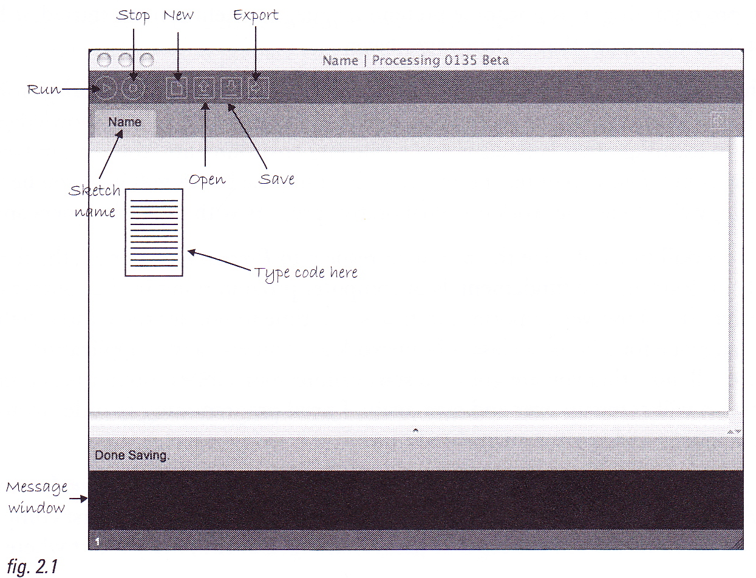
The IDE (Development Environment)

Slide 20
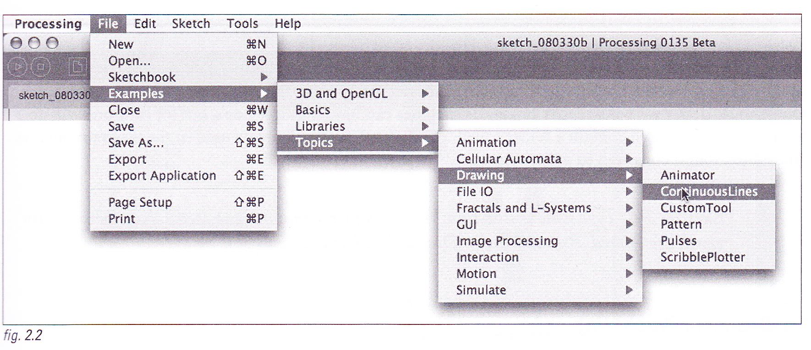
Examples
Can run a Processing sketch full screen by SHIFT-clicking the run button

Slide 21
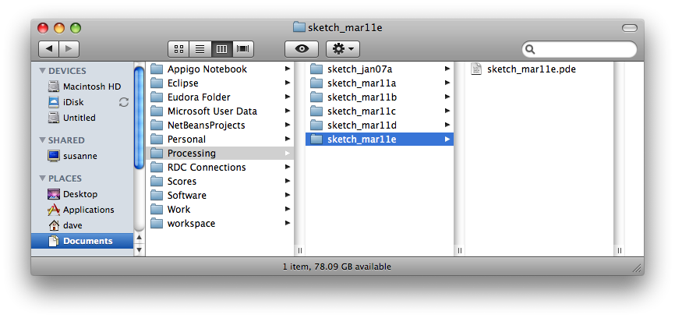
Sketchbook
Processing stores your programs (“sketches”) in a folder called the the “sketchbook”
Sketch stored in a folder in the sketchbook as a file with a .pde extension

Slide 22
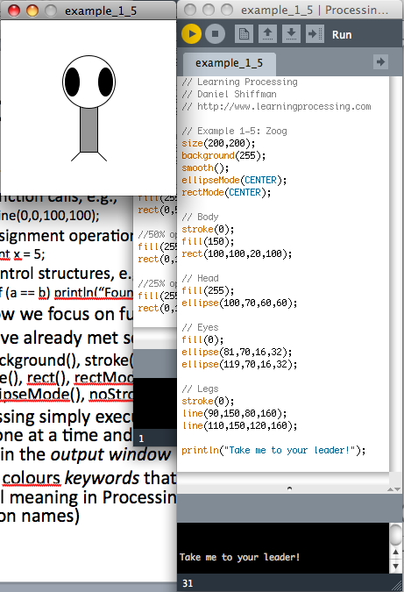
Coding in Processing
Three types of statement in Processing:
Function calls, e.g.,
line(0,0,100,100);
Assignment operations, e.g.,
int x = 5;
Control structures, e.g.,
if (a == b) println(“Found it!”);
For now we focus on function calls
We have already met some functions:
background(), stroke(), fill(), point(), line(), rect(), rectMode(), ellipse(), ellipseMode(), noStroke(), noFill(), size()

Slide 23
Coding in Processing
Processing simply executes the lines of code one at a time and displays the result in the output window
Editor colours keywords that have a special meaning in Processing (e.g., function names)
Can use println() function to print messages to the message window
Number in status bar indicates current line of cursor
You can write two different types of comment:
Single line comments:
// This is a comment
Multi-line comments:
/* This is the start of a comment that extends over a couple of lines */

Slide 24
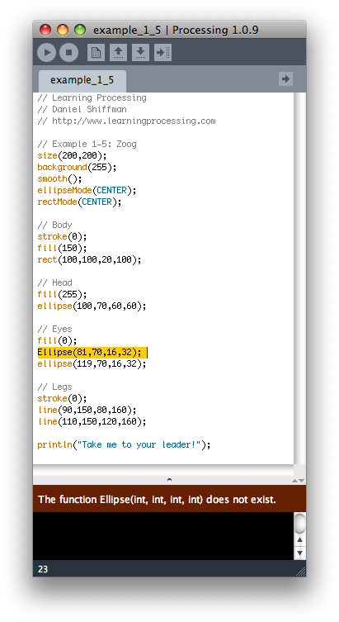
Errors
If you make an error in your code, then you get a message when you try to run the sketch
The line in which the error occurs will be highlighted
Processing is case-sensitive, so “Ellipse” is not the same as “ellipse”

Slide 25
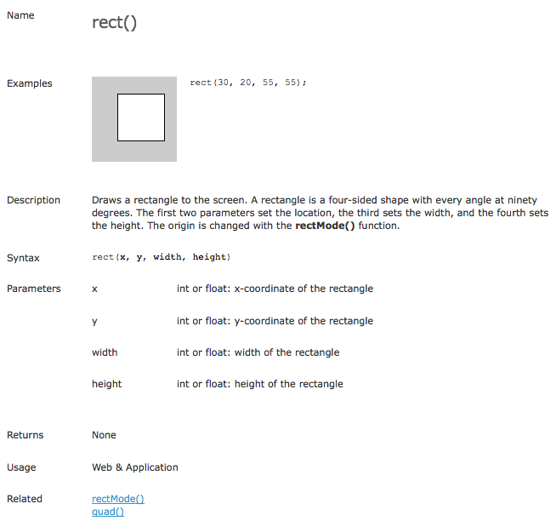
The Processing Reference
Right-click on a keyword and choose “Find in Reference” to get help

Slide 26
The Play button
Pressing the Play button makes your sketch run
The following steps take place:
Your Processing sketch is translated into Java source code
The Java source code is compiled by the Java compiler into Java byte code
The Java byte code is bundled up into an executable .jar file
The .jar file is run by the Java Virtual Machine and the output window opens, showing you what you have made

Slide 27
The Zoog sketch
smooth() enables anti-aliasing which smooths the edges of shapes
no smooth() disables anti-aliasing
size(width, height) resizes the canvas – use it first in your sketch
You can download examples from www.learningprocessing.com
Remember SHIFT-clicking the Run button causes the sketch to run in full screen

Slide 28
Publishing a sketch
You can produce an applet from your sketch that you can upload to your web site and then run in a browser
Press the Export button or choose Export from the File menu
This creates a folder called “applet” in your sketch folder
Upload the whole applet folder and open the index.html file in your browser

Slide 29
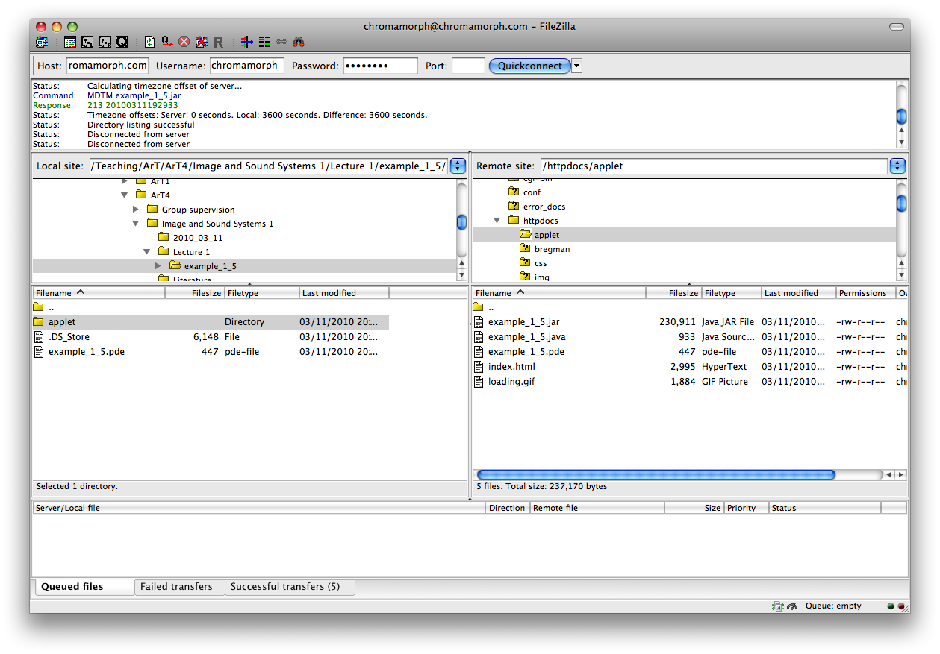
Publishing your sketch

Slide 30
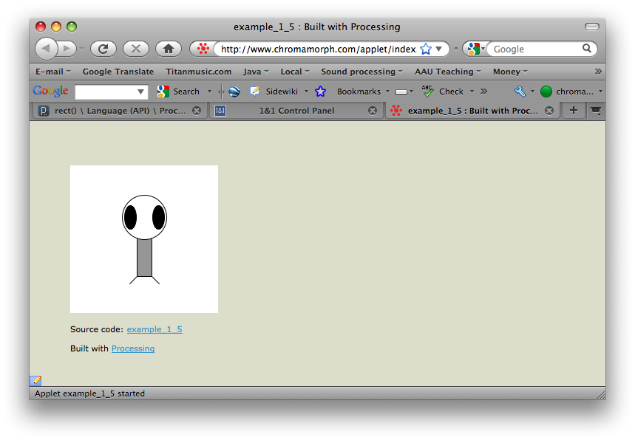
Publishing your sketch
https://87.106.101.49:4643/vz/cp

Slide 31
Interaction
In an animated or interactive sketch, the image changes over time – ideally, at least 30 times per second
There are two parts to writing such a sketch:
Setup the initial conditions for the animation
Draw the screen over and over again, possibly getting user input in between redraws

Slide 32
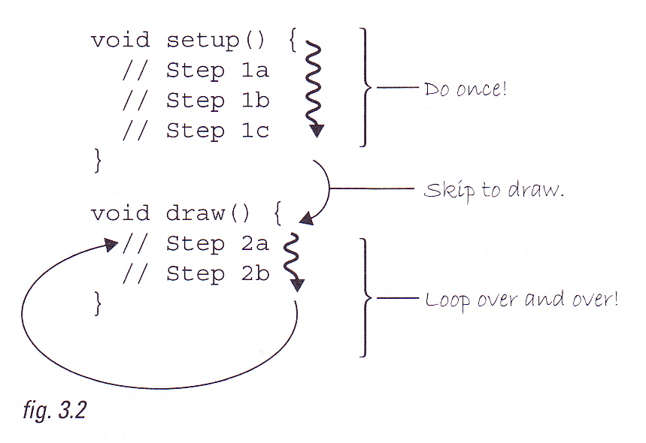
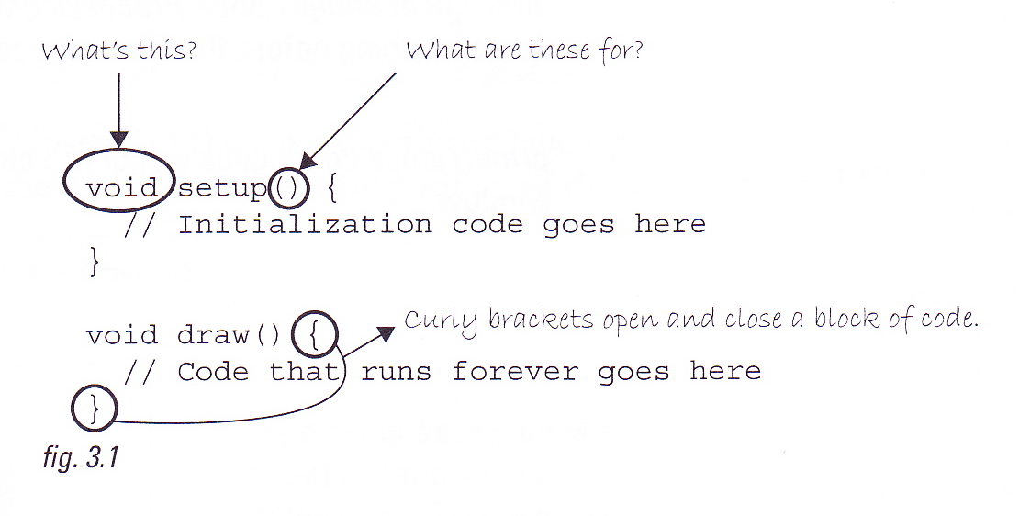
setup() and draw()
Define two functions within your sketch: setup() and draw()
setup() is run once when the program starts
draw() is then run over and over again until the program terminates

Slide 33
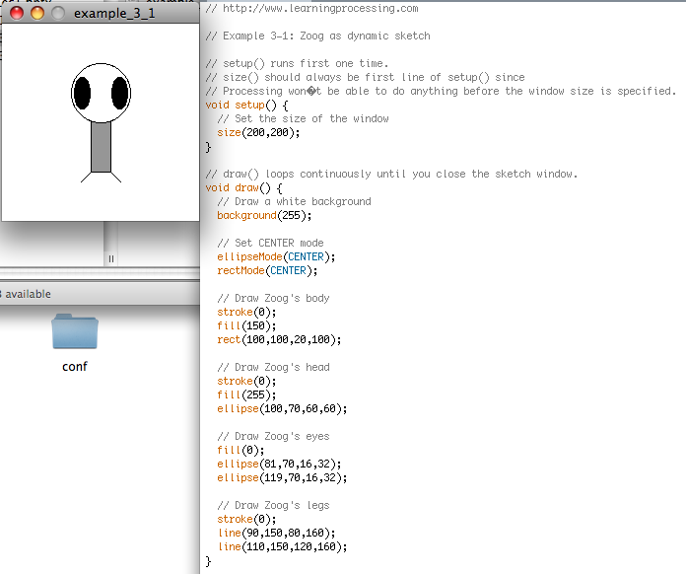
Zoog as a dynamic sketch
draw() executed over and over again until STOP button pressed
But draws the same thing each time, so we can’t see any change!

Slide 34
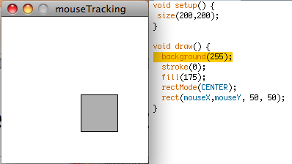
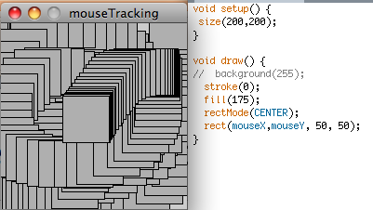
Tracking the mouse’s location
On each frame, Processing updates the values stored in mouseX and mouseY so that they give the current co-ordinates of the mouse pointer
background() clears the display window, so see trails if leave it out of draw()
Display actually updated once per cycle at the end of the draw() function

Slide 35
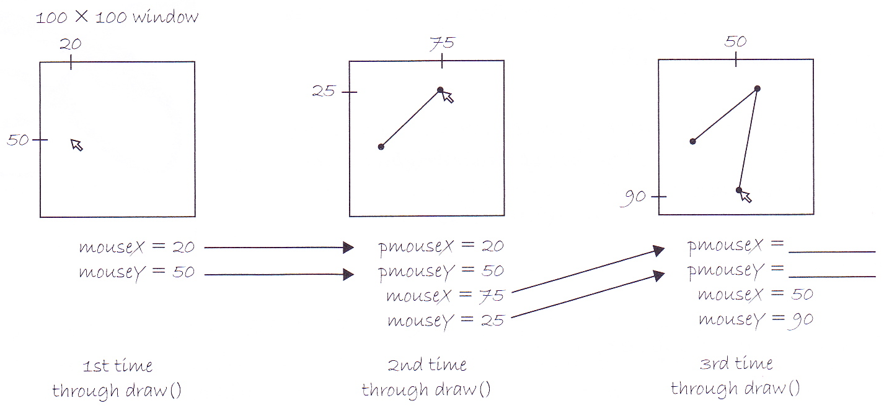
pmouseX and pmouseY

Slide 36
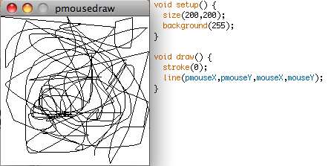
Drawing lines with the mouse

Slide 37
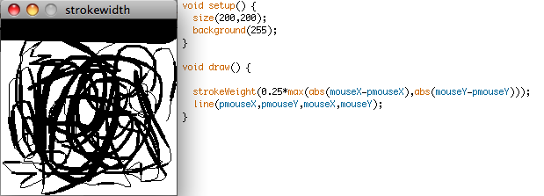
Using the mouse to control strokeWeight()
abs(mouseX-pmouseX)

Slide 38
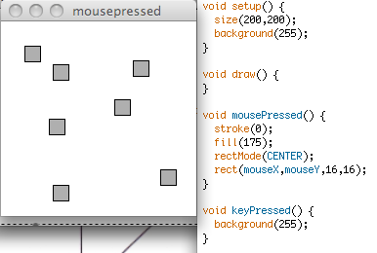
mousePressed() and keyPressed()
To get our sketch to respond to a mouse click, we have to define a function called mousePressed() which tells the program what to do when a mouse button is pressed
Similarly, a function called keyPressed() defines what the program does when a key is pressed

