Slide 1
Pitch-spelling algorithms
David Meredith
Aalborg University

Slide 2
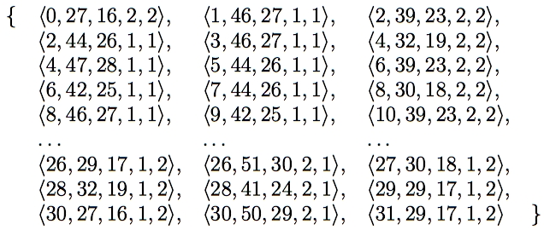
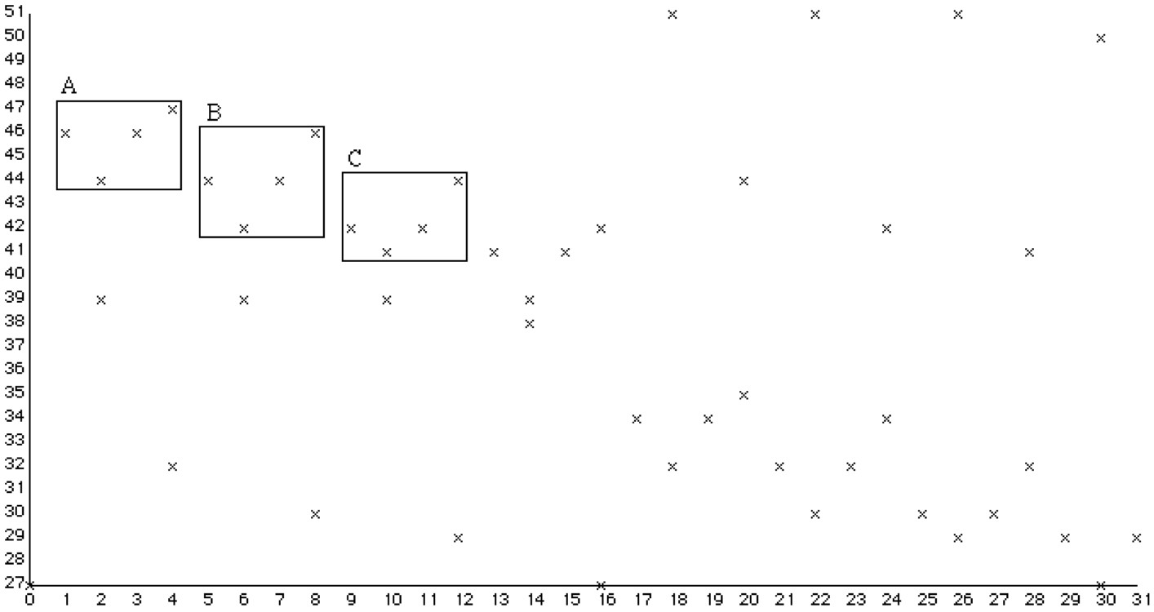
A pitch spelling algorithm takes this...
Computes diatonic pitch of each note from its chromatic pitch and onset time (and possibly duration and voice)
A, B and C sound like versions of the same thing, but are actually chromatically different
Chromatic pitch
Time
Notes:
Pitch spelling algorithm computes the diatonic pitch of each note in a passage given the chromatic pitch and onset time (and possibly the duration and voice too) of each note.
We saw this graph of chromatic pitch against time earlier on and I noted that the three patterns A, B and C, which sound very similar, have different shapes in this representation.

Slide 3
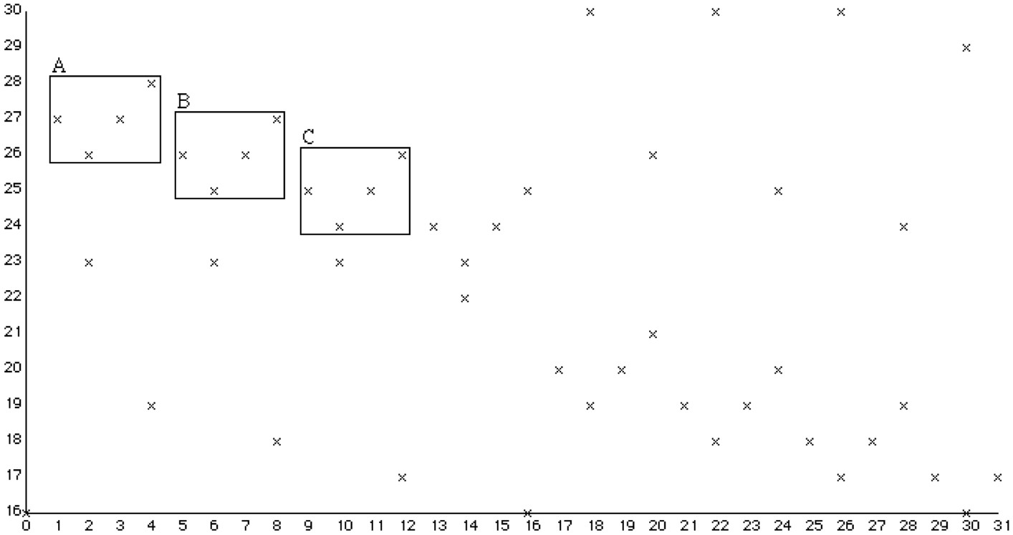
...and computes this
Diatonic pitch representation makes the patterns identical – useful for MIR
Also essential for transcription
Diatonic pitch
Time
Notes:
Knowing the diatonic pitch is useful in musical pattern discovery and pattern matching because certain types of patterns that are perceived to be significantly similar in tonal music have translationally equivalent representations in diatonic-pitch against time representation but do not in a chromatic pitch against time representation.
A pitch spelling algorithm is therefore essential if we want to compute a correctly notated score from a piano-roll-like representation such as MIDI.

Slide 4
Why are pitch spelling algorithms useful?
In transcription, for generating a correctly notated score from a MIDI or audio file
In content-based music retrieval
For representing better the perceived tonal relationships between notes
Allows us to find occurrences that sound like the query but contain different chromatic intervals
For better understanding the cognitive processes that underlie the perception of tonal music

Slide 5
Why is the same sound spelt differently in different contexts?
1
3
2
4
Notes:
The top note in the middle chord in 1 and 2 is physically exactly the same - it's played by pressing the same key on a piano.
[Play 1 and play 2]
In 1, this note is printed as a D flat because it is perceived as being the next note down in the scale from the top note of the first chord which is an E. However, in 2 it is spelt as a C sharp because it is perceived in this context as being two steps down in the scale from the top note in the first chord.
Another way of looking at it is to see that 2 is heard as a modified version of 4 and 1 is heard as a modified version of 3.
[Play 1 and 3 then 2 and 4]

Slide 6
Comparative analysis of pitch spelling algorithms
Algorithms analysed, evaluated and (in some cases) improved
Longuet-Higgins (1976, 1987, 1993)
Cambouropoulos (1996,1998, 2001, 2003)
Temperley (2001)
Chew and Chen (2003, 2005)
Meredith (2003, 2005, 2006, 2007)
Test corpus
195972 notes, 216 movements, 8 baroque and classical composers
almost exactly equal number of notes (24500) for each composer

Slide 7
Longuet-Higgins’s algorithm (1976,1987,1993)
Uses 6 rules to predict pitch names
Rule 1: pitch names as close to tonic on line of fifths
Rules 2-6: deal with chromatic intervals and key changes
Rule 2 incorrectly implemented in music.p
6 versions of algorithm tested
Original and two versions with Rule 2 “corrected”
Same three algorithms with pitch names not restricted to being between G double sharp and A double flat
Two versions of test corpus
Voices arranged “end-to-end” (should be better)
Voices “interleaved” with notes sorted by onset and pitch

Slide 8
Longuet-Higgins’s algorithm - Results
Correcting Rule 2 implementation lowered note accuracy
Made half as many errors when voices end-to-end
Allowing pitch names to be anywhere on the line of fifths doubled number of errors
Original version performed best (NA = 98.21%; SD = 1.79)

Slide 9
Cambouropoulos’s algorithm (1996,1998,2001,2003)
Three published versions of algorithm
Input changed to sequence of MIDI note numbers
Shifting overlapping window
improves running time and avoids boundary errors
Computes all spellings for each window
128 spellings for each 9-note window
Spelling penalised if
contains intervals that are rare in tonal scales
contains double sharps or double flats

Slide 10
Cambouropoulos’s algorithm - Evaluation
18 ways in which two versions of the algorithm could differ
e.g., variable or fixed length window
26 versions implemented and tested
goal to estimate optimal combination of variable features
Window: Variable-length better than fixed-length
Best variable-length window version: NA = 99.07%; SD = 0.46
Increasing window size
increases accuracy but exponentially increases running time
12 note window is practical maximum
Algorithm with ‘optimal’ combination of features:
NA = 99.15%; SD = 0.47

Slide 11
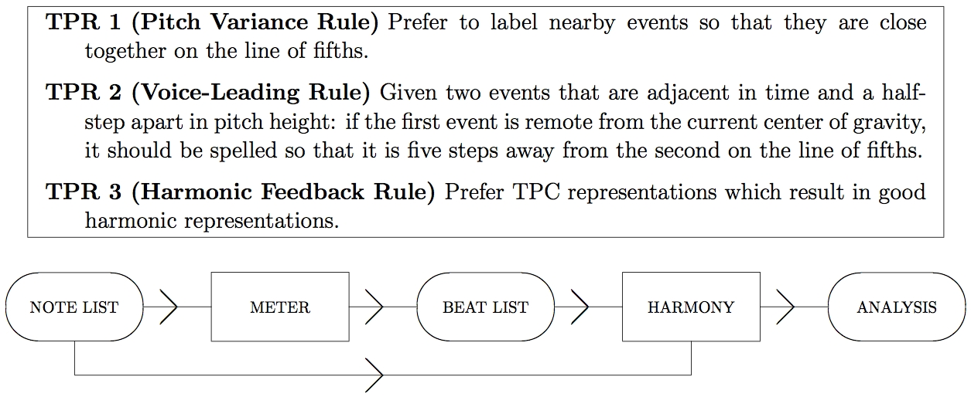
Temperley and Sleator’s pitch spelling algorithm (2001)
Notes:
Temperley’s theory of pitch spelling consists of three tonal-pitch-class preference rules.
Tonal pitch class of a note is an integer that indicates the position of the note on the line of fifths
TPR 1 - steers system toward spelling nearby events so that they are close together on the line of fifths.
TPR 2 - aims to account for way that notes are spelt in chromatic scale segments.
TPR 3 - good harmonic representations = spell chords as traditional triads and sevenths if possible..
Rules implemented by Sleator in harmony program in Melisma.
Harmony program needs note list giving MIDI note number, onset and offset of each note and beat list giving metrical structure as analysed by meter program which is another program in Melisma.
So to compute pitch names using Temperley’s theory, we have to run both the meter and harmony programs on the input data.

Slide 12
Temperley and Sleator’s algorithm - Evaluation
Output of meter program depends on tempo
System tested on 6 versions of corpus, each with different tempo
Best on natural tempo or half-speed corpora
NA = 99.30%; SD = 1.13 (without enh. change)
NA = 97.79%; SD = 4.57 (with enh. change)
Highly sensitive to tempo
at 4 times natural tempo, NA = 74.58%
worse than just spelling all black notes randomly as either sharp or flat!
Simple implementation of TPR 1 alone achieved
NA = 99.04%; SD = 0.65

Slide 13
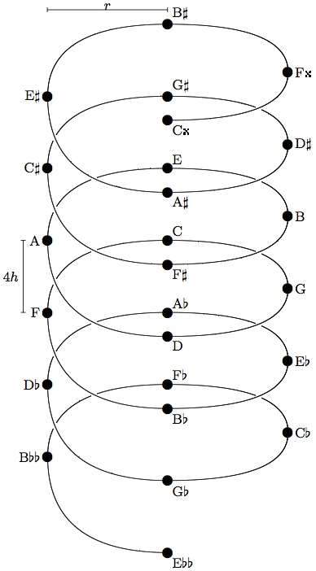
Chew and Chen’s algorithm (2003,2005)
Based on “spiral array” = line of fifths coiled up
Tonic represented by center of effect = Centroid of positions in spiral array of pitch names in preceding window
First spelt so close to global CE, then re-spelt so close to weighted average of local and cumulative CEs
Notes:
1. Chew and Chen’s pitch spelling algorithm is based on Chew’s (2000) “spiral array model” which is a geometrical model of tonal pitch relations constructed by coiling up the line of fifths so that pitch name classes a major third apart are adjacent along the length of the cylinder in which the helix is embedded.
2. In this algorithm, the local tonic at a point in the music is represented by the “center of effect” or CE, which is the weighted centroid of the position vectors within the spiral array of the pitch names of the notes in a window preceding that point in the music.
3. The music is first divided up into time slices called chunks and the algorithm spells the notes a chunk at a time.
4. Notes in chunk first spelt so close to global CE, then re-spelt so close to weighted average of local and cumulative CEs.

Slide 14
Chew and Chen’s algorithm - Evaluation
New implementation allows user to
use line of fifths instead of spiral array
consider notes starting in each window instead of notes sounding in each window when computing CEs
change aspect ratio of spiral array
Run 1296 times on test corpus, each time with different parameter value combination
Best 12 versions scored NA=99.15%, SD=0.4
worked best when all three CEs used, local and cumulative CEs weighted equally and chunks small
Line of fifths worked just as well as the spiral array
See also Meredith (2007b,c)

Slide 15
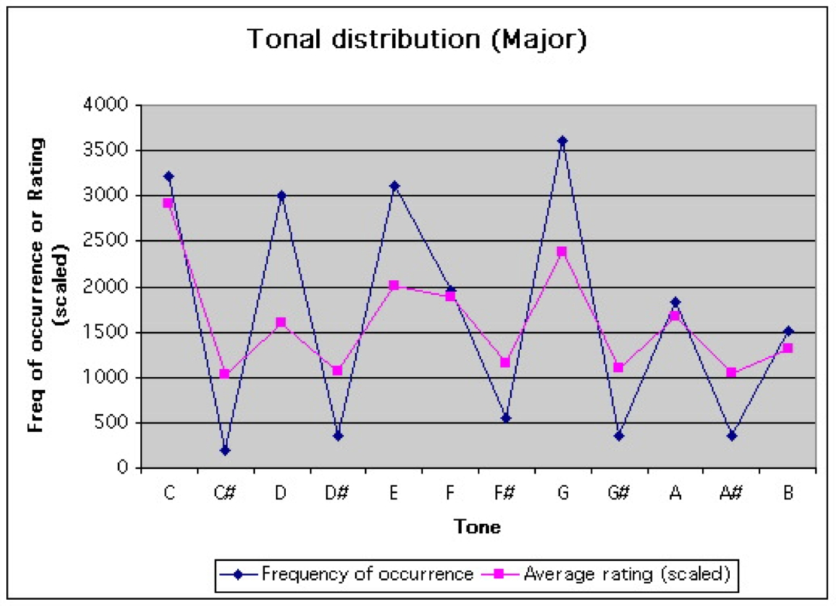
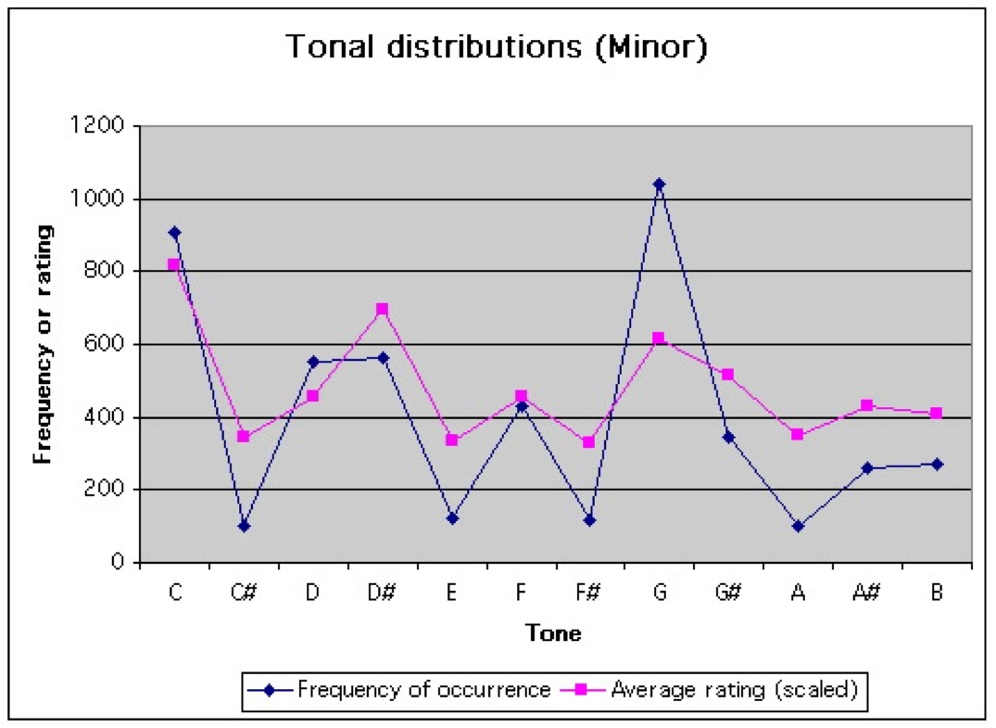
PS13s1 (Meredith, 2003,2005,2006)
Pitch name implied by a tonic is one that is closest to the tonic on the line of fifths
Strength with which tonic implied proportional to frequency of occurrence
Strength with which pitch name implied proportional to sum of frequencies of occurrence of tonics implying pitch name
Notes:
PS13s1 is based on three simple principles.
The first of these is that the pitch name implied by a tonic is the one that is closest to the tonic on the line of fifths.
This is the same as the basic principle underlying Chew and Chen’s algorithm and Longuet-Higgins’s algorithm.
However, in PS13s1, it is not assumed that there is only one tonic at each point in the music and the local tonic is not represented by a single point estimate on the line of fifths as it is in the algorithms of Chew and Chen, Temperley and Longuet-Higgins.
In fact, Krumhansl and Kessler (1982) showed that listeners rarely perceive there to be just one unambiguous tonic at any point within a passage of tonal music.
Instead, each of the 12 pitch classes has a certain degree of tonicness at each point in a piece.
Moreover, Krumhansl (1990) showed that the likelihood of a pitch class being perceived to be the tonic in a passage is strongly correlated with the frequency with which that pitch class occurs in the passage. These graphs show experimental ratings of “tonic-ness” for each pitch class in a major and minor context in pink and the frequency distributions of pitch classes in major and minor tonal works in blue.
This provides some experimental justification for the second assumption of PS13s1, which is that the strength with which a tonic is implied is proportional to the frequency with which it occurs within a context surrounding the note to be spelt.
The final assumption of the algorithm is that the strength with which a pitch name is implied for a note is proportional to the sum of the frequencies with which the tonics that imply that pitch name occur within a context surrounding the note.

Slide 16
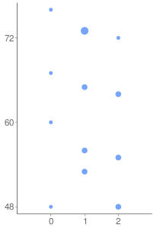
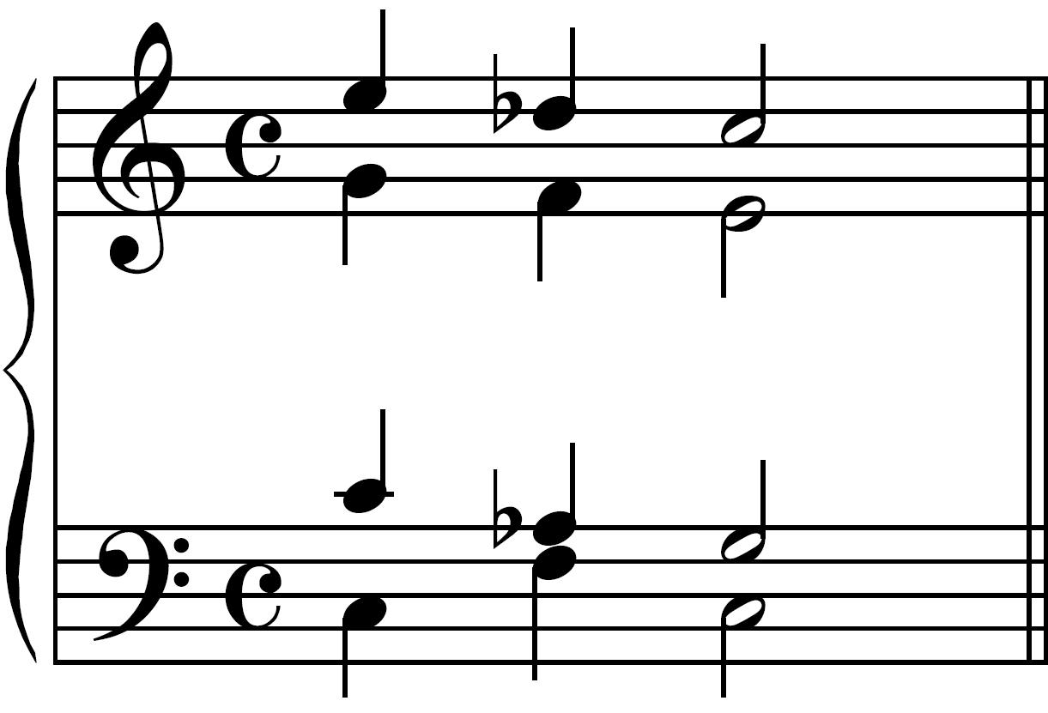
The PS13s1 algorithm
MIDI Note number
Freq
Tonic chroma and pitch name class
Initial pitch name class
Time
Ebb | Bbb | Fb | Cb | Gb | Db | Ab | Eb | Bb | F | C | G | D | A | E | B | F# | C# | G# | D# | A#
2 | 9 | 4 | 11 | 6 | 1 | 8 | 3 | 10 | 5 | 0 | 7 | 2 | 9 | 4 | 11 | 6 | 1 | 8 | 3 | 10
 |  |  |  |  | 1 |  |  |  |  | T
 |  |  |  |  | T1
 |  |  |  |  |  |  |  |  |  |  |  |  |  | T |  |  | 1
 |  |  |  |  | 2 |  |  |  | T
 |  |  |  |  |  |  |  |  |  |  | T |  |  |  |  |  | 1
 |  |  |  |  | 1 | T
Notes:
Told not to assume you know anything about music theory.
Tonic is most stable, final pitch in a key.
The next most stable pitch in a key is called the dominant.
Dominant is always four scale steps above the tonic (i.e., on the staff) and seven semitones above the tonic (i.e., seven notes away on the piano keyboard).
The interval between a tonic and a dominant is called a perfect fifth.
An interval of a perfect fifth corresponds to a frequency ratio of 3/2 which is the interval from the 2nd to the 3rd harmonics in the harmonic series.
We can generate all possible pitch name classes using the interval of a perfect fifth. Doing this produces what is called the “line of fifths”.
I explained earilier that the chromatic pitch or MIDI note number of a note indicates the key on the piano keyboard that you have to press in order to play the note, with the notes numbered consecutively, increasing with frequency. Give examples.
Every note also has an associated chroma which is simply the MIDI note number mod 12. In other words, the chroma indicates the position of the note within its octave. All C naturals have a chroma of 0, all D flats and C sharps have a chroma of 1, all Ds have a chroma of 2 and so on.
The line of fifths has some very special properties
any set of 7 consecutive pitch name classes on the line of fifths forms a major diatonic scale
any set of 12 consecutive pitch name classes on the line of fifths includes all possible chromas from 0 to 11 and therefore defines one possible mapping of chroma onto pitch name
any set of 12 consecutive pitch name classes forms what is traditionally called a harmonic chromatic scale
In general, it seems that the best spelling for a note is the one in the harmonic chromatic scale starting on that note
This means that the best spelling for a note in a given key is generally the spelling that is closest to the tonic of that key on the line of fifths, with notes 6 steps away from the tonic being as sharpend fourths rather than flattened fifths.
Another thing you need to know is that some experimental psychological work by Carol Krumhansl in the eighties and early nineties showed that the degree to which a chroma is perceived to be tonic-like or stable within a particular context is correlated with the frequency of occurrence of that chroma within the context. So, the more frequently a chroma occurs, the more likely it is to be perceived to be the tonic.
Explain input format and context.
Explain chroma frequency distribution (chromagram).
We next make the assumption that if a particular chroma is heard to be the tonic at any point in the piece, it will have a particular fixed pitch name class.
For example, here we assume that if the tonic chroma is 0 at a particular point in the music, then any note with that chroma will be spelt as a C at that point in the music.
These fixed tonic chroma pitch name classes are computed by assigning a reasonably but arbitrary pitch name to the lexicographically first note in the music – in this case, the bass C natural here.
The pitch name of the first note is chosen (arbitrarily) from the range Eb to G# on the line of fifths, and then each fixed tonic chroma pitch name is chosen to be the one that leads to the first note being assigned this arbitrarily chosen initial pitch name.
If the tonic is C (i.e., the chroma of the tonic is 0), then the pitch name of this note that we’re trying to spell would be as close to C on the line of fifths as possible, which means that it would be Db, as shown in this top row here.
Similarly, if the tonic were Db, F or Ab, then the note would alsoc be spelt as a Db.
However, if the tonic were E or G, then the note would be spelt as a C#.
We assume that each possible tonic has an influence on the spelling of the note in proportion to the frequency with which it occurs within the context around the note. In other words, the number of votes that a particular tonic has for a particular pitch name is simply the number of times it occurs within the context around the note. So here, the tonic E has one vote for C# but the tonic F has two votes for Db.
Then we simply add up the votes for each possible spelling and choose the one that has the most votes – in this case, Db.

Slide 17
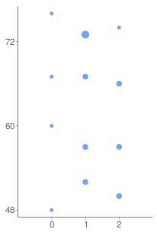
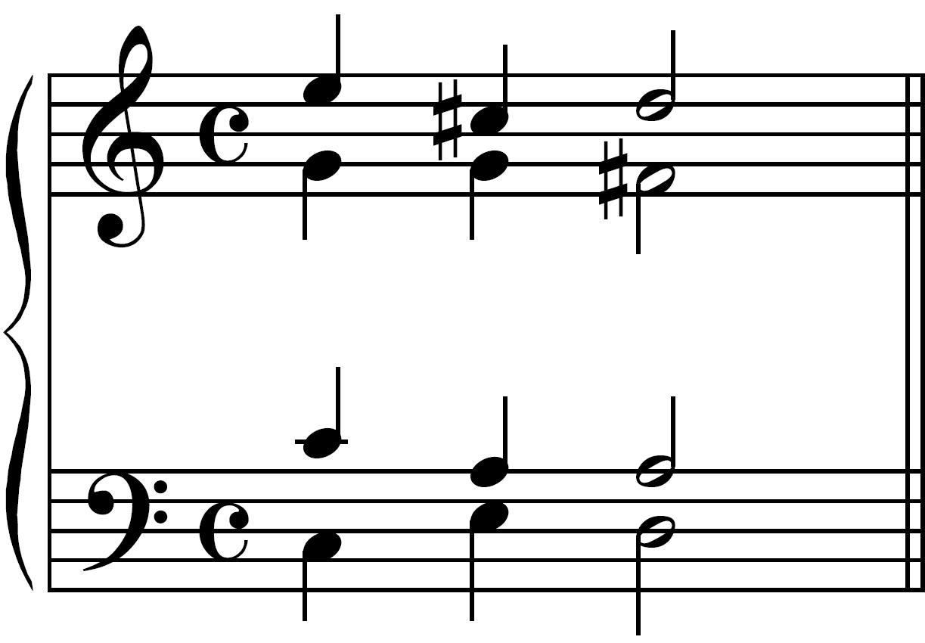
The PS13s1 algorithm
MIDI Note number
Freq
Tonic chroma and pitch name class
Initial pitch name class
Time
Ebb | Bbb | Fb | Cb | Gb | Db | Ab | Eb | Bb | F | C | G | D | A | E | B | F# | C# | G# | D# | A#
2 | 9 | 4 | 11 | 6 | 1 | 8 | 3 | 10 | 5 | 0 | 7 | 2 | 9 | 4 | 11 | 6 | 1 | 8 | 3 | 10
 |  |  |  |  | T1
 |  |  |  |  |  |  |  |  |  |  |  | T |  |  |  |  | 1
 |  |  |  |  |  |  |  |  |  |  |  |  |  | T |  |  | 1
 |  |  |  | T | 1
 |  |  |  |  |  |  |  |  |  |  | T |  |  |  |  |  | 1
 |  |  |  |  |  |  |  |  |  |  |  |  | T |  |  |  | 2

Slide 18
Evaluation criteria and performance metrics
Evaluation criteria
Spelling accuracy - how well an algorithm predicts the pitch names
Style dependence - how much spelling accuracy depends on style
Performance metrics
Note error rate - proportion of notes in corpus spelt incorrectly
Style dependence - standard deviation of note error rates over 8 composers
Robustness to temporal deviations
Best versions of algorithms also run on version of test corpus in which onsets and durations were randomly adjusted
To evaluate how well algorithms would work on files generated directly from performances

Slide 19
Results for algorithms that were most accurate over clean corpus
Algorithm | Clean corpus |  | Noisy corpus
 | NER% | SD | NER% | SD
PS13s1^{x} | 0.56 | 0.49 | 0.61 | 0.54
Temperley* | 0.70 | 1.13 | 3.32 | 3.91
Chew and Chen⁺ | 0.85 | 0.35 | 0.99 | 0.55
Cambouropoulos⁺ | 0.85 | 0.47 | 0.93 | 0.53
Longuet-Higgins§ | 1.79 | 1.79 | 1.75 | 1.71
Fixed LOF Range (Eb-G#) | 4.38 | 1.47 | 4.38 | 1.47
^{x}K_{pre}= 10, K_{post}= 42
*Two-pass, half tempo corpus, without enh. change (MH2PX2)
⁺New optimized versions (CamOpt and CCOP01-06)
§Only when music processed a voice at a time (LH1V)
Notes:
Wolf fifth corresponds to interval from G# to Eb

Slide 20
Some perceptual and cognitive implications
PS13s1 performs best when it uses a substantial “post-context” containing 23-42 notes
None of the other algorithms use a post-context larger than about 3 or 4 notes
Suggests that whether or not a pitch class is perceived to be the tonic at a point depends to some extent on notes that immediately follow it in the music
PS13s1 with only a relatively small local context including a post-context performed better than Chew and Chen’s algorithm which uses all the music preceding the note to be spelt
Suggests that perceived tonic is much more dependent on local context than global context
In agreement with a “concatenationist view of music perception” (Tillmann and Bigand, 2004; Gurney, 1966; Levinson, 1997)

Slide 21
Some perceptual and cognitive implications
Best context sizes for PS13s1 contained from 50 to 58 notes
With music at a “natural” tempo, this corresponds to an average duration of 5.03 – 5.81 seconds
Corresponds well with estimates of the duration of the perceptual present
Fraisse: around 5 s; Clarke: 3-8 s
Events within perceptual present are “directly perceived”
Can therefore be particularly easily re-interpreted in the light of events that occur later in the perceptual present
Therefore feasible that notes occurring up to 4 seconds after the one to be spelt may influence it’s interpretation and therefore its spelling

