Slide 1
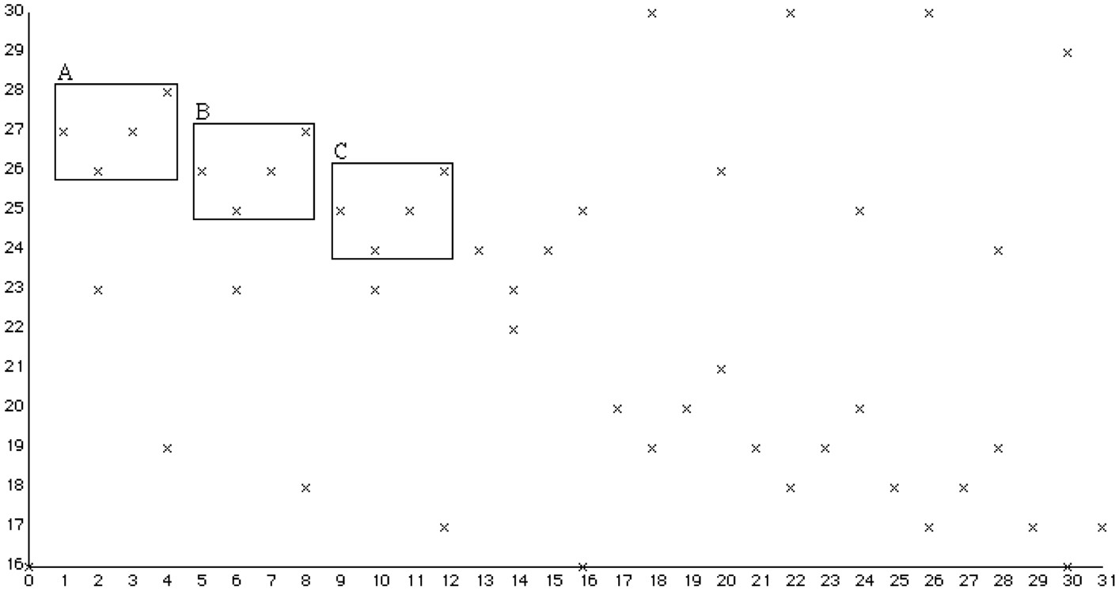
Algorithms for pattern matching and pattern discovery in music
David Meredith
Aalborg University

Slide 2
Uses of musical pattern discovery algorithms
In content-based music retrieval
Creating an index of memorable patterns to enable faster retrieval
For music analysts, performers and listeners
A motivic/thematic analysis can assist understanding and appreciation
In transcription
Helps with inferring beat and metrical structure
similar patterns have similar metrical structure
Helps with inferring grouping and phrasing
“parallellism” (Lerdahl and Jackendoff, 1983) most important factor in grouping
In composition and improvisation
Cure composer’s block by suggesting new material based on patterns discovered in music already written
Automatically create new music that develops themes discovered in music already played
Use analysed thematic structure as a template for a new work

Slide 3
Importance of repeated patterns in music analysis and cognition
Schenker (1954. p.5):
repetition “is the basis of music as an art”
Bent and Drabkin (1987, p.5):
“the central act” in all forms of music analysis is “the test for identity”
Lerdahl and Jackendoff (1983, p.52):
“the importance of parallelism [i.e., repetition] in musical structure cannot be overestimated. The more parallelism one can detect, the more internally coherent an analysis becomes, and the less independent information must be processed and retained in hearing or remembering a piece”
Notes:
Accepted among music analysts and music psychologists that identifying perceptually significant repetitions is an essential step in the process of achieving a rich understanding of a piece of music.

Slide 4
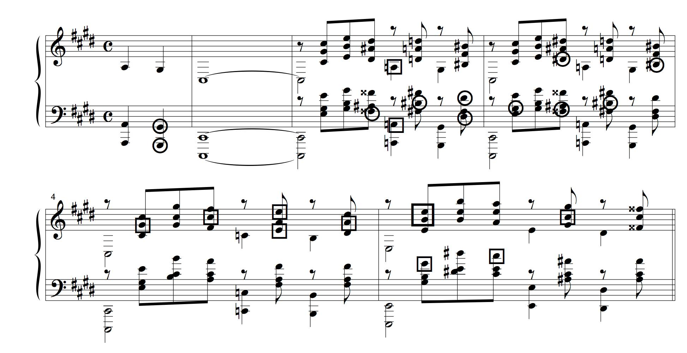

Most musical repetitions are neither perceived nor intended
Rachmaninoff, Prelude in C sharp minor, Op.3, No.2, bars 1-6
Pattern consisting of notes in circles is repeated 7 crotchets later, transposed up a minor ninth to give the pattern consisting of the notes in squares
http://uk.youtube.com/watch?v=MoTyDD0C93U

Slide 5
Interesting musical repetitions are structurally diverse
Want to discover all and only interesting repeated patterns
i.e., themes and motives
Class of interesting repeated patterns is structurally diverse because
patterns vary widely in structural characteristics
many ways of transforming a musical pattern to give another pattern that is perceived to be a version of it
e.g., we can transpose it, embellish it, change tempo harmony, accompaniment, instrumentation, etc.
Notes:
We want our pattern discovery algorithm to find all and only those repeated patterns that an expert listener or music analyst would consider to be important and interesting.
Unfortunately, this class of repetitions is very diverse because
the patterns that are involved in such repetitions vary widely in their structural characteristics; and
there are many different ways of transforming a musical pattern to give another pattern that is perceived to be a version of it (for example)

Slide 6
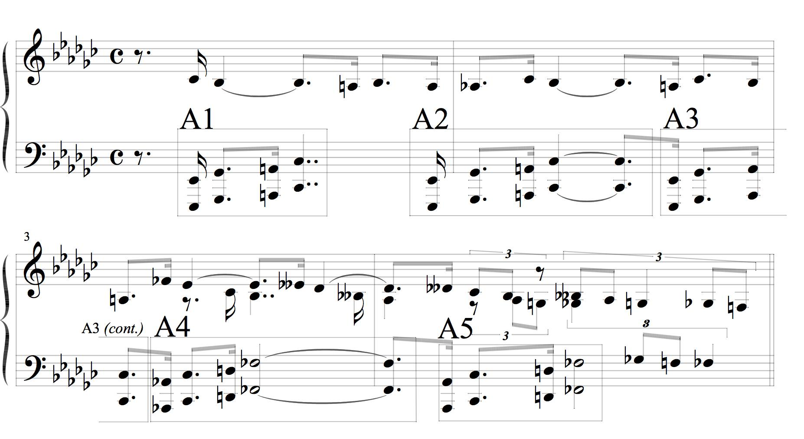
Example of repeated motive
Barber, Sonata for Piano, Op.26, 1st mvt, bars 1-4
Repeated patterns can be just a few notes or whole sections of symphonies
Here repetition in left hand out of phase with right hand – two separate streams
Slightly varied each time (metrical placement, transposed)
Notes:
I’m now going to show you a few examples that illustrate the diversity of the class of interesting musical repetitions.
A repeated pattern can be just a small motive consisting of just a few notes or a whole section of a symphonic movement containing hundreds or even thousands of notes.
Here’s an example of a small repeated motive in the left-hand of the beginning of Barber’s Sonata for Piano, Op. 26.
I’ll play it first with these patterns labelled A1-A5 played louder than the other notes.
Now listen out for these patterns when I play it with all the notes at the same loudness.
Note how the pattern only contains notes in the accompaniment, not the right hand which plays the melody.
Note also how it is not always played at the same pitch: A4 and A5 are a perfect fourth higher than A1 to A3.
Note also that the duration of the last notes in the motive varies.
Metrical positioning of motive varies (A1,A4,A5: 2nd beat; A2: 1st beat; A3: 4th beat)

Slide 7
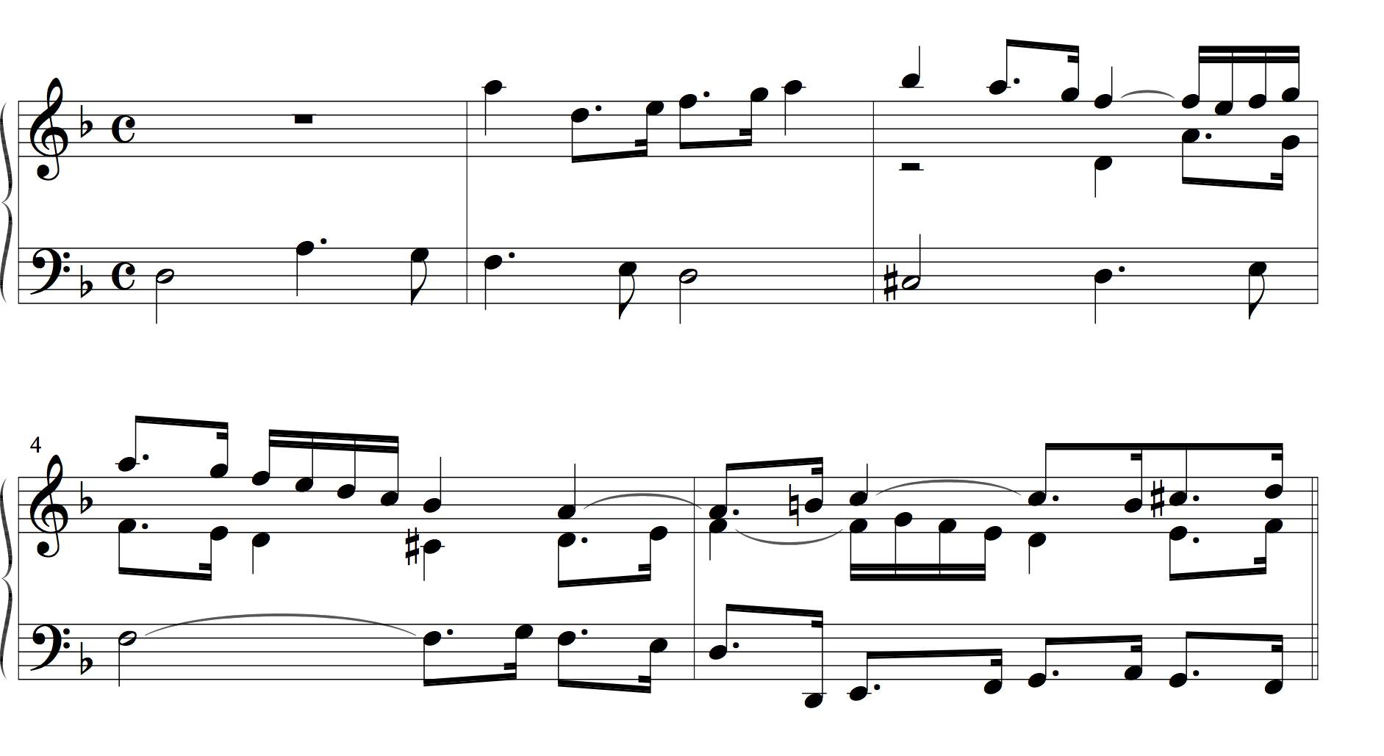
Example of thematic transformation Diminution, Transposition, Inversion
J.S.Bach, Contrapunctus VI from Die Kunst der Fuge, bars 1-5
Notes:
This example shows a theme being transformed by the musical transformations of diminution, transposition and inversion.
The alto part in the blue box is derived from the bass part by transposing it up an octave, delaying its start for two and half bars and halving all the note durations.
If we represented the notes in the music as a set of points on a graph of pitch against time, then the bass part would be mapped onto the alto part by translation and then scaling.
The soprano part is an inversion of the alto part. So, in geometric terms, to get the soprano part from the bass part, you have to reflect it in a horizontal axis and then scale by a 1/2.
Note that the three occurrences of the subject overlap in time and in pitch.
So, whereas the patterns in the previous example were “bounding-box” compact, these patterns are compact only in the sense that each contains all the notes that occur between two time points within a particular voice.

Slide 8
String-based algorithms for discovering musical patterns
Most previous approaches assume music represented as strings
each string represents a voice or part
each symbol represents a note or an interval between two consecutive notes in a voice
Similarity between two patterns measured in terms of edit distance calculated using dynamic programming
see, e.g., Lemstrom (2000), Hsu et al. (1998), Rolland (1999)

Slide 9
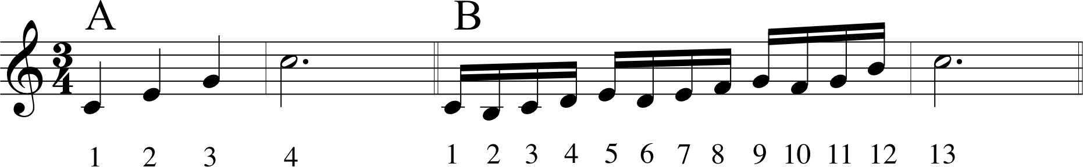
Problems with the string-based approach - Edit distance
B is an embellished version of A
If both patterns represented as strings
each symbol represents pitch of note
then edit distance between A and B is 9
If allow pattern with 9 differences to count as a match, then get many spurious hits

Slide 10
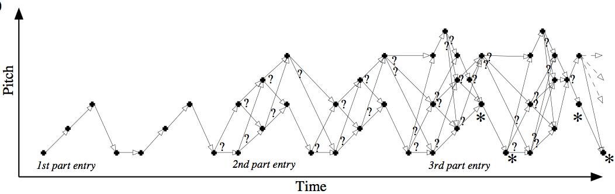
Problems with string-based approach - Polyphony
If searching polyphonic music and
do not know voice to which each note belongs (e.g., MIDI format 0 file); or
interested in patterns containing notes from 2 or more voices
then
combinatorial explosion in number of possible string representations
if don’t use all possible representations then may not find all interesting patterns

Slide 11
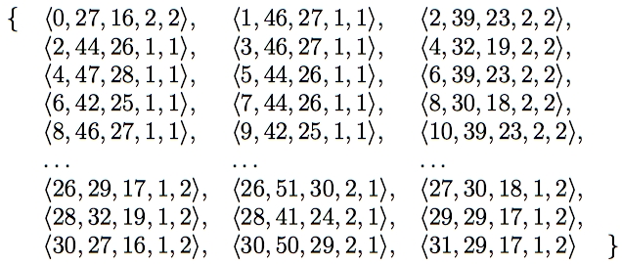
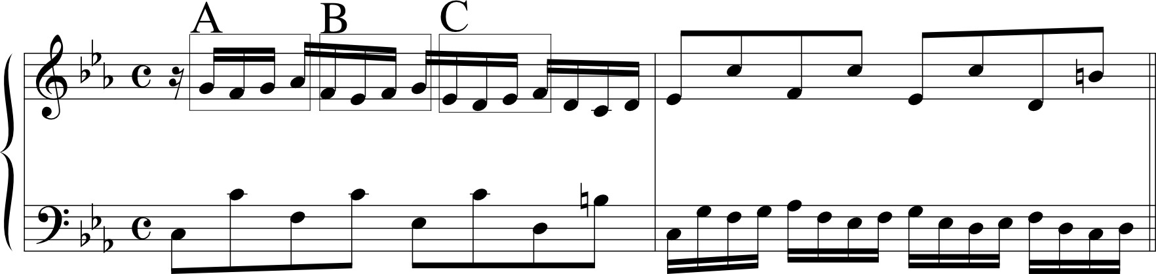
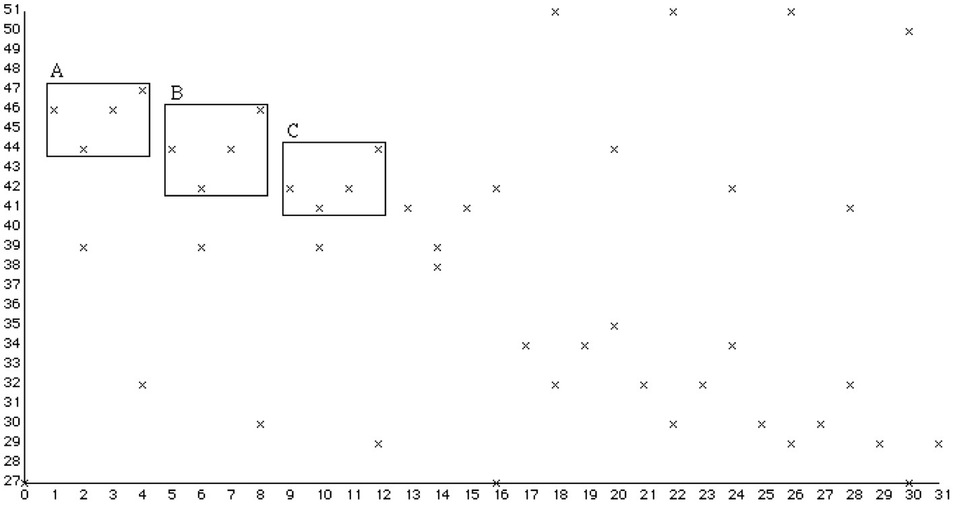
Using multidimensional point sets to represent music (1)
Can avoid problems with string algorithms by using multidimensional point sets instead
A, B and C sound like versions of the same thing, but are actually all different
Notes:
I tried to avoid the problems I’ve just described by using multidimensional point sets instead of strings to represent the music and then developing algorithms to work on these point sets.
The algorithms developed work on point sets of any dimensionality.
There are many possible ways of representing a passage of music using a multidimensional point set but the way shown here has proved to be very useful.
In this representation, the dimensions represent onset time, chromatic pitch, diatonic pitch, duration and voice.
Note that patterns A, B and C sound like versions of the same thing but have different representations in the chromatic-pitch-against time representation. Thus, to find these matches in this representation, you’d have to use an approximate matching algorithm.
However, the notation nicely represents the fact that these three patterns are heard as being versions of the same thing by representing each one as a falling step followed by two rising steps.
By using the diatonic pitch dimension and onset time, we can obtain such a representation.

Slide 12
Using multidimensional point sets to represent music (2)
But diatonic representation is the same, so can use exact matching algorithm to find them
Notes:
When we’re trying to find interesting repeated patterns in tonal music, that is, music which has a key, it is often more fruitful to use a two dimensional projection which gives the diatonic pitch of the note and its onset time, as shown here.
Here, patterns A, B and C are exactly translationally equivalent and can thus be discovered using a fast exact matching algorithm.

Slide 13
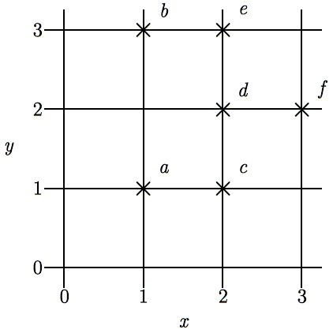
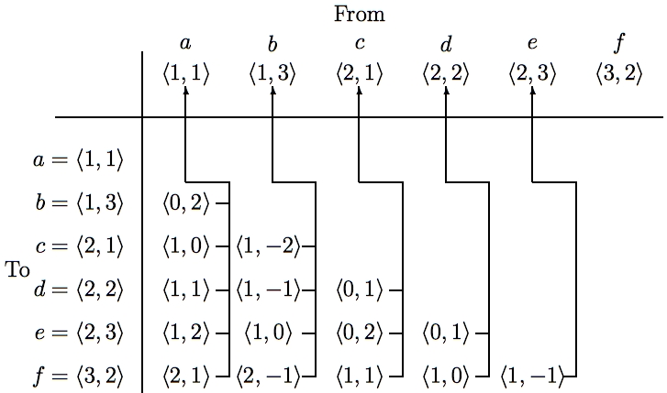
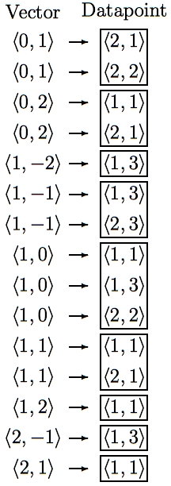
SIA - Discovering all maximal translatable patterns (MTPs)
Pattern is translatable by vector v in dataset if it can be translated by v to give another pattern in the dataset
MTP for a vector v contains all points mapped by v onto other points in the dataset
O(kn² log n) time, O(kn²) space where k is no. of dimensions & n is no. of points O(kn²) average time with hashing
Notes:
The first algorithm I’m going to describe is the SIA algorithm which takes as input a multidimensional point set and discovers, for every vector, the points in this point set that are mapped onto other points in the point set by that vector.
For convenience, I’ll call the complete set of points being analyzed the DATASET and any subset of the dataset a PATTERN.
I say that a pattern is TRANSLATABLE by a particular vector within a dataset if it can be translated by that vector to give another pattern in the dataset. For example, the pattern {a,d} here is translatable within this dataset by the vector <1,0>.
And the pattern that contains ALL the points that are mapped onto other points in the dataset by a particular vector is the MAXIMAL TRANSLATABLE PATTERN for that vector. So the maximal translatable pattern or MTP in this dataset for the vector <1,0> is the pattern {a,b,d} and the MTP for the vector <1,1> in this dataset is {a,c}.
So SIA discovers all the non-empty maximal translatable patterns in a dataset.
It does this by first sorting the points in the dataset into lexicographical order and then computing the vector from each point to every other point in the dataset that is lexicographically greater. These vectors are stored in a table like this one here which we call a VECTOR TABLE. And each vector is stored with a pointer that points back to the origin point for which it was computed, as indicated by these arrows here.
The vectors in this table are then sorted into lexicographical order to give a list like the one here on the right and the MTP for each vector can be found directly by reading off the points attached to the adjacent occurrences of that vector in this list.
The most expensive step is sorting the vectors which can be done in O(kn^2 log n) time. However, by storing the origin points in a hash table and hashing the vectors to get the slot indices, this time complexity can be reduced to O(kn^2).
And also, obviously, the space used is O(kn^2)

Slide 14
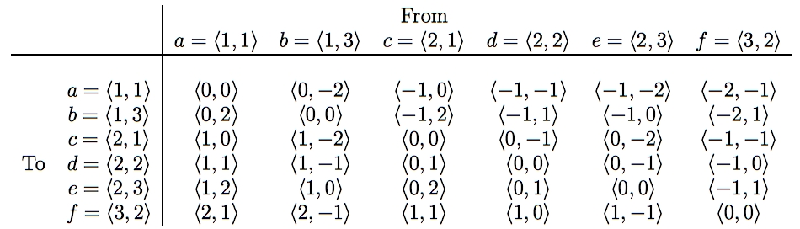
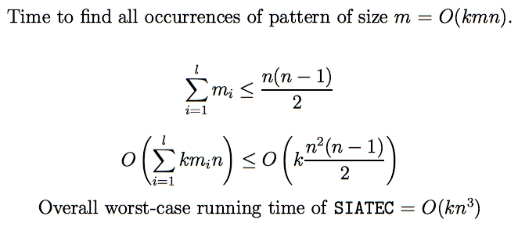
SIATEC - Discovering all occurrences of all MTPs
Translational Equivalence Class (TEC) is set of all translationally invariant occurrences of a pattern
Notes:
SIA only finds one occurrence of each MTP and one vector by which that MTP is translatable within the dataset.
SIATEC, on the other hand, finds all the MTPs using a slightly modified version of SIA and then finds all the vectors by which each MTP is translatable within the dataset.
In other words, it finds all the non-empty MTPs and then all the patterns within the dataset that are translationally equivalent to each MTP.
In SIA, we only needed to compute the vector from each point to every lexicographically greater point because the MTP for a particular vector -v is the same as the pattern that you get by translating the MTP for v by v itself.
However, in this simple implementation of SIATEC, we can find all the occurrences more efficiently by computing all the interpoint vectors and storing them in a table like this one here.
If the points in the dataset are sorted into lexicographical order first, then the vectors in this table increase lexicographically as you descend a column and go from right to left along a row.
Each column contains all the vectors by which the point at the top of the column is translatable within the dataset.
Therefore the set of vectors by which a given pattern in the dataset is translatable is equal to the intersection of the columns headed by the points in that pattern. For example, the pattern {a,c} is translatable within this dataset by the intersection of the columns for which a and c are the origin points.
By exploiting the orderedness of this table, we can find all the occurrences of a k-dimensional pattern of size m in a dataset of size n in a worst case running time of O(kmn).
Now, all the MTPs in a dataset can be found by reading through the list of sorted vectors generated by SIA so we know that sum of the cardinalities of the MTPs is less than or equal to n(n-1)/2.
Therefore the worst case time complexity of this implementation of SIATEC is [as shown] which implies that it is O(kn^3).
And, obviously, it uses O(kn^2) space.

Slide 15
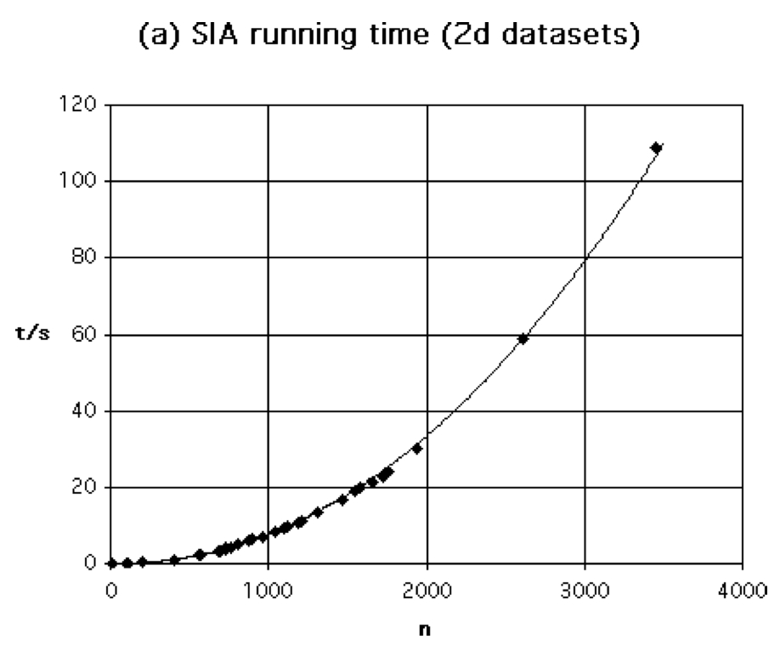
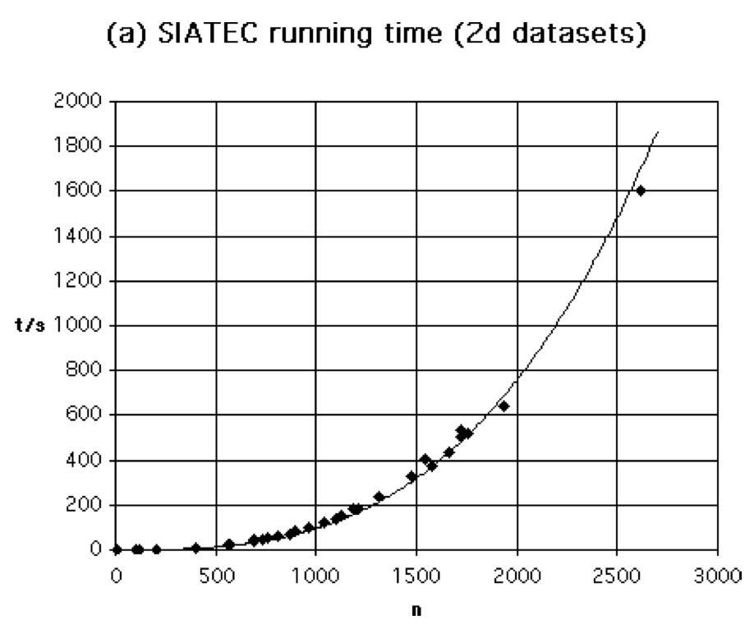
Absolute running times of SIA and SIATEC
SIA and SIATEC implemented in C
run on a 500MHz Sparc on 52 datasets
6≤n≤3456, 2≤k≤5
< 2 mins for SIA to process piece with 3500 notes
13 mins for SIATEC to process piece with 2000 notes

Slide 16
Need for heuristics to isolate interesting MTPs
2^{n} patterns in a dataset of size n
SIA generates < n²/2 patterns
=> SIA generates small fraction of all patterns in a dataset
Many interesting patterns derivable from patterns found by SIA
BUT many of the patterns found by SIA are NOT interesting
70,000 patterns found by SIA in Rachmaninoff’s Prelude in C# minor
probably about 100 are interesting
=> Need heuristics for isolating interesting patterns in output of SIA and SIATEC

Slide 17
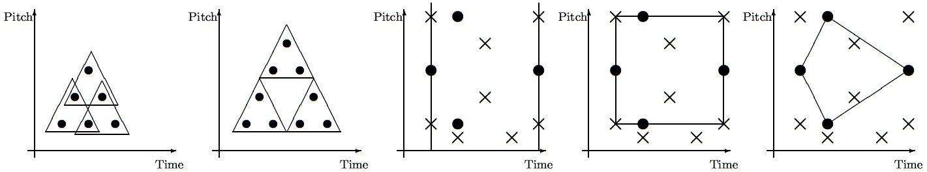
Heuristics for isolating musical themes and motives
Cov=6 CR=6/5 | Cov=9 CR=9/5 | Comp = 1/3 | Comp = 2/5 | Comp = 2/3
Notes:
We found we could go some way towards isolating the themes and motives in a piece of music by using just three simple heuristics which I will now describe.
First, let’s define the coverage of a pattern to be the number of distinct points in the dataset in occurrences of the pattern. For example, the coverage of this triangular pattern in this dataset is 6, but in this dataset, its coverage is 9.
In general, the coverage of a pattern is greater for larger, non-overlapping patterns that occur frequently.
If we represent a passage of music as a set of points in graph of pitch against time, musical themes generally seem to have relatively high coverage.
Next, let’s define the compactness of a pattern to be the ratio of the number of points in a pattern to the number of points in the region spanned by the pattern.
The region spanned by a pattern can be defined in various ways.
For example, we can define the region spanned by a pattern in a pitch-time representation of a passage of music to be the segment containing all the notes that start between the first and last note onsets in the pattern.
Alternatively, we could define the region spanned by a pattern in such a representation to be the bounding box or convex hull of the pattern.
As you can see here, the compactness value obviously depends on how the region spanned by a pattern is defined.
Musical themes typically have at least one occurrence with relatively high compactness since this will make the pattern easier to perceive. However, other occurrences may be highly embellished and thus have lower compactness.
Another interesting heuristic that seems to be useful for isolating themes is the compression ratio that can be achieved by representing the set of points covered by all the occurrences of a pattern by specifying just one occurrence of the pattern together with all the vectors by which the pattern is translatable within the dataset.
For example, by doing this with the triangular pattern in this dataset, we achieve a compression ratio of 6/5. However, in this dataset, the same pattern can be used to achieve a compression ratio of 9/5.

Slide 18
COSIATEC - Data compression using SIATEC
Start
Dataset
SIATEC
List of <Pattern, Translator_set> pairs
Print out best pattern, P, and its translators
Remove occurrences of P from dataset
Is dataset empty?
No
Yes
End
Notes:
We can use SIATEC together with the heuristics I’ve just described to construct a simple compression algorithm which I call COSIATEC. COSIATEC works like this.
First we use SIATEC to generate a list of <Pattern, Translator_set> pairs in which each pattern is an MTP and each translator set contains all the non-zero vectors by which the pattern is translatable within the dataset. This generally gives a more efficient representation of the set of points covered by the occurrences of a pattern.
Then we can use the heuristics I’ve just described - compression ratio, coverage and compactness - to choose the “best” pattern P and this pattern is printed out together with its translator set.
Then all the points covered by P and its occurrences are removed from the dataset.
Then if the dataset is empty, we end; otherwise, we again run SIATEC on the remaining points in the dataset.
The result is a print out of the “best” pattern and its translators for each iteration of the cycle and this printout is usually a compressed representation of the input dataset.
Obviously, the degree of compression achieved depends on the amount of repetition in the dataset.

Slide 19
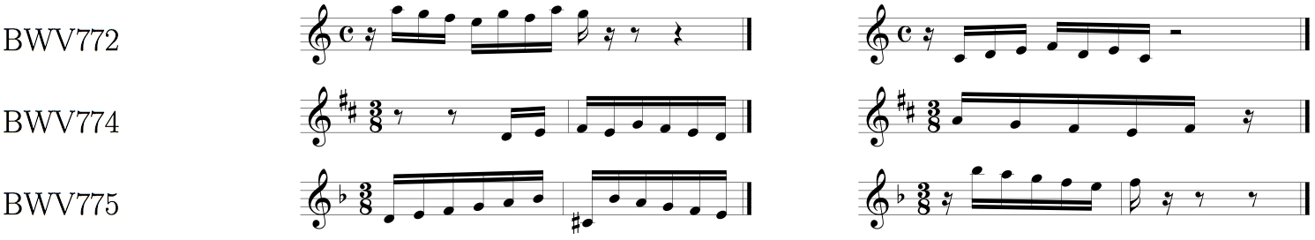
Using COSIATEC for finding themes and motives in music
First iteration
Second iteration
Notes:
When COSIATEC was run on diatonic-pitch-against-time representations of Bach’s 15 two-part inventions, the results were quite encouraging.
In particular, the patterns that achieved the highest compression ratios on early iterations of COSIATEC were often important themes or motives.
Note that the algorithm did not use information about the voice to which each note belonged.

Slide 20
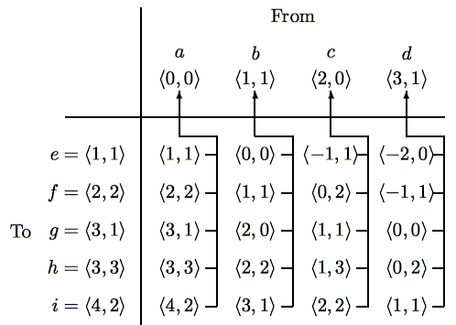
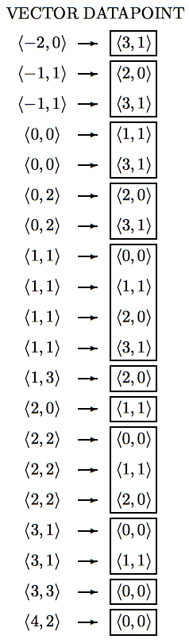
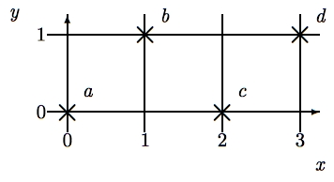
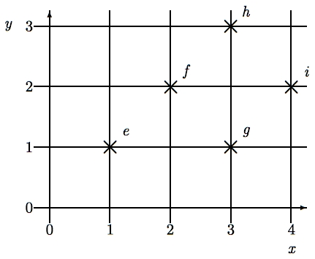
SIAM - Pattern matching using SIA
Query pattern
Dataset
k dimensions
n points in dataset
m points in query
O(knm log(nm)) time
O(knm) space
O(knm) average time with hashing
Notes:
SIA can easily be adapted for point set pattern matching, that is, for finding all the maximal matches under translation of a query point set of size m within some dataset of size n.
Let’s suppose we want to find, for each possible vector, the best match for this k-dimensional query pattern in this k-dimensional dataset.
We sort the points in the query pattern and the points in the dataset into lexicographical order and then compute the vector from each query pattern point to each dataset point and store the vectors in a vector table like this with a pointer from each vector back to its origin point.
Then we sort the vectors in this table to get a list like this.
The maximal match for a given vector is given by the points attached to the consecutive occurrences within this list of the vector.
This algorithm works in O(knm log(nm)) time and O(knm) space. But, again, by storing the origin points in a hash table and hashing the vectors to get the slot indices, the average time complexity can be reduced to O(knm).
Note that to do this in the completely naive way by trying all possible alignments between the query and the dataset and then seeing which query points match up for each alignment would take O(kn^2m^2) time.

Slide 21
Improving SIAM Ukkonen, Lemström & Mäkinen (2003)
Use sweepline-like scanning of the dataset (Bentley and Ottmann, 1979)
Generalized to approximate matching of sets of horizontal line-segments
However, restricted to 2-dimensional representations (unlike SIA-family)
Improved complexity to
O(mn log m + n log n + m log m) running time (without hashing)
O(m) working space
Implemented as algorithm P2 on C-BRAHMS demo web site
<http://www.cs.helsinki.fi/group/cbrahms/demoengine/>
Notes:
Bach Violin Concerto in D minor
16D4 16E4 16F4 16G4 8A4 8D5 8C#5 8A4 8E4
Bach Two-part invention in D major BWV 774
16D5 16E5 16F#5 16E5 16G5 16F#5 16E5 16D5 16A5 16G5 16F#5 16E5 16F#5
J. S. Bach (1685-1750)ApplicatioBWV 994n/aBaroqueMIDIHistogramPS PDF1C5 E5 G5 000
C major triad

Slide 22
Improving SIAM - MSM (Clifford et al., 2006)
Finding size of maximal match is 3SUM hard (i.e., O(n²) )
Reduce problem of multi-dimensional point-set matching to 1d binary wildcard matching
Random projection to 1D
Length reduction by universal hashing
Binary wildcard matching using FFTs
Find best match and check in O(m) time exactly how many points match at the location that can be inferred from this match
Reduces time complexity to O(n log n)

Slide 23
Evaluating MSM: Precision-Recall
Compared with OMRAS (Pickens et al., 2003)
Test set of 2338 documents, 480 used as queries
All score encodings in strict score time
Queries had notes deleted, transposed and inserted
Notes:
Precision is proportion of retrieved documents that are relevant
Recall is proportion of relevant documents that are retrieved

Slide 24
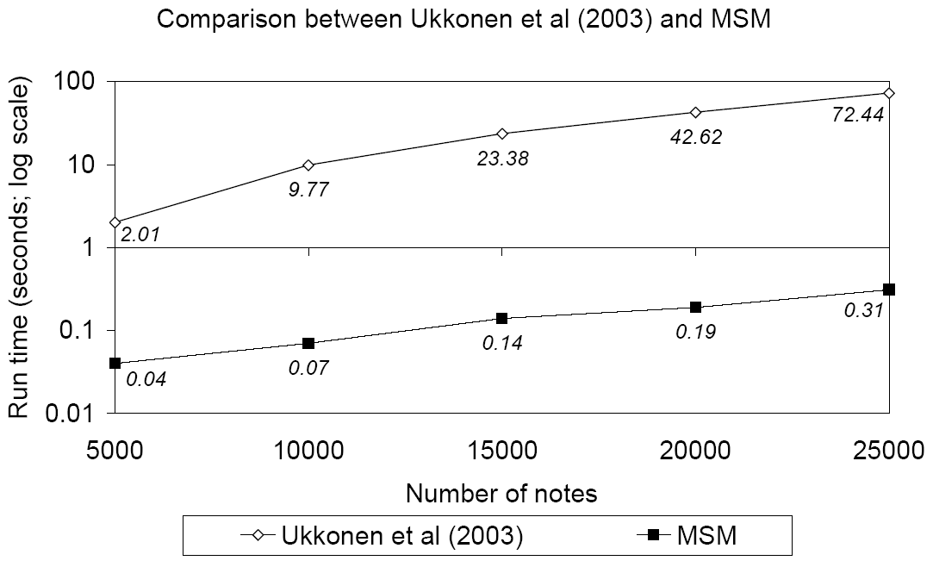
Evaluating MSM: Running time
Run on prefixes of various sizes of first movement of Beethoven’s 3rd Symphony
Each prefix matched against itself
Compared with largest common subset algorithm of Ukkonen, Lemström and Mäkinen (2003)
MSM nearly 2 orders of magnitude faster (log scale)

Slide 25
References
Bent, I. and Drabkin, W. (1987) Analysis. Macmillan.
Bentley, J. and Ottmann, T. (1979) "Algorithms for reporting and counting geometric intersections". IEEE Transactions on Computers, C(28), 643-647.
Clifford, R., Christodoulakis, M., Crawford, T., Meredith, D. and Wiggins, G. A. (2006) "A fast, randomised, maximal subset matching algorithm for document-level music retrieval". In Proceedings of the 7th International Conference on Music Information Retrieval (ISMIR 2006), Victoria, Canada.
Hsu, J.-L., Liu, C.-C. and Chen, A. L. B. (1998) "Efficient repeating pattern finding in music databases". In Proceedings of the 1998 ACM 7th International Conference on Information and Knowledge Management, pages 281-288.
Lemström, K. (2000) String Matching Techniques for Music Retrieval. PhD dissertation, Department of Computer Science, University of Helsinki.
Lerdahl, F. and Jackendoff, R. (1983) A Generative Theory of Tonal Music. MIT Press, Cambridge MA.
Meredith, D., Lemström, K. and Wiggins, G. A. (2002) "Algorithms for discovering repeated patterns in multidimensional representations of polyphonic music". Journal of New Music Research, 31(4), 321-345.
Meredith, D. (2006) "Point-set algorithms for pattern discovery and pattern matching in music". In Content-Based Retrieval, Dagstuhl Seminar Proceedings, 06171.
Pickens, J., Bello, J. P., Monti, G., Sandler, M., Crawford, T., Dovey, M. and Byrd, D. (2003) "Polyphonic score retrieval using polyphonic audio queries: A harmonic modeling approach". Journal of New Music Research, 32(2), 223-236.
Roland, P.-Y. (1999) "Discovering patterns in musical sequences". Journal of New Music Research, 28(4), 334-350.
Schenker, H. (1954) Harmony. University of Chicago Press, London.
Ukkonen, E., Lemström, K. and Mäkinen, V. (2003) "Geometric algorithms for transposition invariant content-based music retrieval" In Proceedings of the Fourth International Conference on Music Information Retrieval (ISMIR 2003), Baltimore.

