Slide 1
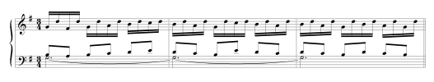
Streaming
David Meredith
Aalborg University

Slide 2
Sequential integration
The connection of parts of an auditory spectrum over time to form concurrent streams (Bregman and Ahad, 1995, p. 7)
  e.g., connection of tones played on a single instrument to form a melody
  we hear a sound to continue even when it is joined by another sound to form a mixture
Sequential integration continues until the sound changes suddenly (e.g., in frequency, timbre, amplitude, location)
  cf. Lerdahl and Jackendoff’s GPR 3 in grouping
Grouping is segmentation of streams into structural units
We usually associate a different stream with each separate sound source
  Brain attempts to analyse mixed sound that reaches ear into streams corresponding to various sources
Each stream has its own independent rhythm and melody
We are better at recognizing patterns and relationships between sounds when they are all in the same stream

Slide 3
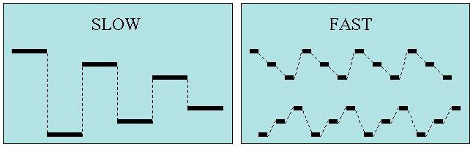
Stream segregation in a cycle of six tones
(Bregman and Ahad, 1995, p.8, Track 1)
Based on experiment by Bregman and Campbell (1971)
Six tones, 3 high alternating with 3 low, repeated several times
When slow, all six tones integrate into a single stream
When fast, split into two streams, one high, one low
Hard to hear temporal relationships between high and low tones when played fast

Slide 4
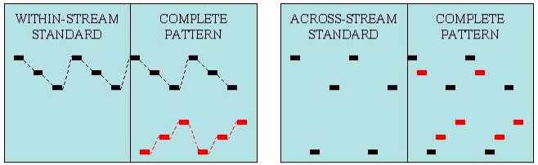
Pattern recognition within and across streams
(Bregman and Ahad, 1995, pp. 9 - 10, Track 2)
In two parts
  In first part
    hear a three-tone standard containing notes in a single stream
    Then have to listen out for standard in the 6-tone comparison pattern
  In second part
    hear a three-tone standard containing notes from different streams
    Again listen out for standard in 6-tone comparison
Much harder to hear the standard in the comparison when it contains notes from more than one stream

Slide 5
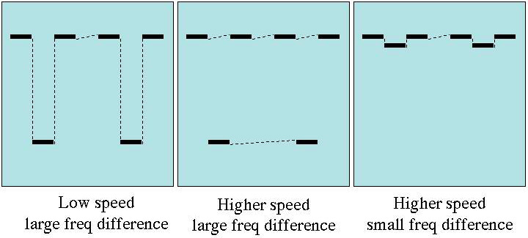
Effect of speed and frequency on stream segregation
(Bregman and Ahad, 1995, pp. 11-12, Track 3)
van Noorden (1975, 1977) used a “galloping” pattern consisting of two high tones with a lower tone in between (see above)
If middle note is similar enough in pitch and timbre to outer notes, then integrate into a single stream with a galloping rhythm
If middle note is different enough in pitch or timbre from outer notes, then splits into two streams, each with an isochronous rhythm
Different rhythms and melodies make it easy to tell whether you are hearing 1 or 2 streams
If keep frequency difference the same, then can split into two streams by increasing speed
  need higher speed for a smaller frequency difference

Slide 6
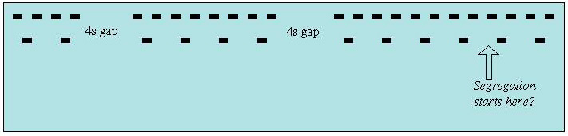
Effect of repetition on streaming
(Bregman and Ahad, 1995, p.13, Track 4)
Pattern only splits after you’ve heard a few repetitions
If we split a stimulus into multiple streams too easily, we would be too sensitive to changes and have an unstable perception of the auditory scene (Bregman, 1990, p.130)
We therefore have a “damped, lazy” response
We start out by assuming only one source and only add sources (streams) if there is enough evidence (e.g., lots of tones clustered into two different frequency regions)

Slide 7

Segregation of a melody from distractor tones
(Bregman and Ahad, 1995, pp. 14-15, Track 5)
Sequence constructed by interleaving tones of a familiar melody with random distractor tones (see above)
  first time you hear the sequence, each distractor tones is within 4 semitones of previous melody tone
  in second and subsequent times, distractor tones become further and further away from melody tones
Put your hand up when you first recognize the melody!
The melody becomes easier to recognize the further away the distractor tones are in pitch
Perceptual links between melody notes are stronger when distractor tones are in a different stream

Slide 8

Compound melody
In Baroque music (particularly on non-sustaining instruments like the harpsichord), common for a single instrument to play part that rapidly alternates between different pitch ranges
Part perceived to segregate into two streams (‘voices’)
Known as compound melody or virtual polyphony
Example above from Prelude in G major from Book 2 of Bach’s Das Wohltemperirte Klavier
  Right hand segregates into two isochronous streams
  Also see “fusion” between parallel tenor part and lower virtual part in compound right hand

Slide 9
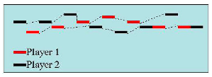
Streaming in African xylophone music
(Bregman and Ahad, 1995, pp. 15-16, Track 7)
Wegner (1990, 1993) identified some interesting instances of sequential integration and stream segregation in Ugandan amadinda music
Two players play a repeating cycle of notes, the notes of one player being interleaved with those of the other
The combined sequence is isochronous and each part is isochronous
But the combined sequence is heard to split into two streams that are not isochronous
Also the the two streams heard do not correspond to the separate parts played – each stream contains some notes from one part and some from the other

Slide 10
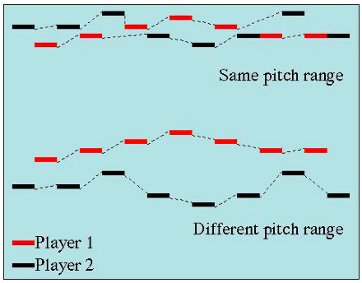
Segregating the two players’ parts in amadinda music
(Bregman and Ahad, 1995, p. 19, Track 8)
Can make each part in amadinda music separately audible by transposing one by an octave
This puts the two parts in separate streams

Slide 11
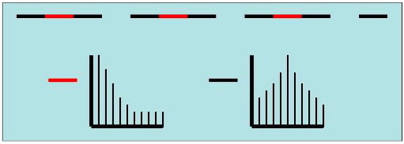
Stream segregation based on timbre difference
(Bregman and Ahad, 1995, p. 21, Track 10)
Stream segregation can also be induced by using tones with different timbre, but the same pitch
We assume tones with different timbres come from different sources, so tend to perceive them as belonging to different streams
Here, middle tone has different timbre from outer tones, so segregates into a different stream at a moderate speed (despite having same pitch)

Slide 12
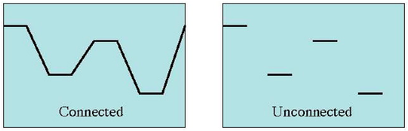
Effects of connectedness on segregation
(Bregman and Ahad, 1995, pp. 23-24, Track 12)
Gestalt principle of “good continuation” also seems to influence streaming
“Good continuation” says that we group elements that lie on a smooth curve
Bregman and Dannenbring (1973) showed that connecting tones with glissandi helps to integrate them into the same stream even if they are widely separated in pitch

Slide 13
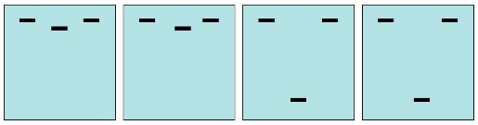
Effects of streaming on timing judgements
(Bregman and Ahad, 1995, pp. 25-26, Track 13)
Saw earlier that it is hard to perceive temporal relationships between tones in different streams
Here, galloping pattern has middle, lower tone temporally either exactly half-way between outer tones or slightly after half-way between the two outer tones
When frequency difference is small, all tones in one stream, so easy to hear whether middle tone is exactly half way between outer tones
When frequency difference is large, much harder to tell whether middle tone is exactly half-way between upper tones
Demonstration based on experiment by van Noorden (1975)

Slide 14
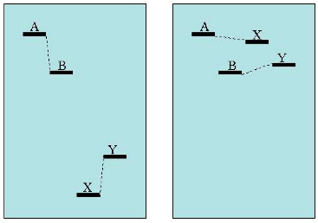
Dependence of streaming on context
(Bregman and Ahad, 1995, pp. 28-29, Track 15)
AB heard as being in the same stream if XY is far away in frequency
AB can be made to be in different streams by bringing XY closer to them in frequency
Can tell AB split into different streams because harder to hear AB in right-hand comparison than left-hand comparison
Based on experiment by Bregman (1978)

Slide 15
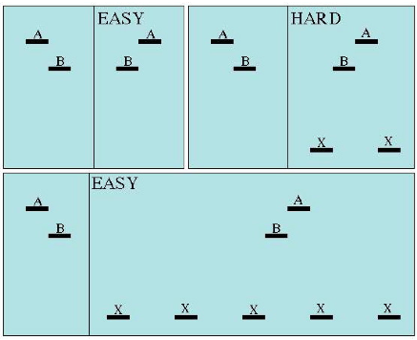
Releasing a two-tone target by capturing interfering tones
(Bregman and Ahad, 1995, pp. 29-30, Track 16)
Try to tell whether AB are in the same order in the comparison
Hard when comparison has just two flanking tones
Easy when comparison preceded by longer sequence of tones that capture flanking tones into a separate stream
Need several repetitions to hear Xs as being in a different stream from AB/BA

Slide 16
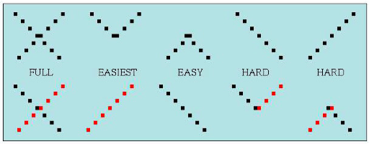
X-Patterns
(Bregman and Ahad, 1995, pp.31-32, Track 17)
X-pattern has two interleaved, crossing, isochronous tone sequences, one ascending and one descending
Remember if you can easily hear a standard in a comparison, this means the standard is in one stream in the comparison
Here, it is harder to hear a complete ascending or descending sequence than a “bouncing” percept
  implies integrate lower notes into one stream and upper notes into another stream
Can make full ascending or descending sequence easier to hear by giving them different timbres
Based on experiment by Tougas and Bregman (1985)

Slide 17
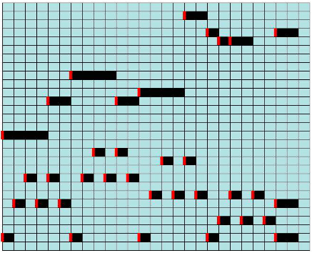
Temperley’s (2001) model of counterpoint
Takes a piano-roll input, quantized to beats at the lowest metrical level
Since also quantized in pitch domain, can represent as a grid of squares
Red bar indicates onset, notes of same pitch cannot overlap
Streaming done only using onset time, offset time and MIDI note number
Predicts voice to which each note belongs

Slide 18
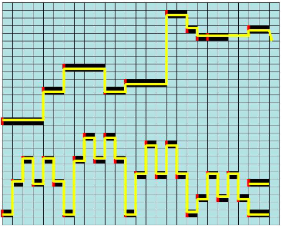
Temperley’s (2001) model of counterpoint:
4 well-formedness rules
CWFR 1: “A stream must consist of a set of temporally contiguous squares on the plane.” (p.97)
A stream doesn’t have to span a whole piece or movement

Slide 19
Temperley’s (2001) model of counterpoint:
4 well-formedness rules
CWFR 2: “A stream may be only one square wide in the pitch dimension.” (p.98)
Note that this means you cannot have a stream of fused chords!

Slide 20
Temperley’s (2001) model of counterpoint:
4 well-formedness rules
CWFR 3: “Streams may not cross in pitch.” (p.98)
Recall results on X-patterns
  We prefer to hear a bouncing percept not a crossing one
However, parts do sometimes cross, so maybe this should be a (strong) preference rule

Slide 21
Temperley’s (2001) model of counterpoint:
4 well-formedness rules
CWFR 4: “Each note must be entirely included in a single stream.” (p.99)
So not possible for part of a note to be in one stream and another part to be in a different stream
Though it is possible for a single note to be entirely in more than one stream

Slide 22
Temperley’s (2001) model of counterpoint:
4 preference rules
CPR 1 (Pitch proximity rule): “Prefer to avoid large leaps within streams.” (p.100)
As discussed earlier (van Noorden, 1975, 1977), large differences in frequency tend to segregate tones into different streams

Slide 23
Temperley’s (2001) model of counterpoint:
4 preference rules
CPR 2 (New stream rule): “Prefer to minimize the number of streams.” (p.101)
As discussed earlier, we begin by assuming 1 stream and need evidence before hearing two or more streams (Bregman 1990, p. 130)

Slide 24
Temperley’s (2001) model of counterpoint:
4 preference rules
CPR 3 (White square rule): “Prefer to minimize the number of white squares in streams.” (p.101)
Musical voices frequently contain rests, but if the rests are too long, the connection between the tones becomes very weak
Recall results of experiment with frequency glides connecting notes (Bregman and Dannenbring 1973)

Slide 25
Temperley’s (2001) model of counterpoint:
4 preference rules
CPR 4 (Collision rule): “Prefer to avoid cases where a single square is included in more than one stream.” (p.101)
This only happens rarely
Example is tone at crossing point in an X-pattern (Tougas and Bregman 1985)

Slide 26
References
Bregman, A. S. (1978). Auditory streaming: Competition among alternative organizations. Perception and Psychophysics, 23, 391–398.
Bregman, A. S. (1990). Auditory Scene Analysis: The Perceptual Organization of Sound. MIT Press, Cambridge, MA.
Bregman, A. S. and Ahad, P. A. (1995). Demonstrations of auditory scene analysis: The perceptual organization of sound. Audio CD.
Bregman, A. S. and Campbell, J. (1971). Primary auditory stream segregation and perception of order in rapid sequences of tones. Journal of Experimental Psychology, 89, 244–49.
Bregman, A. S. and Dannenbring, G. (1973). The effect of continuity on auditory stream segregation. Perception and Psychophysics, 13, 308–312.
Bregman, A. S. and Rudnicky, A. (1975). Auditory segregation: Stream or streams? Journal of Experimental Psychology: Human Perception and Performance, 1, 263–267.
Lerdahl, F. and Jackendoff, R. (1983). A Generative Theory of Tonal Music. MIT Press, Cambridge, MA.
Temperley, D. (2001). The Cognition of Basic Musical Structures. MIT Press, Cambridge, MA.
Tougas, Y. and Bregman, A. S. (1985). The crossing of auditory streams. Journal of Experimental Psychology: Human Perception and Performance, 11, 788–798.
van Noorden, L. P. A. S. (1975). Temporal coherence in the perception of tone sequences. Ph.D. thesis, Eindhoven University of Technology, Eindhoven, The Netherlands.
van Noorden, L. P. A. S. (1977). Minimum differences of level and frequency for perceptual fission of tone sequences abab. Journal of the Acoustical Society of America, 61, 1041–1045.
Wegner, U. (1990). Xylophonmusik aus Buganda (Ostafrika). Number 1 in Musikbogen: Wege zum Verständnis fremder Musikkulturen. Florian Noetzel Verlag, Wilhelmshaven. (Cassette and book).
Wegner, U. (1993). Cognitive aspects of amadinda xylophone music from Buganda: Inherent patterns reconsidered. Ethnomusicology, 37, 201–241.

