Slide 1

Metre
David Meredith
Aalborg University

Slide 2
Theories of musical metre
A theory of musical metre should be able to predict
  points in time when listeners tap their feet or clap in time to music
  periodicities of dance music and swaying movements made by performers
  where the bar lines are placed and what the key signatures are in a score
  how difficult various rhythms are to remember (Povel and Essens, 1985)

Slide 3

A little experiment
Listen to the melody and tap in time to it
  Try to do it so that your neighbour can’t see or hear what you’re doing!
  Tap with a regular beat, so that the taps are isochronous (equal periods between taps)
  On the third repetition of the melody, note whether you are tapping faster, slower or at the same rate as the drum and whether you are tapping in the same places as the drum

Slide 4
Two more little experiments
Now do the same thing again but tap in a way that is a little too fast for comfort, but still in time with the music
  again compare the drumbeats in the third repetition with the points at which you tap
Now do the same thing, but tap in a way that is a little too slow for comfort, but still in time with the music
  again compare with the drumbeats in the third repetition with the points at which you tap

Slide 5

Tapping experiment
For many passages, there is a “most natural speed” at which to tap, which we call the tactus (or, colloquially, the ‘beat’)
There are typically several different speeds at which one can tap in time to a passage of music
  indicated by three rows of dots above
  each row is called a metrical level

Slide 6
Tapping experiment
When you tap at a speed that is slower than the tactus, you just miss out some of the tactus beats
When you tap at a speed that is faster than the tactus, you include all the tactus beats and insert extra beats in between
So beats at higher (slower) metrical levels are ‘stronger’ than beats that only appear at lower (faster) metrical levels
The metrical strength of a beat can be represented by the number of dots underneath it in the diagram above

Slide 7
Tapping experiment
The metre or metrical structure of a passage is a structural description of the perceived strength of every beat in the passage
  represented by the three rows of dots in the diagram above
In many, unambiguous cases, people tend to agree about the most appropriate points at which to tap
But in ambiguous cases, there may be disagreement
We generally cannot describe exactly why we tap at any given time – it just “feels right”

Slide 8
Lerdahl and Jackendoff’s Generative Theory of Tonal Music (GTTM)
Four interacting modules
  Grouping structure: motives, themes, phrases, sections
  Metrical structure: “hierarchical pattern of beats”
  Time-span reduction: how some events elaborate or depend on other events
  Prolongational reduction: the “ebb-and-flow of tension”
Each module contains well-formedness rules and preference rules

Slide 9
Lerdahl and Jackendoff’s (1983) Metrical Well-Formedness Rules
“MWFR 1. Every attack point must be associated with a beat at the smallest metrical level present at that point in the piece” (pp. 72, 347)
“MWFR 2. Every beat at a given level must also be a beat at all smaller levels present at that point in the piece” (pp. 72, 347)
  cf. tapping experiment: do not miss out beats that would tap if tapping at a slower speed

Slide 10
Lerdahl and Jackendoff’s (1983) Metrical Well-Formedness Rules
“MWFR 3. At each metrical level, strong beats are spaced either two or three beats apart” (pp. 69, 347)
  only applies to certain styles of music
“MWFR 4. The tactus and immediately larger metrical levels must consist of beats equally spaced throughout the piece. At subtactus metrical levels, weak beats must be equally spaced between the surrounding strong beats.” (pp. 72, 347)
  Special case for subtactus levels to account for triplets, for example.

Slide 11

Lerdahl and Jackendoff’s (1983) Metrical Preference Rules
“MPR 1 (Parallelism) Where two or more groups or parts of groups can be construed as parallel, they preferably receive parallel metrical structure.” (pp. 75, 347)
  e.g., first and second two-bar phrases begin similarly, so we prefer to assign them parallel metrical structures (i.e., with the downbeat on the C5 crotchet)

Slide 12
Lerdahl and Jackendoff’s (1983) Metrical Preference Rules
“MPR 2 (Strong beat early) Weakly prefer a metrical structure in which the strongest beat in a group appears relatively early in the group.” (pp. 76, 347)
  Most pieces, sections and phrases begin either on a downbeat or with a short anacrusis
  MPRs 1 and 2 relate to grouping structure

Slide 13
Lerdahl and Jackendoff’s (1983) Metrical Preference Rules
“MPR 3 (Event) Prefer a metrical structure in which beats of level L_{i} that coincide with the inception of pitch-events are strong beats of L_{i} .” (pp. 76, 347)
  Avoid hearing syncopations as far as possible
  If strong beats occurred above on second and fourth quavers in each bar, then almost no strong beat would coincide with an event onset
  Applies only to certain styles (not African or rock music, for example)

Slide 14
Lerdahl and Jackendoff’s (1983) Metrical Preference Rules
“MPR 4 (Stress) Prefer a metrical structure in which beats of level L_{i} that are stressed are strong beats of L_{i} .” (pp. 79, 347)
  Loudness is a cue to metrical strength
  But can perceive metre easily without loudness cues – as shown in this example!

Slide 15
Lerdahl and Jackendoff’s (1983) Metrical Preference Rules
“MPR 5 (Length) Prefer a metrical structure in which a relatively strong beat occurs at the inception of either
  a relatively long pitch-event,
  a relatively long duration of a dynamic,
  a relatively long slur,
  a relatively long pattern of articulation
  a relatively long duration of a pitch in the relevant levels of the time-span reduction, or
  a relatively long duration of a harmony in the relevant levels of the time-span reduction (harmonic rhythm).” (pp. 84, 348)
MPR 5 can conflict with MPR 4 if there is a quiet long note alternating with a loud short note
  MPR 4 acting alone or MPR 5b?
  MPR 4 conflicting with MPR 5a?

Slide 16

Lerdahl and Jackendoff’s (1983) Metrical Preference Rules
“MPR 6 (Bass) Prefer a metrically stable bass.” (pp. 88, 348)
  intensifies effect of other MPRs when they apply to the bass
“MPR 7 (Cadence) Strongly prefer a metrical structure in which cadences are metrically stable; that is, strongly avoid violations of local preference rules within cadences.” (pp. 88, 348)
  How do we identify cadences? How determine if it is a “masculine” ending (weak-to-strong) or a “feminine” ending (strong-to-weak)?
  In example above, cadence is only point of metrical stability (from Beethoven, Piano Sonata, Op. 110)

Slide 17
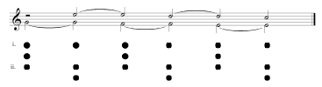
Lerdahl and Jackendoff’s (1983) Metrical Preference Rules
“MPR 8 (Suspension) Strongly prefer a metrical structure in which a suspension is on a stronger beat than its resolution.” (pp. 89, 348)
  Listen to suspension above and decide which of the two interpretations sounds more natural
  MPR 8 predicts the first version is more natural (reinforced by MPR 6)

Slide 18
Lerdahl and Jackendoff’s (1983) Theory of Metrical Structure
Summary
Lerdahl and Jackendoff provide a fairly complete theory of metrical structure perception
Adopt a preference rule system architecture consisting of “well-formedness rules” and “preference rules”
Do not propose any weighting of the rules to resolve rule conflicts
There are circular dependencies between the modules in Lerdahl and Jackendoff’s theory
Nevertheless, theory has been implemented as computer programs (e.g., Temperley, 2001; Hamanaka et al. 2005)

Slide 19
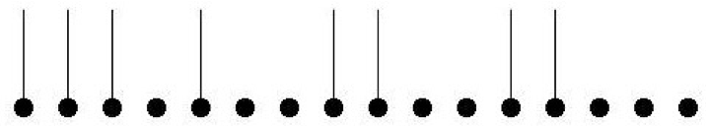
Povel and Essens’ (1985) theory of temporal pattern perception
Easy to tap in time to a passage of music and most people agree on where to tap
Povel and Essens (1985) propose that when we hear a repeated rhythmic pattern, an internal clock is induced which ‘ticks’ in time with the stimulus
Povel and Essens investigated this by playing subjects repeated tone patterns in which each tone has the same duration, pitch, timbre and loudness
Some of the tones sound accented even though they are all identical
Listen to the pattern above and make note of which tones sound accented

Slide 20
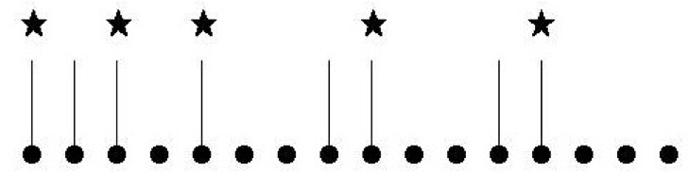
Povel and Essens’ (1985) theory of temporal pattern perception
Predict that a tone sounds accented if
  it is relatively isolated
  it is the second tone in a cluster of two tones
  it is the first or last tone in a cluster of three or more tones
Predicts pattern of accents above
Can algorithmically predict perceived beat from pattern of accents

Slide 21
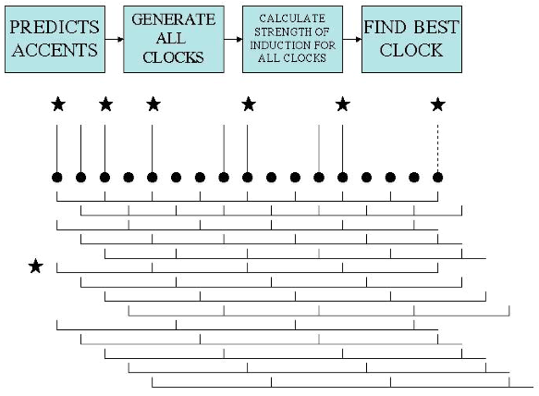
Povel and Essens’ (1985) model
First predict accented tones using 3 rules
Generate all clocks with period < half length of pattern
Every onset time is a multiple of 200ms
Calculate degree of implication of each clock
Strongest clock is one with fewest ticks coinciding with gaps or unaccented notes

Slide 22
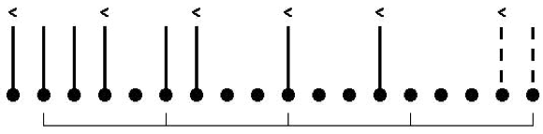
A pattern that doesn’t strongly induce any clock
Some rhythmic sequences do not induce any clock strongly because there is no clock for which many ticks coincide with accented notes
Accents shown above beats
Best clock shown by brackets below

Slide 23
Povel and Essens’ first experiment
Hypothesis: Patterns that more strongly induce an internal clock are easier to learn and more accurately reproduced
Subjects had to reproduce a pattern after listening to it as often as they liked
Measured how many times subjects had to listen to a pattern and how accurately they reproduced it
Significant correlation between strength of clock induction and ease with which patterns were learnt
Found patterns not inducing any clock were the most difficult to learn
  These patterns were encoded figurally
    Inter-beat intervals categorised simply as long or short
  Contrasts with durational coding which is where events are perceptually ‘attached’ to clock ticks

Slide 24
Povel and Essens’ second experiment
Subjects had to reproduce pattern after hearing it accompanied by a bass tone on the ticks of the strongest clock
Addition of bass tone on clock tick aided learning and reproduction
Suggests that rhythm is encoded cognitively in terms of a clock

Slide 25
Povel and Essens’ third experiment
Listen to the two sequences above and decide whether or not the upper parts are the same

Slide 26
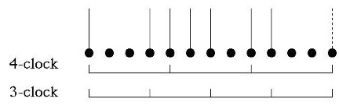
Povel and Essens’ third experiment
9 out of 10 people unable to recognize that the upper parts are the same when the bass clock is different
Suggests that way that seqence is encoded depends on clock that is induced

Slide 27
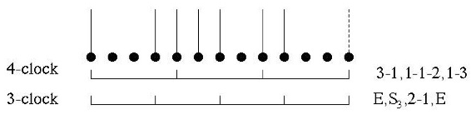
Povel and Essens’ (1985) encoding system
Povel and Essens propose an encoding system
  If a clock unit is subdivided into equal parts, then encoded as S_{n} where n is the number of parts
  An empty clock unit is encoded as E
  Unequally divided clock tick encoded as ratio of lengths of parts
Diagram shows how same sequence encoded using different clocks
  More efficient encoding with 3-clock than 4-clock
Hypothesize that sequence sounds simpler when accompanied by clock that allows for shorter encoding
  Results of P&E’s third experiment support this

Slide 28
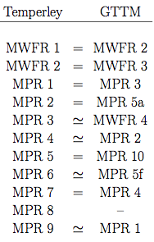
Temperley’s (2001) theory of metrical structure
Most rules borrowed from GTTM metre module (see left)
Temperley’s model can process performed, polyphonic music
Temperley converts L&J’s MWFR 4 into a preference rule (Temperley’s MPR 3)
  beats should be “maximally evenly spaced”
Only rules 1-5 implemented in Melisma program
Predicted correct tactus in 85% of performed cases and 90% of quantized cases in small corpus of 46 excerpts from Kostka and Payne (1995a, 1995b)
See Meredith (2002)

Slide 29
References
Hamanaka, M., Hirata, K. & Tojo, S. (2005). ATTA: Automatic time-span tree analyzer based on extended GTTM. Proceedings of the Sixth International Conference on Music Information Retrieval (ISMIR 2005), London. pp. 358—365. http://ismir2005.ismir.net/proceedings/1015.pdf
Kostka, S. & Payne, D. (1995a). Tonal Harmony. New York: McGraw-Hill.
Kostka, S. & Payne, D. (1995b). Workbook for Tonal Harmony. New York: McGraw-Hill.
Lerdahl, F. and Jackendoff, R. (1983). A Generative Theory of Tonal Music. MIT Press, Cambridge, MA.
Meredith, D. (2002). Review of David Temperley’s The Cognition of Basic Musical Structures (Cambridge, MA: MIT Press, 2001). Musicae Scientiae, Vol.6, No.2, pp. 287-302.
Povel, D.-J. and Essens, P. (1985). Perception of temporal patterns. Music Perception, Vol.2, pp. 411–440.
Temperley, D. (2001). The Cognition of Basic Musical Structures. MIT Press, Cambridge, MA.

