Slide 1
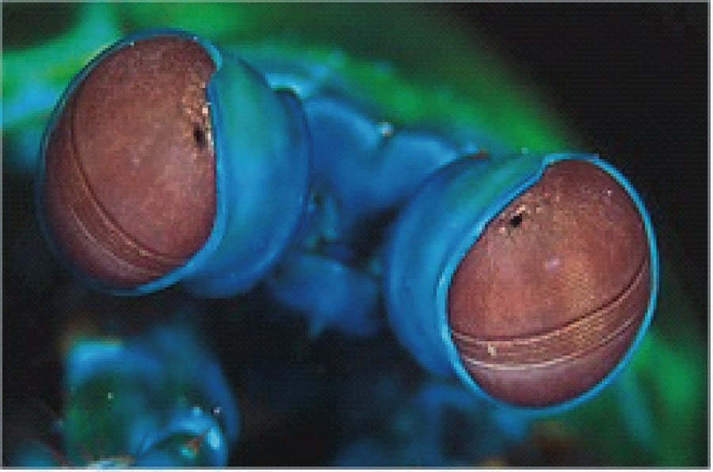
Colour Vision
David Meredith
Aalborg University
dave@create.aau.dk

Slide 2
Source
This lecture is based on Chapter 5 of
  Snowden, R., Thompson, P. and Troscianko, T. (2006). Basic Vision: An Introduction to Visual Perception. OUP. ISBN: 978-0-19-928670-6.

Slide 3
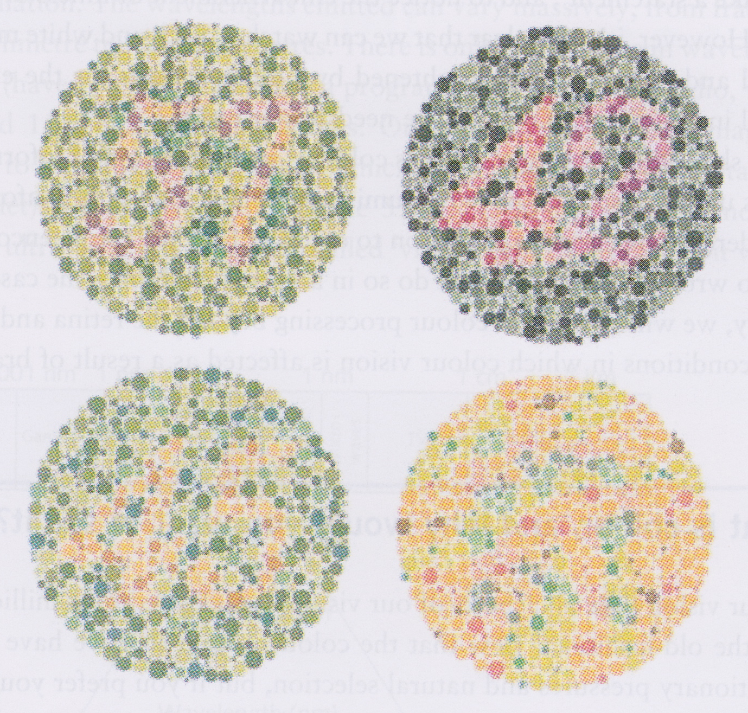
Ishihara plates
57, 42, 45, nothing = “normal”
35, 2, nothing, 73 = protanopes (no red cones)
35, 4, nothing, 73 = deutranopes (no green cones)
Invented by Dr. Shinobu Ishihara in 1917
Full test involves 38 different plates
NB: This reproduction should not be used as a formal test for colour-blindness!!

Slide 4
Overview
Many of the colours seen by humans are not seen by other animals
Other animals see colours that we do not see
Why do some animals have colour vision?
Why does our colour vision differ from that of other animals?
Some primates (incl. humans) have two colour vision systems
  one shared with lots of other mammals
  one shared only with some other primates

Slide 5

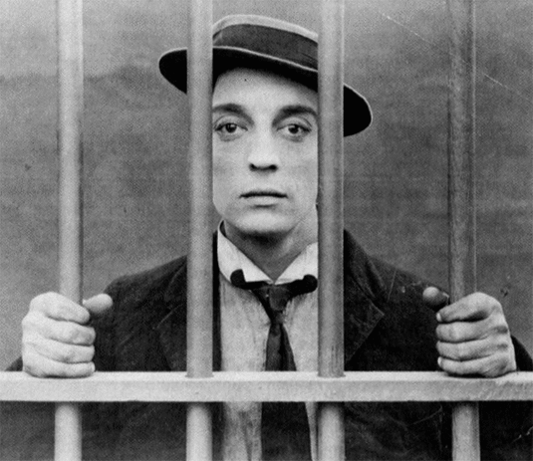

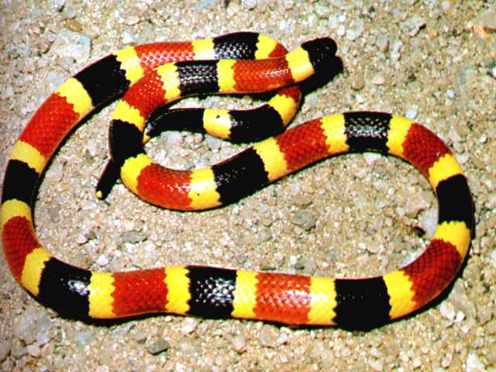
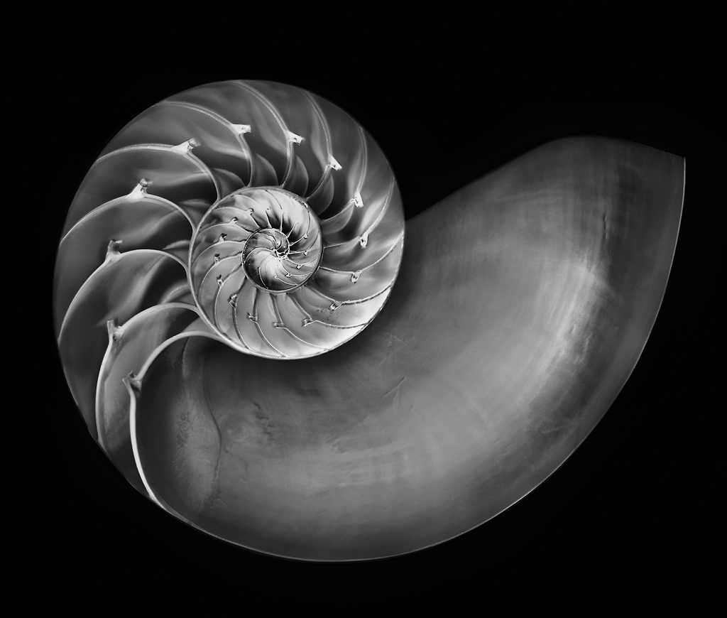
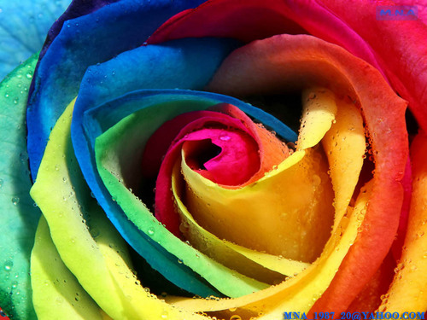
Introduction
Colour used to signal danger and attract attention
Colour indicates illness or embarrassment
But can enjoy a black and white movie or photograph
What do we use colour information for?
What advantage does colour vision give over the simple detection of luminance levels
How does the retina encode colour and what causes colour blindness?
How is colour information in the brain?

Slide 6
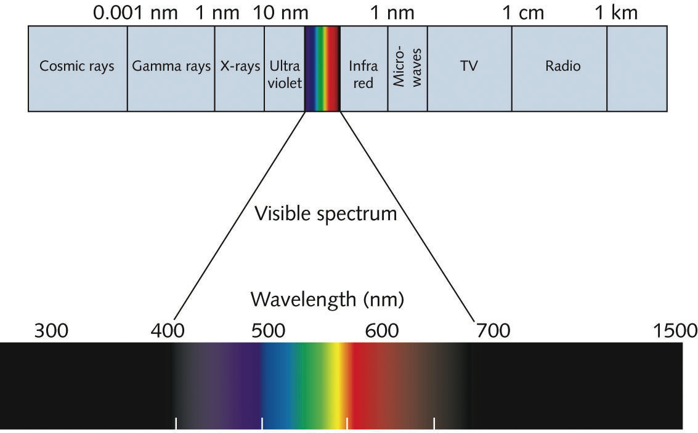
The nature of light
Visible light is only one small segment of the electromagnetic spectrum
  from 400-700nm wavelength
EM waves vary enormously in wavelength
    Long-wave radio waves can have a wavelength of 1500m
    X-rays have wavelengths down to about 0.000000001m
Microwaves can be used to heat up your lunch
Ultra-violet waves can be used to give you a tan

Slide 7
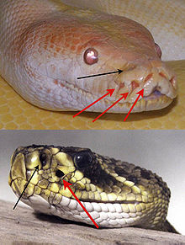
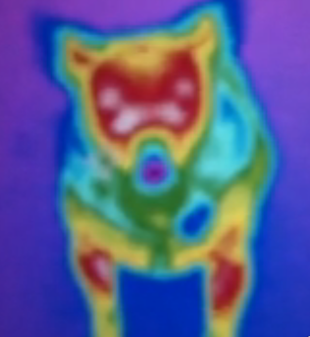
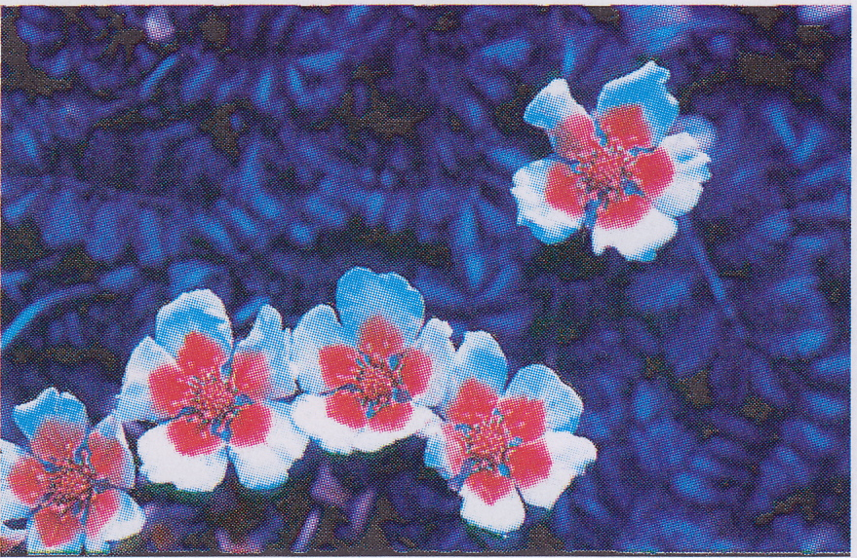
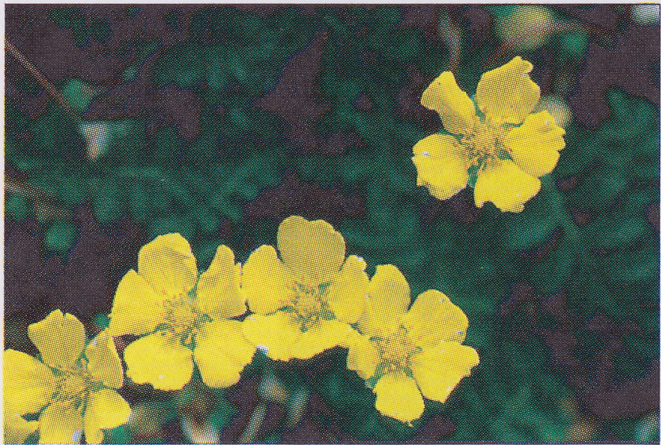
The “Visible Spectrum”
The “Visible Spectrum” (400-700nm) is not visible to all species
Snakes “see” infrared light produced by warm furry bodies
  They do this with their pit organs
Some birds and insects see ultra-violet
  top-right=UV, bottom-right=normal light: note different patterns!

Slide 8
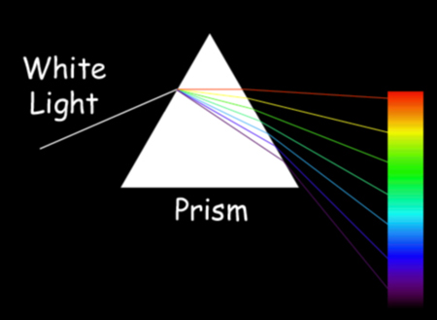
White light is a mixture of light at many wavelengths
White light contains light at many different visible frequencies (and therefore wavelengths)
Different wavelengths are refracted by different amounts when they travel from air into glass
So when they come out of the glass, they are going in different directions
The prism separates the light at different frequencies in the white light
The light itself is not coloured – EM waves of different frequencies produce different sensations when they hit our retinas

Slide 9
Colour vision in different animals
Every colour we can see can be formed by mixing red, green and blue in different quantities
  This is because we only have 3 different types of cone
You don’t need colour visions if
  you don’t have a complex central nervous system to deal with all the information (e.g., earthworm, limpet)
  you are nocturnal and so need high sensitivity (e.g., cat, bat)
  you live in a colourless environment (e.g., the bottom of the sea)
The mantis shrimp has 10 different types of cone whereas we only have 3. But it has poor ability to distinguish between different shapes. So it tells what something is by its colour, not its shape!

Slide 10
Colour vision in animals
Only some primates have vision like we do
Other mammals and some primates have two types of receptor: “yellow” cones and blue cones
  Cannot distinguish red from green very well
  Thus a bull should react the same to a green rag as it does to a red rag!
Many other animals have colour vision
  Insects, birds, fish and crustaceans (e.g., shrimps)

Slide 11
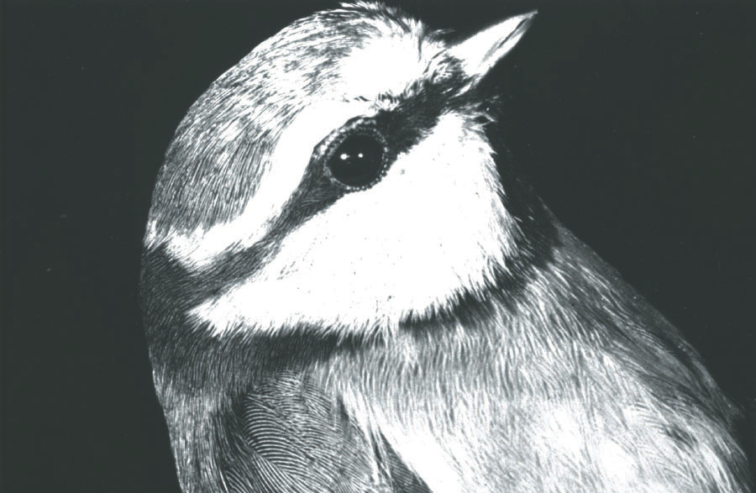
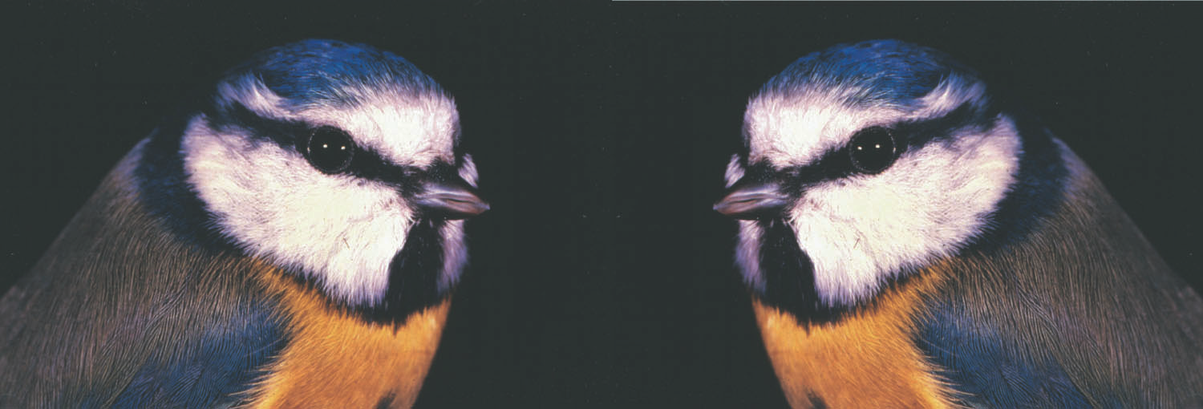
Ultraviolet vision in animals
Insects and birds often have a set of cones that respond best to UV light (which is invisible to us)
  Insects co-evolved with flowers, so many flowers have patterns that are only visible in UV light
  Some birds have patterns that visible in UV light

Slide 12
Infra-red vision
Snakes “see” IR radiation with their pit organs
We feel IR only as heat
Seeing IR would be very useful – particularly in the dark
  Hence the invention of infra-red night-vision goggles and cameras
Grass reflects a lot of green light (around 560nm)
Grass reflects even more IR light
If you walk on grass, you crush the cells and the water leaks out
  Water absorbs IR light, so if you look at grass with night-vision goggles, you can see if someone has walked on it!

Slide 13
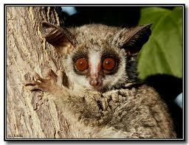
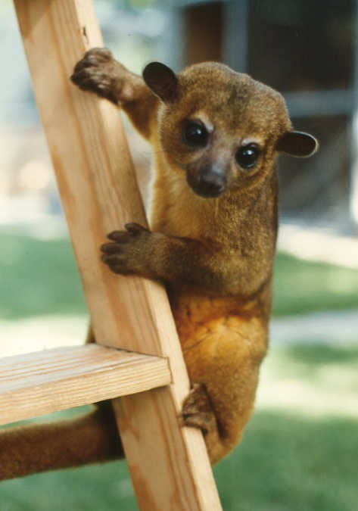
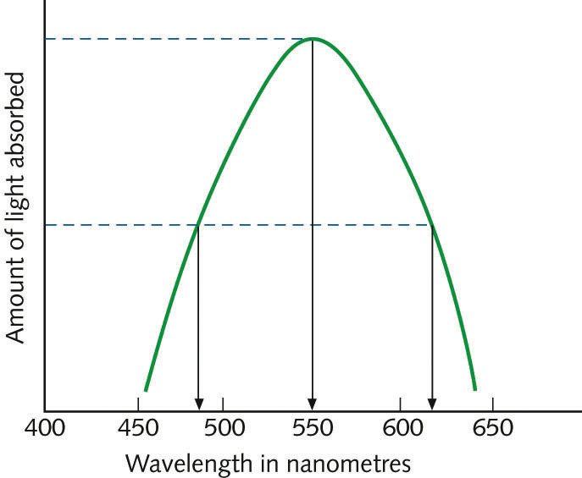
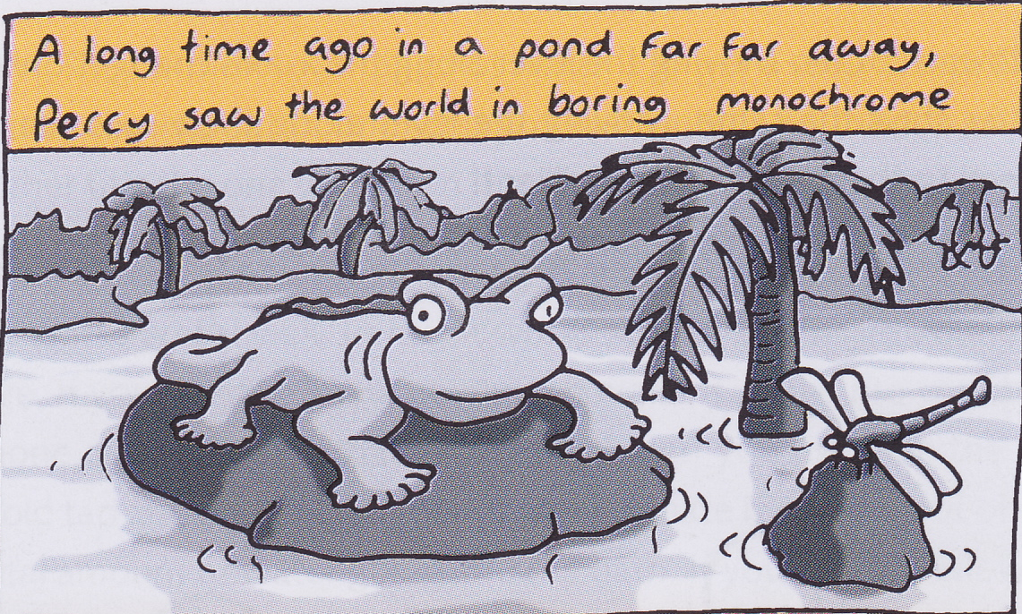
A single-cone system:
Monochromatic vision
The most primitive form of vision is monochromatic vision which uses only one type of cone that is tuned to a particular frequency of light
Most of what we look at is green (or at least it used to be) so our single type of photoreceptor should probably be tuned to 550-560nm, the frequency of most of the light reflected by chlorophyll
Monochromatic vision suffers from the principle of univariance
  For any two light beams with different frequencies within the range of response of the photoreceptor, it is possible to adjust their intensities so that they cause the receptor to fire at the same rate
Some nocturnal mammals have single-cone, monochromatic vision
  e.g., bushbabies, raccoons, kinkajous, whales, seals

Slide 14
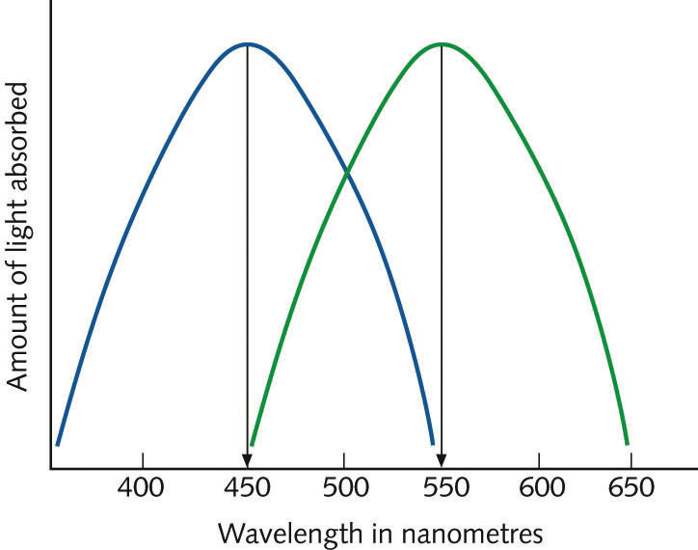
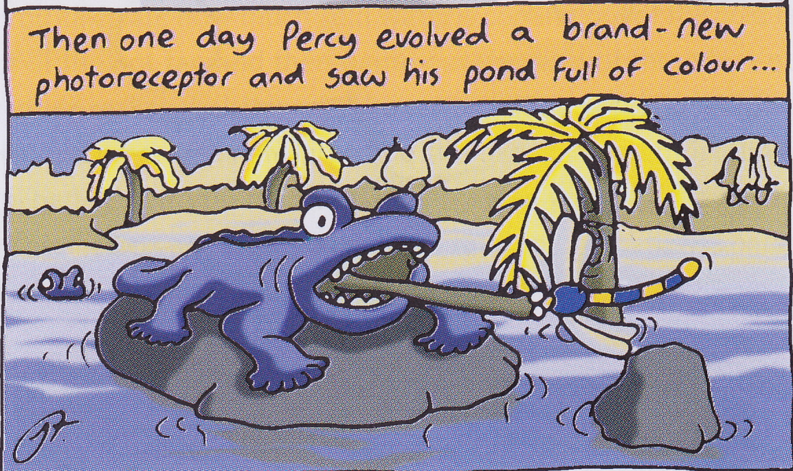
A two-cone system:
Dichromatic vision
Suppose we have two types of cone, one type tuned to 550nm and the other tuned to a higher frequency (i.e., longer wavelength) of 450nm
We can now distinguish more colours because our brains are given a distribution of excitation over two types of cone
  e.g., we can now distinguish wavelengths of 500nm from those of 600nm because the 500nm waves also stimulate the blue cones, but the 600nm waves do not
We can now tell the sky from the ground
Nearly all mammals have two-cone, dichromatic vision
  e.g., cats, dogs, cows
Having two types of cone means having fewer cones of one type, which means reducing visual acuity
Acuity is determined by the maximum number of cones of a single type per square degree of field

Slide 15
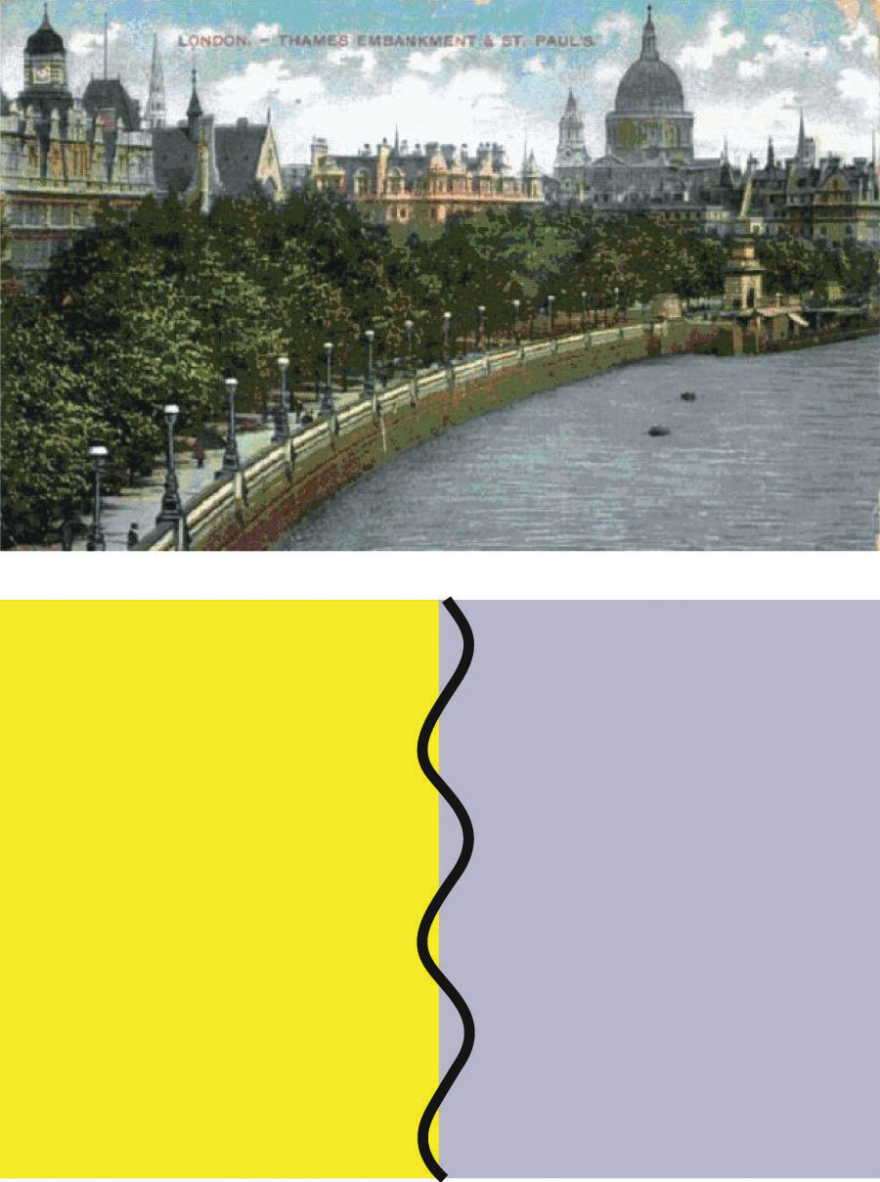
Retaining acuity while adding colour
Can retain acuity but add colour by only introducing a few cones of the second type
  e.g., lots of yellow cones for acuity, plus a few blue cones so that we get more colour resolution
Have only the more frequent type of cone in the fovea to get the maximum acuity in the centre
Short-wave light (blue and shorter) is actually always slightly out of focus
  This is called chromatic aberration
So it doesn’t matter too much if we don’t have high acuity for blue light
Having some colour vision allows distinction between, e.g., different types of plant (useful if one type is poisonous)

Slide 16
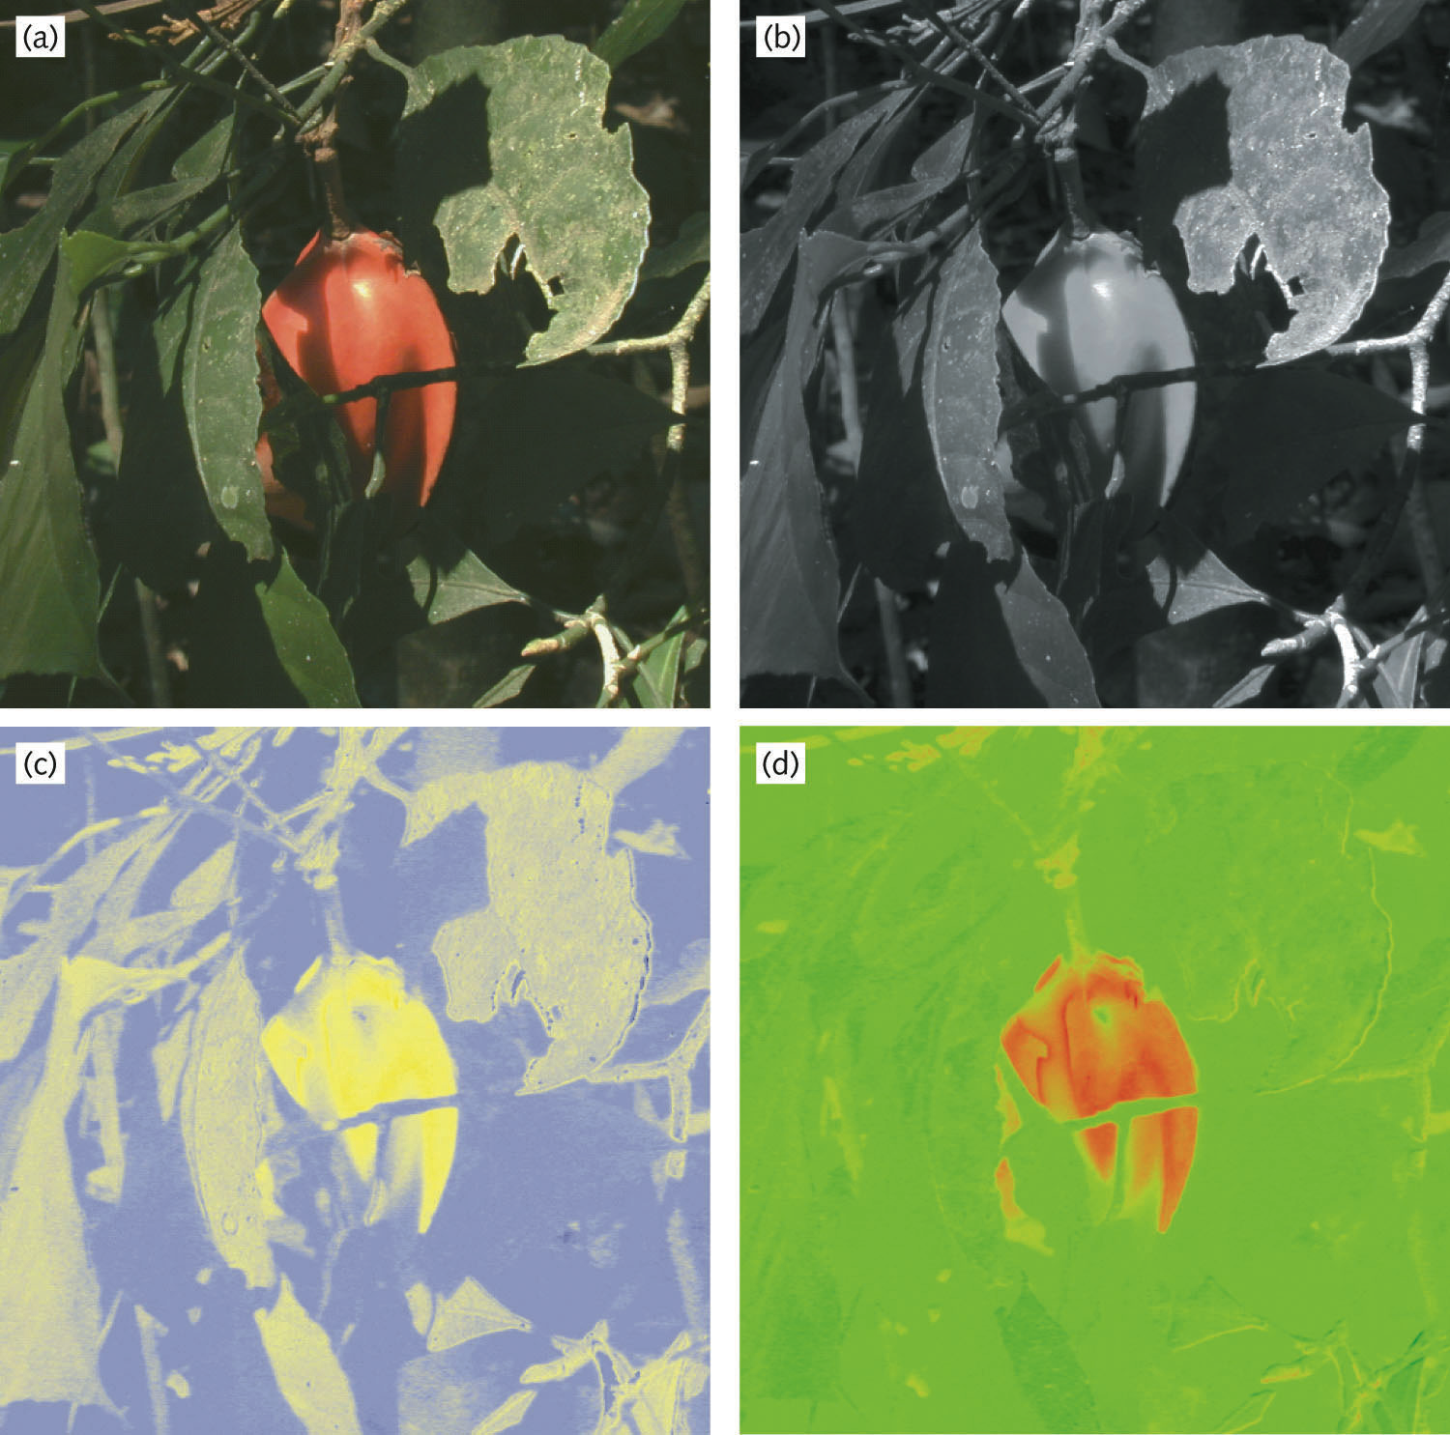
A three-cone system:
Trichromatic vision
If we were to add a third cone, what wavelength should it be tuned to?
Identifying ripe red fruit against leaves in bright sunlight is hard if you only have only 1 type of cone (b) or only yellow and blue cones (c)
Seeing the fruit is easy if you have red-green trichromatic vision
Red-green trichromatic vision comes from replacing yellow cones with a mixture of red cones and green cones
Red-green trichromatic vision also removes “dappled” nature of foliage so that we can see it all as being green and therefore the same stuff (compare c and d)

Slide 17
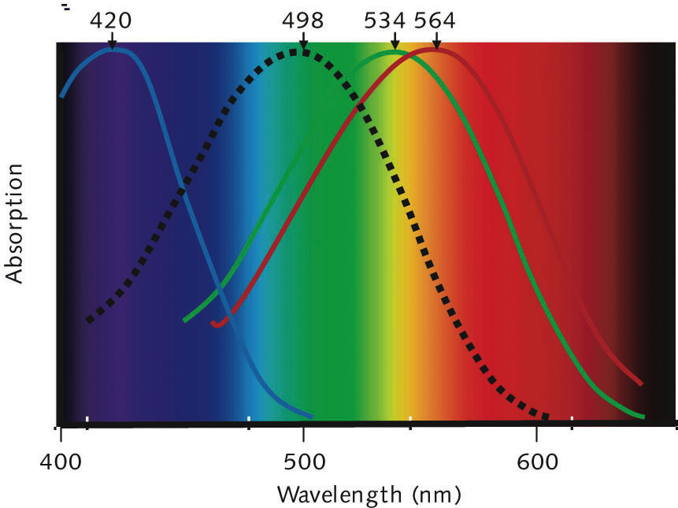
Trichromatic vision system
Turn dichromatic into trichromatic by replacing yellow cones (560nm) with two new types of cone, one slightly longer (“red” cones) and one slightly shorter (“green” cones)
Happened about 30-40 million years ago
Only humans and some other primates have such trichromacy
Many animals (but not mammals) have more than three cone types
  birds commonly have 4 (including a UV cone type)
  some shrimps have 10 or more types of cone
Absorption characteristics of human cones and rods. Note how close red and green cones are to each other. This is evidence that they evolved from a single type of cone. Rods are given by the dotted line.

Slide 18
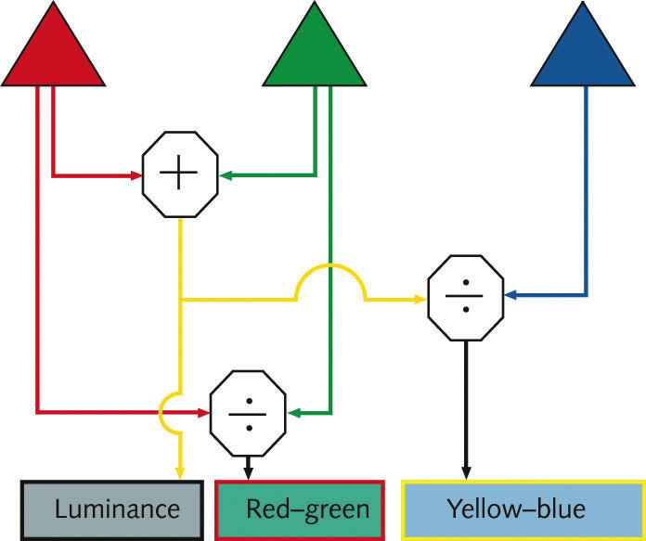
Colour opponency
Signals from red and green cones added to give an encoding of luminance (brightness)
Signals from red and green cones compared (÷) to give % of light that is red and % of light that is green
Combined signal from red and green cones compared with signal from blue cones to give % of light that is yellow and % of light that is blue
If increase overall brightness, then proportions of different colours stay the same, so perceived colour stays the same, but luminance increases
If we change frequency without changing brightness, then luminance stays the same (roughly – blue cone signal is ignored), but Red-Green and/or Yellow-Blue signals change producing change in perceived colour
Luminance encodes brightness. Colour encoded as ratios of red to green and yellow to blue (opponent coding).

Slide 19
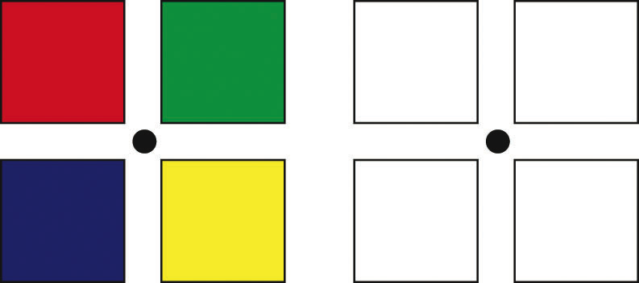
Colour after-effect

Slide 20
Colour after-effect
After adaptation:
  Top-left should be green
  Top-right should be red
  Bottom-left should be yellow
  Bottom-right should be blue
Adaptation to a particular colour reduces sensitivity to that colour and swings each opponent channel towards its opposite

Slide 21
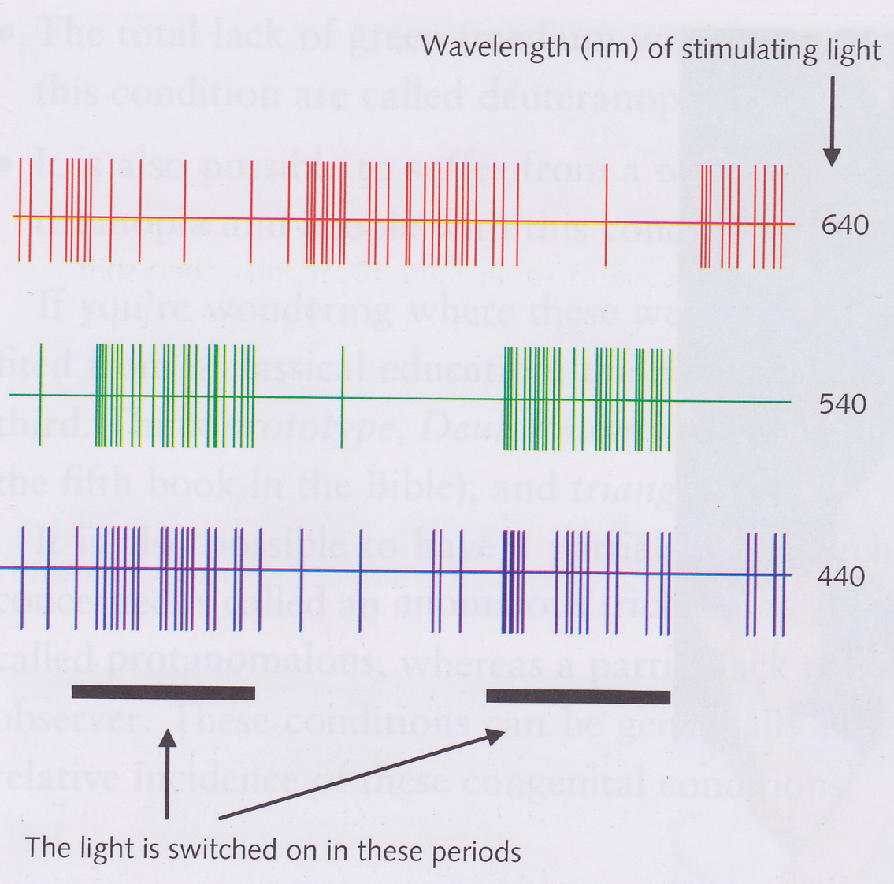
Colour-opponent cells
Colour-opponency suggests there are cells that are excited by the G cones and inhibited by the R cones (G+/R- cells)
Should also be B+/Y-, B-/Y+ and G-/R+ cells
Such cells have been found in many animals
Figure shows response of macaque LGN P-cell
  P-cells code for colour
B/Y signal probably has its own special pathway via the K-cells
  the koniocellular pathway

Slide 22
Two colour vision systems!
We seem to have two vision systems:
  a very old, dichromatic one based on blue/yellow comparison which we share with most other mammals
  a much newer system in which the red is compared with green that helps with identifying ripe fruit
There are monkeys in the rainforest that eat a particular type of yellow fruit and have red and green cones that are optimally tuned for the distinguishing these fruit from the background foliage
Swapping yellow cones for red and green ones also helps with shadow removal

Slide 23
Colour “blindness”
If you have all three types of cone, then you are a trichromat
If you lack one type of cone, you can still distinguish many colours that differentially stimulate your remaining two types of cone
  in this case you are a dichromat
Protanopia is the total lack of red cones
Deuteranopia is the total lack of green cones
Tritanopia is the total lack of blue cones
If you only partially lack a particular type of cone, then you are an anomalous trichromat and you are
  protanomalous if you partially lack red cones
  deuteranomalous if you partially lack green cones

Slide 24
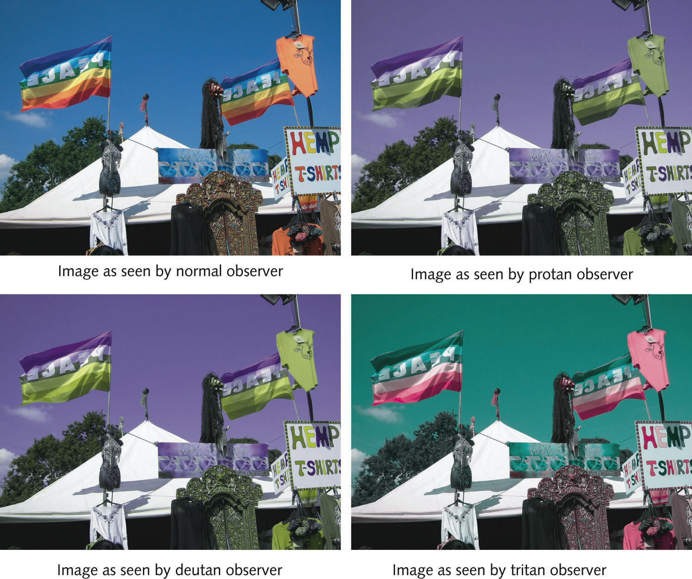
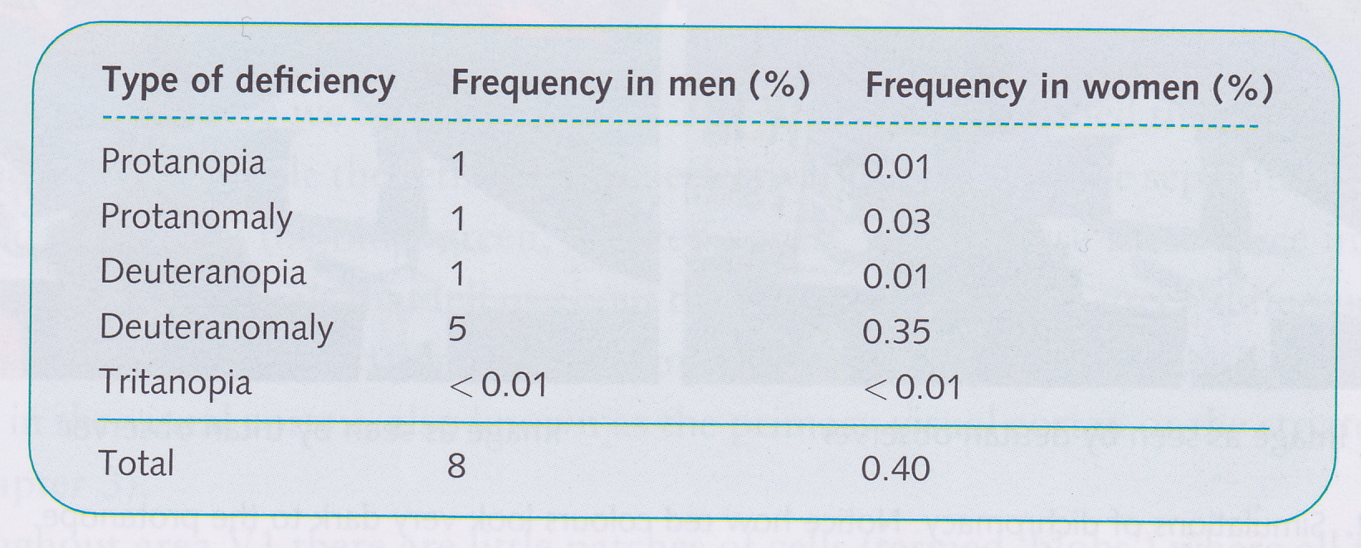
Colour “blindness”
Congenital colour defects are much more common in men than women (almost 8% of men have a colour defect)
Tritanopia can arise due to disease (e.g., diabetes)

Slide 25
Colour in the cortex
R/G signal sent to LGN P-cells
B/Y signal sent to LGN K-cells
In V1 there are “blobs” of cells that are sensitive to colour, surrounded by cells that are indifferent to colour
These V1 colour cells convey information to V4
In V4, possible that most cells are selective to particular colours
  These cells seem to respond to colour not frequency

Slide 26
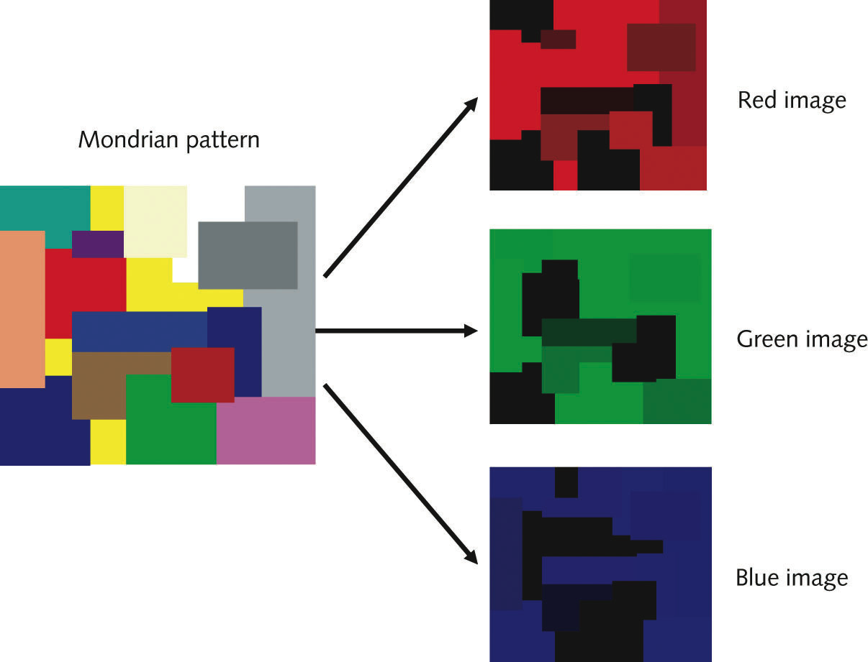
Colour constancy
The frequencies in the light that reflects off an object depend on the frequencies in the light that hits it
But the colour of an object doesn’t change much when the light that hits it changes colour!
  My blue jumper still looks blue at sunset when there is only low-frequency (reddish) light hitting it

Slide 27
Colour constancy
Edwin Land did an experiment with Mondrian patterns made of many overlapping patches of different colours
If you look at one patch and change lighting conditions, then colour of patch seems to change
But if you look at the whole pattern and change the lighting conditions, the colour of the same patch does not change
Seems we can infer the lighting from the effect that it has on lots of different colours and then compensate to figure out the “real” colour of the object
But with a single isolated patch, we have nothing to compare it with, so we can’t compensate

Slide 28
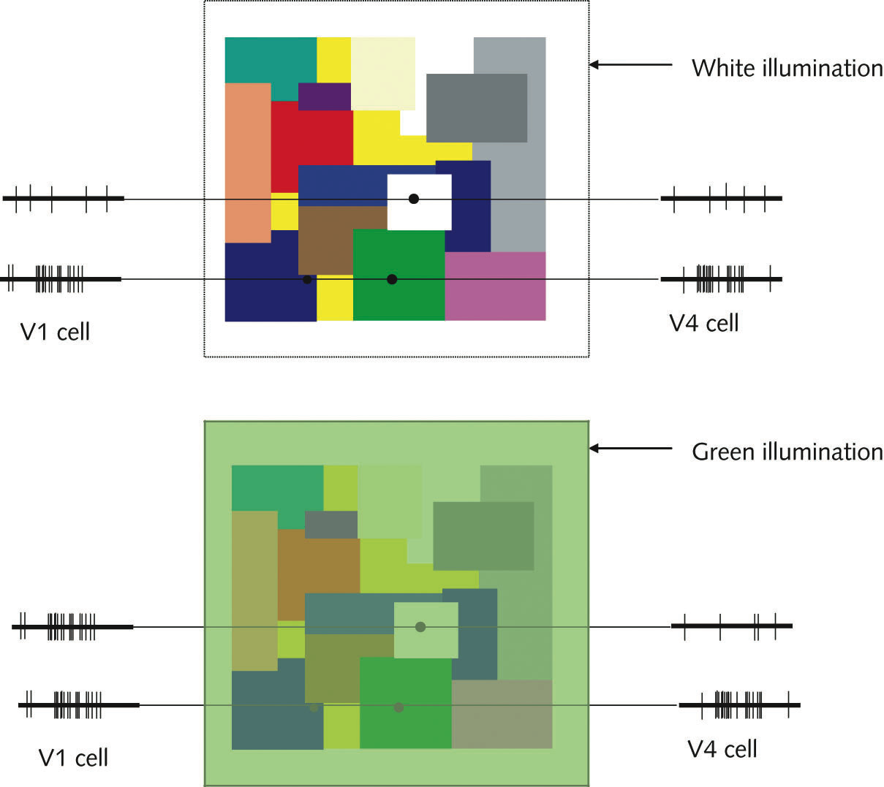
Colour constancy in V4
V1 cell tuned for green light is excited by a white patch illuminated with green light
V4 cell tuned for green colour is not

