Slide 1
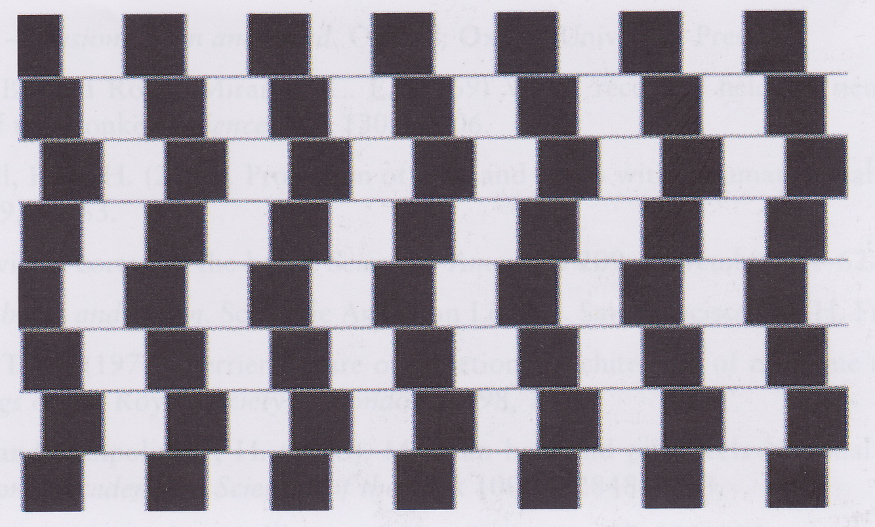
Spatial Vision
David Meredith
Aalborg University
dave@create.aau.dk

Slide 2
Source
This lecture is based on Chapter 4 of
  Snowden, R., Thompson, P. and Troscianko, T. (2006). Basic Vision: An Introduction to Visual Perception. OUP. ISBN: 978-0-19-928670-6.

Slide 3
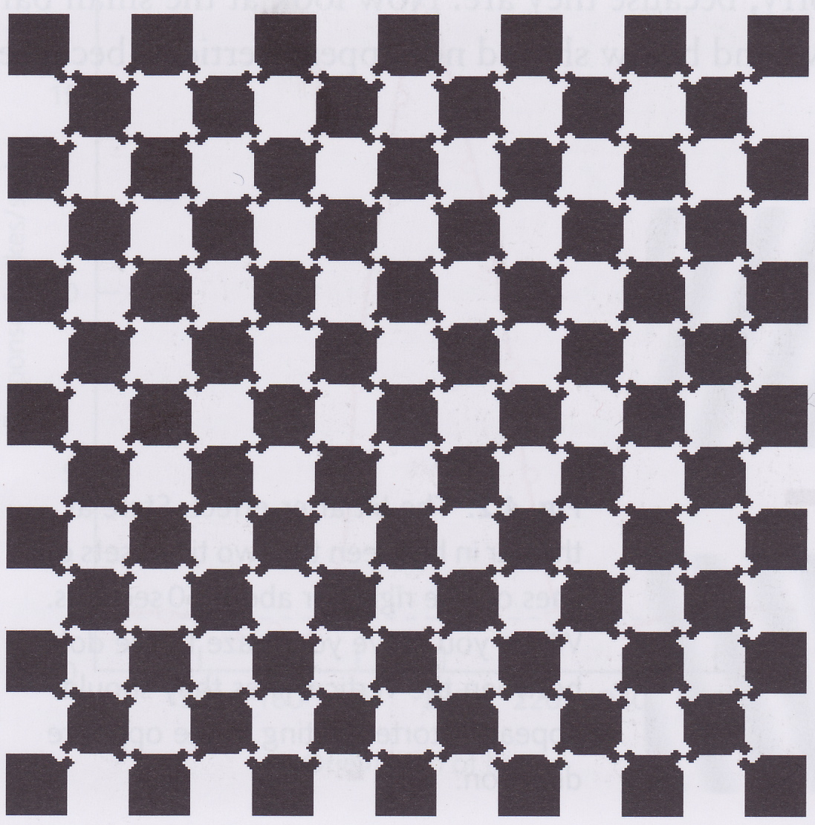
Overview
Most experiments on vision have been carried out on animals – can we be sure that human vision works in the same way?
At left, we see an orderly array of black and white blocks, but this isn’t what it looks like
Focus in this lecture is on how humans see objects
  size, position, orientation
How do we see objects when our heads can be tilted and we can be at any distance from what we are looking at?
Vision is an active process – our brains construct an interpretation of what we see
Sometimes we construct the wrong interpretation

Slide 4
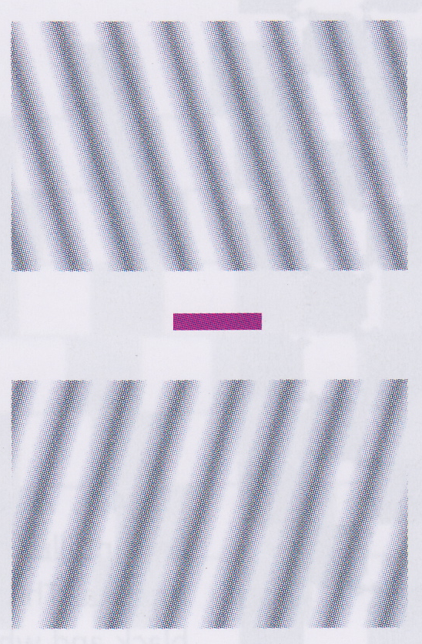
The Tilt After-Effect
Stare at the pink bar for about a minute

Slide 5
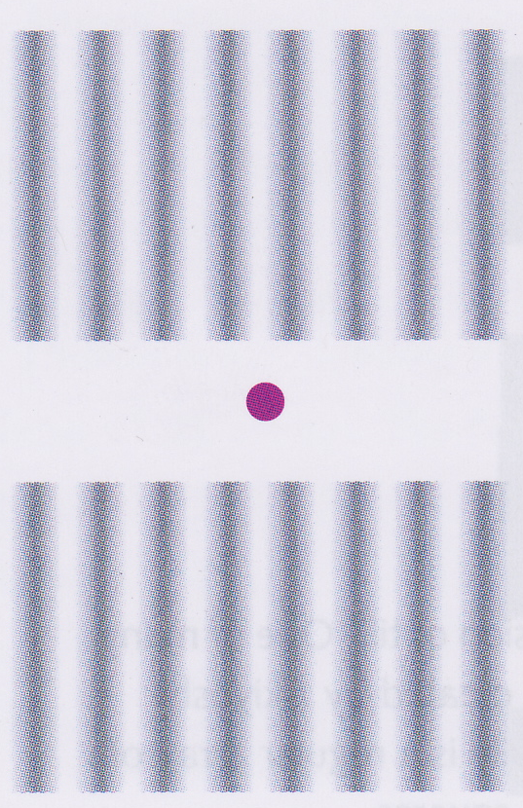
The Tilt After-Effect
Now look at the pink dot
What do you see?

Slide 6
The Tilt After-Effect
Bars at top will look tilted clockwise and bars at bottom look tilted anticlockwise
This is the tilt after-effect
Evidence that we have orientation-specific neurons that work like those discovered in cats and monkeys

Slide 7
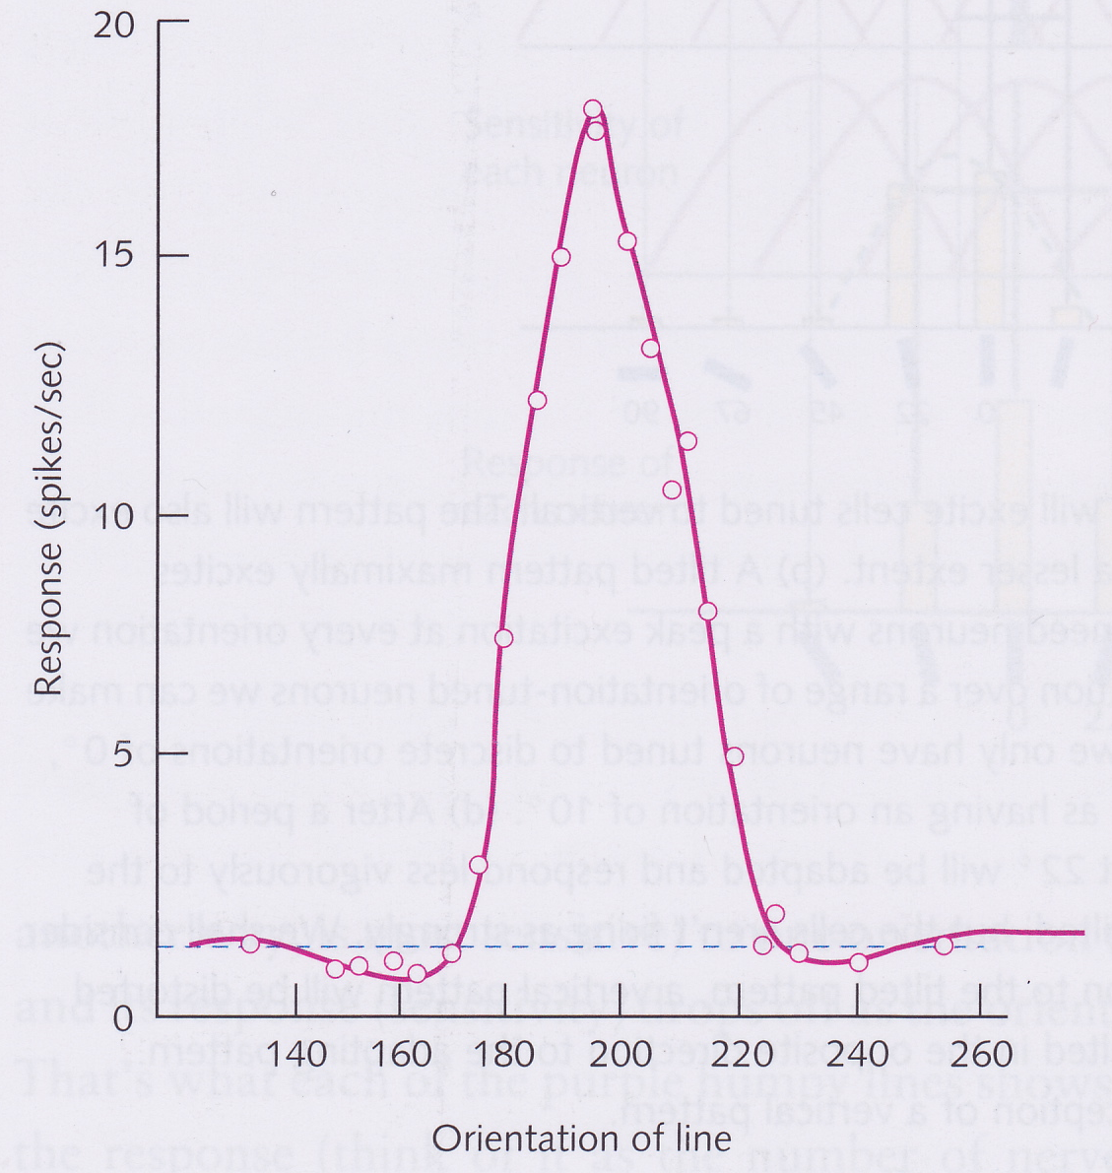
Neural explanation of tilt after-effect
Hubel and Wiesel showed there were V1 cells that respond to lines with a particular orientation, or tilt
Each cell is tuned to a particular orientation that it responds most strongly to
But it also has a non-zero bandwidth so that it also responds to lines tilted at other angles close to that which causes the maximal response

Slide 8
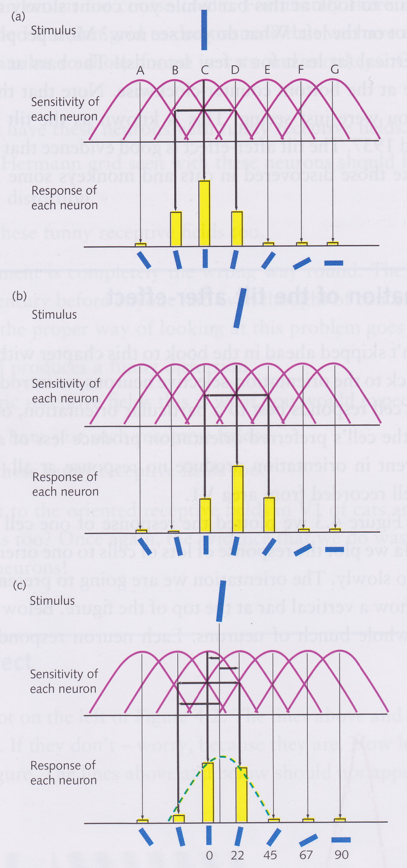
Neural explanation of tilt after-effect
Vertical line excites cell tuned to a vertical line, but also, to a lesser extent, cells tuned to neighbouring orientations
Tilted line maximally excites neurons tuned to its degree of tilt
We don’t need neurons with a peak orientation at every possible angle
  each angle will have its characteristic distribution or pattern of excitation over several neighbouring neurons

Slide 9
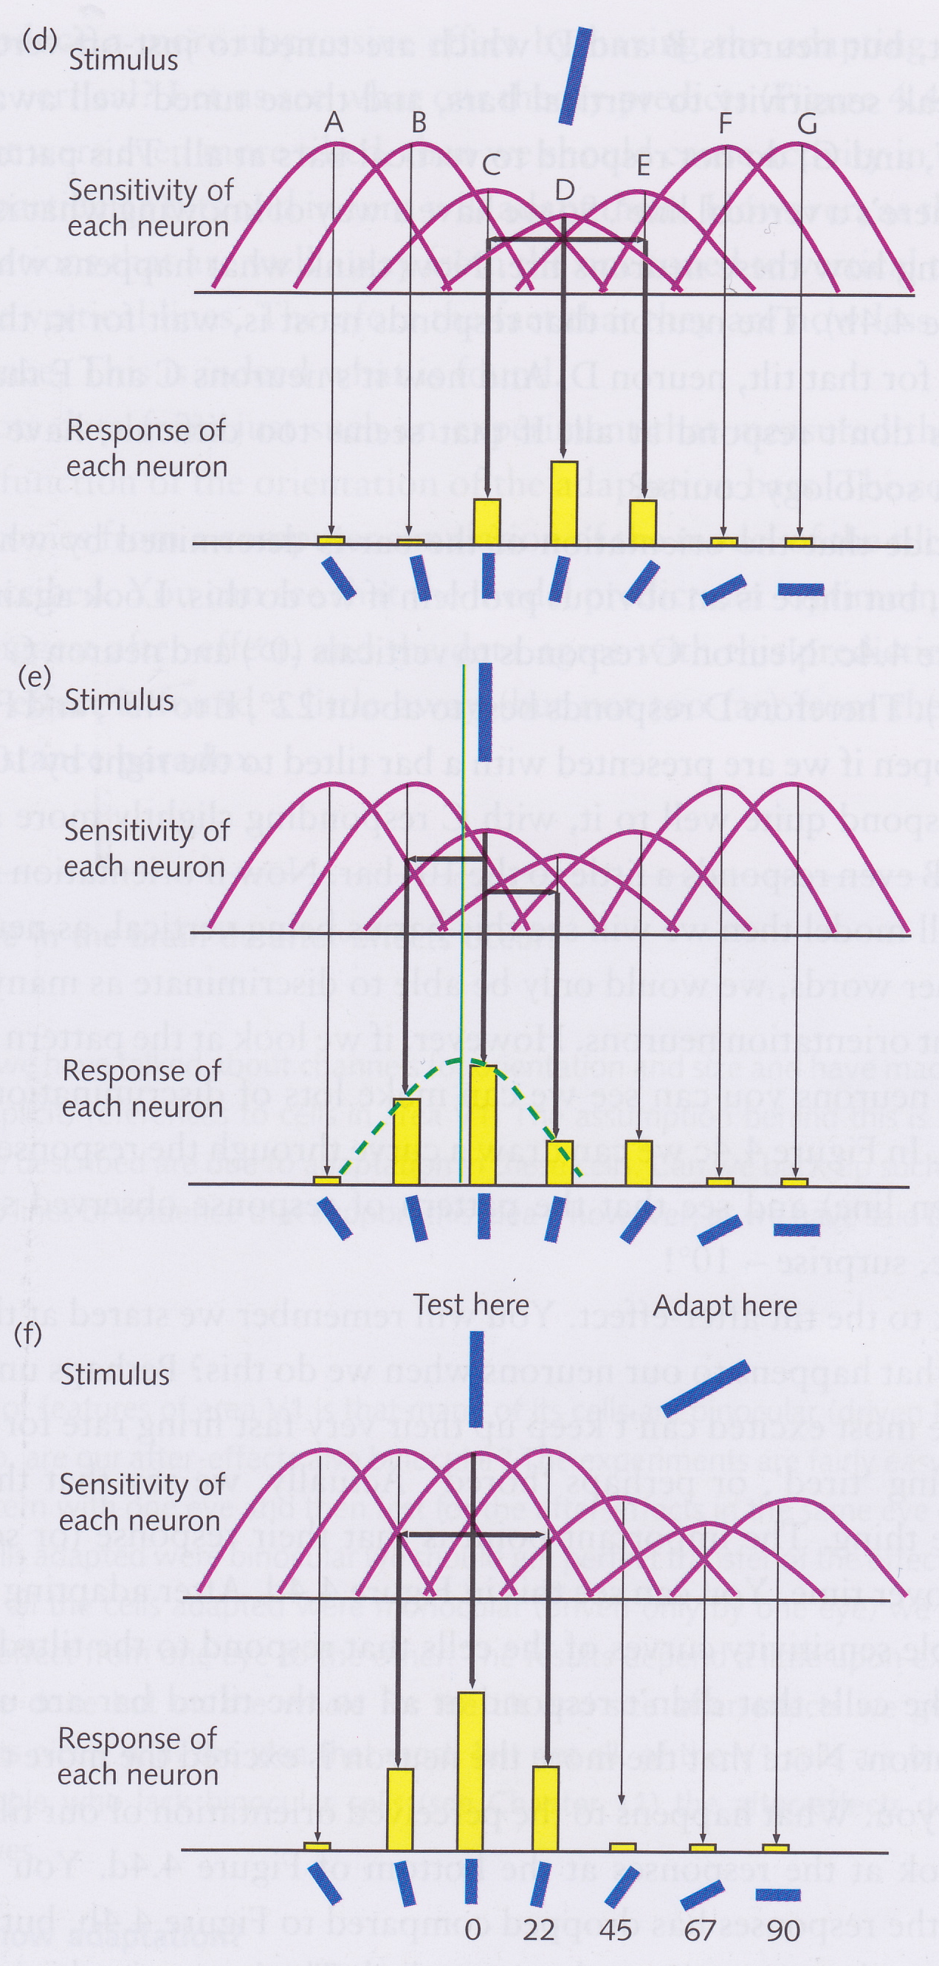
Neural explanation of the tilt after-effect
After a while, cell that responds best to 22 degrees adapts (i.e., starts responding less strongly)
  Note that the pattern of excitation is basically still the same – just lower
If vertical line presented immediately after adaptation, then pattern of activation now different from before adaptation
  Pattern is weighted towards cell that responds to a line tilted in the opposite direction
If adapt to a line much further away from vertical, then no after-effect because cells neighbouring the vertically tuned cell are unaffected

Slide 10
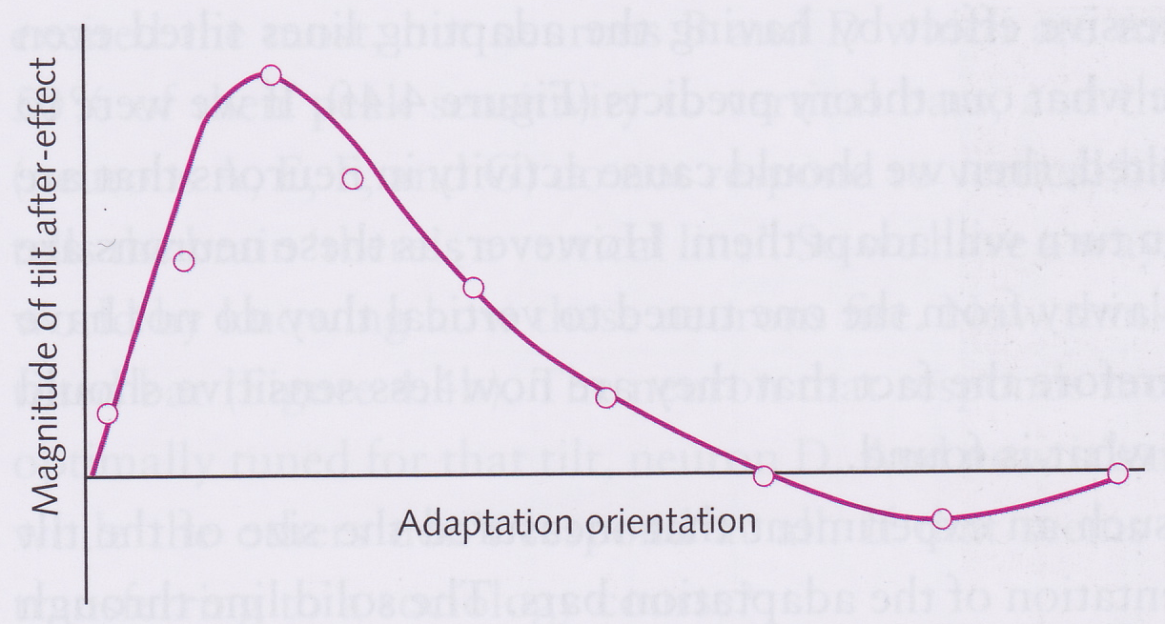
“Distance paradox”
Dots in graph show experimentally measured size of tilt after-effect for different adaptation angles
Solid line is predicted effect from theory just described
Maximum effect when adaptation stimulus is 10-20 degrees from test stimulus
For larger tilt differences, the effect decreases

Slide 11
Where in the brain do after-effects occur?
Evidence from binocularity
  Look at the tilted grid with the left eye only, then look at the vertical grid with the right eye only (Slides 4 and 5)
    Do you see the effect?
  About 70% transfer from one eye to the other – indicates that effect cannot occur before V1, since all lower cells are monocular
Evidence from cell recording
  Shows the retinal and LGN cells do not adapt to a grating, whereas V1 cells do

Slide 12
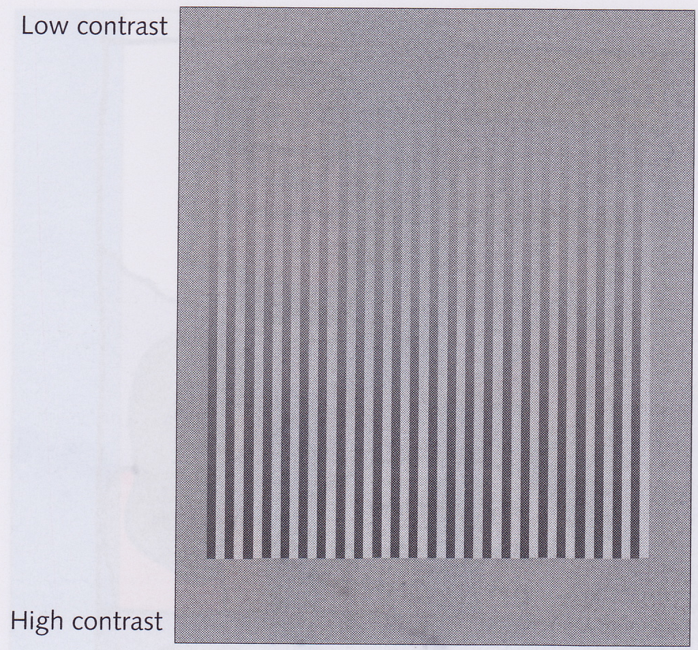
Varying the contrast of a grating
This grating is low-contrast at the top and high-contrast at the bottom
When the contrast gets low enough, we become unable to see the grating
Bar detecting cells respond better to high-contrast gratings than low-contrast ones

Slide 13
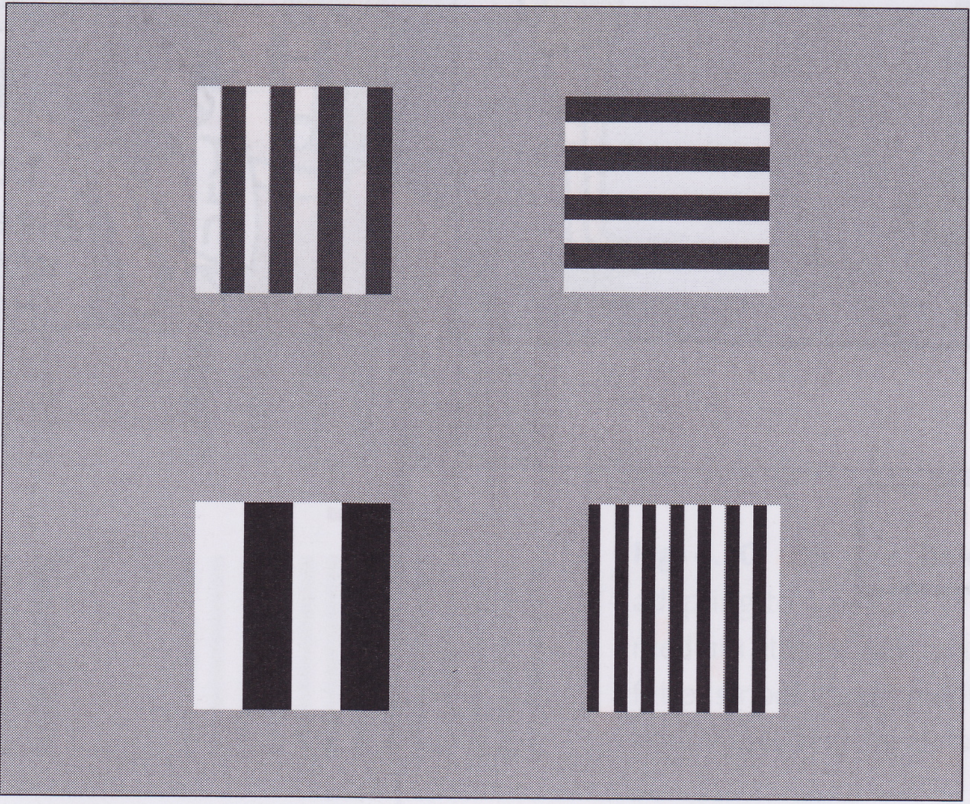
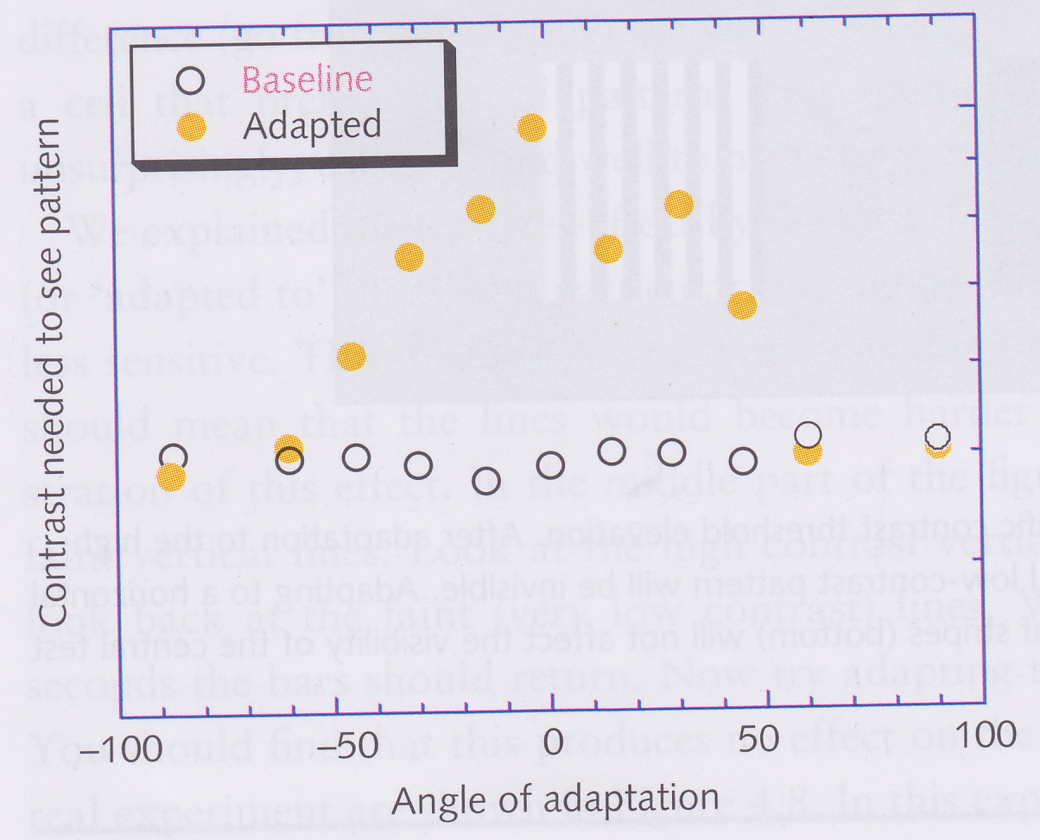
Tilt-specific threshold elevation
Stare at the top-left grating for 30 s, then shift to the centre of the figure
  Low-contrast grating at centre becomes invisible
Stare at the top-right grating for 30 s, then shift to the centre
  Low-contrast grating remains visible
Only cells tuned to the adaptation orientation have their thresholds lowered
  Other cells with different orientations remain unaffected

Slide 14
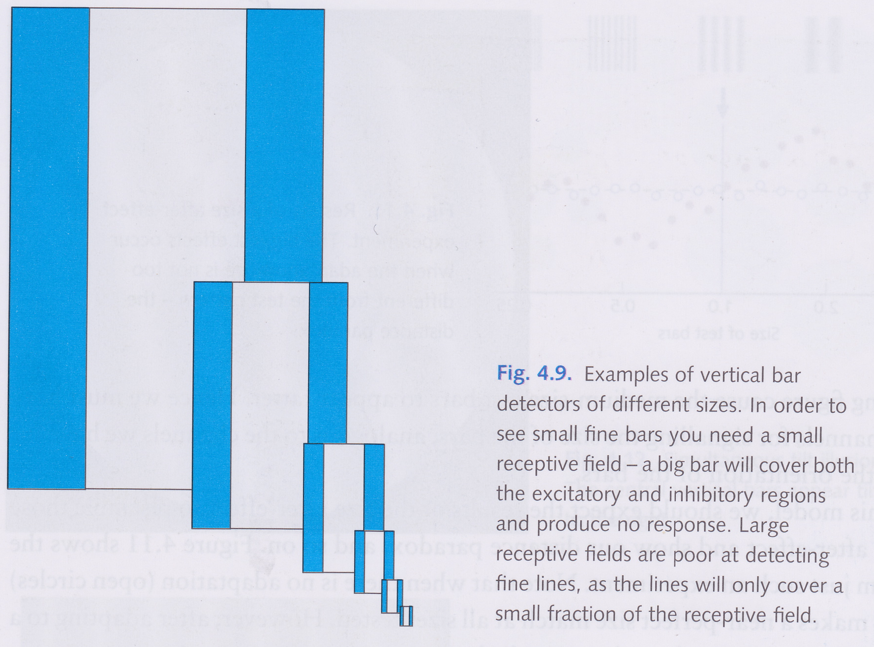
Vertical bar-detectors of different sizes

Slide 15
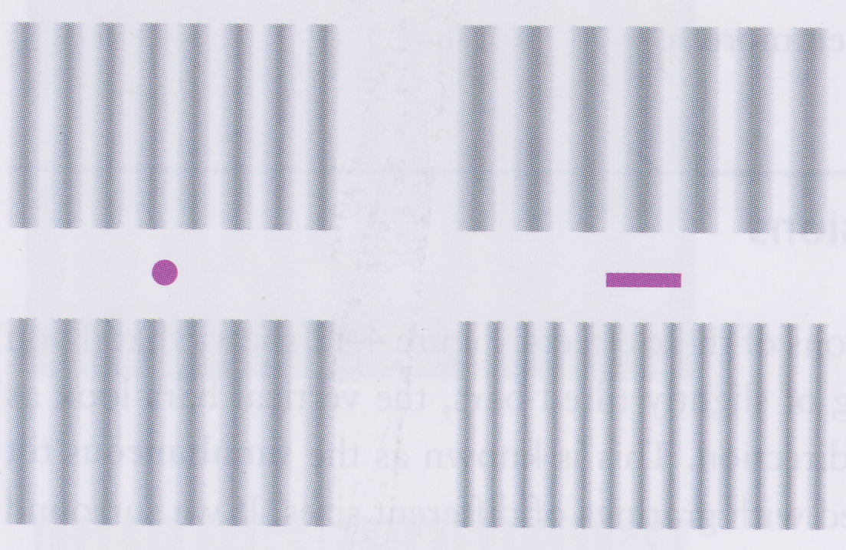
The size after-effect

Slide 16
The size after-effect
Works just like tilt after-effect
When stare at pink line, fat bar detectors become adapted in upper field and thin bar detectors become adapted in lower field
When shift to pink dot
  Adapted fat bar detectors make less contribution to upper field
    Bars look thinner than they are
  Adapted thin bar detectors make less contribution to lower field
    Bars look fatter than they are

Slide 17
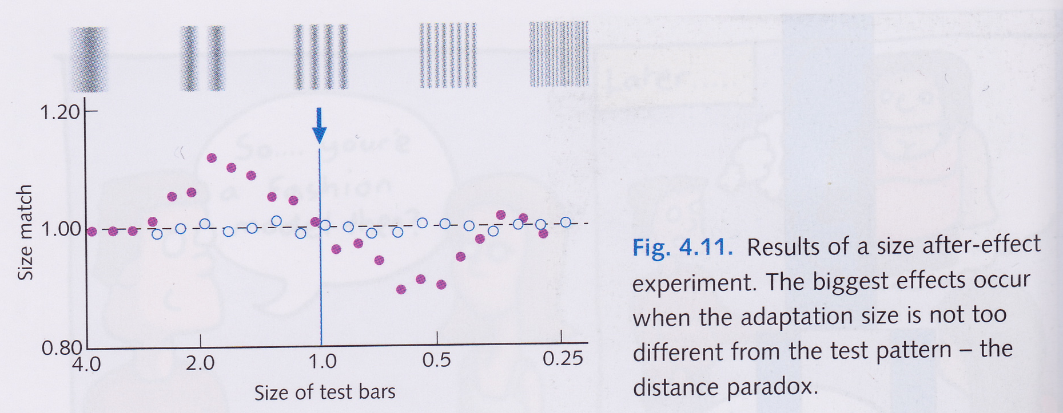
Size after-effect distance paradox
When adapt to a grating of size 1, bars that are a little fatter appear even more so and bars that are a little thinner appear thinner still

Slide 18
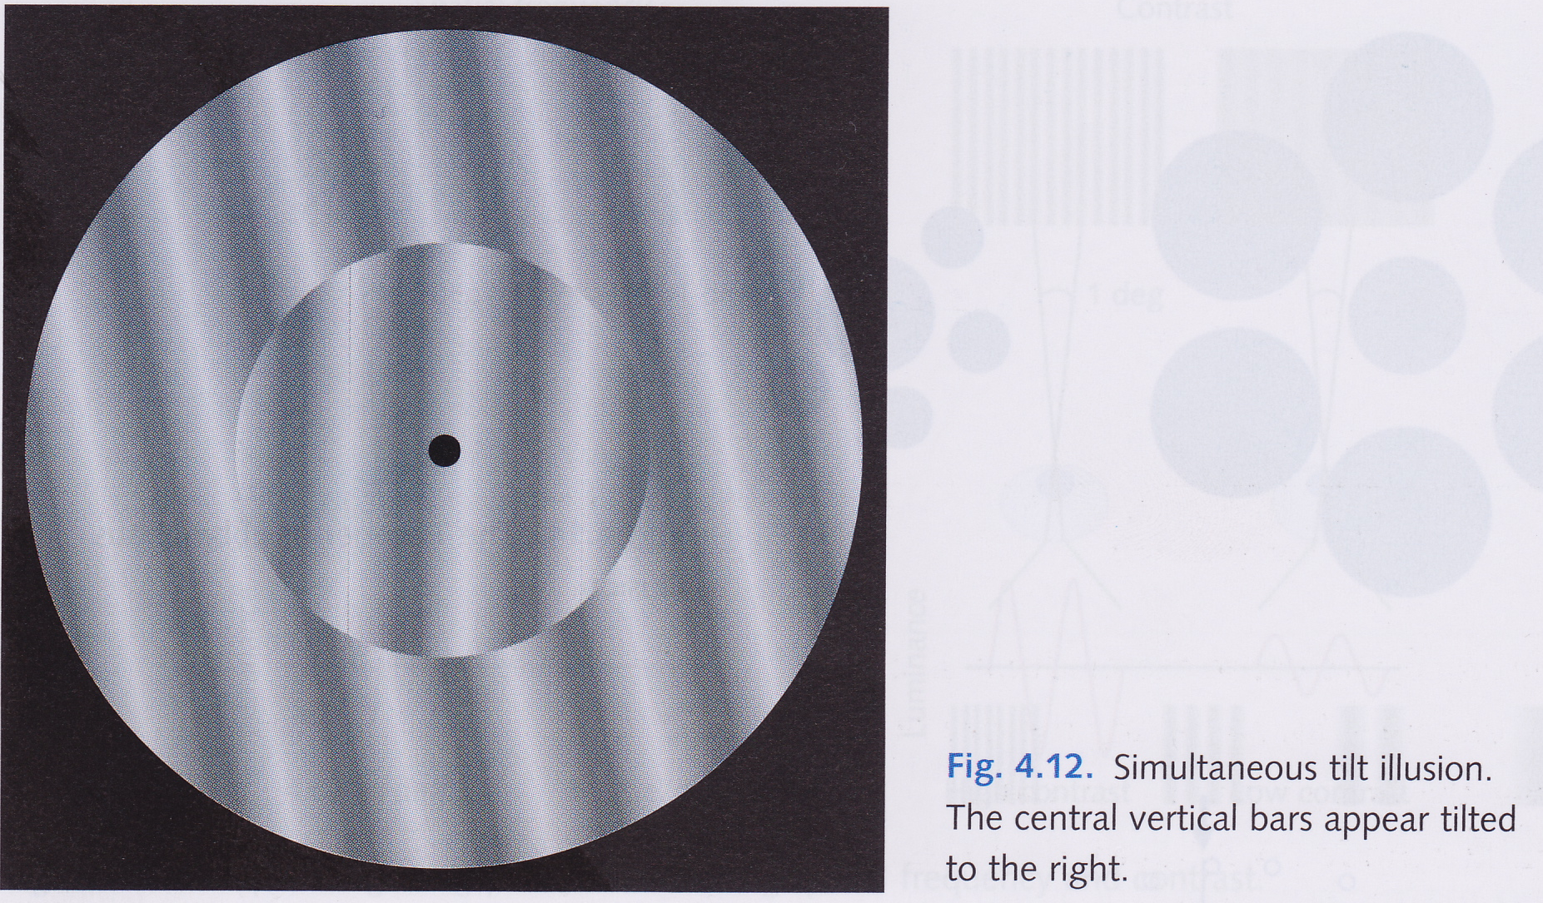
Simultaneous tilt illusion

Slide 19
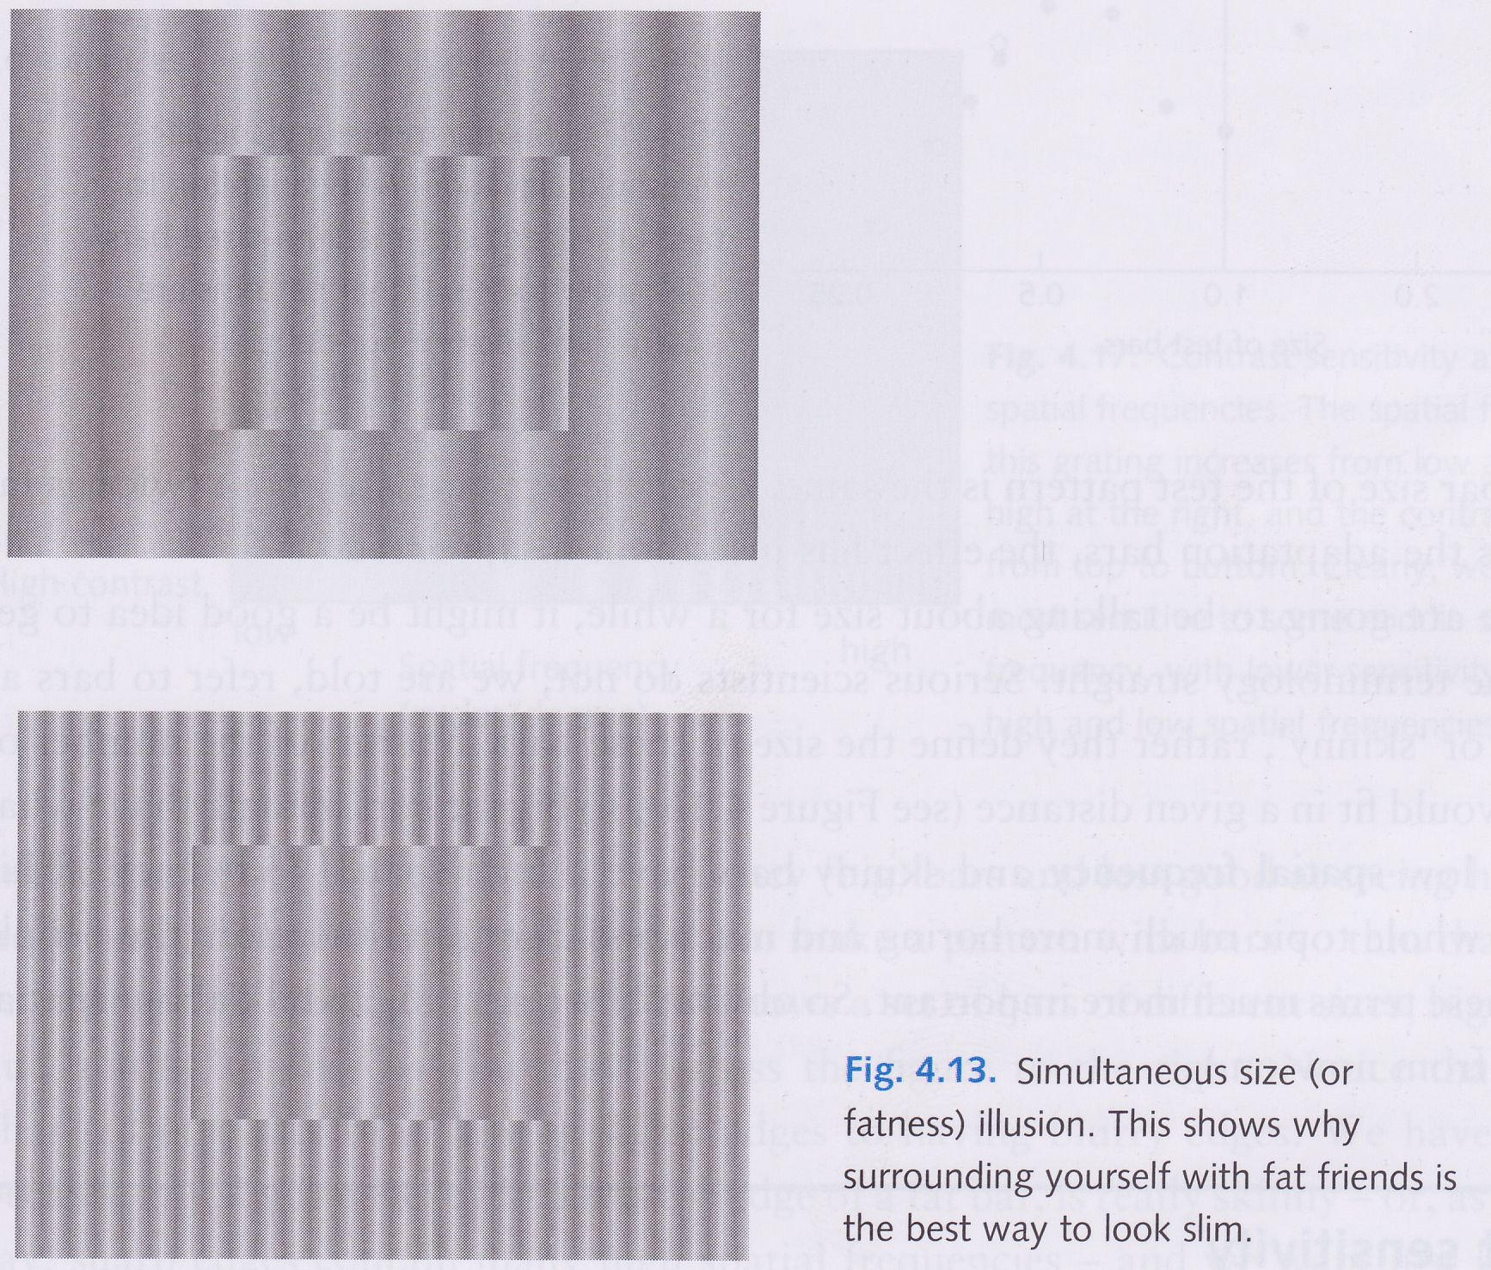
Simultaneous size illusion

Slide 20
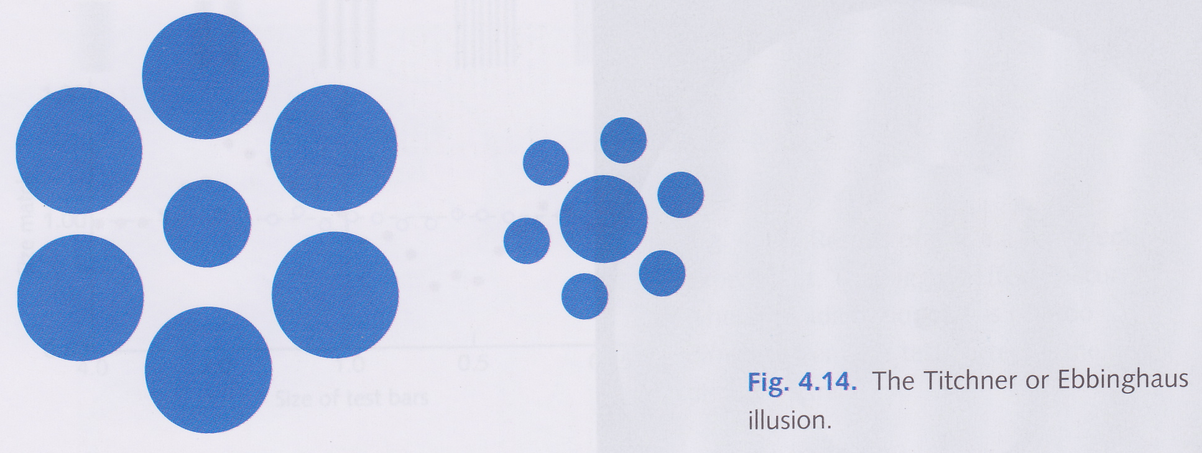
Titchner or Ebbinghaus illusion

Slide 21
Size-specific threshold elevation
Adapting to bars of a particular size (and orientation) raises the threshold for subsequently seen bars of same size, but not for bars of a different size
  Shows size-specificity of bar-detectors
Stare at bottom left or bottom right gratings
  Shouldn’t change visibility of centre grating, whereas staring at top left grating does
A grating of thin bars is said to have a high spatial frequency
A grating of fat bars is said to have a low spatial frequency

Slide 22
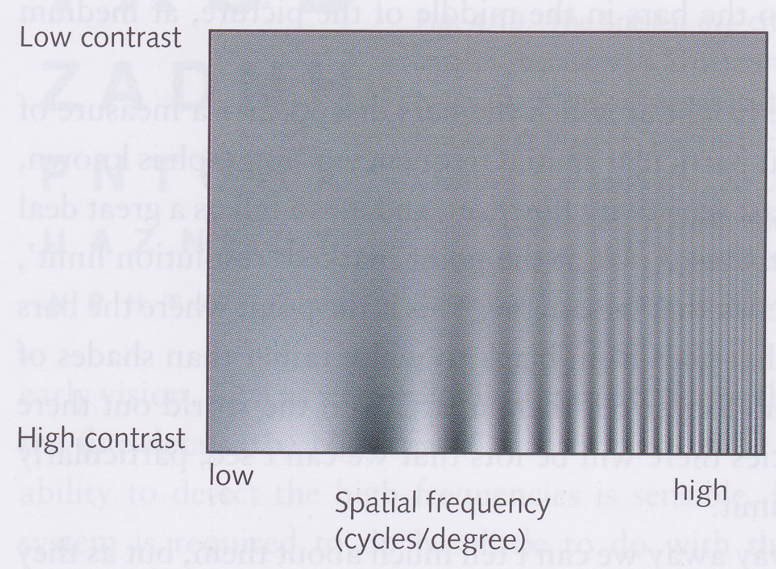
Contrast sensitivity
Most sensitive to medium spatial frequencies
Thresholds of visibility are higher for very low or very high spatial frequencies
Bars have fuzzy edges because sharp edges contain many high spatial frequencies (cf. Fourier spectrum)

Slide 23
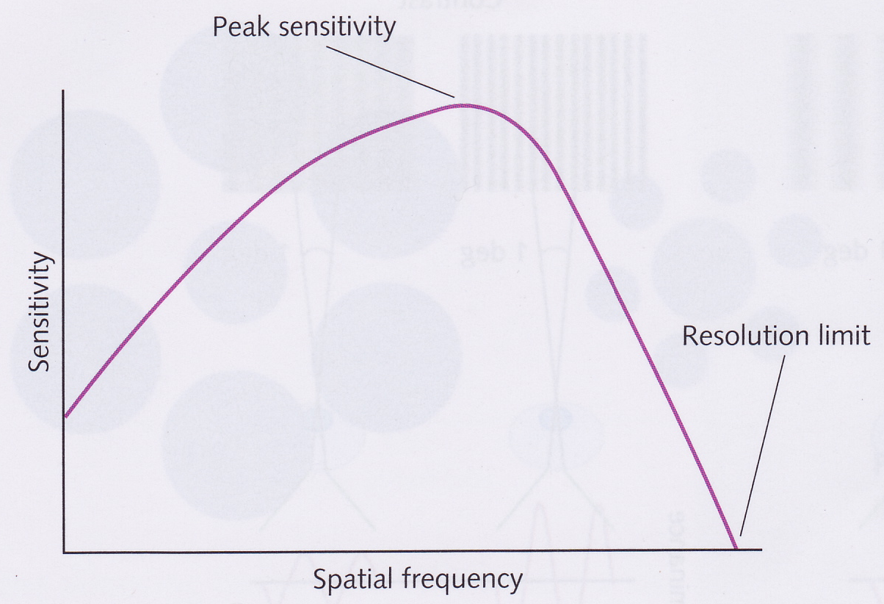
Spatial contrast sensitivity function
Shows contrast at which bars disappear
Resolution limit is highest spatial frequency that we can discern
Window of visibility is area under the graph
  Invisible if contrast too low for a particular frequency
  Invisible if spatial frequency is too high
Resolution limit also known as visual acuity

Slide 24
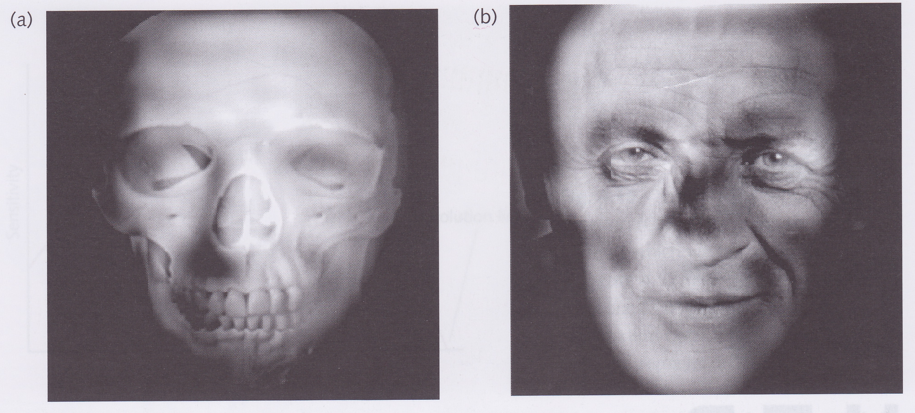
Spatial frequency channels
(a) has high frequency components of skull and low-frequency components of Anthony Hopkins
(b) has high frequency components of Anthony Hopkins and low frequency components of skull
Close up, (a) looks like a skull and (b) looks like Anthony Hopkins
Far away, (a) looks like Anthony Hopkins and (b) looks like a skull
When far away, high frequency components go beyond resolution limit
Close up, can filter out high frequencies by squinting or placing tracing paper over the image

Slide 25
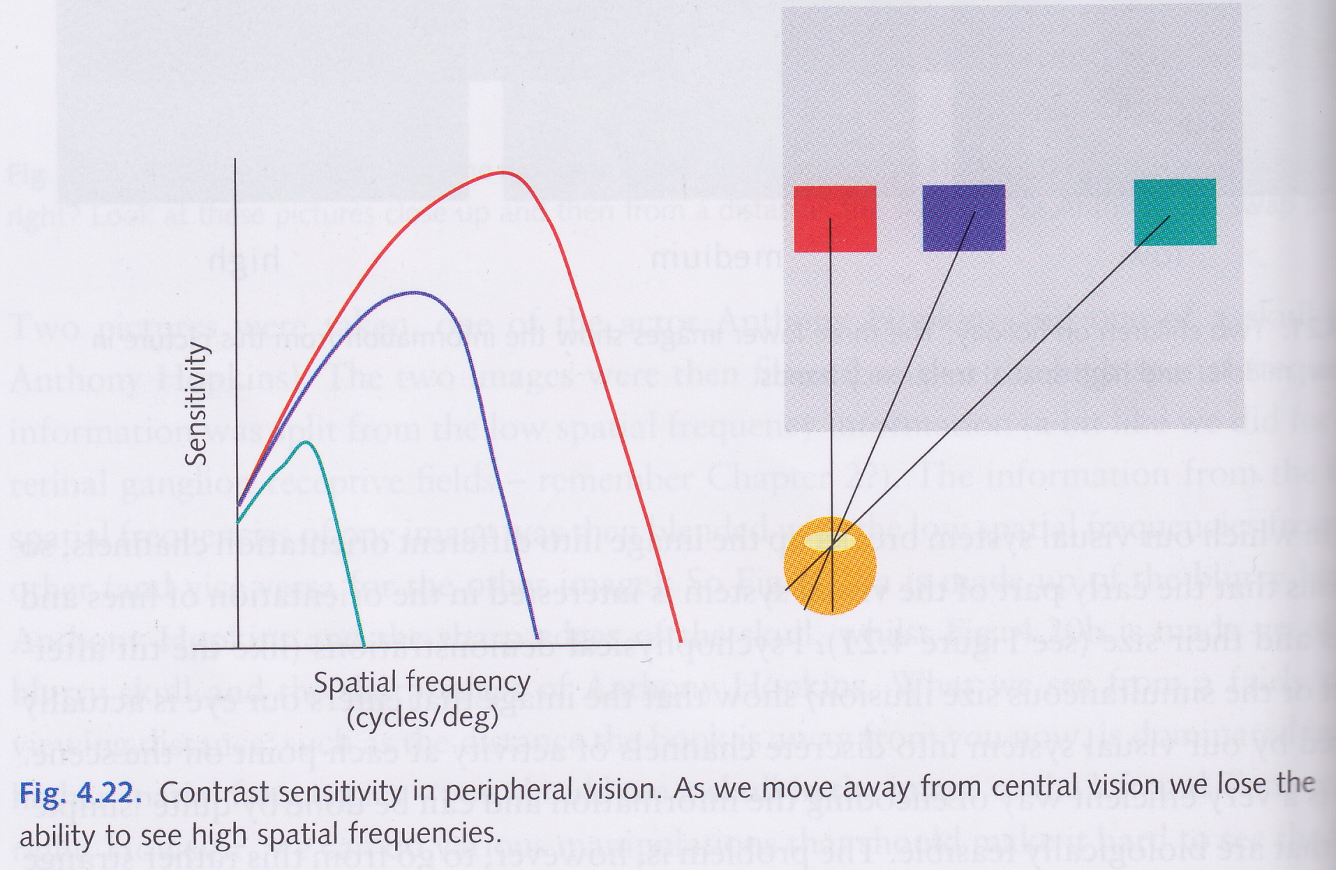
Peripheral vision
Foveal receptive fields are smaller than those in peripheral field
  Means high visual acuity in fovea than peripheral field
Further away from fovea we go
  higher the contrast we need to see a particular spatial frequency
  lower the resolution limit (i.e., highest spatial frequency we can see)

Slide 26
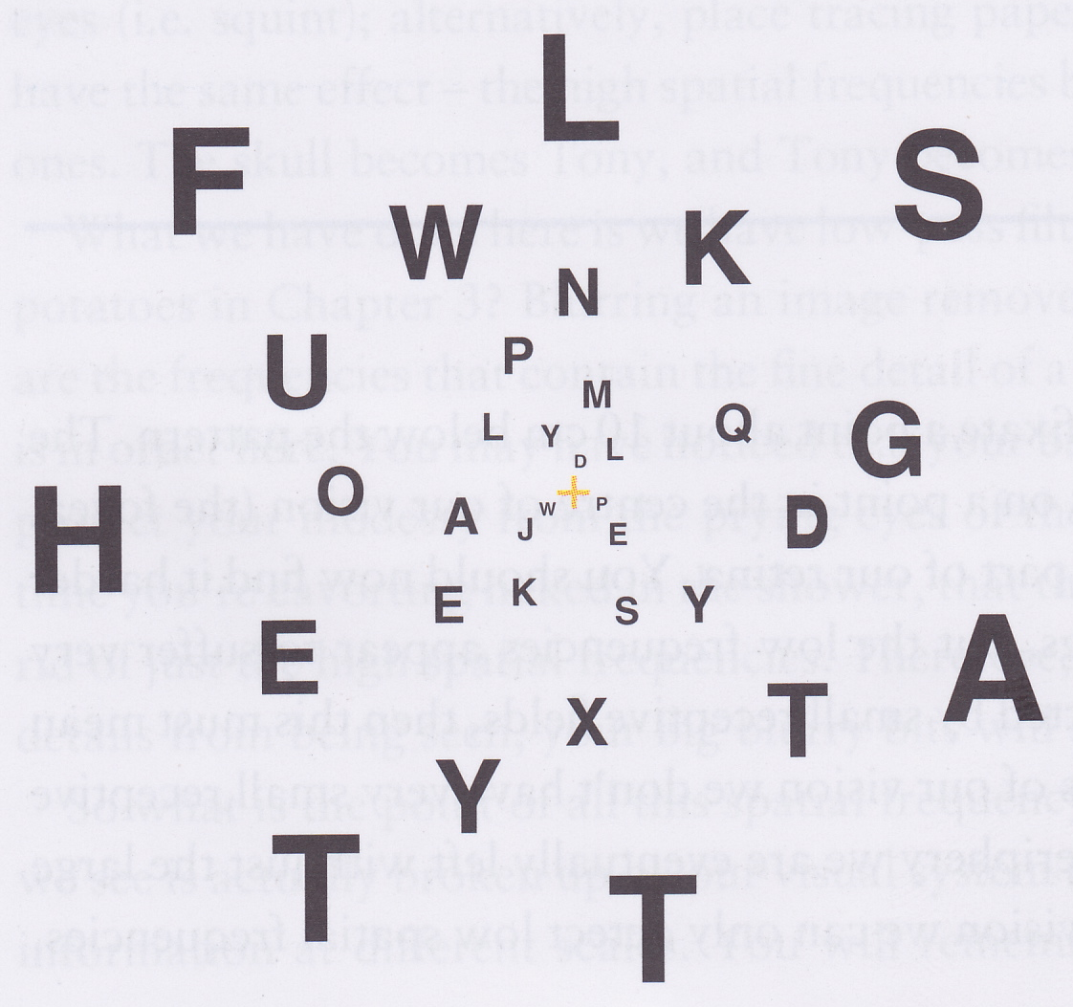
Peripheral vision
Fixate on centre
Each letter stimulates about the same number of V1 cells
So letters should be equally legible

Slide 27
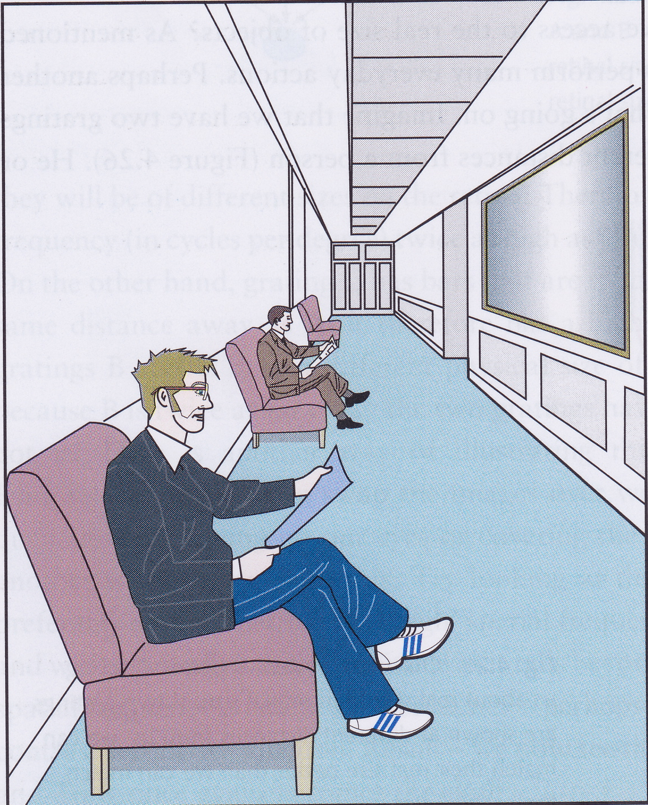
Retinal vs. Real Size
Which man is bigger?

Slide 28
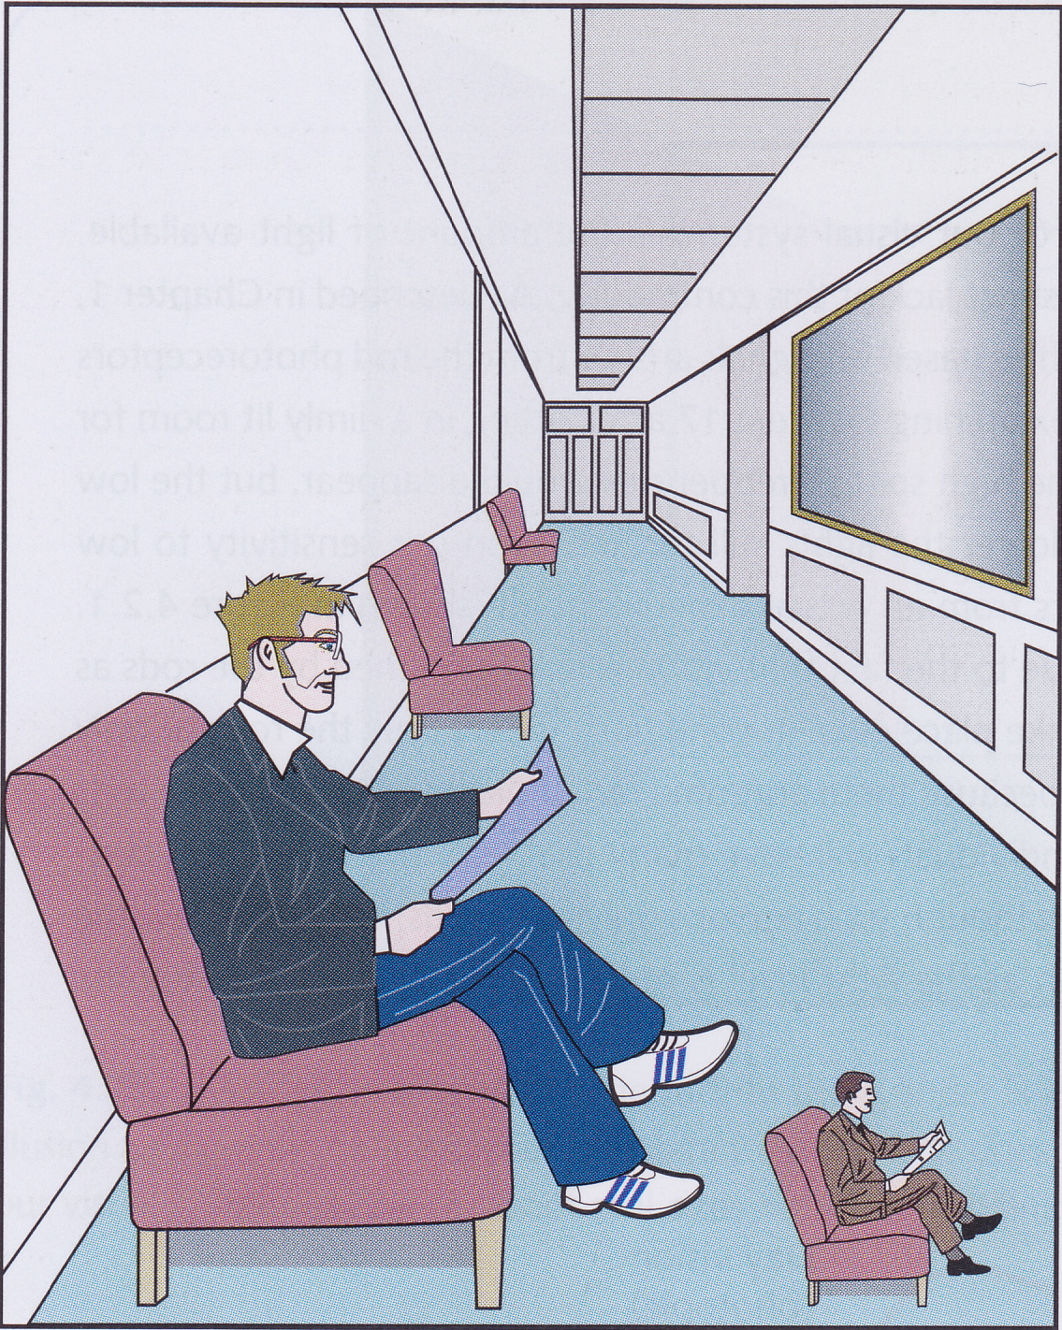
Retinal vs. Real Size
What about now?
We are better at judging real size than retinal size

Slide 29
Constancies
Size constancy
  Ability to perceive accurately the real size of objects regardless of distance
Orientation constancy
  Ability to know what’s up and down regardless of how tilted your head is
Shape constancy
  Ability to see that wheels are round on a speeding car, or that doors and windows are rectangular regardless of their angle of presentation
Colour constancy
  Ability to detect similarity of colour regardless of lighting conditions

