Slide 1
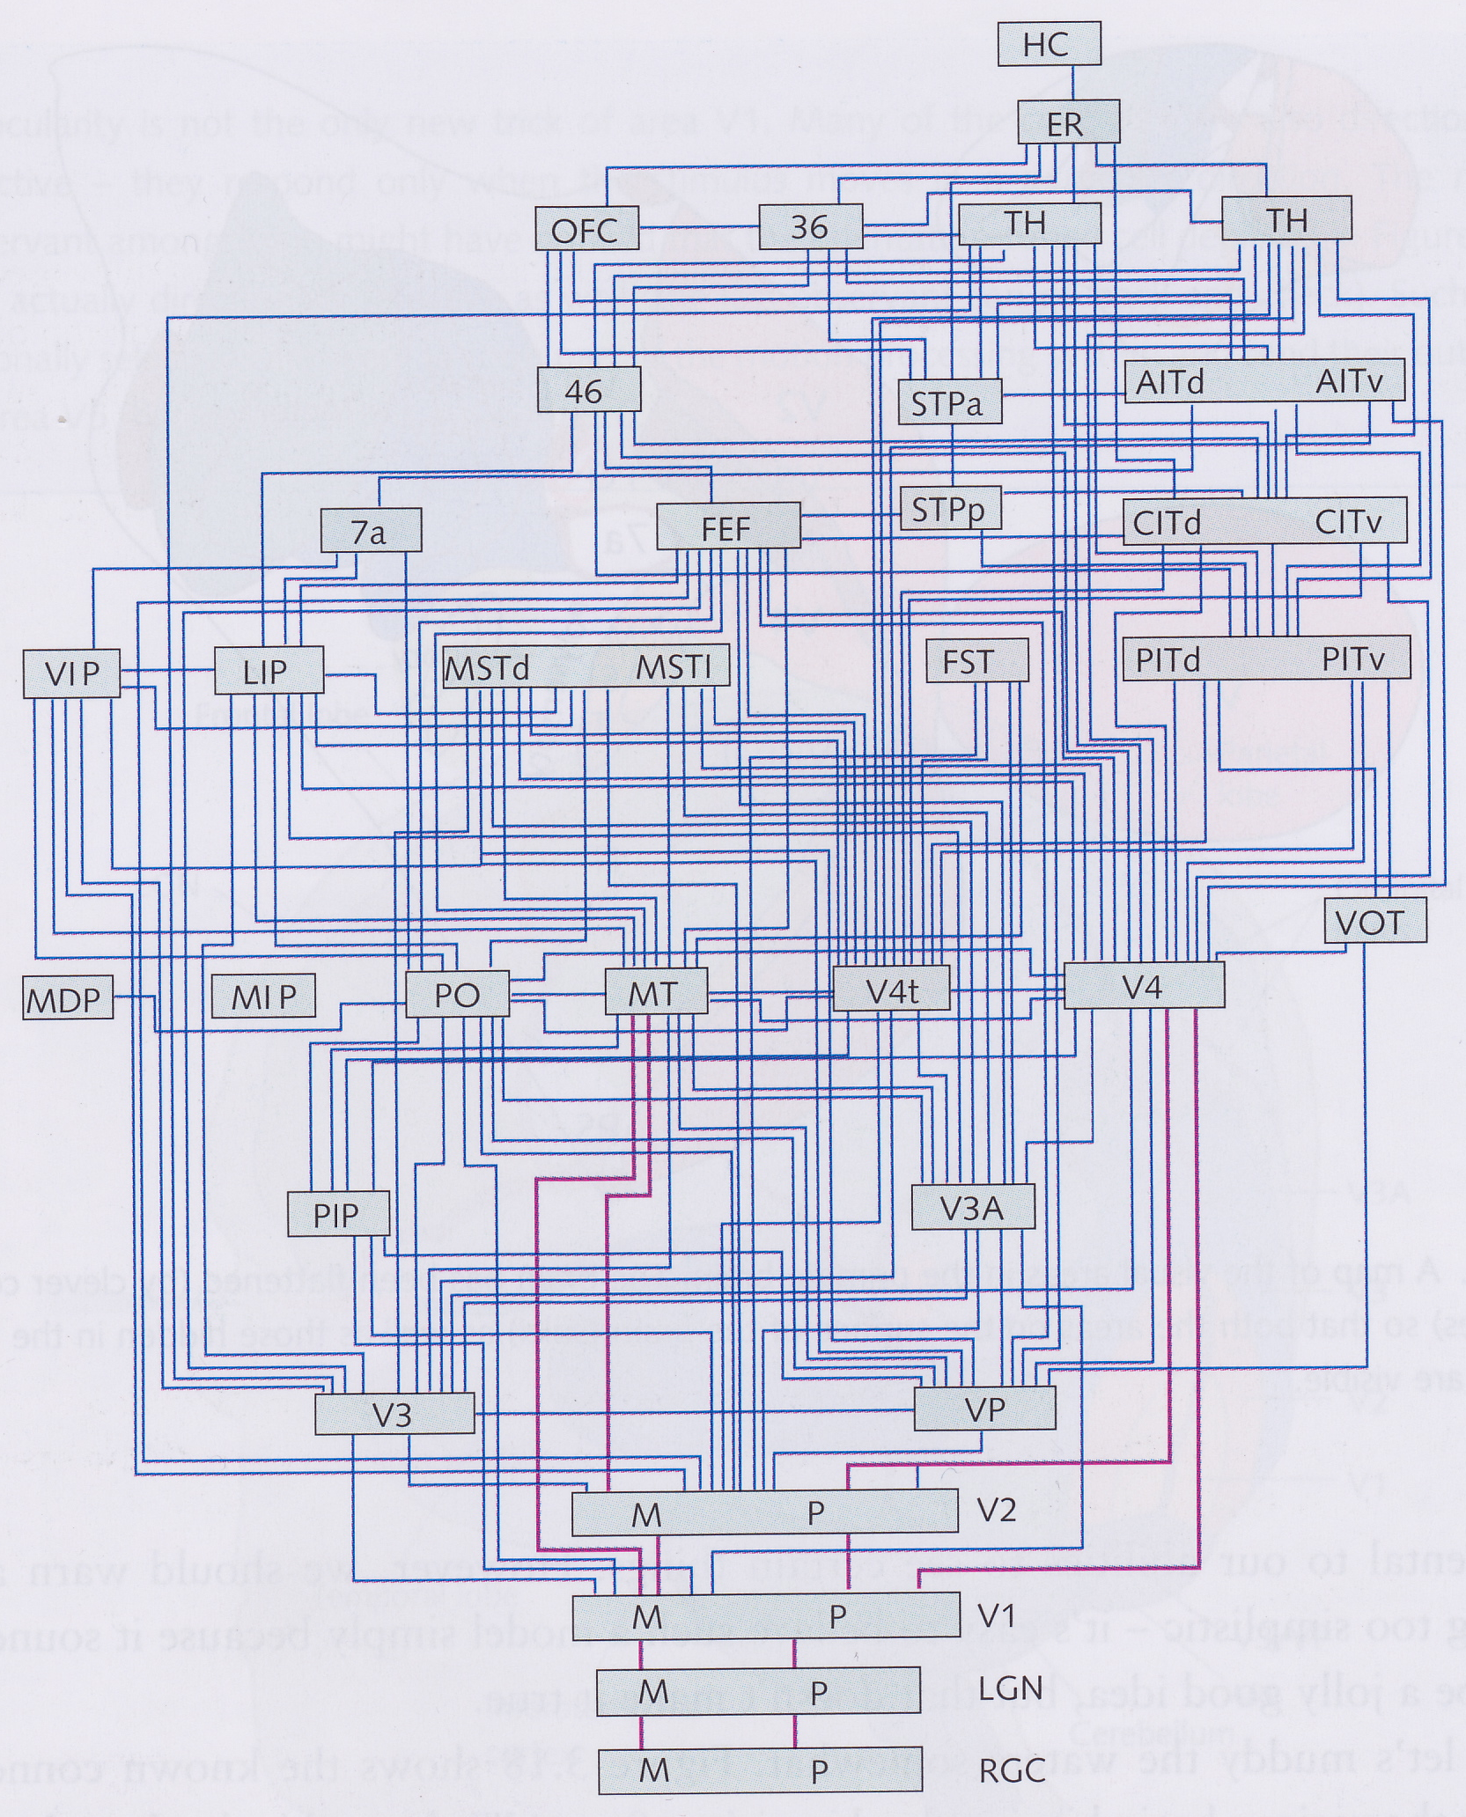
The Visual Cortex
David Meredith
Aalborg University
dave@create.aau.dk

Slide 2
Source
This lecture is based on Chapter 3 of
Snowden, R., Thompson, P. and Troscianko, T. (2006). Basic Vision: An Introduction to Visual Perception. OUP. ISBN: 978-0-19-928670-6.

Slide 3
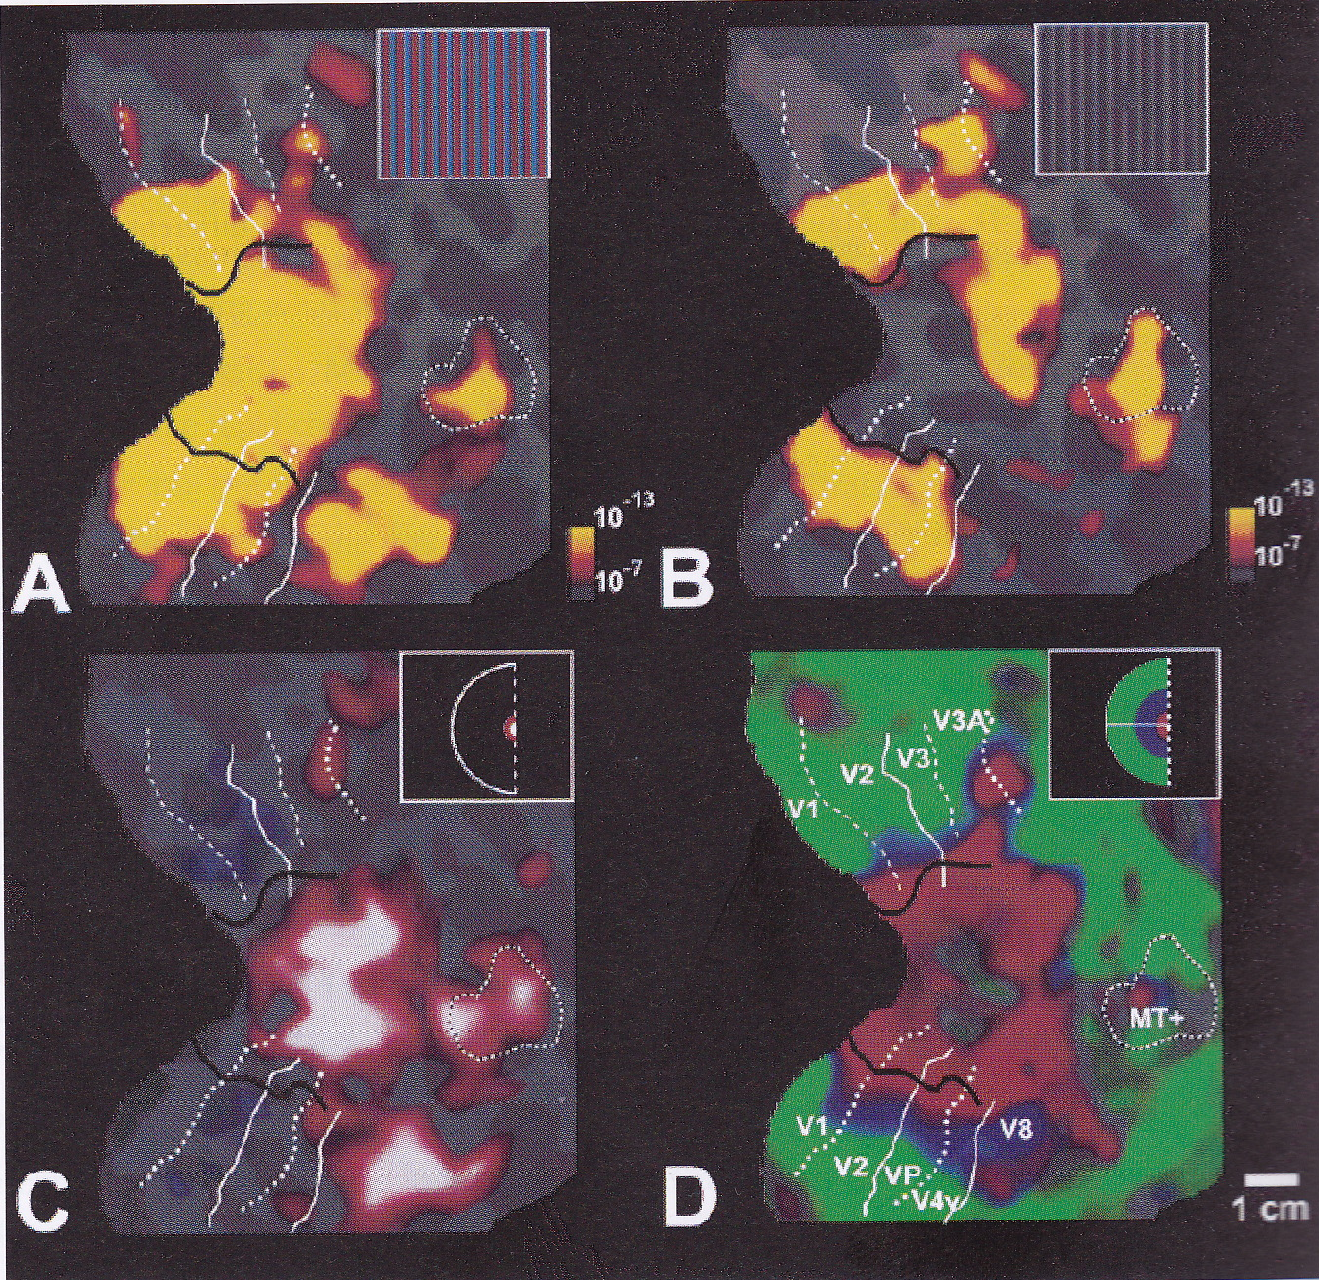
The Visual Cortex
fMRI maps of the human visual cortex
Photopic vision
Scotopic vision
Fovea only
Peripheral vision

Slide 4
Overview
More than half of the cortex dedicated to seeing the world
LGN and retinal ganglion receptive fields are concentric and antagonistic
Individually, these cells can detect points of light and edges (but not the edge’s orientation or the direction of the gradient across the edge)
Now consider how multiple cells with circular receptive fields can work together to perform more complicated tasks
Detection of orientation of edges and bars
Detection of faces and even more complex things
Is there a grandmother cell?

Slide 5
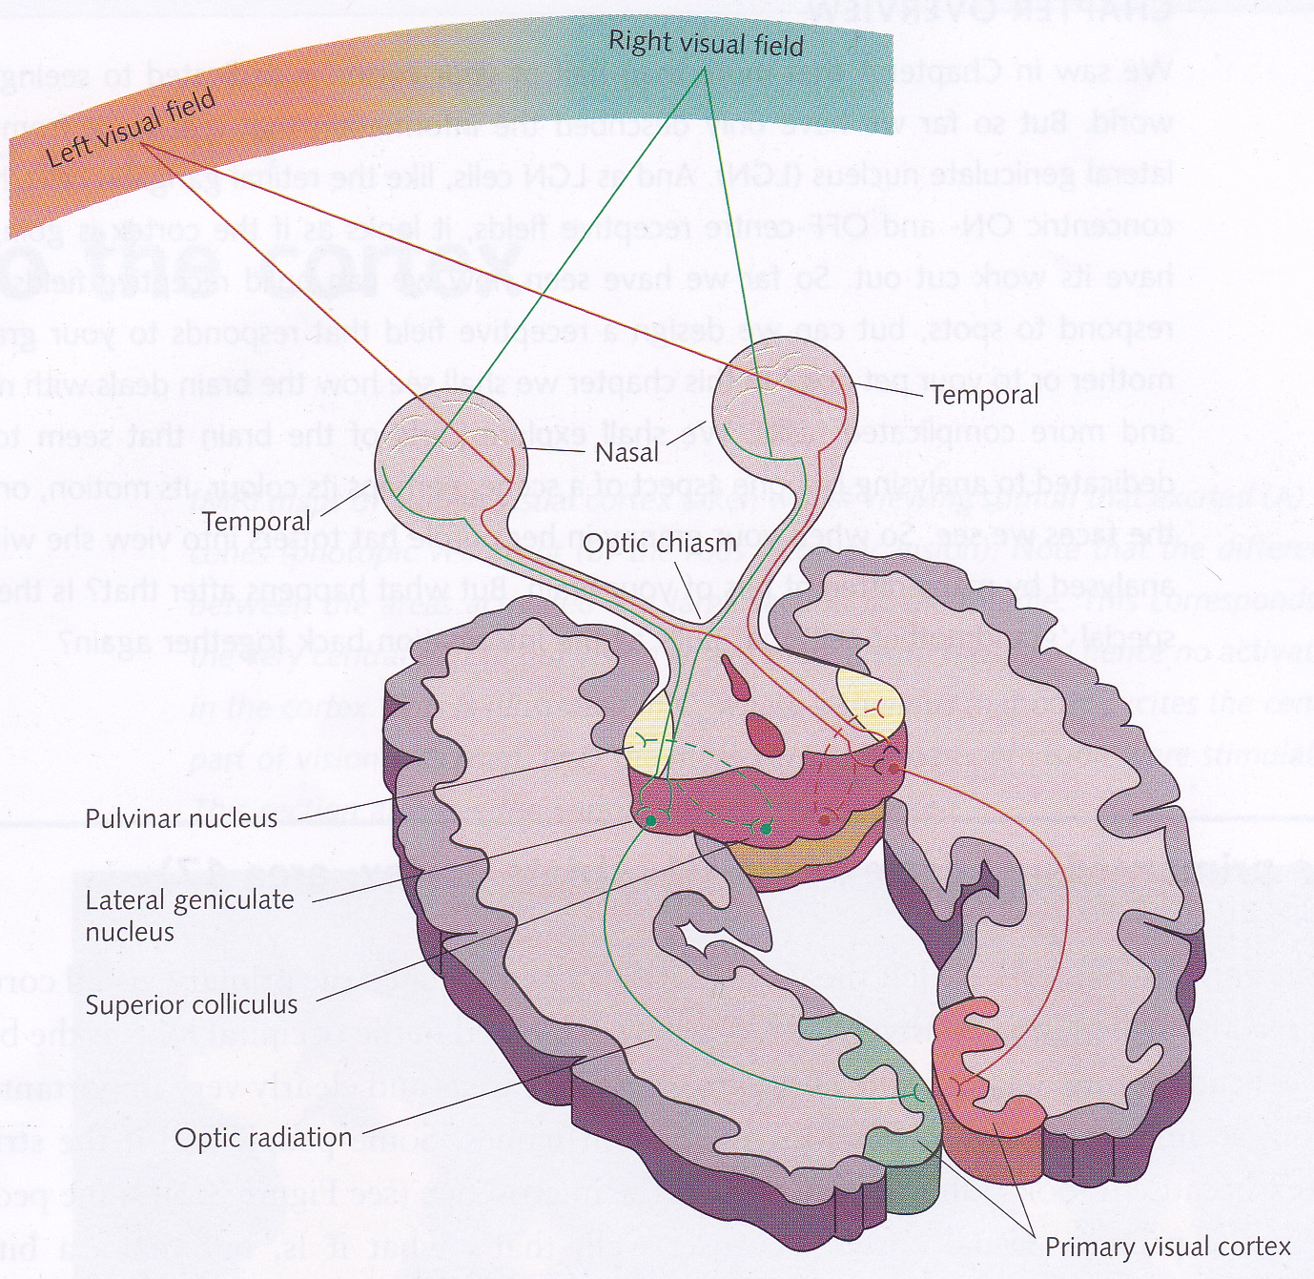
The Primary Visual Cortex (V1)
In the occipital lobe at the back of the brain
Largest of the visual areas
AKA “striate cortex” because it looks stripey under a microscope
In a cat, also called “area 17” and in a monkey it is called V1

Slide 6
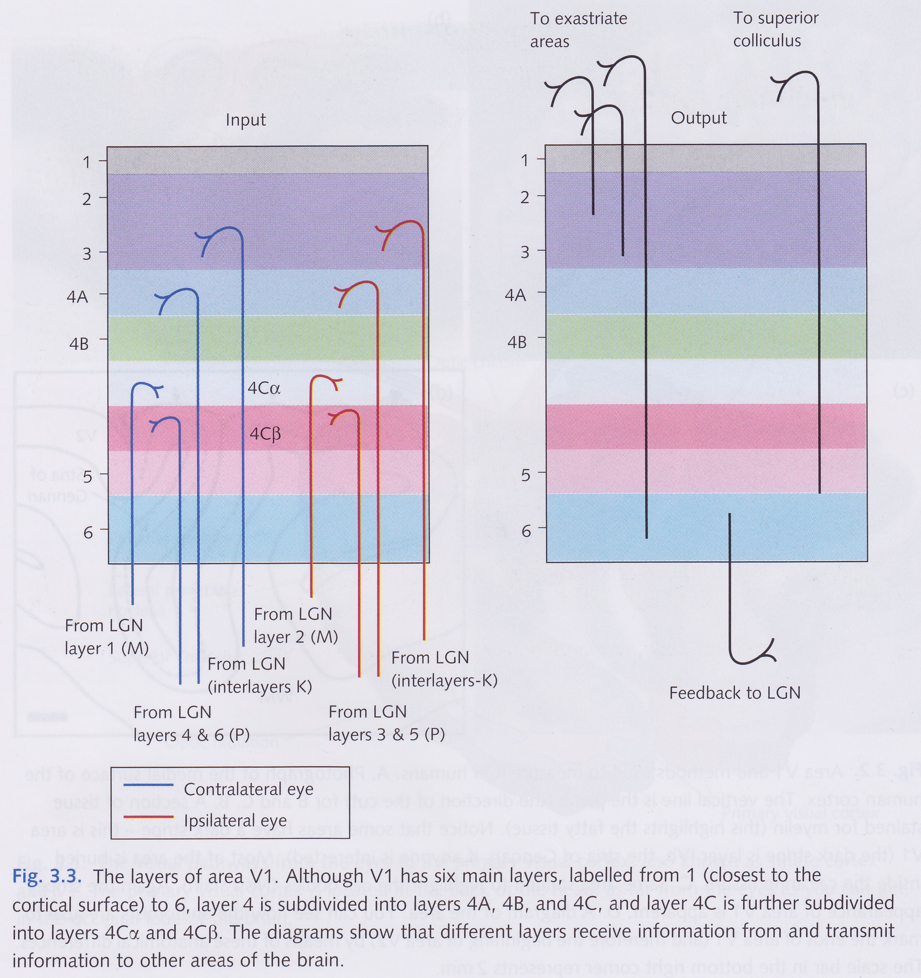
The layers of V1
Some layers receive information from the LGN
Some layers send on information to higher visual areas
Layer 6 sends information back to the LGN
Input from left eye separated from input from right eye
M-, P- and K-cell pathways project to different layers

Slide 7
Orientation selectivity
When recorded, cells in V1 do not respond to spots of light
Hubel and Wiesel (Hubel 1963, Hubel and Wiesel 1977) found that single cells in V1 respond to line segments at a particular orientation
e.g., one cell might respond to a line at 15 degrees from vertical while another responds best to horizontal lines
Each cell is tuned more or less sharply to a particular orientation
responds less strongly to other orientations

Slide 8
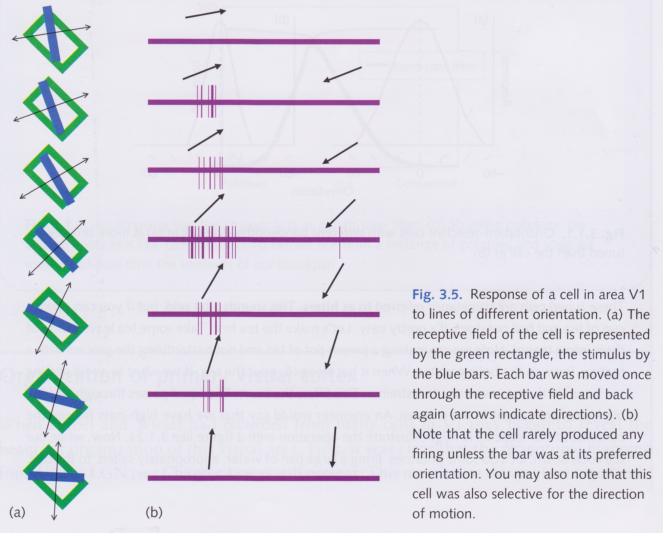
Orientation selectivity

Slide 9
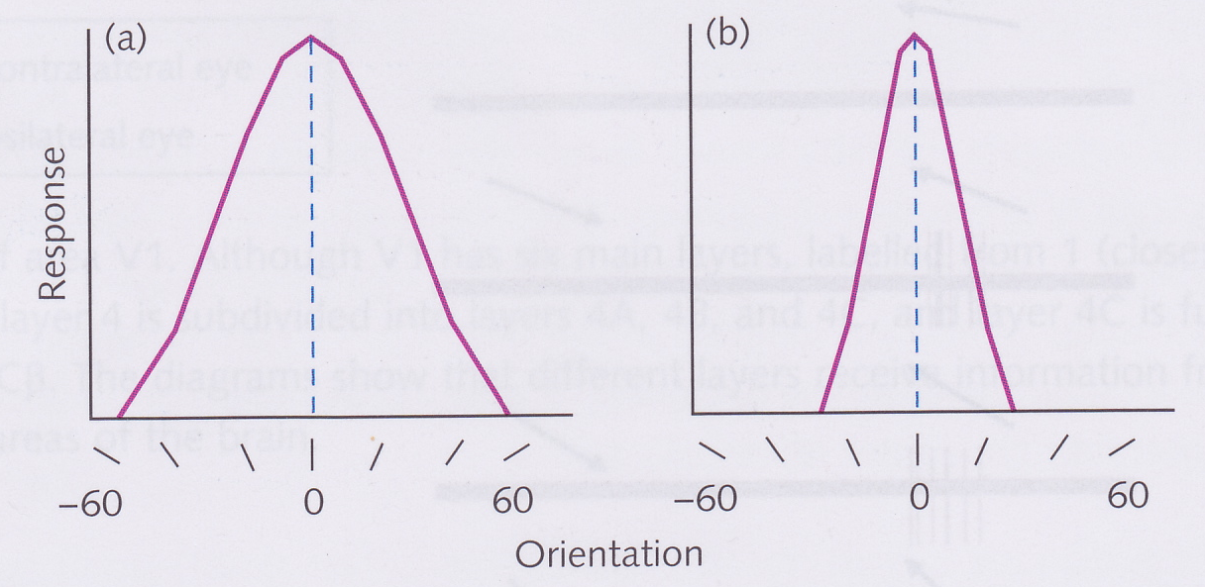
Tuning in vision
Say a cell is tuned to a particular stimulus when it responds more strongly to that stimulus than it does to others
A cell that is tuned to bars at a particular orientation will also respond quite strongly to bars at a slightly different orientation
A cell that is sharply tuned to a particular orientation is said to have a narrow bandwidth
The broader the bandwidth of a cell, the less sharply tuned it is

Slide 10
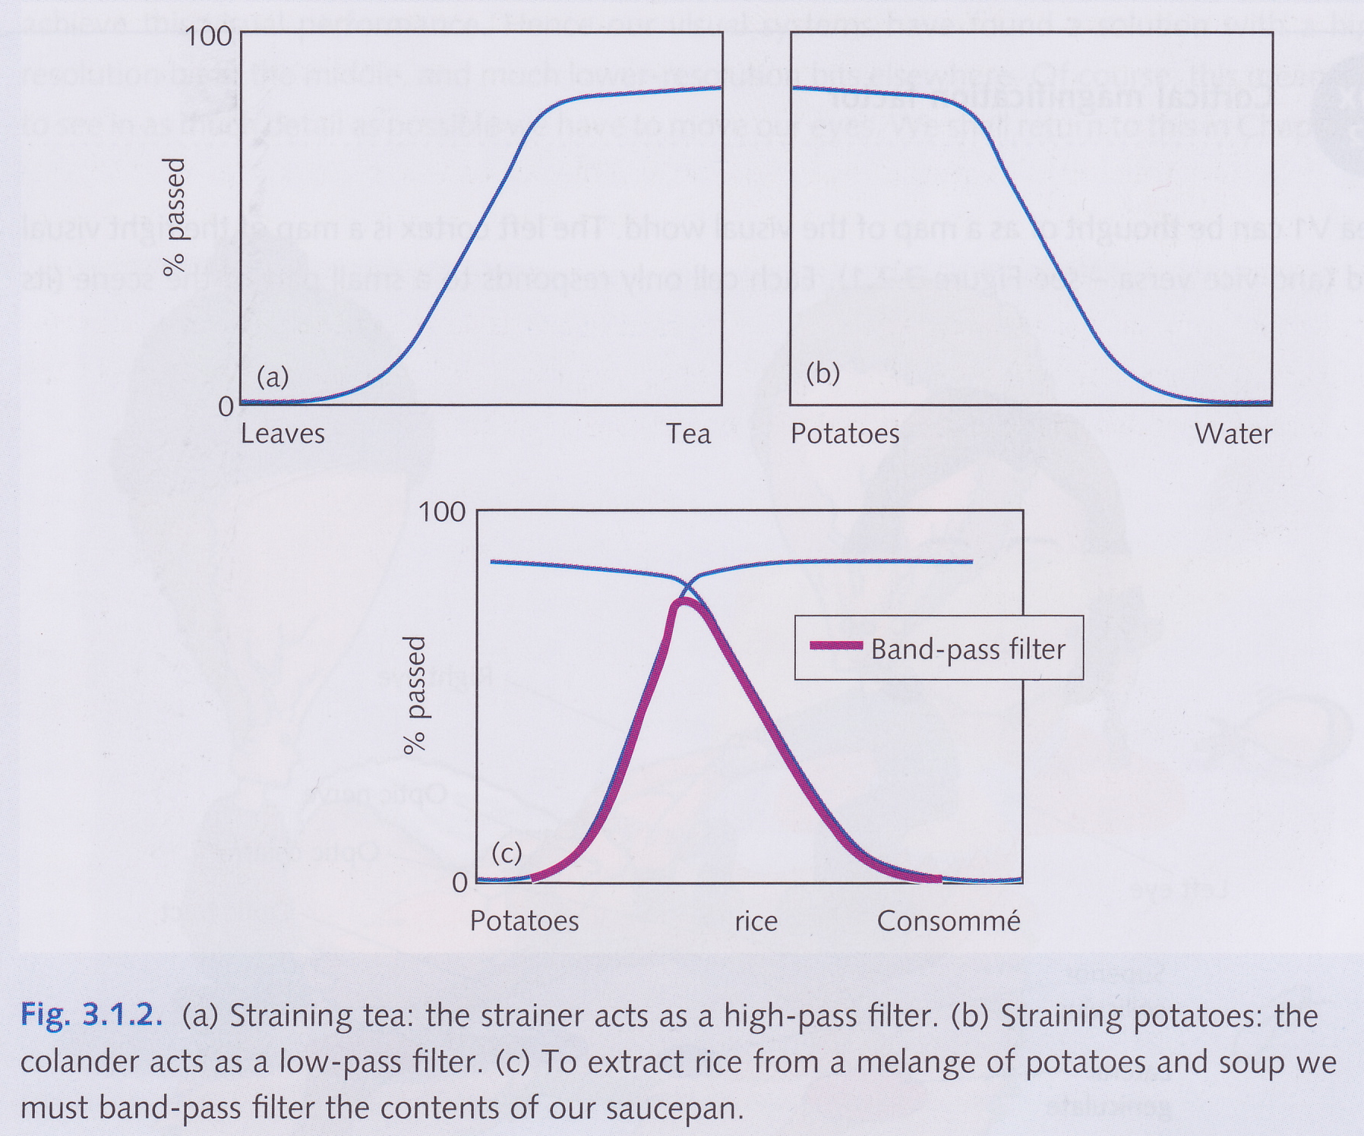
Tuned cells act as filters

Slide 11
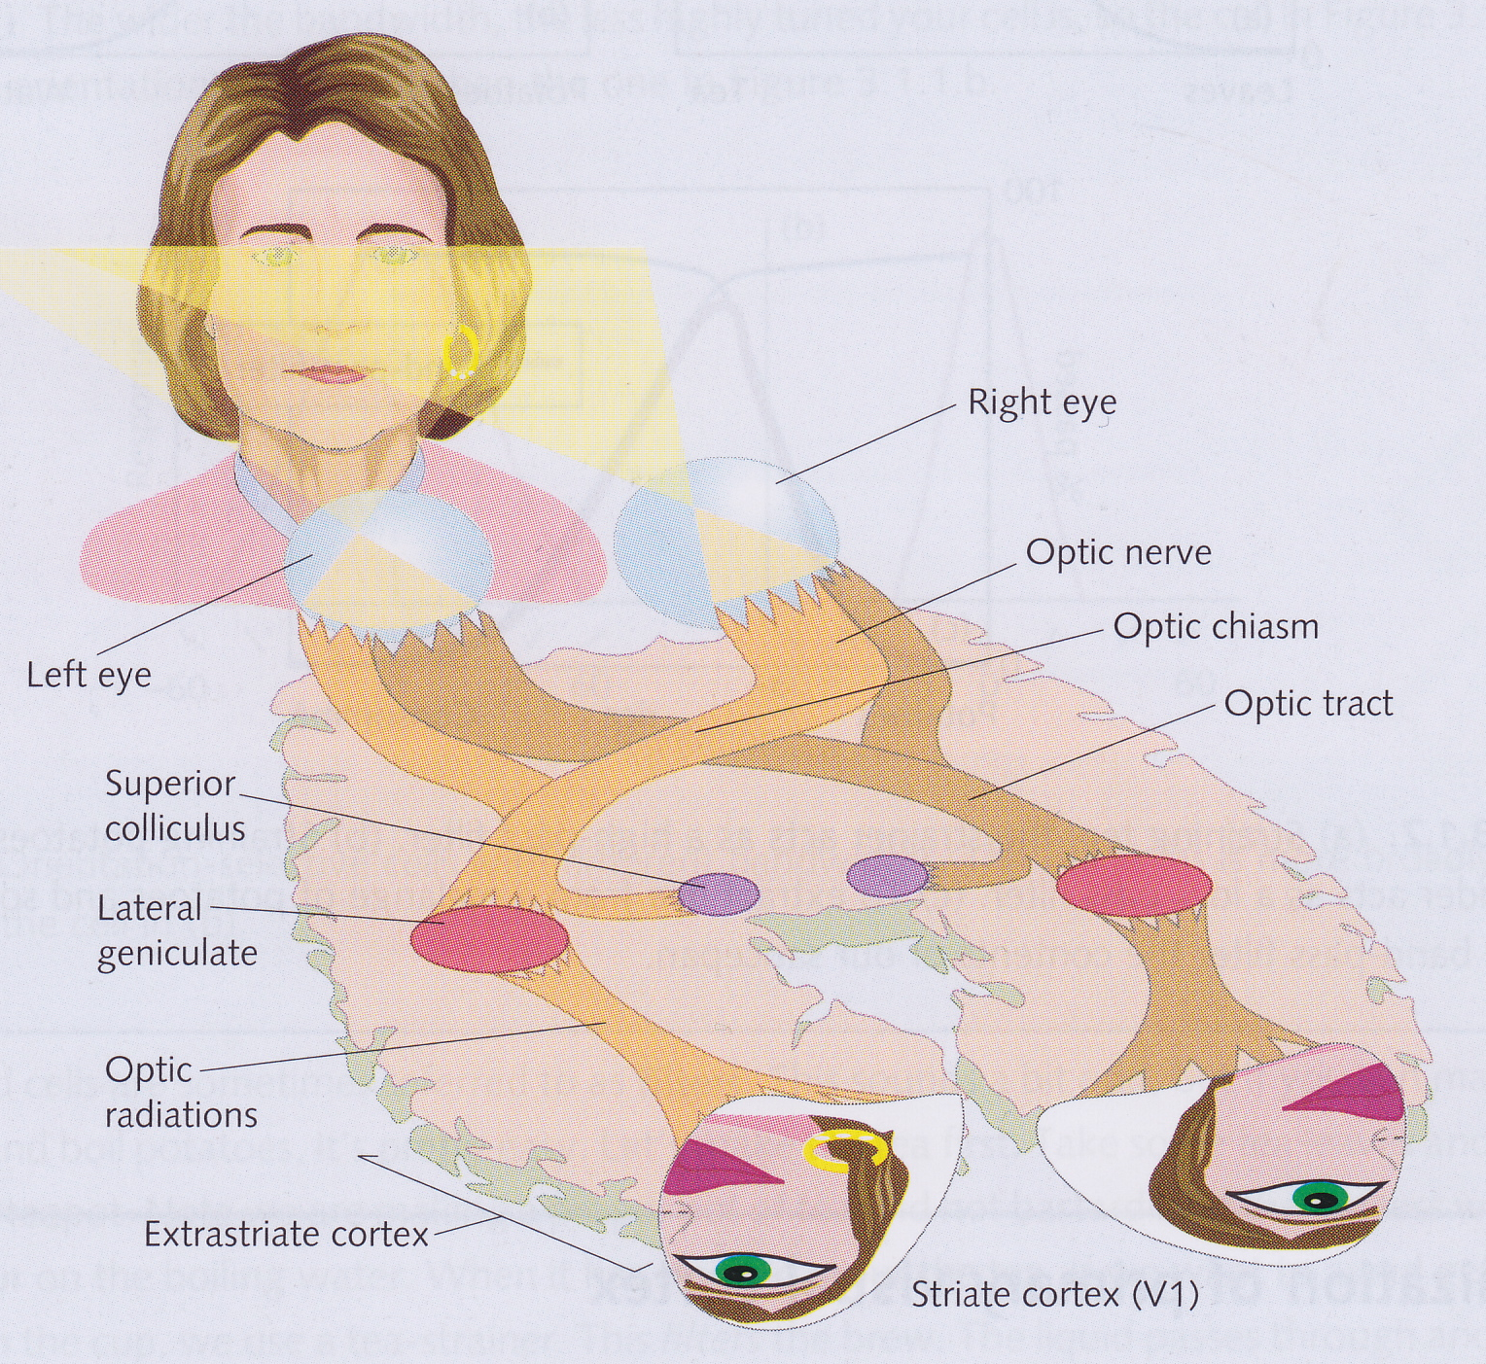
Organisation of primary visual cortex
Like LGN, V1 has retinotopic organisation
Receptive fields of nearby V1 cells are nearby in the retina
Each V1 maps half of the visual field
Only a small overlap
Your left hemifield is processed by your right V1 and vice versa

Slide 12
Cortical magnification factor
Many more V1 cells dedicated to centre of field of view (fovea) than peripheral view
Number of V1 cells per square degree of field of view decreases as move further from centre
Whole field of view is 20000 deg²
Fovea covers about 1 deg²
If evenly distributed, fovea would account for 1/20000 of area of V1
Actually accounts for 1/10 of V1
2000 times its fair share!
We say that the cortical magnification factor is 2000 for the centre of our field of view
If the resolution over the whole field of view was as high as it is at the centre, our brain would have to weigh 10 tonnes!
But this isn’t necessary because if we need to see something in high resolution, we can move our eyes so that it falls on the fovea

Slide 13
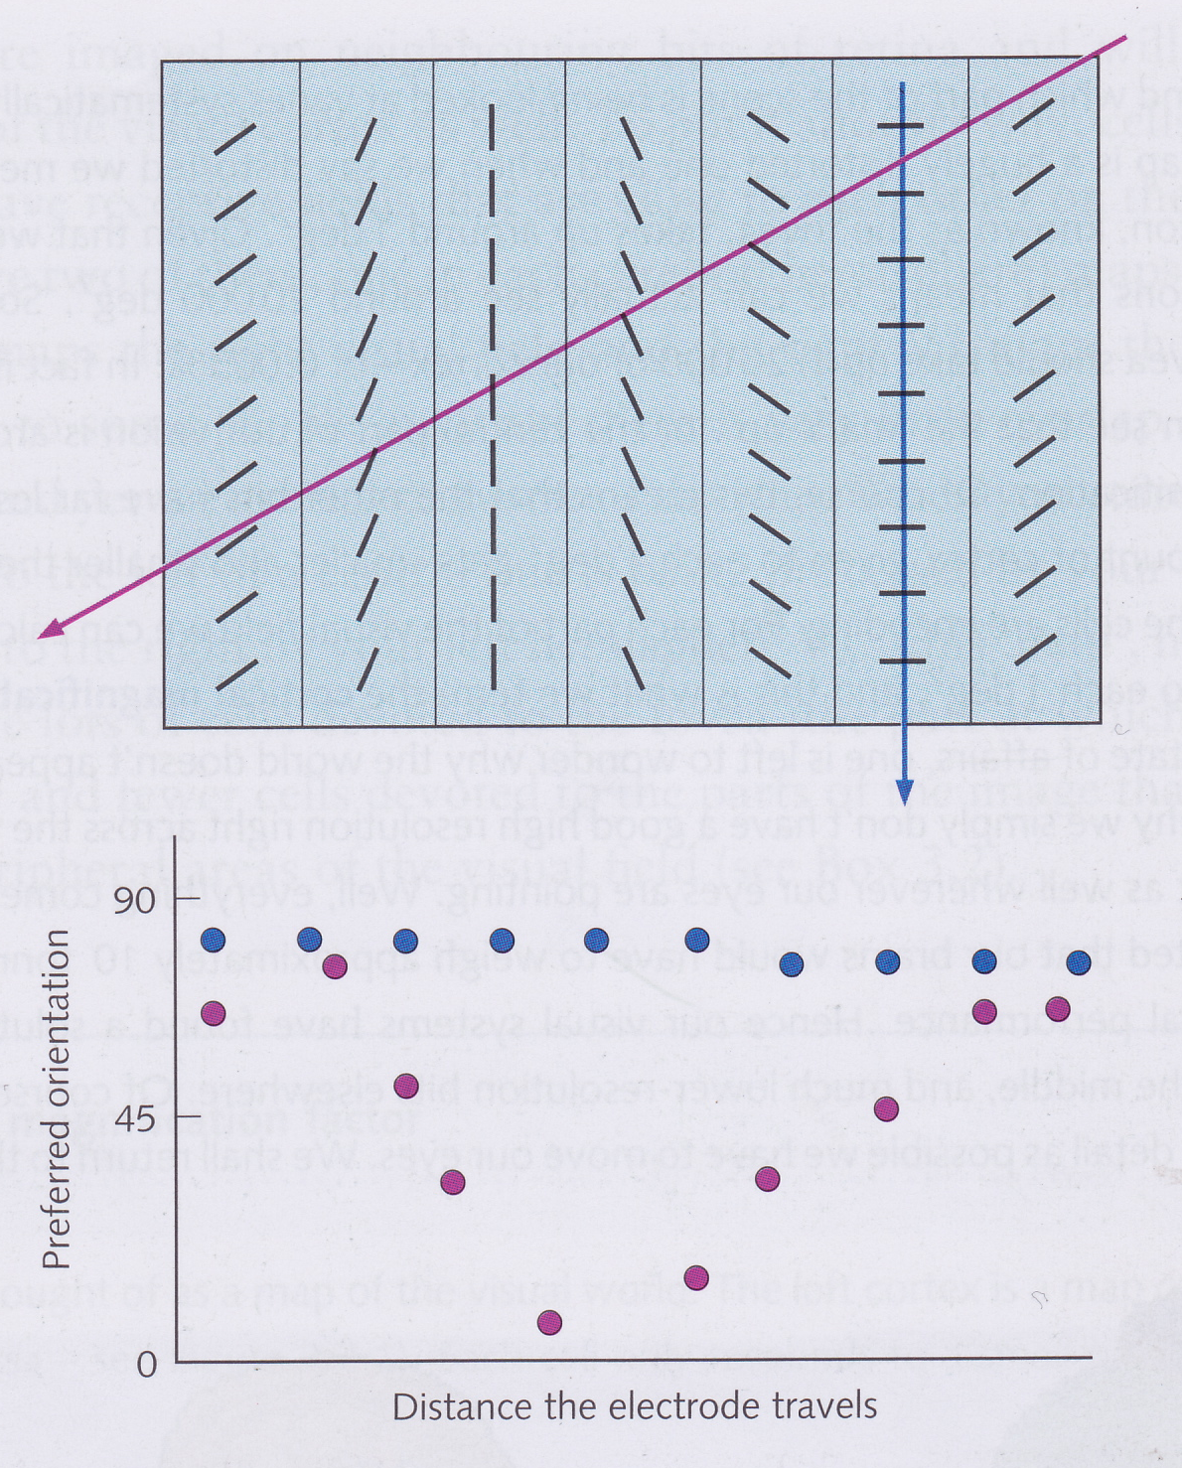
Orientation columns
Hubel and Wiesel found that the cortical cells in a column at right angles to the surface all had the same orientation (blue line)
When electrode inserted at an angle, characteristic orientation progresses in an orderly manner (pink line)
Cells therefore organised into orientation columns
A whole set of columns covering all orientations is called a hypercolumn
Each column is about 1 mm² of the cortical surface
Adjacent hypercolumns code adjacent areas in the visual field
Hypercolumns in the centre of the field code small area
Hypercolumns coding peripheral field code larger areas
So we see a line of a particular orientation in a particular place because a particular cell fires!
How far can this idea be taken? Is there a cell that fires when we see a dog and another cell firing when you see your grandmother? This idea is called the grandmother cell hypothesis

Slide 14
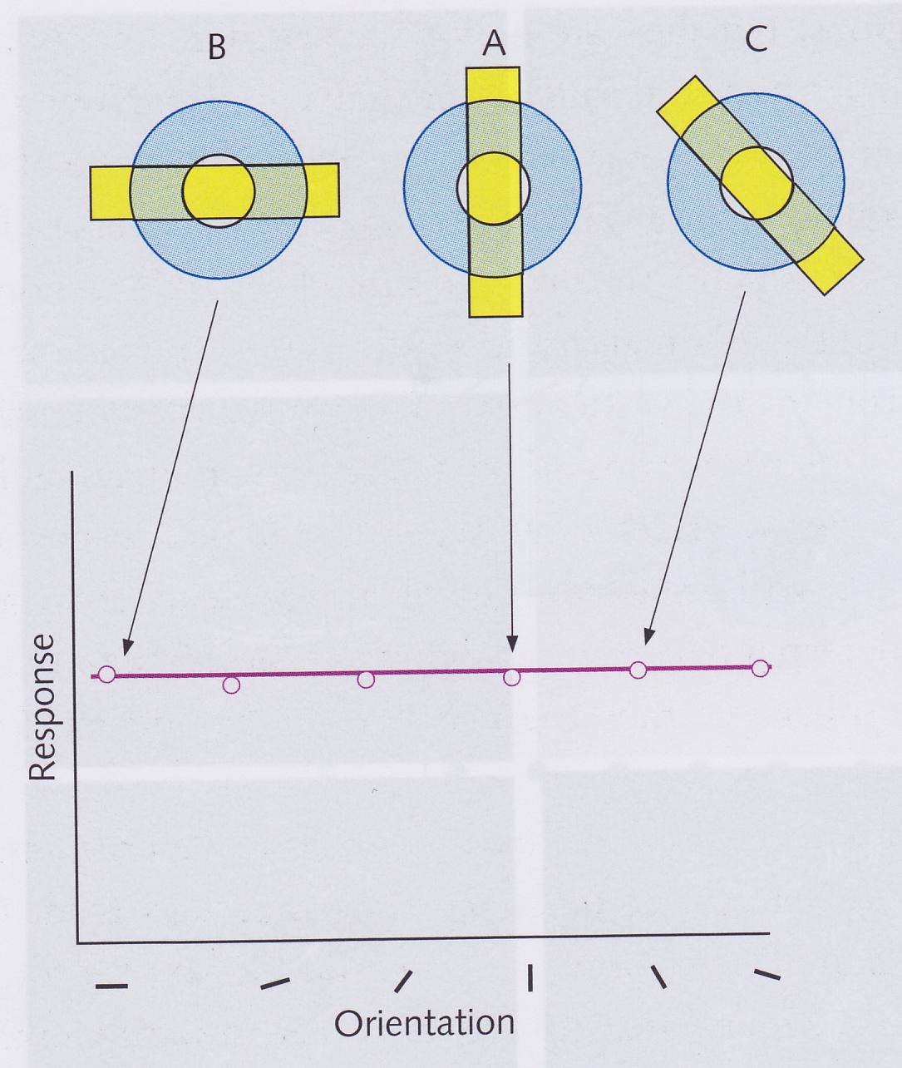
Orientation selectivity
How can a single V1 cell be tuned for a particular orientation?
LGN cells have circular receptive fields, so cannot distinguish between different orientations
We need receptive fields of a different shape!

Slide 15
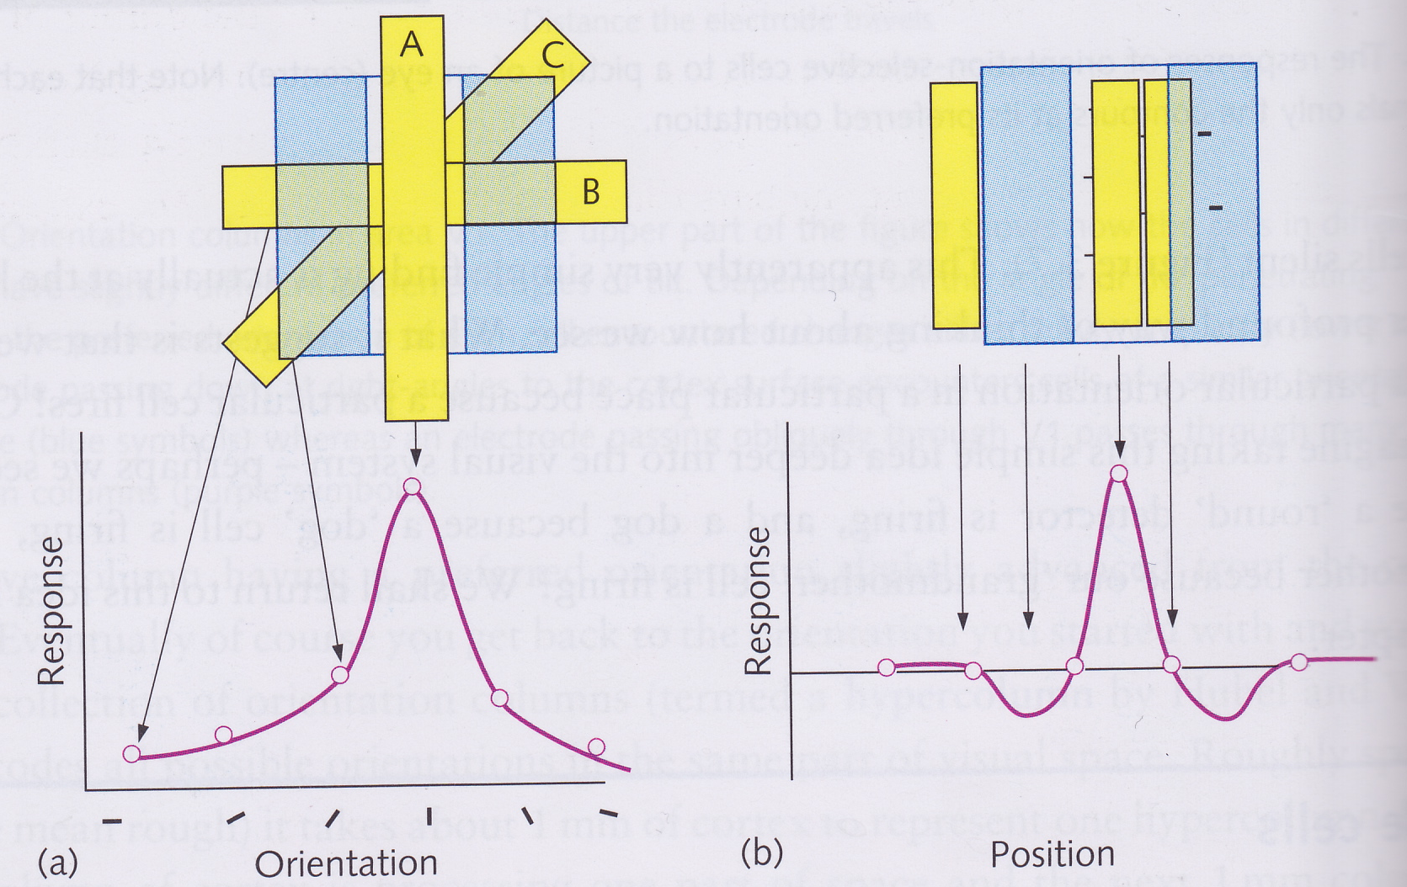
Bar-detecting receptive fields
Some V1 cells have receptive fields that only give a strong response when there is a bar in a particular orientation
Give a weaker response if the bar is tilted at a slightly different angle from that to which the cell is tuned
Tilted receptive fields respond best to bars tilted at the same angle

Slide 16
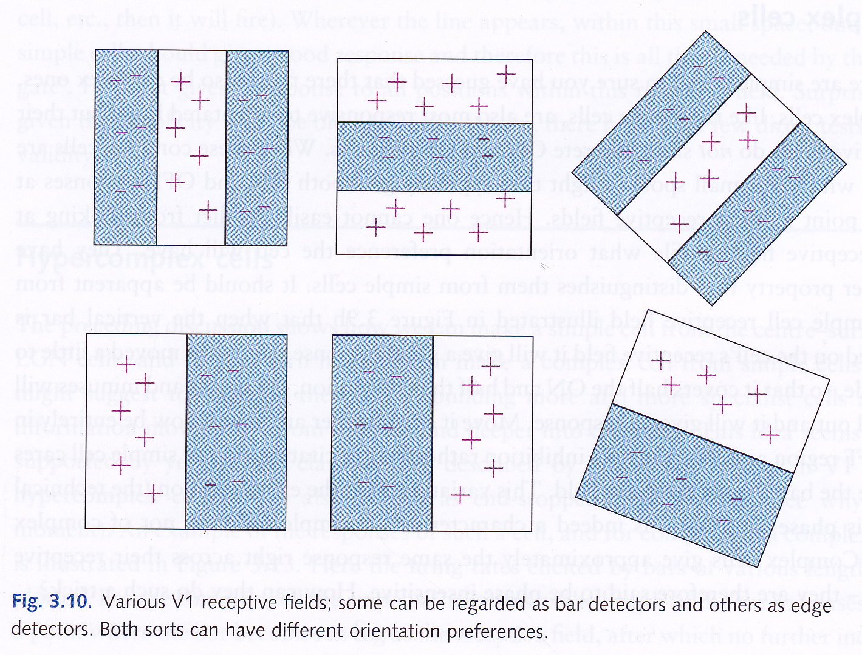
Bar and edge detectors

Slide 17
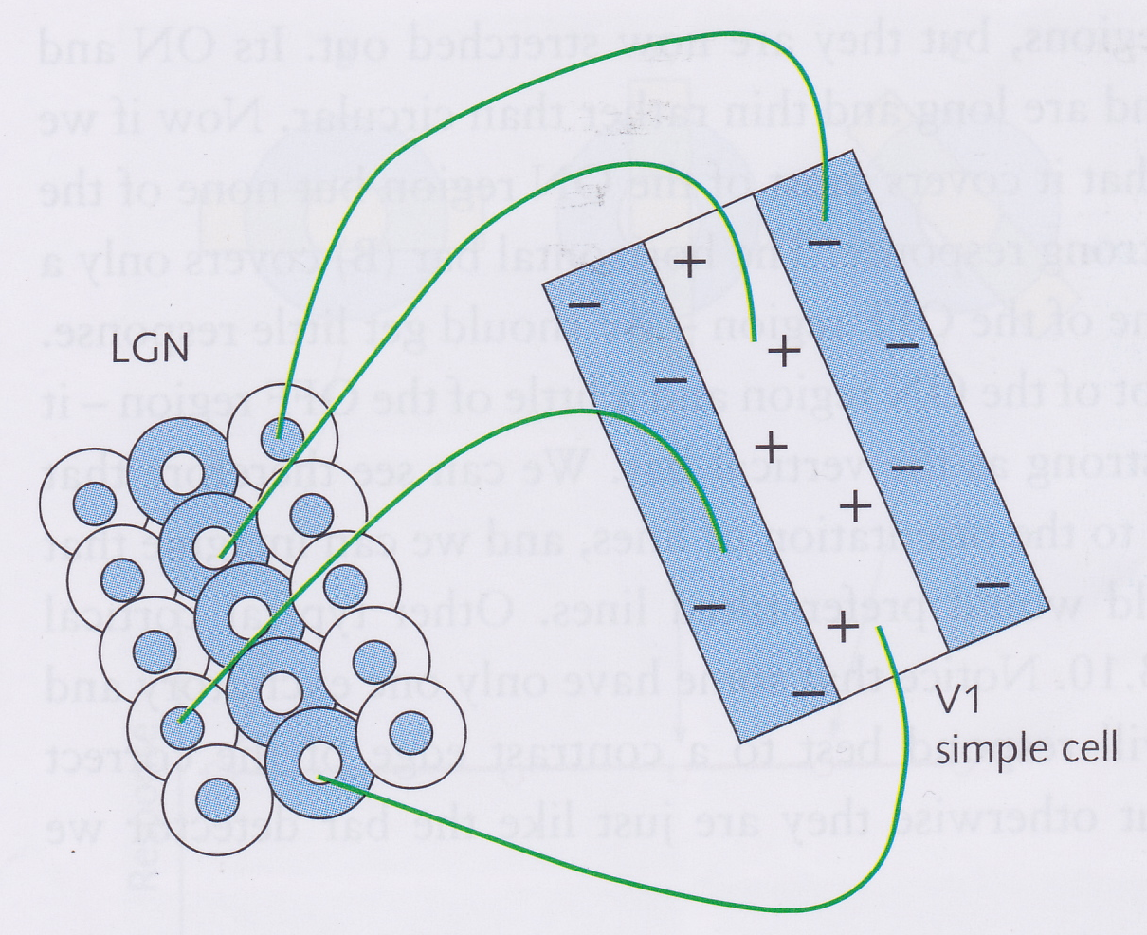
V1 Simple cell
A V1 cell that detects bars will receive input from a number of LGN cells
The RFs of these LGN cells are arranged as three lines of cells, the middle line with ON-centre RFs and the outer lines with OFF-centre RFs
Such a V1 cell that receives input from a set of adjacent LGN cells is called a simple cell

Slide 18
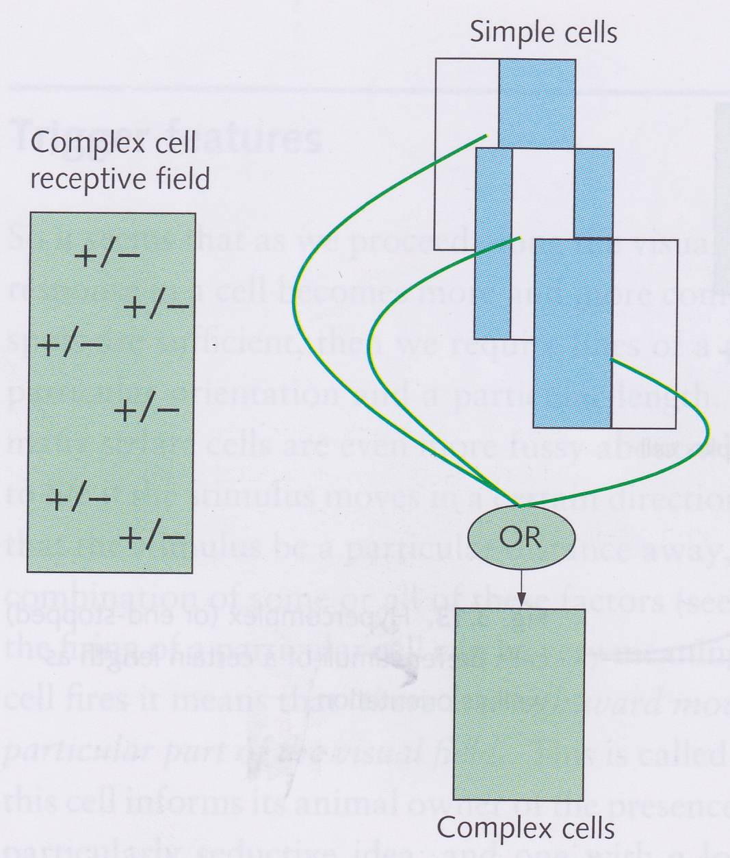
V1 Complex cell
A V1 simple cell only responds maximally to a bar when it is in a specific location within the cell’s receptive field
This is called phase sensitivity
A V1 complex cell can respond maximally to a bar with a specific orientation if it occurs anywhere in the cell’s receptive field
This is called phase insensitivity
Complex cell performs OR operation on inputs from a number of simple cells

Slide 19
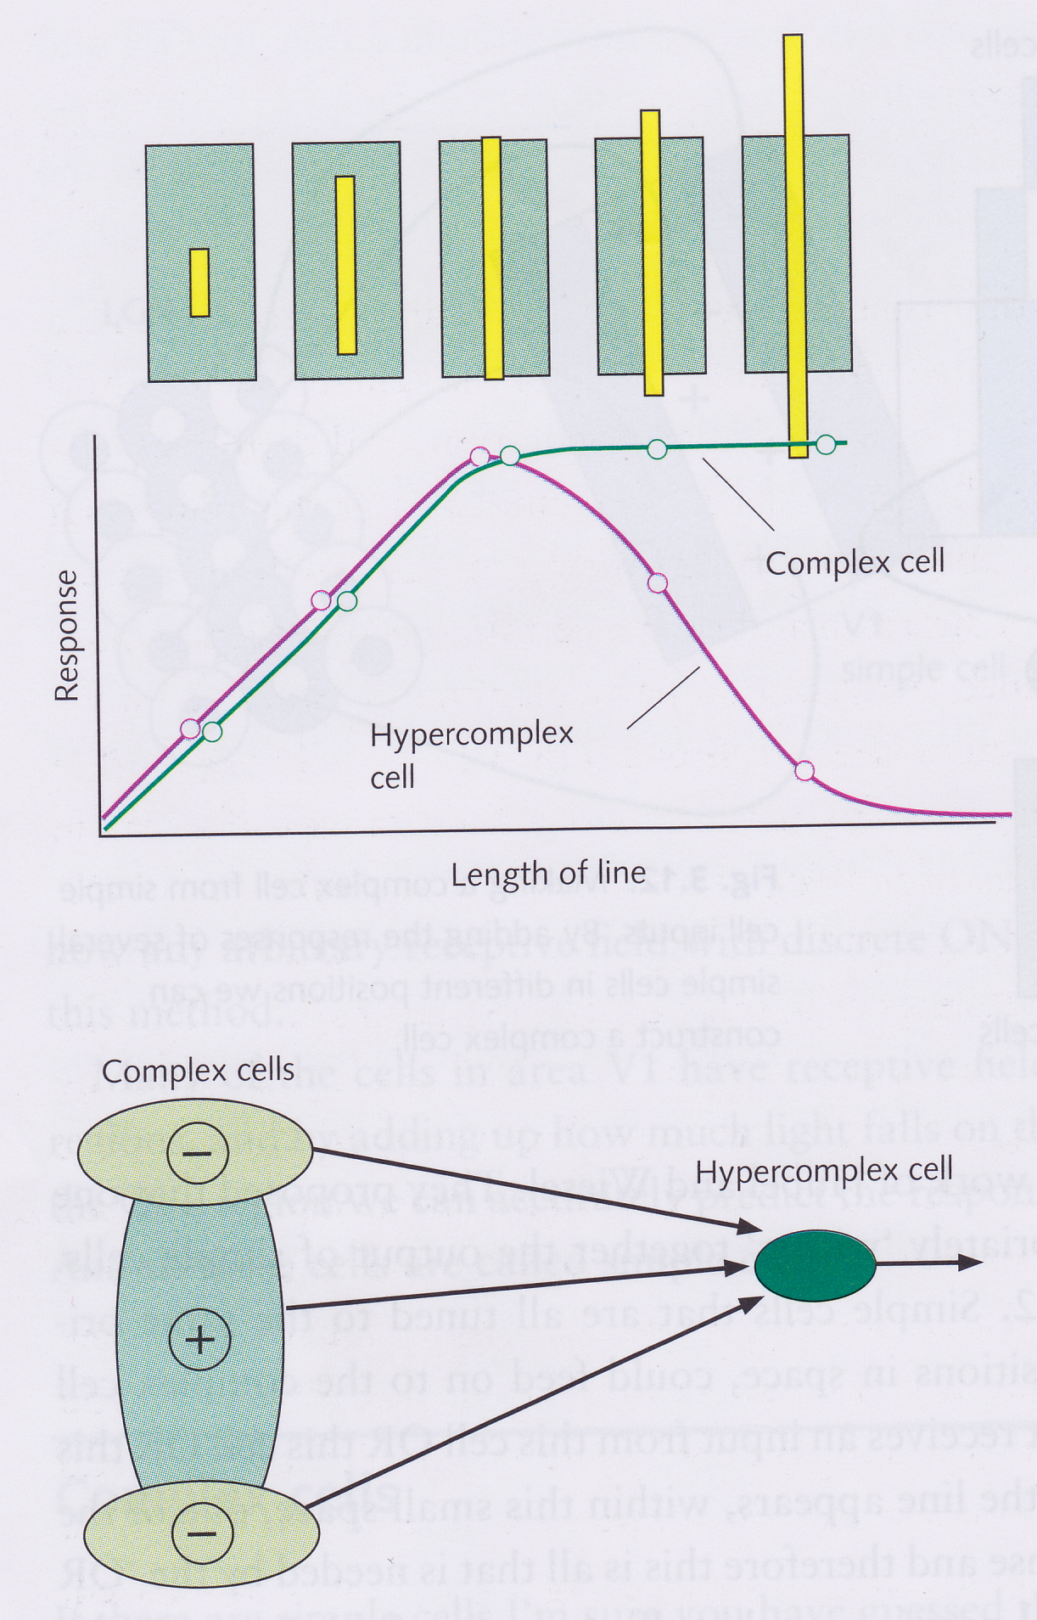
V1 Hypercomplex cells
Each simple cell integrates input from a number of LGN cells, each with a circular RF
Each complex cell integrates input from a number of simple cells, each with a rectangular RF
A hypercomplex cell integrates input from a number of complex cells so that it responds maximally to a bar with a particular orientation and length

Slide 20
Trigger features
As we move higher up the visual pathway, the stimulus to which a cell responds becomes more and more complex and specific
LGN: Edges and bars without orientation
Simple cells: bars or edges in a particular place with a particular orientation
Complex cells: bars or edges in the RF of the cell with a particular orientation
Hypercomplex cell: bars or edges with a particular orientation and length
Trigger feature is what a cell responds maximally to
Some cells have even more complex trigger features
e.g., rightward-moving line at 15 degrees to the vertical in this particular region of the visual field
Letvinn et al. (1959): bug detectors in frogs that respond only to small, dark, convex objects moving rapidly

Slide 21
Neural doctrine
Barlow (1972):
“Just as physical stimuli directly cause receptors to initiate neural activity, so the active high-level cells directly and simply cause the elements of our perception”
Hypothesis that for each thing we can recognize there is a cell at some high-level in the visual pathway that responds specifically to this thing
Not much evidence for this – very hard to find evidence since we can’t know beforehand what thing a particular cell codes for and we can’t test the cell on all possible things!

Slide 22
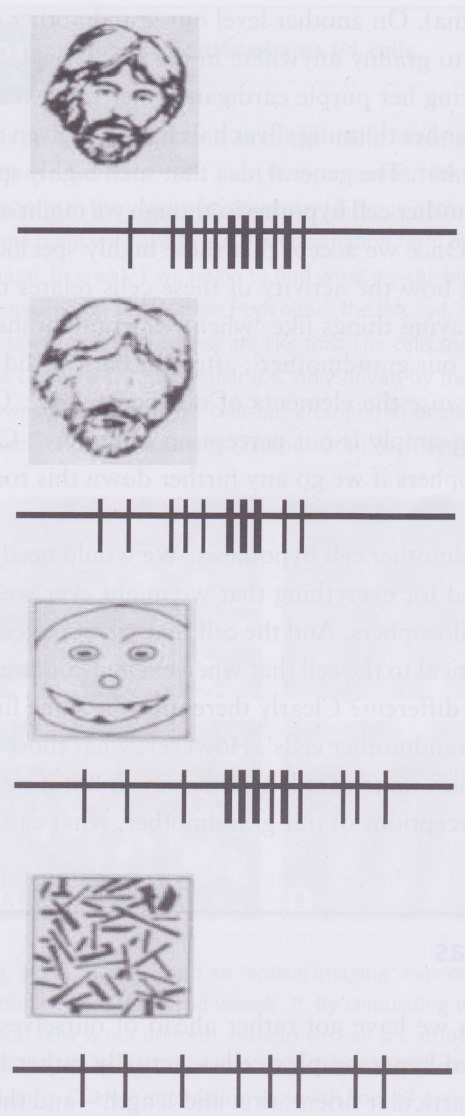
Face cells
Face-selective cells in the inferior temporal lobe of the primate brain
Just a few synapses away from the striate cortex
Removing eyes (in the picture, not the animal) reduces response
Cannot prove that cell doesn’t also respond to something else too

Slide 23
The Grandmother Cell Hypothesis
If we have cells that respond to faces, maybe we have cells that respond to individual people, such as one’s grandmother
Such a cell would be very specific – responding to a particular person
But it would also be very general, since it must respond to your grandmother regardless of where she is or what angle you’re looking at her from or what she is wearing

Slide 24
Grandmother cell hypothesis
Proposal that there is a specific cell that responds to each thing that we can recognize is implausible
Suggests that if we delete that cell, we would lose the ability to recognize the thing that it codes for
In practice, it seems that different things are coded in a distributed way – as a pattern of activation over a whole area of cells

Slide 25
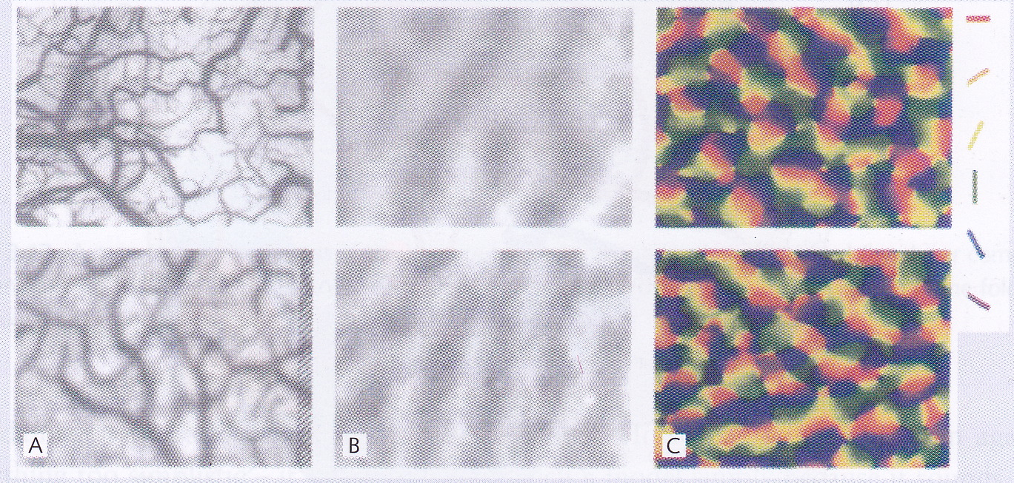
Columnar organisation in V1
Each cell in the LGN is monocular – it receives information from only one eye
V1 cells that receive information directly from LGN are also monocular
Arranged in ocular dominance columns alternating between the eyes
A is a high-resolution image of the cortical surface
B shows that blood flow is in stripes when one eye is stimulated, showing that cells associated with each eye are arranged in columns
C colour coding of orientation columns in a monkey (two rows are from different monkeys)

Slide 26
Binocular cells and other properties of V1 cells
V1 begins to put information from both eyes together to give a single view of the world
70% of V1 cells are binocular
Nearly all cells in later extrastriate areas are binocular
Combining information from both eyes allows for depth perception
Some cells are directionally selective (see slide 8) and send information on to area V5

Slide 27
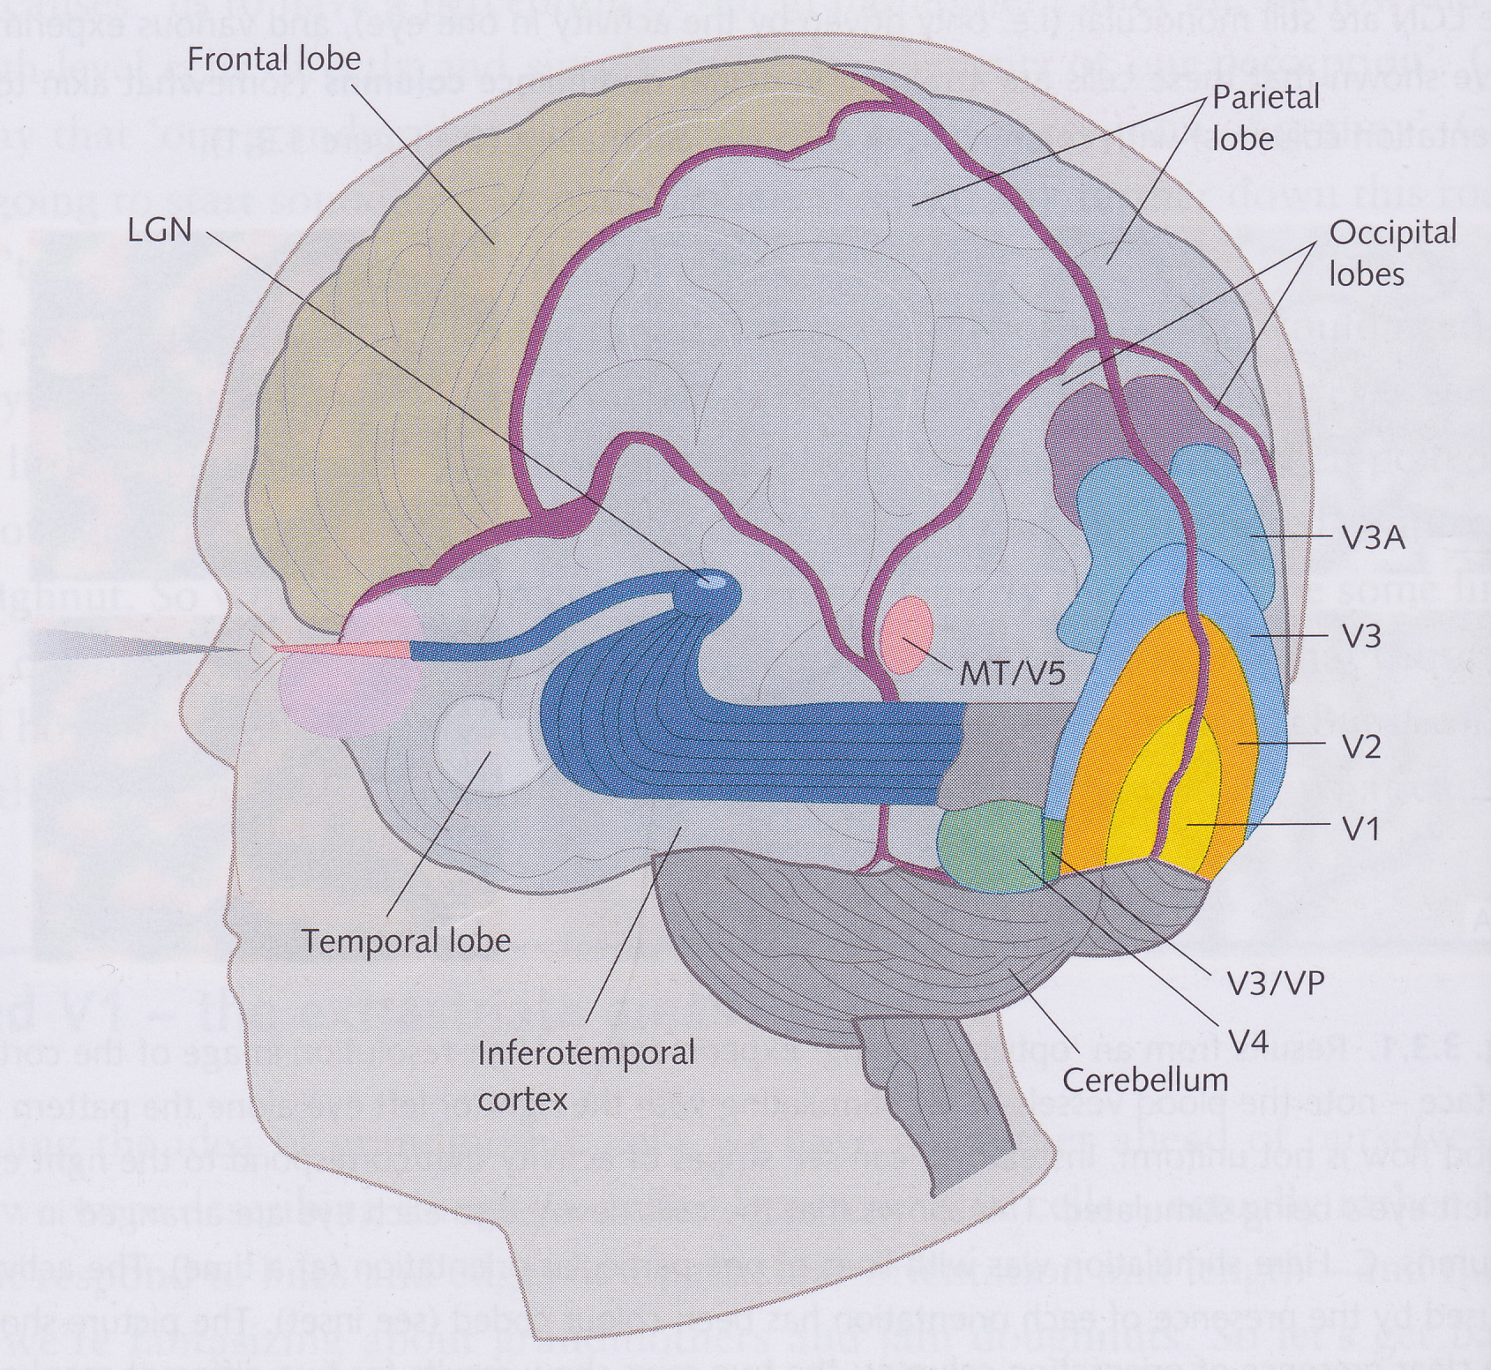
Beyond V1 – The Extrastriate Areas
V1 is retinotopic
V1 cells code for orientation, direction of motion, binocular disparity, colour, etc.
V2 is next to V1 and is also retinotopic
More than 30 visual areas beyond V1 in the extrastriate cortex

Slide 28
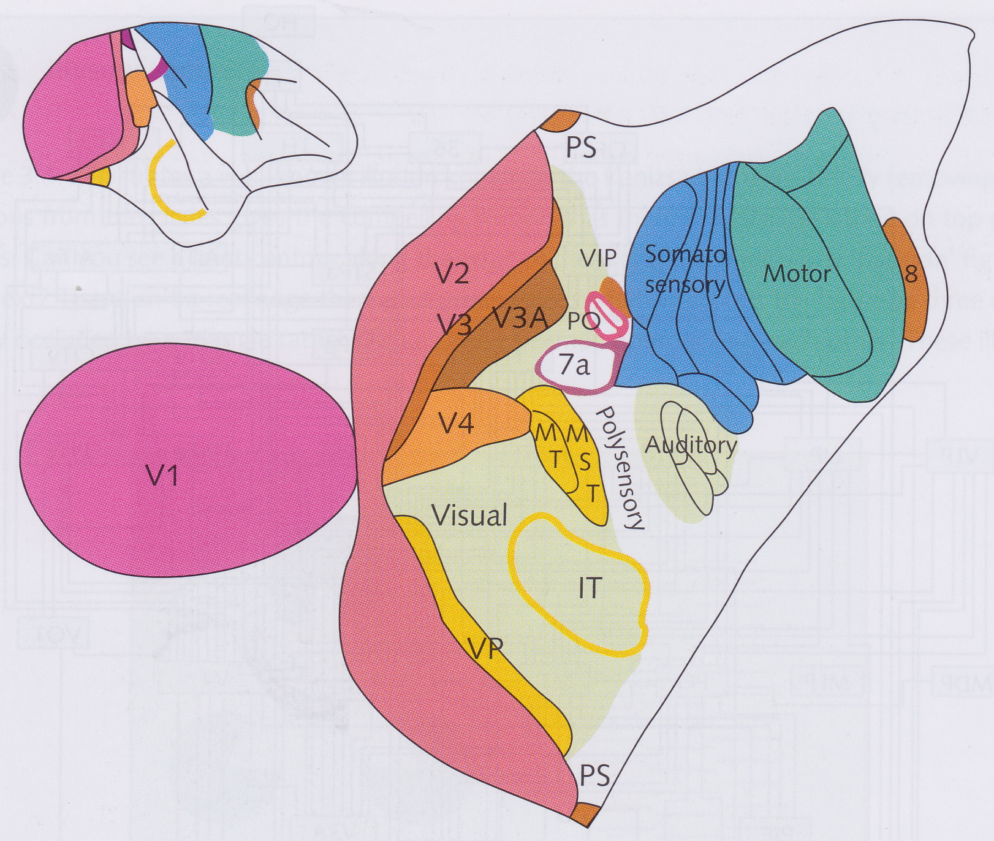
Extrastriate Visual Cortex
Over 30 areas of cortex dedicated to vision
Why so many?
Maybe each region specialized for particular aspect of vision, e.g.
V3: form perception
V4: colour perception
V5: motion perception
V9: eye movements
But this is a simplification!

Slide 29
Connections between visual areas
Connections between visual areas are very complex
Both bottom-up and top-down connections
Higher regions can control how lower regions respond to input
So no area can be totally isolated and responsible for a single aspect of vision

Slide 30
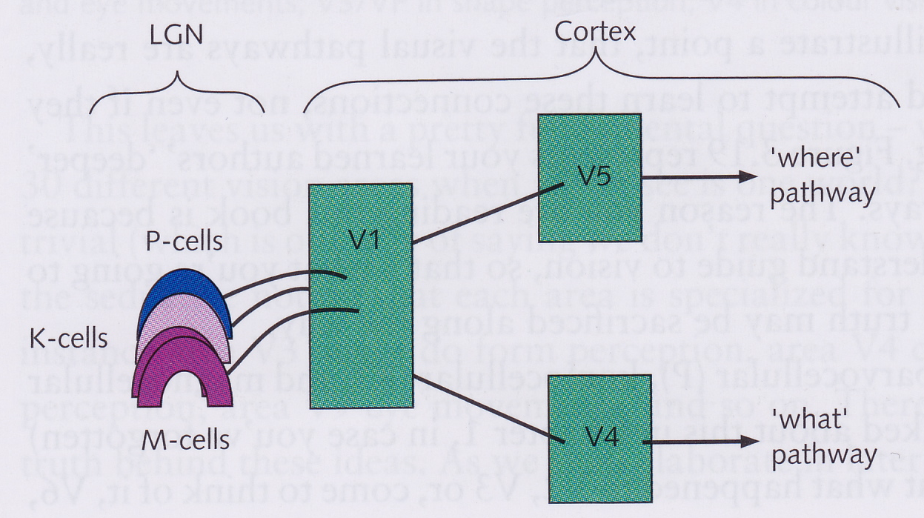
The “what” and “where” pathways
Simplified map of connections between visual areas
Start with parvo-, magno- and koniocellular streams from the LGN
Roughly speaking,
M-cells project to V5, which projects to a “where” pathway
P-cells project to V4, which projects to a “what” pathway
V5 cells triggered by movement, selective for speed and direction
V4 cells may be triggered by colour
How are all the different features of a scene (e.g., colour, movement) integrated into a single percept?

Slide 31
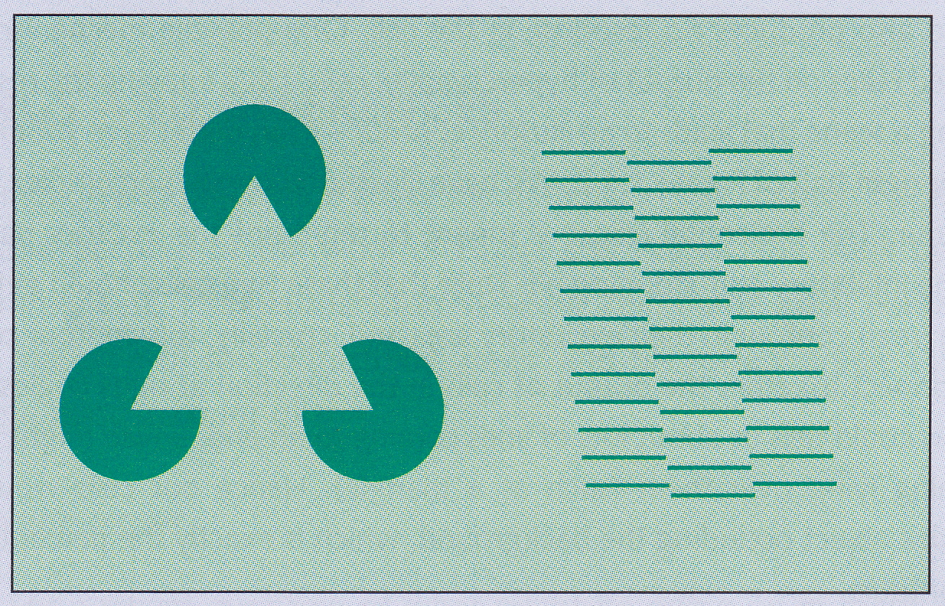
Illusory Contours
Kanisza triangle (at left)
seen as a triangle occluding 3 circles
not as 3 pacmen on a collision course
Vertical sloping lines between line segments
V1 cells do not respond to illusory contours
Some V2 cells respond to illusory contours like they were real lines

Slide 32
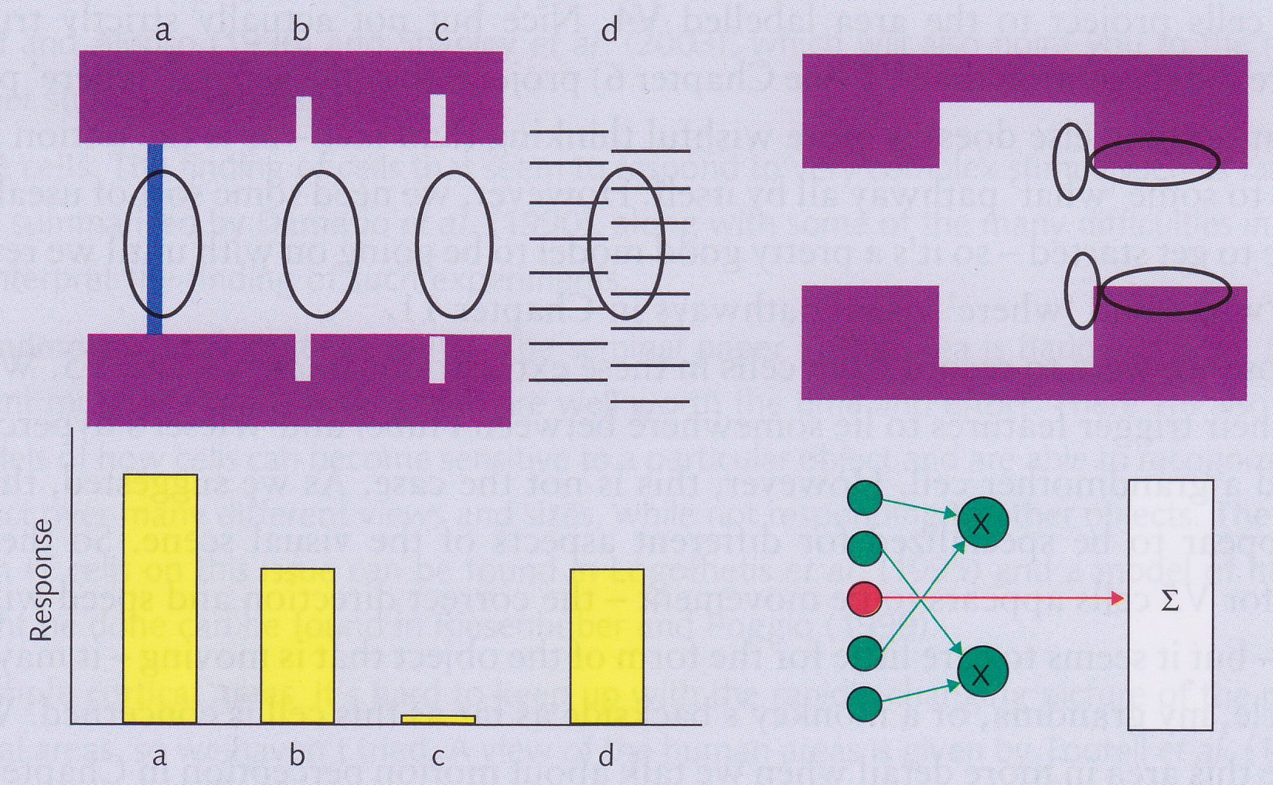
V2 cells responding to illusory contours
V2 cell responds well to a, b and d
In c, interrupting line prevents perception of contour
Can explain with hypercomplex cells:
Two cells shown would be highly excited
Mind hypothesizes that there is something covering the region between the two cells, but that if there wasn’t, these would also be excited by a vertical line
Seems that two aligned hyper-complex cells must cause intermediate hypercomplex cells to be stimulated

