Slide 1
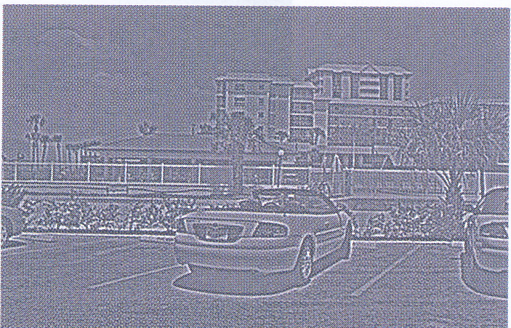
Signalling Changes
David Meredith
Aalborg University

Slide 2
Reading for this lecture
This lecture is based on Chapter 2 of
  Snowden, R., Thompson, P. & Troscianko, T. (2006). Basic Vision: An Introduction to Visual Perception. OUP. (ISBN: 978-0199286706)

Slide 3
Overview
Visual systems must deal with an enormous range of conditions
How does our visual system turn the light coming into the eyes into a model of the world around us?
Early visual system discards lots of information
Keeps information about edges and changes in an image
Does nothing unless it has to
  So if something doesn’t change for a long time, it can completely disappear!

Slide 4
Vision must be selective
Vision’s job is to give us the information we do need…
  e.g., ripe fruit, a bus coming towards us, a face that we recognize
…and discard the information we don’t need

Slide 5
How much information passes through the retina?
120 million rods, 8 million cones in each eye
Assume 200-300 shades of light (levels of luminance) ≈ 256 levels = 8 bits = 1 byte
So roughly 130 Mb in each retina
Assume 30 frames per second: 130 x 30 = 3900 Mb = 3.9 Gb per second per eye!
So a DVD (4.7Gb) on which you can store at least 1 feature-length movie is not big enough to store even 1 second of all the information that is coming into the retinas of the two eyes
The optic nerve has only 1 million nerve fibres, so only a summary of this information gets sent on to the brain

Slide 6
Receptive fields
Most of our knowledge about retinal ganglion cells comes from single cell recording studies
A retinal ganglion cell is firing at a fairly low baseline rate even when it is not being stimulated
When light is shone on the retina, the firing rate of a particular cell will stay the same unless the light is shining on a very specific area of the retina
If the light is shining on the small area with which a particular ganglion cell is associated, then the firing rate of the cell can go up or down!
This area of the retina to which a ganglion cell is sensitive is called the receptive field of the cell

Slide 7
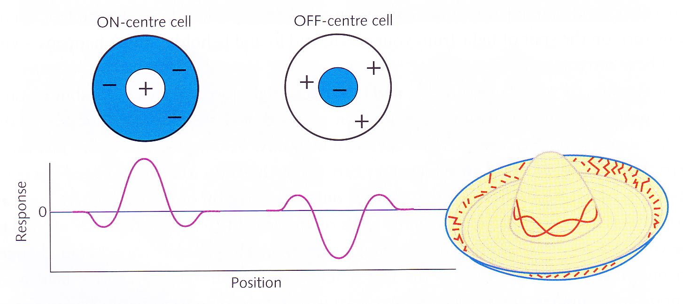
ON-centre and OFF-centre cells
If we shine light on one part of the receptive field for a cell, then the firing rate increases (the ON region)
  This is called excitation
If we shine it on another part of the receptive field, the firing rate decreases (the OFF region)
  This is called inhibition
Receptive fields have a circular, centre-surround form
There are two types:
  ON-centre cells: the centre is ON and the surround is OFF
  OFF-centre cells: the centre is OFF and the surround is ON
The maximum excitation or inhibition is caused by light shining on the centre of the centre region and on a point on a circle through the centre of the surround
  This gives a “Mexican hat” shaped curve for the response of the ganglion cell to light within its receptive field

Slide 8
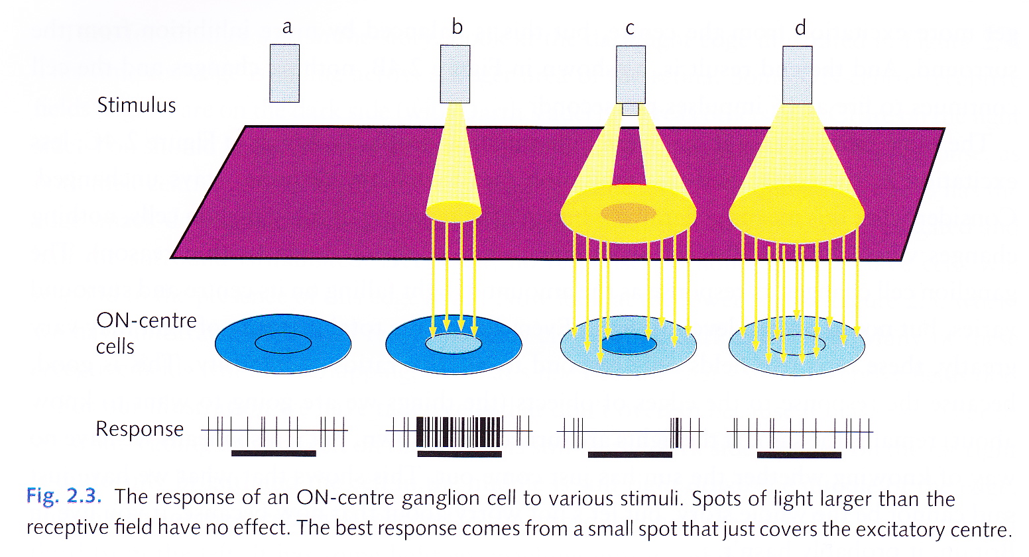
Response of ON-centre cell

Slide 9
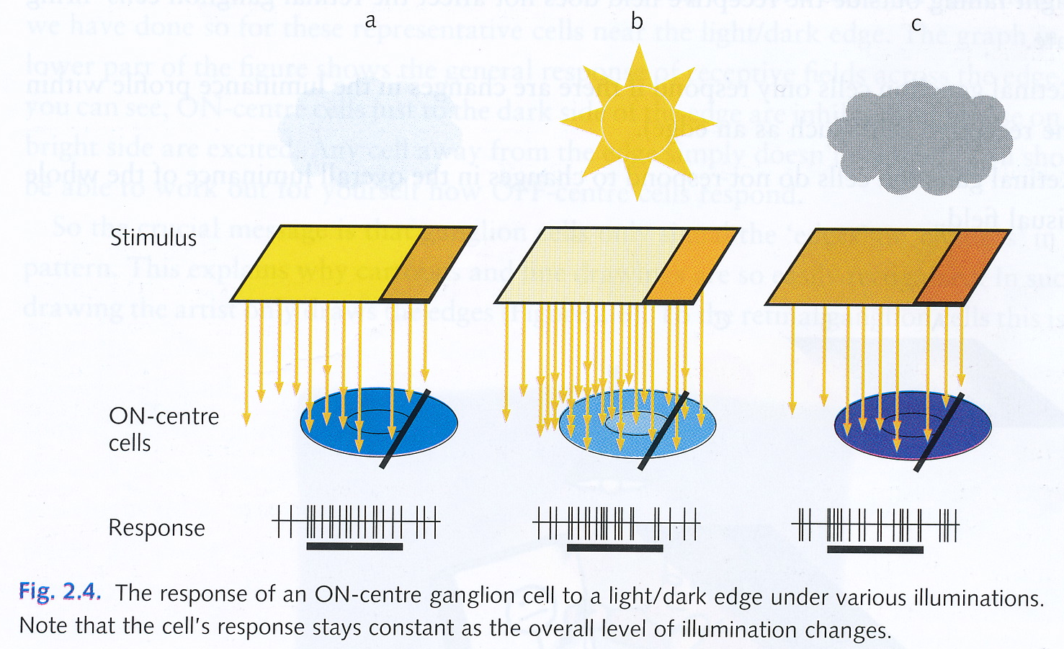
Response of an ON-centre cell to a light/dark edge

Slide 10
The story so far
Light falling outside the receptive field has no effect on firing rate
The number of inhibitory receptors in the OFF region is typically equal to the number of excitatory receptors in the ON region
  So a retinal ganglion cell only responds if the illumination in the OFF region is different from that in the ON region (e.g., when there’s an edge across the field)
If the overall illumination of the visual field changes, this does not cause a large change in the firing rate of a retinal ganglion cell

Slide 11
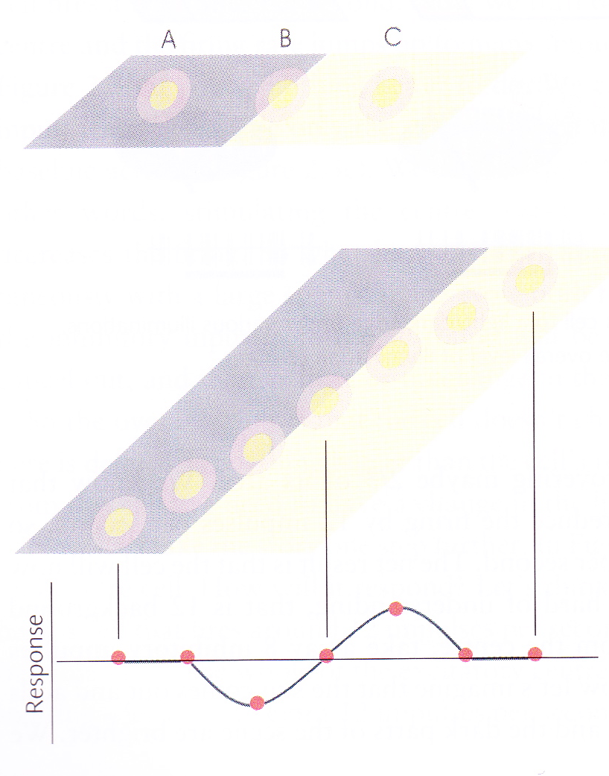
Signalling edges
A, B and C are not responding because activation of ON = activation of OFF
Receptive fields actually usually overlap, though they don’t here
Groups of ganglion cells can signal edges or changes in the field
Note that the group of cells tell us which side of the edge is dark and which is light

Slide 12
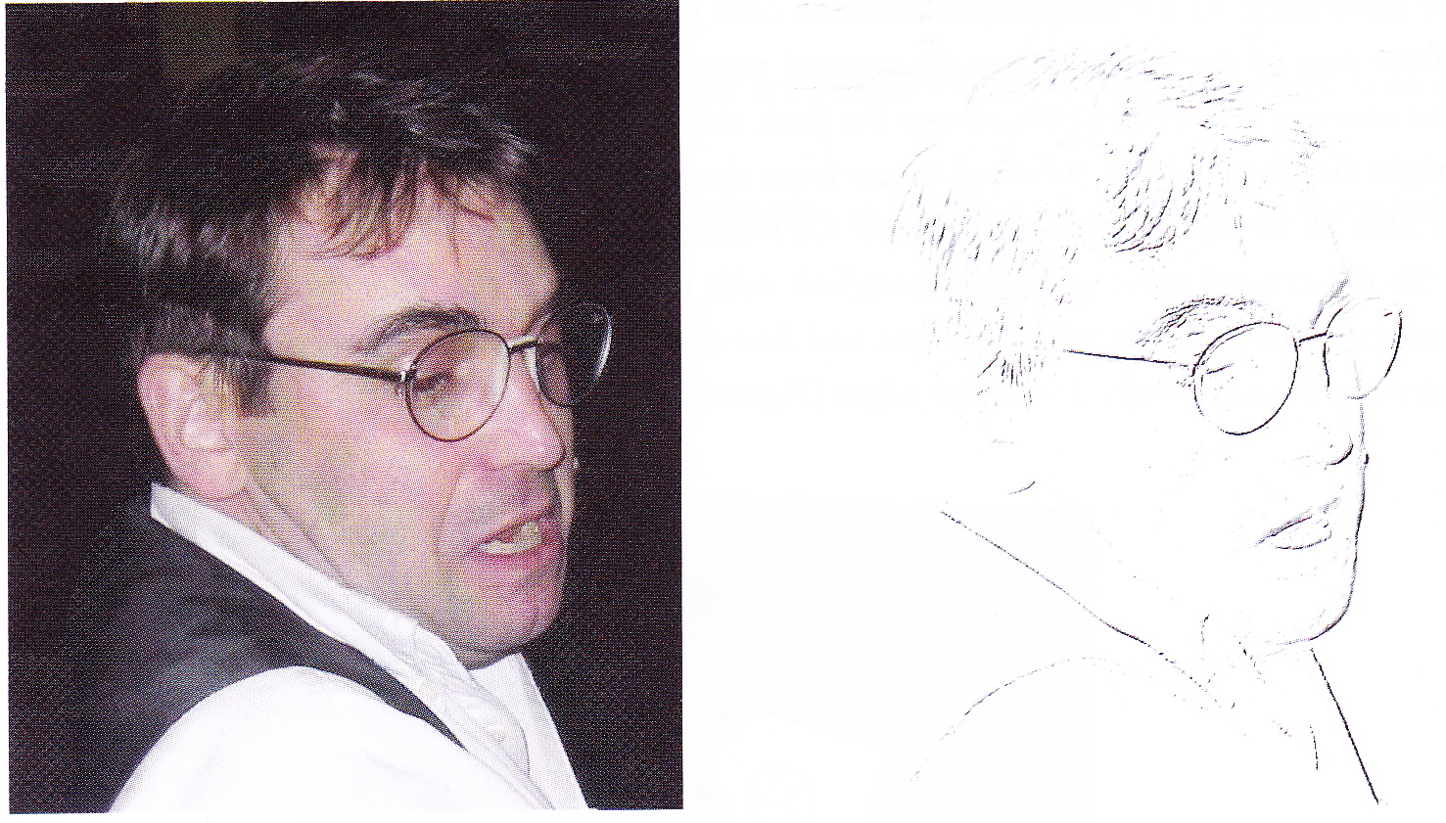
Ganglion cells signal changes
Cartoons and line drawings work because they contain most of the information that the visual system uses to recognize and make sense of a scene – that is, the edges or changes
Having to send on only the change information means that there is much less information that needs to be sent along the optic nerve

Slide 13
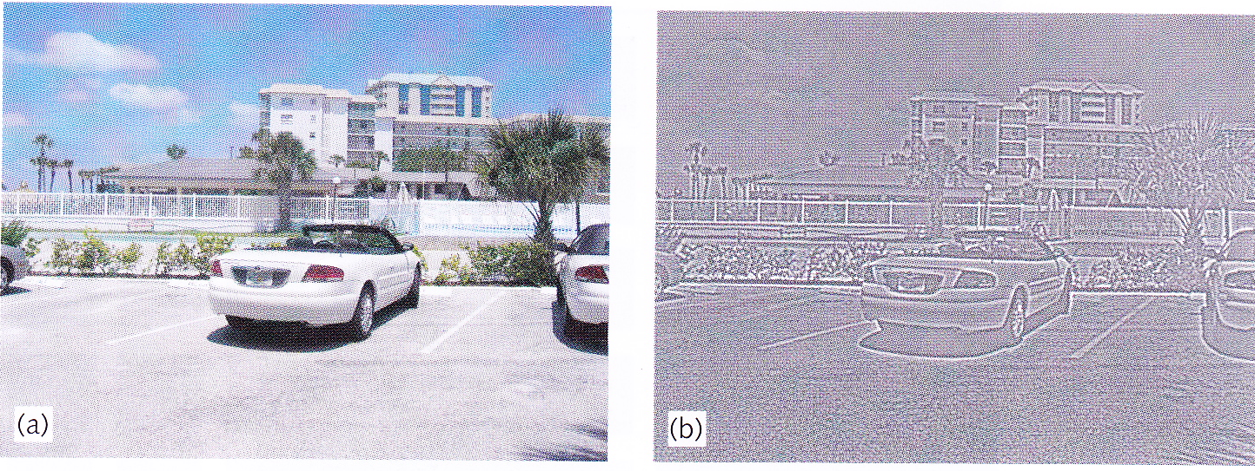
Filtering with an ON-centre ganglion cell receptive field
In (b), grey is no response, black is inhibition, white is excitation
An edge indicated by a black line and a white line next to each other
Black line on the dark side of the edge, white line on the brighter side of the edge
Means that typically less than 10% of the ganglion cells are used to code the picture

Slide 14
Concentric, antagonistic receptive fields
Ganglion cells have concentric, antagonistic receptive fields
This type of antagonism is called lateral inhibition

Slide 15
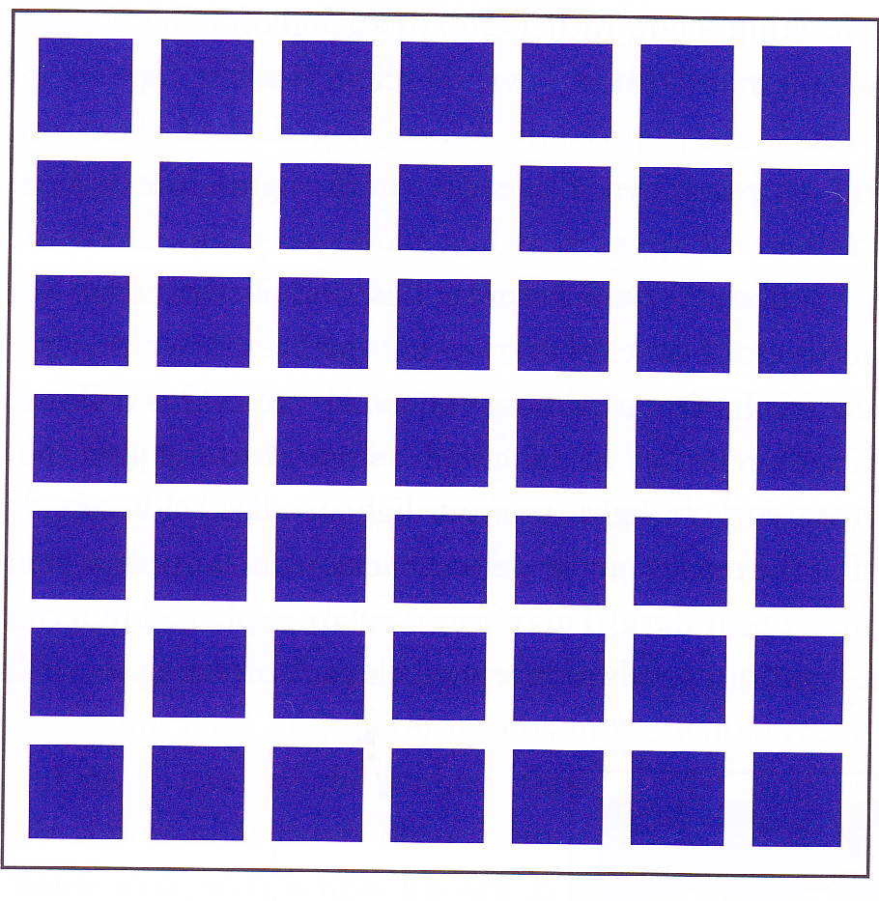
Hermann or Hering Grid

Slide 16
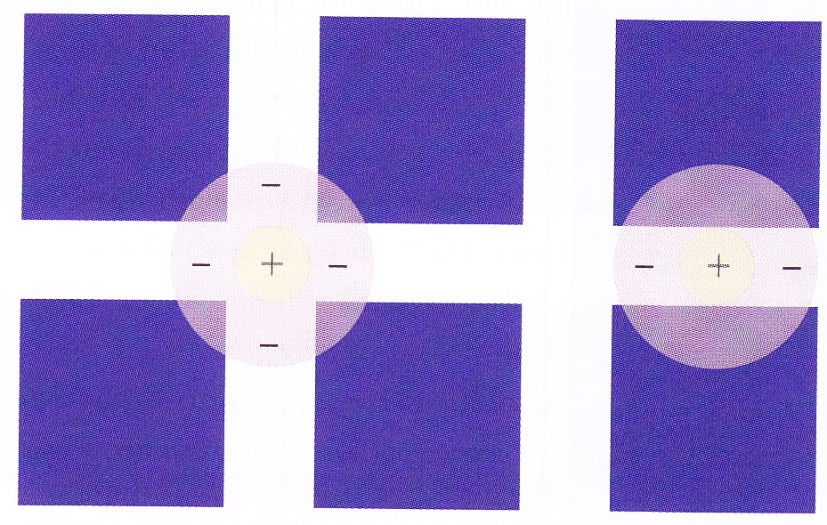
Explanation of Hermann grid
ON-centre receptive field centred on a junction had more light hitting its inhibitory surround than one centred on a street adjacent to a junction
  Lower firing rate interpreted as lower luminance
Receptive field in the fovea are too small to span a junction, so only peripheral vision affected

Slide 17
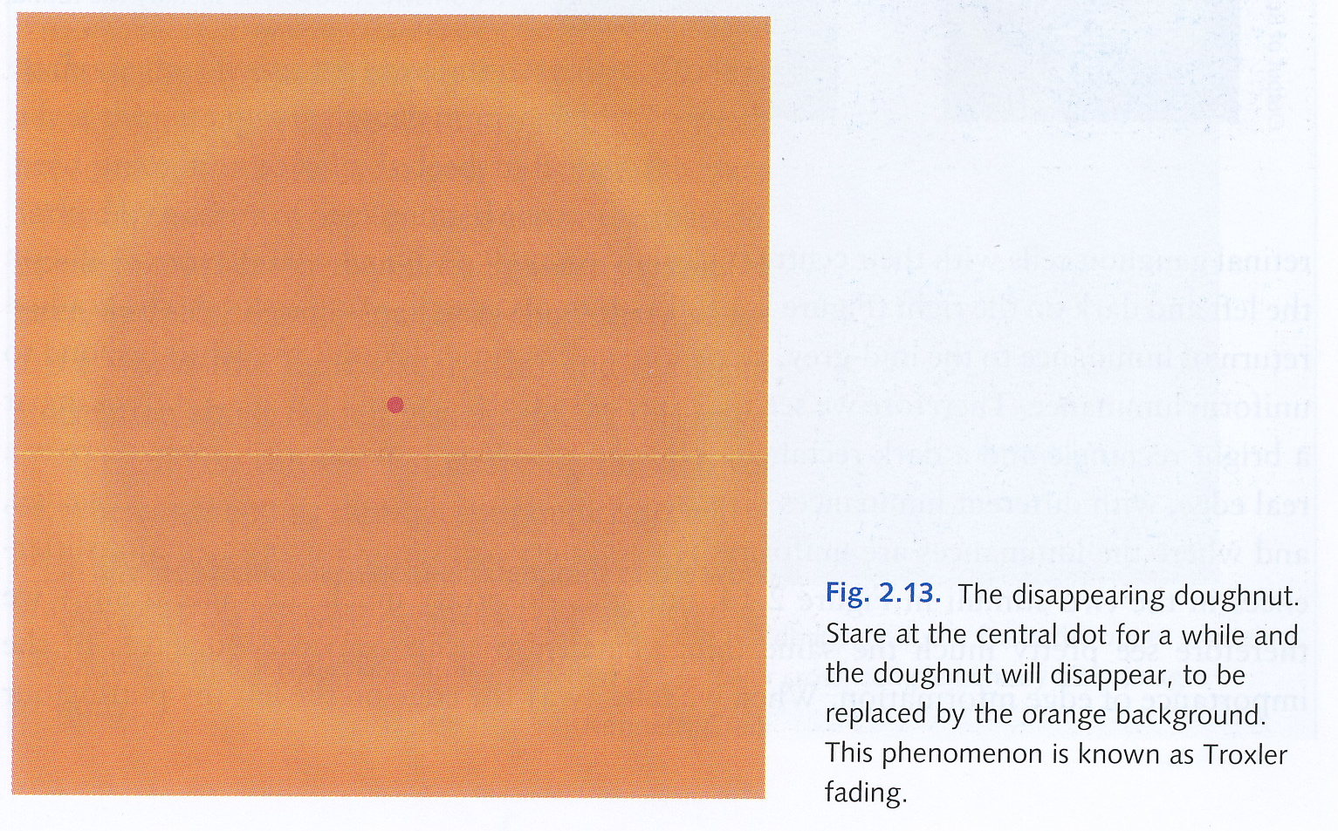
Troxler fading

Slide 18
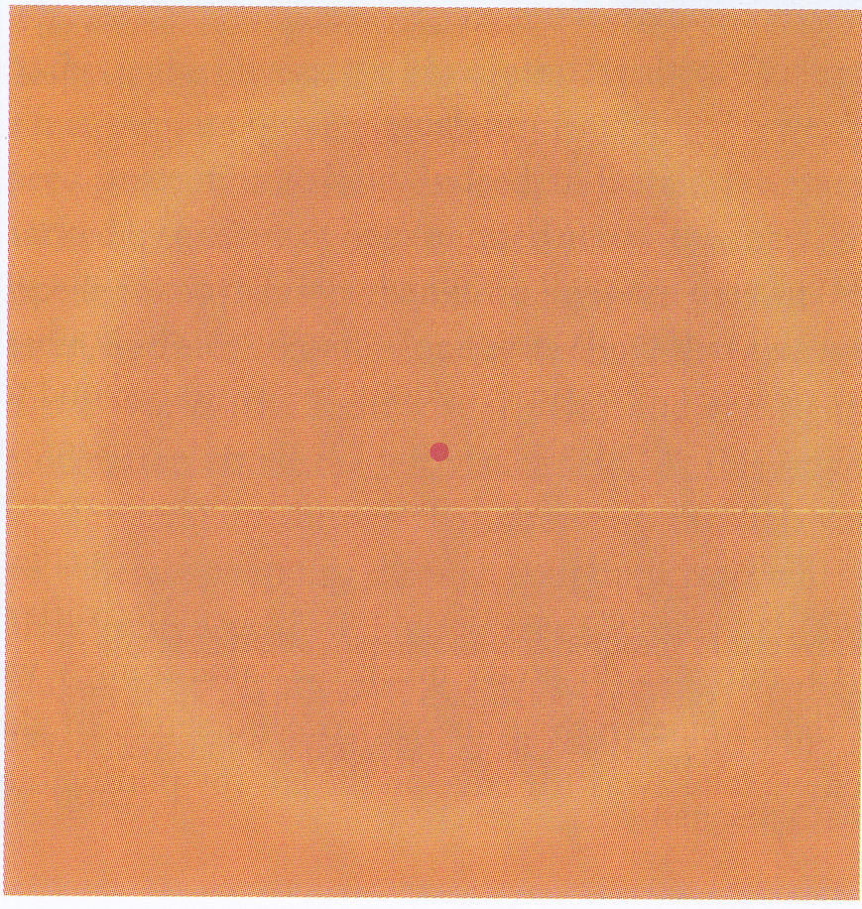
Explanation of Troxler fading
Visual system picks up edges of rectangle and assumes colour on inside of edge continues until another edge is detected
Doughnut edge is blurry and eyes are still, so fail to pick up the doughnut edge, so visual system assumes colour continues through this edge

Slide 19
Craik-O’Brien-Cornsweet illusion
http://web.mit.edu/persci/gaz/gaz-teaching/flash/craik-movie.swf

Slide 20
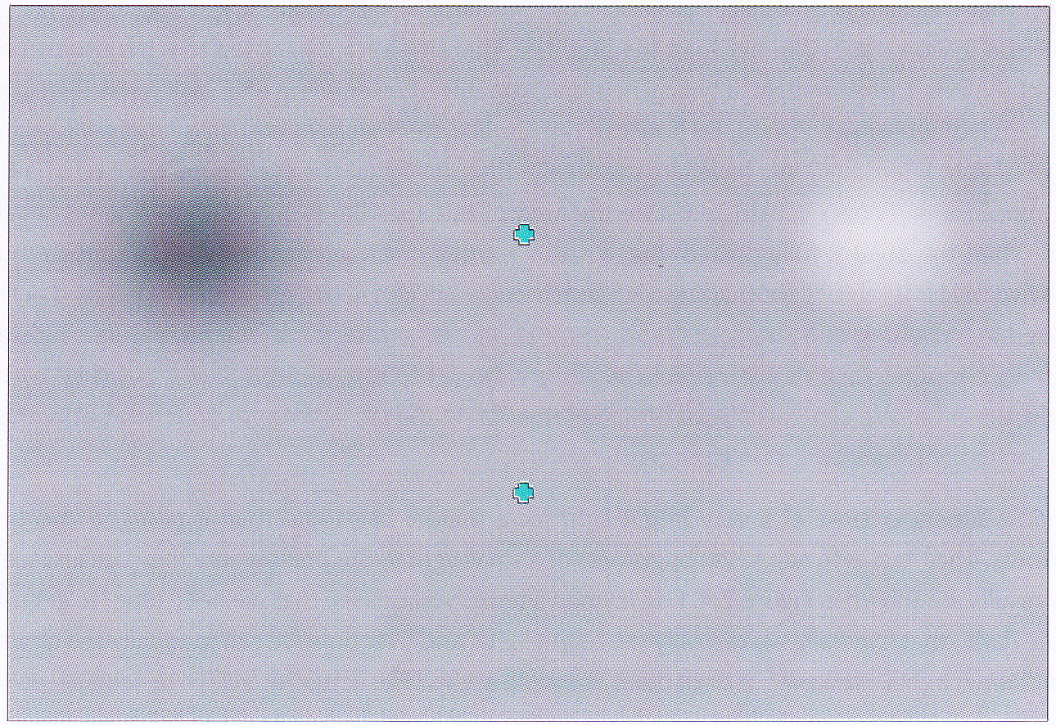
More Troxler fading

Slide 21
Change over time
Retina is detector of change in time as well as space (edges)
Some cells have a sustained response: they keep firing at the same high rate when they are stimulated
Other cells are transient: they give a short burst of high-rate firing
Even sustained response cells return to baseline after a while

Slide 22
Explanation of Troxler fading
Tremor: constant small movement of eyes
If tremor is eliminated, then after a while your whole visual field goes a dull grey
In the Troxler fading example, the transient cells report no change in the image and the sustained cells eventually lose interest too
Because cells have adapted to the pattern at the top, when you move your eyes down to the lower cross, your eyes register an increase in brightness on the left (threshold reduction, hence a white blob) and a decrease in brightness on the right (threshold elevation, hence a black blob)

Slide 23
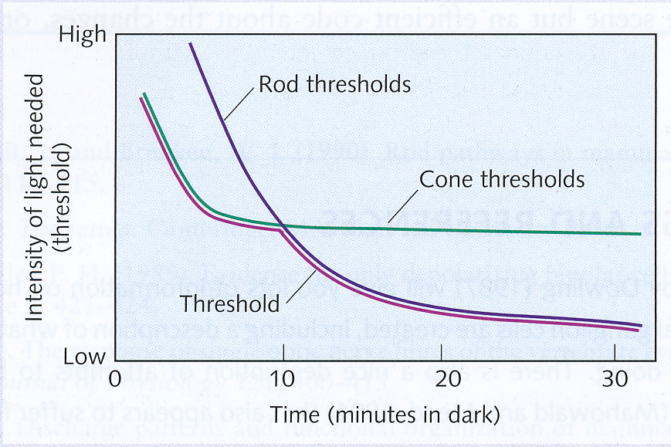
Dark adaptation
After looking at a bright light, both cones and rods get bleached
If then placed in the dark
  cones recover quickly to their normal sensitivity after about 5 minutes
  rods recover to their normal (lower) sensitivity after about 30 minutes
Takes about 10 minutes before rod sensitivity is lower than cone sensitivity
Therefore ability to see in the dark increases for about 5 minutes, then stays constant for about 5 minutes, then increases again after 10 minutes and improves until you’ve been in the dark for about half an hour

