Slide 1
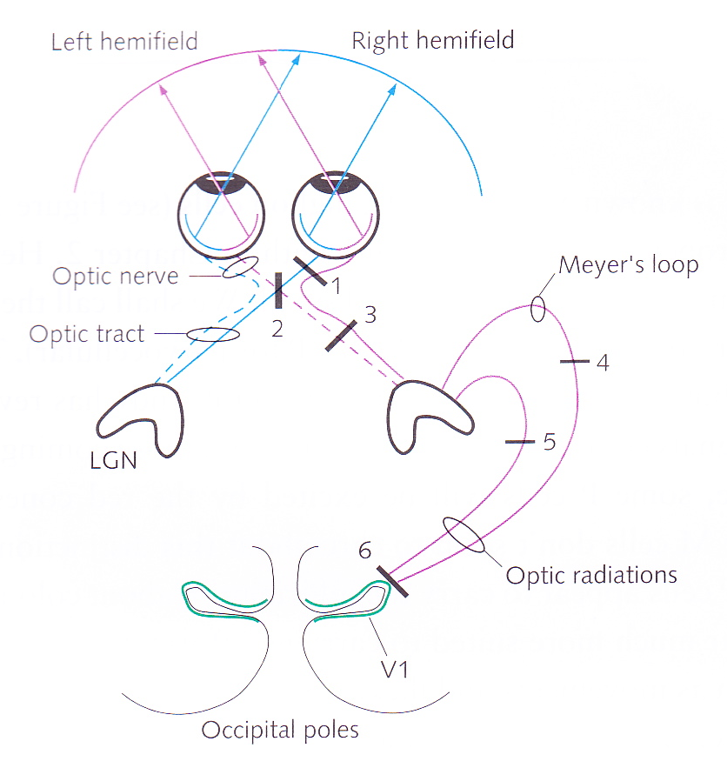
The Eye and Beyond
David Meredith Aalborg University

Slide 2
Reading for this lecture
This lecture is based on Chapter 1 of
Snowden, R., Thompson, P. & Troscianko, T. (2006). Basic Vision: An Introduction to Visual Perception. OUP. (ISBN: 978-0199286706)

Slide 3
Overview
Eye produces an upside-down (inverted) image on the retina
How does this upside-down image get converted into a percept?
Retina turns the upside-down image into electrical nerve signals, representing information about the scene that is used by the brain to create a model of the world outside

Slide 4
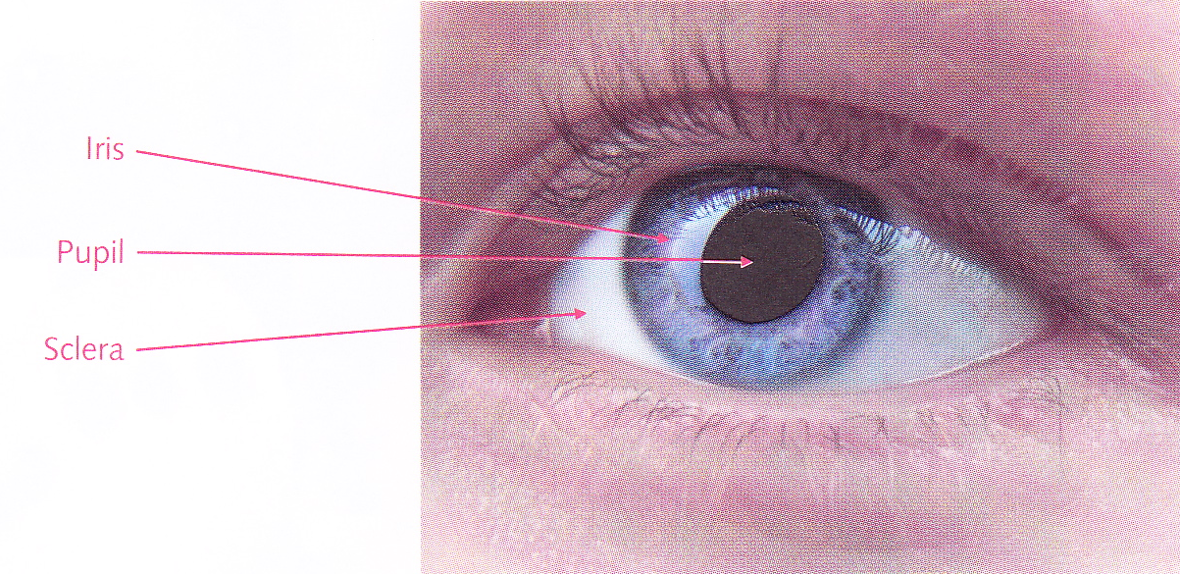
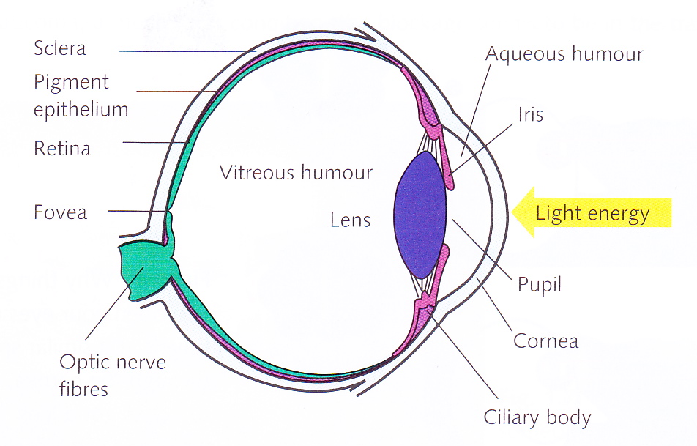
The eye
Cornea is transparent lens through which light enters eye
¾ of focusing power comes from cornea
¼ of focusing power comes from the lens itself
Cornea and lens focus light onto a sensor array at the back of the eye called the retina

Slide 5
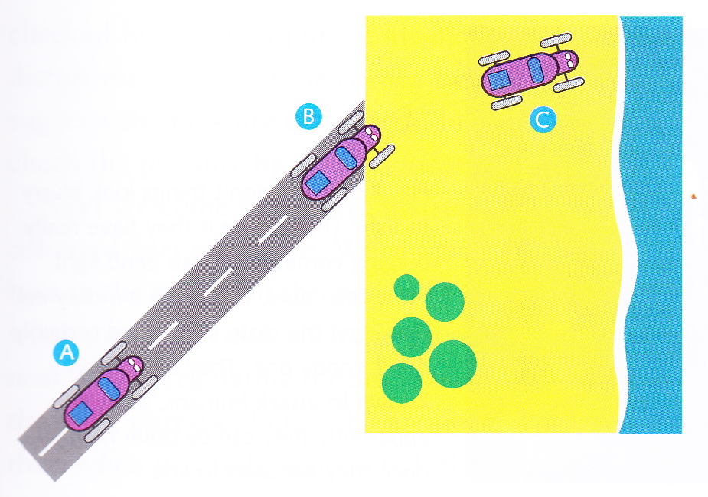
Lenses
A lens bends or refracts light
It must
be curved
be made of stuff through which light travels more slowly than it does in air
it must have a higher refractive index than air
Light going from air into a lens is like a car driving from tarmac onto sand
The right-hand wheels slow down before the left-hand wheels so the direction of the car changes

Slide 6
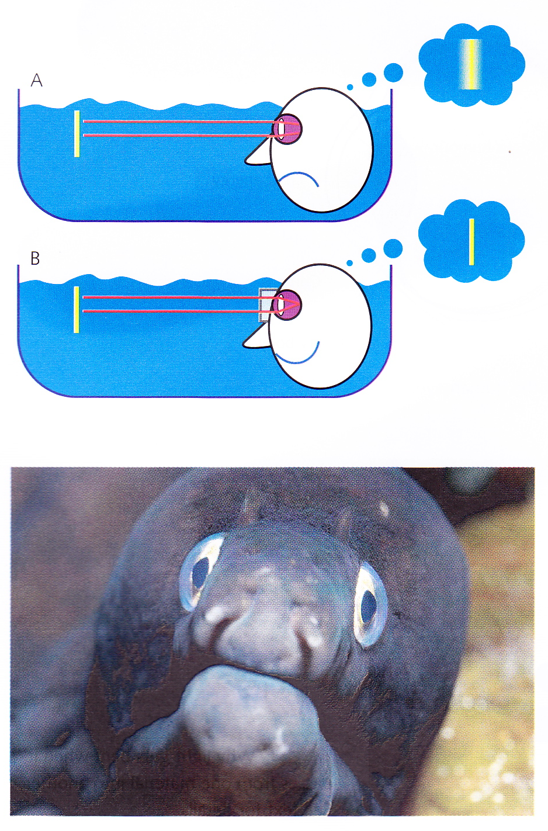
Seeing underwater
Water and cornea have similar refractive indices, so light not bent very much
Hard to focus underwater
Wearing goggles produces air-cornea boundary again
Fish have more bulging eyes that bend the light more so they can focus

Slide 7
Iris and pupil
Iris provides an adjustable aperture
in bright light, iris constricts making pupil small
in low light, iris relaxes making pupil large
Pupil size also changes depth of field
Large pupil -> narrow depth of field
Small pupil -> large depth of field
Pupil also dilates when we’re aroused or on drugs
Women with large pupils are supposed to be more attractive and deadly nightshade causes the pupils to dilate when applied to the eyes
hence the Latin name, belladonna
Chinese jade dealers are also rumoured to use pupil size to determine how interested the customer is in a piece of jade

Slide 8
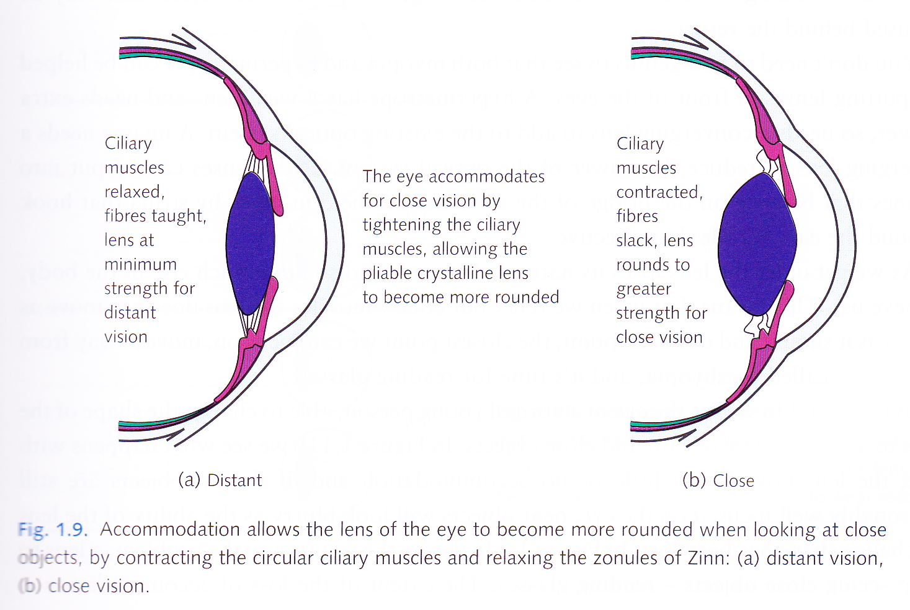
The lens

Slide 9
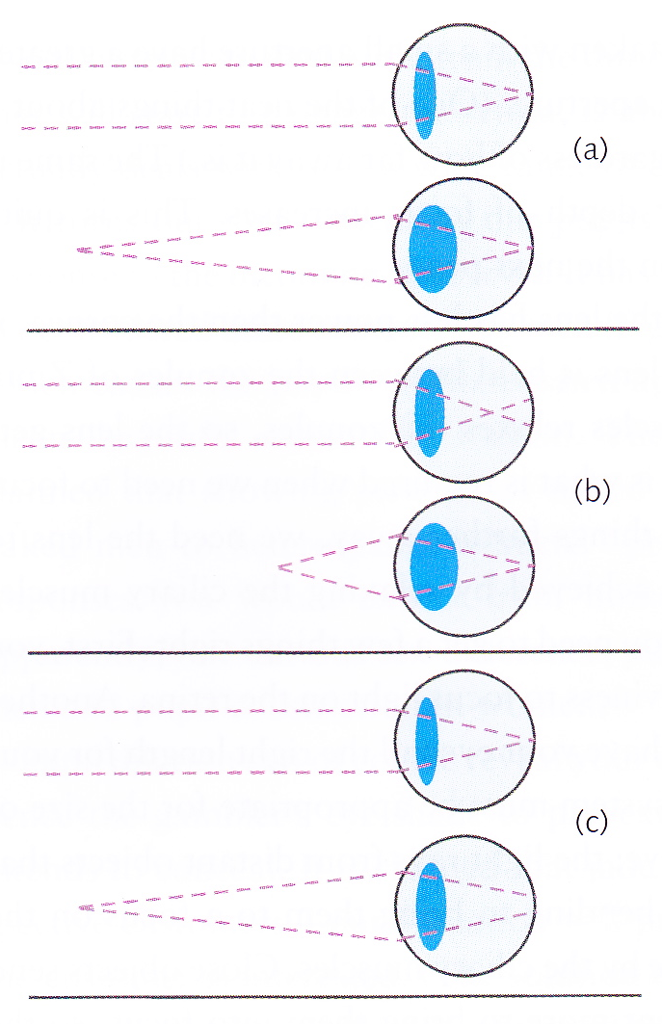
Emmetropic vision, myopia & hypermetropia
(a) Emmetropic vision
cornea right curviness and eye right length for lens to focus close and distant objects
(b) Myopia (short-sightednes)
distant objects focused in front of retina
eye too long, cornea too curvy or lens not thin enough
(c) Hypermetropia (long-sightedness)
close objects focused behind the retina
eye too short, cornea not curvy enough, or lens can’t get thick enough

Slide 10
Myopia or hypermetropia?
Problem | Myopia | Hypermetropia
Cornea too convex
Cornea not convex enough
Eye too short
Eye too long
Lens cannot get thin enough
Lens cannot get thick enough
Ciliary muscles too weak

Slide 11
Myopia or hypermetropia?
Problem | Myopia | Hypermetropia
Cornea too convex | ✔
Cornea not convex enough |  | ✔
Eye too short | ✔
Eye too long |  | ✔
Lens cannot get thin enough | ✔
Lens cannot get thick enough |  | ✔
Ciliary muscles too weak |  | ✔

Slide 12
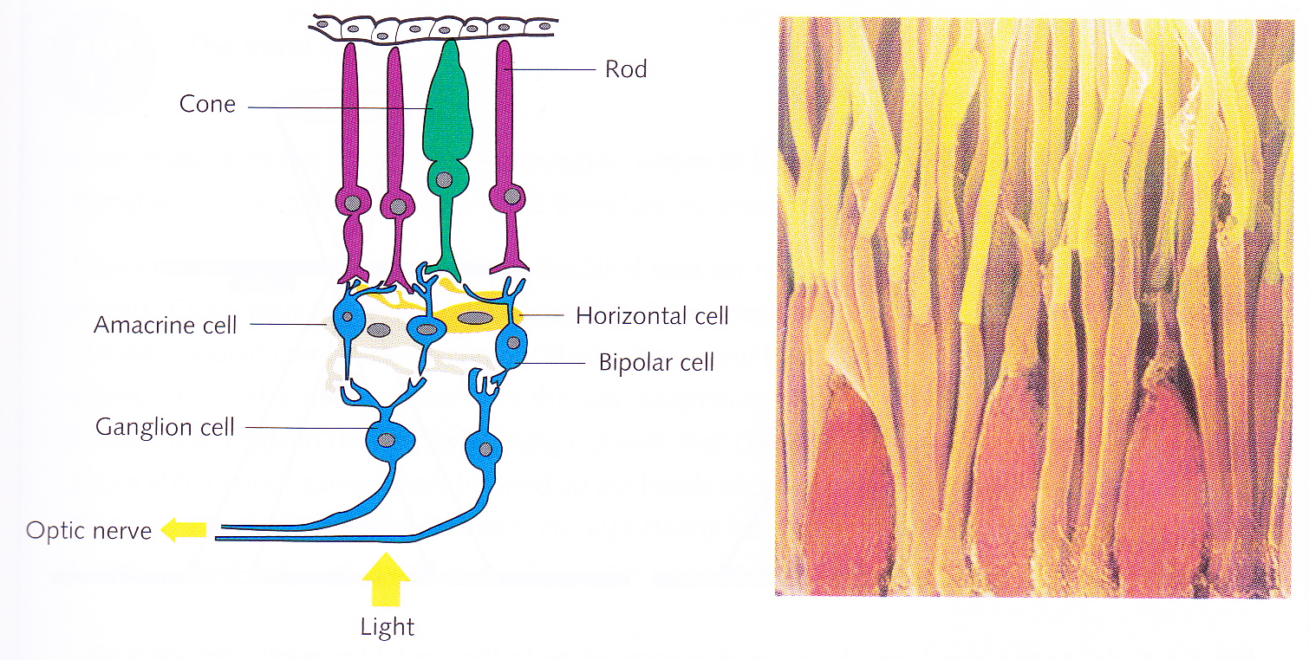
The retina
Light approaches from below in diagram
Light-sensitive photo-pigments in outer segments of photo-receptors (top)
Light travels through nerves before reaching receptors
Allows blood to reach photo-receptors more easily
Octopus has receptors in front of nerve fibres
Is our arrangement accidental? But works well so never selected out?

Slide 13
The retina
Neural processing begins when light reaches outer segments of photoreceptors
Photoreceptors synapse onto bipolar cells which synapse onto retinal ganglion cells
Ganglion cells carry information to cortex
Horizontal cells and amacrine cells connect across retina, regulating the activity in the bipolar cells

Slide 14
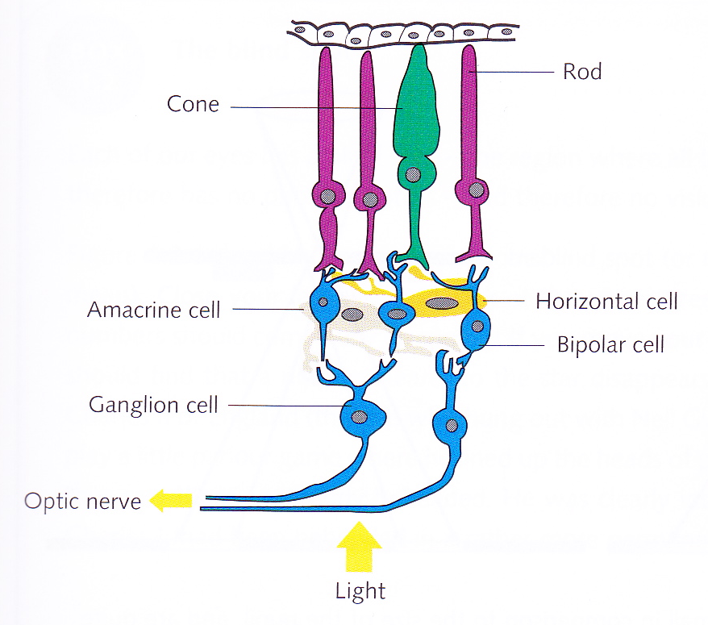
Photoreceptors
Two types of receptor: rods and cones
Rods contain rhodopsin
rhodopsin is purple, so it absorbs green light best
Three types of cone:
red: sensitive to long wavelengths
green: sensitive to medium wavelengths
blue: sensitive to short wavelengths

Slide 15
Photoreceptors – the rods
Rods respond well to dim light
As illumination increases, activity in rods increases to a maximum which is reached while light is still quite dim
So rods not much use in bright light
When only rods are operating, we call it scotopic vision

Slide 16
Photoreceptors – the cones
Cones are less sensitive to light than rods, so don’t respond very much in dim conditions
Responsible for most daytime vision
When only cones are operating, we call it photopic vision
When both rods and cones are operating, we call it mesopic vision

Slide 17
Adaptation - Bleaching of rods
In bright daylight, rods adapt to being at maximum activation and become bleached
If suddenly go into the dark, takes some time for rods to start working again
But cones cannot operate in the dark
So it takes some time before we can see, if we suddenly go from bright light to darkness

Slide 18
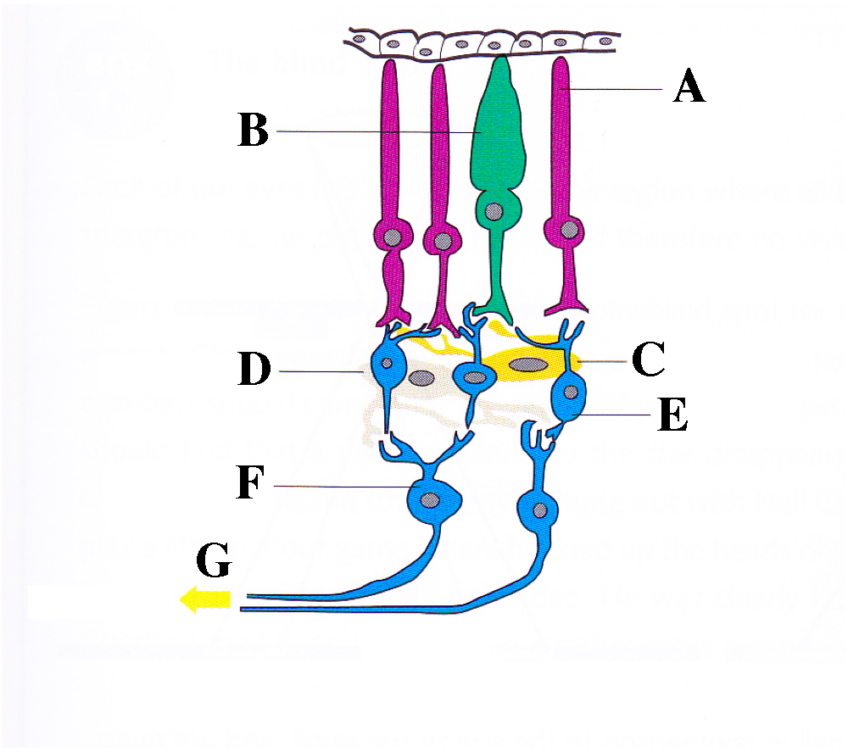
Test!
Give the correct names for A to F
What does the arrow G signify?
Which direction is light coming from?
When you’ve written down your answers, stick the post-it to the desk!

Slide 19
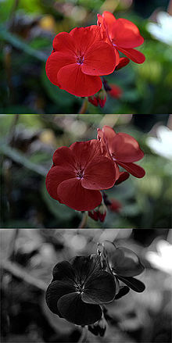
Purkinje shift
Rods are most sensitive to green light
Cones are most sensitive to yellow light
Purkinje shift
Red is relatively brighter than green in daylight but the reverse in low illumination
The leaves of a red rose in low illumination will look relatively bright, compared with the rose which will look dark
What colour light should you use just before briefing pilots for a night mission?

Slide 20
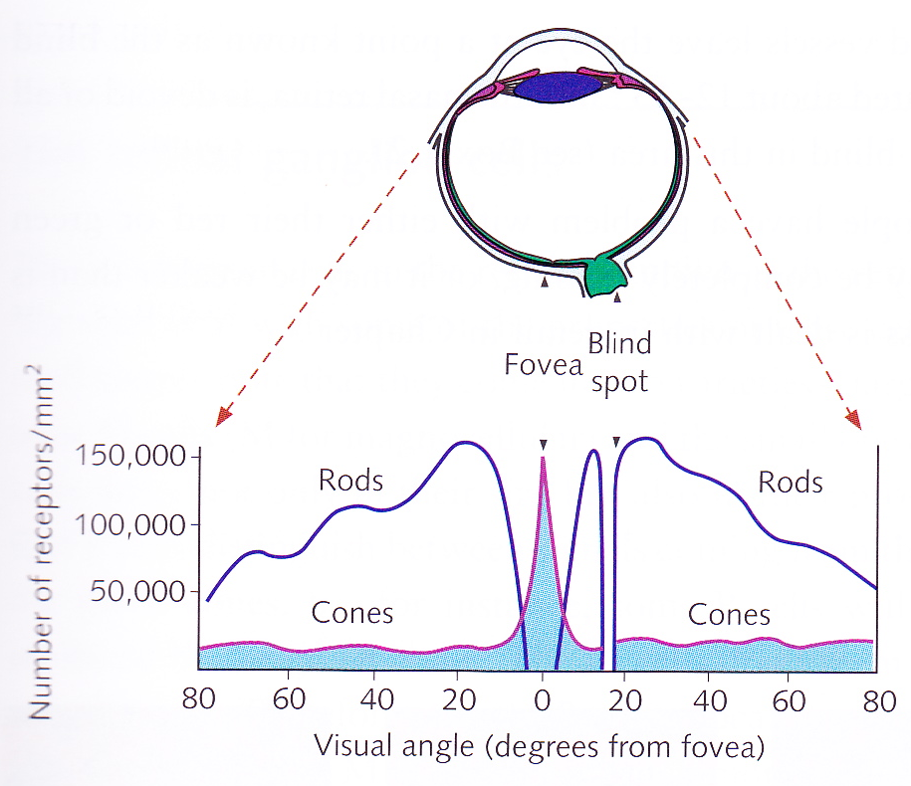
Radial distribution of rods and cones
Cones heavily concentrated in centre of retina – the fovea
No rods in fovea
Rods most concentrated 12-15 degrees into periphery
So cannot see a star if you look straight at it
Blind spot is where nerve cells and blood vessels leave the eye
about 12-15 degrees into periphery
no receptors, so blind in this area

Slide 21
Retinal ganglion cells
Two types of retinal ganglion cells:
large, M cells (for magnocellular)
small, P cells (for parvocellular)
P cells distinguish between signals from red and green cones
e.g., some P cells excited by red cones, inhibited by green cones
M cells do not distinguish between signals from red and green cones
Therefore P cells carry information about colour
M cells carry information about dynamic aspects of vision – movement, flicker, etc.
All ganglion cells lead to the lateral geniculate nucleus (LGN)
M and P cells lead to different areas of the LGN

Slide 22
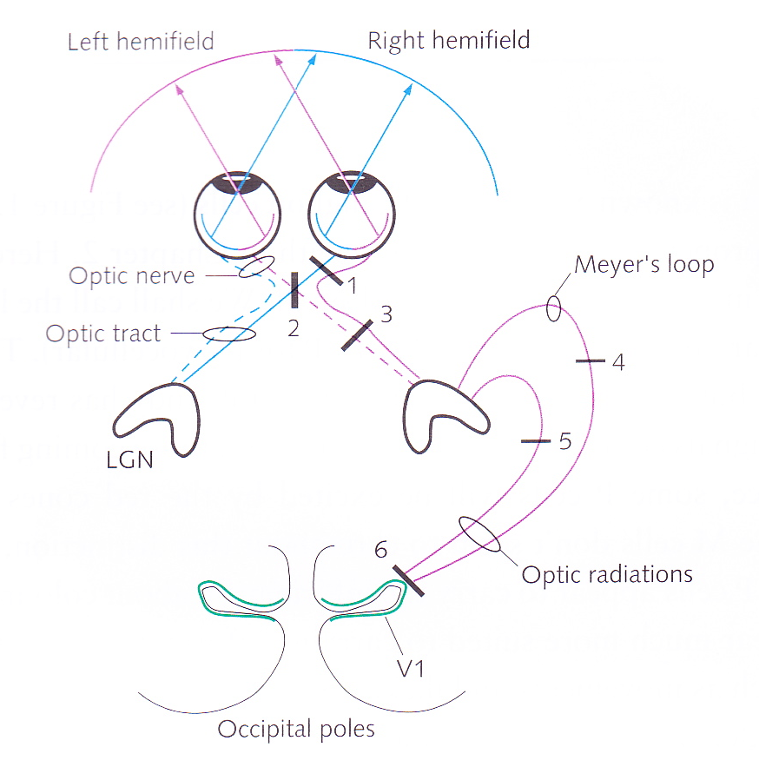
Optic nerve and optic tract
Optic nerve goes from blind spot to visual cortex at back of head
Nerves from two eyes converge at optic chiasm where there is a partial decussation
nasal fibres cross sides
After chiasm, left-side fibres encode right visual field and vice versa
After chiasm, optic nerve is called optic tract
Cutting an optic nerve blinds one eye, cutting an optic tract gives you hemianopia: unable to see one side of the visual field

Slide 23
Lesioning at different points in the visual pathway
What would be the effects of lesioning at the points marked 1 to 6 in the diagram?

Slide 24
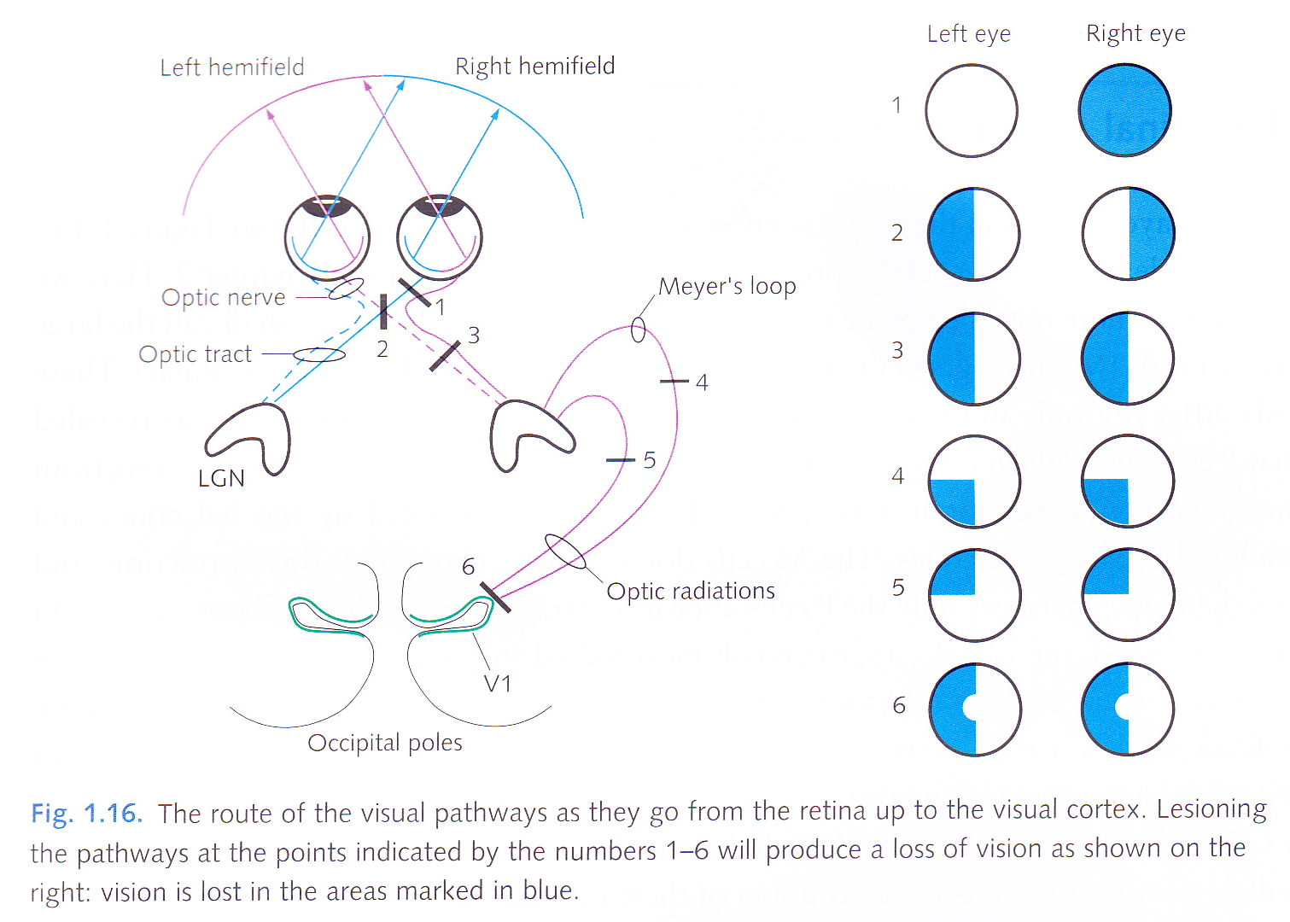
Lesioning at different points in the visual pathway

Slide 25
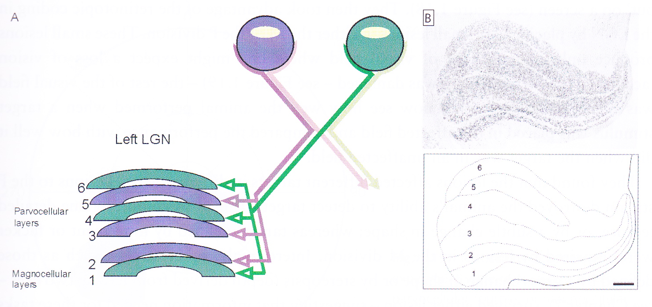
Lateral geniculate nucleus (LGN)
Information from different eyes goes into different layers in the LGN
In left LGN
layers 1, 4 & 6 are contralateral
layers 2, 3 & 5 are ipsilateral
Layers 3 & 4 seem to be the same as layers 5 & 6
Redundancy?
Retinotopic mapping in each layer – ganglion cells adjacent in the retina project to adjacent cells in the LGN

Slide 26
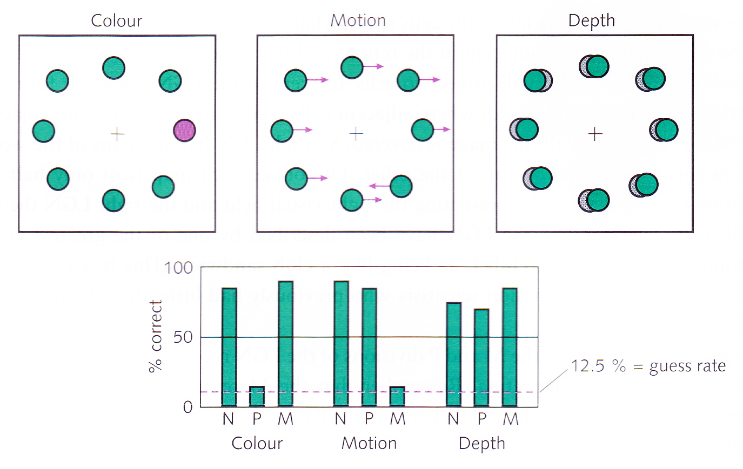
M and P layers in LGN
Schiller et al. (1990)
Animal fixates on centre and moves eye to ‘odd one out’
Small area of LGN lesioned, corresponding to small field area
P layer lesion destroys detection of targets defined by colour, fine detailed texture or subtle change in shape
M layer lesion removes detection of moving or flickering targets
Gross change of shape or stereopsis survived both types of lesion

Slide 27
Reference
Schiller, P. H., Logothetis, N.K., and Charles, E. R. (1990). Functions of the colour-opponent and broad-band channels of the visual system. Nature, 343, 68—70.

