Slide 1
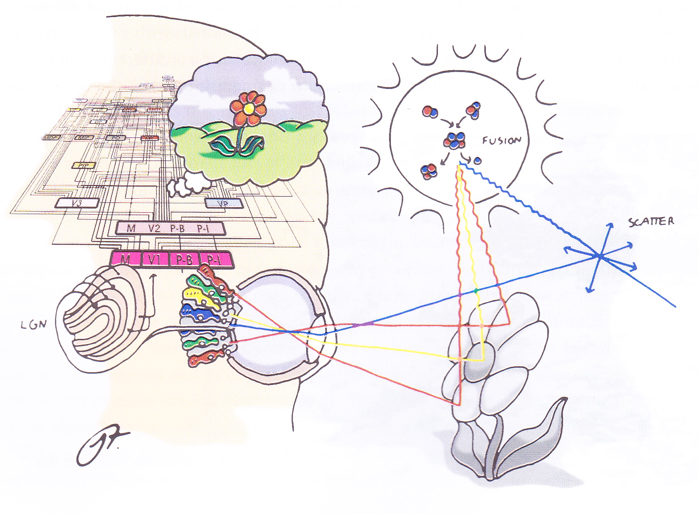
Introduction to Visual Perception
David Meredith Aalborg University

Slide 2
Reading for this lecture
This lecture is based on Chapter 0 of
Snowden, R., Thompson, P. & Troscianko, T. (2006). Basic Vision: An Introduction to Visual Perception. OUP. (ISBN: 978-0199286706)

Slide 3
Vision must be easy, right?
Vision must be easy - with just a glance, we can tell
that it’s likely to rain because there are clouds on the horizon
that someone we’ve never seen before is unhappy
who someone is even if they are almost completely covered up
whether a dog in the distance is a German Shepherd or an Afghan Hound, just from its silhouette or by the way it moves

Slide 4
Vision is really hard!
We manage to do all the (apparently) simple things on the previous slide by using the following process:
Balls of light (photons) are shot out in all directions from a light source
A tiny fraction of these balls bounce off objects around us.
A tiny fraction of the balls that bounce off these objects find their way into our eyes where they bounce off an array of sensors that send information to our brain
Analogous to a person with a net catching balls and then, by inspecting the contents of the net, doing all the things that vision does

Slide 5
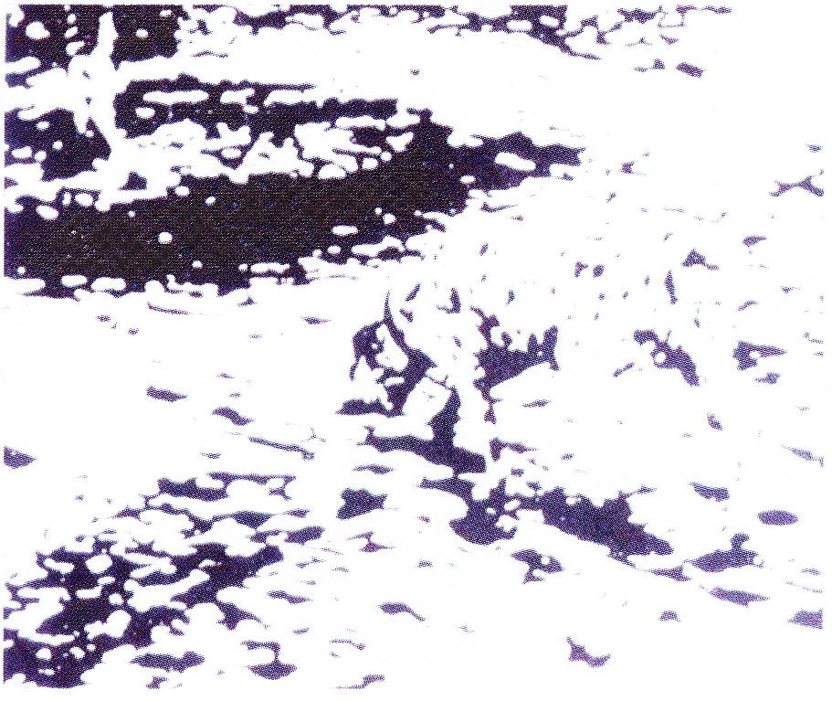
What do you see?

Slide 6
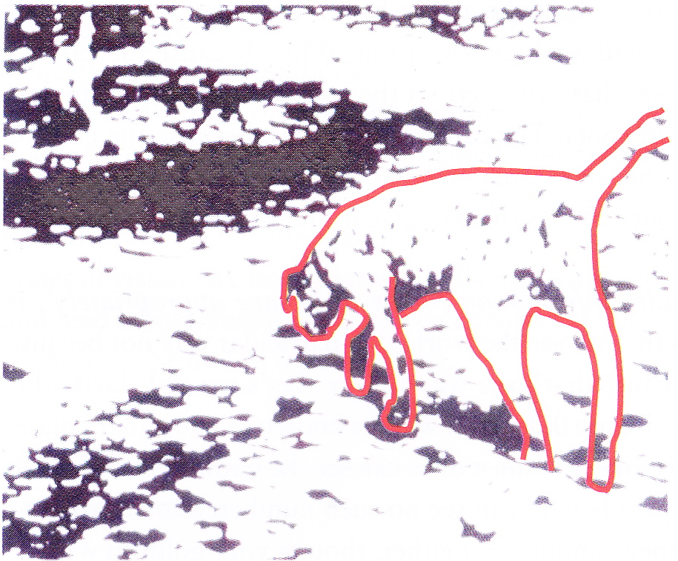
Did you see this?

Slide 7
Vision is active, not passive
Brain constantly trying to make sense of the information it receives from the eyes
Once you see the picture as a dog, it’s hard to go back to seeing it as just random spots
The eye may be like a camera in that it basically focuses the light onto an array of sensors that record the pattern of hue, luminance etc.
But vision does much more than that
Vision gives us the necessary information for us to behave appropriately

Slide 8
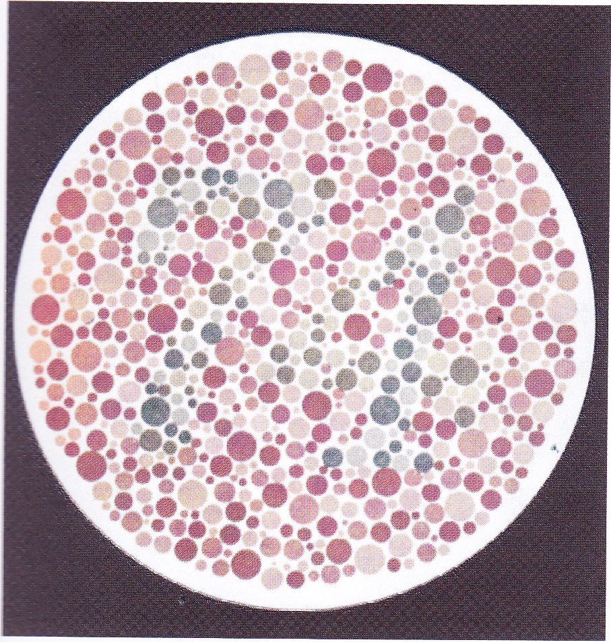
Write down what you see

Slide 9
Colour blindness
Previous slide shows an Ishihara plate for testing colour-blindness
If you couldn’t see the number 74, then you may be red-green colour blind
Dogs and cats are red-green colour blind
As are most other mammals (horses, cattle, etc.)
Don’t shake a green rag at a bull!
Many fish can distinguish red from green
Directly depends on physiology
The types of cones you have – more later!

Slide 10
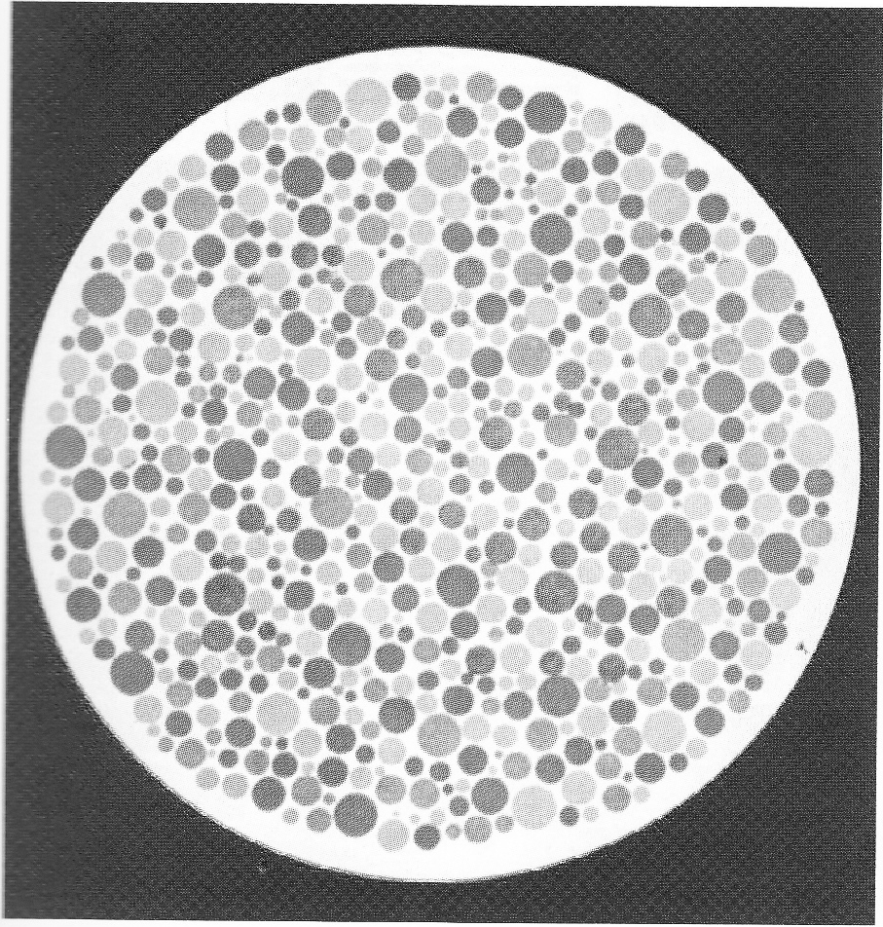
Night vision – what do you see now?

Slide 11
Night vision
In low illumination, you cannot see colour
Green-ness is an invention of the brain, produced only when there is enough illumination

Slide 12
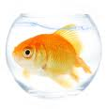
Why have we evolved to see colour?
Distinguishing between red and green allows us to do (important) things that we could not otherwise do
e.g., tell the difference between ripe and unripe fruit
Dogs normally don’t pick fruit, so perhaps not as useful to them
Goldfish don’t pick fruit either, but they can tell the difference between red and green

Slide 13
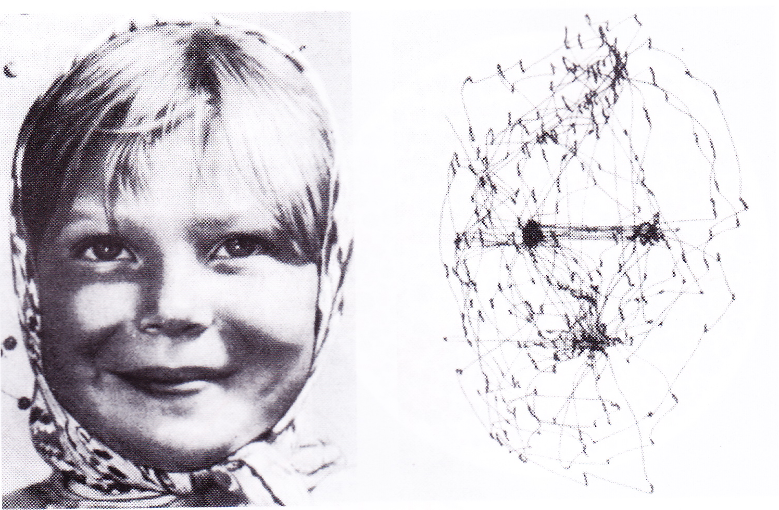
Active information retrieval
Even when looking at a stationary picture, eyes move 3-4 times per second
Move from one point of interest to another
Good detail only in centre of view
Use peripheral view to grab information about potentially interesting parts of scene

Slide 14
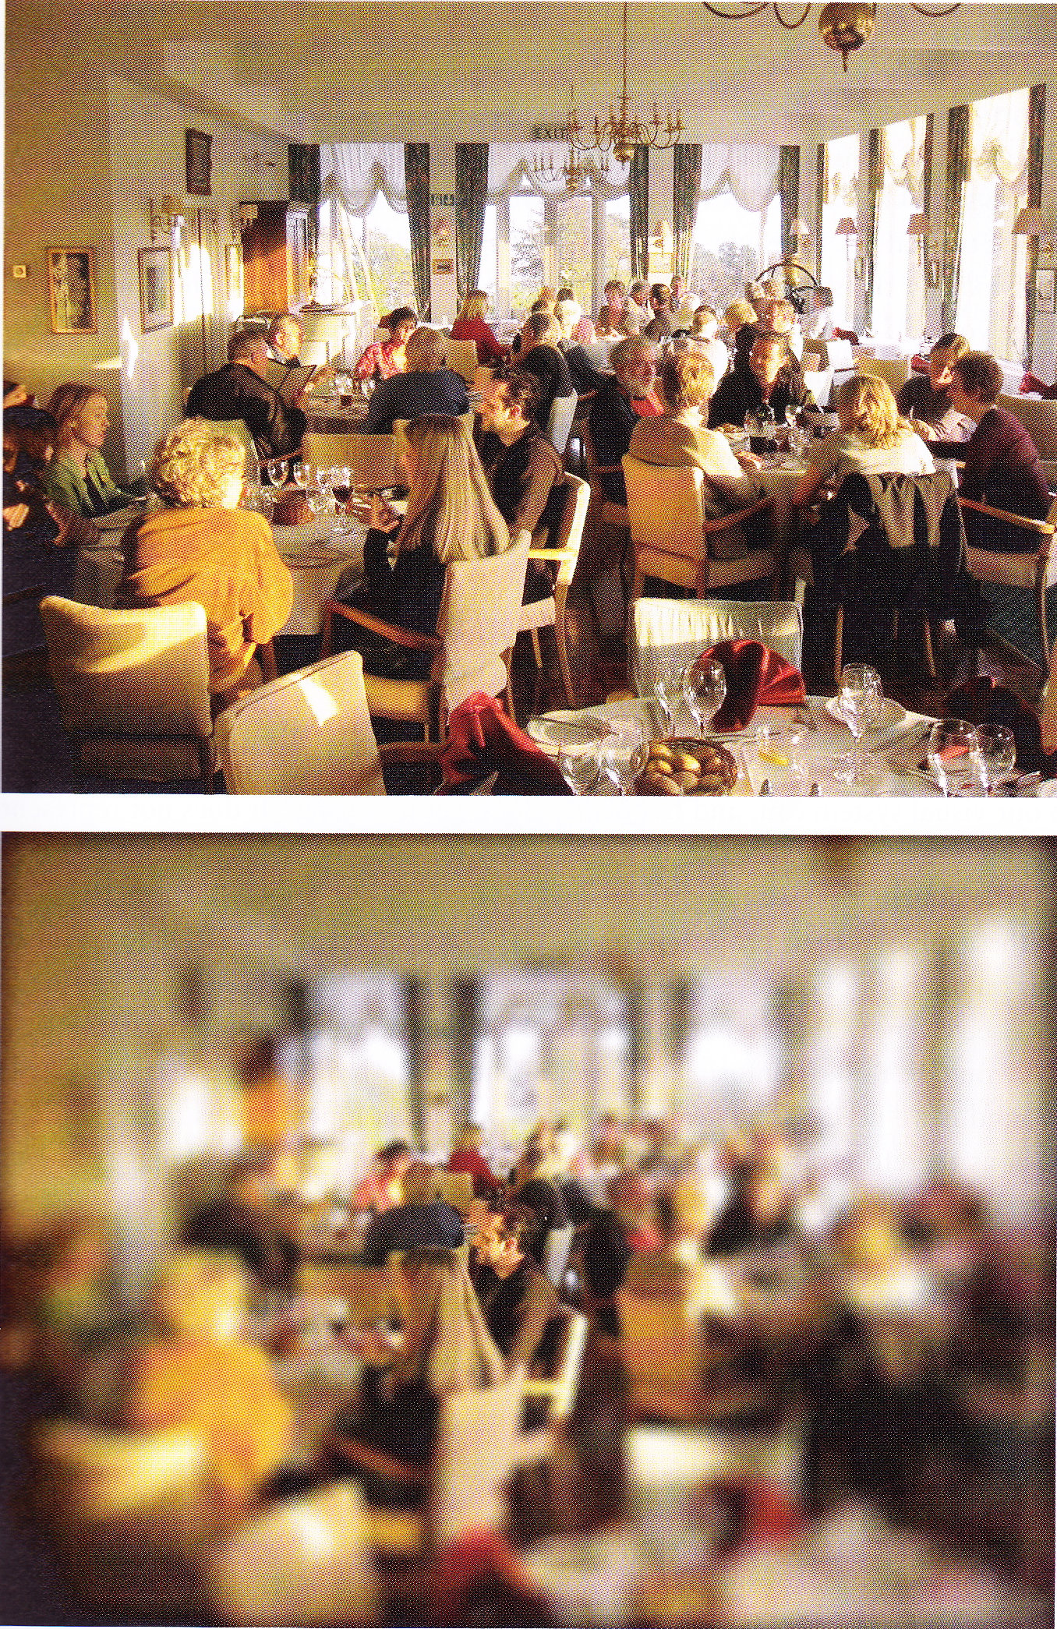
Acuity decreases with eccentricity
Central vision gives really good detail
As move away from centre, vision gets worse and worse
Can only see one small area clearly at any one time
So need to move our eyes around to get a full picture
How do we decide where to look next?
Use poorly seen information to guide eye movements

Slide 15
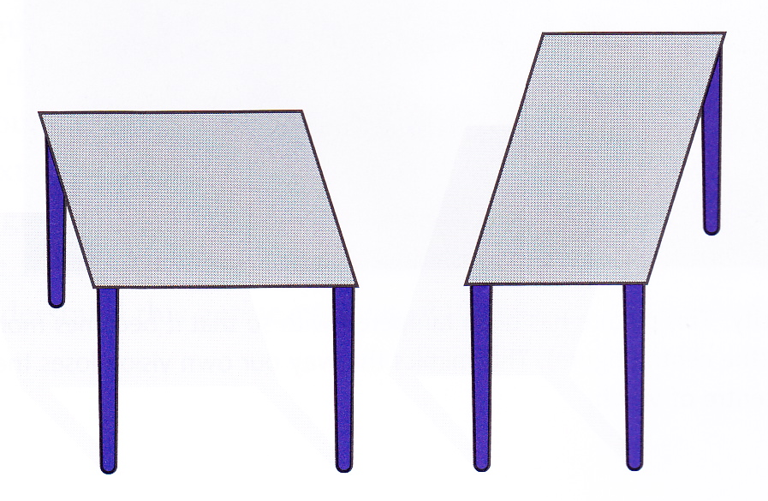
Are the tables the same shape?

Slide 16
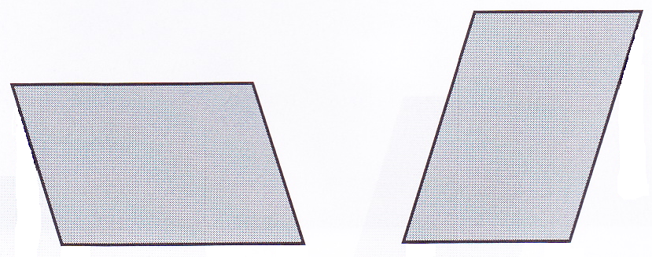
Are the parallelograms the same shape?

Slide 17
Vision is clever, not stupid
Tries to interpret the input in the most useful way
When you see a picture of a table, you interpret the picture as a representation of a 3d situation
When you see a picture of an abstract shape, there is no motivation to interpret it as a representation of a 3d situation
So vision’s job is not to tell us about the image of the scene projected on the retina
Vision’s job is to tell us what is really out there in the world

Slide 18
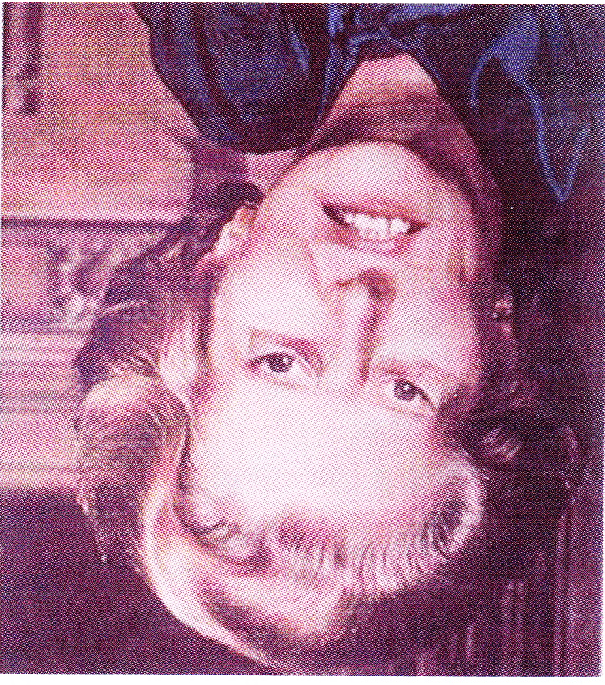
Does she look happy?

Slide 19
What about now?

Slide 20
Face recognition
Our brains are particularly good at recognizing the main features of a face (eyes, mouth) when they are the right way up, but not when they’re upside-down
When we see a face, our brain tries to process it as though it is the right way up (faces usually are in the real world!)

Slide 21
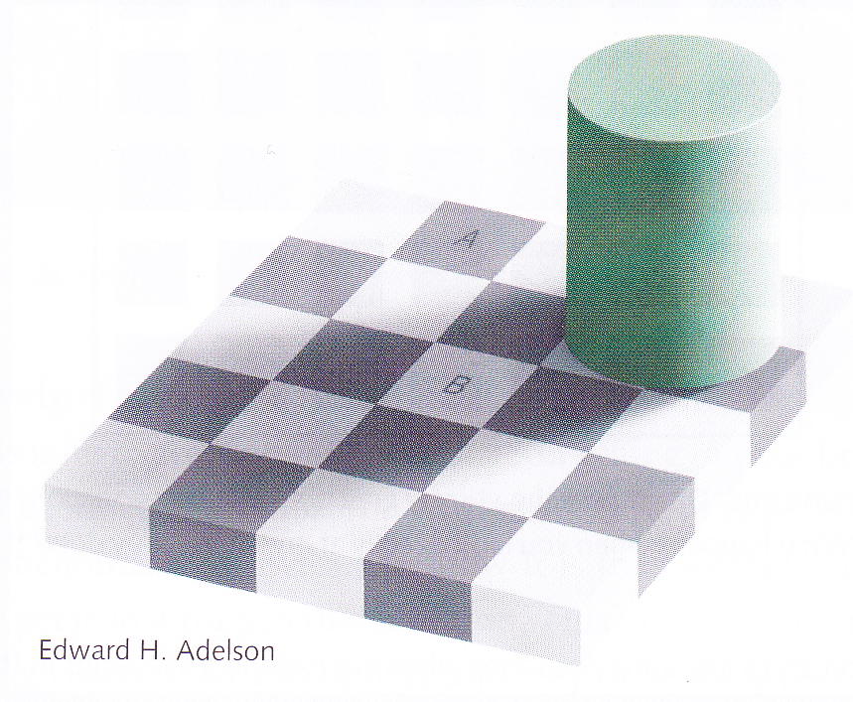
The Adelson Illusion

Slide 22
When is an illusion not an illusion?
We “incorrectly” perceive B as being lighter than A
But is this really incorrect?
We interpret the image on the page as though it were a 3d scene and in the real scene, A would be darker than B because of the shadows
Misinterpreting scenes in the real world would certainly be an illusion, e.g.,
underestimating our speed in fog
underestimating distance under water

Slide 23
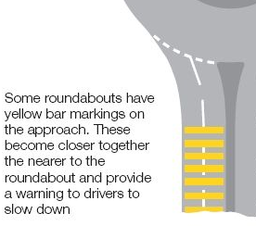
Adaptation
You’ve been driving on a motorway for a while, then turn onto a minor road where you have to drive more slowly
Everything now seems to go too slowly
This is adaptation
Many accidents caused by this illusion
By studying it and understanding it, we can find solutions that can save lives

Slide 24
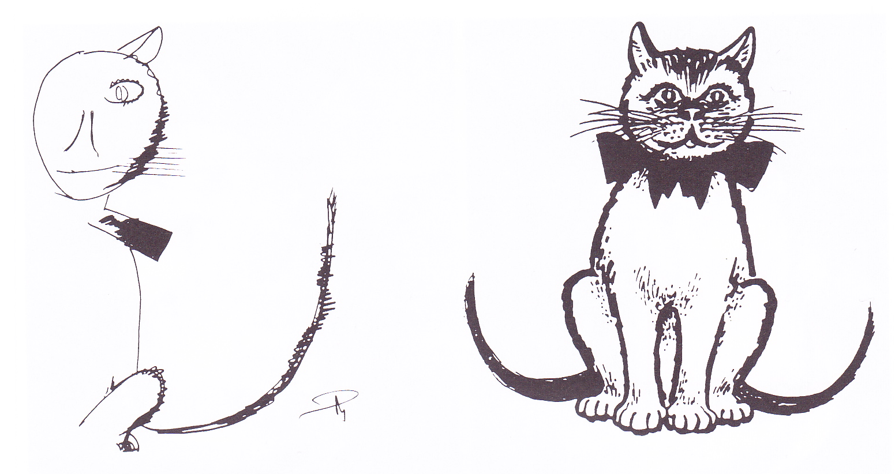
Visual neglect
When the system breaks, it can tell us a lot about how it works
A patient with visual neglect only sees one half of the visual field
only copies half a cat (and doesn’t notice it has two tails!)
only eats half the food on their plate
Tells us that there is something in a normally functioning brain that ensures that we pay attention to both sides of our visual field

Slide 25
What does “vision” include?
Vision includes
Conscious vision
Vision that you’re aware of
Unconscious vision
Vision you’re not aware of
e.g., unconsciously “seeing” the leg of a chair and avoiding it while you’re walking around a room
Vision perhaps starts when the light hitting the photoreceptors is transduced into electrical nerve signals that are sent to the brain
So vision happens (mostly) in the brain, not the eye

Slide 26
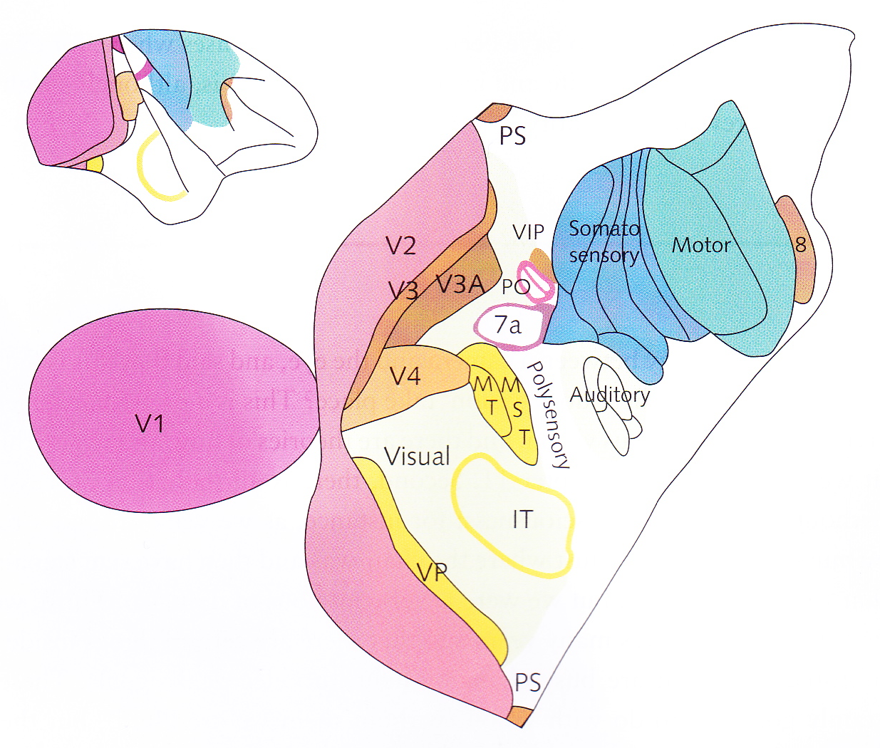
Vision and the brain
At left, cortex of primate “unrolled”
Parts that are involved in vision are coloured
over 50% of cortex involved in vision
rest of senses use about 10% of cortex
10-20% used for body movement
Not much left for hard sums!
That’s why they’re hard!
Vision is “easy” because so much of our brain is dedicated to it
Over 30 areas, each making a different contribution to vision
e.g., MT contains cells that only fire when something is moving in the visual field
if this part is damaged, the person ceases to be able to see motion
Information from the different areas has to be integrated to give a unified percept

