Slide 1
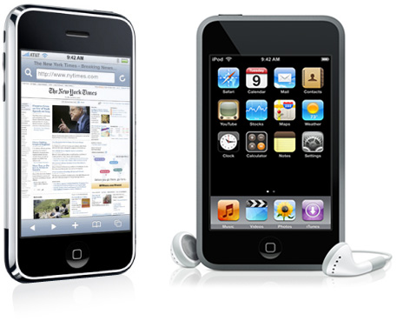
iOS Programming
Medialogy, Semester 7, 2010
Aalborg University, Aalborg
http://mea.create.aau.dk/course/view.php?id=26
David Meredith dave@create.aau.dk

Slide 2
Resources
Learning Objective-C: A Primer
http://developer.apple.com/library/ios/#referencelibrary/GettingStarted/Learning_Objective-C_A_Primer/index.html#//apple_ref/doc/uid/TP40007594
Your First iOS Application
http://developer.apple.com/library/ios/#documentation/iPhone/Conceptual/iPhone101/Articles/00_Introduction.html#//apple_ref/doc/uid/TP40007514
XCode Workspace Guide
http://developer.apple.com/library/ios/#documentation/DeveloperTools/Conceptual/XcodeWorkspace/000-Introduction/Introduction.html#//apple_ref/doc/uid/TP40006920
Learning Objective-C
http://developer.apple.com/library/ios/#referencelibrary/GettingStarted/Learning_Objective-C_A_Primer/index.html#//apple_ref/doc/uid/TP40007594
The Objective-C Programming Language
http://developer.apple.com/library/ios/#documentation/Cocoa/Conceptual/ObjectiveC/Introduction/introObjectiveC.html#//apple_ref/doc/uid/TP30001163
Object-Oriented Programming with Objective-C
http://developer.apple.com/library/ios/#documentation/Cocoa/Conceptual/OOP_ObjC/Introduction/Introduction.html#//apple_ref/doc/uid/TP40005149
iOS Overview
http://developer.apple.com/library/ios/#referencelibrary/GettingStarted/URL_iPhone_OS_Overview/index.html
iOS Technology Overview
http://developer.apple.com/library/ios/#documentation/Miscellaneous/Conceptual/iPhoneOSTechOverview/Introduction/Introduction.html#//apple_ref/doc/uid/TP40007898
Cocoa Fundamentals Guide
http://developer.apple.com/library/ios/#documentation/Cocoa/Conceptual/CocoaFundamentals/Introduction/Introduction.html#//apple_ref/doc/uid/TP40002974
iOS Application Programming Guide
http://developer.apple.com/library/ios/#documentation/iPhone/Conceptual/iPhoneOSProgrammingGuide/Introduction/Introduction.html#//apple_ref/doc/uid/TP40007072
iPhone Human Interface Guidelines
http://developer.apple.com/library/ios/#documentation/UserExperience/Conceptual/MobileHIG/Introduction/Introduction.html#//apple_ref/doc/uid/TP40006556
View Controller Programming Guide for iOS
http://developer.apple.com/library/ios/#featuredarticles/ViewControllerPGforiPhoneOS/Introduction/Introduction.html#//apple_ref/doc/uid/TP40007457

Slide 3
Sources for this lecture
iOS Overview
http://developer.apple.com/library/ios/#documentation/Cocoa/Conceptual/CocoaFundamentals/Introduction/Introduction.html#//apple_ref/doc/uid/TP40002974
Learning Objective-C: A Primer
http://developer.apple.com/library/ios/#referencelibrary/GettingStarted/Learning_Objective-C_A_Primer/index.html#//apple_ref/doc/uid/TP40007594
Your First iOS Application
http://developer.apple.com/library/ios/#documentation/iPhone/Conceptual/iPhone101/Articles/00_Introduction.html#//apple_ref/doc/uid/TP40007514

Slide 4
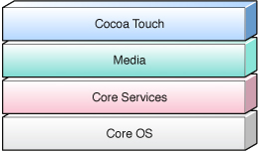
iOS Technology Layers
iOS kernel based on variant of Mach kernel found in Mac OS X
Above this are layers used to implement applications
Core OS and Core Services contain low-level services such as basic IO, data types, networking
Written in C
Examples include Core Foundation, CFNetwork, SQLite, POSIX thread access, UNIX sockets

Slide 5
iOS Technology Layers
Media and Cocoa Touch layers contain code in C and Objective-C
Media layer includes 2D and 3D drawing, audio and video
includes OpenGL ES, Quartz, Core Audio and Core Animation
Cocoa Touch layer mostly written in Objective-C
includes frameworks for most commonly-used infrastructure including
Foundation framework which supports collections, file management, networking etc.
UIKit framework supports visual infrastructure, including windows, views, controls and controllers
Other frameworks give you access to photo libraries, contacts, accelerometer and other hardware features

Slide 6
iOS Technology Layers
Always start with the top layer and work down only if necessary!
Start with the Cocoa Touch layer and the UIKit in particular
Makes it easier for you to make your application behave in a standard way

Slide 7
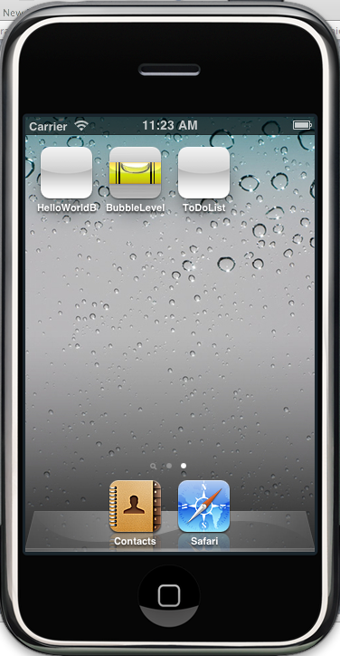
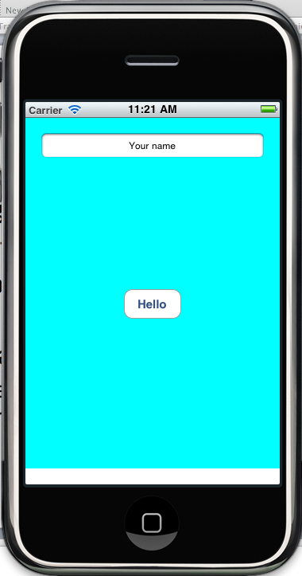
Writing code for iOS
iOS SDK supports creation of GUI applications running natively in iOS
Applications live on the user’s Home screen
iOS app occupies whole screen when it runs
No separate document windows
An iOS app responds to touch events
Unlike desktop applications, iOS apps can respond to complex touch gestures such as swipes, pinch-open and pinch-close gestures

Slide 8
Writing code for iOS
When writing for iOS, always consider how the user will use your app
Apps should be clean and simple showing only what the user needs in the moment
Everything the user might need must be quickly accessible and visible
Exploit the novel ways in which the user can interact with the device
e.g., accelerometer and camera
When starting your app, initially you will use the Foundation and UIKit frameworks in the Cocoa Touch layer

Slide 9
Where to start
XCode provides some built-in project templates that can help you create simple applications
Need to understand the basic design patterns and conventions of iOS
Need to understand the fundamentals of programming using the Cocoa frameworks
Refer to the Cocoa Fundamentals Guide
Then can go on to learn more about the iOS development process
Refer to the iOS Application Programming Guide

Slide 10
Learning Objective-C: A Primer
Objective-C is a superset of ANSI C that supports object-oriented programming
Objective-C is used to build Cocoa and Cocoa Touch applications
To include a header file in your source code, you use the #import directive
This does the same as #include except that it makes sure the same file is not included more than once
Extension | Source type
.h | Header files. Header files contain class, type, function and constant declarations
.m | Source files that contain Objective-C and/or C code.
.mm | Source files that contain C++ code (as well as, possibly, C code and Objective-C code)

Slide 11
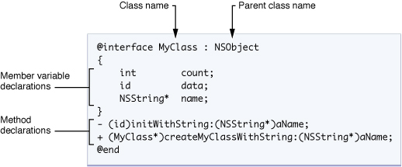
Classes
A class in Objective-C is defined in two parts:
an interface part in a header file (.h)
an implementation part in a .m or .mm file
Interface
declares class and public methods
declares instance variables and properties
Implementation contains definitions of methods

Slide 12
Strong and weak types
MyClass *myObject1; // Strong typing
id myObject2; // Weak typing
Objective-C allows both strong and weak typing
A strong type includes the class name in the variable declaration
A weakly typed variable is declared to be of type id
Weak typing can be used in collection classes where the collection needs to be able to contain any type of object
Use the syntax ClassName *var; to indicate that var is a pointer to an object of type ClassName
Object references in Objective-C must always be pointers
An id-type variable does not need a star
id-type variables are automatically pointers

Slide 13
Methods
In Objective-C you can have
instance methods (like ordinary methods in Java)
class methods (like static methods in Java)
Instance method belongs to a particular object, i.e. instance of a class
So must create an instance of the class on which to call the instance method
Class method belongs to a class
So can be called on the class name itself

Slide 14
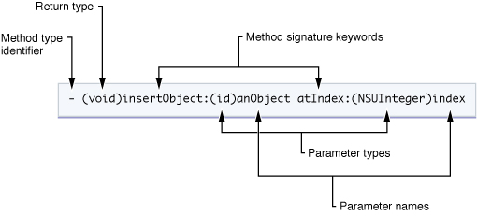
Methods
Instance methods preceded by a ‘-’ sign
Class methods preceded by a ‘+’ sign
Each signature keyword followed by a colon and then parameter
Each parameter has a type (in parentheses ‘()’) and a name
Method name (e.g., insertObject:atIndex:) is concatenation of signature keywords and colons
If a method has no parameters, then no colon after first (and only) keyword

Slide 15
Messaging
[myArray insertObject:anObject atIndex:0];
Send a message to an object by placing all inside square brackets (“[]”)
If the method is an instance method, put the reference to the object first and then the method signature keywords, each followed by its required argument, separated by a colon
Can replace an object reference with an expression that returns an object of the right type
[[myAppObject theArray] insertObject:[myAppObject objectToInsert] atIndex:0];

Slide 16
Dot syntax in accessor methods
[[myAppObject theArray] insertObject:[myAppObject objectToInsert] atIndex:0];
[myAppObject.theArray insertObject:[myAppObject objectToInsert] atIndex:0];
[myAppObject setTheArray:aNewArray];
myAppObject.theArray = aNewArray;
If an instance variable is declared to be a property, then it has accessor methods
Getter: -(type)propertyName
Setter: -(void)setPropertyName:(type)
Can use alternative dot syntax instead of square brackets for calling accessor methods

Slide 17
Class methods
NSMutableArray *myArray = nil; // nil is essentially the same as NULL
// Create a new array and assign it to the myArray variable.
myArray = [NSMutableArray array];
Define a class method by preceding its definition with a ‘+’
Class methods often used as factory methods to create new instances
Also used to access information shared by all instances of the class
In example above, array, is a class method defined on the NSArray class
NSArray is a superclass of NSMutableArray
array returns a new, initialized NSMutableArray object

Slide 18
Class implementation
@implementation MyClass
(id)initWithString:(NSString *)aName {
self = [super init];
if (self) {
name = [aName copy];
}
return self;
}
+ (MyClass *)createMyClassWithString: (NSString *)aName {
return [[[self alloc] initWithString:aName] autorelease];
}
@end
Implementation framed by two compiler directives
@implementation ClassName
@end

Slide 19
Declared Properties
@property BOOL flag;
@property (copy) NSString *nameObject; // Copy the object when assigned.
@property (readonly) UIView *rootView; // Declare only a getter method.
Convenience notation for declaring and implementing accessor methods on instance variables
Property declarations appear in the interface file (.h file)
Use the @property compiler directive, followed by the type and name of the variable
Optionally include “custom options” in parentheses between the compiler directive and the type
If a property is readable, then a getter is defined for it that has the same name as the variable
If a property is writeable, then a setter is defined for it of the form –(void) setPropertyName:(type)

Slide 20
Synthesizing properties
@synthesize flag;
@synthesize nameObject;
@synthesize rootView;
@synthesize flag, nameObject, rootView;
In the implementation file for the class, use the @synthesize compiler directive to generate getters and setters for your properties specified in the interface
Using properties
reduces the amount of code you have to write
allows you just to specify the special requirements for each property in the custom options (e.g., copy, readonly, retain)

Slide 21
Strings
NSString *myString = @"My String\n”;
NSString *aString = [NSString stringWithFormat:@"%d %@", 1, @"String"];
// Create an Objective-C string from a C string
NSString *fromCString = [NSString stringWithCString:"A C string”
encoding:NSASCIIStringEncoding];
Objective-C supports C style strings and characters
But Objective-C frameworks (e.g., UIKit, Foundation) use the NSString class instead of the String class
NSStrings have built-in memory management for arbitrary-length strings, support for Unicode, printf-style formatting etc.
To initialize an NSString with a string literal, just precede the opening double-quote with an ‘@’

Slide 22
Protocols
@interface MyClass : NSObject <UIApplicationDelegate, AnotherProtocol>{
}
@end
@protocol MyProtocol
- (void)myProtocolMethod;
@end
A protocol in Objective-C is like an interface in Java
A protocol defines an interface that other classes implement
Protocols are often used to specify an interface for a delegate object
For example, UIApplication class implements behaviour required of an application
You do not subclass UIApplication to process notifications in the way that you want
Instead, UIApplication forwards notifications to a delegate class that implements the UIApplicationDelegate protocol
Specify that a class implements a protocol by putting the protocol in angle brackets after the superclass
Protocol does not define instance variables and does not have a parent class
Protocols can specify both required and optional methods

Slide 23
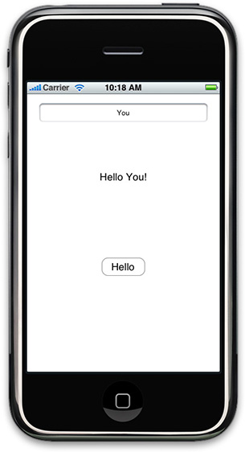
Building a simple iOS application
Overview and design patterns
Creating a project in Xcode
Adding a View Controller
Inspecting the Nib File
Configuring the View
Implementing the View Controller

Slide 24
Overview
Going to create a simple app that has a text field, a label and a button
You type your name in text field, press the button and a message appears in the label that includes what you have typed in the text field

Slide 25
Design patterns
Main patterns used in this application are
Delegation
Model-View-Controller
Target-Action

Slide 26
Delegation
Where an object forwards notifications and messages to another object (the delegate) to carry out the actions
Alternative to subclassing
In this example,
Application object tells its delegate when it has finished loading
Delegate then carries out custom configuration
Delegate creates a controller to set up and manage the view
Text field also tells delegate when user taps DONE key so that label can be updated
Delegate is usually defined as a protocol that can be adopted (i.e., implemented) by any other class

Slide 27
Model-View-Controller Pattern
Models
Represent objects and data (e.g., spaceships and weapons in a game, ToDo items and Contacts, shapes in a drawing program)
Here the model is just a string representing the text field’s string
Views
know how to display model objects
may let user edit model objects
Here, a main view contains three subviews (text field, label and button)
Controllers
mediate between views and models
Here, controller takes data from text field (view), stores it in a string (model) and then updates a label (view)

Slide 28
Target-Action
When a user manipulates a control element in the display (a view, e.g., presses a button), this causes a message (action) to be sent to another object (target)
Here, button tells controller to update the model (string) and a view (label), based on the user’s input

Slide 29
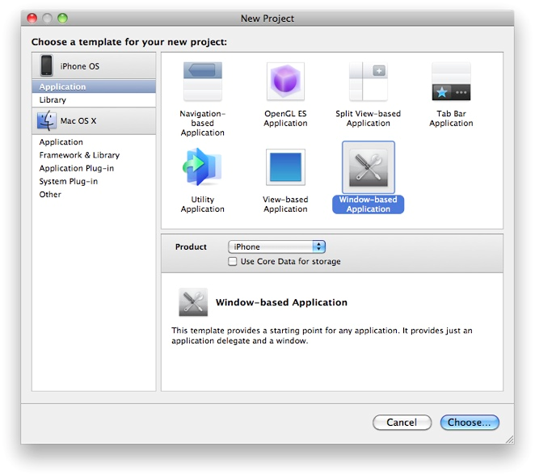
Creating the project

Slide 30
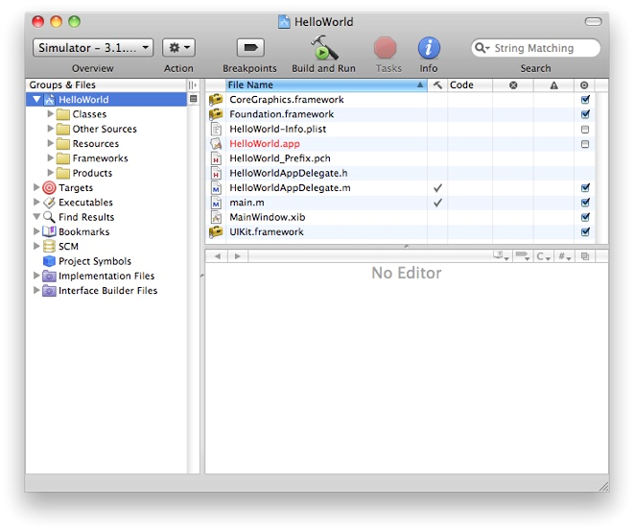
Build and Run
In top-left corner, can choose whether to run on the simulator or on a provisioned device
You have to be registered as an iPhone developer to test on a device

Slide 31
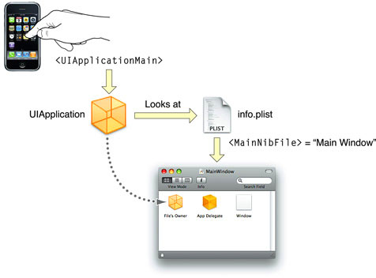
Application bootstrapping
main.m contains main function that calls UIKit function, UIApplicationMain that creates application object and application delegate and starts event cycle.
Also scans Info.plist file which may give name of a nib file to be loaded.

Slide 32
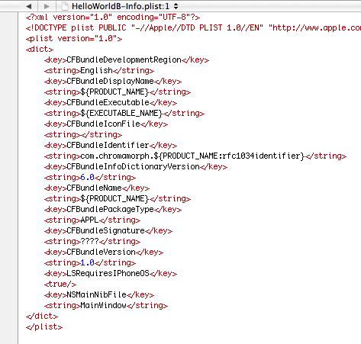
Info.plist
Tells UIApplicationMain function to load the MainWindow nib file. This contains an archive of interface objects (e.g., made using Interface Builder).

Slide 33
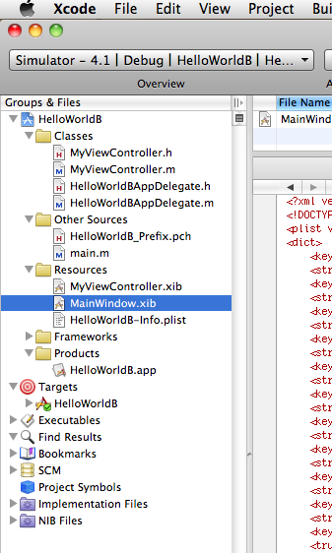
The nib file (actually a .xib file!)
NIB stands for “NextStep Interface Builder” and originates in the NextStep operating system first developed in the late 1980s
Now it’s an XML file, so its file extension is XIB
Double click on a XIB file and it opens in Interface Builder

Slide 34
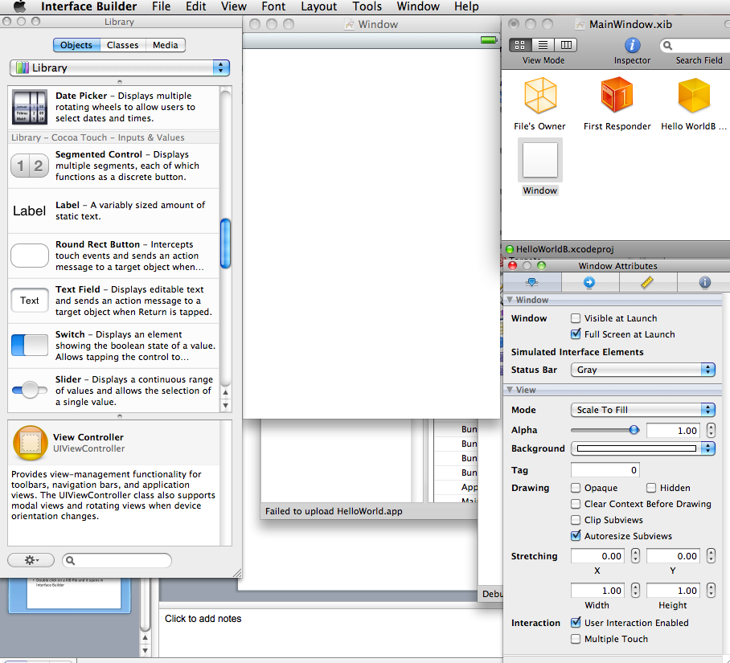
The XIB file

Slide 35
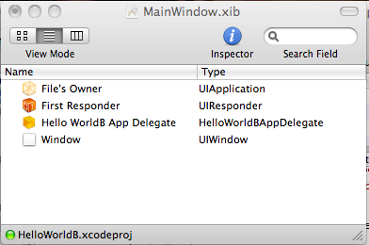
The XIB file
File’s Owner – here, this is the UIApplication object
An instance of HelloWorldBAppDelegate, set to be the application’s delegate.
A window – background set to white and visible at launch. This is the window you see when the application launches

Slide 36
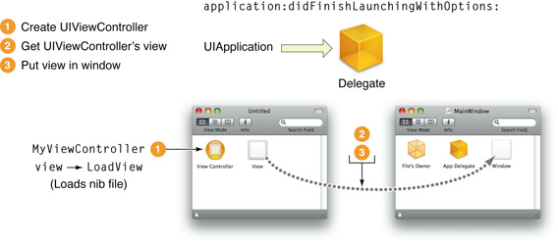
After launch…
When application has finished launch, sends its delegate an application:didFinishLaunchingWithOptions: message
Delegate then typically creates a view controller object and asks this view controller for its view
Delegate then puts this view into the window in the main xib file

Slide 37
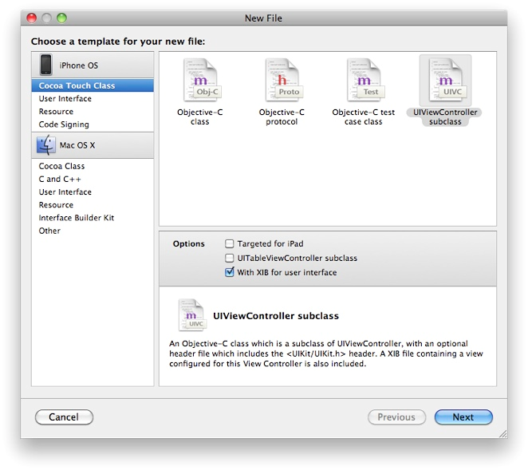
Adding a View Controller
An iOS application typically has a View Controller object that mediates between the main view and the model objects
UIKit provides the UIViewController class which you subclass to produce your own custom view controller object
Each view controller should control exactly 1 screen’s worth of view

Slide 38
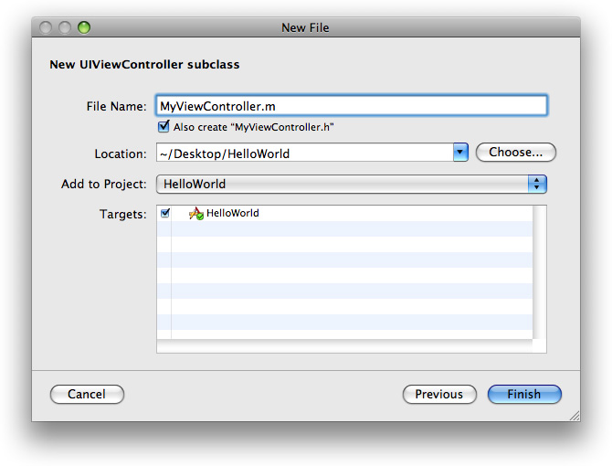
Creating a View Controller
Name your new subclass of UIViewController and make sure your program is checked as a target

Slide 39
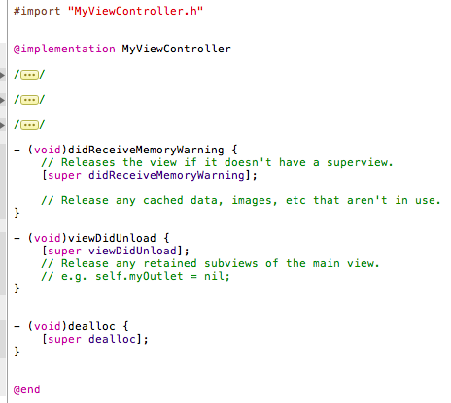
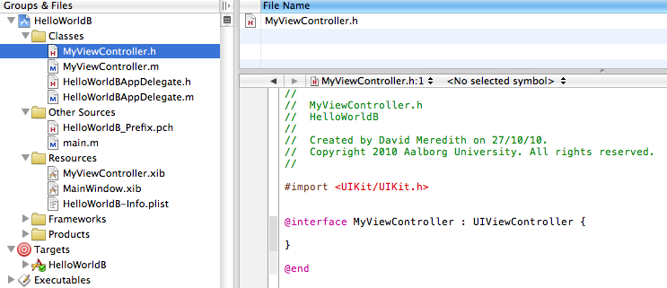
Adding a View Controller
MyViewController.h and MyViewController.m added to Classes folder
Stub implementations of some methods added to implementation source file.
Stub implementations of methods added to
MyViewController.xib added to Resources folder

Slide 40
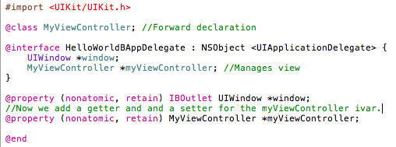
Adding a View Controller property
Tell the app delegate class about the view controller class using a forward declaration
View Controller member variable
Make myViewController a property

Slide 41
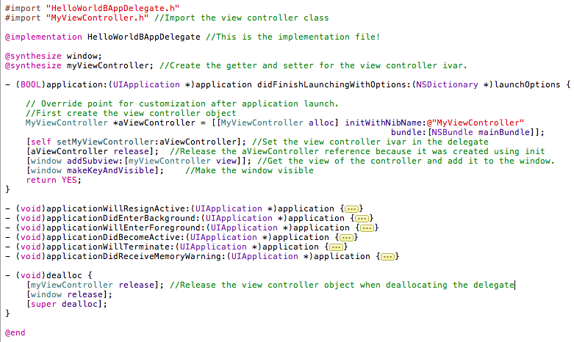
Creating the View Controller instance

Slide 42
Using Interface Builder
Use Interface Builder to create your user interface
Doesn’t generate code (cf. Netbeans GUI builder)
Interface Builder generates a “nib” file which contains an archive of objects
When the app is launched and the nib file is loaded, the objects are unarchived and restored to the state they were in when they were archived
Also the connections between the objects are restored

Slide 43
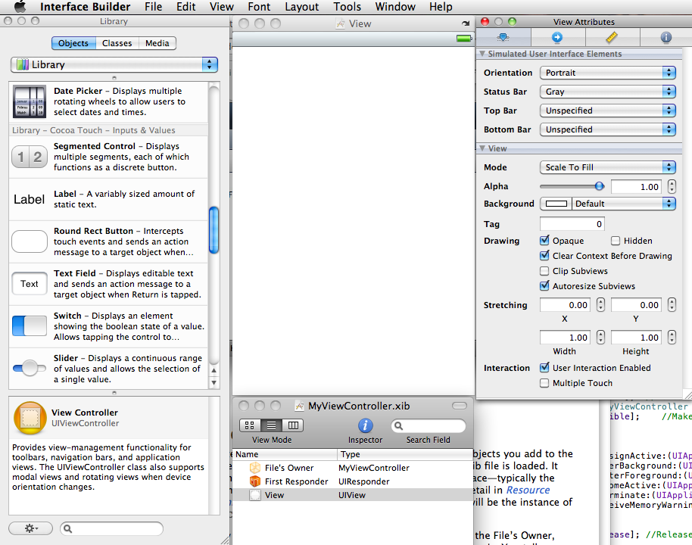
Inspecting the view controller’s nib file
The nib file contains three objects
the File’s Owner
the First Responder and
the View
File’s Owner proxy
This is a reference to the object that owns this nib file. In this case, this will be an instance of MyViewController.
First responder
Object given first opportunity to respond to user events. Depends dynamically on, e.g., which view currently has focus.

Slide 44
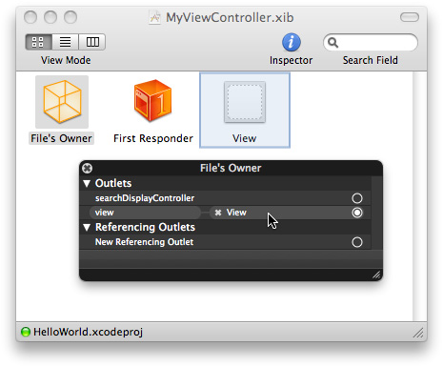
The View Outlet
An outlet is an attribute of an object that references an item in a nib file
Here, the view outlet (member variable) in the MyViewController object is connected to the UIView object in the nib file
view outlet inherited from UIViewController
So when nib file is loaded, view instance variable in the view controller set to equal the UIView object in the nib file

Slide 45
Loading the nib file
View controller loads nib file automatically in its loadView method
loadView is called if the controller’s view is needed and does not exist
This can either be at the start of the program or if the view has been deleted due to memory shortage
Set the background of the view controller’s view to a different colour, then run the program

Slide 46
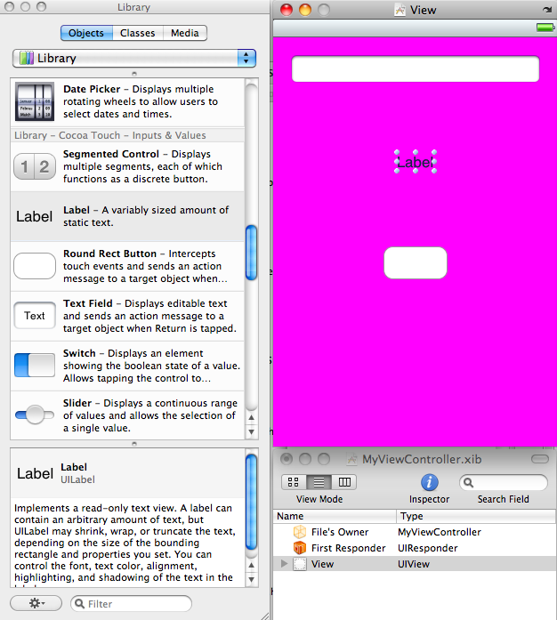
Adding UI elements to the view
Add elements to the window by dragging them from the Library in Interface Builder
Change properties of elements (e.g., text, size) by selecting element and editing its Attributes window

Slide 47
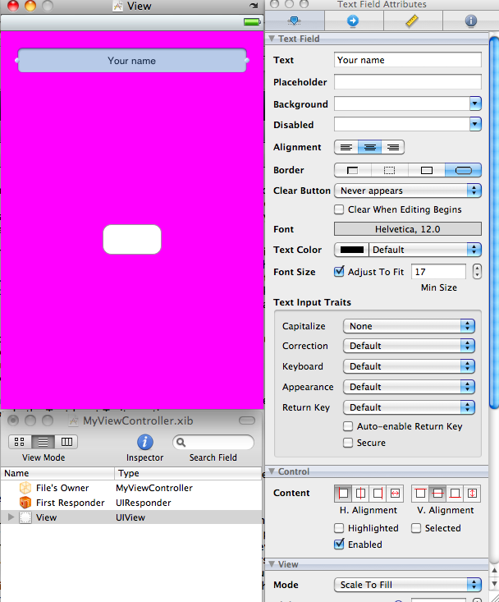
Configuring the UITextField
Ensure “Clear Context Before Drawing” is checked
Set the automatic capitalization
Set the Keyboard type to default
Set the keyboard return key to Done
Test application – cannot get rid of keyboard!

Slide 48
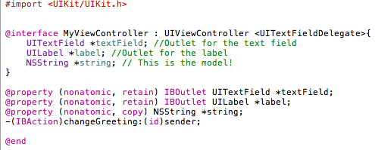
The View Controller Interface
View Controller must have instance variables (outlets) that connect to the interface components (text field, label and button)
These outlets can be made into properties that are specified to be Interface Builder outlets (using the IBOutlet keyword)
Also declare an action method, changeGreeting, that updates the label in response to user input
MyViewController object will also act as a delegate for the UITextField, so specify that it adopts the UITextFieldDelegate protocol

Slide 49
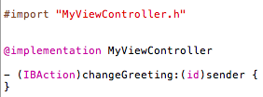
View Controller implementation
In order to test, need to add a stub implementation of the changeGreeting action method to the View Controller implementation file

Slide 50
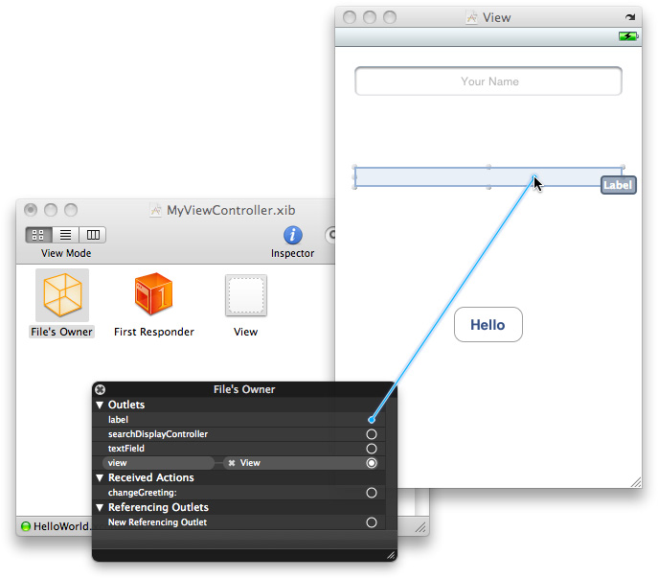
Making connections
In IB, connect the File’s Owner’s label outlet to the label element in the view
Connect the File’s Owner’s textField outlet to the UITextField element in the view
Connect the Touch Up Inside button event to the changeGreeting action in the File’s Owner object
As lift finger off button, changeGreeting message sent to MyViewController which is UITextFieldDelegate
Connect the text field’s delegate to the File’s Owner

Slide 51
Implementing the View Controller
Need to do three things to implement the view controller
Deal with the properties and instance variables (outlets)
Implement the changeGreeting: method
Ensure keyboard is dismissed when Done is tapped

Slide 52
The Properties
Properties declared in the interface file have to be synthesized in the implementation file
In dealloc, must relinquish ownership of the properties

Slide 53
The changeGreeting: method
Retrieves string from text field, sets the controller’s string instance variable
@”World” is a string constant that is used if the text field is empty
initWithFormat: creates a new string using a format string
%@ indicates that a string should be substituted

Slide 54
Making the keyboard disappear
When text field becomes First Responder, keyboard is automatically shown
Keyboard is dismissed when text field loses First responder status
Make the keyboard disappear by making the text field resign its first responder status
UITextFieldDelegate protocol has a textFieldShouldReturn: method which is called when the user taps the Return button (whatever this button is actually called in the view)
Send the text field a resignFirstResponder message to make text field lose its first responder status and thus cause the keyboard to close

