Slide 1
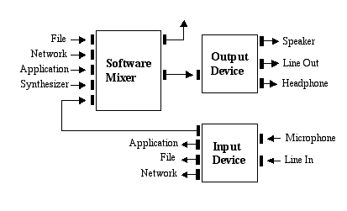
Java Sound API
Medialogy, Semester 7, 2010
Aalborg University, Aalborg
http://mea.create.aau.dk/course/view.php?id=26
David Meredith dave@create.aau.dk

Slide 2
Resources
The Java Sound Resources web site
  http://www.jsresources.org/
The Java Sound Tutorial
  http://download.oracle.com/javase/tutorial/sound/TOC.html

Slide 3
Overview
Java Sound API is a low-level API for controlling and manipulating sound data
Can be used for both audio data and MIDI
Provides the lowest level of sound support
  Can install, access and manipulate mixers, synthesizers and other audio and MIDI devices
  Other APIs provide a higher level sound API, e.g. Java Media Framework
Does not provide any fancy graphical editors
  You can build these using the Java Sound API!

Slide 4
Audio and MIDI
Java Sound API provides support for both audio and MIDI processing
  javax.sound.sampled
    Interfaces for capture, mixing and playback of digital, sampled audio
  javax.sound.midi
    Interfaces for MIDI synthesis, sequencing and event transport
Two other packages allow service providers to create custom software components that extend an implementation of the Java Sound API
  javax.sound.sampled.spi
  javax.sound.midi.spi

Slide 5
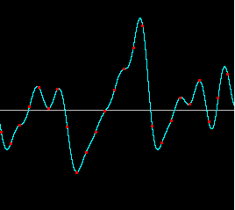
Sampled audio
Sampled audio (digital audio data) is handled by the javax.sound.sampled package
A sample is an instantaneous measurement of the pressure in a sound wave
An analogue sound signal can be converted to a digital one by sampling the analogue sound wave many thousands of times per second (see figure)

Slide 6
Sampled audio
A digital representation of a sound wave is just a sequence of numbers, where each number gives the air pressure (displacement or instantaneous amplitude) in the wave at a particular instant in time
The temporal resolution depends on the sampling rate
The resolution of the amplitude measurement depends on the quantization which is the number of bits in the number used to represent the amplitude
CD quality sound is sampled at 44.1kHz, with each sample being represented by a 16 bit number
  There are therefore 65536 different values that are used to represent the instantaneous amplitude

Slide 7
Sampled audio
Java Sound API allows different sorts of audio components to be installed and accessed
Supports
  input and output from a sound card (for playback and recording)
  mixing multiple streams of audio
Mixer might receive sound data from a file, streamed from a network, from another application program, from a synthesizer or from the sound card

Slide 8
MIDI
javax.sound.midi provides API for processing MIDI data
  transmitting MIDI messages between devices and programs
  sequencing MIDI events
  synthesizing sound from MIDI events
A MIDI event is an instruction to an instrument, telling it how to create a sound
  A MIDI event is not raw audio data
A MIDI event can be, for example
  an instruction to start playing a particular note on a particular instrument
  an instruction to change the tempo
  an instruction to bend the pitch of a note
  an instruction to start sustaining notes
MIDI events can be sent to a synthesizer which then generates sound in response to the MIDI messages it receives

Slide 9
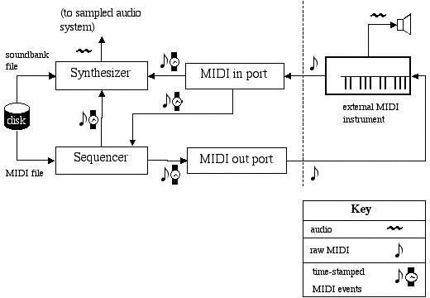
MIDI
Synthesizers can be implemented entirely in software or they can take the form of hardware devices that a program can connect to via a MIDI output port on the system’s sound card
Java Sound API provides interfaces that abstract synthesizers, sequencers, input and output ports

Slide 10
Service Provider Interfaces
SPI interface packages
  javax.sound.sampled.spi
  javax.sound.midi.spi
contain APIs that let software developers create new audio or MIDI resources that can be plugged into an implementation of the Java Sound API
For example, a service provider could provide
  an audio mixer
  a midi synthesizer
  a file parser that can read or write a new type of file
  a converter that translates between different sound formats
Services can be
  software interfaces to hardware devices
  pure software services

Slide 11
Overview of javax.sound.sampled
Focused on problem of moving bytes of audio data into and out of the system and from one device to another
Involves opening input and output devices and managing buffers that get filled with real-time sound data
Also can involve mixing different audio streams together
javax.sound.sampled provides
  methods for converting between audio formats
  methods for reading and writing sound files

Slide 12
Streaming and “in-memory” audio
Sampled package provides classes for handling buffered audio data streams (e.g., writing and reading large amounts of audio data to and from a disk)
Also provides classes for processing short audio clips loaded entirely into memory (e.g., to be looped, or started and stopped at random positions)
To play or capture audio in Java Sound API, you need
  formatted audio data
  a mixer
  a line

Slide 13
Formatted audio data
Audio data is transported and stored in lots of different formats
There are two types of format
  Data formats
    Format of data as it is being transported
  File formats
    Format of data as it is stored

Slide 14
Audio Data Formats
Data format defines how a stream of bytes representing sampled sound should be interpeted
  e.g., “raw” sampled audio data already read from a file or captured from a microphone
Typically need to know
  How many samples per second (sample rate)
  How many bits per sample (quantization)
  Number of channels
  …

Slide 15
AudioFormat class
An audio data format is represented in Java Sound by an AudioFormat object with following attributes
  Encoding technique (usually PCM)
  Number of channels (1 = mono, 2 = stereo)
  Sample rate (CD quality is 44100 samples per second)
  Number of bits per sample per channel (CD quality is 16)
  Frame rate
  Frame size in bytes
  Byte order (big-endian or little-endian)

Slide 16
Encoding technique
PCM encoding can be linear or non-linear
In a linear encoding, the sample value is proportional to the instantaneous amplitude
  The sample value can be represented by a signed or unsigned integer or a float
In a non-linear encoding (e.g., µ-law or a-law), the amplitude resolution is higher at lower amplitudes
  Used for companding speech in telephony

Slide 17
Frames
In PCM, non-compressed formats, a frame contains the data in all channels for a particular sample
  So the frame size in bytes would be the number of channels multiplied by the number bytes used to store a sample in single channel
    e.g., 2 bytes per channel if 16 bit quantization
  Here, frame rate is same as sample rate
In compressed formats (e.g., MP3), each frame might represent several samples and have extra header information
  So here, frame size is not equal to sum of sample sizes for a given instant
  And frame rate can be different from sample rate
  Here, sample rate and sample size refer to PCM data produced by decoding the compressed format

Slide 18
File formats
Audio file format specifies format in which sound is stored in a file (e.g., WAV, AIFF, AU)
Represented in the Java Sound API by a AudioFileFormat object, which contains
  The file type (e.g., WAVE, AIFF, etc.)
  File’s length in bytes
  Length in bytes of audio data stored in file
  An AudioFormat object specifying data format
AudioSystem class provides static methods for reading and writing sounds in different formats and converting between formats
AudioSystem also let’s you get a special type of stream called an AudioInputStream on a file

Slide 19
AudioInputStream class
AudioSystem has static method
getAudioInputStream(audioFile)
  Returns an AudioInputStream object that allows for reading from the audio file
AudioInputStream is a subclass of InputStream that has an AudioFormat object
  Gives direct access to samples without having to worry about the sound file’s structure

Slide 20
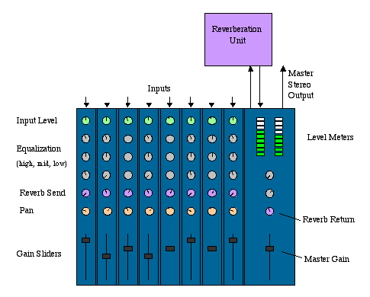
Mixers
In Java Sound API, an audio device that has various audio inputs and outputs is represented by a Mixer object
A Mixer object handles one or more streams of audio input and one or more streams of audio output
  e.g., may mix several input streams into one output stream
The mixing capabilities of a Mixer object may be implemented in software or in a hardware device

Slide 21
Ports on Mixers
A microphone or a speaker is not considered a device – it is a port into or out of a Mixer object
A port provides a single stream of data into or out of the mixer
A Mixer object representing a sound card might have several input and output ports, e.g.
  line-in, microphone
  speaker, line-out, headphones
A Java Sound Mixer has a source from which it gets audio data and a target to which the mixer sends audio data

Slide 22
Lines
A line is a path for moving audio from one place to another
Typically, a Line is a path into or out of a Mixer object
  Though a Mixer is also a specialized Line object
Input and output ports (e.g., speakers and microphones) are Lines
A Line can also be a data path along which audio data is transmitted to and from a Mixer
Audio data flowing through a Line can be mono or multi-channel
  Not possible with analogue data flowing through one port of a physical mixer, which is always mono
Each line has an AudioFormat object that specifies (among other things) the number of channels of data in it

Slide 23
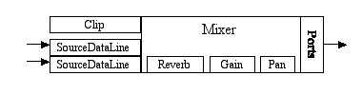
An audio output system
Figure represents a whole Mixer object in the Java Sound API
This Mixer has 3 inputs and some output ports
Inputs include
  a Clip: a line into which you load a complete short sound
  two SourceDataLines: lines that receive buffered, real-time audio input streams
Each input line may (or may not) have its own controls (e.g., reverb, gain, pan)
Mixer reads from all input lines and sends to output ports after possibly processing with its own controls

Slide 24

An audio input system
Data flows into the mixer from the input ports (e.g., mic and line-in)
Mixer has gain and pan controls that can modify the sound signal
Sound sent on (e.g., to a program) through the TargetDataLine output
A Mixer may have more than one TargetDataLine delivering the output sound data to various different targets simultaneously

Slide 25
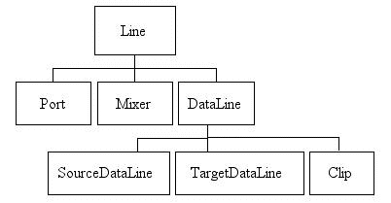
The Line interface hierarchy
Line has several subinterfaces
A Line has
  Controls including gain, pan, reverb and sample rate
  Open or closed status: opening a line reserves it for use by the program; closing it makes it available to other programs
  Events: generated when a line opens or closes; received by registered LineListener objects

Slide 26
Ports
Simple Lines for input and output of audio to and from audio devices
E.g., microphone, line input, CD-ROM drive, speaker, headphone and line output

Slide 27
Mixer
Represents either a hardware or software device
A Mixer can have various source and target lines
Source lines feed audio into the Mixer
Target lines take mixed audio away from the mixer
Source lines can be input ports, Clips or SourceDataLines
Target lines can be output ports or TargetDataLines
Can synchronize two or more of a mixer’s lines so they can all be started, stopped or closed by sending a message to just one line in the group

Slide 28
DataLine
Subinterface of Line that provides following additional features
  Audio format
  Media position
  Buffer size (write to source, read from target)
  Level
  Start, stop, resume playback and capture
  Flush and drain
  Active status
  START and STOP events

Slide 29
TargetDataLine
Receives audio data from a Mixer object
Adds methods for
  reading data from its buffer
  finding out how much data currently available for reading

Slide 30
SourceDataLine
Receives audio data for playback
Adds methods for
  writing data to the buffer
  finding out how much data the line can receive without blocking

Slide 31
Clip
Line into which audio data can be loaded prior to playback
Audio data is pre-loaded so can loop sounds and start and stop at any position
But only short sounds can be loaded!

Slide 32
AudioSystem
AudioSystem has static methods for learning what sampled-audio resources are available and obtaining the ones you need
  e.g., can list available Mixers and choose the one that has the types of Line that you need
AudioSystem can be used to obtain
  Mixers
  Lines
    every line is associated with a Mixer, but can be obtained directly using AudioSystem without first obtaining its Mixer
  Audio format conversions
  Files and streams specialized for audio data

Slide 33
Information objects
Different types of Line object have Info objects that describe them
e.g.,
  Mixer.Info objects describe Mixers
  Line.Info objects describe Lines
  Port.Info objects describe Ports
  DataLine.Info objects describe DataLines
    including Clips, TargetDataLines and SourceDataLines)

Slide 34
Getting a Mixer
Typically start by getting a Mixer or a Line so that you can get sound into or out of your computer
Can get an array of Mixer.Info objects for all installed Mixer objects using
  Mixer.Info[] mixerInfos = AudioSystem.getMixerInfo();
Can use getName(), getVersion(), getVendor() and getDescription() methods to get information out of a Mixer.Info object
Can get a specific Mixer as follows
  Mixer mixer = AudioSystem.getMixer(mixerInfo);
  where mixerInfo is a Mixer.Info object
See GetMixer.java

Slide 35
Getting a Line
There are two ways to get a Line
  Directly from the AudioSystem class
  From a Mixer object that you’ve already obtained using the AudioSystem.getMixer(mixerInfo) method

Slide 36
Getting a Line from AudioSystem
If you only need a Line and not a Mixer, then you can get a Line directly without first getting the Mixer object that it belongs to, e.g.,
  SourceDataLine line = (SourceDataLine) AudioSystem.getLine(info);
  where info is a subclass of Line.Info (Port.Info or DataLine.Info)
See
  line 22 in Example01Player.java
  line 45 in Example02Recorder.java
  line 24 in Example03ClipPlayer.java

Slide 37
Playing back audio
Two types of Line you can use for playing sound
  Clip
    All sound data loaded into memory before playback
    Can loop sound, start and stop anywhere
    Has to be short enough to be loaded into memory
  SourceDataLine
    Buffer repeatedly loaded with data from a stream
    Use for long sounds or if length of sound cannot be known in advance of playback (e.g., monitoring sound during capture)

Slide 38
Playback using a Clip
File clipFile = new File(clipFileName);
audioInputStream = AudioSystem.getAudioInputStream(clipFile);
AudioFormatformat = audioInputStream.getFormat();
DataLine.Info info = new DataLine.Info(Clip.class, format);
clip = (Clip) AudioSystem.getLine(info);
clip.addLineListener(this);
clip.open(audioInputStream);
clip.loop(nLoopCount);
Use AudioSystem.getAudioInputStream(clipFile) to get an AudioInputStream on a file
Use AudioInputStream.getFormat() to find the AudioFormat of the audio file
Construct a DataLine.Info object specifying the Clip.class
Obtain a Clip using AudioSystem.getLine(info)
Open the Clip and Loop it or start it
Use setMicrosecondPosition to set start position
See Example03ClipPlayer.java

Slide 39
Playback using a SourceDataLine
File soundFile = new File("resources/ChopinOp10No1Start.wav");
AudioInputStream audioInputStream = AudioSystem.getAudioInputStream(soundFile);
AudioFormataudioFormat = audioInputStream.getFormat();
DataLine.Info info = new DataLine.Info(SourceDataLine.class, audioFormat);
SourceDataLine line = (SourceDataLine) AudioSystem.getLine(info);
line.open(audioFormat);
Obtain a SourceDataLine directly from the AudioSystem
Obtain AudioFormat from audio file
Open the SourceDataLine to reserve it for your program
  SourceDataLine.open(AudioFormat) takes an AudioFormat object as its argument
    cf. AudioInputStream argument when opening a Clip

Slide 40
Playback using a SourceDataLine
int nBytesRead = 0;
byte[] abData = new byte[128000];
while (nBytesRead != -1) {
nBytesRead = audioInputStream.read(abData, 0, abData.length);
if (nBytesRead >= 0)
line.write(abData, 0, nBytesRead);
}
Play back sound using a SourceDataLine by starting the Line and then writing data repeatedly to the line’s playback buffer
Use
int Line.write(byte[] byteArray, int offset, int length)
to write data to the Line’s buffer
Line starts sending data to its Mixer which delivers to its target
When Mixer starts delivering to its target, the SourceDataLine emits a START event which can be caught by a LineListener, causing its update method to be run (see Example03ClipPlayer.java)
write method returns as soon as it’s finished writing, not when buffer is empty, so there can be time to write more data before buffer becomes empty

Slide 41
Using SourceDataLine.drain()
while (nBytesRead != -1) {
nBytesRead = audioInputStream.read(abData, 0, abData.length);
if (nBytesRead >= 0)
line.write(abData, 0, nBytesRead);
}
line.drain();
line.close();
line = null;
After writing the last buffer-full of data to the SourceDataLine, call drain() to make sure all the data is presented before continuing execution
drain() blocks until buffer is empty
Use stop() method to stop playback
Use flush() method to empty the buffer without playing

Slide 42
Recording Audio data
See Example02Recorder.java

