Slide 1
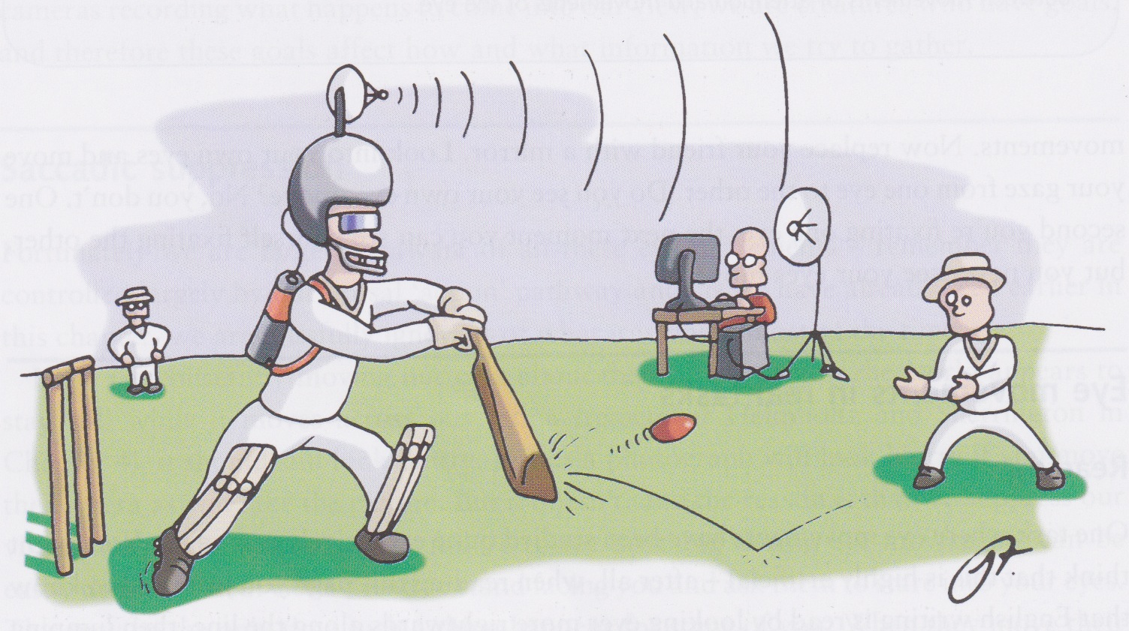
Vision and Action
David Meredith
Aalborg University

Slide 2
Source
This lecture is based on Chapter 11 of
Snowden, R., Thompson, P. & Troscianko, T. (2006). Basic Vision: An Introduction to Visual Perception. OUP. (ISBN: 978-0199286706)

Slide 3
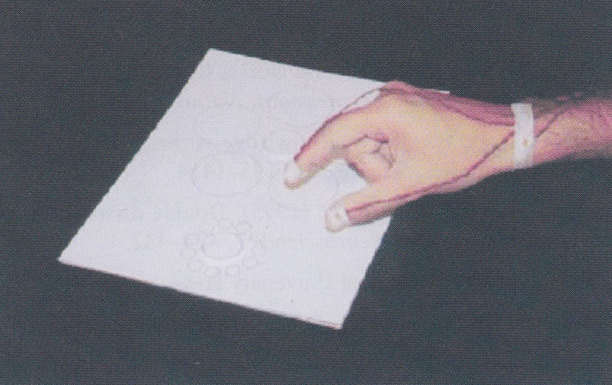
Vision and action
The perceptual system sees a visual illusion, but our visual action system is not fooled
Two disks that appear to be different in size (Ebbinghaus illusion) produce identical and appropriate grasping actions when the subject attempts to pick them up

Slide 4
Overview
Vision would be useless unless it allowed us to act effectively in the world
How do we use it to avoid getting run over by a bus or catch prey or work out whom we’d like to date?
We also know that vision only develops fully if it is combined with action
Studying vision without action is like admiring a sports car without taking it for a spin
So let’s take it for a spin...

Slide 5
“What” and “where” streams
Visual information passes from the eyes, through the LGN to V1
From V1 it is sent forth to the “extrastriate cortex” which is a large collection of different brain areas
Each extrastriate area can be understood as being in either the “what” stream or the “where” stream

Slide 6
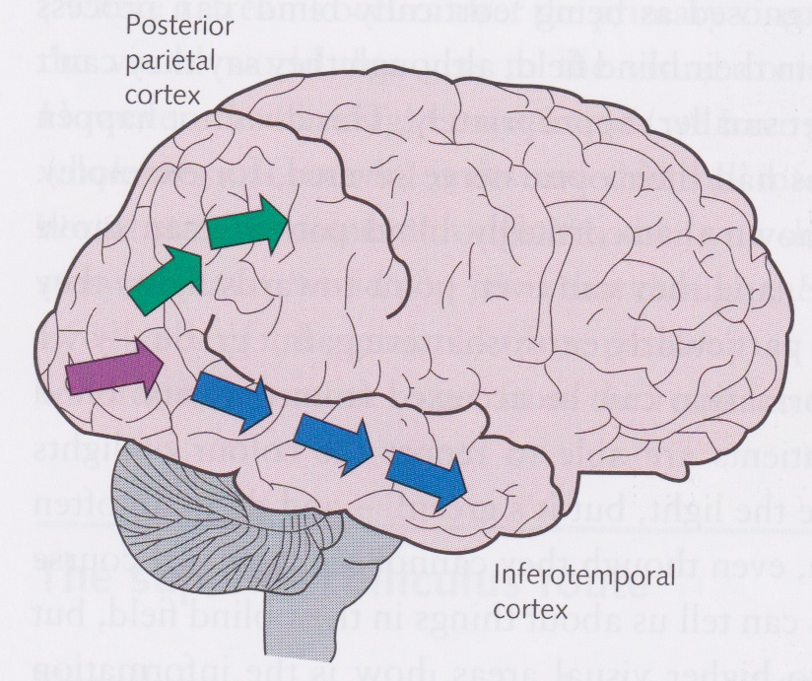
“What” and “where” streams
“What” stream (blue)
Travels ventrally from V1 to the inferotemporal cortex
object recognition and discrimination
“Where” stream (green)
Travels dorsally from V1 to the posterior parietal cortex
locates objects in the world and lets us interact with them

Slide 7
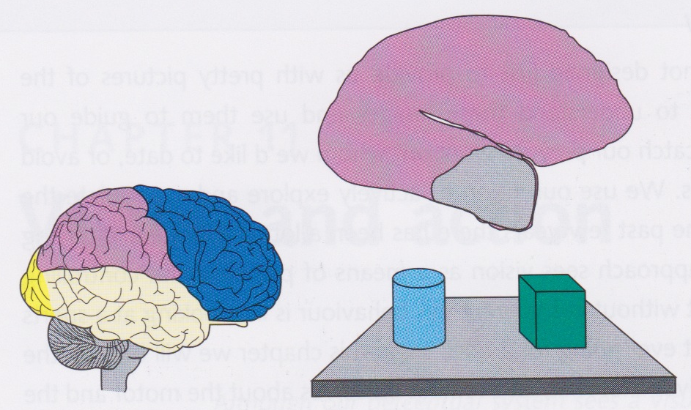
Damage to the “what” pathway
Lesions in the monkey inferotemporal cortex cause inability to discriminate between objects (Ungerleider and Mishkin, 1982)
Place food always under cylinder, but move objects on each trial
Normal monkey learns quickly that food always under cylinder, monkey with lesions in IT fails to learn this
Ventral stream therefore known as the “what” pathway

Slide 8
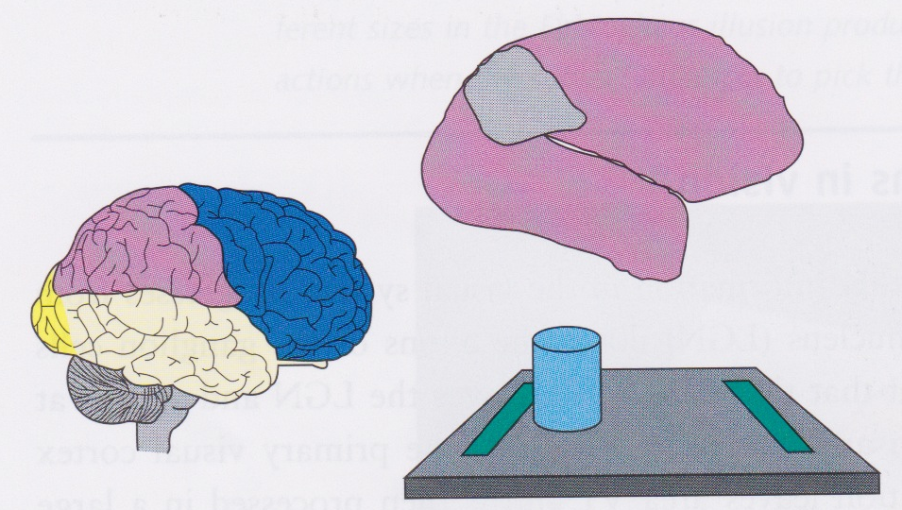
Damage to the “where” pathway
Lesions in the parietal cortex cause monkey to become unable to make decisions based on location
Food placed into food well (green line) near cylinder
Cylinder moved randomly on each trial
Monkey needs to be able to identify location of cylinder, but cannot if lesions in parietal cortex
Therefore dorsal pathway known as “where” pathway

Slide 9
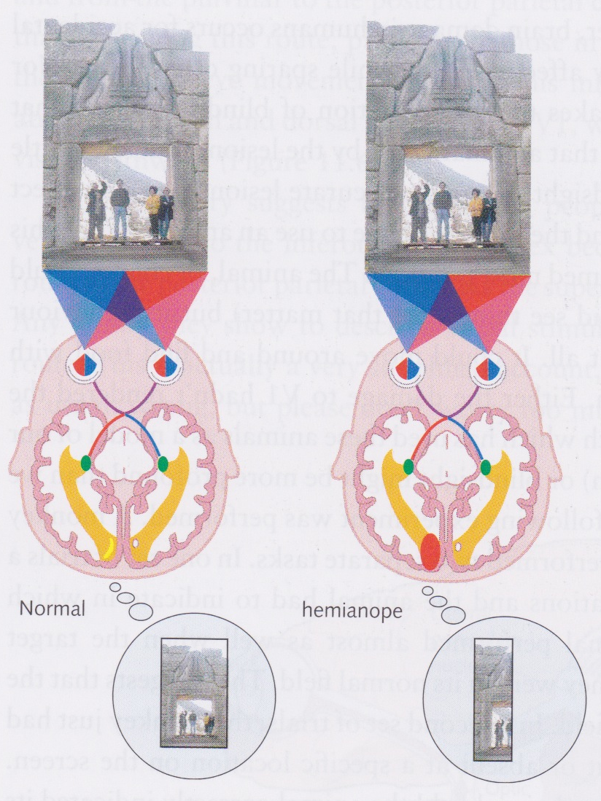
Blindsight
Damage to the left V1 causes right field hemianopia
Cannot see in the right hemifield
However, some such patients are able to tell us certain things about what is in the right hemifield even though they are not aware of being able to see anything there!
This is called blindsight

Slide 10
Blindsight
In patients with blindsight, pupils constrict when light shone in scotoma
Even sometimes move their eyes towards lights they are not aware of being able to see
Can sometimes even point towards lights that they are not aware of being able to see
Some patients can correctly identify the colour of lights in the scotoma
So quite a lot of visual information that isn’t being transmitted through V1

Slide 11
Blindsight in monkeys
Blindsight has been studied in destriate monkeys
V1 removed
Monkey could still move around and find food, apparently as easily as before the removal of V1
Monkey could identify location of a target in blind field as well as in visible field
When had to indicate whether a target was present, typically failed to indicate presence of target in blind field
But if forced to choose where it didn’t see the target, it gets it right!
Similar to results obtained with patients with damage to V1

Slide 12
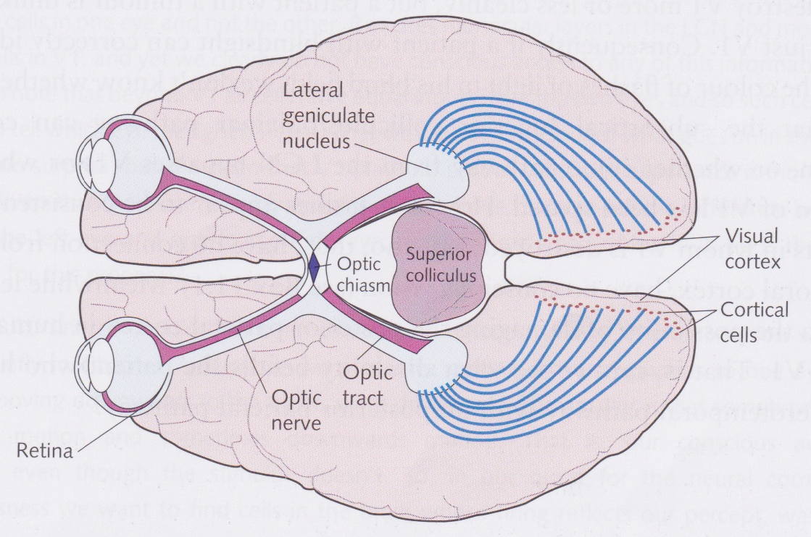
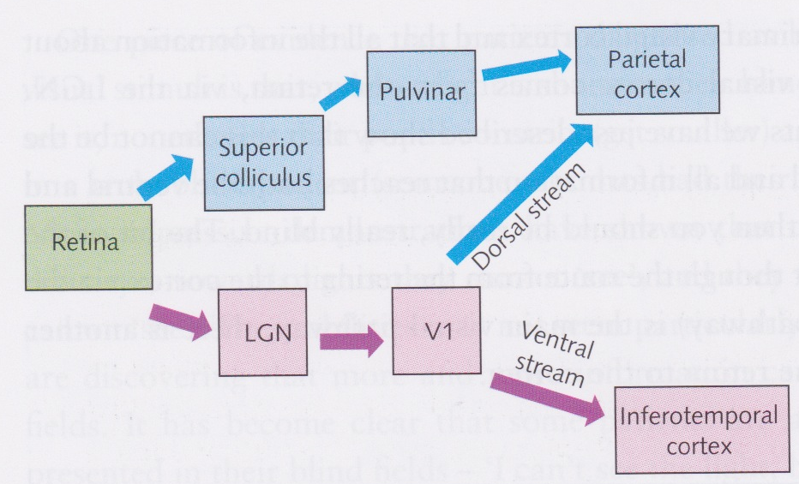
The superior colliculus route
Only about 90% of the retinal ganglion cells go to the LGN, most of the rest go to the superior colliculus, then the pulvinar, then the posterior parietal cortex
Same place as “where” pathway

Slide 13
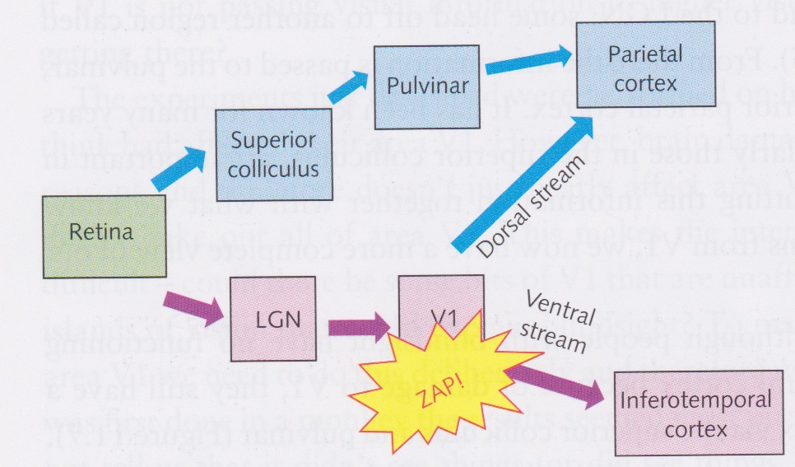
Superior colliculus route and blindsight
If V1 is damaged, then some visual information can still get to the posterior parietal cortex via the superior colliculus route
So should expect some ability to identify locations of objects, but reduced ability to discriminate between objects
If V1 is destroyed, then subject generally has no conscious vision

Slide 14
Neural correlates of consciousness
Without V1, patient’s brain can “see” to some degree, but subject is not aware of being able to see
This relates to the search for the “neural correlates of consciousness”
A lot of work done on this by Crick and Koch
Without V1, subject loses conscious vision, but this does not mean that consciousness “resides” in V1
You could lose conscious vision by poking your eyes out, too!

Slide 15
V1 and utrocular perception
Blindsight suggest we are not aware of activity in the “where” pathway (aka. the “action” or “how” pathway)
Utrocular perception suggests that we are not directly conscious of activity in V1
If you’re in a dark room and you have a light flashed in one eye, you cannot tell which eye the light was flashed in
Suggests only conscious of activity in binocular cells

Slide 16
Binocular rivalry and consciousness
Upward-moving grating presented to one eye, downward-moving grating presented to the other
Perception is of grating moving upwards some of the time and downwards the rest of the time
Want to find neural correlate of this changing percept

Slide 17
Motion after-effect and binocular rivalry
Upward-moving grating in one eye, downward in the other
If adapt to the moving gratings, then downward after-effect in one eye and upward in the other
Implies adaptation in V1, since monocular and direction specific
Lehmkuhle and Fox (1975) measured which grating subject was experiencing at each instant
Discovered after-effect was proportional to time of retinal exposure, not time of experience
Suggests not conscious of activity in V1

Slide 18
Consciousness and MT
Logothetis and Schall (1989) recorded MT cells in monkey while it was looking at moving gratings (up in one eye, down in the other)
Monkey’s perception alternated between up and down
Most MT cells responded constantly throughout trial indicating response to retinal motion
Some cells changed with monkey’s perception

Slide 19
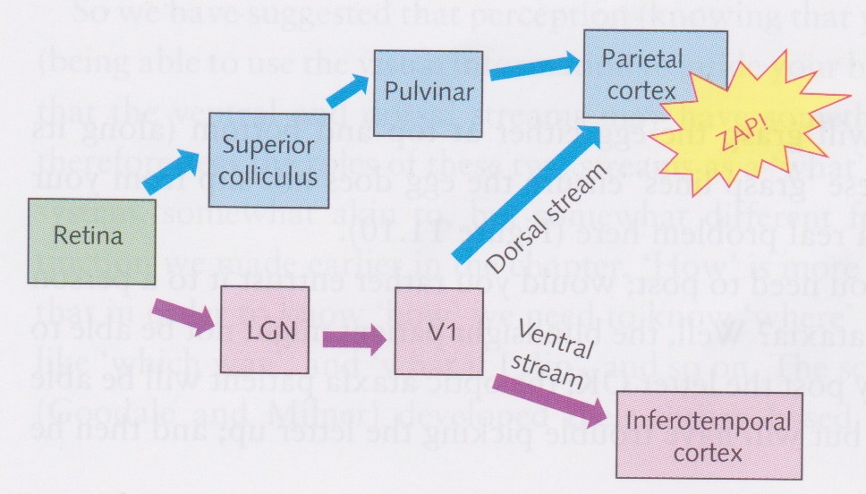
Bálint-Holmes syndrome (optic ataxia)
1909 Bálint reported patient with damage to posterior parietal cortex who could not reach out and grasp objects
1918 Holmes reported patients with gunshot wounds unable to determine orientation of objects in space
This is known as Bálint-Holmes syndrome or optic ataxia

Slide 20
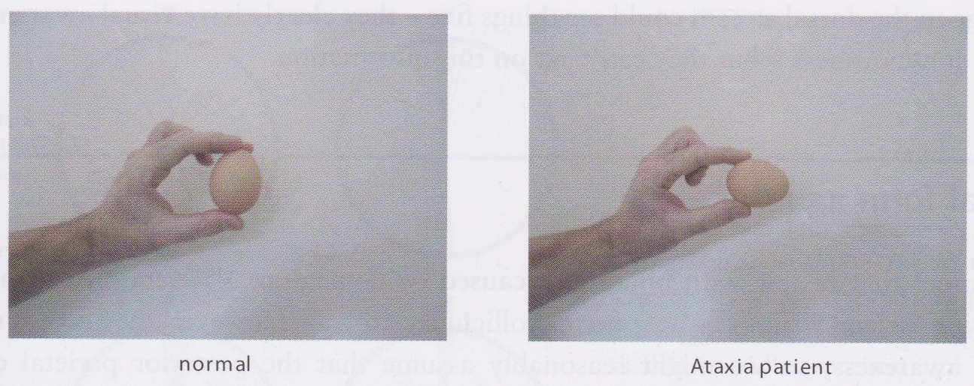
Optic ataxia
Patients with optic ataxia can see and recognize objects normally (ventral pathway) but cannot pick up objects or manipulate them
Consider picking up an egg
Normal person grasps egg at points of maximum height or width
Ataxic patient fails to do this (see above)

Slide 21
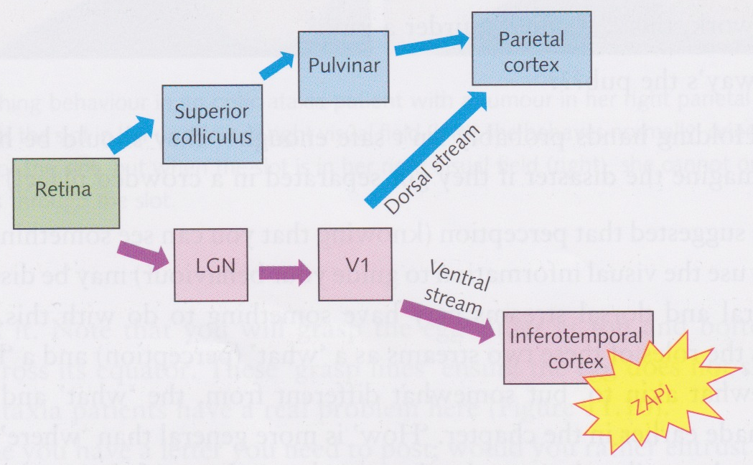
Visual form agnosia
What happens if a patient is damaged in the ventral stream after V1 – i.e., in the inferotemporal cortex?
Might expect that patient has blindsight since V1 activity seems not to be conscious and dorsal pathway is not conscious
Not quite true...

Slide 22
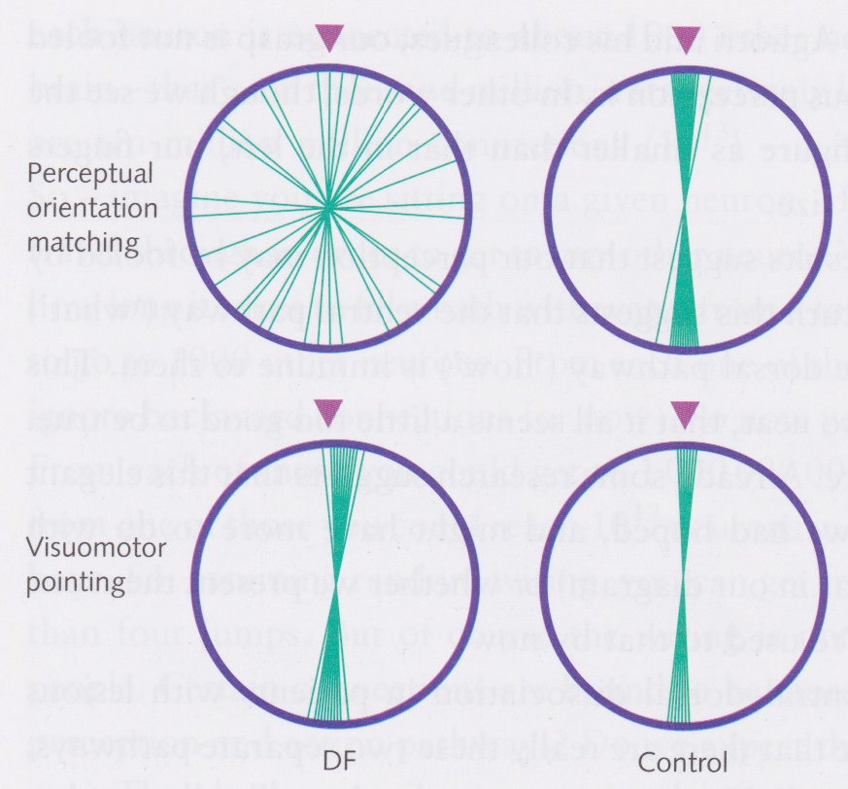
Visual form agnosia
DF suffered damage to IT as a result of carbon monoxide poisoning
Became unable to match the orientation of a line to that of a slot (upper part of figure)
But able to accurately post letters into the slot
Suggests ventral pathway is to do with perception whereas dorsal pathway is to do with action
Note that DF had visual awareness (unlike patient with blindsight)

Slide 23
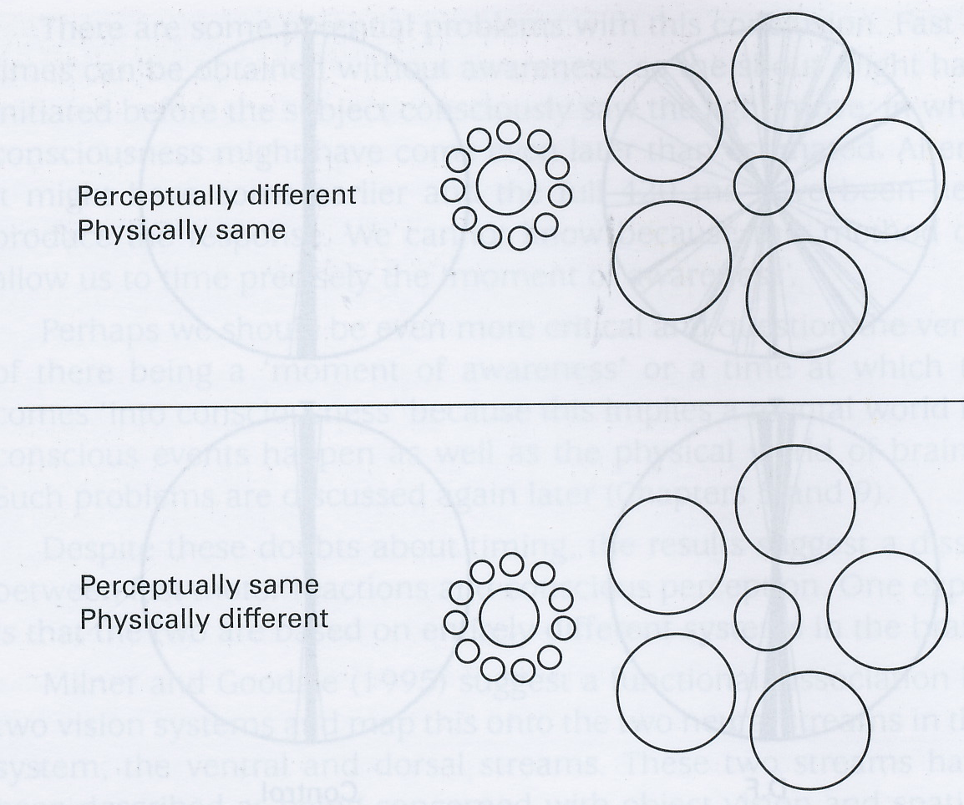
Dissociation of perception and action
Can use Ebbinghaus or Tichener circles illusion to show dissociation between ventral and dorsal visual pathways

Slide 24
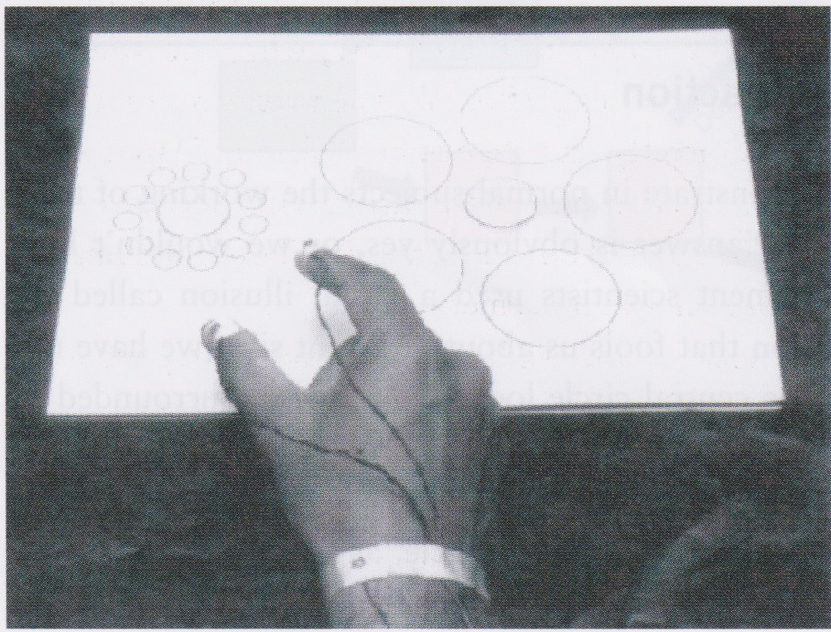
Dissociation of perception and action
Subjects reach out and grasp the central circle
Even though the circles look as though they are different sizes, our visuo-motor system is not fooled – the fingers adjust to the correct size for both circles!
However, some doubt as to whether this is the full story
Suggests disconnection between ventral and dorsal streams
But each neuron is connected to about 1000 other neurons and there are “only” about 10¹⁰ neurons
If connections were random, then could get from any neuron to any other neuron in less than 4 jumps
So probably not complete dissociation between the action and perception pathways

Slide 25
Eye movements
Vision is clearest in the centre of the field falling on the fovea
When we want to see something in detail, we move our eyes so that the thing falls on the fovea
Only takes 20ms or so to change the direction of gaze (saccade)
Can do this voluntarily (cf. endogenous cues for attention)
Also possible to attend to something that you’re not looking at directly, though this is less natural
So close connection between saccades and attention

Slide 26
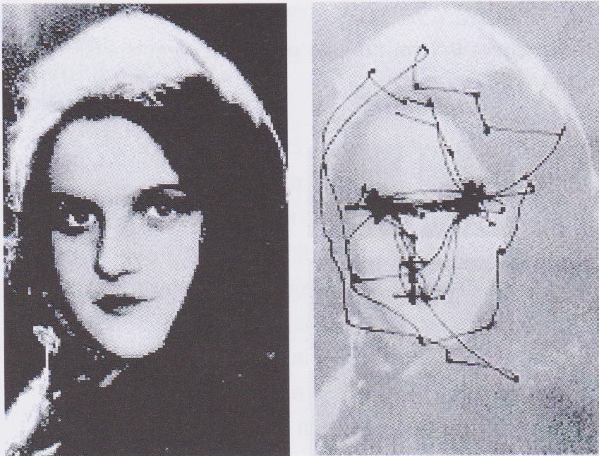
Saccades
Typically make about 3-4 saccades per second or about 200000 per day
Eyes tend to move from one point of interest to another
What you find interesting depends on what your goals are

Slide 27
Saccadic suppression
Saccades controlled (unconsciously) by the dorsal “action” pathway
Vision does not look blurry because it is suppressed during the saccade movement
If you stare into the eyes of someone else, you will see their eyes move
If you stare in the mirror into your own eyes, you will not see your eyes move because of saccadic suppression

Slide 28
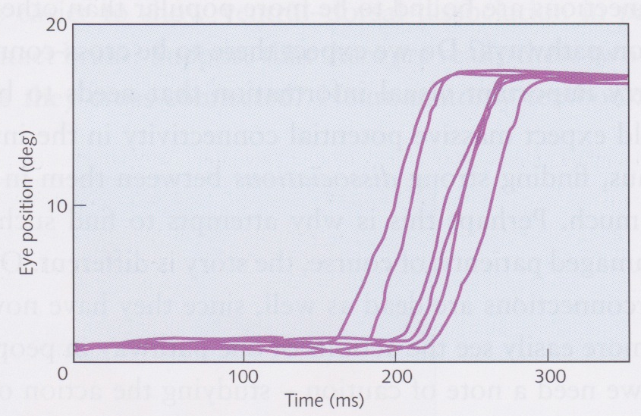
Saccades are stereotyped
Saccades are stereotyped
Each time we make a saccade of a particular size, eyes follow the same pattern of movement
accelerates, reaches maximum, rapidly slows down
Maximum speed depends on how far eye moves
Can reach over 100 degrees/second

Slide 29
Saccades are ballistic
Saccades are planned ahead of time, and, once initiated, cannot be stopped
If move target while saccade occurring, then will miss its target
Graph shows saccades for an object moving 15 degrees to the left
very rapid
quite long latency period (ca. 200ms after target motion)

Slide 30
Other eye movements
Smooth pursuit eye movements occur when you are tracking a moving object
If large areas of the visual field move (e.g., looking out of a train window), then eyes fixate on a particular point and rotate to maintain point of fixation
Tremors or drifts occur all the time in the eye and can only be removed by taking paralytic drugs or by stuffing putty behind your eyes
These constant small movements prevent the cones from adapting and the field from going totally grey

Slide 31
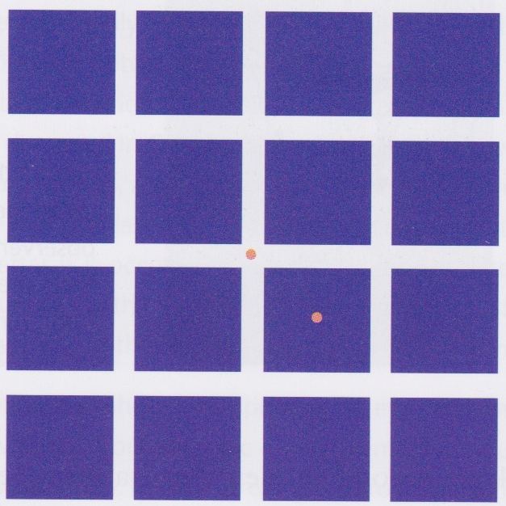
Tremors and drifts
Stare at the central orange dot for about 20 seconds, then move gaze to off-center orange dot
Should see grid after-image dancing around, indicating that your eyes cannot stand still

Slide 32
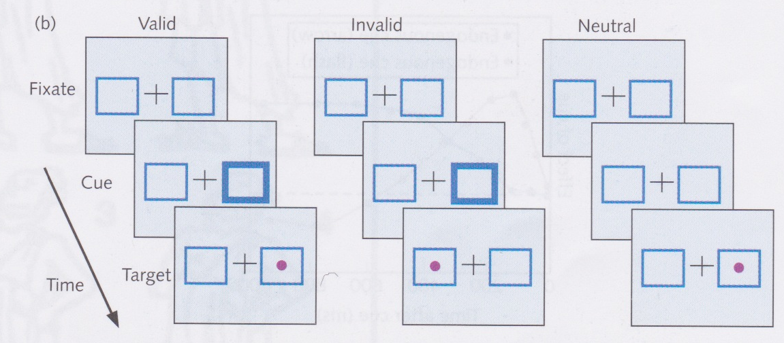
Eye movements and attention
Attention connected with gaze direction
Attention moves before eyes move
Remember cueing paradigm
Fixate on central cross, then given exogenous cue which is flashing box
Draws attention, have to resist moving eyes
Hence primes eye movement

Slide 33
Eye movements and attention
Several brain areas involved in controlling eye movements
Frontal eye fields (FEF) and superior colliculus (SC)
These areas are topographically organised
If stimulate a point in one of these maps, then eyes move to the corresponding location in the visual field
But stimulation must be large enough!
If stimulation not large enough then get subthreshold microstimulation and the movement is primed, but the eyes don’t actually move

Slide 34
Eye movements during reading
Points of fixation when carrying out particular tasks are not random
driving
playing cricket or tennis
Athletes develop strategies for fixating on the ball to improve their performance
Also true for reading
Don’t just move our eyes smoothly along the line of text and then drop to the beginning of the next line

Slide 35
Eye movements during reading
When reading,
eyes move by about 8 characters at at time
independent of font size!
not all movements are forward – refixations
More of these when text is hard to understand
points of fixation are not random – rarely land in between words – usually first half of word is fixated

Slide 36
Eye movmements during reading
If movements not random, then must know something of text ahead
What information taken in during each fixation?
Can use various gaze-contingent paradigms to find out

Slide 37
Gaze-contingent paradigms
Moving window paradigm
Text outside of window replaced with nonsense
Used to find out area over which reader takes in information
Moving mask paradigm
Text within window is replaced with nonsense
Boundary paradigm
Change word ahead of current word to see how it changes ease with which text is read

Slide 38
Gaze-contingent paradigms
Reveal that perceptual span is surprisingly small
Masked area must be more than 7 characters long otherwise reading becomes impossible
Moving window paradigm shows that perceptual span is asymmetric
modifying letters 4 characters to the left or 10 characters to the right of fixation reduces reading ability

Slide 39
Boundary paradigm
Changing a word in front of the fixation point to one that is orthographically similar to the actual word does not slow down reading too much
Changing the word to a completely different word slows down reading even if the the word has a similar meaning to the original one
Indicates that only process future words in a visually superficial way
Experiments where language of following word changed confirms this

Slide 40
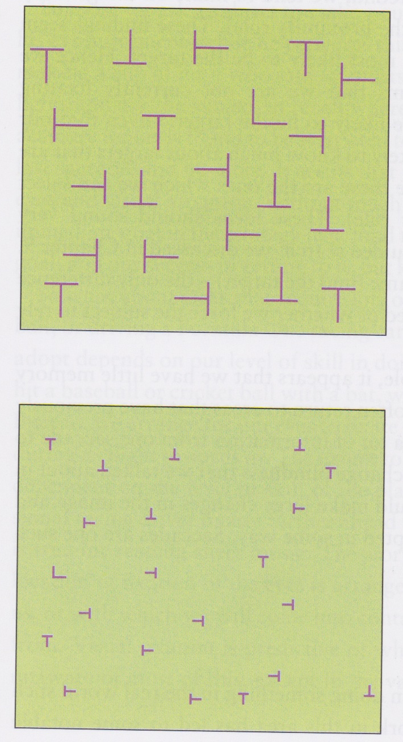
Eye movements in visual search
Correspondence between time taken to perform visual search and number of saccades
In “parallel”, preattentive search, only one saccade made – directly to target!!!
In “serial” search, saccades seem to be governed by two rules
Similarity rule - eyes saccade to elements that look like the target
Proximity rule – eyes move to elements near previous fixation
limited perceptual span, so can only extract features (e.g., colour, orientation) from elements close to fixation point
Poor memory for previous fixation points – tend to often return to previously fixated positions

Slide 41
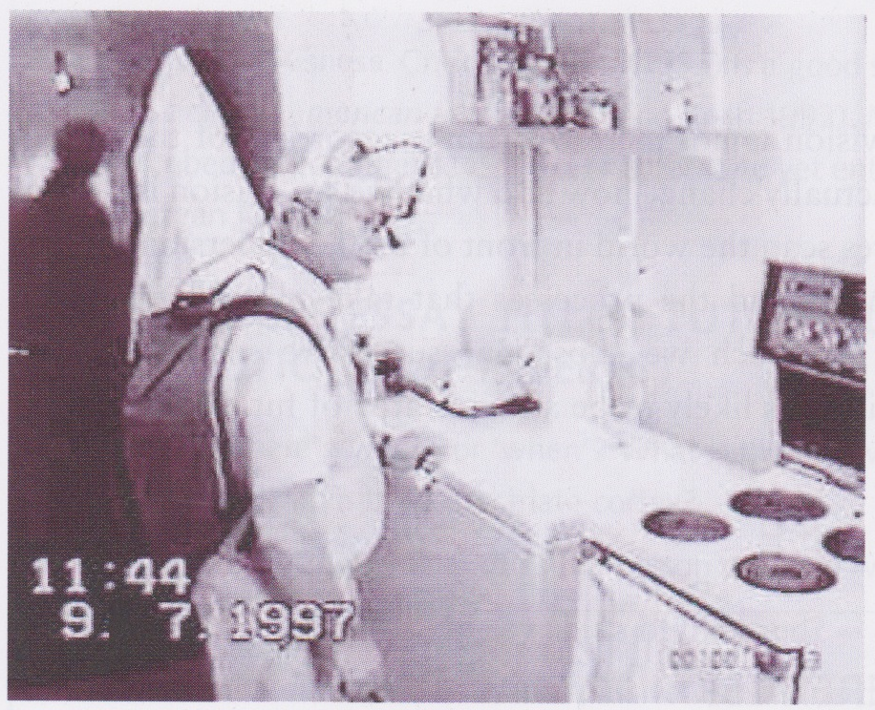
Eye movements during everyday tasks
“Everyday tasks” =
in UK: making a cup of tea, playing cricket
in US: eating a peanut-butter and jelly sandwich, catching “flyballs”
Get subject to carry out an “everyday task” (making a cup of tea)
After random periods switch light off and ask him where he was just looking
aware of where looking only up to before last saccade
conscious of goal and whether successful in achieving it
not conscious of all actions involved in achieving goal

Slide 42
Eye movements during skilled tasks
In skilled tasks, eye movements depend on how skillful we are at the task
If about to hit a ball, fixate ahead of ball during its flight
more skilled players fixate further ahead of ball
In general, more skilled we are, further ahead we can look while
e.g., racing driver looks further ahead
musician looks further ahead when reading sheet music

