Slide 1
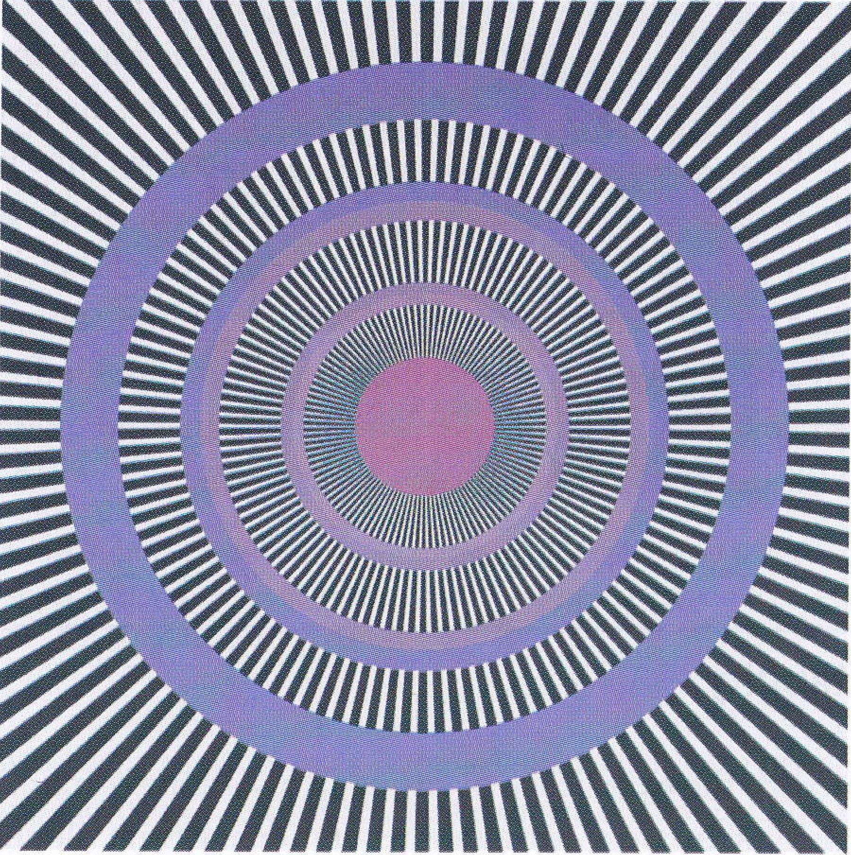
The Perception of Motion
David Meredith
Aalborg University

Slide 2
Source
This lecture is based on Chapter 6 of
Snowden, R., Thompson, P. & Troscianko, T. (2006). Basic Vision: An Introduction to Visual Perception. OUP. (ISBN: 978-0199286706)

Slide 3
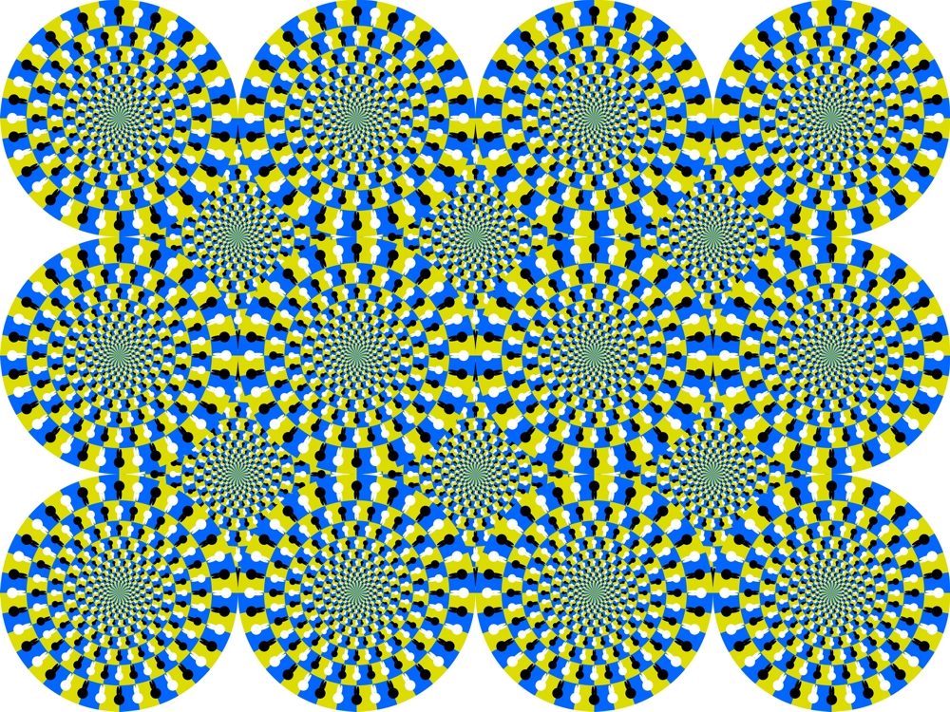
U-zu-maki glasses by Akiyoshi Kitaoka

Slide 4
U-zu-maki glasses by Akiyoshi Kitaoka
“Uzumaki” means spirals or swirls
“U” = Rabbits, “zu” = figure, “maki” = rotation
Appear to move when you move your eyes
Works best in periphery
High-contrast edges all on right (clockwise) side of each white or black “ear” in some circles, all on the other side in other circles
High contrast transmitted faster up visual pathway than low-contrast, so motion detectors in the cortex receive information from some parts of image faster than from others
Contrast detectors respond to difference in timing as though motion is being detected

Slide 5
Overview
Not hard to imagine a world with no colour
Try imagining a world with no motion!
Some people suffer from this
Crossing the road becomes a terrifying ordeal
Part of the brain dedicated to perception of motion
How to build a motion detector
How we see movement in TV and films
If we see movement, how do we decide what is moving – them or us?

Slide 6
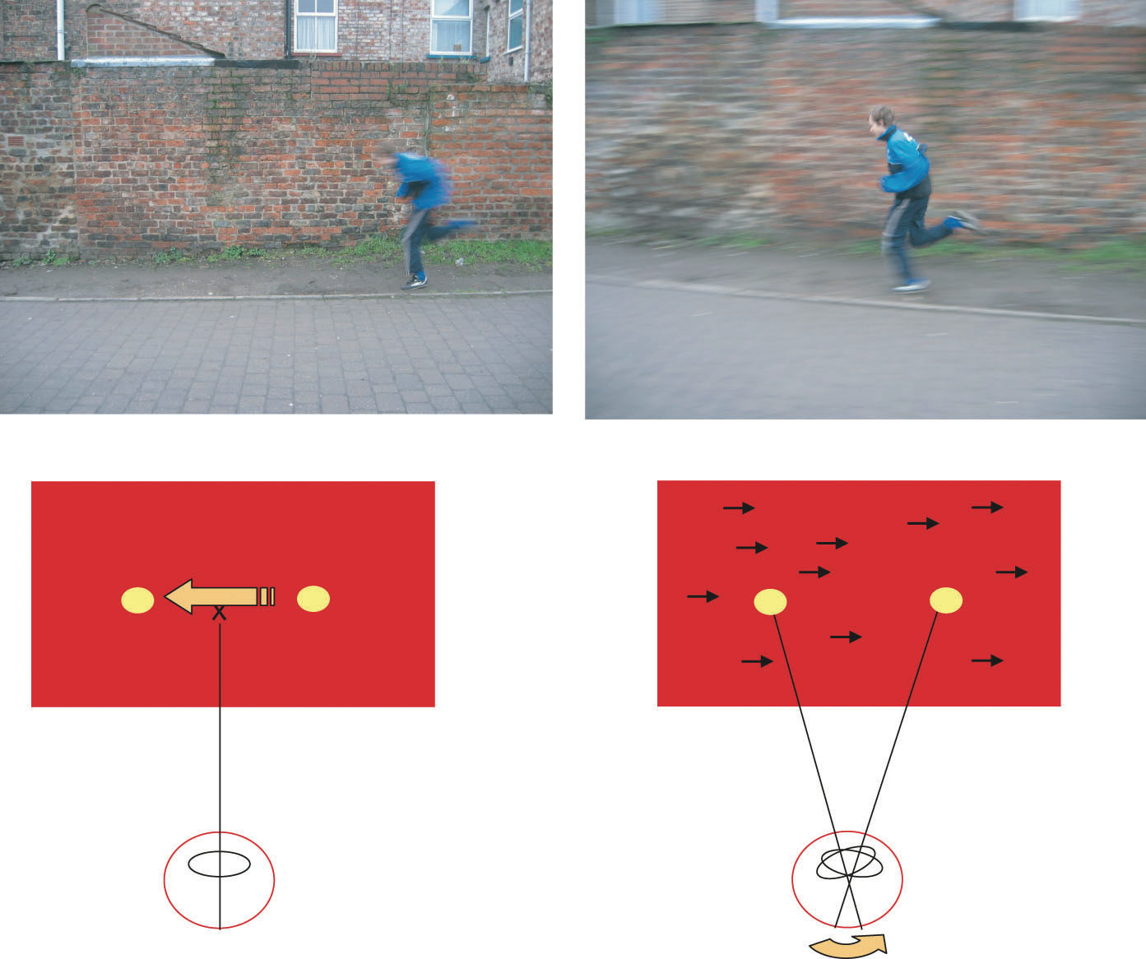
Two ways of seeing movement
Retinal-movement system
Movement on the retina: a moving spot moves across the retina
Eye/head movement system
Tracking: eyes follow moving target with smooth pursuit eye movements
No retinal movement, yet still perceive motion
But background does move across retina
But if black background, still perceive motion

Slide 7
Retinal movement with no perceived motion
If you move your eyes across a stationary scene, the retinal image moves, but no motion is perceived
So brain must use information from both motion systems to decide whether movement is taking place

Slide 8
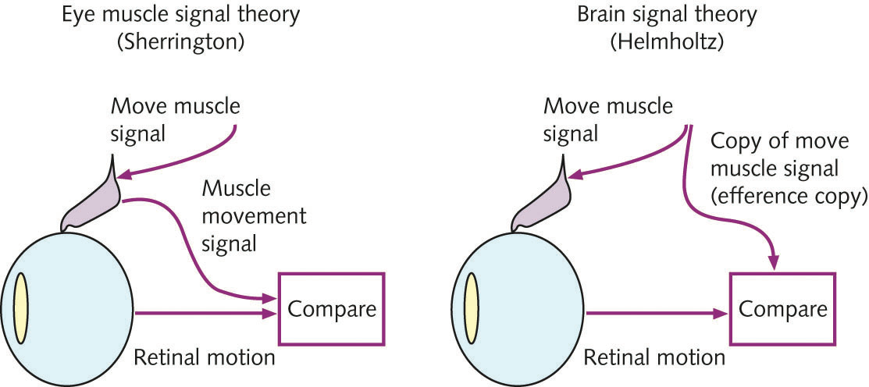
Sherrington vs. Helmholtz
Must track eye movements to detect motion when there is, or is not, retinal movement
Two theories of how brain tracks eye movements
Sir Charles Sherrington: brain compares retinal image motion with eye muscle movements (“inflow theory”)
Hermann von Helmholtz: brain compares retinal image motion with copy of efferent signal to move eyes (“outflow theory”)
Efferent copy = Corollary discharge

Slide 9
Germany 5 – England 2
Tracking an object: no retinal motion, eye movement tracked either by eye muscle movement (Sherrington) or efferent signal commanding eye movement
Sherrington 1 – Helmholtz 1
Bright light afterimage moves even though stationary on retina – as for 1.
Sherrington 2 – Helmholtz 2
Poke eye while staring – stretches eye muscle: Sherrington predicts no movement, since eye-muscle provides information; Helmholtz predicts movement since no efferent copy.
Movement perceived: Sherrington 2 – Helmholtz 3

Slide 10
Germany 5 – England 2
Get a bright-light afterimage, shut your eyes, keep them still and poke one of them
Sherrington predicts movement since muscle stretched; Helmholtz predicts no movement since no efferent eye movement signal
No movement: Sherrington 2 – Helmholtz 4
Stop eyeball from moving by using curare (which paralyses your lungs and suffocates you) or stuffing putty behind your eyes (quite painful)
No retinal movement, no eye muscle movement, eye-movement command sent
Sherrington predicts no movement, Helmholtz predicts movement
Movement perceived: Sherrington 2 – Helmholtz 5

Slide 11
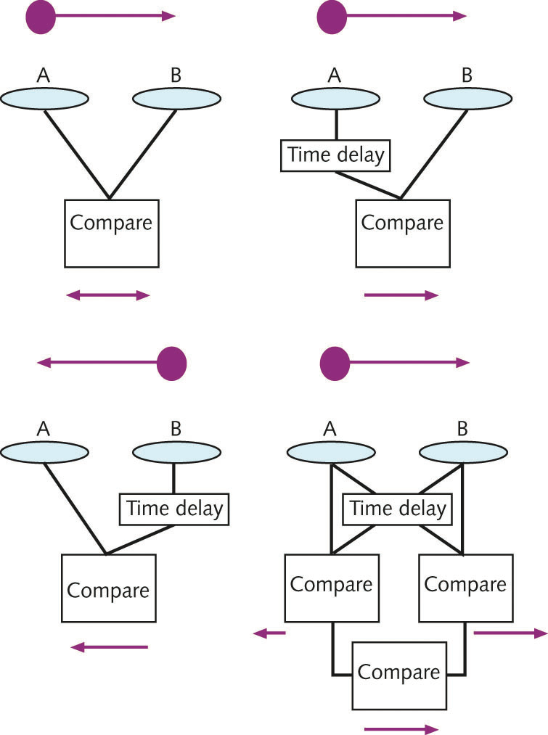
A motion detector
Top left:
spot moves from A to B
receptive fields detect spot at A and B within some time period
Movement detected, but no direction
Top right:
receptive field at A delayed firing
A fires at same time as B
movement detected from A to B at a particular speed
movement from B to A does not produce firing at the same time
Delay-and-compare model

Slide 12
A motion detector
Bottom left:
motion from B to A detected
motion from A to B not detected because no simultaneous firing
Bottom right:
Compares responses of two delay-and-compare models tuned to opposite directions of motion
Can detect motion in both directions using one time delay

Slide 13
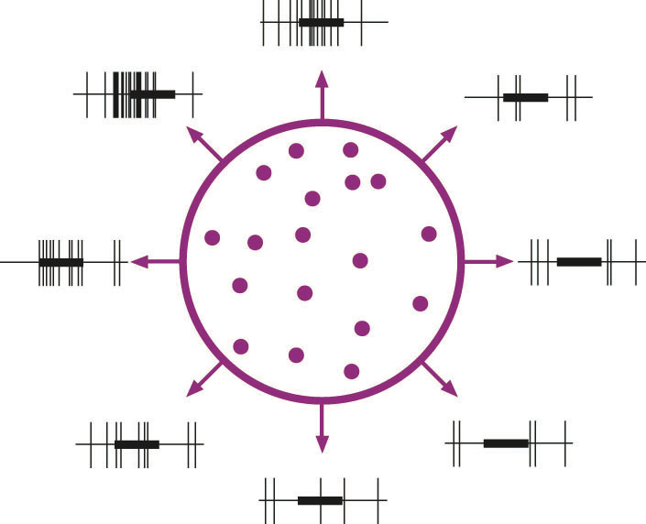
Where does motion detection happen in the brain?
Not in the retinal ganglion cells and not in the LGN – cells here can’t tell left from right
First signs of motion direction sensitivity happen in V1
In V5 (MT), nearly every cell has directional sensitivity
In some animals (e.g., frogs, rabbits), retina already sends information about direction of movement

Slide 14
Why is motion detection important?
Helps to detect prey or predators
Cat moves very slowly when stalking so that prey doesn’t notice it
Then moves very quickly at the last moment so that prey can’t do anything about it

Slide 15
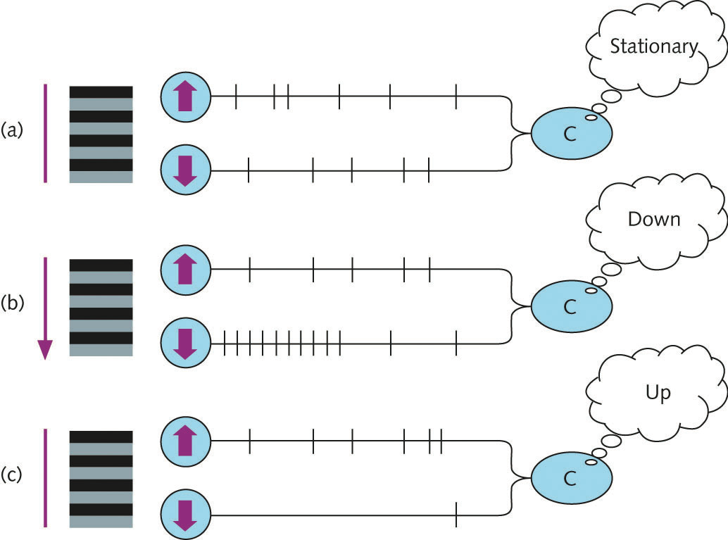
The motion after-effect
We have motion detectors for all directions (cf. bar detectors for all orientations)
Each motion detector tuned to movement in a particular direction
If stare at something moving in a fixed direction, then tuned detectors adapt (become fatigued)
Afterwards, stationary objects seem to move in the opposite direction
Discovered by Addams in the 1830s when staring at a waterfall in Scotland

Slide 16
The motion after-effect
Stationary object stimulate up and down equally
Staring at a downward stimulus desensitizes down-detector (adaptation)
Look again at stationary object, then down-detector fires less than normal, so stimulus seems to move up
You see motion, but the objects don’t move position!
So position and motion coded independently

Slide 17
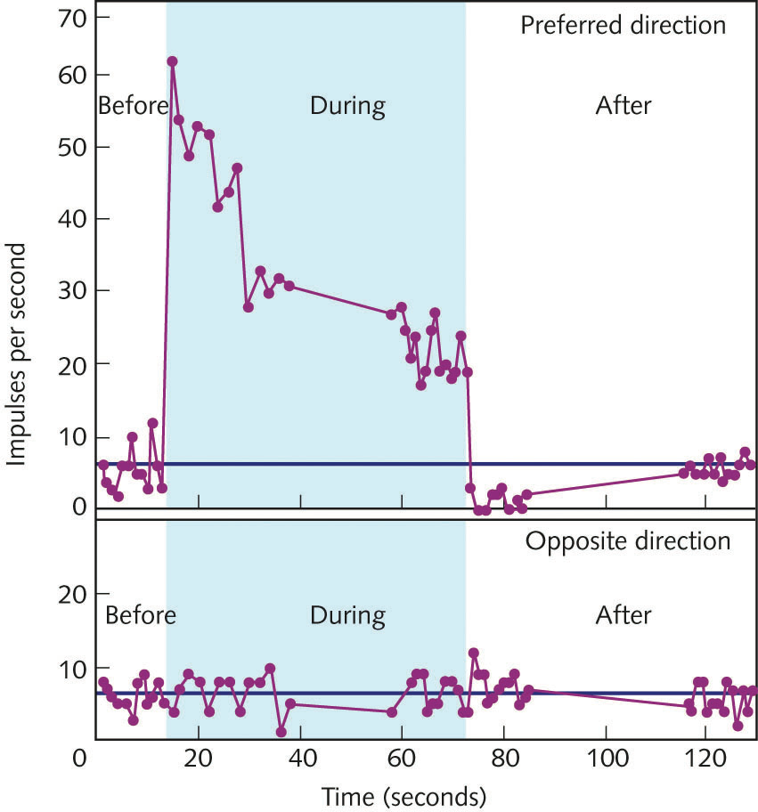
Speed of motion
How is the speed of motion coded?
Hypothesis: faster the stimulus, faster the cell fires
At left: rate of firing in rabbit ganglion cell tuned for motion
No motion: low base rate
Motion in tuned direction: high firing rate
Then rate drops to a plateau while stimulus present
Then drops to zero when stimulus removed
Then rate returns to low base rate

Slide 18
Speed of motion
If firing rate codes speed, then perceived speed of stimulus should drop while being perceived (due to adaptation)
This is observed in humans
We adapt to motion in a particular direction so that it becomes perceived to be slower and slower – it may even stop!
e.g., driving fast on the motorway
Motion after-effect results from drop of activity below baseline immediately after stimulus removed

Slide 19
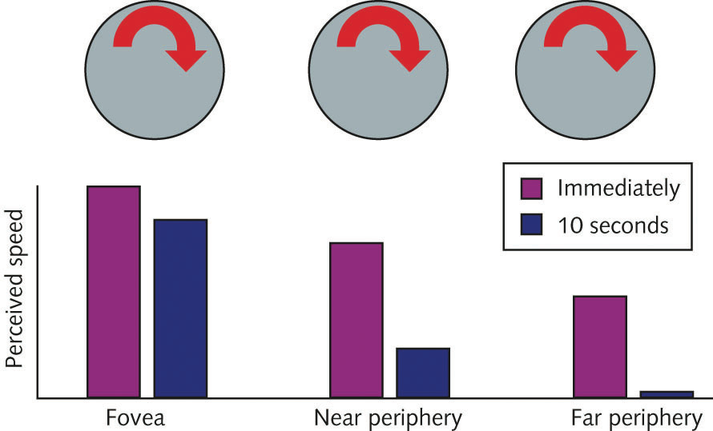
Stopped visual motion
Perceived speed goes down the longer we look at the moving stimulus
Perceived speed of moving object in periphery is lower than object in centre of field of view
After enough time, a rotating disc that is far enough into the periphery may even appear to stop moving!

Slide 20
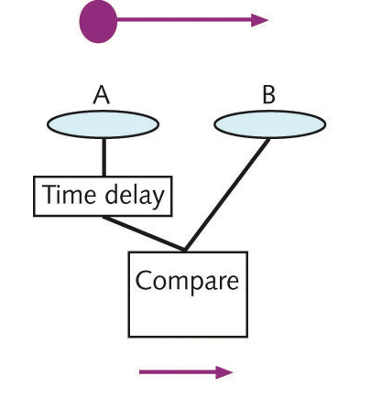
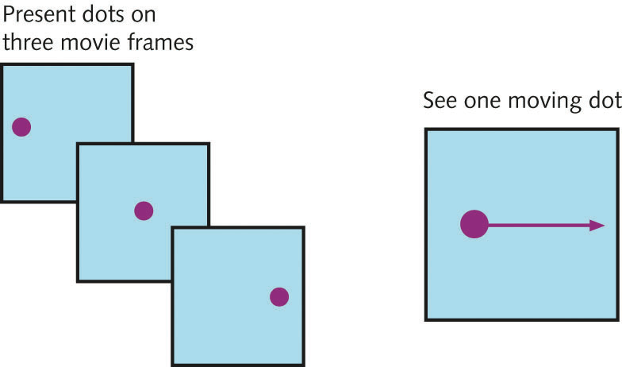
Apparent motion
Motion detector triggered if RF at A stimulated and then RF at B stimulated at appropriate period later
Doesn’t necessarily result from actual motion from A to B
Could be due to apparent motion of two separate stimuli
principle used in film and animation
Creating motion from stills requires stills to be presented at just the right frequency
too fast, seem simultaneous
too slow, then no motion perceived
Inter-frame period needs to be about the same as the period used by the motion detectors to sample for motion

Slide 21
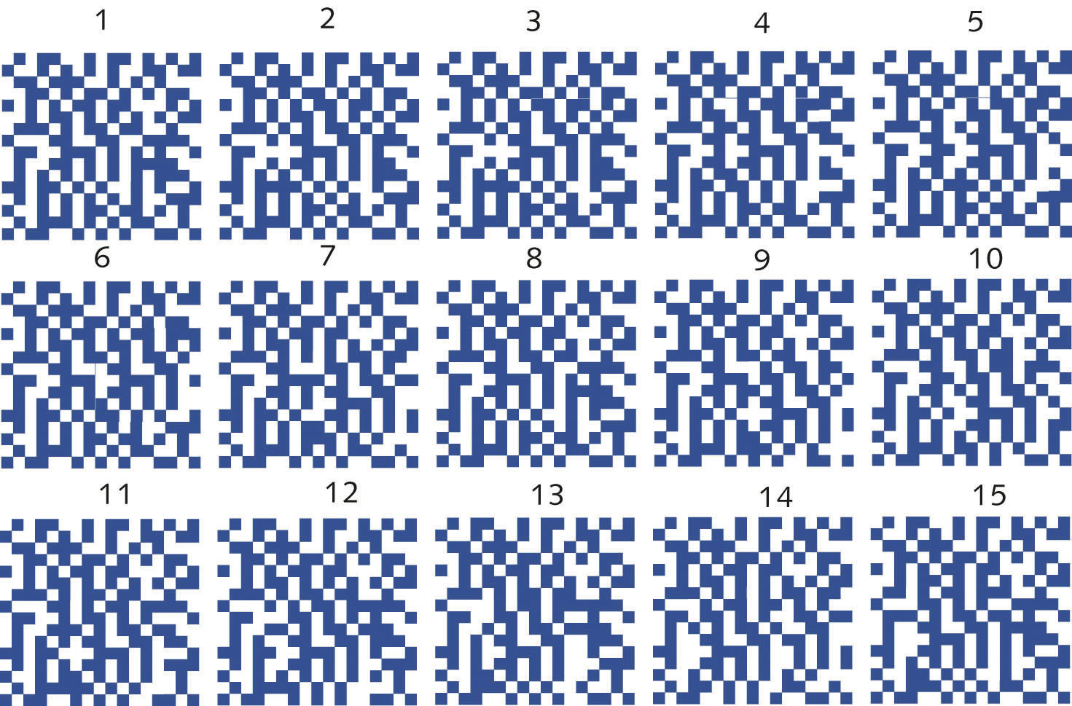
Random dot kinematogram
How can we determine whether someone infers motion from two stills or perceives motion between two stills?
Make it hard for them to see the difference between the stills
Can use random dot patterns and move just a small part of the pattern on each frame
When presented in series, the moving area is easy to perceive

Slide 26
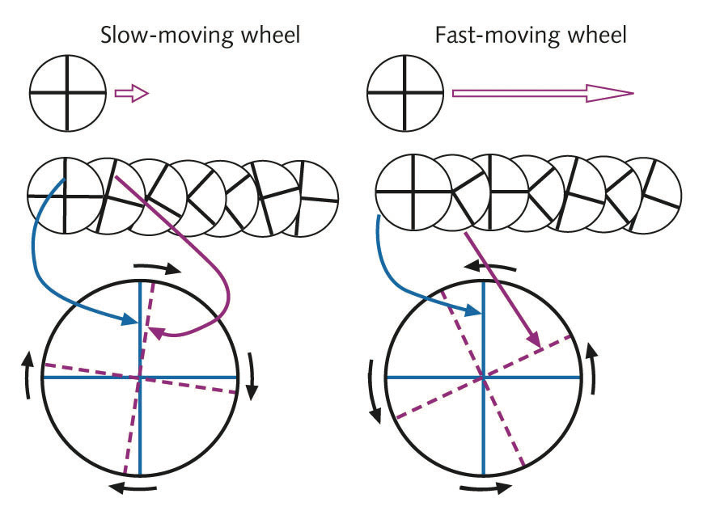
Aliasing (aka. The “Waggon-wheel” effect)
If you have very fast motion, then the frame-rate can be too slow to represent it properly, and you get aliasing
Each spoke is perceived to move to the position of the nearest spoke in the next frame
If rate is fast enough, the nearest spoke may be a different spoke – the one behind it
Needs frame-based film or stroboscopic lighting (e.g., fluorescent lighting)
Can it happen in normal daylight?

Slide 27
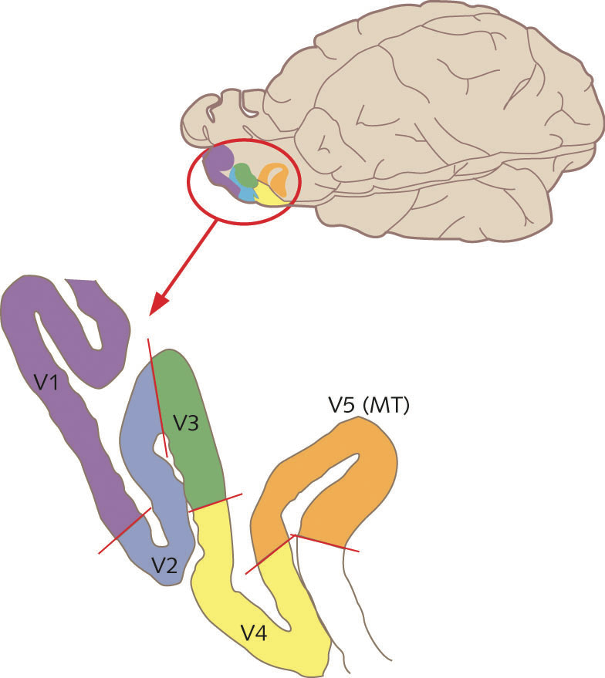
Motion blindness and area MT (V5)
If the part of the brain that specialises in motion detection is damaged, then we see the world as a sequence of stills (akinetopsia)
Difficult to cross road, since need to make two conscious separate observations and compare the two in order to determine if a vehicle is moving
V5 (MT) is the area that specializes in motion detection

Slide 28
V5 (MT)
Receives information from the M-cells in LGN, via V1
Cells are specific to direction of motion
Has a column structure like V1, with each column tuned to a direction of motion instead of an orientation

Slide 29
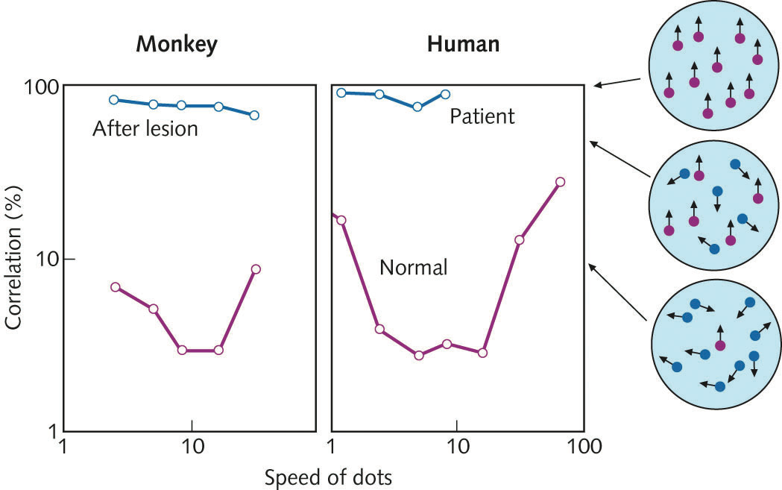
Lesions in V5 (MT)
If V5 or MT is deliberately lesioned in a small area, then this produced an inability to perceive motion in the corresponding region of the visual field
Ability to see motion measured as percentage of dots in a random field that are coherent (moving in the same direction) that is required for the subject to perceive motion
Similar results for a monkey with lesioned V5 and an akinetopsic human
Salzman et al (1990) found that the perception of motion could be directly manipulated by stimulating specific groups of cells in V5

Slide 30
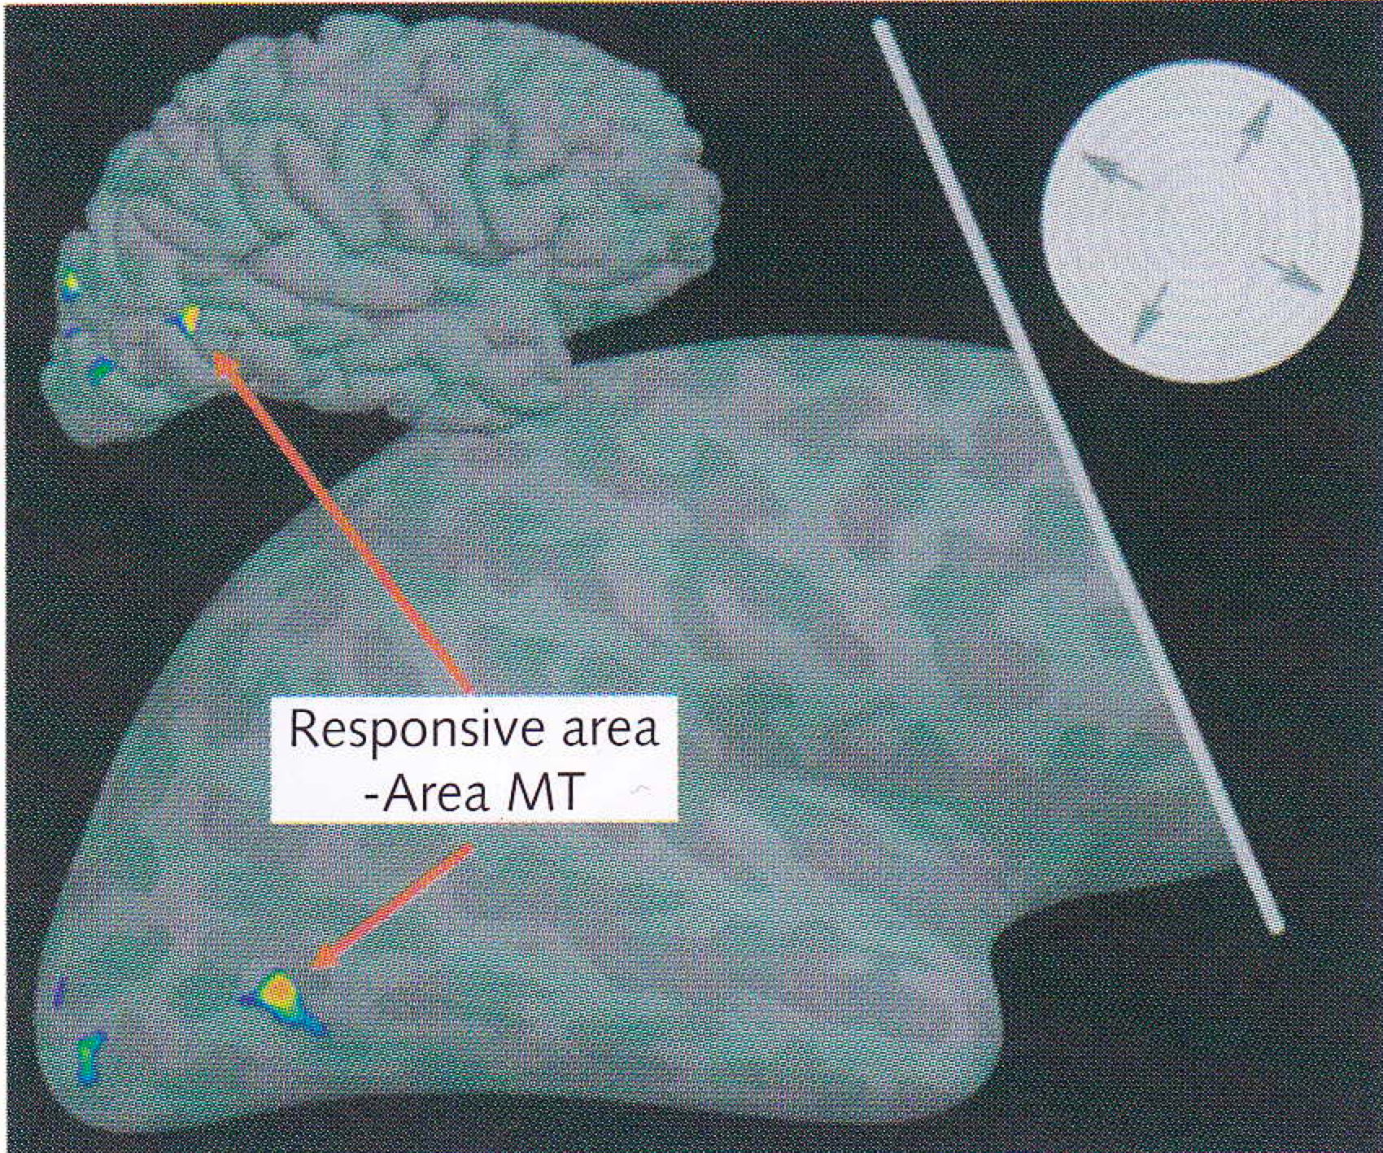
Locating the equivalent of V5 in humans
Do an fMRI of the brain while viewing a stationary scene
Then do an fMRI of the brain while viewing a moving object in the scene
Subtract the first from the second to get the areas of the brain directly involved in responding to the moving object

Slide 31
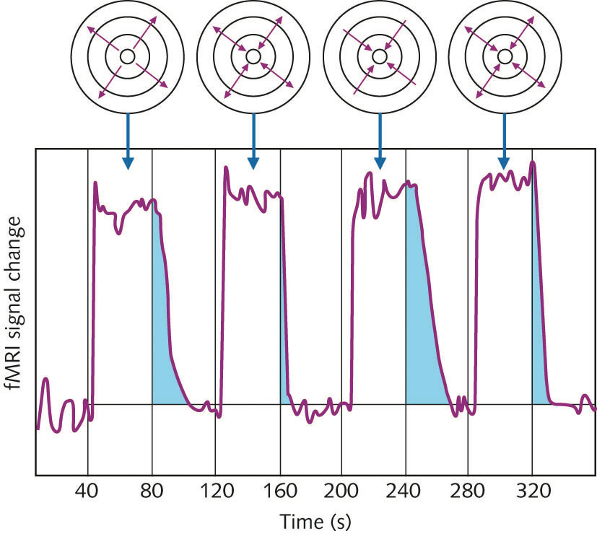
Illusory motion
Subjects adapt to a set of rings that are either
expanding continuously
contracting continuously
alternately expanding and contracting
When viewing stationary rings after test, continuously expanding/contracting rings resulted in an MAE
indicated in continued activity in MT

Slide 32
Illusory motion
“The Enigma” by Isia Levant
Many people perceive circular motion in the purple/lilac rings between the spokes
Been shown that MT is activated when people view this image
Does activity in MT cause the illusory motion or does the illusory motion cause activity in MT?

Slide 33
What moves and what stays still?
Induced movement
When there are clouds on a windy night, the moon seems to move in the opposite direction
A tall building seems to be falling if there are clouds moving past it in the sky
You’re sitting in a stationary train and the adjacent train starts moving: it feels like your train has started moving
Usually assume backgrounds are stationary and foreground objects are moving
Usually assume walls and buildings aren’t moving
Autokinetic effect: dim light (e.g., distant cigarette) appears to move against a dark background

Slide 34
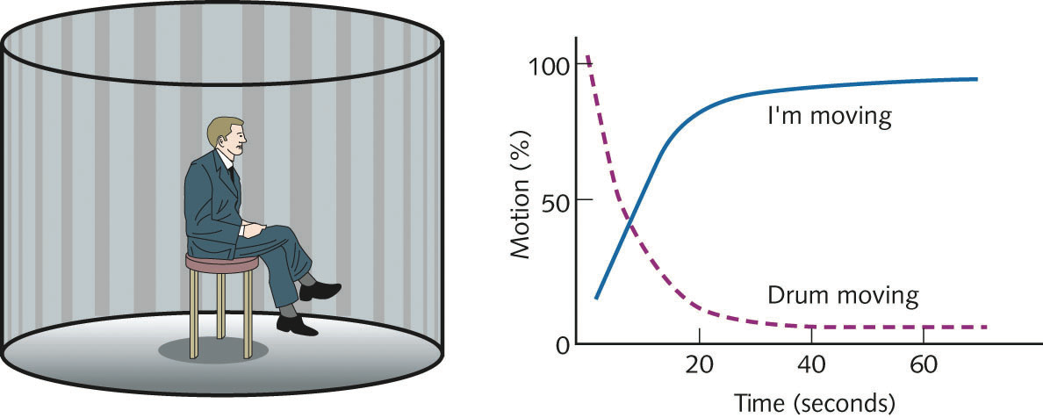
Vection and stability
You’re sitting in a stationary train and the adjacent train starts moving: it feels like your train has started moving
Feeling of self motion is called vection – can be induced in an optokinetic drum
Start by feeling that the drum is rotating
Soon start feeling that you are rotating inside the drum
Usually vestibular organ signals change in movement of the body – no signal in an optokinetic drum, so start by feeling that the drum is moving
But once reach constant speed of rotation, don’t expect vestibular organ to respond, so start feeling that wall is stationary.

Slide 35
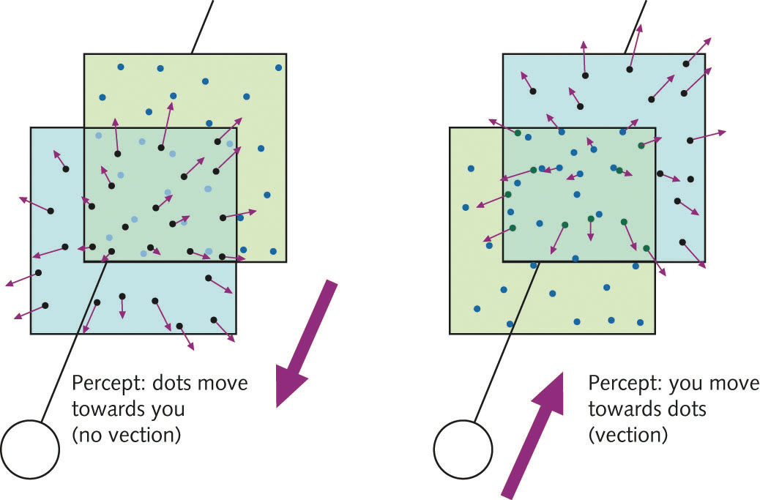
Vection
Two transparent sheets, each covered by dots
Move the front sheet, nearest to the observer
Observer sees sheet approaching
Move the rear sheet towards the observer
Observer feels as though he is approaching the sheet – vection
Assumption that the background is stationary

Slide 36
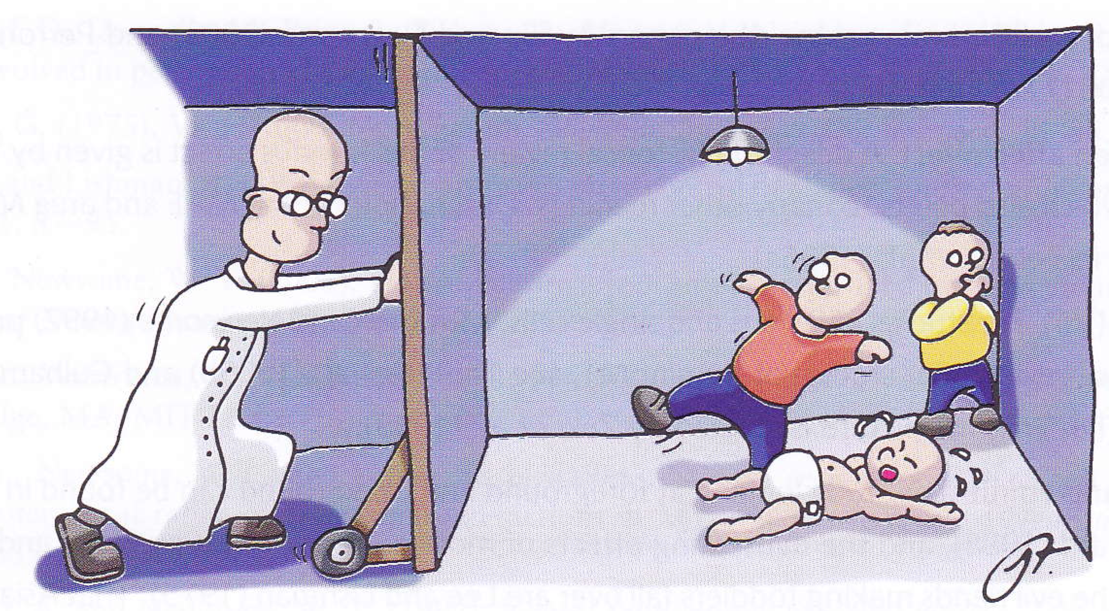
Making children fall over
Very young children aren’t very good at standing up
Lee and Lishman (1976) put children in a room with a moving wall and moved the wall towards or away from the children
We preferably perceive walls to be stationary
When the wall is pushed towards the child, he feels like he’s falling towards the wall, leans backwards to correct and falls on his bum
When the wall is moved away from the child, he feels like he’s falling backwards, leans forwards to compensate and falls on his nose

Slide 37
Vection and vomit
Vection can produce motion sickness
Especially in east Asian people
One hypothesis is that there is a conflict between what the vestibular system feels and what the eyes see
But why should this make you throw up?
Been suggested that you know something is wrong, so your brain thinks you’ve been poisoned and so makes you empty your stomach
What are the implications for virtual reality systems?

