Slide 1
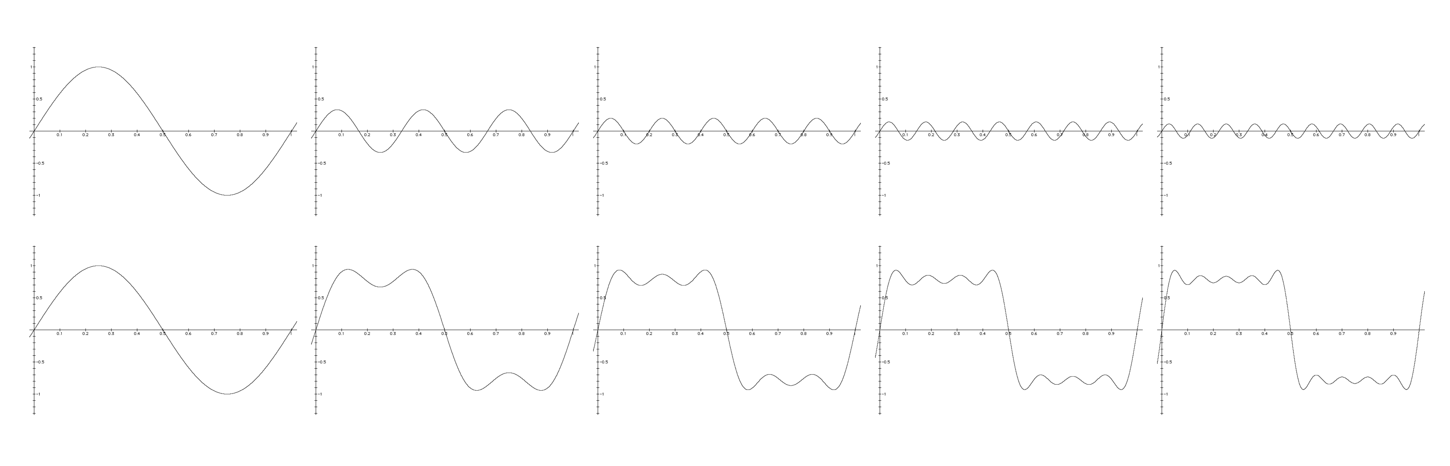
Sound waves
David Meredith
Aalborg University

Slide 2
Physical properties of sound waves
Sound waves can be
  Periodic (e.g., tuning fork, violin)
  Non-periodic (e.g., explosion, hand-clap)
Sound waves can be
  Progressive (e.g., tuning fork, hand-clap)
  Stationary (e.g., inside an organ pipe)
Source of a sound is a vibrating object
Sound waves are mechanical
  They need a material medium (cannot be transmitted through a vacuum, cf. EM waves)

Slide 3
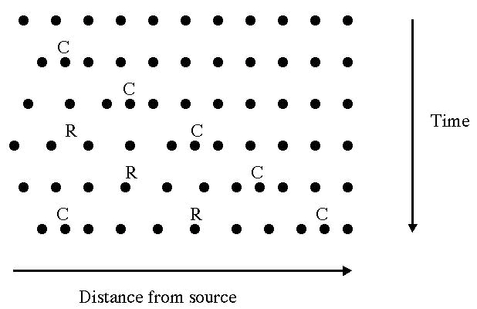
Oscillations of molecules in a sound wave
In a sound wave, molecules at a point are alternately compressed and rarefied
  pressure oscillates around ambient pressure
  density also oscillates
Oscillatory motion superimposed on normal random motion of molecules
Sound waves are longitudinal
  The direction of oscillation is the same as that of propagation
Disturbance is transmitted, not material!

Slide 4
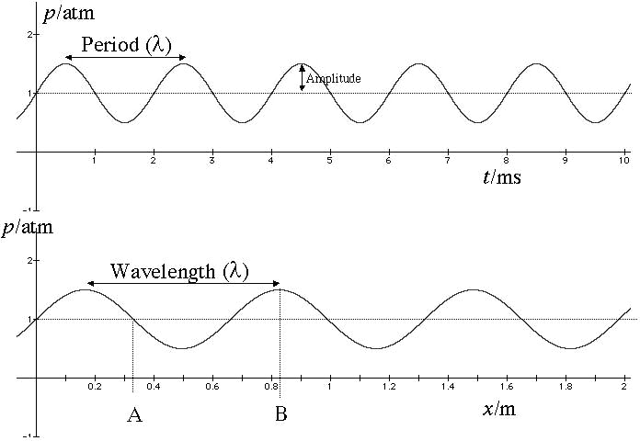
Waveforms and simple tones
Waveform is a graph showing
  pressure vs. time for a particular point in space
  pressure vs. distance from source for a particular instant in time
Simplest sound wave is a sinusoid
  Called a simple tone or pure tone

Slide 5
Waveforms and simple tones
Period is the time taken for the pressure variation to complete one cycle
Frequency is the number of cycles completed in one second
If the waveform is not simple, but still periodic, then the number of cycles per second is called the periodicity of the wave
Frequency and periodicity are expressed in hertz (Hz)
  1 Hz = 1 cycle per second

Slide 6
Waveforms and simple tones
Amplitude of a wave at a point in space is the difference between the mean pressure at the point and the maximum pressure at that point
  Sometimes called maximum amplitude
  Amplitude often used to refer to instantaneous pressure displacement

Slide 7
Waveforms and simple tones
Phase is how far through its cycle a wave has gone at a particular time in a particular place
Phase difference between A and B is
3π/2 or ¾ of a cycle
Wavelength (λ) is distance between two consecutive positions with the same phase at an instant
Speed (c) of a wave is the number wavelengths per second multiplied by the wavelength:
  c = fλ

Slide 8
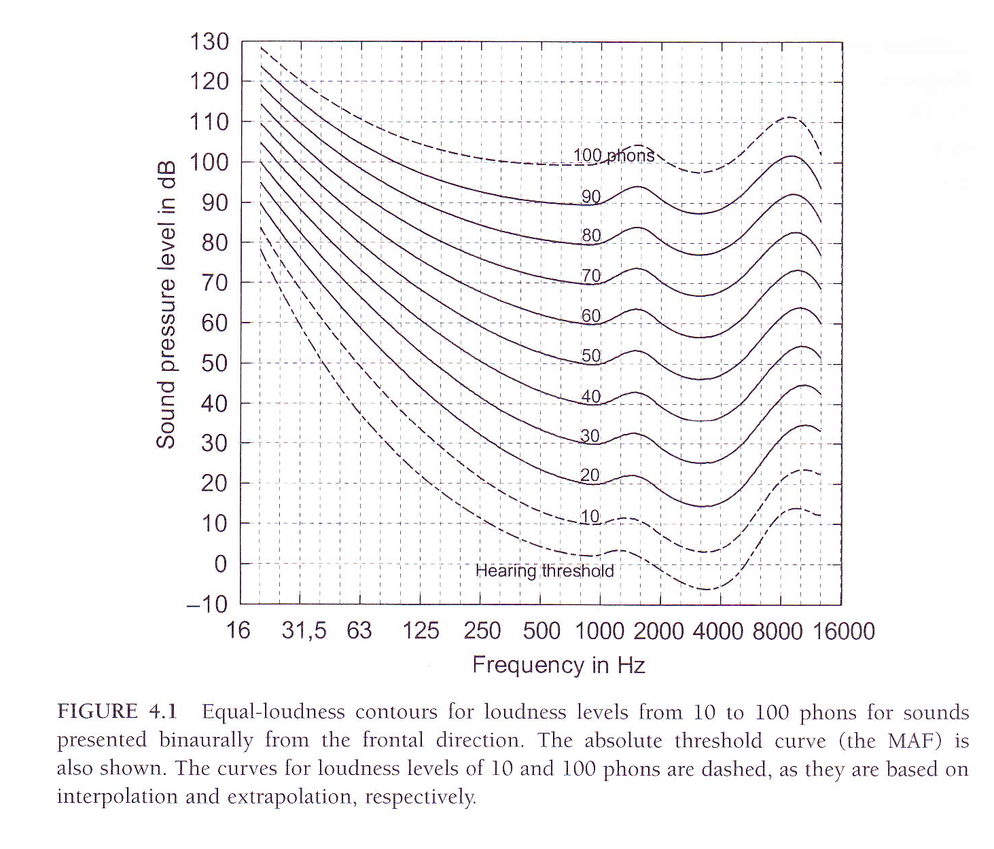
Power, intensity and loudness
Power of a wave is the amount of energy transmitted (or work done) per unit time
Power is proportional to
  the square of the frequency
  the square of the amplitude
  the speed
Intensity of a wave is the power per unit area of the wavefront: I = P/A
Loudness depends on the intensity and sensitivity of the listener to the frequency of the sound

Slide 9
Pitch, periodicity and frequency
Any periodic sound with a frequency between about 20Hz and 5000Hz will evoke a sensation of pitch
ASA defines pitch to be that perceptual attribute of a sound that allows it to be ordered on a musical scale
Any sound that has a pitch is called a tone
  Most tones are periodic, but not all – bell sounds have pitch but are not strictly periodic
Pitch of a tone is related to its frequency or periodicity
Pitch of a complex tone is indicated by specifying the frequency of a simple tone that has the same pitch
Frequency is a physical quantity, pitch is a psychological quantity

Slide 10
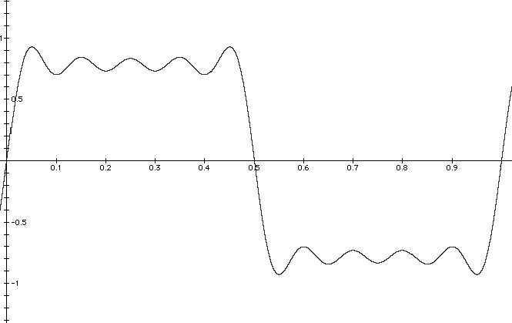
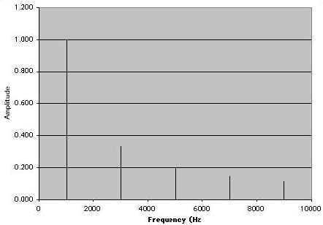
Fourier analysis and spectra
Graph at bottom left shows Fourier spectrum for waveform at top left
Fourier’s theorem states that any complex waveform can be expressed as the sum of a set of sinusoidal simple tones with particular frequencies, amplitudes and phases
Spectrum at left shows that waveform can be constructed by adding simple tones at 1000, 3000, 5000, 7000 and 9000Hz with the amplitudes indicated

Slide 11
Fourier analysis and spectra
Each simple tone component is called a Fourier component or partial of the complex wave
When all frequencies are integer multiples of the lowest component, then it is a harmonic complex tone
  Each component called a harmonic
  Lowest component called the fundamental

Slide 12
Fourier analysis and spectra
Fundamental frequency of a harmonic complex tone is equal to the periodicity of the tone
Fourier component with frequency n times the fundamental is the nth harmonic

Slide 13
Constructing a harmonic complex tone
Shows how a square wave can be built up by adding together odd-numbered harmonic
The amplitude of nth harmonic is 1/n times the amplitude of the fundamental
Here all the components are in phase
  But if they weren’t, it wouldn’t make much difference!
Can choose to attend to just one component or the whole complex tone (Ohm’s Acoustical law – cf. colour vision)

Slide 14
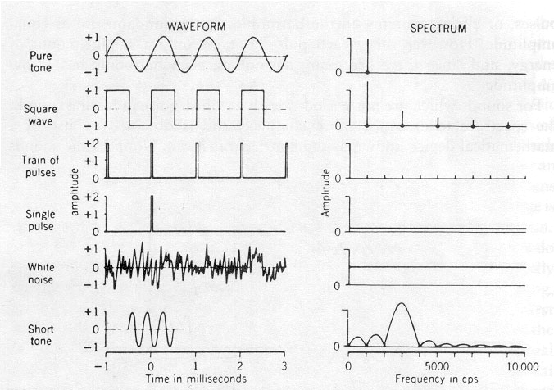
Fourier spectra
Fourier spectrum shows frequency and amplitude of each sinusoidal component in a complex wave form
Tells us nothing about phase relationships between components
  use a phase spectrum for this
Only infinitely long sounds have line spectra
White noise and click have flat spectra
  For click, all components start with phase π/2
Tone pulse is intermediate between simple tone and click

Slide 15
Sound level
Intensity = Power/Area of wavefront
We can hear sounds that vary in intensity over a very wide range
  Gunshot is 10¹² times as intense as the quietest whisper
Generally use a logarithmic scale for intensity
If x and y are two intensities, then the sound level of x relative to y is log₁₀(x/y) Bels
  e.g., if x = 100y, then x is 2 Bels more intense than y
Usually use dB instead of Bels: 10 dB = 1 Bel
  if x = 100y, then x is 20dB more intense than y
Increase of 10dB means multiplying intensity by 10
Increase in 3dB means doubling intensity

Slide 16
Sound pressure level and sensation level
If we want to express absolute sound levels, then we need to define a standard intensity for comparison
dB SPL (sound pressure level) is relative to an intensity of 10⁻¹² W/m²
  close to the threshold of human hearing
Sensation level is relative to individual’s threshold for that sound

