Slide 1
Approaches to Human Cognition: Cognitive Neuropsychology and Computational Cognitive Science
David Meredith
Aalborg University

Slide 2
Source
Chapter 1 of
Eysenck, M. W. and Keane, M. T. (2010). Cognitive Psychology: A Student’s Handbook. Sixth Edition. Psychology Press, Hove. ISBN: 978-1-84169-540-2.

Slide 3
Cognitive Neuropsychology

Slide 4

Cognitive Neuropsychology
Concerned with patterns of cognitive performance shown by brain-damaged patients
Brain-damaged patients have suffered lesions: damage in the brain caused by injury or disease
Studying brain-damaged patients can tell us a lot about how healthy brains work

Slide 5
The case of AC (Coltheart et al. 1998)
AC was a 67-year-old man who had suffered several strokes
Had problems with object knowledge
Had almost no knowledge of visual aspects of objects
e.g., colour of animals, whether certain species have legs
95% correct when classifying animals as dangerous or not
90% correct when deciding whether an animal can be eaten
>90% correct when asked about auditory perceptual knowledge of animals

Slide 6
The case of AC (Coltheart et al. 1998)
Inferences:
No single object knowledge system
Visual information about objects stored separately from other types of knowledge (e.g., auditory)
Can combine with MRI to get a clue as to which brain areas are affected
And therefore involved in visual object recognition

Slide 7
The modularity assumption
In cognitive neuropsychology, it is assumed that the cognitive system is composed of relatively independent modules
Modules exhibit domain specificity
They respond only to one class of stimuli (e.g., faces)
Fodor (1983) suggested that we possess input modules involved in encoding and recognizing perceptual inputs
Processing of different aspects of visual stimuli (e.g., colour, form, motion) seem to occur in separate, domain-specific areas

Slide 8
Modularity assumption
Fodor (1983) proposed that there is a central, non-modular central system involved in thinking and reasoning
Attentional processes seem to be domain-independent
Some evolutionary psychologists believe that most information-processing systems are modular (see Barrett and Kurzban, 2006)
They argue that processing will be more efficient if there are lots of specific modules than if there are a few more general ones

Slide 9
Assumption of anatomical modularity
Assumption that each functional module is located in a specific and potentially identifiable area of the brain
Implies that we learn most from patients that have damage to just one anatomical module
Evidence of anatomical modularity in the visual system
But many complex tasks seem to use widely distributed areas of the brain
e.g., Duncan and Owen (2000) found the same areas of the frontal lobes being used for very different complex tasks

Slide 10
Assumption of uniform functional architecture
Coltheart (2001) identified an assumption that he called “uniformity of functional architecture across people”
Assumption that what a part of my brain does is the same as what the same part of your brain does
Actually an assumption across all cognitive psychology

Slide 11
Assumption of subtractivity
The assumption that if something is damaged in a brain, this cannot add functionality to the brain
If patients developed new modules to compensate for the damaged ones, then this would make it hard to infer anything from the behaviour of brain-damaged patients
Assumption most likely to be correct when brain damage happens in adulthood and the evaluation is done soon after the damage has occurred
Brain plasticity allows areas to learn new skills to compensate for damaged areas

Slide 12
Dissociation
A patient performs normally on task X but is impaired on task Y
e.g., Amnesiacs usually have normal short-term memory (X) but impaired long-term memory (Y)
Does this mean that X and Y use different modules and the module used for Y is damaged?
Not necessarily, for example task Y might use the modules used for X but also use additional modules that are damaged
Or maybe Y is just a harder task than X
Y
X
DAMAGE
X
Y
DAMAGE
X
Y
But Y is harder

Slide 13
Double dissociations
Patient A performs normally on task X but is impaired on task Y
Patient B performs normally on task Y but is impaired on task X
For example, some amnesiacs have normal short-term memory but impaired long-term memory; other amnesiacs have impaired long-term memory and normal short-term memory
Provides evidence for two independent modules: one for X and one for Y
X
Y
DAMAGE
X
Y
DAMAGE

Slide 14
Limitations of double dissociations
Usually not simple to distinguish clearly between two tasks
E.g., when does a memory become “long-term” as opposed to “short-term”?
If there are actually more than 2 separate systems involved, then double dissociations can’t help us find them

Slide 15
Associations and syndromes
Association between X and Y if patient is impaired on both tasks
Assumes localized brain damage
What if damaged in adjacent areas of the brain?
A syndrome is a set of symptoms usually found in combination
Lets us assign patients to a smaller number of categories

Slide 16
Groups vs. individuals
Generally have more confidence in findings for groups of patients than individual case studies
But even patients with similar impairments can differ quite noticeably in the details of their performance
So how can we be sure that they have the “same” problem?
We’re usually quite interested in the detailed differences in performance, so this limits the usefulness of group studies
But group studies can be useful early on in research

Slide 17
Single-case studies
Good for detailed study of impairments
A selective impairment found in a particular task in a particular patient could be because
The patient adopts an idiosyncratic strategy
The task is more difficult than the others
A premorbid lacuna (a gap in the patient’s ability that existed before the damage occurred)
The way the re-organised system works (but not the way the original system worked)
Can overcome these short-comings if exactly the same impairment can be found in other cases (multiple single-case studies)

Slide 18
Limitations of cognitive neuropsychology
Subtractivity assumption is that performance of brain-damaged patients is equal to normal performance minus the abilities afforded by the damaged area
However, patients develop compensatory strategies that help them cope with their brain damage
e.g., some patients with alexia (inability to read words) learn to read by identifying each letter individually

Slide 19
Limitations of cognitive neuropsychology
Much work in cognitive neuropsychology based on seriality assumption (Harley, 2004): that processing proceeds from one module to the next
This is clearly incorrect – the brain is massively parallel
Brain damage usually occurs to more than one module – in these cases it is hard to make sense of the findings
Large individual differences in performance between people with similar brain damage resulting from differences in age, expertise, education, etc.

Slide 20
Computational Cognitive Science

Slide 21
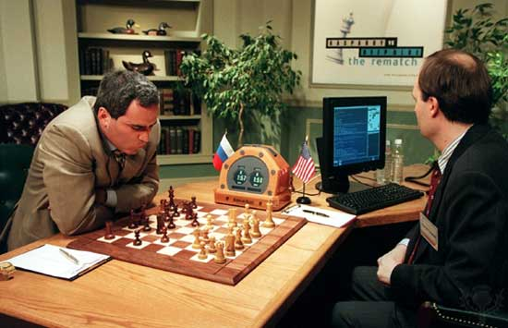
Computational modelling vs. Artificial intelligence
Computational modelling is concerned with constructing computer programs that simulate aspects of human cognitive functioning
Artificial intelligence is concerned with constructing computer programs that can carry out tasks that would require intelligence if performed by a human
However, AI researchers are not usually too concerned with whether the system works in exactly the same way as the process is carried out in the brain
e.g., Deep Blue beat Garry Kasparov in 1997 by using a strategy that is definitely not that used by a human chess player (considering 200 million positions per second!)

Slide 22


The benefits of computational models
They make the assumptions of a theory fully explicit and thus reveal lacunae in a theory
They can be used to make precise predictions
They can be explanatory
e.g., Costello and Keane’s (2000) constraint-based model of conceptual combination (“sand gun”, “pet shark”) which explains both the efficiency and creativity of the process

Slide 23
Issues in computational modelling
Palmer and Kimchi (1986) suggest that you should be able to decompose a theory successively through levels, starting with written statements and ending with the implemented program
You should be able to draw a line saying that above that line, the model is psychologically plausible
The absolute timing of model processes need not be similar to human timing on the same processes
However, the growth of the time taken as the input size increases should be on the same order for both the model and humans if the model is a correct description of the human cognitive process
The model should generate the same output as humans do for the same input

Slide 24
Production systems
A production system is a collection of “IF…THEN…” rules
e.g., “IF the green man is lit, THEN cross the road”
Such a system contains two types of memory
Long-term memory to hold the production rules
Working memory to hold information currently being processed
e.g., if information is in working memory that the green man is lit, then this matches with the production rule in long-term memory and triggers the corresponding THEN instruction: “Cross the road”
If 2 or more production rules have the same “IF” clause, then you need a conflict resolution strategy to determine which to choose

Slide 25
Example production system
Much knowledge can be expressed as a production system (e.g., chess knowledge)
Newell and Simon (1972) first used production systems in general problem solving
Anderson (1993) proposed a framework (or architecture) called ACT-R that uses production rules
Long-term memory contains 2 rules:
IF list ends with an A THEN replace A with AB
IF list ends with a B THEN replace B with A
Working memory input: A
Subsequent working memory contents:
AB
AA
AAB
AAA
AAAB
...

Slide 26
ACT-R
ACT-R (Adaptive Control of Thought - Rational) has been continuously developed since 1993
Most comprehensive version put forward by Anderson et al. (2004) – qualifies as a cognitive architecture
“domain-generic” (Sun, 2007): can be applied to may domains or areas
embodies aspects of cognition that are invariant across individuals and tasks

Slide 27
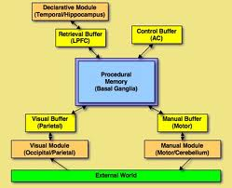
ACT-R
ACT-R makes assumption that cognitive system consists of several modules
Visual object module: keeps track of objects being viewed
Visual location module: where objects are
Manual module: controls hands
Goal module: tracks current goals
Declarative module: retrieves relevant information
Each module has an associated buffer that contains limited important information

Slide 28
ACT-R
Central production system detects patterns in the buffers and takes co-ordinated action
Conflicts resolved by considering the gains and costs associated with each possible outcome

Slide 29
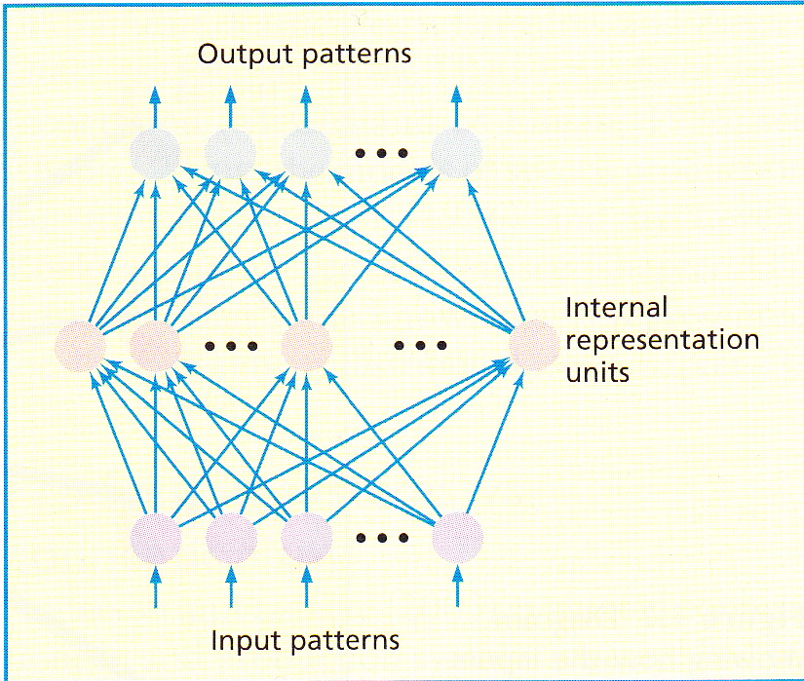
Connectionism
Recent resurgence of interest in connectionist models initiated by books by Rumelhart, McClelland and the PDP Research Group
Also called “neural networks” or “parallel distributed processing”
A network consists of nodes (or units) connected by links, organised into layers

Slide 30
Connectionism
Units affect other units by exciting or inhibiting them
The unit takes the weighted sum of all the input links and generates a single output to another unit if the integrated input sum is above some threshold
Different rules used to change the strengths of the connections between units (learning rules)
A network typically has an input layer, one or more hidden layers and an output layer of units

Slide 31
Connectionism
A representation of a concept is stored as a distributed pattern of activation of the units in the network
The same network can store many different patterns
One important learning rule is backward propagation of errors (BackProp)

Slide 32
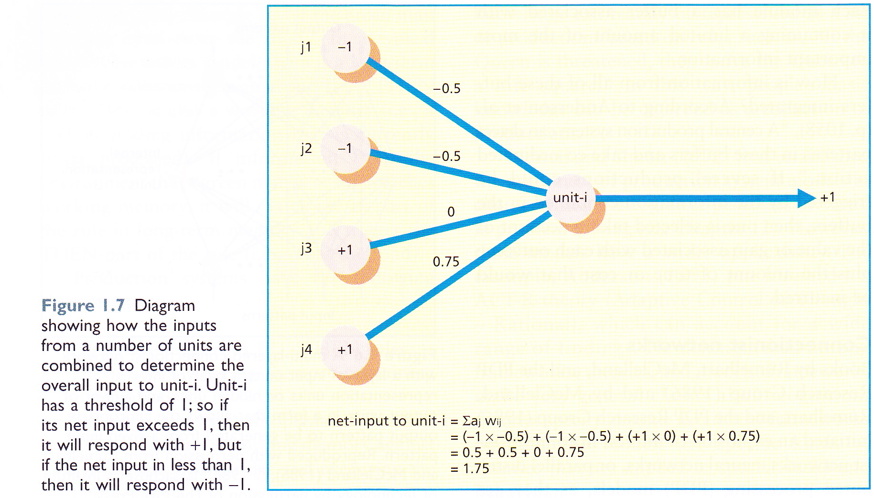
Integrate and fire

Slide 33
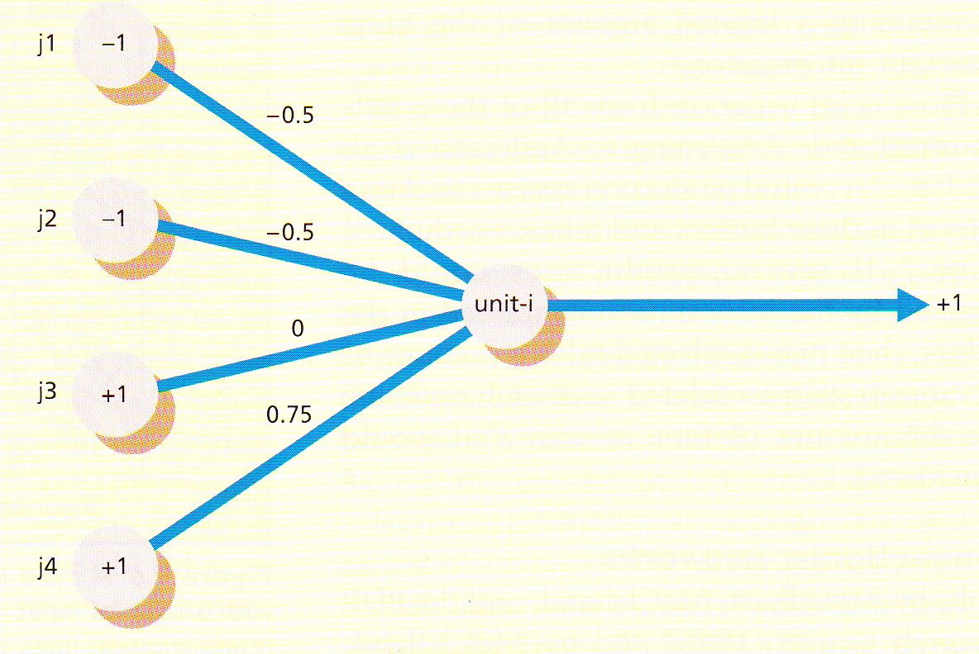
Training a network
A network takes an input represented as a pattern of activation over its input nodes and generates an output as a pattern of activation over its output nodes
Therefore similar to an “IF...THEN...” production rule, though no rules exist and a single network can embody many rules
Trained to associate particular outputs with particular inputs by modifying the weights on the links between the nodes

Slide 34
Back-propagation
Network initialized with randomly weighted links
Output pattern generated by a network for an input pattern compared with known correct output
Weights back-propagated through the network to adjust link weights so that output becomes closer to desired output

Slide 35
NETTalk (Sejnowski and Rosenberg, 1987)
Network trained with 50000 trials to learn spelling-sound relationships of 1000 English words
In test phase, 95% success on training words, 77% on 20000 unseen words
Had “learned” rules of English pronunciation without explicit programming

Slide 36
Issues with distributed representations
In a connectionist network, a representation is stored in a distributed fashion
Argued that this is biologically plausible – i.e., similar to how knowledge is stored in the brain
However, evidence that much information is stored at a specific location in the brain rather than in a distributed fashion (Bowers, 2009)
e.g., Quiroga et al. (2005) discovered a “Jennifer Aniston” neuron in the brain of one participant!
Some localised connectionist models have been proposed, e.g.
reading model of Coltheart et al. (2001)
TRACE model of word recognition (McClelland and Elman, 1986)
speech production models (Dell, 1986; Levelt et al., 1999)

Slide 37
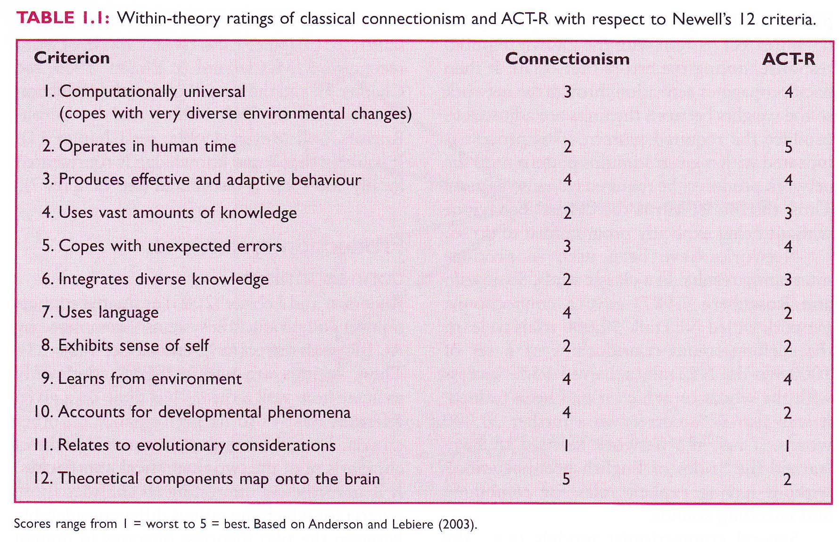
Production rules vs. connectionism

Slide 38
Computational Cognitive Science: Evaluation
Requires theories to be detailed and explicit in order to be implemented as computer programs
Cognitive architectures can give an overarching framework
Connectionist networks can account for learning
Knowledge is represented in a distribute manner (shows graceful degradation)

Slide 39
Computational Cognitive Science: Evaluation
Computational modelling has recently been applied to fMRI data (Becker, 2007)
Computational modelling has also been applied in cognitive neuropsychology (Dell and Caramazza, 2008)
Connectionism can account for parallel processing (cf. cognitive neuropsychology)

Slide 40
Computational Cognitive Science: Limitations
Rarely been used to make new predictions
Connectionist models don’t really resemble the human brain
artificial networks contain far fewer neurons
there are many different types of biological neuron and none are exactly like artificial ones
real neurons are not massively interconnected
Connectionist models have many learning parameters, which allows them to learn almost anything
Most computational models ignore the effect of emotion and motivation on cognition (but ACT-R does contain a motivational module (Anderson et al., 2004))

Slide 41
References
Anderson, J. R. (1993). Rules of the Mind. Lawrence Erlbaum, Hillsdale, NJ.
Anderson, J. R. and Lebiere, C. (2003). The Newell Test for a theory of cognition. Behavioral and Brain Sciences, 26, 587 - 640.
Anderson, M. C., Ochsner, K. N., Kuhl, B. et al. (2004). Neural systems underlying the suppression of unwanted memories. Science, 303, 232 - 235.
Barrett, H. C. and Kurzban, R. (2006). Modularity in cognition: Framing the debate. Psychological Review, 113, 628 - 647.
Becker, S. (2007). Preface to the special issue: Computational cognitive neuroscience. Brain Research, 1202, 1 - 2.
Bowers, J. S. (2009). On the biological plausibility of grandmother cells: Implications for neural network theories of psychology and neuroscience. Psychological Review, 116, 220 - 251.
Coltheart, A. M. (2001). Oxford Dictionary of Psychology. OUP, Oxford.
Coltheart, M., Inglis, L., Cupples, L., Michie, P., Bates, A. and Budd, B. (1998). A semantic subsystem of visual attributes. Neurocase, 4, 353 – 370.
Costello, F. J. and Keane, M. T. (2000). Efficient creativity: Constraint-guided conceptual combination. Cognitive Science, 24, 299 - 349.
Dell, G. S. (1986). A spreading-activation theory of retrieval in sentence production. Psychological Review, 93, 283 - 321.
Dell, G. S. and Caramazza, A. (2008). Introduction to special issue on computational modeling in cognitive neuropsychology. Cognitive Neuropsychology, 25, 131 - 135.
Duncan, J. and Owen, A. M. (2000). Consistent response of the human frontal lobe to diverse cognitive demands. Trends in Neurosciences, 23, 475 - 483.

Slide 42
References (cont.)
Fodor, J. A. (1983). The Modularity of Mind. MIT Press, Cambridge, MA.
Harley, T. A. (2004). Does cognitive neuropsychology have a future? Cognitive Neuropsychology, 21, 3 - 16.
Levelt, W. J. M., Roelofs, A. and Meyer, A. S. (1999). A theory of lexical access in speech production. Behavioral and Brain Sciences, 22, 1 - 38.
McClelland, J. L. and Elman, J. L. (1986). The TRACE model of speech perception. Cognitive Psychology, 23, 1 - 44.
McClelland, J. L., Rumelhart, D. E. and The PDP Research Group. (1986). Parallel Distributed Processing: Vol. 2. Psychological and Biological Models. MIT Press, Cambridge MA.
Newell, A. and Simon, H. A. (1972). Human Problem Solving. Prentice Hall, Englewood Cliffs, NJ.
Palmer, S. E. and Kimchi, R. (1986). The information processing approach to cognition. In T. Knapp and L. C. Robertson, eds., Approaches to Cognition: Contrasts and Controversies. Lawrence Erlbaum, Hillsdale, NJ.
Quiroga, R. Q., Reddy, L., Kreiman, G. et al. (2005). Invariant visual representation by single neurons in the human brain. Nature, 435, 1102 - 1107.
Rumelhart, D. E., McClelland, J. L. and The PDP Research Group. (1986). Parallel Distributed Processing, Vol. 1: Foundations. MIT Press, Cambridge, MA.
Sejnowski, T. J. and Rosenberg, C. R. (1987). Parallel networks that learn to pronounce English text. Complex Systems, 1, 145 - 168.
Sun, R. (2007). The importance of cognitive architectures: An analysis based on CLARION. Journal of Experimental and Theoretical Artificial Intelligence, 19, 159 - 193.

