Slide 1
Approaches to Human Cognition: Experimental Cognitive Psychology and Cognitive neuroscience
David Meredith
dave@create.aau.dk

Slide 2
Source
Eysenck, M. W. and Keane, M. T. (2010). Cognitive Psychology: A Student’s Handbook. Sixth Edition. Psychology Press, Hove. ISBN: 978-1-84169-540-2. Chapter 1.

Slide 3
What is cognitive psychology?
Concerned with internal processes involved in making sense of the environment and deciding what actions to take
Processes include
attention, perception, learning, memory, language, problem solving, reasoning, thinking
Cognitive psychology aims to understand cognition by observing behaviour of people performing various tasks

Slide 4
What is cognitive neuroscience?
Cognitive neuroscience also aims to understand cognition
But cognitive neuroscientists study the brain as well as behaviour of people performing cognitive tasks
“Cognitive psychology” is also used in a general sense to include both experimental cognitive psychology and cognitive neuroscience

Slide 5
Methods used in cognitive neuroscience
Brain imaging techniques
PET: Positron Emission Tomography
fMRI: Functional Magnetic Resonance Imaging
Electro-physiological techniques
Recording electrical signals generated by the brain
Evidence from brain-damaged patients
Can tell us about which brain areas are associated with which cognitive functions

Slide 6
Four approaches to human cognition
Experimental cognitive psychology
Uses behavioural evidence
Cognitive neuroscience
Uses evidence from behaviour and the brain
Cognitive neuropsychology
Uses evidence from brain-damaged patients to understand normal human cognition
Computational cognitive science
Developing computational models of cognitive processes

Slide 7
Experimental cognitive psychology
Pioneering work in the late 1950s kicked off the modern era in cognitive science in various areas:
Concept formation (Bruner et al., 1956)
Language (Chomsky, 1957)
Memory (Miller, 1956)
Problem-solving (Newell et al., 1958)

Slide 8
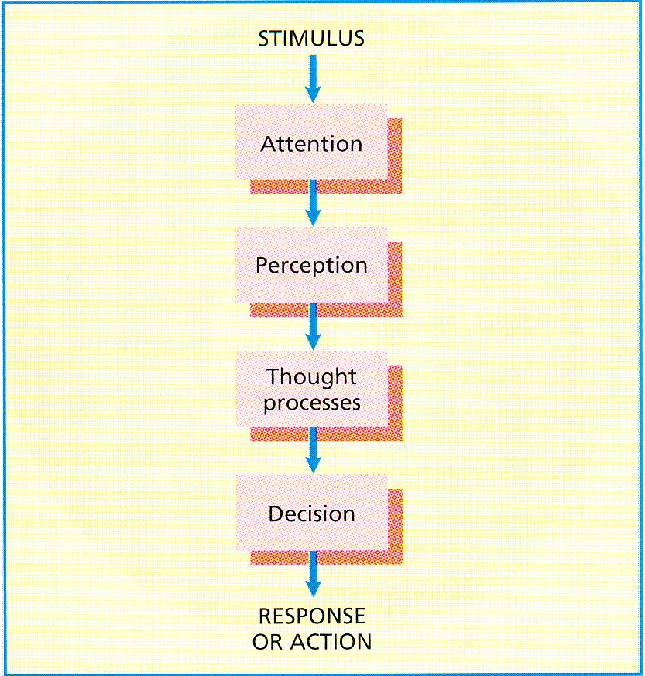
Early information-processing approach
Popular in the 1970s
Bottom-up processing: Processing directly affected by the stimulus
Serial processing: Only one process happening at a time
Drastic oversimplification – lots of instances where top-down processing also occurs
Top-down processing: perceptions influenced by individual’s expectations and prior knowledge

Slide 9
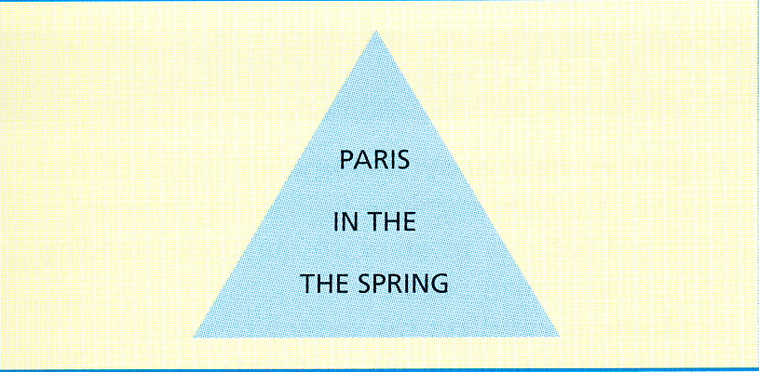
Top-down processing

Slide 10
Top-down vs. bottom-up processes
If processing was purely bottom-up, you would notice the two consecutive occurrences of “THE”
Expectations (i.e., top-down considerations) make us see a well-known expression instead

Slide 11
Parallel processing
Information processing approach suggests serial processing
Actually brain is massively parallel
More likely to use parallel processing on tasks in which we are highly practised
Consider learning to drive:
Initially impossible to steer, change gear, watch other users at the same time
After lots of practice, can do all these things “automatically” - and hold a conversation at the same time!

Slide 12
Experimental evidence
Most work in cognitive psychology involves carrying out experiments on healthy participants in laboratory conditions carefully controlled to eliminate confounding variables
Has given us lots of knowledge about attention, perception, learning, memory, reasoning, etc.

Slide 13
Task impurity issue
Many cognitive tasks involve a complex mixture of different processes
How do we isolate just one of these component processes?

Slide 14
Task purity: Isolating the process of inhibition (Miyake et al., 2000)
Miyake et al. (2000) studied three different processes that involve inhibiting a dominant response:
Stroop task
Anti-saccade task
Stop-signal task

Slide 15
Stroop effect
Discovered by Stroop (1935)
Name the COLOUR in which the word is written!!!

Slide 16
RED

Slide 17
PINK

Slide 18
YELLOW

Slide 19
BLUE

Slide 20
GREEN

Slide 21
Anti-saccade task (Hallett, 1978)
The subject has to pay attention to a target when his or her attention is drawn away from it by a more dominant cue
E.g., identify the direction of an arrow in the right field of view when attention is drawn to a square on the left-hand field of view
I’m going to hold up a certain number of fingers and I want you to call out how many there are
Now try to say how many fingers I’m holding up when I show you the following slides

Slide 22


Slide 23


Slide 24


Slide 25


Slide 26
Task impurity
Miyake et al. (2000) used latent variable analysis to show that there was a common process underlying three different inhibition tasks

Slide 27
Cognitive psychology’s influence on cognitive science
Cognitive psychology has been the driving force behind cognitive science
Knowledge about normal cognition used as the basis for research into damaged-brain behaviour in cognitive neuropsychology
Computational models use pre-computational theories of cognition developed by cognitive psychologists
Tasks chosen by cognitive neuroscientists in brain-imaging studies influenced by those studied by cognitive psychologists

Slide 28
Limitations of the cognitive psychological approach
Ecological validity
People behave differently in the laboratory from how they behave in everyday life
Inferring cognition from indirect measures of behaviour
e.g., sometimes hard to tell if a process is happening in parallel, in series, or overlapping (cascade processing)
Imaging can disambiguate this

Slide 29
Limitations of the cognitive psychological approach
Informally expressed theories and models
Can be explicated by using computational models
Paradigm specificity
Different findings in experiments that apparently test very similar tasks
Lack of consensus on architecture
Many specific theories about narrow areas of behaviour that give little consideration to how they fit into some over-arching architecture
Some architectures have been proposed (e.g., ACT-R and connectionism) but not universally adopted

Slide 30
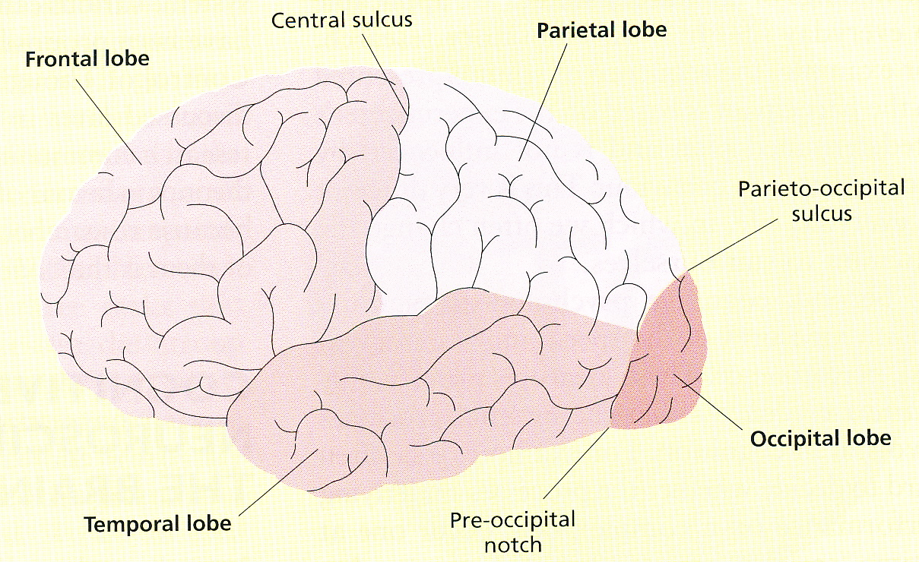
Cognitive neuroscience
50 billion neurons, each neuron connected to up to 10000 other neurons
Each hemisphere of the cerebral cortex is divided into four main lobes: frontal, parietal, temporal and occipital
Sulcus: groove or furrow
Gyrus: ridge

Slide 31
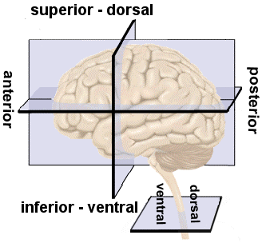
Directions in the brain
Directions labelled as though it is the brain of a quadruped (e.g., a dog)
Dorsal or Superior: Towards the top
Ventral or Inferior: Towards the bottom
Anterior: Towards the front
Posterior: Towards the back
Lateral: Towards the side
Medial: Towards the middle
See http://homepage.smc.edu/russell_richard/Psych2/Graphics/human_brain_directions.htm

Slide 32
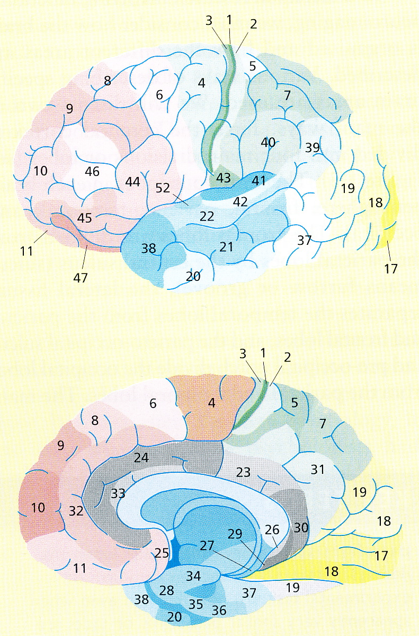
Brodmann’s areas
Korbinian Brodmann (1868 - 1918) devised a cytoarchitectonic map
Areas differentiated by cell structure
Many areas are functionally distinct
41 is primary auditory cortex
17 is primary visual cortex
Top picture is lateral, bottom picture is medial

Slide 33
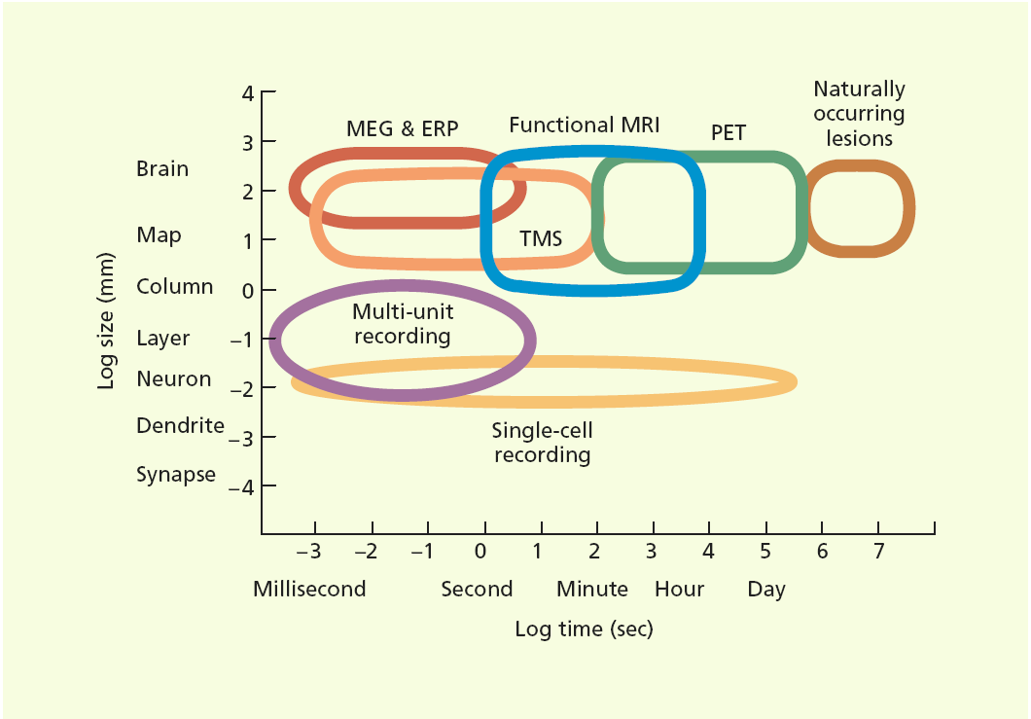
Techniques for studying the brain
Modern techniques allow us to determine where and when activity occurs in the brain when we are carrying out cognitive tasks
So we can find out if the same area of the brain is being used in different tasks
Techniques differ with respect to temporal and spatial resolution
Spatial resolution: how precisely the location of the activity can be identified
Temporal resolution: how precisely the time at which the activity occurred can be identified
High resolution is good if we want a detailed picture of what is going on
Low resolution can be better if we just want a general overview

Slide 34
Techniques for studying the brain
Single unit recording
Insert a micro-electrode (1/110000 mm in diameter) to study activity in a single neuron
Very sensitive, can record changes as small as 1/1000000 V
Event-related potentials (ERPs)
Same stimulus presented repeatedly
Pattern of brain activity recorded using scalp electrodes and averaged
Allows us to work out timing of cognitive processes

Slide 35
Techniques for studying the brain
Positron emission tomography (PET)
Involves detecting positrons emitted by a radioactive substance
Reasonable spatial resolution, poor temporal resolution
Only indirectly measures neural activity
Function magnetic resonance imaging (fMRI)
Images blood oxygenation using an MRI machine
Better spatial and temporal resolution than PET
Also indirect measure of neural activity

Slide 36
Techniques for studying the brain
Event-related functional magnetic resonance imaging (efMRI)
fMRI that compares activity associated with different events
e.g., compare brain activity on a memory test depending on whether participant responds correctly or incorrectly
Magneto-encephalography (MEG)
Measure magnetic fields produced by brain activity
Temporal resolution down to the millisecond and reasonably good spatial resolution

Slide 37
Techniques for studying the brain
Transcranial magnetic stimulation (TMS)
Short burst of strong magnetic field in a localized area that temporarily inhibits processing in that brain area
Causes a brief, localized “lesion”
Can reveal causes rather than just correlations
Results can be hard to analyse

Slide 38
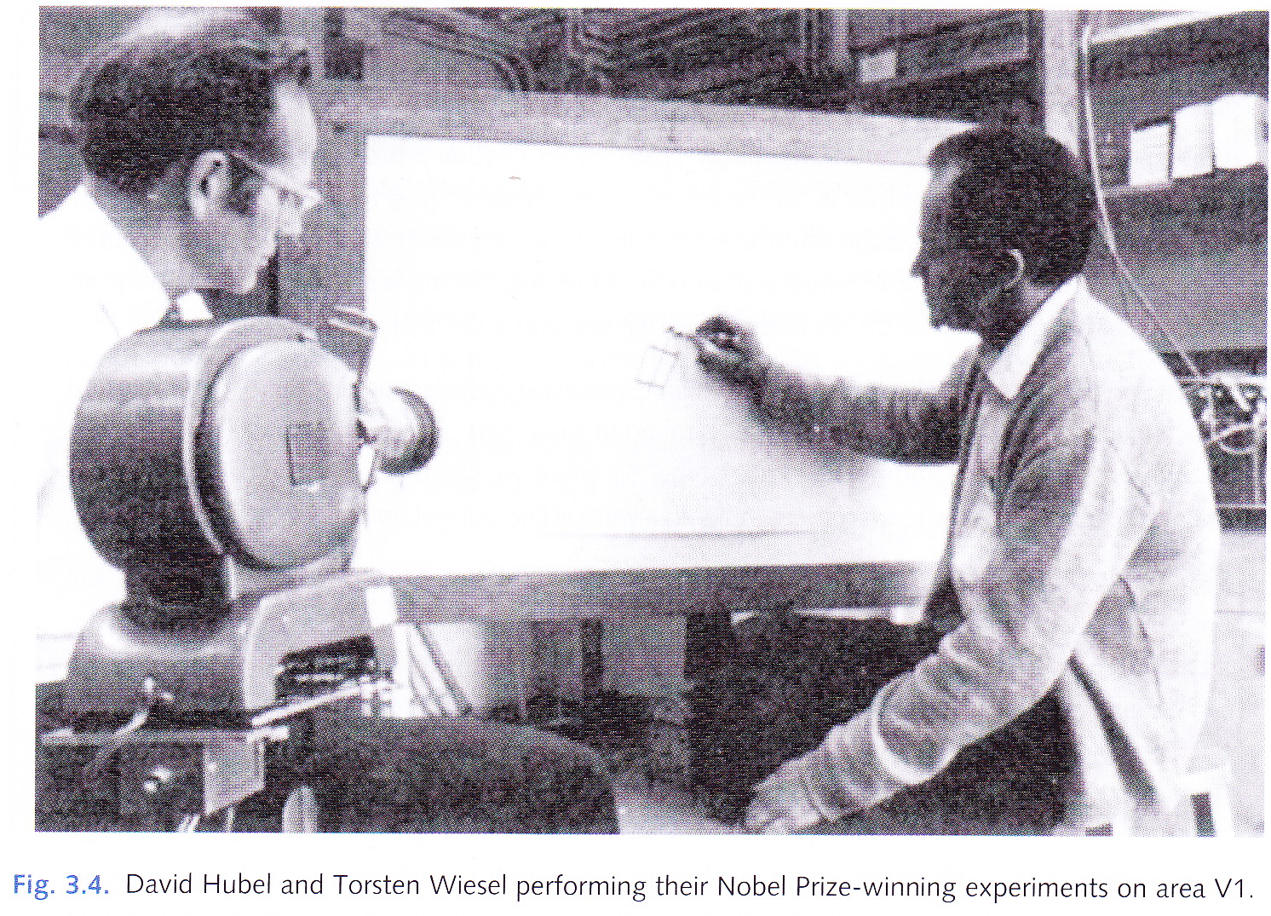
Single-unit recording
Records activity in individual neurons
Famously used by Hubel and Wiesel (1962, 1979) in studies of vision in cats and monkeys
Discovered orientation-specific cells in the visual cortex
Highest spatial and temporal resolution and can be applied over extended periods
Doesn’t reveal functioning in larger brain areas than the single neuron

Slide 39
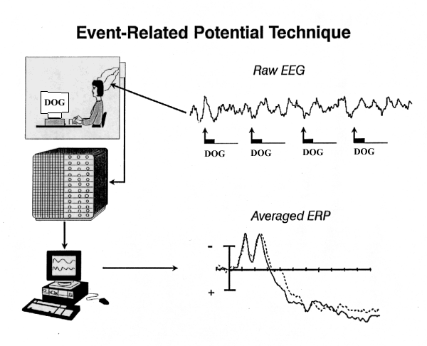
Event-related potentials (ERPs)
Electroencephalogram (EEG) is a recording of electrical potentials in the brain via electrodes placed on the scalp
EEG is sensitive and results shown as a waveform on an oscilloscope
But results sometimes corrupted by background brain activity not related to test
Event-related potentials (ERP) involves EEG of many repetitions of a stimulus, followed by averaging

Slide 40
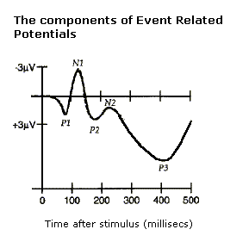
ERPs
ERPs have limited spatial resolution but excellent temporal resolution (down to a few ms)
ERP is a sequence of negative (N) and positive (P) peaks occurring a certain number of ms after stimulus
For example, “N400” is a negative peak occurring 400 ms after stimulus presentation

Slide 41
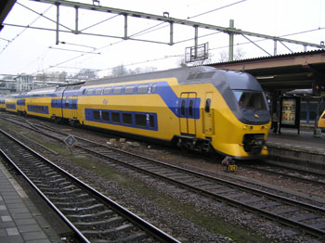
ERPs and psychological theories
Long been claimed that a semantic mismatch involving world knowledge takes longer to detect than one involving only logical knowledge or common sense
Hagoort et al. (2004) measured N400 when participants responded to the two sentences on the left
There was no difference – suggesting no time delay when world knowledge is used
“The Dutch trains are white and crowded.”
“The Dutch trains are sour and crowded.”

Slide 42
ERPs: Pros and Cons
ERPs provide more detail about the time course of a response than most other techniques
cf. measuring reaction times which gives just one measure per trial – ERPs provide a continuous trace
ERPs cannot tell us which brain areas are involved
ERPs of most use when task is simple and involves basic processes occurring at a certain time after stimulus onset – cannot be used to study complex processes like problem-solving

Slide 43
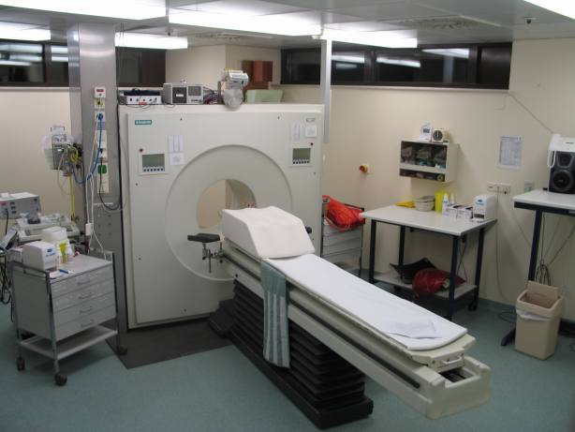
Positron emission tomography (PET)
Based on detection of positrons emitted by radioactive substances
Radioactive water injected into body and soon gathers in brain’s blood vessels
Radioactive water moves quickly to active areas of the brain
Scanner measures radioactivity in different parts of the brain and measurements sent to a computer which creates an image from them

Slide 44
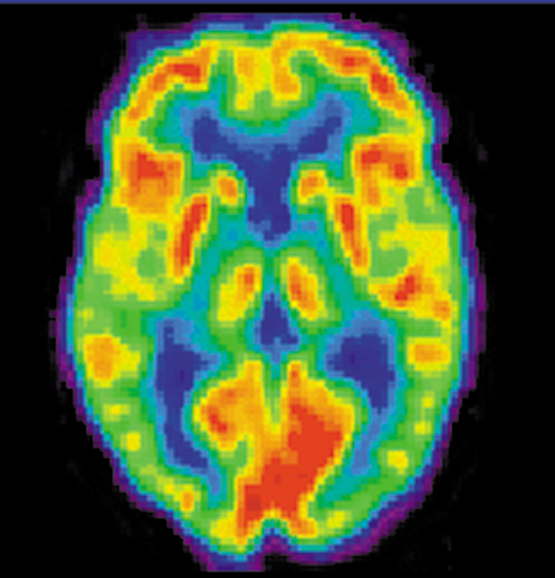
PET: Pros and cons
Reasonable spatial resolution: active areas can be localised to within 5-10 mm
Very poor temporal resolution: shows activity over 30-60 second period
Indirect measure of neural activity
Invasive technique: radioactivity limits frequency with which it can be carried out

Slide 45
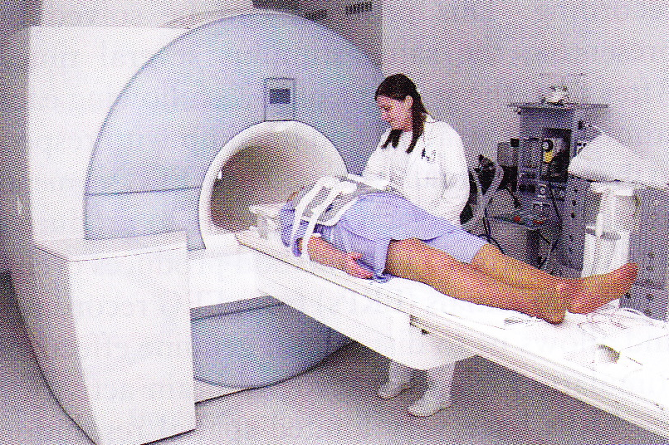
Magnetic resonance imaging (MRI)
Radio waves used to excite atoms in the brain
Causes changes detected by a very large magnet (11 tons)
Data visualized on a computer to produce a 3D model
Tells us about structure, not function

Slide 46
Functional magnetic resonance imaging (fMRI)
Oxyhaemoglobin converted to deoxyhaemoglobin when neurons consume oxygen
Deoxyhaemoglobin distorts local magnetic field
Amount of distortion gives measure of how much deoxyhaemoglobin there is in the blood
Technically, fMRI measures BOLD (“blood oxygen-level-dependent contrast”)
Temporal resolution is about 2-3 seconds
Spatial resolution about 1mm
Largely superseded PET because of improved resolution

Slide 47
Event-related functional magnetic resonance imaging (efMRI)
Wagner et al. (1998) recorded brain activity of participants while learning a list of words using fMRI
Then tested for participants’ memory for the words
12% of words not recognised
Compared brain activity during learning for words remembered with activity for words forgotten
For remembered words, more activity in prefrontal cortex and hippocampus

Slide 48
Limitations of fMRI
Indirect measure of underlying neural activity
Distortion in BOLD signal in certain areas, particularly those close to sinuses and oral cavity (e.g., orbitofrontal cortex)
Scanner is very noisy (problematic for testing with auditory stimuli)
Some people find it claustrophobic and some get headaches and other minor side-effects
Difficult to design tasks that can be carried out in the scanner and that don’t cause much movement (even speech causes too much movement)

Slide 49
Brain-reading
Haxby et al. (2001) got participants to look at pictures from 8 different categories while being recorded with fMRI
Correctly predicted category from brain images in 96% of cases

Slide 50
Brain-reading
Kay et al. (2008) claimed previous work on brain reading limited in two ways
Visual stimuli less complex than in everyday life
Identification simplified by comparing test trials with results previously obtained on training trials
Kay et al. presented 120 natural novel images that were reasonably complex
fMRI data allowed correct identification in 92% of cases for one participant and 72% for another (chance would have been 0.8%)
Used receptive field models to predict response for each test image and compare this with the observed response in the participants.

Slide 51
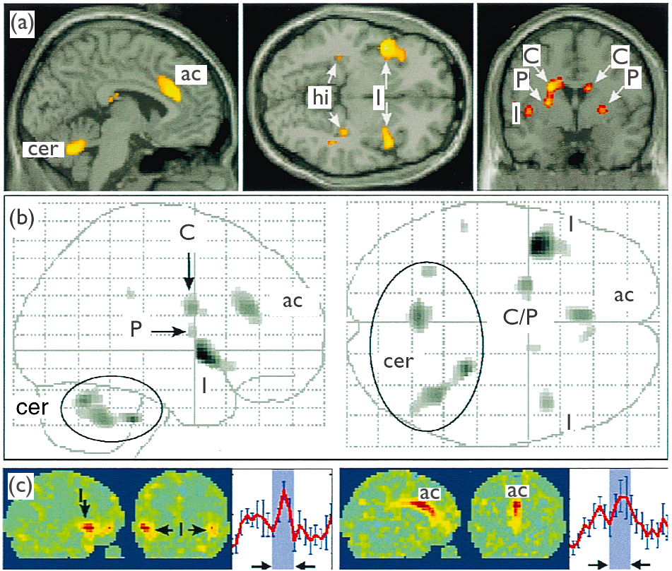
The neural basis of romantic love (Bartels and Zeki, 2000)
Used fMRI to study activity in brains of 17 people who were deeply in love
Compared activity when viewing pictures of loved one with activity when viewing pictures of friends of similar age and same sex as loved one
Showed activity restricted to foci in medial insula, anterior cingulate cortex and, subcortically, the caudate nucleus and putamen
Suggests a unique network of activation for romantic love!

Slide 52
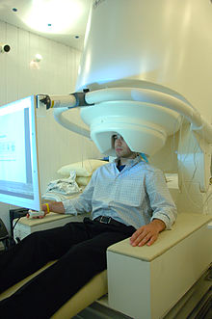
Magneto-encephalography (MEG)
Uses a superconducting quantum interference device (SQUID) to measure magnetic fields produced by brain activity
Magnetic fields in brain are much smaller than earth’s magnetic field – so detection is complicated
But less distortion than with EEG
Excellent temporal resolution (at ms level)
Very good spatial resolution
VERY expensive – uses liquid helium (i.e., has to be cooled to around 4K) and needs specially shielded rooms
© National Institute of Mental Health, National Institutes of Health, Department of Health and Human Services

Slide 53
Studying V5 with MEG
Anderson et al. (1996) used MEG to study V5 (MT) in humans
Showed that V5 responds to motion-contrast patterns
Showed that V5 becomes active about 20ms after V1 indicating that some basic visual processing precedes motion detection

Slide 54
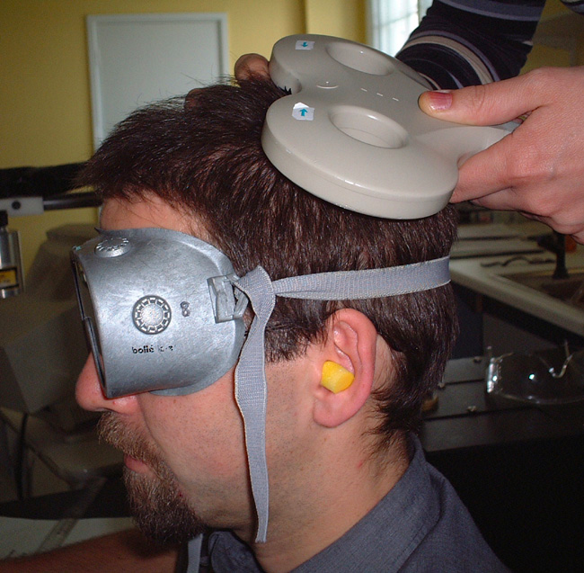
Transcranial magnetic stimulation (TMS)
Strong but brief (< 1ms) magnetic field created close to the participant’s head
Generally inhibits processing activity in a volume of about 1 cm³
Several pulses usually administered in a fairly short time – repetitive TMS (rTMS)
© Human Pain Research Group, University of Manchester
http://www.hope-academic.org.uk/painresearch/PainSystems.htm

Slide 55
TMS
Usually applied also to a non-critical region as a control
Produces a “temporary lesion” in the affected area
So if TMS impairs performance in a task, then can conclude that region is involved in carrying out the task
Can be used to show that activity in a particular area is necessary for normal performance in a particular task
So can be used to show causal dependencies on brain areas rather than just correlations

Slide 56
Using TMS to show active involvement of an area in a task
Johnson and Zatorre (2006) asked participants to perform visual and auditory tasks separately and together (dual-task condition)
Dorsolateral prefrontal cortex only active in dual-task condition – but this didn’t prove that this area was necessary for the dual-task condition
Johnson, Strafella and Zatorre (2007) repeated experiment with rTMS applied to the dorsolateral prefrontal cortex
This caused impaired performance in the dual-task condition, strengthening the argument that this area was necessary in that condition

Slide 57
Using TMS to study timing of brain processes
Cracco et al. (1999) showed that participants’ abilities to detect letters were maximally impaired when TMS applied 80-100 ms after presentation of the letters

Slide 58
TMS and rTMS: Advantages
Allows for selective lesioning of specific areas of the brain, so can show necessity of an area for a particular function
cf. fMRI which only shows correlations or associations between brain areas and function
Advantage over natural lesions studied in cognitive neuropsychology: can compare performance in same individual with and without lesion
Also, brain-damaged patients can develop compensatory strategies to counter impaired performance
TMS too short-term for this to happen

Slide 59
TMS: Limitations
Effects are complicated: usually decreases activity in affected area, but occasionally increases it
Can only be applied to areas beneath the skull that are not overlaid with muscle
fMRI studies have shown that TMS can affect areas remote from the point of application (Bohning et al., 1999)

Slide 60
Six issues in cognitive neuroscience: 1. The “neuroimaging illusion”
Patterns of brain activation only provide indirect evidence relating to cognitive processing
Most methods do not directly measure neuronal activity

Slide 61
Six issues in cognitive neuroscience: 2. Associations between brain images and behaviour are correlational
Imaged activity in a particular brain area while performing a task doesn’t imply necessity of brain area for the task
Activation might be caused by
Particular strategy chosen by participant
Participants worrying about task performance
Participants unnecessarily monitoring performance
TMS can show causal relationship between brain area and task

Slide 62
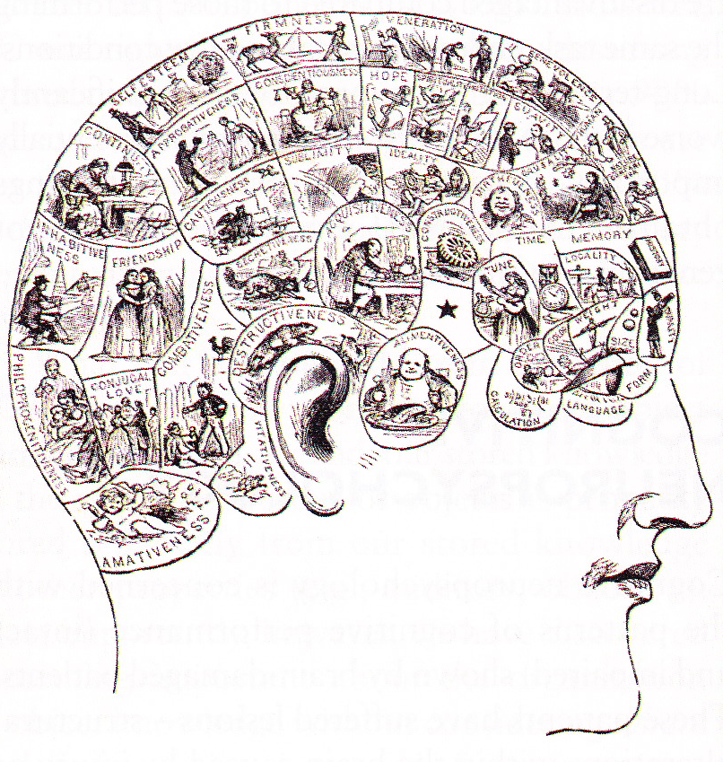
Six issues in cognitive neuroscience: 3. Assumption of functional specialisation
Functional neuro-imaging research based on assumption that each brain area specialised for a particular function
fMRI has been compared with phrenology – the (incorrect) idea that various mental faculties are revealed by bumps on the skull
Some justification for assumption of functional specialisation for basic processes, but not complex ones
Substantial integration and co-ordination between brain areas

Slide 63
Six issues in cognitive neuroscience: 4. Is neuroimaging relevant to cognitive theories?
In recent years, we have increased knowledge of where psychological processes occur in the brain – so can use psychological theories to predict patterns of brain activation
Can use neuro-imaging to resolve controversies in cognitive psychology

Slide 64
Using neuroimaging to resolve controversies in psychology
How does visual imagery arise?
Kosslyn (1994) argued that visual imagery uses the same processes as visual perception
Pylyshyn (2000) claimed it uses propositional knowledge about what things would look like in the given situation
Kosslyn and Thompson (2003) analysed functional imaging studies and found that visual imagery is generally associated with activation in V1

Slide 65
Using neuroimaging to resolve controversies in psychology
Some early cognitive psychologists (e.g., Deutsch and Deutsch, 1963) proposed that even unattended stimuli receive thorough processing
ERP studies have shown that unattended stimuli (both visual and auditory) are less thoroughly processed than attended stimuli, even shortly after presentation (Luck, 1998)

Slide 66
Six issues in cognitive neuroscience: 5. Task-related changes in brain activity are usually small
Patterns of brain activity are similar in different states of consciousness including coma, anæsthesia and slow-wave sleep (Boly et al., 2008)
So much of what is going on in the brain is just basic functioning!
Performing a task typically changes brain activity by only a small amount (5% or less)
Task performance can decrease brain activity in certain areas and increase it in others

Slide 67
Six issues in cognitive neuroscience: 6. Ecological validity and paradigm specificity
Ecological validity and paradigm specificity are issues in cognitive neuroscience as well as in cognitive psychology
Consider fMRI –performing a task in a narrow tube with loud noises and minimal movement hardly simulates everyday life!
Gutchess and Park (2006) showed that long-term recognition memory is significantly worse in an fMRI environment than it is in a normal everyday environment
This casts doubt on the generalisability of results from fMRI studies

Slide 68
References
Anderson, S. J., Holliday, I. E., Singh, K. D., and Harding, G. F. A. (1996). Localization and functional analysis of human cortical area V5 using magneto-encephalography. Proceedings of the Royal Society of London: Series B, 263, 423 – 431.
Bartels, A. and Zeki, S. (2000). The neural basis of romantic love. NeuroReport, 11:17, 3829 – 3834.
Bohning, D. E., Shastri, A., McConnell, K. A., Nahar, Z., Lorberbaum, J. P., Roberts, D. R., et al. (1999). A combined TMS/fMRI study of intensity-dependent TMS over motor cortex. Biological Pyschiatry, 45, 385 – 394.
Boly, M., Philips, C. Tshibanda, L., et al. (2008). Intrinsic brain activity in altered states of consciousness: How conscious is the default mode of brain function? Annals of the New York Academy of Sciences, 1129, 119 – 129.
Bruner, J. S., Goodnow, J. J. and Austin, G. A. (1956). A Study of Thinking. John Wiley, New York.
Chomsky, N. (1957). Syntactic Structures. Mouton, The Hague.
Cracco, R. Q., Cracco, J. B., Maccabee, P. J. and Amassian, V. E. (1999). Cerebral function revealed by transcranial magnetic stimulation. Journal of Neuroscience Methods, 86, 209 – 219.
Deutsch, J. A. and Deutsch, D. (1963). Attention: Some theoretical considerations. Psychological Review, 93, 283 – 321.
Gutchess, A. H. and Park, D. C. (2006). fMRI environment can impair memory performance in young and elderly adults. Brain Research, 1099, 133 – 140.
Hagoort, P., Hald, L., Bastiaansen, M. and Petersson, K. M. (2004). Integration of word meaning and world knowledge in language comprehension. Science, 304, 438 – 441.
Hallett, P. E. (1978). Primary and secondary saccades to goals defined by instructions. Vision Research, 18:10, 1279 – 1296.
Haxby, J. V., Gobbini, M. I., Furey, M. L., Ishai, A., Schouten, J. L. and Pietrini, P. (2001). Distributed and overlapping representations of faces and objects in ventral temporal cortex. Science, 293, 2425 – 2430.
Hubel, D.H. and Wiesel, T. N. (1962). Receptive fields, binocular interaction and functional architecture in the cat’s visual cortex. Journal of Physiology, 160, 160 – 154.
Hubel, D.H. and Wiesel, T. N. (1979). Brain mechanisms of vision. Scientific American, 249, 150 – 162.

Slide 69
References (cont.)
Johnson, J. A. and Zatorre, R. J. (2006). Neural substrates for dividing and focusing attention between simultaneous auditory and visual events. NeuroImage, 31, 1673 – 1681.
Johnson, J. A., Strafella, A. P. and Zatorre, R. J. (2007). The role of the dorsolateral prefrontal cortex in bimodal divided attention: Two transcranial magnetic stimulation studies. Journal of Cognitive Neuroscience, 19, 907 – 920.
Kay, K. N., Naselaris, T., Prenger, R. J. and Gallant, J. L. (2008). Identifying natural images from human brain activity. Nature, 452, 352 – 355.
Kosslyn, S. M. (1994). Image and Brain: The Resolution of the Imagery Debate. MIT Press, Cambridge, MA.
Kosslyn, S. M. and Thompson, W. L. (2003). When is early visual cortex activated during visual mental imagery? Psychological Bulletin, 129, 723 – 746.
Luck, S. J. (1998). Neurophysiology of selective attention. In H. Pashler, ed., Attention. Psychology Press, Hove, UK.
Miller, G. A. (1956). The magic number seven, plus or minus 2: Some limits on our capacity for processing information. Psychological Review, 63, 81 – 93.
Miyake, A., Friedman, N. P., Emerson, M. J., Witzki, A. H., Howerter, A. and Wager, T. (2000). The unity and diversity of executive functions and their contributions to complex “frontal lobe” tasks: A latent variable analysis. Cognitive Psychology, 41:1, 49 – 100.
Newell, A., Shaw, J. C. and Simon, H. A. (1958). Elements of a theory of human problem solving. Psychological Review, 65, 151 – 166.
Pylyshyn, Z. W. (2000). Situating vision in the world. Trends in Cognitive Science, 4, 197 – 207.
Stroop, J. R. (1935). Studies of interference in serial verbal reactions. Journal of Experimental Psychology, 18, 643 – 662.
Wagner, A. D., Schacter, D. L., Rotte, M., Koutstaal, W., Maril, A., Dale, A. M., Rosen, B. R. and Buckner, R. L. (1998). Building memories: Remembering and forgetting of verbal experiences as predicted by brain activity. Science, 281, 188 – 191.

