Slide 1
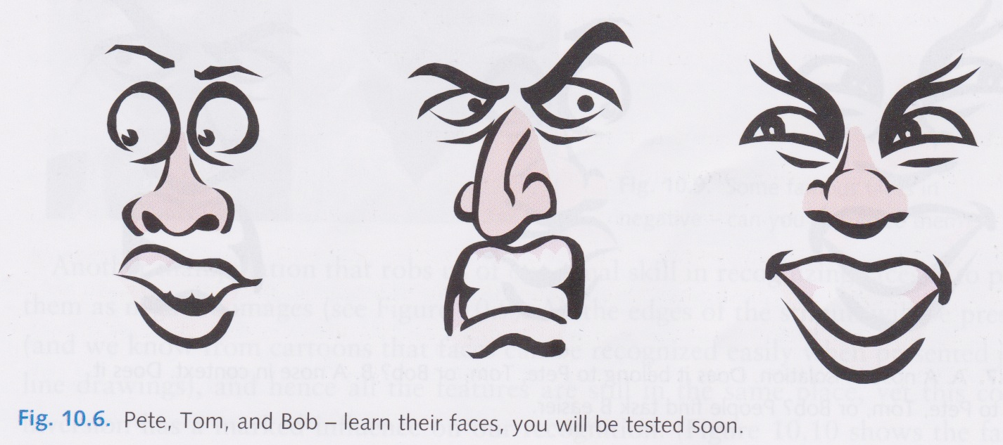
The Perception of Faces
David Meredith
Aalborg University

Slide 2
Source
This lecture is based on Chapter 10 of
Snowden, R., Thompson, P. & Troscianko, T. (2006). Basic Vision: An Introduction to Visual Perception. OUP. (ISBN: 978-0199286706)

Slide 3
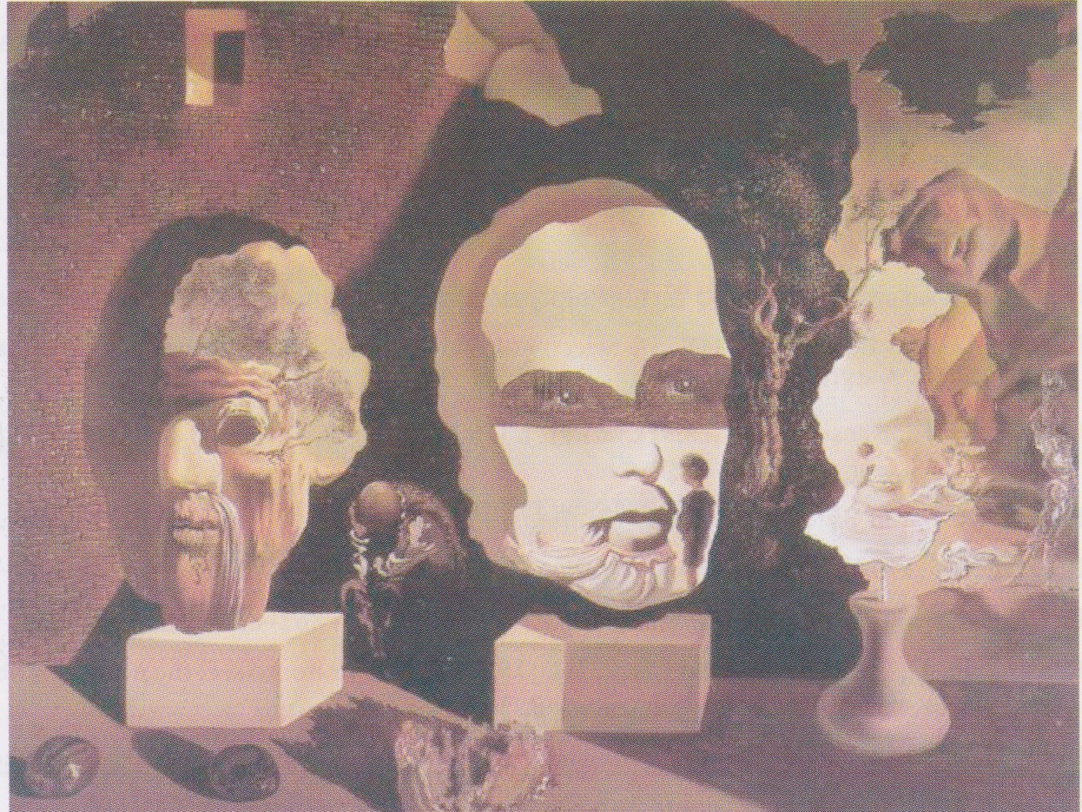
The perception of faces
“Old Age, Adolescence, Infancy (The Three Ages)” by Salvador Dali (1940)
Uses technique of “double imagery”, where objects and figures are grouped to form other objects
We automatically interpret these three composite figures as faces of different ages

Slide 4
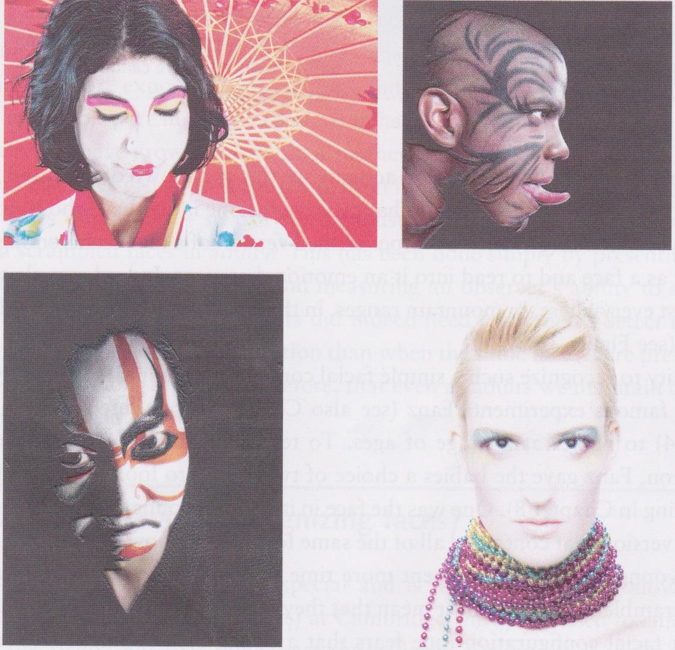
Overview
We need to be able to recognize our family, our friends and our enemies in order to function properly in society
We can read others’ emotions, thoughts and moods from their faces
We judge the beauty of others’ faces and use it as a factor to decide who we spend our lives with
We spend a great deal of time making sure that our faces look in a particular way
We have evolved a special ability for recognizing and processing faces
When this ability is taken away, it causes lots of problems and distress

Slide 5
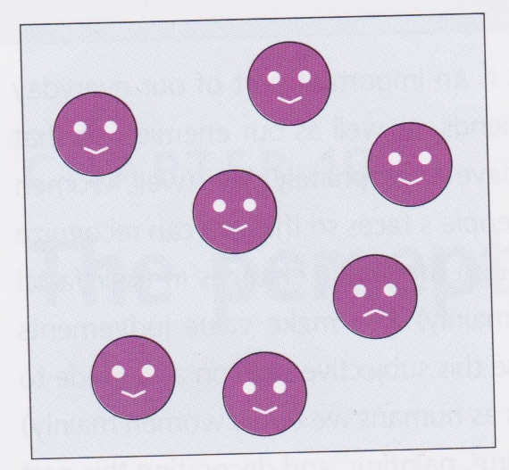
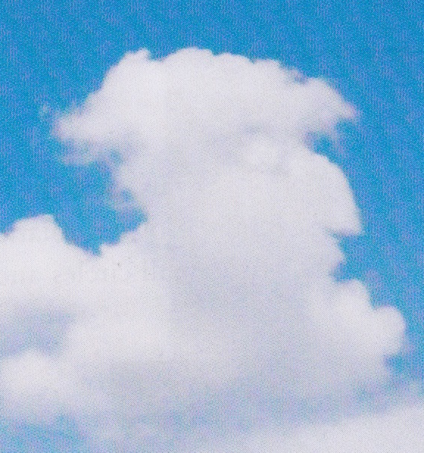
Faces everywhere
We see a face even if it’s just a circle, containing two smaller circles and a bent line
We can even tell the mood of such a face!
We see faces everywhere, even where there aren’t any
in clouds, in misshapen vegetables, in the moon, in mountain ranges

Slide 6
Babies’ perception of faces
Babies as young as 2-3 months prefer to look at faces than at images constructed by jumbling up the elements of a face (Fanz)
If the faces are waved in front of the baby, then even new-borns show a preference for faces than any other stimuli
However, when baby reaches 1-2 months, moving the face does not increase the preference
A baby as young as 2 days old will spend more time tracking a picture of the face of its mother than any other face – could be some form of imprinting
cf. chicks that follow the first large moving thing they meet
Even adults are faster at recognizing the location of a face than a scrambled face

Slide 7
Faces are special
If we are flashed a picture of a face, then we are more likely to remember it than if we briefly see an image of something else, like a dog, an aeroplane or an ink blot

Slide 8
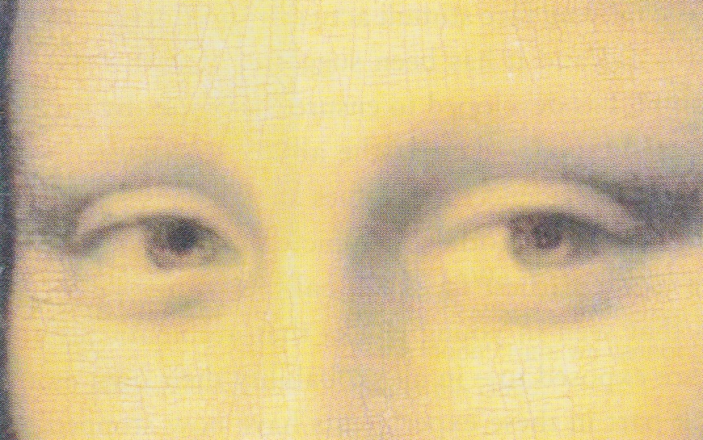
Gaze direction
Direction of gaze and eye movements give us lots of information about what a person is thinking or feeling
Bob is looking at Tom but glancing occasionally at Jane
Bob is listening to Tom but is a bit bored and easily distracted by Jane
Gaze direction tells us what the person is attending to
The Mona Lisa seems to be looking over your shoulder!
Ability to interpret gaze direction used as a measure of empathy (theory of mind)
Autistic children tend not to be very good at this

Slide 9
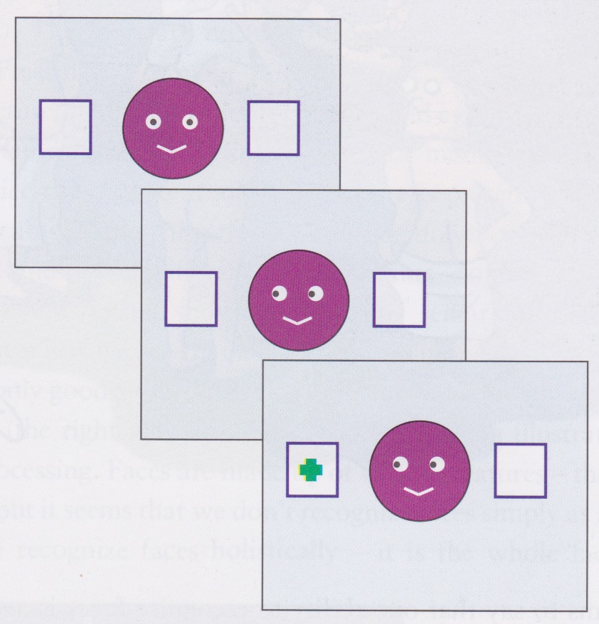
Gaze direction
If we see someone’s direction of gaze suddenly change, then our attention is automatically grabbed (exogenous cue)
it could be that the other person has seen something dangerous or very interesting that we need to know about!
If use cues on left, then attention exogenously drawn in the direction of the face’s gaze
for 200-600ms after cue, reaction times are shortened in the direction of the face’s gaze
if it were an endogenous cue, then effect would last longer

Slide 10
Eye-witness testimony
Laboratory research suggests we are very good at recognizing faces
But eye-witnesses of crimes are notoriously bad at remembering faces
Quite minor changes in a face can reduce recognition, such as hairstyle, clothing
Better at remembering a face if it is in the same context that we saw it before

Slide 11
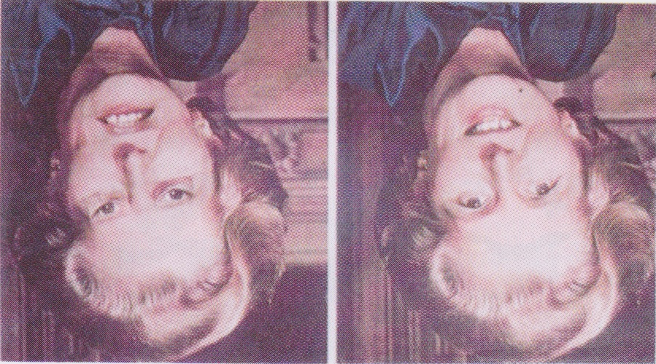
Feature configurations
Many people when looking at the “Thatcher illusion” do not notice the difference between the images when presented briefly upside down
When turned the right way up, everyone notices the difference immediately
Seem to be only good at decoding facial expressions when faces are the right way up

Slide 12
Holistic face recognition
Faces made up of features
nose, eyes, mouth,...
But perceived holistically as one unified percept – not a “bag of features”
Much easier to recognize what face a feature belongs to if the feature is presented as part of the face rather than in isolation
As we shall now see...

Slide 13
Study these faces – try to remember them!

Slide 14
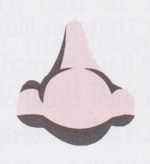
Whose nose is this? (Hard ☹)

Slide 15
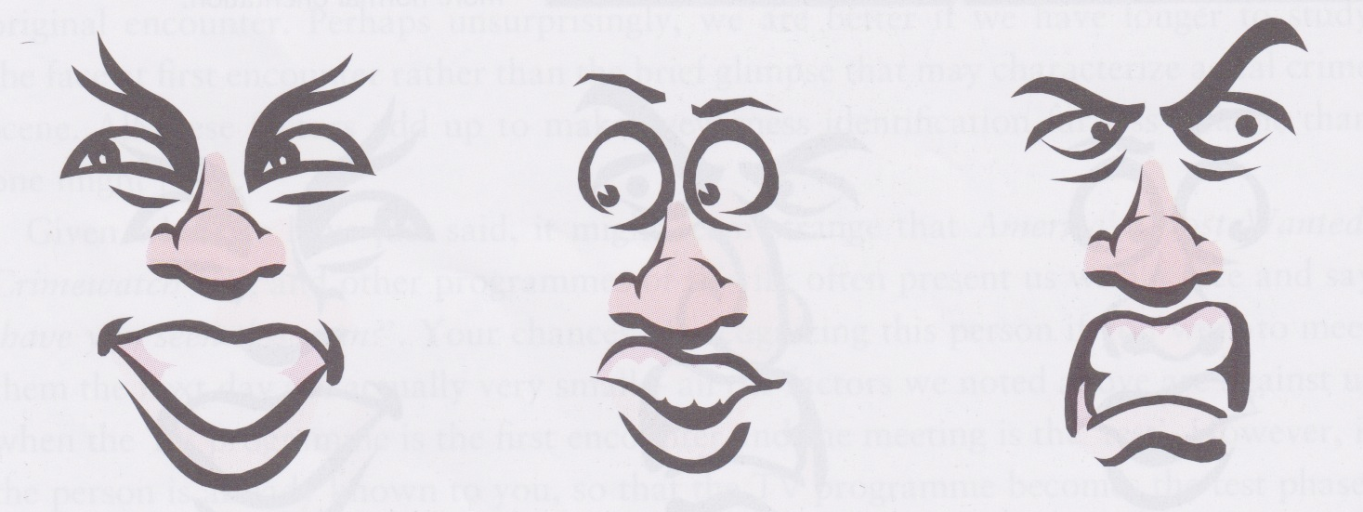
Can you tell whose nose it was now?
Bob Pete Tom

Slide 16
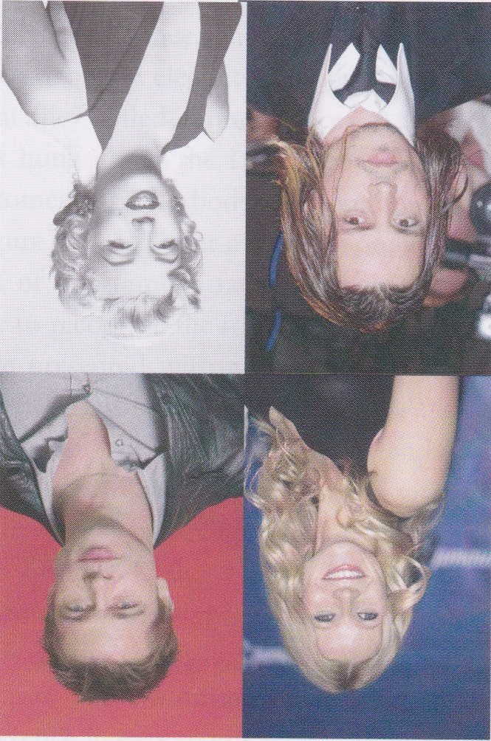
Holistic perception of faces
Holistic perception is a particular feature of face recognition
When experiment repeated using houses and other objects, the effect was not observed
Faces have to be right way up in order for you to recognize them easily
see left!
Not good at recognizing scrambled faces
Face recognition uses holistic or configural cues, not featural ones

Slide 17
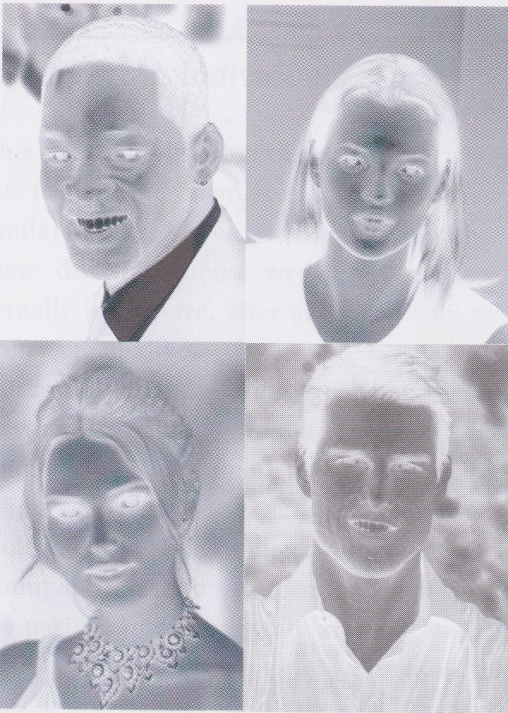
Contrast inversion and face recognition
Contrast inversion severely reduces our ability to recognize faces
Note that these images still have all the same edges and features (eyes, mouth, nose) are in the correct positions

Slide 18
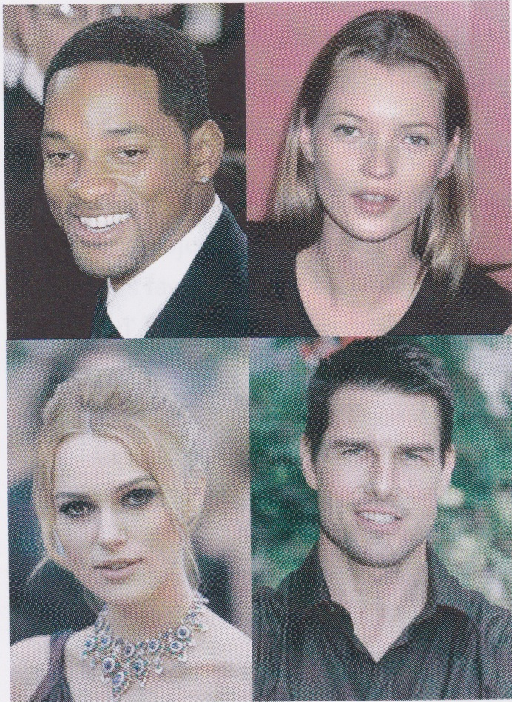
Contrast inversion

Slide 19
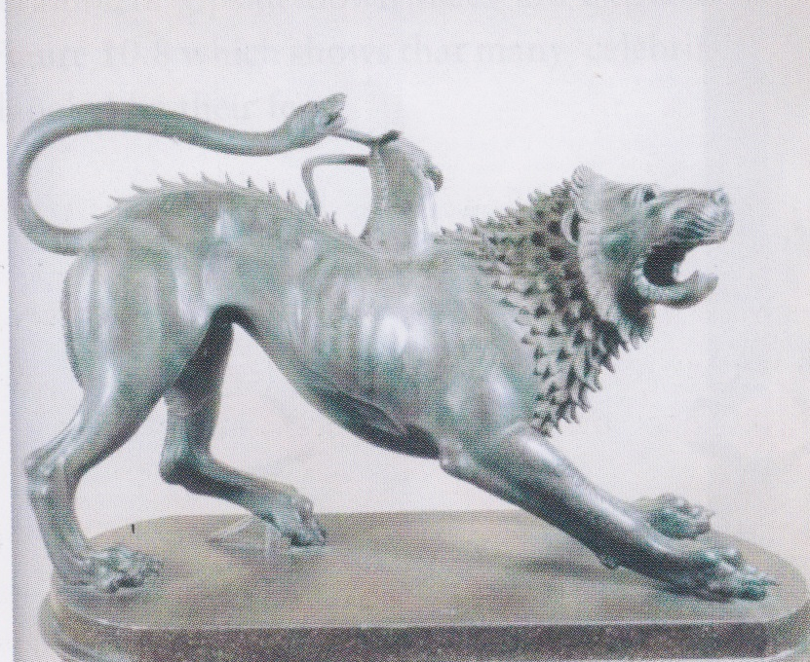
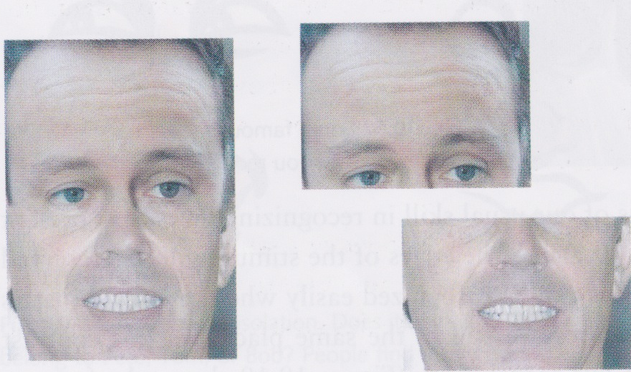
Chimeric faces
Young et al. presented subjects with faces constructed by combining the top half one famous face with the bottom half another
chimeric face named after “chimæra”, a mythical beast with body parts from different animals
If two halves produce a plausible new face, then hard to recognize either face
If bottom of chimeric face covered, then face easier to recognize than if top half covered
If two halves unaligned, then again easier to recognize

Slide 20
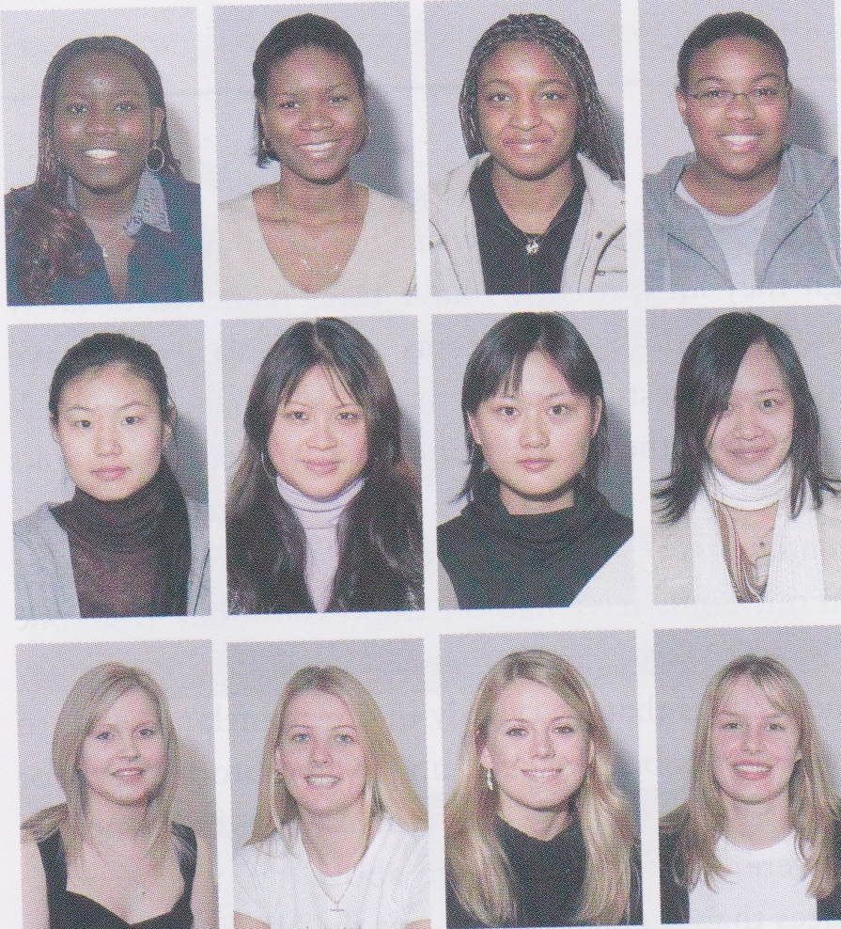
Recognizing individuals
Most faces are actually quite similar – two eyes, nose, mouth, usually in roughly the same relative positions
Yet we are able to discriminate between hundreds of different faces
We tend to be better at differentiating between faces of people that have the same race as us
This is probably due to learning
we have much more exposure to faces of our own race during the critical period of development

Slide 21
Most discrimination skills are learnt from extended exposure
Most skills requiring sensitive discrimination are learnt from extended experience
For example
distinguishing between wines
judging dogs
evaluating Olympic dives
Interestingly, a dog judge will lose his ability to discriminate when presented with upside-down pictures of dogs!

Slide 22
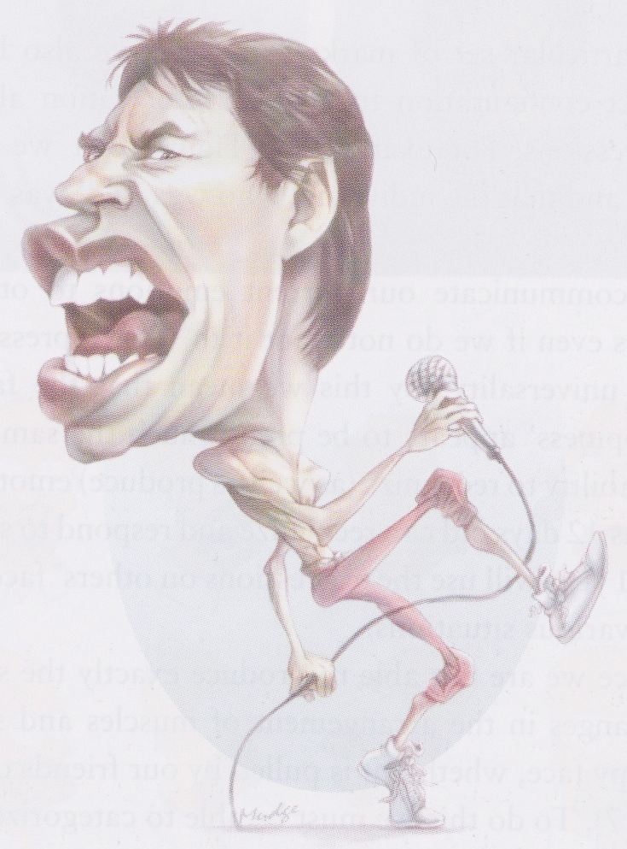
Caricatures
A caricature is an image of a face that accentuates the most characteristic features
Mick Jagger with even bigger lips
Prince Charles with even bigger ears
George Bush with an even more Neanderthal brow
Caricatures are often more easily recognized than the original faces!
Suggests that they reflect way that faces are encoded by the brain

Slide 23
Which one is the real Arnie?
Rhodes et al. (1987) produced caricatures by exaggerating the differences between an actual person’s face and an average face
Also made “anti-caricature” by reducing differences between a face and an average face
Found that people were better at recognizing the caricature than the original and even considered the caricature to be a better likeness than the original!

Slide 24
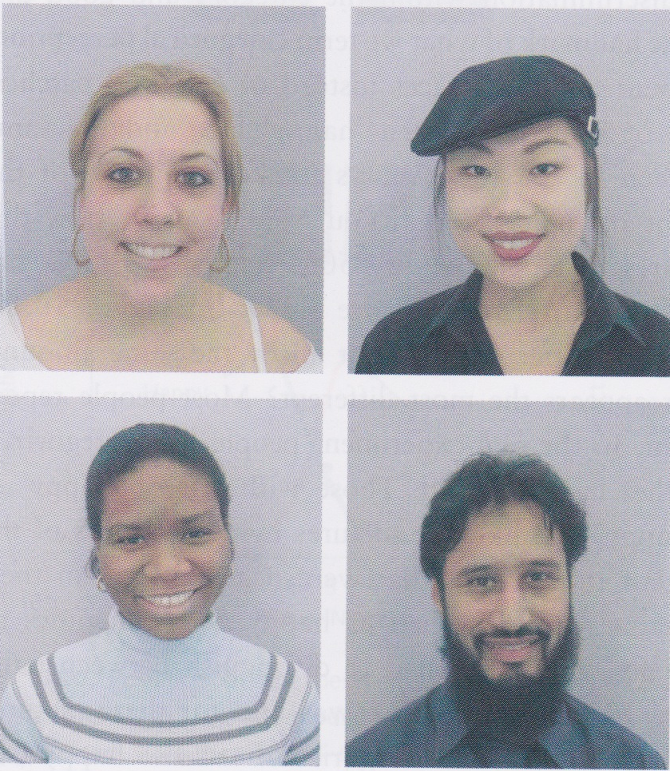
Expressions
Can infer mood and emotions from facial expressions
Expressions of emotion have a great degree of universality
A smile indicates happiness pretty much all over the world
By the time we are 12 days old, we can recognize and respond to some facial expressions
By 1 year old, child will use expressions to guide behaviour

Slide 25
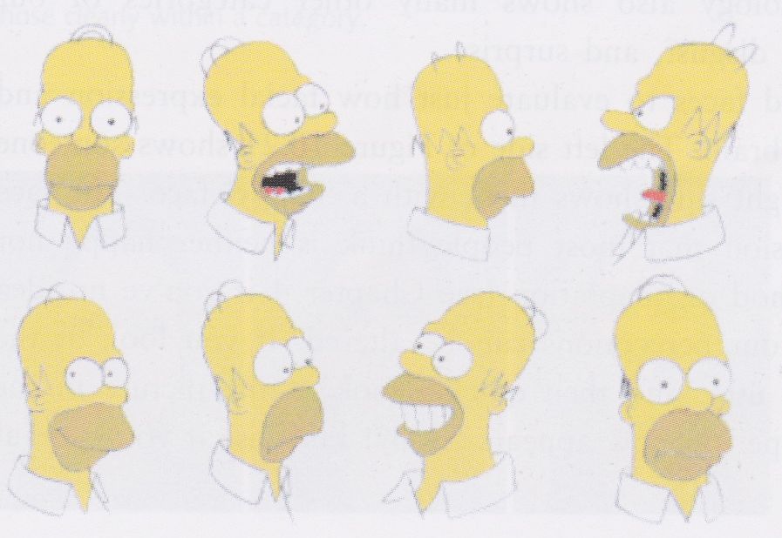
Recognizing emotions from faces
We can recognize an emotion from a facial expression even in someone we have never met
clearly related to universality of facial expressions
also implies categorical perception

Slide 26
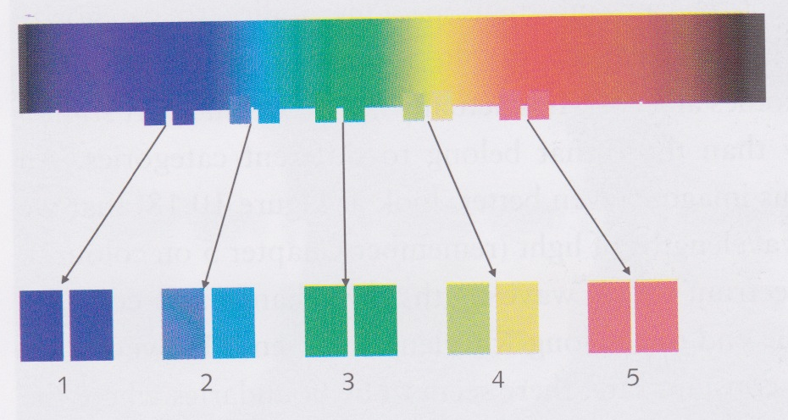
Categorical perception
Recognizing emotions from faces requires categorical perception of facial expressions
your happy face will not be exactly the same as mine
We are not as good at distinguishing between stimuli that fall in the same category
e.g., vowel sounds, colours
See spectrum above – changes in categories seem larger than other changes, even though colours change continuously
Ability to distinguish between frequencies differing by 20nm depends on whether the differences crosses a category boundary

Slide 27
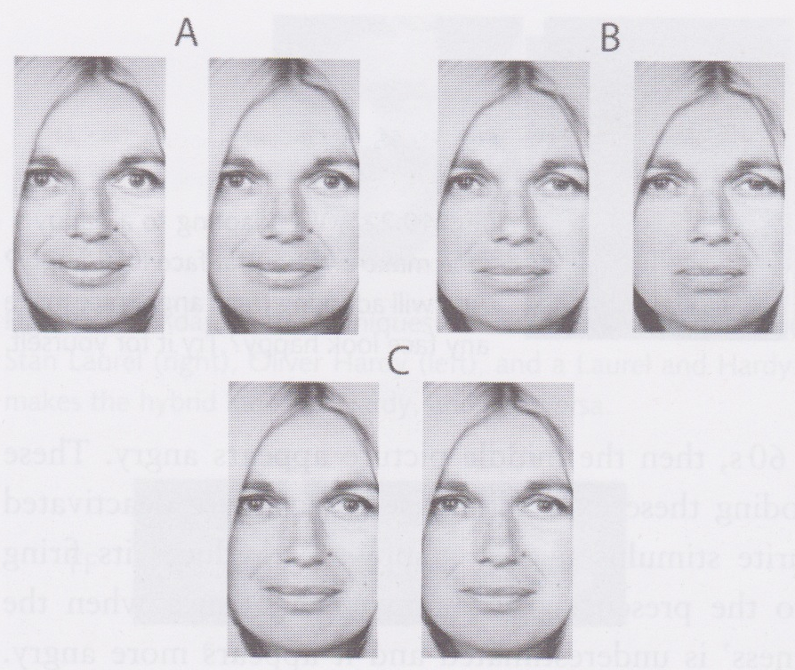
Which pair of faces looks most different?

Slide 28
Categorical perception of expressions
Calder et al (1996) took a happy face and a sad face of the same person, then produced “morphed” mixtures of the two images
Gave images that were, e.g., 80% happy, 20% sad; 70% happy + 30% sad; and so on
The three pairs at left differ by the same amount, but most people find B look the most different
Pictures in B are both close to 50% happy, so commonly fall in different categories
Other pictures usually fall in the same category and so are not seen as being so different
Note that people’s judgement of whether a face was happy or sad in isolation corresponded to the relative amounts of the happy and sad faces used to construct the picture

Slide 29
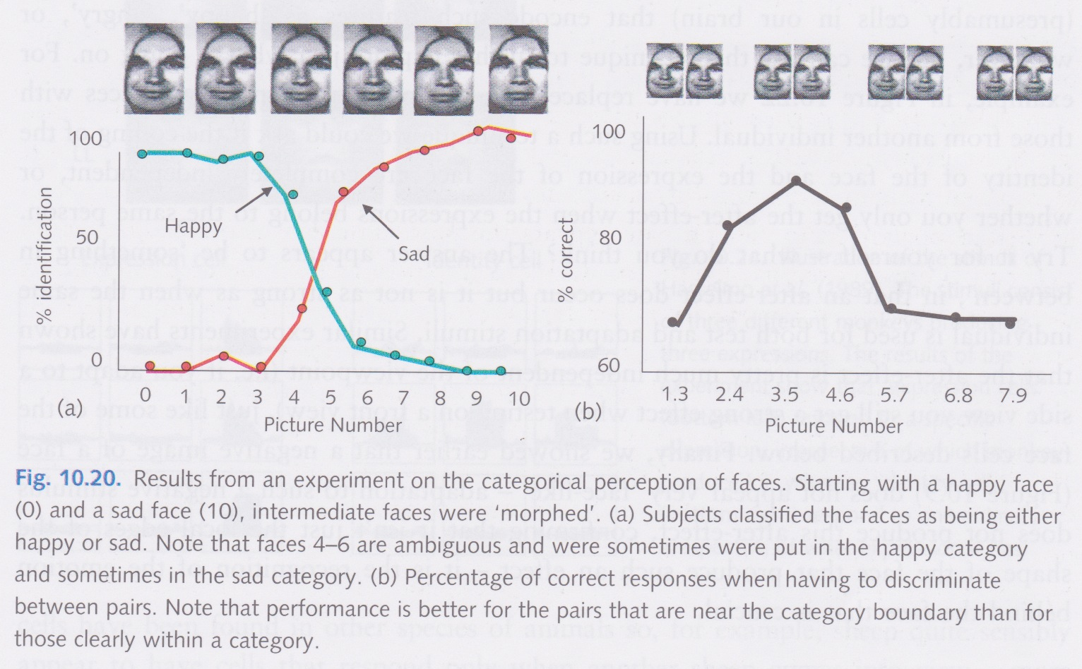
Results of Calder et al

Slide 30
Look at this picture for a little while...

Slide 31
Happy or angry?

Slide 32
Look at this picture for a little while

Slide 33
Happy or angry?

Slide 34
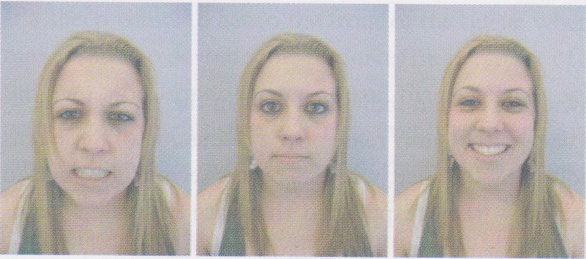
Facial expression after effect
Middle face is a 50-50 morph of the happy face and the angry face
If you look for a while at the angry face, the morphed face looks happy
If you look for a while at the happy face, the morphed face looks angry
This is an adaptation effect like the tilt and motion after-effect
Suggests that we have cells that code for facial expression, that become fatigued (adapted) if stimulated for a period of time

Slide 35
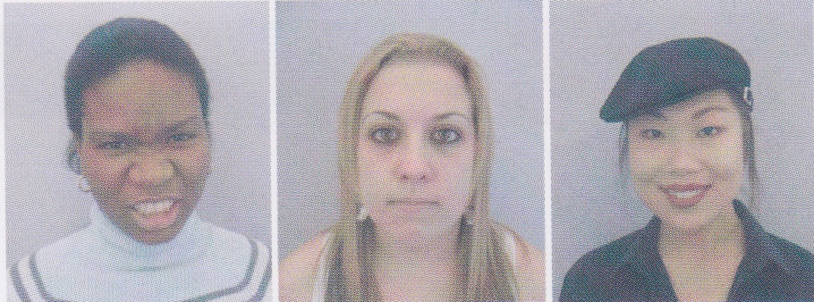
Facial expression after effect
If we replace the happy and angry faces with the faces of different people, then the effect remains, but is not as strong
If we adapt to an image of a face from one viewpoint and then see the face from another viewpoint, the after-effect still occurs
Suggests that we have neural representations of emotions that are independent of viewpoint and even the particular face

Slide 36
Look at Ollie for a while

Slide 37
Ollie or Stan?

Slide 38
Look at Stan for a while

Slide 39
Ollie or Stan?

Slide 40
What does that tell us?

Slide 41
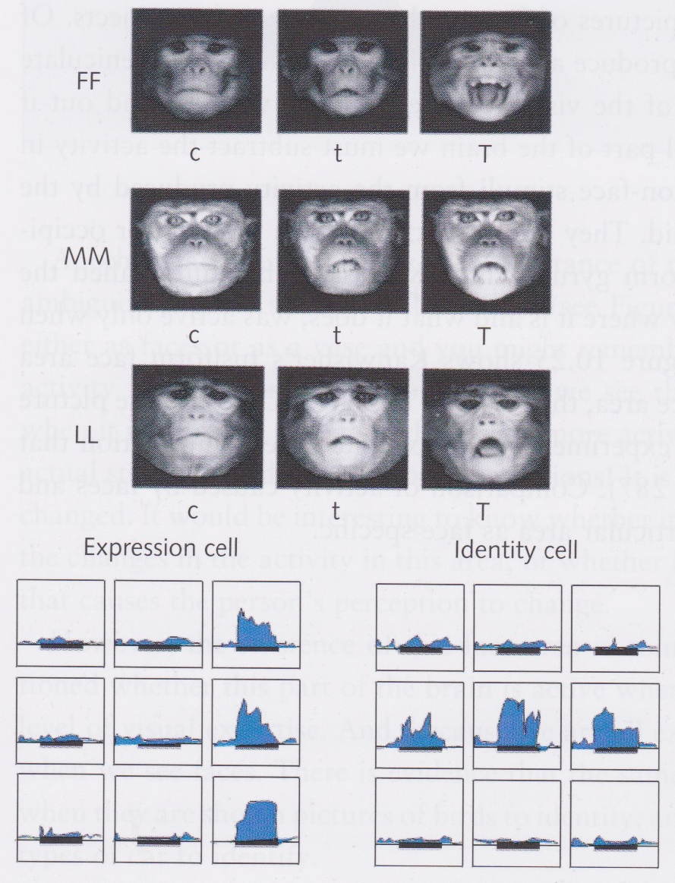
Hasselmo et al: identity and expression specific cells
There are identity-specific cells in the monkey’s temporal cortex that respond to the face of another monkey regardless of its orientation or expression
How can such cells achieve this specificity when fed only with information about edges, orientations, colours, etc.?

Slide 42
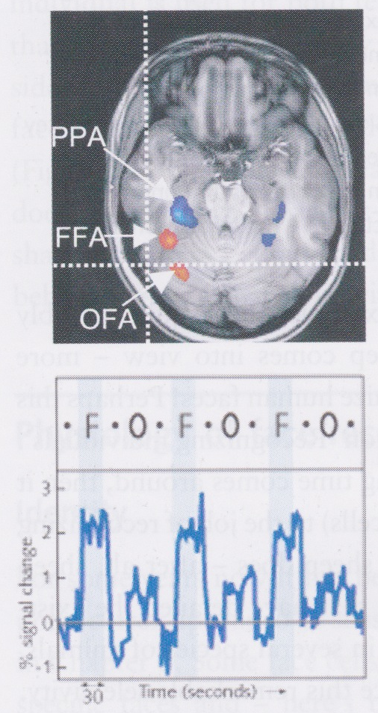
Face areas in humans
Kanwisher et al (1997) used fMRI to show that certain areas become active when viewing faces but not when viewing other objects
Fusiform face area (FFA) and, to a lesser extent, the occipital face area (OFA) seemed to be particularly involved in face perception
Only light up when face isn’t scrambled

Slide 43
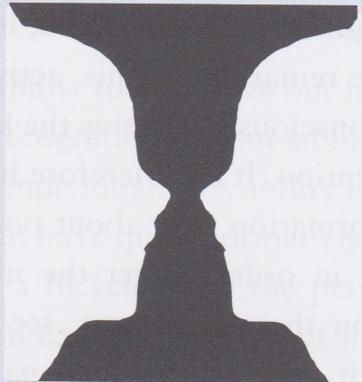
Rubin’s vase and face perception
Andrews et al (2002) showed that whether or not there is activity in the FFA when viewing Rubin’s vase depends on how the image is interpreted by the viewer

Slide 44
FFA might not be specific to faces
Some evidence that FFA involved whenever high-level identification is involved
Bird-watchers identifying birds
Car enthusiasts identifying cars

Slide 45
Brain areas involved in identifying emotion
Superior temporal sulcus (STS) implicated in emotion identification
Same area sensitive to direction of eye-gaze

Slide 46
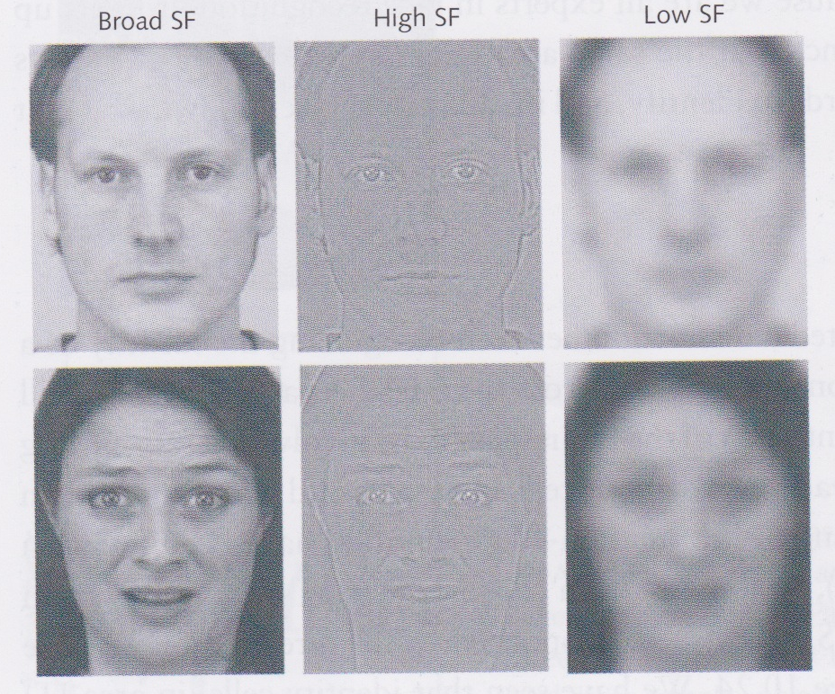
Amygdala
Amygdala (sub-cortical area) also activated by emotion – particularly fear
Even activated if subject is not aware of having seen the fearful face!
Only low-frequency stimuli that activate amygdala (cf. blindsight)

Slide 47
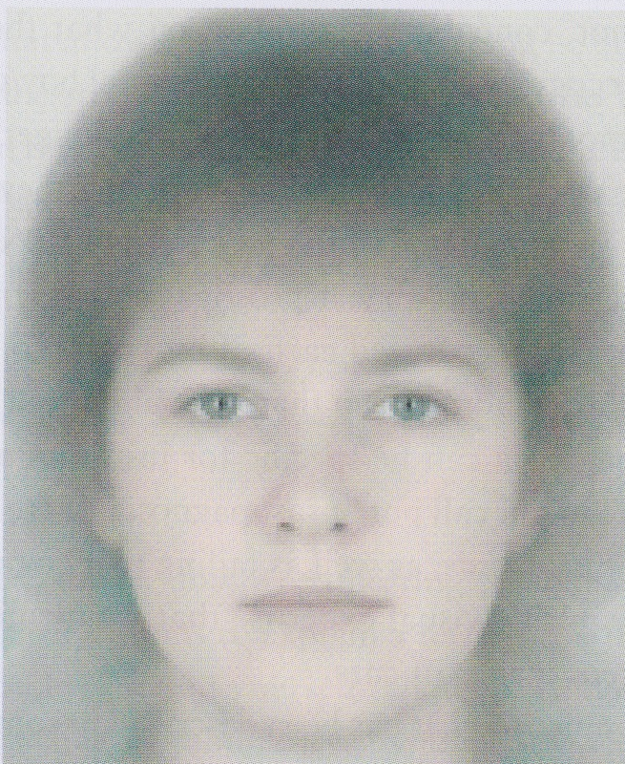
Beauty and average faces
When people asked to rate the attractiveness of faces, they often rate average faces as being the most attractive
When images of lots of faces are averaged, all the individual blemishes and imperfections get removed
However there is a lot of individual differences between people’s judgement of beauty when presented with real faces (as opposed to ones that have been artificially transformed or constructed)

Slide 48
Prosapagnosia
Prosapagnosia is the condition of being unable to recognize faces
Such patients can typically otherwise see as well as the rest of us
Similar visual acuity, contrast sensitivity, etc.
Can recognize people from non-facial cues
e.g., sound of voice, type of shoes or clothes, gait
Can even describe what a person looks like, but cannot identify someone from his or her face

Slide 49
Prosapagnosia
Some patients can recognize the emotion in a face but not the identity
Others can recognize the identity but not the emotion
This is a double dissociation: suggests that emotion and identity are coded separately in the brain
There was even a prosapagnosic farmer who didn’t recognize his family but could recognize each of his cows!
Suggests prosapagnosia may be specific to human faces
Remember FFA has been implicated in expert visual identification – some prosapagnosics cannot identify cars

Slide 50
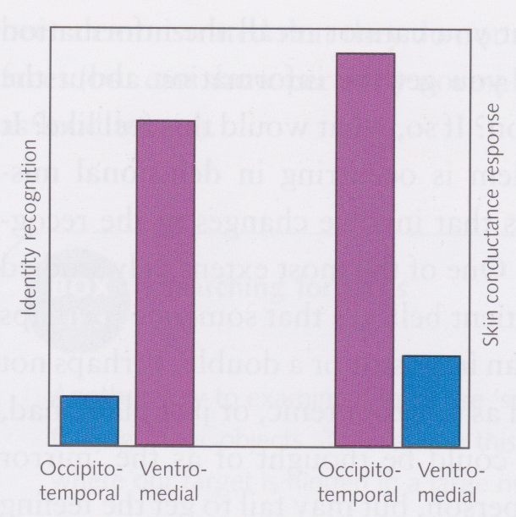
Prosapagnosia
Some prosapagnosics cannot name a face but their covert behaviour suggests that their brain differentiates between familiar and unfamiliar faces
Tranel and Damasio (1985) showed that skin-conductance was different when prosapagnosics presented with familiar faces than unfamiliar ones
Also showed that there were other patients who could identify faces but did not show covert behaviour indicating familiarity

Slide 51
Delusions
Capgras syndrome: feeling that someone you know has been replaced by a double or an impostor
can identify the person, but recognition is not accompanied by a sense of familiarity
Example of a delusional mis-identification syndrome
Ellis and Lewis (2001) noted that this is the mirror image of prosapagnosia

Slide 52
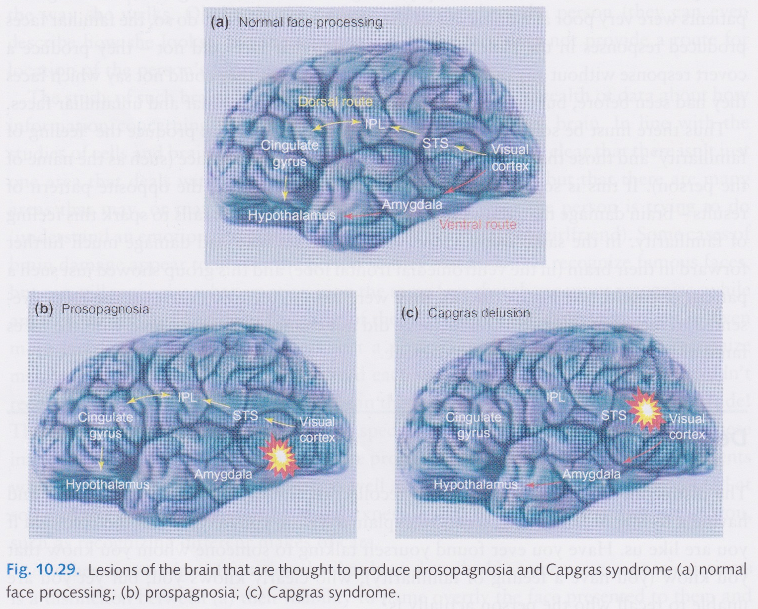
Lesions causing Capgras syndrome and prosapagnosia

Slide 53
Find the face

Slide 54
Find the animal face

Slide 55
Find the scrambled face

Slide 56
Finding faces
We can find a face among a field of distractors in approximately constant time (cf. parallel, pre-attentive search)
We are generally a bit slower at finding animal faces
We are no better at finding scrambled faces than we are at finding any other arbitrary object

