Slide 1
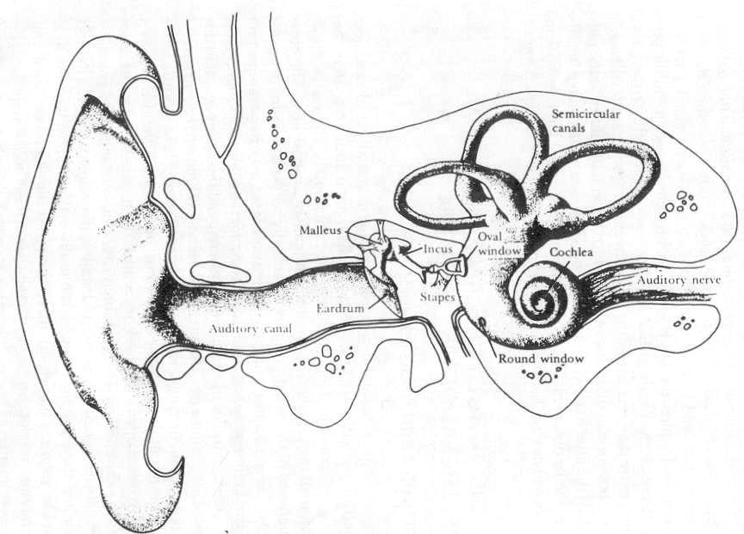
The peripheral auditory system
David Meredith
Aalborg University

Slide 2
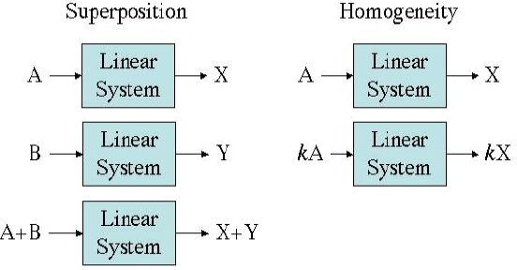
Linearity

Slide 3
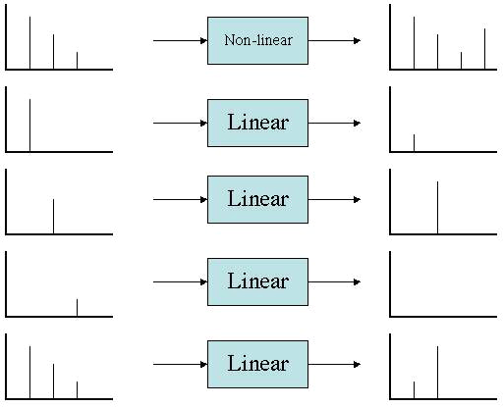
Linearity in acoustic systems

Slide 4
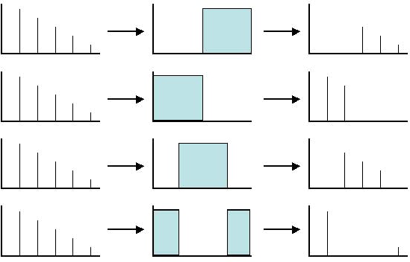
Filters

Slide 5
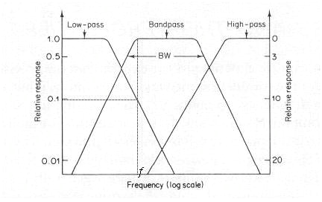
Real filters

Slide 6
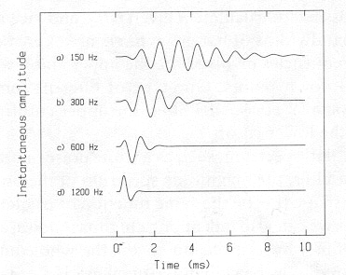
Impulse response
Pass a signal with a flat spectrum through a filter, then output will have same shape as filter characteristic
Click or impulse has a flat spectrum
Narrow band-pass filter has “ringing” response because output resembles a long-lasting sinuoid (which has a pure line spectrum)
Broader the bandwidth, the more the output resembles a click
Narrow bandwidth = good frequency resolution but poor time resolution
Broad bandwidth = good time resolution but poor frequency resolution
Ear has both good time resolution and good frequency resolution...

Slide 7
The peripheral auditory system
Divided into outer, middle and inner ear
Outer ear is pinna and auditory meatus
Pinna contributes to localization and amplification
Tympanic membrane separates middle ear from outer ear – sound travelling down auditory meatus causes tympanic membrane to vibrate

Slide 8
The middle and inner ear
Middle ear consists of auditory ossicles
malleus, incus, stapes - smallest bones in body
Tympanic membrane connected to auditory ossicles
Stapes in contact with the oval window which separates middle ear from inner ear
Inner ear consists of cochlea
spiral-shaped, fluid-filled structure that contains the basilar membrane

Slide 9
The function of the middle ear
Middle ear acts as an impedance matching device that allows more sound to be transmitted to the cochlea
If sound impinged directly on oval window, them most would be reflected because of high acoustic impedance of cochlear fluids and oval window
Oval window is 1/25 area of tympanum – suggests that pressure on oval window is 25 times that on tympanum (i.e., 625 times the intensity)
But ossicles amplify sound by 2: so amplitude multiplied by 50 times – implies 2500 times intensity or 30dB increase!

Slide 10
Middle ear reflex
Loud sounds below 1000Hz trigger middle ear reflex: stapes drawn a little away from oval window
Protects inner ear from sudden loud noises
Takes about 1/10s, so cannot protect against very loud, very sudden noises
Also reduces audibility of one’s own speech

Slide 11
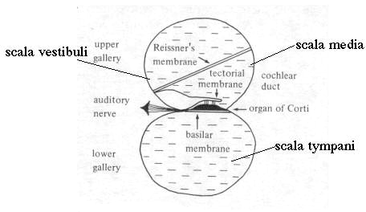
Inner ear
Sound enters inner ear (cochlea) through oval window
Cochlea is spiral, fluid-filled cavity

Slide 12
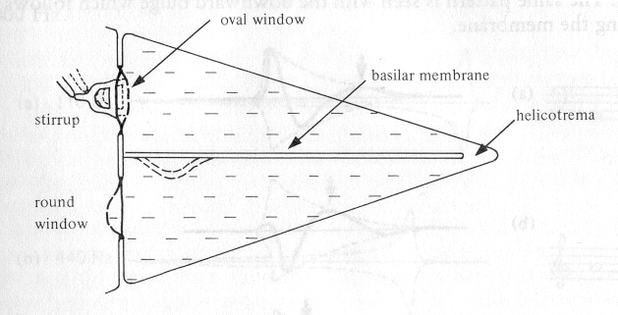
Cochlea
End near oval window called basal end, other end called apical end
Basal end responds to high frequencies, apical end responds to low frequencies

Slide 13
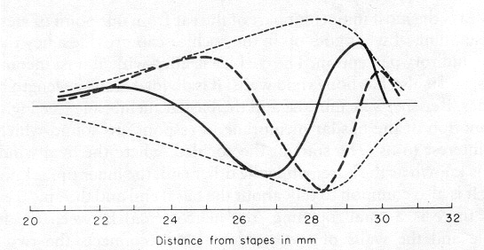
Basilar membrane
Flick a string, then a wave travels along it from the flicked end
Same on basilar membrane
Stiffness of BM decreases as move away from basal end (oval window)
Displacement increases until get to point on BM tuned to frequency of input, then decreases rapidly
Figure shows BM at two instants in time when disturbed by a 200Hz sine wave
Wave disturbance describes an amplitude envelope

Slide 14
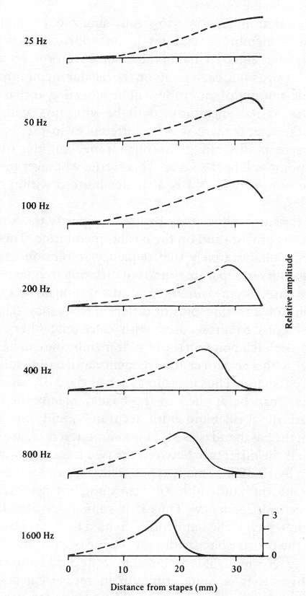
Basilar membrane
von Bekesy (1960) photographed BM in cadavers when responding to high amplitude simple tones of different frequencies
Disturbance dissipates soon after point of maximum response on BM
BM performs crude Fourier analysis on incoming sound

Slide 15
Frequency resolution on BM
Each point on the BM behaves like a bandpass filter
3dB down bandwidth hard to measure on BM, so measure 10dB down bandwidth instead
Ratio of bandwidth to centre frequency (relative bandwidth) approximately constant along BM
Reciprocal of rel. bandwidth is called Q which is measure of sharpness of tuning

Slide 16
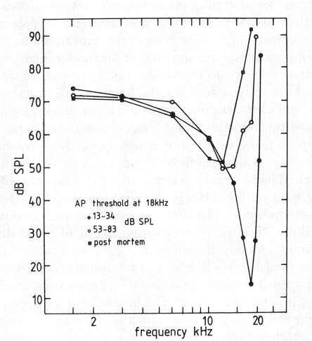
Frequency resolution on BM
Bekesy measured response of BM to very loud sinusoids (140dB) at low frequencies in recently deceased humans using stroboscopic illumination
Bekesy found a relative bandwidth of 0.6
e.g., 600 Hz 10dB bandwidth when CF is 1000 Hz
Too high to account for sharp frequency resolution of ear and auditory neurons!

Slide 17
Frequency resolution on BM
Actual resolution better because
BM is non-linear: response to quiet sounds not predictable by response to very loud ones
Response is physiologically vulnerable: tuning gets less sharp after death - tuning in living animals much sharper than in dead ones
Response influenced by active processes
efferent signals from the cortex

Slide 18
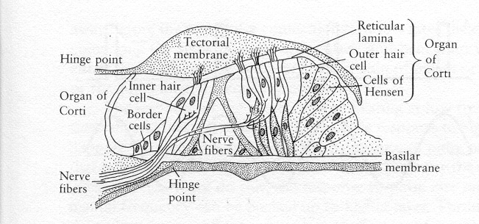
Transduction process and the hair cells
Tectorial membrane just above BM is gelatinous structure
Hair cells between tectorial membrane and BM
Organ of Corti = hair cells + tectorial membrane
25000 outer hair cells in 5 rows in humans, each with about 140 hairs
3500 inner hair cells in 1 row, each with about 40 hairs

Slide 19
Transduction process and hair cells
Tectorial membrane (TM) is hinged so that when BM moves, TM slides over it, bending hair cells
Inner hair cells fire and send signals to the brain
Most afferent neurons connected to the inner hair cells
each hair cell has about 20 neurons connected to it
1800 efferent neurons connected mostly to outer hair cells
length and shape of outer hair cells can be changed by signals from the brain
If outer hair cells affected by drugs, sensitivity reduced

