Slide 1
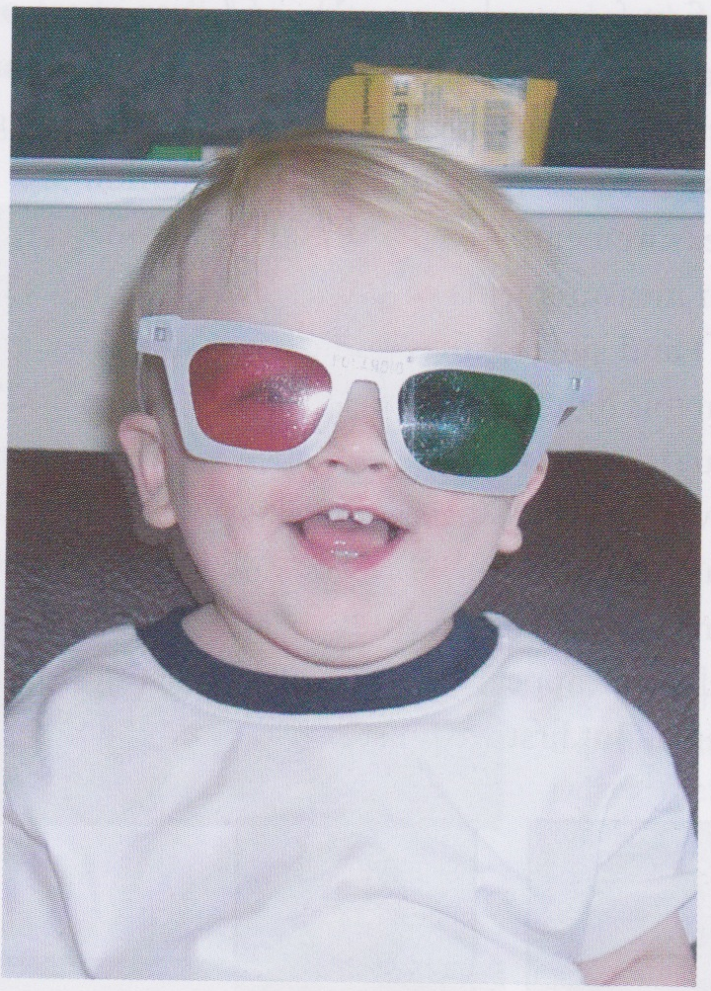
The Development of Vision
David Meredith
Aalborg University

Slide 2
Source
This lecture is based on Chapter 8 of
Snowden, R., Thompson, P. & Troscianko, T. (2006). Basic Vision: An Introduction to Visual Perception. OUP. (ISBN: 978-0199286706)

Slide 3
The development of vision
Child wearing red/green glasses to test his stereo vision
Child must have good visual input during early life if he is to develop normal adult vision

Slide 4
Overview
William James described the baby’s world as a “booming, buzzing confusion” – it is certainly a bit blurry
What can a baby see?
Can it tell the difference between its mother and the next-door neighbour?
Can it see the colours, movements and shapes that we see as adults?
How do we find out what a baby sees?
Child needs good visual input in the early years if it is to develop normal adult vision later in life

Slide 5
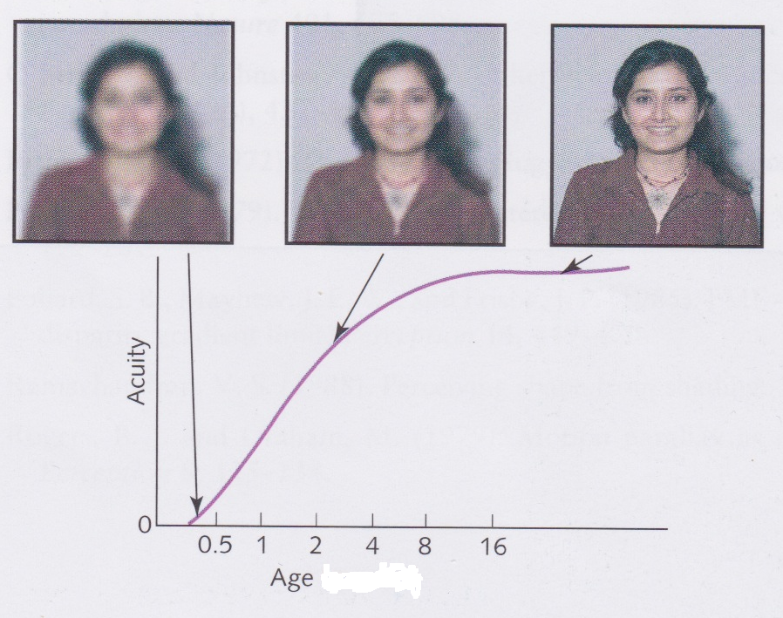
Introduction
Vision gradually develops over the early months and years until adult levels are achieved during the teenage years
Very young child lacks visual acuity and so cannot see fine detail
This does not mean that it “looks blurry” to the child
adults lack acuity in the periphery, but the image doesn’t “look blurry”

Slide 6
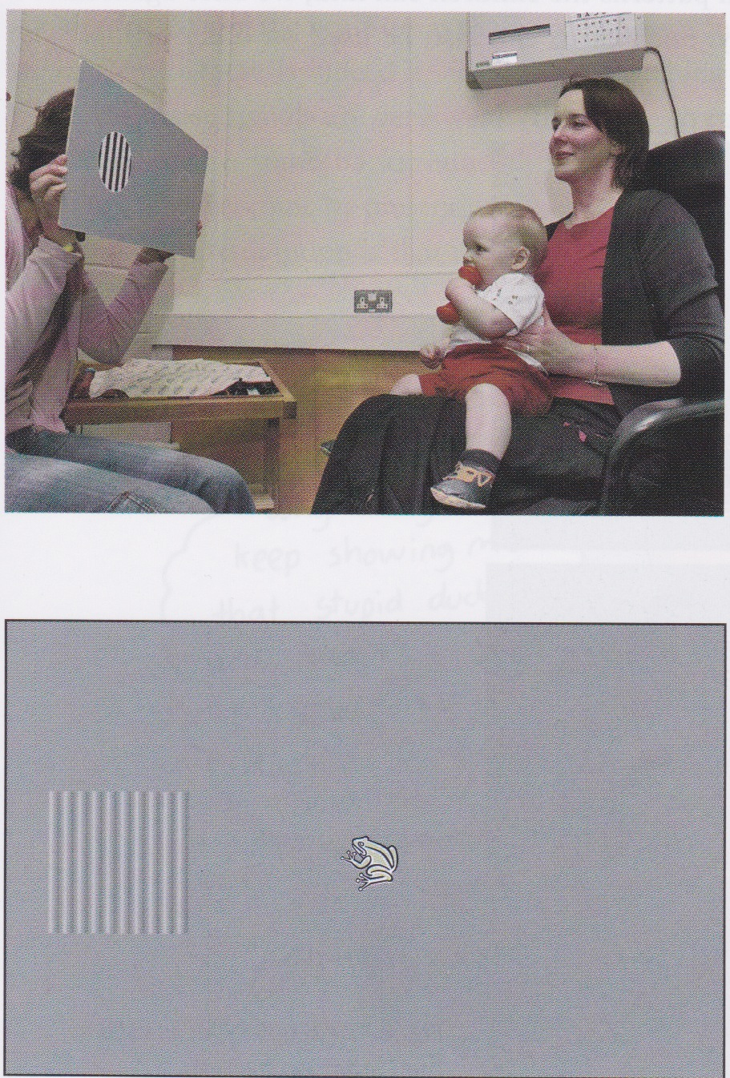
Measuring a baby’s vision
Preferential looking:
baby shown card with grating on one side and something interesting on the other
baby’s attention drawn to the interesting object
if the baby can see the grating, then it will look at it
make the stripes thinner until the baby stops looking at the grating – this is the limit of spatial acuity
can change contrast to get measure of contrast sensitivity

Slide 7
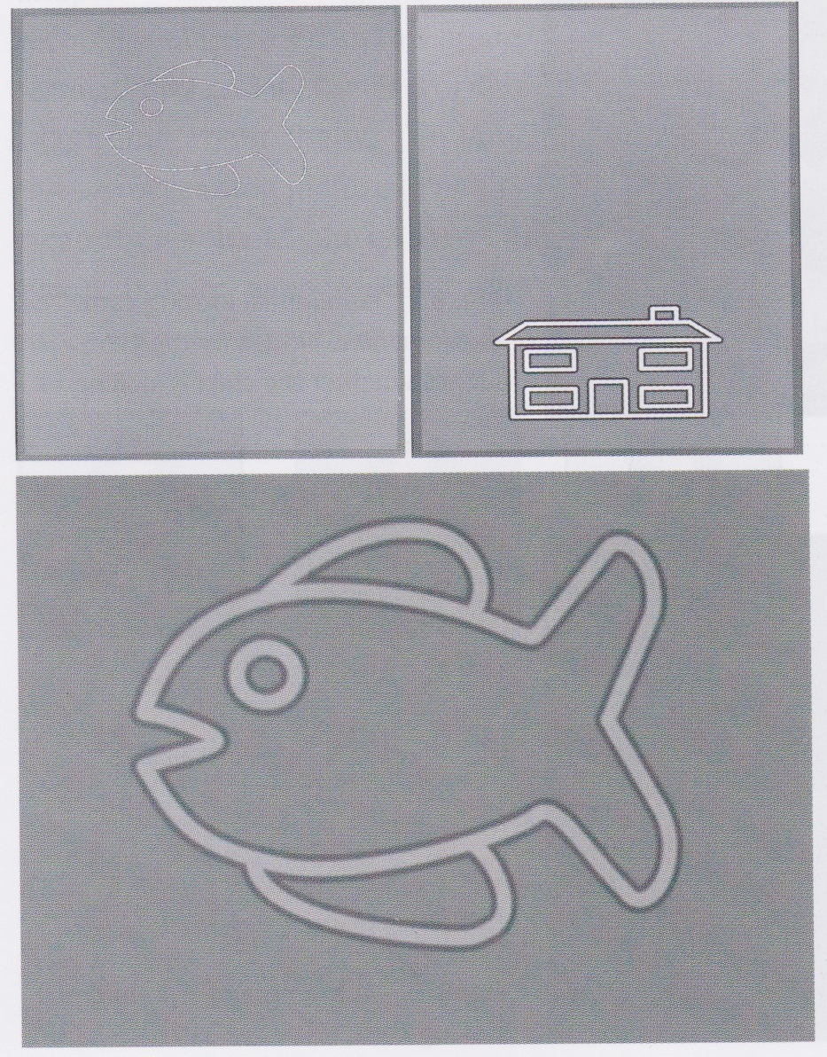
Optotype cards
At about 1 year old, babies lose their interest in gratings
An optotype card, as used in the Cardiff Acuity Test, has a special figure drawn on it which can only be seen if the viewer has sufficient acuity
Each figure is drawn with a white line with a black line on each side of it
amounts of black and white are balanced so that when blurred they look the same grey as the background

Slide 8
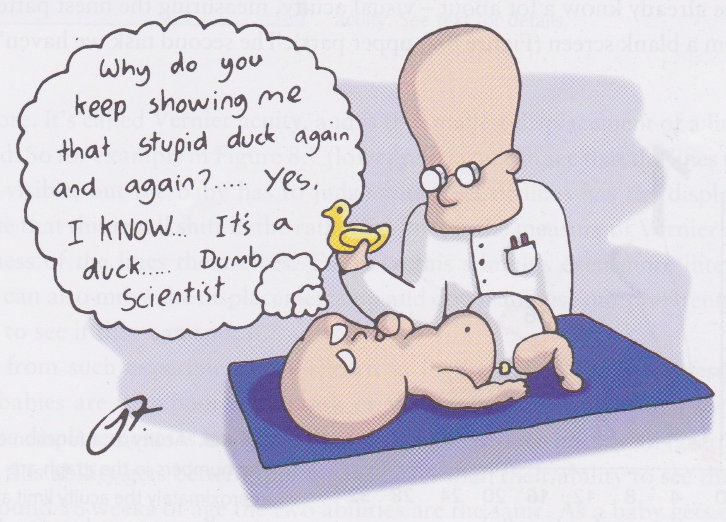
Boredom and thumb-sucking
Babies get bored and like to suck their thumbs
If you draw their attention by showing them a new image, they stop sucking their thumbs
Then they start again when they get bored
You can tell if the baby has seen a change in the image by whether it stops sucking its thumb

Slide 9
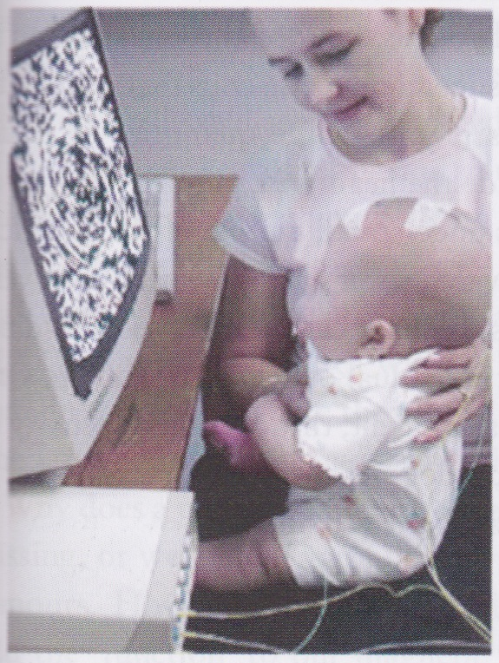
Visually evoked potentials
Techniques described already rely on the behaviour of the baby in the experiment
Can also measure brain activity directly using visually evoked potentials (VEPs)
Place electrodes on scalp (not into brain!)
Poor spatial resolutions since measures response of whole area of brain near the electrode
Good temporal resolution

Slide 10
Visually evoked potentials
Signal due to brain activity in response to stimulus is weak compared with random noise from other electrical activity in the brain
So stimulus presented many times (ca. 100) and an average response is computed
this increases the signal-to-noise ratio

Slide 11
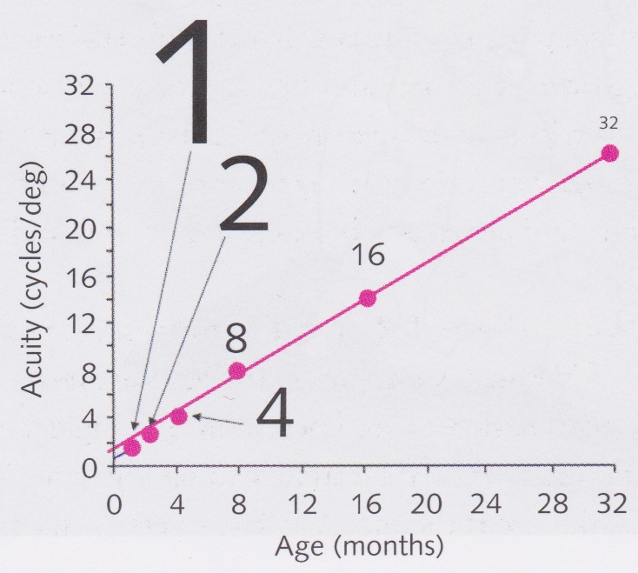
Spatial vision – acuity limit
Baby’s vision is fairly blurred, so can only make out fairly large objects
Acuity increases over the first two years or so as shown at left
Approximately smallest letters that can be made out at each age at normal reading distance

Slide 12
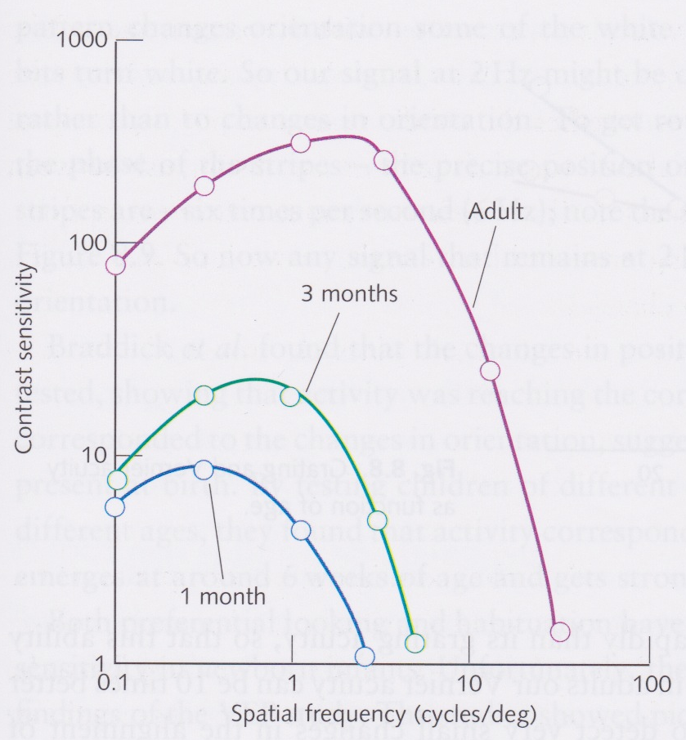
Contrast sensitivity
Graphs on left show how contrast sensitivity develops in babies
Note that 3 month old babies require more than 10 times as much contrast as adults in order to be able to see medium and low spatial frequencies
Adult levels of sensitivity only achieved by about 8 years old
Other animals achieve adult levels of acuity much earlier
e.g., monkeys have it by 1 year old

Slide 13
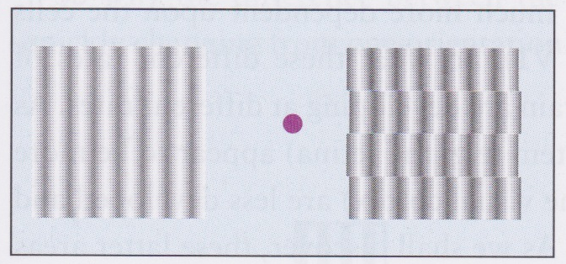
Vernier acuity
Introduce small shifts in the lines of a grid as shown above right
Can move these shifts up and down
If the baby preferentially looks at the grid with the shifts, then indicates that it can see the shifts moving

Slide 14
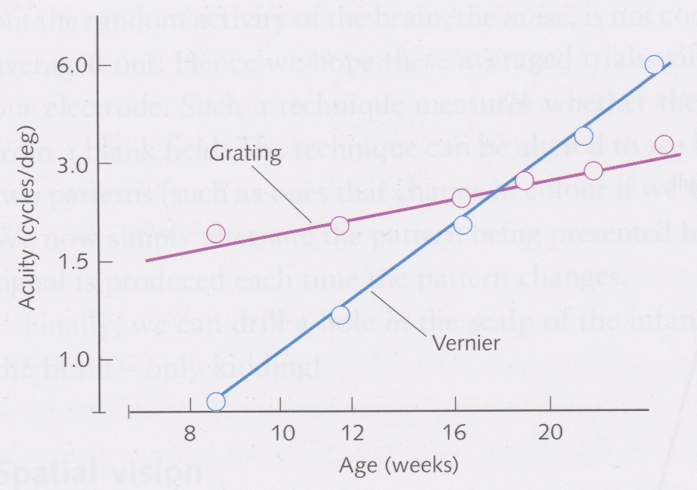
Vernier acuity
Newborns have very poor Vernier acuity
Threshold for Vernier acuity much worse than for normal grating acuity
But ability increases much quicker than for grating acuity so that two types of acuity are about equal at around 4 months old
Vernier acuity continues to improve faster than grating acuity
In adults, Vernier acuity can be 10 times better than grating acuity, allowing us to detect very small changes in alignment

Slide 15
Vernier and grating acuity
Why does Vernier acuity develop later and improve faster than grating acuity?
Grating acuity depends on the eye and the retina
Vernier acuity depends on the cells in V1
The eye and the early parts of the visual system are more developed at birth than the more central parts (e.g., V1)
V1 develops more than the eye over the early years of life

Slide 16
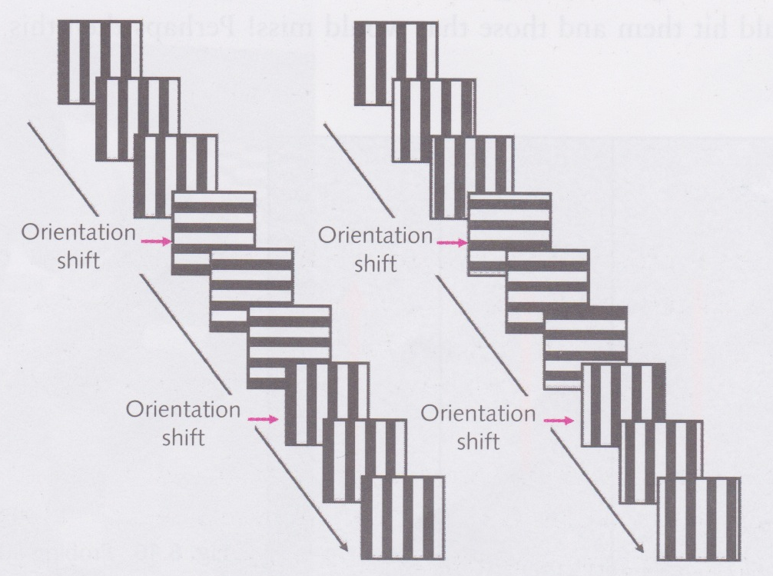
Feature detection
Braddick et al. (1986) used VEPs to explore whether a baby’s V1 has cells that are orientation-selective
Used pattern that changes orientation with a particular frequency (2Hz) and then recorded activity in cortex to see if there were any signals with the same frequency

Slide 17
Feature detection
But if only change orientation, 2 Hz recorded signal could just be due to changes in dark and bright areas
So changed orientation with 2 Hz frequency and phase with 6 Hz frequency (as in RH figure)
More likely that a 2 Hz signal will now come from orientation

Slide 18
Feature detection
Changes in position caused corresponding signal in youngest babies, but changes in orientation did not
Sensitivity in orientation begins after about 6 weeks and gets steadily better over the following weeks

Slide 19
Feature detection
Preferential looking and habituation also used to explore orientation sensitivity in infants
Present with one grating and then a new pair of gratings, one with the same orientation as the first and one with a different orientation
Infants tends to look at new grating, not old one
So must be able to tell the difference
But only when stimuli aren’t moving
Hence different results with VEP

Slide 20
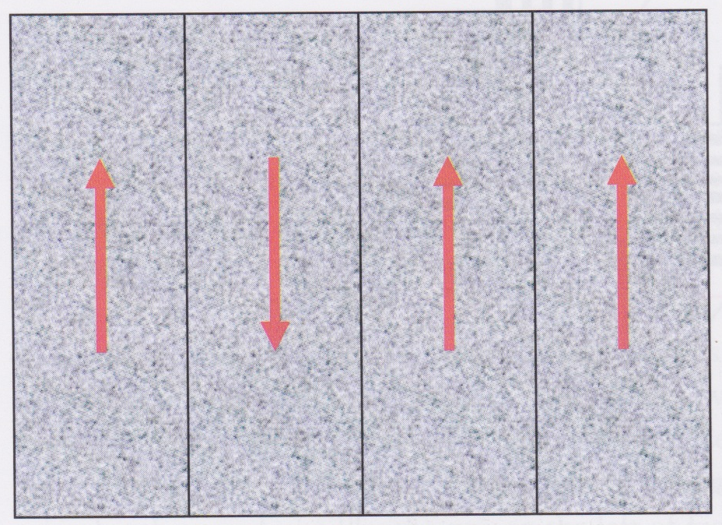
Motion perception
Can use VEP or preferential looking to explore motion perception in babies
In test at left, dots in 3 of the 4 sections are moving up and 1 moving down (black lines and red arrows not present in test)
If baby is interested in odd-man-out section, then indicates difference in motion direction can be seen
First able to spot medium motion after about 12 weeks, slow and fast motion sensitivity follow
Could explain why failed to find orientation specificity when using dynamic stimuli

Slide 21
Motion perception: Looming stimuli
Experimenters appear to swing a large concrete slab at the baby
Measure alarm induced
Babies capable of distinguishing between slabs that would hit them and slabs that would miss
Suggests born with ability to recognize an impending collision

Slide 22
Colour
Babies can see in colour but hard to say whether they see colours the same way that we do
Can discriminate red from green from an early age
Discrimination of blue poor before 1 month, but improves rapidly by 2 months

Slide 23
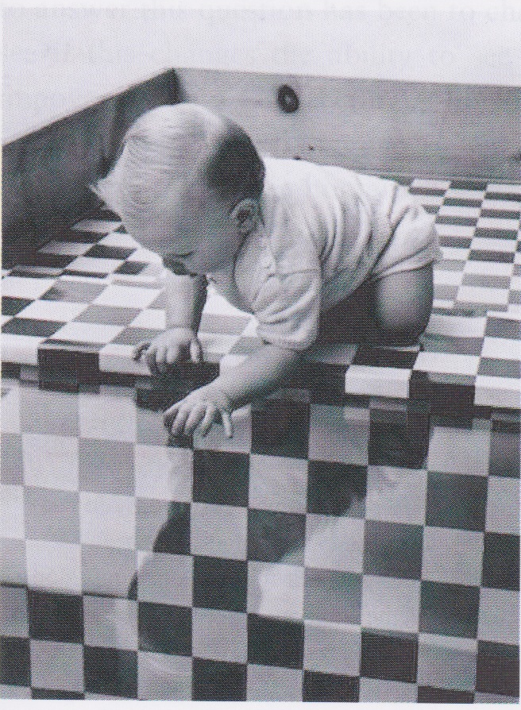
Depth perception and stereopsis
Dangle a baby over a balcony and see if it gets distressed
Just kidding
Use Gibson’s (1960) “visual cliff”
Infant placed on glass sheet that is either over a patterned surface or over a void
Infants prefer patterned surface
Shows sensitivity to depth, but not necessarily stereopsis

Slide 24
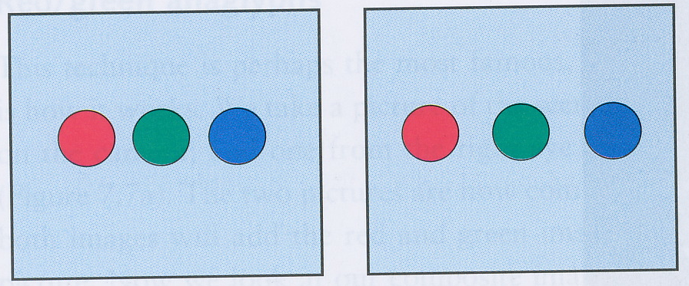
Stereopsis
Can use preferential looking at stereograms to test if babies have stereopsis
If baby prefers to look at protruding area of stereogram, then indicates it has stereopsis
Cannot do this at birth but develop ability at around 4-6 months

Slide 25
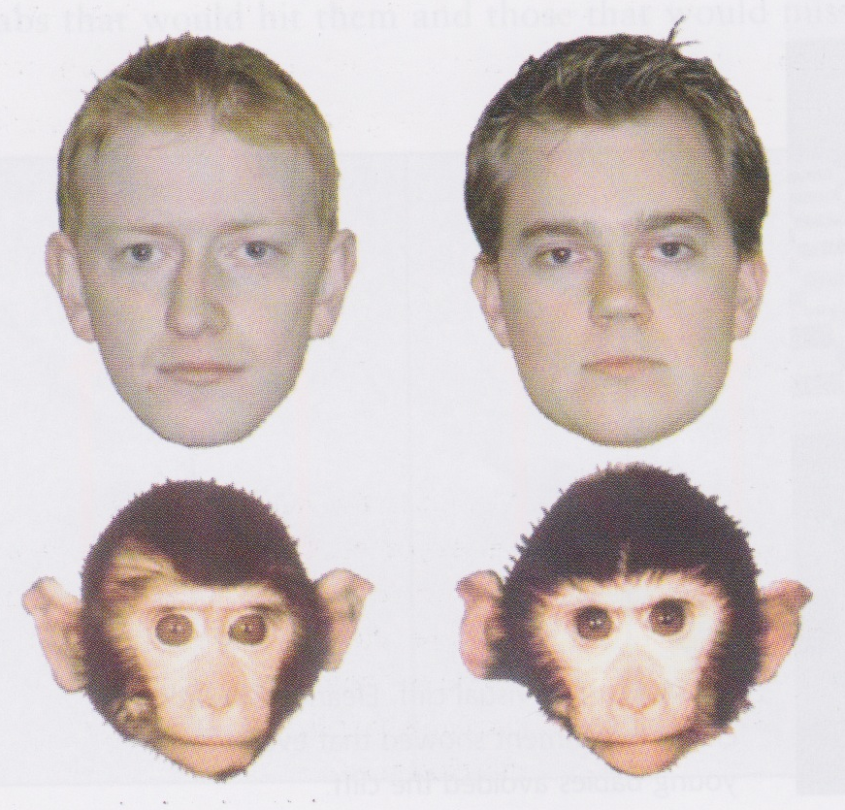
Development of face perception
Adults find it easy to tell the difference between the human faces
Adults find it hard to distinguish between the two monkeys, but babies (less than 10 months’ old) find it easy!

Slide 26
Development of face perception
By the team they reach 10 months’ old, babies also find it hard to tell the difference between the monkeys
Can explore this with habituation and preferential looking:
Show one monkey until the baby gets bored
Then show both monkeys – if the baby prefers the new one, then indicates he or she can tell the difference

Slide 27
Perceptual narrowing
Example of perceptual narrowing
start life able to distinguish between many different stimuli
but soon learn to categorise certain stimuli together and then lose ability to distinguish between them
lose ability to distinguish stimuli that we are not exposed to
happens also with vowel sounds (Trehub)
Retain ability to distinguish between human faces, but not monkey faces

Slide 28
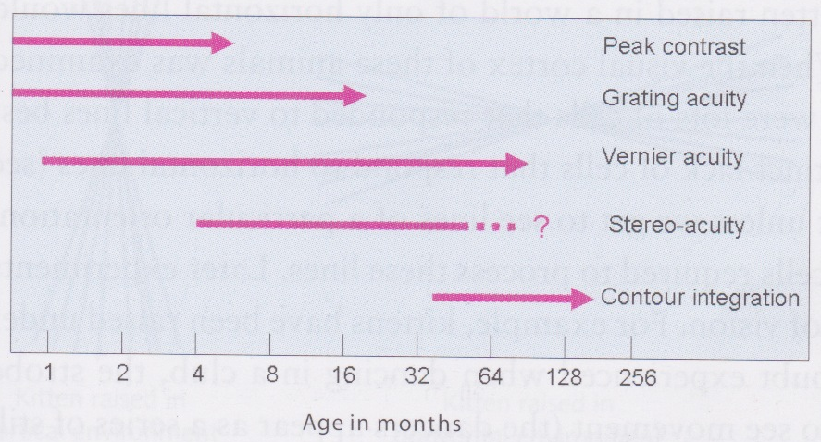
Movshon’s law
“Things start out badly, then they get better; then, after a long time, they get worse again.”
Baby starts with poor vision in some respects, this then this improves over a long period
Some abilities develop quickly (e.g., peak contrast), others develop slowly (e.g., contour integration)

Slide 29
Selective rearing experiments
Used to find out what effect environment has on the development of vision
Kitten raised with one eye closed during early life sees normally with open eye and is almost blind in the closed eye
Almost no cortical cells driven by closed eye
So must have vision in an eye if it is to develop properly

Slide 30
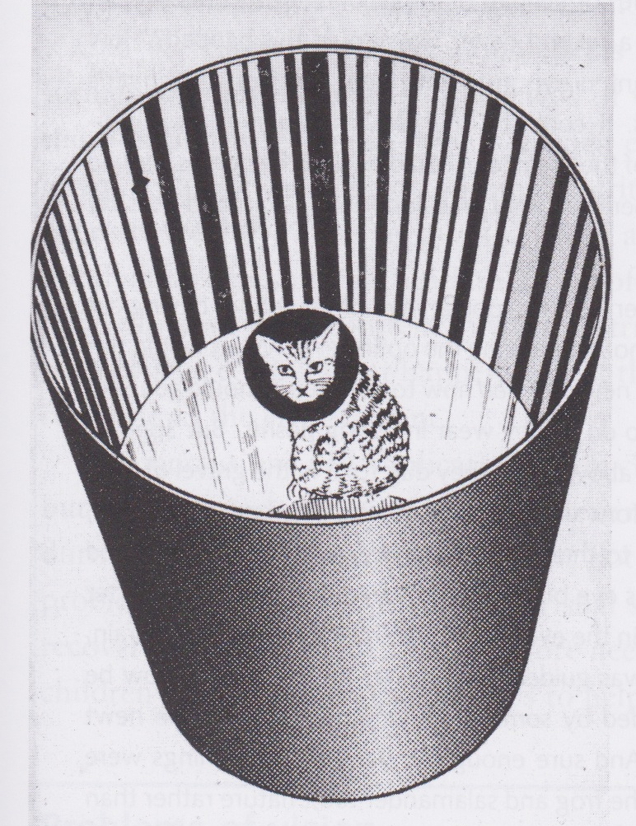
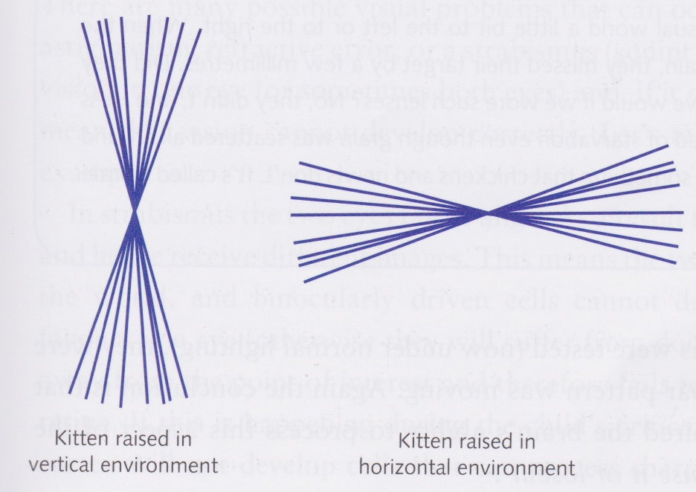
Environmental surgery
Remove something from environment rather than from brain
Blakemore and Cooper (1969) raised cats in a world of vertical lines
Adult cats could only detect lines that were close to vertical
Lots of cortical cells that responded to vertical lines, but almost none that responded to horizontal lines

Slide 31
Selective rearing
If a kitten is raised in strobe lighting, then fails to develop ability to see direction of movement
“Use or it lose it”
Critical period is period during which deprivation of a particular aspect of vision causes permanent failure to develop that aspect of vision
critical period for a particular aspect depends on aspect since different visual abilities develop at different rates and times
After critical period is over, deprivation does not permanently stunt development

Slide 32
Reversing effects of deprivation
If rear a kitten with one eye closed; then rear same kitten with other eye closed during critical period, then develops vision in both eyes, but not stereopsis (which requires both eyes to be open simultaneously)
Problems in vision in young children therefore need to be corrected within the critical period if the child is to develop normal adult vision

Slide 33
Problems of vision
Various problems can occur during the development of vision
e.g., astigmatism, refractive error, strabismus

Slide 34
Strabismus – “Lazy eye”
Strabismus: two eyes fail to align
Two eyes see very different parts of the visual field and so binocularly driven cells don’t develop normally
If child favours one eye, other drifts from point of interest and doesn’t get a sharp image – no cortical cells develop that can process sharp images from the lazy eye
Misalignment can be corrected with surgery to adjust muscles controlling eyes – but must be done during critical period
If fail to develop sharp images in both eyes, then condition called amblyopia (“blunted vision”) arises
Amblyopia is failure to see high spatial frequencies – fewer cortical cells tuned to these frequencies

Slide 35
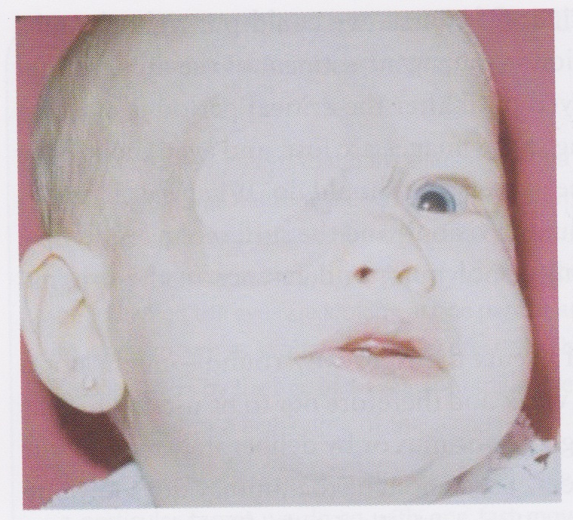
Putting things right
To fix strabismus can place patch over lazy eye during critical period
Causes lazy eye to work harder, which lets it develop better
Child should usually wear patch for 2 hours per day
Can have beneficial effect up to 6 years’ old, but sooner it is done, the better
Can cause stereopsis to fail to develop because eyes are not used together enough

Slide 36
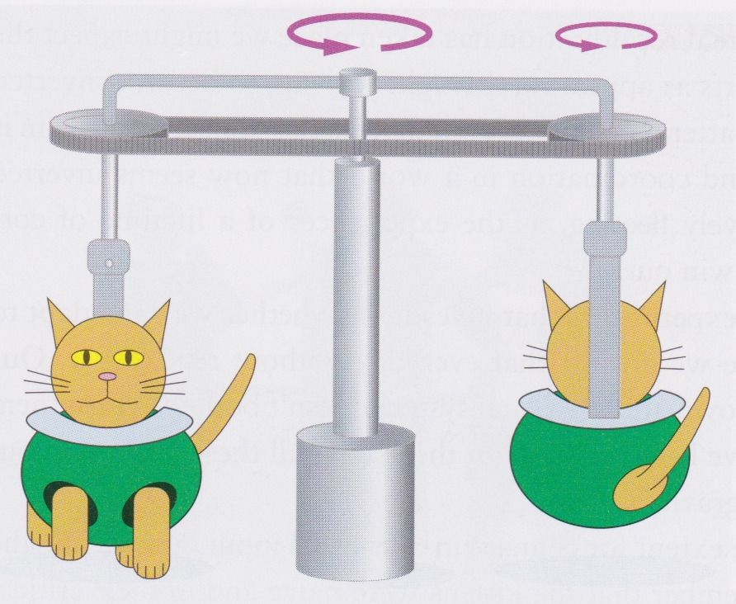
Active vs. passive vision
Need good quality input during the critical period if good adult vision is to develop
Experiments have shown that, in addition, one must interact with the world in order to develop good vision
“Kitten carousel” (Held and Hein, 1963)
Two kittens with no previous visual experiences
Then one allowed to explore freely while other dragged around in a gondola by the first
Active kitten developed much better depth perception than the one that had only had passive experience

Slide 37
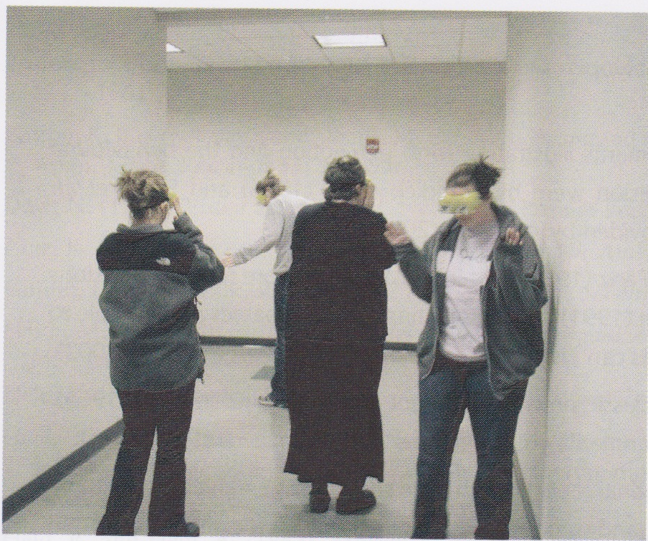
Stratton (1897) and Kohler (1962)
Got participants to wear inverting goggles
When arm moved up, they saw it move down
no correspondence with proprioception
After a few days, adapted to new inverted world
Stratton even rode a motorcycle through Innsbruck with the goggles on!

Slide 38
Compensation or re-calibration?
When they take the inverting goggles off after adapting to them, what happens?
World appears inverted again! Though effects are shorter than when goggles are put on – presumably because of a previous lifetime of being used to that way of seeing things
Of course, retinal image is actually upside down normally, brain inverts retinal image all the time

Slide 39
The student carousel
Held and Bossom (1961) did an experiment a bit like the kitten carousel but on students
Participants wore distorting prisms that shifted vision sideways about 10 degrees
Went on a tour in pairs to adapt to prisms: one member of each pair pushed the other one in a wheel chair
So one wheel chair only received passive stimulation
Pusher became good at operating with prisms, pushee didn’t
When lenses removed, pusher took longer to adapt back to normal vision

