Slide 1
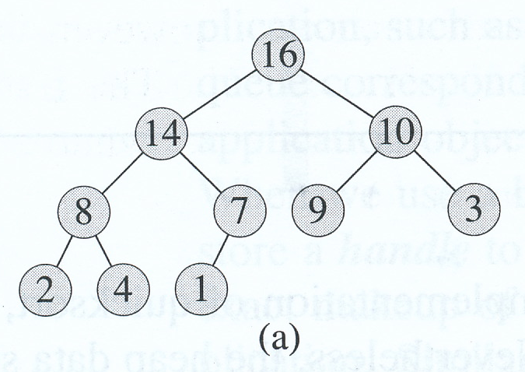
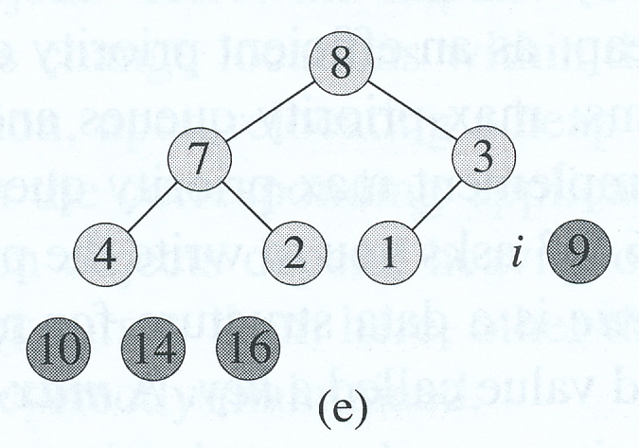
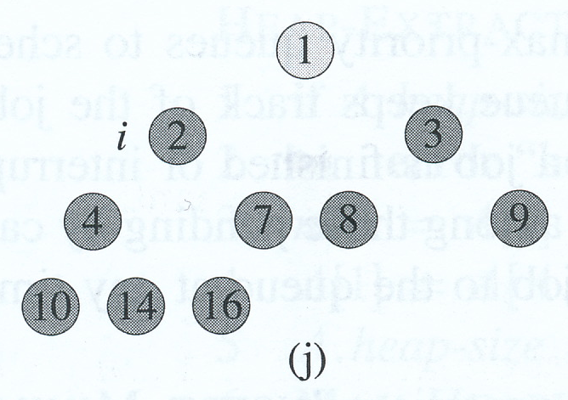
Heaps, Heapsort and Priority Queues
David Meredith
dave@create.aau.dk

Slide 2
Source
Chapter 6 of
Cormen, T. H., Leiserson, C. E., Rivest, R. L. and Stein, C. (2009). Introduction to Algorithms. (Third edition). MIT Press, Cambridge, MA.

Slide 3
Introduction
Heapsort, like Merge Sort has a running time of O(n lg n)
But Heapsort sorts in place
only a constant number of array elements are stored outside the array at any one time
Heapsort uses a data structure called a heap
Heaps are useful in other algorithms too
Heaps can be used to make a priority queue
NB: A heap data-structure is not the same as what is referred to as “the heap” in Java or Lisp, which is the area in memory that is garbage-collected

Slide 4
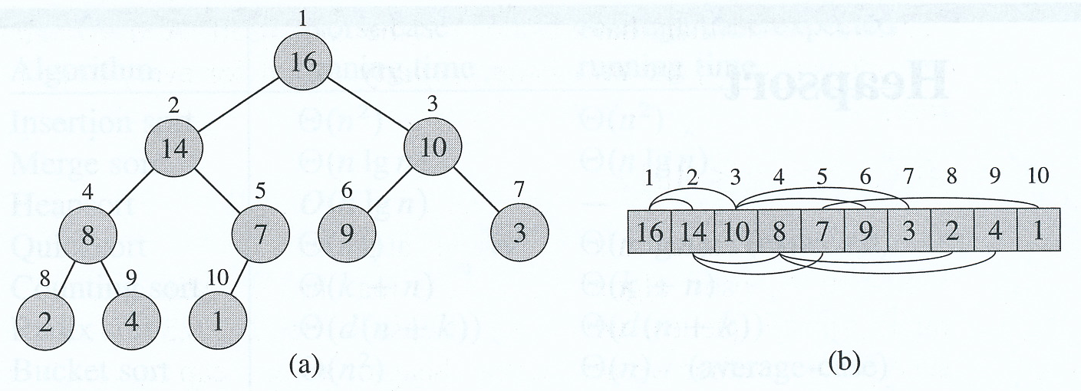
Heaps
A (binary) heap is an array (b) that can be viewed as a nearly complete binary tree (a)
Tree is filled on all levels except leaf level which is filled from left up to a certain point

Slide 5
Heaps
If A is a heap, then
A.length is the length of the array
A.heap-size is the number of elements stored in the heap
A.heap-size can be at most A.length but may be less

Slide 6
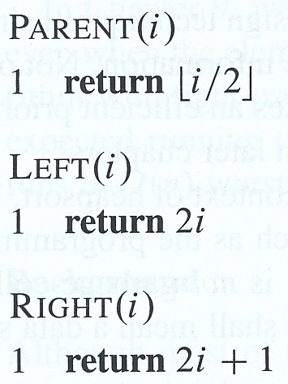
Heaps
Parent can be implemented by shifting binary representation of i one bit to the right
Left can be implemented by shifting binary representation of i one bit to the left
Right can be implemented by shifting binary representation of i one bit to the left and then adding 1 as the low-order bit

Slide 7
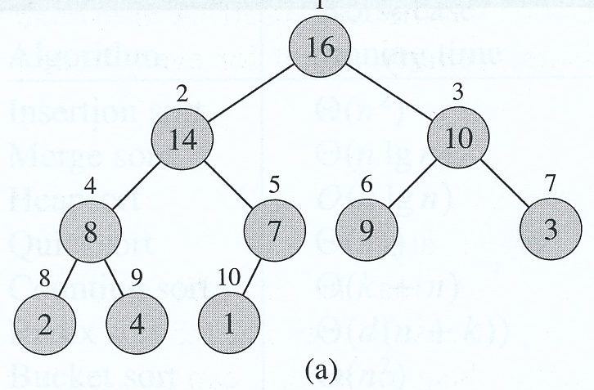
Max-heaps and min-heaps
Two kinds of binary heap:
max-heap satisfies the max-heap property: Every node is less than or equal to its parent A[Parent(i) ≥ A[i]]
min-heap satisfies the min-heap property: Every node is greater than or equal to its parent A[Parent(i) ≤ A[i]]

Slide 8
Height
Height of a node in a heap is the number of edges in the longest simple downward path from the node to a leaf
e.g., height of node 2 is 2, height of node 1 is 3
Height of a heap is height of its root
Basic operations on heaps take O (lg n) time since they are proportional to the height of the tree

Slide 9
Procedures on heaps
Max-Heapify
maintains max-heap property
O(lg n) time
Build-Max-Heap
produced max-heap from unordered input array
O(n) time
Heapsort
sorts an array in place
O(n lg n) time
Max-Heap-Insert, Heap-Extract-Max, Heap-Increase-Key, Heap-Maximum
allows heap to implement a priority queue
O(lg n) time

Slide 10
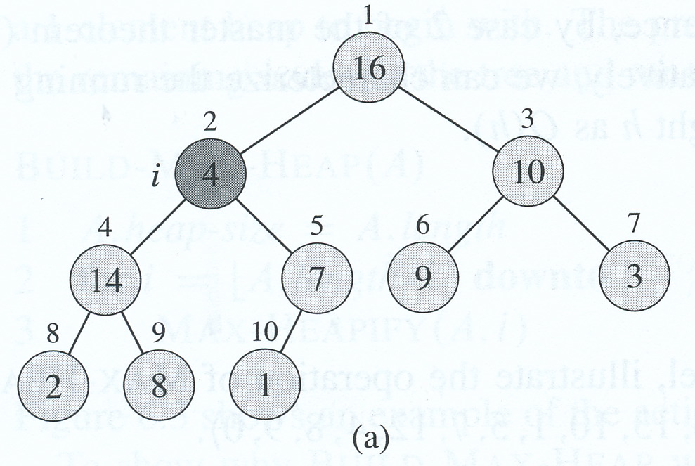
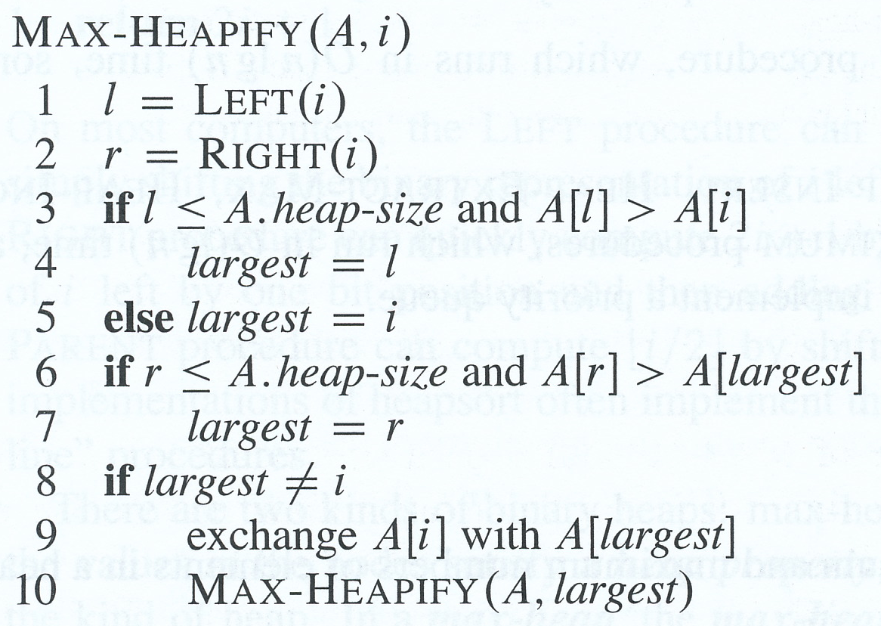
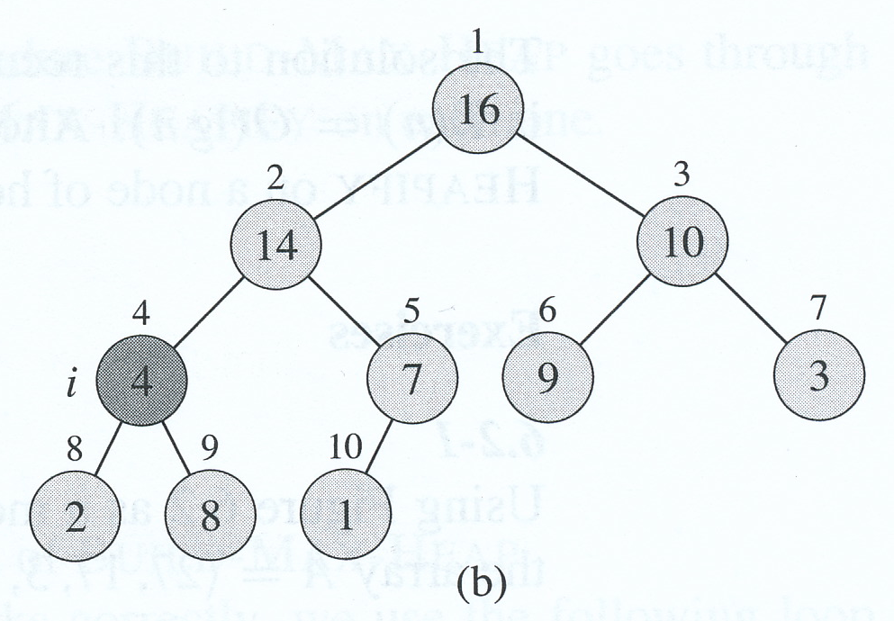
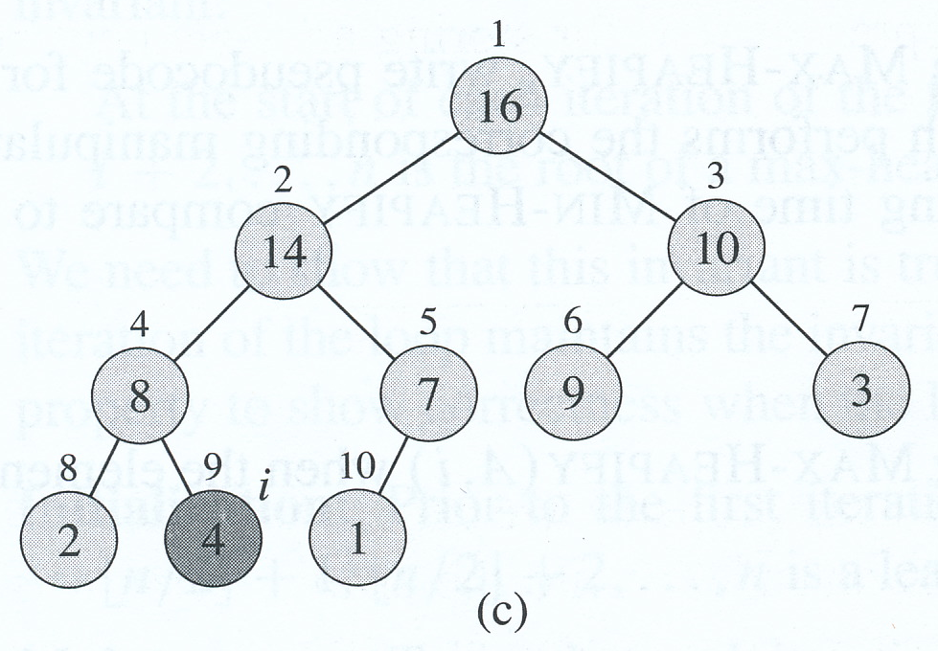
Max-Heapify

Slide 11
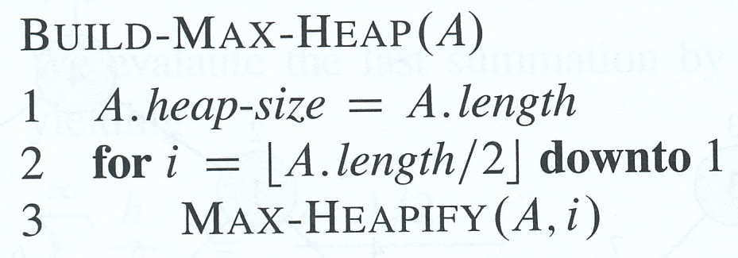
Building a heap
Every leaf is already a 1-element heap
Remember a heap is an array (see above)
Build-Max-Heap goes through remaining nodes and runs Max-Heapify on each one

Slide 12
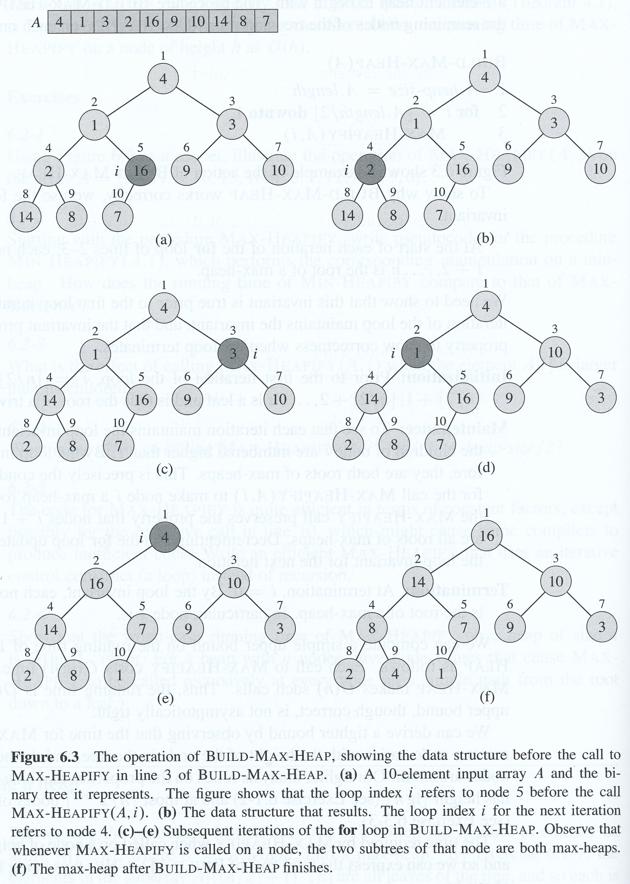
Building a heap
Loop invariant: At the start of each iteration, nodes i+1, i+2,... are all roots of max-heaps
Initialization: At the start, i = floor(n/2), so i+1, i+2, ... are all roots of max-heaps
Maintenance: Children of i have higher indices than i, therefore they are max-heaps. So Max-Heapify(A,i) makes i a max-heap
Termination: i = 0, so 1, 2,...n all roots of max-heaps

Slide 13
Running time of Build-Max-Heap
Each call to Max-Heapify costs O (lg n) time
Build-Max-Heap makes O(n) such calls
So running time is O(n lg n)
But this isn’t asymptotically tight!

Slide 14
A tighter bound on running time of Build-Max-Heap

Slide 15
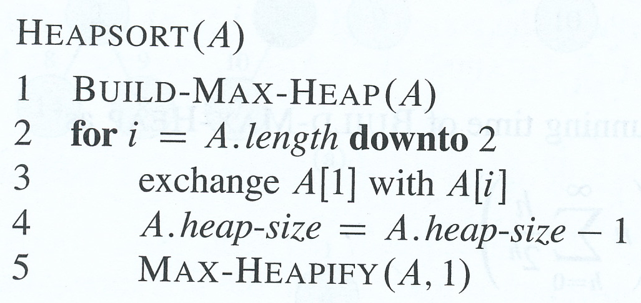
Heapsort
Takes an input array, A[1..n], and runs Build-Max-Heap on it
Max element is A[1] – so can put it in its final position in the sorted output array (at the end)
Exchange A[1] with A[n]
Decrement A.heapSize to discard A[n] from the heap
Children of heap root are heads of max-heaps
But root of heap may not head a max-heap any more
So call Max-Heapify(A, 1) to restore max-heap property for root of heap
Gives a max-heap in A[1..n-1]
Repeat process for new max-heap of size n – 1
Then again and again until heap size is 2

Slide 16
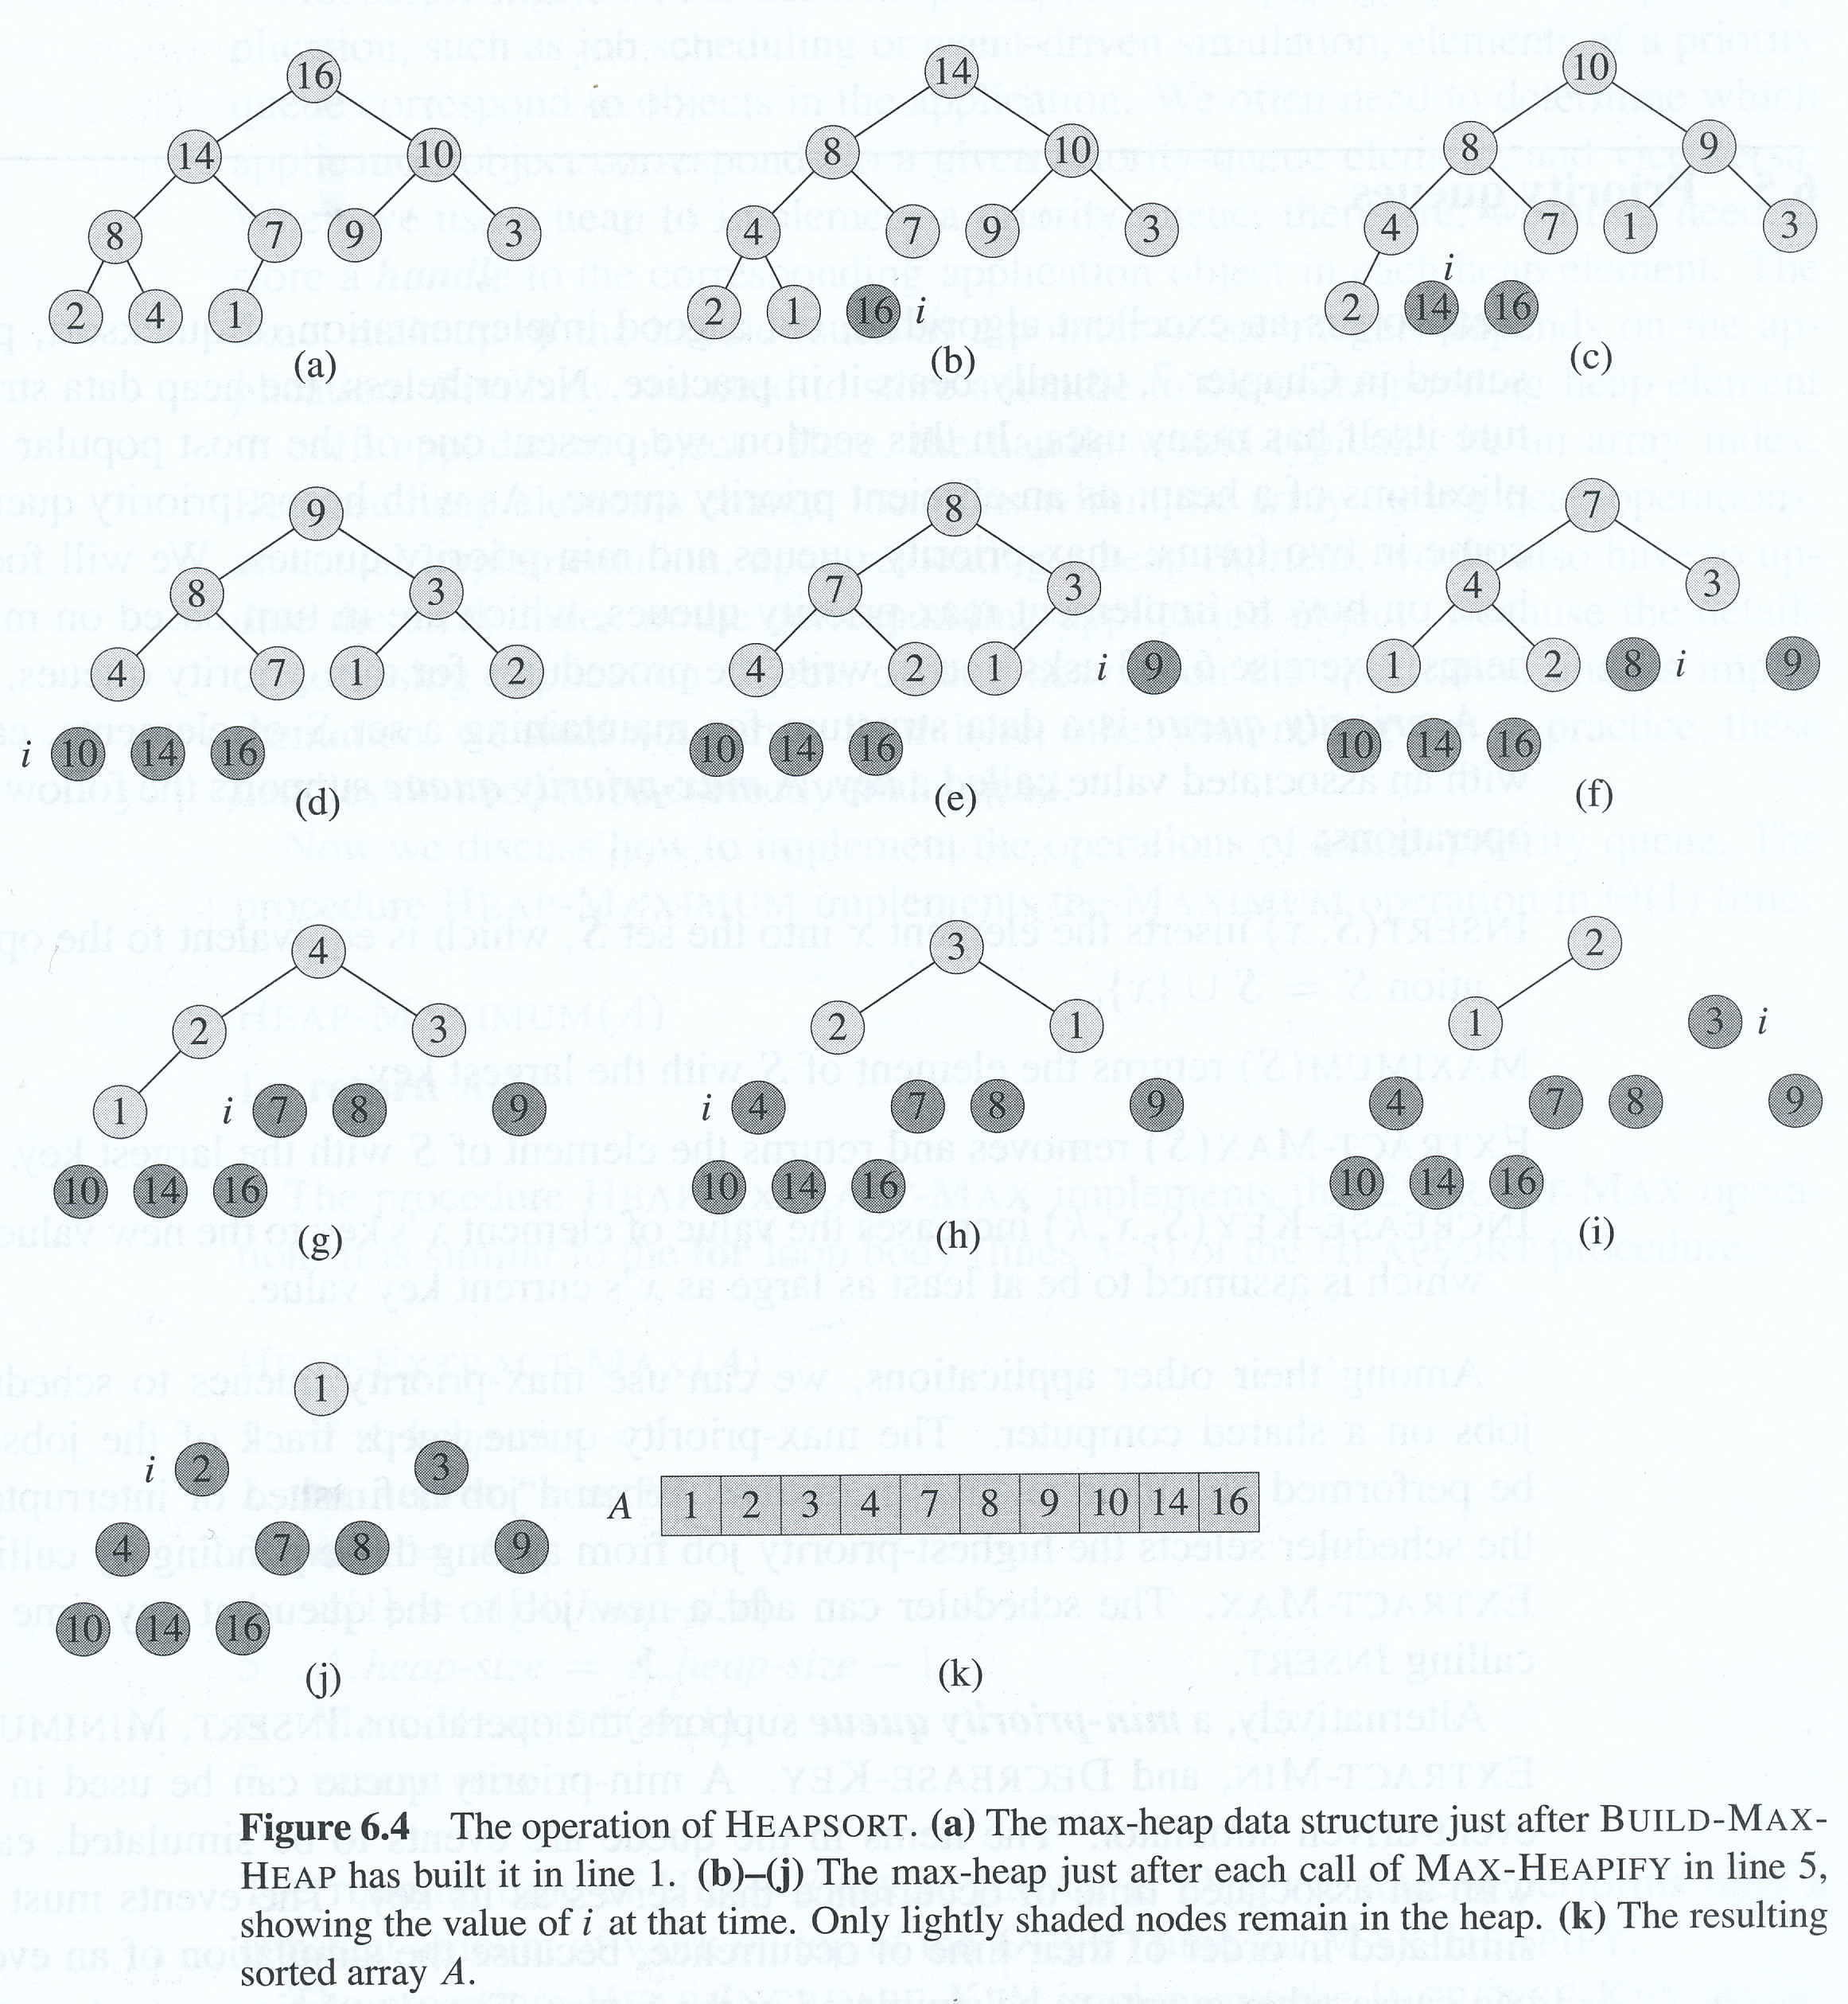
Heapsort
Shows operation of Heapsort after initial max-heap has been built
Takes O(n lg n) time since Build-Max-Heap is O(n) and each call to Max-Heapify is O(lg n)

Slide 17
Priority queues
Heap can be used to build an efficient priority queue
Priority queues come in two types:
max-priority queues
min-priority queues
Priority queue stores a set S of elements, each with an associated value, or key

Slide 18
Max-priority queues
Max-priority queue supports following operations
Insert(S,x) inserts x into S
Maximum(S) returns element with largest key
Extract-Max(S) removes and returns element with largest key
Increase-Key(S,x,k) increases value of x’s key to k
Assumes k is greater than or equal to x’s key
Max-priority queue can be used to schedule jobs on a shared computer
Uses Extract-Max to get next highest-priority job whenever a job is finished or interrupted
Scheduler adds a job to the queue by using Insert

Slide 19
Min-priority queue
Supports operations Insert, Minimum, Extract-Min and Decrease-Key
Can be used in an event-driven simulator
items in queue are events to be simulated
key of each item is time of occurrence
events must be simulated in order of time of occurrence
simulation of an event may cause other events to occur some time afterwards
uses Extract-Min to choose next event to simulate
uses Insert to insert new events into min-priority queue

Slide 20
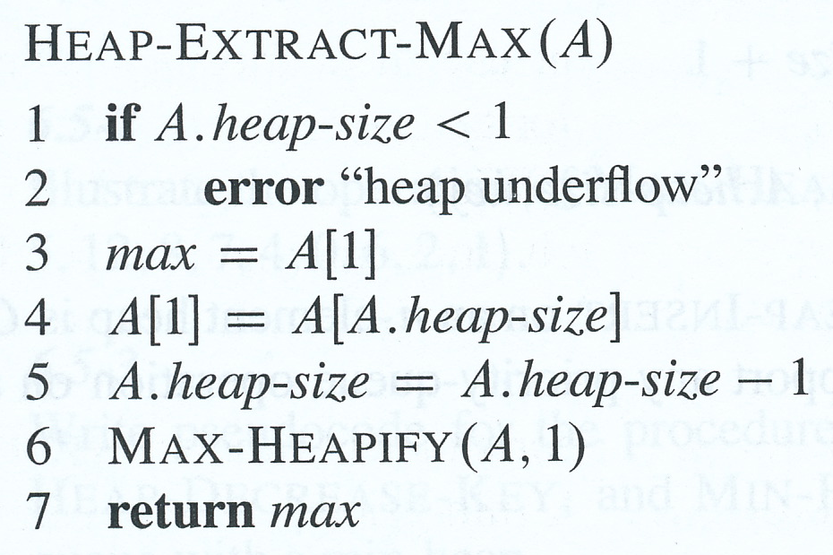
Implementing a max-priority queue
Heap-Maximum implements Maximum operation in Θ(1) time
Heap-Extract-Max implements Extract-Max
resembles body of for loop in Heapsort
running time is O(lg n)
performs constant amount of work on top of O(lg n) time for Max-Heapify

Slide 21
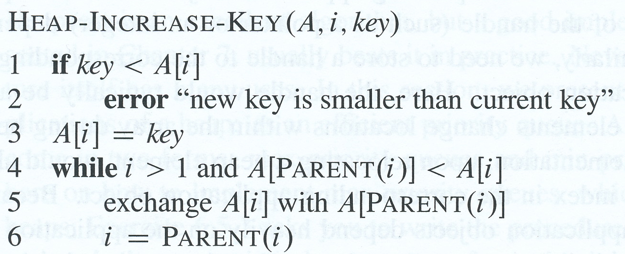
Implementing a max-priority queue
Heap-Increase-Key implements Increase-Key
first updates key of A[i] to k
this might make key of A[i] greater than the key of its parent
so traverses simple path from node i to the root to find correct place for increased key
repeatedly compares element with its parent, exchanging keys until the element’s key is less than or equal to its parent’s key
Running time is O(lg n) since path from updated node to root is O(lg n)

Slide 22
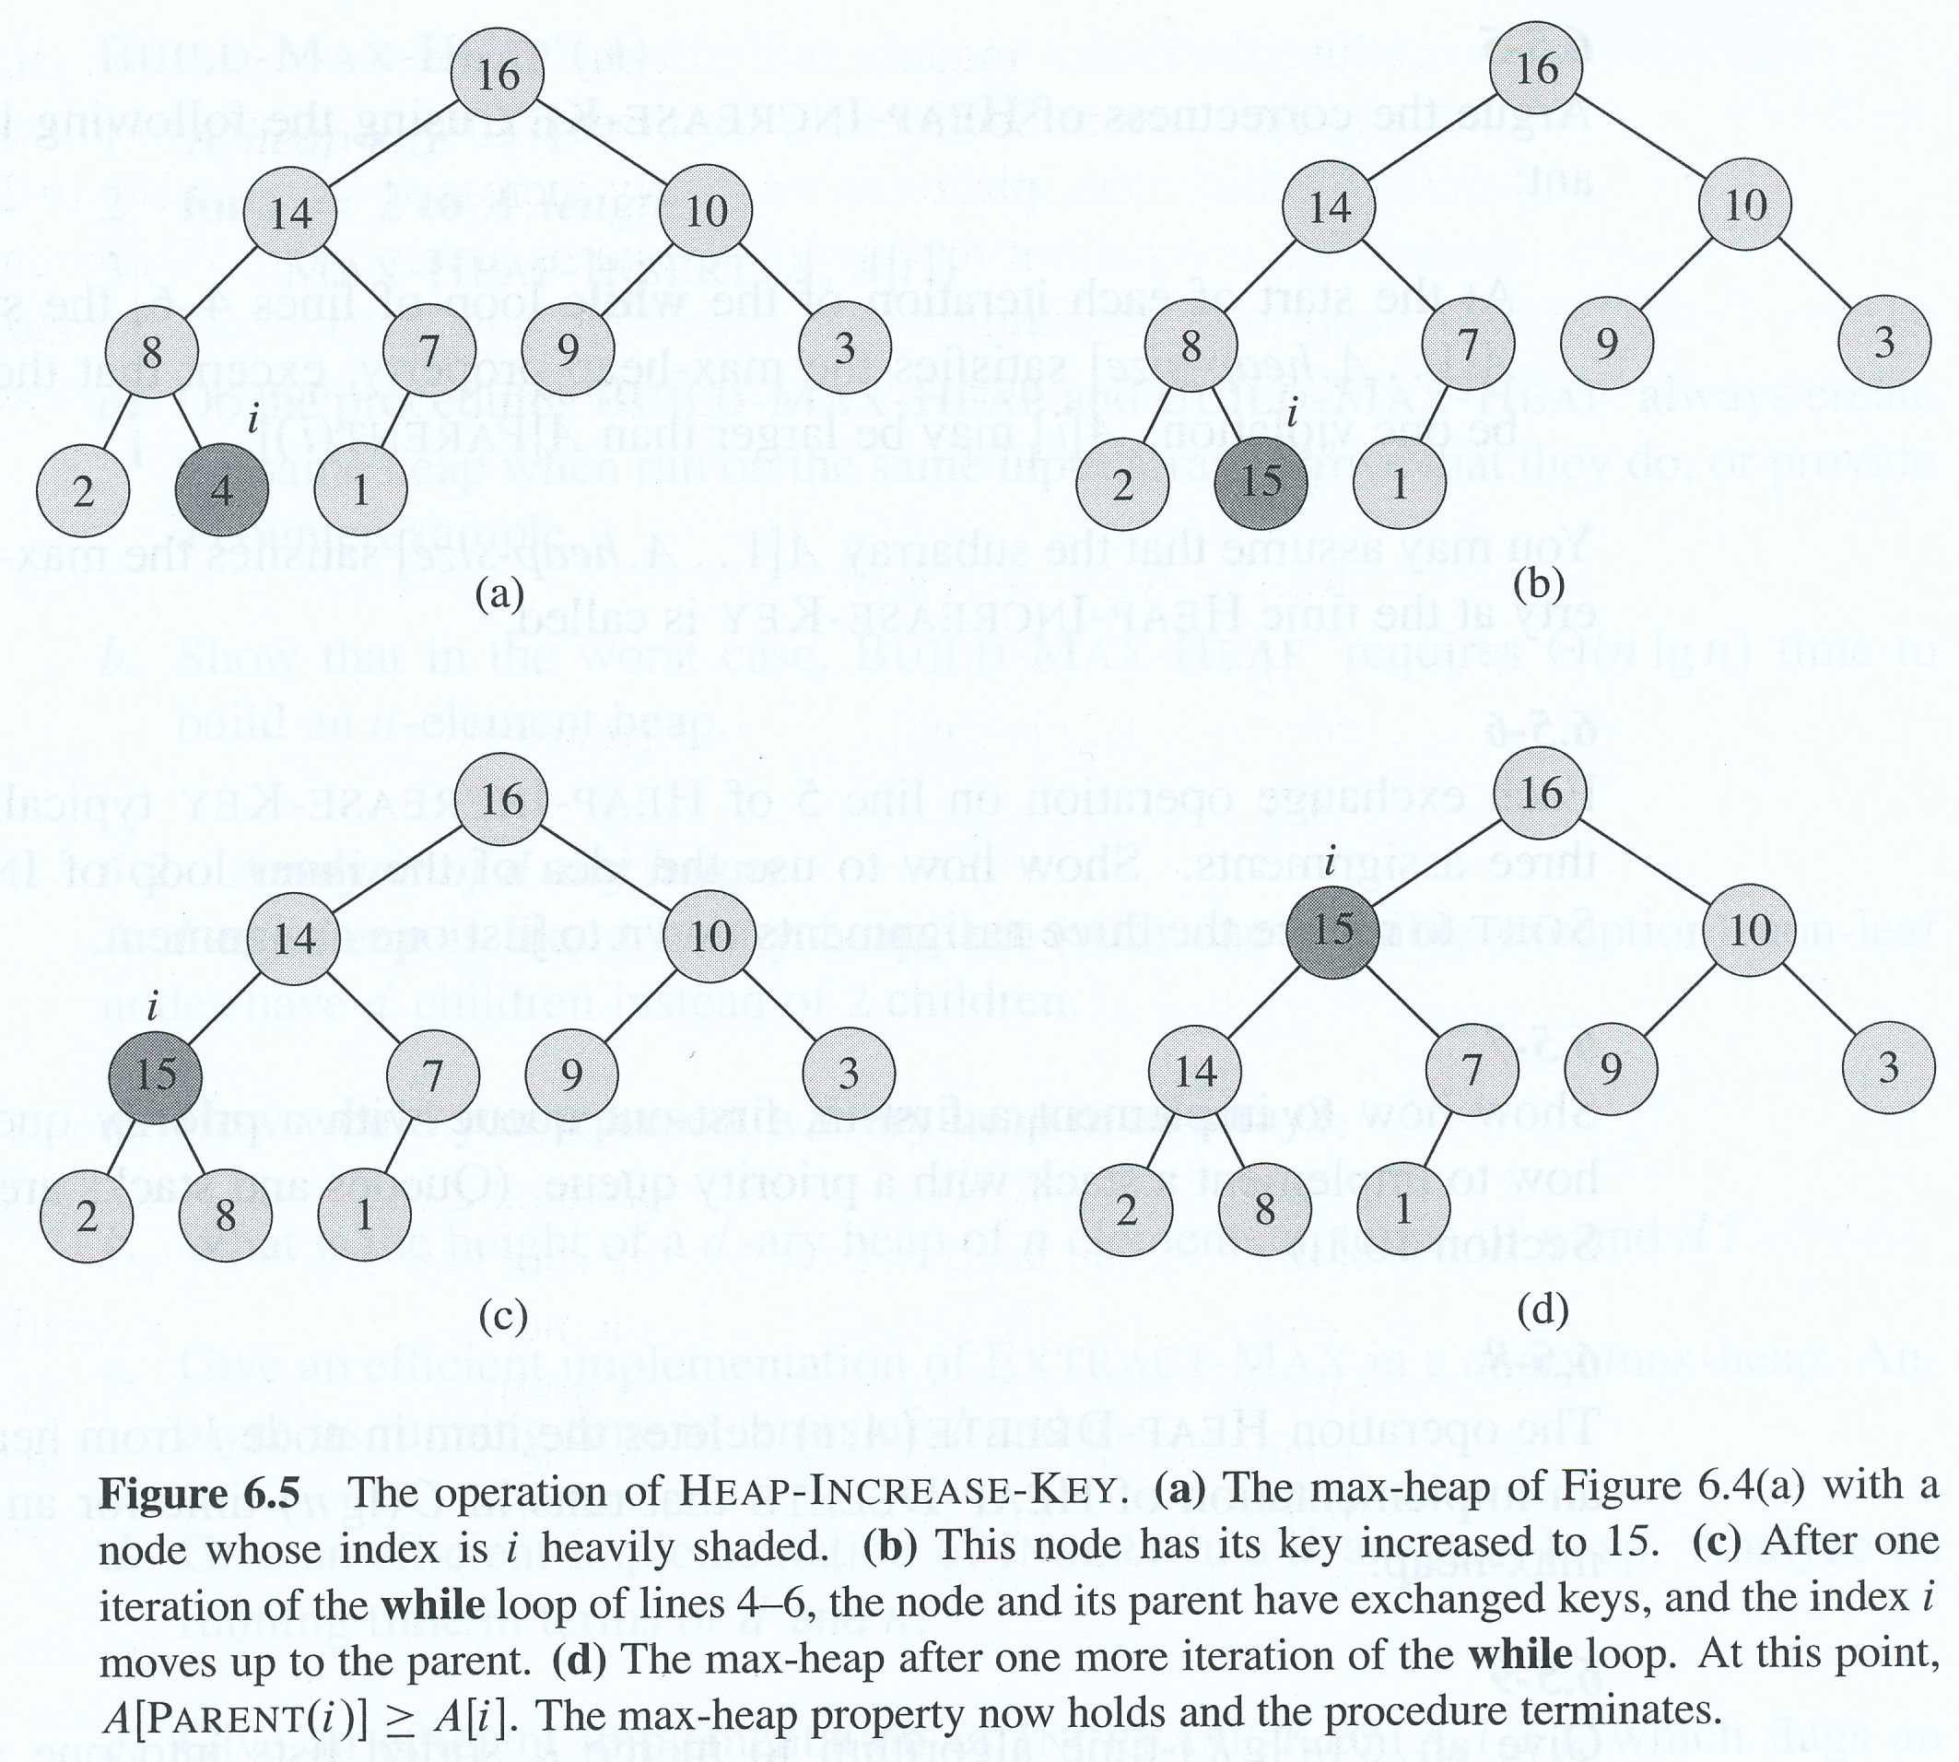

Slide 23
Implementing a max-priority queue
Max-Heap-Insert implements Insert operation
Takes new key as an argument
First adds a new leaf with key -∞
Calls Heap-Increase-Key to set the key of this new node to the correct value and maintain the max-heap property
Running time is O (lg n)
So a heap an support a priority queue operation on a set of size n in O(lg n) time

