Slide 1
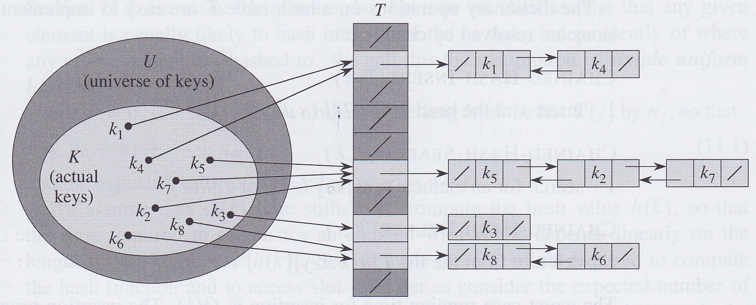
Hash tables
David Meredith
dave@create.aau.dk

Slide 2
Source
Chapter 11 of
Cormen, T. H., Leiserson, C. E., Rivest, R. L. and Stein, C. (2009). Introduction to Algorithms. (Third edition). MIT Press, Cambridge, MA.

Slide 3
Introduction
A hash table is an effective data structure for implementing a dictionary
i.e., a data structure that supports INSERT, SEARCH and DELETE
SEARCH in a hash table takes as long in the worst case as a linked list – Θ(n)
But the average time for SEARCH in a hash table is just O(1), under reasonable assumptions

Slide 4
Direct addressing
In an ordinary array, you can examine an arbitrary position in O(1) time
cf. a linked list, where you have to count the number of steps to the place you want from the head (O(n))
We can use an ordinary array and its fast direct addressing if we can afford to allocate an array that has one position for every possible key

Slide 5
Hash tables
If number of keys actually stored is small relative to the number of possible keys, then hash table is good alternative to an ordinary array
Hash table’s size is proportional to number of keys stored
Instead of using the key itself as an index into an array, the index in a hash table is computed from the key value using a hash function
This can mean that two or more keys can be “hashed” to the same hash table index
This is called a collision

Slide 6
Hashing
Collisions can be handled either by
Chaining
More than one key maps to the same array index
or Open Addressing
which we’ll come to later...
Hashing is a very effective technique
O(1) average time for dictionary operations
When set of keys doesn’t change once stored, can do perfect hashing – O(1) time in the worst case!

Slide 7
Direct address tables
Direct addressing works well when the universe of possible keys, U, is fairly small, U={0,1,...m-1}
Use a direct address table or array, T[0..m-1] in which each slot corresponds to a key in U
Slot k points to an element in the set with key k
If there is no element with key = k, then T[k] = NIL

Slide 8
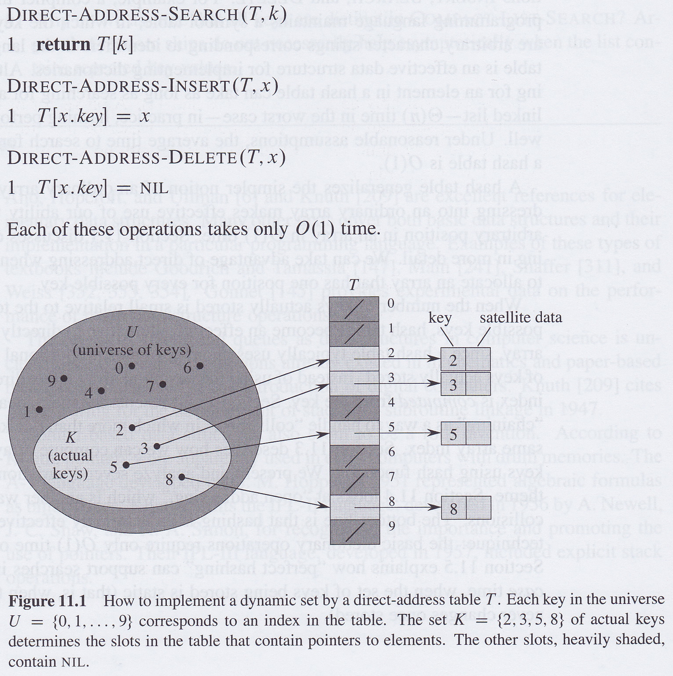
Direct-address tables

Slide 9
If |U| is large
If U is large, then may become impossible to allocate enough memory for a direct address table with the same number of slots as the cardinality of U
Also, typically the number of different elements in U that are actually used may be much, much smaller than the size of U, meaning lots of wasted space in the direct address table

Slide 10
Hash tables
If K is the set of keys actually used, then a has table requires only Θ(|K|) slots but still allows for searching in O(1) time...but “only” O(1) average time
for direct addressing, access is O(1) in the worst case
In direct addressing, element with key, k, is stored in the slot with index k
In a hash table, element with key, k, is stored in the slot with index h(k) where h is the hash function and h(k) is the hash value of k
h maps the universe U of keys onto the slots in a hash table, T[0..m-1]
m-1 is typically much less than |U|

Slide 11
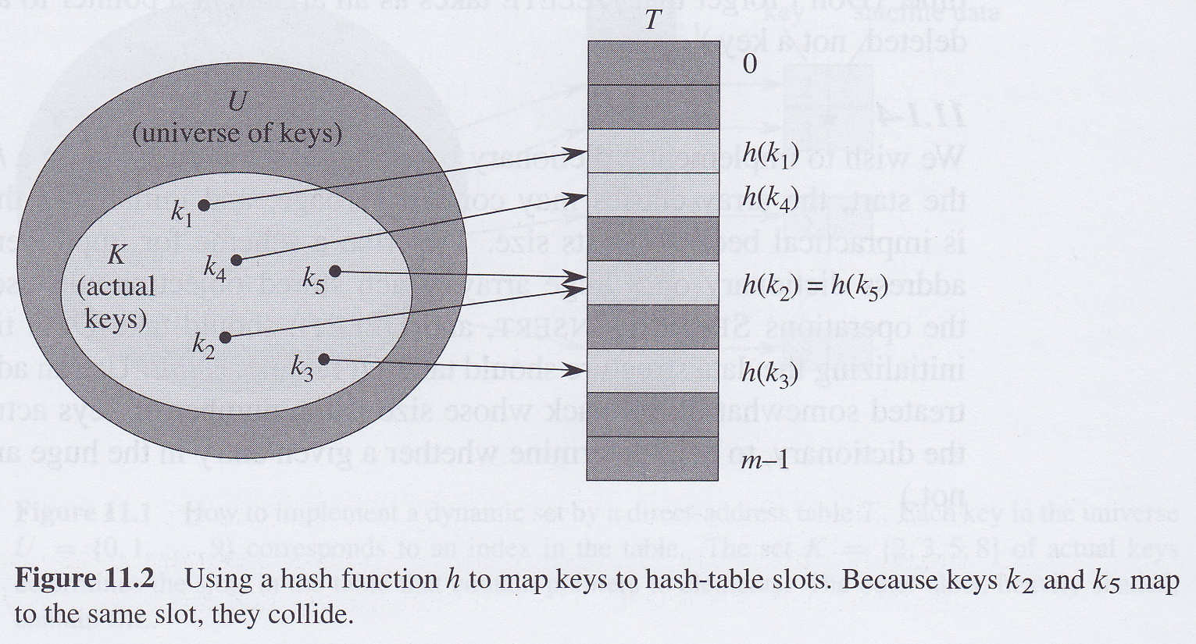
Hash table

Slide 12
Collisions
If the size of the hash table, m, is much less than the size of the universe of possible keys, then it’s possible for two different keys to map to the same slot in the hash table
This is called a collision
Try to minimise the number of collisions by carefully defining the hash function
One option is to make h a “random” function
Other ways of handling collisions are by chaining or open addressing

Slide 13
Chaining
Place all elements that hash to the same slot into a linked list whose head is pointed at by a pointer stored in the slot

Slide 14
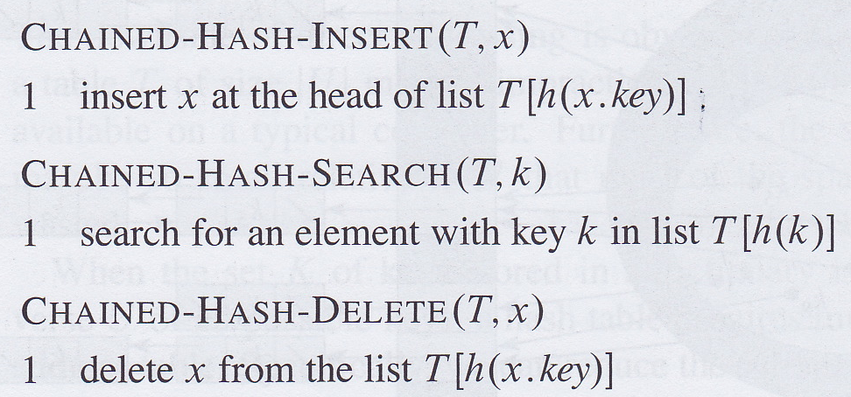
Dictionary operations when using chaining to resolve collisions

Slide 15
Resolving collisions by chaining
Worst-case running time for insertion is O(1)
Worst-case time for searching is proportional to the length of the list headed by the pointer in the slot with index h(k)
If lists are doubly-linked, then can delete an element in O(1) time
Because CHAINED-HASH-DELETE takes a reference to the node to be deleted as an argument (not its key)
If chains are only singly linked, then need a helper pointer that has to find the predecessor of the node to be deleted, so deletion is as slow as searching

Slide 16
How long to search when chaining?
Hash table, T, has m slots that stores n elements
Load factor, α, is n/m = average length of a chain
In worst case, all n elements hash to the same slot and we have a chain of length n
This is the same as a linked list

Slide 17
Simple uniform hashing
If any given element is equally likely to be hashed to any of the m slots, then we have simply uniform hashing
In this case, the expected length of a chain is the load factor, α = n/m
Takes Θ(1) time to compute hash function and Θ(α) time to search the chain for the appropriate hash value, giving Θ(1+α)
If we ensure that m is at least proportional to n, then n = O(m) and α = n/m = O(m)/m = O(1)
Therefore searching can be done in O(1) time on average, provided we have simple uniform hashing
Deletion and insertion can be done in O(1) worst-case time, so all dictionary operations can be done in constant time on average

