Slide 1
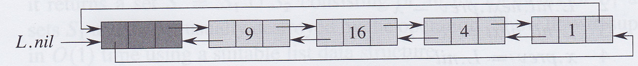
Elementary data structures
David Meredith
dave@create.aau.dk

Slide 2
Source
Chapter 10 and pages 229-231 of
  Cormen, T. H., Leiserson, C. E., Rivest, R. L. and Stein, C. (2009). Introduction to Algorithms. (Third edition). MIT Press, Cambridge, MA.

Slide 3
Dynamic sets
Sets in computer programs can grow, shrink or otherwise change over time
  they are dynamic
If you need to insert, delete and test for membership, then you need a dictionary
Other processes need more complicated operations
  e.g., max-priority queue which needs operations like extract max

Slide 4
Elements of a dynamic set
Each element of a dynamic set usually represented by an object with attributes that we can refer to with a pointer
Some kinds of dynamic sets assume each object has a key
  If all keys are different, then dynamic set is a set of key values
Object in a dynamic set may have satellite data that is not used by the dynamic set
Object may also have attributes that are manipulated by the set operations that contain pointers to other elements, for example
Some dynamic sets assume that the keys are drawn from a totally ordered set
  e.g., real numbers, Strings under lexicographical ordering
  allows definition of a minimum operation and a “next larger” operation

Slide 5
Operations on a dynamic set
Two categories of operation
  queries just return information
  modifying operations change the values in the set
Typical operations on a dynamic set:
  SEARCH(S,k) – returns pointer x to an element in S such that x.key = k or NIL if no such element in S
  INSERTS(S,x) – modifying operation that puts the element pointed to by x into S
  DELETE(S,x) – modifying operation that removes the element pointed at by x
  MINIMUM(S) – query that returns pointer to element with lowest key
  MAXIMUM(S) – query that returns pointer to element with largest key
  SUCCESSOR(S,x) – query that returns next larger element after x (or NIL)
  PREDECESSOR(S,x) - query that returns next smaller element after x (or NIL)

Slide 6
Stacks and queues
In a stack or a queue, the element by the DELETE operation is predetermined
In a stack, DELETE removes most recently added element
  Last In, First Out (LIFO)
In a queue, DELETE removes element that has been in set for longest time
  First In, First Out (FIFO)
Stacks and queues can be implemented with arrays

Slide 7
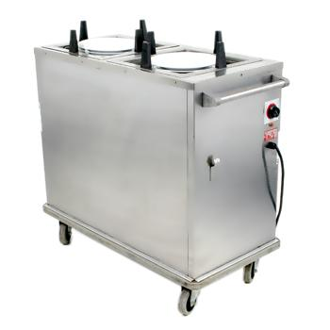
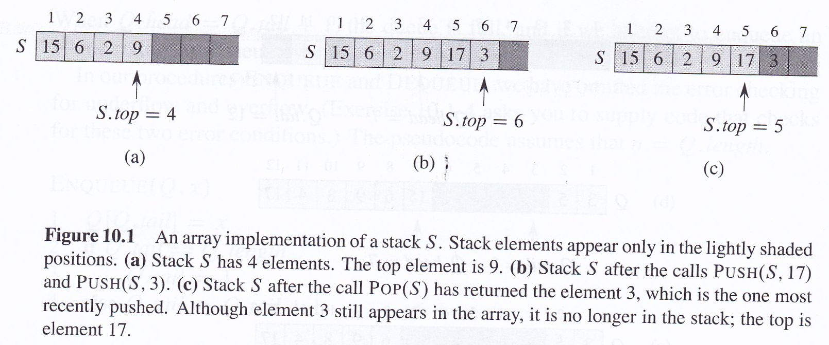
Stacks
INSERT is called PUSH, DELETE is called POP

Slide 8
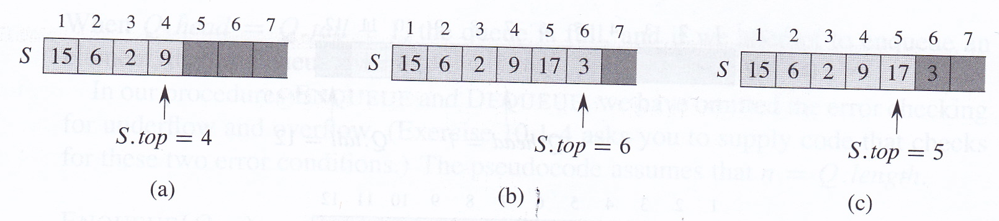
Stacks
S.top references most recently inserted element
Stack contains elements S[1..S.top]
If S.top = 0, stack is empty
If we try to POP an empty stack, we get stack underflow
If S.top > n, where n is length of array that implements stack, then we get stack overflow

Slide 9
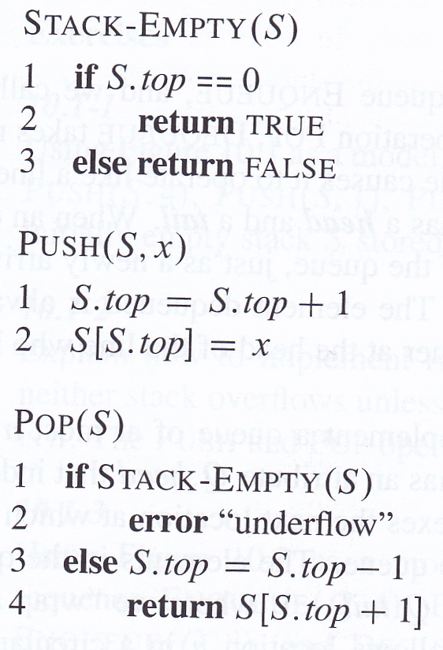
Implementing stack operations
Each stack operation takes O(1) time

Slide 10
Queues
INSERT on a queue is called ENQUEUE
DELETE on a queue is called DEQUEUE
Queue has a head and a tail
  just like a real queue at the supermarket!
ENQUEUE puts a new element at the tail of the queue
DEQUEUE removes the element at the head of the queue (FIFO)

Slide 11
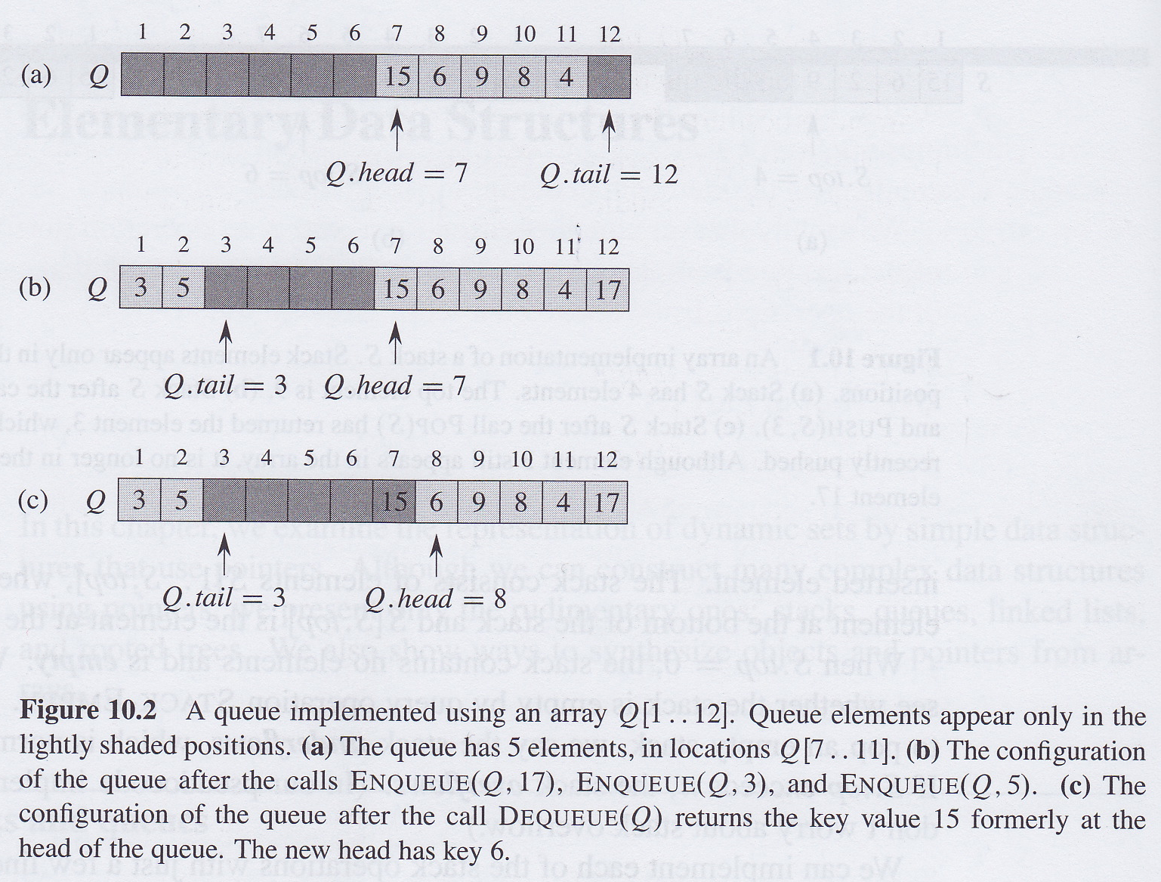
Queues
Can implement a queue of n – 1 elements using an array of n elements
Q.head points at head of queue, Q
Q.tail points at tail of queue, Q
Elements in queue are in locations:
  Q.head, Q.head+1,...Q.tail-1 where Q[1] follows element Q[n]
    i.e., we “wrap around” when we go past location n

Slide 12
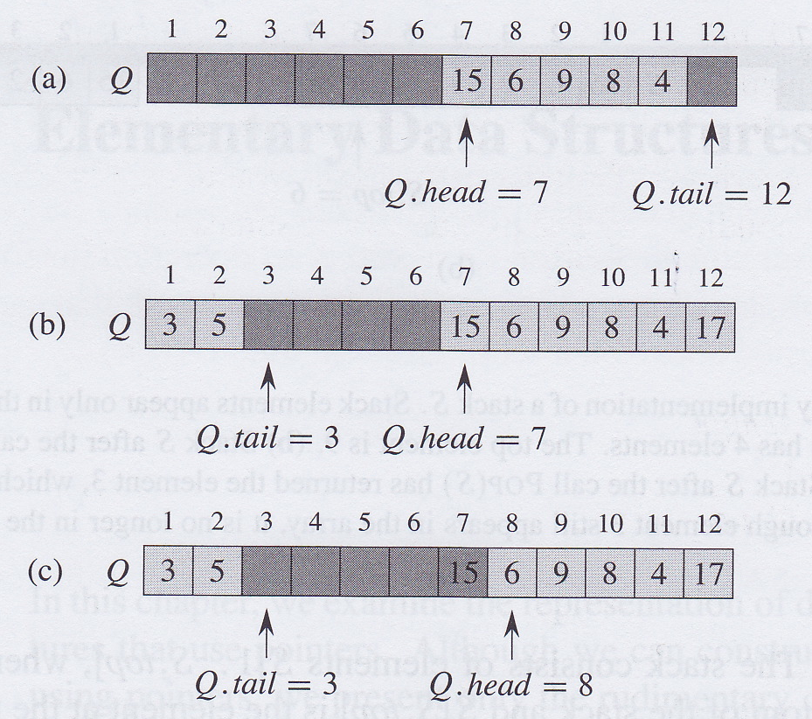
Queue underflow and overflow
When Q.head = Q.tail, then queue is empty
Initially, Q.head = Q.tail = 1
If queue is empty and we try to dequeue, then we get queue underflow
If Q.head = Q.tail + 1, then queue is full
If queue is full and we try to enqueue, then we get queue overflow
Q.length gives size of underlying array that implments the queue, not the number of elements in the queue

Slide 13
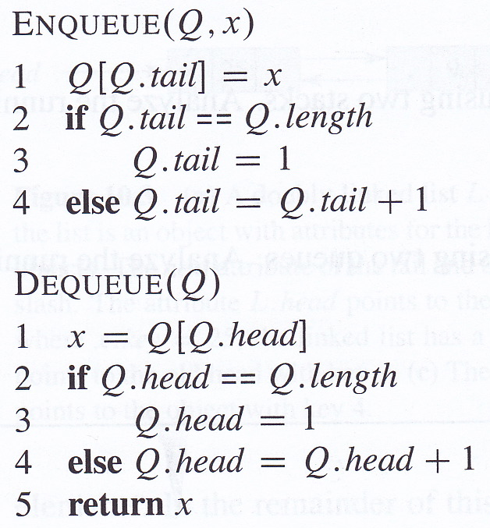
Implementing ENQUEUE and DEQUEUE
ENQUEUE and DEQUEUE take O(1) time
Don’t bother here with error-checking
  You can add it as an exercise!

Slide 14
Linked lists
Linked list is a data structure consisting of elements linked together with pointers
Each element contains a pointer to the next element in the list
Linked lists support all the dynamic set operations, but not necessarily efficiently!

Slide 15
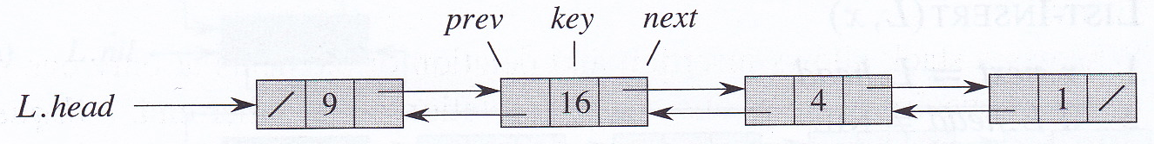
Doubly-linked list
Each element in a doubly-linked list has a key and two pointers, prev and next, that point to the previous and next elements in the list, respectively
If x.next is NIL, then x is the tail of the list
if x.prev is NIL, then x is the head of the list
L.head is defined to be a reference to the head of list L
If L.head = NIL, then the list is empty

Slide 16
Sorted, unsorted and circular lists
In a singly-linked list, each element has no prev attribute
In a sorted list, the head has the least key and the tail has the greatest key
In an unsorted list, the elements appear in any order
In a circular list, L.head.prev points at L.tail and L.tail.next points at L.head
From here on, we’ll consider only doubly-linked, unsorted lists

Slide 17
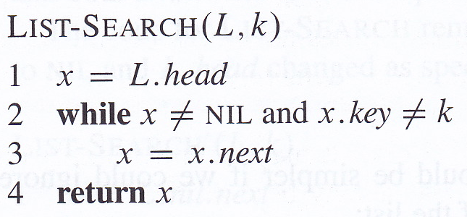
Searching a linked list
LIST-SEARCH takes Θ(n) time in the worst case

Slide 18
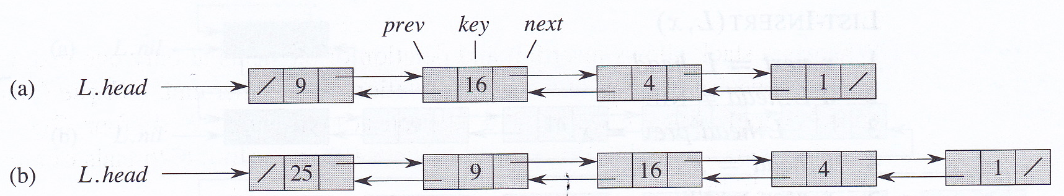
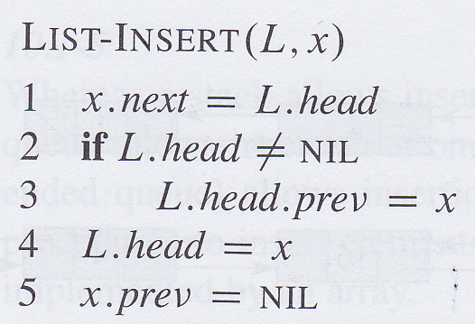
Inserting into a linked list
Given a list element, x with key already set, LIST-INSERT “pushes” x onto the front of the linked list so that x becomes the new head of the list
LIST-INSERT runs in O(1) time

Slide 19
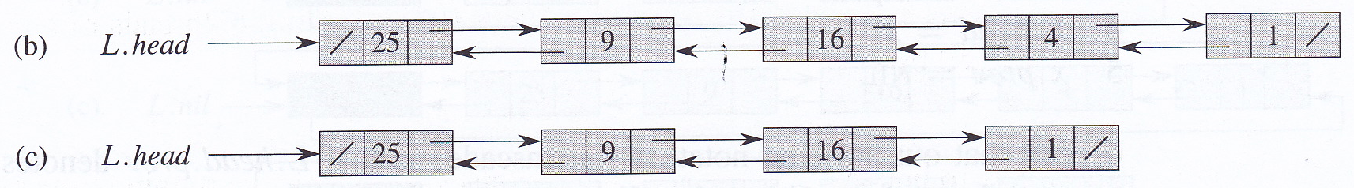
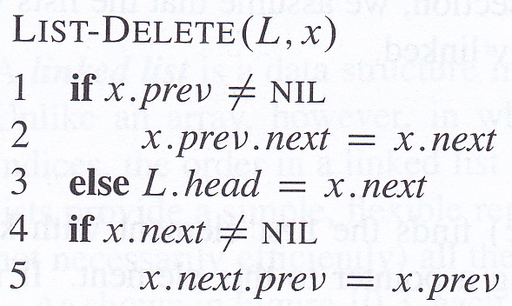
Deleting from a linked list
LIST-DELETE runs in O(1) time, but if we have to find an element with a particular key first, then Θ(n) time is needed in the worst case to run LIST-SEARCH

Slide 20
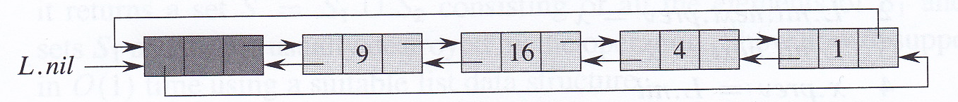
Sentinels
Sentinel is a dummy element in a circular, doubly-linked list that lets us simplify boundary conditions
L.nil is a sentinel that represents NIL
L.nil lies between the head and the tail of the list
  L.nil.next points at head of list
  L.nil.prev points at tail of list
  next attribute of tail and prev attribute of head point at the sentinel, L.nil
L.head and L.tail no longer needed

Slide 21
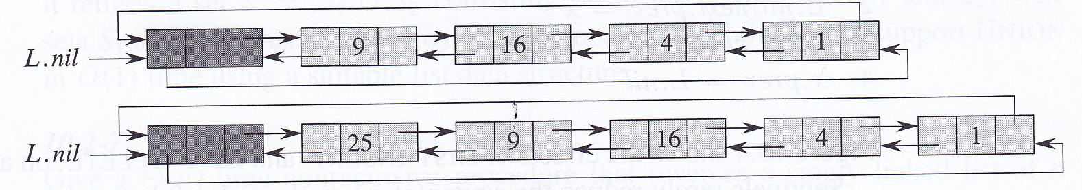
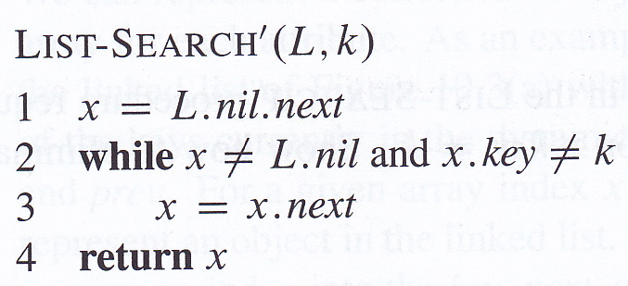
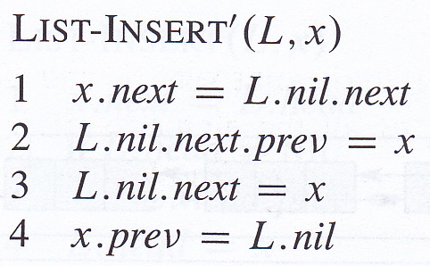
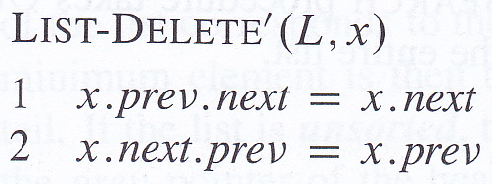
DELETE, SEARCH and INSERT with sentinels
Sentinels can make the code simpler but don’t change asymptotic bounds on running time
But can reduce running time by a constant factor
Add a storage overhead, so don’t use if you have lots of very small lists

