Slide 1
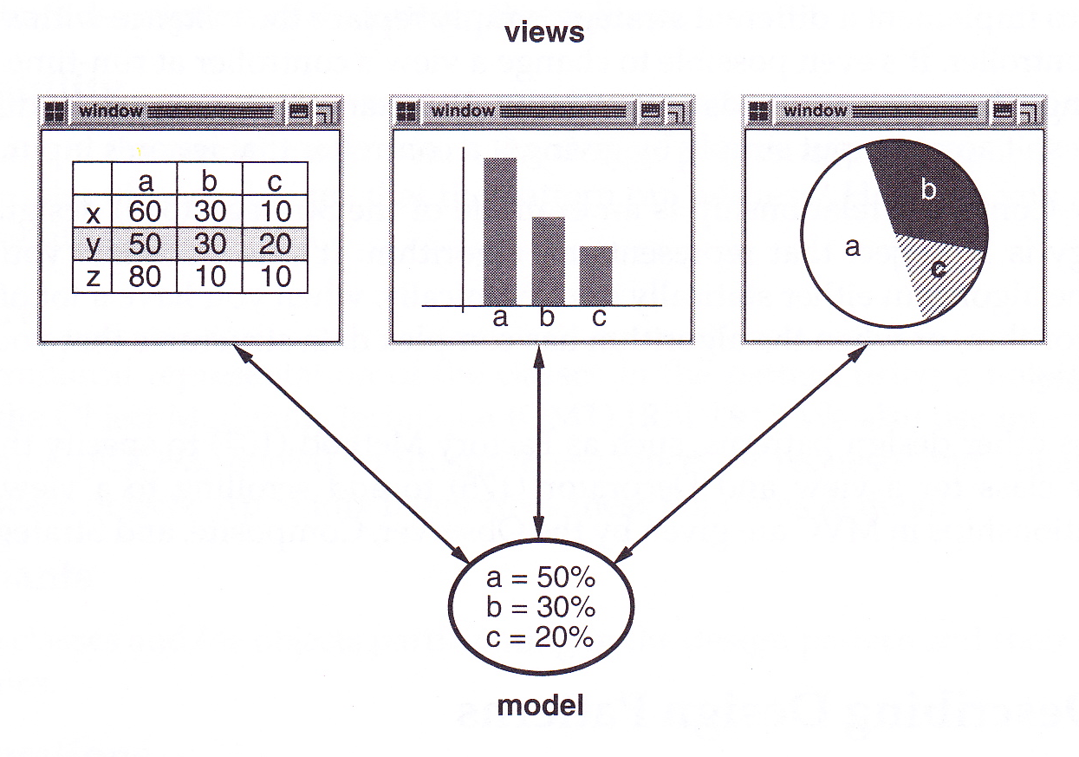
Introduction to Design Patterns
David Meredith
dave@create.aau.dk

Slide 2
Sources
The material in this lecture is based primarily on:
  Gamma, E., Helm, R., Johnson, R. & Vlissides, J. (1995). Design Patterns: Elements of Reusable Object-Oriented Software. Addison-Wesley, Boston. ISBN: 0201633612.
    One of the most cited books in software engineering – 18155 citations in Google Scholar!

Slide 3
Design Patterns
A design pattern is a simple, elegant solution to some specific, commonly occurring programming problem
  Typically the result of many person-years of accumulated programming wisdom
  Generally the result of trying to maximize flexibility and reusability

Slide 4
Design patterns in other disciplines
Patterns were used in architecture and urban design before software engineering:
  Alexander, C., Ishikawa, S. & Silverstein, M. (1977). A Pattern Language: Towns, Buildings, Construction. Oxford University Press, Oxford. ISBN: 0195019199.
    A language for building and planning that provides patterns (i.e., standard solutions) for designing towns, neighbourhoods, houses, gardens, rooms etc.

Slide 5
Designing reusable object-oriented software
Designing reusable OO software involves
  finding the right objects
  factoring these into the right classes at the right granularity (size)
  defining the right interfaces and inheritance hierarchies
  establishing the right associations (relationships) between the classes and interfaces
A design has to
  solve a specific problem
  but also has to be flexible enough to be modified and improved easily in response to user feedback
Almost impossible to get a design right the first time
  Expect to have to throw (at least) one away (Brooks, F. P. (1995). The Mythical Man Month: Essays on Software Engineering. (Anniversary Edition). Addison-Wesley.)

Slide 6
Using the best known solutions instead of hacking your own home-made ones
Expert designers know not to try to solve every problem from first principles
  They look around for the best available solution and then apply it over and over again in appropriate situations
  What makes them experts is that they know about the best solutions that have already been developed for solving certain well-understood problems
You will therefore find recurring patterns of collaborating classes and communicating objects in well-designed OO systems
  These patterns solve specific design problems
  Make OO systems more flexible, elegant and reusable
A design pattern systematically names, explains and evaluates an important and recurring design in OO systems

Slide 7
What is a design pattern?
A pattern has four elements:
  Pattern name sums up problem, solution and consequences in a couple of words
    Lets us design at a higher level of abstraction
    Lets us communicate more efficiently
  Problem description explains problem and its context. Could involve
    Description of specific problem
    Description of object or class structures that result in an inflexible design
    List of conditions in which pattern can be applied
  Solution describes elements that make up design and their relationships, responsibilities and collaborations
    Doesn’t describe particular implementation, only a template for producing a solution to a particular type of problem
    Usually involves a handful of collaborating classes organised into an appropriate class model
  Consequences of applying the pattern, costs and benefits, e.g., issues of space and time complexity, implementation, impact on flexibility, extensibility and portability

Slide 8
Model-View-Controller
Used to build interfaces in Smalltalk-80
Consists of 3 types of object:
  Model is application object that contains all the logic
  View is a screen presentation of the model
  Controller defines how UI responds to user input
MVC decouples views and model by using a subscribe/notify protocol
  When model changes, broadcasts notification, registered view receives notification and updates itself
Can have many views for one model
  Can add views without updating model
Model doesn’t need to know about any of the views
Example of the Observer (293) pattern

Slide 9
Model-View-Controller
In Smalltalk MVC, views can be nested
CompositeView class is a subclass of the View class that can contain other Views (and therefore other CompositeViews)
Means a client can treat a CompositeView just like a View
Example of Composite (163) pattern
  Used when we want to be able to treat a group of objects just like a single object

Slide 10
Model-View-Controller
In Smalltalk MVC, can also change the way that a view responds to user input without changing model and without changing visual appearance
  e.g., change keyboard shortcut or have a pop-up menu
Can do this because Controller is decoupled from View and Model
Can have several different Controller objects, each implementing a different control strategy
  Can even change Controller at run-time
This is an example of the Strategy (315) pattern
  a strategy is an object that represents an algorithm to be used in a particular context

Slide 11
Describing Design Patterns
In Gamma et al. (1995), each pattern is described according to a standard template that has the following sections:
  Pattern name and classification
  Intent
  Also known as
  Motivation (an example of where the pattern can be used)
  Applicability (situations in which pattern can be used)
  Structure (in OMT, a precursor of UML)
  Participants (classes/objects and their responsibilities)
  Collaborations (between objects to carry out responsibilities)
  Consequences
  Implementation
  Sample code (in C++)
  Known uses
  Related patterns

Slide 12
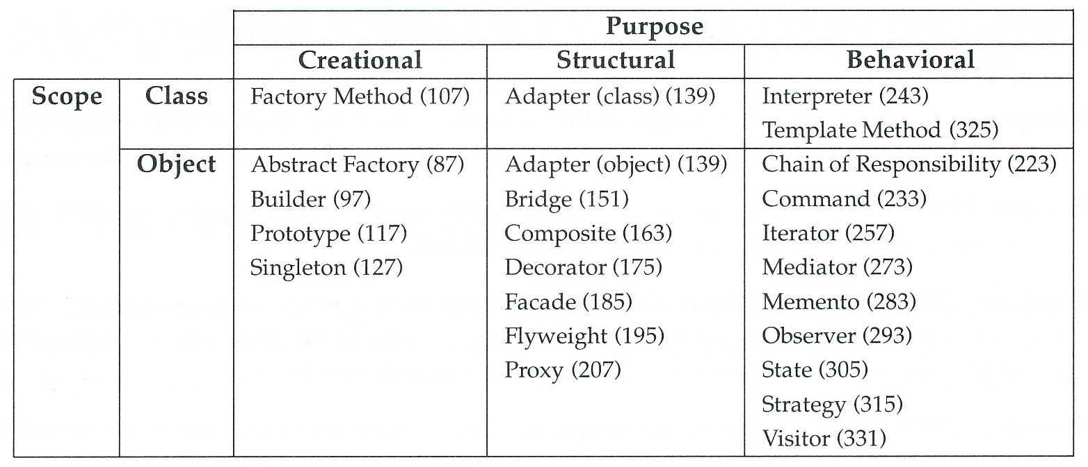
Design pattern space
Creational object creation
Structural composition of classes and objects
Behavioral object interaction and distribution of responsibility
Class scope relationships between classes and subclasses (static, compile-time)
Object scope relationships between objects (dynamic, run-time)

Slide 13
Creational Design Patterns
Name (page number) | Intent
Abstract Factory (87) | Provide an interface for creating families of related objects
Builder (97) | Separate construction of a complex object from its representation
Factory Method (107) | Define an interface for creating an object but let subclasses decide which class to instantiate
Prototype (117) | Create new objects by copying a prototypical instance
Singleton (127) | Ensure a class only has one instance and provide a global point of access to it

Slide 14
Structural Design Patterns
Name (page number) | Intent
Adapter (139) | Convert a class’s interface into one that clients expect
Bridge (151) | Decouple abstraction from implementation
Composite (163) | Compose objects into tree structures. Lets objects and groups of objects be treated uniformally
Decorator (175) | Attach additional responsibilities to an object dynamically without subclassing
Façade (185) | Provides unified interface to a subsystem’s set of interfaces, making the subsystem easier to use
Flyweight (195) | Use sharing to support large numbers of small objects efficiently
Proxy (207) | Surrogate for another object to control access to it

Slide 15
Behavioral Design Patterns
Name (page number) | Intent
Chain of Responsibility (223) | Decouple request sender from receiver by chaining possible receiving objects and passing request along chain until it is handled
Command (233) | Encapsulate a request as an object (allows you to assign different requests to clients, queue or log requests, support undoable operations)
Interpreter (243) | Define a grammar with an interpreter that uses grammar to interpret sentences in the language
Iterator (257) | Access the elements in an aggregate without exposing its implementation
Mediator (273) | An object that encapsulates how a set of objects interact, reducing coupling between participants
Memento (283) | Capture and store an object’s internal state so that it can be restored later
Observer (293) | Define a many-to-one dependency so that when a single object’s state changes, its dependents are updated
State (305) | Allow object to change behaviour depending on its state (object may appear to change class)
Strategy (315) | Define a class to represent a family of algorithms that can be used interchangeably in a particular context
Template Method (325) | Define skeleton of an algorithm, deferring some steps to subclasses
Visitor (331) | Define an operation to be carried out on all objects in a collection without changing structure of objects

Slide 16
Solving problems with patterns
Can use design patterns to solve various problems:
  Finding appropriate objects
  Determining object granularity
  Specifying object interfaces
  Specifying object implementations
  Building flexible, reusable software
  Relating run-time and compile-time structures
  Designing for change

Slide 17
Finding Appropriate Objects
Object packages data and the procedures that operate on that data
Procedures usually called methods or operations
Object performs an operation when it receives a request (or message) from a client
Operations should be the only way of changing an object’s internal data or state
  The internal representation of the data should be hidden
    i.e., instance variables should generally be private
  This ensures encapsulation
Decomposing a system into classes is usually hard because lots of (sometimes conflicting) factors come into play
  encapsulation, granularity, dependency, flexibility, reusability, etc.
Various methods proposed for finding classes
  Noun identification technique
  Collaboration-Responsibility Cards
  Modelling the real world
  …
Patterns help to identify the less obvious classes
  e.g., decorator classes, representing algorithms as objects in the Strategy (315) pattern

Slide 18
Determining Object Granularity
Objects can vary a lot in size and number
  From hardware components to application
Patterns help to determine appropriate object granularity
For example
  Façade (185) describes how complete subsystems can be represented as a simple interface
  Flyweight (195) describes how to support very large numbers of very small objects

Slide 19
Specifying Object Interfaces
Operation’s signature specifies its name, its arguments and the type of its return value
  e.g., int computeX(int x, int y)
The interface of an object is the set of all signatures of its operations
The interface of an object defines all the requests (or messages) that it can understand
If a class C implements a particular interface I, then all instances of class C are of type I
  An object may therefore have more than one type if it implements more than one interface
  Two objects of different class can have the same type if they implement the same interface
A type S is a subtype of another type T if S inherits from T and the interface T is subset of the interface of S
  In this case, T is a supertype of S
It is possible for two objects to have identical interfaces and completely different implementations

Slide 20
Messages
Selectors and arguments
myClock understands two types of messages
    getTime()
    setTime(newTime:Time)
every message has a selector
    getTime
    setTime
a message may have arguments:
    getTime() has no arguments
    setTime(newTime:Time) has one argument, newTime, which must be of type Time
arguments may be objects themselves
  for example, Time may be a class of objects

Slide 21
Messages: Signatures
every message has a signature
  the combination of its selector and the pattern of types of its arguments
for example, myClock might understand the messages
    readTime(string : String)
      Reads a time value from a String
    readTime(file : File)
      Reads a time value from a File
These two messages have the same selector but different patterns of arguments:
    readTime(string : String) takes a String argument
    readTime(file : File) takes a File argument
=> signatures are different
=> could both be defined within a myClock object
      Example of method overloading

Slide 22
Sending messages
Message sent to an object by giving the object's name, followed by a full stop, followed by the message
    myClock.getTime() sends the message getTime() to myClock
“object A sends the message msg() to object B”
  => instruction “B.msg()” occurs within one of A's methods
Object can send messages to
  itself
  a value of one of its own attributes
  an argument of one of its operations
  a new object created by one of its operations

Slide 23
An object’s public interface
object's public interface defines messages it will accept from anywhere
interface usually provides signature (i.e., selector and arguments) and return type of each message
  E.g., getTime() : Time
public interface may also contain attributes but this is usually a bad idea
  we may want to change object so that changing an attribute value has some other side effect
  or may want to change the type of an attribute
  can do this without changing interface if the attribute value is set or retrieved using operations
  thus preserving encapsulation
  Cf. example of polar and cartesian co-ordinate representations of position in a Point object

Slide 24
An object’s private interface
methods within an object may need to access attributes directly
  so an object may send itself any message that it understands and access any of its own attributes – even if they are private
  e.g., a get() method will usually have to access an attribute directly within the same object
=>
  object has a public interface which any part of the system can use
and
  larger private interface which the object itself and other privileged parts of the system can use
an object may make different parts of its private interface available depending on its role within a particular context
  it may then implement or realize two or more different public interfaces
    Cf. class implementing multiple interfaces in Java

Slide 25
Classes
Each object has
  Attributes
    Each attribute is a place to store data
  Operations
    The messages that the object understands
    Each operation is implemented by a specific method
Often want many objects with same attributes and methods
  E.g., every object representing a customer in a company’s invoicing system
  Therefore have a “template” that lets us make as many objects of a particular type as we want
  This template is called a class definition

Slide 26
Classes and class definitions
A class definition is an “object factory” or an object type specification
  it defines the attributes and methods that are possessed by all objects of a particular type (or "class")
Two objects are in the same class if they are created using the same class definition
If the elements of a data type are objects, then that type is a class
A class definition also specifies the visibility of each attribute and method
  i.e., whether it is public or private
Class definition therefore also defines the public and private interfaces of the objects in its class
Instantiating a class means creating a new object of that class
Every object is an instance of the class to which it belongs

Slide 27
Class example
myClock is an object of class Clock with attribute
- time : Time
and operations
+ getTime() : Time
+ setTime(newTime : Time)
Each Clock object has
  a private attribute called time which stores a value of type (or class) Time
  a public operation with selector getTime which returns a value of type Time
  a public operation with selector setTime which takes a single argument of type Time and returns no value
the definition of class Clock specifies methods to implement the operations
  getTime()
  setTime(newTime : Time)
the public interface of class Clock contains the operations
  getTime()
  setTime(newTime : Time)
the private interface of class Clock would in addition contain the attribute
  time

Slide 28
Inheritance
Building a simulation of a zoo in which each type of animal is represented by an object
Set of attributes depends on type of animal
If define independent class for each type of animal then break “write once” principle

Slide 29
Inheritance
Inheritance is the process by which a class contains all the attributes and operations of its superclasses
Define class Animal which contains attributes common to all animals
Define Bird to contain everything in Animal plus wingSpan
Define Parrot to contain everything in Bird
Define Quadruped to contain everything in Animal plus height, foreLegLength and hindLegLength
Define Elephant to contain everything in Quadruped plus trunkLength and tuskLength
Here only write each distinct attribute once
Elephant inherits from Quadruped which inherits from Animal
Bird inherits from Animal
Quadruped is a subclass (or derived class) of Animal
Quadruped is a superclass (or base class) of Elephant
Quadruped is a specialization of Animal
Animal is a generalization of Quadruped
An Elephant is a Quadruped
An Elephant is an Animal

Slide 30
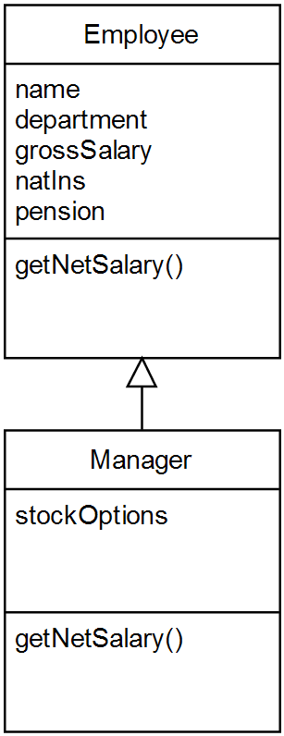
Method overriding
Each employee represented by an object in personnel system
Way that net salary calculated depends on type of employee
Managers can have stock options
getNetSalary takes stock options into account in a Manager object but not an Employee object
Method executed when Manager receives getNetSalary different from method executed when Employee receives getNetSalary message
getNetSalary method in Employee is overridden in the Manager class

Slide 31
When to use inheritance
Using inheritance increases coupling between classes which makes them less reusable
A subclass should require all attributes and operations of its superclass and add to or override these
If a class does not override or add to its superclass’s operations or attributes, then think twice about making it a subclass!
A triangle needs a different type of display() operation from a Circle, but both are Shapes
  Make Circle and Triangle subclasses of Shape
A German Shepherd is a special type of Dog but requires no attributes or operations other than those in a Dog
  Add a breed attribute to Dog
✗
✓

Slide 32
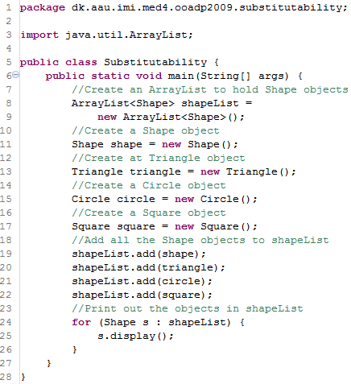
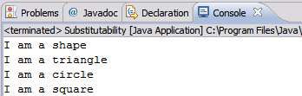
Substitutability, polymorphism and dynamic binding
The Liskov Substitution Principle:
  If p is a variable that refers to an object of class x, then p may refer to any object from any subclass of x (Liskov, B. & Wing, J. M, 1994)
Variable s in lines 24-25 is polymorphic
  from Greek: poly = many, morph = form or shape
  can refer to objects of many different classes (Shape, Circle, Triangle, Square)
Actual method run in line 25 only decided at runtime because program doesn’t know at compile-time the types of the objects in shapeList
  This is called dynamic binding or late binding because the method implementation is bound to the method call late (i.e., when the program is running rather than when it is compiled)

Slide 33
Programming to an interface, not an implementation
A client should send requests to interfaces or abstract classes (i.e., as high up the inheritance hierarchy as possible)
  It is then easy to define new subclasses that the client can use
  This greatly reduces dependencies between subsystems
Therefore:
  PROGRAM TO AN INTERFACE, NOT AN IMPLEMENTATION
  This is basically the same as saying that a client should assume as little as possible about the way that a request it makes will be carried out
The creational design patterns (Abstract Factory (87), Builder (97), Factory Method (107), Prototype (117), Singleton (127)) provide mechanisms for instantiating concrete classes while clients actually only know about interfaces or abstract classes

Slide 34
Inheritance vs. Composition
Two most common methods of reusing functionality are
  inheritance
  object composition
Inheritance
  “white-box reuse”: subclass knows about internals of superclass
Object composition
  Add functionality by letting objects of a class refer to objects of another class and use their functionality
  “black-box reuse”: only public interface of component object is visible

Slide 35
Inheritance
Defined statically at compile time
Easy to use in an OO language
Can modify inherited operations that call overridden operations
Cannot change inherited implementations at runtime
Subclass strongly dependent on implementation of its superclass
Inheritance breaks encapsulation and increases coupling
Better to inherit only from abstract classes or implement interfaces

Slide 36
Object composition
Defined dynamically at runtime by object acquiring reference to another object
Because composed object accessed only through its interface, don’t break encapsulation
  can replace component object with any other that has the same interface
  container object does not depend on implementation of component object (cf. inheritance)
In general:
  Favour object composition over class inheritance

Slide 37
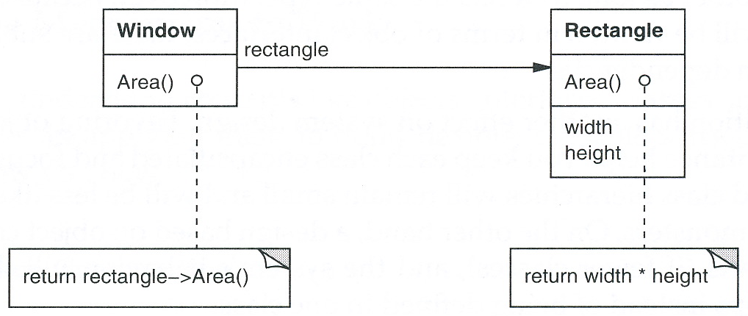
Delegation
Delegation is a way of making composition as powerful for reuse as inheritance
Two objects involved in handling a request: object that receives request (receiver) delegates operations to a delegate object
In inheritance, subclass can delegate a request to an operation defined in its superclass
  can refer to receiver object itself using the “self” variable
In object composition, the containing object can delegate an operation to a component object (a delegate)
  Receiver passes a reference to itself as an argument in the message to the delegate

Slide 38
Delegation
For example, instead of making class Window a subclass of class Rectangle, class Window could contain a Rectangle variable to which it delegates Rectangle-specific behaviour
  Window has a Rectangle instead of being a Rectangle
  Window must now explicitly forward requests to Rectangle
See diagram above where Window class delegates Area operation to its contained Rectangle
At runtime, Window can become circular, provided there exists a Circle class with the same type (i.e., interface) as Rectangle
Delegation is used in many patterns, e.g.:
  In State (305), current state represented by a delegate State object
  In Strategy (315), request delegated to a particular Strategy object that carries it out
  In Visitor (331), operation performed on each visited object is delegated to the Visitor object

Slide 39
Designing for change
Maximising reuse is mostly about anticipating how a system might change
If you don’t try to take into account how the system might evolve, you risk having to do substantial re-design in the future
Design patterns ensure that a system can change in certain ways
Each pattern lets some aspect of the system vary independently of other aspects

Slide 40
Causes of redesign
Creating an object by specifying a class explicitly
Dependence on specific operations
Dependence on hardware and software platforms
Dependence on object representations or implementations
Algorithmic dependencies
Tight coupling
Extending functionality by subclassing
Inability to alter a class conveniently

Slide 41
Causes of redesign:
Creating an object by specifying a class explicitly
Commits you to a particular implementation instead of a particular interface
Should create objects indirectly using patterns such as Abstract Factory (87), Factory Method (107) and Prototype (117)

Slide 42
Causes of Redesign:
Dependence on specific operations
When specify a particular operation, commit to one way of satisfying request
Avoid hard-coded requests to allow the way a request is handled to be changed at both runtime and compile-time
Can use Chain of Responsibility (223) and Command (233) to help with this

Slide 43
Causes of Redesign
Dependence on hardware and software platforms
Software that depends on a particular platform will be harder to port
Try to limit platform dependencies
Abstract Factory (87) and Bridge(151) help us to do this

Slide 44
Causes of Redesign
Dependence on object representations or implementations
Clients that know and depend on how an object is represented, stored, located or implemented might need to be changed when the object changes
Hide this knowledge from clients – allow them to access the object only through its implementation-independent public interface
Design patterns: Abstract Factory (87), Bridge (151), Memento (283), Proxy (207)

Slide 45
Causes of redesign:
Algorithmic dependencies
Algorithms often extended, improved or replaced during development and reuse
Objects should not depend on algorithms that are likely to change
Relevant design patterns:
  Builder (97), Iterator (257), Strategy (315), Template Method (325), Visitor (331)

Slide 46
Causes of redesign
Tight coupling
Hard to reuse a class if it is tightly coupled with another
  Tight coupling leads to monolithic systems
    Can’t change anything without it affecting something else
Design patterns use abstract coupling and layering to promote loosely-coupled systems
Relevant design patterns: Abstract Factory (87), Bridge (151), Chain of Responsibility (223), Command (233), Façade (185), Mediator (273), Observer (293)

Slide 47
Causes for redesign:
Extending functionality by subclassing
Defining a subclass usually involves deep understanding of superclass
  Overriding one operation might require overriding another
Object composition and delegation provide flexible alternatives to inheritance for combining behaviour
But can make systems harder to understand
Relevant design patterns: Bridge (151), Chain of Responsibility (223), Composite (163), Decorator (175), Observer (293), Strategy (315)

Slide 48
Causes for Redesign:
Inability to alter a class conveniently
Sometimes need to modify a class that cannot be modified conveniently
  e.g., not open source or would mean changing lots of existing subclasses
Relevant design patterns: Adapter (139), Decorator (175), Visitor (331)

