Slide 1
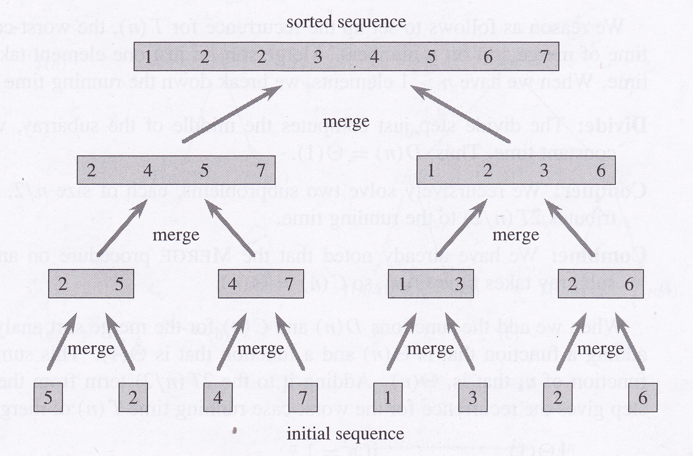
Introduction to Algorithms
David Meredith
dave@create.aau.dk

Slide 2
Resources
Chapters 1 to 3 of
  Cormen, T. H., Leiserson, C. E., Rivest, R. L. and Stein, C. (2009). Introduction to Algorithms. (Third Edition). MIT Press. ISBN: 0-262-53196-8.
There is now a third edition of this book:
  http://mitpress.mit.edu/catalog/item/default.asp?ttype=2&tid=11866
  http://www.amazon.co.uk/Introduction-Algorithms-T-Cormen/dp/0262533057

Slide 3
Algorithms
An algorithm is a well-defined computational procedure that takes some value (or set of values) as input and produces some value (or set of values) as output
An algorithm solves some well-defined computational problem that specifies some desired input/output relationship

Slide 4
The Sorting Problem
Input: A sequence, S, of n numbers,
<a₁, a₂, … a_{n}>
Output: A permutation of S,
S’ = <a’₁, a’₂, … a’_{n}>, such that a’₁ <= a’₂ <= … <= a’_{n}
Instance of the sorting problem:
  if S = <31, 41, 59, 26, 41, 58>, then
  S’ = <26, 31, 41, 41, 58, 59>

Slide 5
Correctness of an algorithm
An algorithm is correct if it halts with the correct output for every input instance
A correct algorithm solves a particular computational problem
An incorrect algorithm might not halt with some input instances or its output might be different from what is desired for some input instances
Sometimes a very fast incorrect algorithm can be more useful than a much slower correct algorithm, if the error rate can be controlled

Slide 6
Expressing algorithms
An algorithm can be expressed as
  pseudocode
  a computer program
  in a natural language, perhaps mixed with maths
  as a hardware design
  …
but it must be a precise (unambiguous) description of the computational procedure to be followed

Slide 7
Some examples of computational problems
Human genome project
  http://www.ornl.gov/sci/techresources/Human_Genome/home.shtml
  determine sequence of 3 billion base pairs in human DNA
  storing this information in a database
  developing tools for data analysis
Information retrieval
  How do you achieve almost instantaneous retrieval of information from the internet which contains billions of pages?
Networking and parallel processing
  How do you best route data across a large network?
  How do you best allocate jobs to multiple processors?
Security
  How do you ensure that private information stored electronically remains private?
Geographical information systems
  How do we calculate the fastest route between two points anywhere on a road map?

Slide 8
Data structures
The specific way that the information is stored and organised is a major factor in determining the possible efficiency of a solution
Data structures are designed to facilitate access and modifications to data

Slide 9
Hard problems
Algorithm’s efficiency usually measured in terms of the time and space (i.e., memory) required for it to run on an input of size n (i.e., containing n values)
There are some problems, known as NP-complete problems, for which no efficient solution is known
Has not been proved that no efficient solution exists for any NP-complete problem
If an efficient solution can be found for just one NP-complete problem, then efficient algorithms exist for all of them!
Good to know which problems are NP-complete because if you can show that your problem is equivalent to an NP-complete one, you can give up trying to find an efficient correct solution to it and perhaps resort to an algorithm that gives only a good solution most of the time
Example: the “travelling salesman problem”
  Find the shortest route to follow if you have to make deliveries at a number of different locations

Slide 10
Practical importance of algorithm efficiency
n | Merge sort | Insertion sort | Result
10 | 0.0002 seconds | 0.0000002 seconds | Insertion sort 1000 times faster
100 | 0.003 seconds | 0.00002 seconds | Insertion sort 170 times faster
10000 | 0.7 seconds | 0.2 seconds | Insertion sort 3 times faster
1000000 | 100 seconds | 33 minutes | Merge sort 20 times faster
1000000000 | 1.7 days | 63 years | Merge sort 13000 times faster
Insertion sort takes time c₁n² to sort n items
Merge sort takes time c₂nlog₂n to sort n items
Merge sort has a factor of log₂n where insertion sort has a factor of n, which is much larger
Typically, c₁ < c₂, but when n is large, this advantage of insertion sort becomes insignificant
Suppose c₁ is 2 and c₂ is 50 and we run insertion sort on a machine that is 100 times faster than the one we run merge sort on:
  Insertion sort machine: 10⁹ instructions per second
  Merge sort machine: 10⁷ instructions per second
For large inputs, total performance depends more on algorithms than it does on fast hardware, system architecture, intuitive interfaces etc.

Slide 11
The Sorting Problem
Input: A sequence, S, of n numbers,
<a₁, a₂, … a_{n}>
Output: A permutation of S,
S’ = <a’₁, a’₂, … a’_{n}>, such that a’₁ <= a’₂ <= … <= a’_{n}
Instance of the sorting problem:
  if S = <31, 41, 59, 26, 41, 58>, then
  S’ = <26, 31, 41, 41, 58, 59>
Numbers to be sorted are also called keys

Slide 12
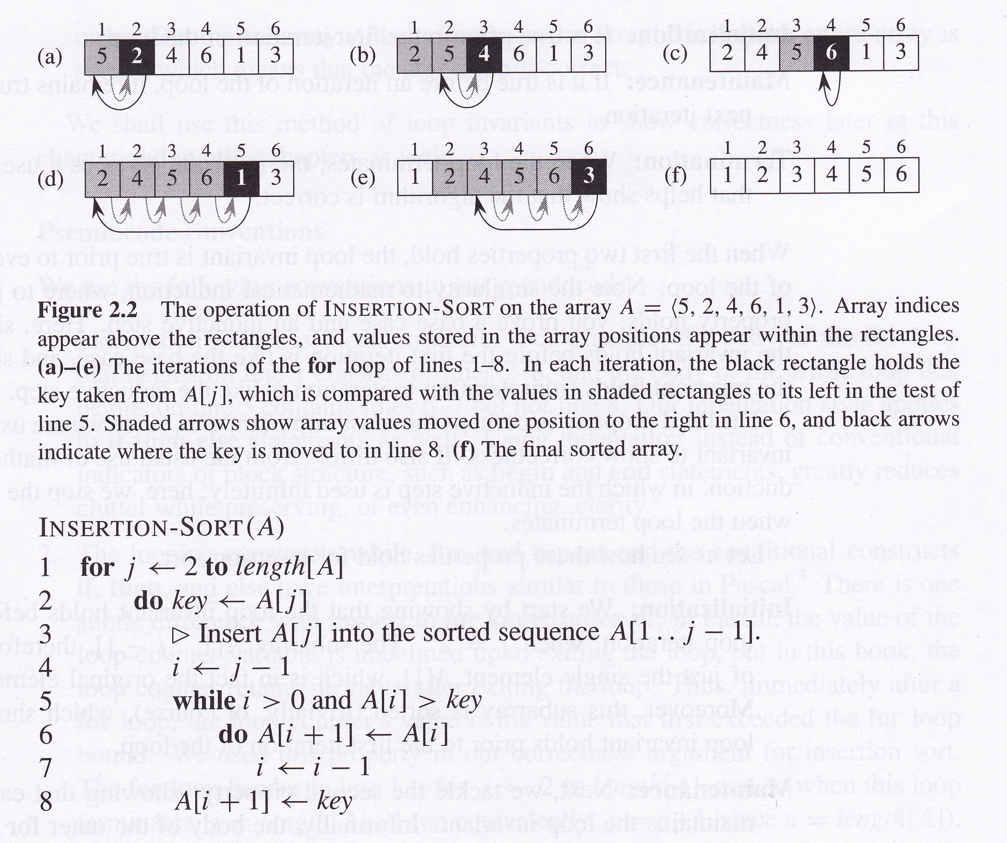
Insertion sort

Slide 13
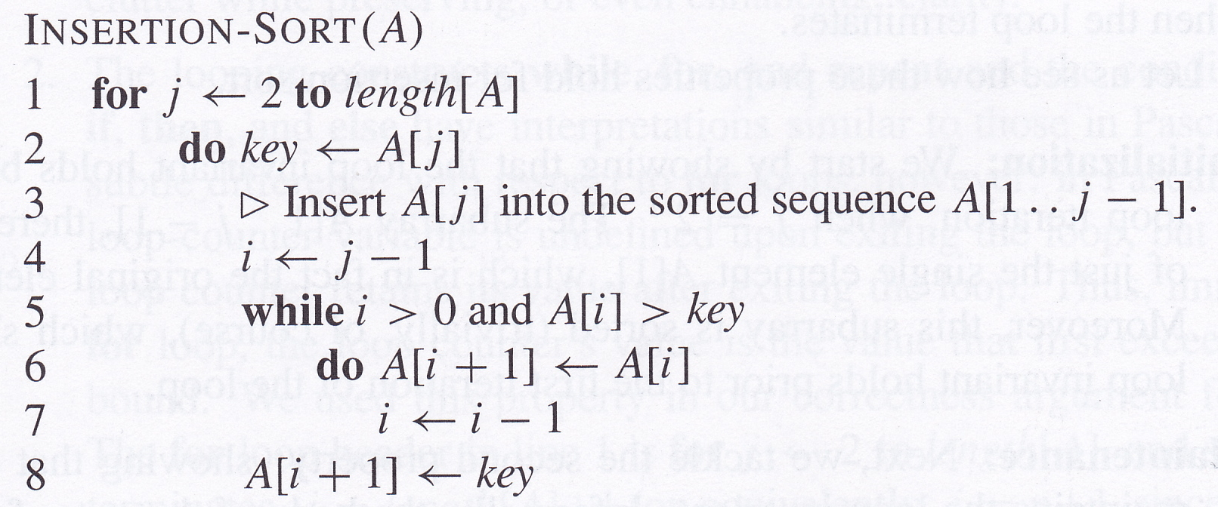
Loop invariants
Loop invariant: “At the start of each iteration of the for loop of lines 1-8, the subarray A[1..j-1] consists of the elements originally in A[1..j-1] but in sorted order.”

Slide 14
Showing correctness using loop invariants
To show correctness, we must show three things about the loop invariant:
  Initialization: It is true before the first iteration.
  Maintenance: If it is true before an iteration, then it is true before the next iteration.
  Termination: When the loop terminates, the invariant gives us a property that helps prove the algorithm’s correctness
Initialization and maintenance work like mathematical induction
  show that loop invariant is true before every iteration

Slide 15
Correctness of insertion sort
Initialization: when j = 2, A[1..j-1] contains just A[1] which is sorted. Therefore loop invariant holds before the first iteration.
Maintenance: on an iteration, A[1..j-1], A[1..j-2], A[1..j-3], etc. are moved one to the right and A[j] is inserted in the correct position. Therefore, if A[1..j-1] was sorted at the beginning of the iteration, then it is still sorted at the beginning of the next iteration.
Termination: “for” loop ends when j exceeds n (length of A) – that is, when j = n + 1. Therefore, after last iteration, loop invariant says that “the subarray A[1..n] consists of the elements originally in A[1..n] but in sorted order.” In other words, the array is sorted!

Slide 16
Analysing algorithms
Analysing an algorithm means predicting the resources that it requires (e.g., time, memory, communication bandwidth, computer hardware, etc.)
Most interested in running time (also interested in space – i.e., memory)
Generally assume algorithm will run on a random access machine (RAM)

Slide 17
Random Access Machine (RAM)
Single-threaded execution
Constant-time instructions include
  simple arithmetic (+,-,*,/,%,floor, ceil)
  data movement (load, store, copy)
  control (branching, subroutine calls and returns)
Data types are integers and floating point numbers

Slide 18
Analysing insertion sort
n | Merge sort | Insertion sort | Result
10 | 0.0002 seconds | 0.0000002 seconds | Insertion sort 1000 times faster
100 | 0.003 seconds | 0.00002 seconds | Insertion sort 170 times faster
10000 | 0.7 seconds | 0.2 seconds | Insertion sort 3 times faster
1000000 | 100 seconds | 33 minutes | Merge sort 20 times faster
1000000000 | 1.7 days | 63 years | Merge sort 13000 times faster
Time taken increases with input size
Running time usually expressed as a function of the size of the input
For a given input size, running time depends on how sorted the sequence is at the start
Here, “size of input” means the number of items in the sequence to be sorted
“Running time” is the number of primitive operations executed
  here, “primitive operation” will usually (but not always) be one line of pseudocode
  assume each line is executed in constant time (independent of size of input) and that line i takes time c_{i}

Slide 19
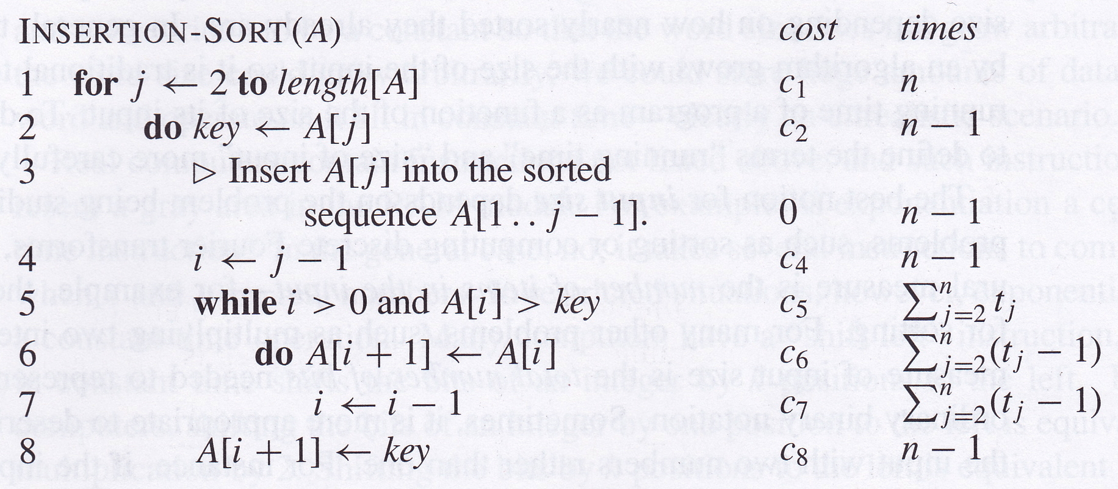
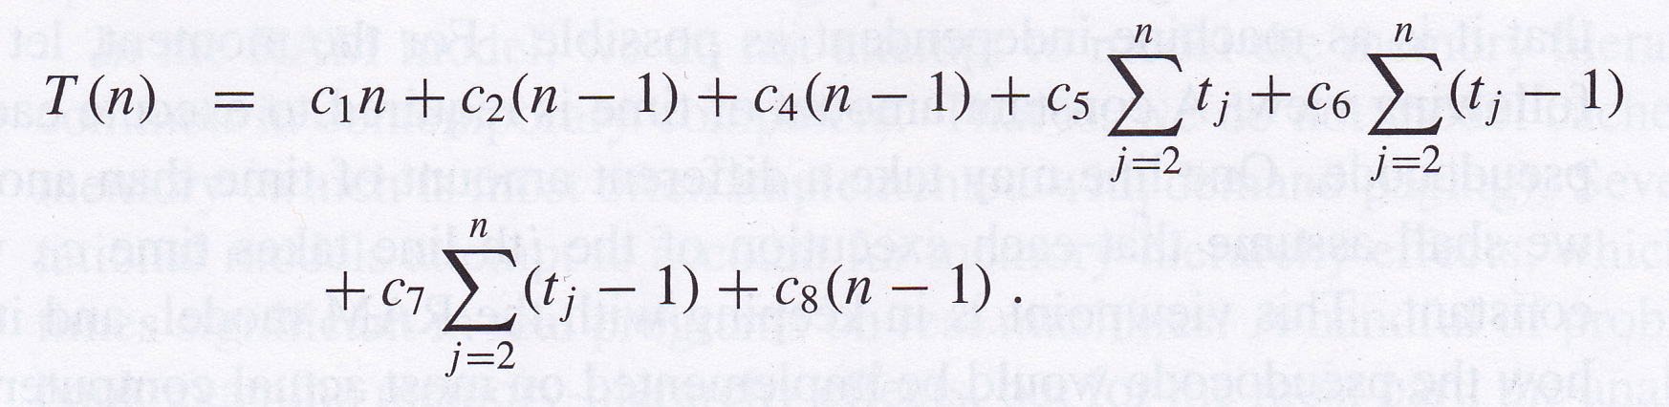
Running time of insertion sort
t_{j} is the number of times that line 5 is executed for the given value of j

Slide 20
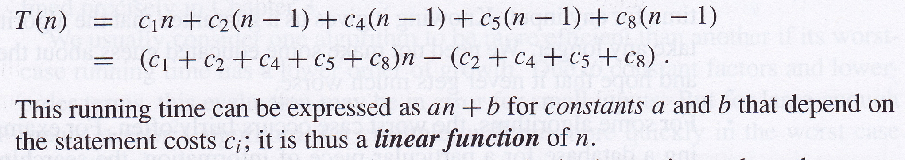
Insertion sort best-case running time
Best-case running time occurs when the sequence is already sorted
  On each iteration, only has to check previous item and identify that it is less than the current one
    implies t_{j} is 1 for each j

Slide 21
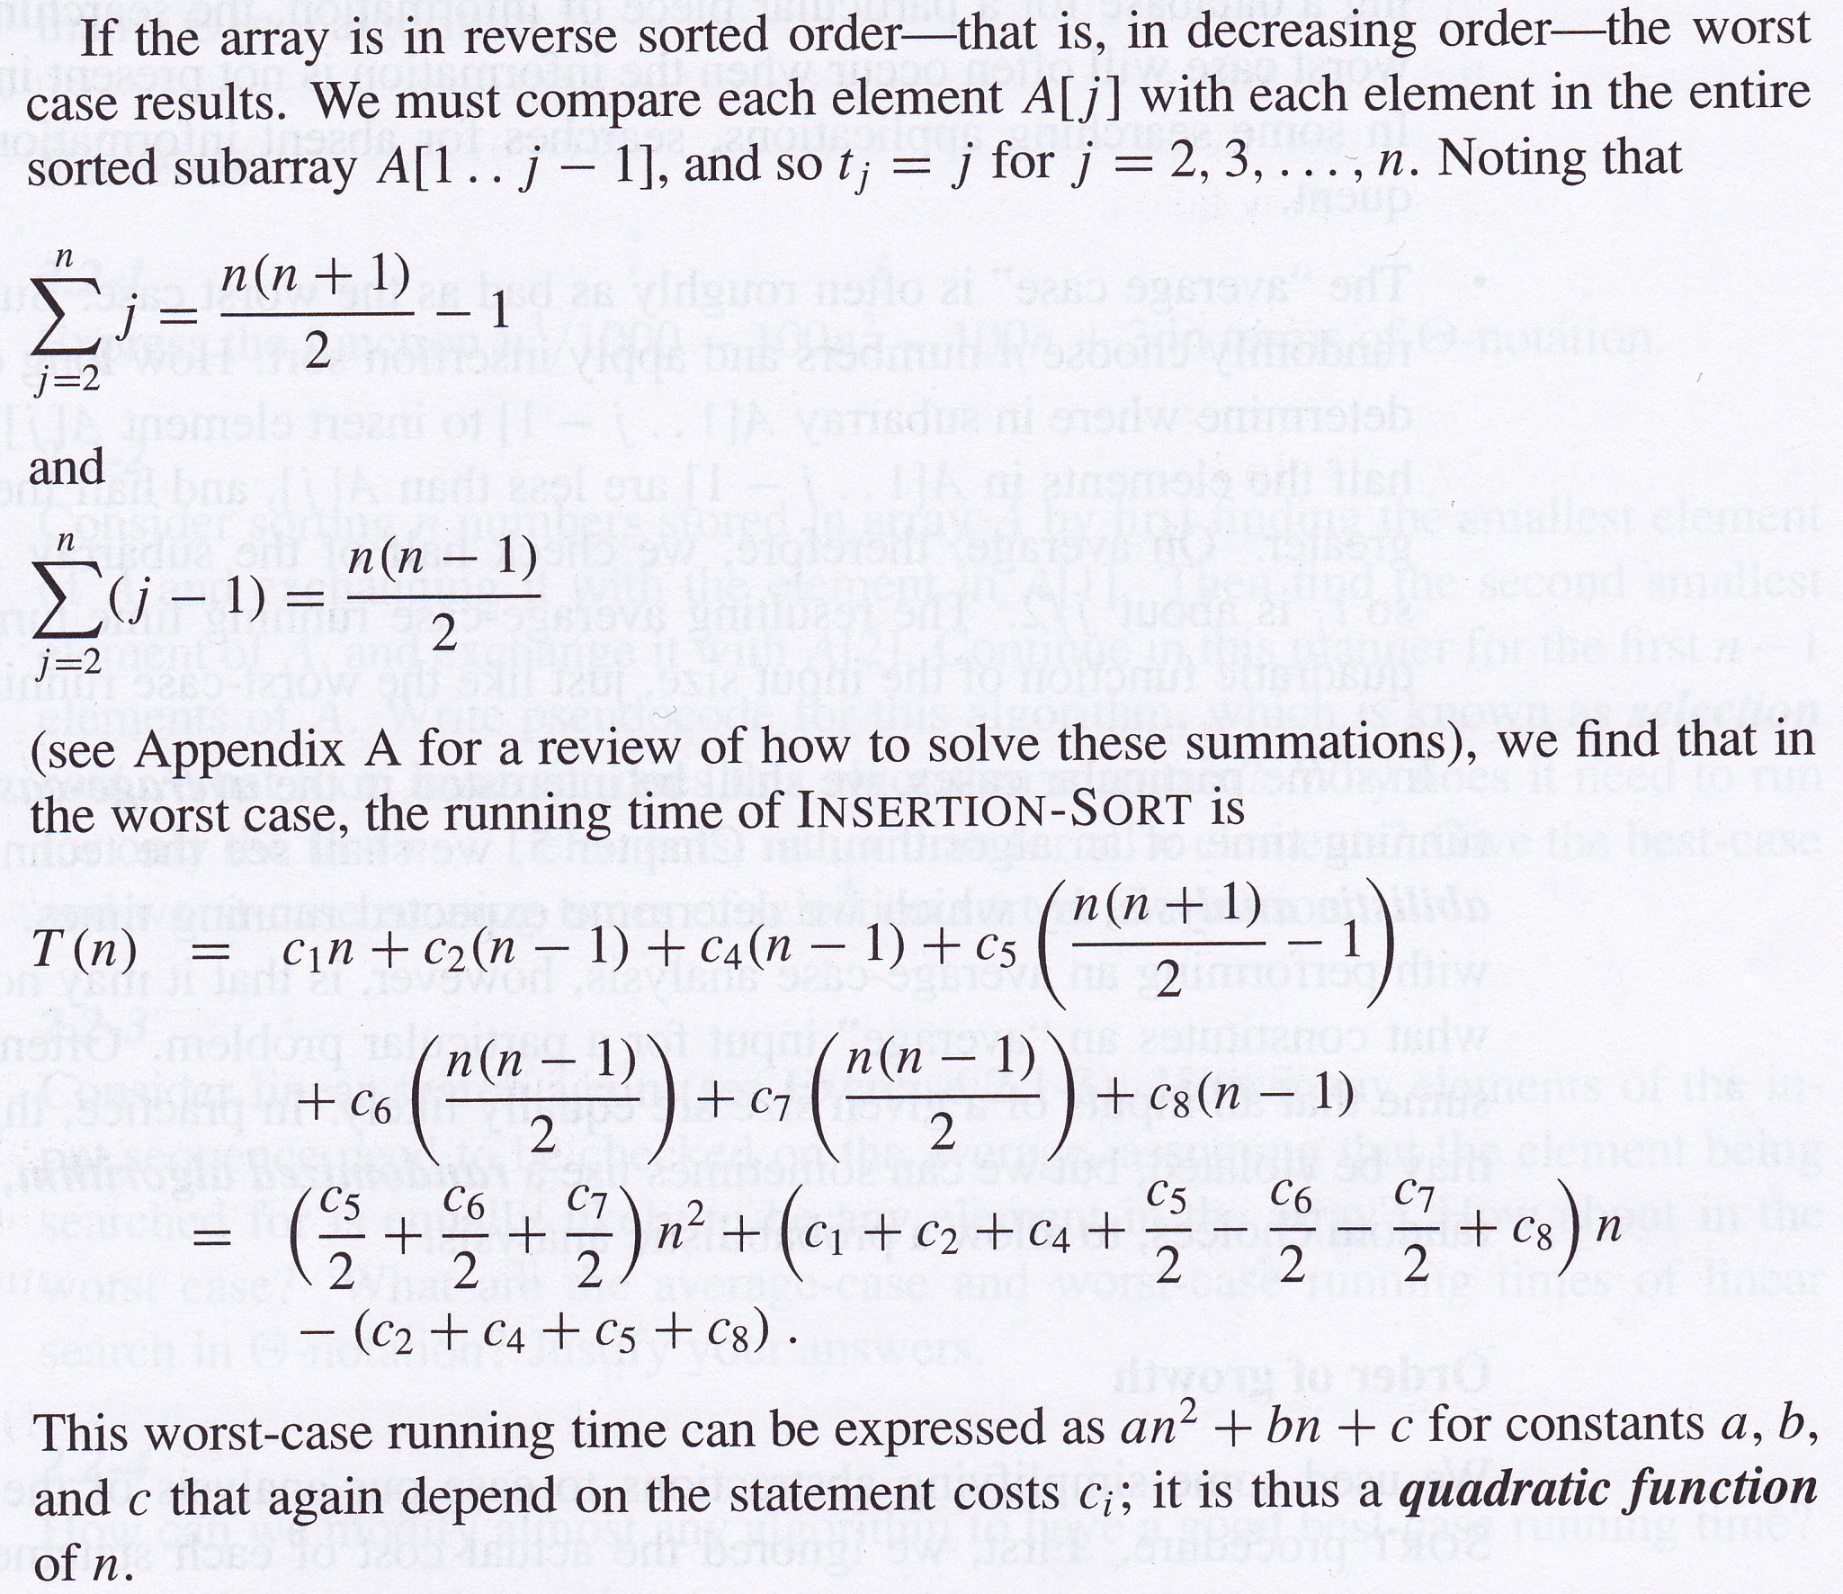
Insertion sort worst-case running time

Slide 22
Focus on worst-case running time
Worst-case is an upper bound – guaranteed that running time won’t be any longer
For some algorithms (e.g., database search algorithms), worst-case can occur quite often (failure to find what we’re searching for)
Sometimes interested in average-case or expected running time
  need to do some probabilistic analysis
  sometimes not obvious what an “average case” is

Slide 23
Order of growth
Insertion sort worst-case running time is
an² + bn + c
  ignores actual values of constants c_{i} for each line
Generally ignore lower order terms in this expression since these are usually insignificant for large n
Also generally ignore the constant term for the highest-order term in the time function since constant factors are generally specific to particular platforms and hardware

Slide 24
Order of growth
We therefore generally say that insertion sort has a worst-case running time of Θ(n²)
  This means that the worst-case running time grows as a quadratic function of n
An algorithm is usually considered more efficient than another if its worst-case running time has a lower order of growth
  This can lead to incorrect conclusions for specific running times for small inputs, but holds as the input size grows indefinitely

Slide 25
Recursion and divide-and-conquer
A recursive algorithm is one that calls itself
  Could be that the algorithm calls another function that calls the first algorithm
  In a recursive algorithm, there will be more than one call to the algorithm on the call stack
The divide-and-conquer approach has 3 steps:
  Divide the original problem into smaller sub-problems that are all similar to the original problem
  Conquer the subproblems recursively
  Combine the subproblem solutions to solve the original problem

Slide 26
Merge Sort
Uses the divide-and-conquer paradigm:
  Divide: Divide the n-element sequence into two equal-length subsequences
  Conquer: Sort the two shorter subsequences recursively using merge sort
  Combine: Merge the two sorted subsequences to produce the sorted original sequence
Merge sort called recursively on smaller and smaller sequences until it is called on sequences containing only 1 element…which are already sorted

Slide 27
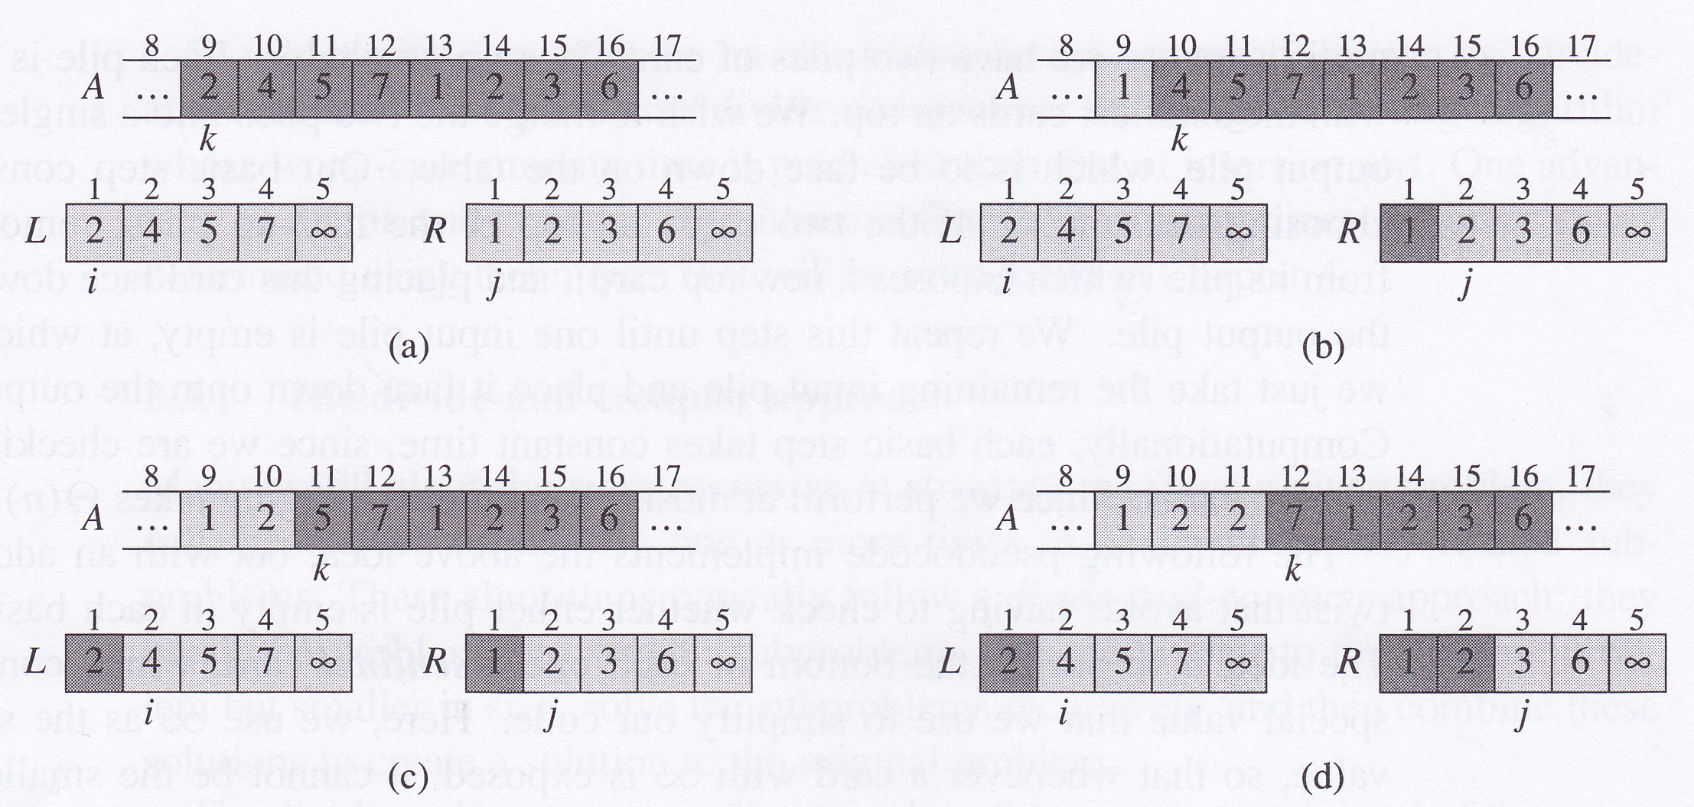
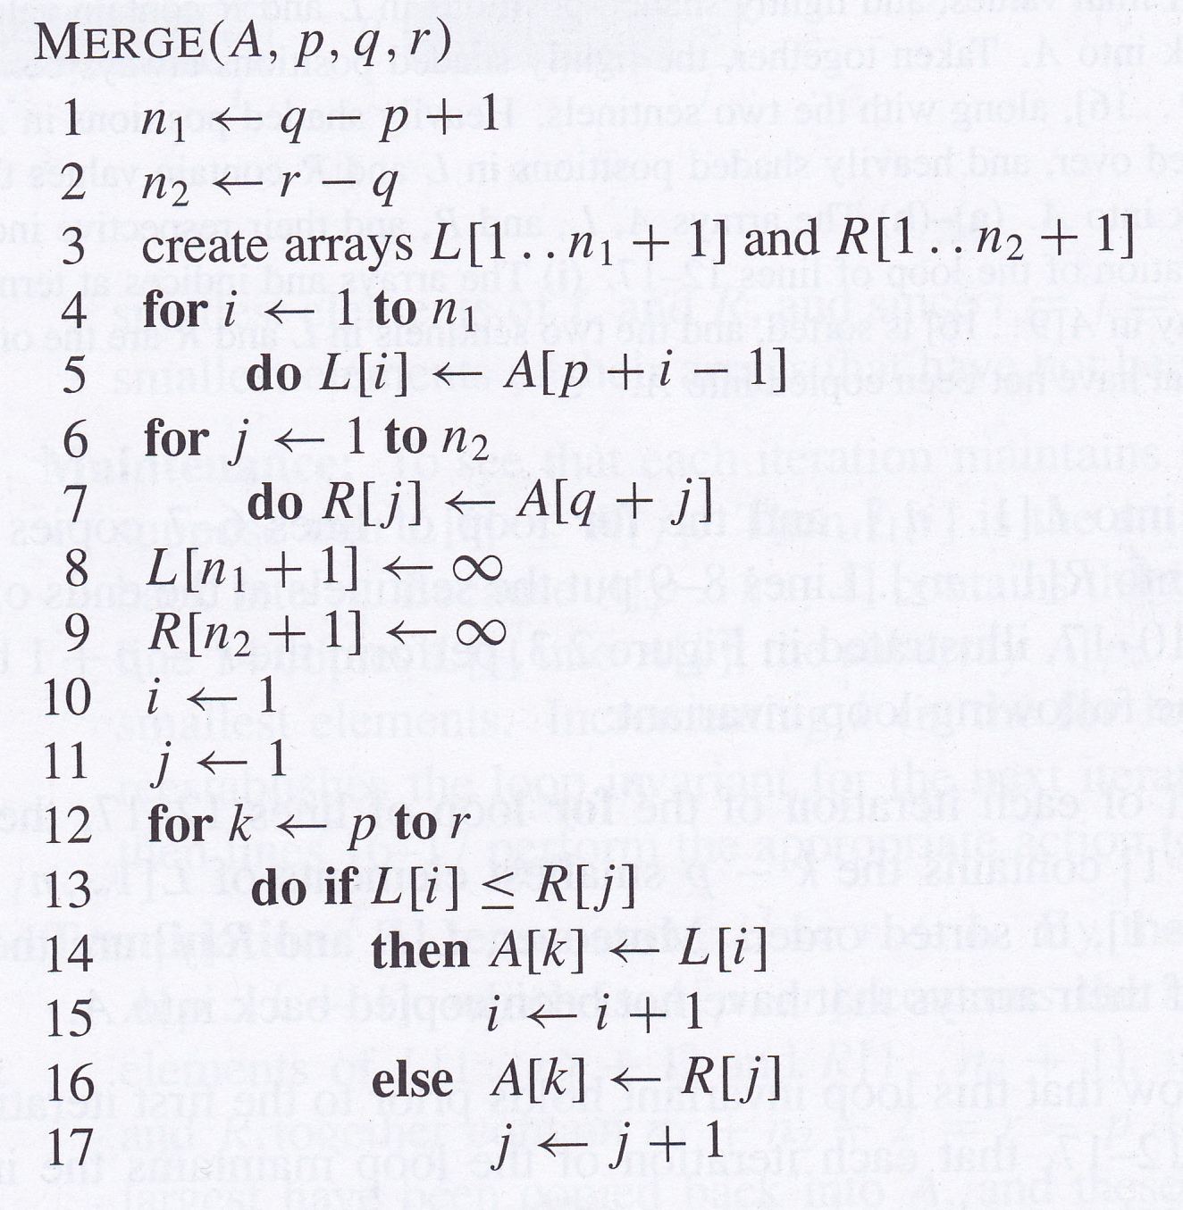
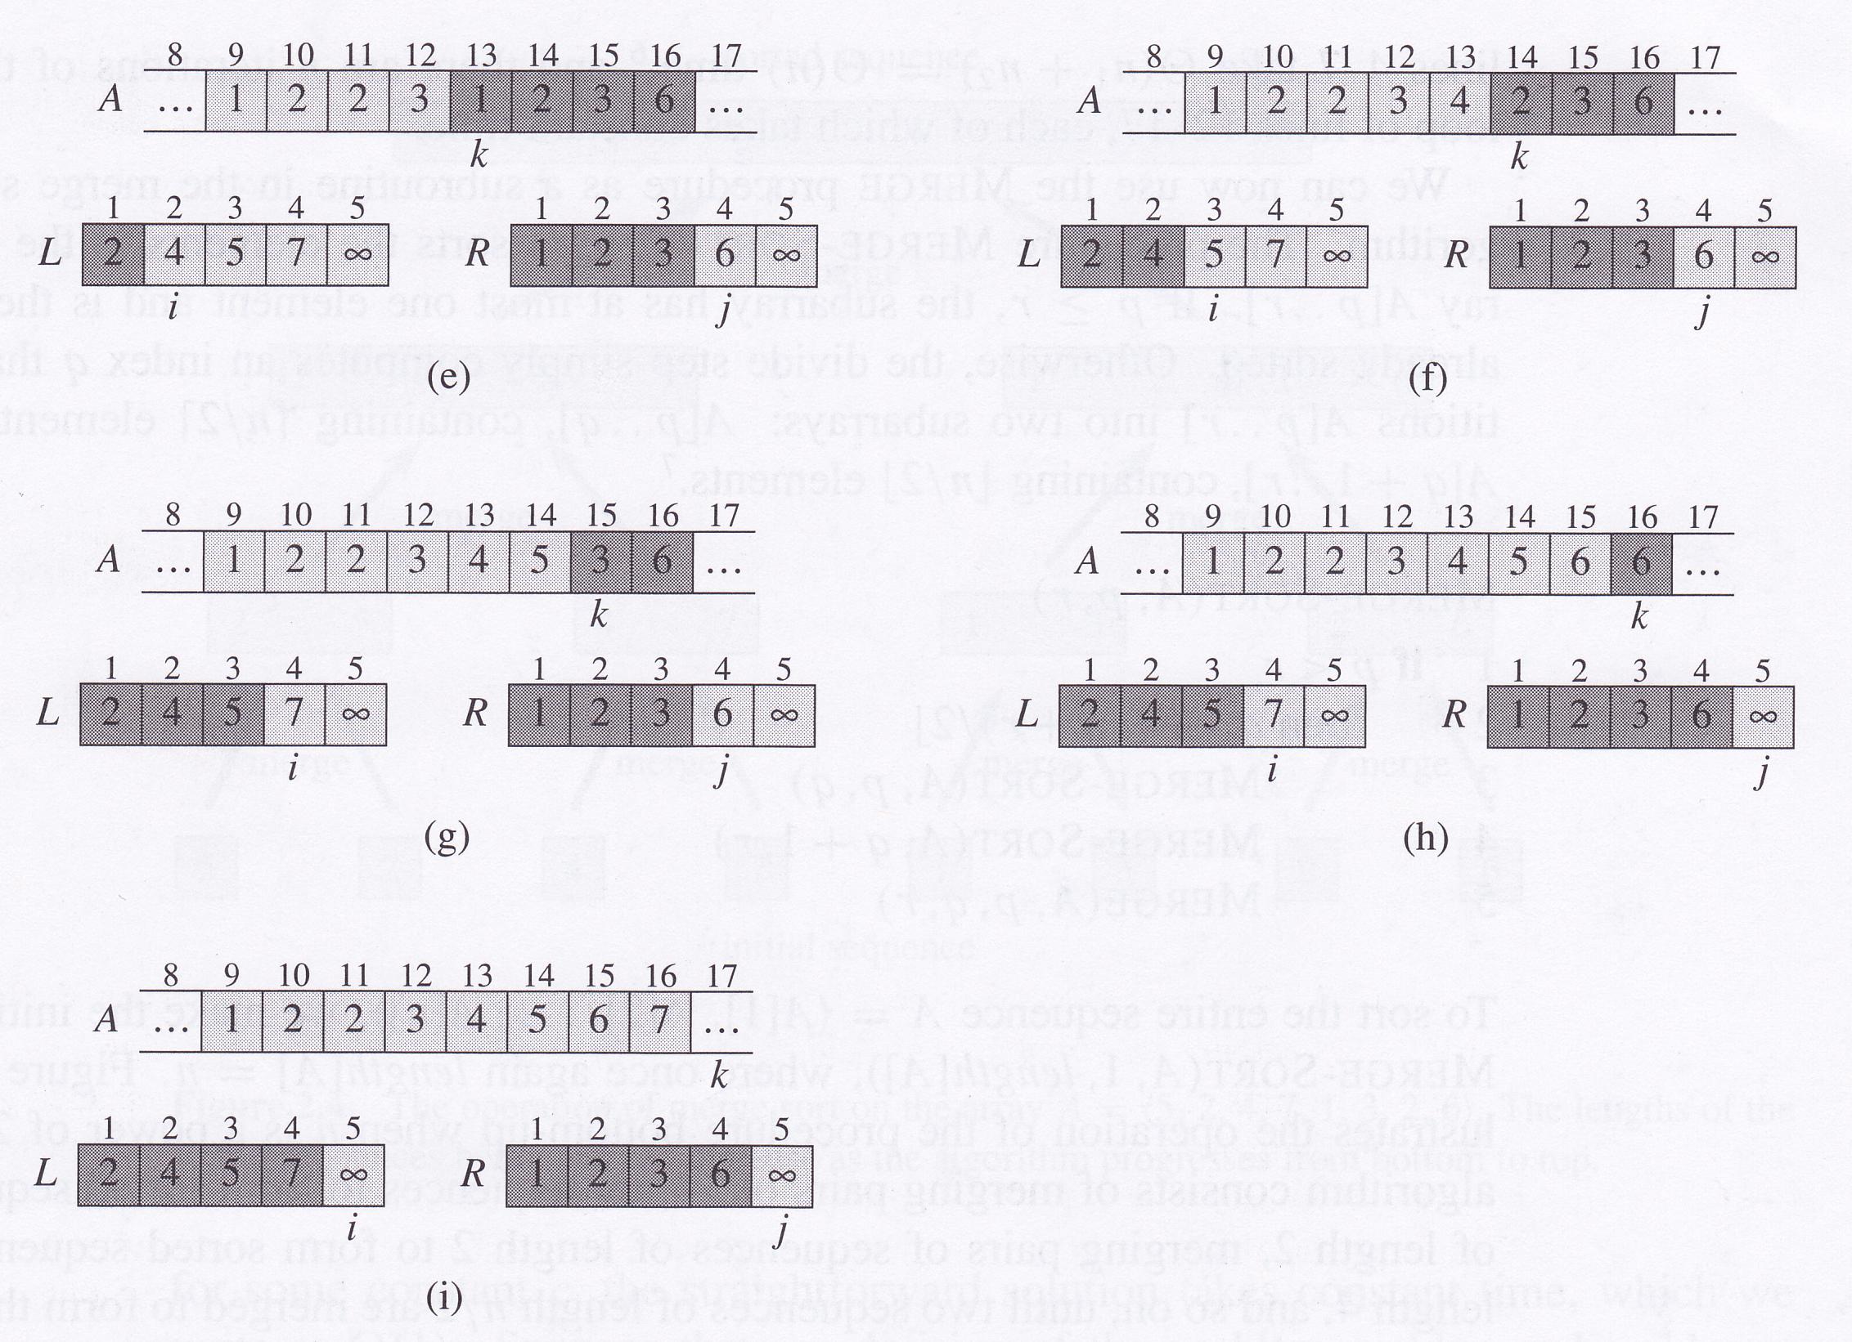
Merge algorithm
MERGE algorithm is Θ(n)

Slide 28
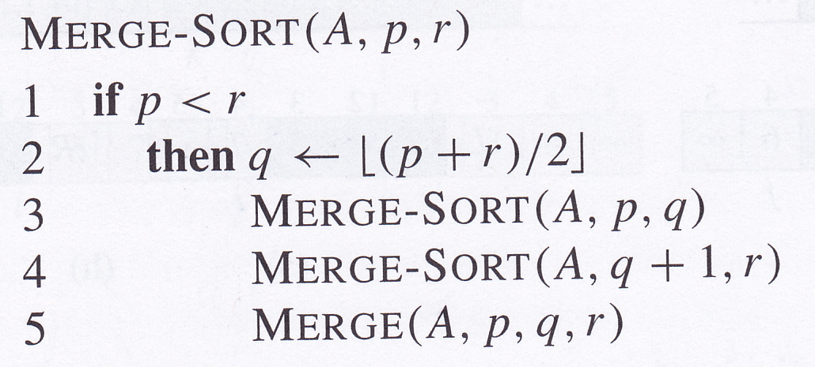
Merge sort
Sorts A[p..r]
If p >= r, then at most 1 element in A, so A is already sorted
If p < r, then A[p..r] divided into two subarrays:
  A[p..q] containing ceil(n/2) elements
  A[q+1..r] containing floor(n/2) elements
Start by calling Merge-Sort(A,1,length[A])

Slide 29
Merge sort

Slide 30
Analysing divide-and-conquer algorithms
The running time of a recursive algorithm can usually be described using a recurrence or recurrence equation
Let T(n) be running time on input of size n
If n <= c, running time is constant, Θ(1)
  e.g., when sequence in merge sort contains 1 element
Assume divide problem into a subproblems and that each subproblem is 1/b times the size of the original
  in merge sort, a and b are both 2
Denote time taken to divide into subproblems by D(n)
Denote time taken to combine the subproblems to produce final solution by C(n)

Slide 31
Analysis of merge sort
We assume n is a power of 2 to simplify the argument
Total time is given by the recurrence
Merge sort on 1 element takes constant time, Θ(1)
Following divide-and-conquer paradigm:
  Divide Computes middle of subarray and takes constant time: D(n) = Θ(1)
  Conquer Recursively solve two subproblems, each of size n/2 which contributes 2T(n/2) to running time
  Combine Merge subroutine on an n-element array takes time Θ(n), so C(n) = Θ(n)
D(n)+C(n)=Θ(1)+Θ(n)=Θ(n) so recurrence for worst-case running time of merge sort is

Slide 32
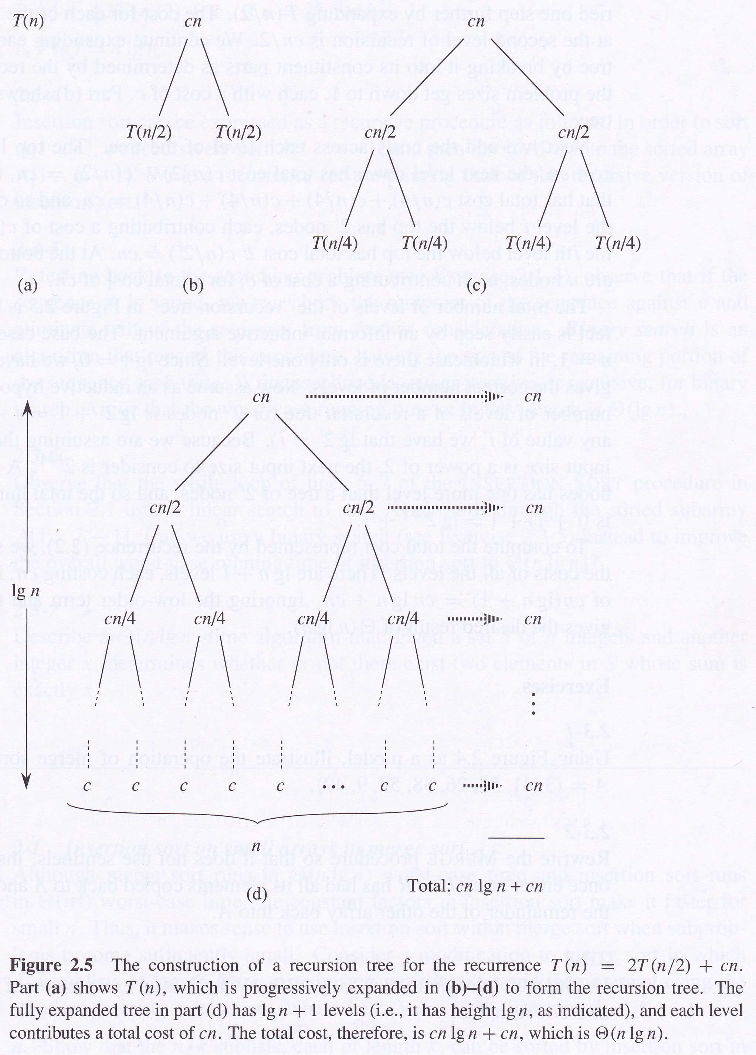
Analysis of merge sort
Replace Θ(1) with c and Θ(n) with cn in recurrence
In recursion tree, ith level contains 2^{i-1} terms, each term is
cn/(2^{i-1})
So each level takes cn time
When the bottom level contains 2^{j} terms, there are j+1 levels in total
The lowest level contains n terms, but n = 2^{log}2^{n}, so there are log₂n+1 levels in total
So total time is cn(log₂n+1)
c can be either the larger or the smaller of the two constants, therefore the worst-case running time of merge sort is Θ(nlog₂n)

Slide 33
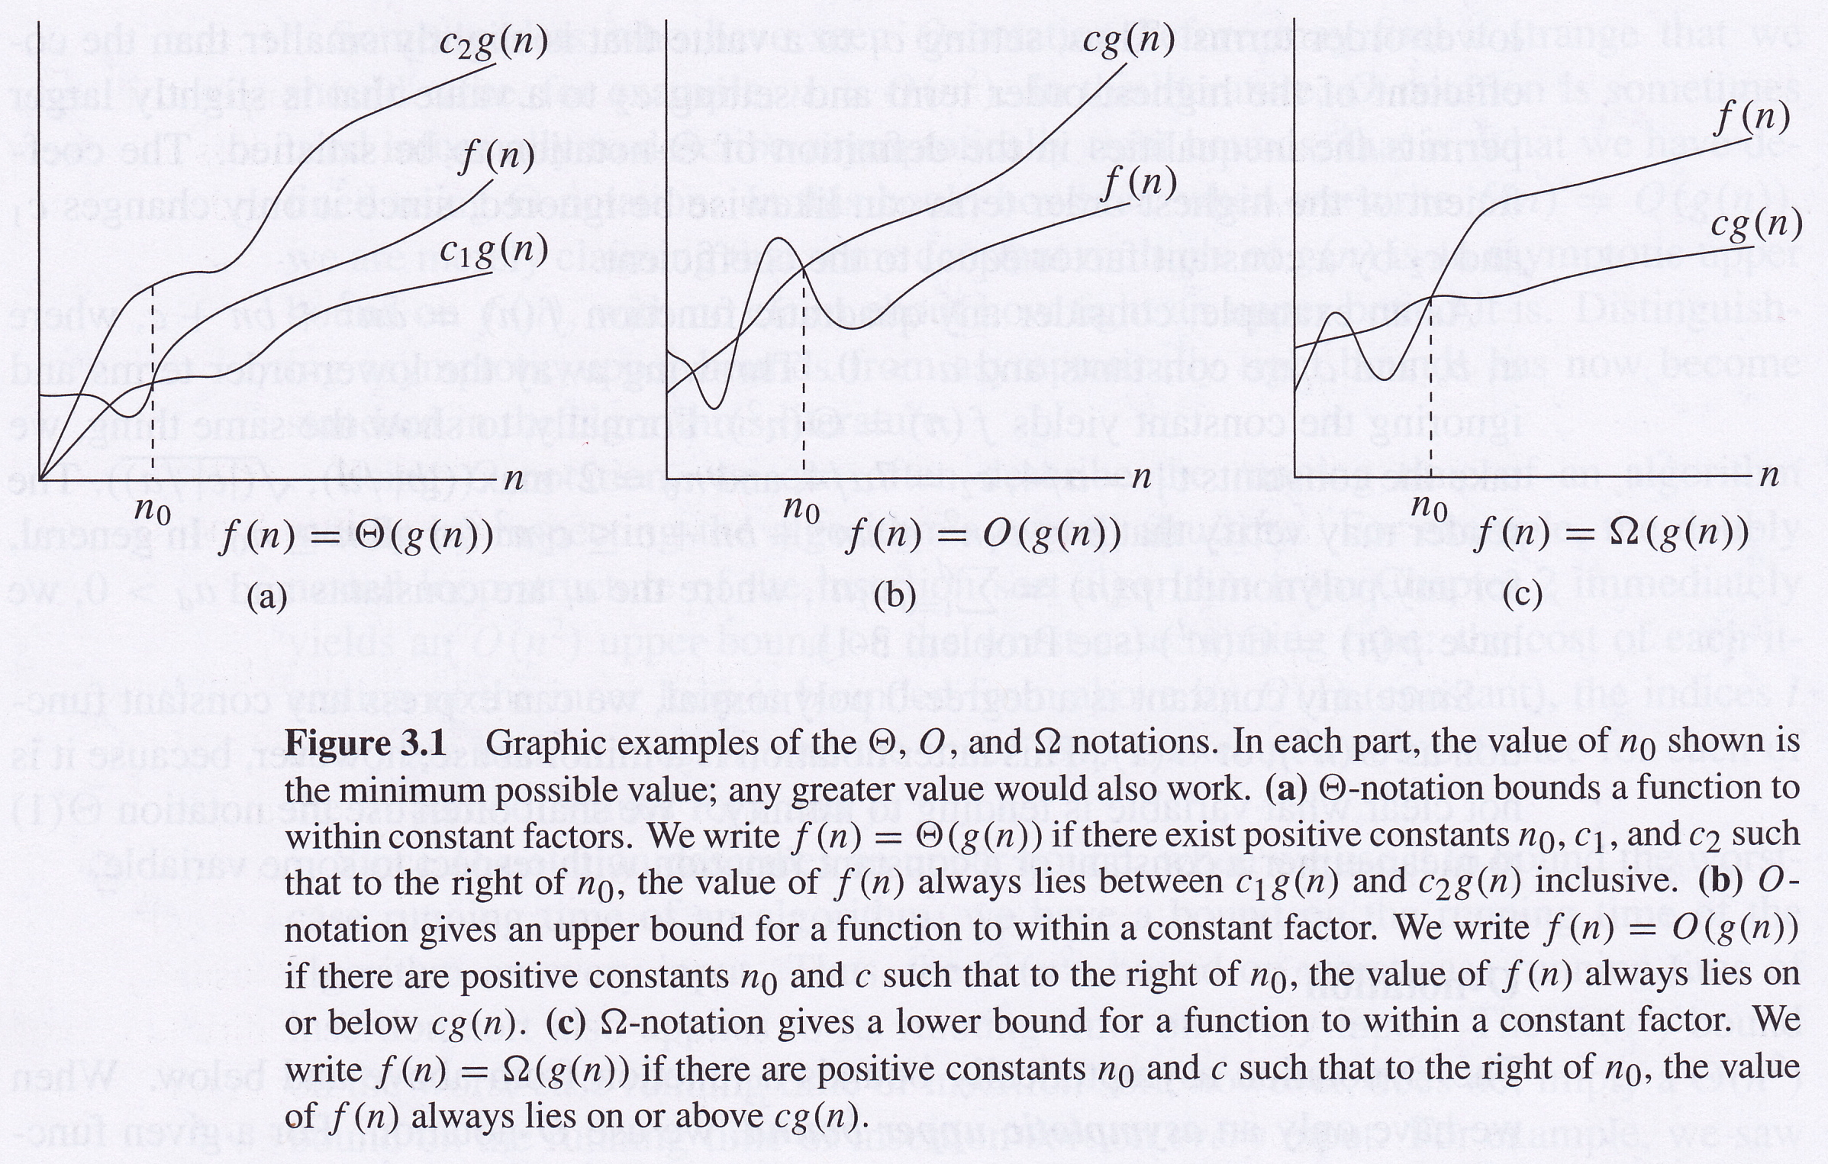
O, Θ and Ω notation

