Slide 1

Pandas
David Meredith
dave@create.aau.dk

Slide 2
Pandas
The Pandas library provides high-performance, easy-to-use data structures and data analysis tools
The main data structure is the DataFrame, which you can think of as an in-memory 2D table (like a spreadsheet, with column names and row labels)
Many features available in Excel are available programmatically, such as creating pivot tables, computing columns based on other columns, plotting graphs, etc.
You can also group rows by column value, or join tables much like in SQL.
Pandas is also great at handling time series.

Slide 3
Pandas data structures
Pandas contains the following useful data structures:
Series objects – a 1D array, similar to a column in a spreadsheet, with column name and row labels
DataFrame objects – 2D tables, similar to a spreadsheet
Panel objects – a dictionary of DataFrames (like an Excel Workbook)

Slide 4
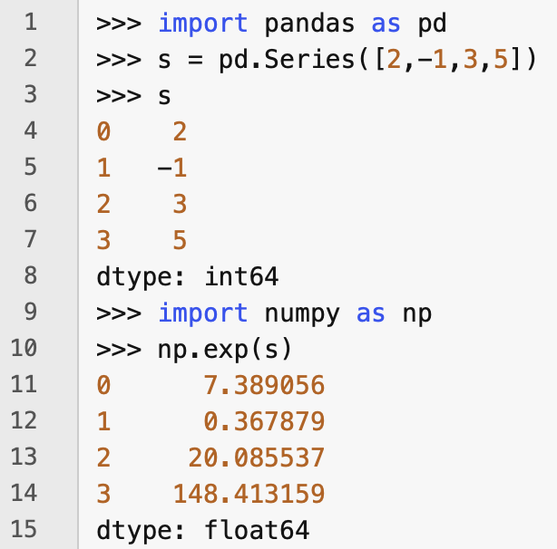
Creating a Series
You can create a Series object by using the pd.Series() constructor
Series objets are like 1D NumPy ndarrays, and you can often pass a Series object as an argument to NumPy functions

Slide 5
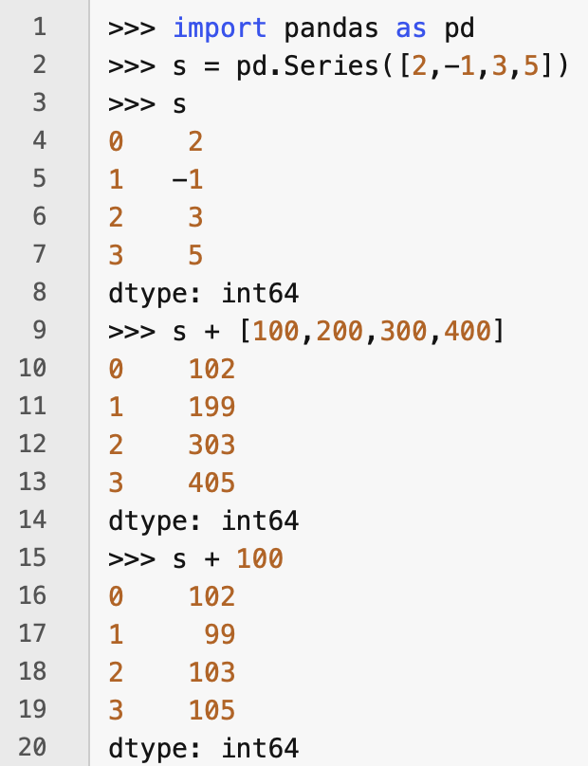
Arithmetic operations on Series objects
Arithmetic operations on Series objects apply element-wise, just as for ndarrays
The broadcasting rules apply when the arguments are not the same shape

Slide 6
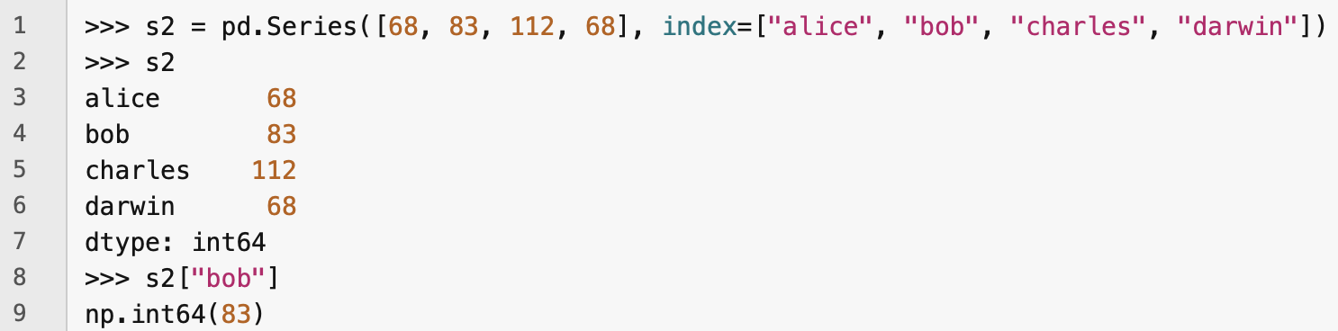
Index labels
Each item in a Series has a unique identifier called an index label
By default, the index label is the position of the item in the Series (starting at 0)
You can also set the labels manually
You can then use the Series just like a dict

Slide 7
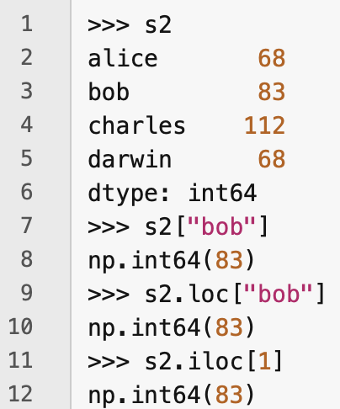
Using loc and iloc
When accessing a Series by label, use the loc attribute
When accessing a Series by integer, use the iloc attribute

Slide 8
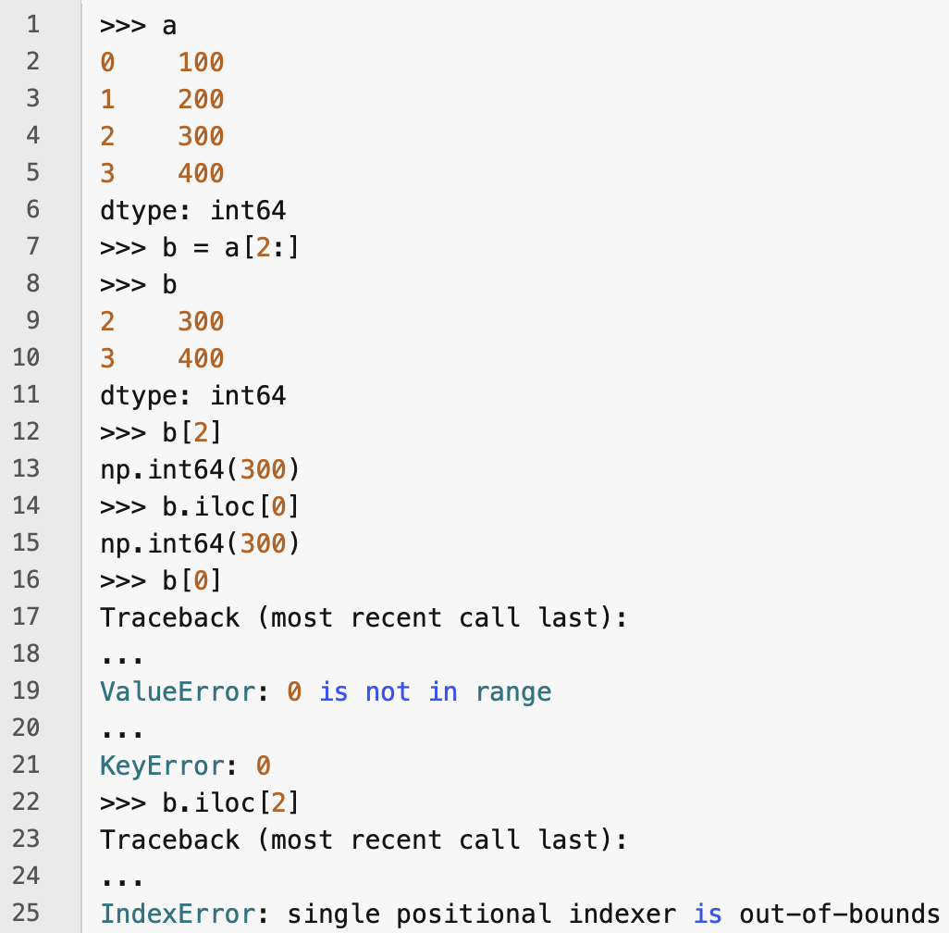
Slicing a Series object
Slicing a Series object also slices the index labels – the index label of an item in a Series stays constant, even when the item is in a slice

Slide 9
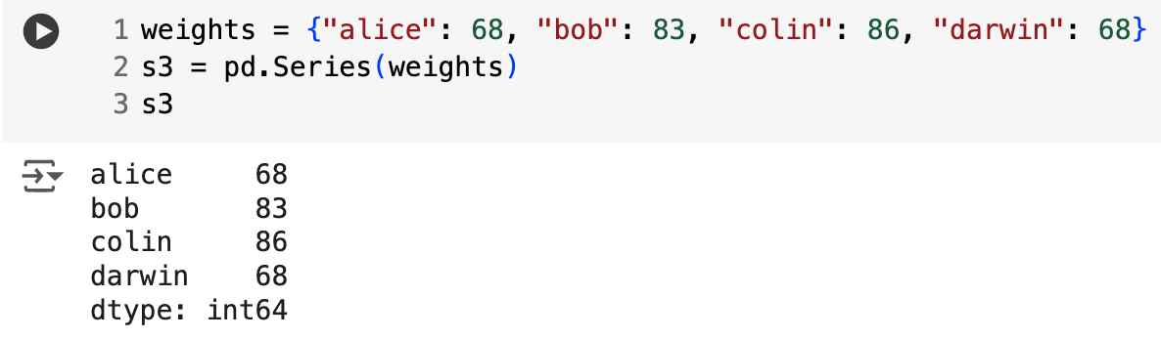
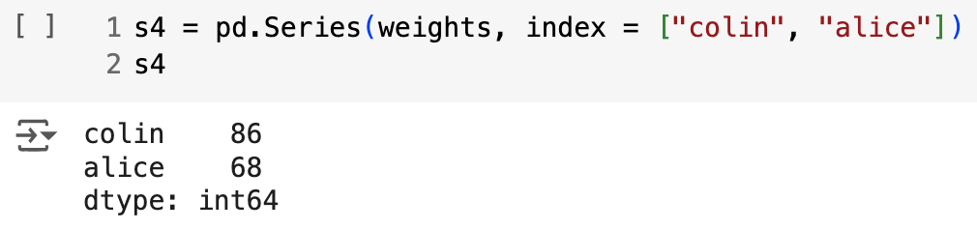
Creating a Series from a dict
You can construct a Series object from a dict simply by giving the dict to the Series constructor as an argument
You can select a subset of the items in a dict to include in the Series

Slide 10
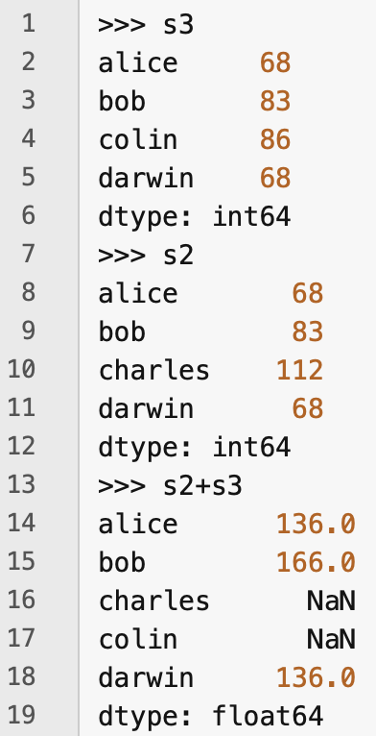
Automatic alignment of index labels
When an operation involves multiple Series objects, pandas automatically aligns them by matching index labels
Result contains union of index labels from argument Series
If an index label is missing from one of the argument lists, then the result of addition for that item is NaN – i.e., missing

Slide 11
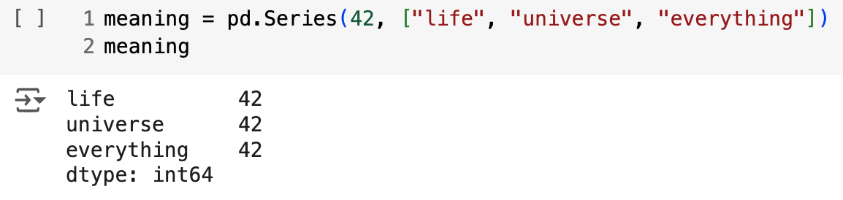
Initializing a Series with a scalar value
You can initialize a Series with a scalar value and a list of index labels

Slide 12
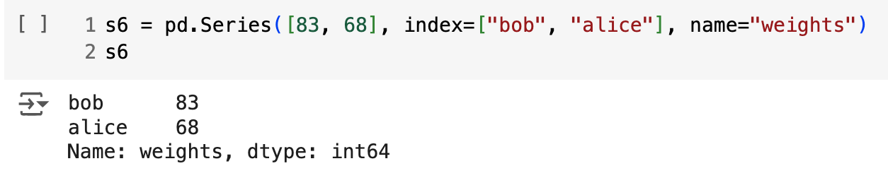
Series name
You can assign a name to a Series

Slide 13
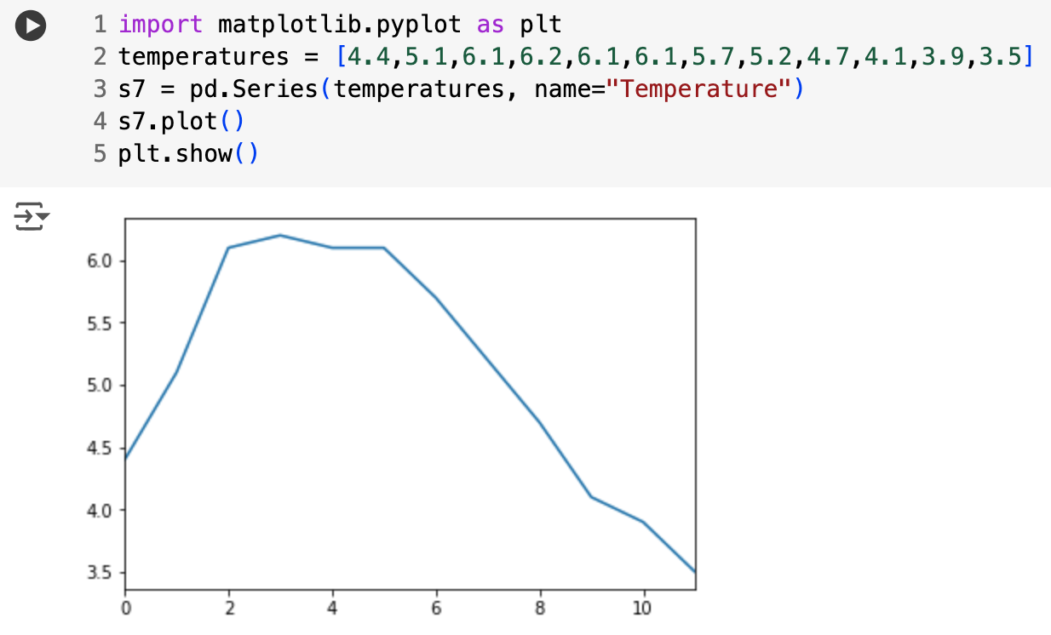
Plotting a Series
You can plot a series by importing matplotlib, creatin a Series, then calling its plot() method, then calling pyplot.show()
There are lots options for plotting your data – refer to the "Visualization" section of the pandas documentation

Slide 14
Handling time
Pandas has excellent support for handling time information
it can represent periods (e.g., 2016Q3) and frequencies (e.g., "monthly")
it can convert periods to timestamps and vice versa
it can resample data and aggregate values any way you like
it can handle timezones

Slide 15
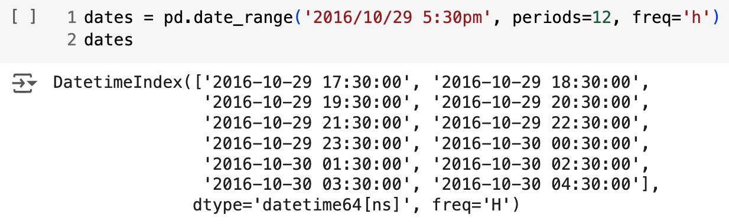
Time range
We can use pd.date_range() to create a time series
Example above returns a DatetimeIndex containing one datetime per hour for 12 hours, starting on October 29th 2016 at 17.30

Slide 16
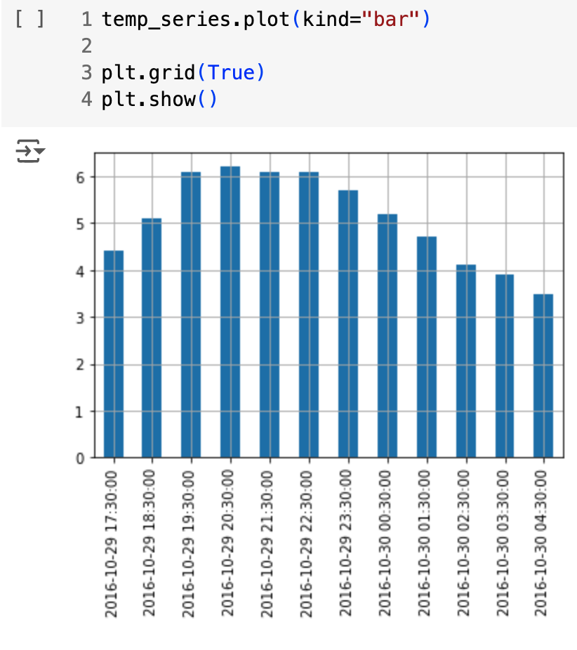
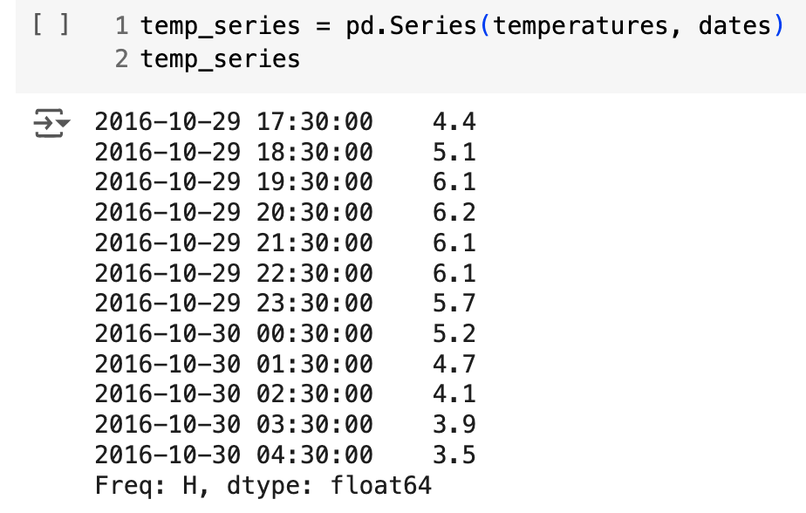
Using a DatetimeIndex as an index in a Series
A DatetimeIndex can be used as an index in a Series
temperatures was defined above

Slide 17
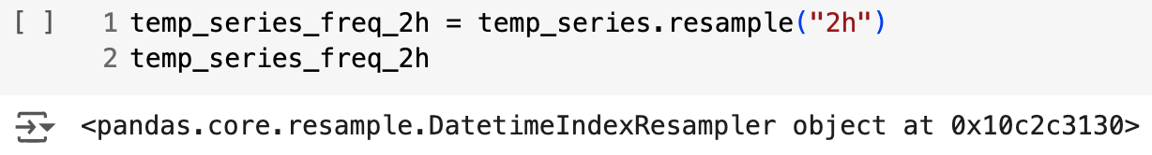
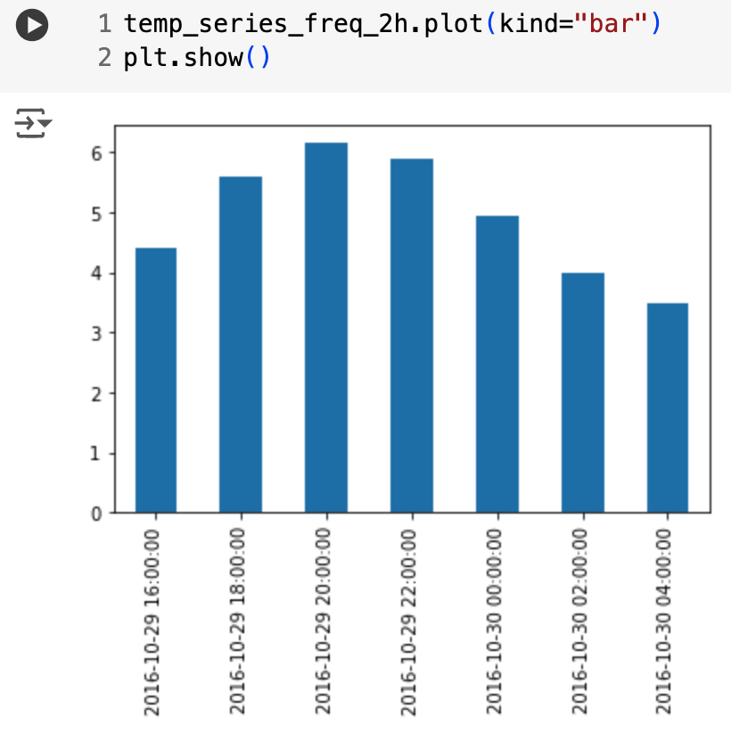
Resampling a time series
A time series can be resampled by calling its resample() method and specifying a new frequency
This is a deferred operation, meaning that it is only carried out when it becomes necessary
Here we can cause the resampling to be done by calling the mean() method

Slide 18
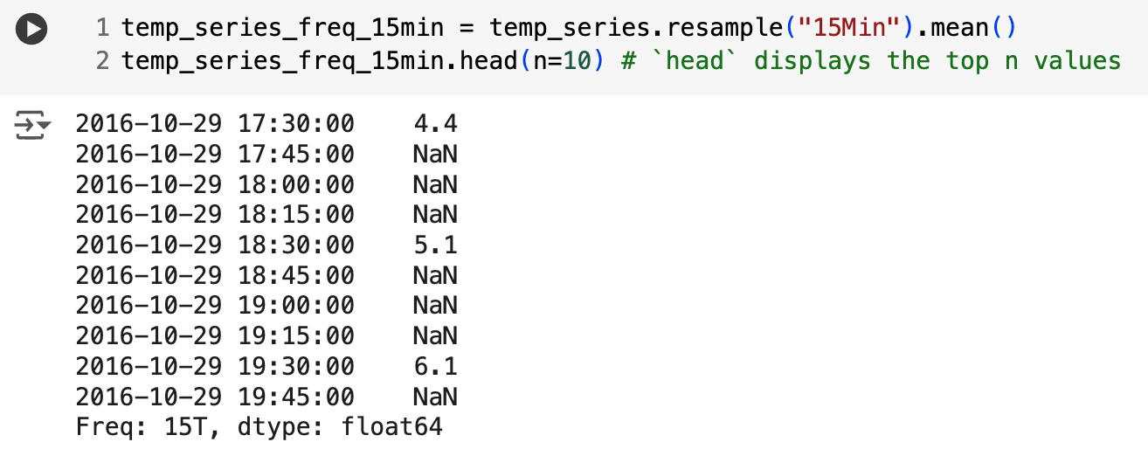
Upsampling and interpolation
The previous example was an example of downsampling
We can also upsample (increase the frequency), but this will create gaps in our data

Slide 19
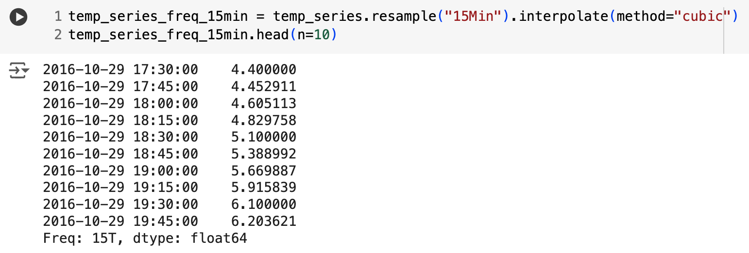
Filling gaps with interpolation
We can fill the gaps with interpolation
The default is to use linear interpolation, but we can also use another method, e.g., cubic interpolation

Slide 20
DataFrames
A DataFrame is essentially a dictionary of Series objects
You can
define expression to compute columns based on other columns
create pivot tables
group grows
draw graphs
...

Slide 21
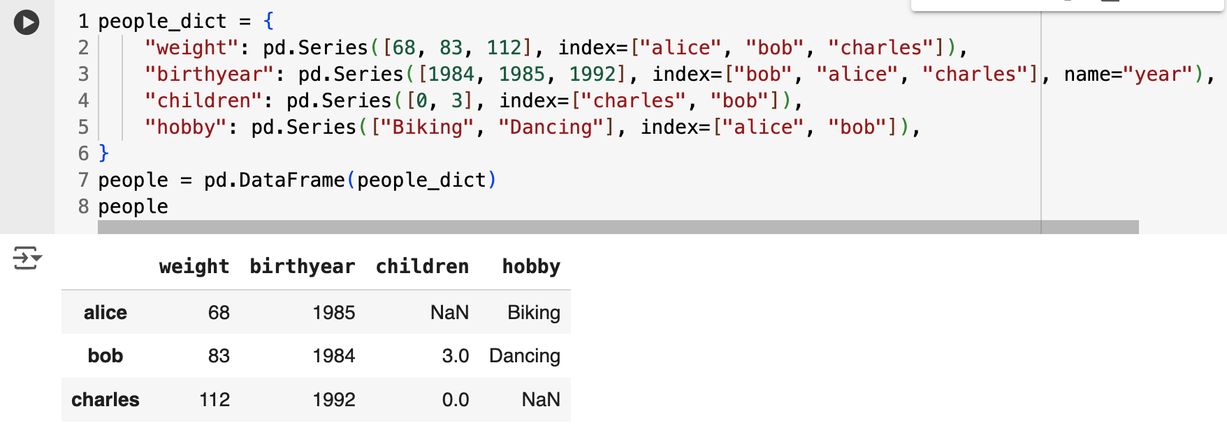
Creating a DataFrame
You can create a DataFrame by passing a dictionary of Series objects
Note in the example above that
the Series objects were automatically aligned on their indices
missing values are represented as NaN
Series names are ignored

Slide 22
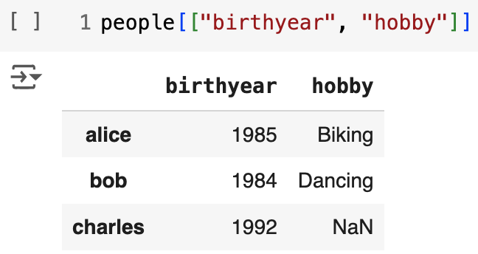
Selecting multiple columns by their keys
You can select multiple columns by their keys

