Slide 1

NumPy
David Meredith
dave@create.aau.dk

Slide 2
Source
https://numpy.org
https://colab.research.google.com/github/ageron/handson-ml3/blob/main/tools_numpy.ipynb

Slide 3
NumPy
NumPy is the fundamental library for scientific computing with Python
Founded on a powerful, N-dimensional array object – an ndarray
Contains functions for linear algebra, Fourier transforms and random number generation
Open source, developed and maintained on GitHub
Interoperable – supports a wide range of hardware and computing platforms and plays well with distributed, GPU, and sparse array libraries
Core of NumPy is well-optimized C code, so it is fast
Has a high-level syntax which makes it accessible to programmers with a broad range of backgrounds and experience

Slide 4
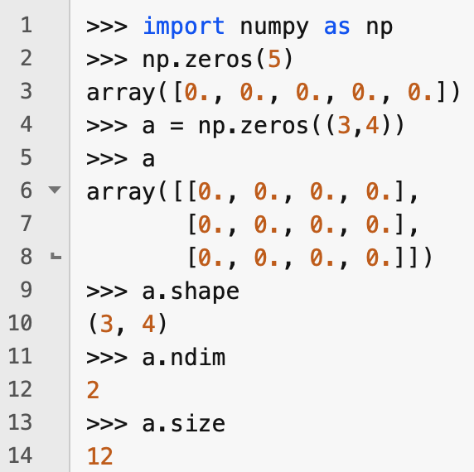
Creating arrays
We can create an array full of zeros using the NumPy zeros() function
Each dimension of a NumPy array is called an axis
The number of axes is called the rank of the array
accessed through the ndim method
The shape of an array is a tuple containing the lengths of the axes
accessed through the shape method
The rank of an array is equal to the length of its shape
The size of an array is the number of elements in it
i.e., the product of the axis lengths
accessed through the size method

Slide 5
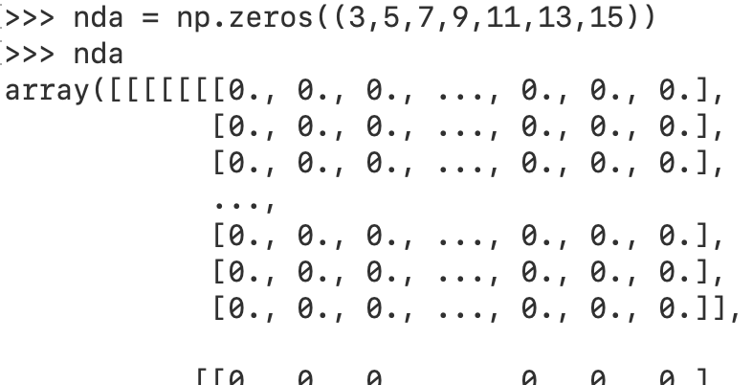
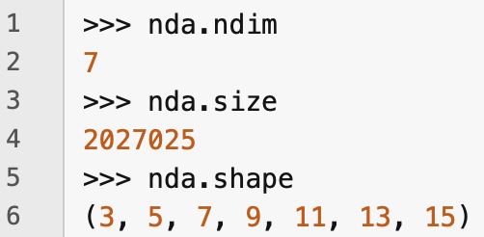
N-dimensional arrays
An array can have any rank

Slide 6
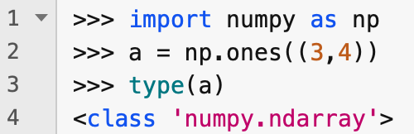
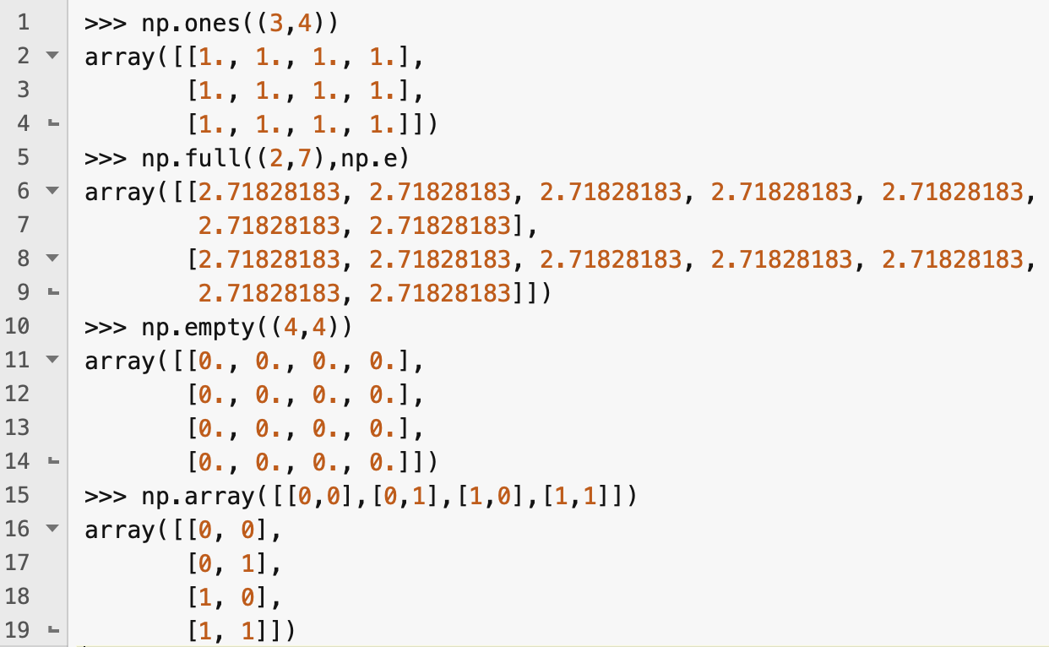
Other ways of creating a NumPy ndarray
NumPy arrays have type numpy.ndarray
You can create ndarrays using a variety of different NumPy functions
ones()
full()
empty() – contents uninitialized
array() – constructed from a regular Python list

Slide 7
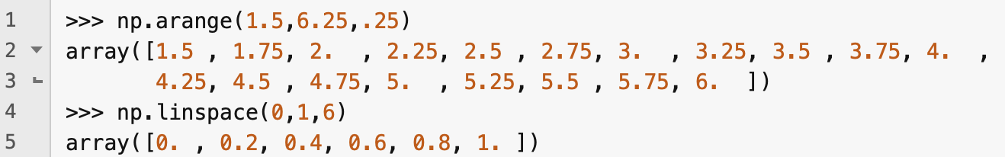
arange() and linspace()
You can create arrays using NumPy's arange() and linspace() functions
arange() is similar to Python's range() function, but also works with float arguments
linspace(a,b,n) returns an evenly spaced sequence of n values from a to b, inclusive

Slide 8
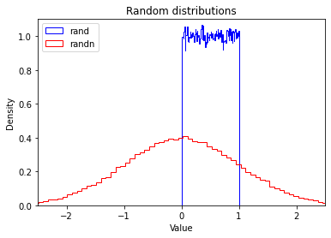
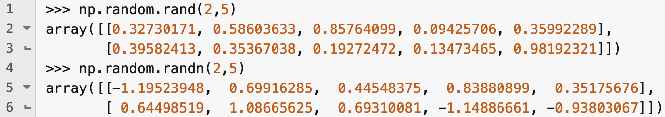
Arrays of random numbers
You can use the random.rand() and random.randn() functions to generate arrays with random values
random.rand(a,b) generates an a x b array containing random float values between 0 and 1 (uniformly distributed)
random.randn(a,b) generates an a x b array containing random numbers sampled from a Gaussian (normal) distribution, with mean 0 and variance 1

Slide 9
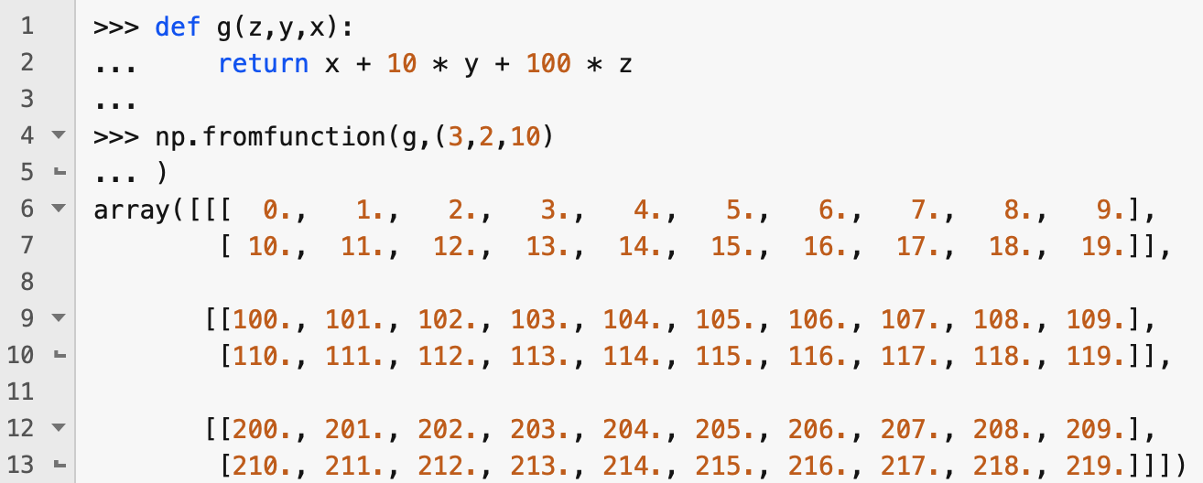
Generating values from a function
You can use the fromfunction() function to initialize an array from a function that takes as input the coordinates of an element in the array
Note how the ordering of the function parameters maps to the dimensions (axes) of the array

Slide 10
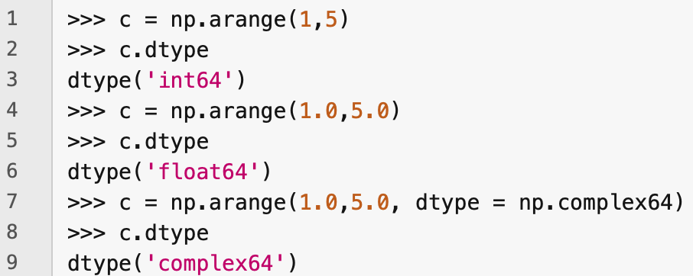
Array data - dtype
All elements in an ndarray must be of the same type
The type is stored in the array's dtype property
You can also set the type of the array elements when the array is constructed using the dtype keyword parameter
Available types include signed and unsigned ints of various widths, floats with different precisions, and complex numbers

Slide 11
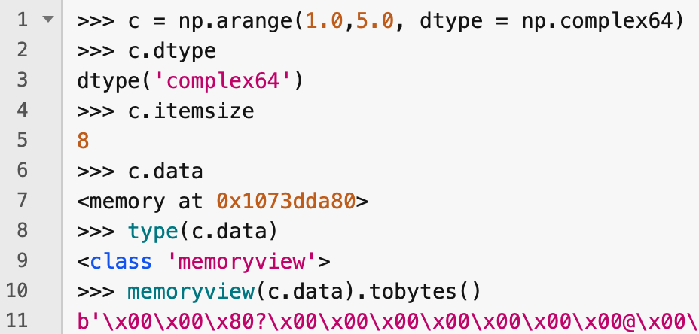
itemsize and data attributes
An ndarray's itemsize attribute stores the number of bytes used to store each element in the array
The array's data is actually stored as a 1d byte array, which you can access through the data attribute
In Python 3, the data attribute is a memoryview object
A memoryview object has a tobytes() method that returns the sequence of bytes in the memoryview

Slide 12
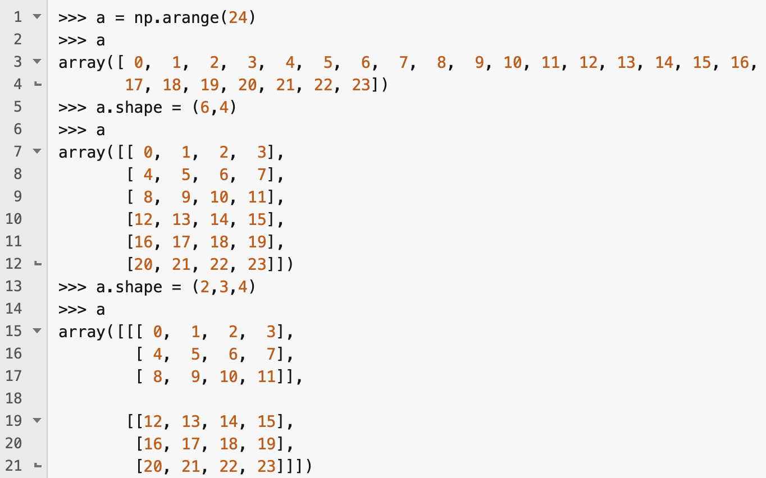
Reshaping an array in place
The data in an array is stored as a 1d byte array and the shape is stored separately as a tuple
You can therefore change the shape of an ndarray just be setting its shape attribute, provided you don't change the size of the array

Slide 13
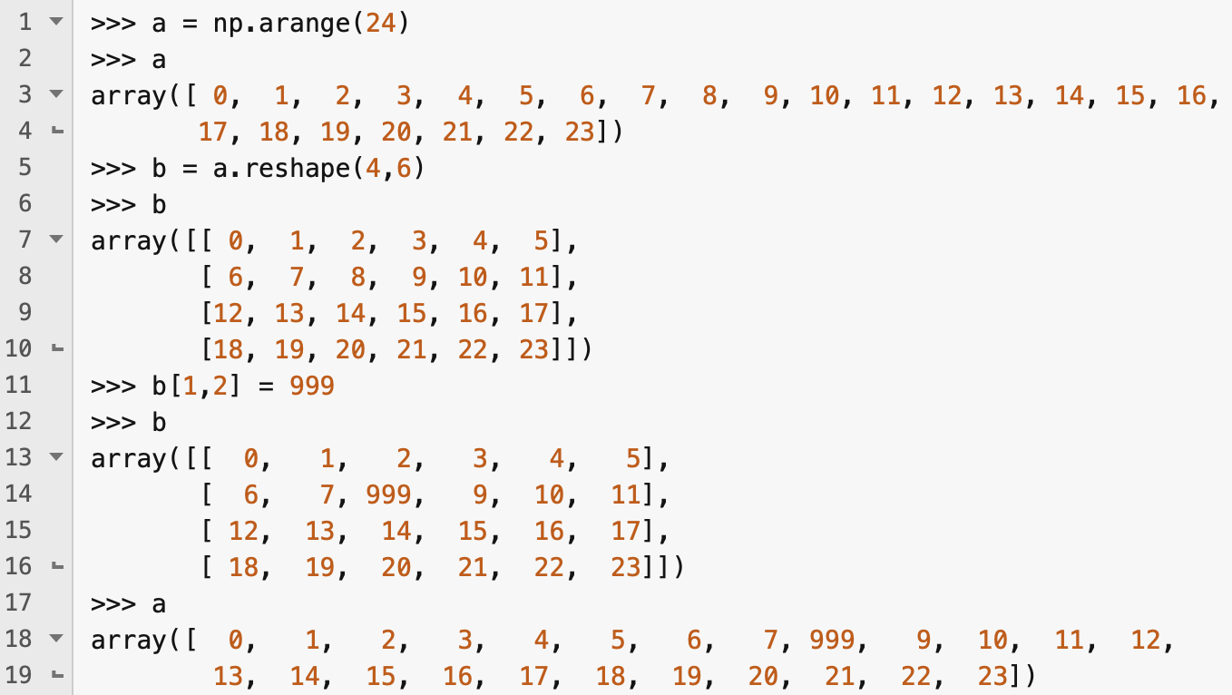
Using the reshape() method
The reshape() method produces a new array object with the specified shape, but referring to the same array data
In other words, you end up with two ndarray objects sharing the same data
This means that if you change the content of the array through one reference, it will also be visible through the other

Slide 14
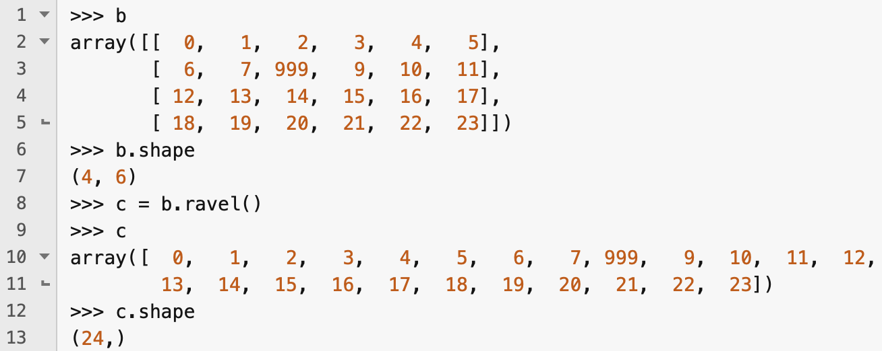
The ravel() method
The ravel() method returns a new 1d ndarray that refers to the same data as the array on which it is called

Slide 15
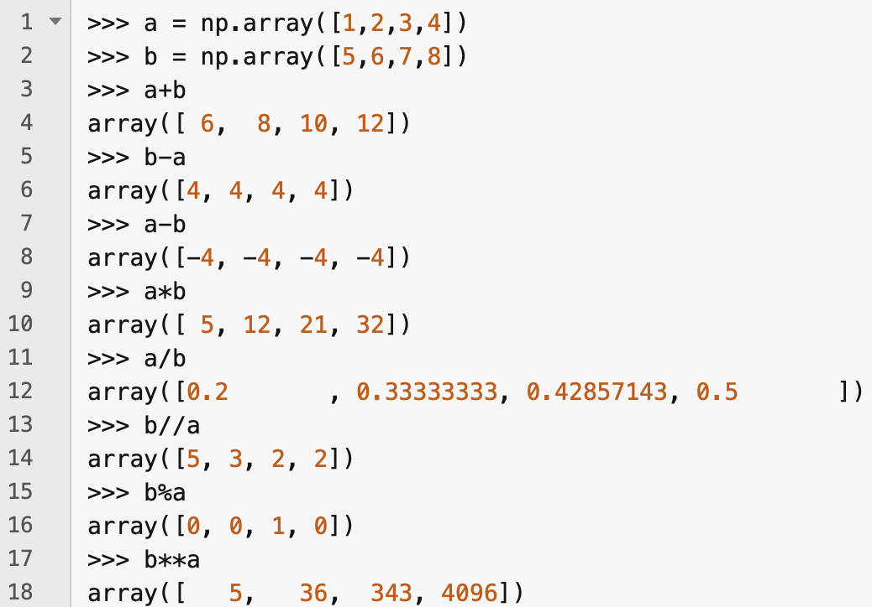
Arithmetic operations
All the usual arithmetic operations can be used with ndarrays – they apply elementwise!
Note that the * operator does elementwise multiplication – it does not do matrix multiplication!
If the operand ndarrays do not have the same shape, then NumPy applies the broadcasting rules

Slide 16
Broadcasting
When NumPy receives ndarrays of different shape when it expects arrays of the same shape, it applies the broadcasting rules:
If arrays don't have the same rank, then 1s are prepended to the shapes of the lower-ranking arrays until their ranks match
An array with an axis length of 1 behaves as though the length of that axis was equal to the length of that axis in the input array that has the longest length for that axis. The single value in that axis is repeated as many times as required.
After applying rules 1 and 2, the sizes of the arrays must match, otherwise the arrays cannot be broadcast together

Slide 17
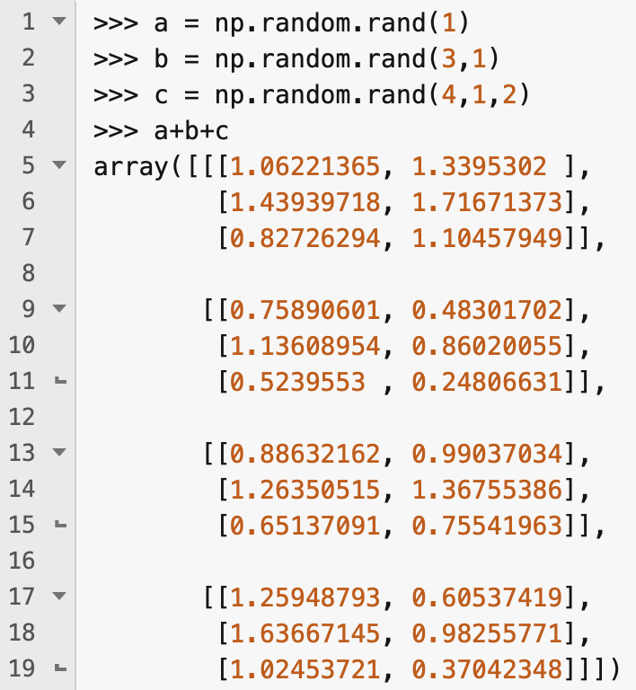
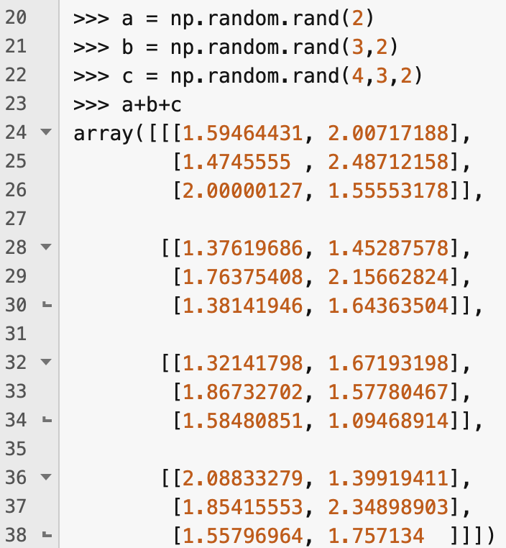
Applying broadcasting rules
Working from right to left, each corresponding axis length in the shape must be a 1 or the same as in the other argument arrays
If an array shape is otherwise shorter than the others, that's ok (because it will be padded with 1s)
For example, the following sets of shapes can be broadcast together
(2), (3, 2), (4, 3, 2)
(1), (3,1), (4,1,2)
The following cannot:
(2), (3,3), (4,3,2)
(1), (2,1), (4,3,2)

Slide 18
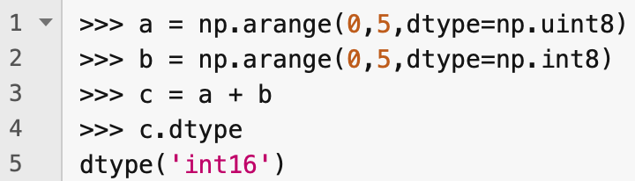
Upcasting
When trying to combine arrays with different dtypes, NumPy will upcast dtypes as necessary to a type that can handle all possible values of the dtypes in the argument arrays (regardless of what the actual values of the elements in the arrays are)
E.g., on left, all actual values could have been uint8s, but the smallest type that includes all values representable by uint8s and int8s is int16, so NumPy upcasts the values to int16s

Slide 19
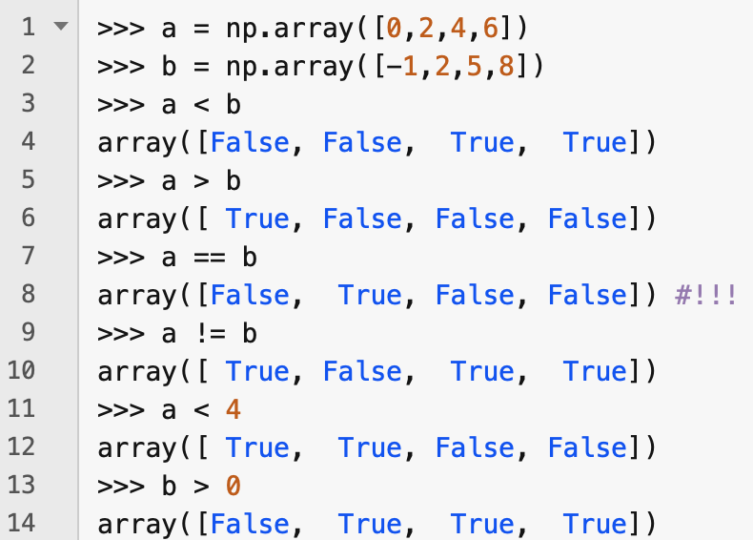
Comparison operators
Comparison operators are also applied elementwise

Slide 20
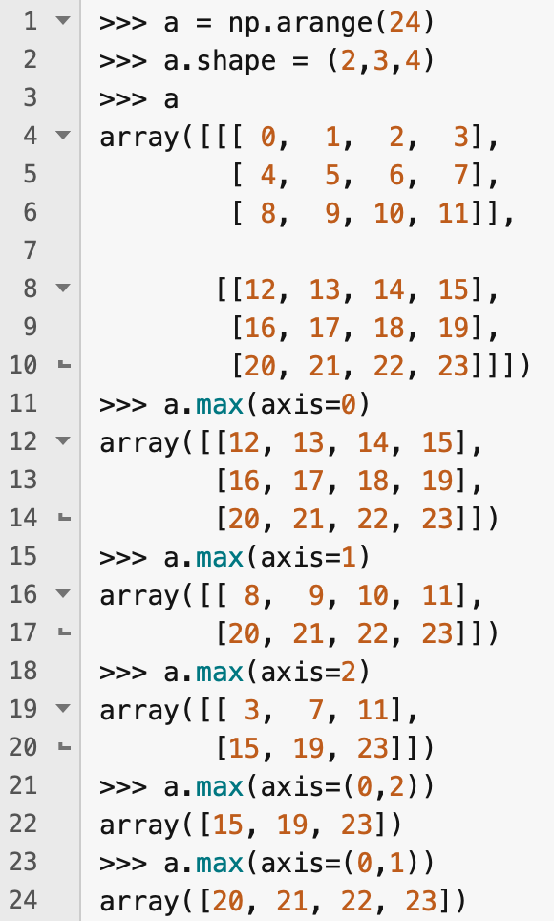
Mathematical and statistical functions
Many mathematical and statistical functions and methods are available for ndarrays
.mean(), .min(), .max(), .sum(), .prod(), .std(), .var()
Without arguments, these just apply to all arguments, regardless of shape
You can also specify axes to which they should be applied with the axis keyword parameter

Slide 21
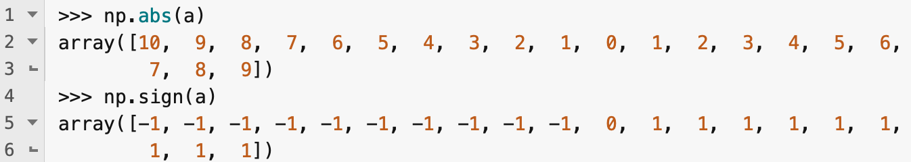
Universal functions (ufuncs)
NumPy provides fast, element-wise functions called universal functions or ufuncs
These include, e.g., np.abs, np.sqrt, np.exp, np.log, np.sign, np.ceil, np.modf, np.isnan, np.cos
np.modf returns fractional and integral parts of an array, element-wise

Slide 22
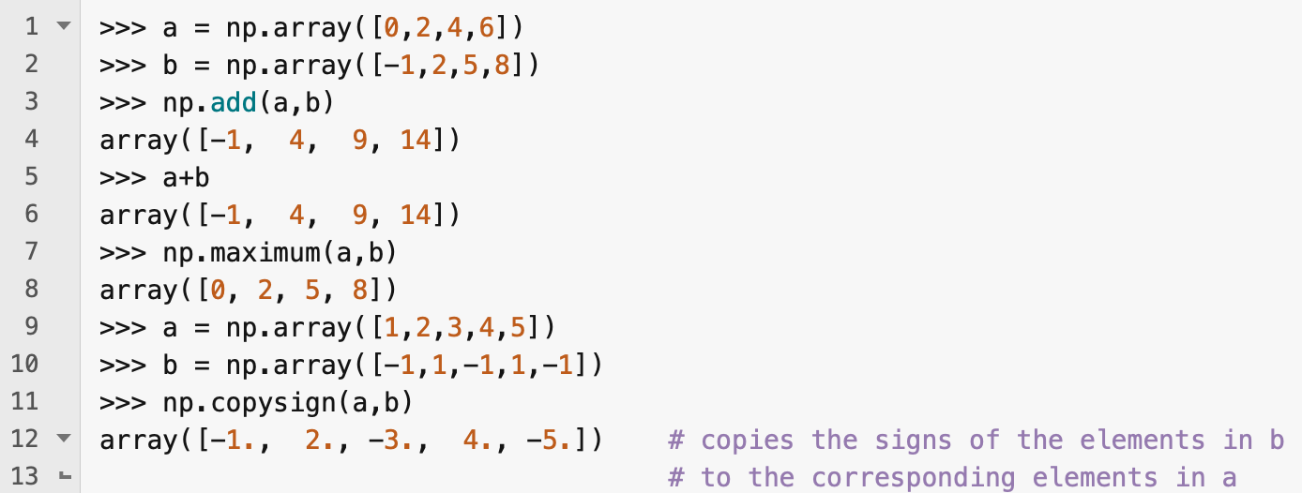
Binary universal functions
There are lots of binary ufuncs that apply element-wise to two ndarrays
Broadcasting rules are applied if the arrays are of different shape
Some are equivalent to the arithmetic and comparison operators we have seen already

Slide 23
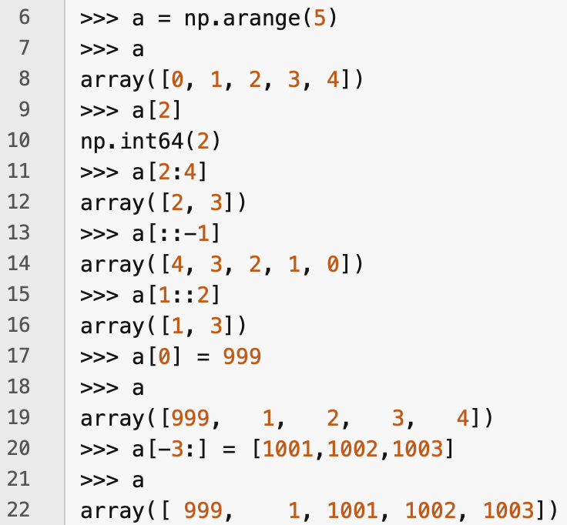
Array indexing and slicing
In 1d arrays, you can index and slice more-or-less as for regular Python lists
You can also assign values to elements or slices as for regular lists (see lines 17 and 20)

Slide 24
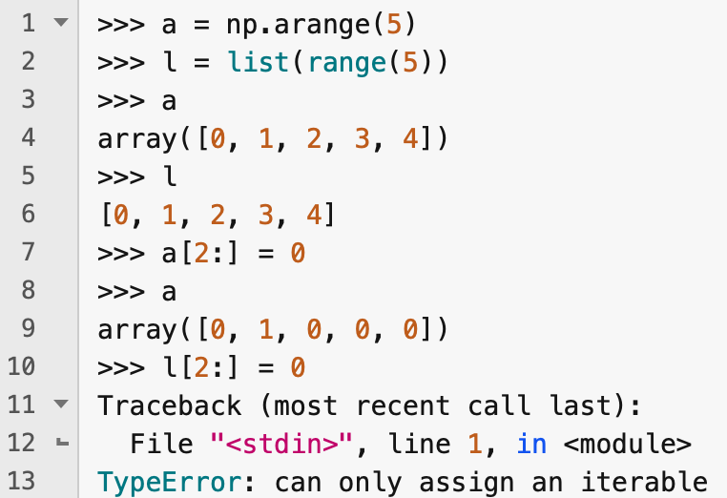
Differences from regular Python lists
The broadcasting rules mean that you can, e.g., assign a single value to all the values in a slice of an ndarray
You can't do this with a list

Slide 25
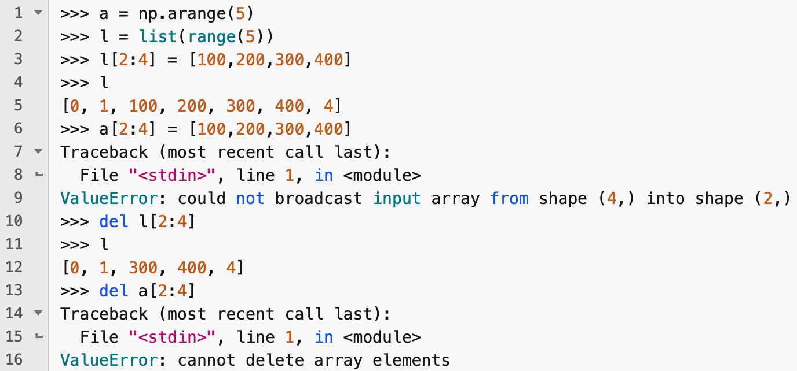
Differences from Python lists
You cannot grow an ndarray by assigning a list to a slice that is longer than the original slice
Nor can you delete elements from an ndarray

Slide 26
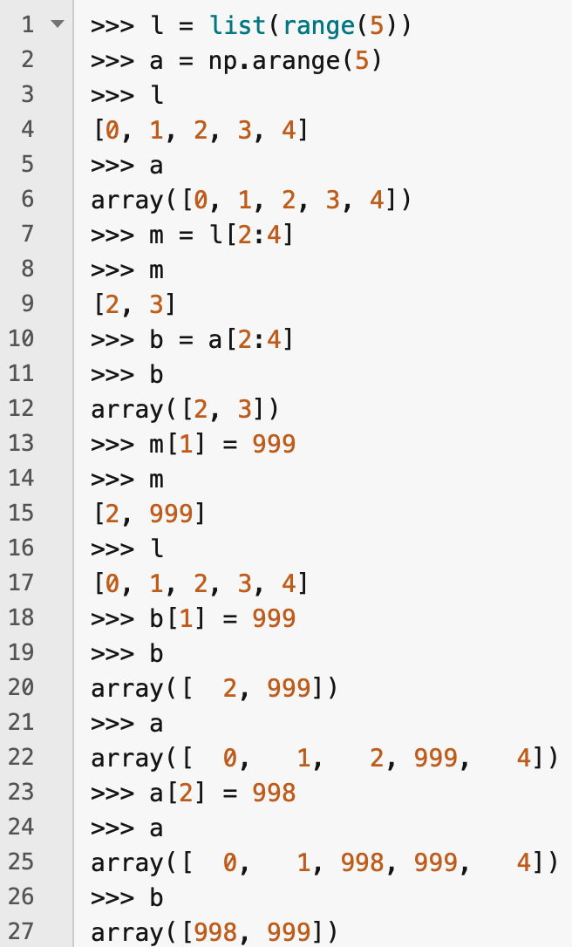
Slices of ndarrays are views onto the array
Slices of ndarrays are views onto the array – not copies of parts of the array
So if you create a slice of an ndarray and then modify the slice, you will also modify the original ndarray
Similarly, if you modify the original array in the region of the slice, the slice will also be modified!
This is not the case with a list

Slide 27
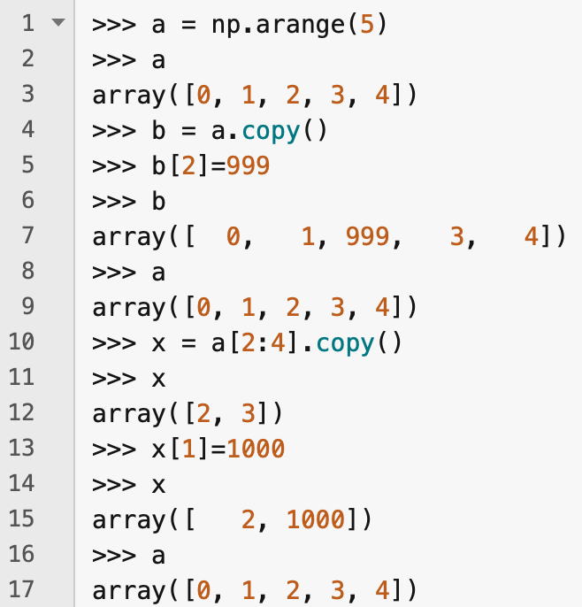
.copy() method
You can make a copy of an ndarray or a slice of an ndarray with the .copy() method

Slide 28
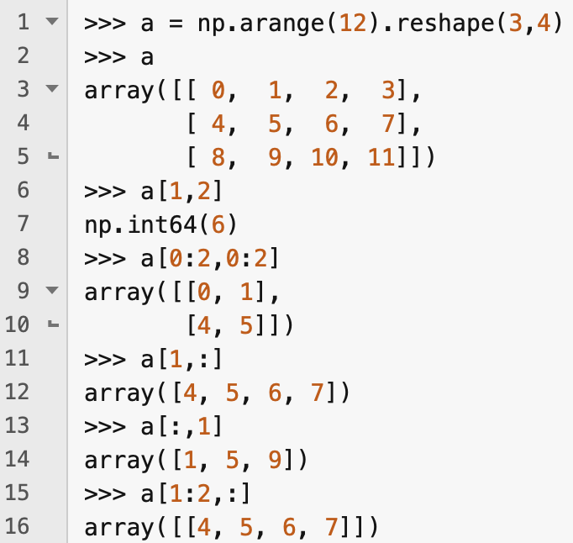
Multidimensional arrays
Multidimensional arrays can be accessed by giving an index or slice for each axis, separated by commas

Slide 29
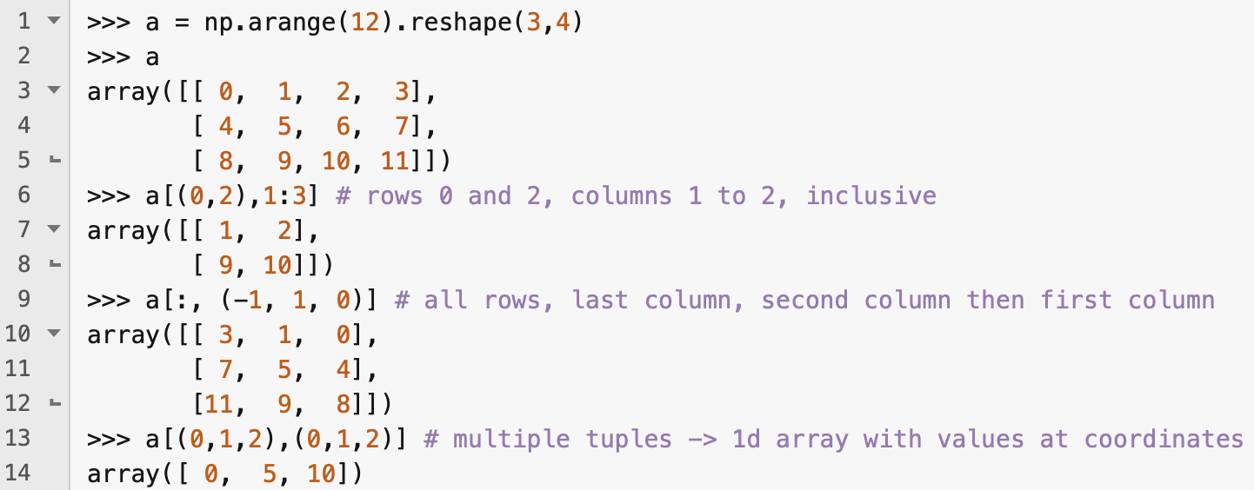
Fancy indexing
You can specify a tuple containing the indices you are interested in – this is called fancy indexing

Slide 30
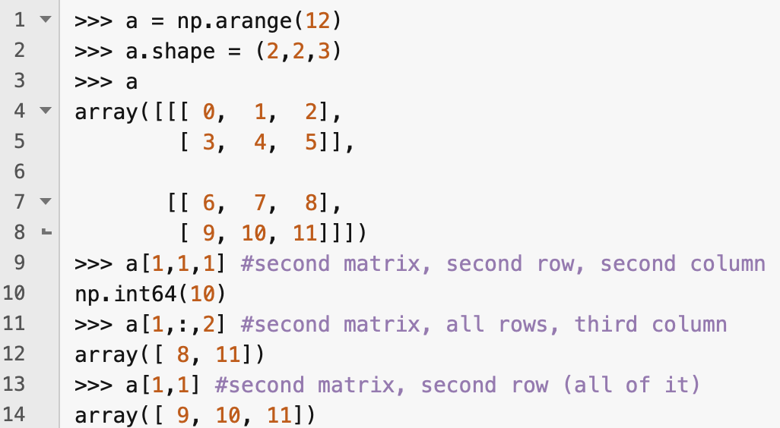
Higher dimensions
Same indexing and slicing techniques apply to higher-rank ndarrays

Slide 31
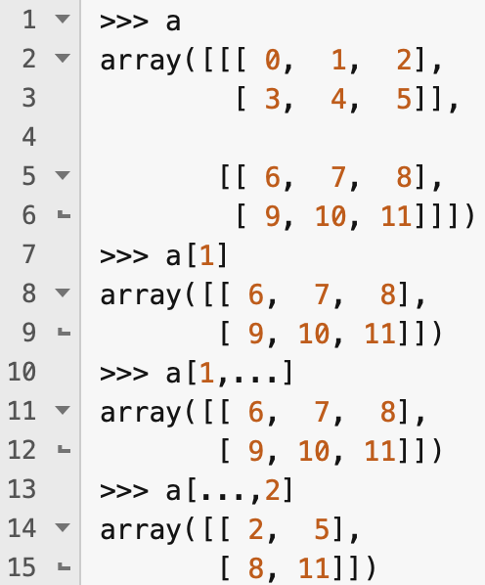
Ellipsis (...)
You can use the ellipsis to specify a range of axes without saying exactly how many axes this includes

Slide 32
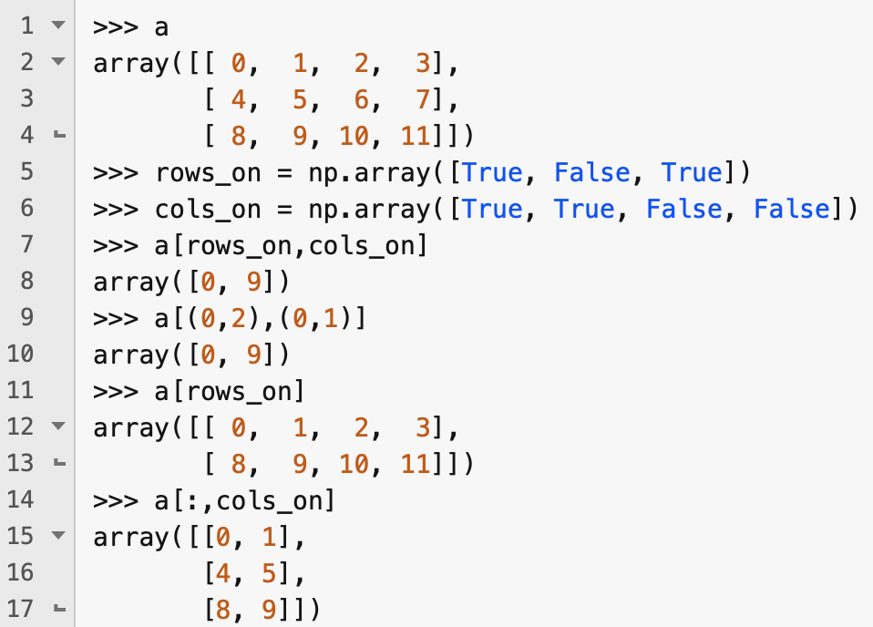
Boolean indexing
You can also specify a set of selected indices using an ndarray of Boolean values

Slide 33
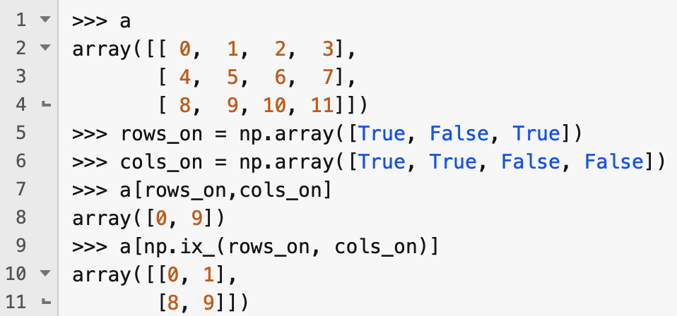
np.ix_
You can use the np.ix_ function to select all the elements in specified sets of values for multiple axes

Slide 34
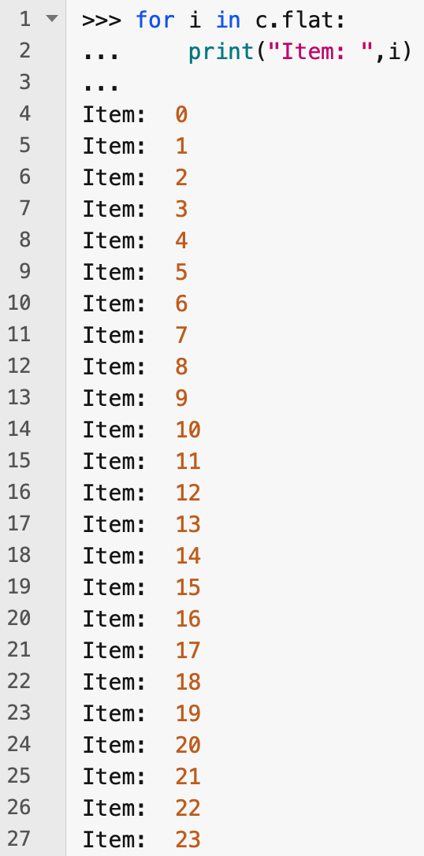
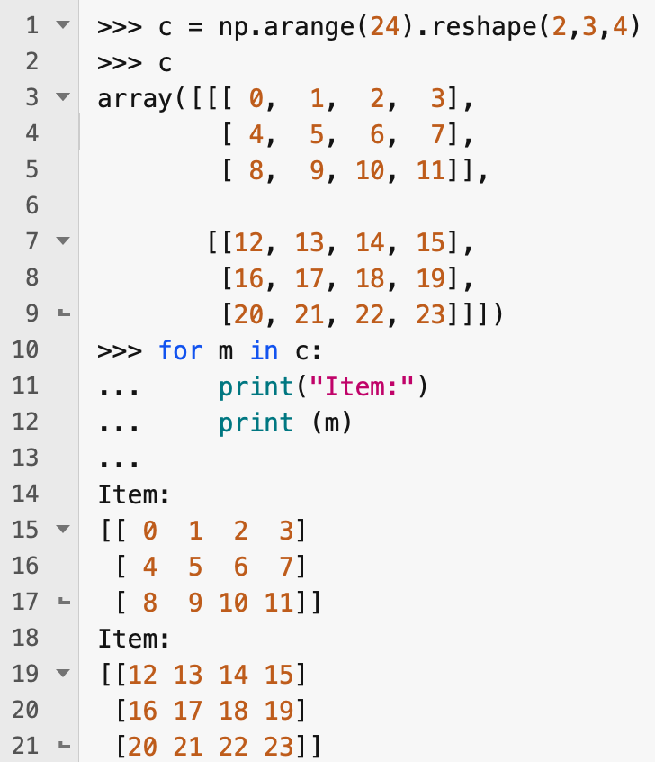
Iterating
Iterating over ndarrays is similar to iterating over Python lists
Iterating over ndarrays is done with respect to the first axis
You can iterate over all elements in the array by using the .flat attribute

Slide 35
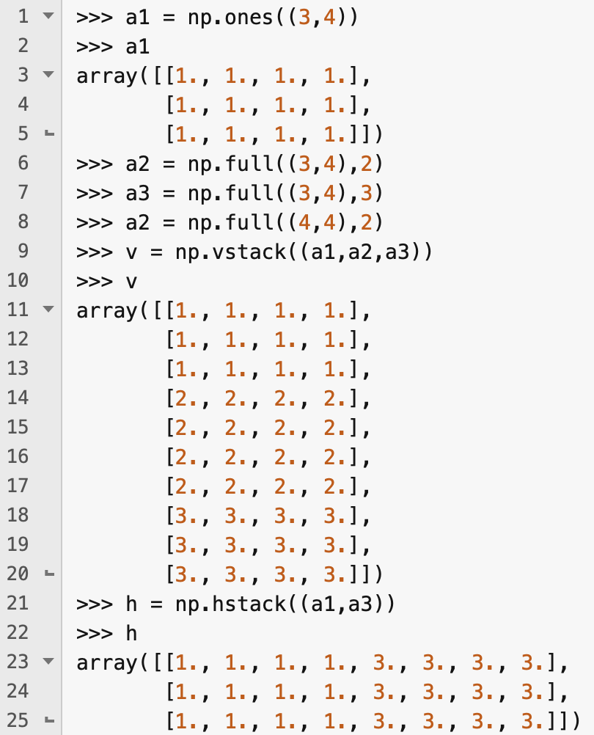
Stacking arrays
NumPy offers several functions for stacking arrays together
vstack() concatenates arrays together vertically – the argument arrays must have the same number of columns
hstack() concatenates arrays together horizontally – the argument arrays must have the same number of rows

Slide 36
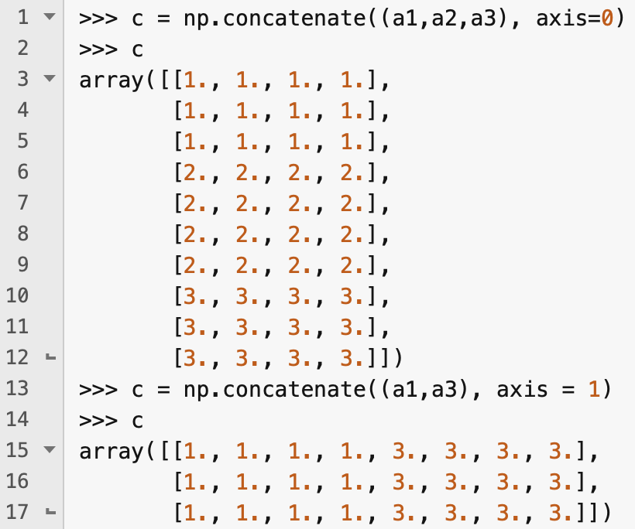
concatenate()
The concatenate() function can stack arrays along any given axis
axis=0 is equivalent to vstack
axis=1 is equivalent to hstack

Slide 37
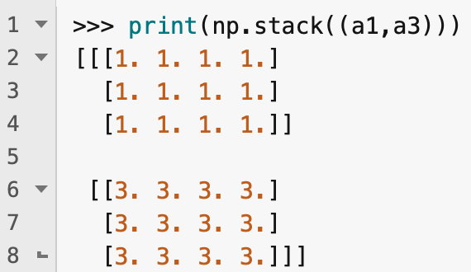
stack()
stack() stacks arrays along a new axis rather than one that is already present in the argument arrays
All argument arrays must have the same shape

Slide 38
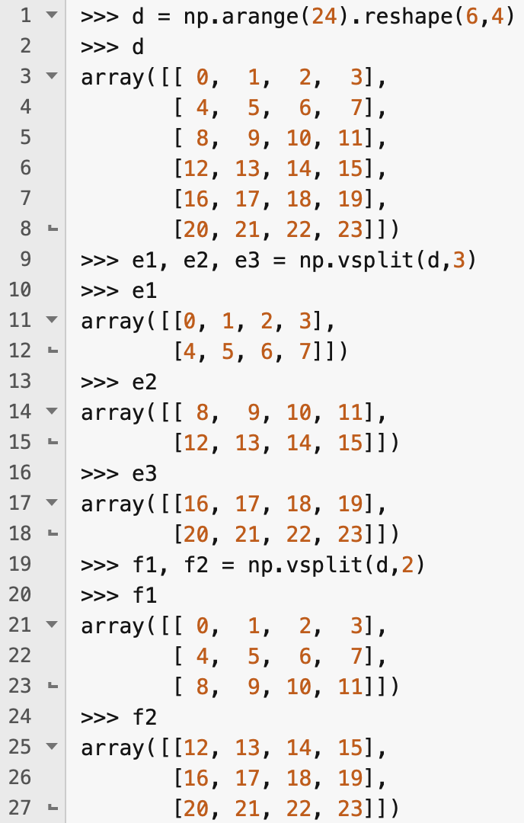
Splitting arrays – vsplit()
Splitting is the opposite of stacking
vsplit() splits an array vertically
The second argument of vsplit specifies the number of segments to split the array into
This must be a factor of the length of the input array

Slide 39
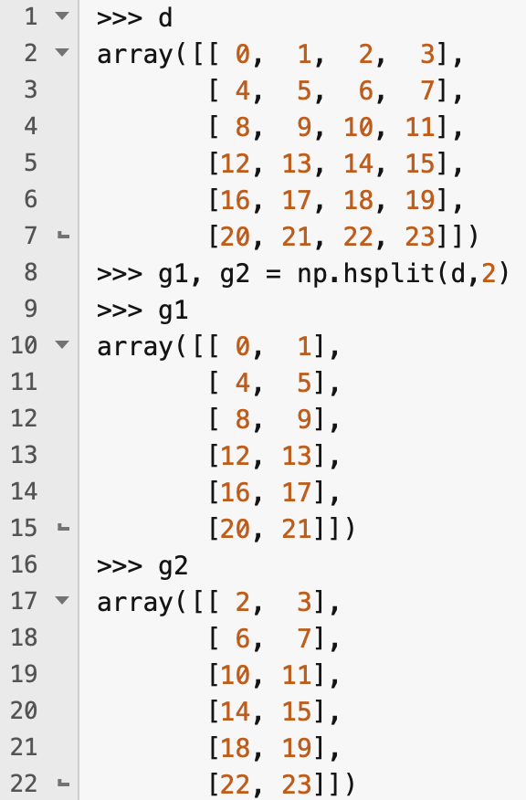
Splitting arrays – hsplit()
hsplit() splits an array horizontally into a number of equally sized segments

Slide 40
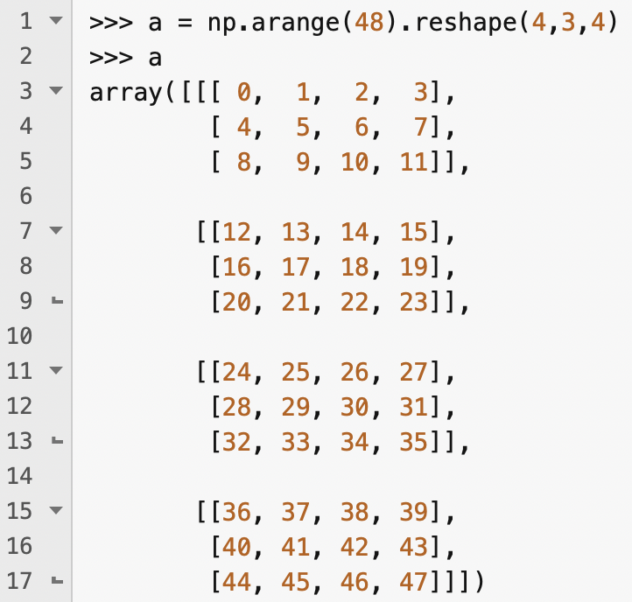
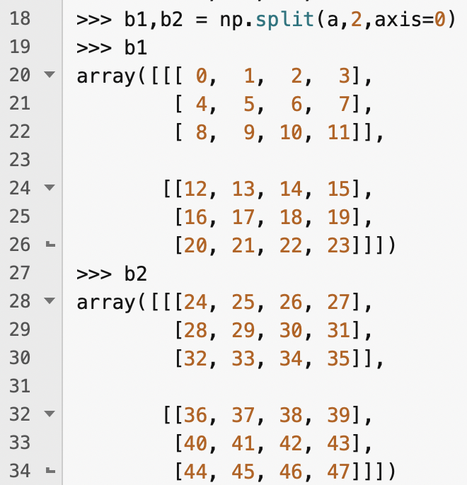
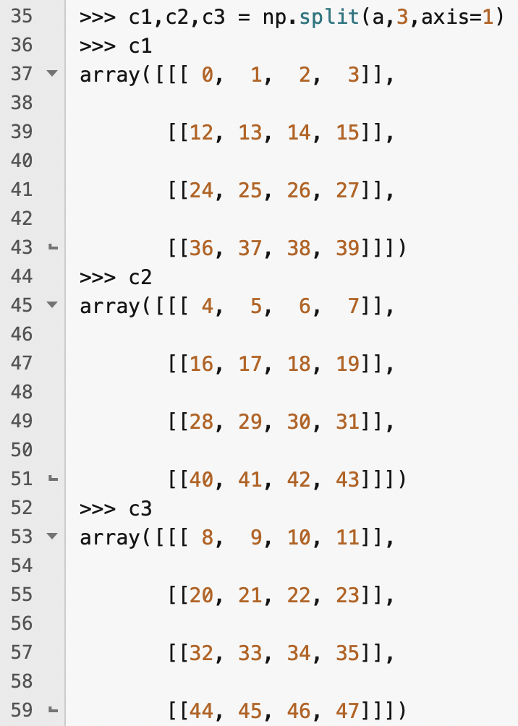
split()
There's also a split() function that lets you split an array along any axis

Slide 41
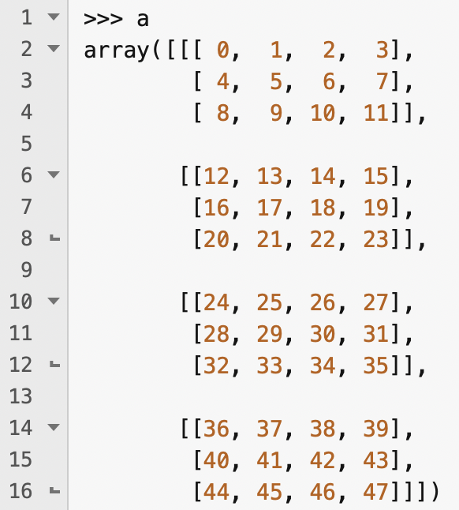
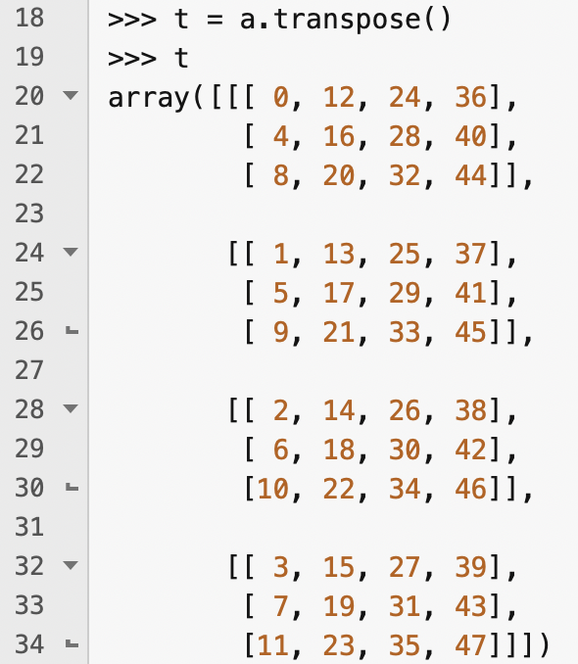
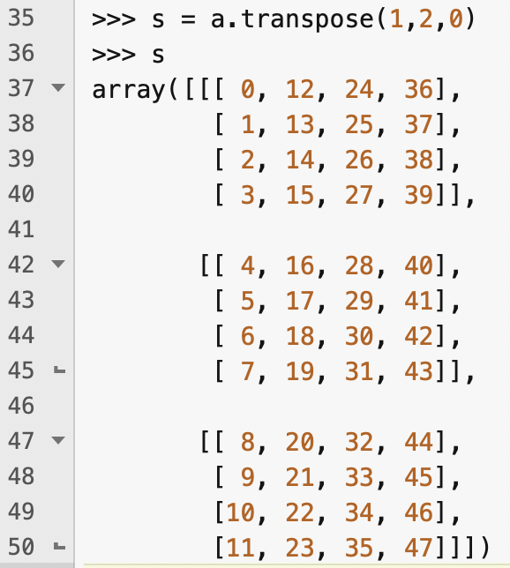
Transposing arrays
The transpose() method creates a new view onto an ndarray's data with the axes permuted in a specified order
By default, it reverses the order of the axes

Slide 42
Linear algebra
2D NumPy arrays can be used to represent matrices efficiently and do linear algebra
There is a separate tutorial on linear algebra here:
https://colab.research.google.com/github/ageron/handson-ml3/blob/main/math_linear_algebra.ipynb

Slide 43
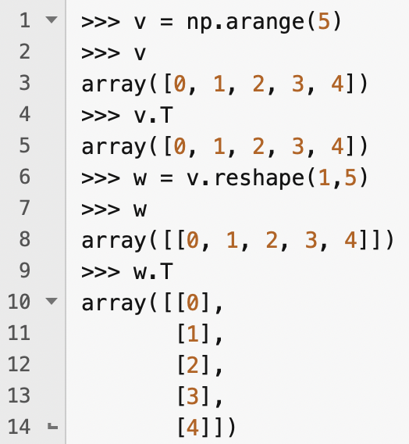
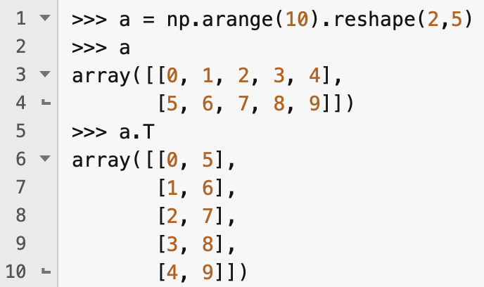
Matrix transpose
The T attribute is equivalent to calling transpose() when rank is greater than or equal to 2 (i.e., it reverses the order of the axes)
T attribute has no effect when rank is 1 – you have to use a single-row, 2d matrix instead

Slide 44
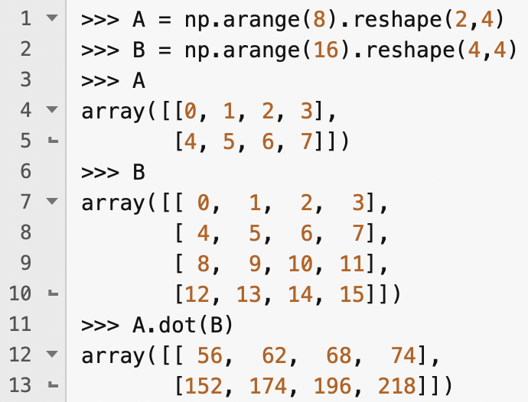
Matrix multiplication
Recall that * does element-wise multiplication (aka. the Hadamard product)
To do proper matrix multiplication, you use the dot() function

Slide 45
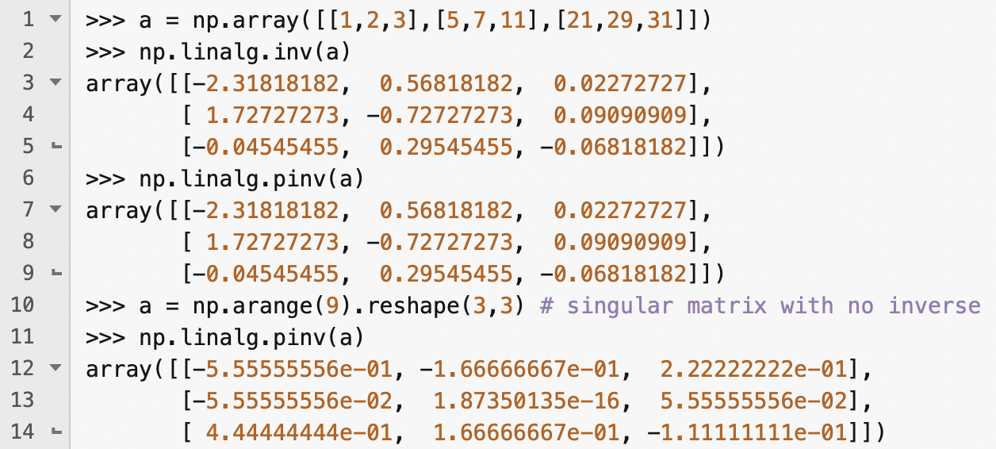
Matrix inverse and pseudo-inverse
Many linear algebra functions are available through the numpy.linalg module
The inv() function returns the ordinary inverse of a square matrix
The pinv() function computes the pseudoinverse of a matrix, aka. the Moore—Penrose inverse
Used to compute a "best fit" approximate solution to a system of linear equations that lacks an exact solution
Scikit learn uses the pseudoinverse to do linear regression

Slide 46

Identity matrix
If you multiply a matrix by its inverse, you get the identity matrix
If you do this on a computer, you typically get small floating point errors
You can create an N x N identity matrix by calling np.eye(N)

Slide 47

QR decomposition
A QR decomposition is a decomposition of a matrix, A, into a product, QR, where Q is an orthonormal matrix and R is an upper triangular matrix
QR decomposition is used to solve the linear least squares problem in linear regression

Slide 48

Determinant, eigenvalues, eigenvectors
The det() and eig() functions compute the determinant, eigenvalues and eigenvectors of a square matrix

Slide 49
Other linear algebra operations
NumPy also provides functions for calculating other important results such as singular value decomposition, diagonal, trace and solving systems of linear equations
We'll cover these when they become important!

Slide 50

Vectorization
NumPy's element-wise array operations are highly optimised, so can be significantly faster to use these rather than iterating over the elements in an array using for loops

Slide 51


Saving and loading ndarrays
ndarrays can be saved and loaded in either binary or text format
The save function creates and stores a file in binary format If you omit a file extension, NumPy automatically adds .npy

Slide 52

Saving and loading a file in text format
The savetxt() function saves an ndarray in csv form with tab delimiters
You can change the delimiter
To load a text file, use the loadtxt() function
Only works with 1D and 2D arrays

