Slide 1
Python Workshop Session 4: Modules
David Meredith
Aalborg University
dave@create.aau.dk

Slide 2
Source
https://docs.python.org/3/tutorial/modules.html

Slide 3
Modules
(base) 16:47:44:~ % /usr/local/bin/python3
Python 3.12.4 (v3.12.4:8e8a4baf65, Jun 6 2024, 17:33:18) [Clang 13.0.0 (clang-1300.0.29.30)] on darwin
Type "help", "copyright", "credits" or "license" for more information.
>>> x = 10
>>> exit()
(base) 16:48:07:~ % /usr/local/bin/python3
Python 3.12.4 (v3.12.4:8e8a4baf65, Jun 6 2024, 17:33:18) [Clang 13.0.0 (clang-1300.0.29.30)] on darwin
Type "help", "copyright", "credits" or "license" for more information.
>>> x
Traceback (most recent call last):
File "<stdin>", line 1, in <module>
NameError: name 'x' is not defined
If you leave the Python interpreter and then enter it again, all the definitions you have made will be lost
If you want to use Python as anything more than a calculator, then you need to be able to save your programs in files – this is known as "creating a script"
As your scripts get larger, you may want to re-use parts of them and you may find yourself having to organise your code so that definitions of related functions and classes are stored together, perhaps in the same file
Python supports this by allowing you to put definitions in a file, and then use them as a script or in an interactive instance of the interpreter
In Python, such files are called modules

Slide 4
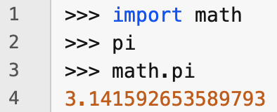
Importing modules
The definitions in a module can be made available by importing it, either into another module or into the main module---the current namespace of the interpreter or the definitions made available by executing a script at the top level

Slide 5
What is a module?
A module is a file containing Python definitions and statements
The file name of a module is the module name with a .py extension
Within a module, the module's name (as a string) can be accessed through the special variable, __name__ (i.e., two underscores, then the name, then two more underscores)

Slide 6
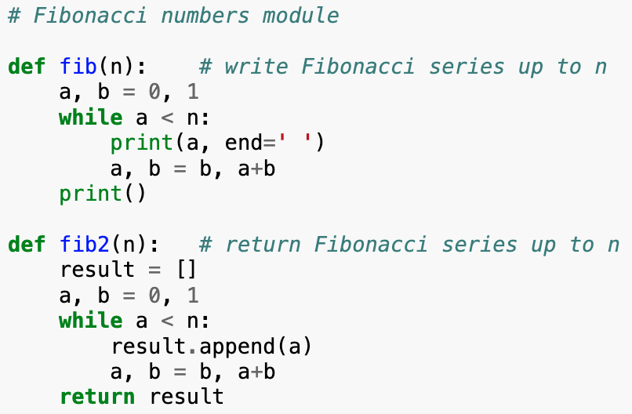
Creating and importing a module
Create a file called fibo.py with the contents on the left
Go to the command line, cd to the directory containing the fibo.py file, then start up the Python interpreter
Then type the following at the prompt in the Python interpreter: >>> import fibo (>>> is the prompt itself – you don't type this!)

Slide 7
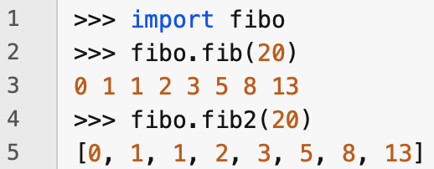
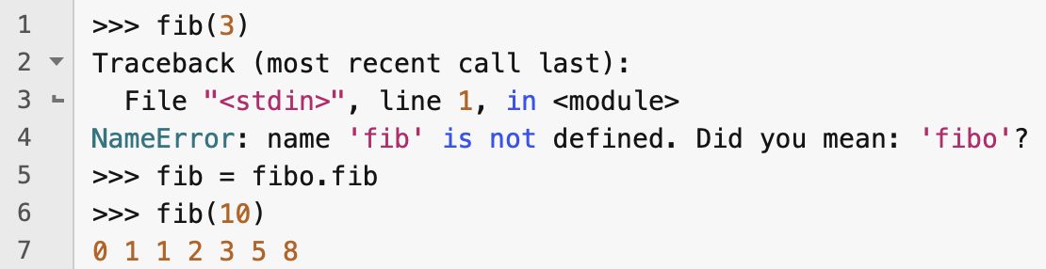
Accessing imported definitions
Typing the import command does not add the definitions directly to the current namespace – this would risk overwriting some exiting definitions
So the imported definitions are accessible by typing the module name, followed by a dot, then the name of the object or function
If you want to be able to access a defined function or object using a shorter name, then you can just assign it to the shorter name

Slide 8
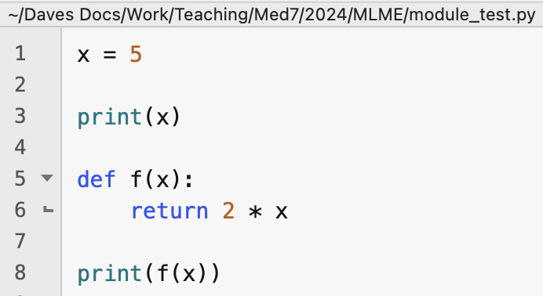
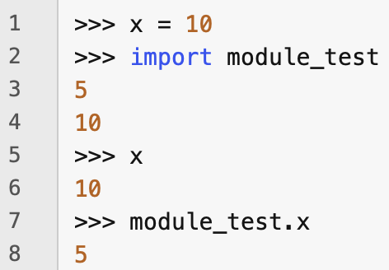
Loading a module
When a module is loaded (i.e., either imported or run as a script), all the statements in it are run once
If a statement is a definition of a function or a variable, then that function or variable becomes accessible within the module's namespace
If a statement simply calls a function, then that function call only happens when the module is loaded
Each module has its own private namespace (accessible through the module's name)
The module's namespace serves as the global namespace for all the definitions and statements in the module
This means that you can define a name in the global scope of a module without worrying about this name colliding with some other object already defined with that name in the user's environment

Slide 9
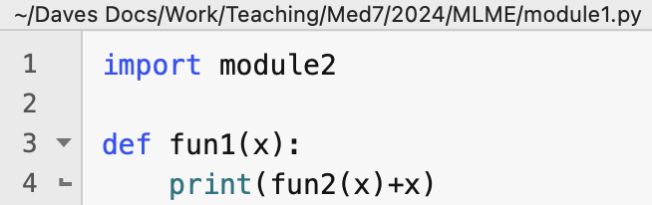
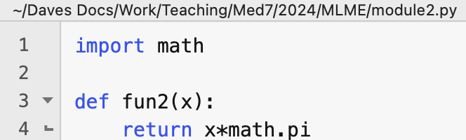
Modules can import other modules
It is customary to place import statements at the beginning of a module in the module's global scope
This adds the imported module names to the global namespace of the module

Slide 10
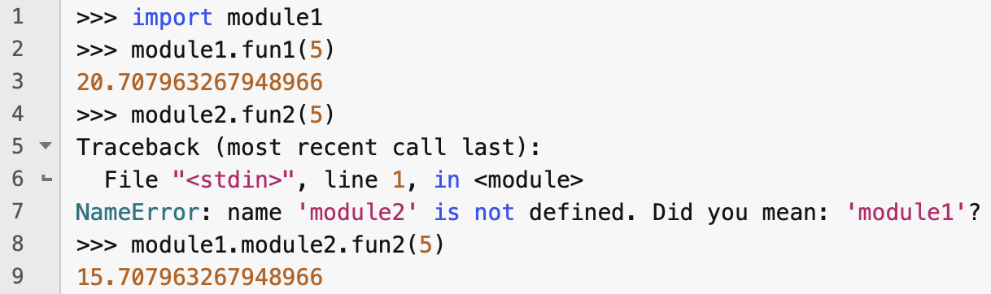
Accessing modules imported from other modules
Note that if you import module1, which imports module2, then module2 can only be accessed through module1's namespace

Slide 11
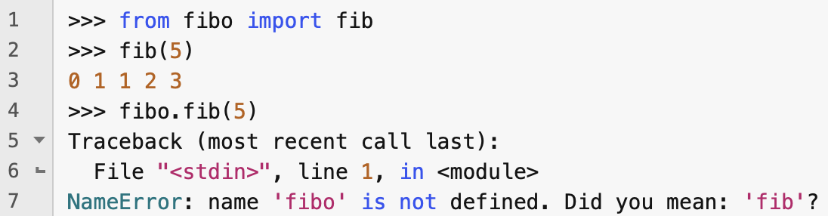
Importing names from a module's namespace
You can import individual names from a namespace without importing the whole module, using the from keyword
If you do this, the imported names become directly available in the importing module's namespace – you don't have to prefix references to these names with the name of the module from which they were imported
Indeed, the imported module itself is not available!

Slide 12
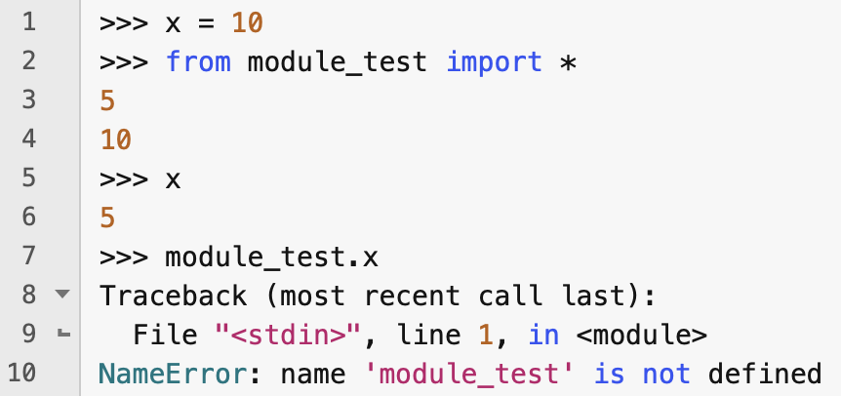
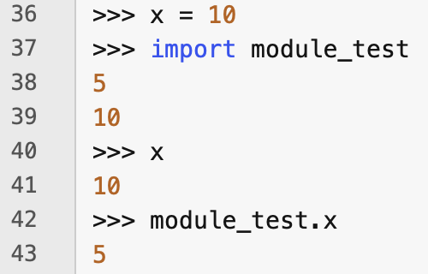
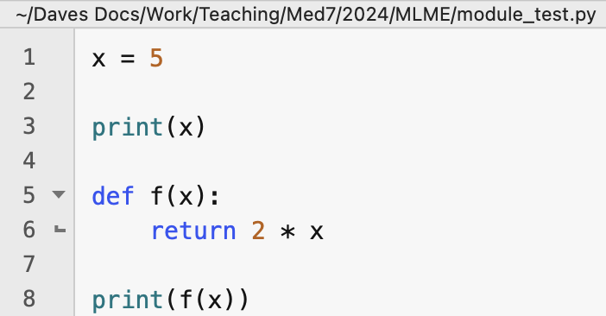
Importing all names from a module
You can import all the names (definitions) from a module with the * wildcard character
This imports all names except those that begin with an underscore
This can be dangerous, since the imported names can hide pre-existing definitions
Compare the two examples above

Slide 13
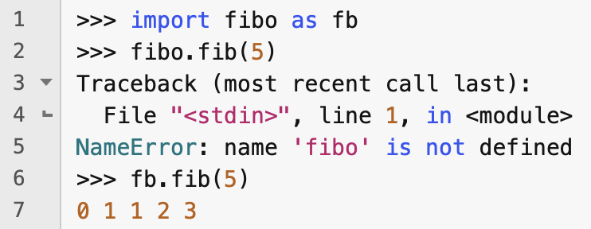
Assigning a short name to a module using as
You can bind a different name to an imported module by using the as keyword at the end of the import statement
Note that the newly bound name replaces the standard module name which can no longer be used

Slide 14
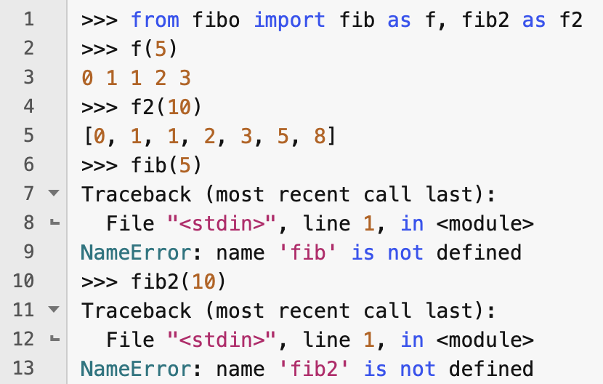
Using as and from together
You can import some names from a module using from and then change the names by which they will be known in the importing namespace

Slide 15
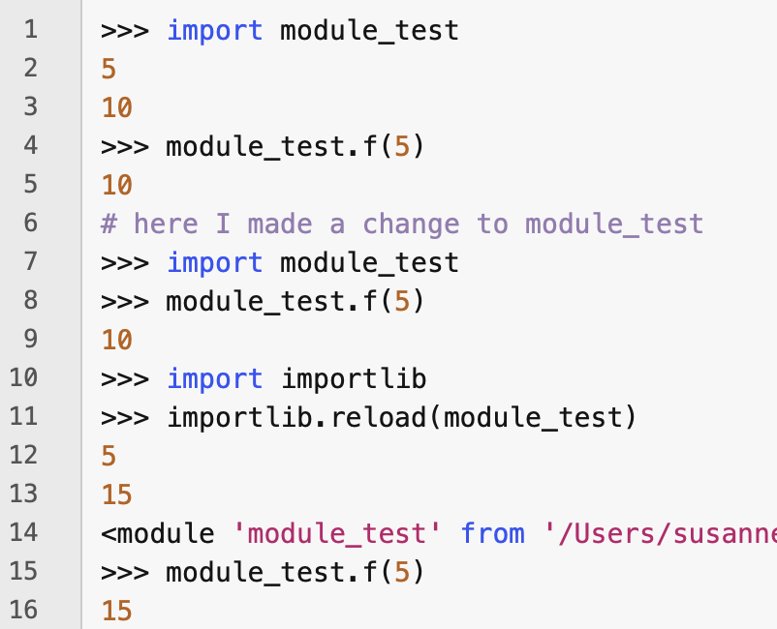
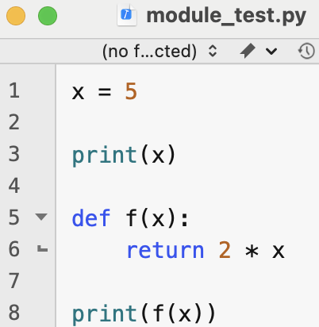
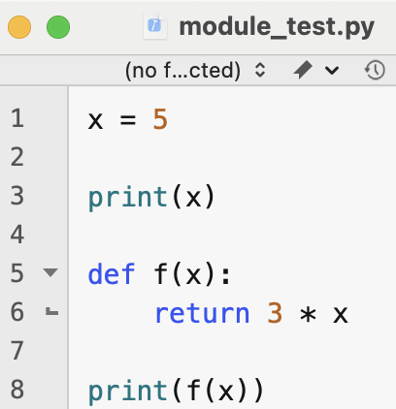
Reloading modules into the interpreter
Before
After
Each module is only imported once per interpreter session
So if you change a module, you need to restart the interpreter before importing it
Alternatively, you can reload a single module using the reload() function defined in the importlib module (see above)

Slide 16
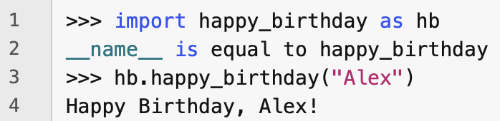
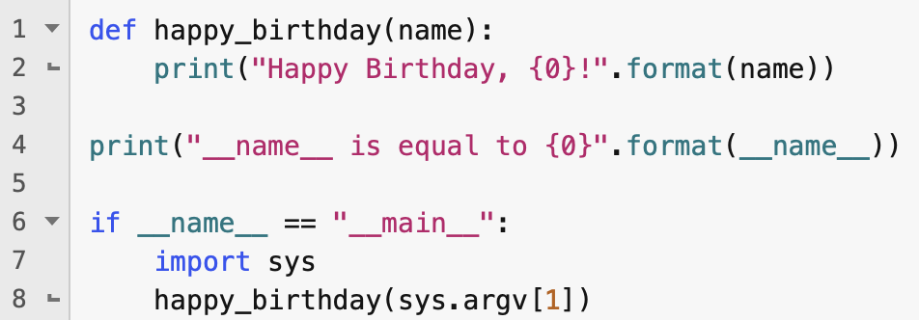
Executing a module as a script
If you import a module using the import statement, then the value of the special variable,, __name__, inside the module's namespace is the name of the module
However, if you run a Python module by giving it as a command-line argument when you start the Python interpreter, the value of __name__ inside the module becomes "__main__"
This means that you can get the module to behave in a particular way only when it is run as a script from the command line, by testing if the value of __name__ is "__main__" and then executing some code only if this condition is true
In the example above, the script runs the happy_birthday function with an argument entered on the command line

Slide 17
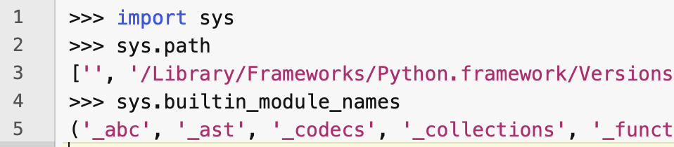
The module search path
If you import a module, the interpreter searches for a module with that name in the following places in the following order:
among built-in modules (listed in sys.builtin_module_names)
the list of directories in the variable, sys.path, which is initialized to
the current directory of the command line when the interpreter was inoked or the directory containing the input script if python was called with a script
directories listed in the PYTHONPATH environment variable
the installation-dependent default

Slide 18
"Compiled" Python modules
Python caches the compiled version of each loaded module in the __pycache__ directory under the name module.version.pyc
e.g., the spam module might be stored as __pycache__/spam.cypthon-33.pyc
Python checks modification date of source against compiled version to see if it needs recompiling
Compiled modules are platform independent
Always recompiles a source module that is loaded from the command line
Does not check cache if there is no source module

Slide 19
Standard modules
Python comes with a library of standard modules, described in the Python Library Reference
Some standard modules are built into the interpreter
these provide access to functionality outside the core language, such as interaction with the operating system
these modules are platform-dependent (e.g., on Windows systems, the winreg module is usually provided)

Slide 20
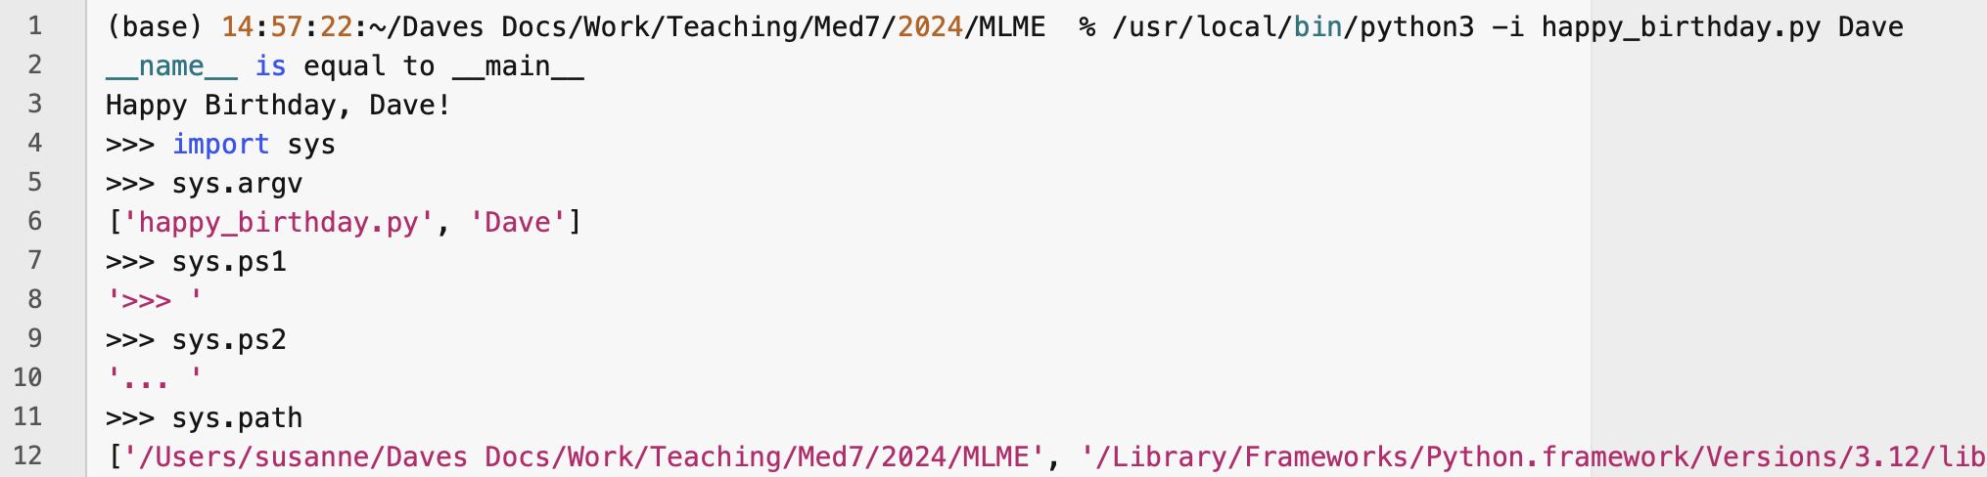
sys module
A particularly useful standard module is sys. This can be used for
accessing command-line arguments, sys.argv
defining primary and secondary prompts: sys.ps1, sys.ps2
defining the module search path: sys.path

Slide 21
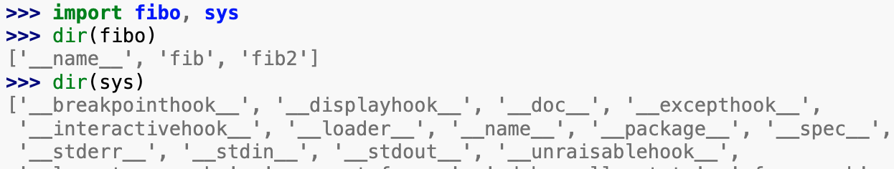
dir() function
The dir(module_name) returns a sorted list of the names that a module defines
With no arguments, dir() returns a list of the currently defined names

Slide 22
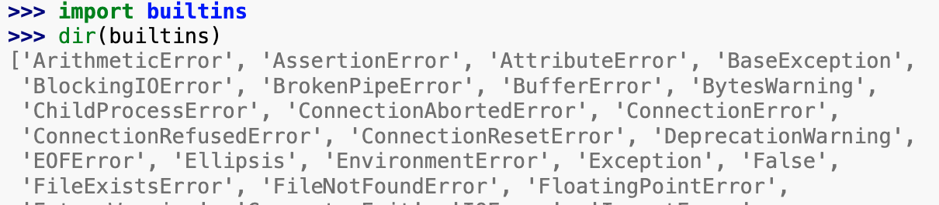
builtins standard module
dir() does not list built-in names of functions and variables
This is provided by running dir(builtins)

Slide 23
Packages
As in Java, Python allows you to organise your modules into packages
A package is a collection of modules and (sub-)packages
This allows you not to worry about the names that you give to your modules colliding with the names that other developers have given their modules
For example, you might want to build a system for parsing and analysing protein data which uses some specific mathematical functions that you want to collect together into a module called math
So long as your entire system of modules is enclosed within a package (e.g., one called "daves_proteins"), then you don't have to worry

Slide 24
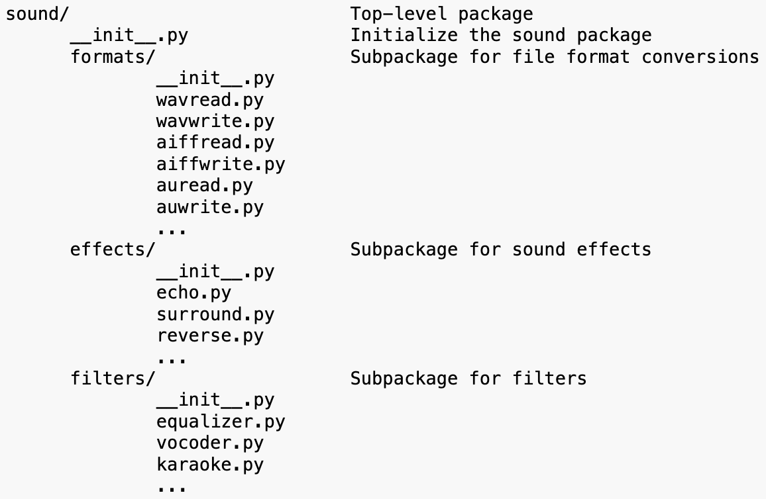
Packages
Suppose you want to build a library of modules for processing audio data
You may want to be able to read and write many different audio file formats (e.g., .wav, .aiff, .au, .mp4a)
You may also want to support many different types of audio processing operations
You could structure your package as shown on the right

Slide 25
Packages
The __init__.py modules identify their containing directories as Python packages
In the simplest case, __init__.py can be empty
But it can also contain initialization code

Slide 26


Packages
Users can load individual modules from the package by preceding the module name by the package name and a dot, e.g.,
You can also use from to avoid having to give the fully qualified name of an imported name each time you use it

Slide 27
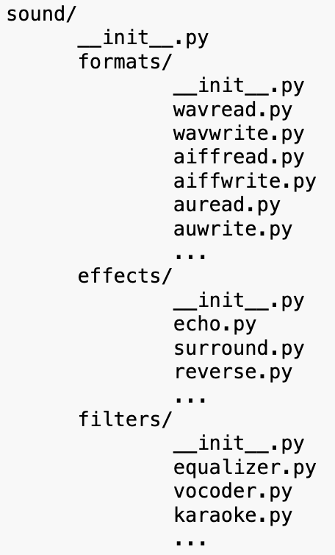
Importing * from a package
Suppose we want to import all the modules in a package using a statement like from sound.effects import *
One might hope that this causes Python to discover all the modules and sub-packages in sound.effects and imports all the defined names
This could cause unwanted side-effects that should only happen when a module is explicitly imported
The package author should therefore provide an explicit index of the package

Slide 28
__all__
To provide an index of the modules that should be imported when the user uses a from import statement, define an __all__ list in the package's __init__.py module
For example, the following line could appear in the __init__.py module in the effects package:

Slide 29
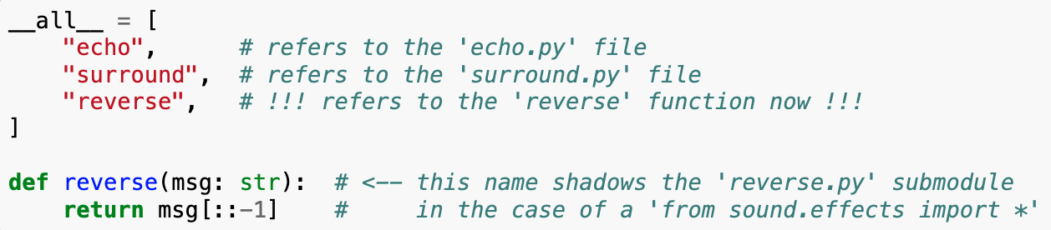
__all__
If you redefine the name of a package in __all__ in the __init__.py file after the definition of __all__, then this will hide the package and it will effectively not be imported

