Slide 1
Python Workshop
Session 3:
Data Structures
David Meredith
Aalborg University
dave@create.aau.dk

Slide 2
Sources
The following sections from the Python Tutorial
  https://docs.python.org/3/tutorial/datastructures.html
Chapter 10 and pages 229-231 of
  Cormen, T. H., Leiserson, C. E., Rivest, R. L. and Stein, C. (2009). Introduction to Algorithms. (Third edition). MIT Press, Cambridge, MA.

Slide 3
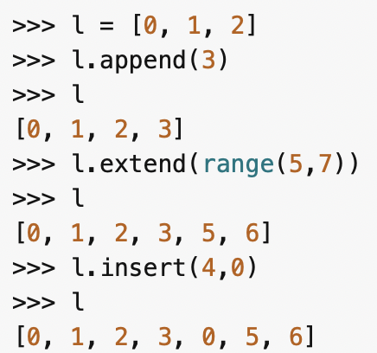
Adding items to a list
list.append(x) adds an item, x, to the end of the list
list.extend(iterable) extends the list by appending all the items in or generated by the iterable
list.insert(i,x) inserts x at position i in the list

Slide 4
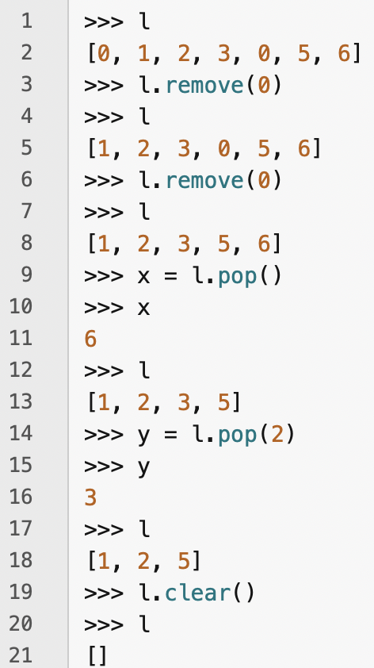
Removing items from a list
list.remove(x) removes the first occurrence of x from the list
list.pop([i]) removes the item at position i and returns it
    with no arg, removes and returns last item in list, so the list functions as a stack
list.clear() removes all items from the list

Slide 5
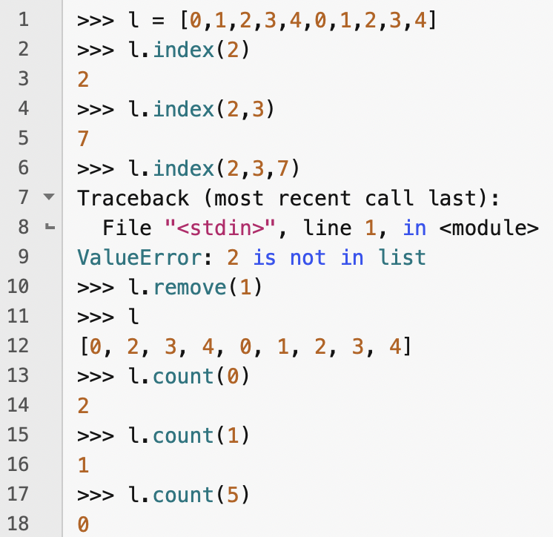
Finding items in a list
list.index(x, [, start [, end]]) returns index of first item in list equal to x
  if start provided, then only searches list beginning at position start
  if end provided, then only searches list up to position end (exclusive)
  always returns index of found item wrt original list
list.count(x) returns frequency with which x occurs in list

Slide 6
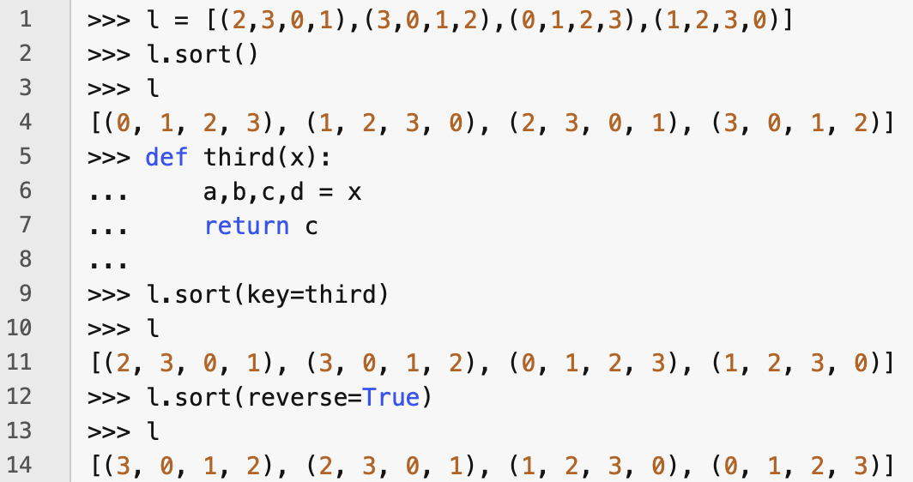

Ordering items in a list
list.reverse() reverses the order of the elements in the list
list.sort(*, key=None, reverse=False) sorts the list
  * indicates that all following parameters are keyword-only
  key is a function that takes each item in the list as its argument and returns a value that is used as a key for sorting
  reverse is a boolean value: if true, then list is sorted in reverse

Slide 7
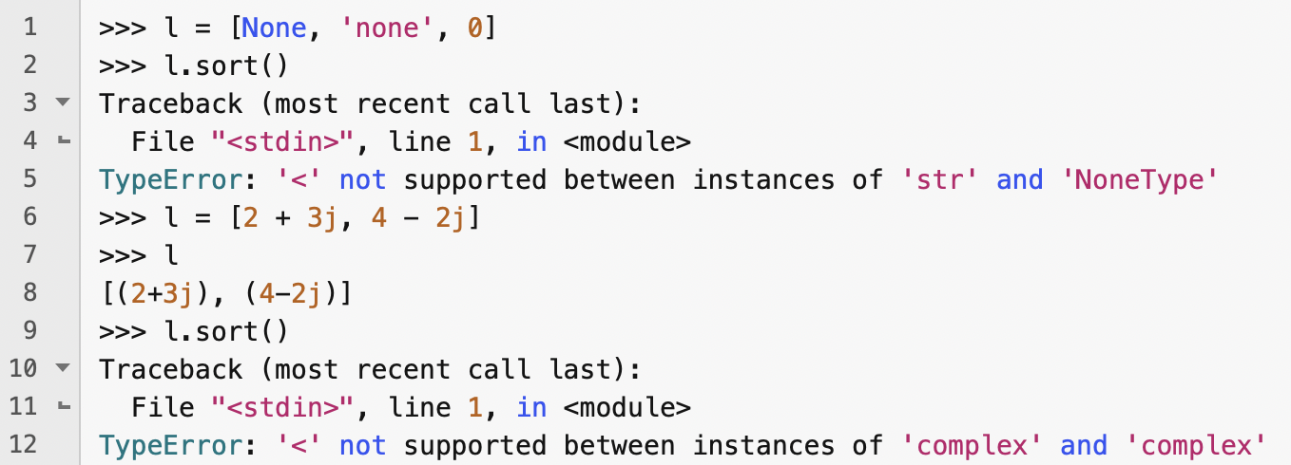
Some lists cannot be sorted
If the items in a list are not of the same type, then they cannot be sorted
There are also some types that do not have a defined natural ordering, so lists of items of these types cannot be sorted either

Slide 8
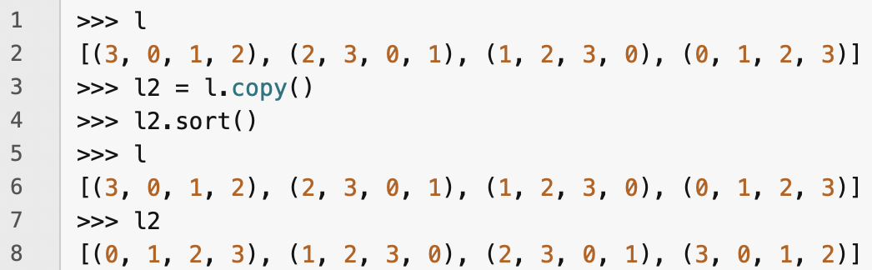
Copying a list
list.copy() creates a shallow copy of a list

Slide 9
Some list methods return None
Some of the list methods return the special value, None
  append, extend, insert, remove, clear, sort, reverse
It is a Python design principle that any method or function that only modifies a mutable data structure should return None

Slide 10
Dynamic sets
Sets in computer programs can grow, shrink or otherwise change over time
  they are dynamic
If you need to insert, delete and test for membership, then you need a dictionary
Other processes need more complicated operations
  e.g., max-priority queue which needs operations like extract max

Slide 11
Elements of a dynamic set
Each element of a dynamic set usually represented by an object with attributes that we can refer to with a pointer
Some kinds of dynamic sets assume each object has a key
  If all keys are different, then dynamic set is a set of key values
Object in a dynamic set may have satellite data that is not used by the dynamic set
Object may also have attributes that are manipulated by the set operations that contain pointers to other elements, for example
Some dynamic sets assume that the keys are drawn from a totally ordered set
  e.g., real numbers, Strings under lexicographical ordering
  allows definition of a minimum operation and a “next larger” operation

Slide 12
Operations on a dynamic set
Two categories of operation
  queries just return information
  modifying operations change the values in the set
Typical operations on a dynamic set:
  SEARCH(S,k) – returns pointer x to an element in S such that x.key = k or NIL if no such element in S
  INSERTS(S,x) – modifying operation that puts the element pointed to by x into S
  DELETE(S,x) – modifying operation that removes the element pointed at by x
  MINIMUM(S) – query that returns pointer to element with lowest key
  MAXIMUM(S) – query that returns pointer to element with largest key
  SUCCESSOR(S,x) – query that returns next larger element after x (or NIL)
  PREDECESSOR(S,x) - query that returns next smaller element after x (or NIL)

Slide 13
Stacks and queues
In a stack or a queue, the element removed by the DELETE operation is predetermined
In a stack, DELETE removes most recently added element
  Last In, First Out (LIFO)
In a queue, DELETE removes element that has been in set for longest time
  First In, First Out (FIFO)

Slide 14
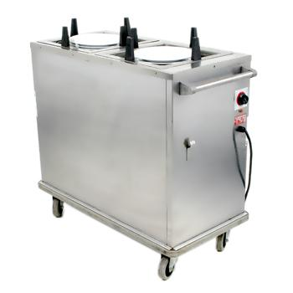
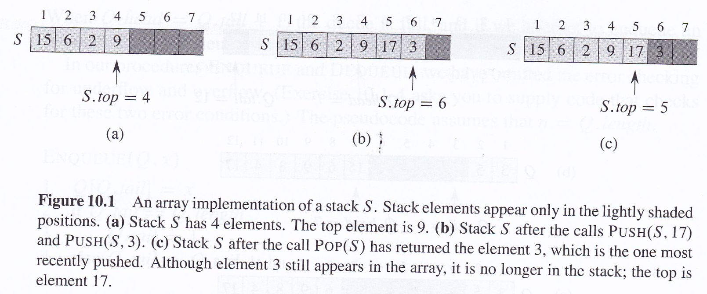
Stacks
INSERT is called PUSH, DELETE is called POP

Slide 15
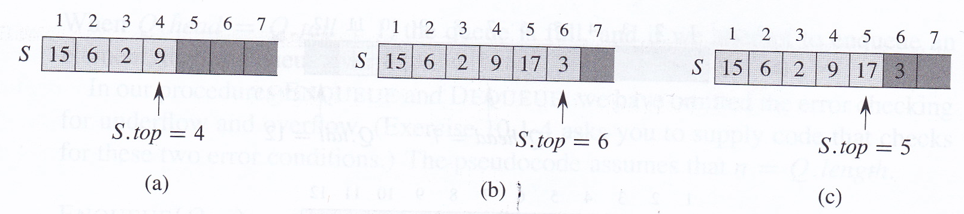
Stacks
S.top references most recently inserted element
Stack contains elements S[1..S.top]
If S.top = 0, stack is empty
If we try to POP an empty stack, we get stack underflow
If S.top > n, where n is length of array that implements stack, then we get stack overflow

Slide 16
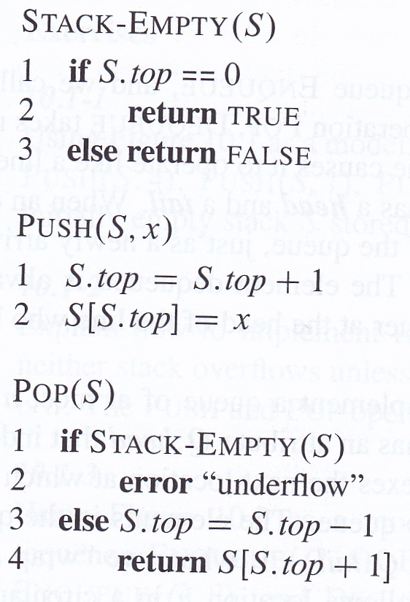
Implementing stack operations
Each stack operation takes O(1) time

Slide 17
Queues
INSERT on a queue is called ENQUEUE
DELETE on a queue is called DEQUEUE
Queue has a head and a tail
  just like a real queue at the supermarket!
ENQUEUE puts a new element at the tail of the queue
DEQUEUE removes the element at the head of the queue (FIFO)

Slide 18
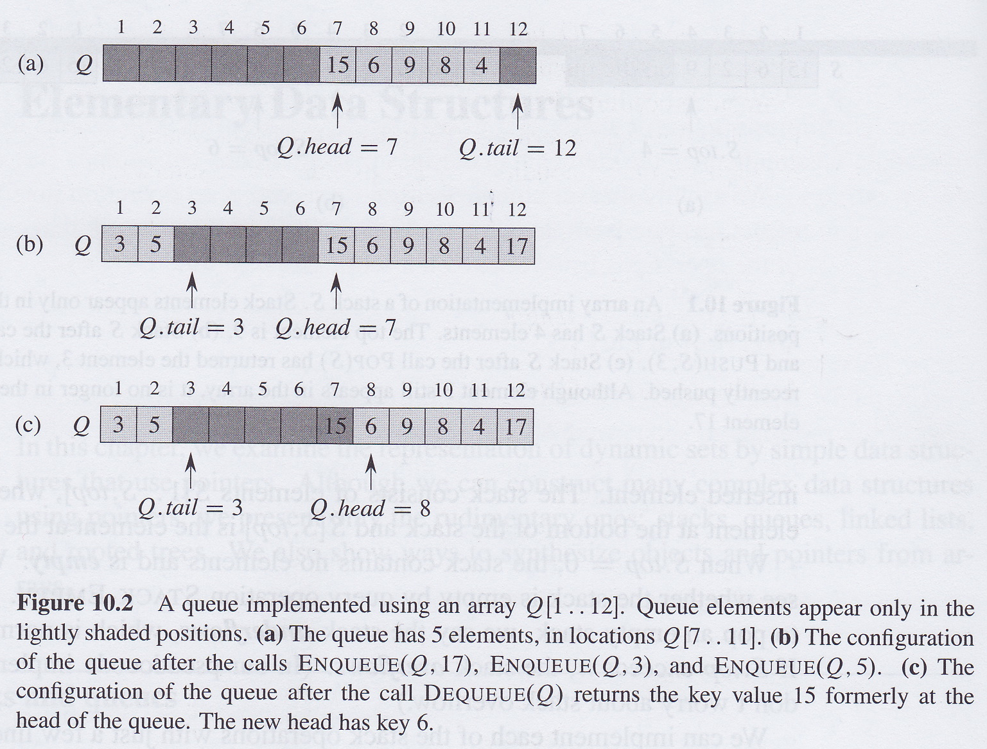
Queues
Can implement a queue of n – 1 elements using an array of n elements
Q.head points at head of queue, Q
Q.tail points at tail of queue, Q
Elements in queue are in locations:
  Q.head, Q.head+1,...Q.tail-1 where Q[1] follows element Q[n]
    i.e., we “wrap around” when we go past location n

Slide 19
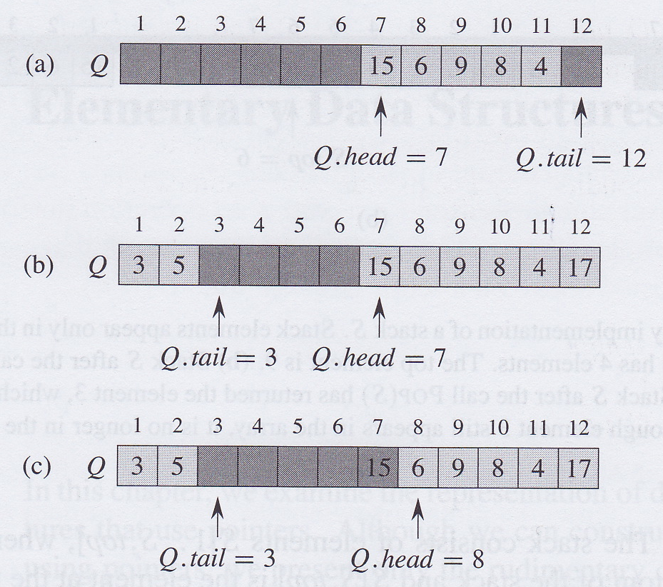
Queue underflow and overflow
When Q.head = Q.tail, then queue is empty
Initially, Q.head = Q.tail = 1
If queue is empty and we try to dequeue, then we get queue underflow
If Q.head = Q.tail + 1, then queue is full
If queue is full and we try to enqueue, then we get queue overflow
Q.length gives size of underlying array that implements the queue, not the number of elements in the queue

Slide 20
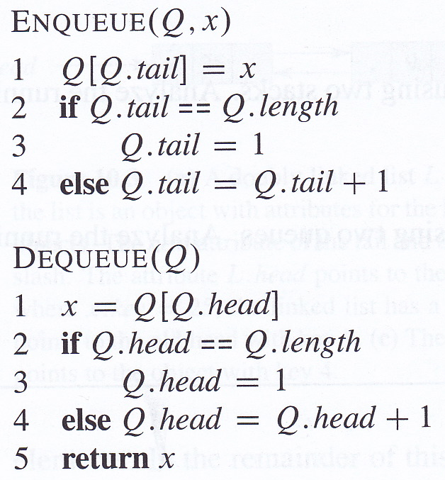
Implementing ENQUEUE and DEQUEUE
ENQUEUE and DEQUEUE take O(1) time
In practice, there would also be error checking for queue underflow and overflow

Slide 21
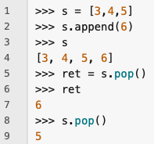
Using lists as stacks
Lists are well-suited to being used as stacks
Use append() for PUSH

Slide 22
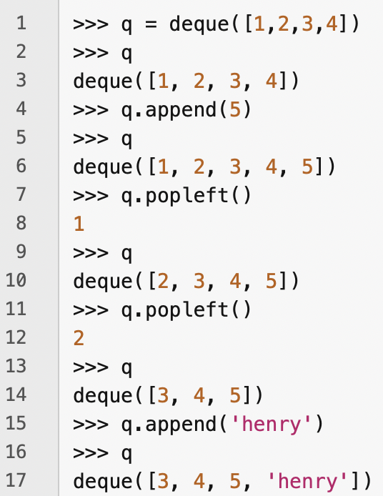
Using lists as queues
Python lists are not optimal for implementing queues because inserting an element at the beginning of a list involves shifting all the other elements by one step
To implement a queue, use collections.deque which provides constant time implementations of enqueue and dequeue
  It also provides an efficient stack implementation

Slide 23
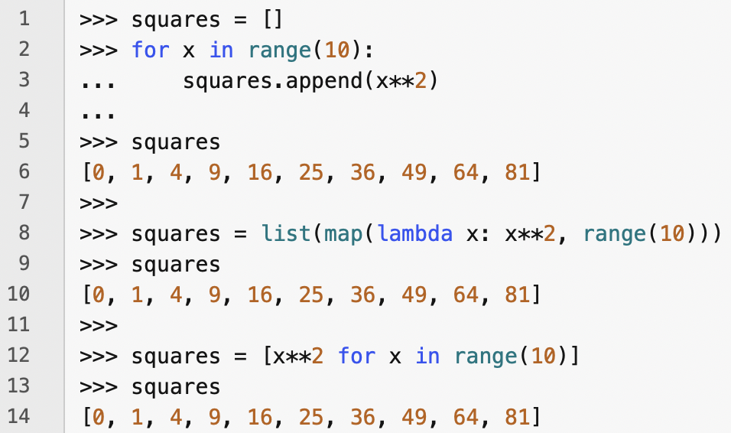
List comprehensions ('listcomps')
A list comprehension or 'listcomp', for short, is a way of concisely defining a new list of objects
Typically, a listcomp is used to create a list where each element is the value of an expression in which the terms iterate over some series of values
On the left at the top, we make a list of square numbers by defining a for loop
Apart from being quite verbose, this also creates a variable, x, that persists after we've finished using it – always a bad idea!
We then create a list of square numbers using the map() function which applies its first argument (a function) to each element in the second argument (a list or iterable)
Finally, we create a list of squares using a list comprehension – note how much more concise and readable this is than the other methods!

Slide 24
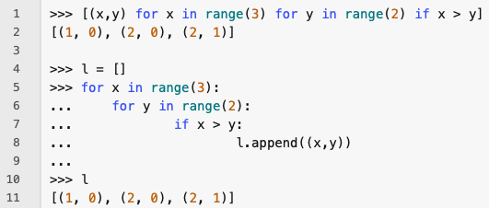
List comprehensions
A list comprehension is enclosed in square brackets like a list
Between the brackets, we start with an expression that is evaluated for each set of values generated by one or more for and if clauses
After the expression, there must be at least one for clause
After the first first for clause, there can be any number of for or if clauses
The listcomp in line 1 on the left is equivalent to the code in lines 4-10
  Note that the order of fors and ifs is the same in the two versions
Note that tuples must be parenthesized in listcomp expressions

Slide 25
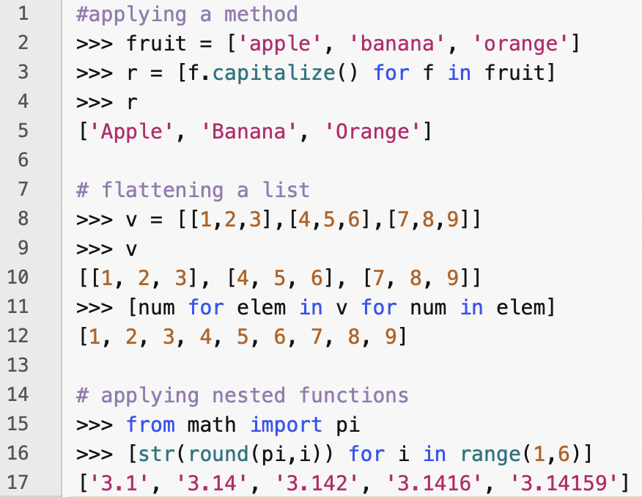
List comprehensions
List comprehensions can be used to flatten lists
The expression can involve applying a function or method to each element generated by the for and if clauses
Functions in expressions can be nested

Slide 26
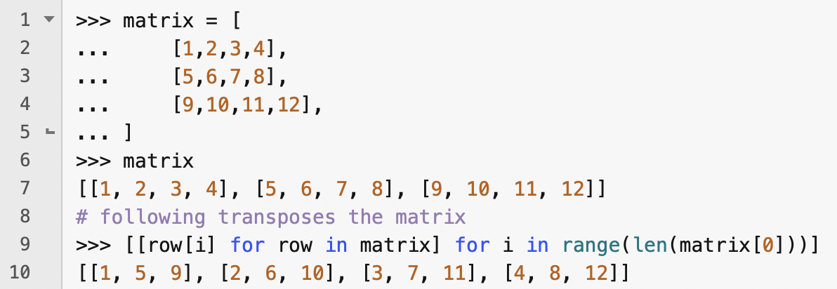
Nested list comprehensions
The expression in a listcomp can itself contain another listcomp
Expression above transposes a matrix implemented by a nested list
  Though a better way to do this would be to use the zip function, as follows:

Slide 27
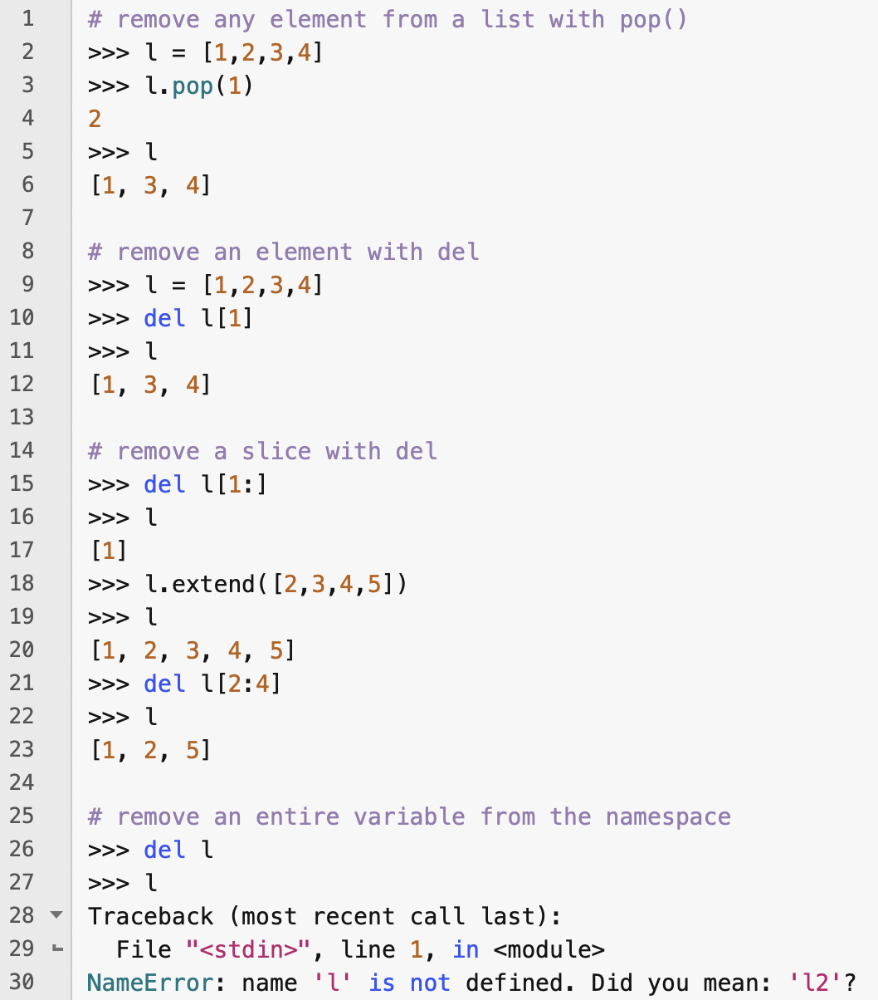
The del statement
The pop() method can be used to remove any item from a list by providing its index as an argument
But pop() also returns the value that it removes from the list
The del statement can be used to remove any slice from a list
It can also be used to remove variables altogether from the current namespace

Slide 28
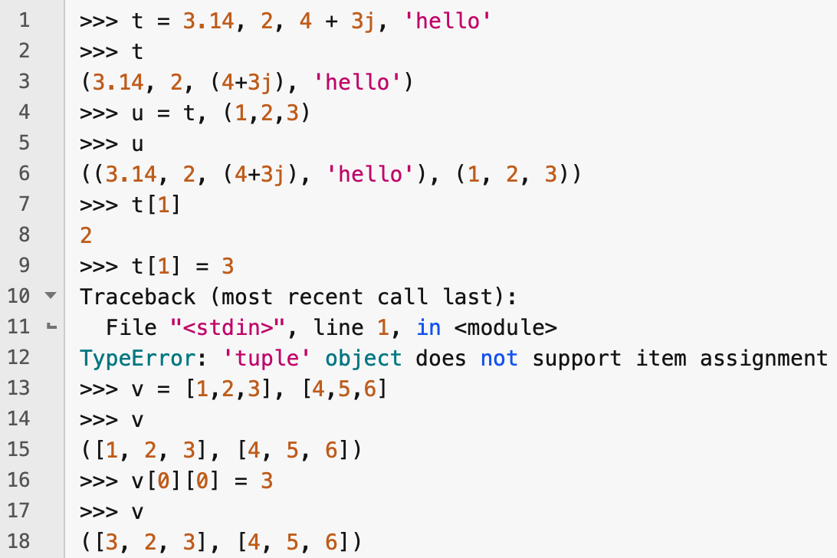
Tuples and sequences
Lists and strings are special types of sequence
  This is why you can do indexing and slicing on them
Another standard sequence type is tuple
A tuple is a sequence of values separated by commas
When defining them, you don't need to use parentheses – it is the commas that define them as tuples
They are output with parentheses
Tuples can contain tuples
Tuples are immutable
The elements in a tuple may be mutable

Slide 29
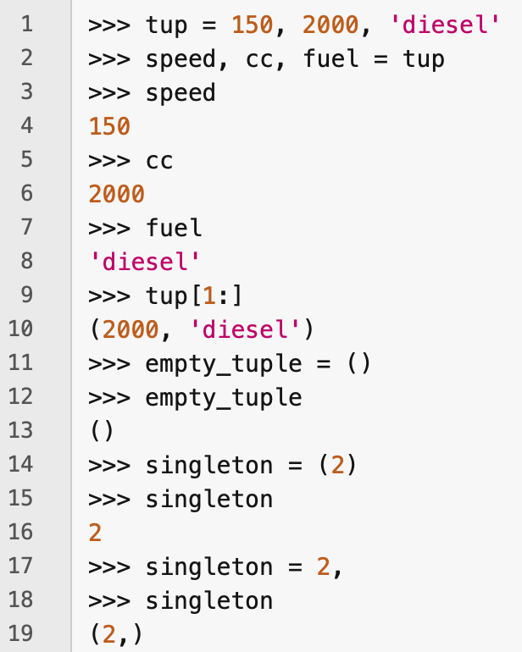
Tuples
Tuples often contain a heterogeneous sequence of elements that are accessed via unpacking or indexing
  In namedtuples you can access attributes by their attribute names
An empty tuple is constructed by an empty pair of parentheses
A tuple with one element is constructed by following a value with a comma
  Note that you cannot construct a singleton tuple by placing a value between parentheses!

Slide 30
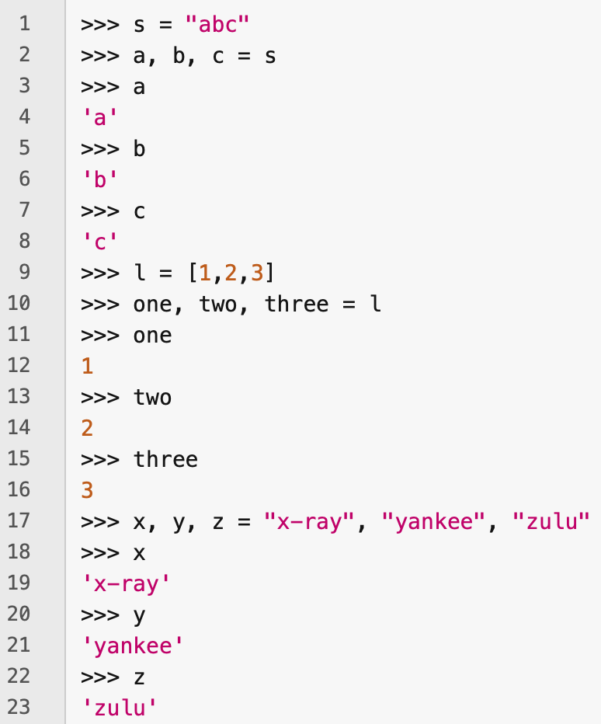
Sequence unpacking
Sequence unpacking can be used with any type of sequence
Multiple assignment is a combination of sequence packing and unpacking

Slide 31
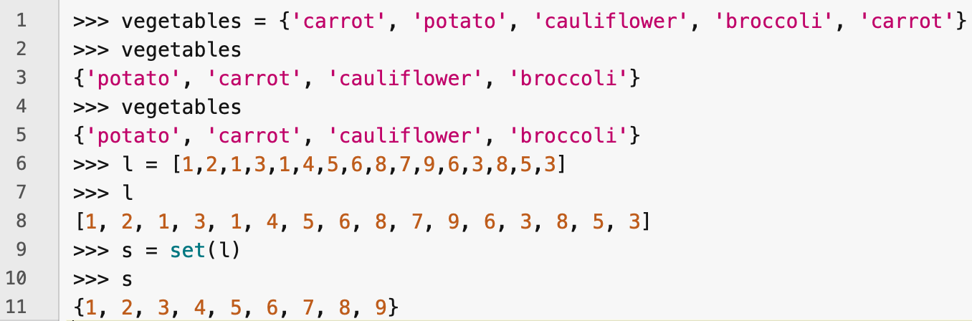
Sets
Python has a set data type
A set is an unordered collection with no duplicates
Sets can be used for removing duplicates from a list
Sets are constructed either with curly braces, {...}, or by using the set() function
  An empty set must be constructed using set(), not {} – {} constructs an empty dictionary

Slide 32
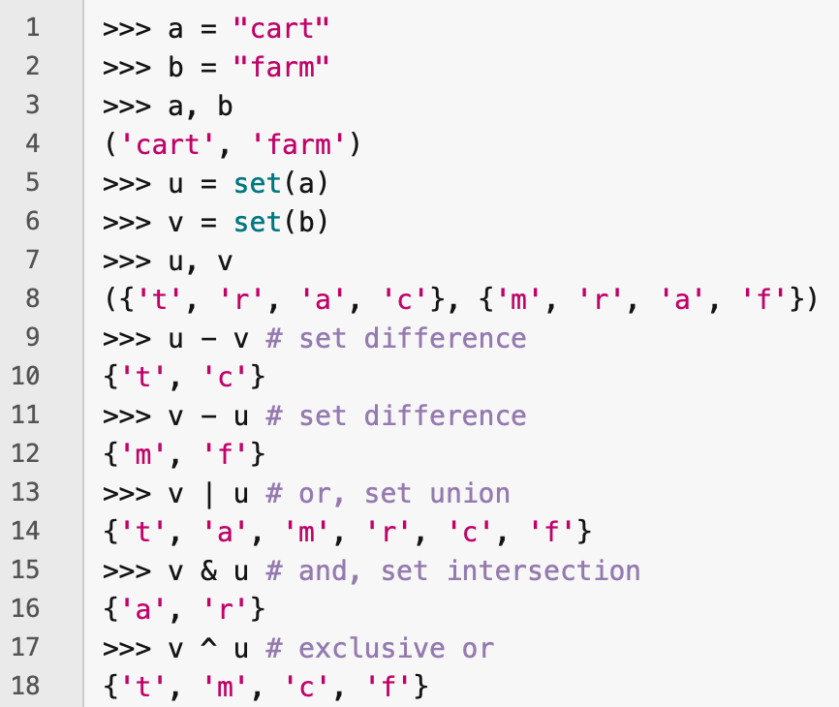
Set operations
Sets support the mathematical operations of union, intersection, difference and symmetric difference

Slide 33
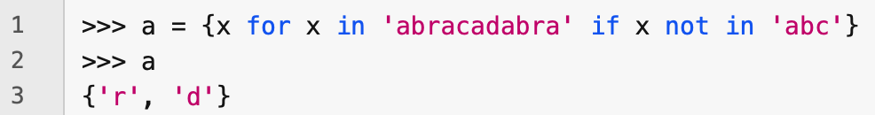
Set comprehensions
You can construct sets using set comprehensions that follow rules that are similar to list comprehensions

Slide 34
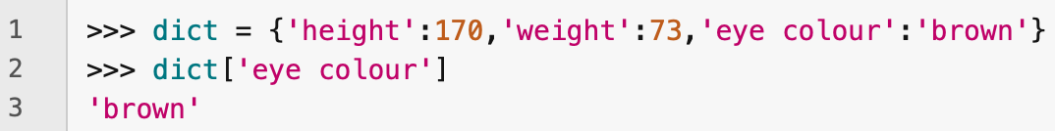
Dictionaries
Dictionaries in Python are basically the same as "associative arrays" or "maps" in other languages
A dictionary is an unordered set of key—value pairs
In a dictionary, values are accessed through their keys, not via indexing or slicing
A key can be any immutable type: a string, a number, or even a tuple in which each element is immutable
Within a dictionary, each key must be unique
A pair of braces, {}, creates an empty dictionary
They are input and output as lists of comma-separated, key:value pairs

Slide 35
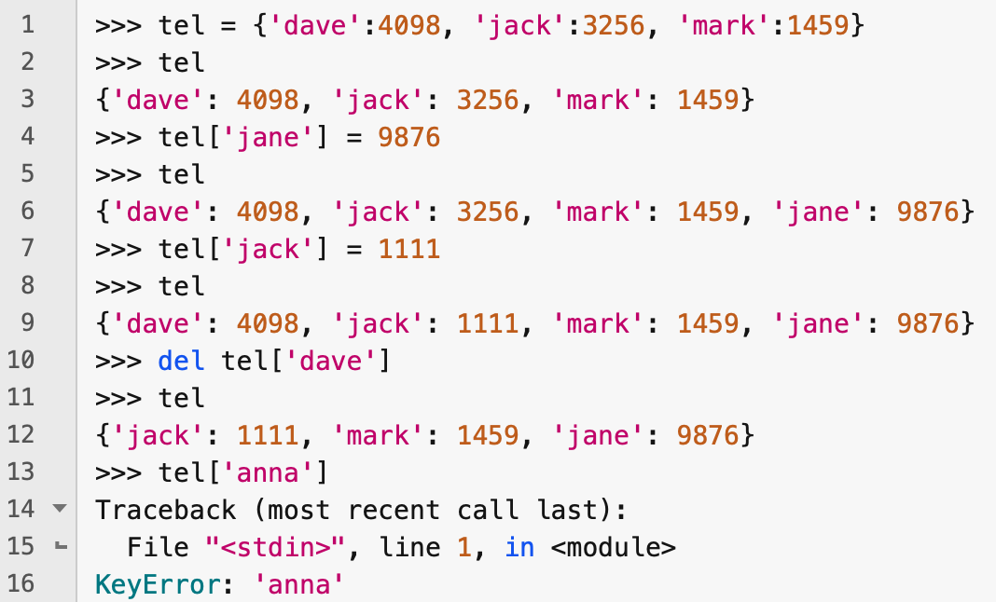
Dictionary operations
The main operations on dictionaries are storing a new key:value pair and retrieving the value associated with a key
key:value pairs can also be deleted with the del statement
You can change the value associated with a key by storing a new value with that key
It's an error to try to retrieve the value associated with a non-existing key

Slide 36
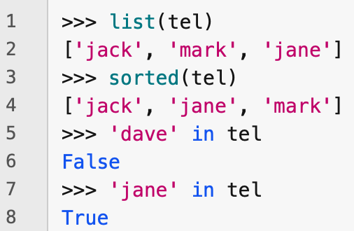
More on dictionaries
list(d) returns a list of the keys in the dictionary
sorted(d) returns a list of the keys in the dictionary, in sorted order
Check if a key is in a dictionary by using the in keyword

Slide 37
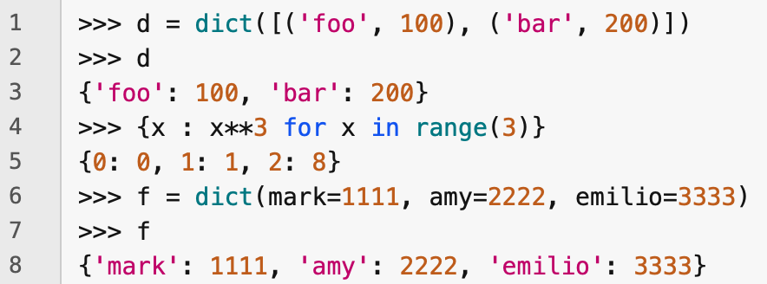
Other ways to construct dictionaries
The dict() constructor builds a dictionary from a sequence of key—value pairs
Dictionaries can also be constructed through comprehensions
If keys are simple strings, then you can specify them in the form of keyword arguments

Slide 38
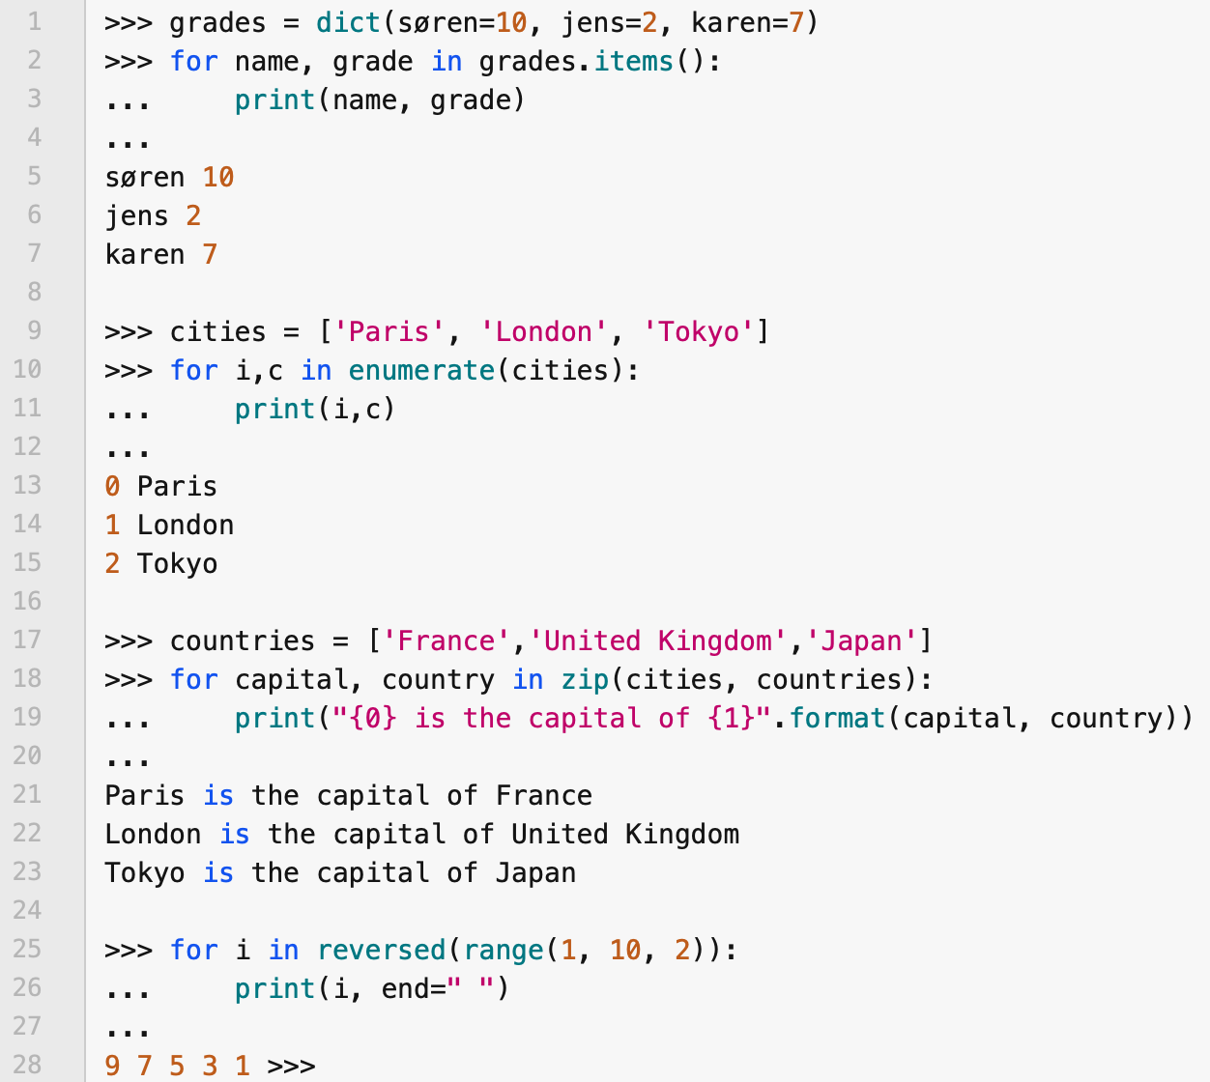
Looping techniques
You can get both the keys and the values when iterating over a dictionary by using the items() method
You can get both the indices and the values when iterating over a sequence by using the enumerate() function
You can iterate over two or more sequences at the same time using the zip() function
You can iterate backwards over a sequence by calling the reversed() function

Slide 39
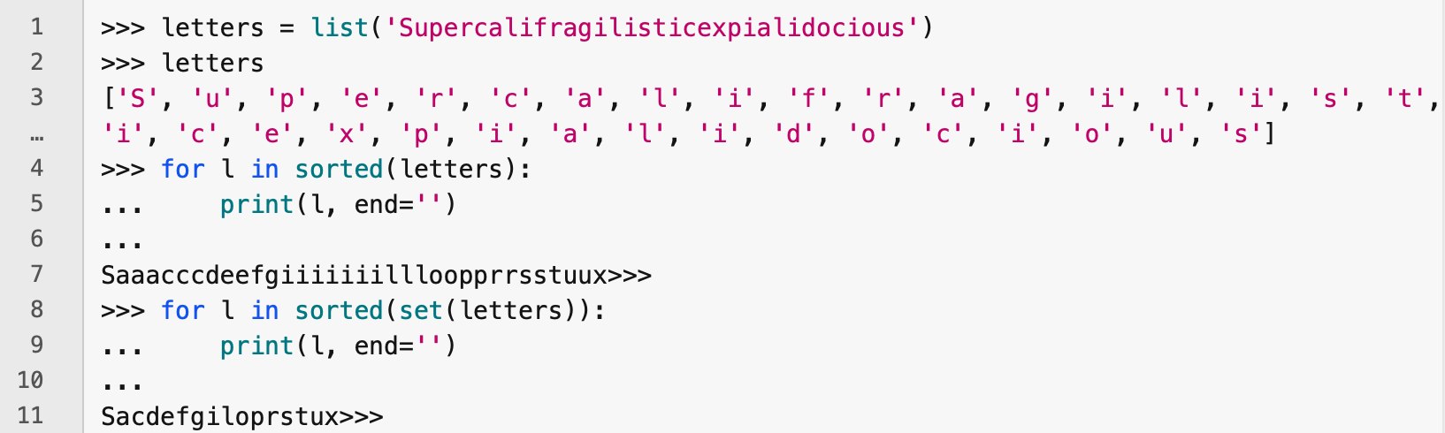
More looping techniques
Use sorted() to iterate over a sequence in sorted order
  Returns a new sorted list whilst leaving the original list unchanged
To iterate over unique elements of a list, use set()
  set() and sorted() are often used together to iterate over a sorted set containing the distinct elements in a list

Slide 40
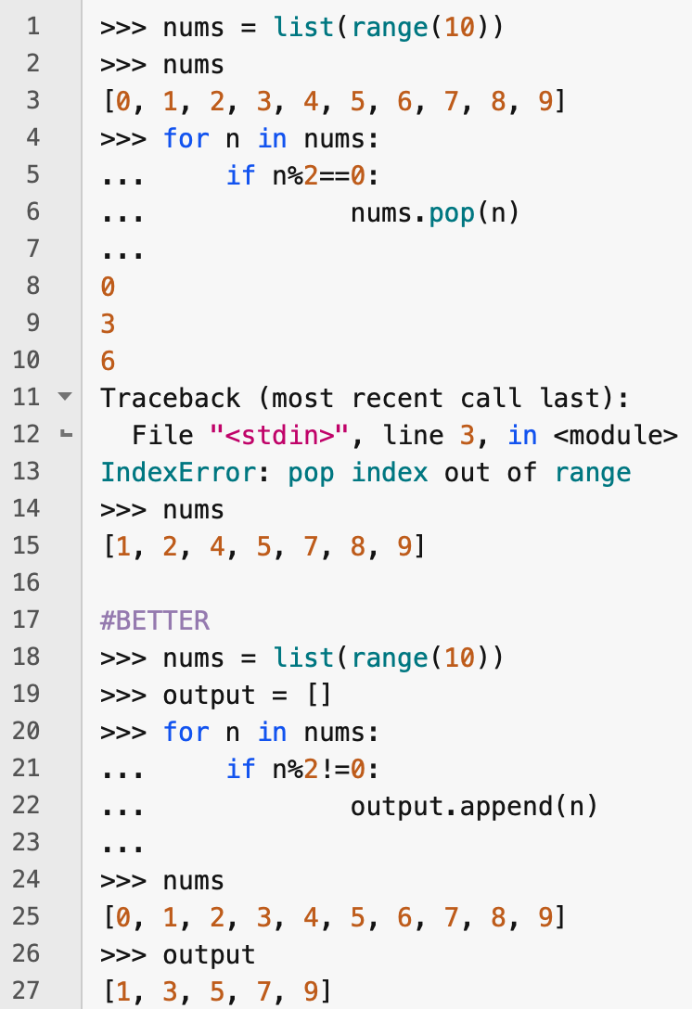
Changing a list while iterating over it
Usually better not to change a list while you are iterating over it
Instead, create a copy of the list to iterate over or create a new list to hold the result of the iteration

Slide 41
More on conditions
The conditions in while and if statements can contain any operators, not just comparisons
Membership and identity comparison operators
  in and not in determine whether an element is in a container
  is and is not determine whether two objects are the same object
Comparisons can be chained
  e.g., a < b == c tests if b is greater than a and equal to c
Comparisons can be combined with the boolean operators, and, or and not
  not has highest priority of the three; or has the lowest priority
    e.g., A and not B or C is the same as (A and (not B)) or C

Slide 42
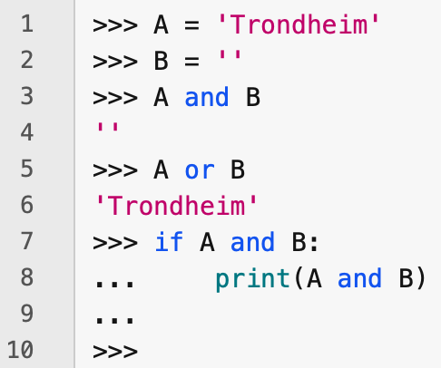
Short-circuit operators
Returns value of last operand evaluated
and and or are short-circuit operators – operands are evaluated from left to right and evaluation stops as soon as there is enough information to determine the value of the whole expression
For example, if A is True and B is False, then
  A or B does not evaluate B
  A and B does need to evaluate B
When A and B are non-Boolean values, then the value returned by a short-circuit operator is the last evaluated operand
Evaluates Boolean value of expression

Slide 43
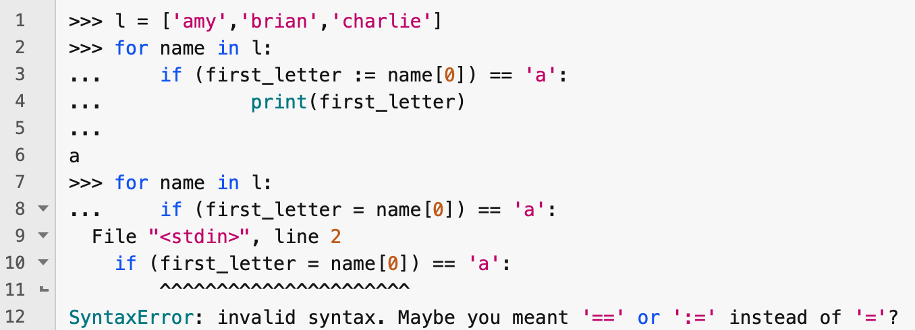
Walrus operator (:=)
An assignment within an expression has to be made using the "Walrus operator", :=
This is to avoid a common bug in C-based languages where = is used in an expression where == was intended

Slide 44
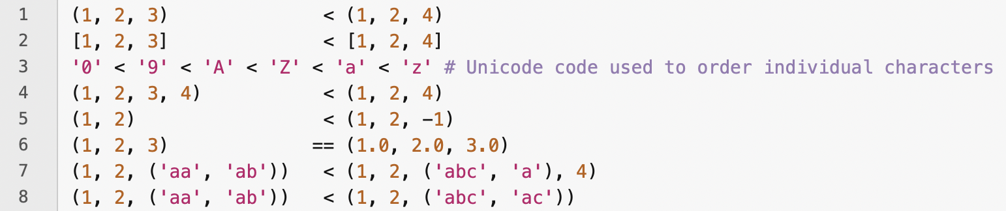
Comparing sequences and other types
Sequences of the same type are compared using lexicographical ordering – the way words are sorted in a dictionary
Proper prefixes of a sequence come first,
  e.g., ab comes before abc
If a sequence contains a sequence, then the ordering is done recursively
Characters are ordered using their Unicode code points
Objects of different types can be compared provided they have appropriate comparison methods (e.g., integers and floating point numbers)

Slide 45
Exercises
Exercise 1
Use a Python list to implement a queue with a fixed finite capacity. Make sure that the ENQUEUE and DEQUEUE functions signal when there is queue underflow and overflow.
Exercise 2
Do an experiment which demonstrates the difference in running time for the ENQUEUE operation when you use a list or a collections.deque for implementing a queue with an unbounded capacity.
Exercise 3
Construct a list or set comprehension that evaluates to a list or set containing all and only the prime numbers less than 200.
Exercise 4
Write a Python function that takes a list, x, as input and returns a sorted list that contains every element in x in ascending order exactly once (i.e., with no duplications).

