Slide 1
Python Workshop
Session 2:
Control Flow, Functions, Parameters and Arguments
David Meredith
Aalborg University
dave@create.aau.dk

Slide 2
Source
The following sections from the Python Tutorial
  https://docs.python.org/3/tutorial/controlflow.html

Slide 3
More control flow tools
In this session, we'll start at looking at the mechanisms Python provides for controlling program flow – i.e., determining which lines of code executes next
Python provides a number of mechanisms for this, including if, for, range(), break, continue, else on loops, pass and match
We will look at each of these in turn

Slide 4
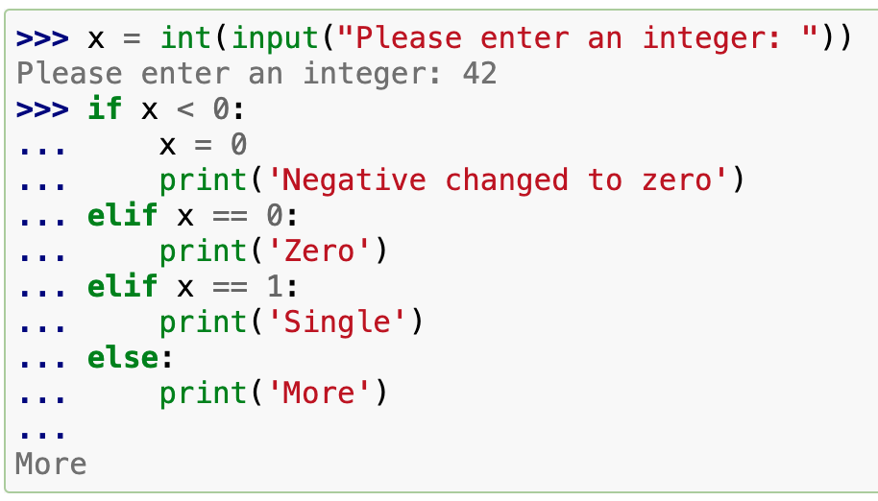
if statements
There can be zero or more elif parts and the else part is optional
elif is (obviously) short for "else if"
  There is nothing in Python that is equivalent to "switch" or "case" in other languages
Sometimes a match statement is more appropriate if you're comparing the value of a variable to several constants – we'll consider this later

Slide 5
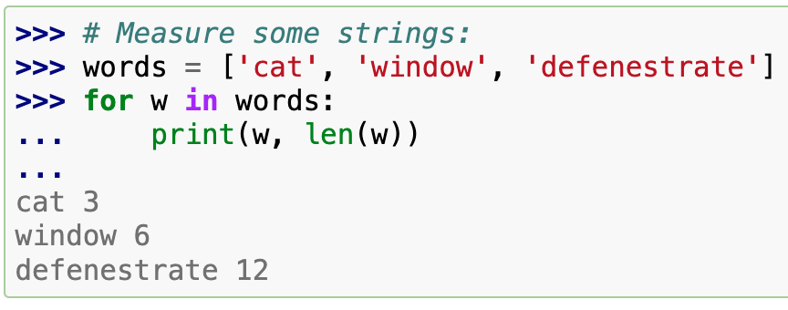
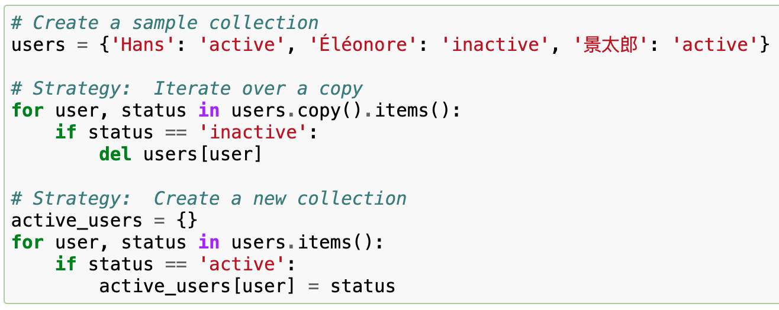
for statements
The for statement in Python is a bit different from 'for' statements in other languages like Java or C
In Python, the for statement always iterates over a sequence, which could be, for example, a list or a string
It's usually more straightforward not to change a sequence while you are iterating over it
Instead, iterate over a copy of the sequence or create a new sequence
The examples on the left introduce the Python Dictionary data type, which we'll cover later
  These are like associative arrays in other languages

Slide 6
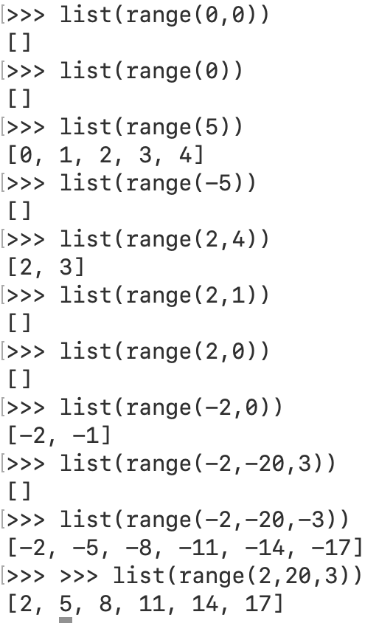
The range() function
The range() function can take 1, 2 or 3 arguments and generates a sequence of values over which one can iterate
With just one argument, range(x) generates the values 0 to x – 1
With two arguments, range(a,b) generates values a to b-1
With three arguments, range(a,b,s) generates values from a to at most b-1 if b is greater than a and from a to b+1 if a is greater than b, in steps of size s

Slide 7
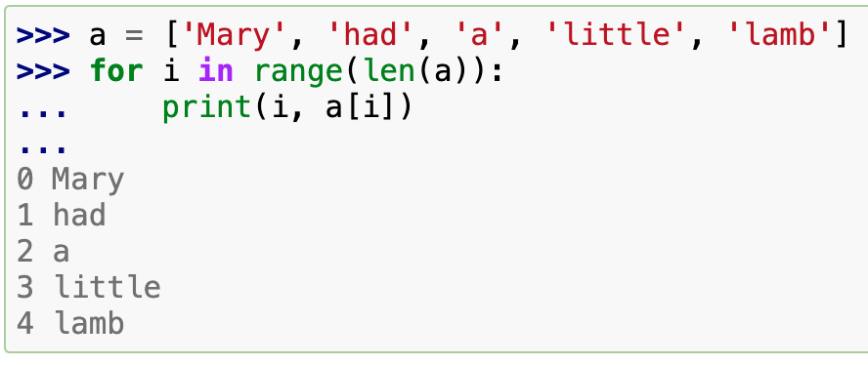
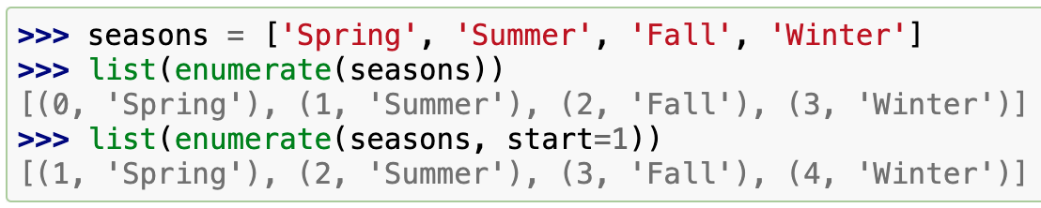
Using range to iterate over a list
If you need to keep track of the position of an element in the list as you iterate over it, then you can use the idiom on the left
For this purpose, you can also use enumerate

Slide 8
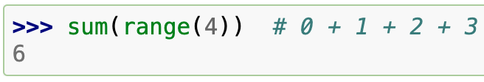
range() returns an iterable object
range() does not return a list, though the object it returns behaves a bit like a list
The object returned by range() is an iterable object that generates each successive value in a sequence but never actually stores the entire sequence anywhere
As we have seen the for statement can use the iterable object returned by range()
The sum() function can also take an iterable object as its argument (see on the left)

Slide 9
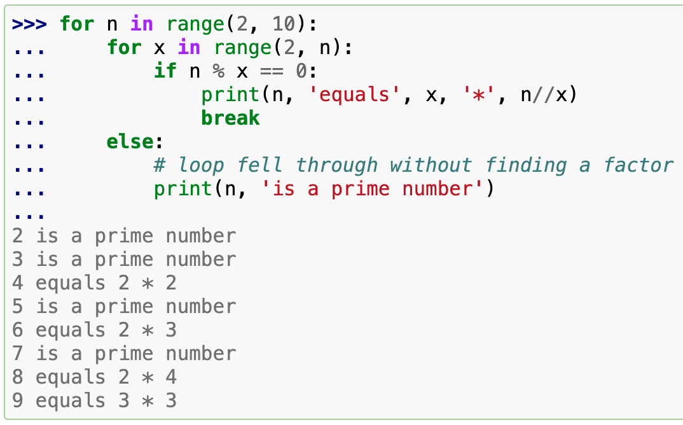
break and else clauses on loops
The break statement breaks out of the innermost enclosing for or while loop
A for loop can include an else clause
  in a for loop, the else clause is executed after the loop reaches its final iteration
  in a while loop, the else clause is executed after the condition becomes false
  an else clause is not executed if the loop is terminated by a break
A loop's else clause has more in common with a try statement's else clause than an if statement's else clause (we'll see this later)

Slide 10
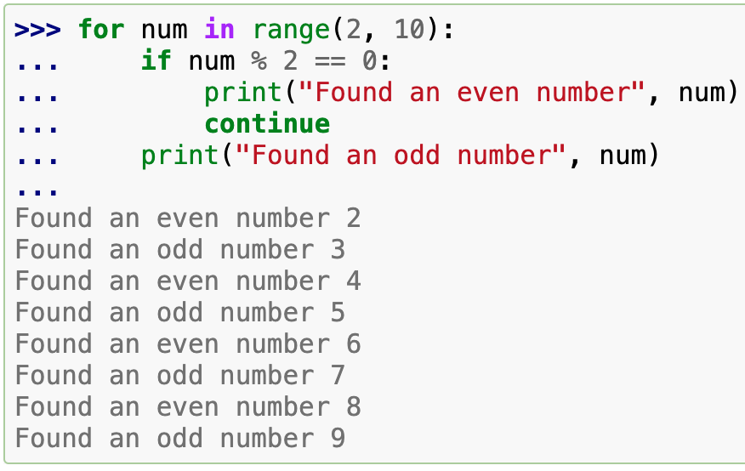
continue
The continue statement causes execution to go directly to the beginning of the next iteration, skipping any lines of code that remain in the current iteration

Slide 11
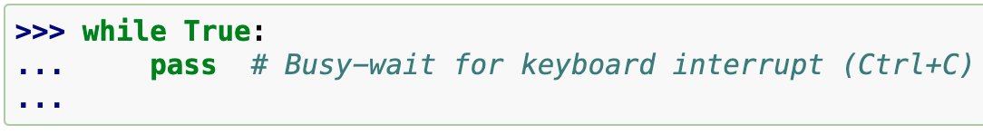
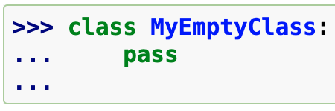
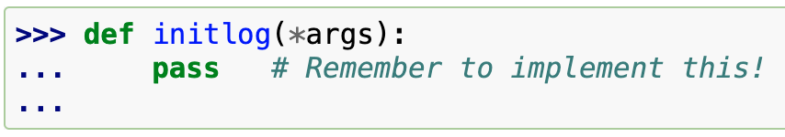
pass statement
A pass statement does nothing at all
It is used when a statement is required by the syntax but no action needs to be taken
Some examples of using pass include
  in the body of a while loop during busy waiting
  creating minimal classes
  as a placeholder for the body of a new function that you haven't written yet

Slide 12
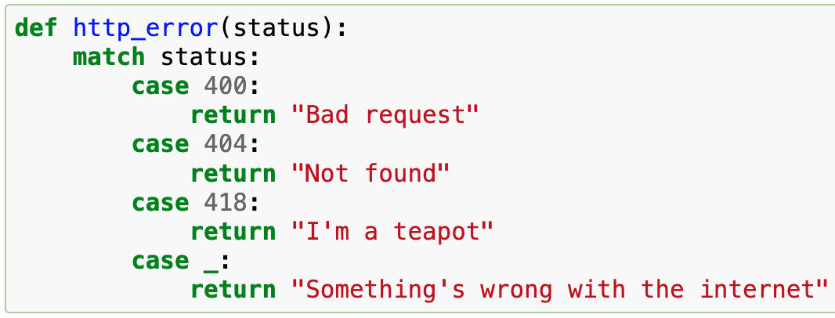
match statement
A match statement takes an expression and compares its value to successive patterns, given as one or more case blocks
It looks a bit like a 'switch' statement in C, Java or JavaScript, but its actually more similar to pattern matching languages like Rust or Haskell
Only the first pattern that matches gets executed and it can also extract components from the value into variables
The value _ is a wildcard that matches anything

Slide 13
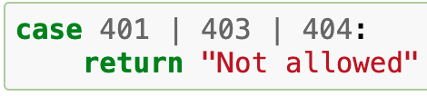
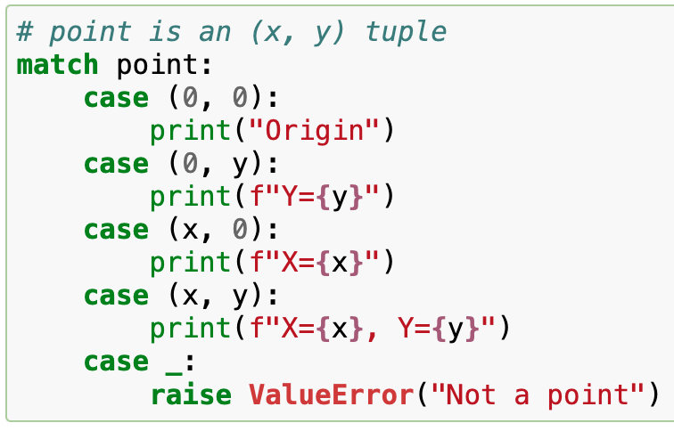
match statement
You can combine several literals in a single pattern using | ("or")
Patterns can be used to bind variables and can look like unpacking assignments
  f"Y={y}" is a formatted string literal, indicated by the prefixed 'f'
  The "{y}" is an expression, y, whose value will replace the expression
  "case (x, y):" matches any point which is simply an ordered pair – the values of the pair get bound to x and y so that they can be used in the print statement
    This resembles an unpacking assignment

Slide 14
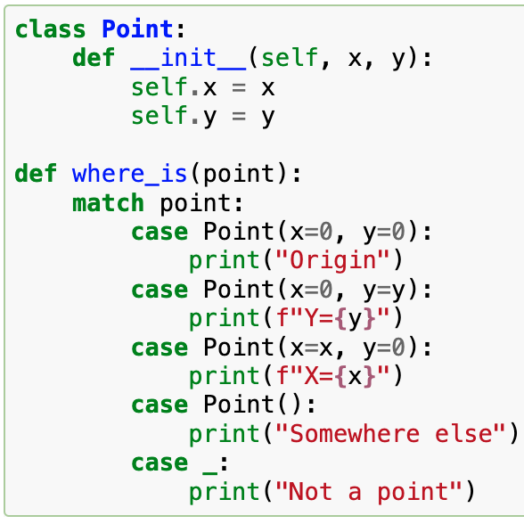
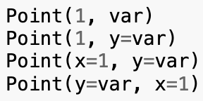
match statement with classes
To match objects, you can use case patterns that resemble constructors but that have the ability to capture the values of attributes into variables
With some builtin classes that provide an ordering for their attributes (e.g., dataclasses), you can use positional parameters
You can also set the __match_args__ special attribute in a class definition to define a specific position for attributes in patterns
  For example, if __match_args__ is set to ("x", "y"), then the patterns on the right are all equivalent, and all bind the y attribute to var

Slide 15
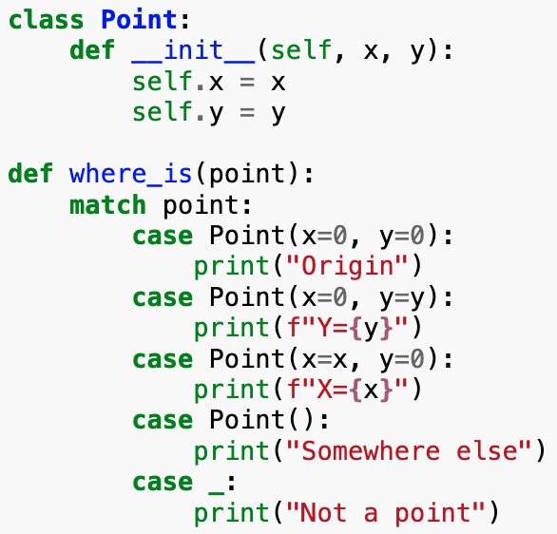
More on match patterns
Read a match pattern as an extended form of what you would put on the LHS of an assignment
Only standalone names (e.g., var) are assigned to
Dotted names (e.g., foo.bar), attribute names (e.g., "x=", "y=") and class names (e.g., Point(...) ) are not assigned to

Slide 16
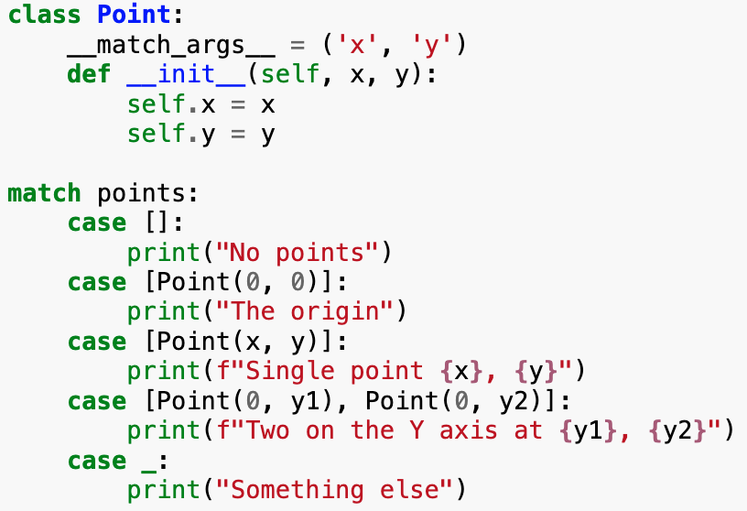
More on match patterns
Patterns can be nested inside container data structures
Example on the left shows how a list of points can be matched with positional parameters
  Note that __match_args__ has been set in the definition of Point

Slide 17
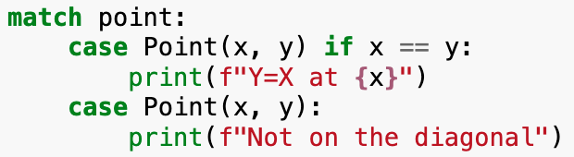
guards: if clauses in patterns
We can add an if clause to a pattern to add constraints to it
This is called a guard, as in UML
If the guard is false, then match goes on to the next case block
Value capture happens before the guard is evaluated

Slide 18
Other key features of match
Tuple and list patterns match any sequence except strings
  They also do not match iterators
Sequence patterns (i.e., tuples and lists) work in a similar way to unpacking assignments. For example,
  [x, y, *rest] and (x, y, *rest) will bind the first two elements to x and y, respectively and then put the rest in a list called rest
  (x, y, *_) uses the special variable, _, in order not to bind any elements after the first two
Subpatterns can be captured using the as keyword. For example
case (Point(x1, y1), Point(x2, y2) as p2): ...
captures the second Point object in the input into a variable called p2

Slide 19
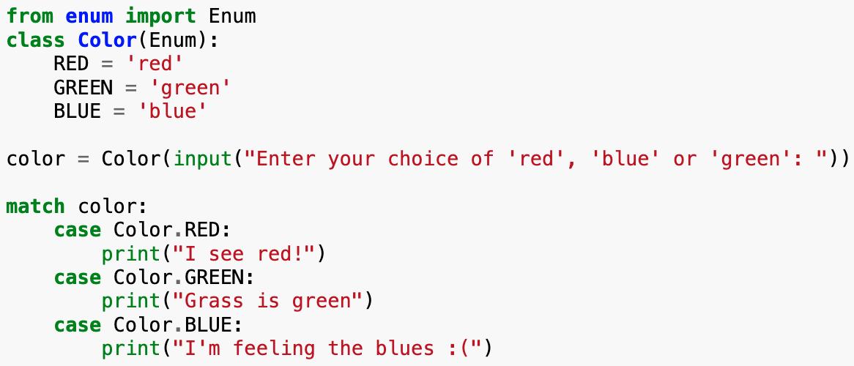
Other key features of match
Mapping patterns: {"bandwidth": b, "latency": l} captures the values of the properties named "bandwidth" and "latency" from a dictionary
  Extra keys are ignored unless you capture them into a list using **rest
Most literals are compared by equality, but singletons like True, False and None are compared by identity (since there is only one instance of each of them)
Patterns can use named constants, but they must be written as dotted names in order for them not to be mistaken for capture variables (see above)

Slide 20
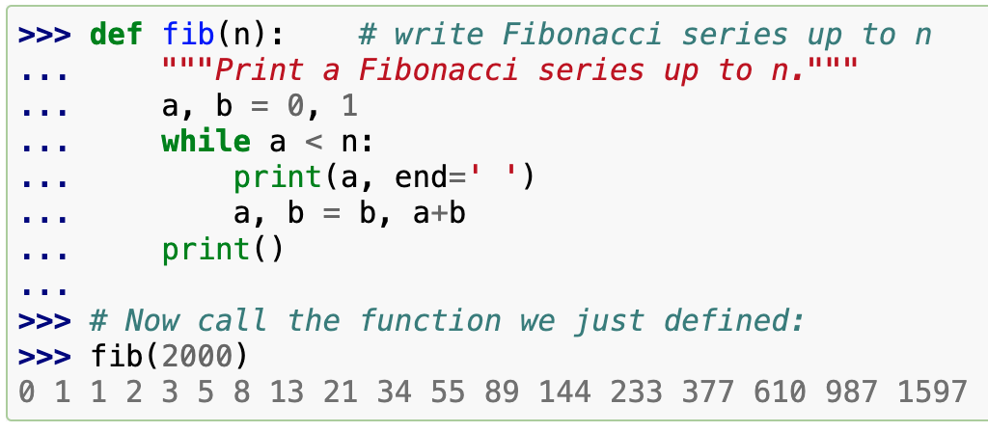
Defining functions
On the left, we define a new function, fib(n), that prints a Fibonacci series up to n
The keyword, def, introduces the function definition
It must be followed by the function name and a parenthesized list of formal parameters
The statements that form the body of the function start on the next line and must be indented
Optionally, the first statement of a function body can be a string literal which serves as the function's documentation string or docstring
  docstrings are used by some tools to automatically generate online or printed documentation (cf. JavaDoc)

Slide 21
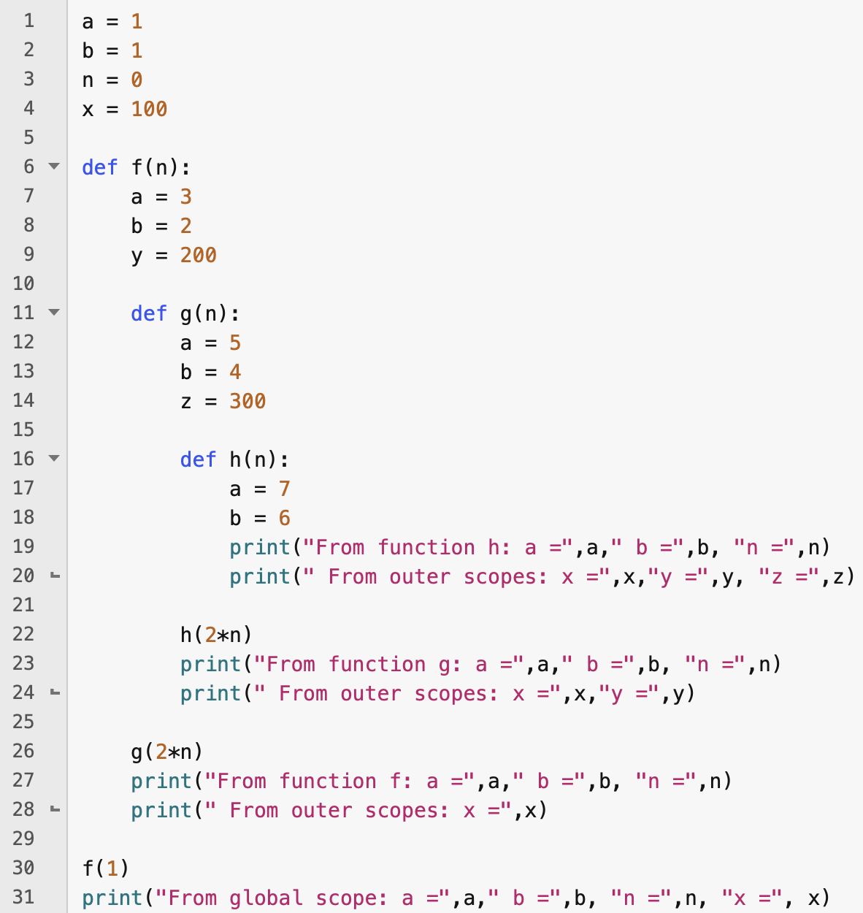
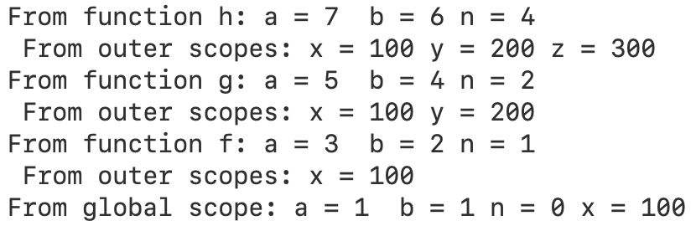
Function scope
Executing a function creates a new symbol table for variables defined locally within the function
When processing a variable reference, the interpreter
  first looks in the local symbol table,
  then the local symbol tables of enclosing functions
  then the global symbol table
  then the table of built-in names

Slide 22
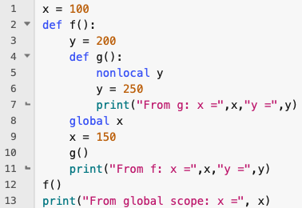
global and nonlocal keywords
If you want to make a change to the value of a variable defined outside the local function scope, then you need to declare the variable as global or nonlocal within the scope where you want to change it and before you make the change
Use nonlocal to refer to a variable that is defined in enclosing, non-global scope (e.g., a containing function definition)
Use global to refer to or create a global variable
What would happen if we changed nonlocal to global in the example?

Slide 23
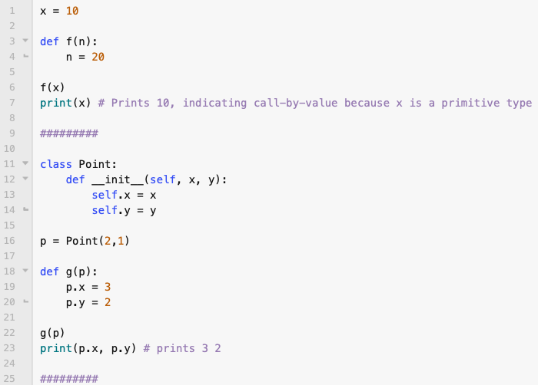
Parameters and arguments
If the argument is a primitive type (like a number or a boolean) then the local variable storing the argument is a copy of the value passed – this is "pass-by-value"
If the argument is an object (i.e., an instance of a class), then the value passed to the function is a reference to the object
This means that if you modify within the function, then that change will be seen in the object passed to the function after the function has finished executing

Slide 24
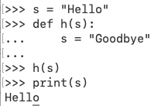
Parameters and arguments
In the first example, we pass a reference to a string as the argument
Inside the function we set the local variable s to refer to a different string, "Goodbye"
But the global variable, s, is still referring to the string "Hello", so that is what is printed on the last line
Here we make the local variable refer to a different object; we are not modifying the object to which the local variable is referring
Python strings are immutable, so we actually cannot modify the string referred to by the local variable!

Slide 25
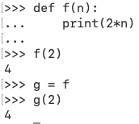
Functions are "first-class citizens"
Makes the name, g, refer to the same object as f refers to
Functions are "first-class citizens", meaning that they can be
  assigned to variables
  passed as parameter values
  returned by functions
  stored in data structures
A function is an object, whose name is defined by the function definition (i.e., the "def" clause)
The defined name of a function is simply a reference to the function object
This means that we can create new references to the same function object and thereby give it other names

Slide 26
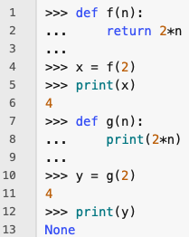
Values returned by functions
The function f on the left returns a value which is twice that of its argument
Use a return statement to specify when and what a function returns
If a function does not contain any return statement, then it returns the special value None
  cf. null or nil in other languages

Slide 27
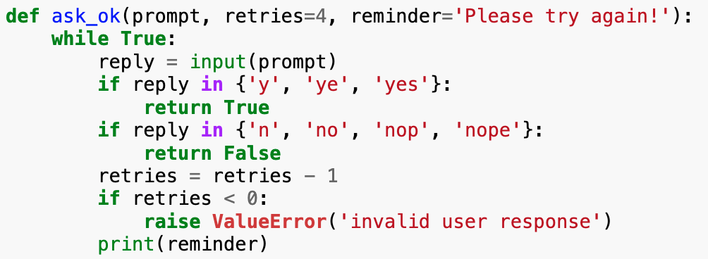
Parameters with default arguments
In the function definition, you can specify a default argument (i.e., value) for a parameter, as shown on the left
You can then call the function with fewer arguments than there are parameters, as parameters with default arguments only need to be assigned arguments in the function call when you want them to have values that differ from their default arguments

Slide 28
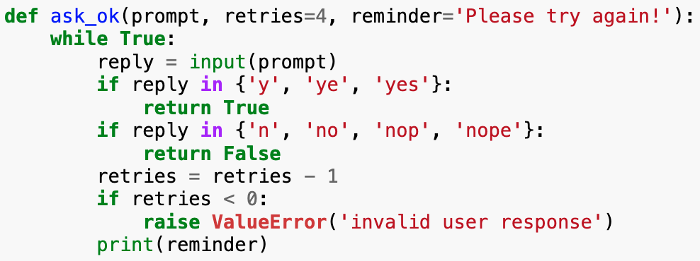
Parameters with default arguments
The function above can be called in several ways using positional arguments, for example,
  ask_ok('Overwrite file?')
  ask_ok('Overwrite file?', 2)
  ask_ok('Overwrite file?', 2, 'Have another go!')

Slide 29
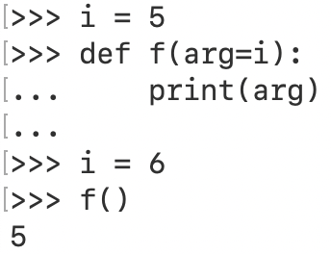
Parameters with default arguments
Default values are evaluated once at the point where the function definition occurs (see example on left)

Slide 30
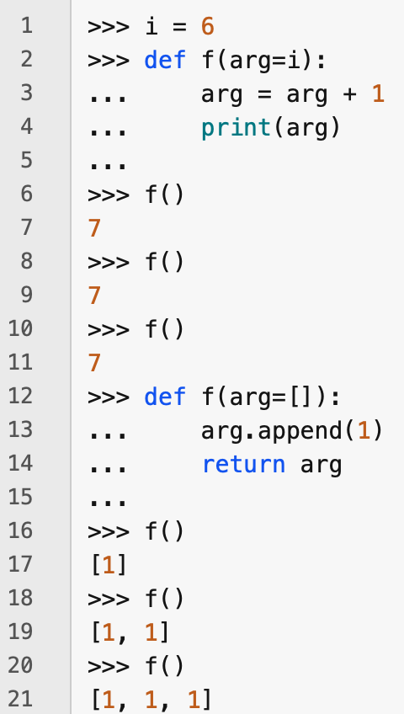
Parameters with default arguments
Default arguments are evaluated once
If the argument is a mutable reference value, and its value is changed within the body of the function, then its new value persists to the next call of the function
Note that if the argument is of a primitive type, then its value remains constant after the initial assignment

Slide 31
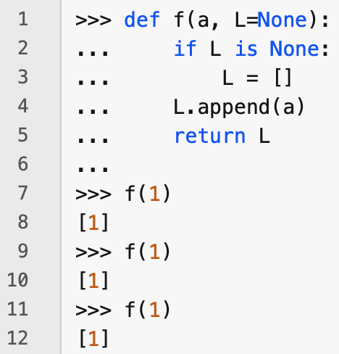
Avoiding persistence of reference values between calls
You can avoid the problem on the previous slide by assigning a default argument of None, and then setting the value inside the function

Slide 32
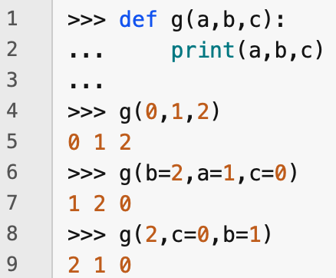
Keyword arguments
When calling a function, you can assign arguments using either positional order or keyword arguments
If you assign using positional order only, then Python determines which value to assign to which argument by its position, according to the ordering of the parameters in the function definition
If you use keyword arguments only, then you can give the arguments in any order you like
If you use a mixture of positional and keyword arguments, then the keyword arguments must come after any positional arguments
  Why?

Slide 33
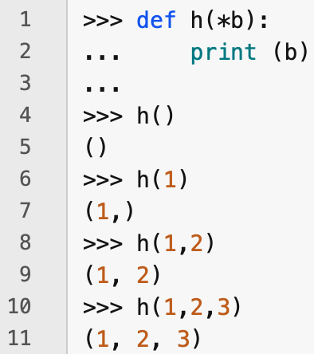
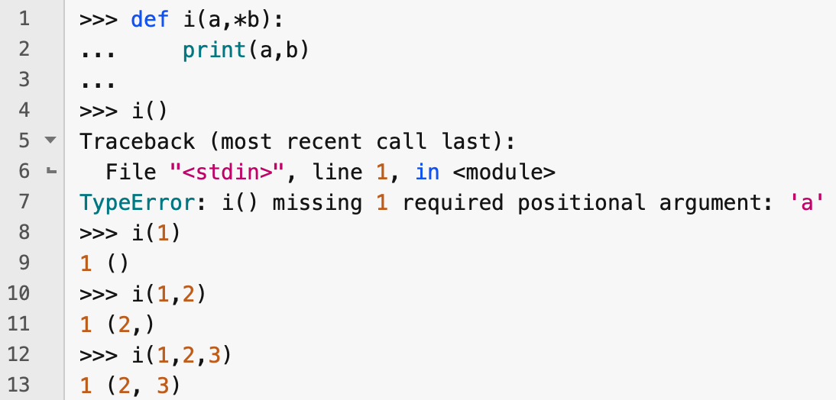
Variadic arguments
A tuple in Python is defined by the comma, not the parenthesis – you can represent a tuple without parentheses. So a tuple with one element is printed with a comma after that element.
A variadic argument allows the function to be called with any number of arguments
The name of a variadic argument must begin with a single *
The variadic argument is usually the final parameter, and must come after any normal parameters (i.e., ones without default values)
The arguments provided in the function call after any normal arguments or keyword arguments are collected together into a tuple and stored in a variable with the name of the variadic argument (without the *)

Slide 34
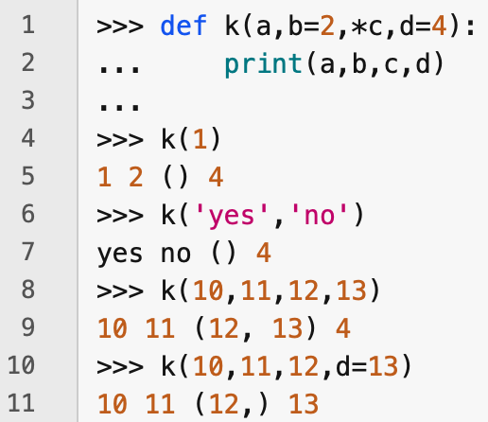
Variadic arguments
If your function needs to have parameters with default arguments, then these can come after the variadic argument, but then you can only assign values to the parameters with default arguments by using keyword arguments
If you want to be able to assign values to parameters with default arguments using positional arguments, then these must come before the variadic argument

Slide 35
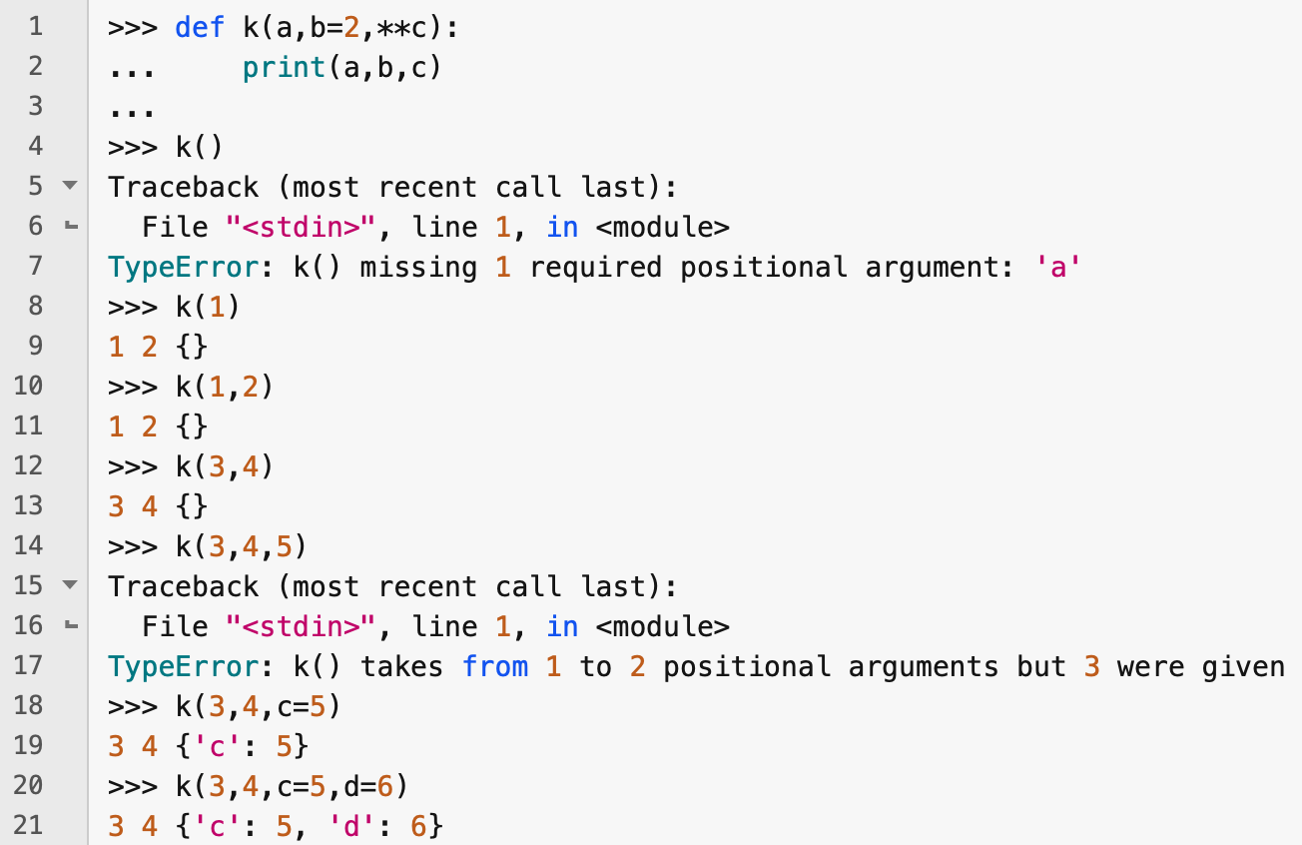
Variadic dictionary parameters
A parameter with a name that starts with two asterisks is a variadic dictionary parameter (or "var-keyword argument")
A variadic dictionary parameter must be the last parameter in the function definition
A var-keyword arg only collects keyword arguments, not positional arguments
  If you want to collect positional arguments, then you need to use an ordinary variadic parameter

Slide 36
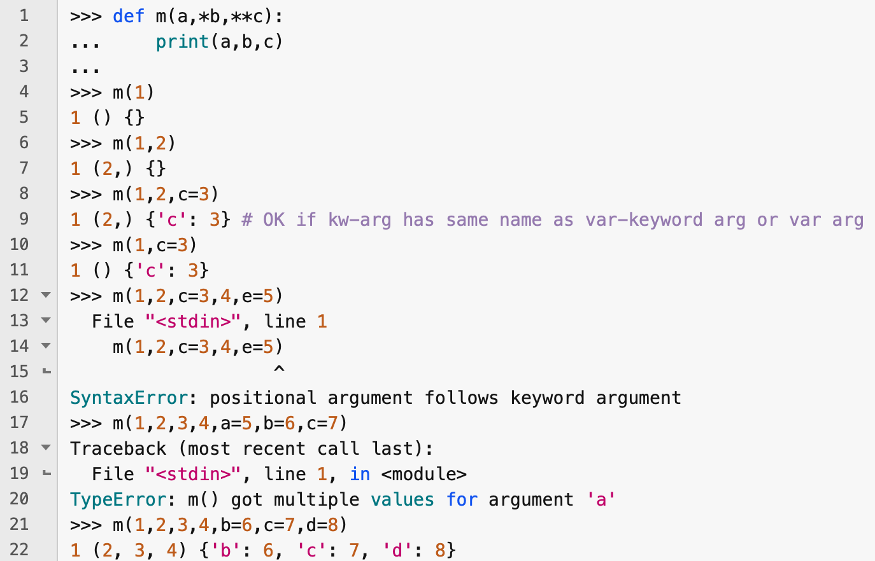
Using *arg and **kwargs parameters together
You can use *arg and **kwargs parameters together
The **kwargs parameter must be the last parameter
When you call the function, all positional arguments must precede any keyword arguments
The **kwargs argument captures all keyword arguments that are not captured by parameters with default arguments
Note that you cannot assign a value to an ordinary parameter twice in the same call by using both positional and keyword arguments

Slide 37
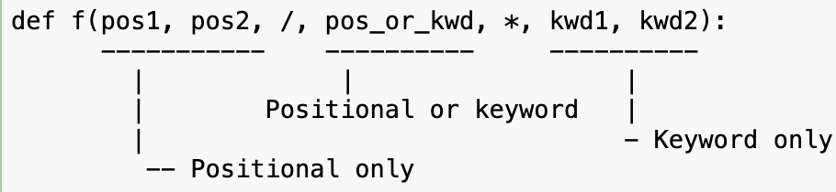
Specifying positional and keyword parameters
You can explicitly specify whether a parameter is
  positional only
  keyword only
  positional or keyword
You do this using the special parameters, / and *
/ must precede * in the parameter list and each must occur at most once
All parameters before the / parameter are positional only
All parameters after the * parameter are keyword only
The others can be accessed positionally or by keyword

Slide 38
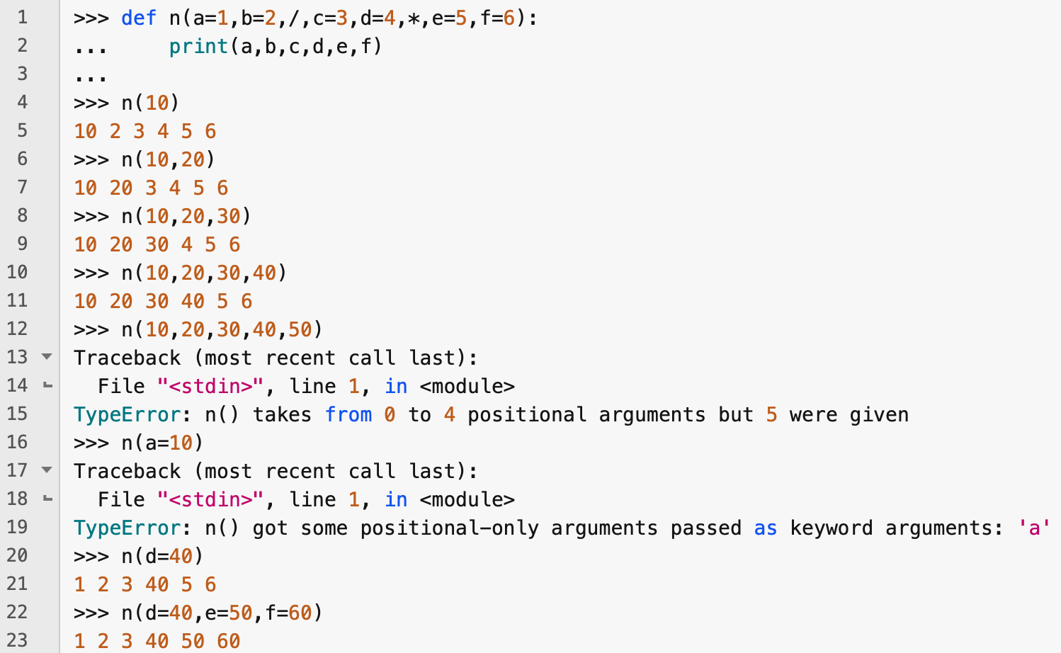
Specifying positional and keyword arguments
In line 12, we try to assign a value to e positionally, but it comes after the * in the parameter list, so it is keyword only
In line 16, we try to assign a value to a with a keyword, but it comes before the / in the parameter list, so it is positional only

Slide 39
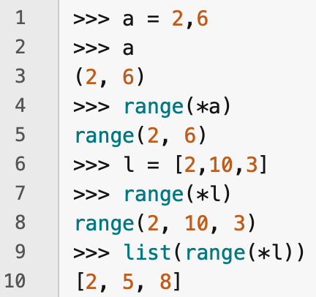
Unpacking argument lists
You can unpack a list or a tuple using the * operator
You can then use the unpacked tuple or list as a sequence of arguments to a function

Slide 40
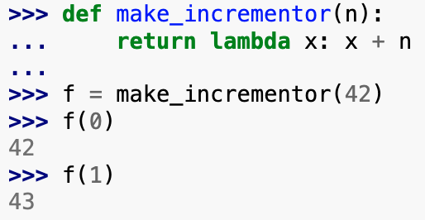
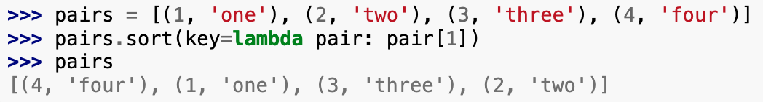
Lambda expressions
You can create small anonymous functions using the lambda keyword
The lambda keyword is followed by a parameter list, then a colon, then a single expression
This can be convenient if you want to pass a simple function as an argument

Slide 41
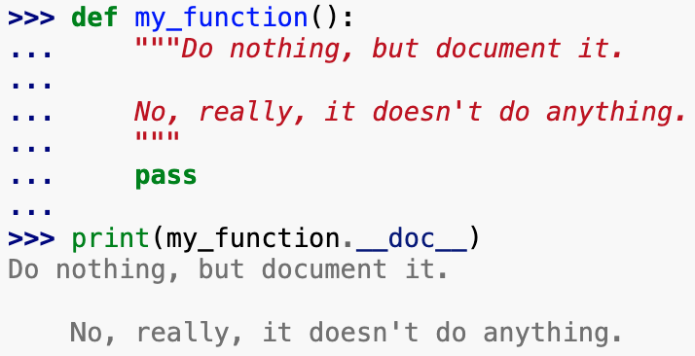
Documentation strings
Documentation strings can be specified as the first statement in a function or class definition by typing the string enclosed in triple quotes
Conventionally, when writing a documentation string,
  make the first line a short summary of the object's purpose
  make the second line blank
  then write the rest of the documentation, explaining calling conventions, side effects etc.
The first non-blank line after the first line defines the indentation for the entire string

Slide 42
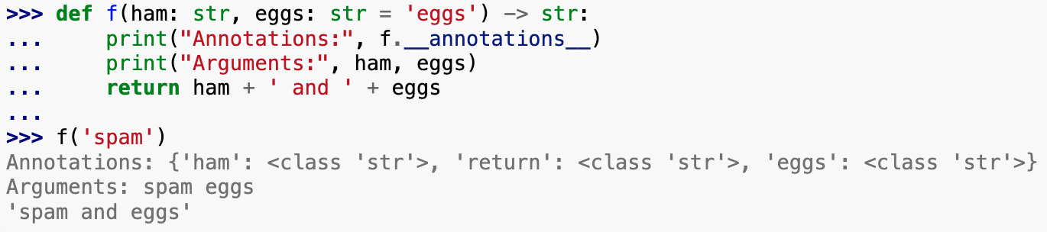
Function annotations
Function annotations are optional metadata about the types used by user-defined functions
They are stored in the __annotations__ attribute of the function as a dictionary and have no effect on any other part of the function
Parameter and return types are annotated as shown on the left

Slide 43
Coding style
It is important to format your code so that it is easy to read by other Python developers and by yourself at a later time
The best practice is to adhere to an established conventional coding style, such as the one defined in PEP 8
  https://peps.python.org/pep-0008/
You should read this guide, but the highlights of it are as follows:
  Use 4-space indentation, not tabs
  Keep lines no more than 79 characters wide
  Use blank lines to separate class and function definitions
  Put comments on lines of their own
  Use docstrings
  Use spaces around operators and after commas
  Use lowercase_with_underscores for functions and methods
  Use UpperCamelCase for classes
  Always use self as the name for the first method argument
  Use UTF-8 or, if you want maximum portability, ASCII encoding
  Don't use non-ASCII characters in identifiers even if there is the slightest chance that people speaking a different language will read or maintain the code

Slide 44
Exercises
Exercise 1
Write a Python function that takes two string arguments, x and y, and returns the index of the first occurrence of x in y, or -1 if x does not occur in y.
Exercise 2
Write a function that takes two arguments, a list, l, and a function, f, and returns a list containing the results of applying f to each element in l. Test your function by defining an argument function, f, that returns the square of an input number.
Exercise 3
Write a function that takes any number of numbers as its arguments and returns the sum and mean of the numbers as a pair, (sum,mean).

