Slide 1
Python Workshop Session 1: The interpreter, numbers, strings, and lists
David Meredith
Aalborg University
dave@create.aau.dk

Slide 2
Sources
The Python Tutorial
https://docs.python.org/3/tutorial/index.html
Python Wikipedia article
https://en.wikipedia.org/wiki/Python_(programming_language)

Slide 3
Introduction
Python is by far the most widely used programming language in machine learning
We’ll therefore start the course with an introduction to the Python programming language and some of the main Python scientific libraries, NumPy, Pandas and Matplotlib
Today we’ll focus on the Python language itself
In the second day of the workshop, we’ll look at the scientific libraries

Slide 4
The Python programming language
Python
is relatively easy to learn and has a simple syntax
has efficient high-level data structures
has a simple but effective approach to object-oriented programming
is interpreted and has an interactive REPL that make it ideal for scripting and RAD
is by far the most commonly used programming language in machine learning
is free and open-source and available for all major platforms
You can download the latest version from https://www.python.org
has a huge user community and supported by tens of thousands of libraries for computing in all sorts of domains

Slide 5
The Python programming language
The Python interpreter can be extended with new functions and data types implemented in C or C++
Python is often used as an extension language for customizable applications
A formal definition of the syntax and semantics of the Python language is given in the The Python Language Reference:
https://docs.python.org/3/reference/index.html#reference-index
The standard objects and modules are described in the specification of The Python Standard Library:
https://docs.python.org/3/library/index.html#library-index

Slide 6
Extending and embedding Python
To write extensions of Python in C or C++, you will need to read and consult the following:
Extending and embedding the Python interpreter
https://docs.python.org/3/extending/index.html#extending-index
Python/C API Reference Manual
https://docs.python.org/3/c-api/index.html#c-api-index
You can add new built-in functions or modules to the interpreter by implementing it in C
This is good if you need a process to run very fast or if you want to use third-party libraries that are only available in binary form
You can also use this knowledge to embed the Python interpreter in an existing application written in C

Slide 7
Content of today’s workshop
Today we aim to cover most of the material in the The Python Tutorial
Today we'll cover the following
Using the Python interpreter
Using Python as a calculator
Control flow (if, for, range(), break, continue, pass, match, etc.)
Defining functions
Data structures
Modules
By the end of today, you should know enough about Python to be able to read and write Python modules and programs

Slide 8
Installing Python
In order to follow the workshop, you will need to have a working copy of Python 3 on your machine
Instructions on installing the most recent version of Python 3 are given here:
https://docs.python.org/3/using/index.html
You will need to have a text editor or IDE installed to edit Python scripts, some examples are:
PyCharm
IDLE (provided with the standard installation)
your favourite text editor

Slide 9
Why Python?
Python is simple to use but also offers more structure and support for writing large programs (e.g., modules, classes)
Python offers much more error checking than C and it is a very-high-level language
It has high-level data types built in, such as arrays and dictionaries
Because of its more general data types, it can easily be applied to a broader range of problems than languages like Awk or Perl, yet many things are at least as easy in Python as they are in these other scripting languages

Slide 10
Why Python?
Python lets you organise your code into modules and classes
It comes with a large number of standard modules that let you carry out a wide range of tasks such as file I/O, system calls, networking, even building GUIs (e.g., with Tk)
Python is interpreted, which can save you time when developing because there is no need for compilation and linking between changes – the interpreter can be used interactively
Python programs are generally shorter than equivalent programs in lower-level languages like C, C++ or Java because
high-level data types let you express complex operations succinctly
statement grouping is done by indentation alone
no variable or argument declarations are necessary

Slide 11
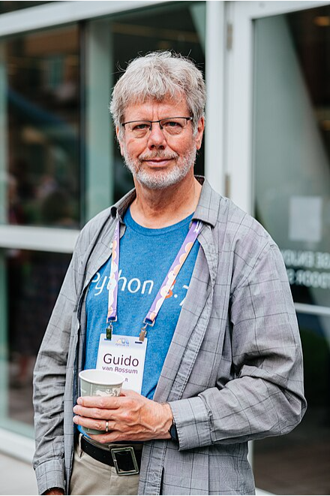
Some background
Python was invented in the late 1980s by Guido van Rossum and first released in 1991 as Python 0.9.0
Python 2.0 was released in 2000
Python 3.0 was released in 2008
Last release of Python 2 was version 2.7, released in 2020
We will use Python 3.12, which is the current stable release and the only version with active support

Slide 12
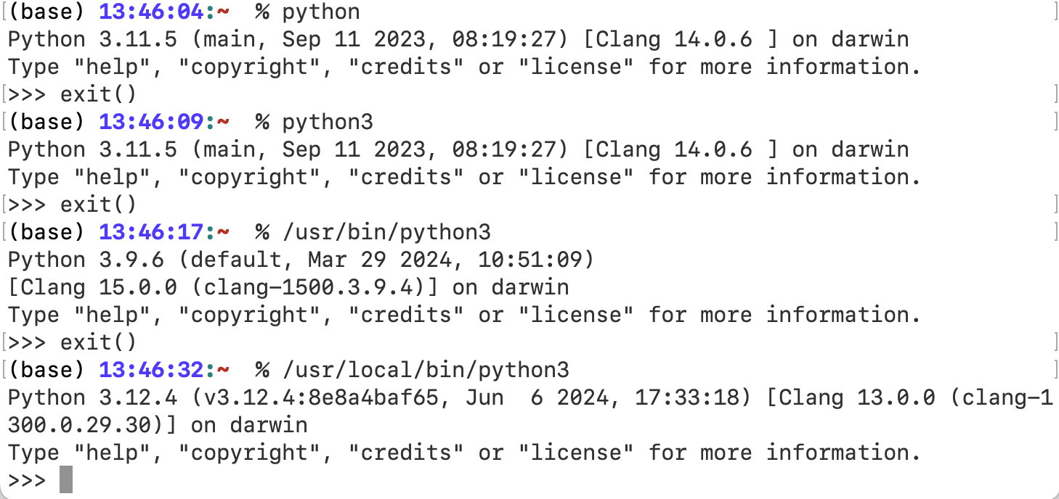
Using the Python interpreter
You can start the interpreter either from the command line or from within an IDE, like IDLE or PyCharm
You may have a number of versions of Python installed on your machine, so you need to be sure you’re using the right one!
You can quit the interpreter by typing Ctrl-D on Unix/MacOs or Ctrl-Z on Windows
You can also type quit(), exit() or sys.exit()

Slide 13
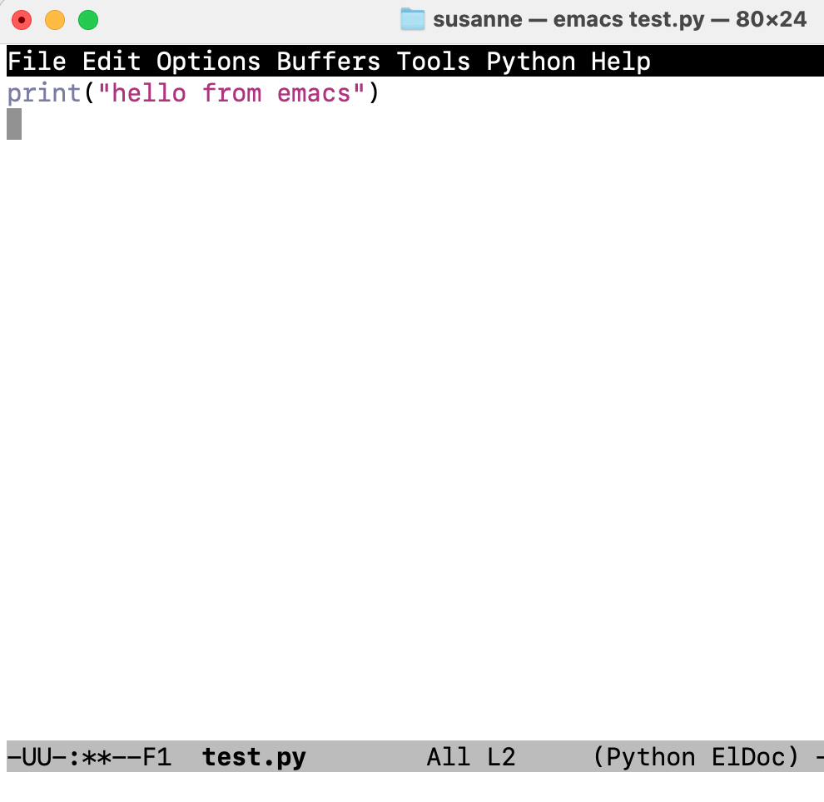
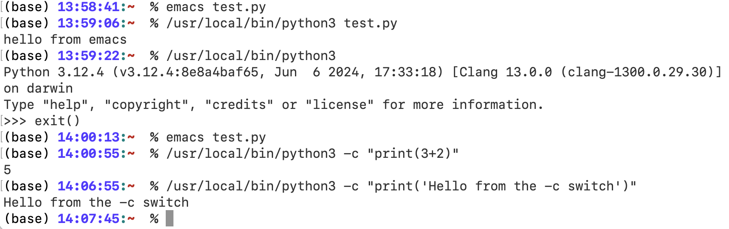
Using the Python interpreter
Interpreter has line-editing features like interactive editing, history substitution and code completion
If you start Python without any command-line arguments, then you are put into the interactive interpreter
If you start Python with a file-name as an argument, then Python executes the script in the file
If you precede the file name with –i, then it enters interactive mode after executing the script
If you start Python with the –c switch, then it executes the command following the switch (which should usually be in quotes)
You can also get Python to execute some modules as scripts using the –m switch. In this case, you only have to give the name of the module, not the full file name, e.g.,
% python –m venv

Slide 14
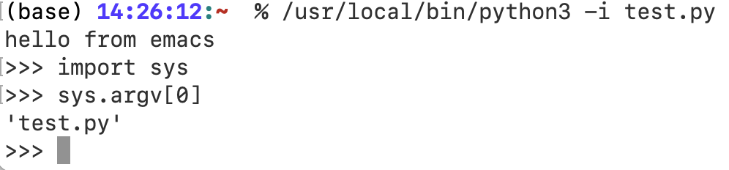
Argument passing
Any arguments given to the invocation of Python from the command line are stored in a list called sys.argv
To access this list, you first have to import the sys module by typing
import sys
Then you can access the arguments using array indexing:
sys.argv[0]

Slide 15
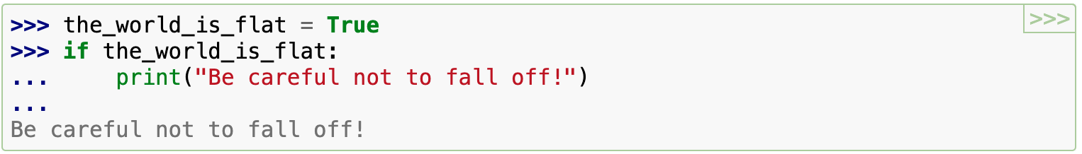
Interactive mode
Interactive mode lets you enter commands at the command line after a primary prompt, which is usually >>>
If your command is not complete, then the interpreter requests more input from you using the secondary prompt, usually ...
Note that you need to type the indents manually, other the interpreter will signal an error!
To complete the command, type enter on an empty line after the secondary prompt

Slide 16
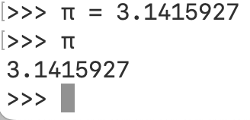
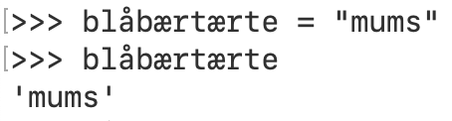

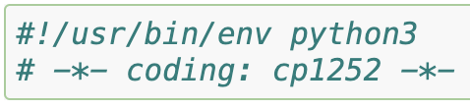
Source code encoding
By default, Python source files are assumed to be encoded in UTF-8
This means that in principle you can use any characters you want in your code, but it is recommended that you limit yourselves to ASCII characters in order to ensure maximum portability
To display all UTF-8 characters, your editor must recognize that the file is using UTF-8 and use a font that supports all the characters in the file
You can declare that your file uses a different encoding by adding a special comment line as the very first line in the file (see left) (unless the file starts with a UNIX shebang line)

Slide 17
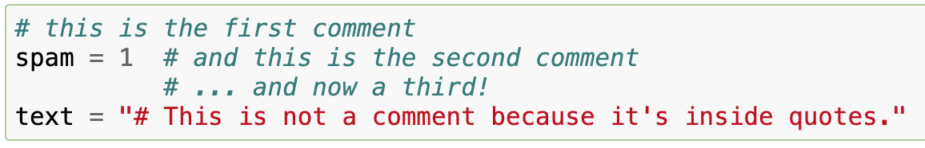
Comments
Comments in Python start with a # character and extend to the end of the line
A # character within a string literal is just a # character

Slide 18
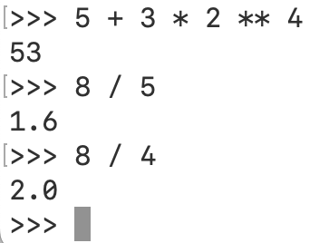
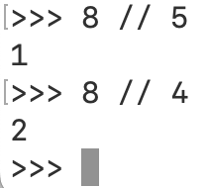
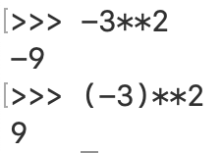
Using the Python interpeter as a calculator
Expressions are evaluated from left to right using the normal precedence rules
** > *, / > +,-
e.g., 5 + 3 * 2 ** 4 = 5 + (3 * (2 ** 4)) = 53
Note that – has lower precedence than **, so - 3 ** 2 = - 9
Integers have type int
Numbers with a decimal point have type float (e.g., 4.2, 3.141, 2.0)
Division always evaluates to a float
a//b gives the floor of a/b and returns an int

Slide 19
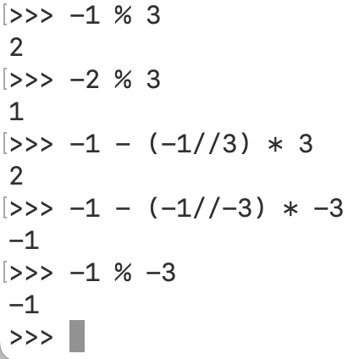
Arithmetic expressions
The % operator properly implements the mathematical modulus operator, that is
a % b = a – ((a//b) * b)

Slide 20
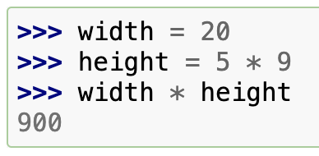
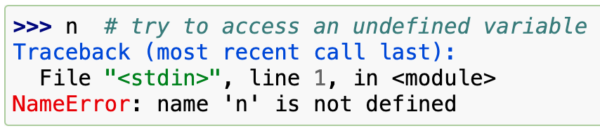
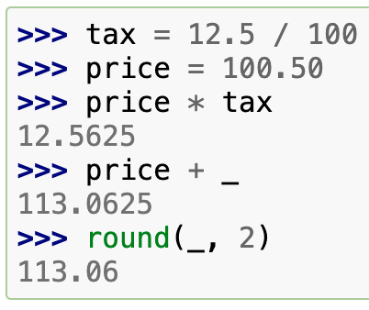
Variables
= is the assignment operator
You cannot use a variable until it has been assigned a value
In interactive mode, the last printed expression is stored in the variable _ (underscore)
This should be considered read-only!

Slide 21
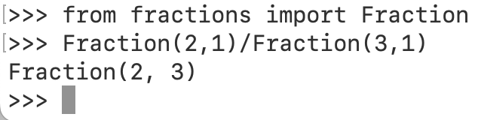
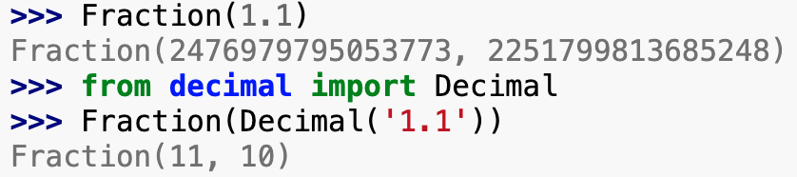

Other types of number
Python also has Decimal and Fraction types and in-built support for complex numbers
Decimal has greater precision than float but a smaller range
Fraction lets you do rational arithmetic
The complex type lets you do complex arithmetic

Slide 22
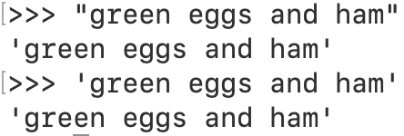
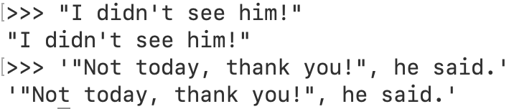
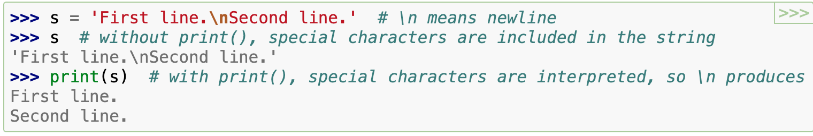
Text (strings)
Python handles text through string objects, i.e., objects of type str
Strings can be delimited by either double quotes or single quotes
If you want a single quote in a string, then you delimit the whole string with double quotes (and vice versa)
If you have both double and single quote characters inside the string, then you need to escape at least one of them
The string definition and output printed to the shell can look different (see first example on left)
Use print() to get a more readable output that omits the surrounding quotes and prints special characters

Slide 23
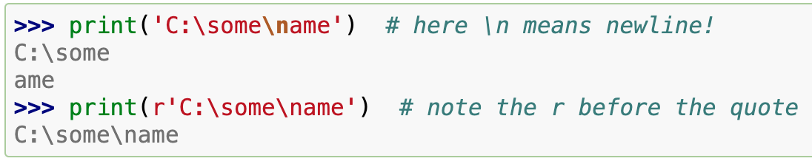
Raw strings
If you don’t want the backslash to be interpreted as an escape character, then you can define the string to be a raw string by preceding it with the letter r

Slide 24
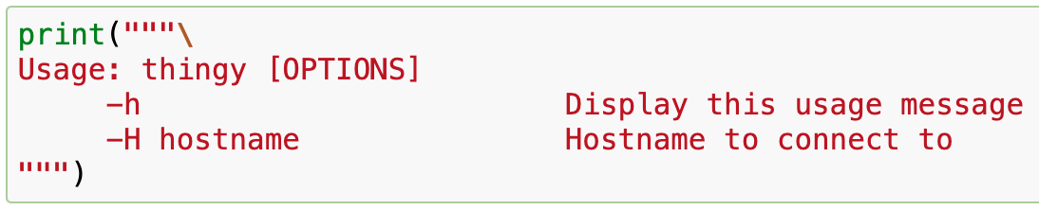
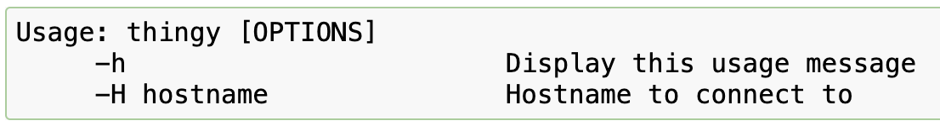
Multi-line string literals
A string literal can span more than one line
A multi-line string literal is delimited by """... """ or '''...'''
End-of-lines are included in the string unless you add a \ at the end of a line

Slide 25
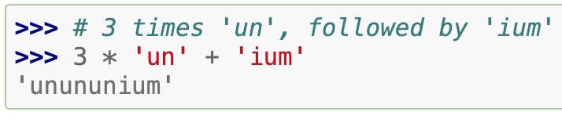
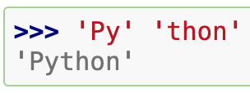
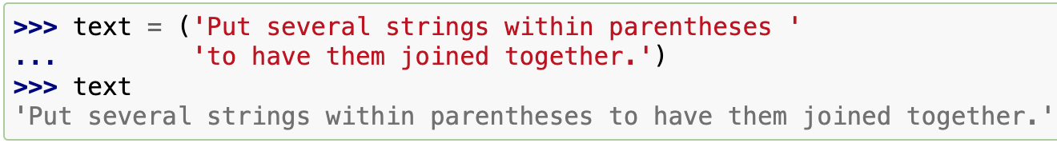
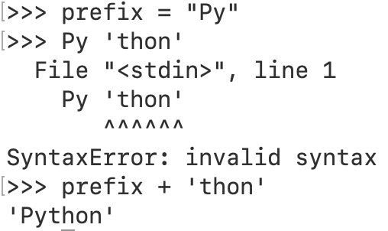
Repetition and concatenation of strings
Strings can be concatenated with + and repeated with *
Two or more string literals can be concatenated simply by typing them next to each other
Useful if you want to break long strings
Only works with literals, not str variables
To concatenate a literal with a variable, use +

Slide 26
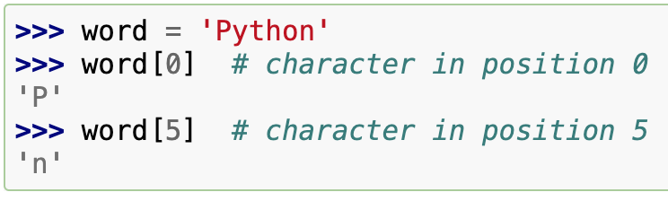
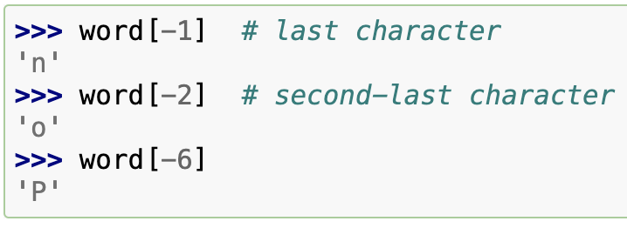
Indexing strings
Strings can be indexed with the first character having index 0
There is no character type in Python – a character is just a string of length 1
Indices can be negative, so that counting starts from the end of the string
0 = -0

Slide 27
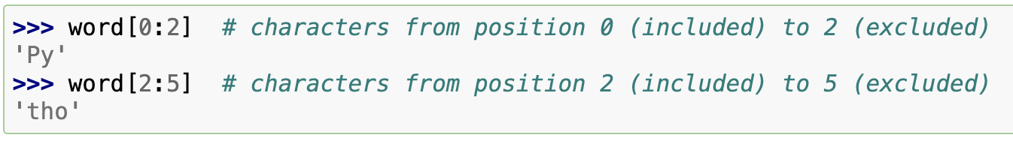
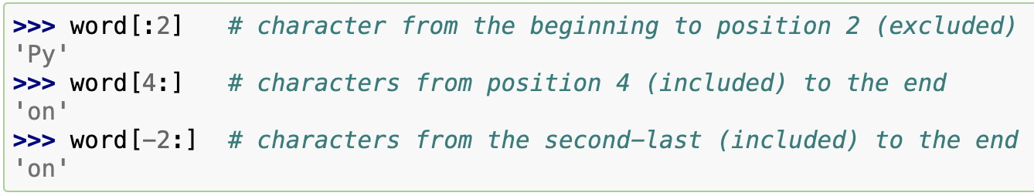
Slicing strings
Indexing only accesses individual characters (strings of length 1)
If you want substrings in general, then you use slicing
An omitted first index defaults to 0; an omitted end index defaults to the size of the string being sliced
Character at start position always included; character at end position always excluded
This ensures that s[:i] + s[i:] = s

Slide 28
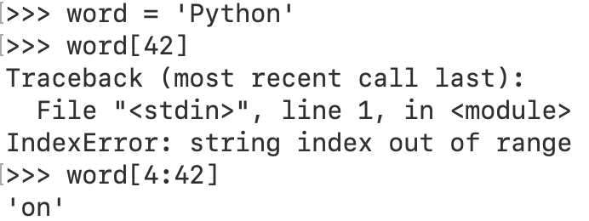
Out-of-range indices and slices
Using an index that is out of range gives an error
Out-of-range slices, however, are handled gracefully

Slide 29
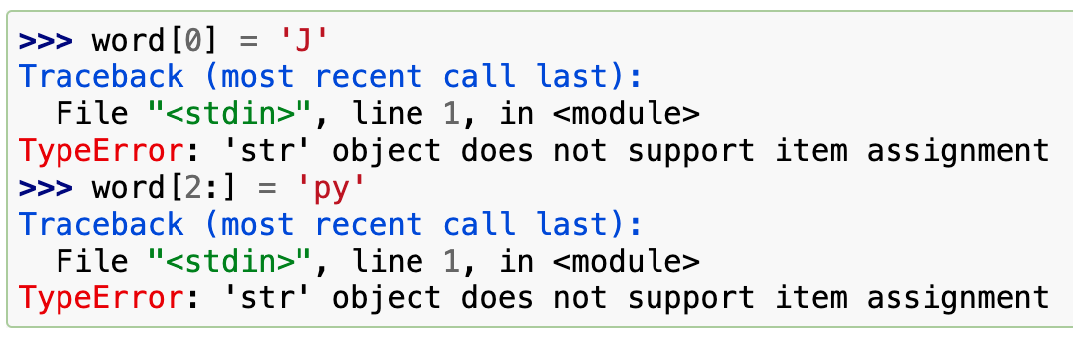
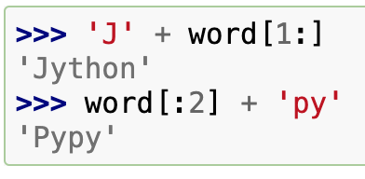
Strings are immutable
Python strings cannot be changed after they have been constructed – they are immutable
Assigning to a position in a string results in an error
You can create a new string from an existing one

Slide 30
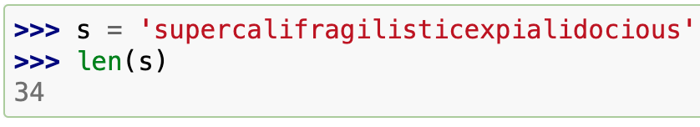
len()
The in-built function, len(), returns the length of a string

Slide 31
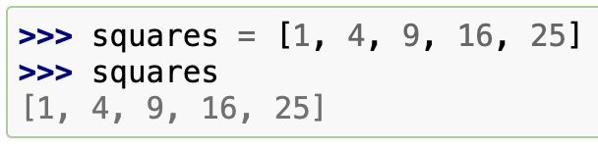
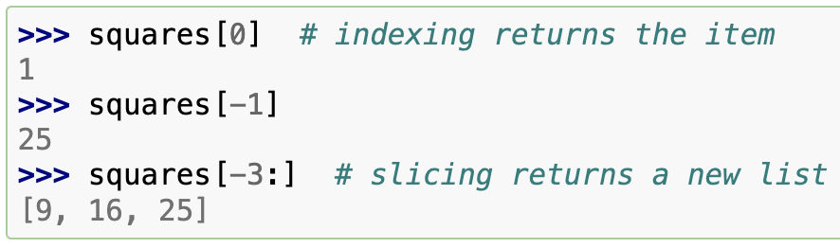
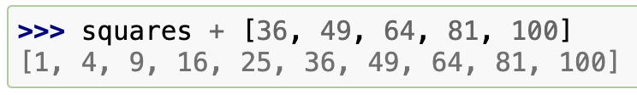
Lists
A list in Python is a sequence of objects that may not all be of the same type
A list is written in square brackets and the items are delimited by commas
Lists can be indexed and sliced and support operations like concatenation

Slide 32
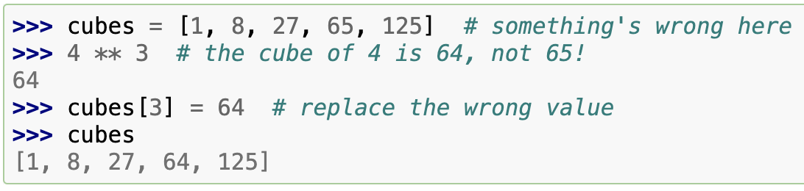
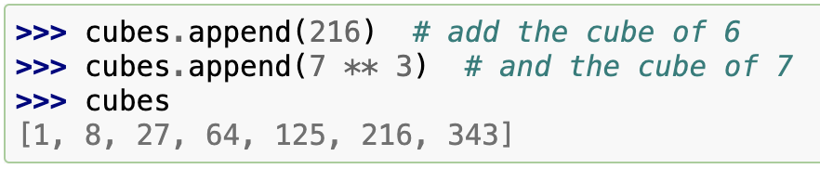
Lists are mutable
Lists are mutable – you can change their content
You can also append items to a list using the append method

Slide 33
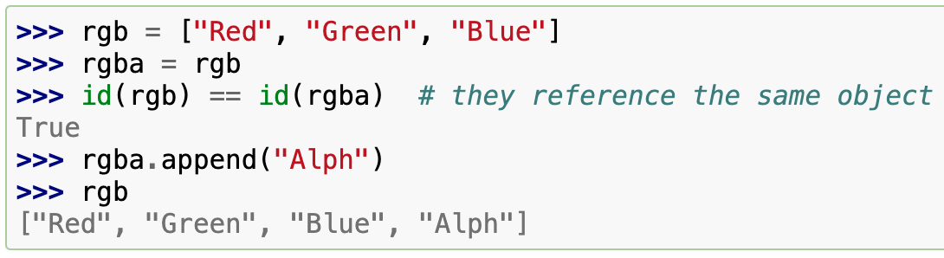
Assignment of lists
Simple assignment in Python never copies data
If you assign a list to a variable, the variable refers to the already existing list
Any changes you make to the list will be visible through all the variables that refer to that list
We can use the id() function to identify the specific object in memory
In CPython, this is the address of the object in memory

Slide 34

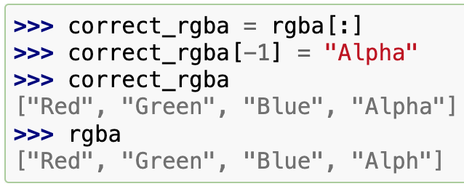
Slice operations
A slice returns a shallow copy of a segment of a list

Slide 35
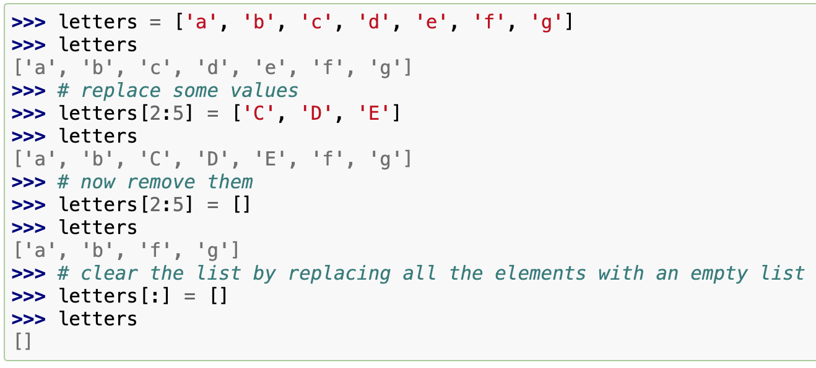
Assignment to slices
You can assign new sublists to slices of an existing list, which can change the size of the existing list or empty it completely

Slide 36
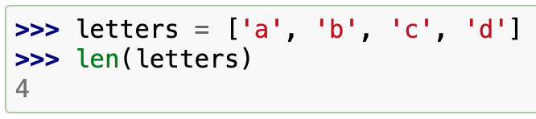
len()
The built-in function, len(), also works on lists

Slide 37
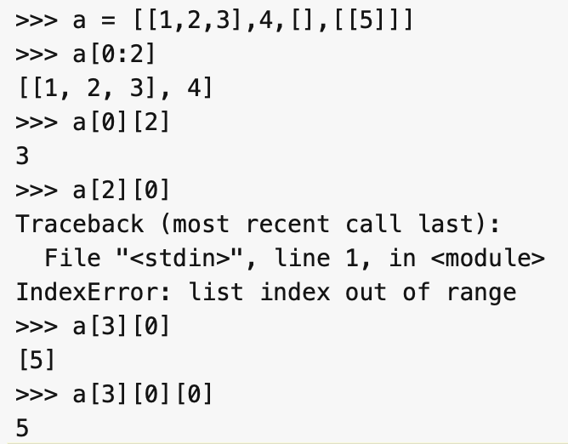
Nested lists
Lists can contain lists
Indexing and slicing works the same way on nested lists as it does on non-nested lists

Slide 38
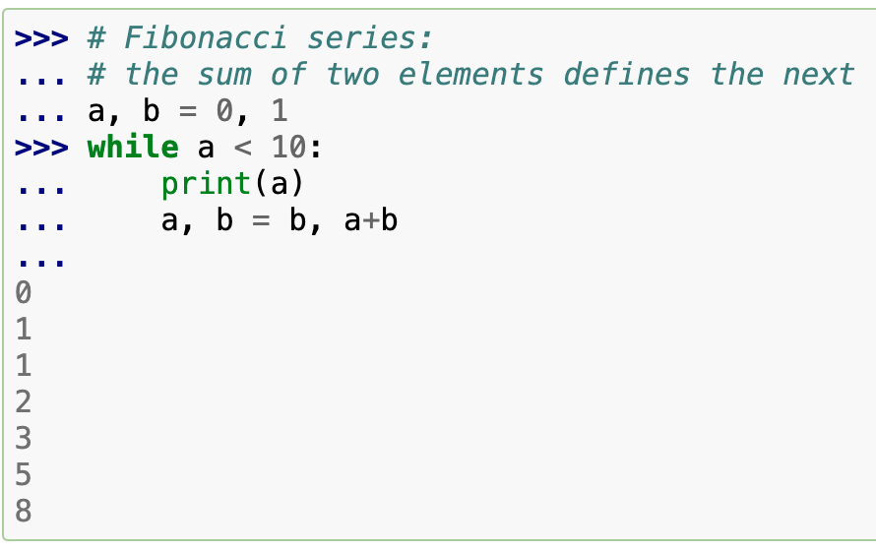
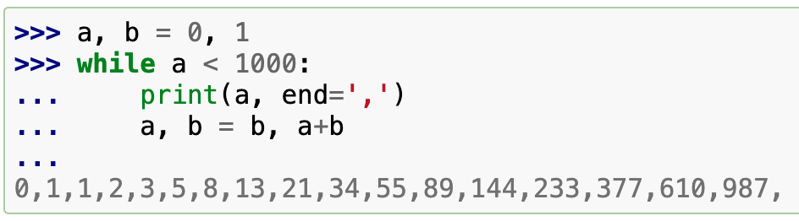
First steps towards programming
We can even write code directly into the interpreter
For example, the code on the left generates a prefix of the Fibonacci series
This code introduces a number of interesting new features
multiple assignment – in the first and last lines, a and b are assigned simultaneously
RHS evaluated left-to-right before assignment
boolean expressions – the while loop executes while a < 10
In Python, any non-zero int value is true, any non-zero length sequence is true
Boolean comparison operators are as in other languages
scope define by indentation – in the interpreter, you need to enter a blank line to indicate the end of the code
print() prints a new line by default – use the keyword argument, end, to avoid this

Slide 39
Exercises
Exercise 1
Install the most recent version of Python 3 on your system. Make sure you know how to start this particular installation and not some other version of Python that is already installed on your system.
Exercise 2
Write a Python function that takes a list of numbers as input and outputs the maximum, minimum and median values in the list.
Exercise 3
Write a Python function that takes a string as its only argument and prints out the frequency with which each letter occurs in the string. The function should only print out the frequency of occurrence for letters that actually occur in the input string.
Exercise 4
Write a Python function that takes any sequence as its argument and returns the reverse of the sequence. Get the function to notify the user when the input sequence is a palindrome.

