Slide 1
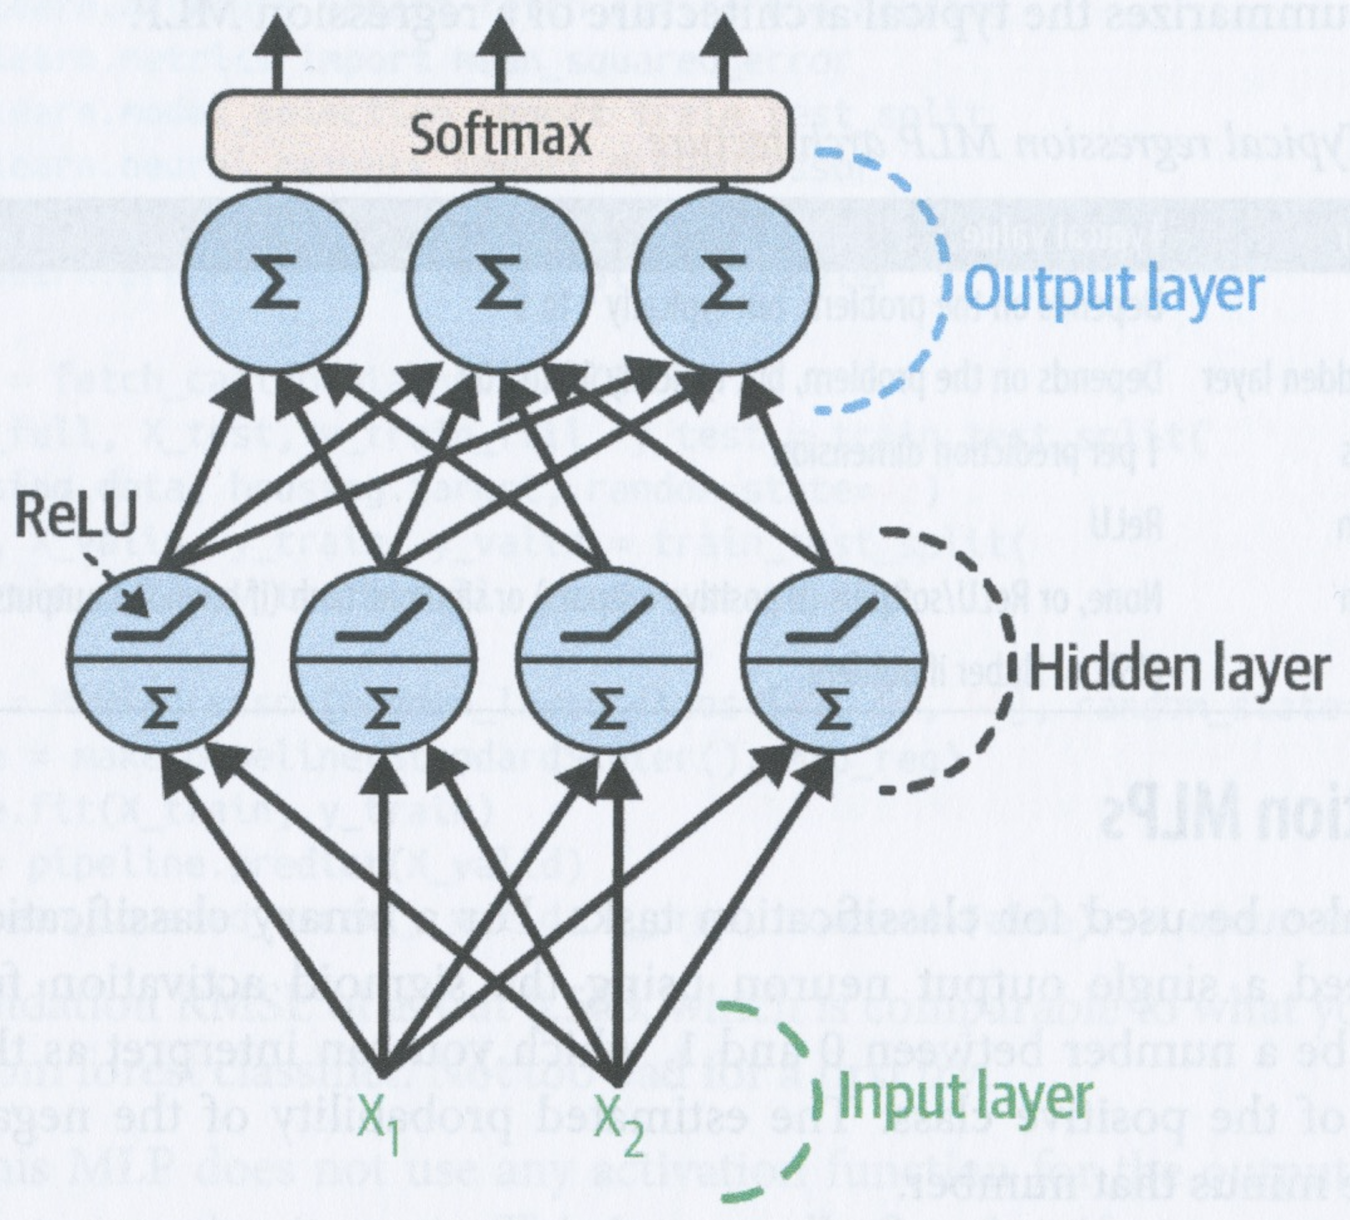
Introduction to Artificial Neural Networks
David Meredith
dave@create.aau.dk
Aalborg University

Slide 2
Sources for this lecture
Chapter 10 of
Géron, A. (2023). Hands-On Machine Learning with Scikit-Learn, Keras & TensorFlow. (Third edition). O’Reilly. Available at
https://www.amazon.de/-/en/Aur%C3%A9lien-G%C3%A9ron/dp/1098125975/
https://www.saxo.com/dk/hands-on-machine-learning-with-scikit-learn-keras-and-tensorflow_bog_9781098125974
https://factumbooks.dk/?search_string=hands-on+machine+learning+with+scikit-learn
Jupyter Notebook for this lecture:
https://github.com/ageron/handson-ml3/blob/main/10_neural_nets_with_keras.ipynb

Slide 3
Artificial neural networks - ANNs
Many technologies have been inspired by nature
Velcro was inspired by burdock plants
Birds inspired flying machines and aeroplanes
It is natural that we should be inspired by the brain to build thinking machines
Artificial neural networks (ANNs) were inspired by the networks of neurons found in brains
However, the artificial neurons found in ANNs have evolved to be quite different from neurons in natural brains – even to the extent where some have suggested calling artificial neurons units instead of neurons

Slide 4
ANNs are at the core of deep learning
ANNs are at the core of deep learning
ANNs are versatile, powerful and scalable and can be used to tackle very large and very complex machine learning tasks, such as classifying billions of images (e.g., Google Images) or powering speech recognition services (e.g., SIRI) or winning against world champions at Go (DeepMind’s AlphaGo)

Slide 5
In this lecture
In this lecture, we will
introduce ANNs, starting with a tour of the very first ANN architectures and leading up to multilayer perceptrons
begin to look at how to implement neural networks in TensorFlow’s Keras API
Keras is a powerful and elegant API for building, training, evaluating and running ANNs

Slide 6
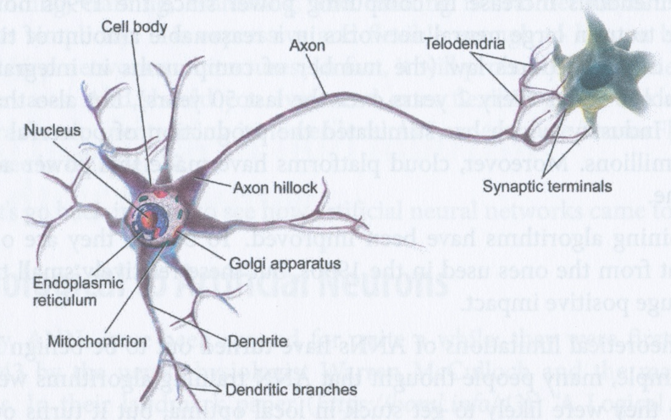
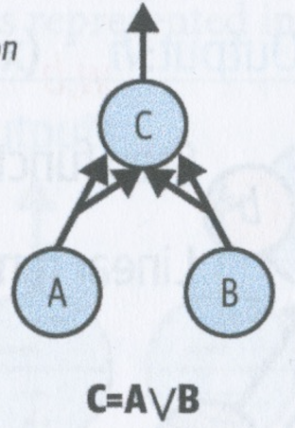
From biological to artificial neurons
ANNs were first introduced in 1943 by Warren McCulloch and Walter Pitts in their paper, “A logical calculus of ideas immanent in nervous activity”
McCulloch and Pitts proposed a simplified computational model of how biological neurons might work together in animal brains to perform complex computations using propositional logic
Since then, many other architectures have been proposed for neural networks

Slide 7
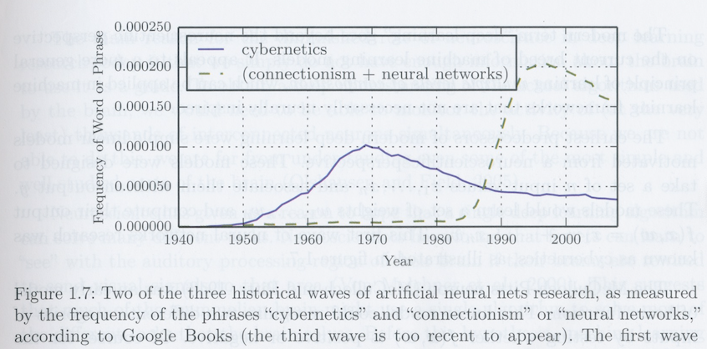
The early progress of ANNs
The early success of ANNs led to widespread belief that we would soon be able to build truly intelligent machines
However, in the 1960s, it became clear that there were some difficult problems to solve before this would be possible, so funding for ANN research went elsewhere
In the 1980s, new architectures were invented and better training techniques were developed, which sparked a renewed interest in ANNs – or connectionism, the study of neural networks
However, progress was slow and other ML techniques (e.g., SVMs) were advancing more quickly and seemed to have a more solid theoretical foundation

Slide 8
The third wave of neural networks
We are now in a third wave of interest in ANNs, that seems to be here to stay
We believe this wave will continue, unlike the previous two, because
there is now a huge quantity of data available to train neural networks
ANNs frequently outperform other methods on large and complex problems
the tremendous increase in computing power makes it possible to train ANNs in a reasonable amount of time
cloud platforms make this computing power available to everyone
training algorithms have been improved
some theoretical obstacles to progress in the 1990s turned out to be fairly benign and could be overcome in practice
e.g., many thought in the 1990s that ANNs were doomed to be stuck in local optima, but this turns out not to be a big problem in practice, especially for larger neural networks, as the local optima often perform almost as well as the global optimum
ANNs have entered a virtuous circle of funding and progress

Slide 9
Biological neurons
A biological neuron consists of a cell body containing the nucleus and other organelles and many branching extensions called dendrites
It also has one, typically much longer extension called an axon which can be up to 10s of thousands of times longer than the cell body
At its end, the axon splits into many branches called telodendria
At the tip of each telodendrion is a synapse which interfaces with the dendrites (or cell bodies) of other neurons

Slide 10
Biological neurons
Biological neurons produce short electrical impulses called action potentials (APs)
APs travel along the axons and cause the synapses to release chemicals called neurotransmitters
acetylcholine, norepinephrine, dopamine, gamma-aminobutyric acid (GABA), glutamate, serotonin, and histamine
These neurotransmitters are taken up by the dendrites and cell bodies of other neurons that interface with the axon’s synaptic terminals
If a neuron takes up a sufficient amount of neurotransmitters in its dendrites over a short enough period (a few milliseconds), this makes it fire its own electrical impulse (action potential)
Note that some neurotransmitters are inhibitory, meaning that they actually inhibit the receiving neuron from firing

Slide 11
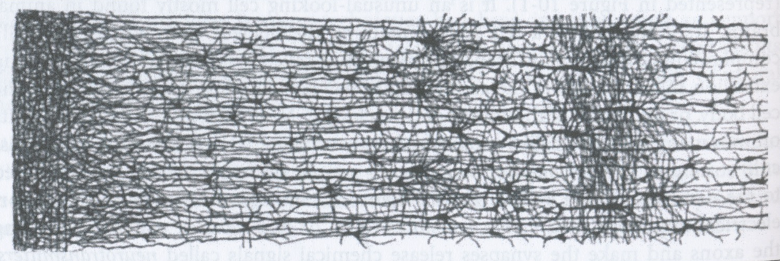
Biological neural networks (BNNs)
The principle underlying the basic operation of single neuron seems to be fairly simple
Actually, what I’ve described is a gross simplification of what individual biological neurons actually do
But biological neurons are organised into complex, highly connected networks containing billions of neurons
This means that biological neurons can perform complex computations

Slide 12
Biological neural networks are organised into layers
Much research is still going on into the architectures of biological neural networks
One thing this research has shown is that BNNs in a brain are organised into consecutive layers, especially in the cerebral cortex (e.g., the striate cortext that deals with vision)
It seems that sensory input comes into one layer which then maps this input onto an output that is sent to the next layer, and so on

Slide 13
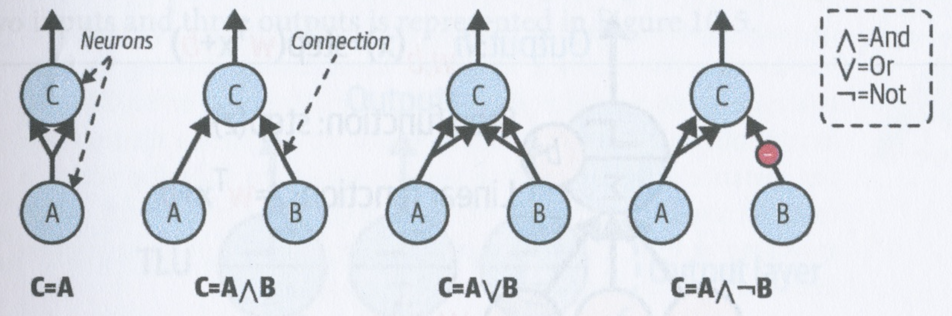
Logical computation with neurons
McCulloch and Pitts proposed a very simple model of a neuron, which later become known as an artificial neuron
In this model, each neuron has two or more binary inputs and one binary output
If the number of inputs activated is greater than some threshold, the neuron fires – it activates its output
Any logical expression can be computed using a small network built from such simple artificial neurons
For example, above we show a number of small networks for computing some basic logical expressions, assuming that the neuron C fires when it has two or more (excitatory) inputs
Note that in the fourth example, neuron B inhibits neuron C, cancelling out at least one of the inputs from A, so C only fires when B’s output is not active
Clearly, such simple networks can be combined to compute logical expressions of any complexity

Slide 14
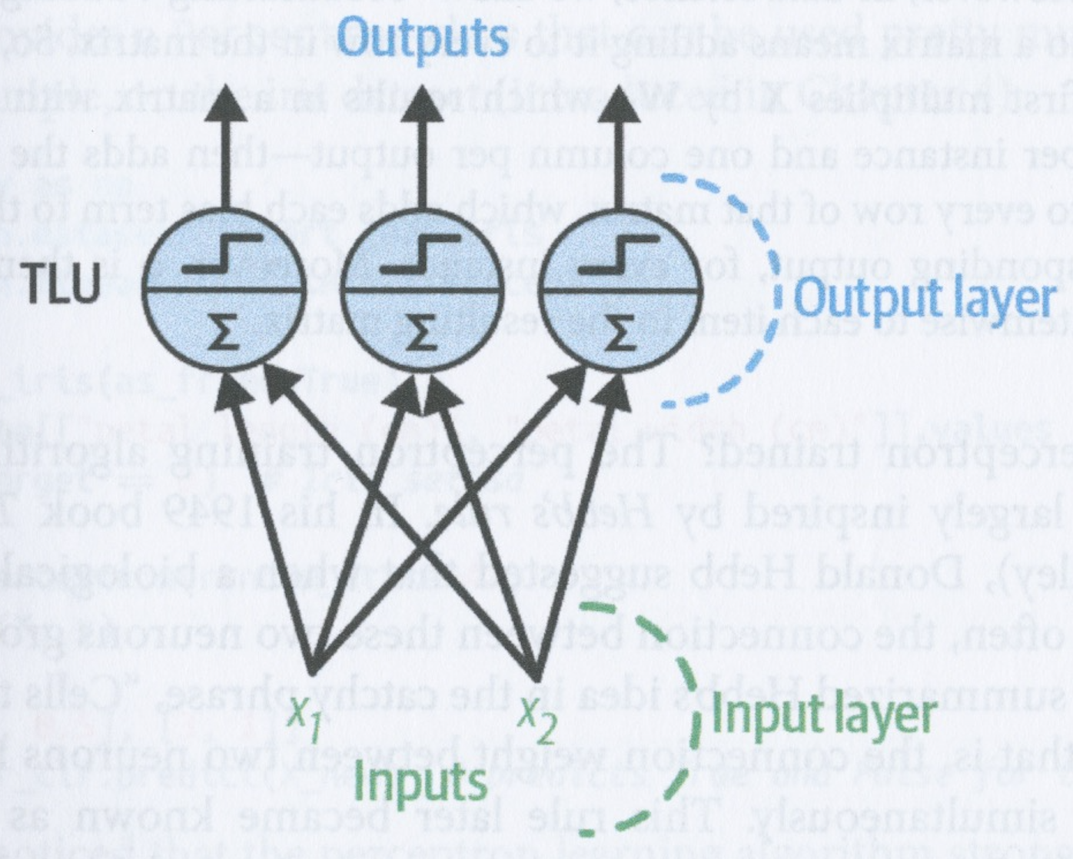
The perceptron
The perceptron is a straightforward neural network architecture, invented by Frank Rosenblatt in 1957
It is based on a slightly more complicated model of a neuron than that of McCulloch and Pitts, called a threshold logic unit (TLU)
In a TLU, the inputs and outputs are numbers, rather than boolean values

Slide 15
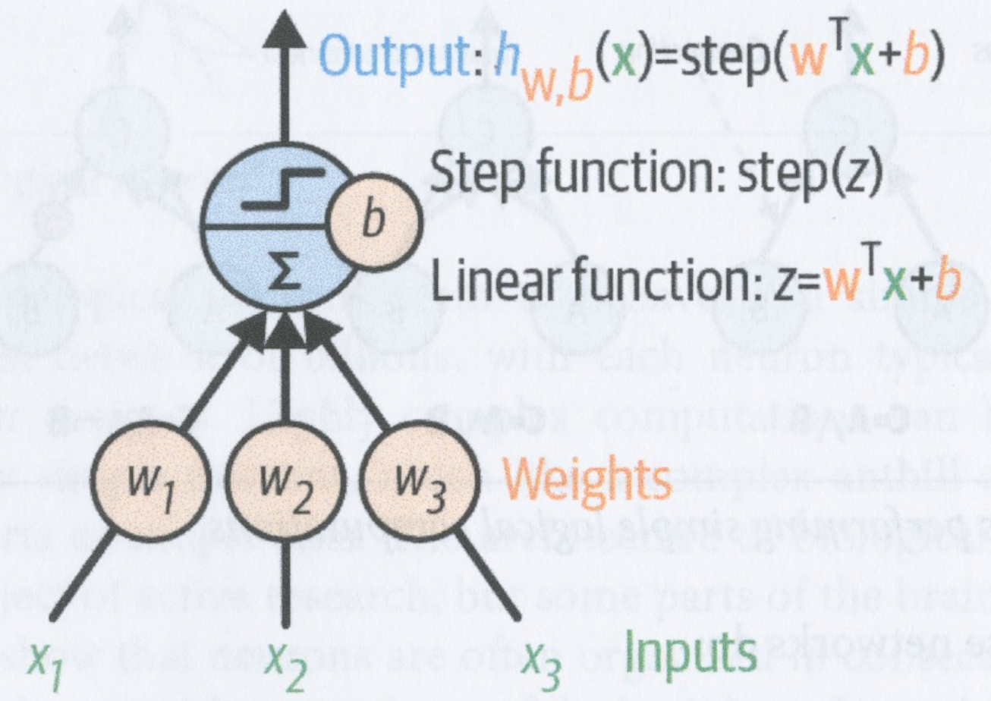
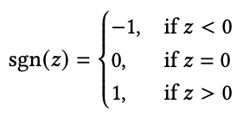

The threshold logic unit (TLU)
The TLU first computes a linear function of its inputs to get a value, z
Each input, x_{i}, is multiplied by a weight, w_{i}
The sum of the products of the weights and the input values is then added to a constant called the bias, b, to get z (see above)
This should look familiar!
z is then given as input to a step function which returns either 0 or 1 (or sometimes -1, 0 or 1)
Two common step functions are the Heaviside function and the sign (or signum) function (see above)

Slide 16
A TLU can perform simple linear classification
A TLU is almost like logistic regression, except that it uses a step function instead of the logistic function
As in logistic regression, the model parameters are the weights w and the bias, b
A single TLU can perform simple linear binary classification – it computes a linear function of its inputs and if this exceeds a threshold, it outputs the positive class
For example, we could try to train a single TLU to classify irises based on petal length and width – in this case, we would need to find two weights and a bias

Slide 17
A perceptron has a fully connected layer of TLUs
A perceptron consists of a single layer of TLUs in which each TLU is connected to all the inputs
Such a layer is called a dense layer or a fully connected layer
The inputs themselves form the input layer
The layer of TLUs produce the output, so this layer is also called the output layer
The figure on the left shows a perceptron with two inputs and three outputs
A perceptron can perform multi-output classification – it can assign more than one label to an input (multilabel), and each label can be chosen from more than one set of possibilities (multiclass)

Slide 18

Computing the outputs of a fully connected layer
The outputs of a fully connected layer can be computed using the equation above
X is the dataset of instances, where each column corresponds to a feature and each row corresponds to an instance
W is the weights matrix:
each column gives the set of input feature weights for a single neuron
each row gives the weights over all the neurons for a single input feature
b is the bias vector: it gives the bias for each neuron
The function, ɸ, is the activation function: in the case of a perceptron of TLUs, this will be a step function

Slide 19
Computing the outputs of a fully connected layer
Suppose we have k neurons, m instances, and n features (inputs)
The matrix multiplication XW multiplies the m x n input data matrix by the n x k weights matrix to produce a m x k matrix, where each row gives the outputs of all the neurons for a single input instance
We then add b, which is a row of k biases, one for each neuron
In math, we cannot add a 1 x k row vector to a m x k matrix, but in data science, we interpret this addition to mean that we “broadcast” the addition to all the rows in the matrix
i.e., we add b to every row in XW to produce a new m x k matrix
Note that the activation function, ɸ, is applied to every item in the resulting matrix to produce another m x k matrix

Slide 20
Hebbian learning
Rosenblatt proposed a learning algorithm for a perceptron that is based on a rule proposed by Donald Hebb in 1949
Hebb’s rule is that if one neuron triggers another neuron often, then the connection between the two neurons grows stronger
Perceptrons are trained using a variant of this rule that takes into account the error made by the network when it makes a prediction
The perceptron learning rule reinforces connections that help to reduce error

Slide 21
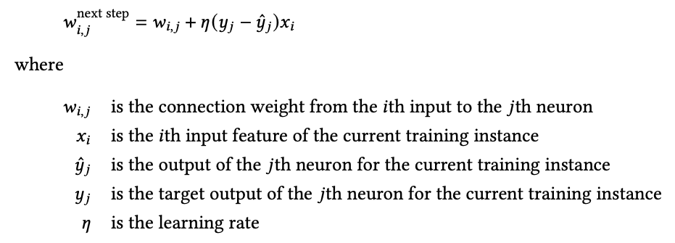
Perceptron learning
The perceptron is fed one training instance at a time
For each instance it makes a prediction
For each output neuron that makes an incorrect prediction, it reinforces the connection weights from the inputs that would have contributed to the correct prediction using the equation above

Slide 22
Perceptron convergence theorem
The decision bounday of a TLU is linear, so perceptrons are incapable of learning complex patterns (like logistic regression classifiers)
If the training instances are linearly separable, then the perceptron training rule will converge to a solution – this is called the perceptron convergence theorem

Slide 23
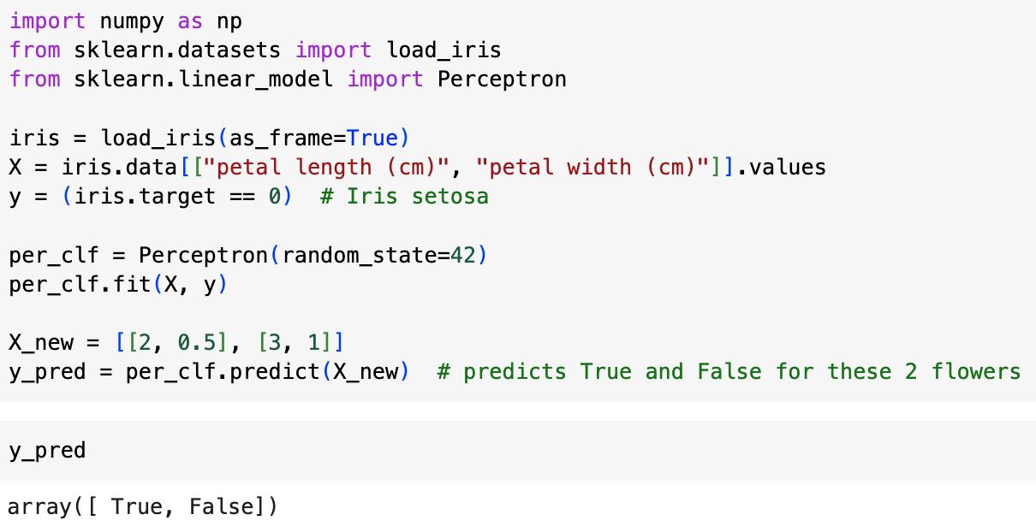
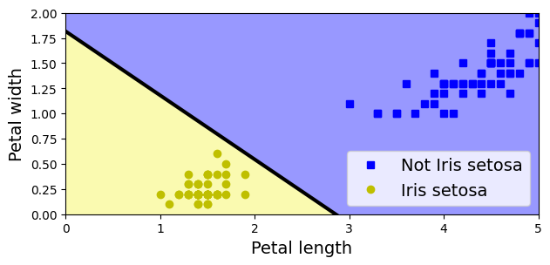
Perceptrons in Scikit-Learn
Scikit-Learn provides a Perceptron class that can be used as shown above
When a perceptron finds a decision boundary that separates the classes, it stops learning
This can mean the decision boundary ends up being quite close to one of the classes (cf. SVM)

Slide 24
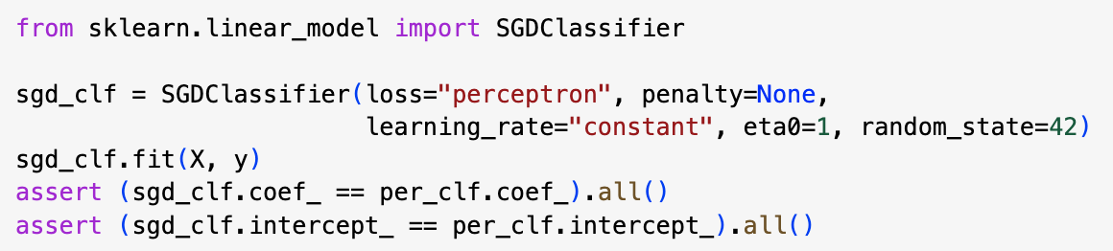
Perceptrons in Scikit-Learn
Perceptron strongly resembles stochastic gradient descent
In fact, the Perceptron class is equivalent to using an SGDClassifier with the following hyperparameters:
loss=“perceptron”
learning_rate=“constant”
eta0=1 (the learning rate)
penalty=None (no regularization)

Slide 25
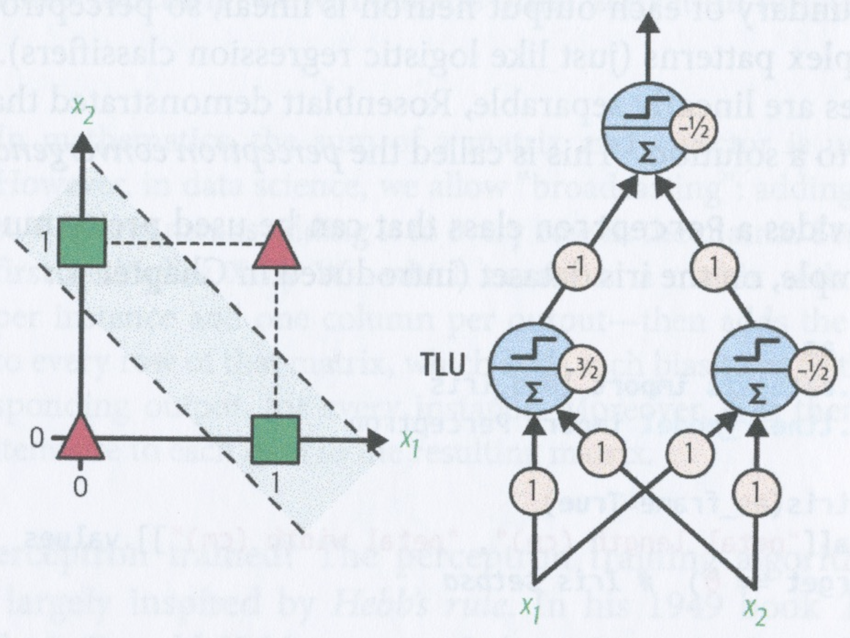
Limitations of perceptrons
In 1969, Minsky and Papert showed that perceptrons are incapable of solving some simple problems, such as the exclusive OR classification problem
This is actually true of all linear classification models (e.g., logistic regression classifiers), but some researchers expected more from perceptrons and were so disappointed that they stopped working with neural networks altogether
It turns out that some of these problems can readily be solved by stacking multiple perceptrons, to produce a multilayer perceptron (MLP)
For example the multilayer perceptron on the left solves the exclusive OR problem

Slide 26
Perceptrons vs. other types of model
Logistic regression classifiers output a class probability, but perceptrons do not
Perceptrons don’t use any regularization by default and training stops as soon as there are no more prediction errors on the training set
So perceptrons do not usually generalize as well as logistic regression or a linear SVM classifier
However, perceptrons may train a bit faster

Slide 27
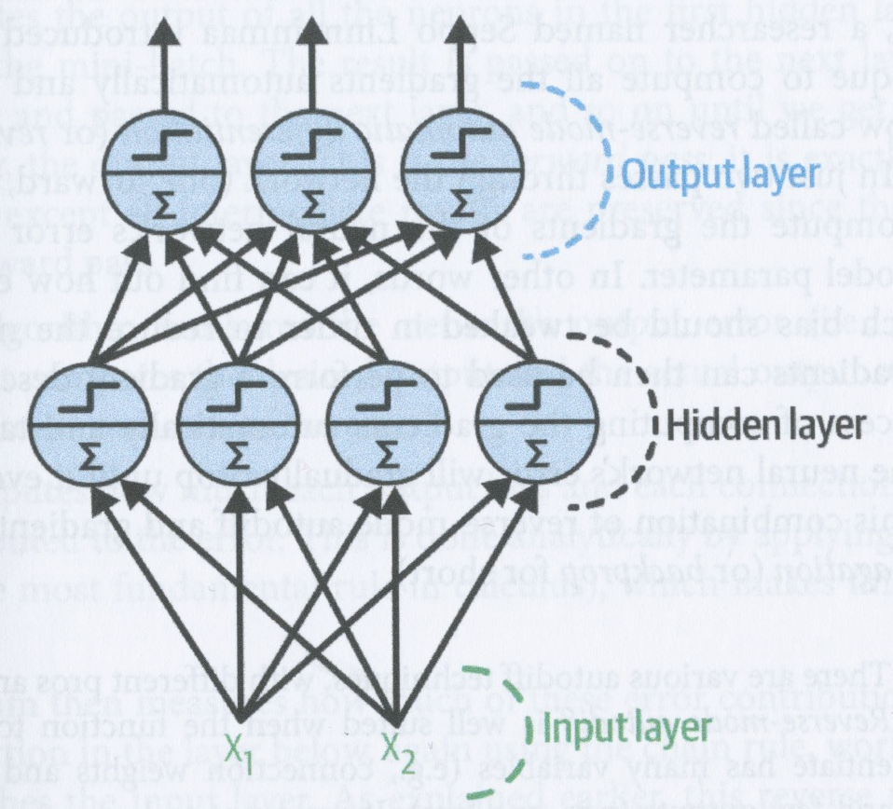
Multilayer perceptrons
An MLP is composed of
an input layer
one or more layers of TLUs called hidden layers
a final layer of TLUs called the output layer
Layers close to the input layer are called lower layers
Layers close to the output layer are called upper layers
The signal flows from the input layer to the output layer, so this is called a feedforward network (FNN)
When an ANN contains a deep stack of hidden layers, it is called a deep neural network (DNN)

Slide 28
Training MLPs with backpropagation
For many years, researchers struggled to find a way to train MLPs
In the 1960s, some researchers considered using gradient descent, which depends on computing the gradients of the model’s error with respect to the model parameters
It wasn’t clear at the time how to do this efficiently when a model contains so many parameters – especially with the computing resources that they had then

Slide 29
Training MLPs with backpropagation
In 1970, Seppo Linnainmaa proposed a technique in his masters thesis to compute all the gradients automatically and efficiently
This method is called reverse-mode automatic differentiation (or reverse-mode autodiff)
With this method, it was possible to compute the gradients of the neural network’s error with regard to every model parameter with just one forward pass and one backward pass through the network
This allows the weights and biases to be tweaked to reduce the network’s error and the gradients can be used to perform a gradient descent step
If you repeat this process of computing the gradients and taking a gradient descent step, the error will gradually drop to a minimum
This combination of reverse-mode autodiff and gradient descent is called backpropagation (or backprop)

Slide 30
Backpropagation – the forward pass
Backpropagation handles one mini-batch at a time (e.g., 32 instances) and goes through the training set multiple times
Each pass through the training set is called an epoch
Each mini-batch enters the network through the input layer
The outputs of the first hidden layer are computed for all instances in the mini-batch
These outputs are given as input to the second hidden layer which computes its outputs and so on to the output layer – this is the end of the forward pass
The forward pass is the same as predicting the outputs for the mini-batch, except that all the intermediary neuron outputs are preserved – they are needed for the backward pass

Slide 31
Backpropagation – the backward pass
After the forward pass, the algorithm measures the network’s output error
Computes how much each weight and bias on the output layer contributes to the error
This is done by using the chain rule
Then measures how much of the error contributions came from each connection in the layer below, working backward until it reaches the input layer
This reverse pass efficiently measures the error gradient across all connection weights and unit biases by propagating the error gradient backward through the network
Finally, algorithm executes a gradient descent step that tweaks each weight and bias using the calculated error gradients

Slide 32
Backpropagation - initialization
All weights and biases have to be initialized randomly
If you initialize all weights and biases in a layer to zero, all weights and biases will remain the same as each other
This is equivalent to having just one neuron in a layer

Slide 33
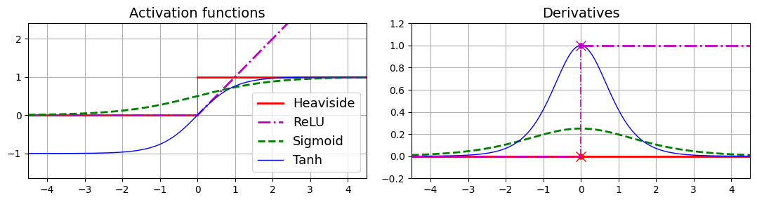
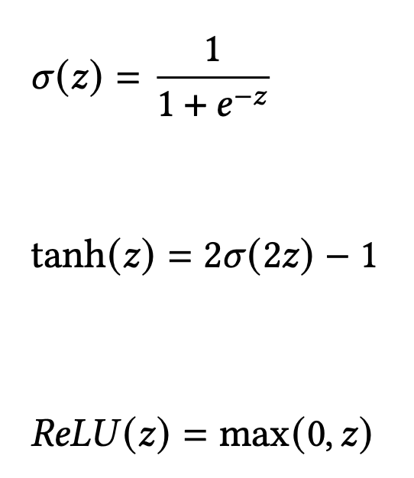
Backpropagation – activation functions
You cannot use a step function with backpropagation because the activation should not have any flat plateaux
Rumelhart et al suggested using the logistic function instead (left top) (also called the sigmoid function)
This function has a well-defined non-zero gradient everywhere
Two other popular choices of activation function to use with backpropagation are
The hyperbolic tangent function (left middle): ranges from -1 to 1 so that a layer’s output tends to be centred around 0 at the beginning of training which can speed up convergence
The rectified linear unit function (left bottom): continuous, but not differentiable at z = 0, and gradient is 0 for z < 0
Nevertheless, works well in practice and is the default choice

Slide 34
Activation functions

Slide 35
Activation functions
Why do we need activation functions?
If you don’t have activation functions, then each layer in the network is just a linear function
If you chain two linear functions, you just get another linear function
In other words, if you don’t introduce some non-linearity with the activation functions, the whole network will just be equivalent to a linear model and you won’t be able to fit data that arises from some complex non-linear process
Conversely, a DNN with non-linear activations can approximate any continuous function

Slide 36
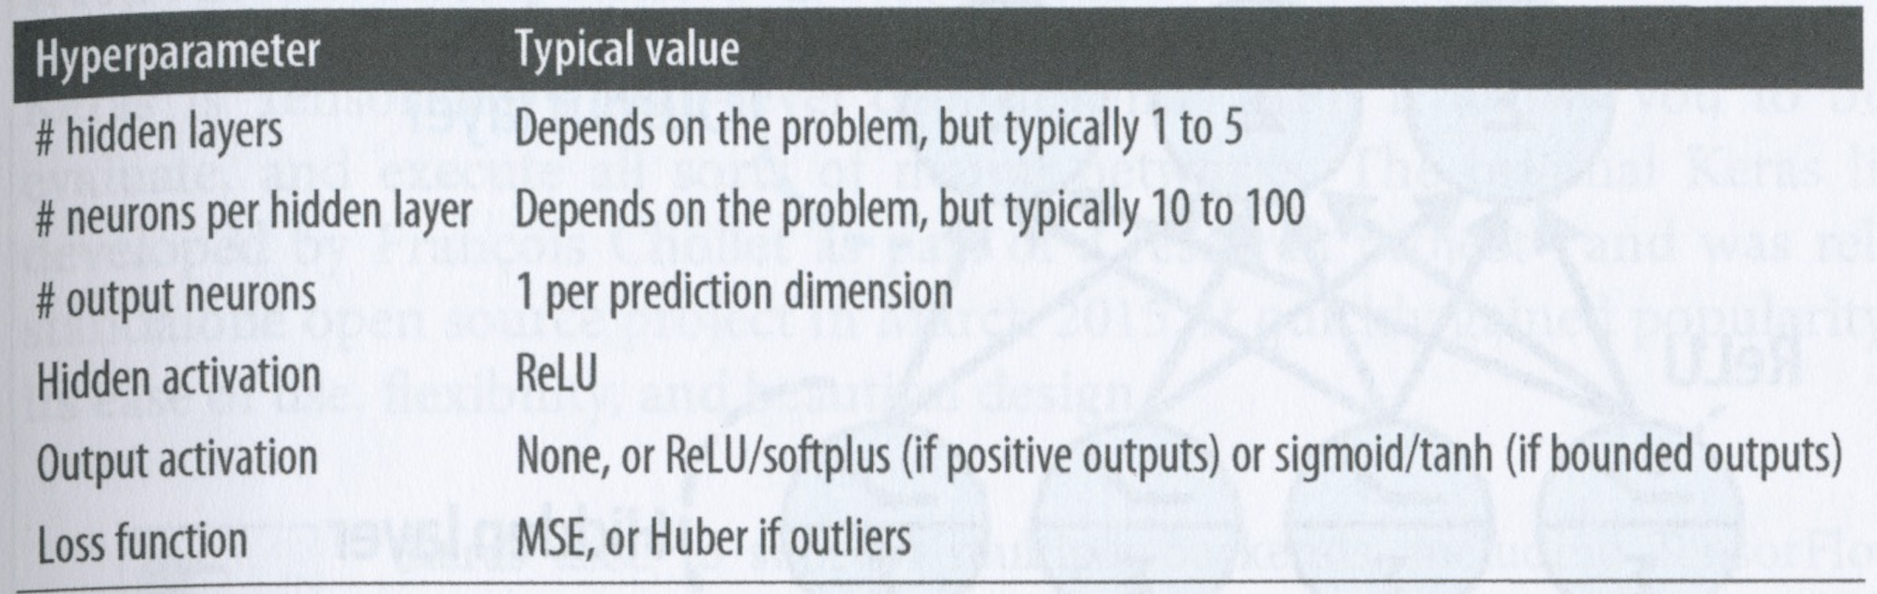
Regression MLPs
MLPs can be used for regression
If you want to predict just one value for each input instance, then you only need one neuron in the output layer
If you want to do multivariate regression (predict multiple values for each input instance), then you need one neuron per output value in the output layer
e.g., if your output is a 2D location, then you need two output neurons

Slide 37
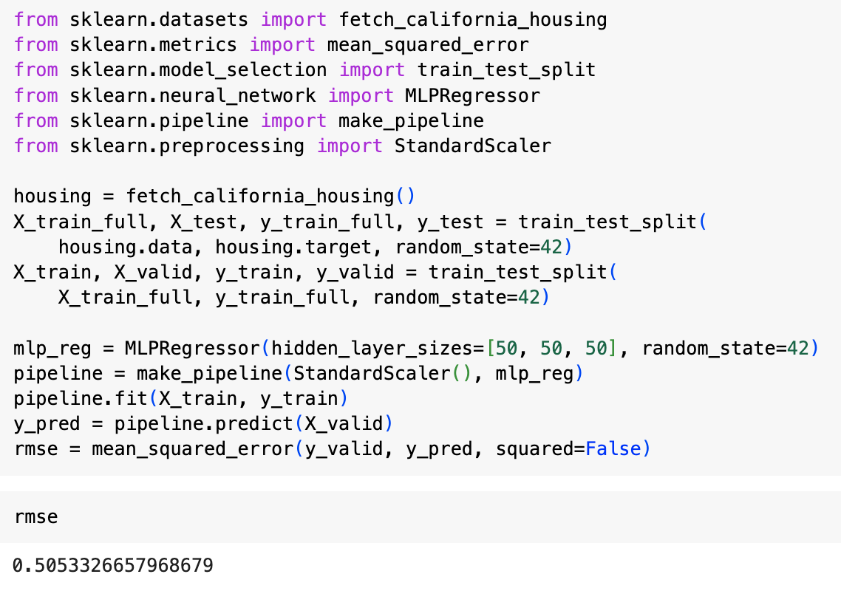
MLPRegressor
Scikit-Learn’s MLPRegressor can be used to build and train MLPs
Example on left builds an MLP with three hidden layers, each with 50 neurons
The MLP is trained on a simplified version of the California housing dataset that only has numerical features and no missing values

Slide 38
MLPRegressor
Starts by fetching and splitting the training data
Creates a pipeline to scale the input features before sending to the MLPRegressor
This is important when using MLP because they use gradient descent

Slide 39
MLPRegressor
Uses ReLU activation function and a variant of gradient descent called Adam (Adaptive Moment Estimation)
It also uses some l2 regularization (cf. ridge regression), which you can control with the alpha parameter
RMSE is 0.505 which compares with what you would get with a random forest classifier

Slide 40
MLPRegressor
This MLP doesn’t use any activation function for the output layer, so it can output any value it wants
If you want to ensure that the output value is positive, then you should use ReLU or softplus as the activation layer for the output layer
softplus is a smoothed variant of ReLU – close to 0 when z is -ve and close to z when z is +ve
If you want to use activation functions in the output layer, you have to use Keras

Slide 41
Summary of MLP regression

Slide 42
Classification MLPs
MLPs can also be used for classification
For binary classification, use a sigmoid activation function that outputs a value between 0 and 1, if output >= 0.5, assign the positive class
For multilabel binary tasks, use one output neuron per label
e.g., predicting simultaneously whether an email is ham/spam and urgent/non-urgent
For multiclass classification, use one output neuron per class and use the softmax function for the whole output layer
e.g., MNIST digit identification into one of 10 classes
see p. 170 in the textbook for details of the softmax function
Since we’re predicting probability distributions, it’s a good idea to use the cross-entropy loss function
see p. 171 in textbook for details

Slide 43
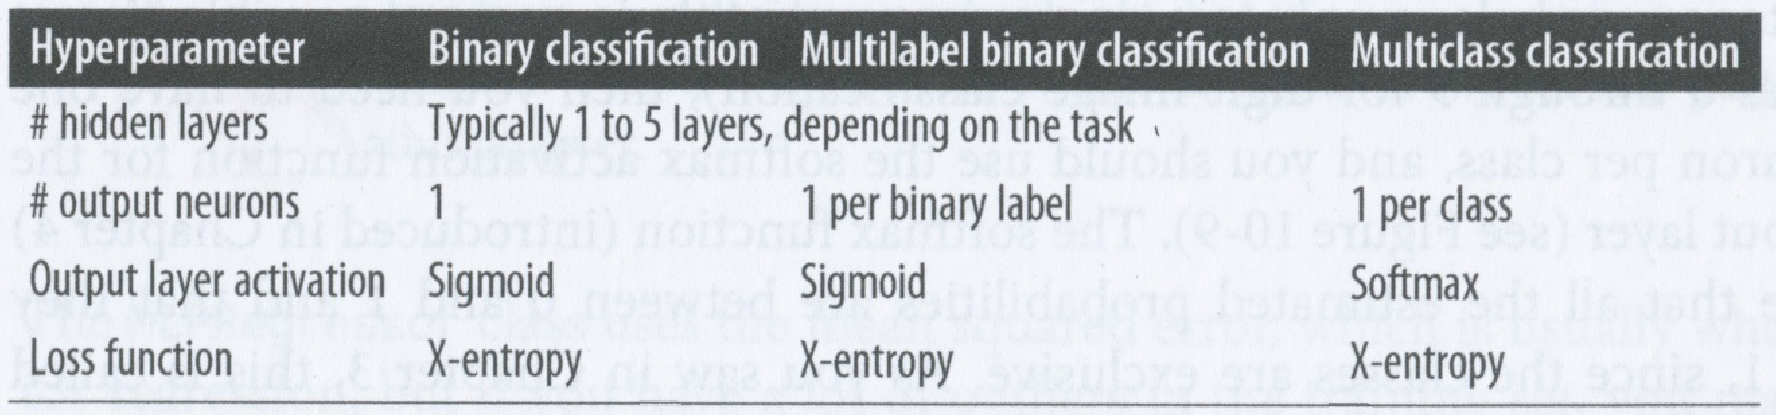
Summary of MLP classification

Slide 44
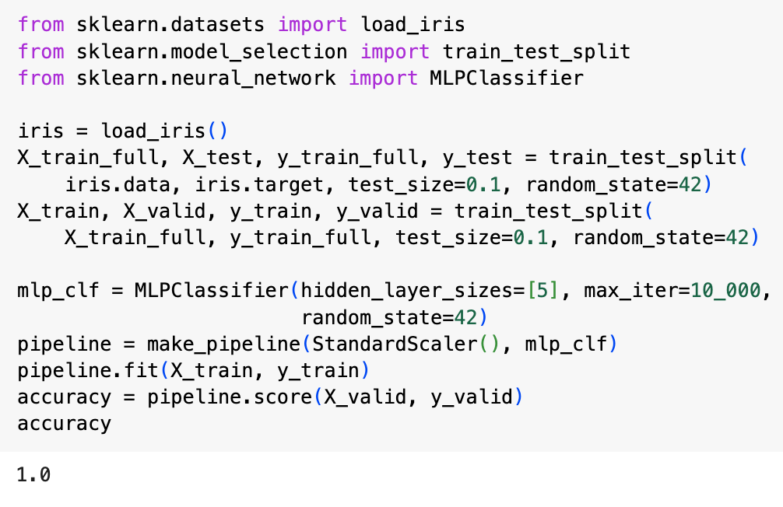
MLPClassifier in Scikit-Learn
Scikit-Learn has an MLPClassifier class which is almost identical to the MLPRegressor except that it uses cross-entropy instead of MSE as the cost function
Example on left applies this class to the Iris dataset
Uses a single hidden layer with 5 neurons and scales the data first

Slide 45

Implementing MLPs in Keras
Keras is TensorFlow’s high-level deep learning API
It lets you build, train, evaluate and execute all sorts of neural networks
The original Keras library was developed by François Chollet and released in 2015
It quickly became very popular because of its elegant and intuitive design and flexibility
If you use Colab then Keras and TensorFlow are already installed
If you want to install them on your own machine, then following the instructions at https://homl.info/install

Slide 46

Building an image classifier using the Sequential API
We’ll use the Fashion MNIST dataset
This is a drop-in replacement for MNIST – exactly the same format as MNIST (70000 grayscale images, each 28 x 28, with 10 classes)
Images in Fashion represent items of clothing rather than digits
This makes the problem significantly harder than MNIST
A simple linear model reaches about 92% on MNIST but only 83% on Fashion

Slide 47
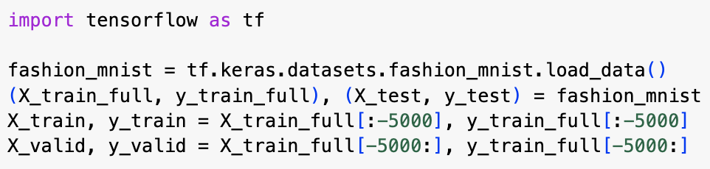
Using Keras to load the dataset
Keras provides some utility functions to fetch and load common datasets, including Fashion MNIST
The dataset is already shuffled and split into a training set of 60k images and a test set of 10k images
We’ll hold out another 5k images for validation

Slide 48
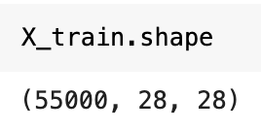
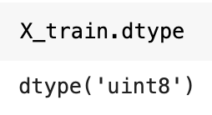
Using Keras to load the dataset
In Fashion MNIST, each image is represented as a 28 x 28 array of uints
cf. MNIST digit dataset, where each image is a 1d array of 784 floats
We will actually scale the pixel intensities to values between 0 and 1 by dividing by 255.0
This also converts them to floats

Slide 49
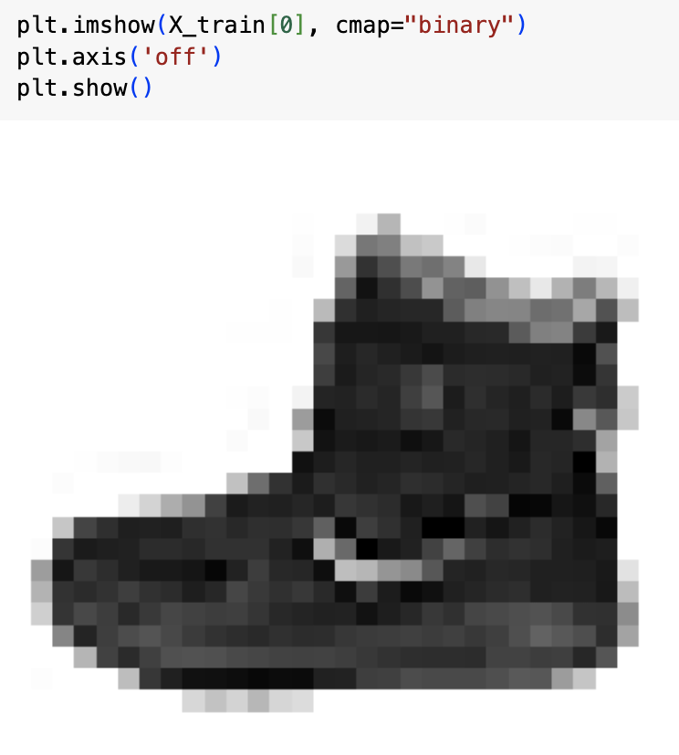
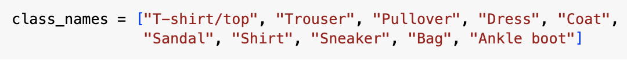
Using Keras to load the dataset
You can plot an image using Matplotlib’s imshow() function
In the digit MNIST, the class label is just the number represented by the image
In Fashion MNIST, we need the list of class names in order to know what we are dealing with

Slide 50
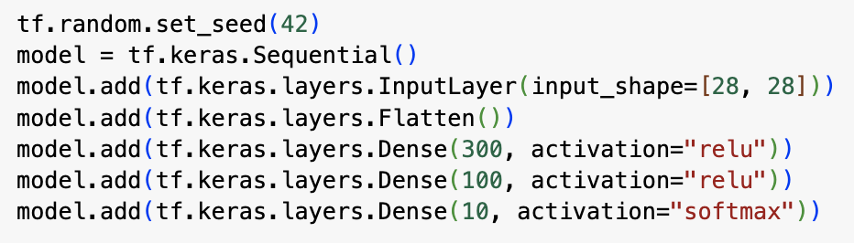
Creating the model using the Sequential API
We can build a classification MLP with two hidden layers using the code above
The first line just sets the random seed to make the results reproducible – this controls the random initialization of the network
The second line creates a Sequential model, which is the simplest type of model in Keras – it creates a network that consists of a single stack of layers, executed sequentially
The third line creates the Input layer and adds it to the model
We give the shape of this layer so that Keras can create a matrix of connection weights that has the same shape

Slide 51
Creating the model using the Sequential API
In the fourth line, we add a Flatten layer
This converts each input image into a 1D array
In the fifth line, we add a Dense layer containing 300 neurons, using the ReLU activation function
Each dense layer manages its own matrix of connection weights and bias vector
When it receives some input, it computes the outputs using the equation above
In the sixth line, we add a second Dense layer with 100 neurons and in the last line, we add an output layer containing 10 neurons using the softmax activation function because we want the classes to be exclusive

Slide 52
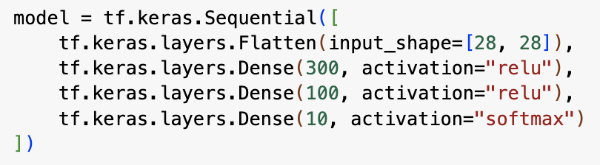
Creating the model using the Sequential API
You can also create the network by passing a list of the layers to the Sequential constructor
In this case, you can drop the input layer and just specify the shape of the input to the first layer

Slide 53
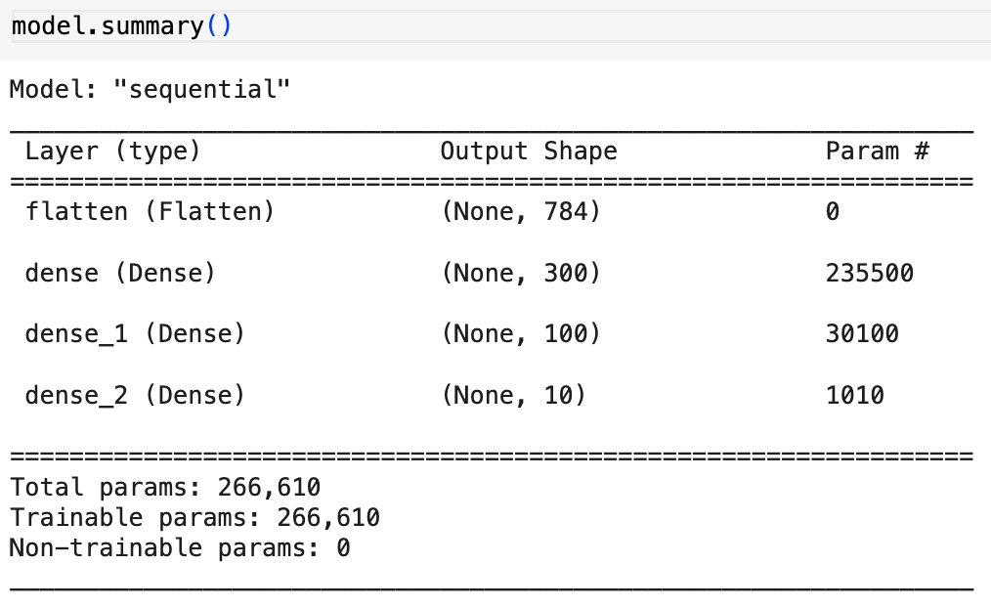
Getting an overview of the network
You can get an overview of the network by using the model’s summary() method
This gives a table like the one on the left
Dense layers typically have a lot of parameters since every unit in the previous layer is connected to every unit in this layer
For example, the first dense layer has 300 x 784 + 300 = 235500 parameters
ANNs with dense layers are therefore extremely powerful and have a high risk of overfitting
Each layer is automatically given a unique name which allows you to merge models together without getting name conflicts

Slide 54
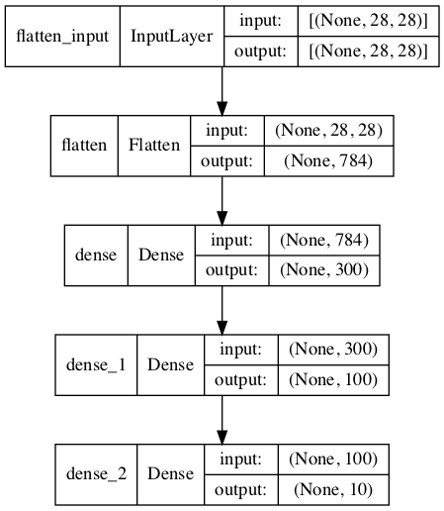
Getting an overview of the network
You can also get a graphical visualization of the network using the tf.keras.utils.plot_model() method
Note that this gives a representation that is “upside down” compared with the ones we have been using so far, so that lower layers are nearer the top of the diagram

Slide 55
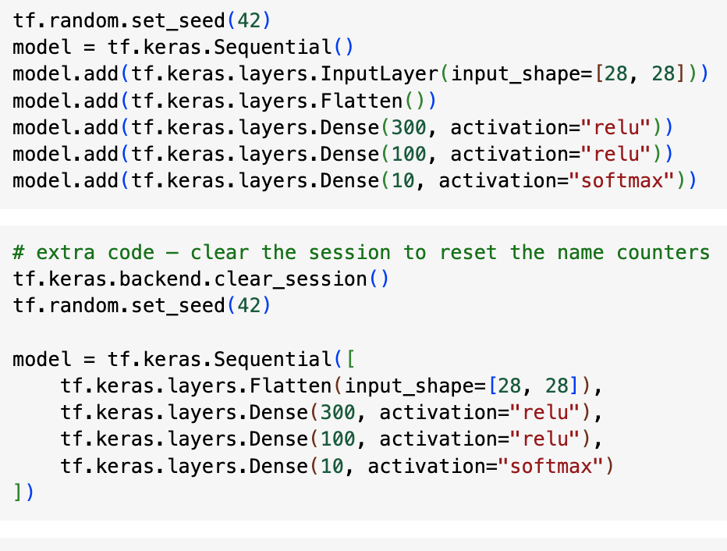
Resetting Keras sessions
Global state managed by Keras is stored in a Keras session
You can clear the session by using the tf.keras.backend.clear_session() method
We did this on the left when we re-initialized the “model” variable

Slide 56
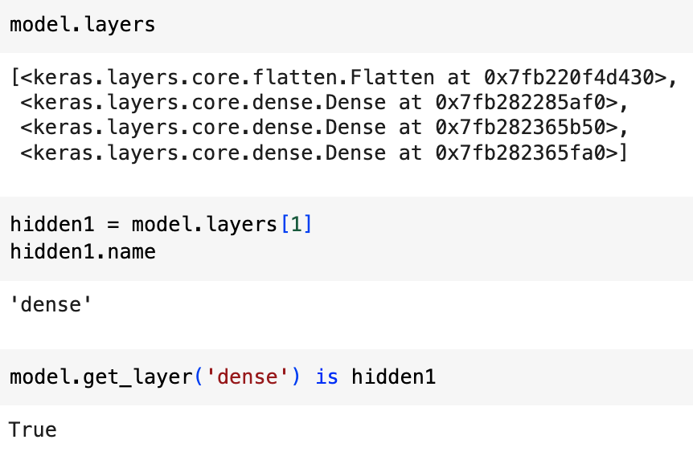
Accessing model layers
You can access the layers using either the layers attribute or the get_layer(layer_name) method
Once you have a layer, you can access its name and you can check its position in the network

Slide 57
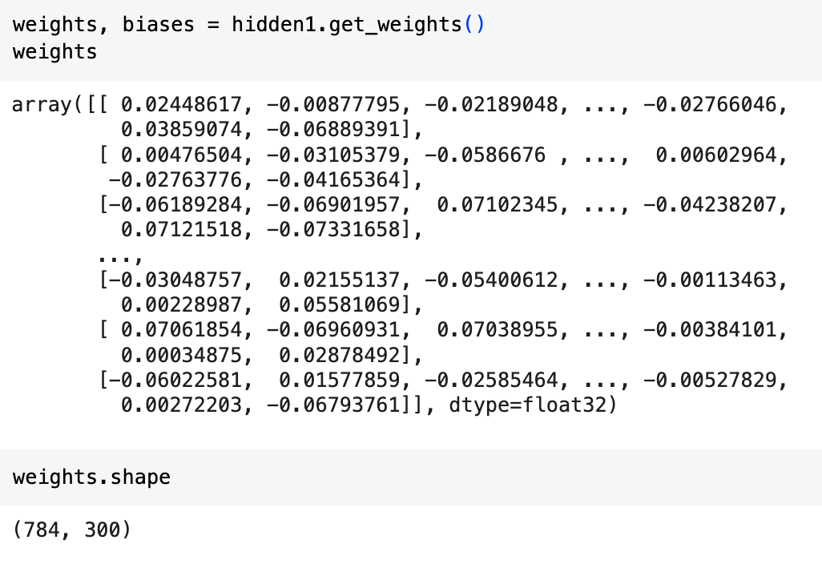
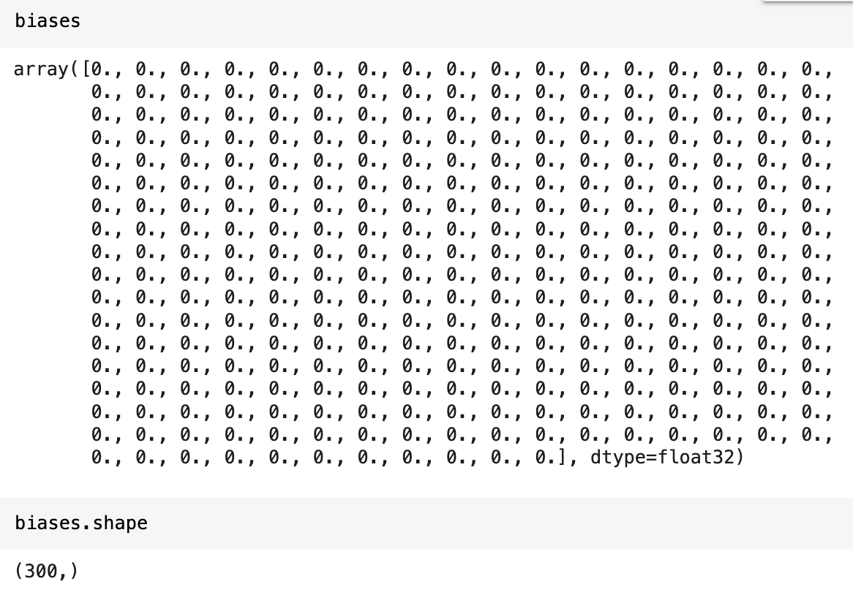
Accessing the weights and biases of a layer
You can access the weights and biases of a layer by using the get_weights() and set_weights() methods
Note that, by default, the weights are randomly initialized and the biases are set to 0

Slide 58
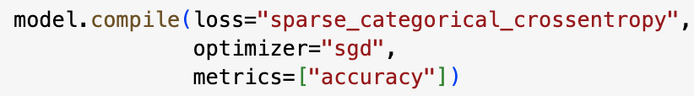
Compiling the model
Once the model has been constructed, you need to compile it using its compile() method (see above)
In the code above, we use
sparse_categorical_ crossentropy loss because the labels are ordinally encoded (from 0 to 9)
If they’d been one-hot encoded, we’d have used categorical_crossentropy instead
optimizer=“sgd” indicating that we will use stochastic gradient descent (i.e., backprop)
actually, we would usually use optimizer=tf.keras.optimizers.SGD(learning_rate=__???__) since we generally want to tune the learning rate
using sgd causes the learning_rate to default to 0.01
metrics=[“accuracy”] ensures the model also returns accuracy, which is useful to know

Slide 59
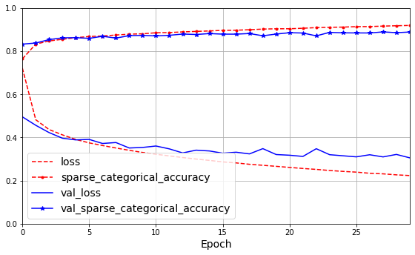
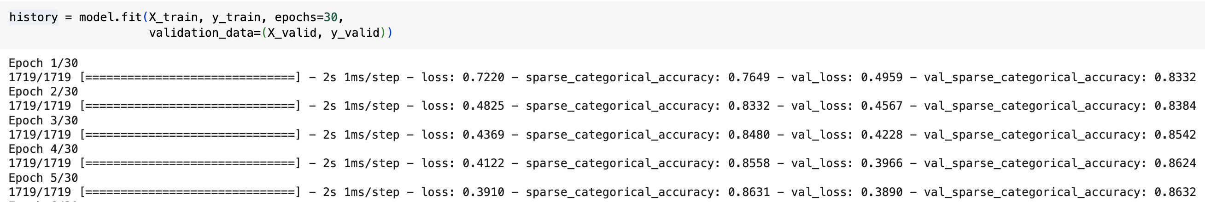
Training and evaluating the model
You train the model as usual by calling its fit() method
Example above trains for 30 epochs
If the validation accuracy is much less than the training set accuracy, then model has probably overfitted
or there could be a bug or a data mismatch between the training and validation sets
On the left, it shows the number of mini-batches processed per epoch
By default, the batch size is 32, so in this case, the algorithm processes 1718 x 32 + 1 x 28 = 55000 instances – that is, one complete pass over the whole dataset on each epoch
Note that validation accuracy and loss are computed at the end of an epoch, while training loss and accuracy are averages over the epoch – so validation scores can be better than training scores

Slide 60
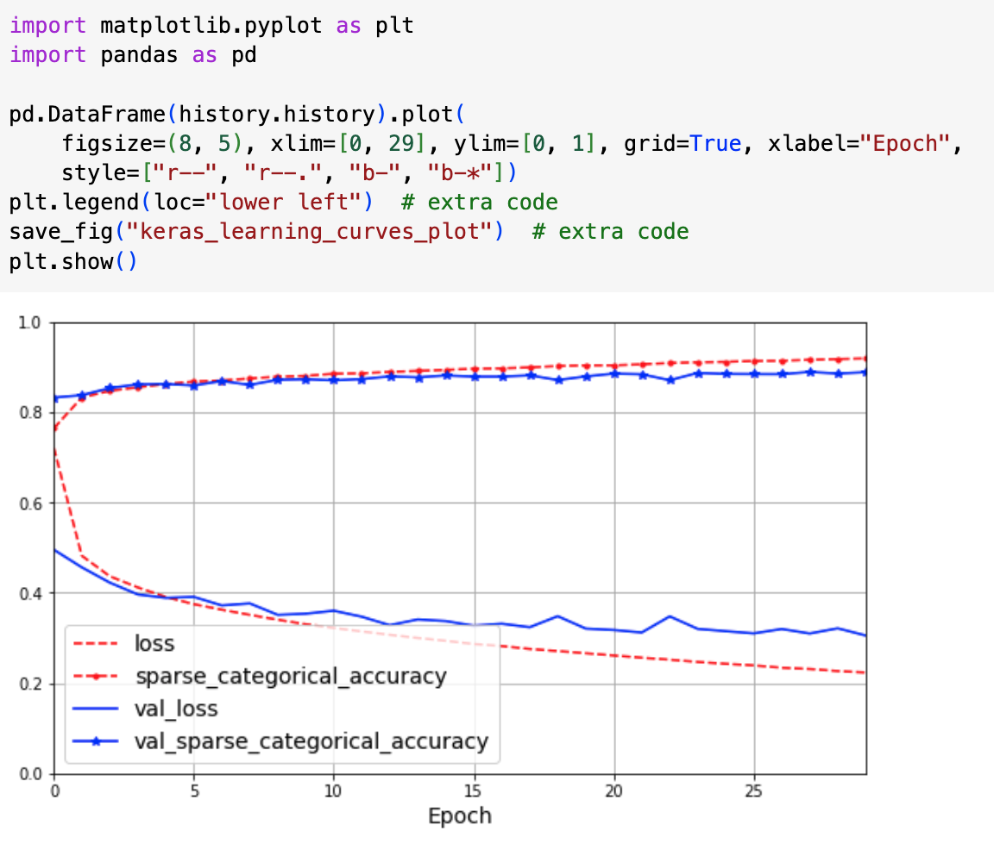
Plotting the learning history
The fit() method returns a History object that contains the history parameters (history.params), the list of epochs (history.epochs) and a dictionary, history.history, containing the loss and extra metrics at the end of each epoch
You can use this dictionary to create a Pandas DataFrame and then call its plot() method to get learning curves like on the left

Slide 61
Tracking accuracy and loss
Both training and validation accuracies increased steadily over the training, while training and validation loss decreased
Validation loss is still going down, which suggests there is still some training to be done
You can do this just by calling fit() again, since Keras just continues training where it left off
You should be able to reach about 89.8% accuracy on the validation set and 100% on the training set in this case

Slide 62
Tuning hyperparameters
If you are not happy with performance, you can go back and tune hyperparameters
First try tuning the learning rate
If that doesn’t help, try another optimizer
Always retune learning rate after changing any hyperparameter
You can then go on to try tuning other hyperparameters such as the number of layers, the number of neurons in each layer, and the types of activation function to use in the hidden layers
You can also modify the batch size using the batch_size parameter of the fit() method (the default size is 32)
When you’re satisfied with your model, test it on the test set before deploying in production – you can do this using the evaluate() method

Slide 63
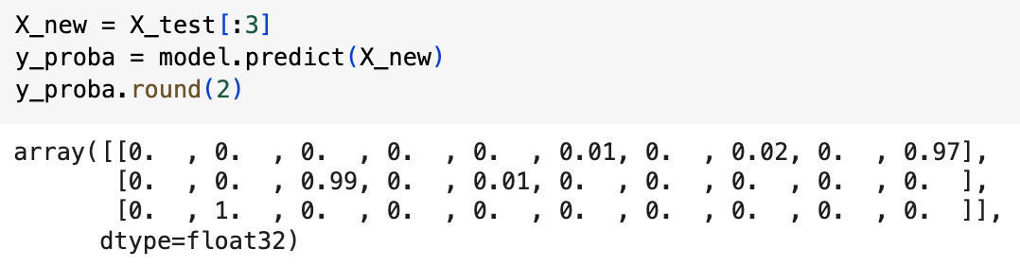
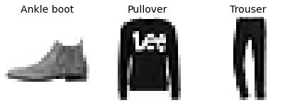
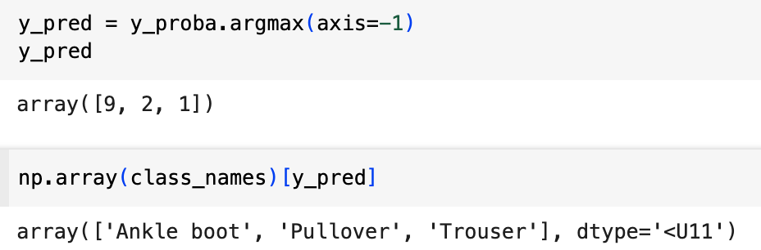
Using the model to make predictions
We can use the model’s predict() method to make predictions on new instances
Above we “predict” the output for the first three members in the test set
The model predicts a probability for each class, like the predict_proba() method in Scikit-Learn classifiers
For the first instance, the model predicts a probability of 96% that the instance is in class 9 (ankle boot), 2% that it is in class 7 (sneaker) and 1% that it is in class 5 (sandal)
You can just get the highest-rated class by using the argmax function, as shown

Slide 64
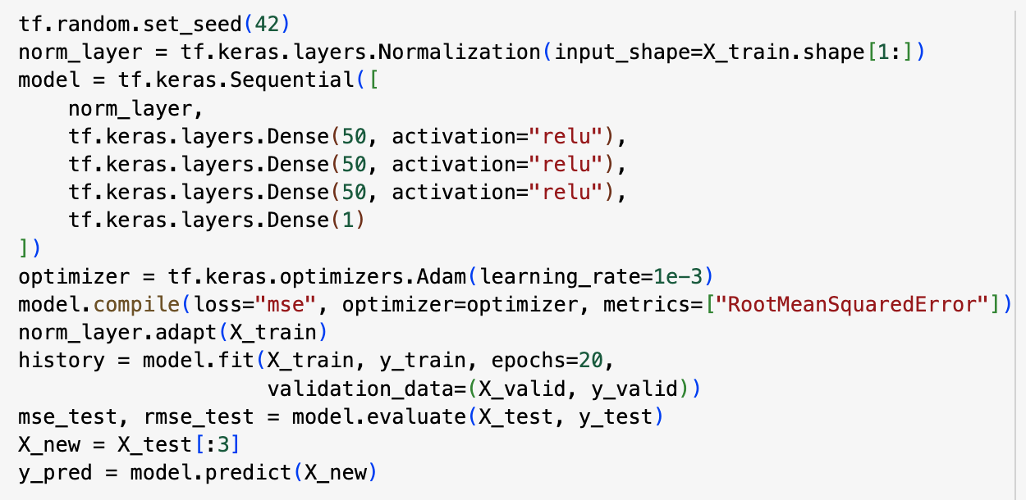
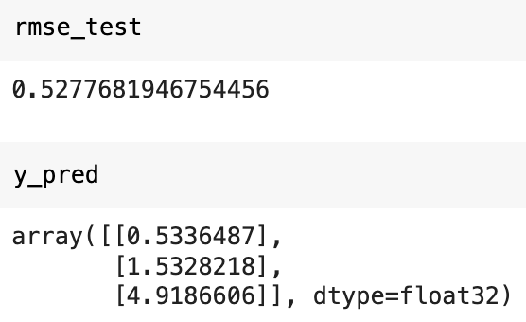
Building a regression MLP using the Sequential API
Let’s tackle the California housing price problem by building the same MLP as earlier, but this time in Keras
This MLP had three hidden layers, each with 50 neurons
This is very similar to doing classification, except now we only have a single output neuron which predicts a price
Other differences are
uses no activation function on the output layer
loss function is mean squared error
metric is RMSE
we’re using Adam optimizer
We don’t need a Flatten layer – instead we use a Normalization layer
This does the same thing as Scikit-Learn’s StandardScaler – note that it must be fitted using its adapt method before training the model

Slide 65
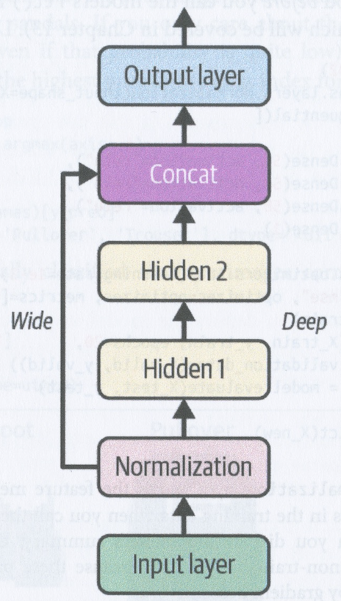
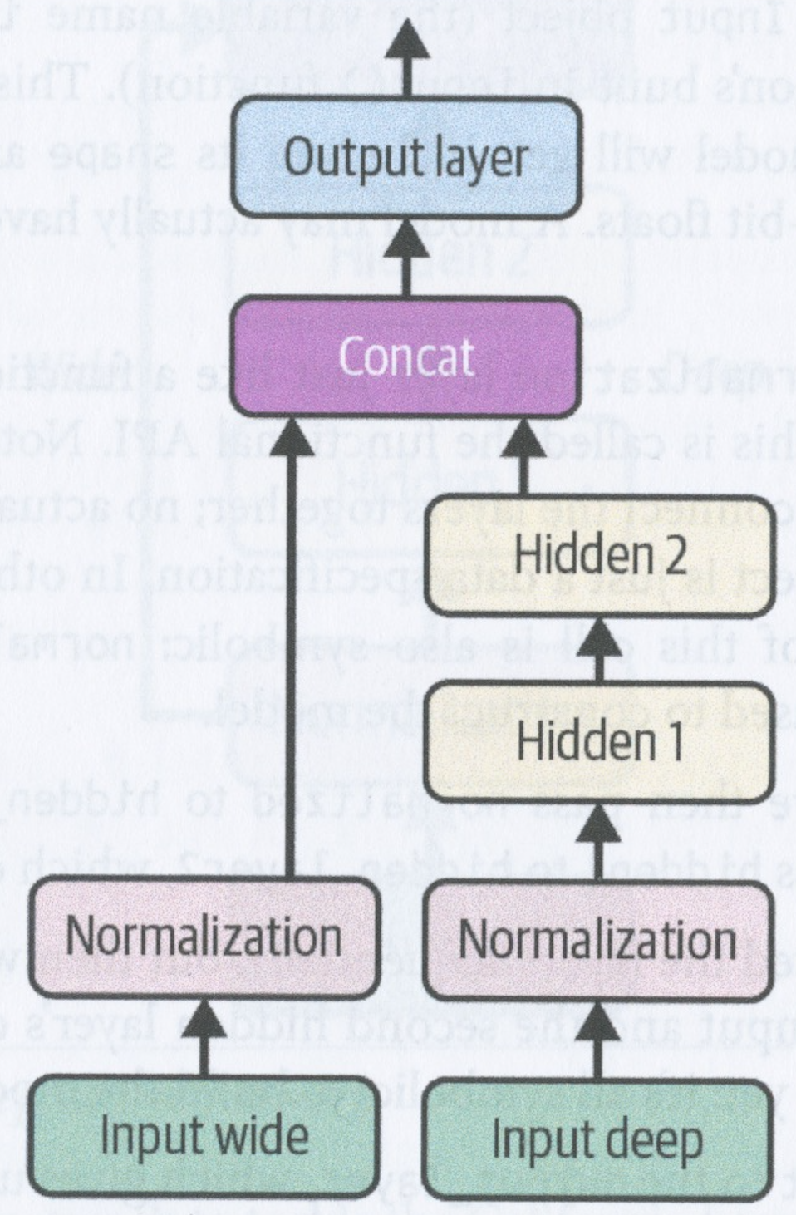
Building complex models using the Functional API
The Sequential API assumes your neural network consists of a single sequence of layers that are executed one after the other, with the inputs to each layer coming only from the previous layer
The Keras Functional API allows you to build networks with more complicated topologies or with multiple inputs and outputs

Slide 66
Wide and deep models
In a Sequential API, the input data can only reach the output after being passed through the hidden layers
This can distort simple patterns in the input data and prevent the network from learning simple rules
A Wide and Deep network (Cheng et al, 2016) allows the network to learn both deep patterns and simple patterns
It does this by connecting all or part of the inputs directly to the output layer

Slide 67
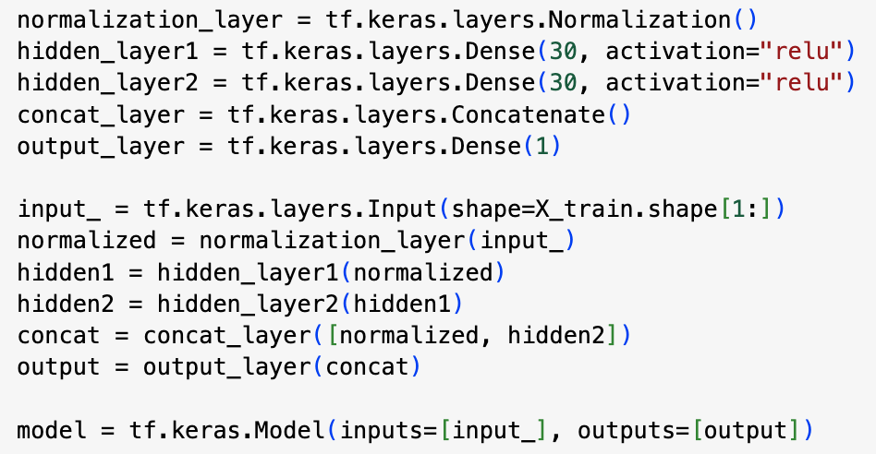
Wide & Deep Model to tackle California Housing problem
On the left we’ve built a wide and deep model to tackle the California housing problem
In the first 5 lines, we construct the layers
In the next 6 lines, we link the layers together by specifying the inputs and outputs of each layer
In the final line we construct the model, pointing at its inputs and the outputs
As before, once you’ve constructed the model, you need to compile it, adapt the normalization layer, fit the model, evaluate it and use it to make predictions

Slide 68
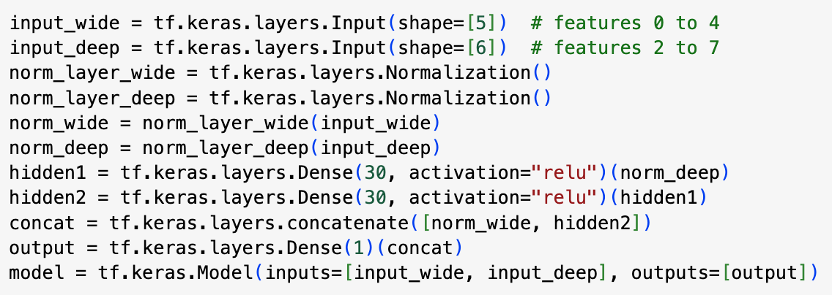
Sending different inputs through different paths
Suppose we want to send some features through the wide path and some features through the deep path
The code above implements the topology on the right
Note that we construct each Dense layer and define its input and output as we go along
Note that we use the tf.keras.layers.concatenate() method instead of constructing a Concatenate layer
Note that we now need to specify an array of two inputs

Slide 69
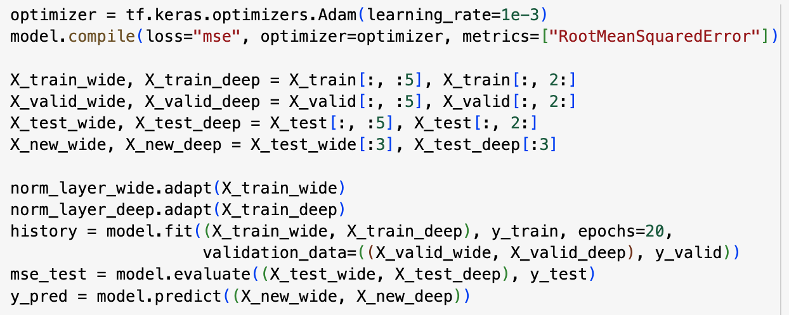
Compiling and training a functional model
When we fit such a multi-input model, we must pass a pair of matrices, one per input: (X_train_wide, X_train_deep)
Same goes for validation and test data
Remember to adapt both normalization layers before fitting!

Slide 70
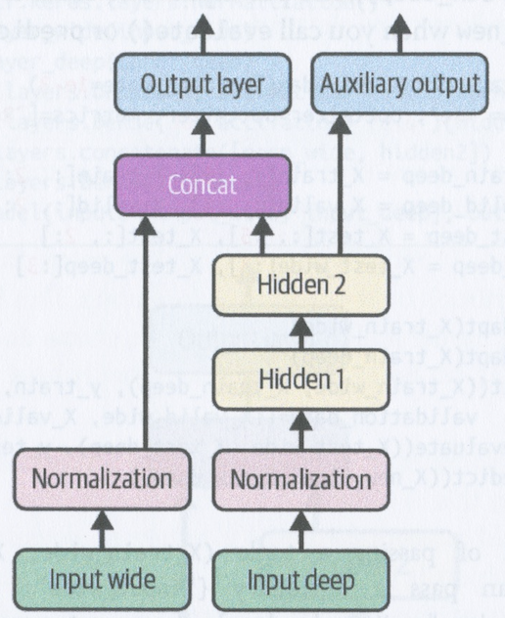
Use cases for multiple outputs
There are many situations where you might want multiple outputs
You may want to locate and classify the main object in a picture – this is both a regression task and a classification task
You may have multiple tasks to perform on the same data
You can get better results by training the same neural network model to carry out all the tasks than by training a separate model for each task
e.g., a model for multitask classification on images of faces might classify both a person’s facial expression and whether or not they are wearing glasses
You may want to make sure that part of tne network outputs something useful on its own without relying on the rest of the network – this can also work as a regularization technique

Slide 71
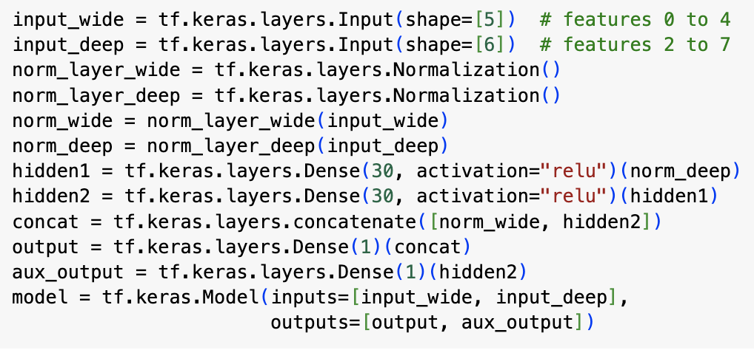
Adding an extra output
Adding an extra output is straightforward using the Functional API
We just connect it to the appropriate layer (see aux_output) and add it to the list of outputs of the model

Slide 72
Compiling and training a multi-output model
Each output needs its own loss function, so you need to provide a tuple of two loss functions when you compile
By default, Keras will add up the losses of the different outputs during training and give them equal weight
Here, the aux_output is only used for regularization – the main output should be given much more weight – we set this using the loss_weights hyperparameter:
loss_weights = (0.9, 0.1)

Slide 73

Compiling and training a multi-output model
When we train the model, we need to provide target labels for each output
So we provide the tuple (y_train, y_train) and (y_valid, y_valid) in the code above – both outputs are trying to predict the same thing

Slide 74
Evaluating a multi-output model
When we evaluate a multi-output model, the evaluate method returns the weighted sum of the losses, the loss for each output and the error metric for each output
Similarly the predict() method returns the predictions for each output

Slide 75
Using Subclassing API to build dynamic models
The models you create using the sequential and functional APIs are static – you build the model from its layers and then exactly the same process is applied to every instance you give to the model
This has many advantages:
the model can be saved, cloned and shared
its structure can be displayed and analysed
the framework can infer shapes and check types and catch errors early
it’s straightforward to debug
But what if you want to involve loops, or varying data shapes or conditional branching or other dynamic behaviours?

Slide 76

Using the Subclassing API
If you want to build dynamic models, then you’ll need to use the Subclassing API
Example on the left uses this API to build the multi-output model we just looked at
We define our own subclass of the keras.Model class
In its constructor, we define properties corresponding to the different layers
We then specify how the layers are applied in the call() method
Here, the call() method just connects the layers together as before
But, in principle, the call() method could involve any code at all, so it allows you to build models that have loops, conditional execution etc.

Slide 77

Saving and restoring a model
Saving a Keras model is as simple as calling the model’s save() method
If you set save_format to “tf”, it saves the model using TensorFlow’s SavedModel format
this is directory containing several files and subdirectories
The saved_model.pb file contains the model’s architecture and logic – this can be used for deployment without exposing your source code

Slide 78
Saving and restoring a model
The keras_metadata.pb file contains extra information required by Keras
The variables subdirectory contains all the parameter values, including connection weights, biases, normalization statistics, optimizer’s parameters, possibly split across several files
The assets directory may contain extra files, such as data samples, feature names, class names, etc.
Since the optimizer is saved with its state, you can continue training after re-loading and it will start where it left off

Slide 79
Saving and restoring a model
Typically, you will make a script to tring the model and save it and then another script (or web service) that loads the model, evaluates it and uses it to make predictions
Loading the model is done using the load_model() method
You can also use save_weights() and load_weights() to save and load just the weights rather than the whole model
While training a large and complex model that takes a long time to train, it’s a good idea to save snapshots of the model periodically during the training
How do you do this? You need to be able to tell the fit() method to save checkpoints – you can do this using callbacks

Slide 80

Using callbacks
The fit() method accepts a callbacks argument, that lets you specify a list of objects that Keras will call at various points during the training
You can specify callbacks to execute
before and after training
before and after each epoch
before and after processing each mini-batch
For example, the ModelCheckpoint callback saves checkpoints of your model at regular intervals during training (by default, at the end of each epoch)

Slide 81

Early stopping with callbacks
If you use a validation set during training, you can set save_best_only=True when creating the ModelCheckpoint callback
This will then only save your model when it performs better on the validation set than any other model so far
This provides and alternative to early stopping: you can just let your model train for as long as you like and then take the best model so far
Another way to implement early stopping is to use the EarlyStopping callback – this will interrupt training when it registers no progress on the validation set for a number of epochs (defined by the patience argument)
If you set restore_best_weights=True, it will then roll back to the best model at the end of the training
You can combine both callbacks to get periodic checkpoints and implement early stopping (see above)
Number of epochs can be set quite high, as the training will stop automatically

