Slide 1
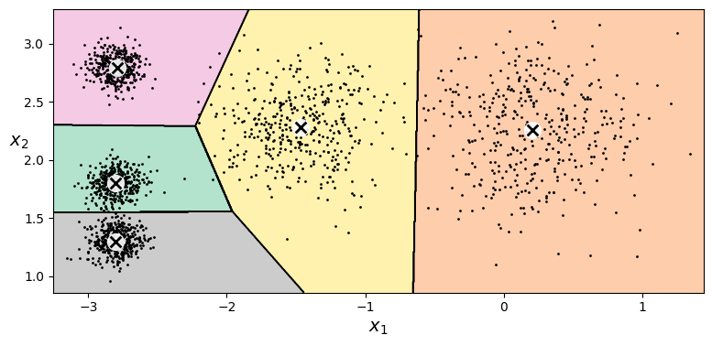
Unsupervised Learning Techniques
David Meredith
dave@create.aau.dk
Aalborg University

Slide 2
Sources for this lecture
Chapter 9 of
  Géron, A. (2023). Hands-On Machine Learning with Scikit-Learn, Keras & TensorFlow. (Third edition). O’Reilly. Available at
    https://www.amazon.de/-/en/Aur%C3%A9lien-G%C3%A9ron/dp/1098125975/
    https://www.saxo.com/dk/hands-on-machine-learning-with-scikit-learn-keras-and-tensorflow_bog_9781098125974
    https://factumbooks.dk/?search_string=hands-on+machine+learning+with+scikit-learn
Jupyter Notebook for this lecture:
  https://github.com/ageron/handson-ml3/blob/main/09_unsupervised_learning.ipynb

Slide 3
Unsupervised learning
Most applications of ML are based on supervised learning
However, most data is unlabelled and labelling data is time-consuming, labour-intensive and error-prone
Supervised learning is where we try to learn the structure in the data from scratch, without having to laboriously label thousands of instances in order to create a training set
Yann Lecun said that if AI is a cake, then unsupervised learning would be the cake, supervised learning would be the icing and reinforcement learning would be the cherry on top!

Slide 4
Unsupervised learning topics
Dimensionality reduction is a form of unsupervised learning
Clustering is where we try to group instances together into clusters, where the instances within a cluster are similar to each other and different in some significant way from the instances in other clusters
Anomaly detection (or outlier detection) is where the system tries to learn what “normal” data looks like so that it can recognize abnormal ones – i.e., anomalies or outliers
  “normal” instances are called inliers
  used in, e.g., fraud detection, detecting defective products, removing outliers from a dataset to improve training
Density estimation is where the system tries to estimate the probability density function (PDF) of the process that generated the dataset
  commonly used for anomaly detection, data analysis and visualization

Slide 5
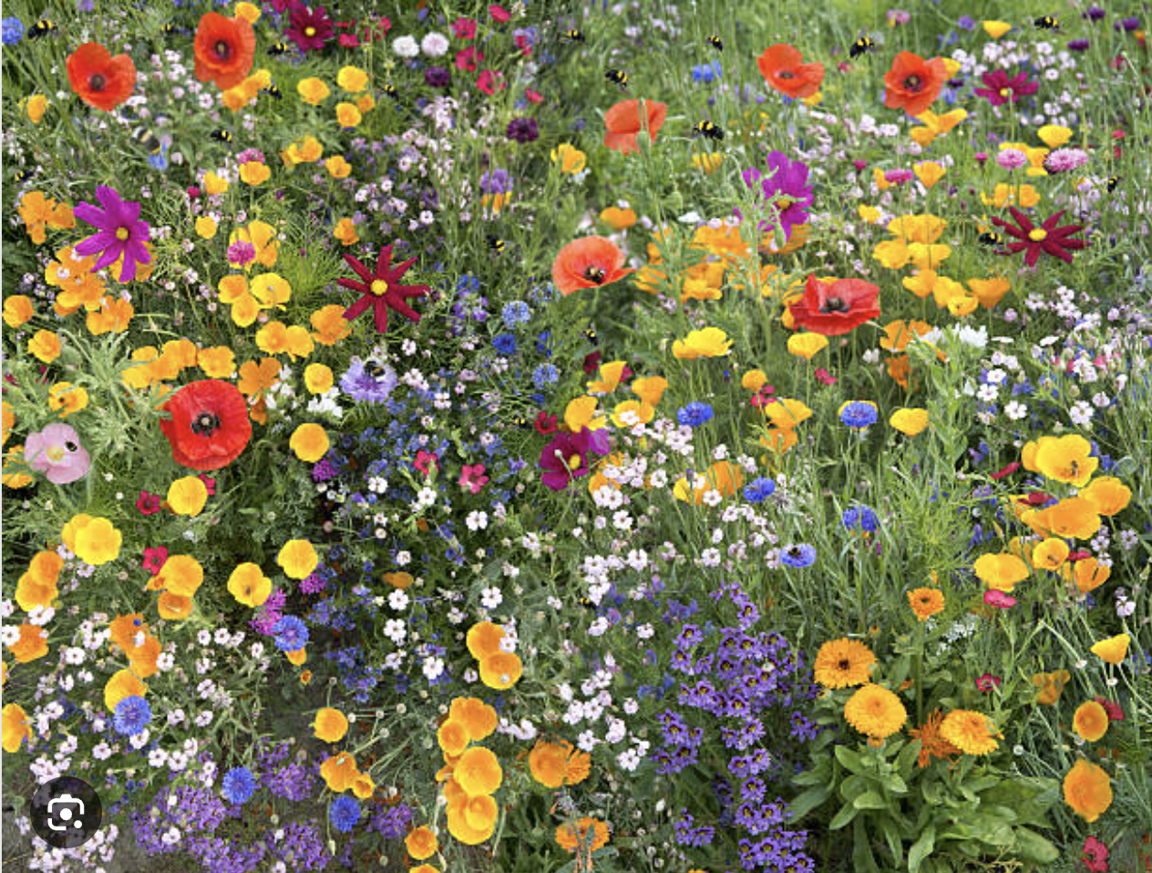
Clustering algorithms: k-means and DBSCAN
You go for a walk in the countryside and see a field full of many different wild flowers
You may not know what the flowers are, but you can probably identify which flowers are the same species as each other
This is called clustering: it is the task of grouping together similar instances and separating them from different instances

Slide 6
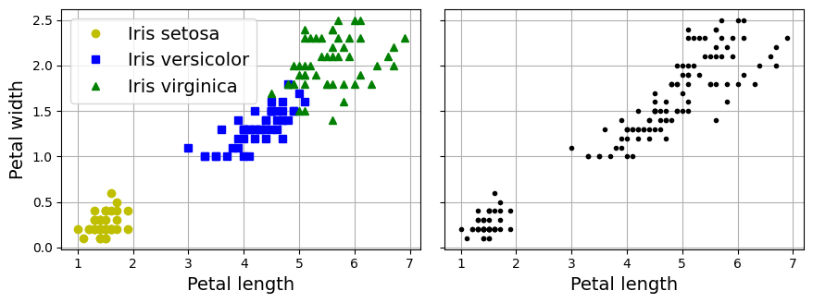
Classification vs. clustering
In clustering, as in classification, each instance get’s assigned to a group
However, clustering is unsupervised – the algorithm does not try to learn how to recognize classes by learning from labelled examples, instead it tries to find the best way of understanding the whole dataset as being built up from different types of instances
The plot above left shows the iris dataset, with the species of an instance indicated by its marker – a classification algorithm could use such a dataset to learn how to identify different types of iris
The plot above right is the same dataset without the species indicated – an unsupervised clustering algorithm will try to identify the best way of splitting this dataset up into classes (or clusters)
In this 2-d representation, it looks like there are only two easily detectable clusters, however a gaussian mixture model can successfully identify all three clusters using the sepal information as well

Slide 7
Some applications of clustering
Data analysis – clustering your data can give you insights into how it is structured
Dimensionality reduction – once you’ve clustered a dataset, you can represent each instance by a vector that gives its affinities to each of the resulting clusters – if the number of clusters is less than the original number of features, then you reduce the number of dimensions
  cf. similarity features, like the geographical similarity to urban centres in the Californian housing price dataset
  you can also just add the derived features – a form of feature engineering
Anomaly detection – any feature that has a low affinity to all clusters is unusual
Semi-supervised learning – if you only have a few labelled instances, then you can propagate their labels to the other members of the clusters of which they are members
Indexing databases for search engines – so that they return all the members of the cluster that is most similar to the query
Image segmentation – segment by colour by replacing all the colours in a cluster by the centroid of that cluster

Slide 8
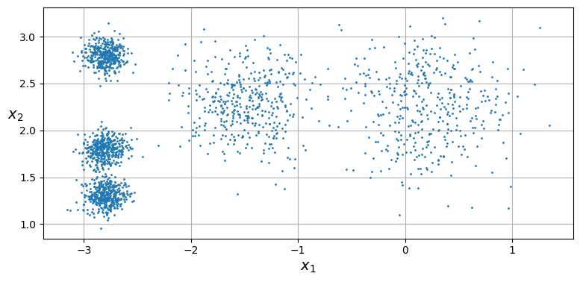
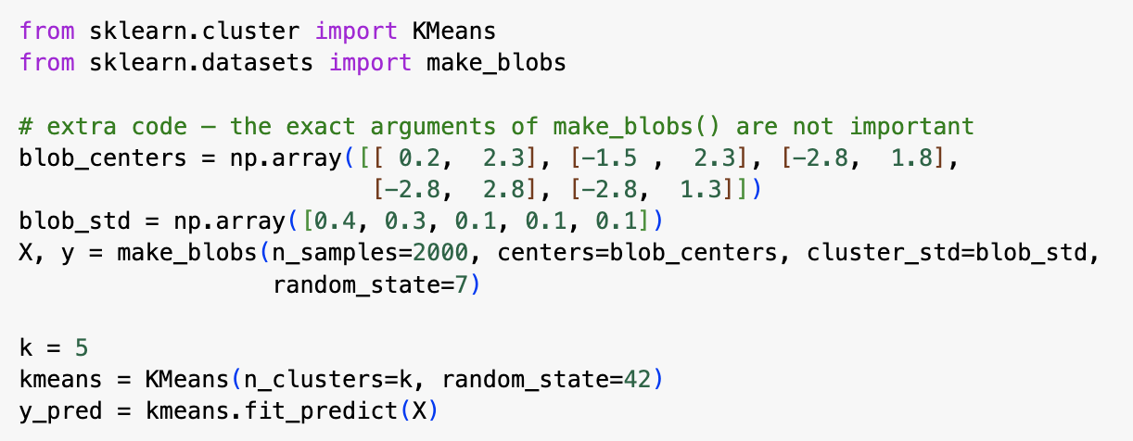
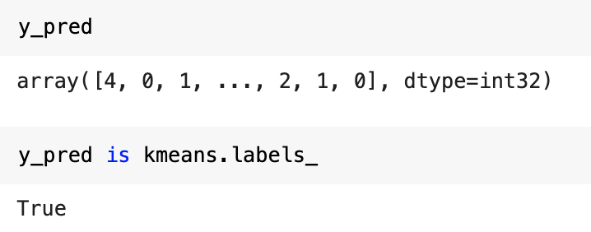
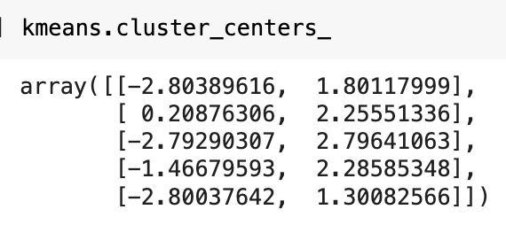
k-means
k-means is a simple clustering algorithm capable of clustering datasets like the one above in just a few iterations
The code above trains a k-means clusterer on the dataset above
Note that you have to specify a number of clusters – the value of k
Once you have fit a KMeans clusterer as above, the predicted cluster of every instance is stored in the labels_ property of the KMeans object
We can also see the cluster centers (centroids) that the k-means algorithm found (see left)

Slide 9
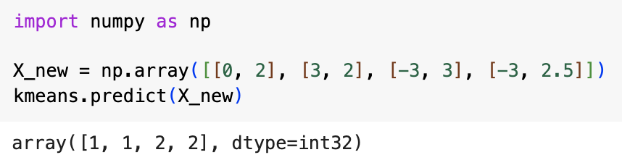
Predicting cluster membership with k-means
Suppose you have some new instances and you want to know which cluster they belong to – you can do this using the model’s predict() method (see above)

Slide 10
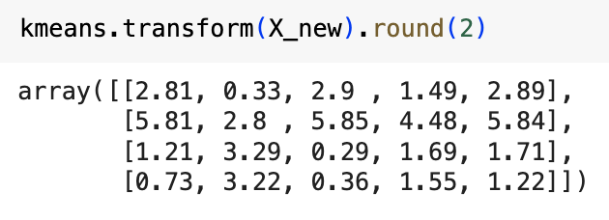
k-means decision boundaries
If you plot the decision boundaries of a k-means model, then you get a Voronoi tesselation (above left) with each centroid marked with an x
Assigning each instance to a single cluster is called hard clustering
Instead, you can assign a vector to each instance giving the distance of that instance from each centroid (above right) – this is called soft clustering
  You can do this using the transform() method
  If you transform the whole dataset in this way, then you end up with a k-dimensional dataset – this can be an efficient non-linear dimensionality reduction technique
  You can also add the extra centroid distance vectors to the original data and increase the number of features

Slide 11
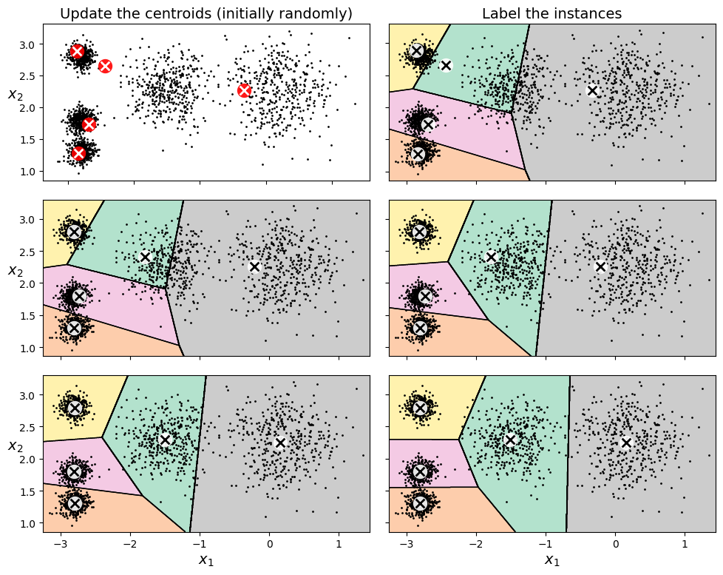
k-means algorithm
Figure on the left illustrates the process of training a k-means model
The process is as follows:
  Start by assigning k centroids at random
  Then label each instance with its nearest centroid
  Then move each centroid so that it is at the centroid of the instances that are labelled with it
  Repeat until the centroids stop moving
The algorithm is guaranteed to converge because the mean squared distances from the instances to their nearest centroids can only go down and cannot go negative
In example on left, after just three iterations, the clustering appears almost optimal!
k-means is typically one of the fastest clustering algorithms

Slide 12
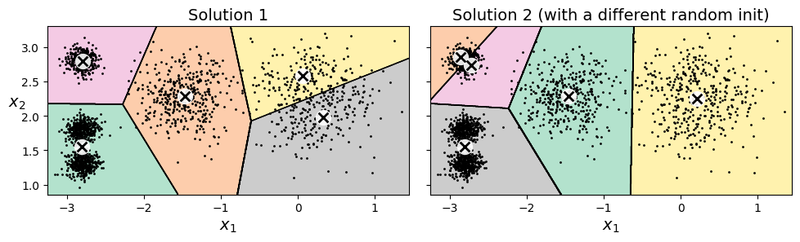
k-means algorithm – suboptimal solutions
The algorithm is guaranteed to converge, but not necessarily to the globally optimal solution
If you are unlucky with your initial choice of random centroids, the algorithm can converge to a local optimum (see above)

Slide 13
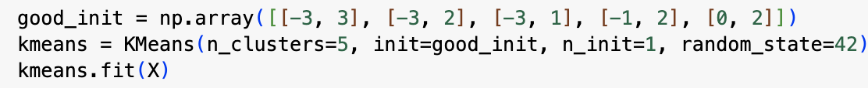
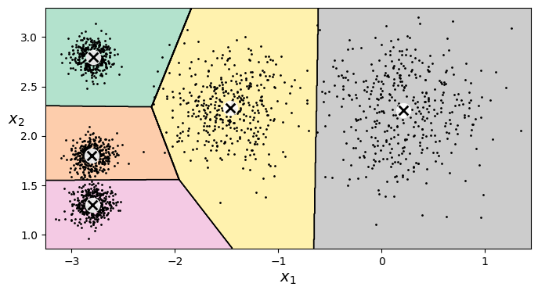
k-means – Centroid initialization methods
If you know roughly where you want the centroids to be, then you can specify the positions of the initial centroids as a parameter when constructing the KMeans object (see above)
  you should also set n_init=1 which ensures that only one run is made on the given set of initial centroids

Slide 14
Centroid initialization methods
inertia = 219.4 inertia = 258.6 inertia = 211.6
Another method is to run the algorithm multiple times with different random initializations and keep the best solution
n_init controls the number of random initializations to try (default is 10)
Measures success of a clustering by using a metric called inertia: this is the sum of the squared distances from the instances to their nearest centroids
  The inertia of a model is accessible through its inertia_ property after training
  Note that the model’s score() method returns the negative inertia because a greater value returned by a score() method must always be better in Scikit-Learn
The KMeans class actually uses a smarter initialization strategy, known as kmeans++ (Arthur and Vassilvitskii, 2006), that tends to select initial centroids that are well separated

Slide 15
Accelerated k-means
If your dataset is very large with many clusters, then the algorithm can often be accelerated by using Elkan’s (2003) algorithm that avoids many unnecessary distance calculations
Elkan’s algorithm exploits the triangle inequality and keeps track of lower and upper bounds for distances between instances and centroids
However, it does not always speed up training and may even slow it down in some cases
You can use Elkan’s algorithm by setting the KMeans parameter algorithm=“elkan”

Slide 16
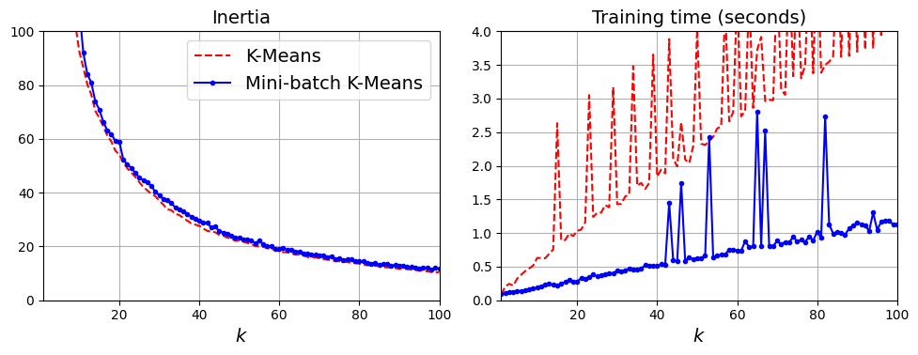
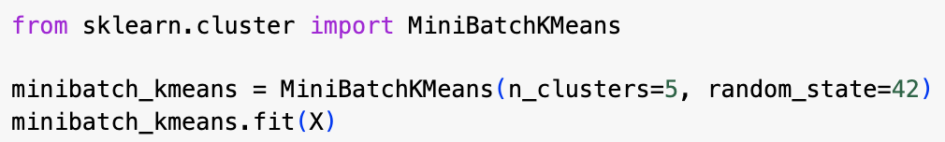
Mini-batch k-means
Another variant on the k-means algorithm was proposed in 2010 by David Sculley: instead of always using the full dataset, use mini-batches, moving the centroids just slightly at each iteration
This generally speeds up the algorithm and can be used to cluster huge datasets that do not fit into memory
You can use this technique in Scikit-Learn by using the MiniBatchKMeans class instead of the KMeans class
The inertia of a model produced using MiniBatchKMeans is generally slightly worse than that of a model produced using KMeans (see graph above left), however mini-batch k-means is faster by a factor of around 3-4

Slide 17
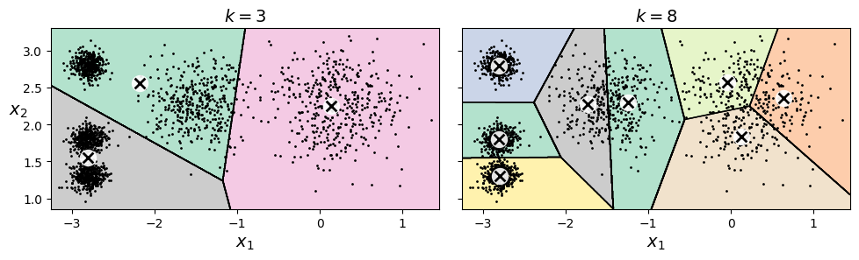
Finding the optimal number of clusters
inertia = 653.2 inertia = 119.1
What if it is not obvious from the data how many clusters we should aim for?
With our dataset, if we set k to 3 or 8, we get rather bad results (see above)
You cannot use inertia to select between models with different numbers of clusters – raising the number of clusters generally decreases inertia

Slide 18
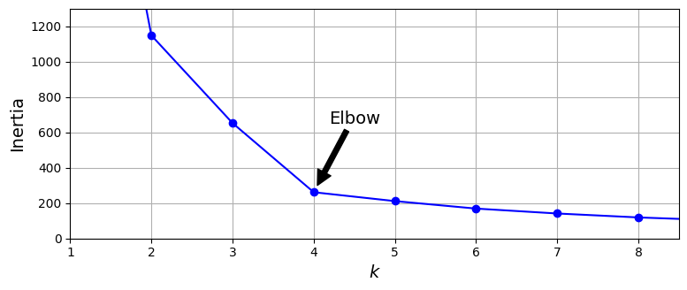
Finding the best number of clusters
If we plot inertia against number of clusters, we get a curve like the one above
Such a curve typically has an “elbow” in it – the inertia drops quickly down to a point (here k=4) and then flattens out (but continues to drop)
This would suggest that there is not much advantage in increasing k much beyond 4
However this is a rather coarse way of deciding on a value of k

Slide 19
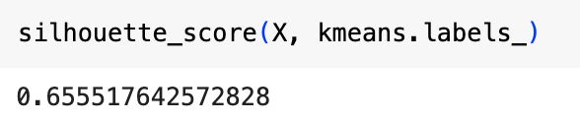
Finding k using silhouette score
A more precise (but computationally more expensive) way of finding a good value for k is to use the silhouette score, which is the mean value of the silhouette coefficient over all instances
The silhouette coefficient is equal to (b - a)/max(a,b) where
  a is the mean distance from the instance to the other instances in the same cluster
  b is the mean distance from the instance to the instances in the next closest cluster
Silhouette coefficient ranges from -1 to +1
  +1 means the instance is close to its fellow cluster members and distant from instances in other clusters (this is good!)
  0 means the instance is close to a cluster boundary (i.e., roughly equally distant from instances in its own cluster and those in the neighbouring cluster)
  -1 might indicate that the instance has been assigned to the wrong cluster
You can compute the silhouette score in Scikit-Learn using the silhouette_score() function

Slide 20
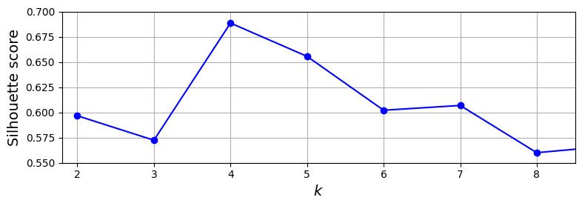
Silhouette score
Graph above compares silhouette scores for different values of k
Confirms that 4 and 5 are good choices for k, but that a higher value would not be optimal – this was not visible using inertia

Slide 21
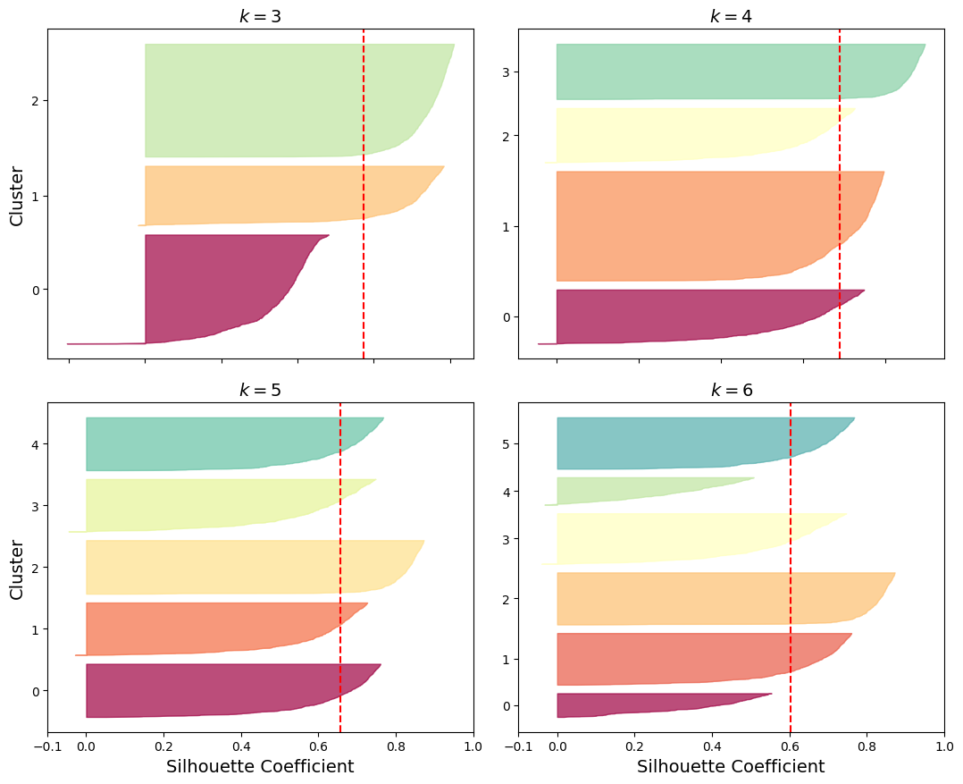
Silhouette diagrams
A more informative visualization is the silhouette diagram
For each cluster, the instances in the cluster are sorted by silhouette coefficient and these coefficients are plotted as a graph, with the area between the curve and the y-axis filled in to produce a “knife” shape
The height of a knife is the number of instances in that cluster, the right and lower edges of the knife form the sorted plot of silhouette coefficients over that cluster
The vertical red dashed lines indicate the mean silhouette score over the clusters
We want the “knives” to extend beyond the red dashed line – if they don’t, this means that many of the instances are too close to instances in other clusters
We also prefer for clusters to be of approximately equal size – which is where k=5 wins over k=4

Slide 22
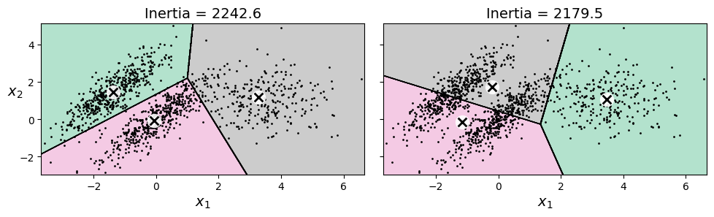
The limits of k-means
k-means is fast, but it has its shortcomings
First, you need to run it several times to avoid getting suboptimal solutions
Second, you need to specify the number of clusters before hand which can be a hassle
Third, k-means does not behave well if clusters have varying sizes, different densities, or non-spherical shapes
  See example above where dataset consists of three ellisoidal clusters of different dimensions, densities and orientations
  It is usally a good idea to scale the input features when using k-means – this can help to make the clusters more spherical

Slide 23
Using clustering for image segmentation
Image segmentation is the task of partitioning an image into multiple segments
There are several variants:
  Colour segmentation: pixels with the same (or similar) colour get assigned to the same segment
    e.g., separating forest from urban areas in a satellite image
  Semantic segmentation: pixels that are part of the same object type get assigned to the same segment
    e.g., in a self-driving vehicle system, all pixels that are part of a pedestrian get assigned to the “pedestrian” segment
  Instance segmentation: pixels that are part of the same individual object get assigned to the same segment
    e.g., different segment for each pedestrian

Slide 24
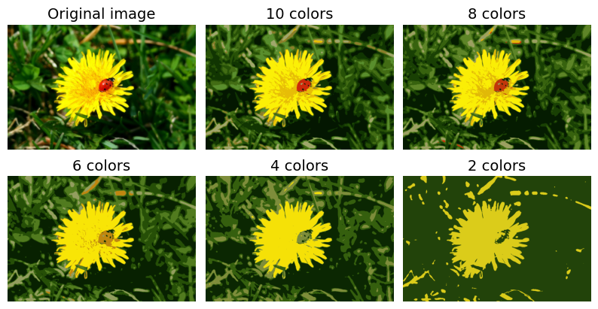
Image segmentation with k-means
CNNs are used in the current state-of-the-art systems for instance or semantic segmentation
Here we’re going to use a much simpler model based on k-means
In the images above, each colour is a cluster – the ladybug is separated into its own cluster when there are 8 or more clusters, but not when there are 6 or fewer

Slide 25
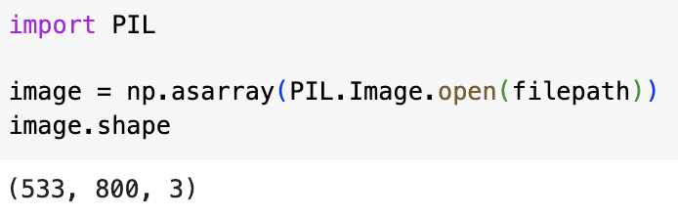
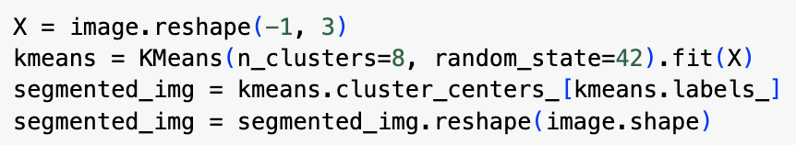
Image segmentation with k-means
We first import the Pillow package and load the ladybug.png image
The image is represented as a 3d array where first dimension size is height, second is width and the third is the length of an RGB vector
We then reshape this array to get a long list of RGB colours, then cluster these colours using k-means using 8 clusters
Then creates a segmented_img array in which each pixel is replaced with the centroid of its cluster
This is then reshaped to give the same shape as the original image
Third row in code above uses advance NumPy indexing

Slide 26
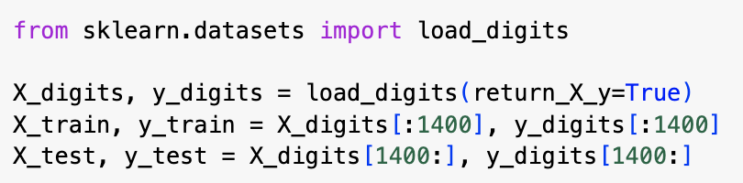
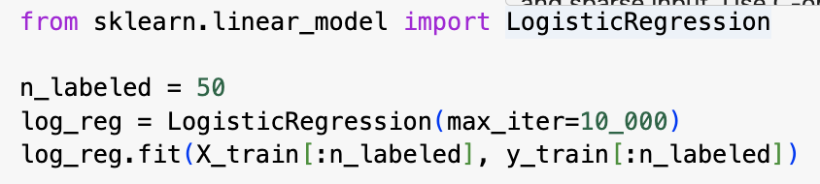
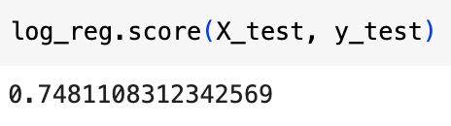
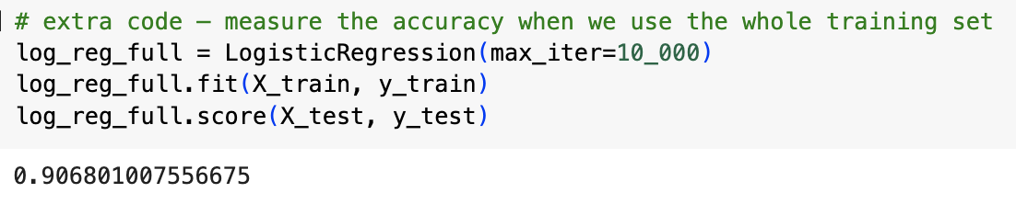
Using clustering for semi-supervised learning
Suppose we have a dataset that contains just a few labelled instances and lots of unlabelled ones
We’ll use the digits dataset as an example: 1797 8x8 grayscale images of handwritten digits
The code on the left first loads and splits this dataset
We pretend we only have 50 labelled instances
To get a baseline performance, we train a logistic regression classifier on these 50 labelled instances – we get only 75% accuracy!
If we train on the whole dataset, we get over 90%

Slide 27
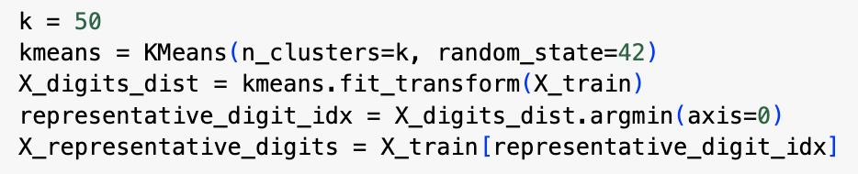
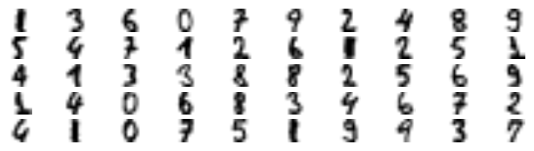
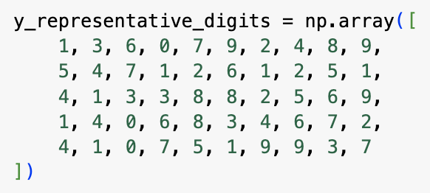
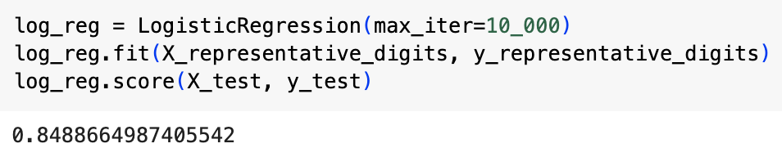
Using clustering for semi-supervised learning
Now we cluster the dataset into 50 clusters using k-means and then we select the image that is closest to the centroid in each cluster – we call these images representative images (see on left)
We then manually label the 50 representative images
Now we have a dataset of 50 labelled instances, but instead of being randomly selected instances, these are all close to the centroids of their clusters
We train a logistic regression classifier again, this time on the representative images and we now get nearly 85% accuracy, even though we’re still only training on 50 images

Slide 28
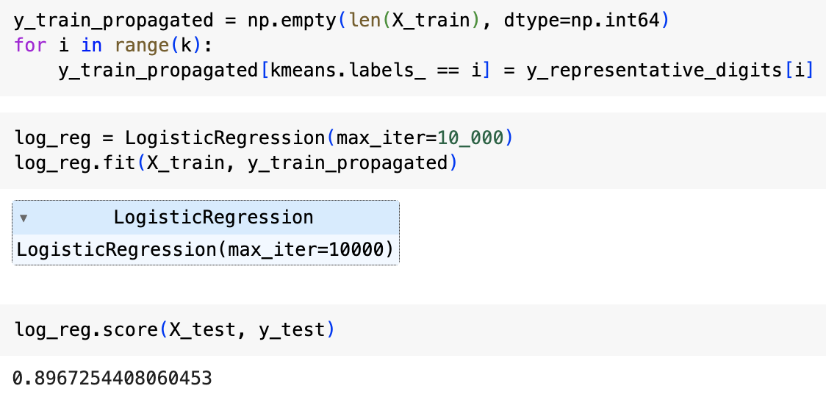
Label propagation
What if we propagate each label to the other instances in its cluster?
  This is called label propagation
Now when we train the model again, we get even better performance!

Slide 29
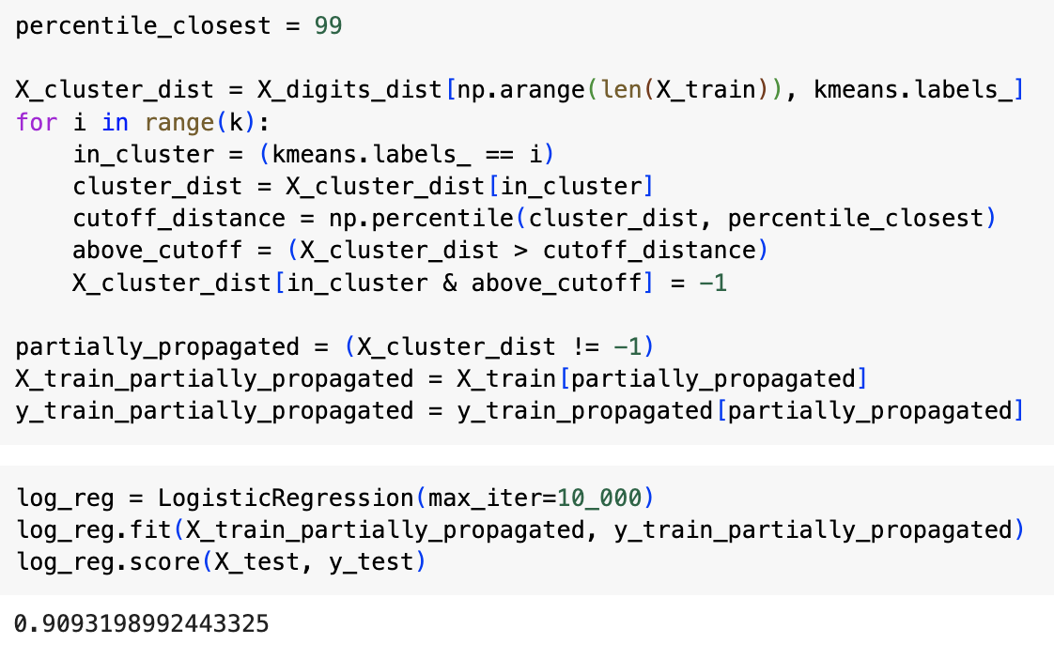
Eliminating outliers
We try to go a step further by eliminating the 1% of the instances that are furthest from their centroids
This gives us another boost – up to nearly 91% accuracy, with just 50 training instances
This is partly due to us dropping outliers and partly due to the propagated labels being very accurate – about 97.5% of the propagated labels are correct

