Slide 1
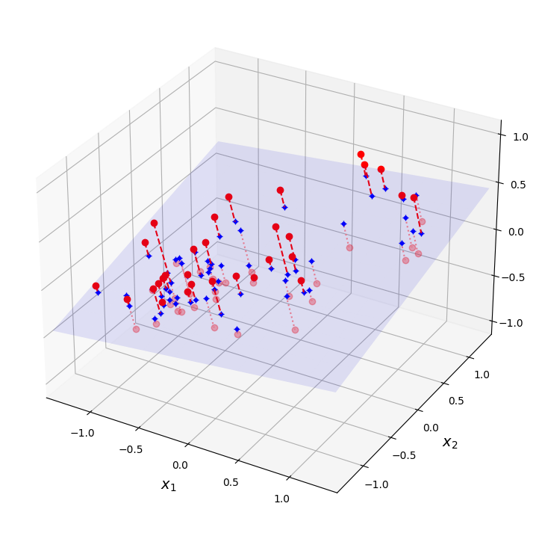
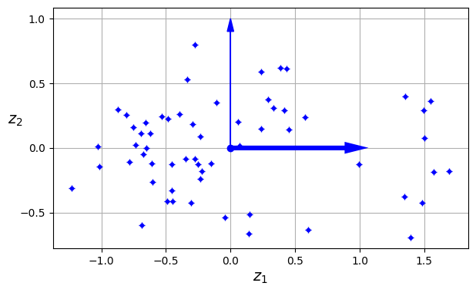
Dimensionality Reduction
David Meredith
dave@create.aau.dk
Aalborg University

Slide 2
Sources for this lecture
Chapter 8 of
Géron, A. (2023). Hands-On Machine Learning with Scikit-Learn, Keras & TensorFlow. (Third edition). O’Reilly. Available at
https://www.amazon.de/-/en/Aur%C3%A9lien-G%C3%A9ron/dp/1098125975/
https://www.saxo.com/dk/hands-on-machine-learning-with-scikit-learn-keras-and-tensorflow_bog_9781098125974
https://factumbooks.dk/?search_string=hands-on+machine+learning+with+scikit-learn
Jupyter Notebook for this lecture:
https://github.com/ageron/handson-ml3/blob/main/08_dimensionality_reduction.ipynb

Slide 3
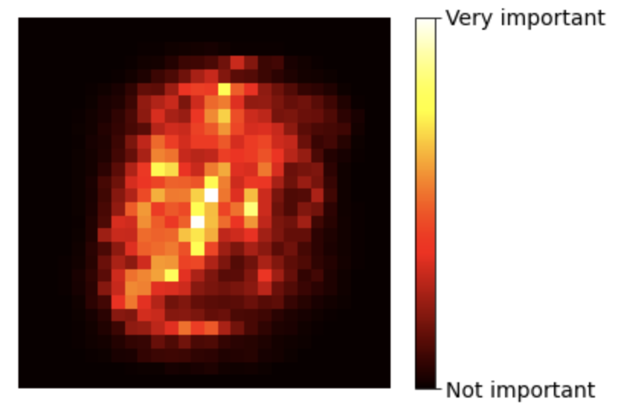
Dimensionality reduction
Many ML problems involve datasets where each instance has thousands or even millions of features
Having so many features not only makes training much slower but also makes it harder to find a good solution – this is called the curse of dimensionality
Fortunately, it is often possible to reduce the number of features considerably in a real-world problems
For example, in the MNIST dataset, pixels on the image borders are typically all white, so they can be dropped without losing any information – as confirmed by the image on the left which visualizes feature importances
Neighbouring pixels are also often correlated, so you can merge them into a single pixel with the mean intensity without losing too much information

Slide 4
Dimensionality reduction
Dimensionality reduction causes information to be lost
So it will speed up training, but it may also reduce performance if important information is lost in the data
It also makes your pipelines more complex
So you should usually start out by training your system on the original data
Sometimes dimensionality reduction gets rid of some noise, which actually improves performance, but this is relatively uncommon

Slide 5
Dimensionality reduction
Dimensionality reduction is also useful for visualization
You can often project your data into a 2- or 3-dimensional representation that reveals interesting insights, such as clusters
This can make it easier to communicate conclusions to non-specialists
In this lecture we will
discuss the curse of dimensionality
consider the two main approaches to dimensionality reduction: projection and manifold learning
go through three popular DR techniques: PCA, random projection and locally linear embedding (LLE)

Slide 6
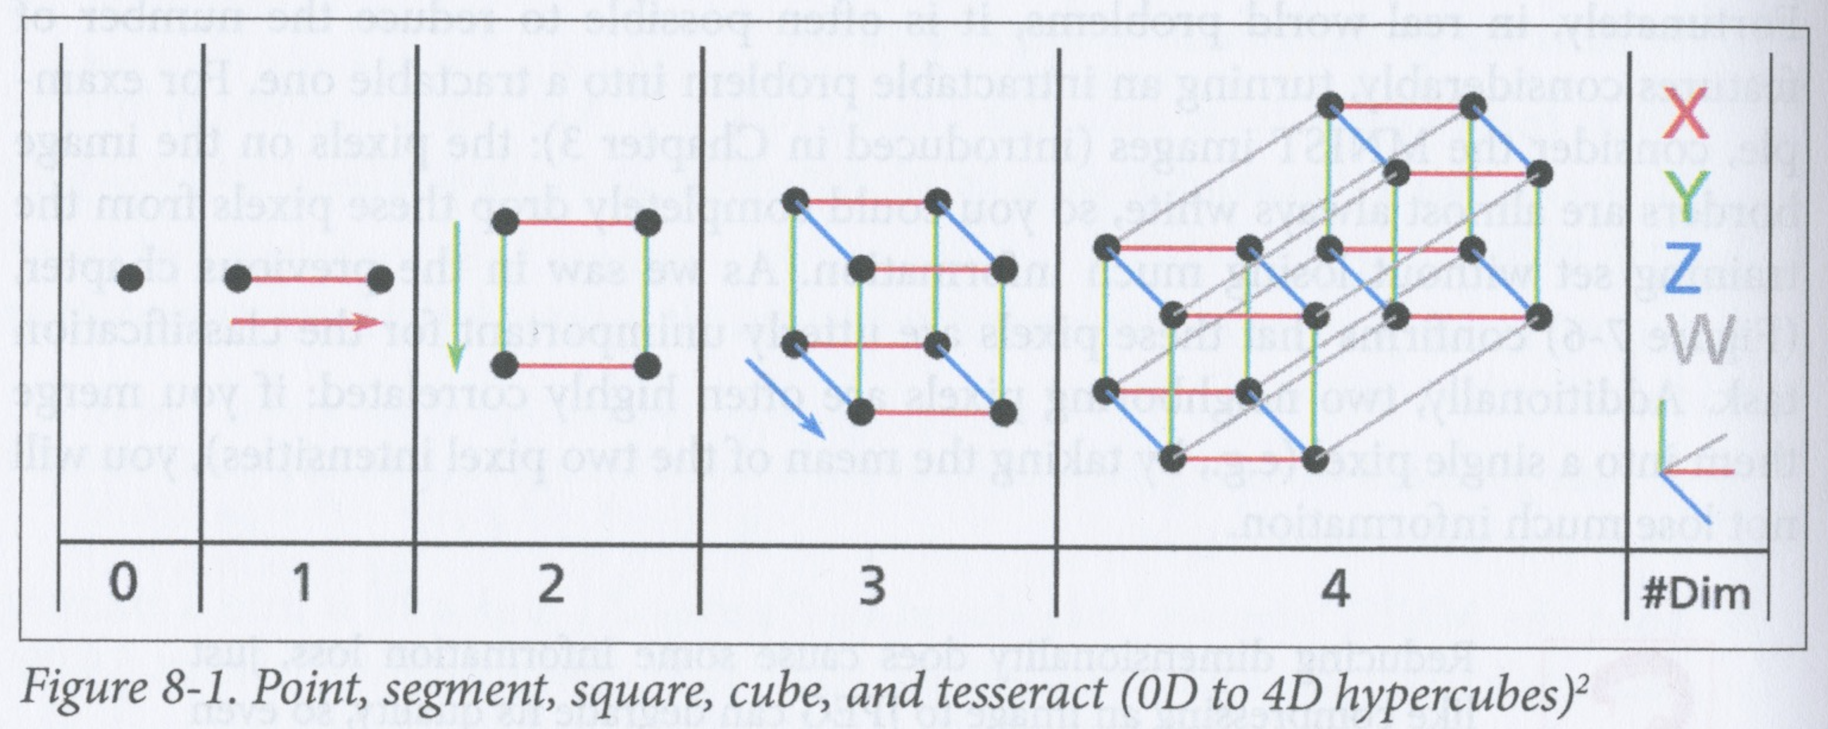
The curse of dimensionality
Most people have trouble intuiting relationships in a space with more than 3 dimensions
Things behave differently in higher-dimensional spaces
For example, if you pick a random point in a unit square, there will be 0.4% chance of it being within 0.001 from an edge
However, for a randomly selected point in a 10000-dimensional hypercube, this probability is 99.999999% - nearly all points in a 10000-dimensional cube are very close to a face

Slide 7
The curse of dimensionality
The average distance between two points in a unit square is about 0.52
The average distance between two points in a unit cube is about 0.66
In a 1-million-dimension unit hypercube, the average distance between two points is 408.25!
So high-dimensional datasets tend to be sparse – the points tend to be a relatively long way apart in the feature space
This means that a new instance is likely to be a long way away from any training instance, which makes predictions less reliable because they are based on instances that are less similar to the new instances
In general, the greater the dimensionality of the training set, the more chance there is of overfitting

Slide 8
The curse of dimensionality
In theory, you could address the curse of dimensionality by increasing the size of the training set until there is a sufficient density of training instances
Unfortunately, the number of instances required to meet a certain density increases exponentially with the number of dimensional
For example, with 100 features (i.e., significantly fewer than in MNIST), all with values between 0 and 1, you would need more training instances than atoms in the universe to bring the average distance between instances down to 0.1
So increasing the size of the training set is typically not enough

Slide 9
Main approaches for dimensionality reduction - Projection
In most real-world problems, training instances are not spread out uniformly across all the dimensions – some features will be almost constant while others are highly correlated
Consequently, the training instances typically lie close to a much lower-dimensional subspace of the original high-dimensional feature space

Slide 10
Projection
Upper plot shows a 3-dimensional dataset represented by small spheres
All the spheres like close to a plane (in lilac)
This plane is a lower-dimensional subspace of the 3-dimensional feature space
If we project each training instance perpendicularly onto this plane, then we get the lower, 2-dimensional plot
Note that the neither of the dimensions in the 2D plot are the same as any of the dimensions in the 3D plot
By projecting to the lilac plane, we have replaced the original 3 features, x₁, x₁, x₃, with two new ones, z₁ and z₂

Slide 11
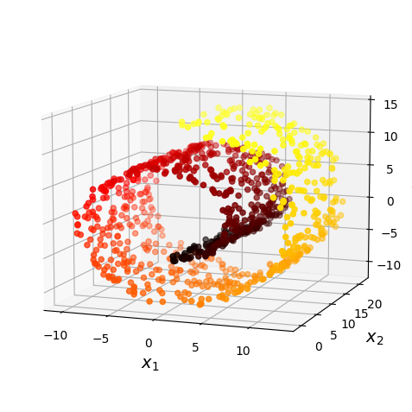
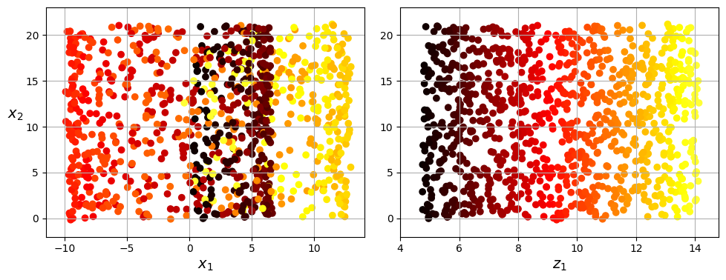
Manifold learning
Projection is not always sufficient, particularly if the subspace twists and turns, like in the Swiss Roll dataset (above left)
If you just project this dataset onto the x1—x2 plane, then you get the plot in the middle, which is not what we want
What we want is to “unroll” the Swiss Roll to give a plot like the one above right

Slide 12
Manifold learning
This dataset is an example of a 2D manifold
A manifold is a shape that can be bent and twisted in a higher-dimensional space
A d-dimensional manifold is part of an n-dimensional space (d < n) that locally resembles a d-dimensional hyperplane
The Swiss roll locally (i.e., at any small region on its surface) resembles a 2D plane, but it is rolled up in a 3D space

Slide 13
Manifold learning
Manifold learning is where we aim to model the manifold on which the training instances lie
It depends on assuming the manifold hypothesis, which is that most real-world high-dimensional datasets lie close to a much lower-dimensional manifold – this is, in fact, often observed empirically
For example, in MNIST, each image is a point in a 784 dimensional space
But in practice only a very tiny proportion of the points in this space actually could be representations of digits – this dataset probably therefore lies close to a lower-dimensional dataset within this space

Slide 14
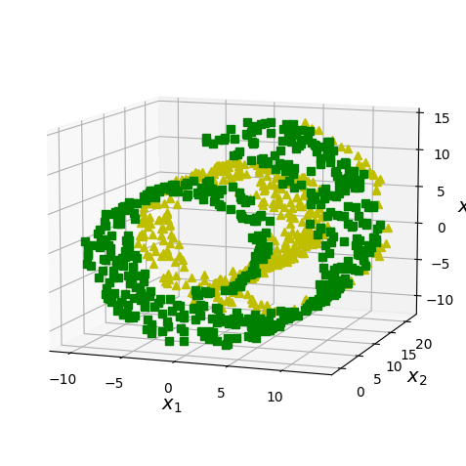
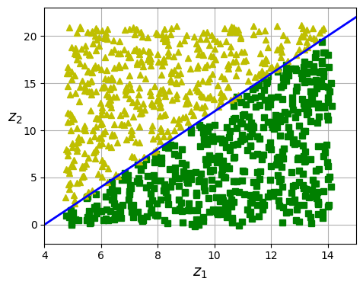
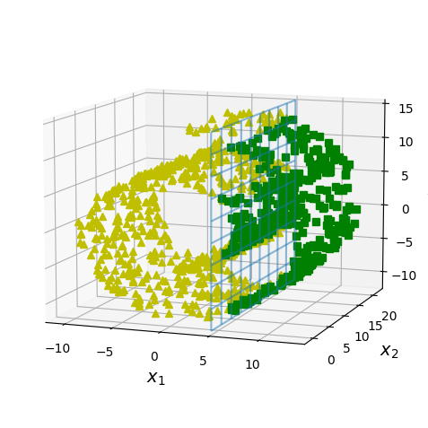
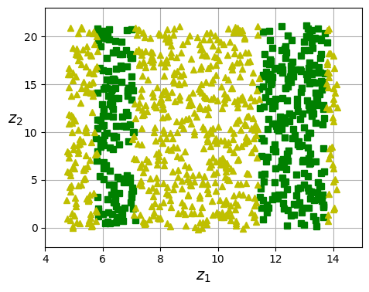
Manifold learning
Manifold assumption is often accompanied by another assumption: that the task at hand will be simpler to solve if expressed in the lower-dimensional manifold
For example, if we unroll the manifold at the top left to get the 2D space at the top right, we get a nice straight decision boundary

Slide 15
Manifold learning
However, the decision boundary in the bottom left space is a simple plane
Whereas, when this manifold is unrolled, the decision boundary becomes more complex
So reducing the dimensionality of your dataset may speed up training, but it won’t necessarily lead to a simpler or better model

Slide 16
Principal component analysis (PCA)
Principal component analysis (PCA) is the most popular dimensionality reduction technique
PCA identifies the lower-dimensional hyperplane that lies closest to the data and then it projects the data onto this hyperplane

Slide 17
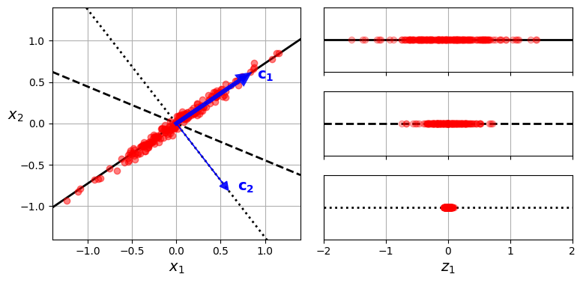
PCA: Preserving the variance
Before you can project your dataset onto a lower-dimensional hyperplane, you need to choose the right hyperplane
The left-hand plot above shows a 2D dataset that we want to reduce to a 1D representation
We could project onto any number of different lines, e.g., the three shown
If we project onto the dotted line, then all the points end up being very close together – we have failed to preserve the variance in the original data
If we project into the solid line, then we maximise the preservation of variance in the original dataset, while also reducing the total number of dimensions

Slide 18
PCA: Preserving the variance
In general, in PCA, we project our high-dimensional dataset onto a lower-dimensional subspace in such a way as to preserve as much of the variance in the original data
In other words, we choose a subspace the preserves as much of the information in the original data as possible
This is the subspace the results in the least mean squared error between the points in the original dataset and the points in the projection

Slide 19
Principal components
In the example above, PCA identifies first the axis that preserves the largest amount of variance
It also finds a second axis that is orthogonal to the first the accounts for the largest amount of remaining variance
In this case, it is the dotted line
If the original data were 3D, then PCA would also then find a 3rd axis, orthogonal to the two already identified that would account for the remaining variance
The ith axis discovered by PCA is called the ith principal component (PC) of the data
In the example above, the first PC is the solid line on which vector c₁ lies and the second is the dotted line on which c₂ lies

Slide 20
Principal components
In the example above, the first two components are the axis that define the surface in which the lilac plane lies
The third axis is orthogonal to this plane
If we want to reduce the representation to two dimensions, then we use the first two PCs
If wanted to reduce to only 1D, we would just use the first PC

Slide 21
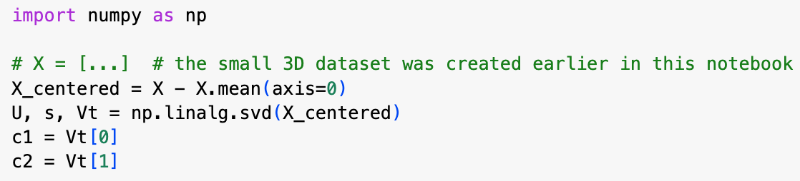
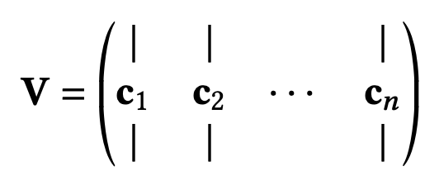
How do you find the PCs of a training set?
There is a standard matrix factorization technique called singular value decomposition (SVD) that decomposes the training set matrix X into the matrix multiplication of three matrices: U𝚺V^{T}
The resulting matrix, V contains the unit vectors that define all the principal components, in order
Python code above uses NumPy’s svd() function to get the PCs of the 3d training set on the left and then extracts the two first PCs

Slide 22
Assumption of centering around origin
PCA assumes that the dataset is centred around the origin
i.e., the origin is at the centroid of the data
Scikit-Learn’s PCA classes take care of this centering for you
But if you implement PCA yourself (e.g., in code above), you must remember to center the data first

Slide 23
Projecting down to d dimensions
Once you’ve found the PCs, you can reduce the dimensionality down to d dimensions by projecting the data onto the hyperplane defined by the first d PCs
Selecting the first d PCs ensures that you preserve as much of the variance as possible in the original data
For example, by choosing the first two PCs in the data on the left, we’ve preserved a lot of the variance in the original data

Slide 24
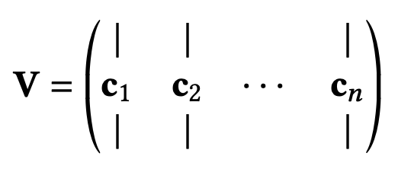
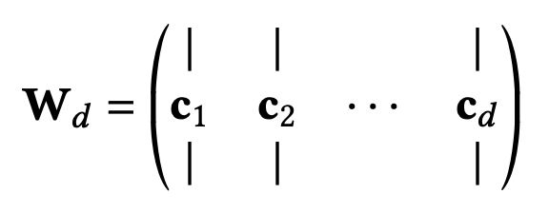


Projecting down to d dimensions
Mathematically, to obtain the reduced, d-dimensional dataset, we matrix multiply the original dataset, X, by a matrix containing the unit vectors for the first d principal components given in the matrix V found using SVD - this matrix of unit vectors is denoted W_{d}
Code above shows how to do this in Python

Slide 25
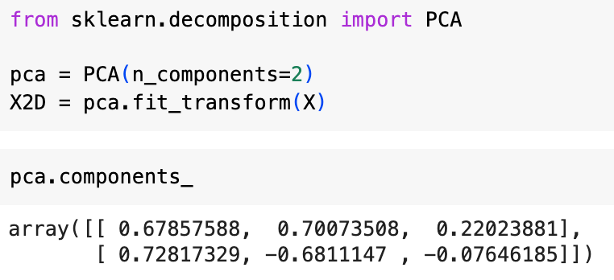
PCA with Scikit-Learn
We can use Scikit-Learn’s PCA class to carry out PCA on our datasets
The PCA class uses SVD, just as we have done
Code above reduces the dimensionality of a dataset to 2 dimensions and automatically takes care of centering
After fitting the PCA transformer to the dataset, the components_ attribute contains the transpose of W_{d}

Slide 26
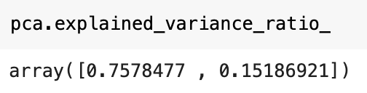
Explained variance ratio
After fitting, the PCA class also contains a variable called explained_variance_ratio_ which gives the proportion of the total variance in the original dataset that is explained by each principal component, in order
For example, the code above shows that in the 3d dataset on the left, the first PC explains 75.78% of the variance and the second explains 15.19% of the variance, leaving only about 9% of the variance to be explained by the discarded third dimension

Slide 27
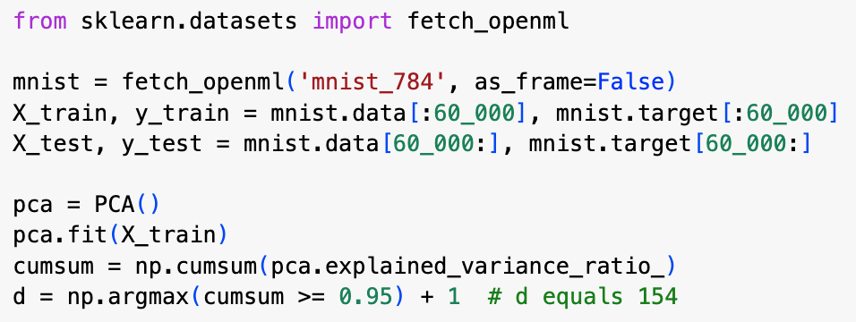
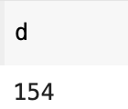
Choosing the right number of dimensions
If you are reducing dimensionality in order to speed up training, then you can choose the least number of dimensions that preserves a sufficiently large proportion of the variance in the original data (e.g., 95%)
If you are reducing dimensionality in order to visualize the data, then you probably want to reduce to 2 or 3 dimensions
Code on the left loads and splits the MNIST data, then performs PCA, then computes the minimum number of dimensions that preserve 95% of the training set’s variance
You can then set n_components to the value of d found and run PCA again

Slide 28
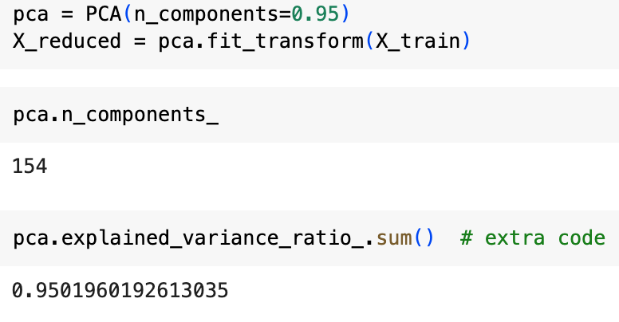
Choosing the right number of dimensions
However, you can also just set n_components to a float between 0 and 1 indicating the ratio of the variance you want to preserve

Slide 29
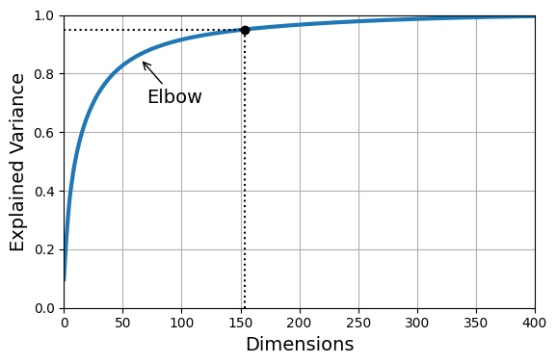
Plotting explained variance against PC dimensions
You can also plot the cumulative sum of the explained variance against the number of dimensions
This typically gives a graph like the one on the left, which has an elbow where the explained variance stops growing so fast
You can see that with the MNIST data, we can probably get away with reducing the number of dimensions to between 100 and 150

Slide 30
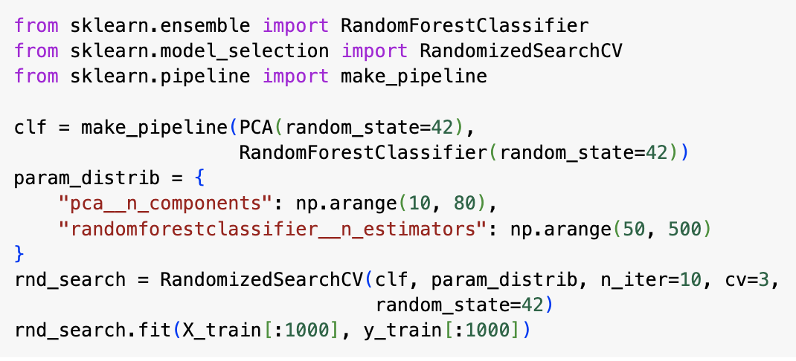
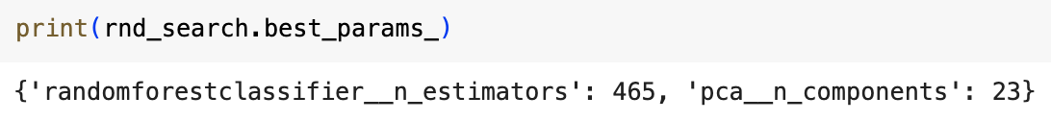
Using RandomizedSearchCV to find number of dimensions
In example on left, we use PCA to reduce the number of dimensions, then apply a random forest classifier
We use a RandomizedSearchCV to find a good combination of the following two parameters:
pca__n_components: the number of PCA dimensions to retain
randomforestclassifier__n_estimators: the number of trees in the random forest
It trains on just 1000 instances and runs for just 10 iterations
It finds that if we use a random forest with 465 trees, we only need a 23-dimensional representation (as opposed to the original 784-dimensional data)
If we were to use a simpler type of model, we’d need more dimensions
e.g., for SGDClassifier, we’d need to retain 70 dimensions

Slide 31
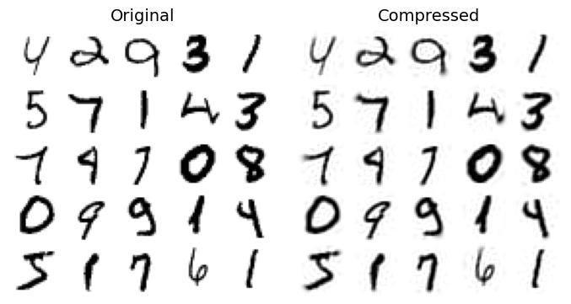
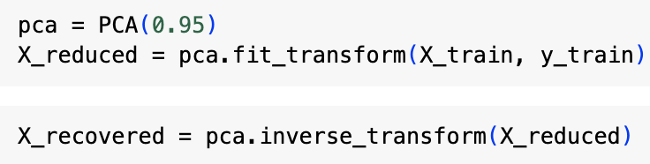

PCA for compression
If we apply PCA to the MNIST data and retain the first 154 PCA components, we retain 95% of the variance (i.e., information) in the original data, but reduce the size of the data to ca. 20% of its original size
The 154 principal components give us a compressed encoding of the data, that we can decompress by applying the inverse of the PCA projection (see code above)
This gives us something close to the original data – the mean squared distance between this decompressed dataset and the original dataset is called the reconstruction error
Image above right shows difference between original data and reconstructed data for MNIST data

Slide 32
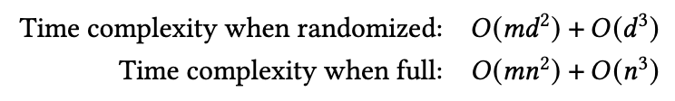
Randomized PCA
The PCA class has a svd_solver hyperparameter that can be set to “randomized”
If this is the case, then Scikit-Learn uses a stochastic algorithm called randomized PCA to quickly find an approximation of the first d components
Expressions above show time complexities when PCA is randomized or full – randomized is much faster when d (number of dimensions) is much less than n (number of features)

Slide 33
Randomized PCA
svd_solver set to “auto” by default – with this setting PCA is randomized if max(m,n) > 500 and n_components is less than 80% of min(m,n)
otherwise it is full
So code above would use randomized even if the svd_solver were omitted - why?

Slide 34
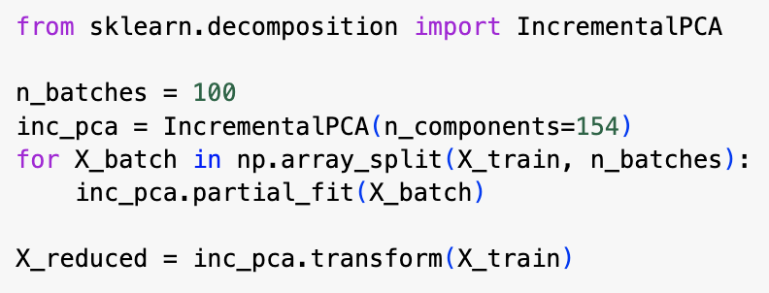
Incremental PCA
The PCA implementations we’ve looked at so far require whole training dataset to be loaded into memory at once
If your dataset is very big, this might not be possible
In this case we can use incremental PCA (IPCA) that let you split the data into mini-batches that are fed in one at a time
Code on the left splits the MNIST data into 100 mini-batches and feeds them to Scikit-Learn’s IncrementalPCA class– this reduces dimensionality to 154, as before
Note that you need to call the partial_fit() method with each mini-batch rather than the fit() method with the whole training set

Slide 35
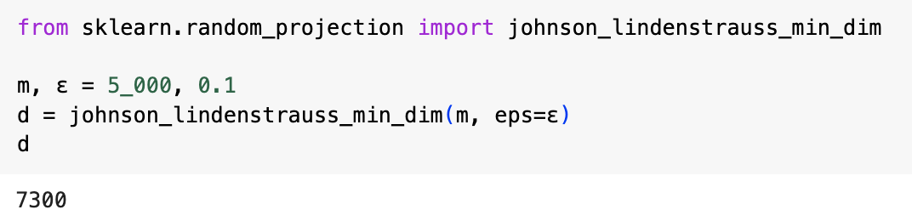
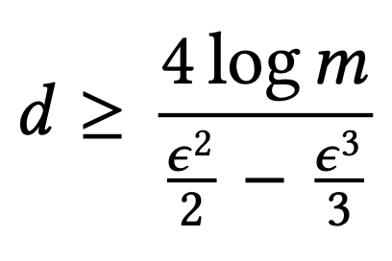
Random projection
In random projection, we project the data to a lower-dimensional subspace using a random linear projection
This sounds crazy, but Johnson and Lindenstrauss proved that doing so is very likely to preserve distances fairly well
J&L also provided an equation for calculating the minimum number of dimensions you are likely to need in order that the squared distances in the transformed data differ from those in the original set by no more than some tolerance, 𝜀 (equation is given on left)
Code above uses J&L’s equation to calculate minimum number of dimensions required to keep 𝜀 below 10% when m is 5000 and n is 20000

Slide 36
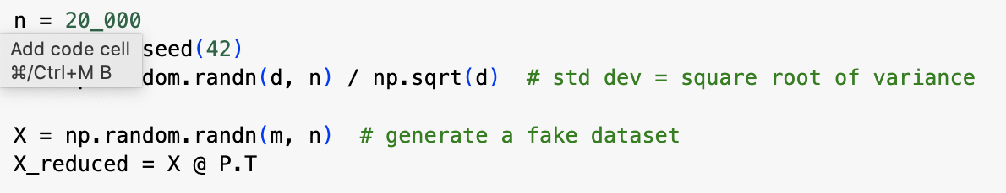
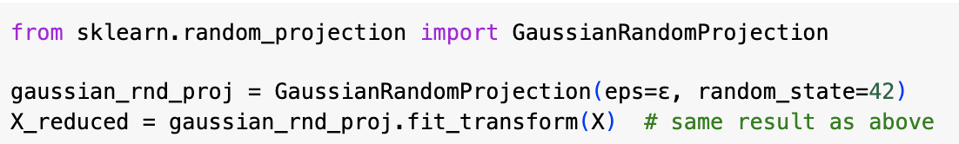
Random projection
We can then just generate a random, d x n matrix, P, and multiply the dataset X by the transpose of P to get the random projection (see code above)
Alternatively, we can use Scikit-Learn’s GaussianRandomProjection class to do exactly the same (see below)

Slide 37
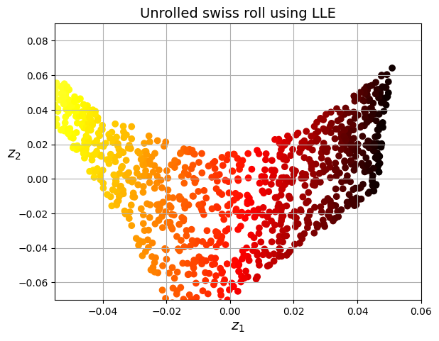
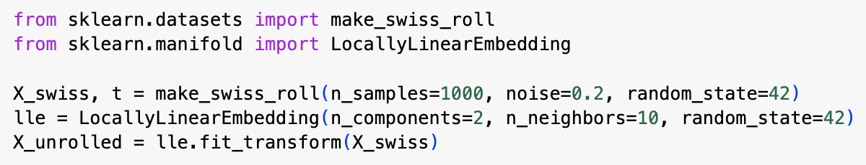
Locally linear embedding (LLE)
Locally linear embedding (LLE) is a manifold learning technique that does not rely on projections at all
LLE first measures how each training instance linearly relates to its nearest neighbours, then looks for a low-dimensional representation of the dataset where these local relationships are preserved
LLE is particularly good ad untwisting and unrolling twisted and rolled-up manifolds, especially when there is not too much noise
The code above creates a Swiss roll dataset and then uses Scikit-Learn’s LocallyLinearEmbedding class to unroll it
Image above right shows the resulting unrolled Swiss roll

