Slide 1
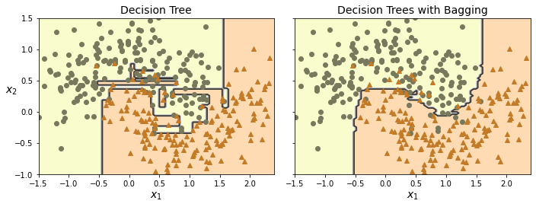
Ensemble Learning and Random Forests
David Meredith
dave@create.aau.dk
Aalborg University

Slide 2
Sources for this lecture
Chapter 7 of
Géron, A. (2023). Hands-On Machine Learning with Scikit-Learn, Keras & TensorFlow. (Third edition). O’Reilly. Available at
https://www.amazon.de/-/en/Aur%C3%A9lien-G%C3%A9ron/dp/1098125975/
https://www.saxo.com/dk/hands-on-machine-learning-with-scikit-learn-keras-and-tensorflow_bog_9781098125974
https://factumbooks.dk/?search_string=hands-on+machine+learning+with+scikit-learn
Jupyter Notebook for this lecture:
https://github.com/ageron/handson-ml3/blob/main/07_ensemble_learning_and_random_forests.ipynb

Slide 3
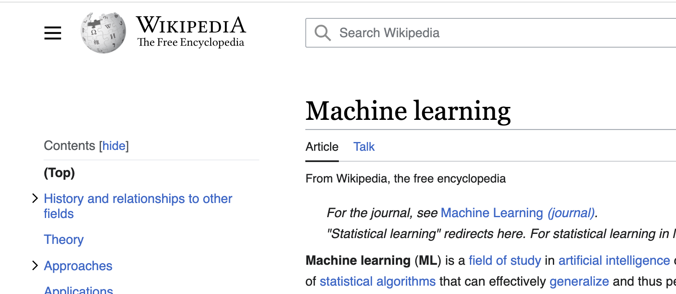

Ensemble learning - the wisdom of the crowd
vs.
If you pose a complex question to a thousand randomly selected people, then aggregate the answer, you’ll often get a better answer than if you ask a single expert – this is called the wisdom of the crowd
Similarly, if you aggregate the predictions of a group of machine learning predictors (classifiers or regressors), you will often get better predictions than if you rely on the prediction of the single best model
A group of predictors is called an ensemble
The technique of using such an ensemble of models is therefore called ensemble learning
An ensemble learning algorithm is called an ensemble method

Slide 4

Random forests
For example, you can train a group of decision tree classifiers, each on a different random subset of a training set
Then you predict the class that gets the most “votes” from the classifiers in the group
Such an ensemble of decision trees is called a random forest
A random forest is a very simple idea, but it is one of the most powerful machine learning algorithms available today
You typically start experimenting with ensemble methods after you have identified some good predictors
The best solutions to very complex problems often involve several ensemble methods working together
see, for example, the Netflix Prize competition (https://en.wikipedia.org/wiki/Netflix_Prize)
In this lecture, we’ll cover the most popular ensemble methods: voting classifiers, bagging and pasting ensembles, random forests, boosting and stacking ensembles

Slide 5
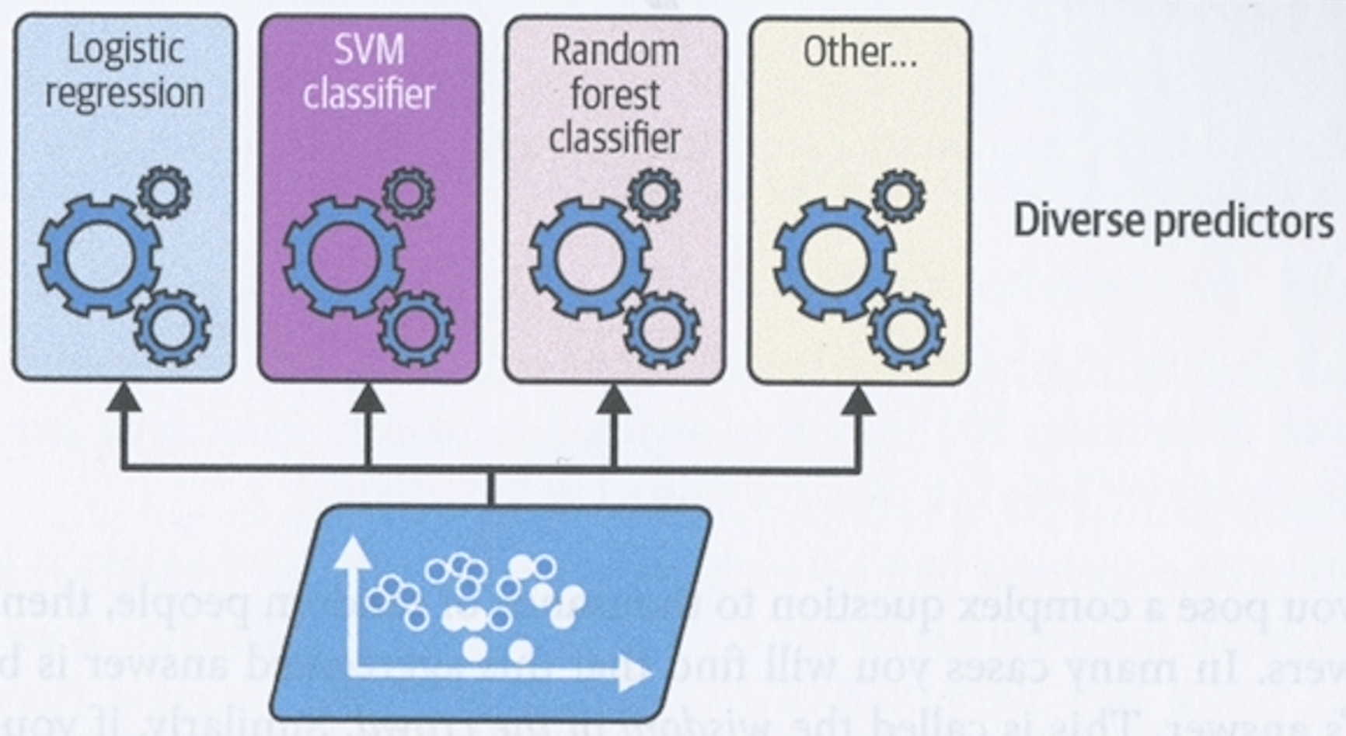
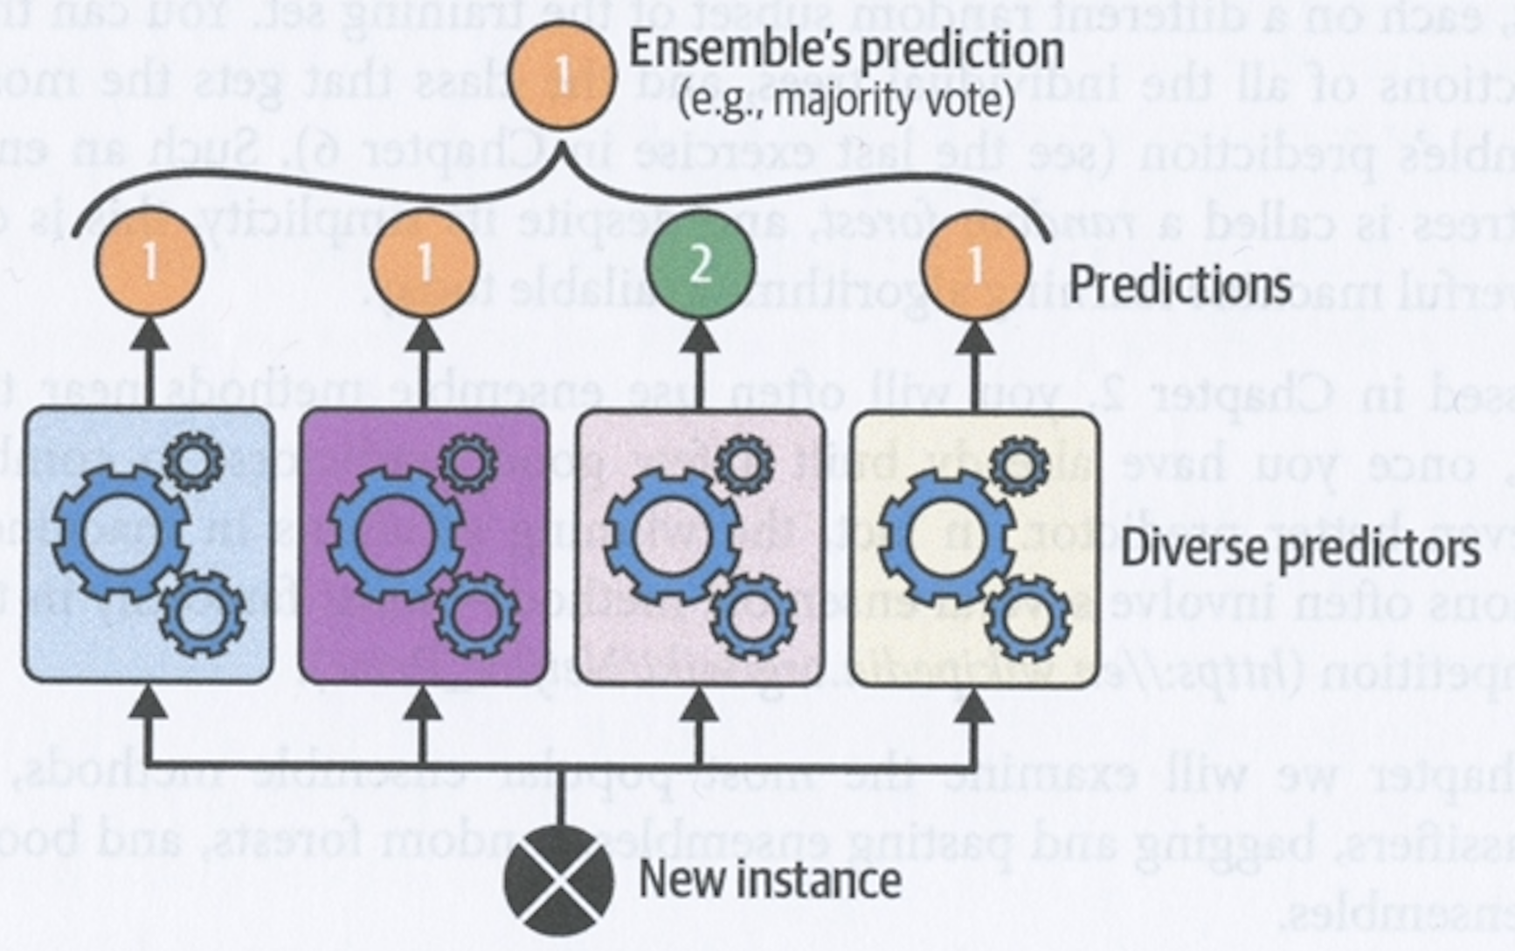
Voting classifiers
Suppose you have trained a number of classifiers of different types that all achieve about 80% accuracy on a task
A simple way to create a better classifier is to aggregate the predictions of these classifiers
For example, you could simply choose the class that gets the most votes from the group of best classifiers that you have trained
This is called hard voting

Slide 6
Hard voting classifier
A hard voting classifier often achieves higher accuracy than the best classifier in the ensemble
Even if the classifiers in the ensembles are all weak learners (i.e., doing slightly better than random guessing), the ensemble can still be a strong learner (i.e., achieving high accuracy)
This depends on there being a sufficient number of weak learners that make different types of error – the models should be as dissimilar to each other as possible

Slide 7
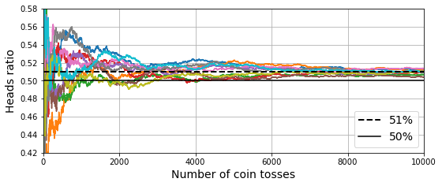
How can we make a strong learner from a group of weak learners?
Suppose you have a biased coin that comes up heads 51% of the time
If you toss this coin 1000 times, then the probability that you will get more heads than tails is about 75%
If you toss the coin 10000 times, then the probability of getting more heads than tails is over 97%
This is due to the law of large numbers: the ratio of heads to tails converges to the probability of getting a head, the more times you toss the coin

Slide 8
Making a strong learner from a group of weak learners
The graph above shows how the ratio of heads to tails changes over 10000 thows for 10 series of throws with a biased coin
Eventually all 10 series get so close to the actual probability of a head that the total ratio remains above 50%
Similarly, if you build 1000 classifiers that are invidivually correct only 51% of the time, and you predict the majority class, then you can expect the ensemble as a whole to give you about 75% accuracy
However this is only true when the classifiers are independent, making uncorrelated errors – this is not the case when they are all trained on the same data

Slide 9
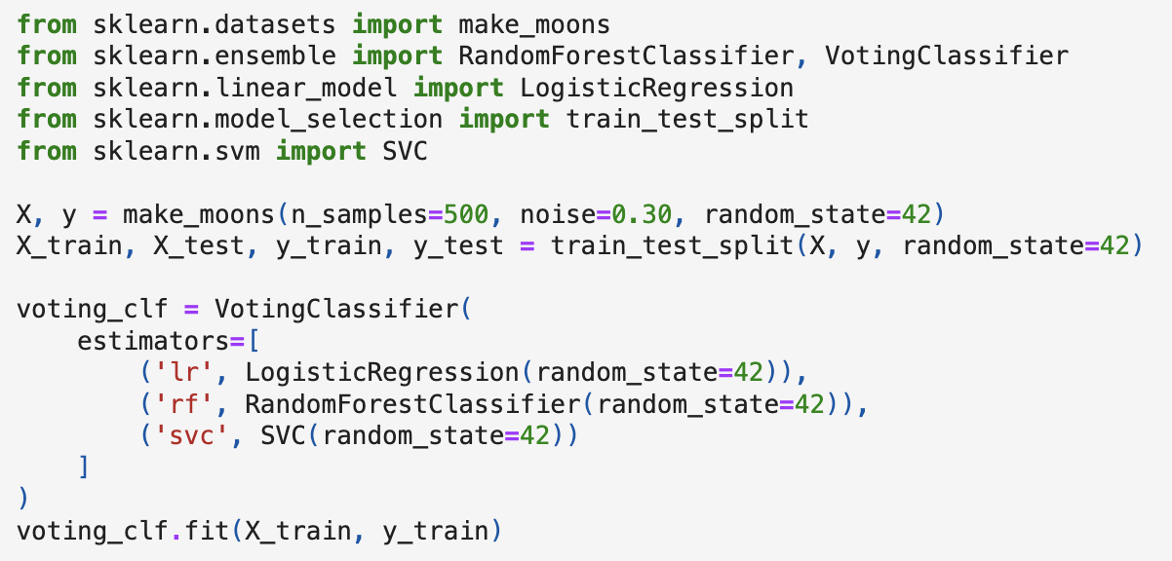
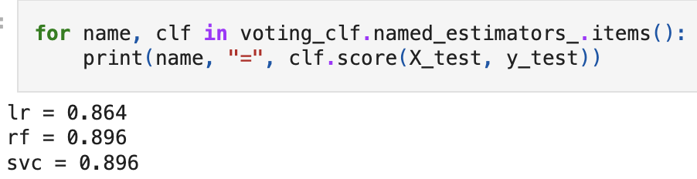
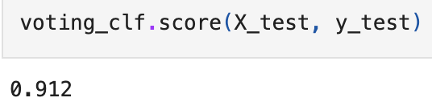
Example hard voting classifier
We can use Scikit-Learn’s VotingClassifier to do hard voting
On the left we load the moons dataset and split it into a training set and a test set
Then we provide a VotingClassifier with a list of (name, predictor) pairs and fit it
VotingClassifer stores the original estimators in its estimators attribute and trains clones of these estimators that it stores in its estimators_ attribute
The voting classifier performs better than any of the individual classifiers in its ensemble

Slide 10
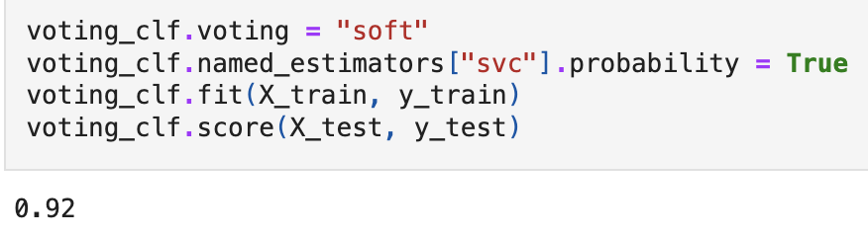
Soft voting
If all the classifiers in the ensemble can estimate class probabilities (i.e., they have a predict_proba() function), then you make an ensemble classifier that predicts the class that has the highest average probability over all the classifiers
This is called soft voting
Soft voting often achieves better results than hard voting because it gives more weight to highly confident votes
To use soft voting, simply set the VotingClassifier’s “voting” hyperparameter to “soft” and ensure that all classifiers in the ensemble can estimate class probabilities
SVC does not predict class probabilities by default – you need to set probability=True
In our moons example, this increases the accuracy to 92%

Slide 11
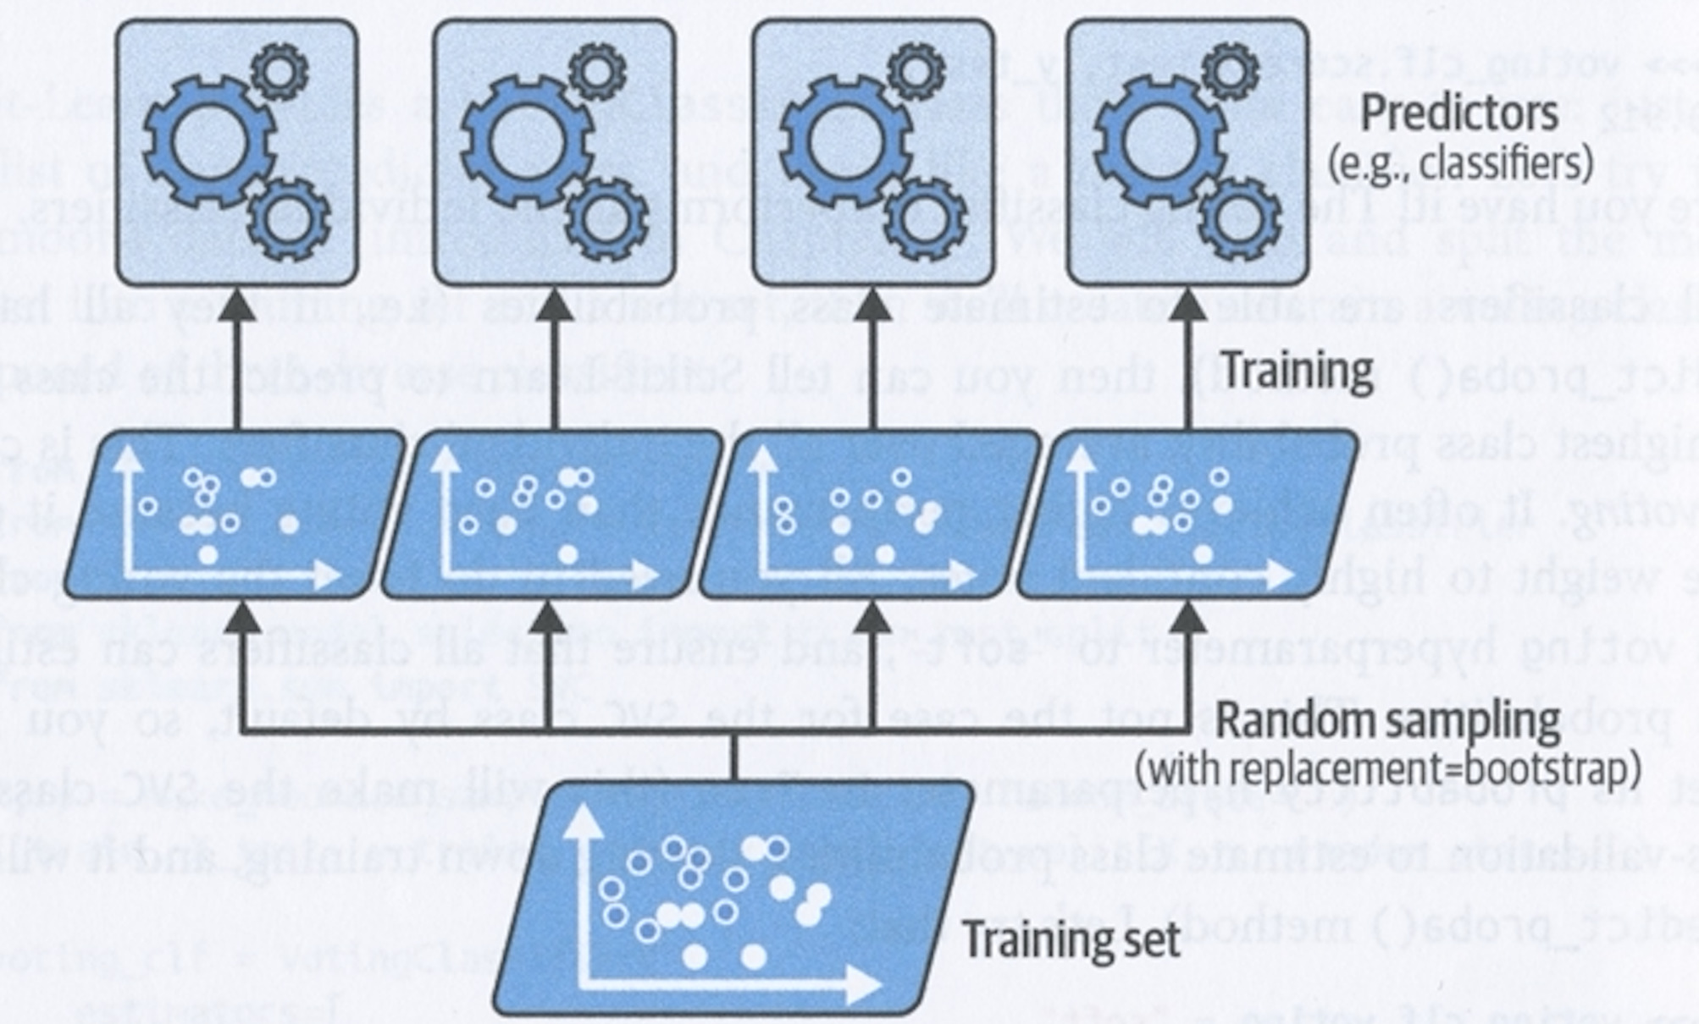
Bagging and pasting
As we’ve seen, one way of getting a diverse, non-correlated set of classifiers is to use very different algorithms
Another way is to use the same algorithm for all predictors, but train it on different random subsets of the training set
When the samples used are drawn with replacement, the process is called bagging (a contraction of bootstrap aggregating)
When the samples are drawn without replacement, the process is called pasting

Slide 12
Bagging and pasting
Once all predictors have been trained, the ensemble makes a prediction by aggregating predictions of all predictors
Aggregation function is usually
statistical mode for classification (i.e., most frequent prediction)
average for regression
Each individual predictor has higher bias than if it were trained on the whole training set
But aggregation reduces both bias and variance
Typically, the ensemble has similar bias to but lower variance than a single predictor in the ensemble trained on the whole training set

Slide 13
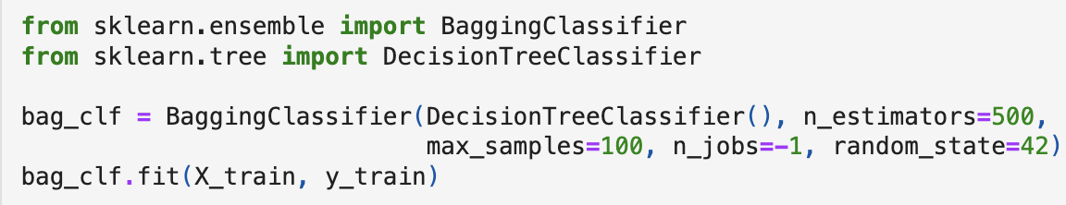
Bagging and pasting in Scikit-Learn
Scikit-Learn provides BaggingClassifier and BaggingRegressor classes for carrying out bagging and pasting
Code above trains an ensemble of 500 DecisionTreeClassifiers on random samples of the training set containing at most 100 instances
The jobs=-1 parameter indicates how many CPU cores to use, -1 indicates all available
If you want to use pasting instead of bagging, then set bootstrap=False
Note that a BaggingClassifier automatically does soft voting if the base classifier has a predict_proba() method (e.g., decision trees)

Slide 14
Bagging and pasting in Scikit-Learn
The plots above compare the decision boundary of a single decision tree (left) with the decision boundary for a bagging ensemble with 500 trees (right)
The ensemble’s predictions are likely to generalize better because the variance is less (i.e., the decision boundary is more regular)

Slide 15
Bagging vs. pasting
Bagging tends to produce more diversity in the samples on which the predictors are trained, so bagging usually has higher bias than pasting
The extra diversity with bagging leads to the predictors being less correlated, which reduces variance
Bagging often results in better models, so it is generally preferred

Slide 16
Out-of-bag evaluation
With bagging, some training instances may be sampled more than once and others may not be sampled at all
By default, BaggingClassifier samples m training instances with replacement, where m is the size of of the training set
It can be shown that in this case, on average, only 63% of the training set is sampled for each predictor
The remaining 37% are called out-of-bag (OOB) instances
If there enough estimators, then each training set instance is likely to be out-of-bag for several estimators, so these estimators can be used to make a fair prediction for that instance
Once there’s a prediction for each instance, you can compute the ensemble’s prediction accuracy

Slide 17
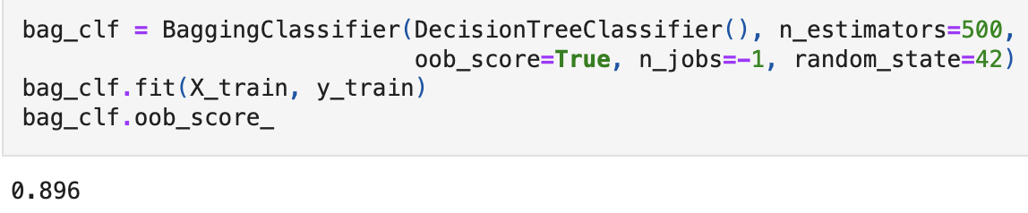
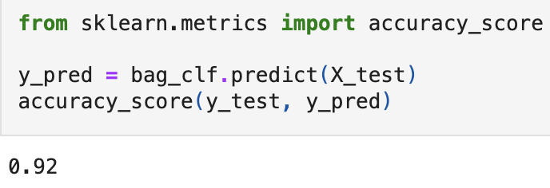
OOB evaluation in Scikit-Learn
If you set oob_score=True when creating a BaggingClassifier, then Scikit-Learn will evaluate the model after training using OOB evaluation (see above top)
The resulting score is in the variable oob_score_
We can then test on the test set when we achieve high enough values under OOB evaluation (see above)

Slide 18
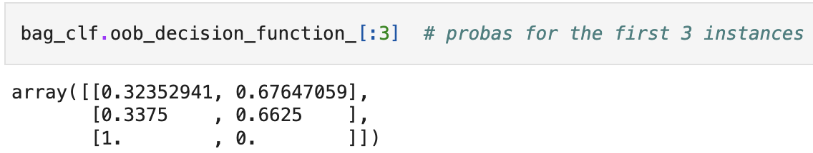
oob_decision_function_
The OOB decision function for each training instance is available through the oob_decision_function_ attribute
If the base estimator has a predict_proba() function, then the OOB decision function returns the class probabilities for the instance

Slide 19
Random patches and random subspaces
BaggingClassifier and BaggingRegressor also support random sampling of features
Feature sampling is controlled by the following hyperparameters:
max_features: the number of features in each random sample
bootstrap_features: True if bagging; False if pasting
This is especially useful if using high-dimensional data (e.g., images), as it can considerably speed up training
Sampling both instances and features is called the random patches method
Sampling features but training on all training instances is called the random subspaces method
You can do this by setting bootstrap=False, max_samples=1.0, as well as setting bootstrap_features=True and/or max_features to a value less than 1.0
Sampling features results in more predictor diversity, which increases bias but lowers variance

Slide 20
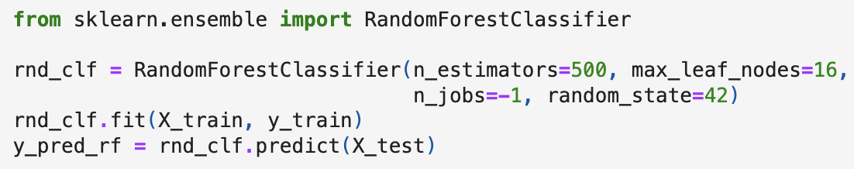
Random forests
A random forest is an ensemble of decision trees, generally trained with the bagging method, typically with max_samples set to the size of the training set
We can build a random forest classifier using a BaggingClassifier and passing it a DecisionTreeClassifier
We can also use the RandomForestClassifier and RandomForestRegression classes, which are more convenient and optimized for making ensembles where the base algorithm is a decision tree
The code above trains a random forest classifier with 500 trees, each limited to a maximum of 16 leaf nodes, using all CPU cores
The RandomForestClassifier has all the hyperparameters of the DecisionTreeClassifier as well as those of the BaggingClassifier

Slide 21
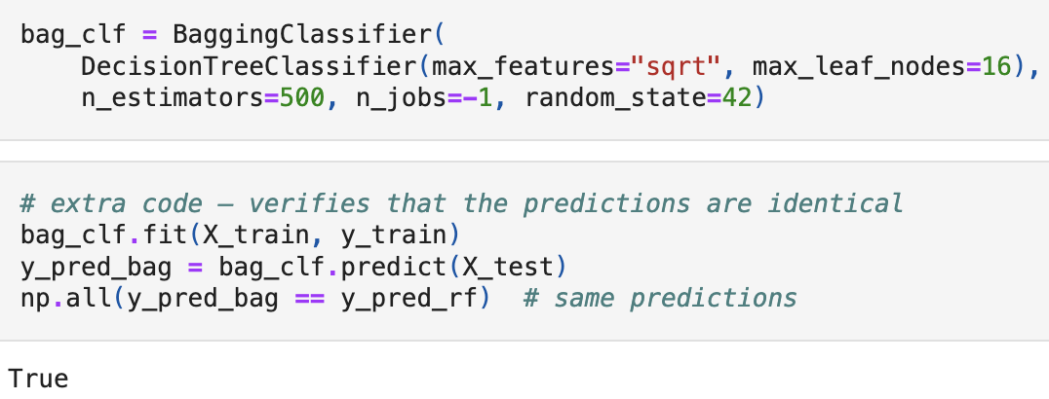
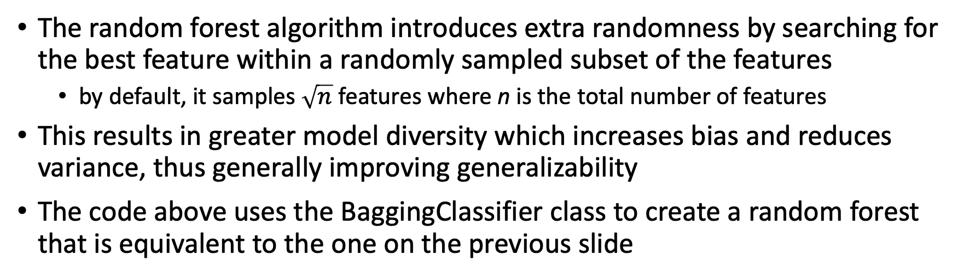
Increasing model diversity by feature sampling
The random forest algorithm introduces extra randomness by searching for the best feature within a randomly sampled subset of the features
by default, it samples $\sqrt{n}$ features where n is the total number of features
This results in greater model diversity which increases bias and reduces variance, thus generally improving generalizability
The code above uses the BaggingClassifier class to create a random forest that is equivalent to the one on the previous slide

Slide 22
Extra-trees
It is possible to create even more model diversity by having the learning algorithm assign random thresholds for the features instead of attempting to find the best possible thresholds
We can do this by setting splitter=“random” when creating a DecisionTreeClassifier
An ensemble of such extremely random trees is called an extremely randomized trees ensemble or an extra-trees ensemble for short
Again, such a model trades an increase in bias for a decrease in variance
Extra-trees classifiers are much faster to train than regular random forests
Scikit-Learn provides the ExtraTreesClassifier and ExtraTreesRegressor classes for building such models

Slide 23
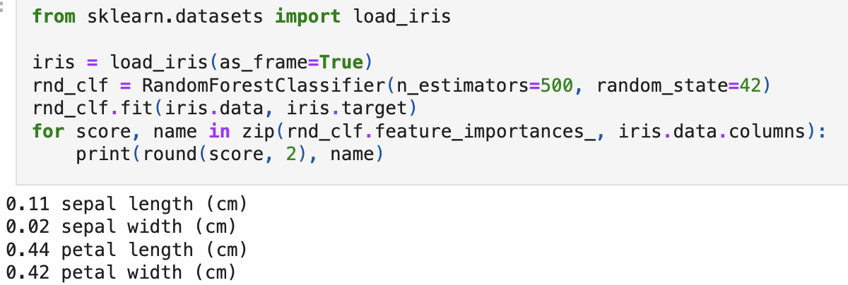
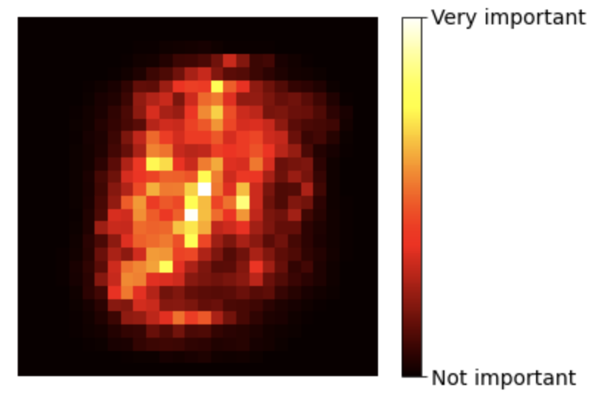
Feature importance
You can measure the relative importance of a feature in a random forest using Scikit-Learn
A feature’s importance is measured by how much the tree nodes that use that feature reduce impurity on average, across all the trees in the forest
the value for a node is weighted by the number of training instances associated with that node
Scikit-Learn automatically calculates the normalized feature importances after training – you can acess them in the variable feature_importances_
The code above trains a RandomForestClassifier on the iris dataset and outputs each feature’s importance
The image above left shows the relative importance of the pixels in the MNIST dataset after training with a random forest classifier

Slide 24
Boosting
Boosting (or hypothesis boosting) refers to an ensemble method that combines a number of weak learners to create a strong learner
The general idea behind boosting is to train each predictor in an ensemble sequentially, so that each one tries to correct the errors of the previous one
There are lots of different boosting methods available, but the most popular are
AdaBoost – short for adaptive boosting
gradient boosting

Slide 25
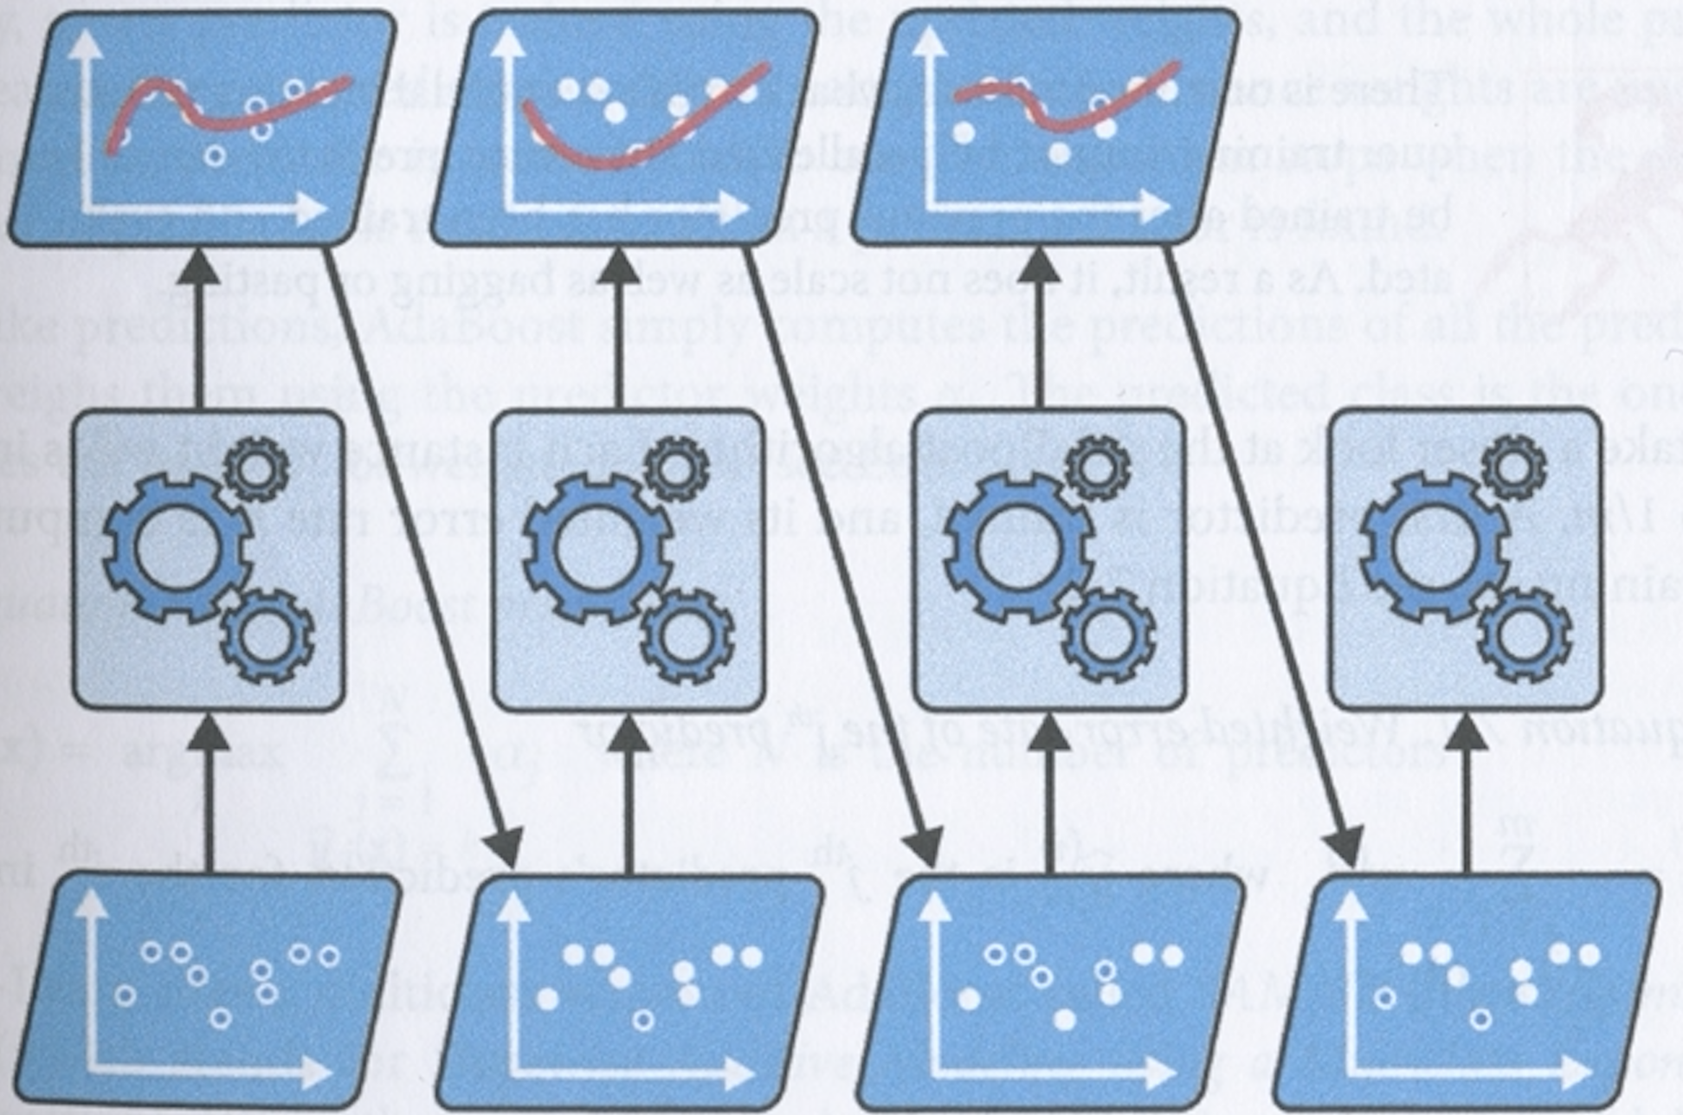
AdaBoost
The approach adopted in AdaBoost is for each new predictor to focus on training instances that its predecessor underfit
This results in new predictors focusing more and more on the hard cases
The algorithm first trains a base classifier (e.g., a decision tree) and uses it to make predictions on the training set
It then increases the relative weight of the misclassified training instances
Then it trains a second classifier, using the updated weights, again makes predictions, updates the instance weights, and so on.

Slide 26
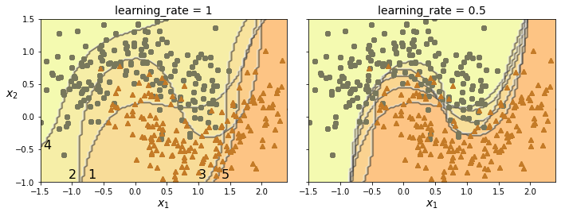
AdaBoost
The plots show the decision boundaries of five consecutive predictors on the moons dataset
here each predictor is a highly regularized SVM classifier with an RBF kernel
The plot on the right uses a learning rate that is half of that used in the plot on the left – i.e., misclassified instances are boosted less on each iteration
The result is a decision boundary that approaches the optimum, like with gradient descent, except that here every model in the sequence is added to the ensemble

Slide 27
AdaBoost
Once trained, the ensemble makes predictions in a similar way to bagging, except that predictors are given different weights depending on their overall accuracy over the weighted training set
One disadvantage of AdaBoost is that it cannot be parallelised, so it does not scale as well as bagging or pasting

Slide 28
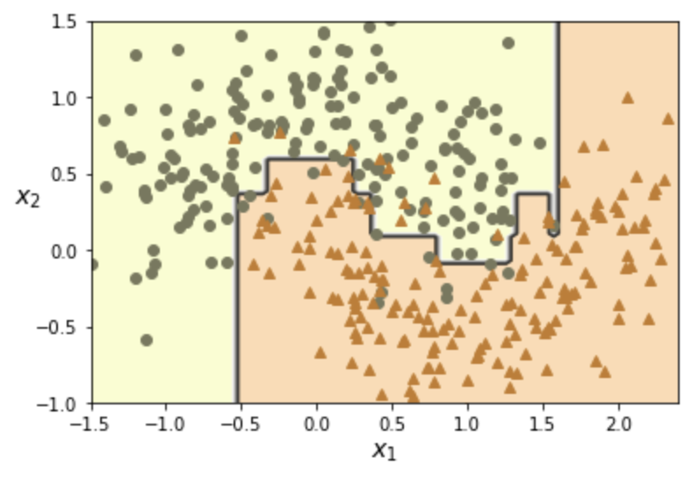
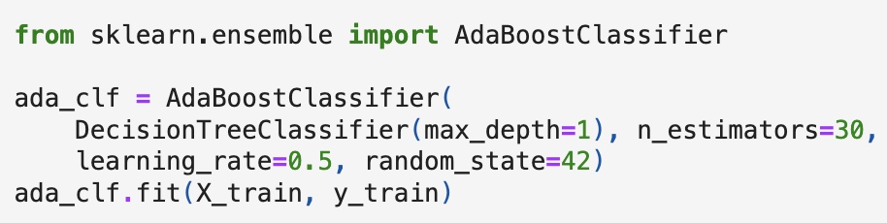
AdaBoost in Scikit-Learn
The code above trains an AdaBoost classifier on 30 decision stumps
a decision stump is a decision tree with max_depth=1 – i.e., a tree consisting of a single splitter node with two leaf nodes
If an AdaBoost ensemble is overfitting the training set, you can try reducing the number of estimators or more strongly regularizing the base estimator

Slide 29
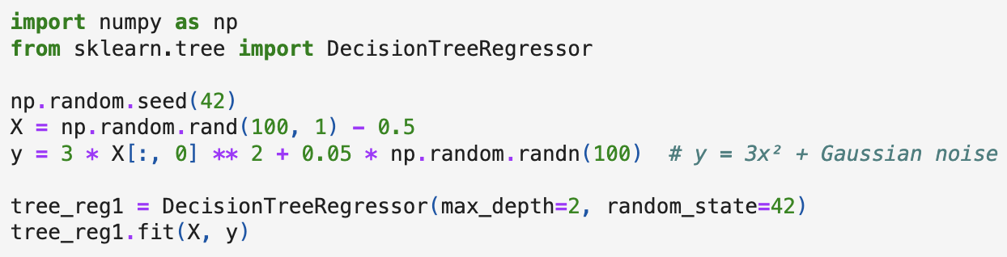
Gradient boosting
Like AdaBoost, gradient boosting works by adding successive predictors to an ensemble, each one correcting the mistakes made by its predecessor
Gradient boosting does this by trying to fit each new predictor to the residual errors of its predecessor
We consider the case where the base predictors are decision tree regressors – this is called gradient tree boosting or gradient boosted regression trees (GBRT)
We begin by generating a noisy quadratic dataset and fitting a DecisionTreeRegressor (see code above)

Slide 30
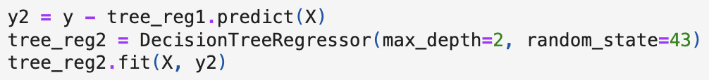
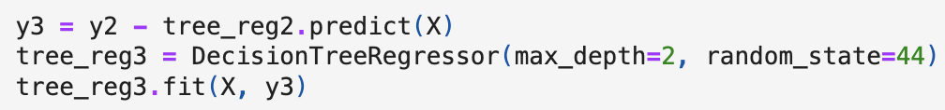
Gradient boosting
Next we train a second DecisionTreeRegressor on the residual errors made by the first predictor:
Then we train a third regressor on the residual errors made by the second predictor:
Now we have an ensemble of three trees and we can make a prediction simply by adding up the predictions of all the trees:

Slide 31
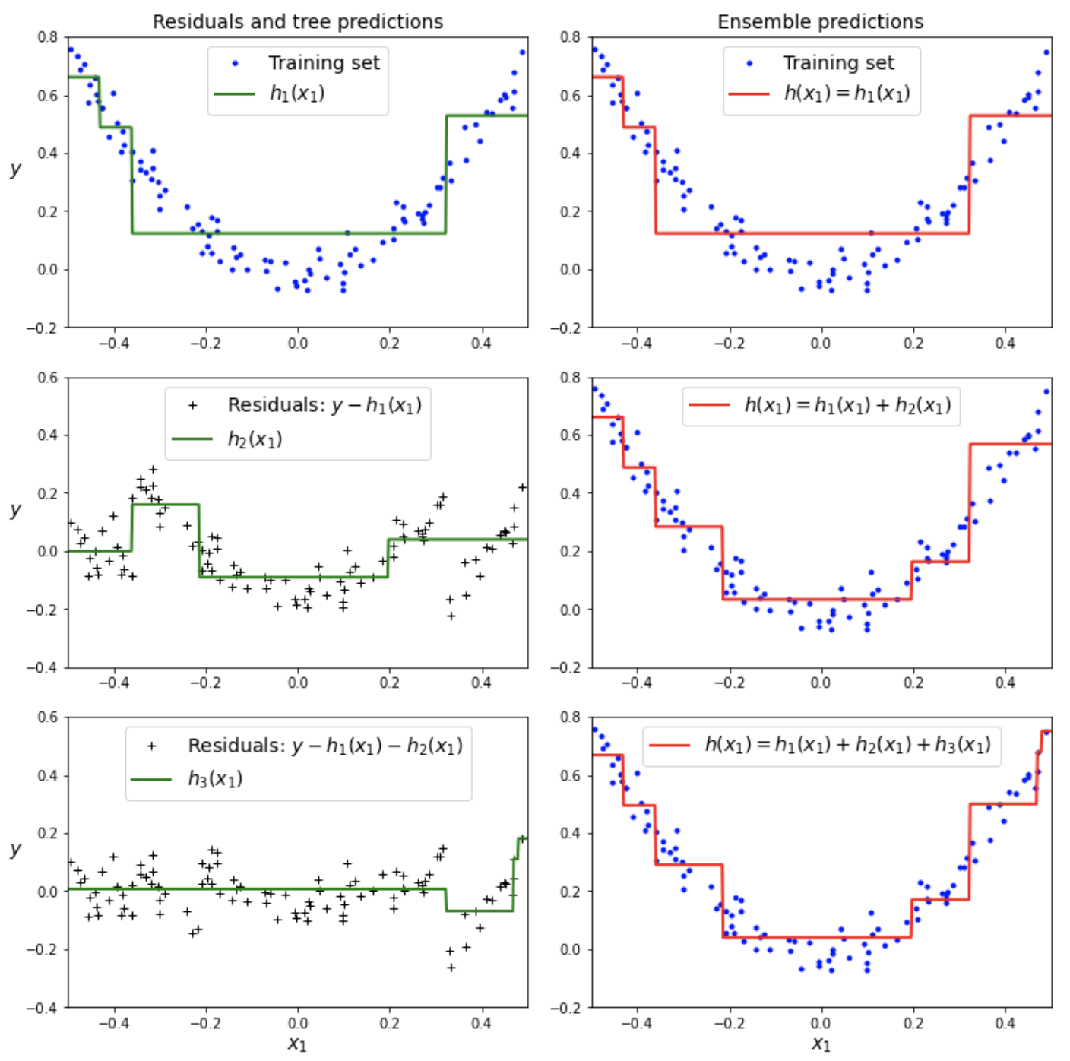
Gradient tree boosting
In the graphs on the right, left column shows predictions of the the three models, right column shows predictions of the ensemble
The ensemble’s predictions gradually get better as one each successive predictor

Slide 32
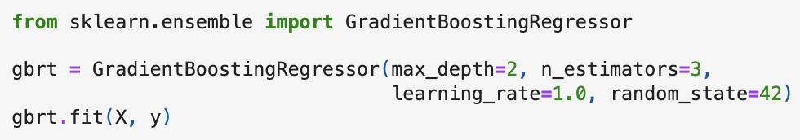
GradientBoostingRegressor
Scikit-Learn’s GradientBoostingRegressor class can be used to train a gradient boosted regression tree (GBRT) ensemble
there’s also a GradientBoostingClassifier class
This class has hyperparameters to control growth of decision trees (e.g., max_depth, min_samples_leaf)
It also has hyperparameters for controlling the ensemble (e.g., n_estimators)
Code above creates same ensemble as the one on the previous slide

Slide 33
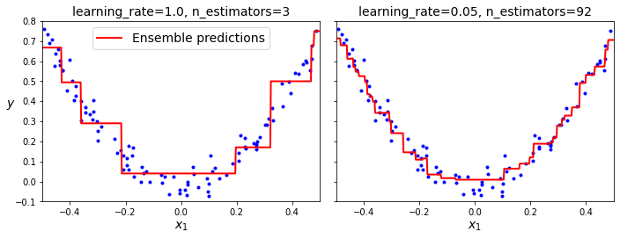
Shrinkage
The learning_rate hyperparameter scales the contribution of each tree
If the learning rate is low, e.g., 0.05, you’ll need more trees to fit the training set, but the predictions will generalize better – this is a form of regularization called shrinkage
Plots above show two GBRT ensembles trained with different hyperparameters
the one on the left does not have enough trees to fit the training set
the one on the right has about the right number of trees – if we added more, it would start to overfit

Slide 34
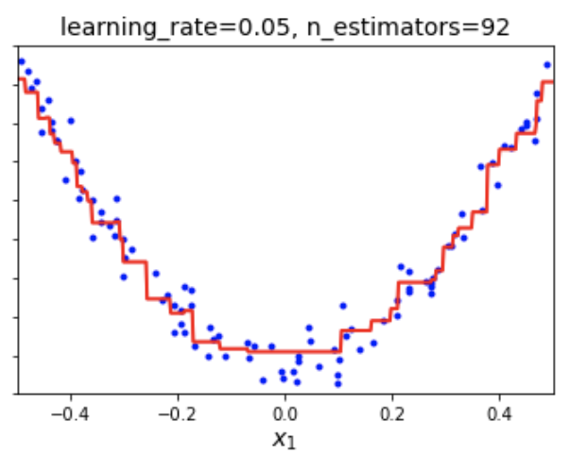
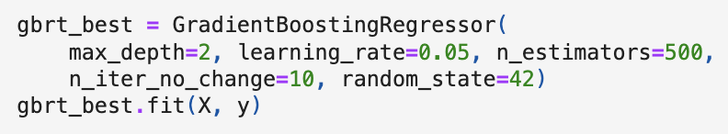
Finding the optimal number of trees
You could find the right number of trees in a GBRT by using GridSearchCV or RandomizedSearchCV
A simpler way is to set n_iter_no_change to some value, e.g., 10, then the GradientBoostingRegressor will stop adding trees when it sees that the last 10 iterations have not helped to decrease the error
This is essentially early stopping with a bit of patience – it tolerates a certain number of iterations with no improvement before stopping

Slide 35
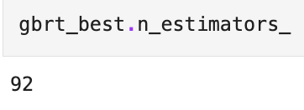
Finding the optimal number of trees
If you set n_iter_no_change too low, training may stop too early and your model will underfit; if you set it too high, it might overfit
We set a fairly low learning rate and a high number of estimators, though, because of early stopping, the actual number of estimators is typically much lower – see above

Slide 36
Finding the optimal number of trees
When n_iter_no_change is set, the fit() method automatically holds back some of the training set for validating each successive tree’s performance
Size of validation set is 10% by default and can be set with validation_fraction
The tol parameter can be used to define the maximum improvement that is considered negligible (default is 0.0001)
You can also speed up training by setting the subsample hyperparameter
For example, subsample=0.25 causes each tree to be trained on 25% of the training instances, selected randomly – this is called stochastic gradient boosting

Slide 37
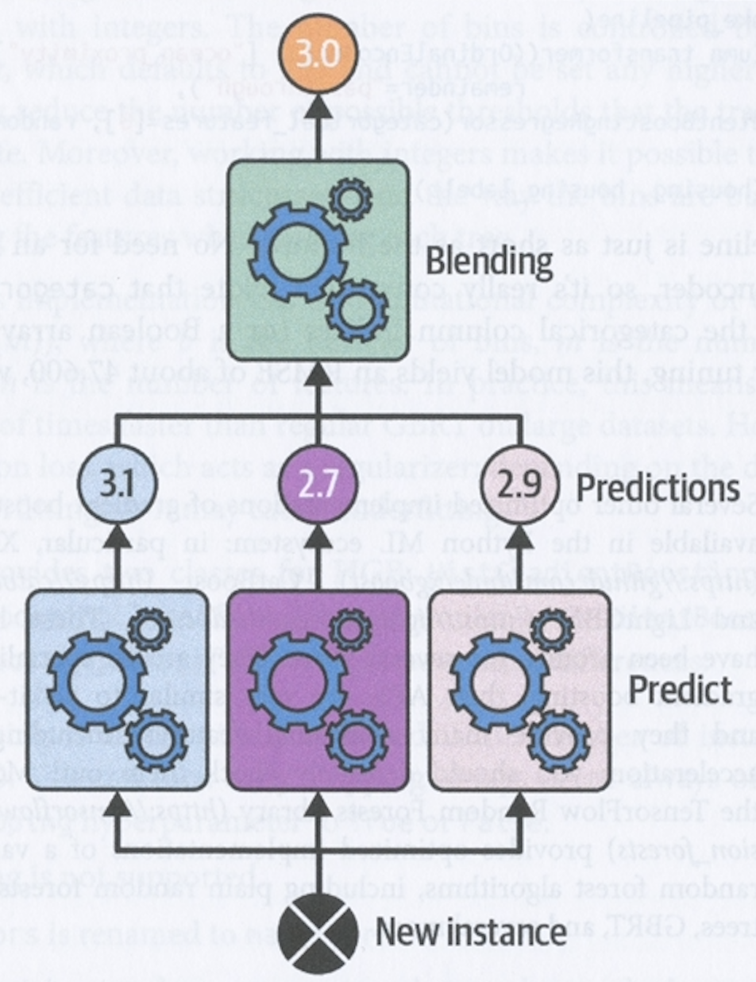
Stacking
Stacking or stacked generalization is based on a simple idea: instead of using a simple aggregator function to combine the predictions of an ensemble of predictors, train a model to perform this aggregation
Diagram on right shows an ensemble of three models making predictions on a new instance
These predictions are given as input to a final predictor – a blender or meta-learner – which makes the final prediction

Slide 38
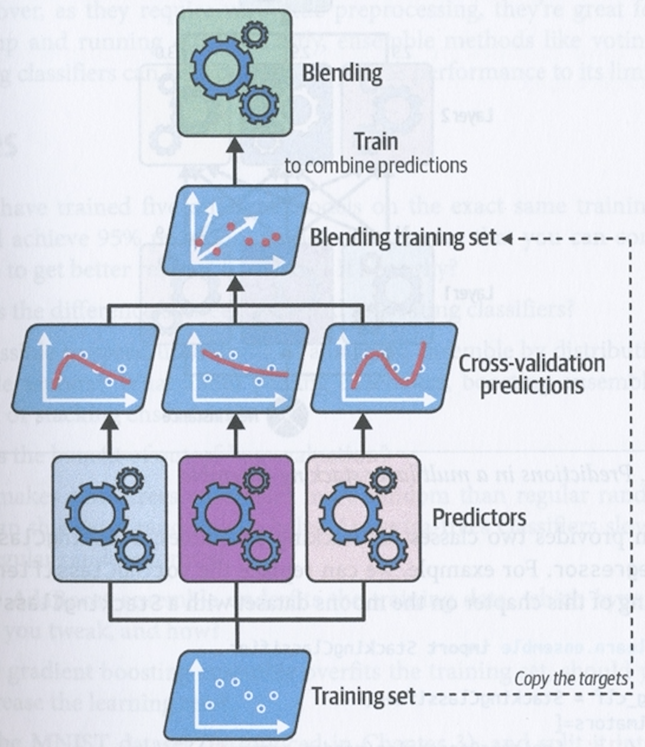
Stacking – training a blender
To train the blender, we need to build the blending training set
To do this, you can use cross_val_predict() on each predictor to get out-of-sample predictions for each instance in the original training set
You use these out-of-sample predictions as input to the blender
The targets are the same as for the original training set
Note that blender contains one input for each predictor in the ensemble, regardless of the number of features in the original training set
When the blender is trained, the predictors are re-trained one last time on the full original training set

Slide 39
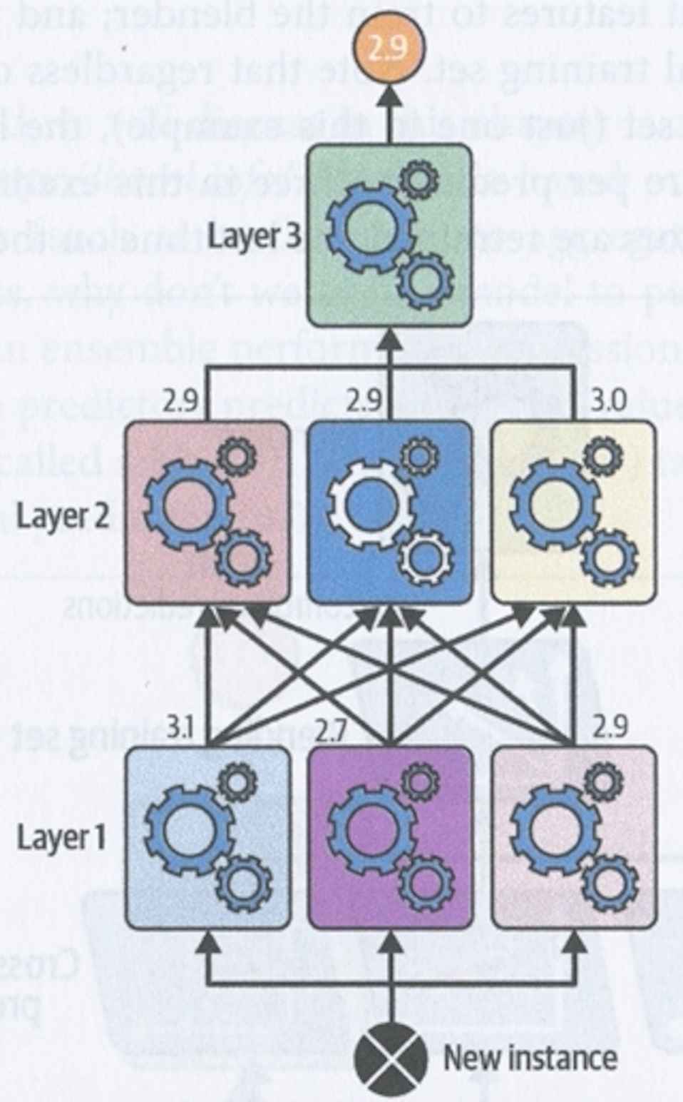
Stacking
One can also train a whole layer of blenders (e.g., a linear regressor and a random forest regressor) and then add one final blender on top to produce the final prediction, as shown on the right
This clearly adds complexity and training time

Slide 40
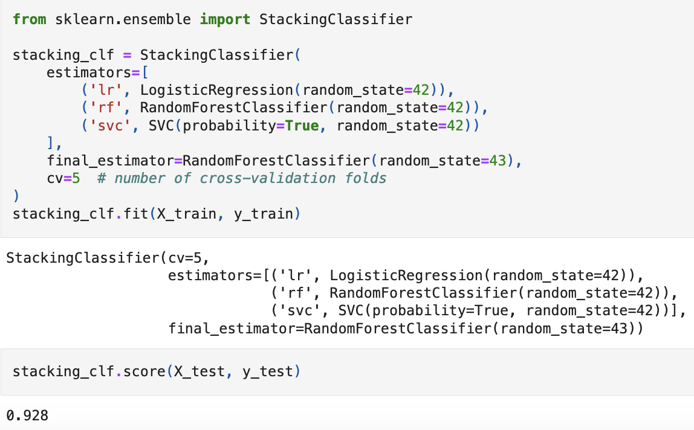
StackingClassifier and StackingRegressor
Scikit-Learn provides two classes, StackingClassifier and StackingRegressor for building stacking ensembles
Code on left replaces the VotingClassifier we used earlier on with the moons dataset
For each predictor, the stacking classifier will call predict_proba() or decision_function() and then use the final_estimator to predict the output value
If you don’t provide final_estimator, then StackingClassifier will use LogisticRegression and StackingRegressor will use RidgeCV
The stacking model improves performance from 92% to 92.8%

