Slide 1
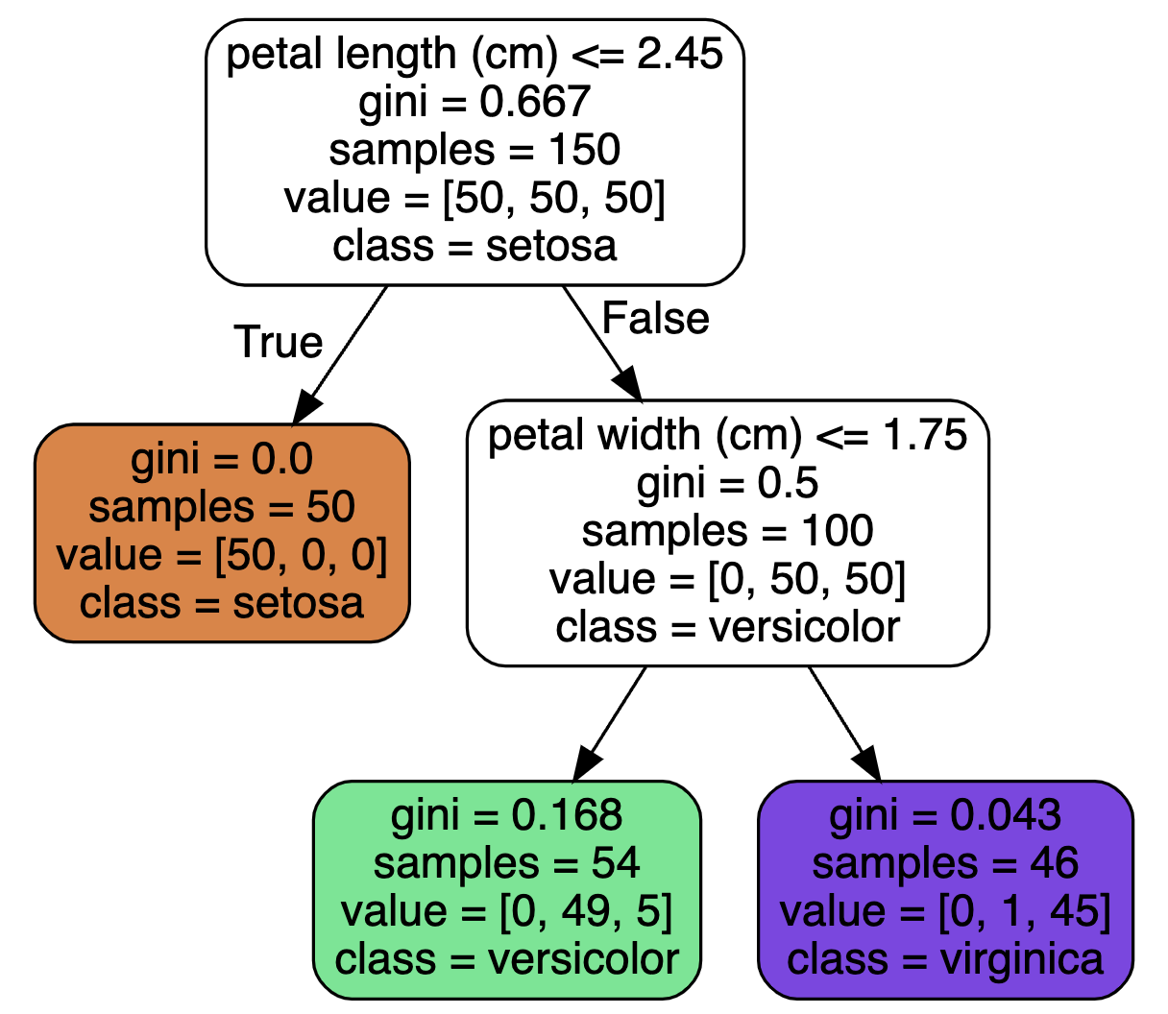
Decision Trees
David Meredith
dave@create.aau.dk
Aalborg University

Slide 2
Sources for this lecture
Chapter 6 of
Géron, A. (2023). Hands-On Machine Learning with Scikit-Learn, Keras & TensorFlow. (Third edition). O’Reilly. Available at
https://www.amazon.de/-/en/Aur%C3%A9lien-G%C3%A9ron/dp/1098125975/
https://www.saxo.com/dk/hands-on-machine-learning-with-scikit-learn-keras-and-tensorflow_bog_9781098125974
https://factumbooks.dk/?search_string=hands-on+machine+learning+with+scikit-learn
Jupyter Notebook for this lecture:
https://github.com/ageron/handson-ml3/blob/main/06_decision_trees.ipynb

Slide 3
Introduction
Decision trees can be used for classification, regression and even multioutput tasks
They are powerful models that can be fitted to complex datasets
for example, in our California House Price problem, we trained a decision tree that overfit the data
Decision trees are also the fundamental components in random forests, which are among the most powerful machine learning algorithms available

Slide 4
Introduction
In this lecture, we will cover
training and visualizing decision trees
making predictions with decision trees
the CART training algorithm used by Scikit-Learn
regularizing decision trees
We’ll start off the next lecture with the following
using decision trees for regression tasks
limitations of decision trees

Slide 5
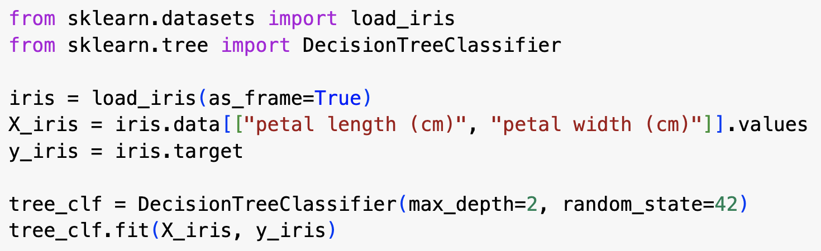
Training a decision tree in Scikit-Learn
Training a decision tree in Scikit-Learn is straightforward – see code above

Slide 6
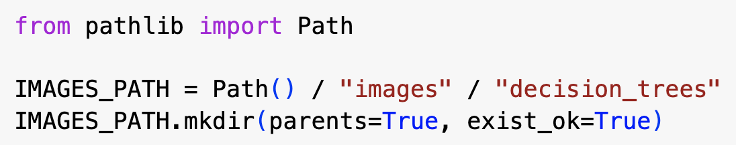
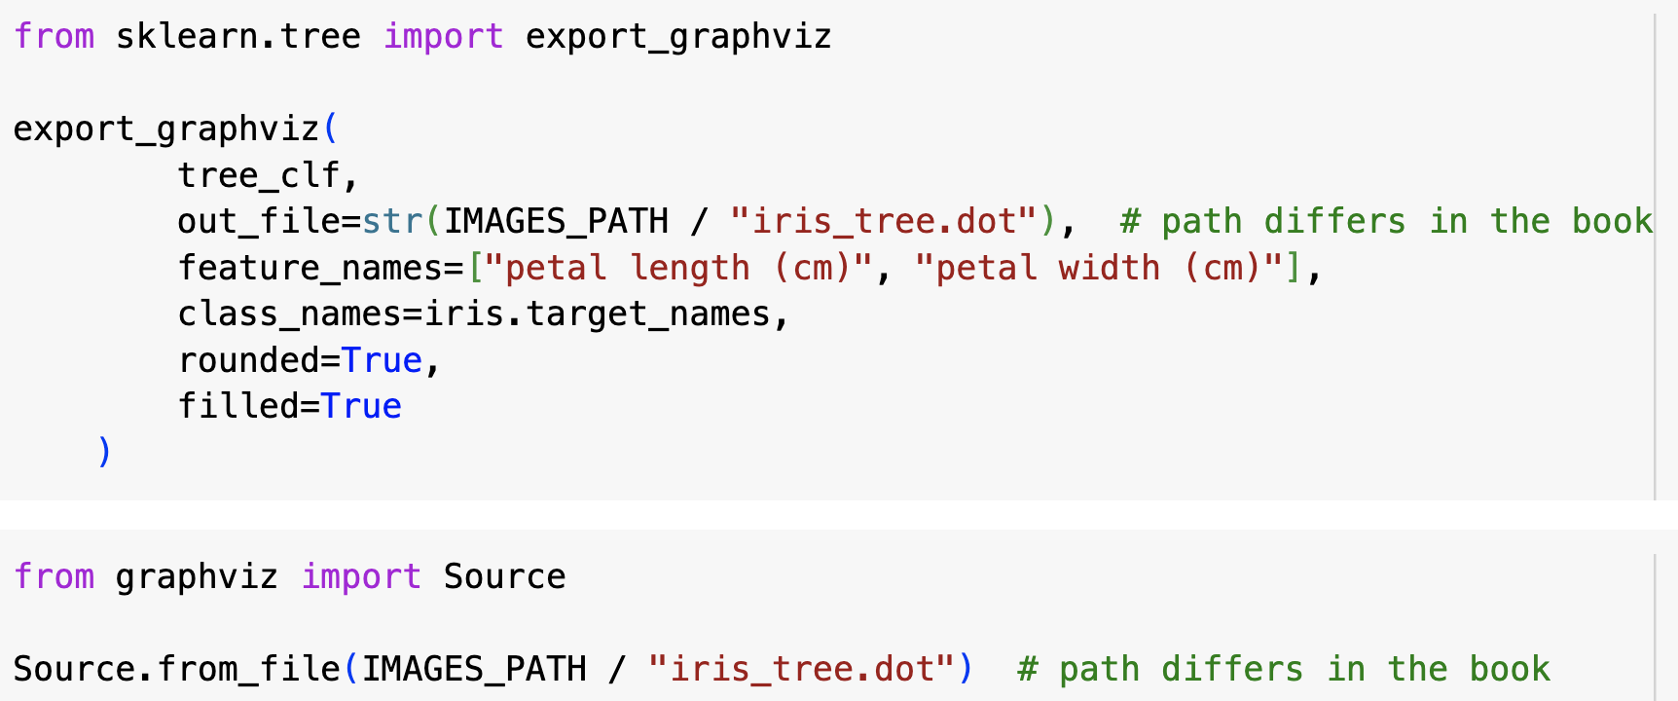
Visualizing a decision tree in Scikit-Learn
To visualize a decision tree, we
create a .dot file using the export_graphviz() function – this file defines a graph that represents a trained decision tree
load and display the .dot file using the Source.from_file() function from the graphviz library (https://graphviz.org)
Graphviz also includes a dot command-line tool that can generate images in various formats (e.g., PDF or PNG) from .dot files

Slide 7
Making predictions with a decision tree
To classify an iris flower using the decision tree on the left, we start at the root node (depth 0) and determine if petal length is <= 2.45 cm
If it is, then we move to the left child (depth 1, left) – this is a leaf node that tells us the class is setosa
If the petal length > 2.45 cm, then we would go from the root node to its right child (depth 1, right)
This is a split node which asks us if the petal width is <= 1.75 cm
If it is, the model predicts the class versicolor (depth 2, left); if it isn’t, it predicts virginica (depth 2, right)
Scikit-Learn uses the CART algorithm to train decision trees, which only generates binary trees
other algorithms, e.g., ID3, can produce decision trees with nodes that have more than 2 children

Slide 8
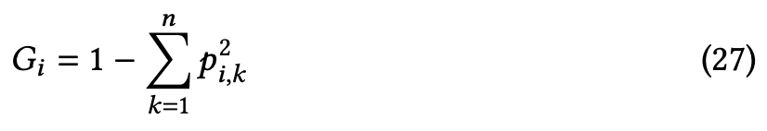
Making predictions with a decision tree
A benefit of decision trees is that they require very little data preparation – they don’t require feature scaling or centering at all!
The samples attribute tells us how many training instances it applies to
The value attribute is an array that tells us how many training instances of each class the node applies to
The gini attribute tells us the node’s Gini impurity
a node is “pure” (gini=0.0), if all training instances it applies to belong to a single class
Gini impurity is computed using eq. 27 above
p_{i,k} is the ratio of the number of instances in kth class in the ith node to the total number of instances in that node

Slide 9
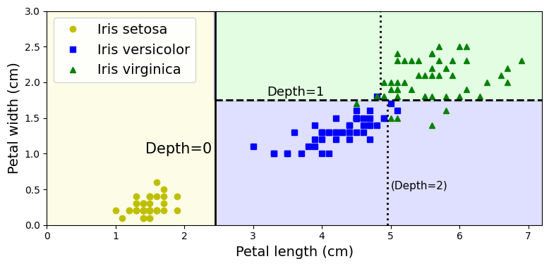
Decision boundaries of a decision tree
The plot shows the decision boundaries of the decision tree we’ve just created
The solid vertical line is the decision boundary of the root node
The left-hand region is pure, so it cannot be split any further
The right-hand region is impure, so it is split again at the horizontal dashed decision boundary, corresponding to a petal width of 1.75cm
max_depth was set to 2, so the tree stops here
If we had set max_depth to 3, then both depth-2 nodes would have become split nodes because they are impure, leading to two more decision boundaries (shown by dotted lines)

Slide 10
Model interpretation: White box vs. black box
Decision trees are intuitive and their decisions are easy to interpret – they are white box models
In contrast, random forests and neural networks are considered black box models because it is usually hard to give simple intuitive explanations for why they make their decisions
This is because they are typically very complex models – if it were possible to explain their predictions more simply, this would indicate that these models were actually overfitting

Slide 11
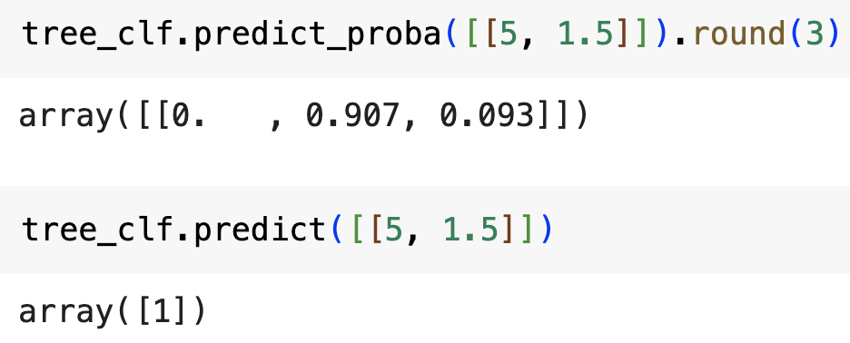
Estimating class probabilities
A decision tree can also give you the probability that an instance belongs to a particular class
For example, if you have a flower whose petals are 5cm long and 1.5cm wide, then you would end up in the depth-2 left node (green) and the model would predict versicolor with a probability of 49/54 ≈ 0.907

Slide 12
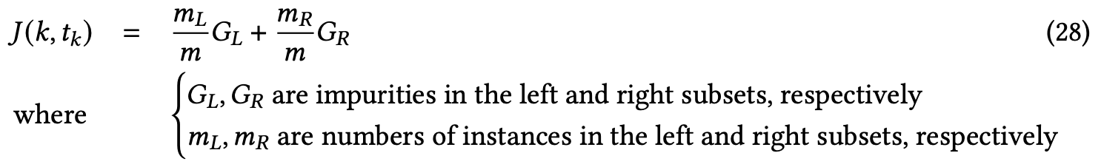
The CART training algorithm
Scikit-Learn uses the Classification and Regression Tree (CART) training algorithm to train (or grow) decision trees
The first step in this algorithm is to divide the training set into two subsets using a single feature, k, and a threshold, t_{k}
e.g., the tree on the left uses the feature petal length and a threshold of 2.45 cm
It does this by searching for the pair, (k,t_{k}), that produces the purest subsets, weighted by their size
Equation above gives cost function that CART tries to minimize

Slide 13
The CART training algorithm
When the CART algorithm has found a pair, (k,t_{k}), that minimizes the cost for the first split, it then applies the same process recursively to each new subset produced and continues until either
the max_depth is reached, or
it cannot find a split that will reduce the impurity
CART is a greedy algorithm – at each stage, it tries to find the best solution at that point in the algorithm
this means that it may not end up finding the best possible solution

Slide 14
Computational complexity
Making predictions involves traversing the tree from the root to a leaf
Decision trees are approximately balanced, so making a prediction takes O(h) time where h is the height of the tree
In the worst case, the tree is O(log₂m) deep, so the worst case time for prediction is O(log₂m) – that is, much better than linear in the size of the dataset
So decision tree predictions are fast even when using large training sets
The training algorithm compares all features on all samples at each node, so the time for training is O(nmlog₂m) – training therefore also scales quite well to large datasets

Slide 15
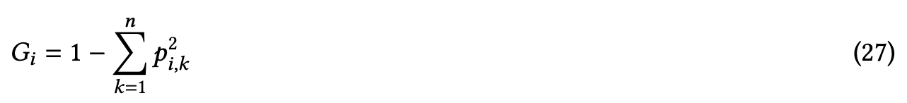
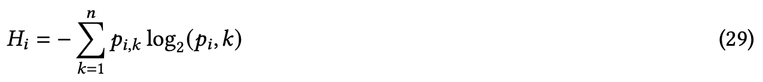
Gini impurity or entropy impurity?
By default, the DecisionTreeClassifier uses Gini impurity (eq.27)
You can set it to use the entropy impurity measure instead by setting the criterion=“entropy” argument (eq. 29)
Entropy measures the average number of bits required to send a message, given some predefined set of possible messages
If we can only send one message, then the entropy is 0
If we can send 4 messages, then we need 2 bits to uniquely identify a message in the set, so the entropy is 2
In a decision tree, the entropy of a node is given by the equation above
Usually it does not make much difference whether you use Gini or entropy impurity
Gini impurity tends to isolate the most frequent class in its own leaf
entropy tends to produce slightly better balanced trees

Slide 16
Regularization parameters
Decision trees make very few assumptions about the training data
as opposed to, e.g., linear models
what kind of error are they therefore unlikely to make?
Unconstrained decision trees therefore tend to closely fit the training data
A decision tree is a non-parametric model in the statistical sense because it does not make assumptions about the distributions in the training data (e.g., that it is linear or normally distributed)

Slide 17
Regularization parameters
To avoid overfitting, we need to restrict the decision tree’s freedom during training
One way of doing this is to set the max_depth parameter
Other parameters can also be used to restrict the shape and size of the decision tree:
max_features – sets max number of features that are evaluated for splitting each node
max_leaf_nodes – maximum number of leaf nodes or regions
min_samples_split – minimum number of samples a node must have before it can split
min_samples_leaf – minimum number of samples a leaf node must have before it is created
min_weight_fraction_leaf – similar to min_samples_leaf, except expressed as a fraction of the total number of weighted instances
Increasing min_* or decreasing max_* hyperparameters will regularize the model

Slide 18
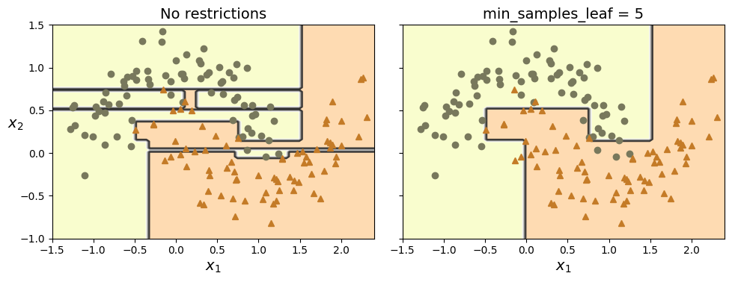
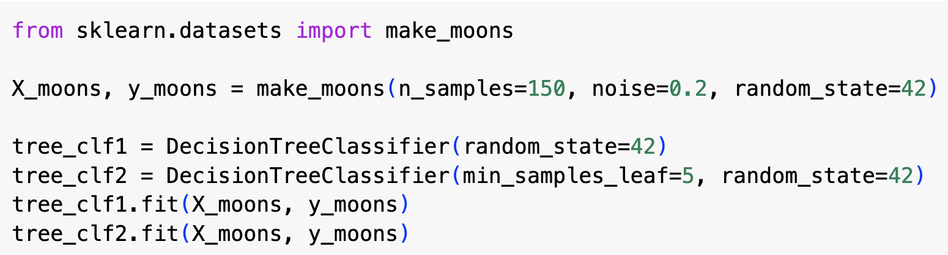
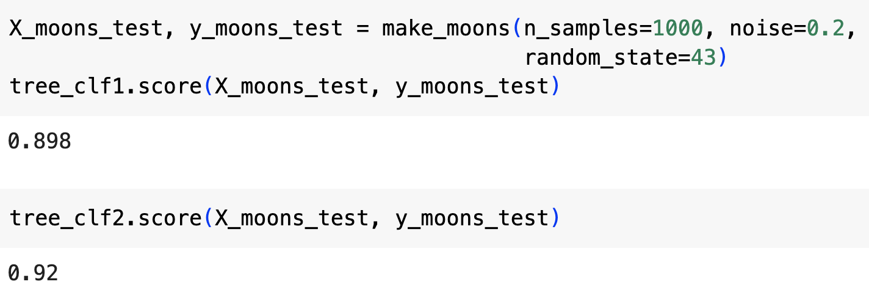
Regularizing a decision tree
We can test regularization on the moons dataset
Code above trains one decision tree with no regularization and one with min_samples_leaf=5
Unregularized model overfits the data; the regularized model will generalize better
We can test this by trying it on another randomly generated dataset with a different random seed

Slide 19
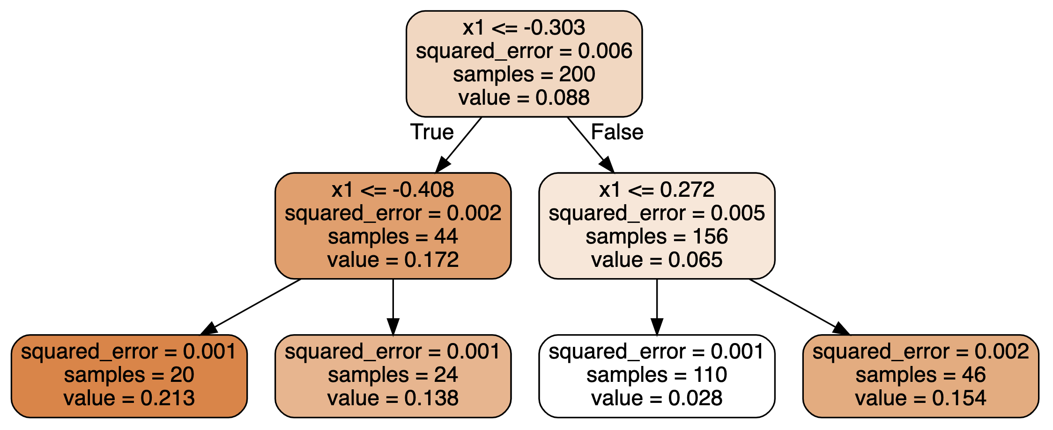
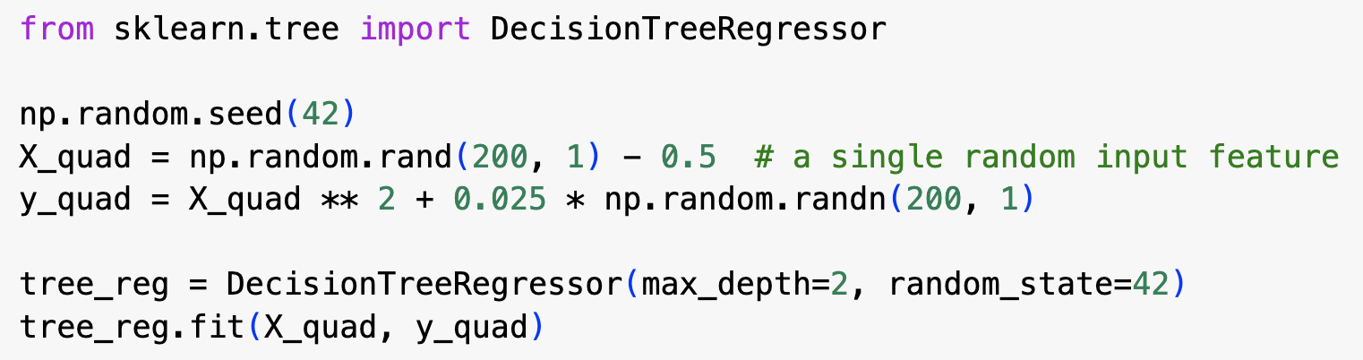
Regression
Decision trees can also be used for regression
We can use Scikit-Learn’s DecisionTreeRegressor
Example uses DecisionTreeRegressor on a noisy quadratic dataset, with max_depth=2

Slide 20
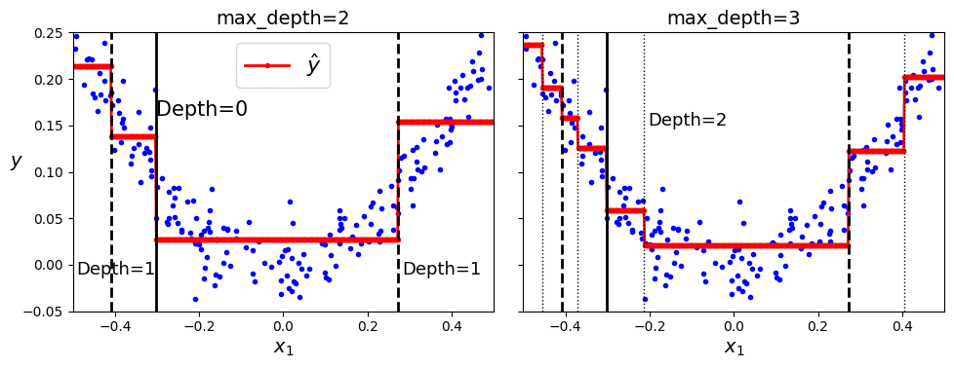
Regression
0.028
A regression tree predicts a value for each input rather than a class
For example, if x₁ = 0.2, then we get false for the root node, true for the rh node at depth 1, which takes us to the third leaf node and a predicted value of 0.028 (indicated by green line in lh graph)
Prediction of leaf node is the average value of the training instances associated with that node (in this case, there are 110 such instances and the squared error is 0.001)

Slide 21
Regression
If you set max_depth to 3, then you get a more detailed model of the data (see rh graph)
Each time the algorithm splits a region, it tries to find a decision boundary that minimises the error in the two resulting sub-regions

Slide 22
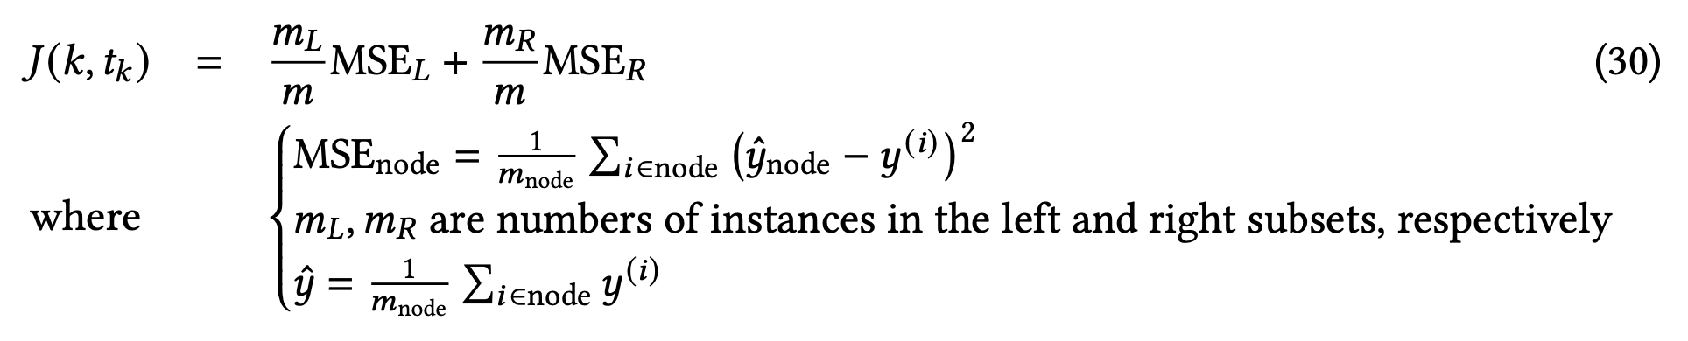
Decision tree regression cost function
When we use the CART algorithm for regression, we use a cost function as above
This minimizes the mean squared error in the two new sub-regions

Slide 23
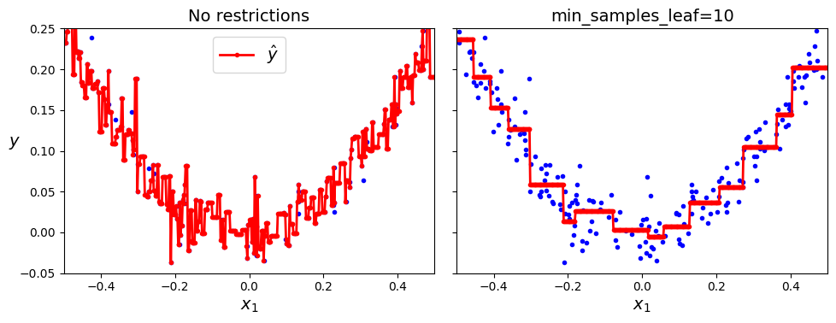
Regression trees with and without regularization
Decision trees are prone to overfitting, so you should always use regularization by setting the hyperparameters
Above left graph shows result when using no regularization
Above right graph shows result when setting min_sample_leaf=10
recall that this sets a lower limit on the number of instances in any one leaf

Slide 24
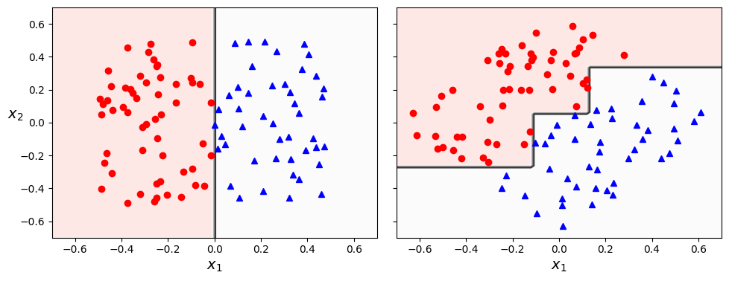
Sensitivity to axis orientation
Decision trees have a lot of good qualities: easy to interpret, simple to use, versatile, require no scaling, powerful
However, they also have a few shortcomings
In particular, they like decision boundaries that are orthogonal to an axis, which makes them sensitive to the data’s orientation
Dataset in the plots above is the same, except that it is rotated through 45 degrees on the right
Decision tree can find perfect separation with a straight line on the left, but needs a much more convoluted decision boundary when the data is rotated
The right-hand solution will probably not generalize well

Slide 25
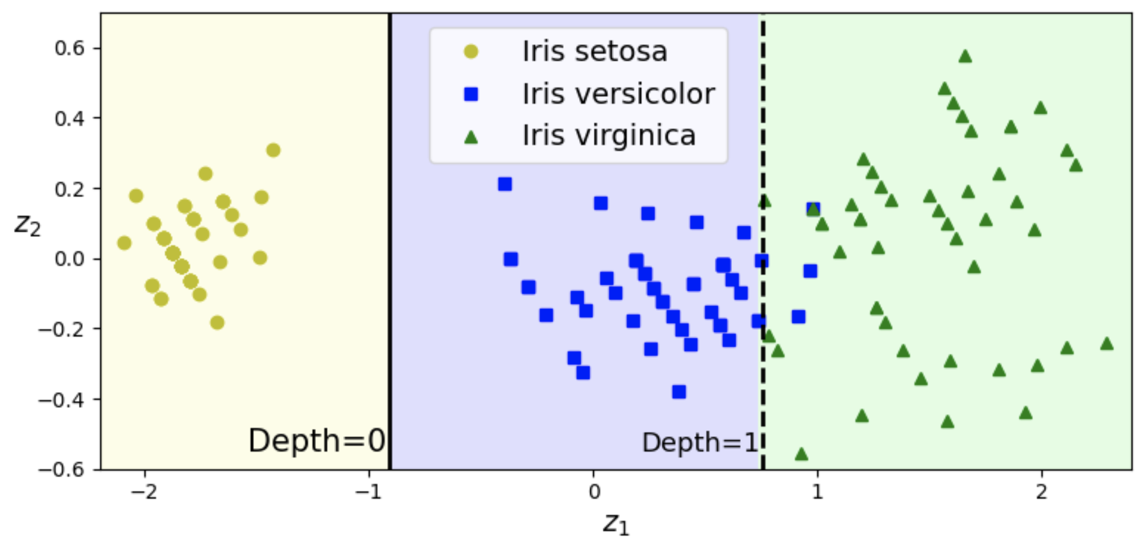
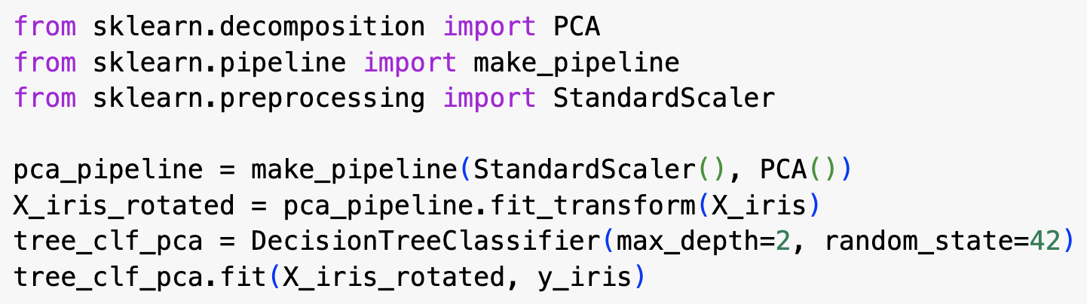
Using PCA to rotate the data
We can address this problem by scaling the data and then rotating it using PCA
PCA rotates the data so that the axes are as independent as possible (i.e., so that the correlation between the new features is minimized)
This often improves performance of a decision tree
Example above shows how we can almost perfectly separate the three classes in the iris dataset with just one feature, z₁, derived using PCA

Slide 26
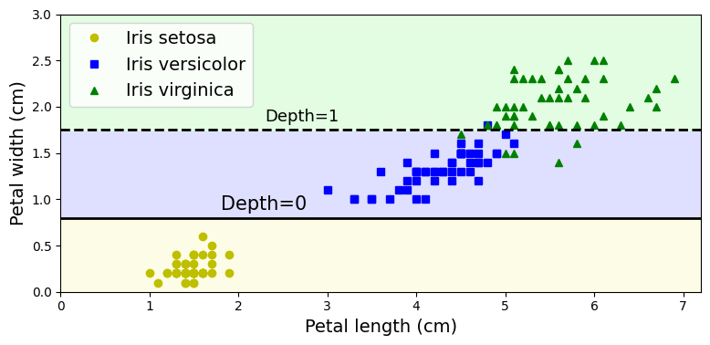
Decision trees have a high variance
Decision trees have high variance, which means that small changes to the data or hyperparameters can produce very different models
In fact, when we use a stochastic learning algorithm that selects the features to evaluate at random for each node, we can get a different model when re-training on the same data with the same hyperparameters
unless we fix the random_state value
Two models above were produced just by changing the random_state value
We can address this and reduce variance by averaging predictions over many trees – that is, by using an ensemble of trees, called a random forest

