Slide 1
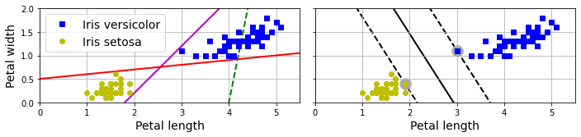
Support Vector Machines
David Meredith
dave@create.aau.dk
Aalborg University

Slide 2
Sources for this lecture
Chapter 5 of
Géron, A. (2023). Hands-On Machine Learning with Scikit-Learn, Keras & TensorFlow. (Third edition). O’Reilly. Available at
https://www.amazon.de/-/en/Aur%C3%A9lien-G%C3%A9ron/dp/1098125975/
https://www.saxo.com/dk/hands-on-machine-learning-with-scikit-learn-keras-and-tensorflow_bog_9781098125974
https://factumbooks.dk/?search_string=hands-on+machine+learning+with+scikit-learn
Jupyter Notebook for this lecture:
https://github.com/ageron/handson-ml3/blob/main/05_support_vector_machines.ipynb

Slide 3
Introduction
A support vector machine (SVM) is a powerful and versatile type of machine learning model that can be used for
linear and non-linear classification
regression
novelty detection
SVMs are particularly good for small to medium-sized datasets (hundreds to thousands of instances), especially for classification
However, the do not scale well to very large datasets

Slide 4
Linear SVM classification
The graphs above show part of the iris dataset
The two classes can clearly be separated by a straight line – they are linearly separable
The plot on the left shows the decision boundaries of three possible linear classifiers
the green line does not separate the classes
the pink and red lines both successfully separate the classes
However, the pink and green lines pass very close to instances in the dataset, so it seems likely that these will not generalize well to new instances

Slide 5
Large margin classification
In contrast, the solid black line in the right-hand diagram is the decision boundary of an SVM classifier
This line separates the classes and stays as far away from the training instances as possible
An SVM tries to fit the “widest possible street” (represented by the dashed lines) between the classes
This is called large margin classification

Slide 6
Linear SVM classification
Adding new instances ”off the street” will not affect the decision boundary at all: it is fully determined – or supported – by the instances that lie on the edge of the “street” – these instances are called the support vectors (circled in the diagram)

Slide 7
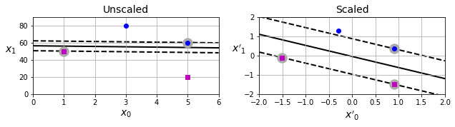
SVMs are sensitive to feature scaling
SVMs are sensitive to feature scaling
The values of the x₁ parameter in the left-hand plot above are much larger than those in the x₀ parameter
This makes the “widest possible street” between the classes rather narrow and almost horizontal
If we scale the features (e.g., with Scikit-Learn’s StandardScaler), the ”street” gets much wider and is also no longer horizontal (right-hand plot)
This makes it more likely that it will generalize to new instances

Slide 8
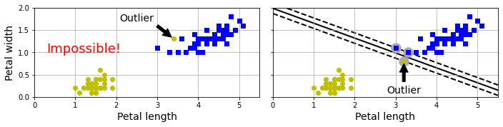
Hard margin classification
If we impose the constraint that all training instances must be “off the street” and (of course) on the correct side of the decision boundary, then this is called hard margin classification
There are two main problems with hard margin classification:
First, hard margin classification only works if the training instances in the different classes are linearly separable
Second, it is very sensitive to outliers
In the left-hand graph above, we add a single outlier that makes it impossible to find a hard margin
In the right-hand graph, we add a single outlier that makes the “widest possible street” much narrower, and therefore unlikely to generalize well to new instances

Slide 9
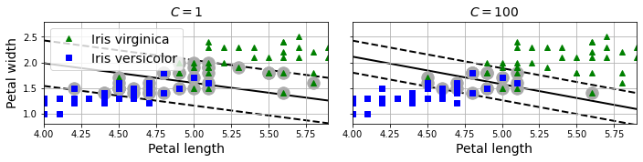
Soft margin classification
To avoid the problems with hard margin classification, we use a more flexible approach, where the objective is to find a good balance between
keeping the street as wide as possible
while limiting the number of margin violations (i.e., instances that end up in the middle of the street or even on the wrong side of the decision boundary)
This is called soft margin classification

Slide 10
Controlling margin violations with the regularization hyperparameter, C
We can control the balance between the number of margin violations and the width of the street using the regularization hyperparameter, C
If you set C to a low value, then we get more regularization: it increases the width of the street and leads to more margin violations (left-hand plot)
All the instances with grey circles behind are margin violations because they are “on the street”
These instances are said to “support” the street
This reduces the likelihood of overfitting – but can lead to underfitting (as it probably does here) if C is too low
If we set C to a high value (right-hand plot), then the street gets narrower and we get fewer margin violations
Here, it seems C=100 gives a more generalized solution than C=1

Slide 11
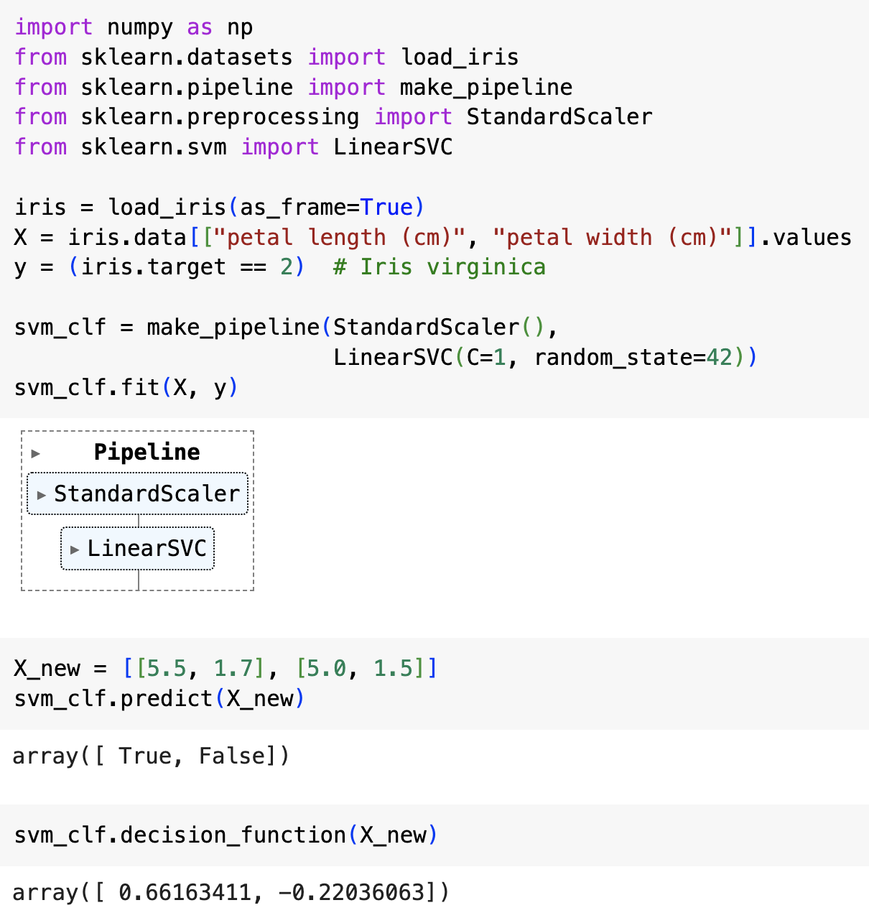
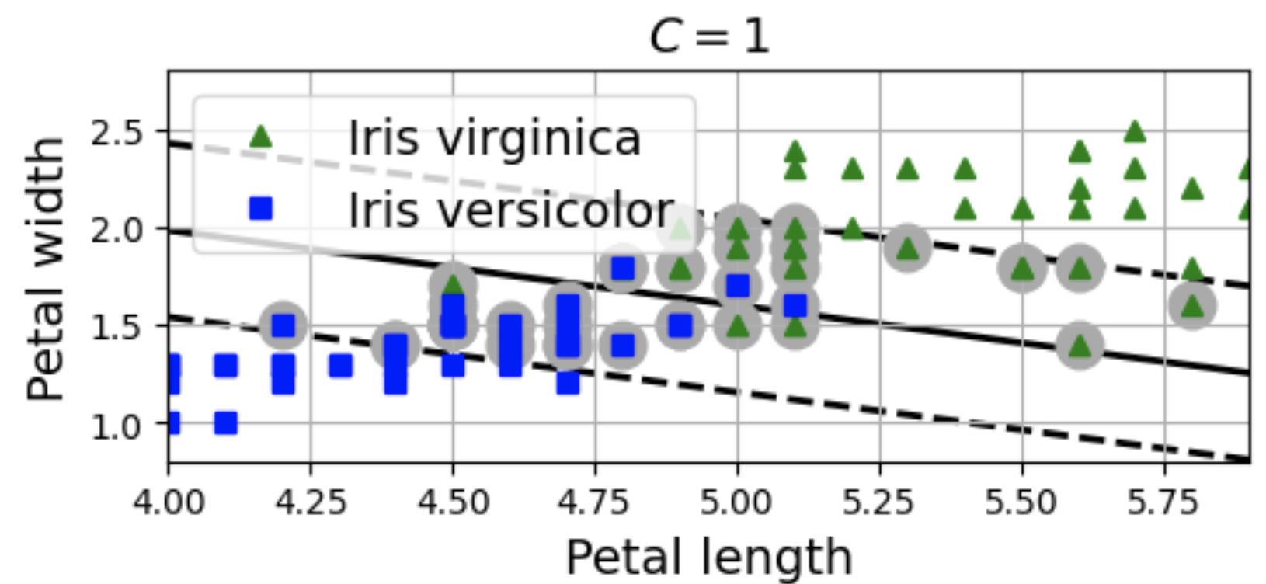
Running an SVM classifier in Scikit-Learn
The code on the left
loads the iris data,
defines the target to be whether or not the instance is virginica (i.e., it is a virginica detector)
scales the features
trains an SVM classifier (LinearSVC) with C=1
uses the classifier to classifier two new instances
The resulting model is the one below
The model predicts the first “test” instance is a virginica and the second is not
The decision_function scores used to make this classification are shown

Slide 12
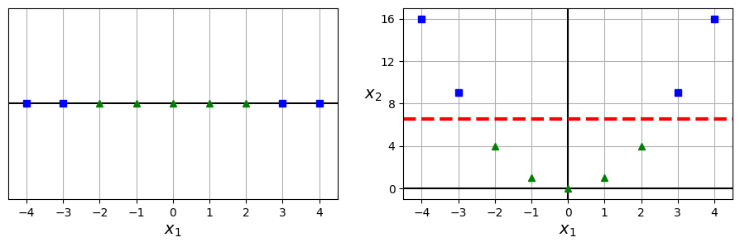
Nonlinear SVM classification
Linear SVM classifiers are efficient and often work surprisingly well
However, many datasets are not even close to being linearly separable (see above left)
One way of dealing with nonlinear datasets is to add more features, such as polynomial features generated from existing features (as we did with polynomial regression)
In example above, the dataset only contains one input feature, x₁
We can add a second feature which is just the square of x₁ to get a dataset that is perfectly linearly separable

Slide 13
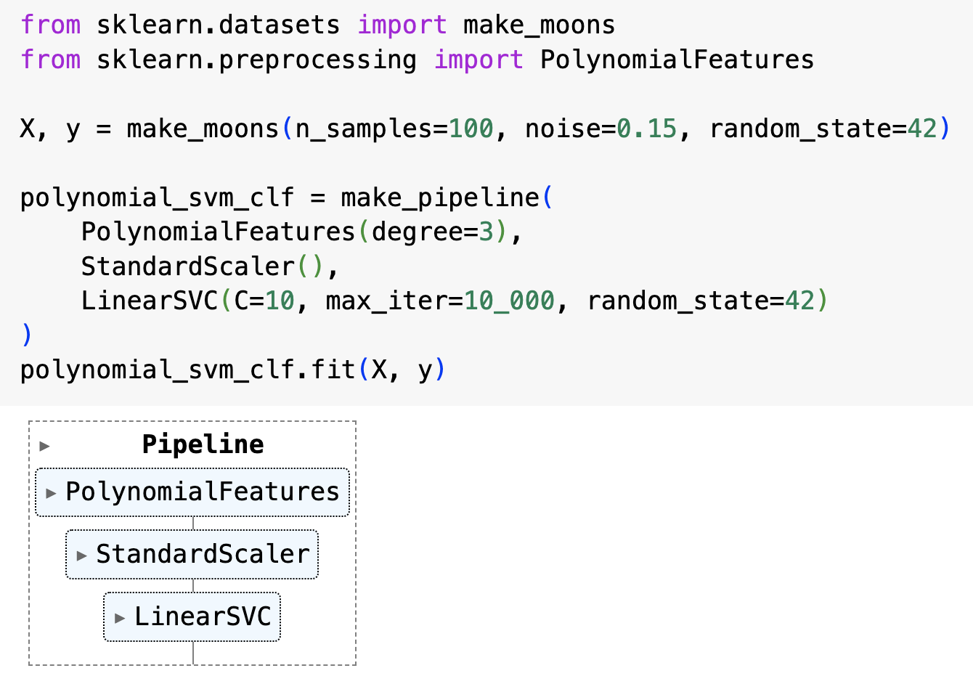
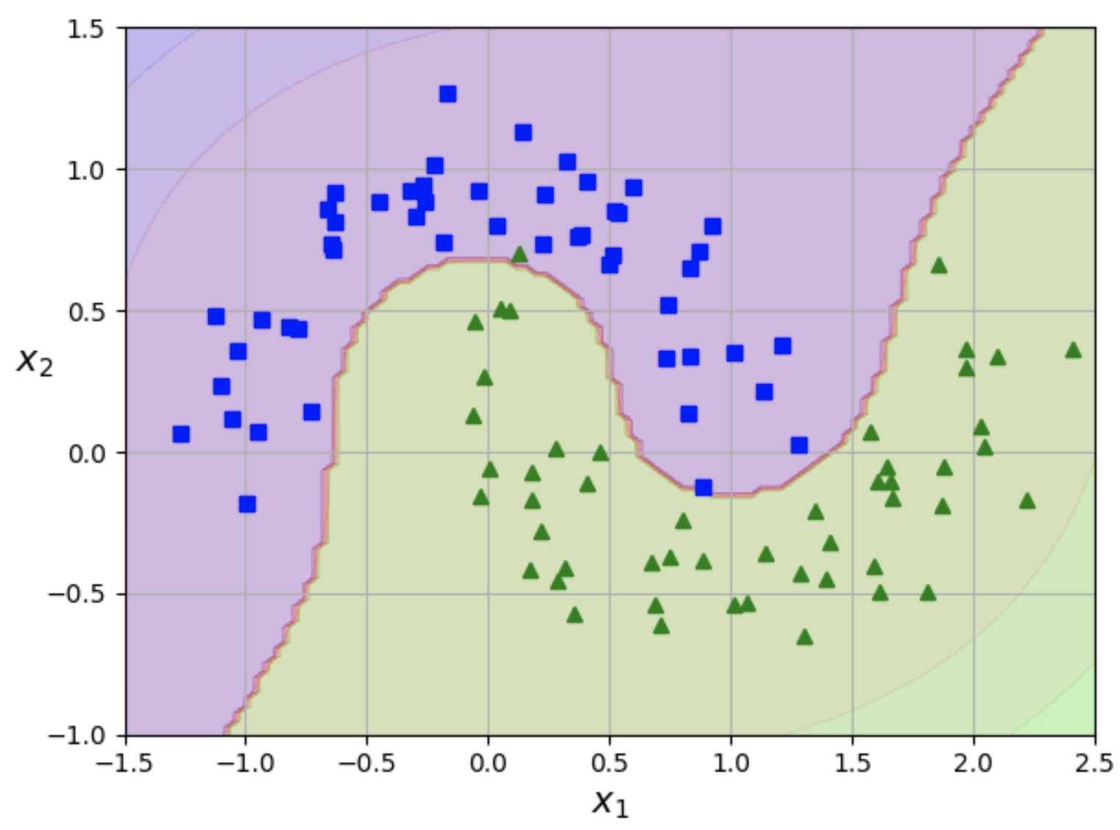
Nonlinear SVM classification
In Scikit-Learn, you can create a pipeline that
generates the new polynomial feature using the PolynomialFeatures transformer
scales the features using a StandardScaler
trains an SVM classifier (LinearSVC)
Plot above shows result of doing this on the “moons” dataset

Slide 14
Polynomial kernel
Generating polynomial features is simple to implement and works well with many different types of machine learning algorithms
However, using a low polynomial degree might not be able to capture the structure in more complex datasets
And with high polynomial degree, you generate a huge number of features making the model too slow

Slide 15
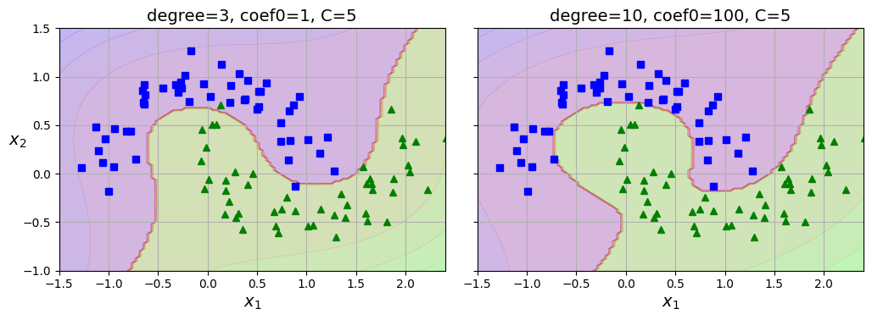
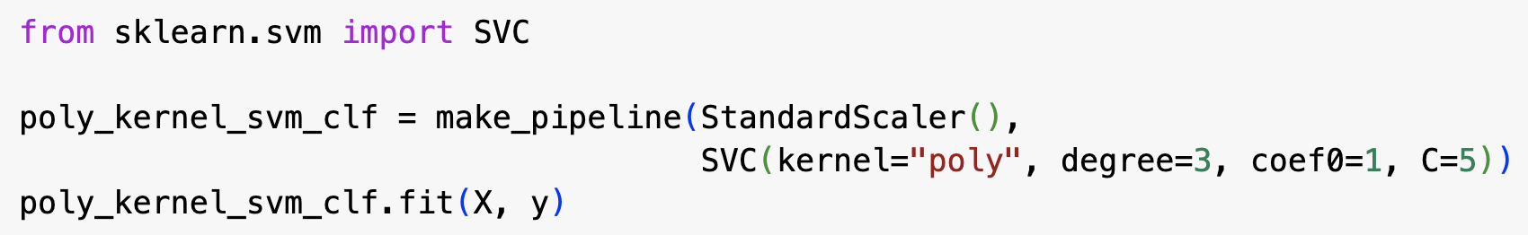
Polynomial kernel
When using SVMs, you have the alternative of using an extremely effective technique called the kernel trick
The kernel trick lets you achieve the same result as if you had added many polynomial features, but without actually adding them, thus avoiding any combinatorial explosion in the number of features and the associated slow-down
This trick is implemented in the Scikit-Learn’s SVC class
The code above trains an SVM classifier using a 3rd degree polynomial kernel (plot above left)
The plot above right shows the result of using a 10th degree kernel
The coef0 parameter controls how much the model is affected by high-degree terms

Slide 16
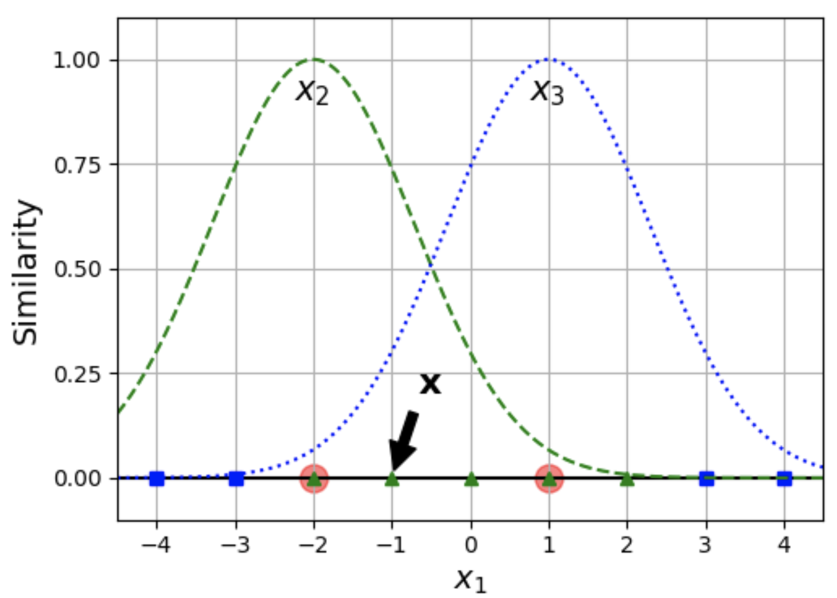
Using similarity features to handle nonlinear problems
Another way of handling nonlinearity is to add features that represent how similar the values in some features are to certain landmarks
We did this in the California house pricing problem, where we represented the locations of districts by how far away they were from certain landmark locations
For example, we could add two landmarks, x1 = -2 and x1 = 1, to the 1D example from earlier and generate two new similarity features where the values are given by a Gaussian RBF with 𝛾 = 0.3 (see left plot above)
Gaussian RBF returns a lower value the further away an instance is from its landmark

Slide 17
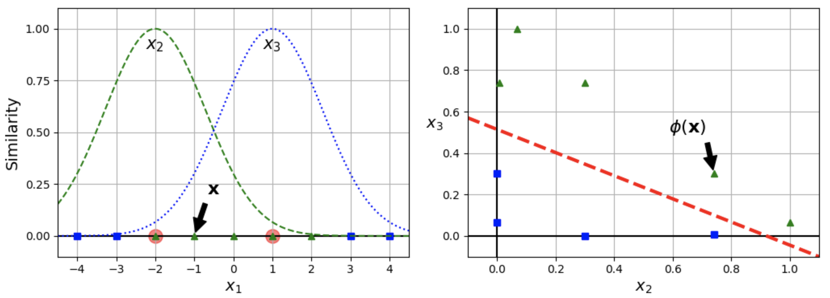
Similarity features
We can now define two new features, x₂ and x₃, where one represents how similar x₁ is to the landmark, x₁ = -2; and the other feature represents how similar x₁ is to the landmark, x₁ = 1
As shown in the plot above right, the dataset is now linearly separable using these new features

Slide 18
Selecting landmarks
How do we select the landmarks?
Simplest approach is to create a landmark at every distinct value of the feature in the training set
This creates many new dimensions and increases chances that the transformed training set will be linearly separable
Downside of this is that you can end up with as many landmarks (and therefore new similarity features) as there are instances in the dataset

Slide 19
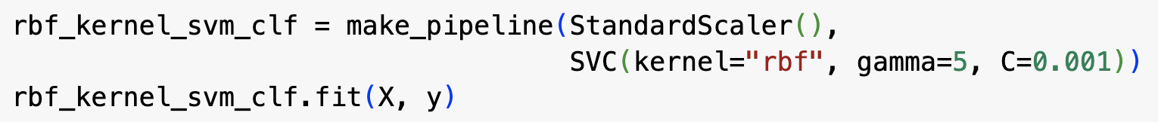
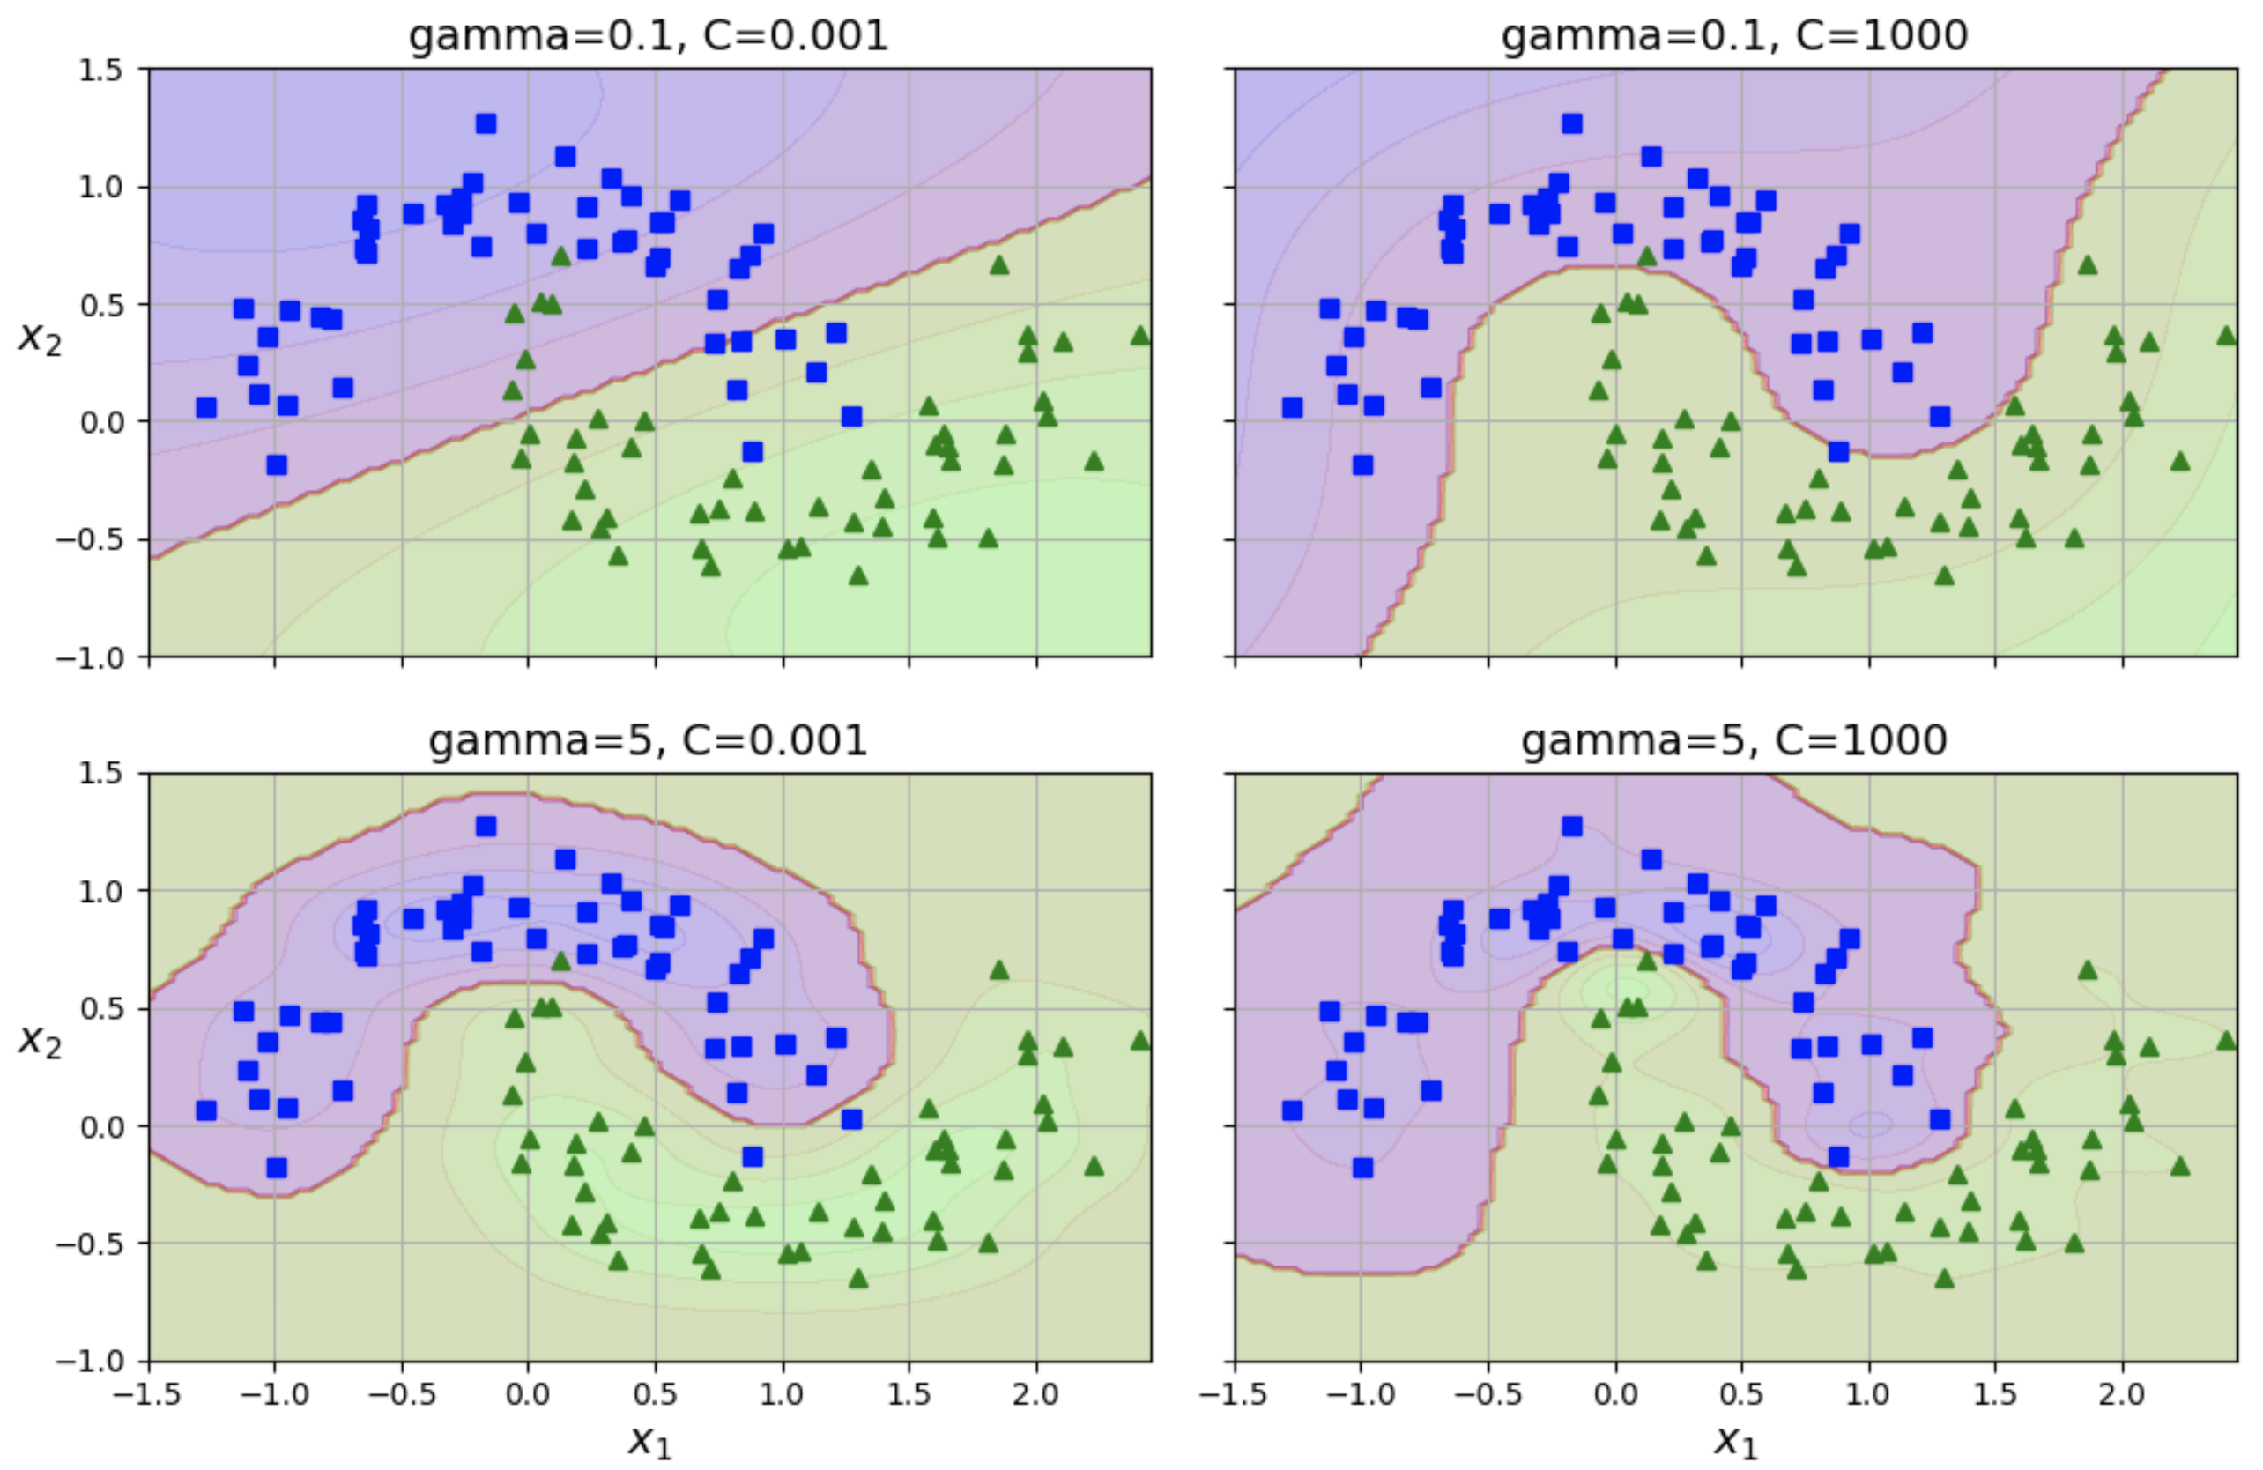
Gaussian RBF kernel
As with adding polynomial features, it can be computationally expensive to add many similarity features
Once again, the kernel trick can be used with an SVM model to make it possible to obtain a similar result as if you had added many similarity features, but without actually doing so
The code above runs an SVM classifier with a Gaussian RBF kernel with 𝛾 = 5 and C = 0.001
result is shown in the bottom left plot

Slide 20
Gaussian RBF kernel – effect of changing 𝛾 and C
Increasing gamma makes the Gaussian RBF narrower, so that the similarity falls more quickly as you move away from the landmark
Each instance’s range of influence becomes smaller and the decision boundary becomes more fussy and irregular (bottom two graphs on left)
Increasing gamma for a feature x_{i} means that more instances have values close to x_{i} = 0
Conversely, decreasing gamma increases each instance’s range of influence and the decision boundary becomes smoother
So 𝛾 acts like a regularization hyperparameter: if your model is overfitting, try decreasing 𝛾; if it is underfitting, try increasing 𝛾
similar to the C hyperparameter

Slide 21
Which SVM kernel should you use?
Always try the linear kernel first
LinearSVC is much faster than SVC(kernel=“linear”), especially if the training set is very large
If your dataset is not too large, then also try kernelized SVMs, starting with the Gaussian RBF kernel – it often works very well

Slide 22
SVM classes and computational complexity
LinearSVC does not use the kernel trick, but does use a highly optimized algorithm that scales linearly with the size of the dataset and the number of features
training time is O(mn)
SVC class uses the kernel trick, so its running time is O(m²n) to O(m³n)
gets very slow if you have hundreds of thousands of instances
best for small to medium-sized nonlinear training sets
scales well with the number of features, especially when these are sparse
running time grows linearly with the number of non-zero features
SGDClassifier also performs large margin classification and its hyperparameters (alpha, penalty, learning_rate) can be adjusted to produce similar results to a linear SVM
uses stochastic gradient descent, so it can do incremental, out-of-core learning on large datasets
running time is O(mn)

Slide 23
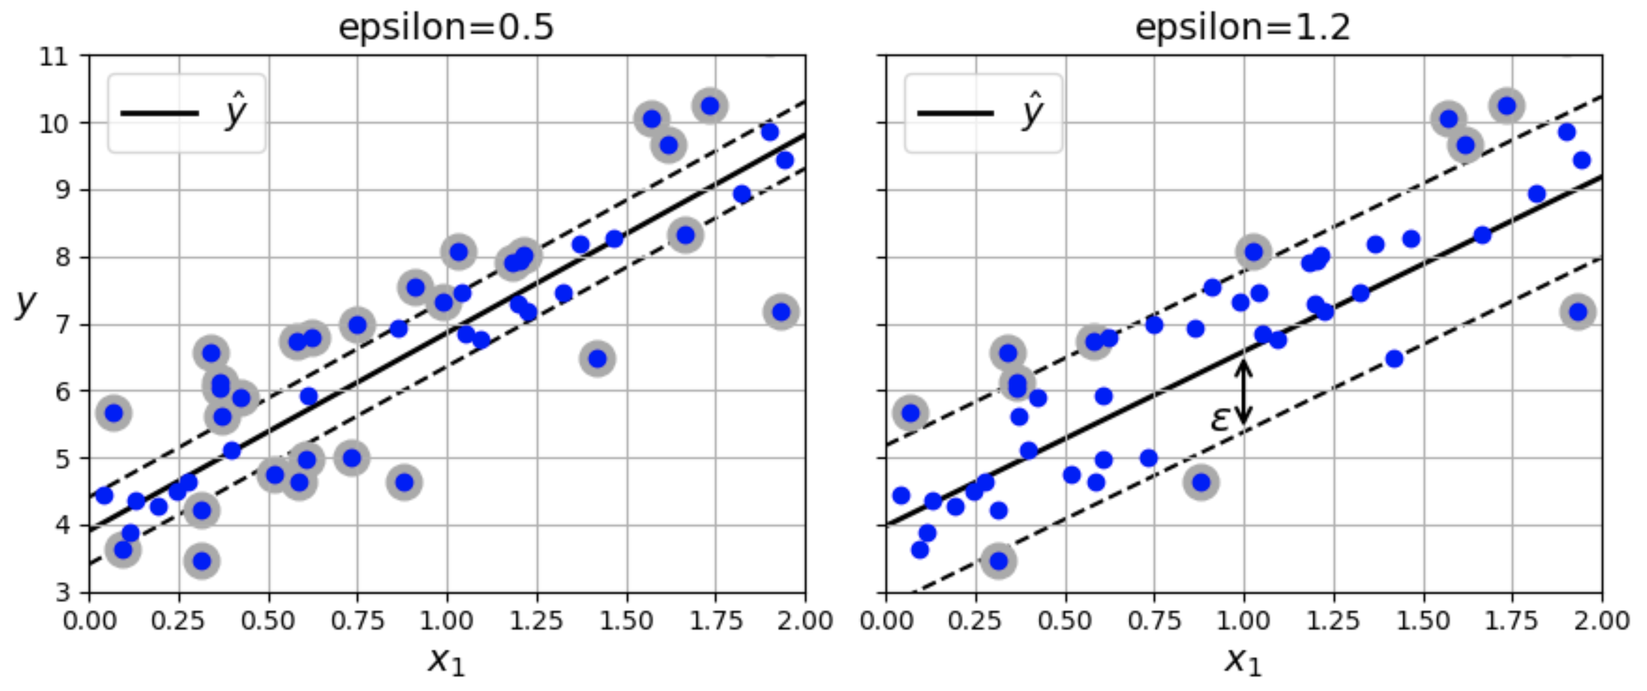
SVM Regression
SVMs can be used for regression as well as classification
When used for classification, the SVM tries to fit the widest possible street between two classes, while minimizing margin violations
where a margin violation is when an instance is on the street
When used for regression, the SVM tries to fit as many instances as possible on the street, while minimizing margin violations
where a margin violation is when an instance is off the street
The width of the street is controlled by a hyperparameter, 𝜀
The plots above show linear SVM regression models with a small margin (𝜀 = 0.5, on left) and a larger margin (𝜀 = 1.2, on the right)

Slide 24
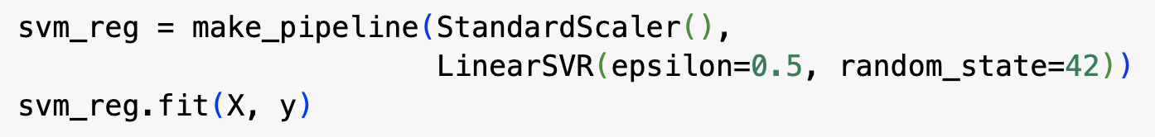
SVM Regression
Decreasing 𝜀 increases the number of support vectors (i.e., instances off the street) – this regularizes the model
If you add more training instances within the margin defined by 𝜀, then the model’s predictions will not be affected – the model is said to be 𝜀-insensitive
You can use the Scikit-Learn LinearSVR class to perform linear SVM regression – code above produces model in the left-hand plot

Slide 25
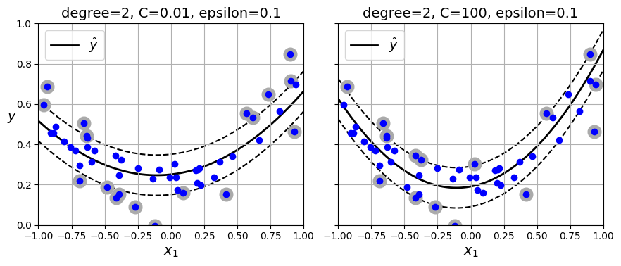
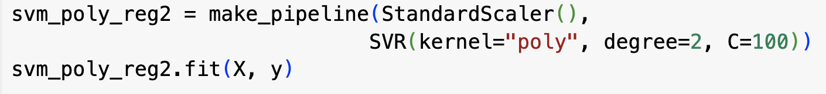
Nonlinear regression with an SVM
You can use a kernelized SVM to do nonlinear regression
Plots above show SVM regression on a random quadratic training set, using 2nd degree polynomial kernel
There is more regularization in the left-hand plot – why?
Code above creates model shown in the right-hand plot

Slide 26
Nonlinear regression with an SVM
LinearSVR class is the regression equivalent of the LinearSVC class
scales linearly with the size of the training set
The SVR class is the regression equivalent of the SVC class
both get very slow when used on large datasets

Slide 27
Hard margin linear SVM classification
As with a logistic regression classifier, a linear SVM predicts the class of an instance by using its decision function to multiply (the transpose of) the parameter vector by the instance’s feature vector to get a score
if the score is positive, then it classifies the instance as being in the positive class (denoted by 1)
if the score is negative, it classifies it as being in the negative class (denoted by 0)
This is done using the equation above
In this equation, x’, is the result of prepending a 1 to the instance’s feature vector, x, 𝜃₀ is the bias term and 𝜃₁ to 𝜃_{n} are the feature weights

Slide 28
Hard margin linear SVM classification
Instead of prepending a 1 to x, we can express the decision function in a different way as shown in eq. 23 above

Slide 29
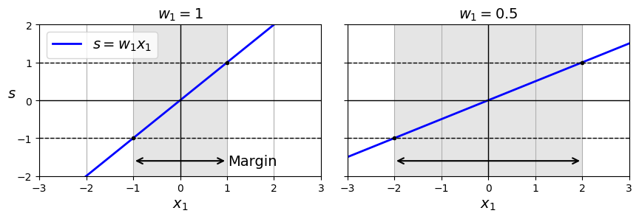
Training a hard margin SVM classifier
Training a linear SVM classifier requires finding w and b that maximise the width of the street while limiting the number of margin violations
To maximise the width of the street, we need to minimise the size of w
Example above shows how margin for a feature, x₁, gets wider as the weight gets smaller – we assume that the borders of the street are at the positions where the decision function returns -1 or +1

Slide 30
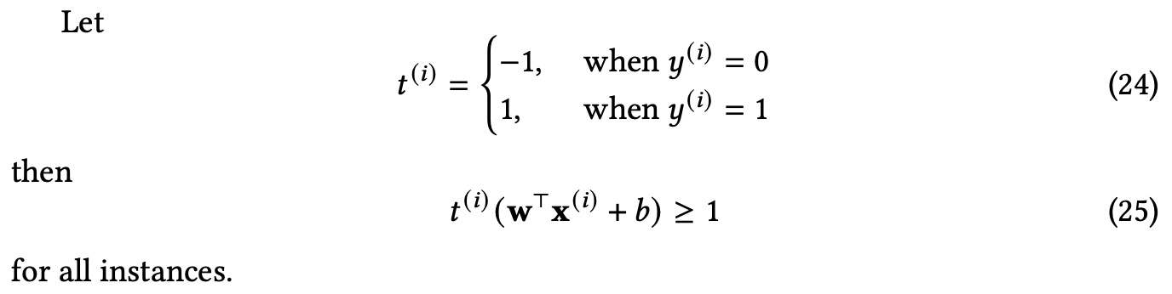
Training a hard margin SVM classifier
To avoid margin violations, we need the decision function to be greater than 1 for all positive training instances and less than -1 for all negative training instances
remember that the margins are positions where the decision function is equal to +1 or -1
We can express this mathematically using eq. 25 above

Slide 31
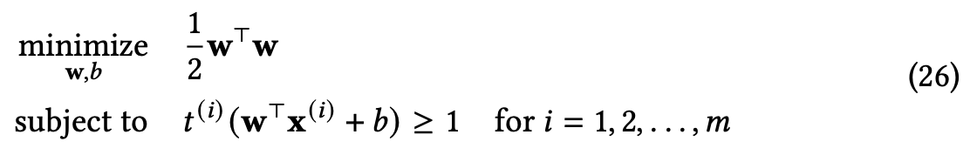
Hard margin linear SVM classifier objective
So the overall optimization problem solved by an SVM classifier can be expressed using the equations above
Note that values minimize the cost function iff they also minimize the l2-norm of w
Defining the cost function in this way means that the gradient is simply w
The l2-norm of w is not differentiable at w = 0, whereas w is – optimization algorithms typically work better if there is a defined gradient everywhere

