Slide 1
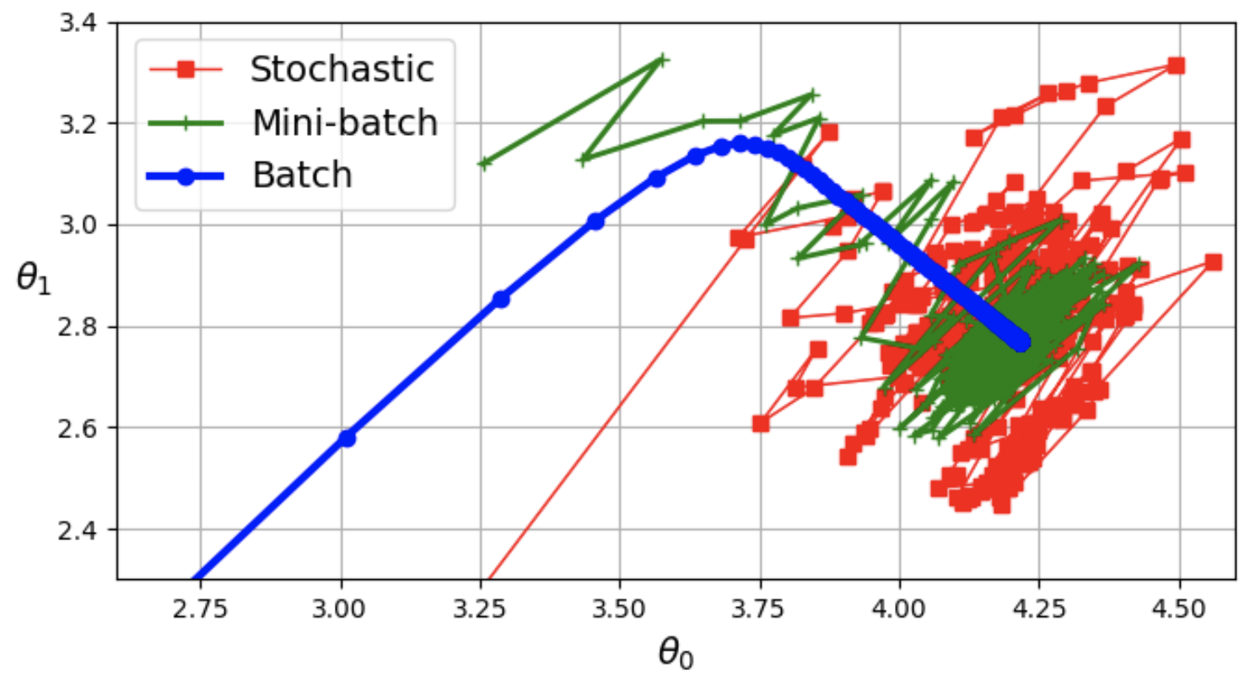
Training Models
David Meredith
Aalborg University
dave@create.aau.dk

Slide 2
Source
Chapter 4 of
  Géron, A. (2023). Hands-On Machine Learning with Scikit-Learn, Keras & TensorFlow. (Third edition). O’Reilly. Available at
    https://www.amazon.de/-/en/Aur%C3%A9lien-G%C3%A9ron/dp/1098125975/
    https://www.saxo.com/dk/hands-on-machine-learning-with-scikit-learn-keras-and-tensorflow_bog_9781098125974
    https://factumbooks.dk/?search_string=hands-on+machine+learning+with+scikit-learn
Jupyter notebook for chapter 4:
  https://github.com/ageron/handson-ml3/blob/main/04_training_linear_models.ipynb

Slide 3
Introduction
If you’ve worked through the exercises so far, you’ll have optimized a regression system, improved a hand-written digit classifier and even built a spam filter from scratch, without having to know how any of these models actually work at a low level!
However, knowing something about how these models work will help you to do things like
  select the appropriate type of model
  choose the right training algorithm
  find a good set of hyperparameters for your task
Understanding how the models work will also help you to debug them and analyse errors
You will also need to understand how models are trained in order to effectively design neural network models

Slide 4
Introduction
In this lecture we’ll look at two very different ways of training a linear regression model (one of the simplest types of model)
We will look at using
  a closed-form equation that computes the best fit model parameters directly from the training dataset
  an iterative optimization approach called gradient descent (GD) that gradually tweaks the model parameters, converging to the values computed using the closed-form equation
    we will actually look at three types of gradient descent: batch GD, mini-batch GD and stochastic GD
We will also look into training a polynomial regression model
  This type of model has more parameters and is therefore more prone to overfitting
We’ll use learning curves to determine whether overfitting has occurred
We’ll look at regularization techniques that can be used to avoid overfitting
Finally we’ll look at two types of model that are commonly used for classification: logistic regression and softmax regression

Slide 5
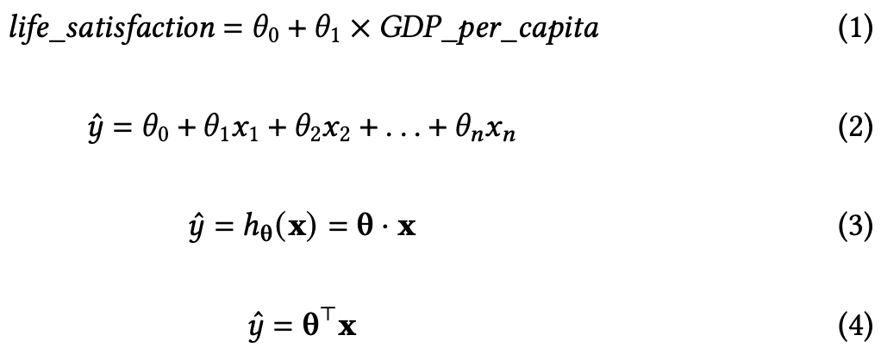
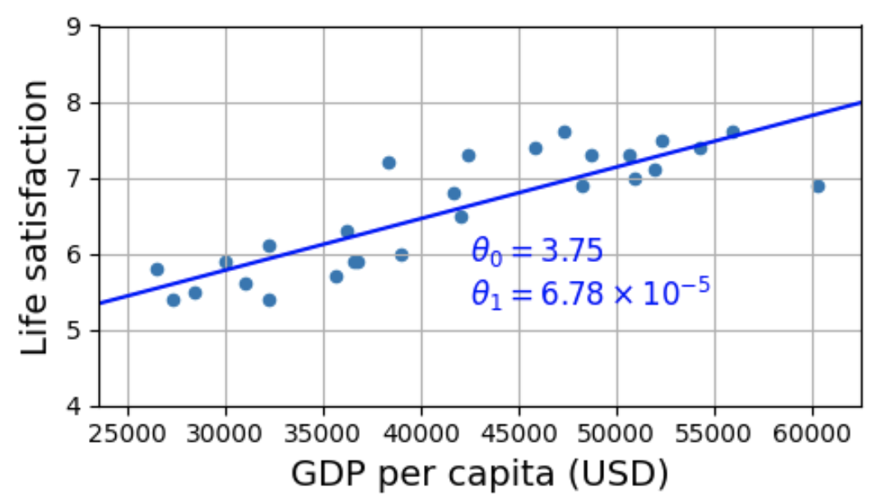
Linear regression
In the first lecture, we looked at a simple linear regression model of life satisfaction as a linear function of GDP per capita (eq. 1)
In this equation, 𝜃₀ and 𝜃₁ are parameters of the model, where 𝜃₀ is the y-intercept (or bias) and 𝜃₁ is the slope of the line
In general, a linear model predicts a value by computing a weighted sum of the input features, plus a constant called the bias term (or intercept) (eq. 2)
We can write equation 2 more concisely by remembering the definition of the dot product, then gathering all the parameters into a parameter vector, 𝛉, and all the input feature values into a feature vector, x (eq. 3)
In eq. 3, we assume 𝛉 and x are column vectors
We can achieve the same computation by transposing 𝛉 and then matrix multiplying it by x (eq. 4)

Slide 6
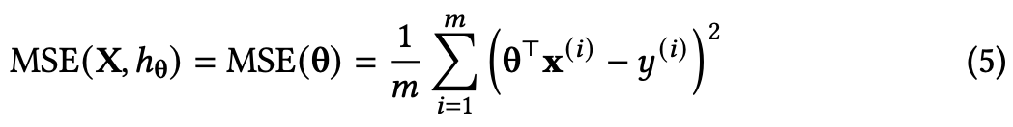
How do we train a linear regression model?
Training a model means finding parameter values that minimise the error in its predictions over some training set of instances
For this we need a performance measure to minimise and we commonly use the root mean square error (RMSE)
But instead of the RMSE, we can just minimise the mean squared error (MSE) instead, since we’ll get the same values for the parameters (eq. 5)

Slide 7
The Normal Equation
There exists a closed-form equation that lets us estimate 𝜃 directly from our input features, X, and our given labels, y (eq. 6)
This equation means that, in order to find the optimal values of the parameters in a linear model, we first multiply the transpose of the matrix of the input features by the input feature matrix, then we take the matrix inverse of the result, then we multiply this by the transpose of the input feature matrix again, then we multiply by the vector of labels

Slide 8
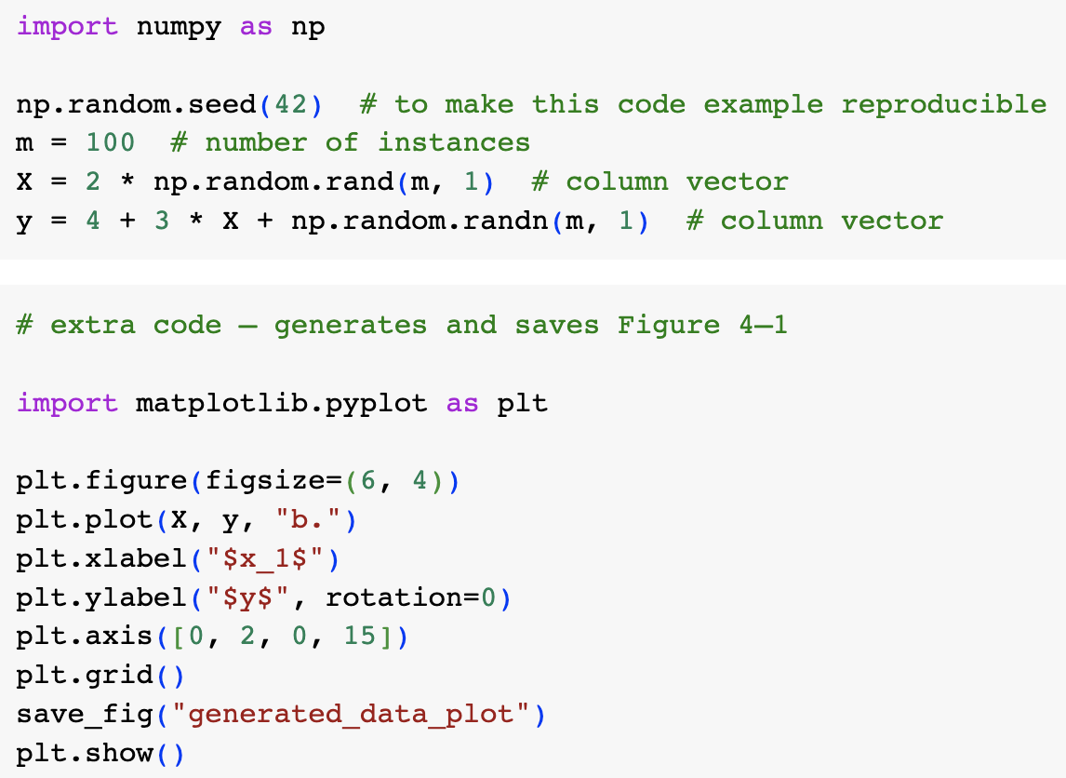
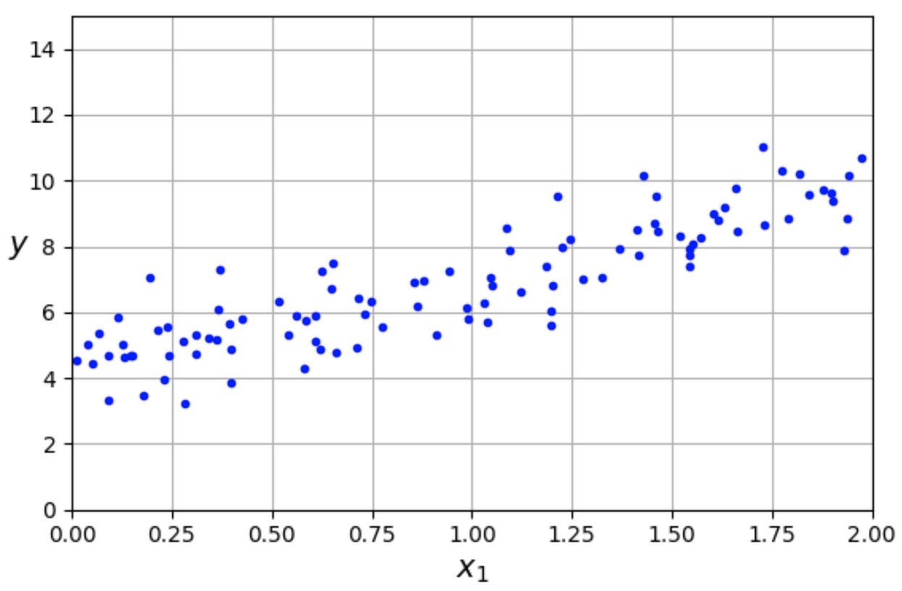
Using the Normal Equation in Python
Let’s experiment with using the Normal Equation in Python
First we need some data that is roughly linear
We can get this by generating a random column vector for the x coordinates and then use a linear function with a random term to generate the y coordinates
  Note that random.rand generates numbers from a uniform distribution, while random.randn generates them from a Gaussian distribution

Slide 9
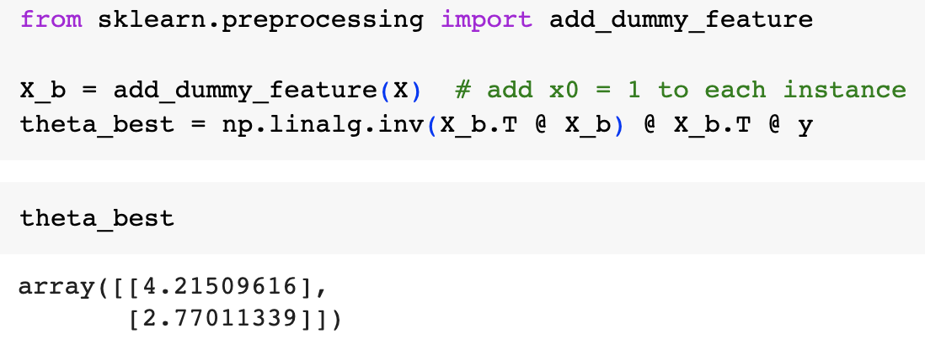
Using the Normal Equation in Python
Having generated some data, we can then use the Normal Equation to try to recover the parameters we used to generate it
We can compute a matrix inverse using NumPy’s inv() function and the @ operator for matrix multiplication
Remember that 𝜃₀ is a constant, so the first feature in each feature vector has to be a 1 - we therefore have to add a “dummy feature” of value 1 to the input feature matrix
Note that the noise we added to the data made it impossible to recover the exact parameter values we used to generate the data, but it is pretty close
The smaller the dataset and the noisier it is, the harder it would be to return the original parameter values

Slide 10
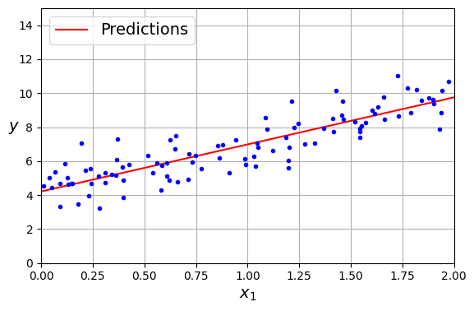
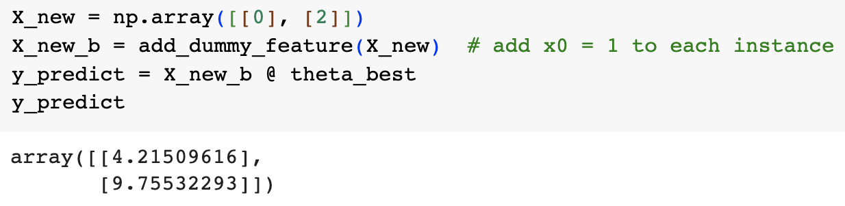
Using the Normal Equation to find parameter values
Having found our parameter vector, we can now use it to make some predictions
We just need to matrix multiply an array to which we’ve added a dummy variable by the parameter vector

Slide 11
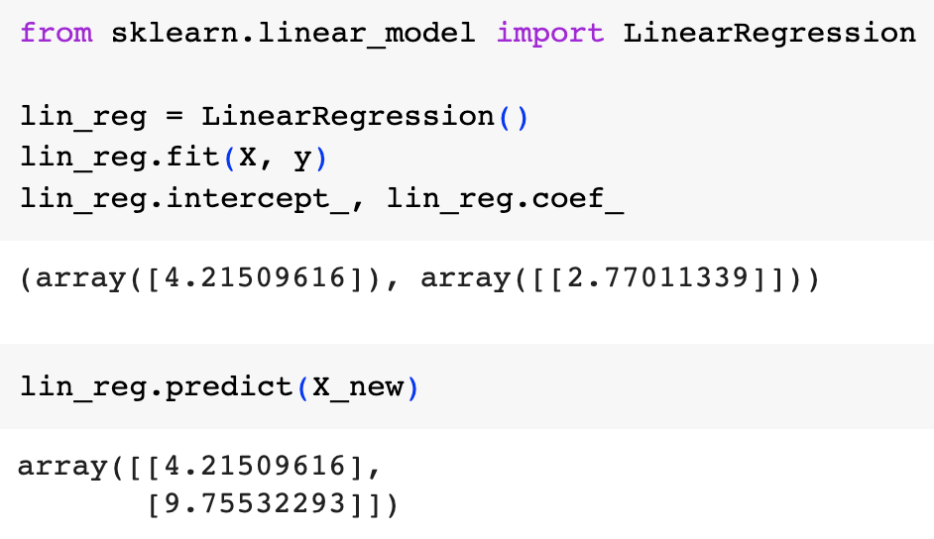
Performing linear regression with Scikit-Learn
As we saw in the first lecture, performing linear regression with Scikit-Learn is very straightforward
We can fit a linear regression model to the same data and then interrogate the object to find out what parameter values it has learnt
  Note that Scikit-Learn separates the intercept (bias parameter) (.intercept_) from the coefficients or feature weights (.coef_)
Note that Scikit-Learn learns the same values as we arrived at using the Normal Equation

Slide 12
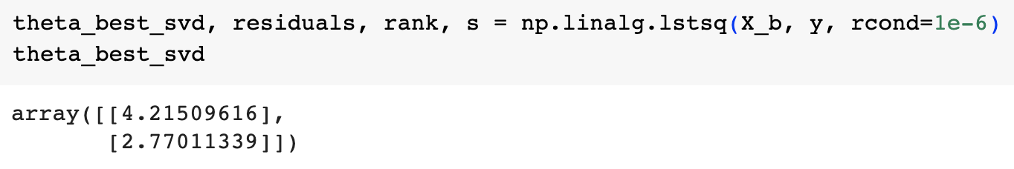
Using scipy.linalg.lstsq and singular value decomposition to find the parameters
The sklearn LinearRegression class uses the scipy.linalg.lstsq() function to calculate the parameter values using the method of least squares
The function multiplies the pseudoinverse, X⁺, by the labels to get the estimated parameter vector

Slide 13
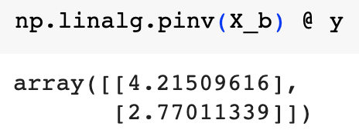
Using the pseudoinverse to calculate the parameter values
You can get the pseudoinverse using the np.linalg.pinv() function
This is computed using a standard matrix factorization technique known as singular value decomposition (SVD)
SVD decomposes the training set matrix into the product of three matrices, X=U𝚺V^{T}
The pseudoinverse, X⁺, is then V𝚺⁺U^{T}
This is actually more efficient than computing the Normal Equation

Slide 14
Running time
The Normal Equation computes the inverse of X^{T}X
This takes at best O(n^{2.4}) time or even up to O(n³) time, depending on which algorithm is used
  So if you double the number of features, the running time goes up by a factor of 5 to 8
The SVD approach is more efficient with a running time of O(n²), so if you double the number of features, the running time goes up by 4 times
Both the SVD approach and the Normal Equation get very slow when the number of features gets large (e.g., over 100000)
However, the running time of both increases linearly with the number of instances

Slide 15
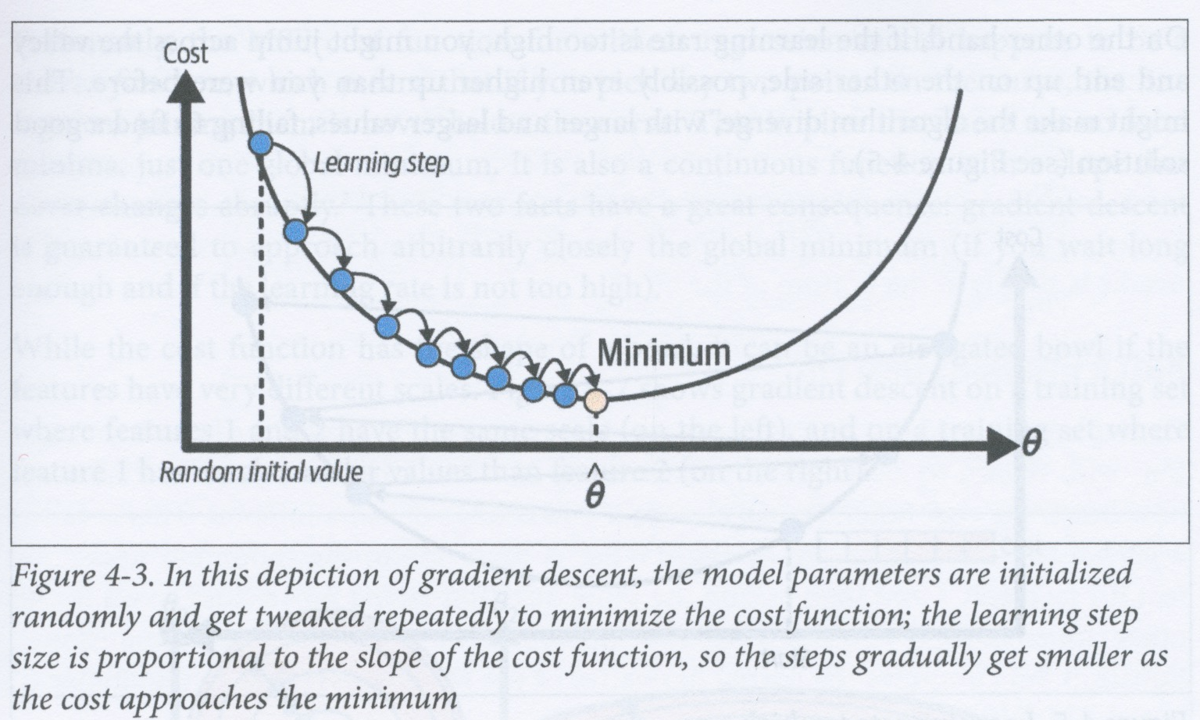
Gradient descent
The normal equation or the SVD approach cannot be used to find parameter values if the data has many features or if there are too many training instances to fit into memory
Gradient descent is a generic optimization algorithm capable of finding solutions to a large range of different problems
The general idea of GD is to tweak parameter values iteratively in order to minimize a cost funtion

Slide 16
Gradient descent
If you are lost in the mountains in fog, then a good strategy for getting to the bottom is to go downhill in the direction of the steepest slope
GD measures the local gradient of the error function wrt the parameter vector, 𝛉, and goes in the direction of greatest descending gradient
Once the gradient is zero, you have reached a minimum

Slide 17
Gradient descent
We start by randomly initializing the parameter vector
Then you improve it gradually, taking one small step at a time, each time trying to reduce the cost function (e.g., the MSE)
The algorithm should converge to a minimum MSE
The learning step size is proportional to the gradient, so the steps get smaller as you reach the minimum

Slide 18
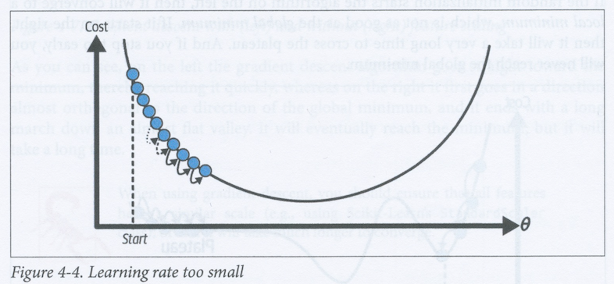
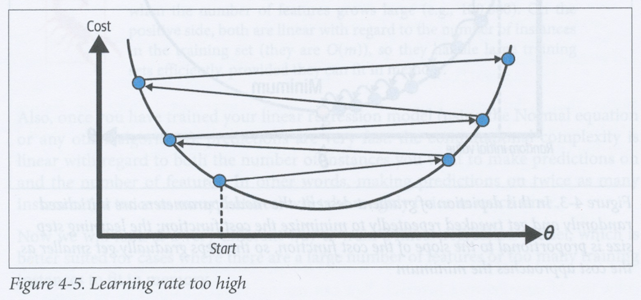
Learning rate
The learning rate hyperparameter determines the size of the steps that are taken
If the learning rate is too slow, then you’ll need many steps to converge to a minimum
If the learning rate is too fast, then you might repeatedly overshoot the minimum and end up on the other side of the valley

Slide 19
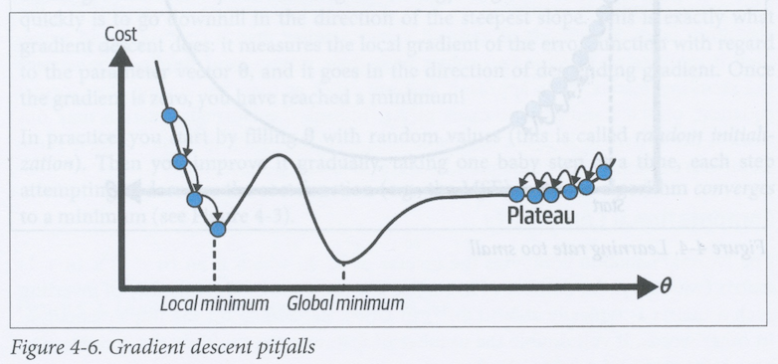
Gradient descent pitfalls
Cost functions are also not always nice simple bowl shapes
The cost function can have local minima and plateaus
If you start on the left in the example above, you’ll end up in a local minimum and never find the global minimum
If you start off on the right, then you’ll hit a plateau and it’ll take many iterations before you start dropping again towards the global minimum

Slide 20
GD is (almost) guaranteed to find a global minimum when using MSE for linear regression
Fortunately, the MSE cost function for a linear regression model is convex, meaning that if you join any two points with a straight line, that line will never be below the curve
Therefore there is only one global minimum
It is also a continous function whose gradient never changes abruptly
This means that GD is guaranteed to approach arbitrarily close to the global minimum, provided you wait long enough and your learning rate is not too high

Slide 21
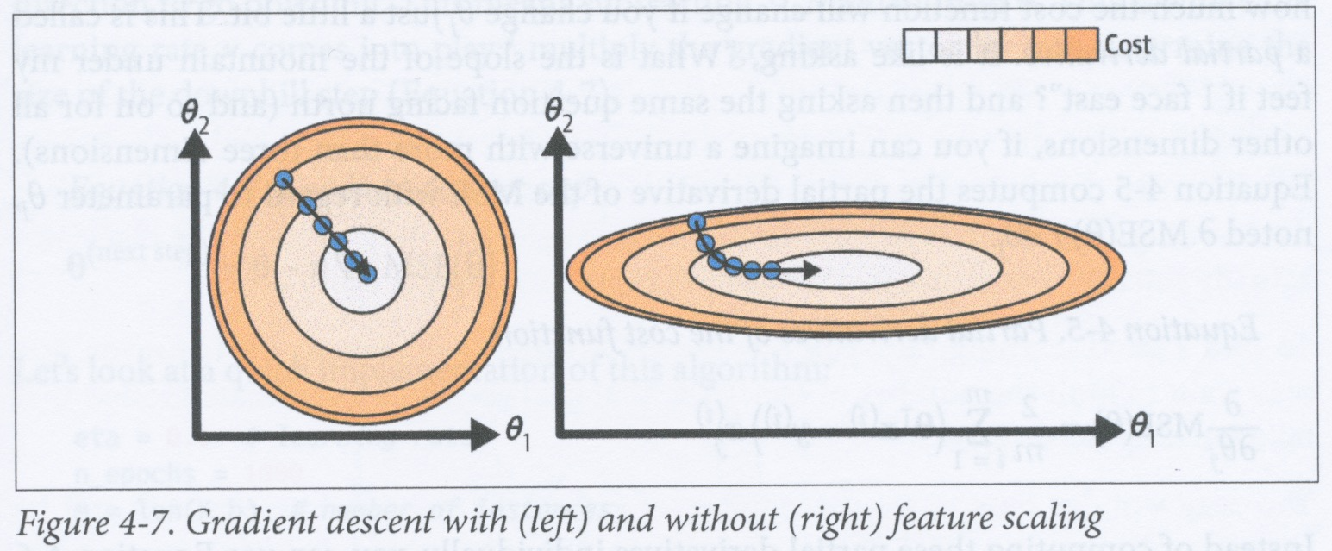
The importance of scaling in gradient descent
Although the MSE cost function has a bowl shape, it can be a very elongated bowl if the features have different scales
If all features have the same scale (see above left), then GD will descend almost directly to the global minimum
However, if the features have very different scales, then GD may start by going in a direction orthogonal to the direction to the minimum and then have to make a long gradual descent to the minimum, using many small steps (remember that the step size increases with the gradient)
This is why it is important to scale your features so that they have a similar range of values (e.g., by using the StandardScaler)

Slide 22
Multidimensional parameter spaces
The example above illustrates gradient descent when looking for the best combination of values for two parameters
In general, a linear model may have any number of parameters, each new parameter adds a dimension to the parameter space, so the search takes longer
Nevertheless, the cost function is convex, so there is always only one global minimum

Slide 23
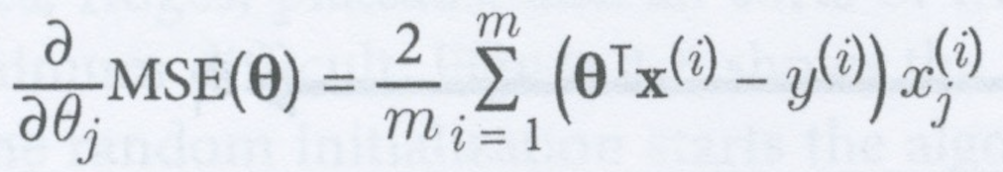
Batch gradient descent
When carrying out gradient descent, you have to compute the gradient of the cost function wrt each parameter, 𝜃_{j}
That is, you need to calculate for each parameter how much the cost function will change if you change that parameter by just a tiny bit
This is called a partial derivative (see above)

Slide 24
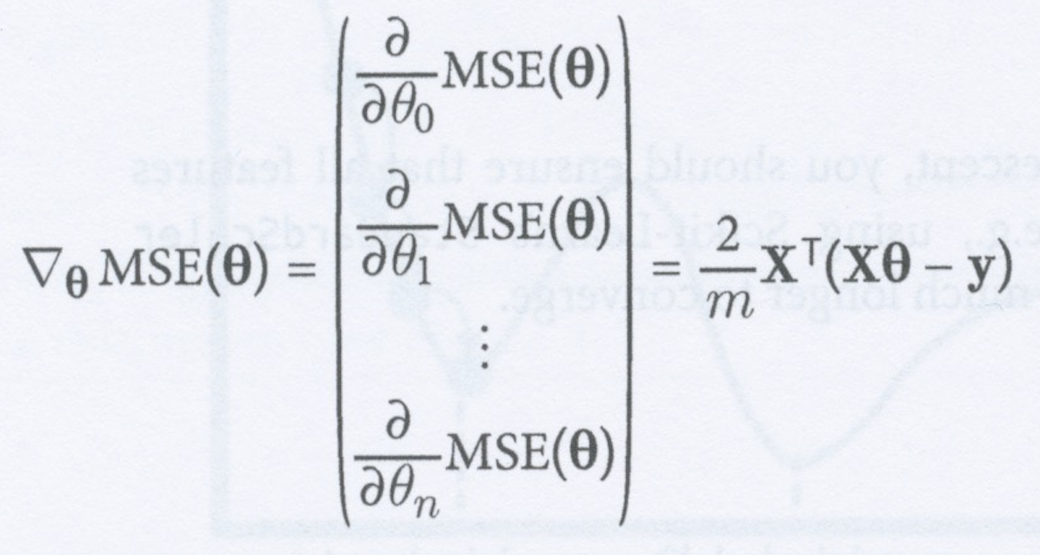
Gradient vector of the cost function
In practice, we compute all the gradients for all the features in one go to give a gradient vector of the cost function
Computing this formula involves calculating the gradients for all features over all the training set at each step in the gradient descent
This algorithm is therefore called batch gradient descent because it uses the whole batch of training data at each step
It is therefore very slow on large datasets
On the other hand, batch gradient descent scales well with the number of features and is much faster than the Normal Equation or SVD decomposition when there are a lot of features

Slide 25
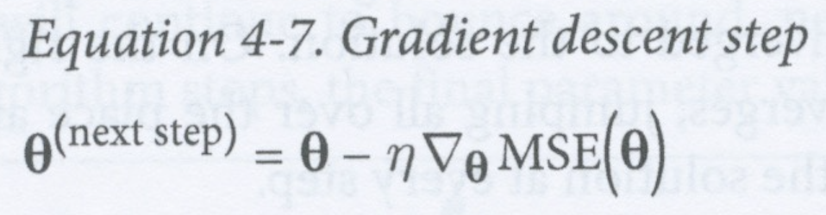
Taking a gradient descent step
Once we’ve computed the gradient vector, which points uphill, we then take a step in the opposite direction (i.e., downhill)
This means subtracting a multiple, η, of the gradient from the current value of the parameter vector to get the next value of the parameter vector
η is the learning rate

Slide 26
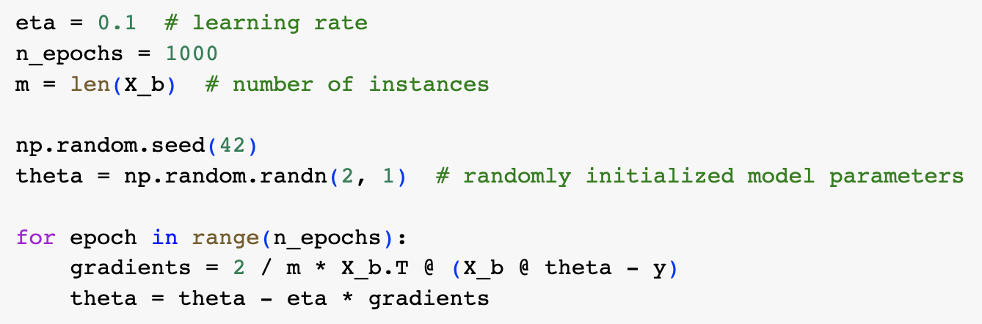
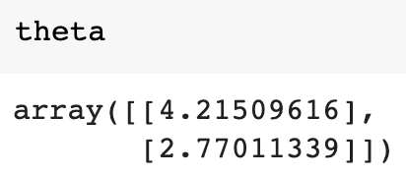
Implementing batch gradient descent in Python
The code above implements the batch gradient descent algorithm
Each iteration over the training set is called an epoch
As you can see, it finds the same best-fit parameter values as the Normal Equation and SVD decomposition

Slide 27
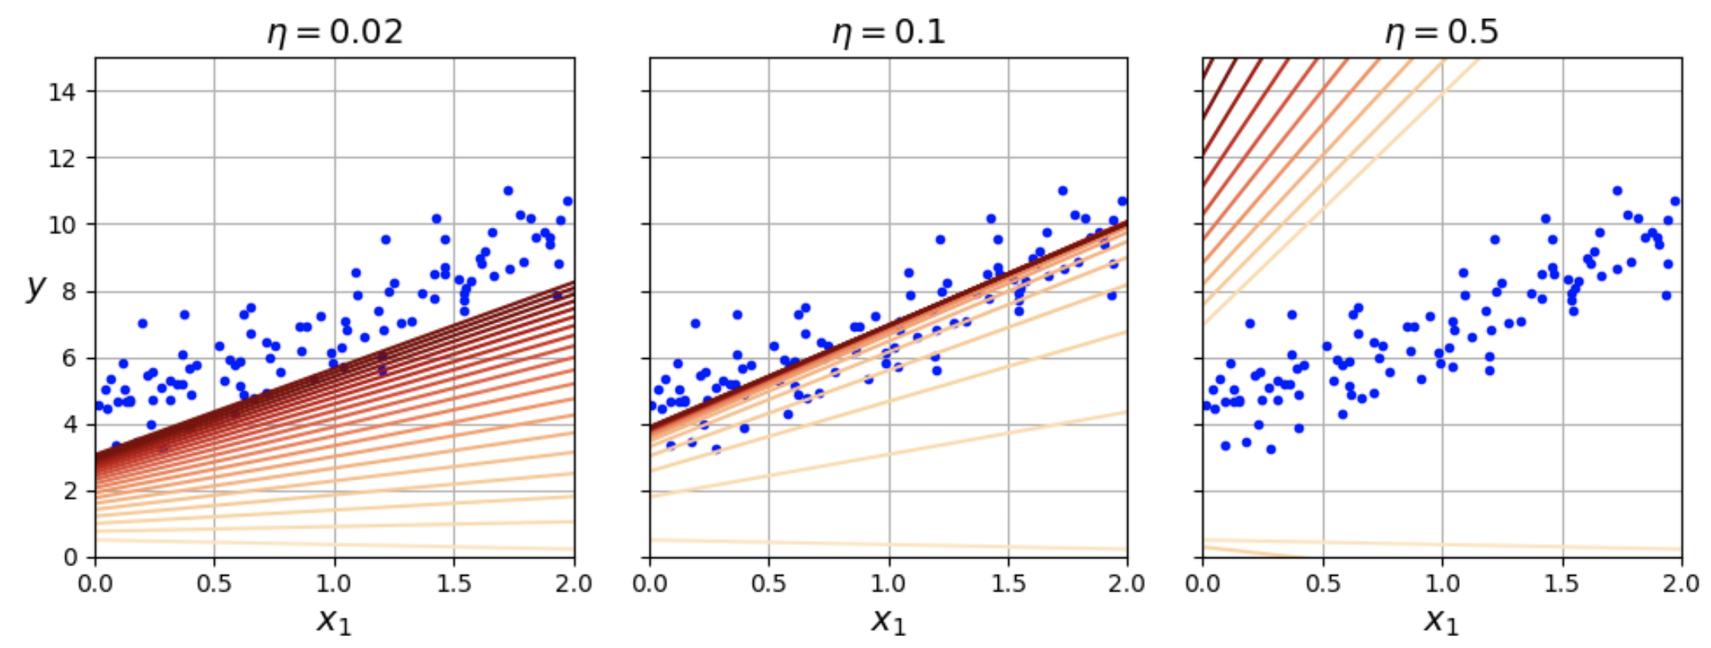
Effect of learning rate, η
Figures above show the first 20 steps of gradient descent using three different learning rates
The palest line is the randomly initialized parameter vector, the lines get darker with each successive epoch
On the left, the learning rate is too slow – it will take many epochs to converge to the optimal solution
In the middle, the algorithm converges quite quickly to the correct solution
On the right, the learning rate is too high – the algorithm diverges, jumping all over the place and actually getting further away from the solution

Slide 28
Finding a good learning rate
You can try to find a good learning rate by using grid search, but you should then set the maximum number of epochs so that learning rates that cause divergence or are too slow will be stopped
How do we decide on the maximum number of epochs?
Set it to be very high, but also interrupt the search when the gradient vector becomes very small, that is, when its norm becomes smaller than some tiny number ε, which we call the tolerance
But remember that the smaller the tolerance, the greater the number of iterations it will take to reach it

Slide 29
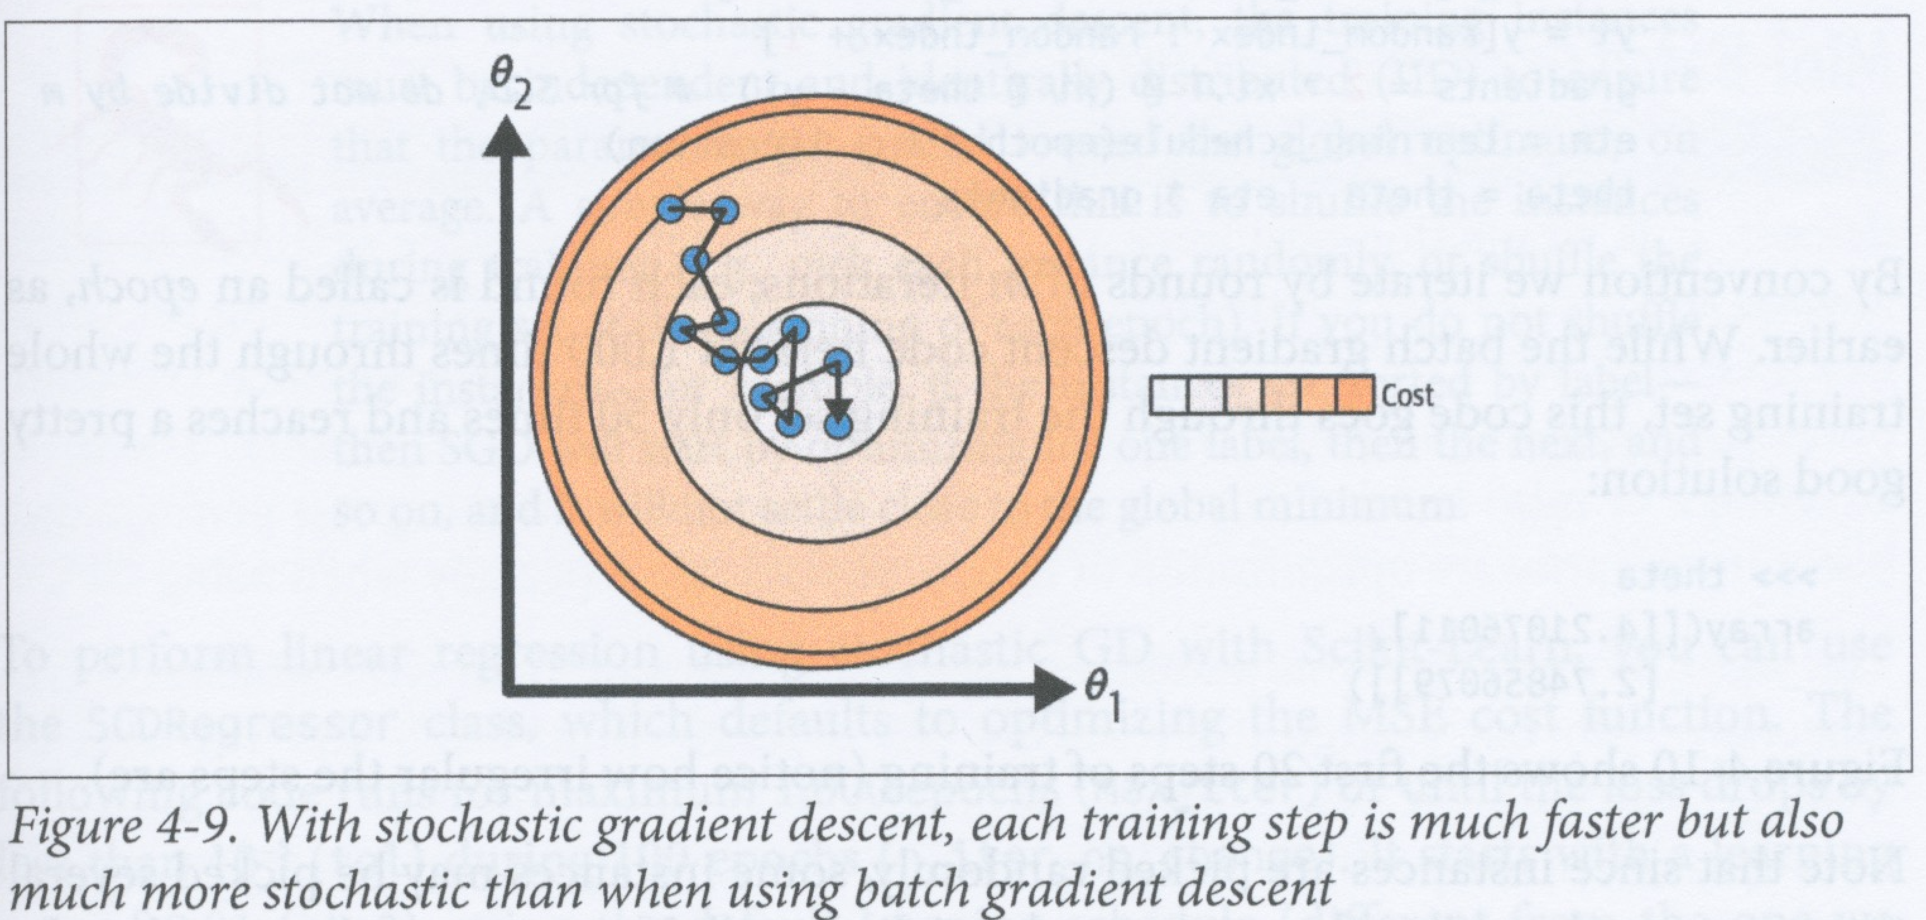
Stochastic gradient descent
In batch gradient descent, the whole training set is used to compute the gradients at every step, making it slow when the training set is large
In contrast, stochastic gradient descent (SGD) picks a single random instance from the training set at each step to compute the gradient
This makes it much faster than batch gradient descent because it has only a tiny amount of data to process at each step
SGD can therefore be used on very large training sets

Slide 30
Stochastic gradient descent
On the other hand, because it is stochastic (random), SGD’s progress towards the minimum is much more erratic
Eventually it will arrive close to the minimum, but it will continue to bounce around the minimum until it finally stops at a value which may be very close to the minimum, but probably won’t be optimal

Slide 31
Stochastic gradient descent
When the cost function is very irregular, SGD can be a good option because it is able to jump out of local minima
So when using SGD, we often gradually reduce the learning rate as the epochs progress – we start with a high learning rate to help the algorithm avoid local minima, then we reduce the learning rate to a low value so that the steps are smaller and the algorithm can more easily settle at the global minimum
This process is called simulated annealing, as it simulates the annealing process by which large, stable crystals are grown out of a liquid

Slide 32
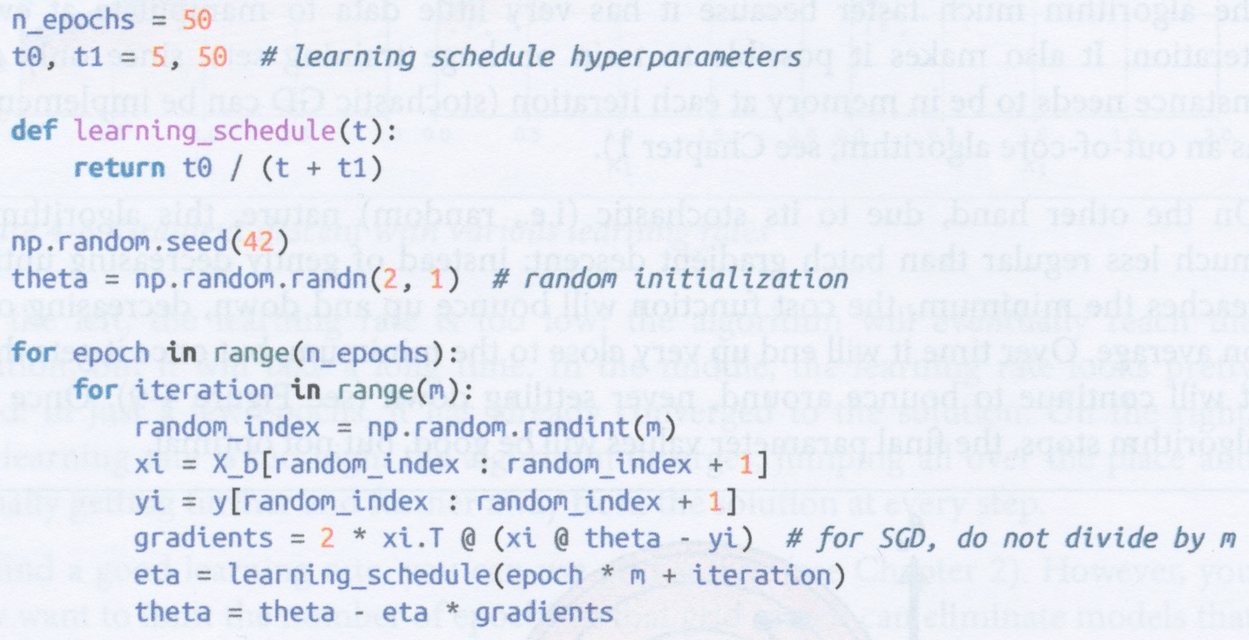
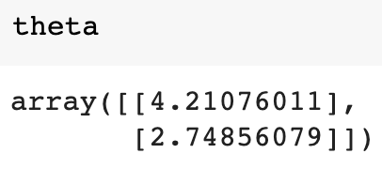
Learning schedule
If we use simulated annealing, then we have to define a learning schedule that controls how the learning rate changes as the iterations progress
  If the learning rate falls too quickly, then you might get frozen half way to the minimum
  If the learning rate falls too slowly, then you may end up hopping around the minimum for a long time
The code on the left implements stochastic gradient descent with a simple learning schedule

Slide 33
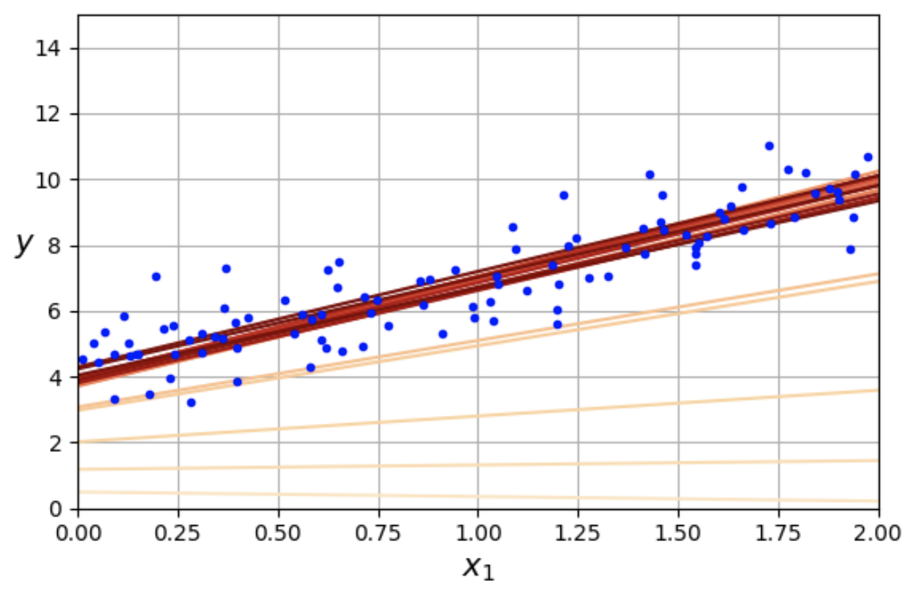
Implementing stochastic gradient descent
The graph on the right shows the first 20 steps of training using SGD, compared with the first 20 steps in batch gradient descent with different learning rates on the left
Note how irregular the steps are compared with batch gradient descent
But remember that SGD is much faster than BGD, especially with large datasets

Slide 34
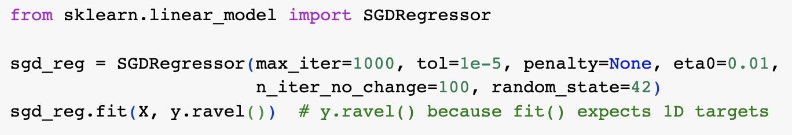
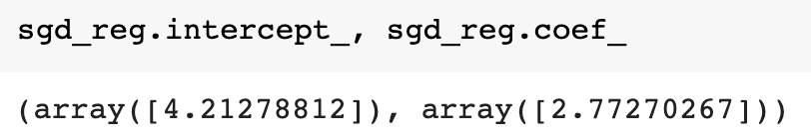
Using Scikit-Learn’s SGDRegressor
You can perform linear regression using stochastic gradient descent using Scikit-Learn’s SGDRegressor class
This defaults to using MSE as a cost function (as we did)
In the code above, we get the regressor to iterate a maximum of 1000 times or until the loss drops by less than 0.00005 (tol) over a period of 100 iterations (n_iter_no_change)
It starts with a learning rate of 0.01 (eta0) and uses the default learning schedule
Finally, it does not use any regularization (penalty=None)

Slide 35
Mini-batch gradient descent
At each step in the training,
  batch GD computes the cost function gradients based on the entire training set
  stochastic GD computes the cost function gradients based on a single, randomly selected instance
  mini-batch GD computes the cost function gradients based on a small set of randomly selected instances, called mini-batches
Main advantage of mini-batch GD over stochastic GD is that you can better exploit parallelism to more quickly do matrix operations
Mini-batch GD typically takes a less erratic path through the parameter space towards the minimum, so it can get closer to the actual minimum
On the other hand, mini-batch GD may find it harder to escape from a local minimum (in cases where we’re not using a convex cost function like MSE)
Figure above shows paths taken by batch GD, SGD and mini-batch GD on the same training set

Slide 36
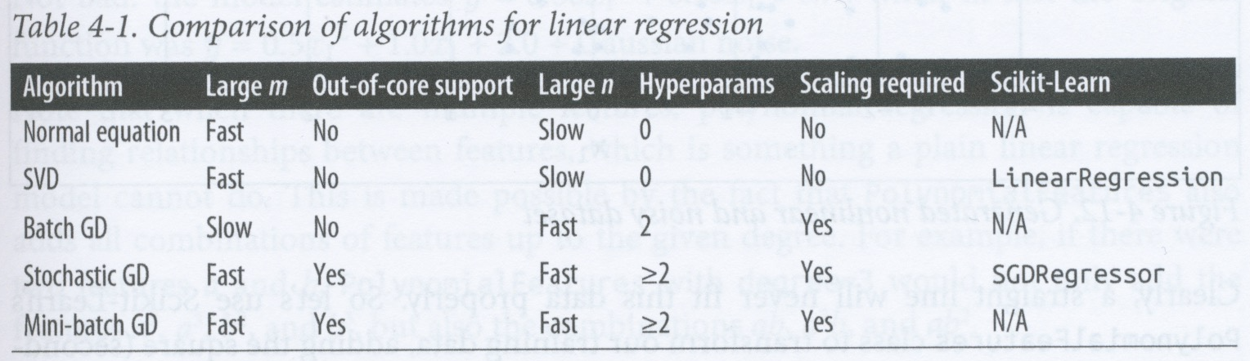
Comparison of algorithms for linear regression
m is number of instances, n is number of features

Slide 37
Polynomial regression
What if we need a model that is more complex than a straight line?
We can actually use linear regression to fit non-linear data
A simple way of doing this is to generate new features that are powers of the features that you are given
  e.g., add a new feature that contains the squares of all the values in a given feature
This is called polynomial regression

Slide 38
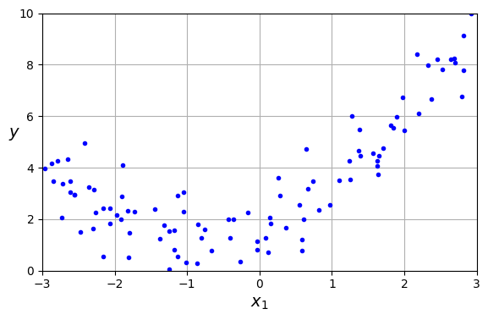
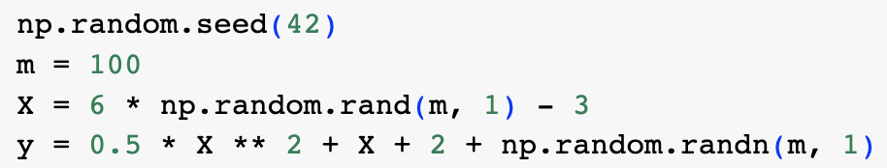
Example of polynomial regression
Suppose we generate some non-linear data by adding noise to a quadratic equation (see code and plot above)

Slide 39
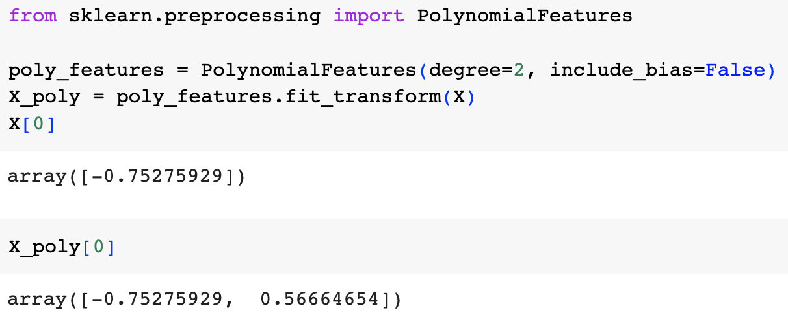
Adding polynomial features
The next step is to use Scikit-Learn’s PolynomialFeatures class to transform our training data, adding the square of each of the existing features as a new feature

Slide 40
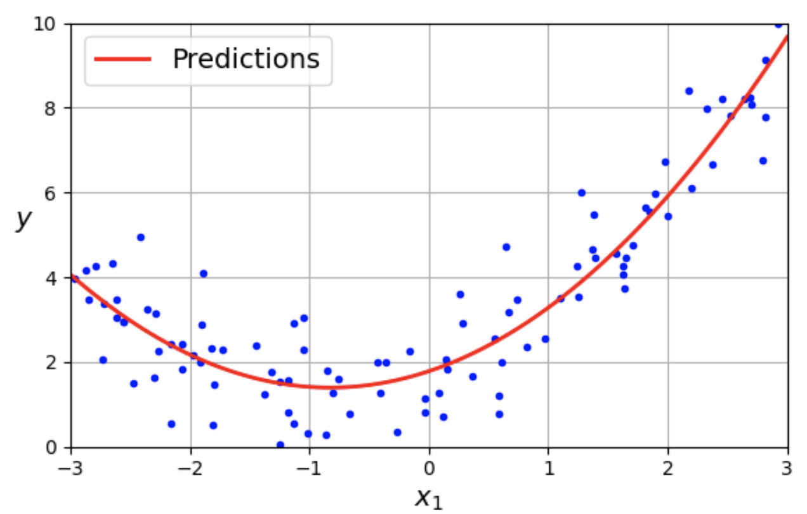
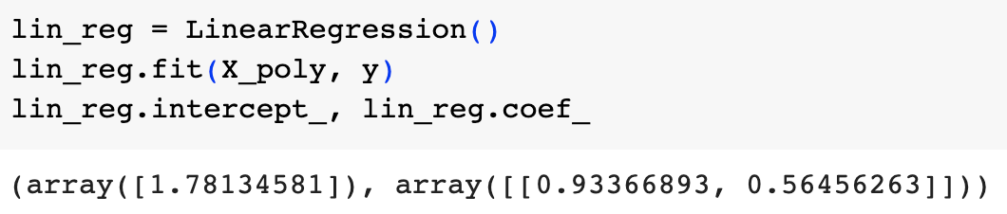
Fitting a linear regressor to the polynomial features
Now we can fit a LinearRegression model to this extended dataset
The regressor finds the parameters 1.78, 0.93 and 0.56 where we actually used the parameters 2.0, 1.0 and 0.5 with Gaussian noise
Note that PolynomialFeatures adds all combinations of features up to the given degree
  e.g., if degree=3 and there are two features, a and b, then this will give a², a³, b², b³, ab, ab², and a²b

Slide 41
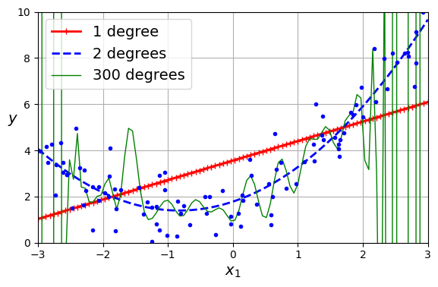
Under- and over-fitting
The higher the degree of the polynomial you use, the more closely you can generallly fit the data (and the more risk of overfitting)
On the left are shown curves for 1-, 2-, and 300-degree polynomial models of our generated non-linear (actually quadratic+noise) data
Here we know that the best model should be the quadratic one – the linear model underfits and the 300-degree polynomial model overfits
But usually we don’t know what the actual underlying model is, so how can we tell if a model is overfitting or underfitting some data?

Slide 42
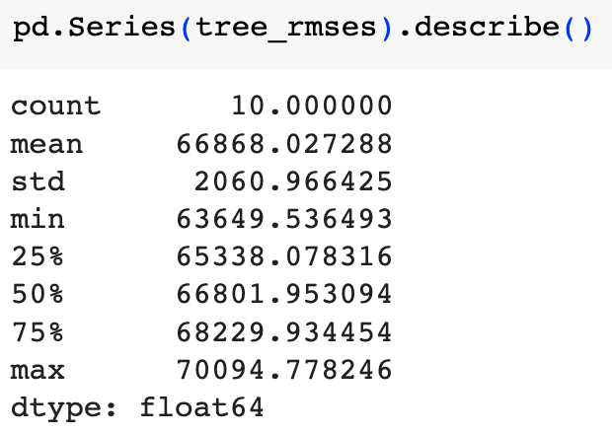
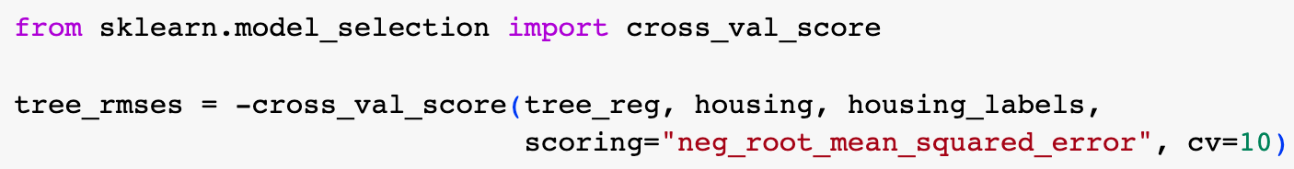
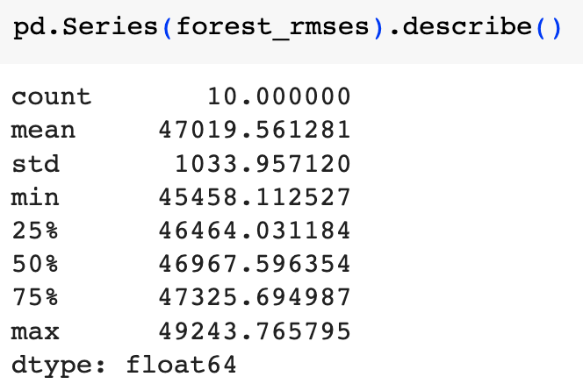
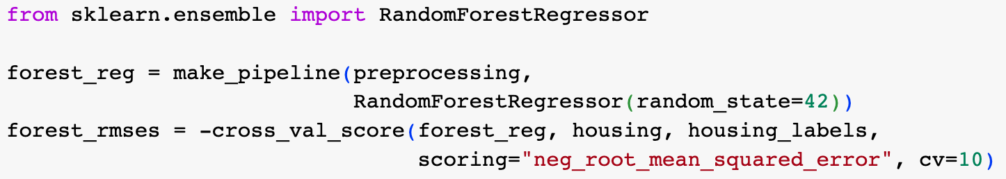
Using cross-validation to test for fitting
In our end-to-end project, we used cross-validation to estimate a model’s generalization performance
If a model performs well on training data but performs poorly on cross-validation metrics, then it is overfitting (i.e., it is too complex)
If a model performs poorly both on the training data and the cross-validation metrics, then it is underfitting (i.e., it is too simple)

Slide 43
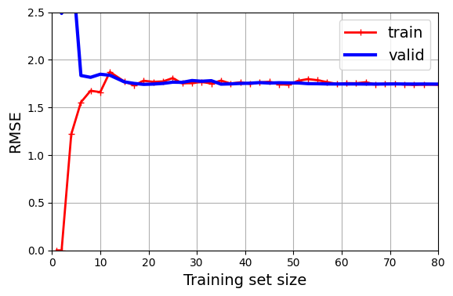
Learning curves
We can also use learning curves to decide whether a model is underfitting or overfitting
This is a graph of the errors on the training set and validation set against training iteration – the model’s errors on the training and validation sets are recorded at regular intervals during the training
If the model cannot be trained incrementally, then it must be trained several times on successively larger subsets of the training set
  A model can be trained incrementally if it supports partial_fit() or warm_start() functions

Slide 44
learning_curve() function
Scikit-Learn has a learning_curve() function that trains and evaluates the model at regular intervals during the training process using cross-validation
By default, learning_curve() retrains the model on growing subsets of the training set
If the model supports incremental learning, then you can set exploit_incremental_learning=True to make it train incrementally
learning_curve() returns training and validation scores for range of training set sizes and for each cross-validation fold

Slide 45
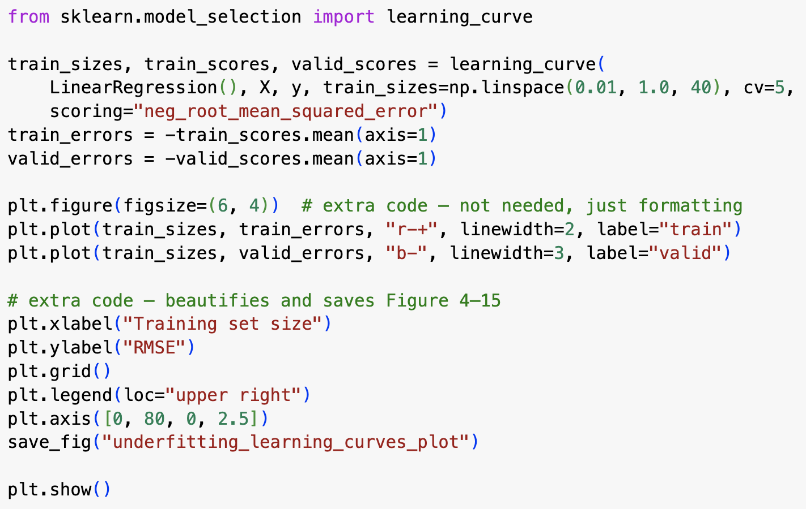
Example of using learning_curve() function
Code and graph on left shows how to get and plot a learning curve
The curve shows that the model is underfitting
Training error starts at 0, indicating that the model can fit the data perfectly
However it rises quickly and reaches a plateau, where adding extra data does not improve the model
Validation error starts high because it has only seen very few training instances
When shown more instances, the model begins to learn (generalize) and the validation error falls
However, quite quickly, the validation error reaches a plateau such that adding more training instances does not improve performance
The plateaus for the training and validation data are very similar
When both training and learning validation curves reach fairly high plateaus that are close together, then this is typical of underfitting

Slide 46
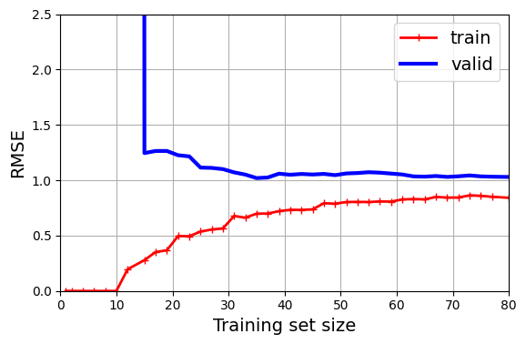
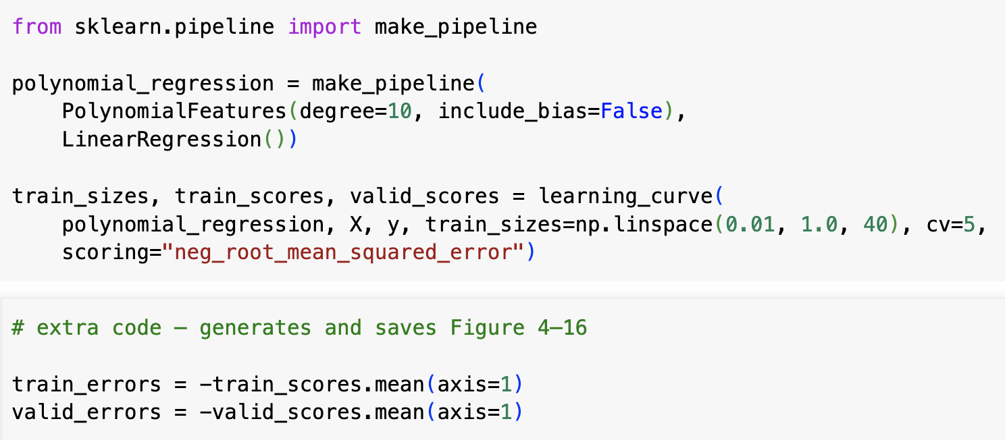
Using learning_curve() on a more complex model
We now consider the learning curves for a 10-degree polynomial model
These curves differ from the linear model in that
  the error on the training data is much lower
  the performance on the validation data is poorer than on the training data – this is the hallmark of overfitting
  If you used more data, the curves would converge and you would reduce overfitting

Slide 47
Bias/Variance trade-off
A model’s generalization error is the sum of three different errors as follows:
  Bias – error resulting from incorrect assumptions, such as assuming that the data is linear when it is actually quadratic
    High bias model is most likely to underfit the data
  Variance – error resulting from the model being too sensitive to small variations in the training data
    A complex model usually has high variance and therefore has a tendency to overfit the data
  Irreducible error – error resulting from noise in the data
    Can potentially reduce this error by cleaning up the data (e.g., fix data sources, use better methods to obtain the data)
Increasing complexity of a model usually increases its variance and decreases its bias
This means there is usually some “sweet spot” in a model’s complexity where the sum of the bias and variance is a minimum

Slide 48
Regularized linear models
One way of reducing overfitting is to regularize a model – i.e., reduce its number of degrees of freedom (free variables)
This makes it less likely that it will overfit the data
For example, you can regularize a polynomial model by reducing its number of polynomial degrees
You can regularize a linear model by constraining the weights of the model, which we can do using
  ridge regression
  lasso regression
  elastic net regression

Slide 49
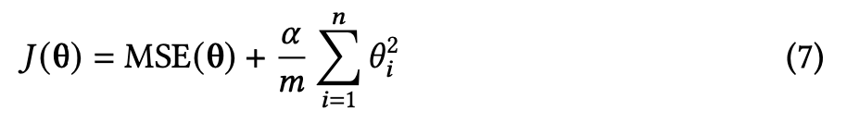
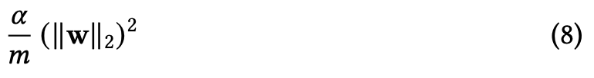
Ridge regression (Tikhonov regularization)
If we define w as the sum of feature weights (parameters), 𝜃₁ to 𝜃_{n}, then the sum regularization term is equal to eq. 8 above
The double vertical lines indicate the l₂-norm
This means we need to add 2ɑw/m to the components of the MSE gradient vector that corresponds to the feature weights (excluding the bias)
It’s important to scale the data (e.g., by using a StandardScaler) before performing ridge regression, as it is sensitive to the scale of the input features
  This is true of most regularized models

Slide 50
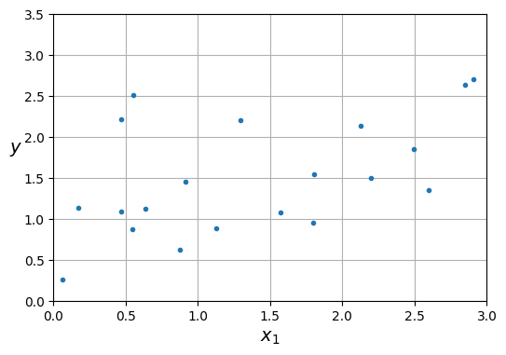
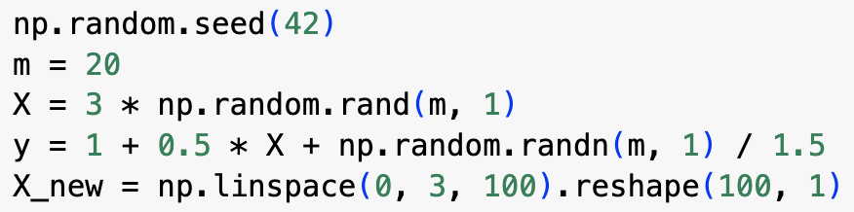
Example of ridge regression
We first generate a small and noisy dataset using a line + Gaussian noise

Slide 51
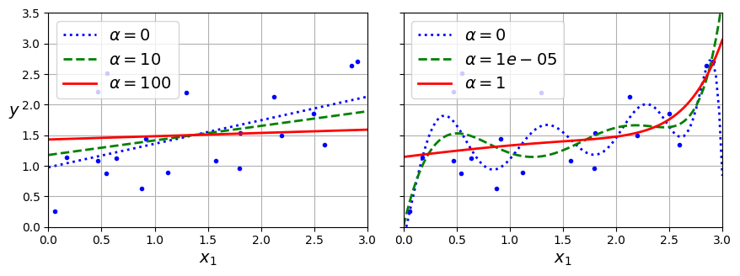
Example of ridge regression
Above left shows some linear ridge models using different values of alpha
Above right shows the results of polynomial regression with ridge regularization
  These are 10-degree polynomial models applied to the data after it is scaled with a StandardScaler
  Note how increasing alpha leads to flatter, simpler models – this decreases the model’s variance and increases its bias

Slide 52
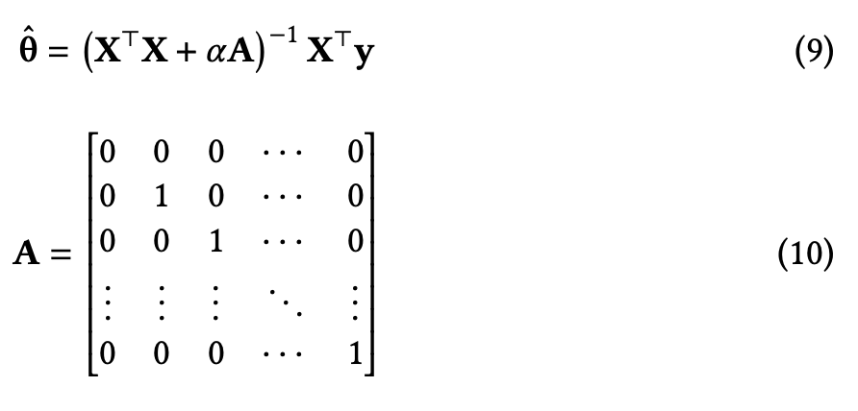

Ridge regression closed-form solution
We can perform ridge regression using either a closed form equation (eq. 9) or gradient descent
In Equation (9), the matrix A is as shown – it is the (n+1)x(n+1) identity matrix, where n is the number of feature vectors and the top left entry is changed to 0
The code above right shows how to do ridge regression using Scikit-Learn using a closed form equation

Slide 53

Using Scikit-Learn to perform ridge regression with stochastic gradient descent
The code above performs ridge regression using stochastic gradient descent
The “penalty” hyperparameter sets the type of regularization to use
Specifying penalty=”l2” causes a regularization term to be added to the MSE cost function equal to alpha times the square of the l2-norm of the weight vector, except it does not divide by m
So we set alpha=0.1/m to get the same result as Ridge(alpha=0.1)

Slide 54

Lasso Regression
Least absolute shrinkage and selection operator regression (Lasso regression) is another regularized version of linear regression
Lasso regression also just adds a regularization term to the cost function (see above)
  Lasso uses the l1-norm of the weight vector rather than the square of the l2-norm
  multiplies the sum by 2ɑ instead of ɑ/m – these values are chosen to ensure that the optimal alpha is independent of training set size

Slide 55


Lasso regression
Figure above shows linear (left) and polynomial (right) models using different levels of lasso regularization
Lasso regularization tends to set weights of least important features to zero – automatically performs feature selection and outputs a sparse model with relatively few non-zero weights
Code above shows example of using Lasso regression in Scikit-Learn

Slide 56


Elastic net regression
Elastic net regression has a regularization term that is a weighted sum of the regularization terms used in ridge regression and lasso regression (see above)
You control the relative amount of each that is used by using the mix ratio, r
  when r=0, elastic net regression = ridge regression
  when r=1, elastic net regression = lasso regression
Example above shows how to use Scikit-Learn’s ElasticNet class
  The l1_ratio argument corresponds to the mix ratio, r

Slide 57
What type of regularization should you use?
Almost always preferable to use some kind of regularization when you do regression
Ridge regression is a good default
If you suspect that only a few of the features are actually useful, then use lasso or elastic net because they tend to reduce the parameters for the useless features to zero
If the number of features is greater than the number of training instances, then lasso can behave erratically, so use elastic net instead
Also prefer elastic net if several features are strongly correlated

Slide 58

Early stopping
Early stopping is when you stop training as soon as the validation error reaches a minimum
This is another way of preventing overfitting
Learning curve on the left is for a complex model being trained on the quadratic+noise dataset we generated earlier
Error on validation set descends to a minimum at around 250 epochs then starts going up again
What does this indicate?
Early stopping simply stops the training when the validation error reaches a minimum – in this case it would produce a better model than if learning were allowed to continue

Slide 59

Early stopping
With stochastic and mini-batch gradient descent, the curves are not so smooth, so sometimes you’re less sure about whether or not you’ve really reached a minimum
One way of addressing this is to keep track of how long it is since you reached the last minimum – when this period becomes greater than some threshold, then you roll back the model’s parameters to what they were at the previous minimum

Slide 60
Logistic regression (aka. logit regression)
Logistic regression can be used for both regression and classification
Logistic regression is commonly used to estimate the probability of an instance belonging to a particular class
If the probability is greater than some threshold (e.g., 50%), then the model predicts that the instance is in the positive class (labeled “1”)
  otherwise it predicts the instance belongs to the negative class (labeled “0”)
When used in this way, logistic regression is a binary classifier

Slide 61

Logistic regression
Like linear regression, logistic regression computes a weighted sum of the input features (plus a bias)
But instead of outputting the result directly, it outputs the logistic of this result using the equation 13 above
The logistic, 𝜎(.), is a sigmoid function that outputs a number between 0 and 1, as shown in the graph above
Once the model has predicted the probability of an instance belonging to the positive class, it can then make its classification depending on whether this probabiliy is greater or less than 0.5
The sigmoid function outputs a value greater than 0.5 iff its argument is greater than 0, so a logistic regressor classifies to the positive class when its argument is positive

Slide 62


Logistic regression cost function
y = -log(x)
We need to train a logistic model’s parameters, 𝚹, so that it predicts high probabilities for positive instances (i.e., members of the positive class) and low probabilities for the negative instances
We can do this using the cost function above
  if the class is positive (y = 1) and the probability is low, then the cost is high
  if the class is positive and the probability is high, then the cost is low
  if the class is negative (y = 0), and the probability is high, then the cost is high
  if the class is negative and the probability is low, then the cost is low

Slide 63

Logistic regression cost function (log loss)
The cost function over a whole training set is the average cost over all the training instances (eq 15)
  If y = 1, then the second term in the square brackets is multiplied by 0
  if y = 0, then the first term in the brackets is set to 0
Eq 15 is called the logistic regression cost function or the log loss
It can be shown using Bayesian inference that minimizing this log loss function will result in the model that has the maximal likelihood of being optimal, assuming the instances within each class have a Gaussian distribution
The less Gaussian the distribution of the instances within the classes, the higher the bias will be

Slide 64
Logistic regression cost function (log loss)
There is no closed-form equation that finds the optimal parameters for a logistic regression model
But cost function is convex, so there is only one global minimum
Therefore you are guaranteed to find this global minimum using gradient descent (provided your learning rate is not too high and you wait long enough)

Slide 65

Logistic cost function gradients
Eq 15 shows the equation for the partial derivative of the log loss function with respect to a particular parameter
It resembles the equation for the partial gradient for batch gradient descent (below left)
For each instance, it computes the prediction error and multiplies by jth feature value, it then finds the average over all training instances
You form the gradient vector from all the partial gradients and then use this in the gradient descent algorithm

Slide 66

The Iris dataset
We can illustrate the use of logistic regression on the iris dataset
The iris dataset is a very commonly used small dataset, available within Scikit-Learn
It contains 150 instances, each with 4 features and a target class feature
The four input features are sepal length, sepal width, petal length and petal width
The target feature has three classes, Iris setosa, Iris versicolor, and Iris virginica

Slide 67


Exploring the dataset
We’ll try to build a classifier that detects Iris Virginica based only on petal width
Note that the instances are not shuffled
Note also that the version of the dataset in Scikit-Learn is different from the one on UCL ML respository, which apparently contains some incorrect datapoints

Slide 68

Splitting the data and training a model
Next we shuffle and split the data and train a logistic regression model

Slide 69

Computing a decision boundary
Graph above shows model’s predicted probability of an instance being an Iris virginica (green line)
The green triangles at the top of the graph show the range of values for Iris virginica
The blue squares at the bottom show the ranges of values for the other species
Note that there is an overlap
Above 2cm, the model is very confident that the flower is a virginica; whereas below 1cm, it is very confident it is not
In between there is a range where the model is unsure about the class
However, there is a decision boundary (vertical dashed line) at about 1.6: above this, the model will predict the positive class; below, it will predict the negative class

Slide 70

Decision boundary with two predictor features
The graph above shows the decision boundary (black dashed line) when we train a logistic regression model on two predictor features (petal length and width)
The decision boundary represents the values where the model predicts a 50% probability of the instance being Iris virginica
The other lines show the points that give probabilities at 15, 20, 60, 75 and 90%
Like other regression models, logistic regression can be regularized using l1 and l2 penalties
  Scikit-Learn actually adds an l2 penalty by default

Slide 71

Softmax regression
The logistic regression model can be generalized to support multiclass classification directly, without using multiple binary classifiers
This is called softmax regression or multinomial logistic regression
In softmax regression, each class has its own parameter vector, 𝛉^{(k)}
  The set of parameter vectors are stored as rows in a parameter matrix, 𝚯
To predict the class of an input instance, x, we left multiply it by the parameter vector for each class to get a vector of scores, s(x)
  Each component of s(x) is computed using equation 17 above

Slide 72

Softmax function
Once we have computed a vector of scores, s(x), for an instance, we can then run this vector through the softmax function (eq. 18 above)
The softmax function returns the probability of an instance, x, being in the class k
  it computes the ratio of the exponential of the score for class k for instance x to the sum of all such exponentials for all K classes for instance x
By default, the softmax regression classifier predicts the class with the highest estimated probability (i.e., the class with the highest score)

Slide 73


Training a softmax regression model
We want a model that estimates a high probability for the correct class and low probabilities for all the other classes
We use the cross entropy cost function for this because it penalizes the model when it estimates a low probability for a target class
Cross entropy is frequently used to estimate how well a distribution of class probabilities matches a single desired target class
In eq 19 above, $y_{k}^{(i)}$is the target probability of instance i being in class k – so in general, this is either 0 or 1, since each instance should be predicted to be in only one class
For each class and each instance, this value is multiplied by the negative of the log of the predicted probability – so when the probability is very low, this value is very high
So, when the target probability is either 0 or 1, the term for each class and each instance is 0 for any unwanted class, very high for the target class if the probability is low for that class and very low for the target class when the probability is high for that class

Slide 74

Cross entropy gradient vector
Because we have a different parameter vector for each class, we also need a cost function gradient vector for each class, which is given by eq. 20 above
You compute the gradient vectors for all the classes, then use gradient descent to find the parameter matrix, 𝚯, that minimizes the cost function

Slide 75

Classifying iris plants using softmax regression
Scikit-Learn’s LogisticRegression classifier uses softmax regression automatically when you train it on more than two classes
  assuming you use the default solver, which is equivalent to solver=“lbfgs”
  also applies l2 regularization by default, controlled by the parameter C
    note that if you increase C, then this leads to less regularization (cf. alpha on the other types of regression)
In example on left, we run the model on an instance with a petal length of 5cm and a petal width of 2 cm and get a prediction of Iris virginica with 96% probability

Slide 76

Decision boundaries
The graph above shows the decision boundaries for the three-class problem, solved using softmax regression
Note that the boundaries between the classes are straight lines
Some iso-probability contours are shown for the Iris versicolor class
Note that this model predicts the most probable class, which does not necessarily have a probability greater than 50% (because there are more than 2 classes)

