Slide 1
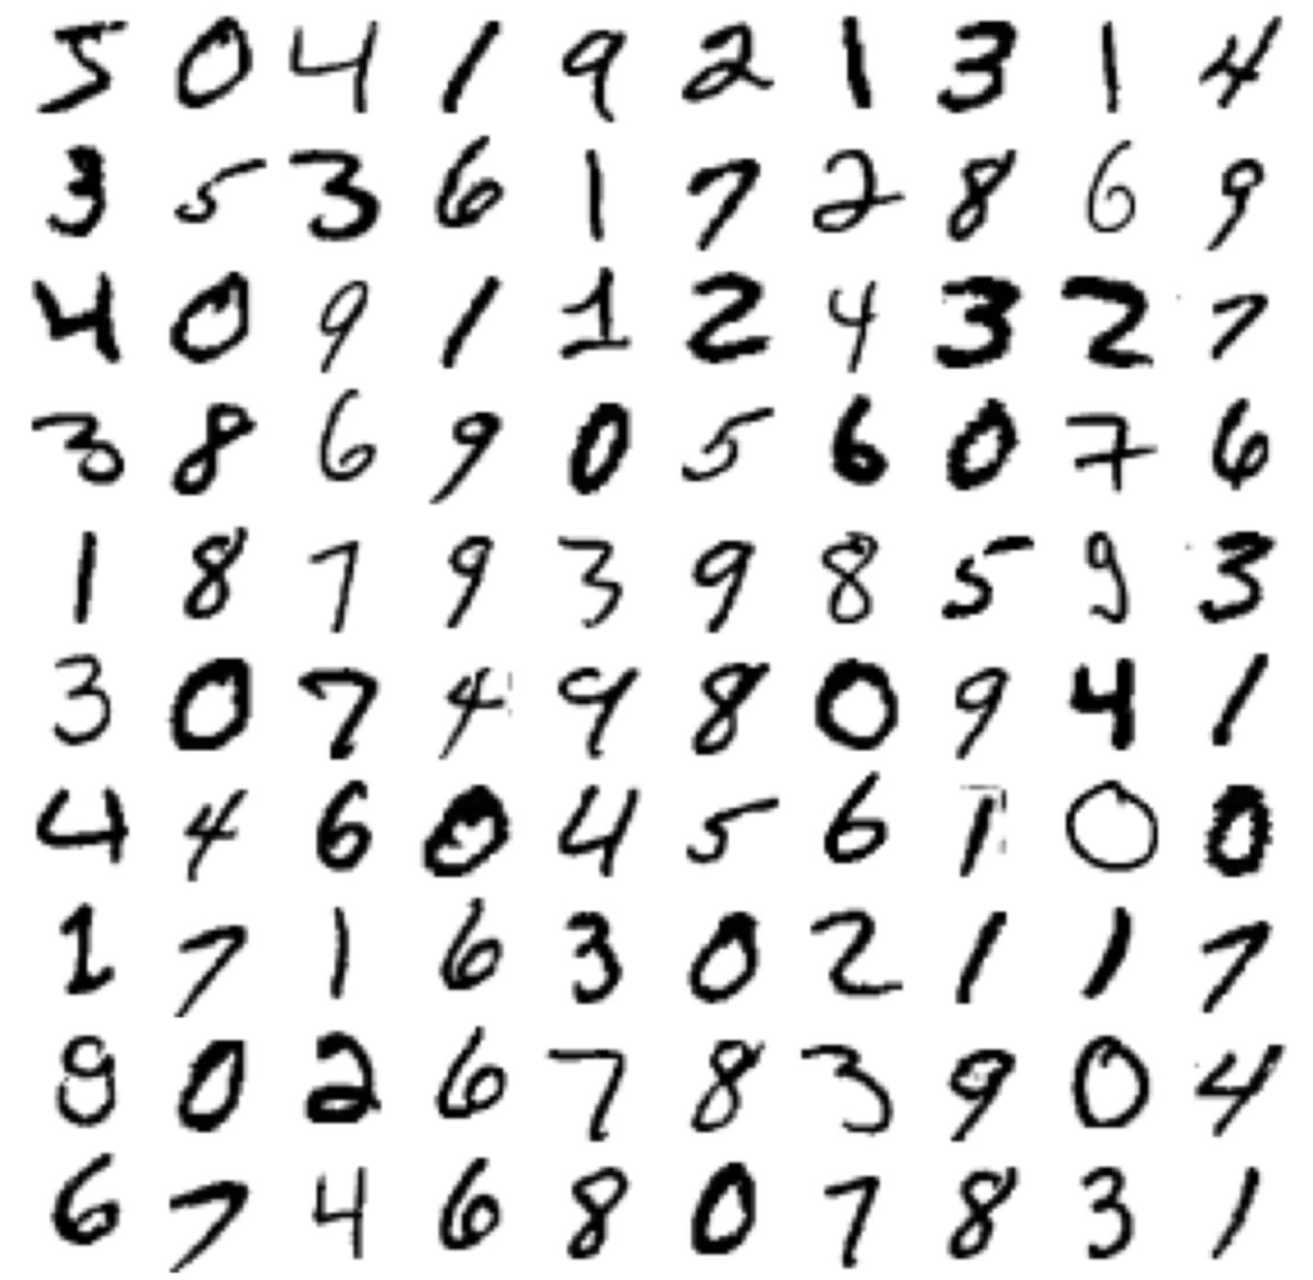
Classification
David Meredith
Aalborg University
dave@create.aau.dk

Slide 2
Source
Chapter 3 of
Géron, A. (2023). Hands-On Machine Learning with Scikit-Learn, Keras & TensorFlow. (Third edition). O’Reilly. Available at
https://www.amazon.de/-/en/Aur%C3%A9lien-G%C3%A9ron/dp/1098125975/
https://www.saxo.com/dk/hands-on-machine-learning-with-scikit-learn-keras-and-tensorflow_bog_9781098125974
https://factumbooks.dk/?search_string=hands-on+machine+learning+with+scikit-learn
Jupyter notebook for chapter 3:
https://github.com/ageron/handson-ml3/blob/main/03_classification.ipynb

Slide 3
Introduction
The most common supervised learning tasks are regression, where you predict values; and classification, where you predict categories or classes
We’ve looked in detail at an entire project where the task was a regression task (predicting median house prices)
We’ll now look more closely at classification systems

Slide 4

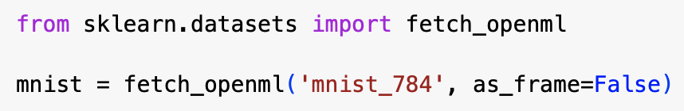
The MNIST dataset*
The MNIST dataset is a collection of 70000 images of hand-written digits, written by high school students and employees of the US Census Bureau
Each digit is labelled with the digit that it represents
It is almost certainly the most widely used dataset in machine learning
It can be obtained from OpenML.org using the code on the left
“5”
* https://openml.org/search?type=data&status=active&id=554

Slide 5
sklearn.datasets
The sklearn.datasets package contains mostly three types of function:
fetch_* functions, e.g., fetch_openml(), that download datasets from the internet
downloaded datasets are cached by default in a directory called ~/scikit_learn_data
load_* functions that load small datasets bundled with Scikit-Learn
make_* functions that generate fake datasets, useful for testing
Generated datasets are returned as a pair, (X, y), where X and y are NumPy arrays, X containing the predictor features and y containing the target feature or class to be predicted
Other datasets are returned as sklearn.utils.Bunch objects which are dictionaries (associative arrays)

Slide 6
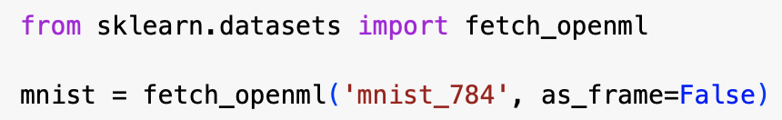
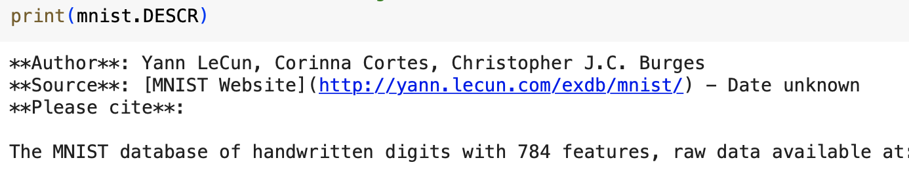
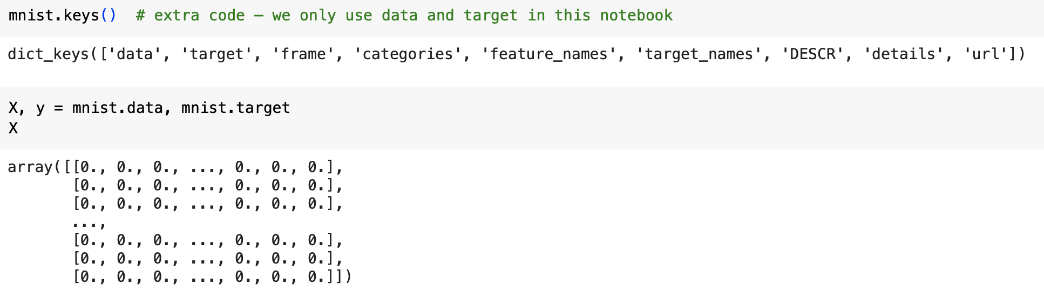
sklearn.datasets
sklearn.utils.Bunch objects have functions and properties that allow you to access the keys, the data, the targets and so on, e.g.,
mnist.DESCR gives a textual description of the dataset
mnist.keys() gives a list of the keys (properties) of the object
Downloaded and loaded datasets typically have “data” and “target” properties that give access to the predictor features and target feature, respectively

Slide 7
The MNIST dataset
fetch_openml() is atypical in that by default the inputs are returned as a Pandas Dataframe and the labels as a Pandas Series
The MNIST dataset contains images and DataFrames aren’t ideal for this, so we set the argument as_frame to false which forces fetch_openml() to return the data as a NumPy array

Slide 8
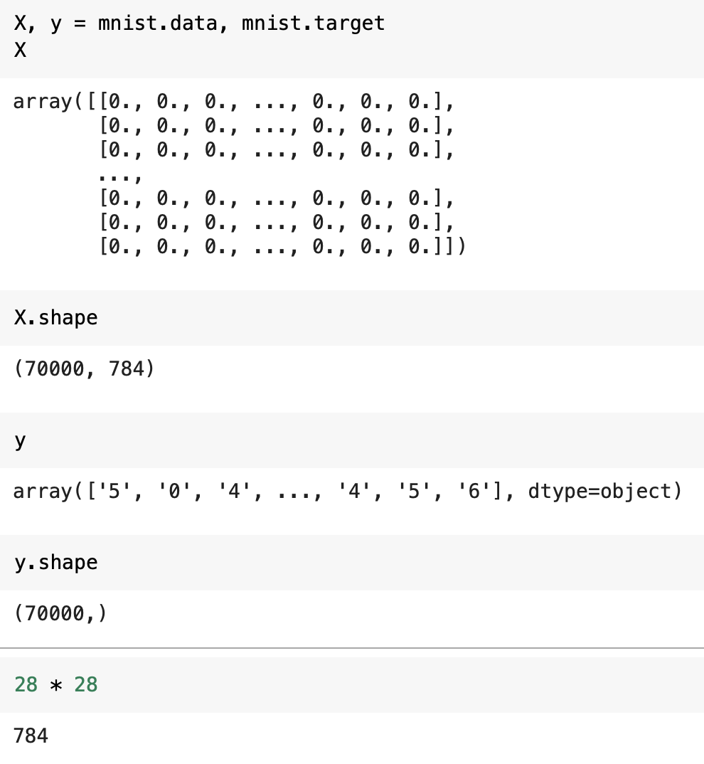
Exploring the MNIST data
You can explore the MNIST data by using the .shape property
You can see that there are 70000 items, each with 784 predictor features and the target feature
The 784 predictor features are the values of the 28 x 28 pixels in each image, ranging from 0 to 255

Slide 9
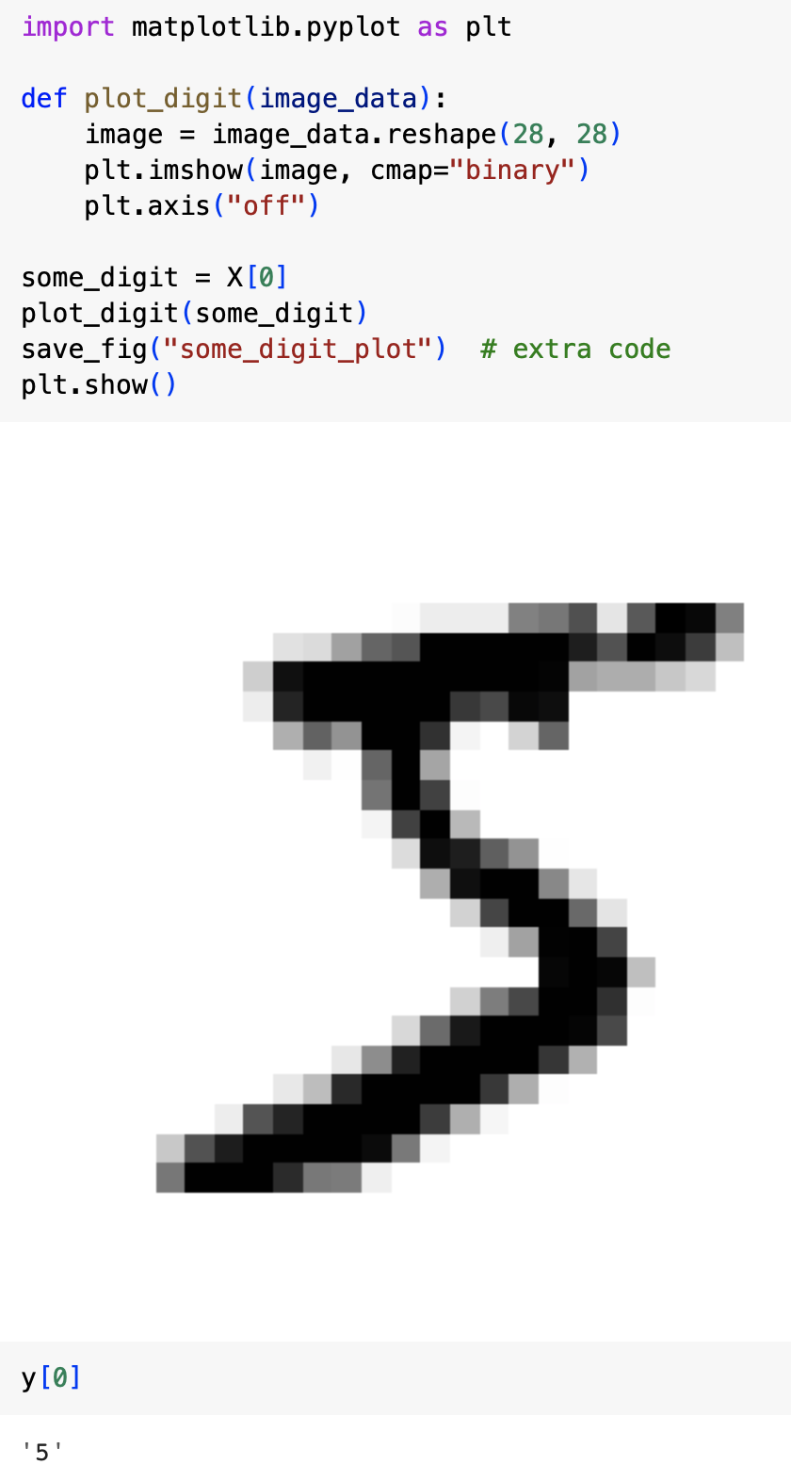
Exploring the MNIST data
We can see one of the images by
grabbing a feature vector (row) in the data NumPy array
reshaping it to a 28 x 28 array
displaying this reshaped array as an image using Matplotlib’s imshow() function
use the cmap=binary argument to get a grayscale color map

Slide 10
Training and test sets
The MNIST dataset is already split into a training set of 60000 images and a test set of 10000 images, which we can obtain using the code above
The training set is already shuffled, guaranteeing that each fold contains a representative sample of all digits
We can therefore safely do cross-validation using this training set
Note that not all datasets obtainable using fetch_openml() are shuffled or split

Slide 11
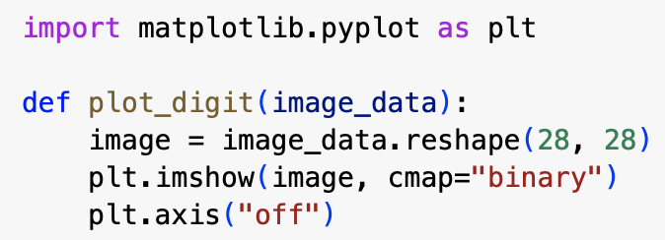
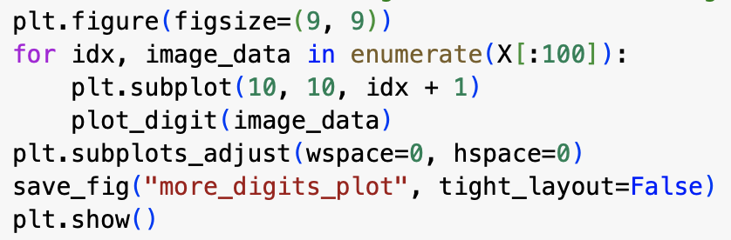
Exploring the MNIST dataset
Having set the test set to one side, we should now ignore it and explore only the training set
On the right is a sample of images from the training set showing the range of different hand-writing styles in the dataset
The code used to produce the image is also shown

Slide 12

Training a binary classifier
We’ll start with a simpler problem than the full digit-recognition problem
We’ll start with the “5-detection” problem, which is a binary classification problem in which we classify each image as either a “5” or a “non-5”
We first create the target training and test vectors for this problem using the code on the left

Slide 13


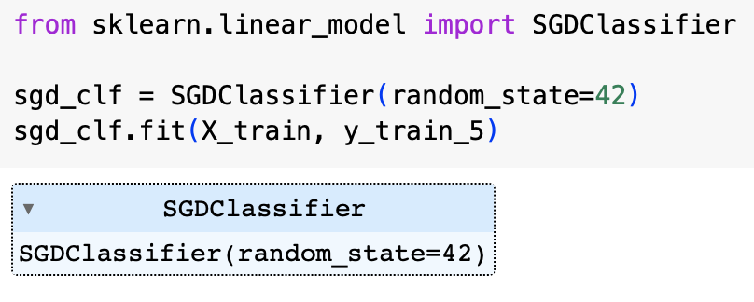
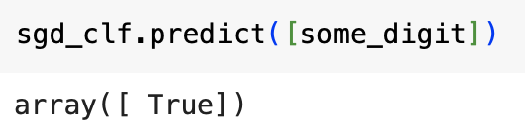
Training and running a classifier
We can try a stochastic gradient descent (SGD) classifier using Scikit-Learn’s SGDClassifier class
SGD classifiers are good at handling very large datasets efficiently because they deal with each training instance independently
This also makes them well-suited to online learning
We can train and run an SGD classifier using the code on the left

Slide 14
Performance measures
Evaluating classifiers is often more complex than evaluating regressors, so we need to introduce a number of new concepts, including
confusion matrices
precision and recall
the receiver operating characteristic (ROC) curve

Slide 15
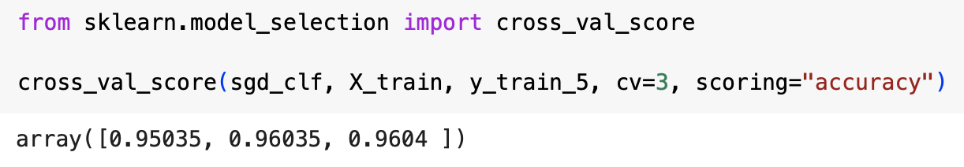
Measuring accuracy using cross-validation
We can use the sklearn cross_val_score function to evaluate our SGDClassifier using k-fold cross-validation
In this example, we set k=3
Recall that k-fold cross-validation means splitting the training set into k folds, then training and testing the model k times, each time using a different fold for testing and the rest for training
In our example, we obtain over 95% accuracy on all three folds ... but why might this not be as good as it sounds?

Slide 16
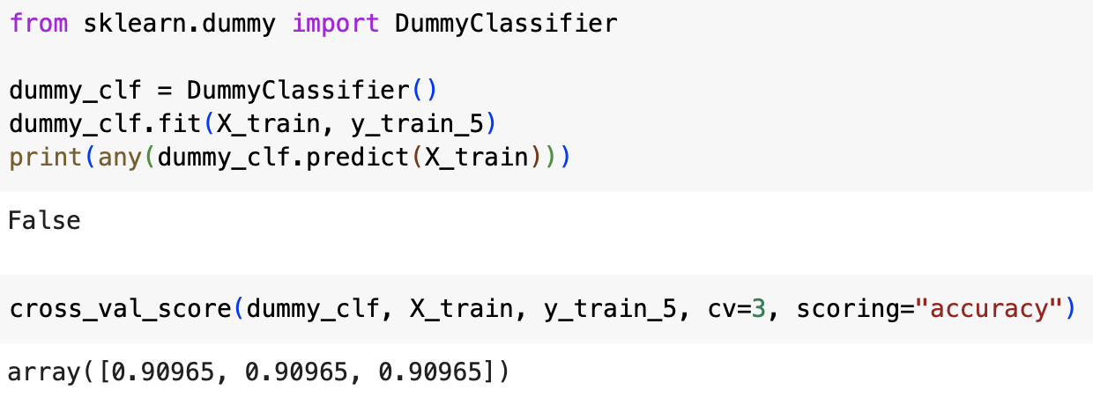
Measuring accuracy using cross-validation
If we use a DummyClassifier that just classifies each image into the most frequent class (in this case, “non-5”), then we still get over 90% accuracy – why?

Slide 17
Measuring accuracy using cross-validation
Over 90% of the images are non-5s, so we can achieve a high score just by predicting a non-5
Demonstrates that using accuracy as a performance measure is not usually the best idea when one uses skewed datasets

Slide 18
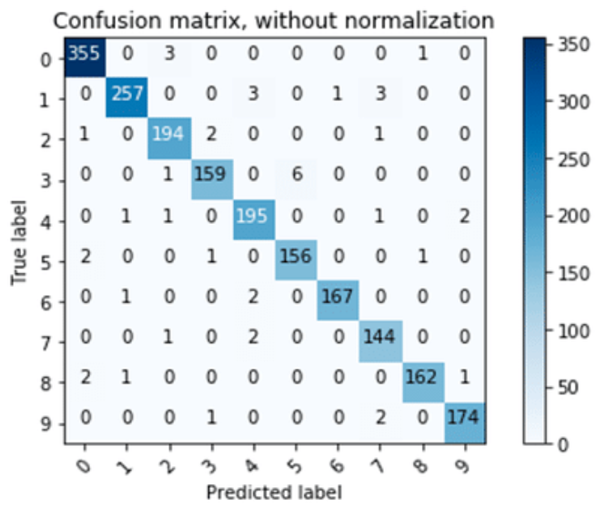
Confusion matrices
A confusion matrix tells you how many times instances of a class A are classified as being in a class B, for all pairs of classes, (A,B)
For example, in the full MNIST digit recognition task, if we wanted to know how many times an 8 was misclassified as a 0, we would look at the entry in the row for digit 8 and the column for digit 0
Oyedotun, Oyebade & Shabayek, Abdelrahman & Aouada, Djamila & Ottersten, Björn. (2018). Improving the Capacity of Very Deep Networks with Maxout Units. 10.1109/ICASSP.2018.8461436.

Slide 19
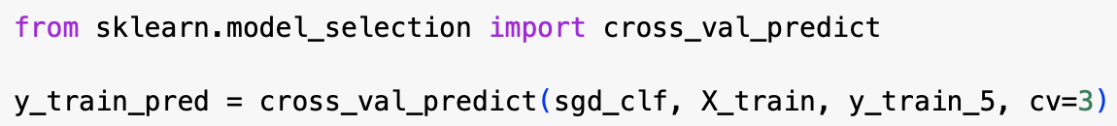
Computing confusion matrices
To compute a confusion matrix, you need to generate a set of predicted labels that can be compared with the set of true labels
We’ll compute the confusion matrix on the training set, as we’re holding back the test set until we’re ready to test what we hope will be a final model
We can use the cross_val_predict() function to generate a set of predicted labels (see code above)

Slide 20
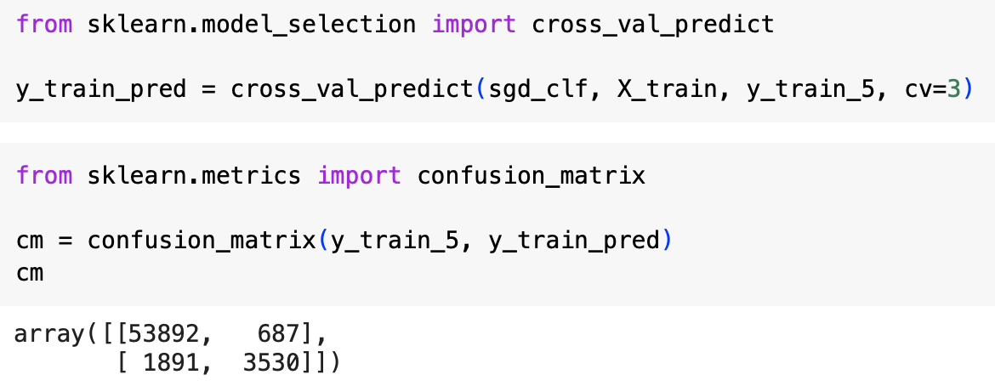
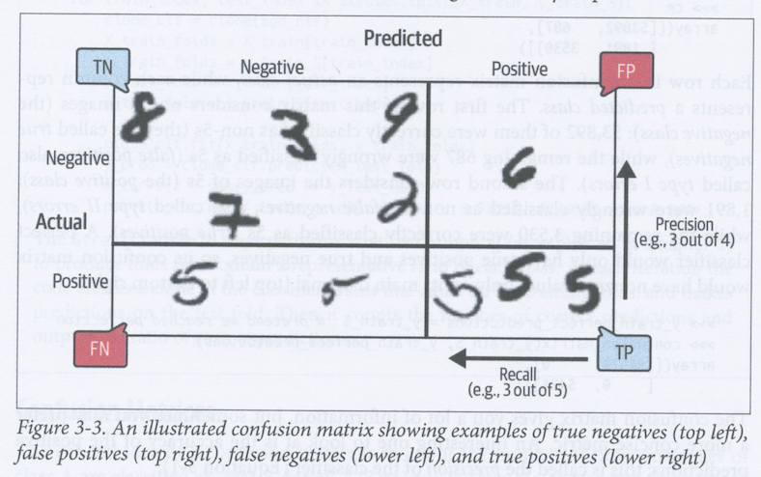
Computing confusion matrices
We can then use the confusion_matrix() function to compute the confusion matrix from the target classes (y_train_5) and the predicted classes (y_train_pred)
Each row in the CM represents the true label, while each column represents the predicted label
In this example, there were
53892 true negatives where a non-5 was correctly classified as a non-5
3530 true positives where a 5 was correctly classified as a 5
687 false positives, where a non-5 was incorrectly classified as a 5
also known as Type I Errors
1891 false negatives, where a 5 was incorrectly classified as a non-5
also known as Type II Errors

Slide 21
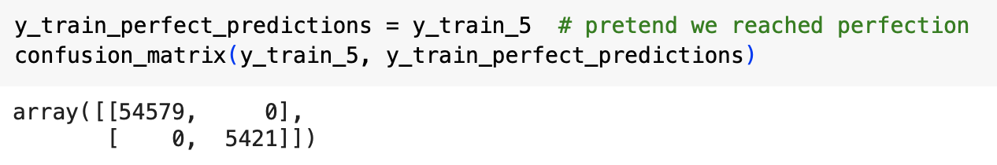
Precision and recall
A perfect classifier would only have true positives and true negatives
The confusion matrix gives a lot of useful information
In particular, it provides the information we need to compute precision, recall and F₁-score

Slide 22
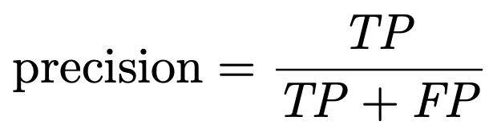
Precision
A prediction is positive if an instance is predicted by our model to be in the “positive” class (in our case, the “5” class)
Otherwise it is negative
A prediction is true if the predicted class is equal to the true class
Otherwise it is false
Precision is the proportion of the positive predictions that are true
In information retrieval terms, it is the proportion of items that are found, that are items you actually want
Ideally, we want everything that is predicted to be in the “positive” class to actually be “positive” – this would give a precision of 1

Slide 23
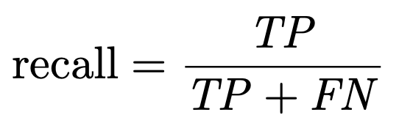
Recall
Recall is the proportion of actually positive instances that are predicted to be positive by the model
In information retrieval terms, recall is the proportion of the items that you want that are found by the model
Ideally, we want our model to “find” all the actually “positive” cases – this would give a recall of 1

Slide 24
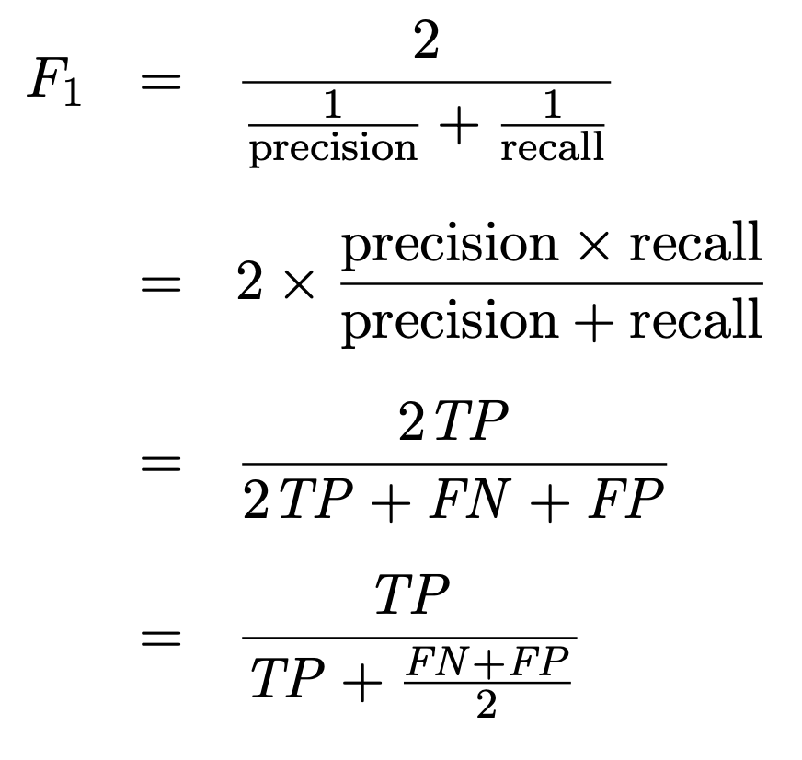
F₁-score
Precision gives us a measure of how good the system is at avoiding false positives
Proportion of what we get that we actually want
Recall gives us a measure of how good the system is at avoiding false negatives
Proportion of what we want that we actually get
We want both precision and recall to be high, so we want a measure that combines the two
The F₁-score is the harmonic mean of the precision and recall
In contrast with the arithmetic mean, the harmonic mean gives more weight to low values
the harmonic mean is usually more appropriate when finding the central tendency of a set of ratios
So, in order to get a high F₁-score, both precision and recall must be high
F₁-score gives us a measure of how good the system is at avoiding false predictions in general, whether they are positive or negative

Slide 25
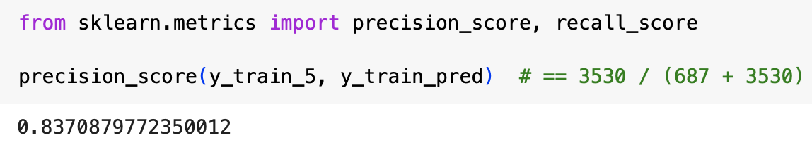
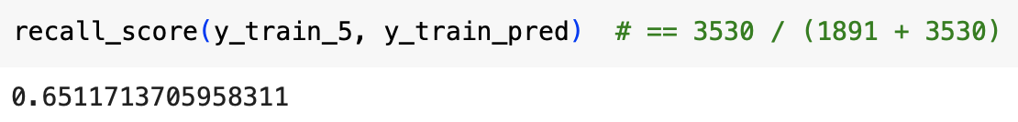
Scikit-Learn functions for computing precision and recall
We can use the Scikit-Learn precision_score() and recall_score functions to give precision and recall respectively
If we run this on our SGDClassifier for detecting 5s, we now get a precision of about 84% and a recall of only 65%
Only 84% of the images it predicts to be 5s are actually 5s
Only 65% of the actual 5s are correctly identified as a 5

Slide 26
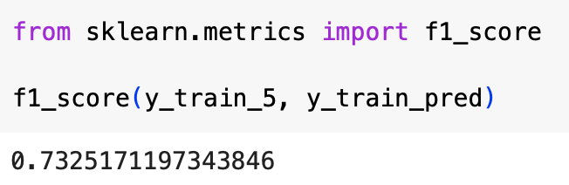
Scikit-Learn function for computing F₁-score
You can use the f1_score() function to compute F₁-score
F₁-score gives equal weight to precision and recall
Sometimes precision is more important than recall or vice-versa, in which case, F₁-score may not be the best overall measure
For example, in a system that filters out videos that are not safe for kids, you are probably more concerned with avoiding letting through unsafe videos than you are about rejecting safe ones
So which should you prioritise more highly, precision or recall, assuming a “positive” video is one that is predicted to be safe?
What about a system that aims to detect shoplifting events, assuming a “positive” prediction is one that predicts that shoplifting is taking place?

Slide 27
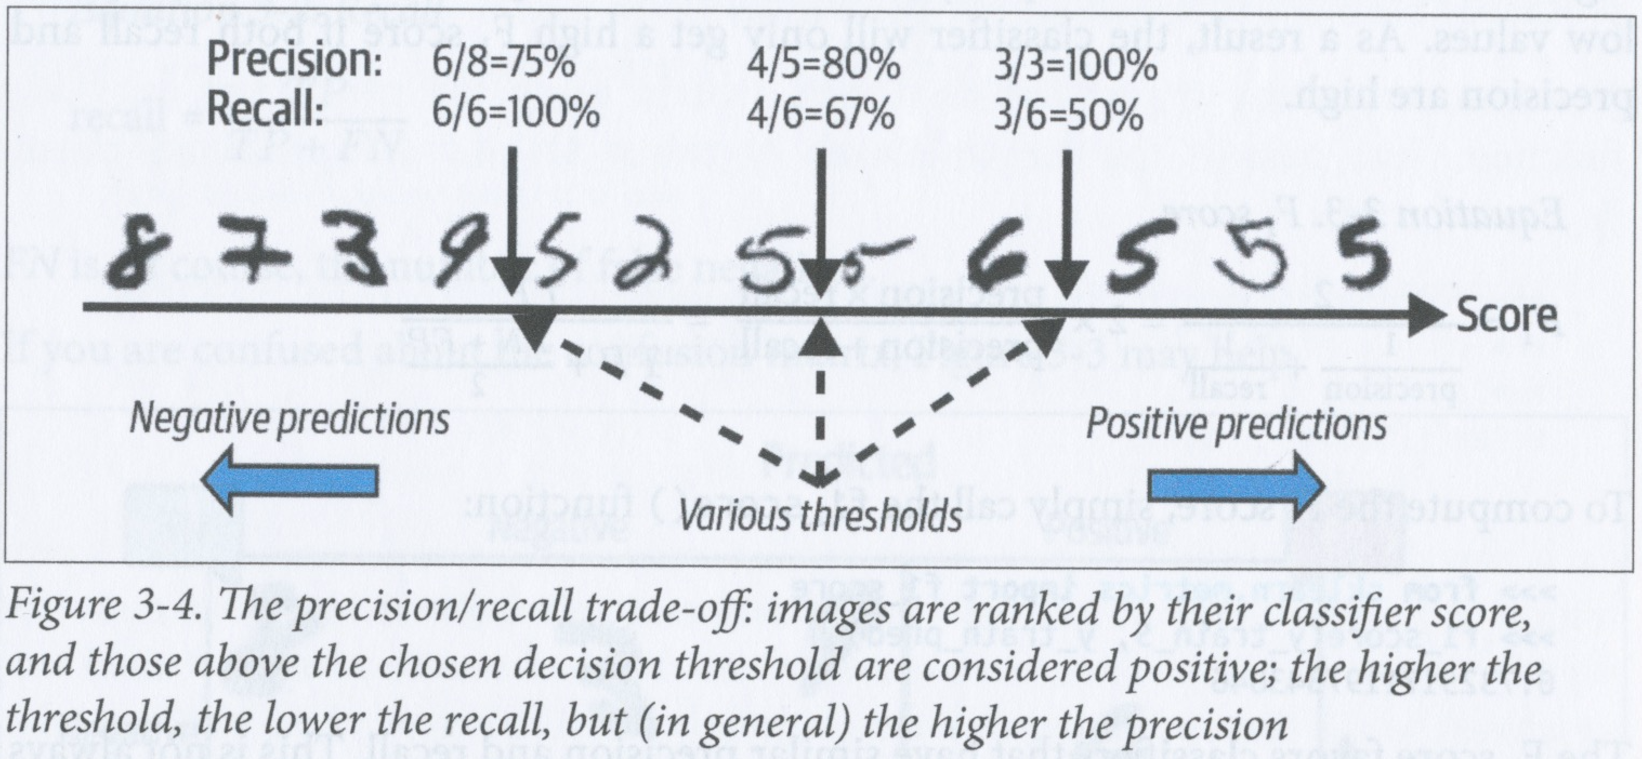
Precision/Recall trade-off
Unfortunately, increasing precision usually results in a decrease in recall, and vice-versa
Most classifiers predict a class based on a score computed using a decision function
The instance is classified to the “positive” class if this score is higher than some threshold
If we raise the threshold, then precision generally rises but recall goes down
If we lower the threshold, then precision generally falls, but recall goes up

Slide 28
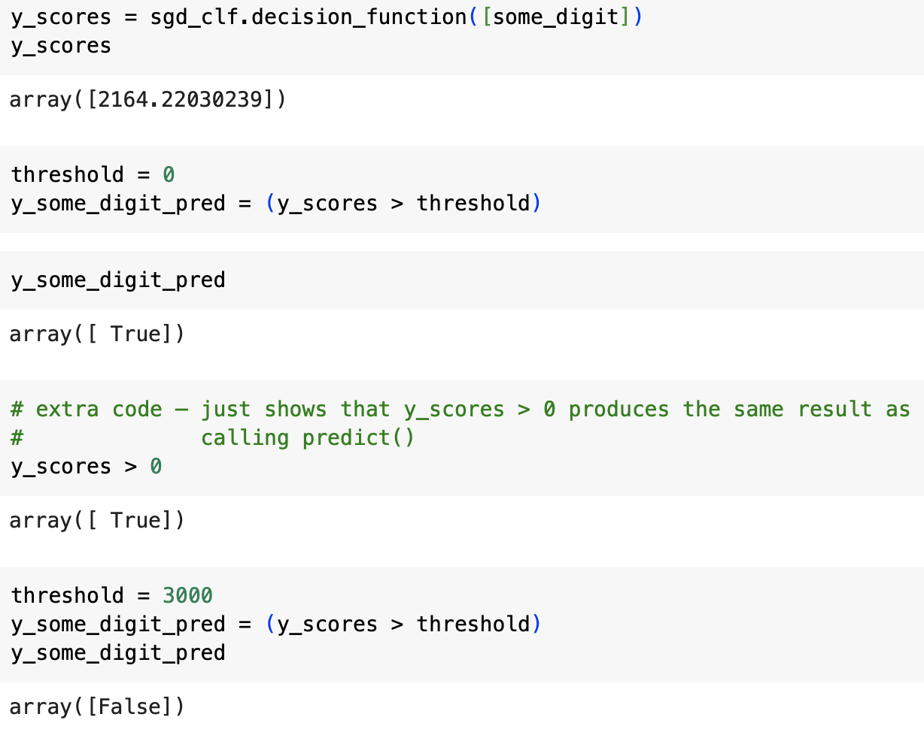
Exploring precision/recall trade-off
Scikit-Learn lets you access the decision function scores computed by a given classifier through the classifier’s decision_function() method
You can then explore the precision/recall trade-off by setting any threshold you want to make predictions based on these scores
Example on left shows score that classifier computes for our example “5” instance
If the threshold is set to 0 (the value that the classifier actually uses), then this 5 is classified as a 5
But if the threshold is raised to 3000, then it is classified as a non-5

Slide 29
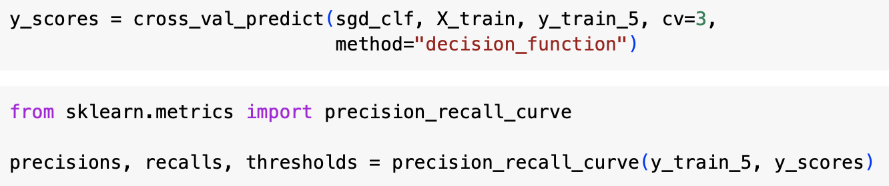
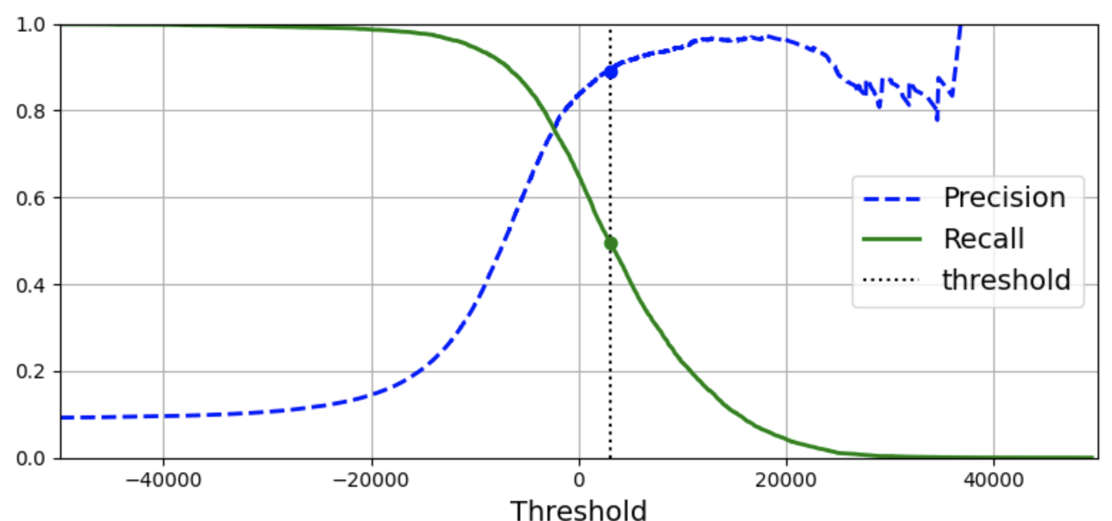
Determining the best threshold value
We can find the best threshold to use by first generating all decision function scores using the method=“decision_function” argument with the cross_val_predict() function
We can then use the precision_recall_curve() function to find precision and recall for all values of the decision function score threshold
Note that you can choose the threshold so that you get almost any value of precision
Note that precision can go either up or down as you increase the threshold, but recall always goes down – why is this?

Slide 30
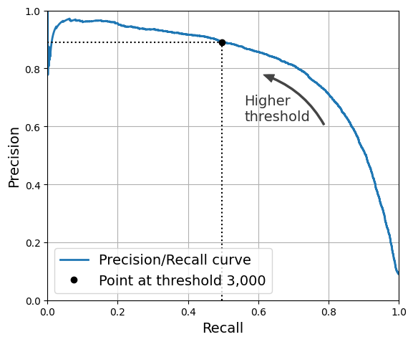
Precision-Recall curves (PR curves)
Another way of usefully representing the performance of a classifier is to plot a precision-recall curve
This curve shows that precision starts to fall sharply at around 80% recall, so we’d probably want to select a threshold that gives us 60-70% recall (depending on the task at hand)

Slide 31
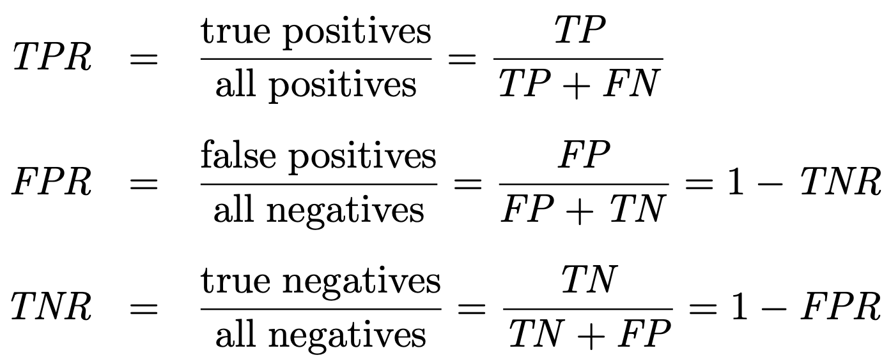
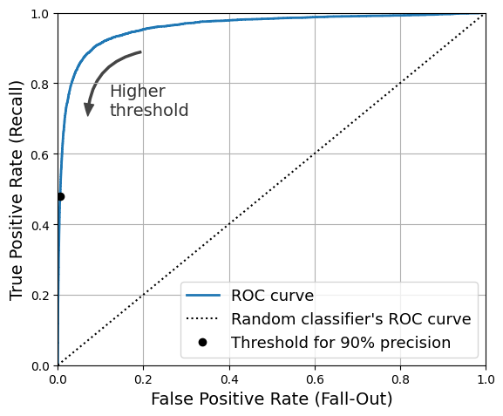
The ROC curve
The receiver operating characteristic (ROC) curve is another commonly used tool for evaluating the performance of a binary classifier
The ROC curve plots recall against the false positive rate (FPR)
In the context of a ROC curve, the recall is known as the true positive rate (TPR)
TPR is also known as sensitivity or hit rate
The FPR is also known as the fall-out
TNR = 1 – FPR is sometimes called specificity
The TPR is the proportion of actually positive instances classified as positive
=> we want TPR to be high
The FPR is the proportion of actually negative instances classified as positive
=> we want FPR to be low

Slide 32
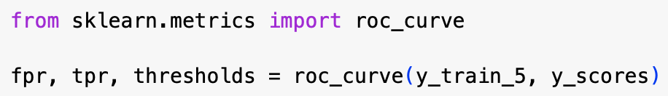
The ROC curve
Use the roc_curve() function in Scikit-Learn to compute the FPR and TPR values for various thresholds
Then plot TPR against FPR using Matplotlib
We can again see the trade-off: the higher the recall (TPR), the higher the FPR

Slide 33
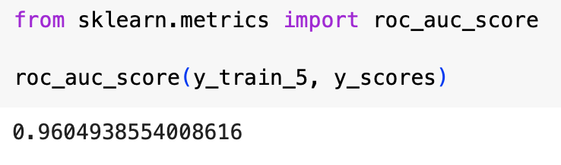
Area under the curve (AUC)
Dotted line shows the expected result for a perfectly random classifier
Better classifiers keep as far as possible away from the dotted line toward the upper left corner
We can measure performance of a classifier by the area under the curve (AUC)
A perfect classifier has an AUC of 1; a random classifier has an AUC of 0.5
Scikit-Learn’s roc_auc_score() function gives an estimate of the ROC AUC

Slide 34
ROC curve vs. PR curve
ROC curve and PR curve give similar information
In general, prefer the PR curve if the positive class is rare or when you care more about false positives than false negatives
Otherwise use the ROC curve
For example, the ROC curve for our 5-detector suggests that the classifier is really good, but this is because there are so few 5s in the data
The PR-curve makes it clear that there is room for improvement in our 5-detector

Slide 35
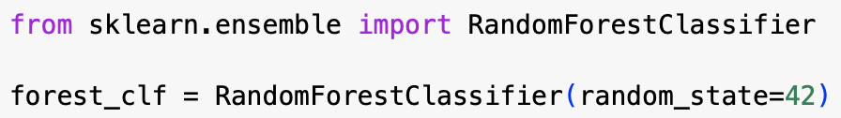
Using a RandomForestClassifier
We’ll now try a RandomForestClassifier and compare it with our SGDClassifier using a PR curve and F₁-score
We need to train the random forest classifier and make it assign a decision function score to each instance
But a random forest classifier doesn’t have a decision function, because it does not work in that way...

Slide 36
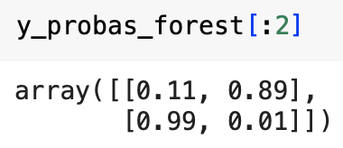
Using a random forest classifier
However, it does have a function, predict_proba(), that returns the class probabilities for each instance – so we can just use the probability of the positive class as a score
All Scikit-Learn classifiers have either a decision_function() method or a predict_proba() method (or both) that can be used to get decision scores
We can call the cross_val_predict() function to train the RandomForestClassifier using cross-validation and have it predict class probabilities using the code above
The classifier predicts that the first image is negative with 0.89 probability and that the second image is positive with 0.99 probability
Note that these are estimated probabilities

Slide 37
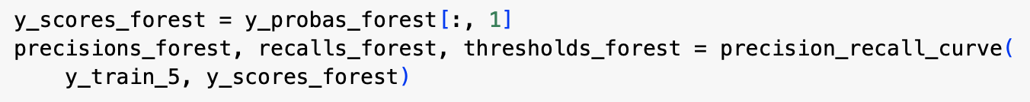
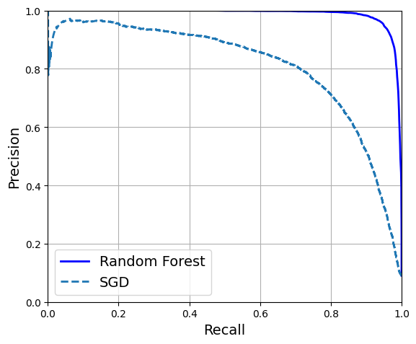
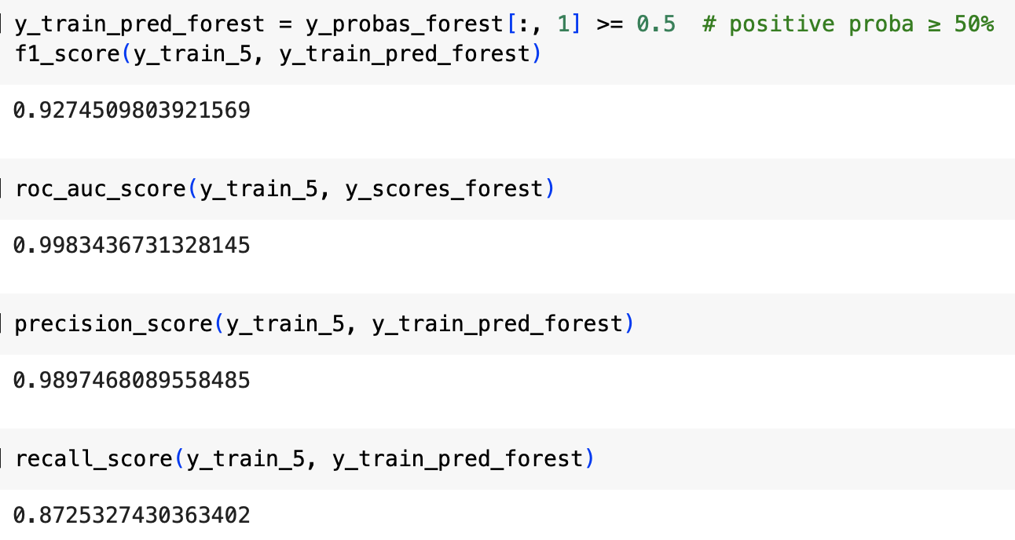
Generating a PR curve for a random forest classifier
We can use the second column of the estimated probabilities to create the precision_recall_curve() function
We can see in the PR curves on the left that the RFC seems much better than the SGD classifier – its precision, recall and F₁ scores are correspondingly much better (see below)

Slide 38
Multiclass classification
So far we’ve considered only binary classifiers
We’ll now look at multiclass classifiers, also called multinomial classifiers
Some types of classifier can perform multiclass classification directly
e.g., LogisticRegression, RandomForestClassifier, GaussianNB
It is also possible to perform multiclass classification with multiple binary classifiers

Slide 39
One-versus-rest strategy
We could perform the full 10-class MNIST digit recognition task using 10 binary classifiers, each trained to detect a different digit
We could use the decision function score from each classifier to select the digit that has the highest score
This is called the one-versus-rest (OvR) or one-versus-all (OvA) strategy

Slide 40
One-versus-one strategy
Another (more expensive) strategy is to train a binary classifier for every distinct pair of classes (discriminating 1s from 0s, 2s from 0s, 3s from 0s, etc.)
This is called the one-versus-one (OvO) strategy
If you adopt this strategy, then for N classes, you need N(N-1)/2 classifiers
So in the MNIST case, you would need 45 classifiers!
However, each classifier only needs to be trained on ca. 20% of the data
Some algorithms (e.g., SVMs) scale poorly with the size of a training set – for these algorithms, the OvO strategy can be practical
However, for most binary classifiers, OvR is preferred

Slide 41
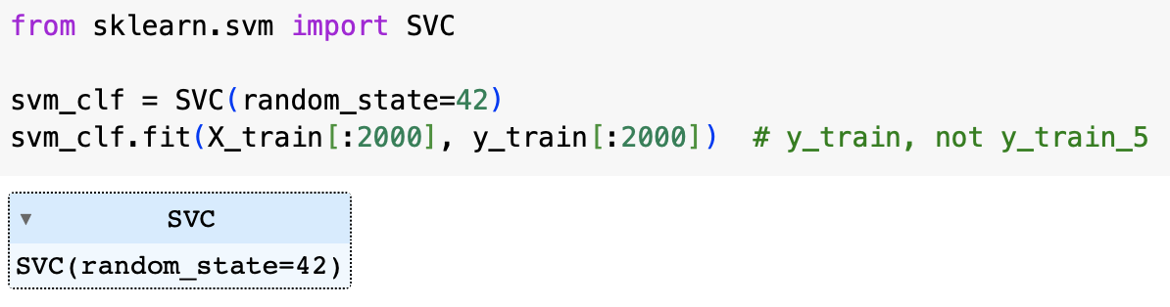
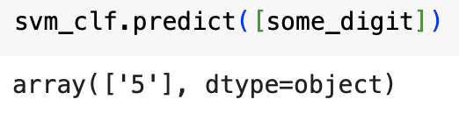
Using a binary classification algorithm for a multiclass classification task with Scikit-Learn
Scikit-Learn detects if you try to use a binary classification algorithm for a multiclass task and automatically adopts either OvO or OvR, depending on the algorithm
For example, we can try training an SVM classifier (sklearn.svm.SVC) on the first 2000 MNIST images
using more would take too much time
In this case, sklearn will adopt an OvO strategy and train 45 binary classifiers
When making a prediction, it will actually make 45 predictions and select the class that won the largest number of duels

Slide 42
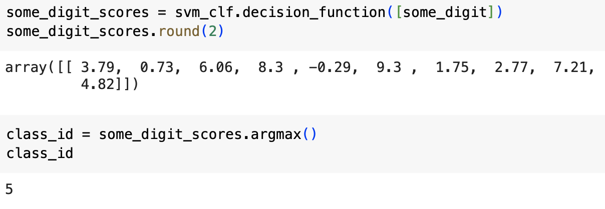
Using an SVM for multiclass classification
Running the decision_function() method reveals that the model returns 10 scores for each instance, one per class
The score for a class is the number of duels it wins plus/minus a tweak to break ties that depends on the classifier score
In this case, the highest score is 9.3, which corresponds to the class 5

Slide 43
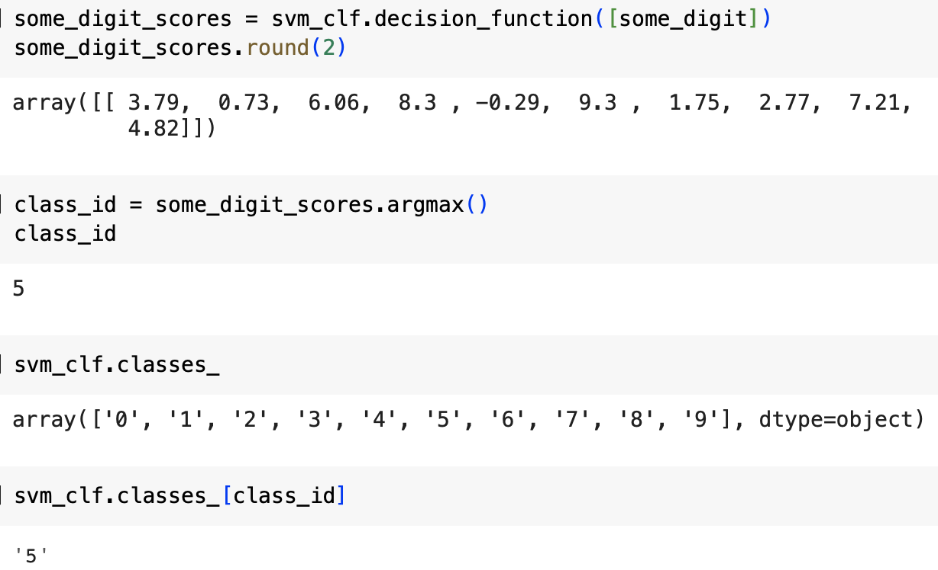
Using an SVM for multiclass classification
When a Scikit-Learn classifier is trained, it stores the list of target classes in its .classes_ attribute
The order of the scores in the arrays returned by the decision_function() method is the same as the order of the classes stored in the .classes_ property
So we can find the index of the maximum score using the .argmax() method and then find the class name by using this index to access the array of classes in .classes_

Slide 44
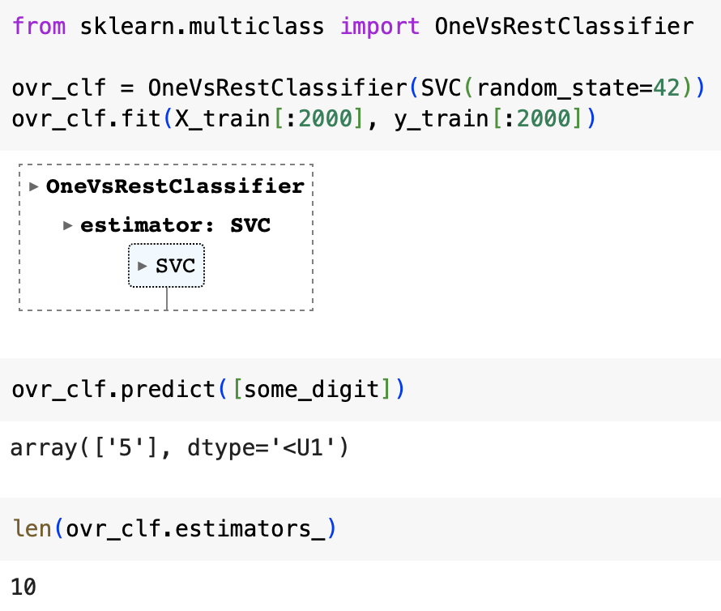
User-selection of OvO or OvR
If you want to use a different strategy from the one that Scikit-Learn automatically uses for a given classification algorithm, then you can use the OneVsOneClassifier or OneVsRestClassifier classes
You simply give a classifier to the constructor for one of these classes when you instantiate it
For example, you can choose to use OvR instead of the default OvO strategy when using an SVM using the code on the left
Note that only 10 classifiers are now trained when running this task

Slide 45
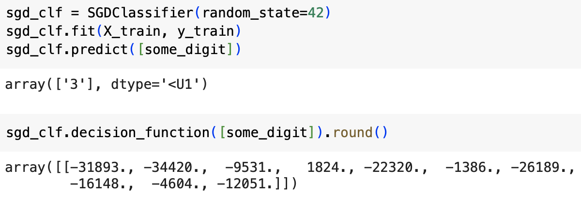
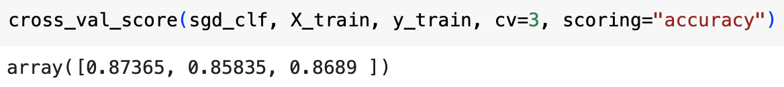
Using an SGD classifier for a multiclass task
When we use an SGDClassifier for a multiclass task, Scikit-Learn uses the OvR strategy by default
In this case, the classifier makes the wrong prediction for our running “5” example
When we look at the scores that the classifier assigns to each class, we see that it is not very confident – nearly all scores are very negative
We can get a better idea of the model's performance in general by using cross_val_score()
It scores over 85% on all folds, whereas a random classifier would be expected to get only 10% - so this isn’t too bad!

Slide 46
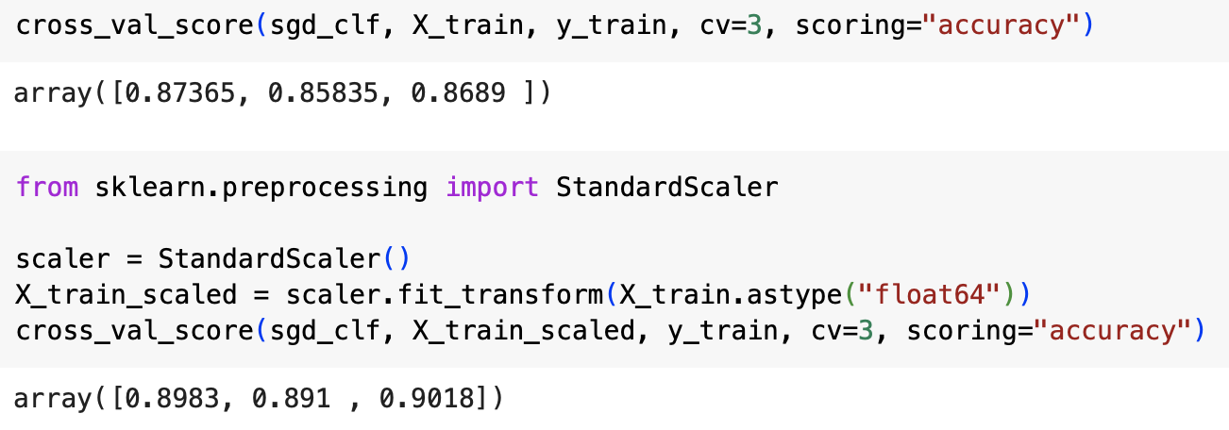
Using an SGD classifier on a multiclass task
In this case we can quite simply improve performance by scaling the inputs

Slide 47
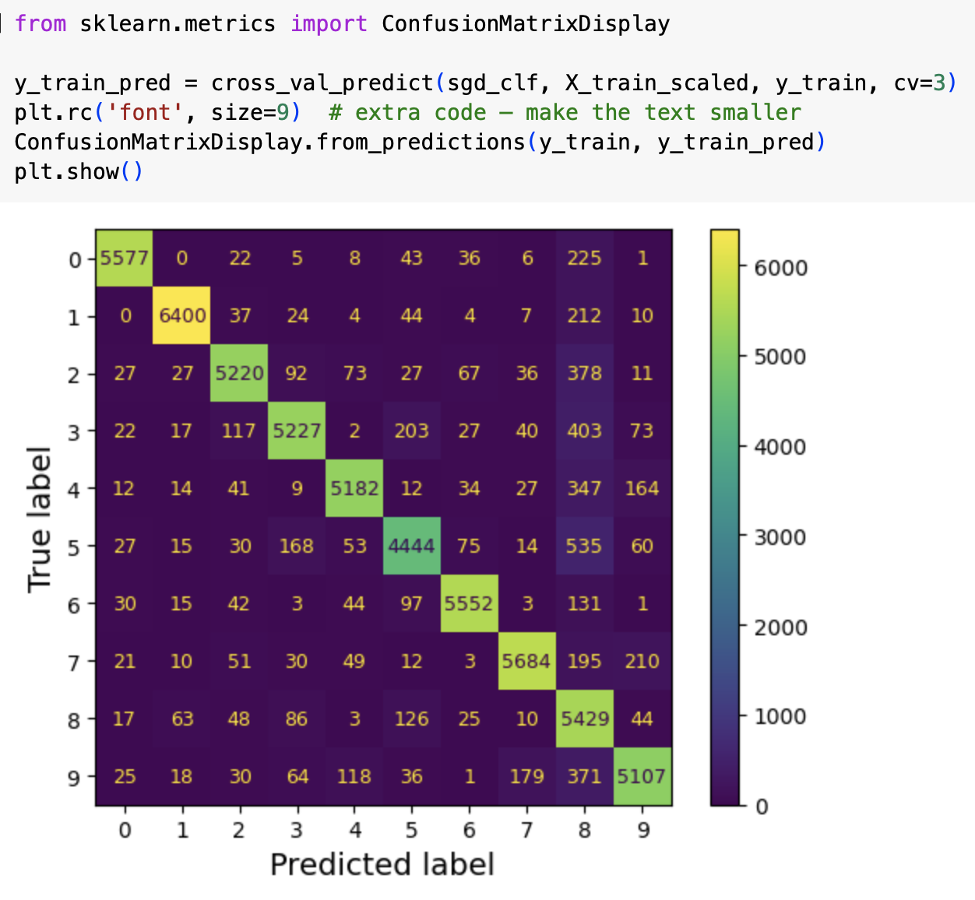
Analysing errors
The first step in analysing your errors is to look at the confusion matrix
Use cross_val_predict() to make predictions
Then pass labels and predictions to confusion_matrix(), as described earlier
When there are 10 classes, the confusion matrix is a 10 x 10 matrix
Larger confusion matrices are easier to understand when they are presented as “heat maps”, where colours represent the values
We can do this using the code shown, which generates the matrix shown

Slide 48
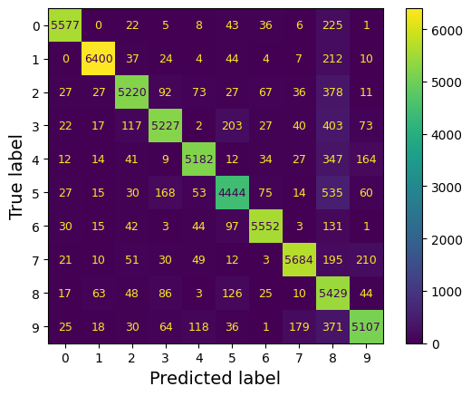
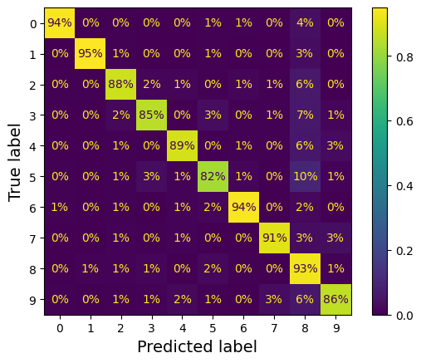
Analysing errors – normalized confusion matrices
Note that the entry at (5,5) is a darker colour than the other entries in the leading diagonal
This could be because there were proportionally more errors or because there were fewer 5s than other digits
You should therefore normalize your confusion matrices, as shown below on the left
each value in the upper matrix is divided by the sum of the values in its row
We normalize by setting the normalize=“true” argument in the from_predictions() method

Slide 49
Analysing errors
Note that 82% of the 5s were classified correctly, with 10% of them being mis-classified as 8s
Note that only 2% of the 8s were misclassified as 5s – confusion matrices are not usually symmetrical!
Note that many digits are mis-classified as 8s – the values in the column for 8 are generally quite high

Slide 50
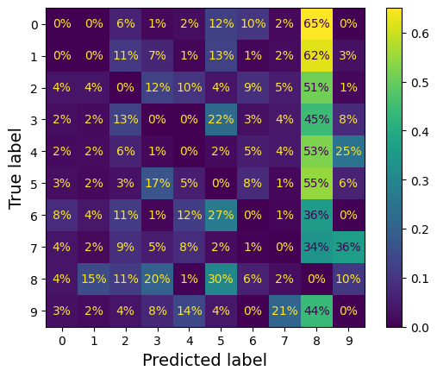

Analysing errors with confusion matrices
We can emphasize the errors in a confusion matrix by putting zero weight on the correct predictions, as shown above
The column for digit 8 is now rather bright, indicating that many errors are due to confusing a digit with an 8
Note that each entry gives the percentage of errors in that row, e.g., 36% of the errors that were made on 7s were due to a misclassification as a 9
However, only 3% of the 7s were actually classified as 9s

Slide 51
Gaining insight into how to improve your model
Confusion matrices can give you insights into how to improve your model
For example, in this case, it seems we should focus on the problem of digits being mis-classified as 8s, we could address this by
getting more training data with images of non-8s that look like 8s
engineering features to help the classifier
preprocessing images so they look more stylised

Slide 52

Analysing individual errors
We can gain insight by analysing individual errors
One way of doing this is by plotting examples of true and false positivies for particular classes in a confusion-matrix-like arrangement (see the notebook for the code for this)
In this case, we might try data augmentation, where we augment the dataset with slightly shifted and rotated versions of the images

Slide 53



Multilabel classification
A multilabel classification system outputs multiple labels for each input
For example, a system that recognizes people in photographs might output for each photograph a list of the people that it thinks are in the picture
Consider the case where we want our system to classify each MNIST image as large vs. small and odd vs. even (from its appearance, not its value!)
The code on the left does this using a knn classifier
One way of evaluating such a classifier is to calculate the mean F1 score across all labels (as shown)
This assumes that all labels have equal support and are equally important
If this is not the case, then we can get a score that gives a higher weight to classes for which there are more instances, using the average=“weighted” option when calling the f1_score() method

Slide 54
Multioutput classification
Multioutput classification is multilabel classification where each label might be multiclass (i.e., have more than 2 possible values)
For example, a system that removes noise from an MNIST-like image could be a multioutput classification system that outputs an array of pixel intensities
the output is multilabel, since there is a label for each pixel in each output
the output is multiclass, since each label can be one of 256 different values

Slide 55




Denoising an image using multioutput classification
We can create training and test sets by adding noise to the MNIST images using NumPy’s randint() function
We keep the original images as the target images
Note that it tries to find the most similar clean digit – this is instance-based learning!

