Slide 1
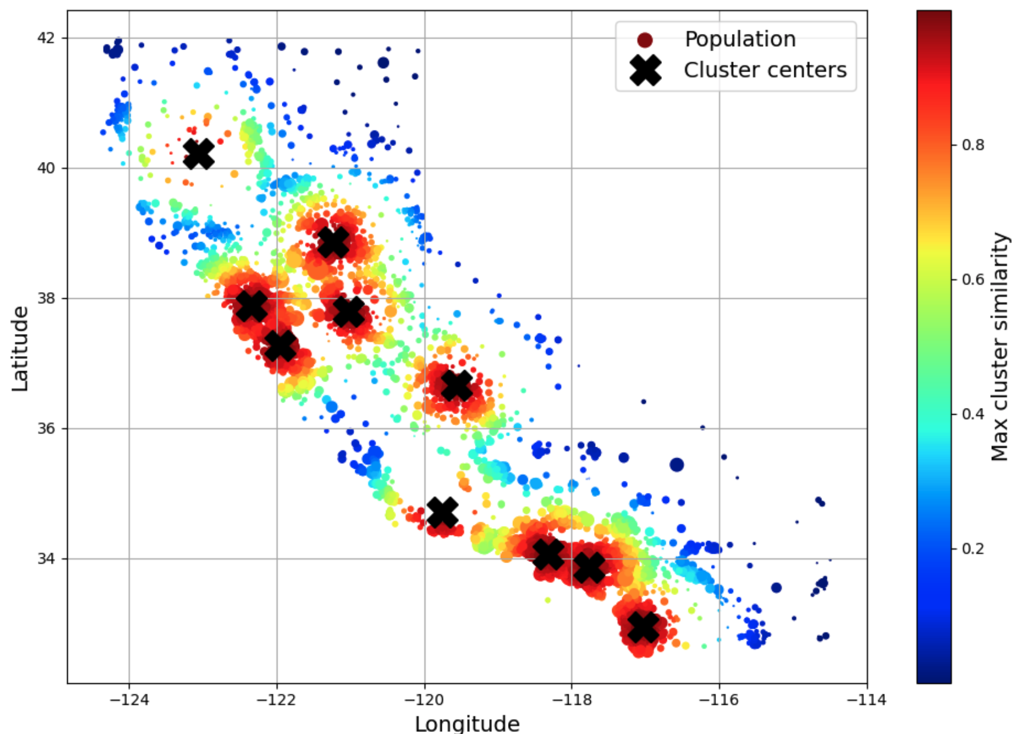
End-to-End Machine Learning Project
David Meredith
Aalborg University
dave@create.aau.dk

Slide 2
Source
Chapter 2 of
Géron, A. (2023). Hands-On Machine Learning with Scikit-Learn, Keras & TensorFlow. (Third edition). O’Reilly. Available at
https://www.amazon.de/-/en/Aur%C3%A9lien-G%C3%A9ron/dp/1098125975/
https://www.saxo.com/dk/hands-on-machine-learning-with-scikit-learn-keras-and-tensorflow_bog_9781098125974
https://factumbooks.dk/?search_string=hands-on+machine+learning+with+scikit-learn

Slide 3
Introduction
In this lecture, we’ll work through an example ML project from beginning to end
We’ll look at
Getting the big picture
Getting the data
Exploring and visualizing the data to get some initial insights
Preparing the data for ML algorithms
Selecting a model and training it
Fine-tuning the model
Presenting your solution
Launching, monitoring, and maintaining the system

Slide 4
Working with real data
When learning about machine learning, it is always best to use real-world data
There are thousands of open datasets available in all sorts of domains
A few good places to look for datasets are
OpenML.org (https://openml.org)
Kaggle.com (https://kaggle.com/datasets)
PapersWithCode.com (https://paperswithcode.com/datasets)
UC Irvine Machine Learning Repository (https://archive.ics.uci.edu/ml)
Amazon’s AWS datasets (https://registry.opendata.aws)
TensorFlow datasets (https://tensorflow.org/datasets)

Slide 5
A few other places to get datasets
“Meta-portals” that list open data repositories:
https://dataportals.org
https://opendatamonitor.eu
Wikipedia’s list of ML datasets (https://homl.info/9)
Quora.com (https://homl.info/10)
The datasets subreddit (https://reddit.com/r/datasets)

Slide 6
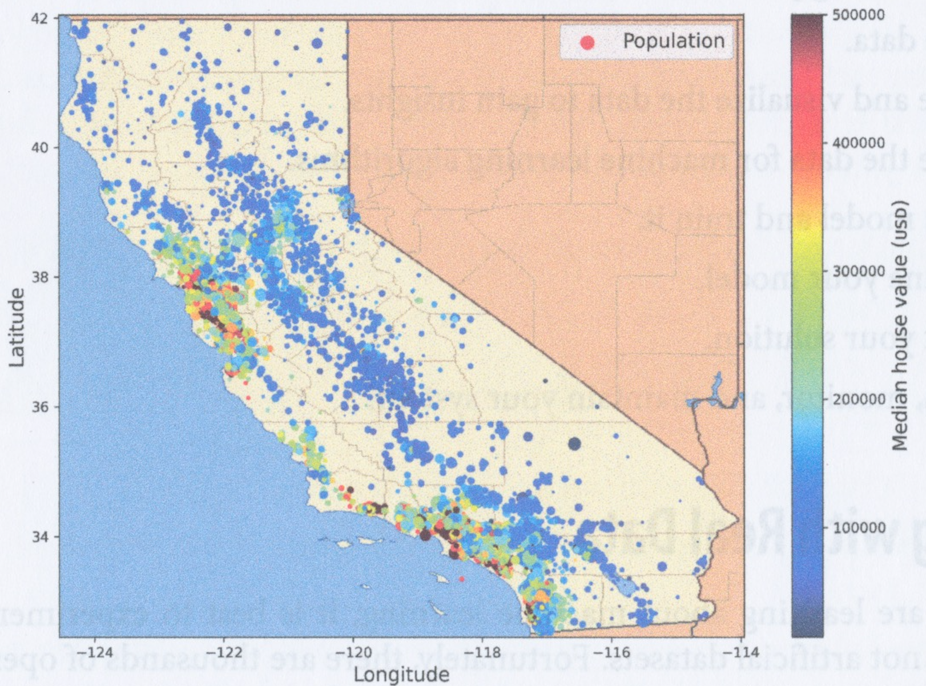
Example dataset to be used in this lecture
In this lecture, we’ll use the California Housing Prices dataset from the StatLib repository, based on 1990 California census
Our task is to predict median house values in California districts, given a number of features from these districts

Slide 7
Looking at the big picture
We’ll start by using the census data to build a model of housing prices in the state
Data includes population, median income, median housing price for each block group in CA
A block group is the smallest geographical unit for which the US Census Bureau publishes sample data
Each block group typically has a population of 600 – 3000 people
We’ll call block groups “districts”
Our model has to learn from this data to predict the median housing price in any district, given all the other metrics

Slide 8
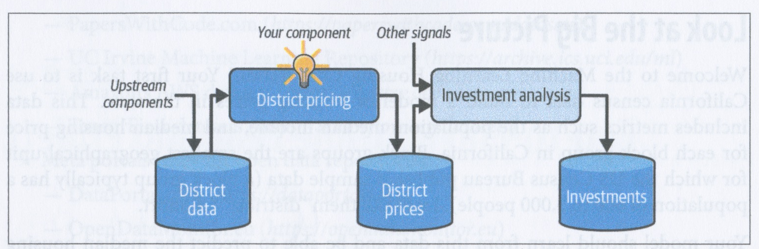
Framing the problem
First we need to know what the model will be used for
This could influence things like
what algorithms we use
what performance measures we use to evaluate the models
how much effort we use on fine-tuning the models
In this case, the output of the model (a predicted median house price for a district) will be fed to another ML model (along with many other signals) that will make a recommendation as to whether to invest in a given area

Slide 9
Framing the problem
Second question to ask is whether there is already a solution in use
You might be able to get insights into how to solve the problem by looking at an existing solution
You can also compare the performance of your new system with that of the existing one
In our (fictional) case there is no existing system
The median house prices are currently estimated manually by applying a complex rule set
This is expensive and time-consuming and estimates are often wrong by more than 30%

Slide 10
Pipelines
A pipeline in ML is a sequence of data processing operations that is carried out to build, test and deploy a model
Each data processing operation in a pipeline typically runs periodically and stores its output in a persistent data store
Each data processing operation typically gets its input data from another data store into which a preceding operation has stored its output
So the process is “asynchronous” in the sense that all steps in the pipeline can be running simultaneously with each other and repeatedly
But each step also depends on all previous steps having generated the data that it needs as input, so in this sense the pipeline is synchronous

Slide 11
What categories of ML model do we need here?
Will the model be supervised, semi-supervised, self-supervised, unsupervised, or an RL task?
Is this a classification task, a regression task or something else?
Should we use batch learning or online learning?

Slide 12
Category of ML model required
In this case we will build a supervised univariate multiple regression model that uses batch learning
Supervised: we will train the model with labelled examples
Each training instance has information about the correct target for that instance – the median house price for the district
Multiple univariate regression: the model uses multiple features to predict a single (univariate) value
Batch learning: the model does its learning in one step on one dataset that is small enough to fit entirely in memory

Slide 13
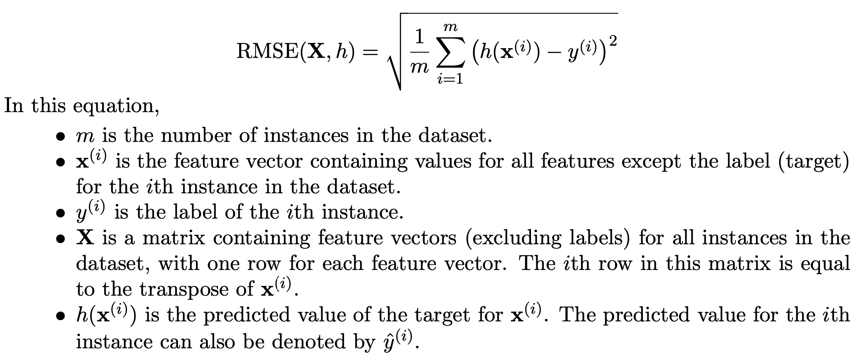
Selecting a performance measure – root mean square error
This is a regression problem and a typical measure of error for a regression problem is the root mean square error (RMSE)

Slide 14
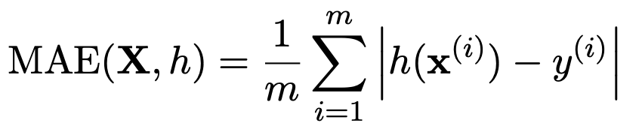
Mean absolute error
If there are many outliers, then it is sometimes preferable to use the mean absolute error (MAE), also known as the average absolute deviation

Slide 15
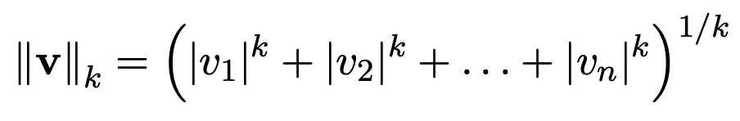
Norms
RMSE and MAE are both examples of norms
A norm is a measure of a distance between two points in a space – in other words, it is a measure of the length of a vector
RMSE is also called the ℓ₂ norm or Euclidean distance or Euclidean norm
MAE is also called the ℓ₁ norm or Manhattan distance or Manhattan norm or city-block distance, because it is the distance in blocks between two points in grid-based city
More generally, the ℓ_{k} norm is given by the equation on the left
Note that
ℓ₀ gives the number of non-zero elements in the vector
ℓ♾ gives maximum absolute value in the vector

Slide 16
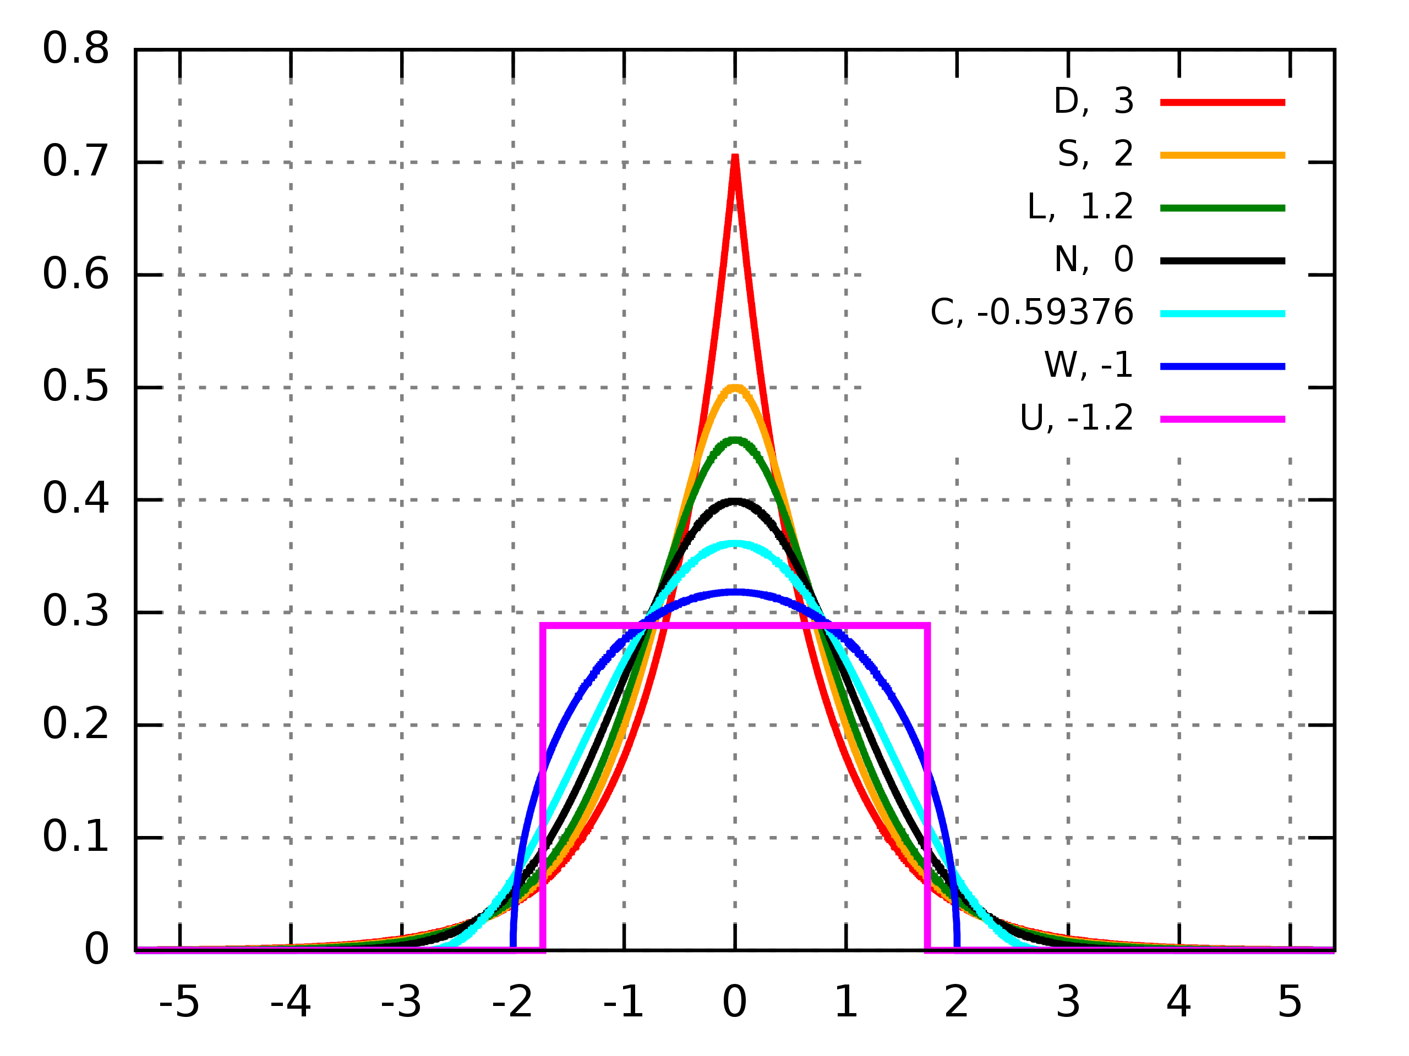
Norms
Higher order norms give more emphasis to larger values and neglect smaller values
This is why RMSE is more sensitive to outliers than MAE
But when outliers become exponentially less frequent as you move away from the centre of the distribution (e.g., as in the normal distribution), then RMSE works well and is generally preferred
By Original: MarkSweep Vector: Andel - MarkSweep, Public Domain, https://commons.wikimedia.org/w/index.php?curid=90664811

Slide 17
Checking assumptions
At this stage in the project, before starting to build your system, you should check and verify that your assumptions are valid
For example, in this project, you should check that the downstream application that uses the values output by your system does indeed need numbers – i.e., actual prices – and not just categories (e.g., “cheap”, “medium”, “expensive”)

Slide 18
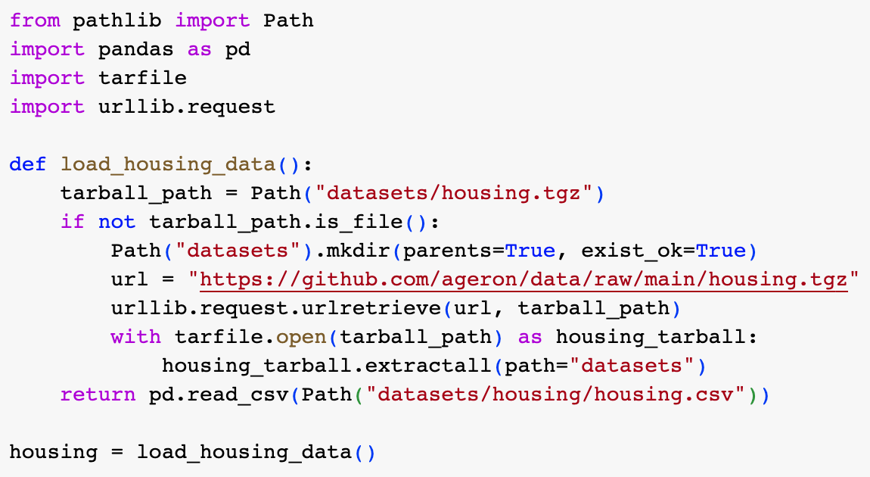
Downloading the data
In general, the data you use in your project may be available in a database or in a repository of files in various formats and you would have to do some processing to get it into a form for training and testing your model
Here, the data is available in a tarball (.tgz file)
The first step is to load the data into a Pandas DataFrame object that contains all the data
This is done using the function shown on the left

Slide 19
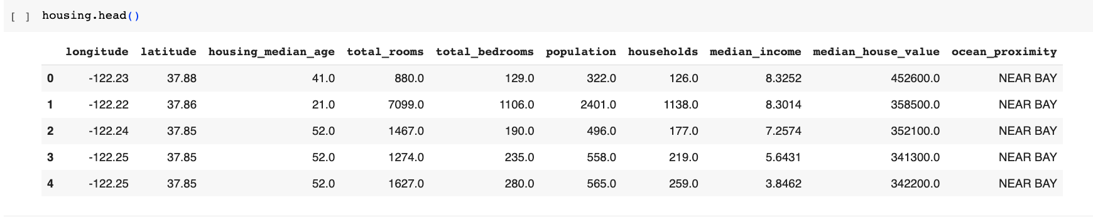
Taking an initial look at the data
It’s a good idea to start by just looking at the data
You can view the first 5 rows by using the .head() method
Each row in this data corresponds to a district and provides 10 pieces of information about it

Slide 20
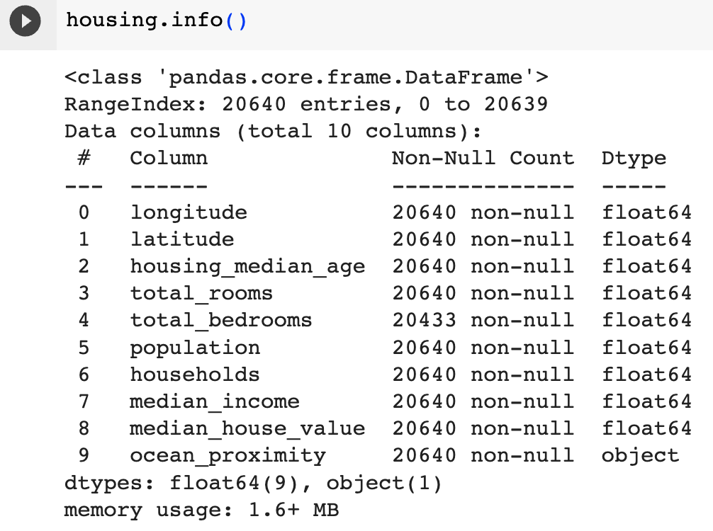
Taking an initial look at the data
The .info() method gives information about the DataFrame object, including number of rows, each column’s type, and name and the number of non-null values
Here there are 20640 instances in the dataset
Note that some of the values for total_bedrooms are null – you will need to take this into account later

Slide 21
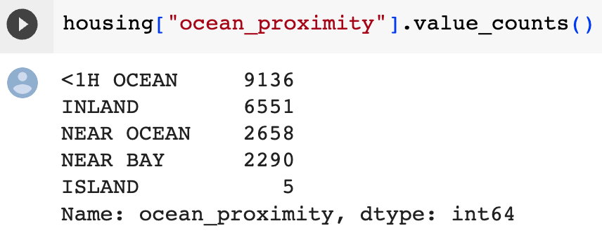
Finding out more about individual fields
All attributes are numerical except ocean_proximity which is of type object
We can find out how many different values there are for this field and how many rows there for each value using the .value_counts() method

Slide 22
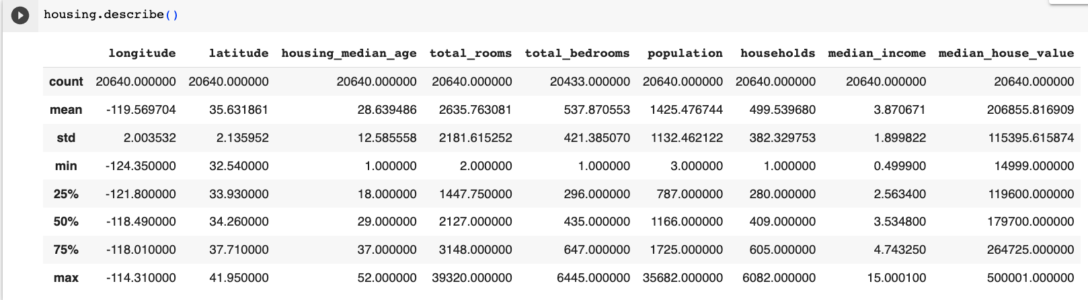
Getting information about all the numerical fields
You can get a summary of information about all numerical fields by using the .describe() method
For each column, this shows the total number of values, the mean, standard deviation, the minimum and maximum, upper and lower quartile and the median

Slide 23
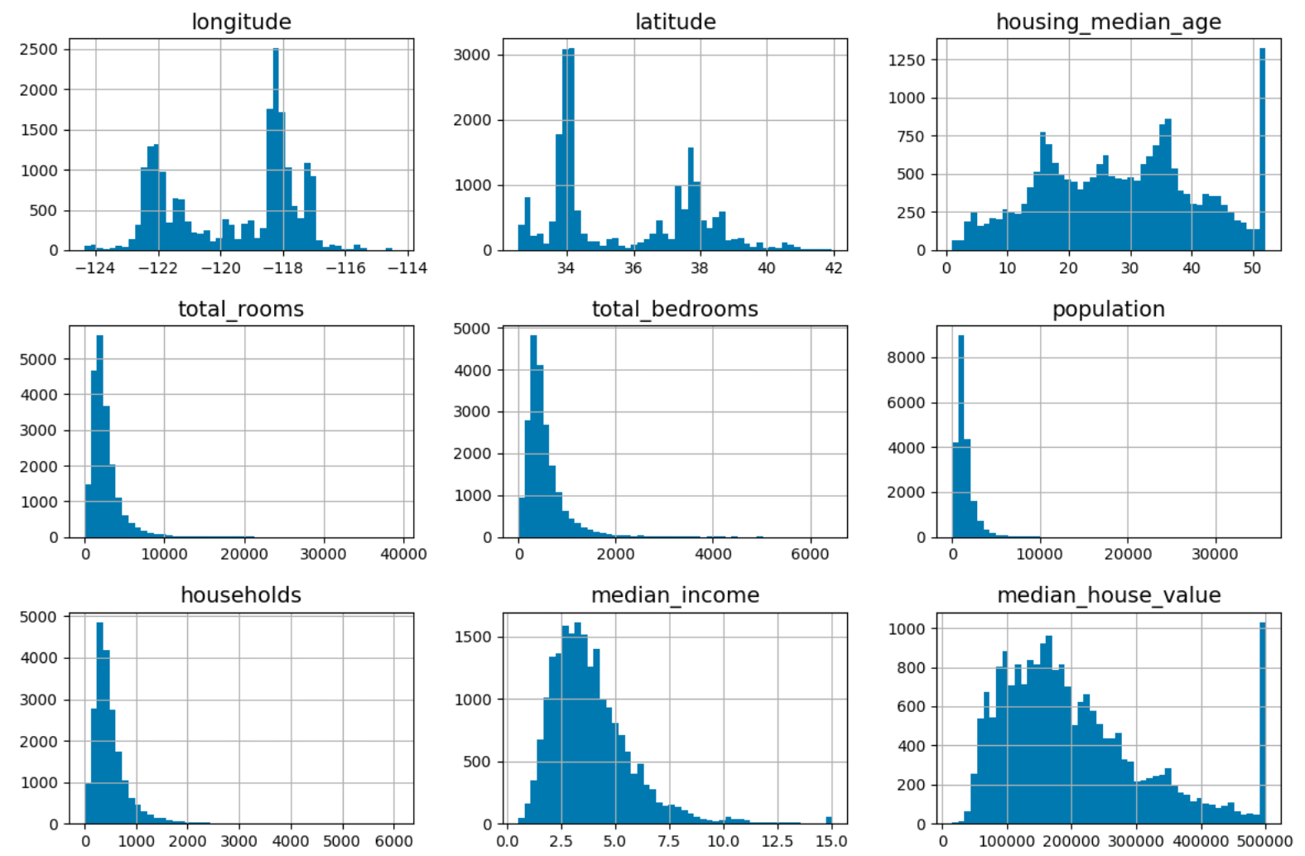
Plotting a histogram for each attribute
You can use the .hist() method to plot a histogram for each of the attributes

Slide 24
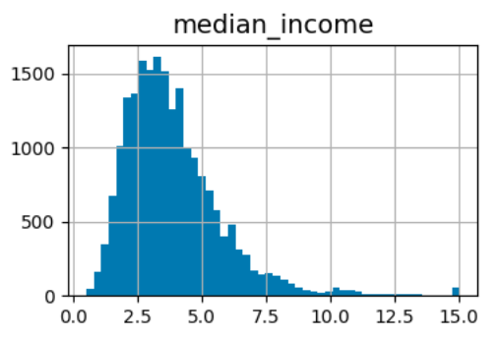
Things to note from the histograms
What are the units of the median_income attribute?
Turns out the these values have been capped above at 15 and below at 0.5 and that each number represents 10000s of USDs
Important for you to understand what the values mean in your data!

Slide 25
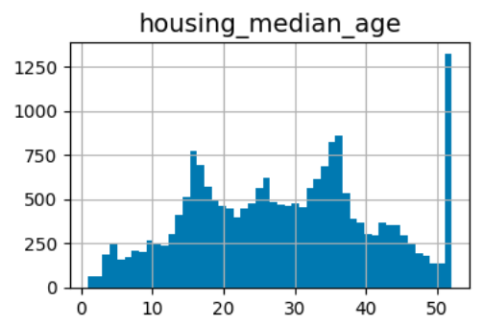
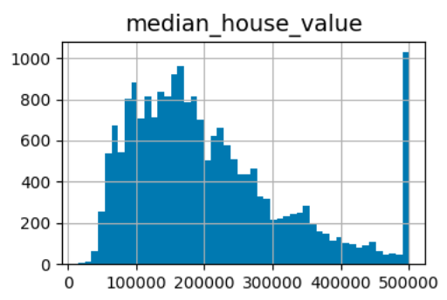
Things to note from the histograms
housing_median_age and median_house_value have a very high frequency at the right hand side
What do you think this means?

Slide 26
Things to note from histograms
It’s because the values were capped at the maximum values shown
Therefore the last entry at the right means the maximum value or above
How might you deal with this?

Slide 27
Things to note from the histograms
The attributes have very different scales
We will discuss this later under the topic of feature scaling

Slide 28
Things to note from the histograms
Many of the histograms are positively skewed
This can make it harder for certain ML algorithms to detect patterns
One way of dealing with this is transform these attributes to have more symmetrical bell-shaped distributions

Slide 29
Data snooping bias
Before examining the data any further, you should set aside a portion of the dataset to be used as a test set and never look at that test set again!
Human brains are very good at seeing patterns and examining the data at this stage that you will eventually use for testing your model could bias you towards using a particular model, which increases the risk of overfitting!

Slide 30
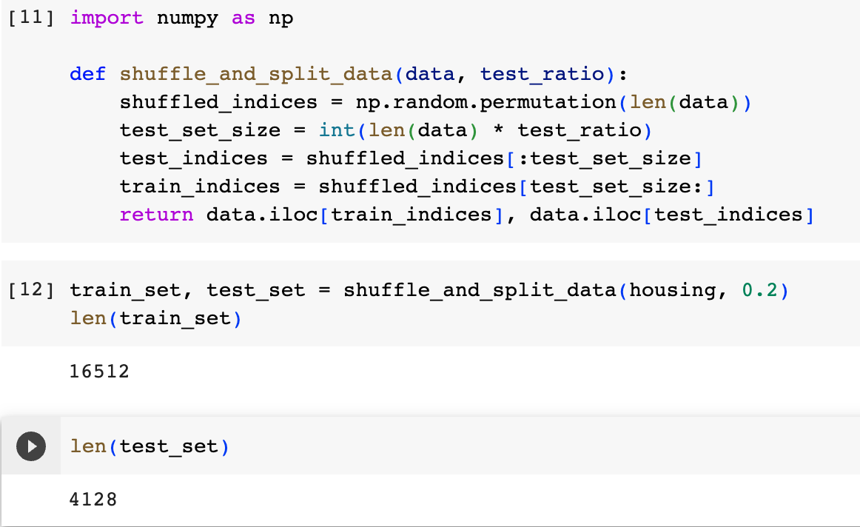
Creating a test set
Next we create a test set
Typically we randomly select 20% of the dataset to be used as a test set and set them aside
If your dataset is very large, then you might be able to get away with using a smaller proportion of the data as a test set
We can create a test set using the code on the left

Slide 31
Replicating a train-test split
If you do what we just did, then the next time you run the shuffle_and_split_data function, it will give a different split of the data into training and test set
If we keep doing this, then eventually, our learning algorithm will see all the test set, which we want to avoid
How can we address this?

Slide 32

Replicating a train-test split
One way to try to replicate a train-test split is to set the random number generator’s seed before carrying out the shuffle-and-split operation
We can do this using a command like the one on the left
But this won’t work if the dataset is updated in between replications

Slide 33
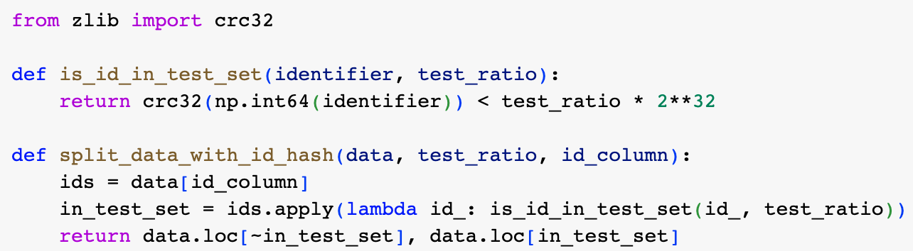
Replicating a train-test split using a hash function
We can more reliably maintain the same train-test split by computing a hash value for each instance in the dataset based on a unique identifier
We assume that there is simple uniform hashing over the full range of the hash function and then assign an instance to the test set if its hash value is less that 20% of the maximum hash value
Note, however, that Python “salts” its hash function whenever it starts up
To prevent this, you need to set the PYTHONHASHSEED environment variable to “0” before Python starts

Slide 34
Replicating a train-test split
Unfortunately, the housing dataset does not have an id column
One way of getting an unique id for each instance would be to use the row index as the ID (see above)
However, this means that any new data added to the dataset needs to be added at the end of the dataset and that no row can be deleted
Another option would be to use a district’s longitude and latitude which should remain constant for any given district (see snippet below)

Slide 35
Using Scikit-Learn’s train_test_split function
Instead of writing your own “shuffle-and-split” function, you could also use Scikit-Learn’s train_test_split function
train_test_split takes a “random_state” argument that you can use to replicate train-test splits across calls
You can also pass it multiple DataFrames, which is useful if you store your labels in a separate DataFrame from the rest of the instance features

Slide 36
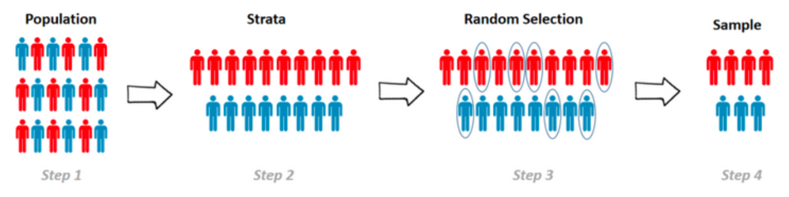
Stratifying to avoid sampling bias
We want both our training set and our test set to be representative of the population of instances
What if the population has certain subsets of different sizes and the differences between those subsets is relevant to the task that we are trying to carry out with our model?
For example, if we want a representative sample of the US population for a survey and we suspect that the responses might depend systematically on the sex of the respondant, then we would want the proportion of females in our sample to be the same as that in the population (ca. 51.1%)
Setting such constraints on a sample’s composition is called stratified sampling
Each of the groups whose proportion is controlled is called a stratum – in this case, the two strata would be males and females

Slide 37
Stratifying our test set by median income categories
Let’s suppose that we think that the median income of a district is a very important factor in determining the median housing price
So we decide that we want our test set to be stratified according to median income categories
This means we have to divide the median income range into segments

Slide 38
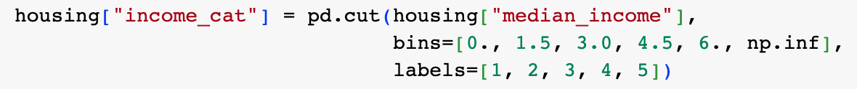
Stratifying the test set according to median income
It is good practice not to have too many strata and to ensure that you have enough instances in each stratum (so that each stratum is properly represented)
We can use the Pandas library cut function to create a new attribute in our housing DataFrame, “income_cat”, whose value is a category determined by the value in an instance’s “median_income” attribute (see snippet above)

Slide 39
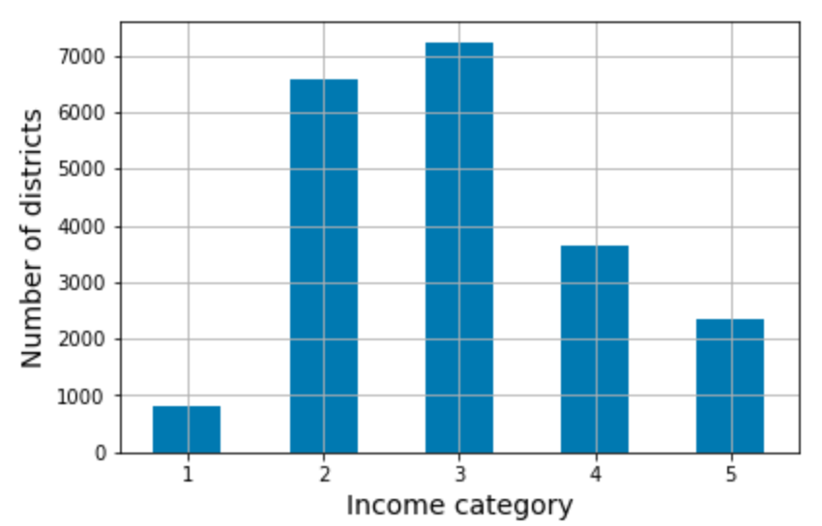
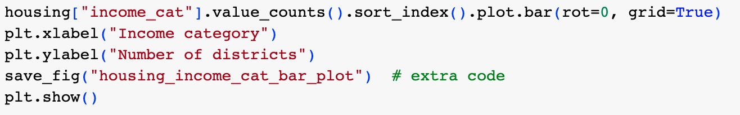
Stratifying the test set according to median income
The pd.cut function creates the new categorical attribute income_cat and the frequency distribution of this category over the dataset is shown on the left
The plot is produced using the code shown

Slide 40
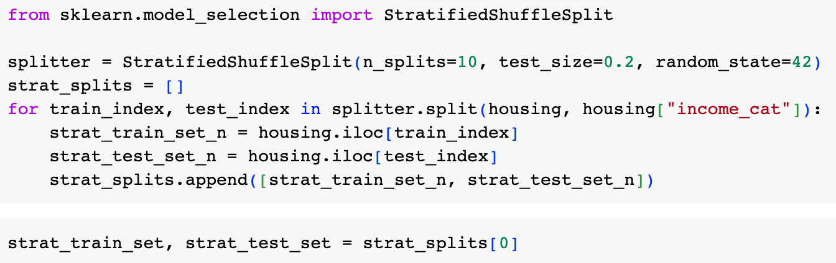
Generating a stratified split using Scikit-Learn
Scikit-Learn provides a number of splitter classes in the package sklearn.model_selection that implement a variety of different strategies for generating a train-test split of your dataset
Each splitter has a split() method that returns an iterator over different training/test splits of the same data
i.e., each split method returns the indices of the dataset instances in the training and test sets, not the actual instances themselves
When we do cross-validation, we will need to be able to generate multiple splits of the dataset and the split() methods allow us to do this
Code above generates 10 different stratified splits of the same dataset (and then selects the first one)

Slide 41
Using train_test_split function to get a single stratified split
We can get a single stratified split using the train_test_split function with its “stratify” argument

Slide 42
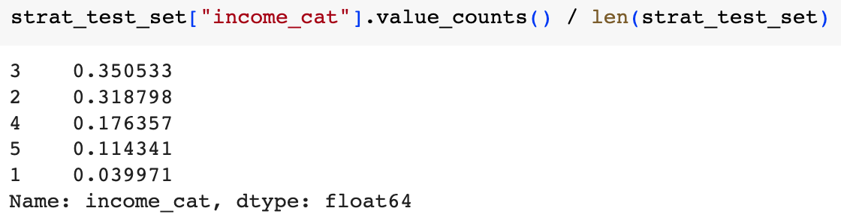
Checking to see if the stratified split worked
We can check that the proportions of the different strata in the test set are approximately the same as in the dataset as a whole using the code on the left

Slide 43
Exploring and visualizing the data to gain insights
We should now examine the training set a bit more thoroughly in order to get some more insight into what kind of models might work well
But we need to be sure we don’t look at the test set any more!
If a training set is very large, then you might want to explore a random subset of it – an “exploration set”
We’re going to experiment with various transformations of the training set, so we make a copy of it to work on

Slide 44
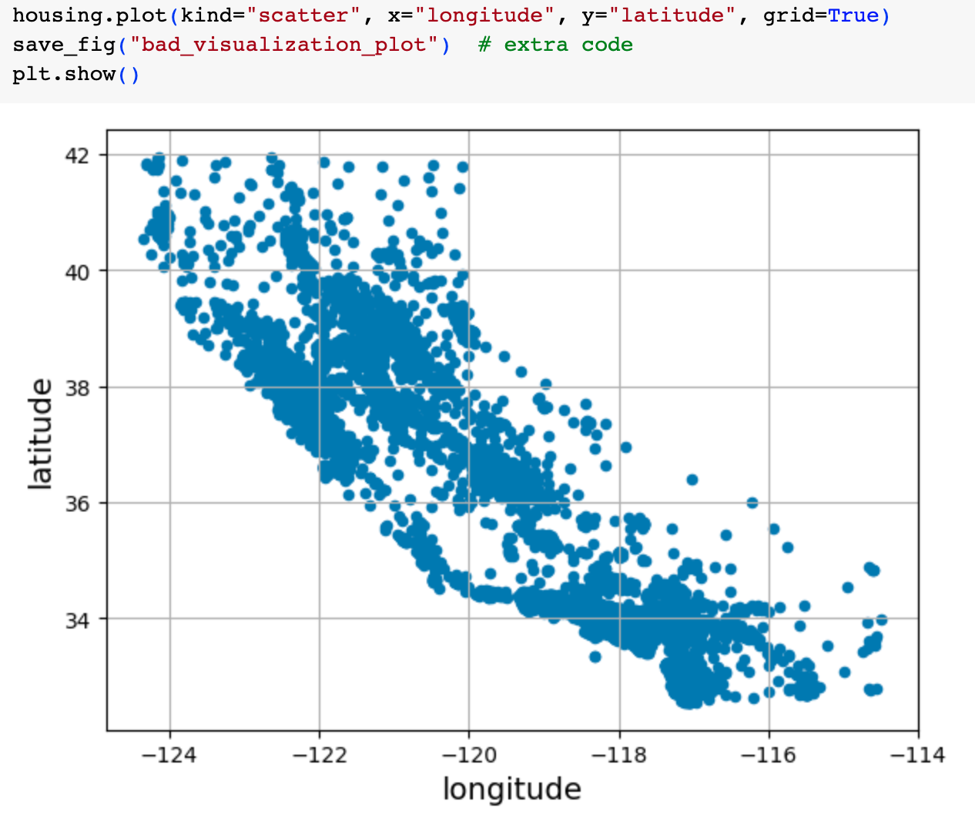
Visualizing geographical data
In this case, the data is geographical, so it makes sense to make a scatterplot of the various districts according to longitude and latitude
This certainly looks like California, but otherwise it is hard to see any pattern

Slide 45
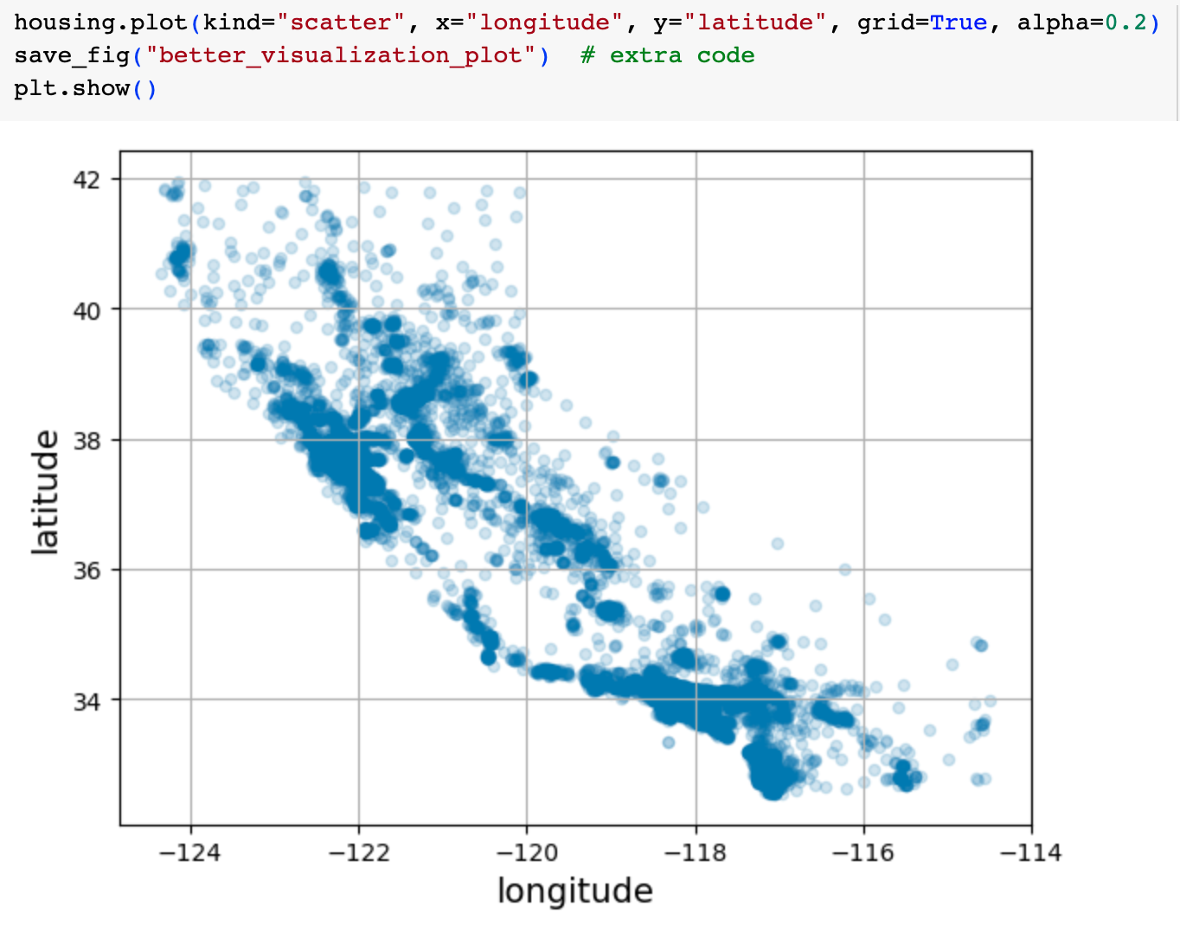
Visualizing geographical data
We can set the alpha value to 0.2 to make it more clear where there is a greater density of data points
This shows better where the high-density areas are lying

Slide 46
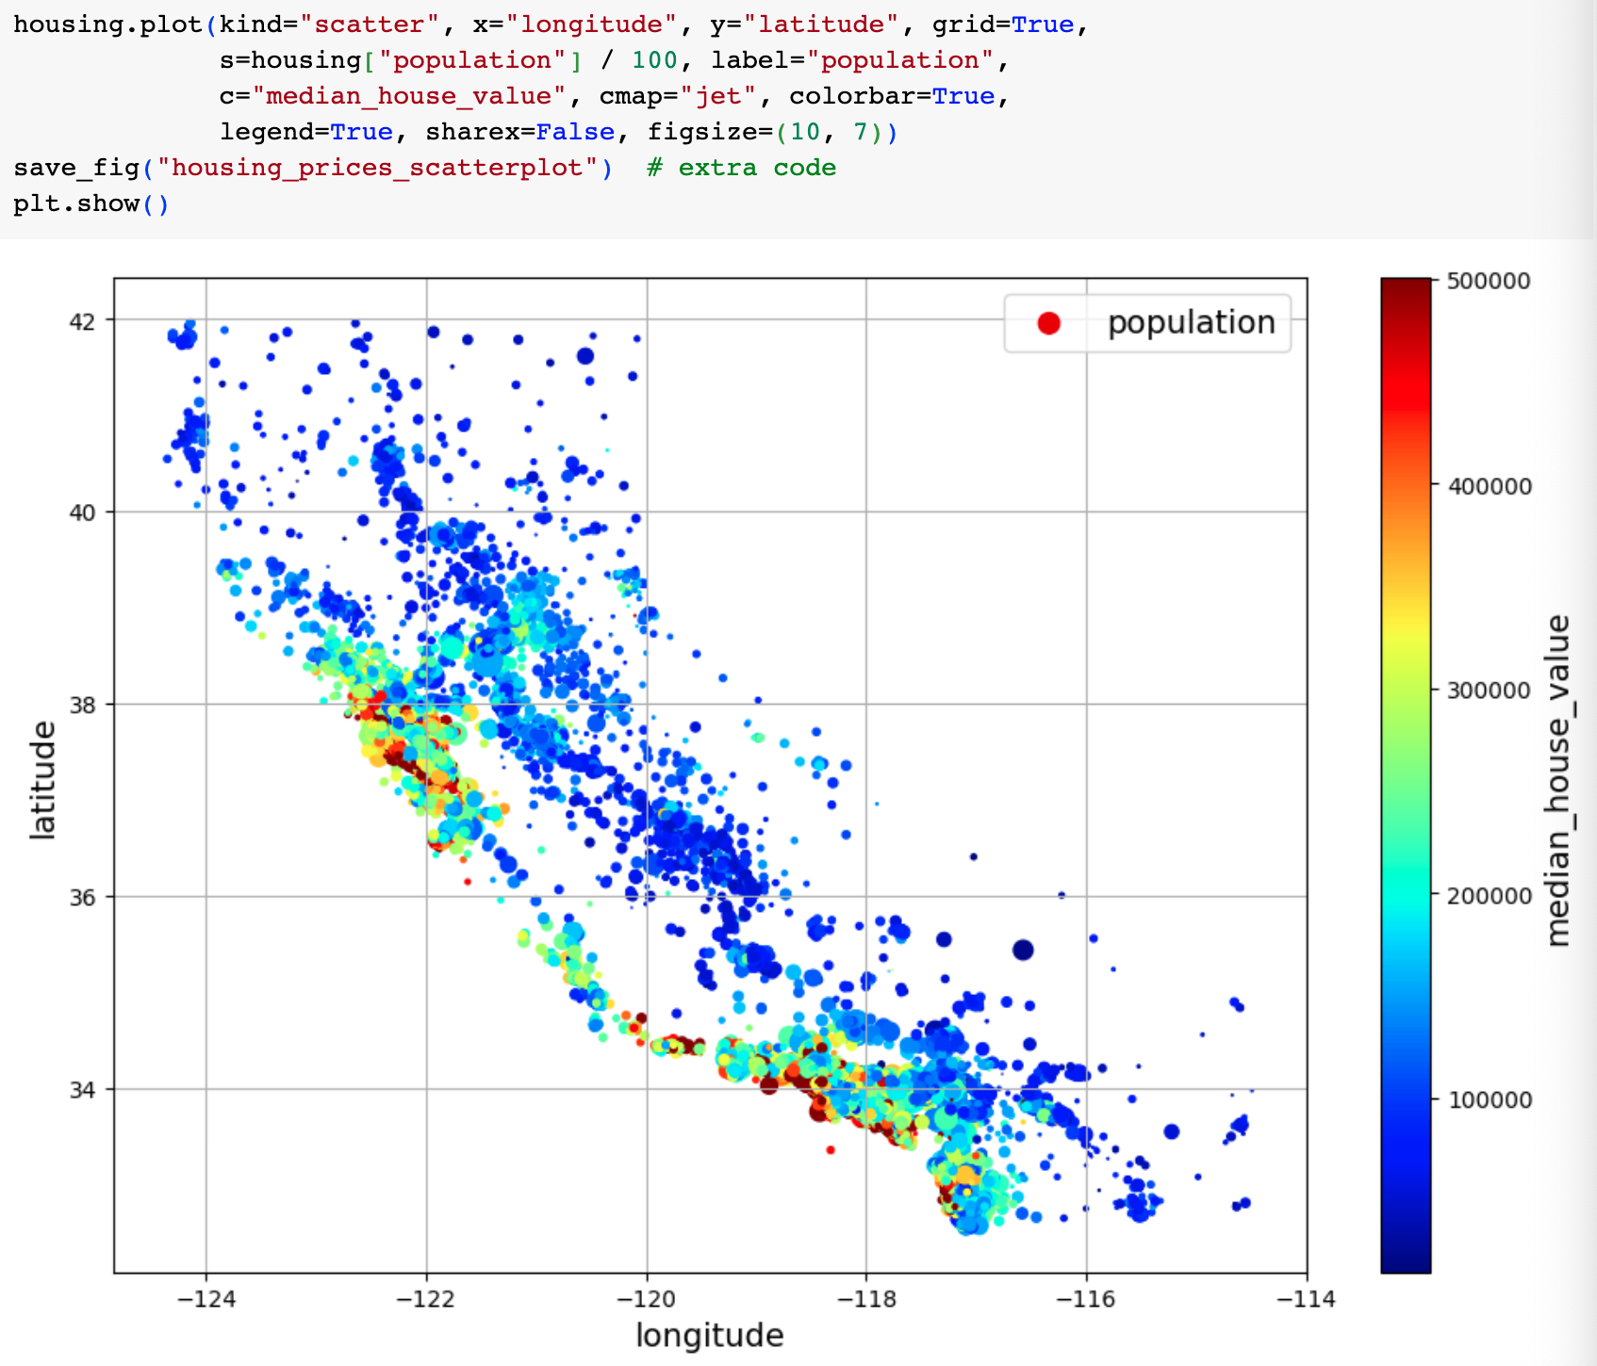
Incorporating population and housing price into the visualization
We can incorporate housing price information and population into the visualization
radius of each circle represents population – option s
the color represents the median_house_value – option c
here we use a predefined color map – option cmap with argument “jet”

Slide 47

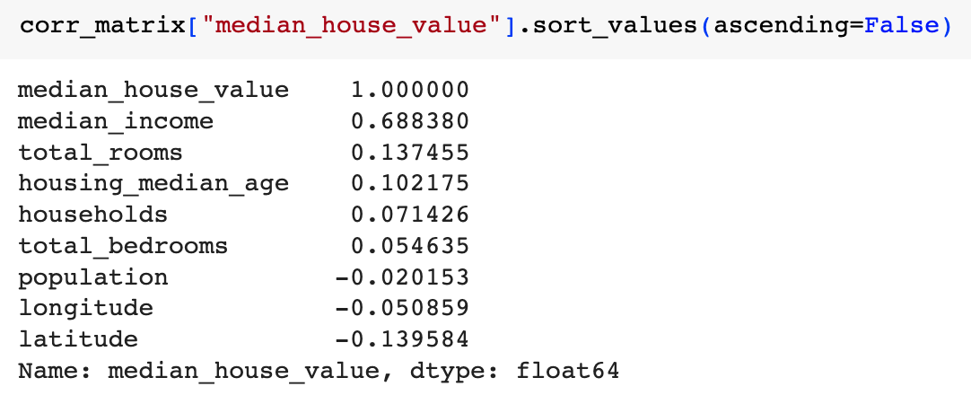
Looking for correlations between attributes
It’s very useful to get an idea of whether there are any significant correlations between the different attributes
We can do this in one step using the DataFrame corr() method which computes Pearson’s r between every pair of attributes
We can then select the column for median_house_value to find the correlation of this attribute with each of the others

Slide 48
Looking for correlations between attributes
You can see that there’s a fairly strong positive correlation between median_house_value and median_income – as you’d expect!

Slide 49
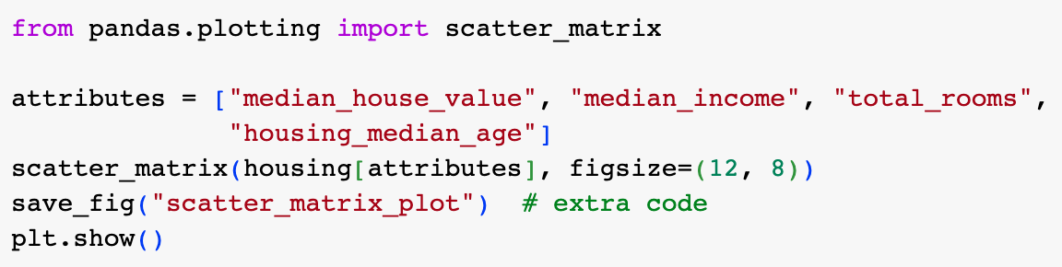
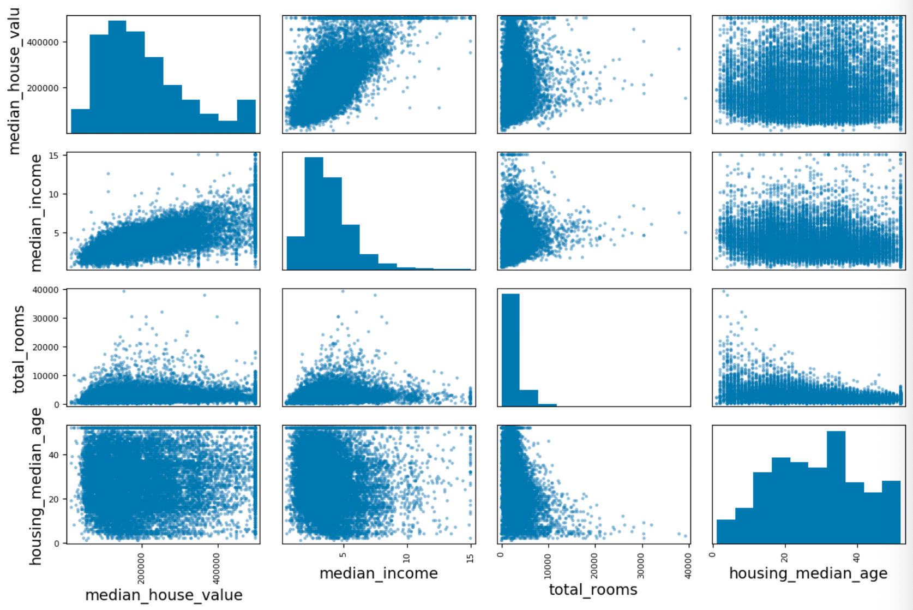
Looking for correlations visually
You can also search for correlations visually using the Pandas scatter_matrix() function
This takes a DataFrame (or part of one) as its argument and produces a scatter plot for every pair of numeric attributes within the frame
This would produce too many graphs if we used all the attributes in our data, so we select a few that look promising
Again, the most promising relationship looks like that between median_income and median_house_value

Slide 50
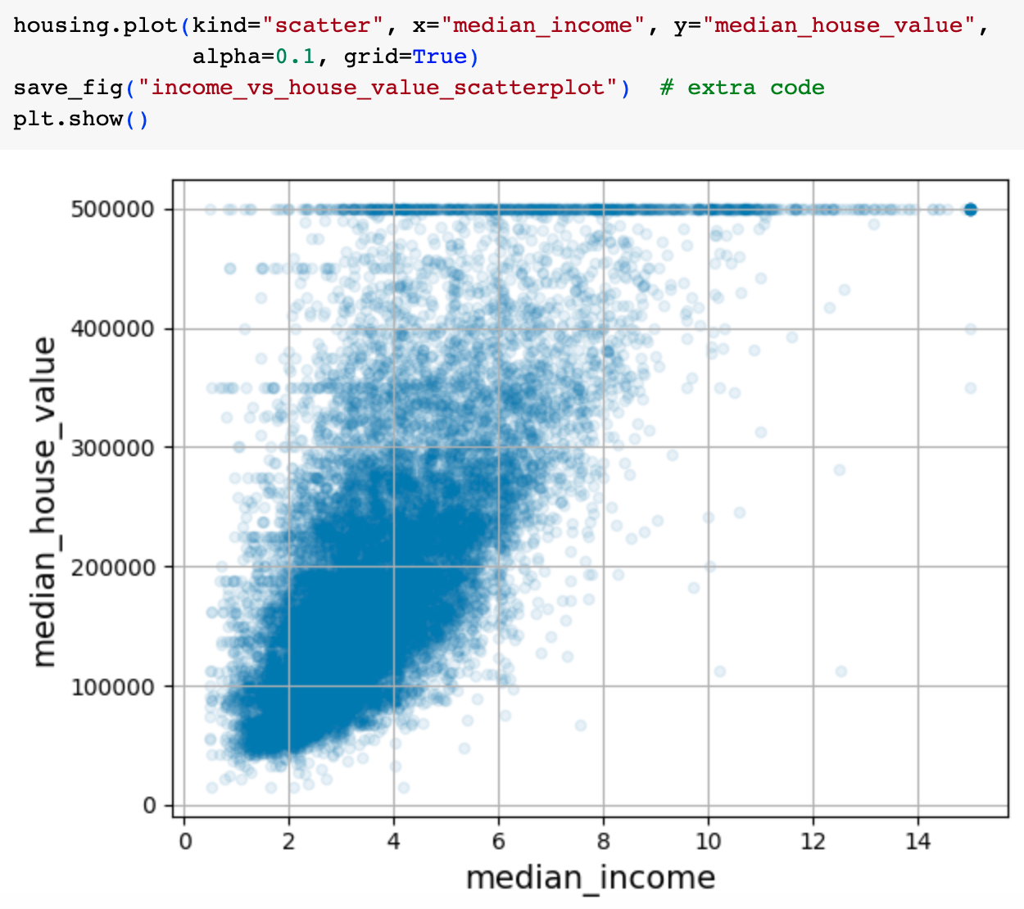
Looking closer at the promising relationships
We can zoom in and look more closely at the scatter plot for median_house_value against median_income
We can see that there certainly seems to be a positive trend
We can also see the price cap at the top
There are also some other horizontal lines at e.g., 450k, 350k – these might be “quirks” in the data that you might want to remove before training a model

Slide 51
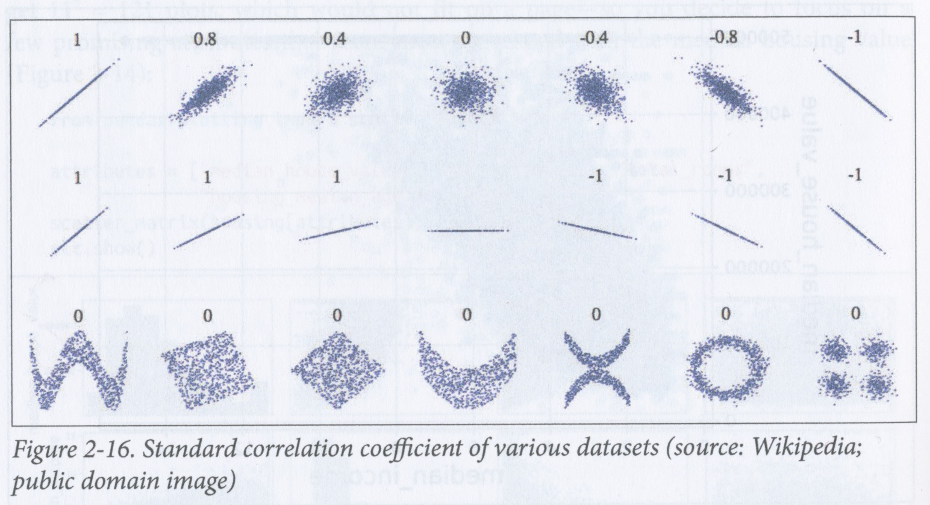
Correlation coefficient
The correlation coefficient only measures linear relationships
It may completely fail to notice non-linear relationships
The figure on the left shows the correlation coefficient for a number of scatter plots
In the plots in the bottom row, there is clearly a relationship, between the variables, but the correlation coefficient is 0!
Note also that the slope of the line does not affect the correlation coefficient – it basically just says whether the two variables “go up and down” in the same places!

Slide 52
Summary so far
We’ve learnt how to get our data and how to split it into a training set and a test set
We’ve also learnt some ways of exploring data both visually and by using correlations
We’ve also found some “quirks” in the data that we may need to remove before using it for training
We found that some of the attributes have skewed distributions that may need to be transformed before learning

Slide 53
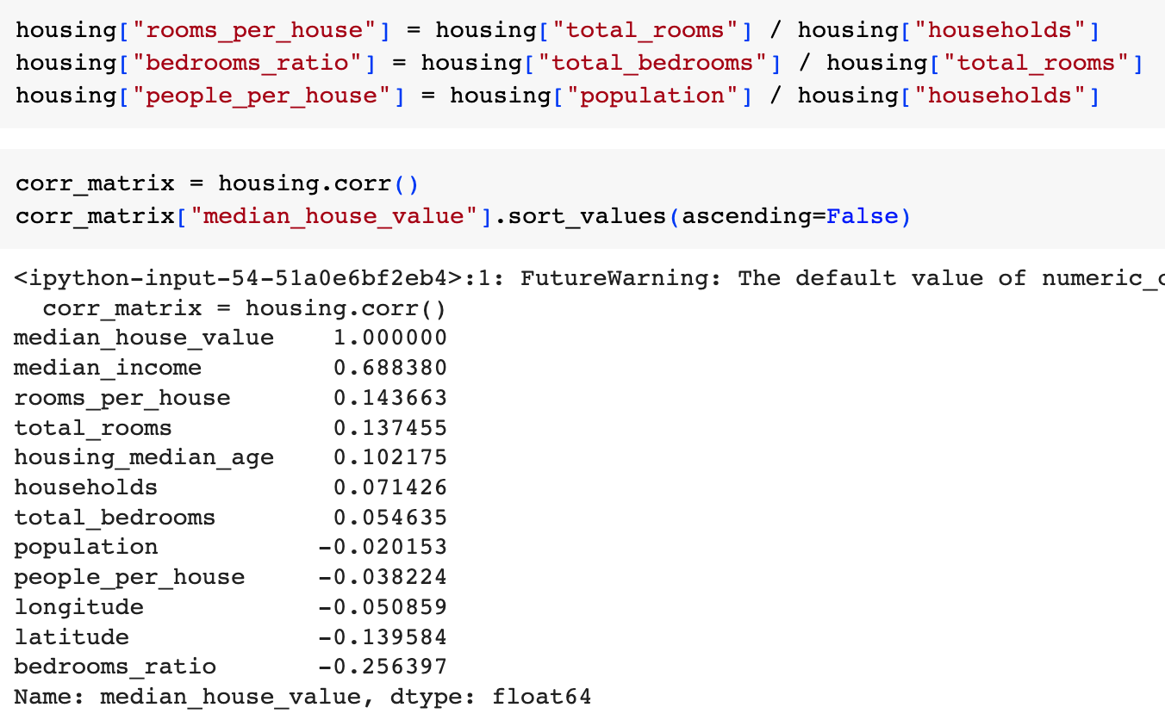
Experimenting with attribute combinations
A final thing to explore before preparing the data for machine learning is to try out various attribute combinations
For example, we could
divide total_rooms by households to get the number of rooms per house for a district
divide total_bedrooms by total_rooms to get the proportion of rooms that are bedrooms for a district
divide population by households to get the number of people per household for a district
Then we can look at the correlation matrix again

Slide 54
End of initial exploratory phase
The bedrooms_ratio attribute is more correlated with the median_house_value that the total number of rooms or bedrooms
Houses with a lower bedroom/room ratio tend to be more expensive
rooms_per_house is more informative than the total number of rooms in a district – obviously, larger houses are more expensive!
This exploratory phase has given us some good insights that we can use to help us in building a first prototype
We can have another round of analysis once we’ve got our first prototype up and running

Slide 55
Preparing data for machine learning algorithms
Having explored and visualized the data, and split it into training and test sets, it is time to prepare it for machine learning
This should be done by running functions on the data rather than by editing it manually because
it makes the process reproducible
you will be able to reuse the functions on other datasets and on this dataset when you update it
you can use the functions when you update the data if you decide to implement your system as an online learning system or if you have periodic updates
it makes it easier compare different transformations of the data

Slide 56
Preparing the data for ML algorithms
First we need to revert to a clean training set (e.g., by copying strat_train_set again
We should also separate predictors from targets, as we won’t necessarily apply the same transformations to the predictors as to the targets
Note that drop() creates a copy of the data and does not affect strat_train_set

Slide 57
Cleaning the data
Most ML algorithms cannot work with missing features, so we need to handle this
Our total_bedrooms attribute had missing values – we can fix this in three ways:
remove the instances (in our case, districts) with missing values
remove the entire attribute from the data
set the missing values to some single value, such as zero, the mean, the median, etc. – this is called imputation

Slide 58
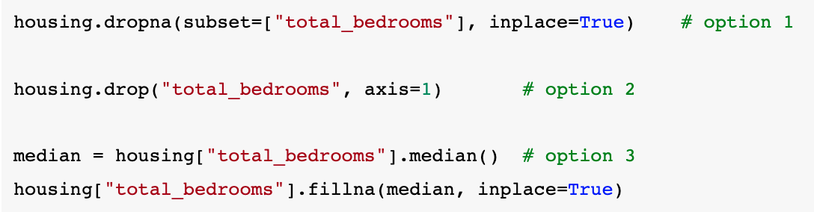
Cleaning the data
We can handle missing data using the Pandas DataFrame methods, dropna(), drop() and fillna()
Note that the “inplace” argument to fillna modifies the object on which it is called

Slide 59
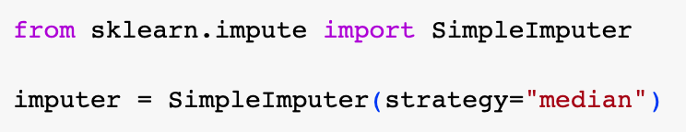
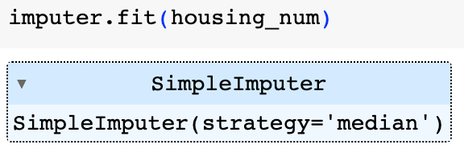
Using a SimpleImputer
We decide to handle the missing data by imputing the median of total_bedrooms into the missing values
We will use SciKit-Learn’s SimpleImputer class to do this
A SimpleImputer stores the medians of all the attributes, so it can be applied later to a test set, a validation set or an update of the training set
Median can only be found on numerical data, so the ocean_proximity attribute has to be removed from our data before fitting the imputer
We can do this by using the select_dtypes method
We then run the imputer using the fit method

Slide 60
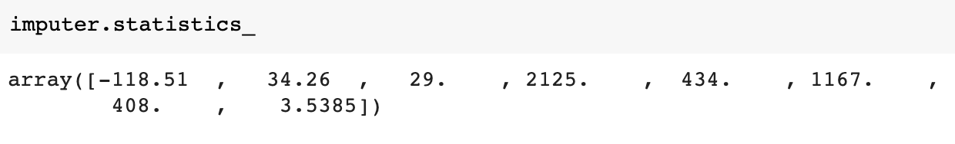
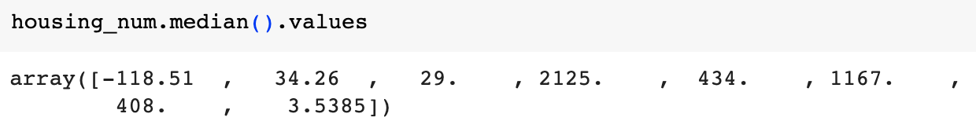
Using a SimpleImputer
The SimpleImputer has now computed the medians of the attributes and stored them in its statistics_ property (see above)
Only the total_bedrooms property currently has missing values, but after an update, there may be missing values in other attributes, so it’s a good idea to compute all of them

Slide 61
Imputers
You can use other strategies with a SimpleImputer:
strategy=“mean”
strategy=“most_frequent” (also supports non-numerical data)
strategy=“constant”, fill_value=... (also supports non-numerical data)
Also more powerful imputers available in sklearn.impute package:
KNNImputer: replaces missing value with mean of k nearest neighbours’ values for that feature, with distance based on all features
IterativeImputer: trains a regression model on each feature and predicts missing values based on all other features, repeatedly trains and replaces, improving prediction each time

Slide 62
Scikit-Learn design principles*
Consistency of UI
Estimators: any object that can estimate parameters based on a dataset (e.g., SimpleImputer
Estimation performed by a fit() method that takes a dataset as a parameter
Hyperparameters stored in instance variables set by constructor (e.g., SimpleImputer’s strategy)
Transformers: estimators that also transform the datset (e.g., SimpleImputer)
Transformation performed by a transform() method that takes the datasaet as a parameter
Transformers also have fit_transform() methods the combine fitting and transforming
Predictors: an object that makes predictions (e.g., LinearRegression model)
Prediction performed using a predict() method that takes a dataset of new instances
Predictor’s score() method measures quality of predictions
Inspection
Estimator’s hyperparameters stored in public instance variables (e.g., imputer.strategy)
Estimator’s learned parameters stored in instance variables whose names end with an underscore (e.g., imputer.statistics_)
Nonproliferation of classes: datasets represented as NumPy arrays or SciPy sparse matrices
Composition: existing classes and building blocks reused as much as possible
Sensible defaults: provides sensible defaults so easy to create a default model
* https://arxiv.org/abs/1309.0238

Slide 63
Transformer output format
In versions of Scikit_learn up to 1.3, transformers output NumPy arrays or SciPy sparse matrices, even when given DataFrames as input
From 1.4.dev0, you can use the sklearn.set_config(transform_output=“pandas”) argument to get output in DataFrame format
See https://scikit-learn.org/dev/modules/generated/sklearn.set_config.html#sklearn.set_config

Slide 64
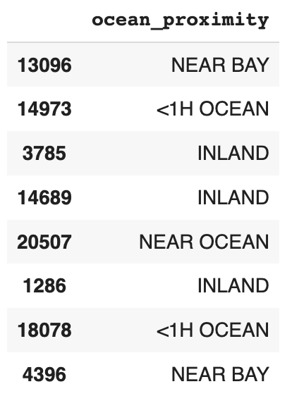
Handling text and categorical attributes
We’ve been focusing so far on numerical attributes, but data may also contain text attributes
In this dataset there is one text attribute, ocean_proximity
The values for the first few instances are shown on the left
Clearly this is not a free text attribute – there is a finite number of possible values
Therefore this is a categorical attribute

Slide 65
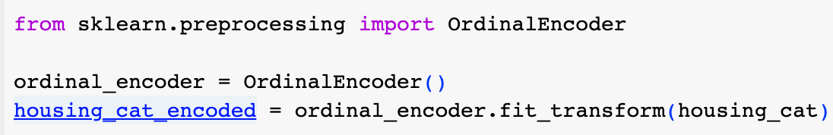
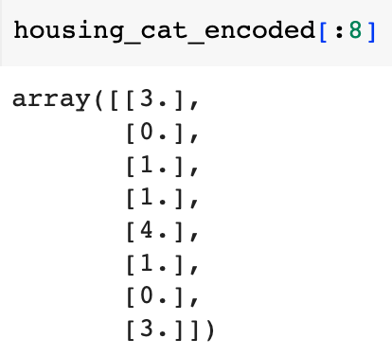
Handling categorical attributes
Most ML algorithms prefer to work with numbers, so we convert the categories in ocean_proximity to numbers
We could use Scikit-Learn’s OrdinalEncoder class to do this
Note that we use its fit_transform method to fit and transform the data in one step
This converts each value in the ocean_proximity attribute into a numerical code, as shown on the right

Slide 66
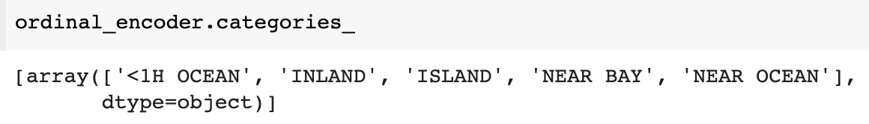
Handling categorical attributes
After using an OrdinalEncoder, you can get a list of the categories it has found from its categories_ instance variable
In our case, there’s just one array, since there’s only one categorical attribute
Unfortunately, ML algorithms assume that numbers that are closer together represent more similar values
e.g., here, an ML algorithm might assume that “<1H OCEAN” is more similar to “INLAND” than it is to “NEAR OCEAN”
This is fine if the categorical attribute is ordinal (e.g., “bad”, “average”, “good”) but not if it is nominal

Slide 67
Representing nominal variables with one-hot encodings
 | <1H OCEAN | INLAND | ISLAND | NEAR BAY | NEAR OCEAN
<1H OCEAN | 1 | 0 | 0 | 0 | 0
INLAND | 0 | 1 | 0 | 0 | 0
ISLAND | 0 | 0 | 1 | 0 | 0
NEAR BAY | 0 | 0 | 0 | 1 | 0
NEAR OCEAN | 0 | 0 | 0 | 0 | 1
We can solve this problem by using a one-hot encoding
To do this, we represent each value as a binary vector whose length is equal to the number of different categories
Each of these vectors has a single 1 in it at the position corresponding to the category it is representing – see above

Slide 68
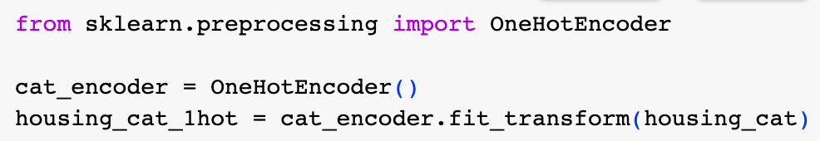
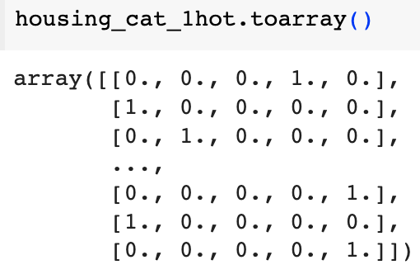
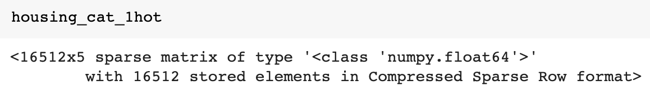
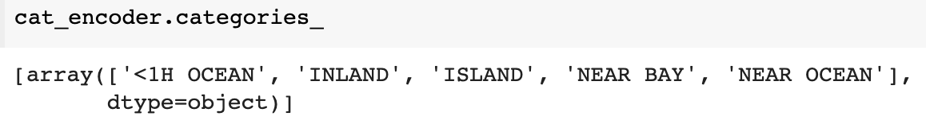
Using OneHotEncoder
Scikit-Learn provides a class called OneHotEncoder for converting categorical values into one-hot vectors
OneHotEncoder returns a sparse array by default, which uses less space
But we can convert this to a dense array using the toarray() method
As with the OrdinalEncoder, we can get a list of categories by inspecting the categories_ property

Slide 69
Feature scaling and transformation
Most ML algorithms do not perform well when the input numerical attributes have very different ranges
For example, in our example, total_rooms ranges from 6 to 39320, while median_income ranges from 0 to 15
Most ML algorithms would, in this case, give far more emphasis to total_rooms than median_income
There are two common ways of scaling to get attributes to have the same range: min-max scaling, and standardization

Slide 70
Always fit scalers to the training data only!
Never use the fit() or fit_transform() methods on any data other than the training set
Once you have fit the training set, you can then use the scaler to transform any other set you want (e.g., validation set, test set, new data)
Training set data will always be scaled to the specified range, however other datasets may contain outliers that are scaled outside of this range
If you want to avoid having instances of other set scaled outside the range, then you should set the clip hyperparameter to true

Slide 71
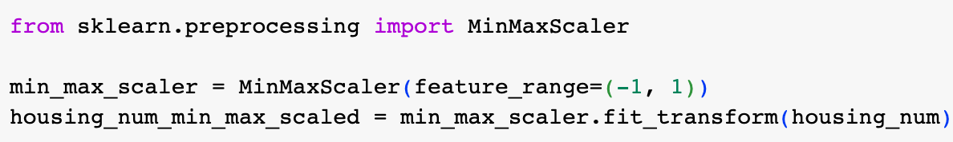
Min-max scaling (normalization)
In min-max scaling (a.k.a., normalization), the values for an attribute are shifted and scaled so that they lie between 0 and 1
i.e., subtract the minimum value and divide by the difference between the maximum and minimum values
Scikit-Learn provides a transformer for doing this: MinMaxScaler
MinMaxScaler has a feature_range hyperparameter that lets you set the output range if you don’t want 0 – 1
e.g., NNs usually work better with zero mean inputs

Slide 72
Standardization
Standardization subtracts the mean from each value and then divides by the standard deviation
So the standardized values have a mean of 0 and a standard deviation of 1
i.e., it converts the data to z-scores
Standardization does not restrict the output to any particular range, so it is less detrimentally affected by outliers
e.g., if there was an incorrect median income value of 100, then when using normalization this would squeeze all the correct values into the bottom 15% of the range; however, standardization would probably not be very much affected since the mean would remain at 0

Slide 73
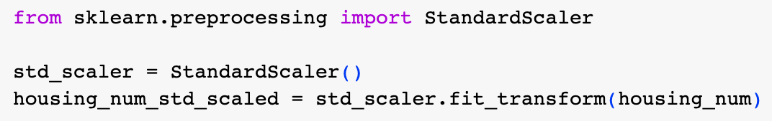
Standardization
Scikit-Learn provides a transformer called StandardScaler for standardizing data

Slide 74
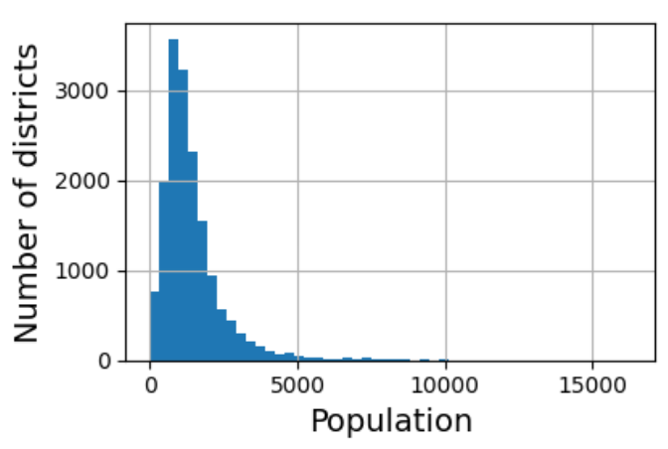
Handling a heavy tail
If a feature’s distribution has a heavy tail (i.e., when values far from the mean are not exponentially rare), both min-max scaling and standardization will squeeze most of the values into a small range
ML algorithms don’t like this!
So you should shrink the heavy tail before you scale the attribute
Ideally, you want the distribution to be roughly symmetrical
If you have non-negative values with a heavy tail to the right, then replacing the feature with its square root can work
or more generally, raising the feature to a power between 0 and 1

Slide 75
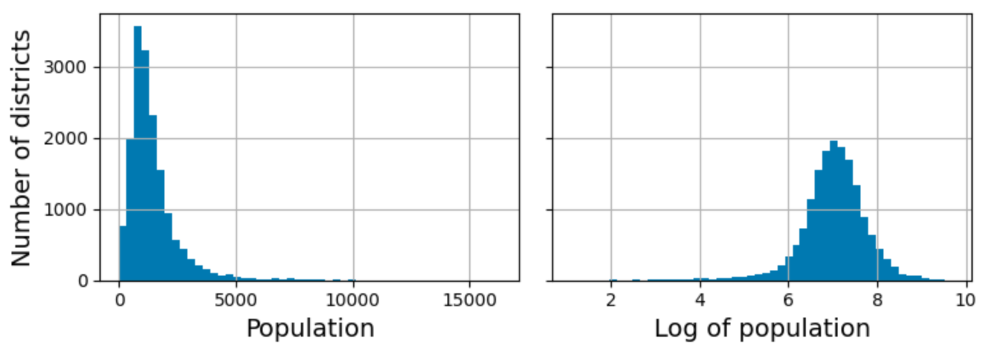
Handling a heavy tail
If the tail is very long and very heavy, as with a power law distribution, then you can try replacing the values with their logarithms
For example, our population feature roughly follows a power law – districts with 10000 inhabitants are roughly 10 times less frequent than districts with 1000 inhabitants (not exponentially less frequent)
Transforming this feature by replacing the values with their logarithms produces almost a distribution that is very close to a Gaussian

Slide 76

Bucketizing
Another approach to handling heavy-tailed features is to bucketize the feature
This means dividing the distribution into buckets that contain an approximately equal number of instances, and replacing each value with the index of the bucket that it belongs to
An example would be to replace each value with its percentile
This produces an approximately flat distribution – you can divide by the total number of buckets to normalize the values into the range 0 – 1
Graph on the left shows result of percentile bucketizing of the median_income feature

Slide 77
Handling multimodal distributions
Bucketizing also sometimes works on multimodal distributions, like our housing_median_age feature
However, in this case, we need to treat the bucket IDs as categories, rather than numerical values
We can do this by encoding the bucket IDs using a OneHotEncoder – which means we don’t want too many buckets...why?
Doing this allows a regressor to learn different rules for different ranges of the feature value
This is why we we want to treat the bucket IDs as categories, not values – if we treated them as values, then a model would aim to find a single rule or model to handle all ranges

Slide 78

Handling multimodal distributions
Another approach is to transform a multimodal distribution into a multi-dimensional feature, in which each dimension represents the distance of the value from a particular mode
In this case, the distance measure should be a radial basis function (RBF) – i.e., a function whose value depends only on the distance of the value from some fixed point
The most commonly used RBF is the Gaussian RBF which returns a value that falls exponentially as the value moves away from the fixed point
For example, we could create a new feature whose value is given by the Gaussian RBF centred on 35

Slide 79
Handling multimodal distributions
If our original value is y, then the transformed value after applying the Gaussian RBF centred on 35 would be exp(– 𝛾(x – 35)²), where 𝛾 determines the rate at which the distance falls as we move away from the centre value
We can create such a feature easily using Scikit-Learn’s rbf_kernel() function (see above)
We would do this for each of the modes to create a new feature vector

Slide 80
Scaling target values
We would also prefer for our target values to not have heavy tails, so we may also need to transform these
For example, we might want to replace the target value with its logarithm
The regression model would then predict the log of the target rather than the target value itself, so we’d have to transform the prediction into the form we want by computing the exponential of it

Slide 81


Scaling target values
Most of Scikit-Learn’s transformers have an inverse_transform() method that makes it easy to invert any transformation
Code above shows how to use a StandardScaler to scale the labels
Then train a linear regression model on the scaled labels
Then use the model to make some predictions on new data
Then transform the predictions back to the values we actually want to predict using the inverse_transform() method

Slide 82


Using a TransformedTargetRegressor
The previous method works fine, but we can do the same thing more conveniently using a TransformedTargetRegressor
We specify what kind of scaler we want to use to transform the labels when we construct it
We then train the regressor on the training set, specifying the untransformed labels
The regressor will automatically use the transformer to scale the labels and train the regression model on these resulting scaled labels
When we make a prediction, the TransformedTargetRegressor will automatically use the scaler’s inverse_transform() method to produce the prediction

Slide 83

Using custom transformers
Scikit-Learn provides lots of useful transformers, but you may sometimes need to write your own
If the transformation doesn’t need any training, then you can just write a function that takes a NumPy array as input and outputs a transformed array
For example, if we want to replace each value in an attribute with its logarithm, then we create our own FunctionTransformer for doing this (see above)
Note that that inverse_func argument is optional, but needed if, e.g., you plan to use your transformer in a TransformedTargetRegressor

Slide 84


Custom transformers with hyperparameters
You can create custom transformers that have their own hyperparameters
Example above shows how to make your own Gaussian RBF transformer centred on the value 35
Note there is no inverse function for the Gaussian RBF funtion, since it is a many-to-one function
rbf_kernel automatically applies the Gaussian to the number of dimensions in its argument

Slide 85

Using a custom transformer to combine features
FunctionTransformers can also be used to combine features
For example, the code above defines a transformer that divides the values in the first attribute by the values in the second attribute

Slide 86
Creating a trainable transformer
We might want to define a transformer that can learn some parameters using a fit() method and then apply them to the data in a transform() method
For this you need to write custom class
Your class does not, strictly speaking, need to inherit from any other base class, but it should have
a fit() method that returns self
a transform() method
a fit_transform() method

Slide 87

Creating a trainable transformer
Although your custom transformer class does not need to inherit from any other class, it is useful for it to inherit from the TransformerMixin class as it then inherits a fit_transform() method for free, that automatically uses the fit and transform methods that you define
You can also add BaseEstimator as a base class which provides get_params() and set_params() methods that can be used for automatic hyperparameter tuning
On left is an example transformer that implements the StandardScaler

Slide 88
Creating a trainable transformer
Note that we use tests drawn from the sklearn.utils.validation package to validate that arguments have the right type etc.
Scikit-Learn pipelines require that a fit method has two args
All Scikit-Learn estimators set the n_features_in_ variable in the fit() method and check that data passed to transform and predict have the right number of features

Slide 89
Creating a trainable transformer
The fit() method must return self
This example is not really complete:
The fit method should set feature_names_in_
It should provide a get_feature_names_out() method
It should provide an inverse_transform() method if the transformation is to be reversible

Slide 90


Custom transformers
A custom transformer may use other estimators in its implementation
For example, the transformer on the left uses a KMeans clusterer its fit method to find the main clusters in the training data
It then uses rbf_kernel in the transform method to measure the distance from an instance to each of the found cluster centroids

Slide 91
Custom transformers
k-means is a clustering algorithm
The number of clusters (k) is a hyperparameter, n_clusters
After training, cluster centres are available in cluster_centers_ attribute
sample_weight argument lets user specify relative weights of samples
Need to set random_state parameter if we want replicability

Slide 92
Applying a trainable transformer
We can apply the ClusterSimilarity transformer, setting the number of clusters to 10
We call fit_transform with latitude and longitude of the districts, weighing each district by its median house price
Uses k-means to find the clusters, then measures distance from each district to each of the 10 clusters
Result is a matrix with one row per district and one column per cluster

Slide 93
Applying a trainable transformer
Graph on left visualizes the output of applying the transformer
Districts are colored according to how close they are to their nearest cluster centre

Slide 94

Transformation pipelines
There are typically many transformation steps that need to be carried out on the data in order to prepare it for machine learning
Scikit-Learn provides a Pipeline class that lets you organise these steps and store them for reuse
For example, the Pipeline on the left can be applied to numerical attributes in order to first impute missing values and then scale the values

Slide 95
Transformation pipelines
The Pipeline constructor takes a list of (name, estimator) pairs, which are to be applied in order to the data
Names need to be unique and must not contain double underscores (‘__’)
We’ll uses these later when we do hyperparameter tuning
All estimators in a pipeline must be transformers, except the last, which can be a transformer, an estimator or a predictor
i.e., each element in a pipeline, except the last must have a fit_transfom method

Slide 96

Transformation pipelines
You can also make a pipeline using the make_pipeline function
This function automatically assigns a name to each pipeline which is the name of its class, converted to lower case (possibly suffixed with “-n” where n is an integer, if there is more than one transformer in a pipeline with the same class)
e.g. simpleimputer-1, simpleimputer-2

Slide 97

Displaying pipelines in Jupyter notebooks
You can get Jupyter notebooks to display Scikit-Learn estimators as interactive diagrams by using the set_config method and setting the display argument to “diagram”

Slide 98

Running a pipeline
Calling the fit method on a pipeline causes the fit_transform method to be called sequentially on all transformers, passing the output of each on as the input of the next, until it gets to the last estimator, on which it calls just fit without transform
This has now trained the pipeline
The pipeline as a whole has the same methods as its final estimator (which may be a transformer or a predictor)
In this case, if you call the pipeline’s transform method, it will sequentially apply all the transformations (including the last) to the data
If the last estimator were a predictor, then the pipeline would have a predict method that, when run, would sequentially apply all transformations and call the predict method on the final estimator

Slide 99
Converting output of a pipeline to a DataFrame
You can convert the output of a pipeline into a DataFrame by giving it as the argument to a DataFrame constructor
You can add column names by using the pipeline’s get_feature_names_out() method

Slide 100

Accessing elements and slices of a pipeline
You can access elements and slices in a pipeline using normal indexing
If you have a Pipeline in a variable called pipeline, then
pipeline[1], returns the second estimator in the pipeline
pipeline[:-1] returns a new Pipeline object containing all but the last estimator in pipeline
You can also access estimators through the .steps attribute or the named_steps attribute
e.g., num_pipeline[“simpleimputer”] returns the estimator named “simpleimputer”

Slide 101

ColumnTransformers
So far, we have handled numerical and categorical attributes separately
But it would be convenient if we could have a single transformer that can handle all the data, applying appropriate transformation steps to each type of data
We can use a ColumnTransformer for this
For example, the ColumnTransformer above applies num_pipeline to the numerical attributes (columns) and a separate cat_pipeline to the categorical attribute

Slide 102
ColumnTransformers
The ColumnTransformer constructor takes a list of triples, containing
a string to identify the pipeline
a transformer or pipeline object
the list of attributes in the data to which the transformer or pipeline should be applied
The second argument can also have the values, “drop” or “passthrough”, if you want to either drop or ignore certain columns in the data
There is also a “remainder” hyperparameter that lets you specify how columns that are not mentioned should be processed

Slide 103

make_column_selector() and make_column_transformer() functions
If you want a particular pipeline within a ColumnTransformer to handle all attributes of a particular type, then you can use the make_column_selector() function to return a selector function
Also, if you don’t care about using a particular naming scheme to give names to the transformers in a ColumnTransformer
e.g., in the ColumnTransformer created above, the transformers will be named pipeline-1 and pipeline-2 instead of num and cat

Slide 104

Applying a ColumnTransformer
Having created our ColumnTransformer, we can now apply it to the housing data
We can also convert the output into a DataFrame, using get_feature_names_out() to get the names of the columns

Slide 105
Gathering all prepreprocessing steps into a single pipeline
We now want to make a pipeline that gathers all our preprocessing steps into a single pipeline
This pipeline will need to do the following:
Impute missing numerical features in all attributes using the median
Impute missing categorical features with the most frequent category
One-hot-encode the categorical features (only one in this case)
Compute three ratio features and add to the data: bedrooms_ratio, rooms_per_house, and people_per_house
Add cluster similarity features to represent distance of a district from the centroids of housing clusters
Where a feature has as long tail, replace the values with their logarithms to make the distribution less skewed
Standardize all numerical features

Slide 106

Building a ColumnTransformer to implement all preprocessing
The preprocessing ColumnTransformer applies the various transformations and pipelines to the appropriate subset of the housing data
Note that the default_num_pipeline is applied to any columns not previously mentioned

Slide 107

Applying the ColumnTransformer and inspecting the result
Applying this ColumnTransformer causes all the transformations to be carried out on the housing data and outputs a NumPy array with 24 features

Slide 108

Selecting and training a model
We’re now at the point where we can select and train a model
We will first train and evaluate on the training set
We can start with a simple model like a linear regressor to see how well that performs as a baseline
We make a pipeline that preprocesses the data and fits the linear regressor

Slide 109



Selecting and training a model
We try out the new regressor on the first five elements in the training set and compare to the target values
We find the error is between 1.8% and 46.8%

Slide 110

Measuring RMSE of predictions on training set
We can measure the model’s total error on the training set using Scikit-Learn’s mean_squared_error function, with the squared argument set to false
We find that the model is out by around $70000 on average
Is the model underfitting or overfitting the data?

Slide 111


Trying a more complex model
Our linear regressor was underfitting the data, so we try a more complex type of model – a DecisionTreeRegressor
We find that the Decision Tree Regressor can fit the training set exactly
We suspect the model has badly overfitted the data
We can check this by using cross-validation

Slide 112


Using cross-validation
We could test our more complex model by using the train_test_split() function to create another training set and test set to evaluate it
An even better way would be to use Scikit-Learn’s k-fold cross-validation feature
The code above randomly splits (partitions) our training set into 10 non-intersecting “folds”
It then trains and evaluates the model 10 times, picking a different fold for evaluation each time and training the model on the union of the other 9 folds
The result is an array containing the 10 evaluation scores
We can wrap these results in a Pandas Series object and then call its .describe() method to give us some stats

Slide 113
Using cross-validation to evaluate the decision-tree model
Now the decision tree doesn’t look quite so good!
The mean is just a little bit less than that for a linear regression model, so we now know that the decision tree model is overfitting quite badly
Note that cross-validation also gives you an estimate of the uncertainty of the evaluation results in the std
Note that Scikit-Learn’s CV features expect an utility function (greater is better), not a cost function (lower is better), so we use the negative of the RMSE
We therefore need to switch the sign back whn we report the RMSE scores

Slide 114


Trying an ensemble method - a random forest regressor
A random forest regressor trains many decision tree regressors on random subsets of the features and averages out their predictions
Such a model that draws on a set of other models is called an ensemble
The mean RMSE over the folds is much lower – around $47000
The RMSE over the whole training set is about 17474 USD, which is much lower, indicating that the model is still overfitting the training set

Slide 115
Try out different model types before fine-tuning
Instead of trying to fine-tune your random forest regressor at this stage, it would be wiser to try out some other types of model
e.g., some SVMs and a neural network
Your goal should be to find a small number of candidate models that you can then go on and fine-tune

Slide 116
Fine-tuning your models
Having made a short-list of candidate models, we then go on to fine-tune them – that is, try to determine the best hyperparameters
There are number of different strategies for doing this:
grid search: systematically try all combinations of parameter values from some given sets
randomized search: tries out a fixed number of different combinations chosen from the hyperparameter search space
usually preferable if the hyperparameter search space is very large
ensemble methods: try different combinations of the individual models that perform best

Slide 117

Grid search
We can use Scikit-Learn’s GridSearchCV class to evaluate all combinations of some specified sets of values for selected hyperparameters
The evaluations are performed with cross-validation
Code on the left searches for best combination of hyperparameter values for the RandomForestRegressor

Slide 118
Grid search
In the parameter grid, you can refer to any hyperparameter of any estimator in a pipeline, even if it is inside several nested pipelines or column transformers
e.g., preprocessing__geo__n_clusters causes Scikit-Learn to look for a hyperparameter n_clusters inside an estimator called geo inside a pipeline called preprocessing
Note that by including the preprocessing steps in the pipeline, we can vary the preprocessing hyperparameters and the model hyperparameters

Slide 119

Grid search
Here, our grid search will try 3 x 3 + 2 x 3 = 15 different hyperparameter values
It uses 3-fold cross validation (cv=3 parameter)
This means there will be 45 rounds of training
You can inspect the best combination found using the best_params_ instance variable

Slide 120

Grid search
You can acces the best estimator found using the best_estimator_ variable

Slide 121
Randomized search
If the search space is so large that it prohibits an exhaustive search through parameter combinations, then a randomized search may be preferable
You can do such a search using the RandomizedSearchCV class
This searches through a fixed number of randomly selected parameter value combinations
Has several advantages over a grid search:
considers many more different values for each parameter than a grid search
if a parameter makes no difference, then adding it does not increase the time
if you have 6 parameters, each with 10 different values, grid search would train the model 1000000 times, whereas randomized search would use the number of iterations you choose

Slide 122

Randomized search
For each hyperparameter, you have to provide either a list of possible values or a probability distribution
Code on left provides probability distributions for the values of the same hyperparameters considered in the grid search

Slide 123


Analysing the best models and their errors
You can often get good insights by inspecting the best models
For example, the RandomForestRegressor’s feature_importances_ variable can give us an idea of how important each attribute is for making accurate predictions
This can give you some hints as to which attributes you might be able to afford to drop

Slide 124
Analysing the best models
You should also look at the specific errors your best models make
Also check that it doesn’t make systematic errors on particular well-defined subsets of the data – e.g., rural or urban, rich or poor, northern or southern, minority or not, etc.
If your model performs consistently badly on a particular category of instances, then you should probably attempt to address the issue before you deploy it

Slide 125


Evaluating the final model on the test set
Once you’ve selected your final model, you can test it on the test set
You can also get a 95% confidence interval for the generalization error using scipy.stats.t.interval()

Slide 126

Saving and launching the model
You can save your final model using the joblib library
To run the model, you need to import any custom classes and functions the model relies on, then load the model using joblib and use it to make predictions

Slide 127

Deploying the model
The code on the left can be used to deploy the model and run it

